Slide 1


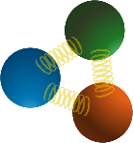

Probing neutron structure
at Jefferson Lab
IoP Nuclear Conference 2026
Andrew Cheyne
(a.cheyne.1@research.gla.ac.uk)
10th April 2026
Co-spokespersons:
Bogdan Wojtsekhowski, Michael Kohl, David Hamilton, Andrew Puckett, William Tireman
Students:
Andrew Cheyne, Saru Dhital, Bhasitha Dharmasena

Slide 2


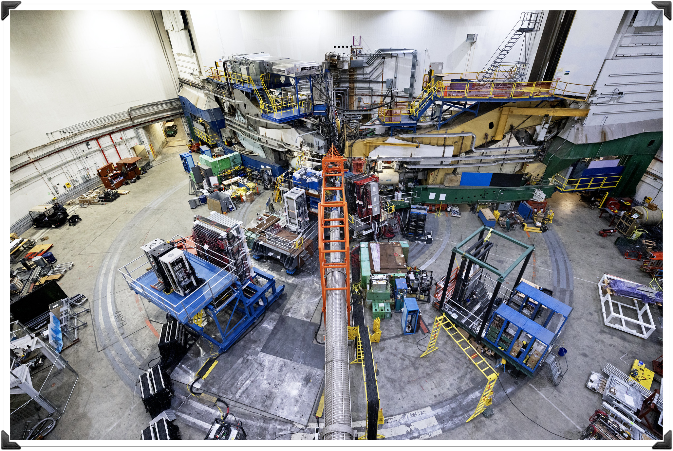
The GEn-RP Experiment:
Neutron Electric Form Factor measurement at 4.4(GeV/c)²
via Charge-Exchange Recoil Polarimetry
Introduction
Motivation
Polarimetry
The GEn-RP experiment
Experiment layout
Preliminary Results

Slide 3
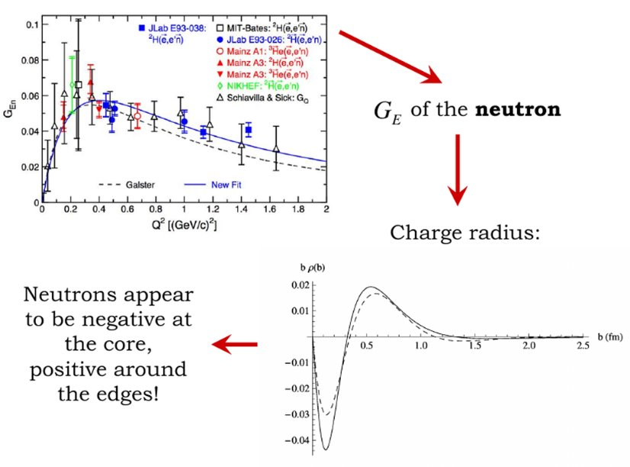
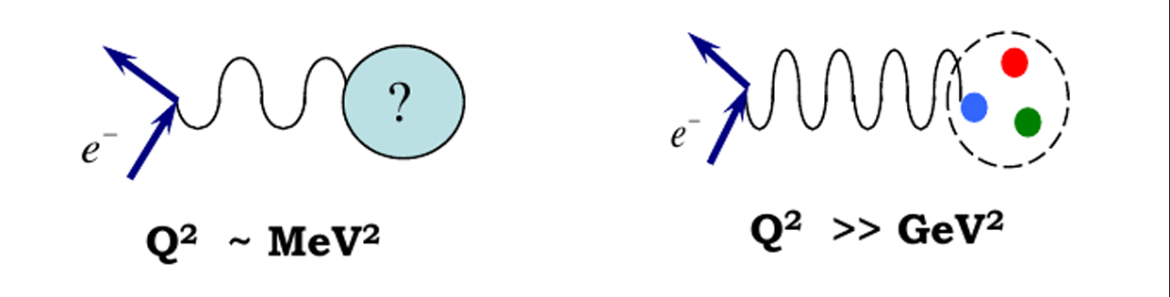
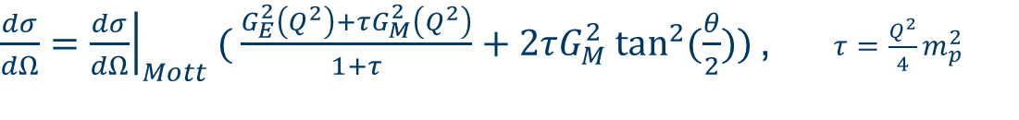
Form Factors
Sach's Form Factors (G_{E} and G_{M})
$\frac{dσ}{dΩ}={\left.\frac{dσ}{dΩ}\right|}_{Mott}( \frac{G_{E}^{2}\left(Q^{2}\right)+τG_{M}^{2}\left(Q^{2}\right)}{1+τ}+2τG_{M}^{2}\tan^{2}{(\frac{θ}{2})) }$, $τ=\frac{Q^{2}}{4}m_{p}^{2}$
Mott cross-section describes a pointlike nucleon, neglecting spin.
Form factors account for the electric and magnetic distributions inside the nucleon*
Functions of Q²
Higher Q² pick out smaller scale details
Must reduce to p/n electric charge and magnetic moment at Q² = 0
In the Breit-Frame these relate to Fourier transforms of charge/magnetisation densities
G_{E} related to charge radius (see right)
Notes:
Breit frame (infinite momentum frame”, elastic scattering where A (hadron) has momentum reversed (pA + pA’ = 0)
Charge density shows a charged core, and
Tail may be suggestive of proton pion fluctuations in the neutron wave function

Slide 4
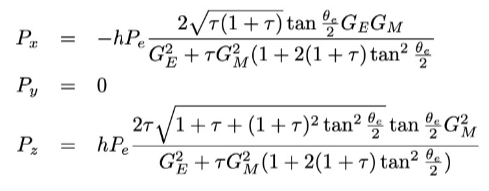
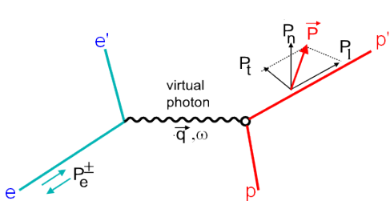
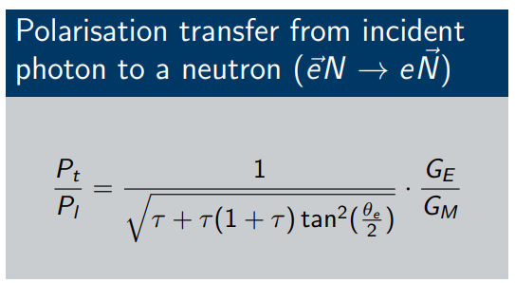

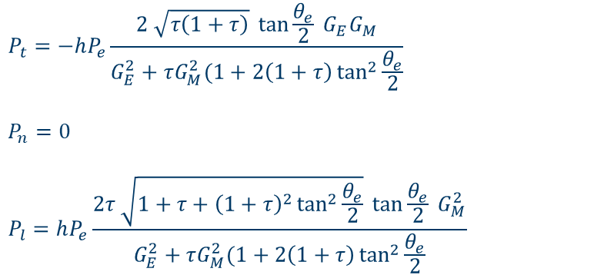
Double Polarisation Measurement
$$P_{t}=−hP_{e}\frac{2 \sqrt{τ\left(1+τ\right)} \tan{\frac{θ_{e}}{2} G_{E}G_{M}}}{G_{E}^{2}+τG_{M}^{2}(1+2\left(1+τ\right)\tan^{2}{\frac{θ_{e}}{2}}}$$
$$P_{n}=0$$
$$P_{l}=hP_{e}\frac{2τ \sqrt{1+τ+{\left(1+τ\right)}^{2}\tan^{2}{\frac{θ_{e}}{2}}} \tan{\frac{θ_{e}}{2} G_{M}^{2}}}{G_{E}^{2}+τG_{M}^{2}(1+2\left(1+τ\right)\tan^{2}{\frac{θ_{e}}{2}}}$$
Extraction G_{E} through with a polarised e⁻ beam
Measured via elastic scattering experiments
For polarised beam, unpolarised target:
Virtual photon transfers polarisation to recoiling nucleon, parameterised by Form Factors.
Taking the ratio of P_{t}/P_{l} simplifies and cancels many systematics
N'
N
E12-17-004 PAC 45 proposal
Polarisation transfer from a polarised electron to an unpolarised nucleon. Recoiling nucleon then has polarisation components Pt and Pl.
$$\frac{P_{t}}{P_{l}}=\frac{1}{\sqrt{τ+τ(1+τ)\tan^{2}(\frac{θ_{e}}{2})}}\frac{G_{E}}{G_{M}}$$
Notes:
Advancements in polarised beam and targets allowed for a polarisation experiments.
Double polarisation method
2017 Bonner prize Perdrisat experiment
Nucleon-nucleon interaction is polarisation dependent.
Modern polarised beam and target advancements made it possible
By measuring Pt and Pl you can take the ratio and extract GE
Cancelling many of the systematics
Tau = q^2 /4M^2
Less sensitive to two-photon contributions than Rosenbluth separation method

Slide 5



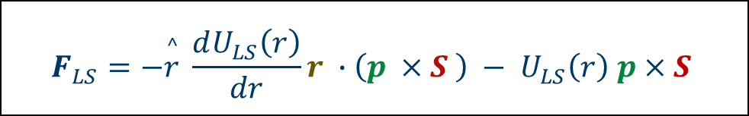
Recoil Polarimetry technique
Measuring polarisation components
Rescatter the recoiling nucleon on an “analyser”
N-N interaction in the analyser causes a spin-dependent deflection in secondary scattering distribution
$$p$$
$$S$$
$$F_{LS}=−\overset{^}{r} \frac{dU_{LS}\left(r\right)}{dr}r ∙\left(p ×S \right) − U_{LS}\left(r\right) p×S$$

Slide 6
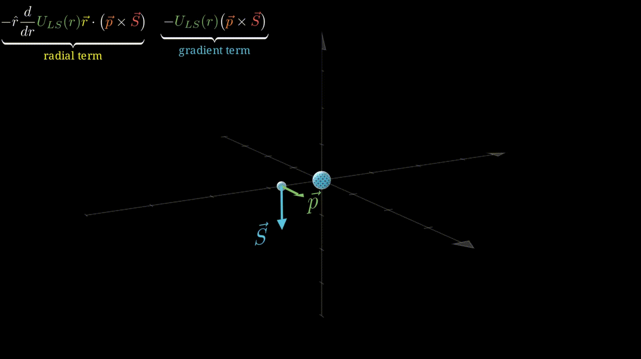
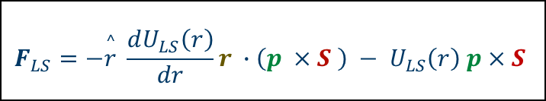
Recoil Polarimetry technique
Producing an asymmetry
N-N interaction in the analyser causes a spin-dependent deflection in secondary scattering distribution
Not sensitive to longitudinal components
Need to precess the P_{L} component into transverse plane prior to secondary scattering
$$F_{LS}=−\overset{^}{r} \frac{dU_{LS}\left(r\right)}{dr}r ∙\left(p ×S \right) − U_{LS}\left(r\right) p×S$$

Slide 7
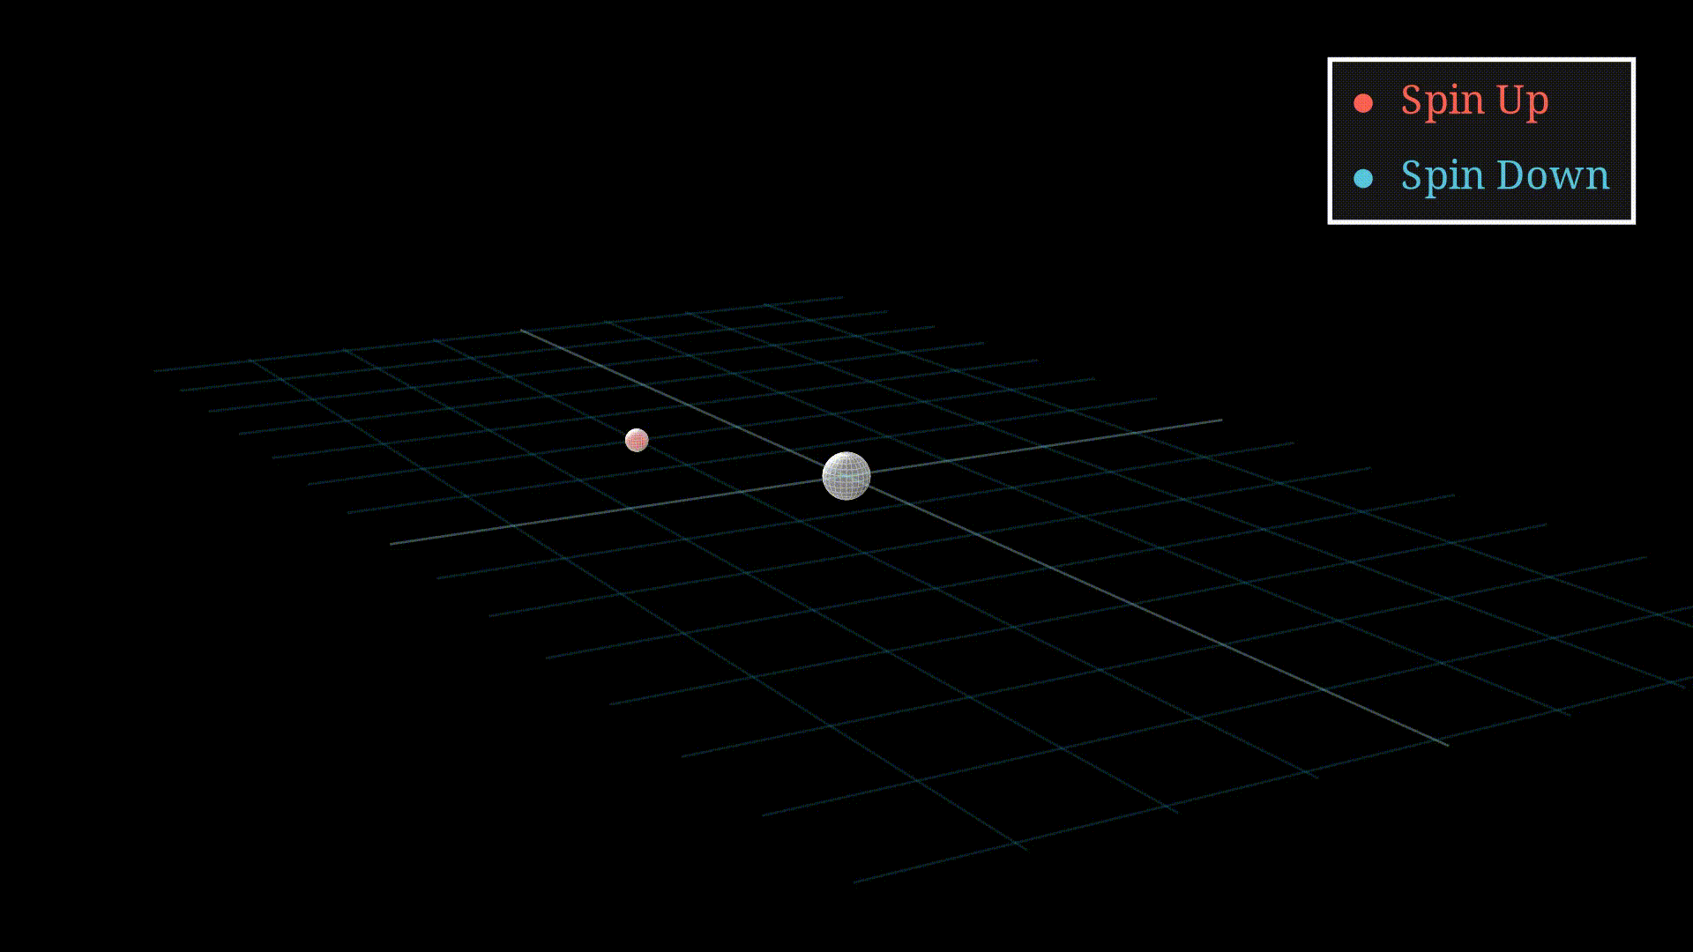
Recoil Polarimetry technique
Producing an asymmetry
N-N interaction in the analyser causes a spin-dependent deflection in secondary scattering distribution
Not sensitive to longitudinal components
Need to precess the P_{L} component into transverse plane prior to secondary scattering
$$F_{LS}=−\overset{^}{r} \frac{dU_{LS}\left(r\right)}{dr}r ∙\left(p ×S \right) − U_{LS}\left(r\right) p×S$$

Slide 8
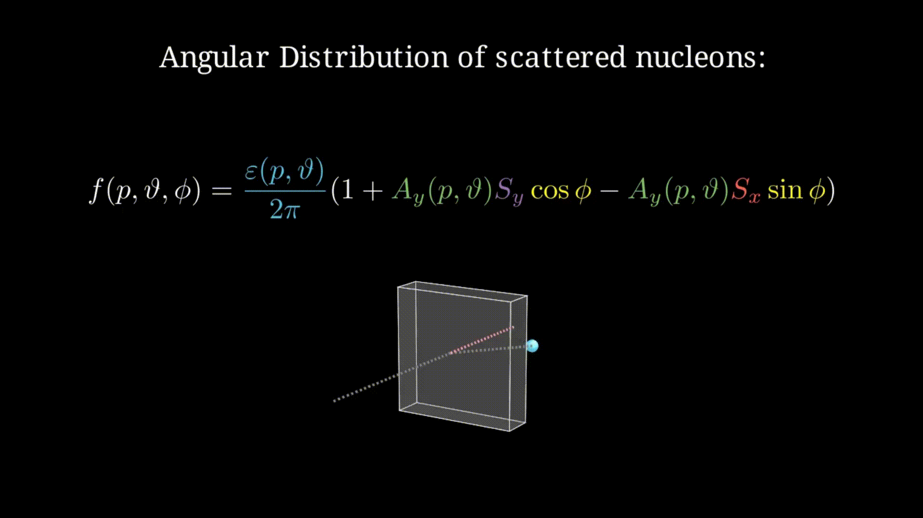
Recoil Polarimetry technique
Producing an asymmetry
N-N interaction in the analyser causes a spin-dependent deflection in secondary scattering distribution
Not sensitive to longitudinal components
Need to precess the P_{L} component into transverse plane prior to secondary scattering
$$F_{LS}=−\overset{^}{r} \frac{dU_{LS}\left(r\right)}{dr}r ∙\left(p ×S \right) − U_{LS}\left(r\right) p×S$$

Slide 9
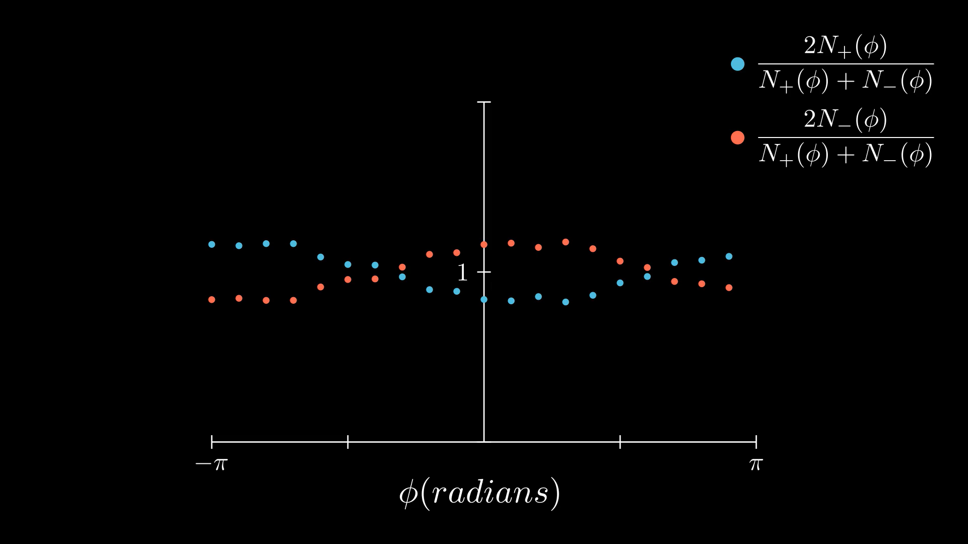
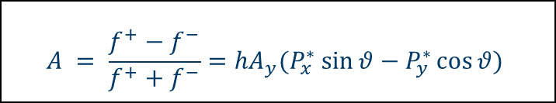
Recoil Polarimetry technique
Form the asymmetry
Forming an asymmetry between +/- beam helicities removes many false asymmetry contributions.
The polarisation at the polarimeter in x*,y* can then be extracted
$$A = \frac{f^{+}−f^{−}}{f^{+}+f^{−}}={hA}_{y}{(P}_{x}^{∗} \sin{θ}−P_{y}^{∗}\cos{θ})$$

Slide 10
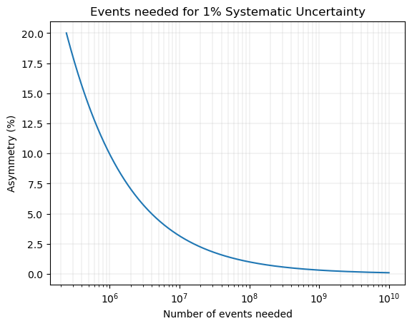


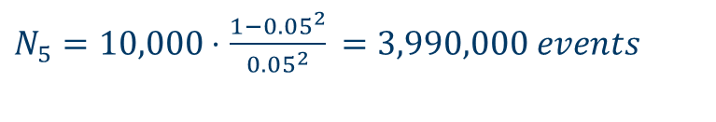
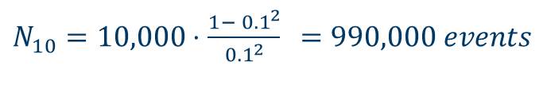



Asymmetry measurement statistics
For a 1% measurement
To obtain a 1% systematic uncertainty doing a Cross-section measurement
number of events needed:
Asymmetry measurement
number of events needed:
$$σ∝N$$
$$\frac{Δσ}{σ}=\frac{1}{\sqrt{N}}$$
$$= \frac{1}{\sqrt{N}}⋅\sqrt{\frac{{1−A}^{2}}{A^{2}}}$$
$$\frac{ΔA}{A}=\sqrt{\frac{{1−A}^{2}}{NA^{2}}}$$
$$N=10,000 events$$
$N_{50}=10,000⋅$ $\frac{{1− 0.5}^{2}}{{0.5}^{2}} =30,000 events$
$N_{10}=10,000⋅$ $\frac{{1− 0.1}^{2}}{{0.1}^{2}}$ $=990,000 events$
$N_{5}=10,000⋅$ $\frac{{1−0.05}^{2}}{{0.05}^{2}}$ $=3,990,000 events$

Slide 11
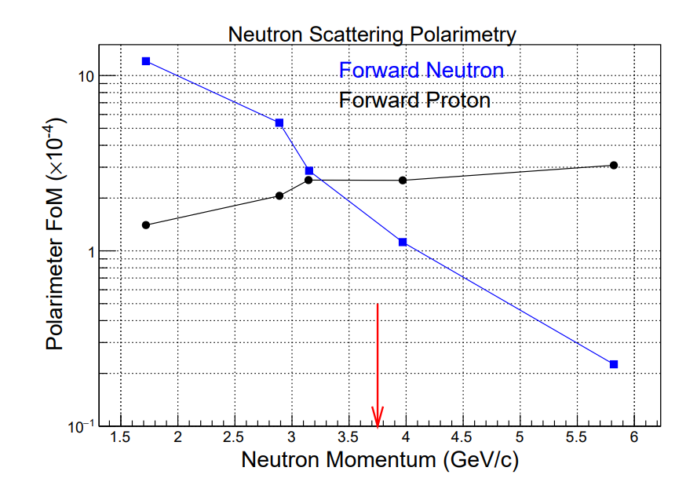
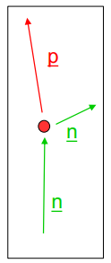
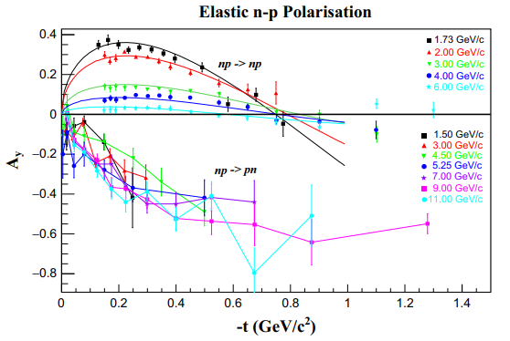

Charge-Exchange Channel
S.N. Basillev et al. EPJ A 56, 26 (2020)
Unlocking higher energy measurements
Analysing power (A_{y}) is a measure of how well your polarimeter separates spin states
Traditional np-np scattering study at JINR showed worse A_{y} at larger energies
Does not appear to be the case for events that undergo charge-exchange in the analyser
Higher analysing power favours charge-exchange at higher energy, despite small efficiency
$$FoM_{pol}^{2}=∫ε\left(p_{n}, θ_{n}^{′}\right)A_{y}^{2}\left(p_{n}, θ_{n}^{′}\right)dθ_{n}^{′}$$
np->pn
“charge-exchange”
Notes:
§ Calculate efficiency of polarimeter as function of θn by Monte Carlo
Ay for np→pn on Cu: new 2016-17 measurement from JINRS.N. Basillev et al. EPJ A 56, 26 (2020)
Neutron measurement on ?
Proton on cu?

Slide 12
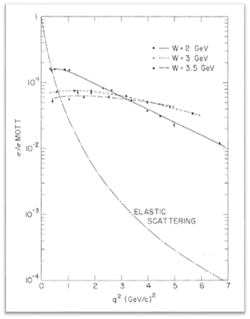
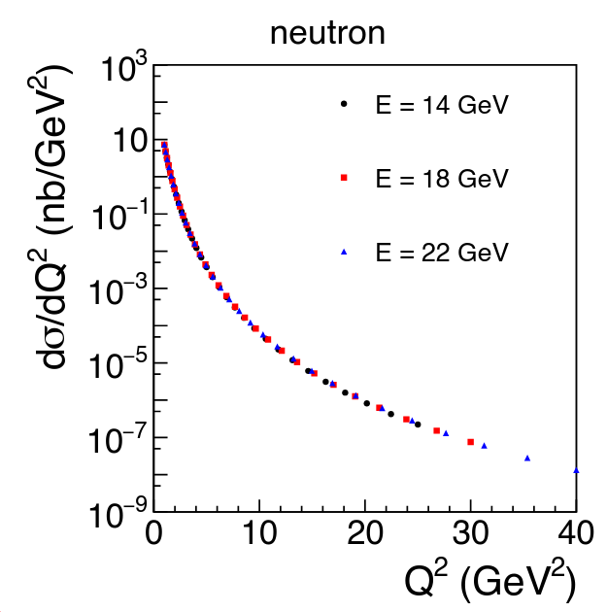
Experimental Challenges
What do we want to measure?
Elastic scattering at large Q²
Small cross section
Large backgrounds
Asymmetry measurement
Need an experimental setup that has:
Highly polarised electron-beam
Large statistics
High luminosity
Large solid angle
Detectors and readout systems to handle extremely high rates
Analyser with good figure of merit
High analysing power channel
Notes:
High lumi means large background,
Large solid angle, open detector, huge background
GigaB per second data rate DAQ
GEM trackers with 40%+ occupancies

Slide 13
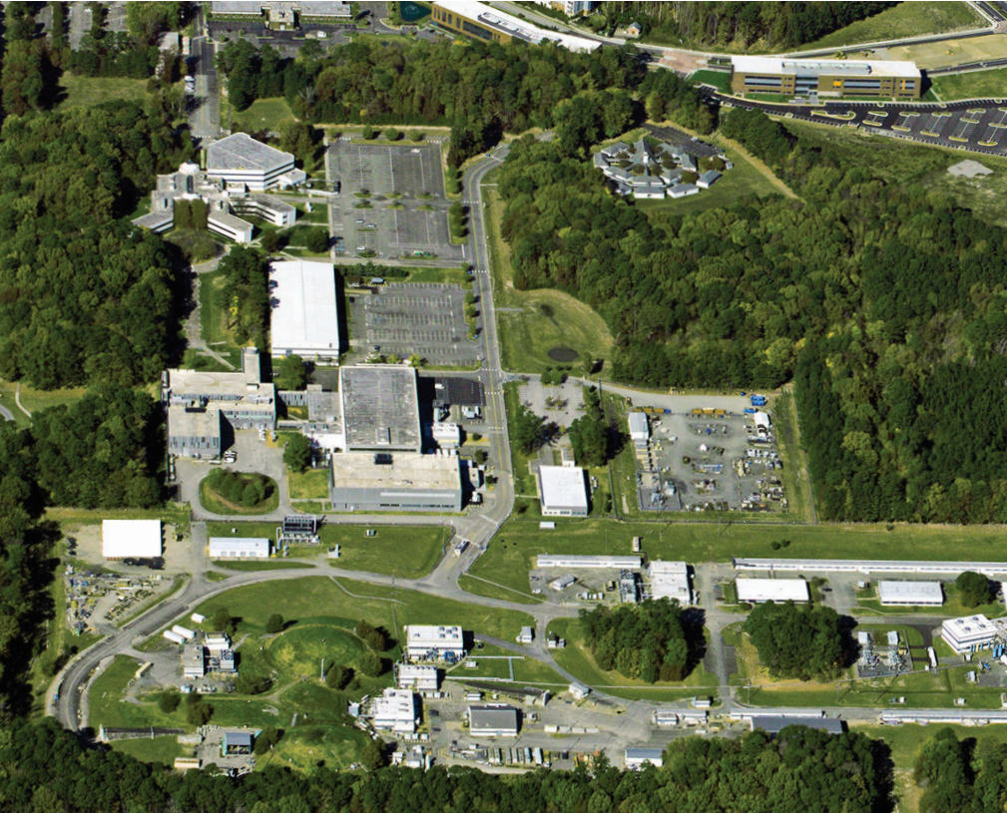
Hall A @ Jefferson Lab
Continuous Electron Beam Accelerator Facility (CEBAF)
Photocathode gun creates continuously injects bunches of electrons into the “racetrack” accelerator.
Two Linear Accelerators (LINAC) utilise superconducting radio frequency (SRF) niobium cavities.
Can achieve 11 GeV Beam Energy (12.5 GeV to Hall D).
Highly linear polarised beam (80%+)
Continuous Electron Beam Accelerator Facility (CEBAF)
Injector: photocathode gun creates continuous waveform (CW) bunches of electrons that are injected into the “racetrack” accelerator.
Two Linear Accelerators (LINAC) utilize superconducting radio frequency (SRF) niobium cavities.
Arc magnets allow for beam recirculation.
Up to 11 GeV Beam Energy (12.5 GeV to Hall D).
Hall A
High Current, High Luminosity (60 uA, L = 10³⁸ e/cm²/s
User-Driven, Open-Floor experiments
SBS program focuses on probing the nucleus by resolving the electromagnetic form factors of nucleons using the SBS spectrometer.
Only place we can do this
Hall A
Hall A
Specialises in high current, high luminosity
Current up to 60 uA
Luminosity ~10³⁸ e/cm²/s
User-Driven, Open-Floor experiments

Slide 14
GEn-RP Experimental Setup
Experimental aim
N'
N
Polarisation transfer from a polarised electron to an unpolarised nucleon. Recoiling nucleon then has polarisation components Pt and Pl.
Notes:
Double check these energy/q2 values
Measure GEn/GMn at Q2 = 4.4 (GeV/c)2 using charge-exchange recoil neutron polarimetry
Beam:
4.3 GeV/c Energy, Pbeam ~80%
30µA on a 15cm LD2 target
Compare F.O.M. for charge-exchange (np→ pn) scattering and the more standard (np→ np)
Demonstrate the feasibility of detecting low-energy recoil protons from an active analyser at large angles in an unshielded environment
Originally proposed to “piggy-back” on the GMn experiment at the 4.5 (GeV/c)2 kinematic

Slide 15
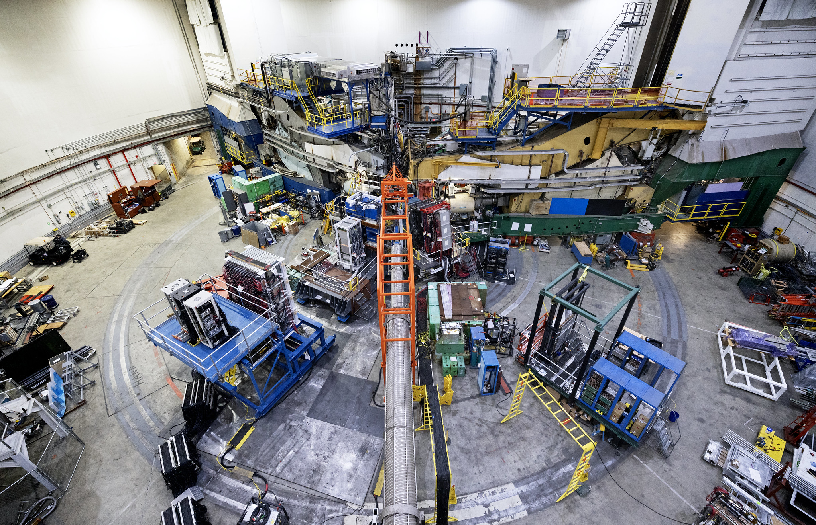
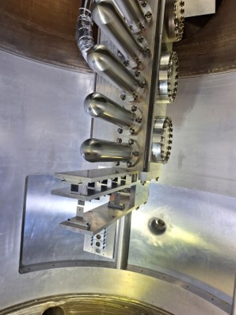
Experimental Setup
View inside the target chamber.
Incoming beamline hole can be seen in the background.
Notes:
Double check these energy/q2 values
Measure GEn/GMn at Q2 = 4.4 (GeV/c)2 using charge-exchange recoil neutron polarimetry
Beam:
4.3 GeV/c Energy, Pbeam ~80%
30µA on a 15cm LD2 target
Compare F.O.M. for charge-exchange (np→ pn) scattering and the more standard (np→ np)
Demonstrate the feasibility of detecting low-energy recoil protons from an active analyser at large angles in an unshielded environment
Originally proposed to “piggy-back” on the GMn experiment at the 4.5 (GeV/c)2 kinematic

Slide 16
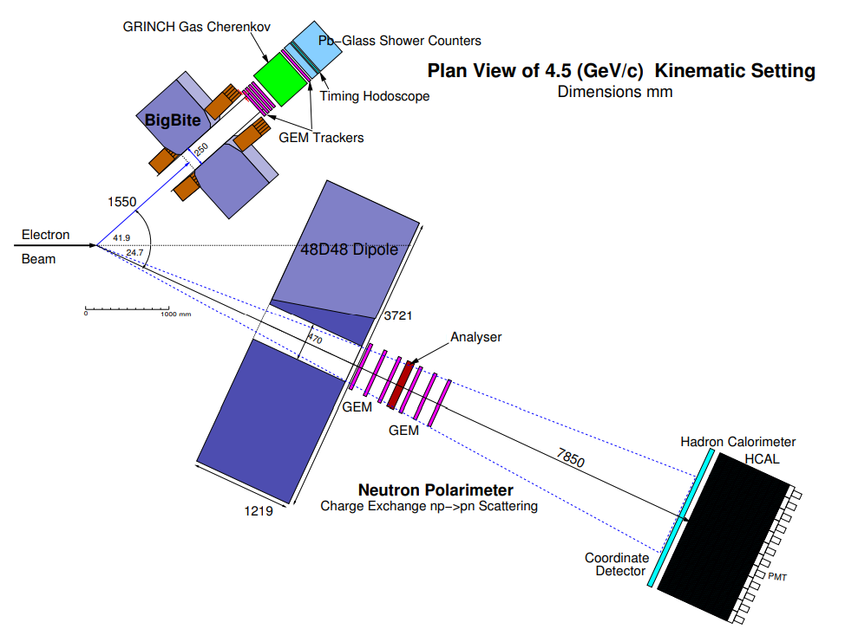
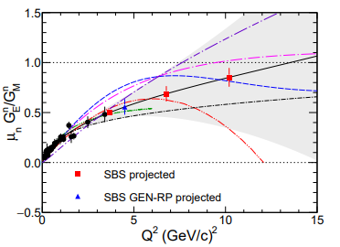
GEn-RP Experimental Setup
Experimental aim
Measure the ratio GEn/GMn at Q² 4.4 (GeV/c)² using recoil polarimetry.
First experiment to measure GEn using recoil polarimetry at high Q²
N'
N
Experiment schematic from GEn-RP proposal
(charge exchange only)
Polarisation transfer from a polarised electron to an unpolarised nucleon. Recoiling nucleon then has polarisation components Pt and Pl.
Notes:
Double check these energy/q2 values
Measure GEn/GMn at Q2 = 4.4 (GeV/c)2 using charge-exchange recoil neutron polarimetry
Beam:
4.3 GeV/c Energy, Pbeam ~80%
30µA on a 15cm LD2 target
Compare F.O.M. for charge-exchange (np→ pn) scattering and the more standard (np→ np)
Demonstrate the feasibility of detecting low-energy recoil protons from an active analyser at large angles in an unshielded environment
Originally proposed to “piggy-back” on the GMn experiment at the 4.5 (GeV/c)2 kinematic

Slide 17
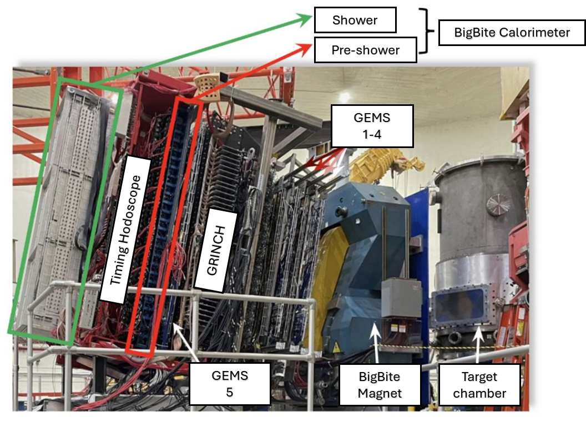
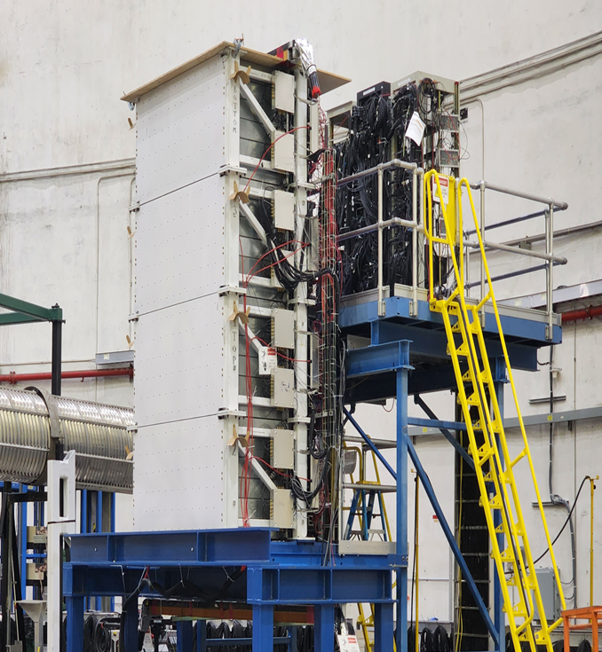
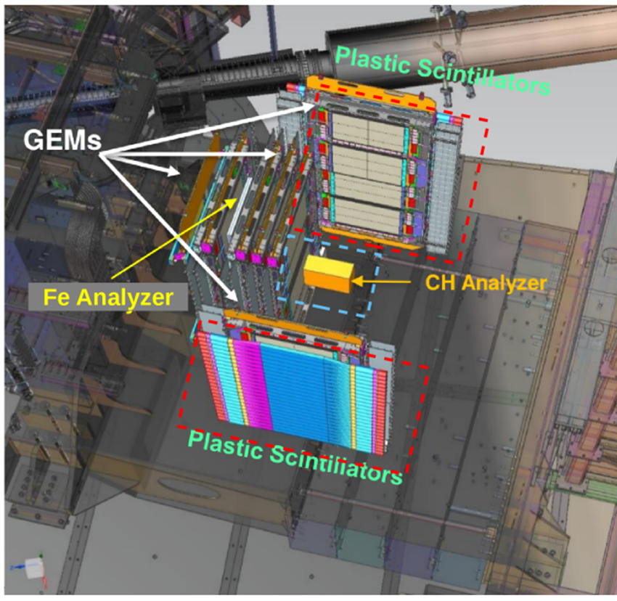

Detector systems
BigBite Spectrometer
Hadron calorimeter
BigBite
Polarimeter
SuperBigBite Spectrometer
Polarimeter
Hadron calorimeter
Notes:
Expectation​:
HCAL
Time resolution ~1 ns​
Energy resolution ~30%​
Position resolution ~ 4cm​
BBCAL
..

Slide 18
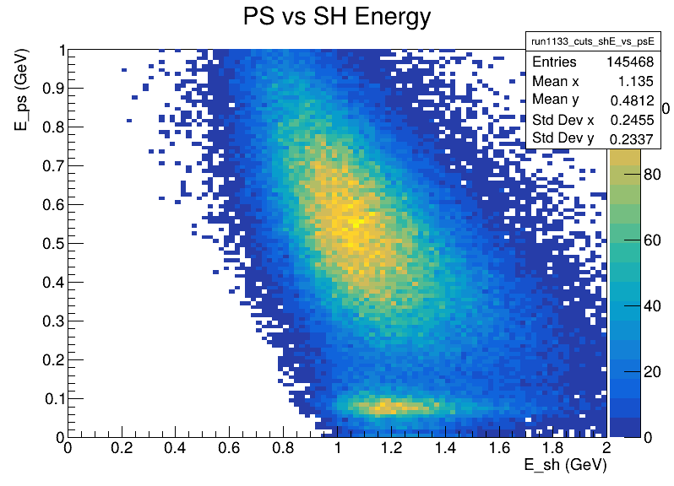
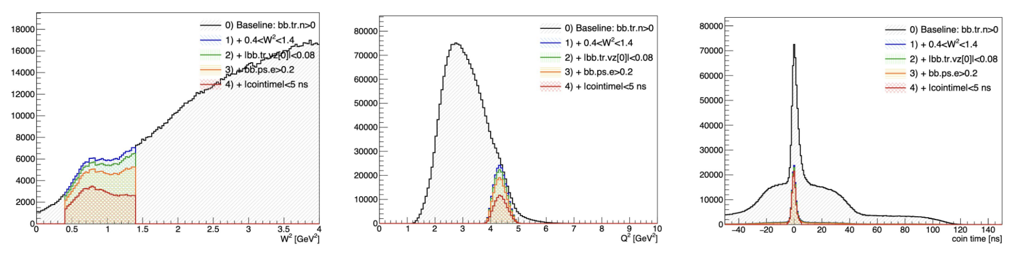
Detector systems – electron arm
BigBite Spectrometer
BigBite
Polarimeter
Hadron calorimeter
Notes:
Expectation​:
HCAL
Time resolution ~1 ns​
Energy resolution ~30%​
Position resolution ~ 4cm​
BBCAL
..

Slide 19
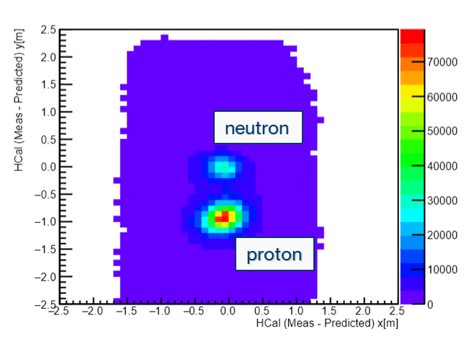
Detector systems – 2 arm analysis
BigBite Spectrometer
Hadron calorimeter
BigBite
Polarimeter
Hadron calorimeter
Notes:
Expectation​:
HCAL
Time resolution ~1 ns​
Energy resolution ~30%​
Position resolution ~ 4cm​
BBCAL
..

Slide 20
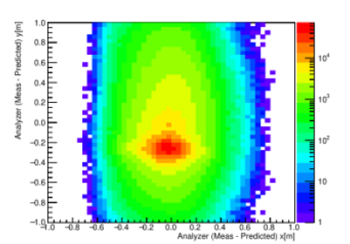
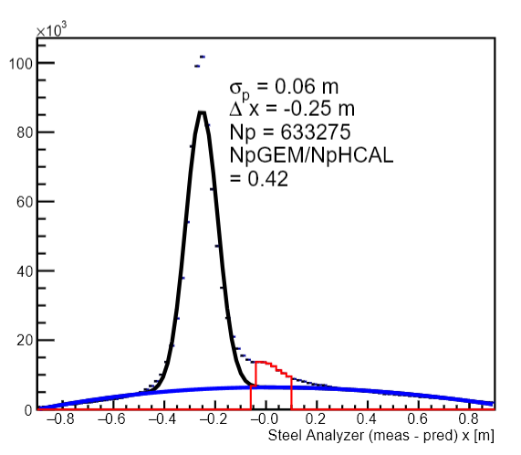
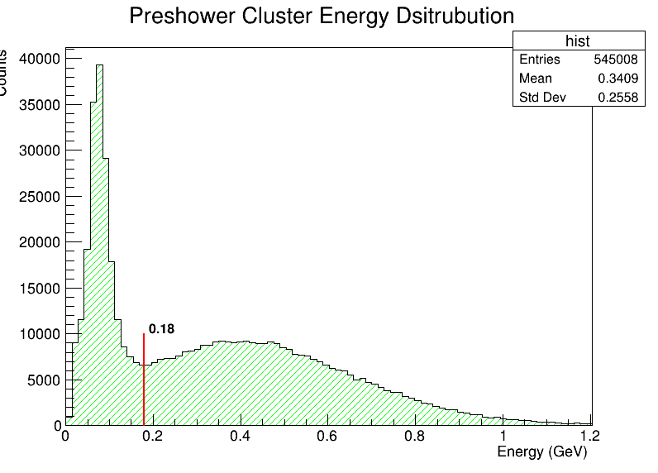
Charge-exchange event selection
BigBite Spectrometer
Polarimeter
BigBite
Polarimeter
Hadron calorimeter

Slide 21
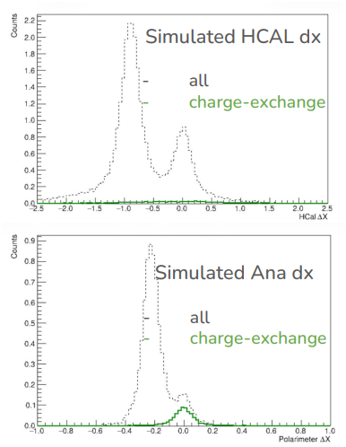
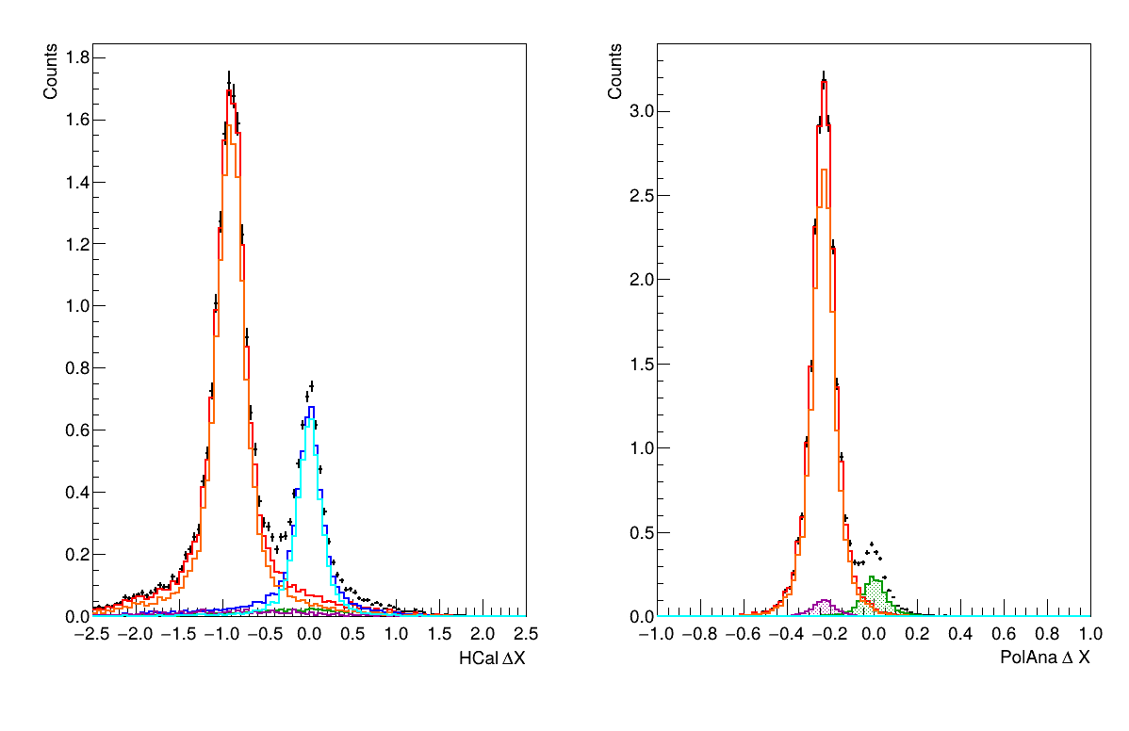
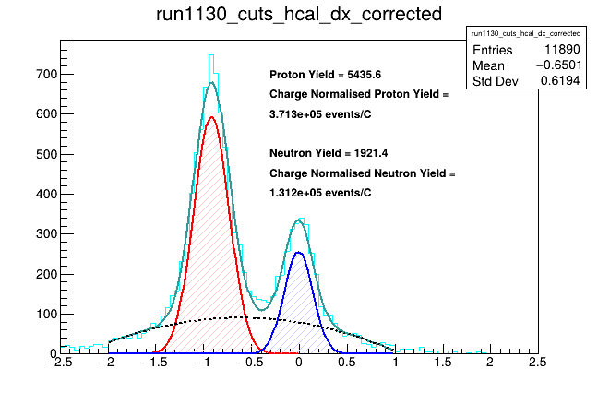
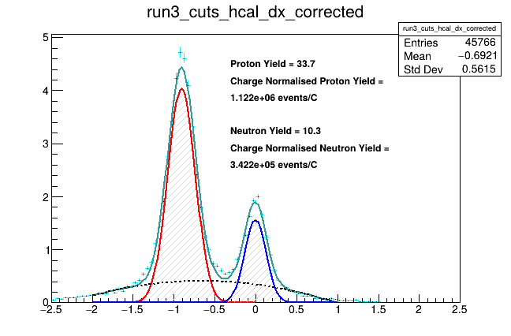
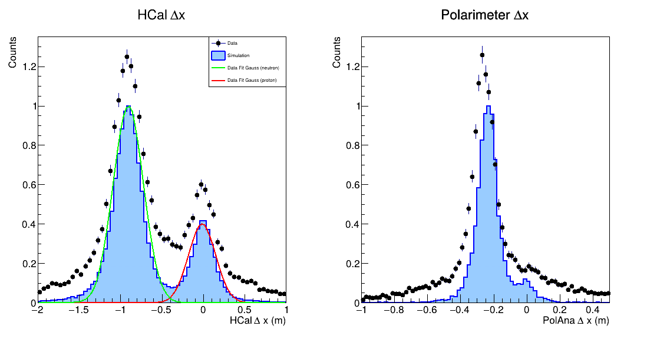
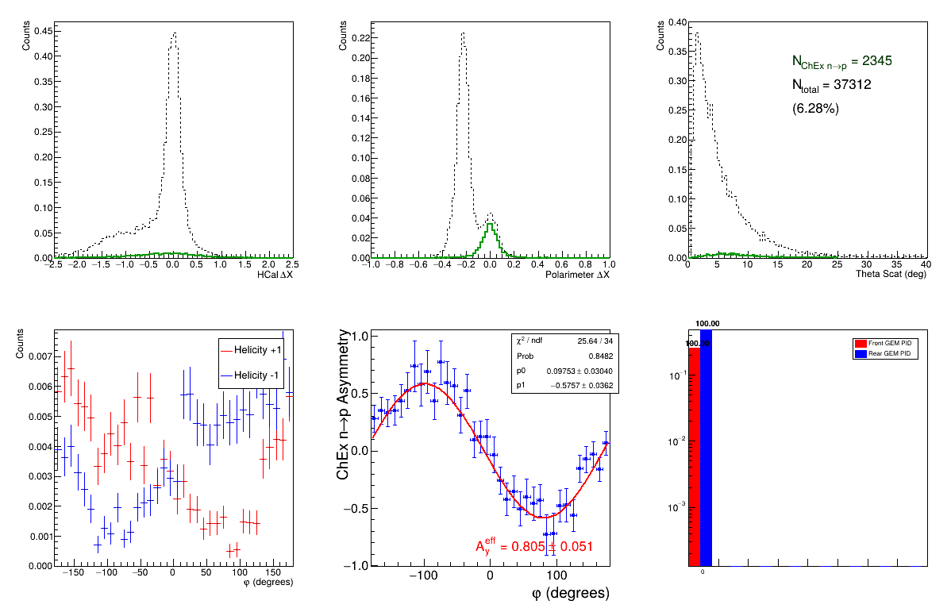
Simulations
Event selection and verification
Compare data vs simulation
Yield/efficiency analysis
Tuning event selection cuts using MC truth
Simulation
Data
Red: Protons
Blue: Neutrons
Green: ChEx Neutrons
Purple: ChEx Protons
Data vs Sim yield analysis
MC event selection study

Slide 22
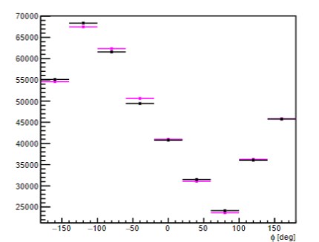
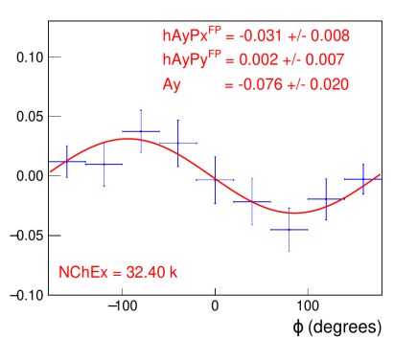

Recoil Polarimeter
HCal
Charge-exchange event analysis
Front
GEMS
Rear
GEMS
Select events where you have neutron into the analyser that undergoes charge exchange
Plot counts vs Φ angle
Neutron
y
x
Φ
Helicity +
Helicity -
Analyser
Proton

Slide 23
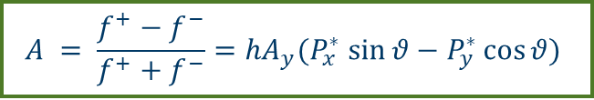
Preliminary Checks (during run)
First look at Asymmetry from the Gen-RP experiment
GEn-RP took data in April-May 2024
Preliminary checks after on ~70% of the data
Binned asymmetry, plotting the difference in counts between +/- helicity states vs azimuthal angle.
Charge-exchange channel shows the expected asymmetry in azimuthal distribution.
Since this result:
Calibrations of subsystems is complete, first data cooking pass ready to begin
Simulation studies to fine-tune event selection cuts
Challenging analysis ongoing!
Plans are underway to use learnings from this experiment for a GEn-RP-7 measurement in Hall C
Preliminary
$$A = \frac{f^{+}−f^{−}}{f^{+}+f^{−}}={hA}_{y}{(P}_{x}^{∗} \sin{θ}−P_{y}^{∗}\cos{θ})$$

Slide 24
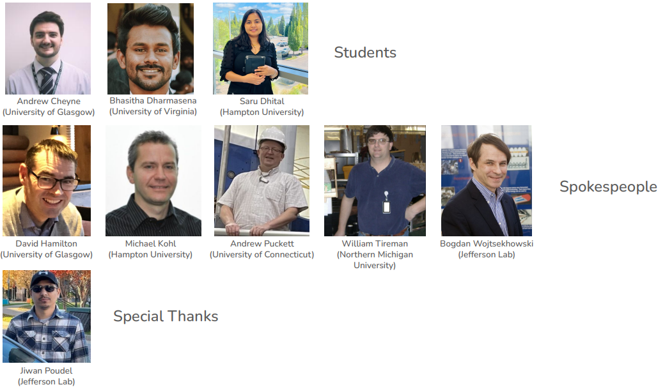
The people
E12-17-004
Measurement of the Ratio GnE /GnM by the Double-polarized… An experimental proposal to Jefferson Lab. PAC 45.
– J. Annand et al. 5 May 21, 2017
Unfinished

Slide 25

Backups

Slide 26
Form Factors World Data
SBS programme at Jefferson Lab
Current world data for Sach’s Form Factors less explored at high 4-momentum transfer
Suite of experiments aiming to measure G_{E}^{n} , and G_{M}^{n} , G_{E}^{p} at high 4-momentum transfer
G_{E}^{n} in particularly unconstrained at high Q²
Proton
“50 Years of QCD” (EPJ C, in press): https://arxiv.org/abs/2212.11107
Neutron
Notes:
Challenges of elastic at higher Q2: cross section drops off at higher Q2
Flavour decomposition
Understanding internal structure at highQ2
Test nuclear models and non-perturb QCD
Strange quark

Slide 27
Run Summary and Current Analysis Status
Current Status
First experiment to measure GEn using recoil polarimetry at high Q²
Charge-exchange channel shows the expected asymmetry in azimuthal distribution.
First pass of detector calibrations are ready for data cooking pass to improve event selection
Secondary Wide-Angle channel and Active analyser data is being looked at, but at early stages
Plans are underway to use learning from this on a higher Q2 measurement at Jefferson Lab
Data Taking summary
GEn-RP took data in April-May 2024
10-12 μA beam current on LD2 target
~3 hours of LH2 data per day
82% polarized beam
11.8 C total LD2 data collected
3-4 kHz data acquisition rate (~1.2 GB/s)

Slide 28
Experimental Setup

Slide 29
Backup
Assumptions:
BigBite solid angle dΩ = 47 msr
Luminosity Len = 5.3 × 10^ 36 cm−2 s −1µA−1
Neutron electric form factor Gn E = 0.0073 (Alberico 2009)
Neutron magnetic form factor Gn M = 0.035 (Alberico 2009)
QE cross section dσ/dΩ = 7.7 × 10^−36 cm2 sr−1
Polarimeter analyzing power (ChEx)Ay = 0.07
Polarimeter efficiency (ChEx) ϵ = 0.05
Polarimeter figure of merit (ChEx) F 2 = 2.5 × 10−4
Electron beam polarization
Pe = 0.8
Expectations:
QE rate = 1.9 Hz µA−1
Neutron transverse polarization component Pt = 0.13
Neutron longitudinal polarization component Pl = 0.79

Slide 30


Detector Calibrations
Both arms need kineatic specific calibrations
Timing Calibrations
Energy calibrations
Remove timewalk and alignment effects due to difference in individual detector components (e.g. cable length, scintillation speed)
PMT-gain matched against reconstructed particle momentum
BigBite E/p resolution improved by ~10% -> ~7% across all runs
Example of timewalk correction for an individual PMT of the hadron arm calorimeter.
Map of average block E/p for preshower showing more uniform distribution after calibrations
Notes:
Looking to ensure uniformity across the detector and track variable.

Slide 31

Proton contamination

Slide 32

Form Factors
Phase space description
A full 5D description of the nucleon has two pillars of measurement:
Inelastic measurements
→ TMDs/PDFs (momentum, k_{T})
Elastic measurements
→ Form Factors (spatial, b_{T})
Commonly expressed as G_{E} and G_{M}.
These describe the electric and magnetic distribution inside the nucleon

Slide 33
Sim Vs Data
Run number | current | charge | sim Yield (/C) |  | actual |  | actual/expected
 |  |  | p | n | p | n | p | n
1130 | 1.20E-05 | 0.01464 | 1.12E+06 | 3.42E+05 | 3.71E+05 | 1.31E+05 | 33.09% | 38.34%
Simulation
Data

Slide 34

Using likelihood estimate for precession

Slide 35
Spin Precession

Slide 36

GEnRP-7
Lessons learned and improvement
Take-aways: •
BB + HCAL efficiency needs improvement
GEM tracking efficiency needs to be improved
Photon flux on front GEMs resulted in high occupancy
Use lead curtain to reduce photon flux on trackers
Additional scintillator plane to define search region
https://github.com/agcheyne/helpDocs/blob/main/SBSangles.html

Slide 37

GEM trackers in GEn-RP
neutron
proton
Additional trackers on hadron arm for GEn-RP, and GEp
Good charge detection should* allow charge exchange channel event selection through track veto.
L0-1: UVa XW layers (single GEM module per layer)
L2-9: UVa XY layers (4 GEM modules per layer)

Slide 38

GEn-RP analyser
Charge Exchange Polarimeter
Removable steel plate between 8 in-line GEM layers
Passive analyser for charge-exchange.
HCal
Large Angle Recoil Proton polarimeter
Active” CH Analyser
two back-to-back X-Y GEM layers and
one 24 paddle hodoscope array

Slide 39

SBS Neutron Polarimeter
Goals

Slide 40


Electron Arm
Shower
Dipole Magnet
5 GEM modules
tracking (42,000 readout strips)
GRINCH
for pion rejection (510 PMTs)
Timing Hodoscope
Precise timing measurements (178 PMTs)
BigBite (Shower + Preshower) calorimeter (241 PMTs)
Energy, position, time, pion rejection
BigBite Calorimeter
Pre-shower
GEMS
1-4
Timing Hodoscope
GRINCH
GEMS
5
BigBite Magnet
Target chamber

Slide 41

GEM trackers
SBS GEM trackers:
High counting rate (~ 400 kHz/cm2 )
Large acceptance & small field integral magnet
Excellent Spatial resolution (70 μm)
Low cost for large tracking system (compared to silicon trackers
High rate compared to Drift chambers
Diagram from Wojciech M. Zabołotny et al.
10.1007/s10894-018-0181-2.

Slide 42


GEM trackers
SBS GEM trackers:
High counting rate (~ 400 kHz/cm2 )
Large acceptance & small field integral magnet
Excellent Spatial resolution (70 μm)
Low cost for large tracking system (compared to silicon trackers
High rate compared to Drift chambers

Slide 43

GEM trackers
Slide from talk by Nilanga Liyanage

Slide 44

GEM trackers
GEMs during GENRP

Slide 45

HCal Trigger

Slide 46

DAQ

Slide 47

Hadron Arm
48D48 Dipole Magnet
p-n separation
Low momentum charged rejection
Spin-precession
More GEM modules*
Tracking, polarimetry*
Hadron calorimeter - HCal
Energy, position, timing
48D48 magnet
GEMS*
HCal

Slide 48

HCal ∆x/∆y
Using information from both arms, we can reconstruct an expected hit position on nucleons on HCal.
∆x/∆y are the difference between the measured and expected hit position¹.
proton
neutron
neutron
proton
¹ Where x is the dispersive direction

Slide 49



Target for GMn, GEn-RP, and KLL
Picture credit: Dave Meekins

Slide 50


Hadron arm timing – LH2 (elastic cuts)

Slide 51


BBCal energy
The change in calorimeter threshold during running can be seen in the E/p vs run number
Run groups separated at these dates
There also appears to be large changes when no changes are made
This appears to be a beam current effect due to misaligned GEMs and other detectors.

Slide 52


Electron arm timing

Slide 53


Two independent methods of looking at hodoscope resolution without reference time contribution.
Both show around 570ps resolution.

Slide 54

Charge Exchange event selection
by Bhasitha Dharmasena (UVa)
Looking at the effect of the analyser

Slide 55

Charge Exchange event selection
by Bhasitha Dharmasena (UVa)
At the moment, the proton vetoing using the Front Tracker doesn’t work as effectively as we would have wanted. This is still being investigated.

Slide 56





Wide angle polarimeter
by Bill Henry (Jlab)
Work ongoing by Saru looking into how much information will recoverable from the side-plane hodoscope and active analyser

Slide 57

GEM alignment – Andrew Puckett (UConn)

Slide 58







