Slide 1


Asli Acar, Mikhail Bashkanov, Dan Watts
1

Slide 2
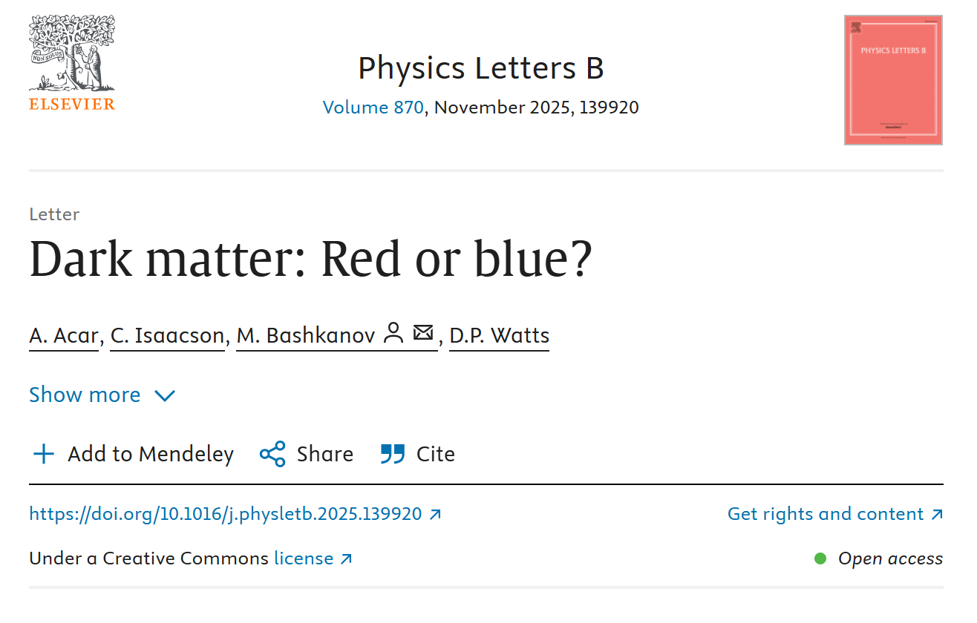
Dark Matter: Red or Blue?
https://arxiv.org/abs/2509.20423
2

Slide 3
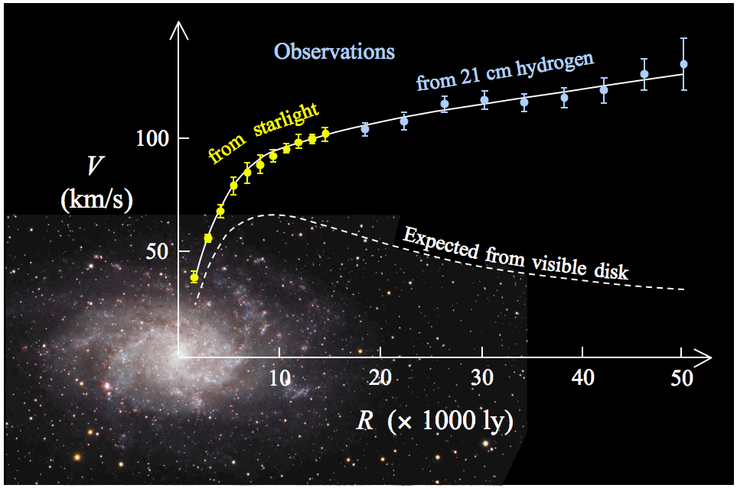
Dark Matter – Why?
3

Slide 4
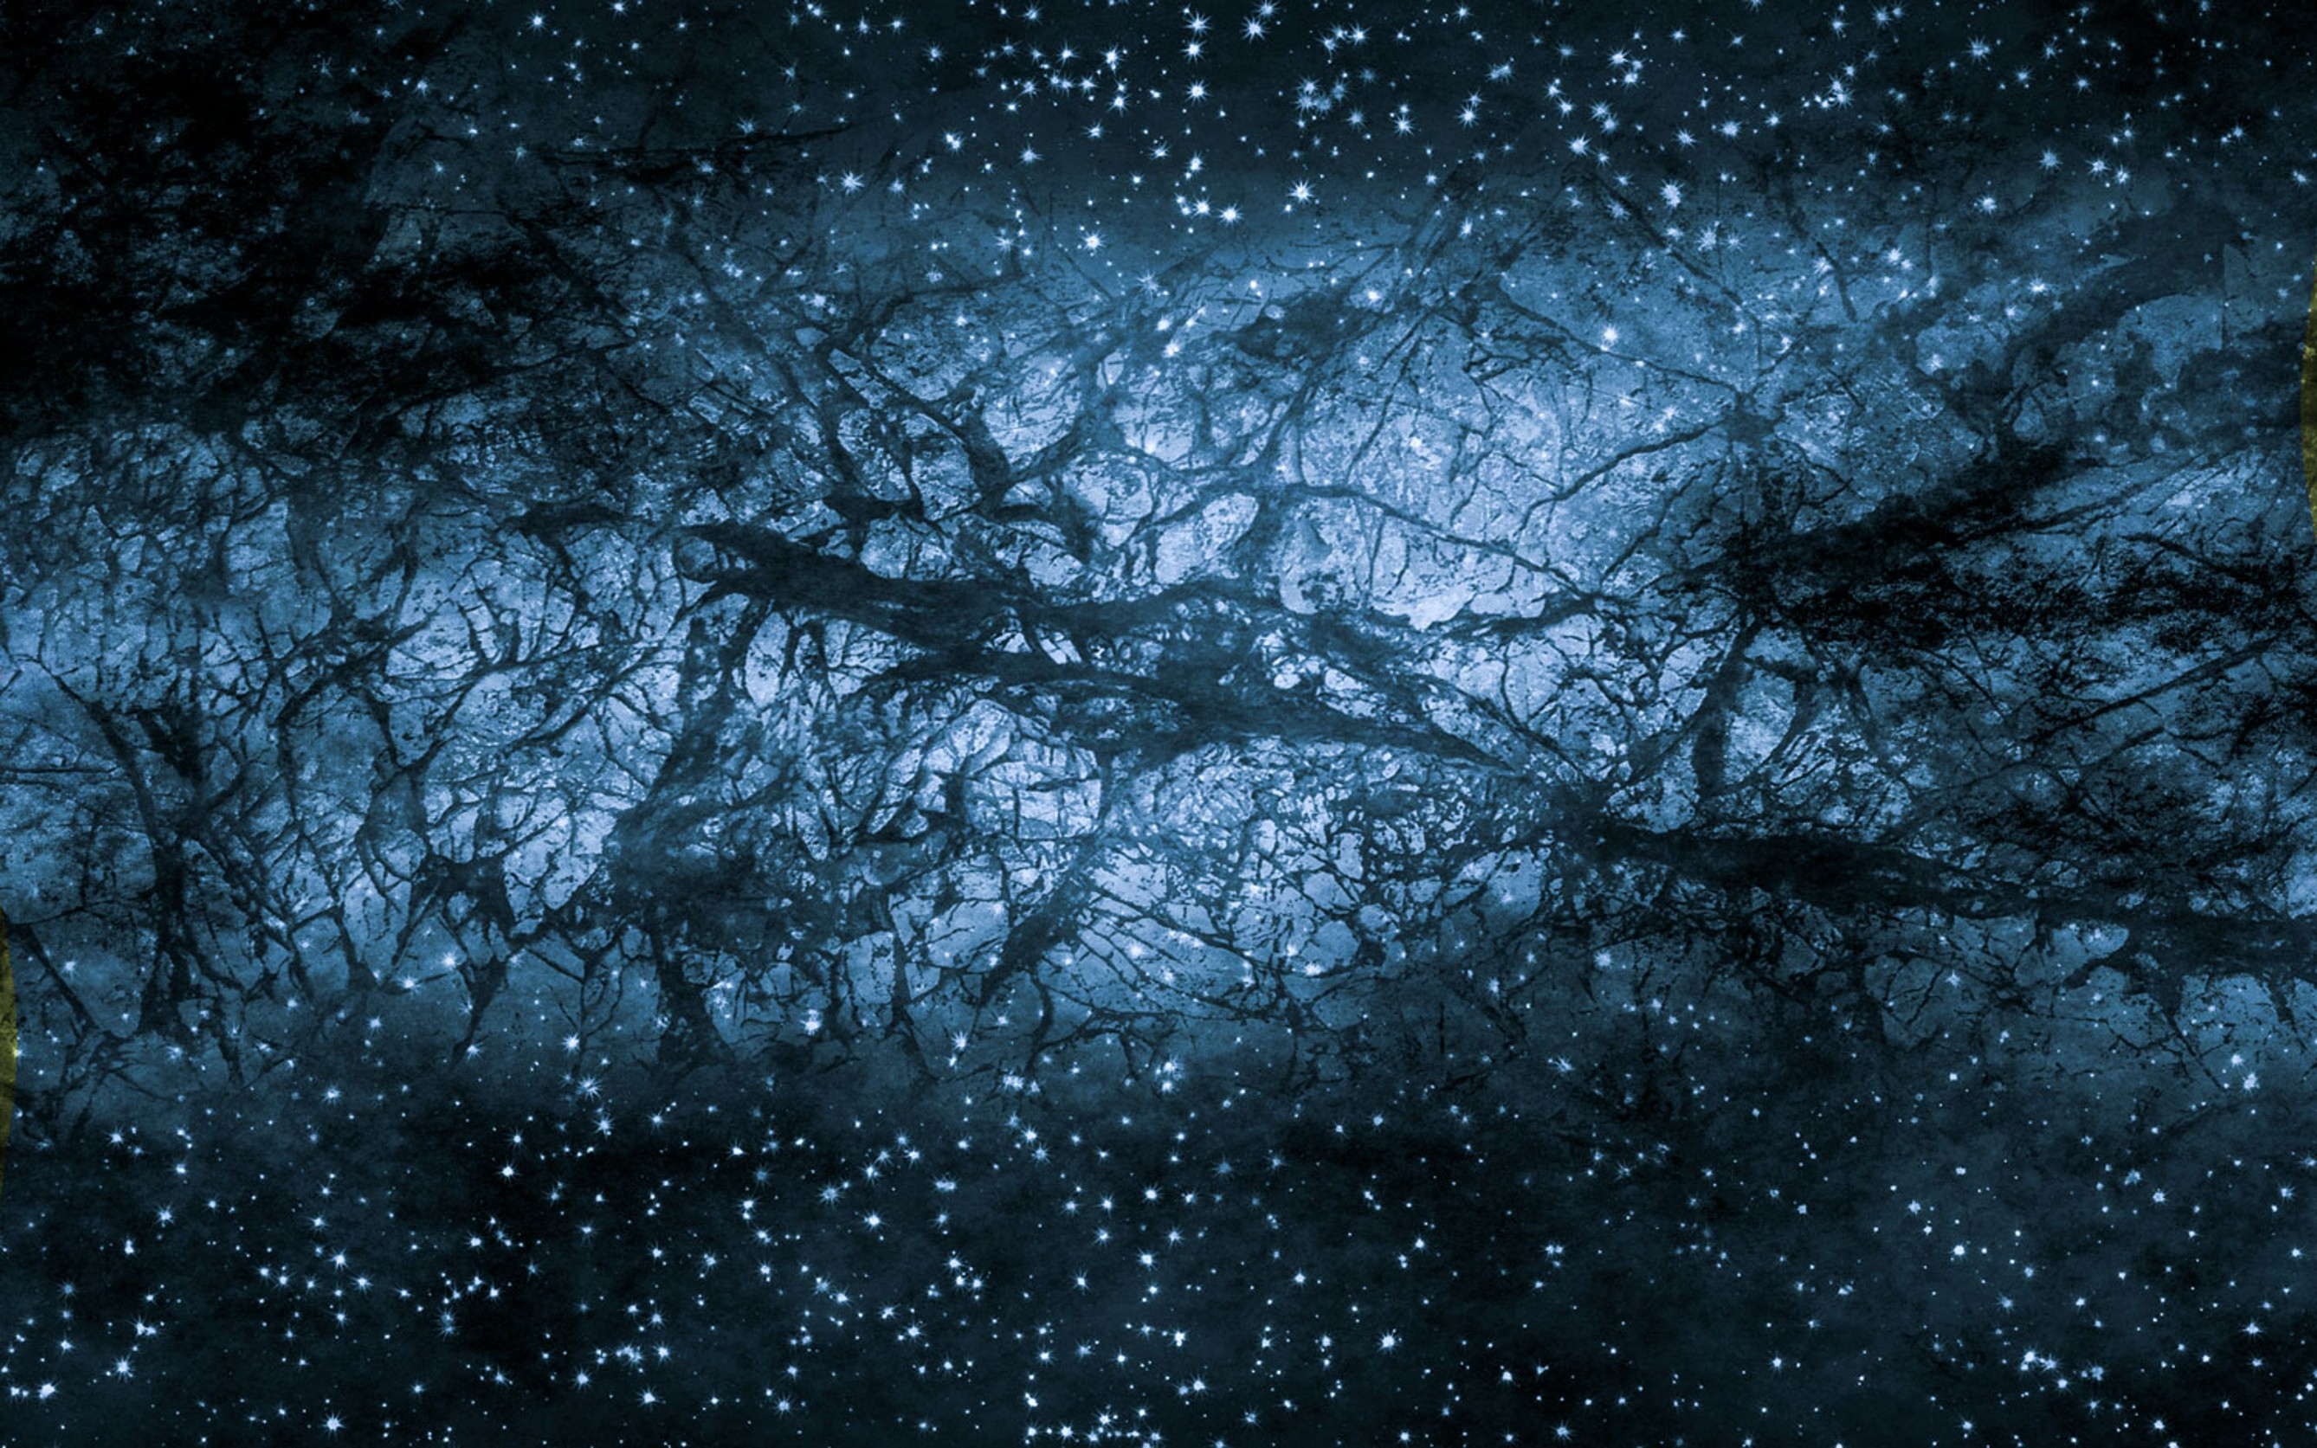
Dark Matter
4

Slide 5




Dark Matter – How?
WIMP’s
Weakly interacting massive particles
axions
MACHO’s
$$μeV$$
T$eV$
$$M_{Plank}$$
Dark Matter Mass
$$M_{⊙}$$
WIMPZillas
Quantum Black holes
5

Slide 6
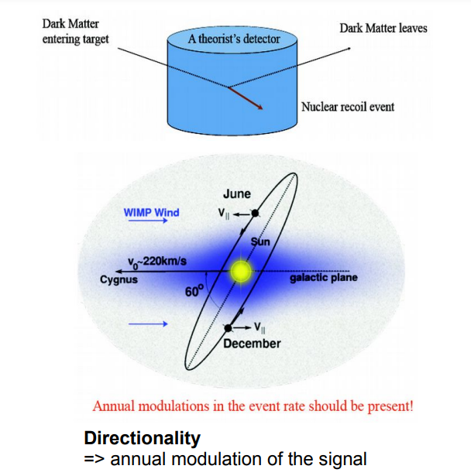
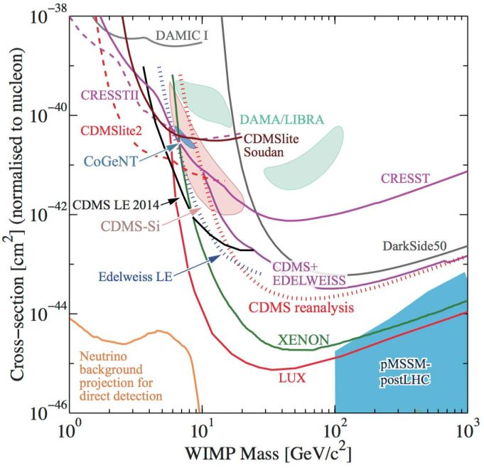
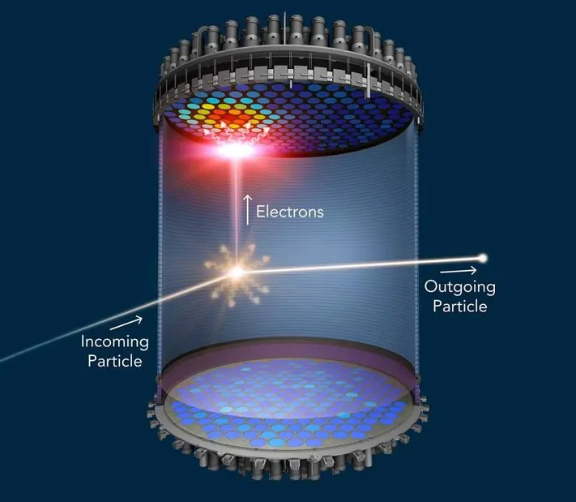

Direct WIMP searches
$$M_{χ}∼1 TeV$$

Slide 7
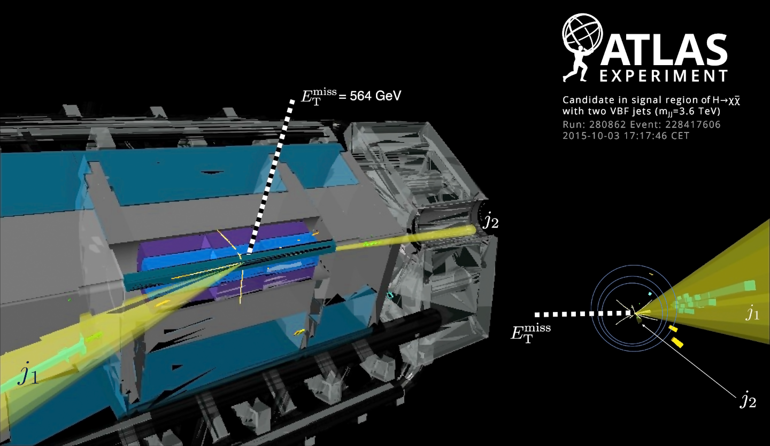
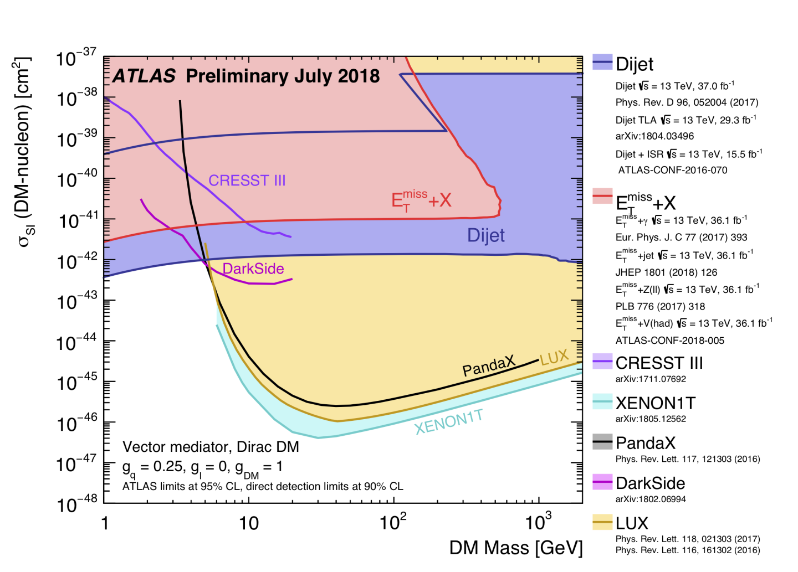

WIMP searches at LHC
$$M_{χ}∼1 TeV$$
7

Slide 8

WIMP – light interactions
Six handshake rule
8

Slide 9
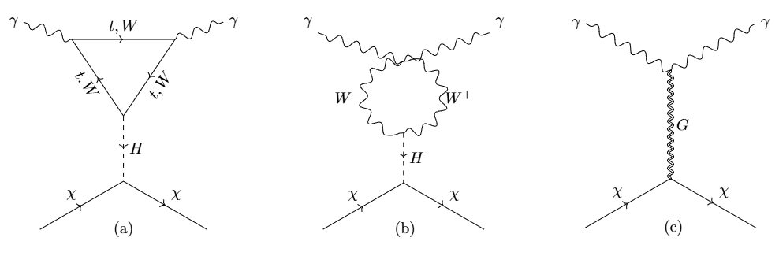
WIMP – light interactions
Six handshake rule in particle physics
9

Slide 10
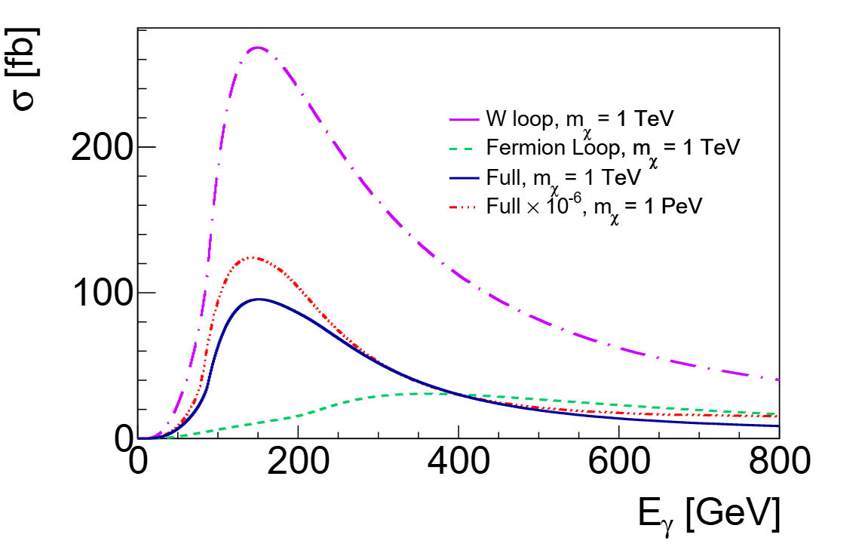
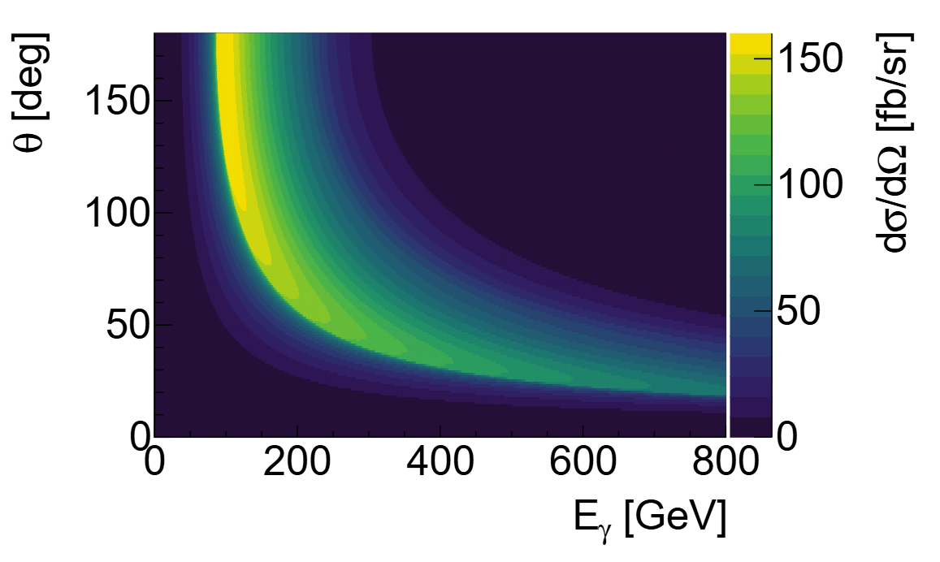
WIMP – light interactions
10

Slide 11


WIMP – light interactions
light
$$χ$$
11

Slide 12
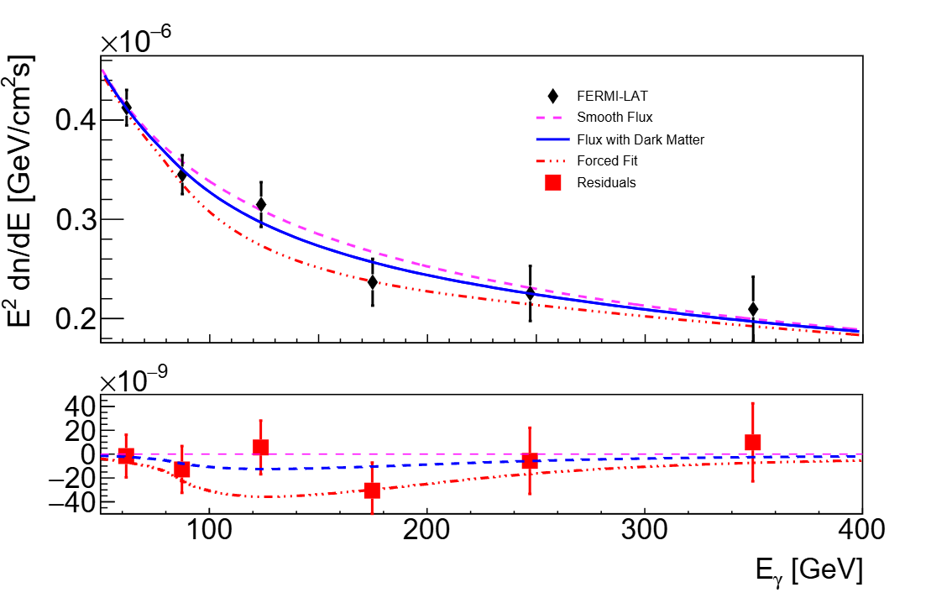
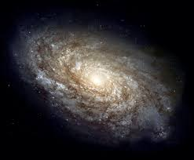
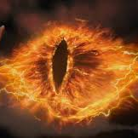
WIMP – light interactions: high energy gamma rays?
12

Slide 13
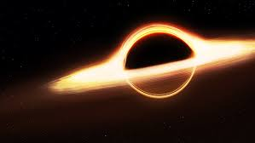
Gravitational dark matter?
13

Slide 14
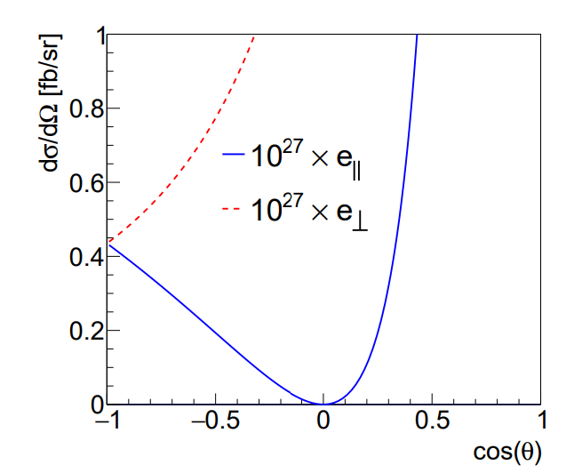
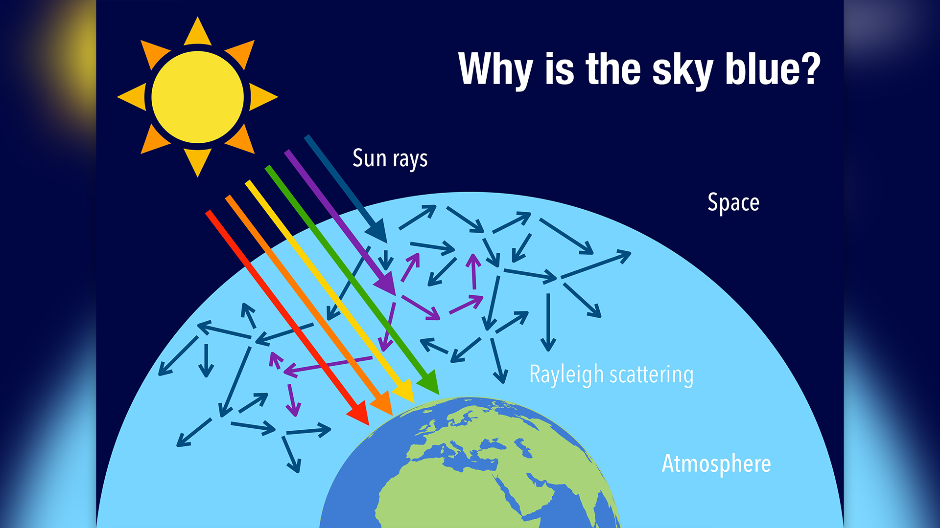
Gravitational dark matter?
14

Slide 15
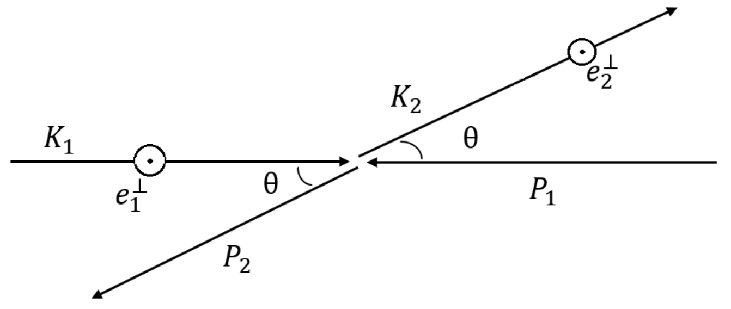
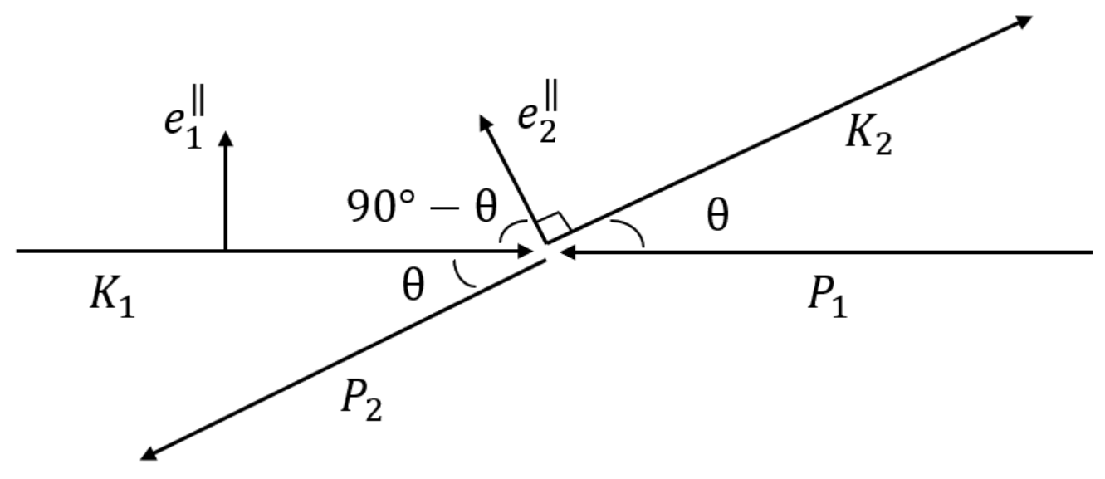
Gravitational dark matter – polarisation effects.
15

Slide 16
Dark Matter detection
@
Accelerators?
16

Slide 17
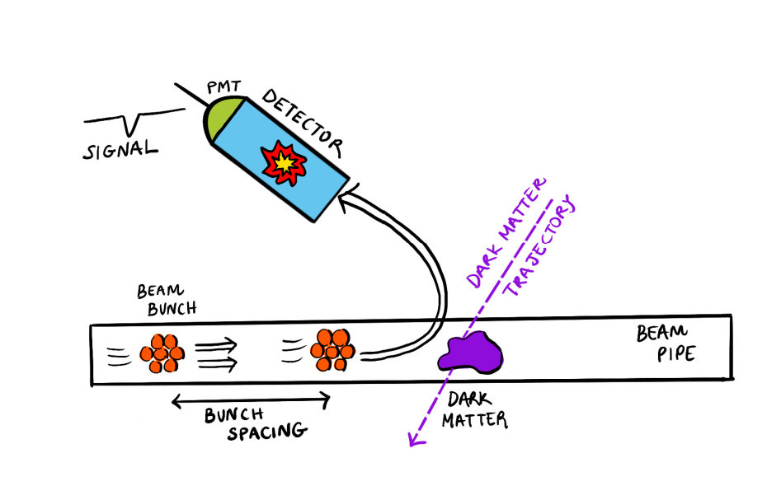
DM vs intense beams
arXiv: 2603.03011
17

Slide 18
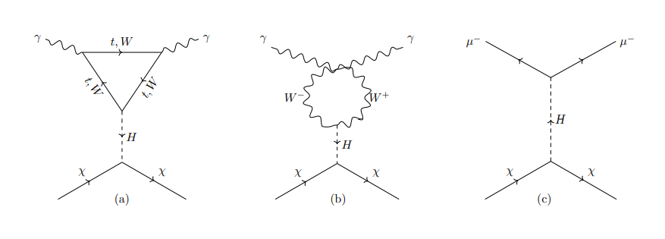
WIMP – particles interactions
18

Slide 19
WIMP – particles interactions
19

Slide 20
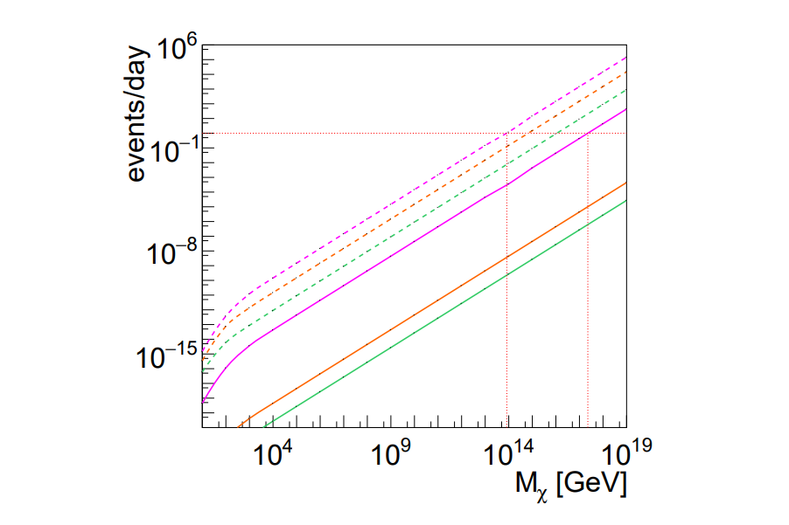
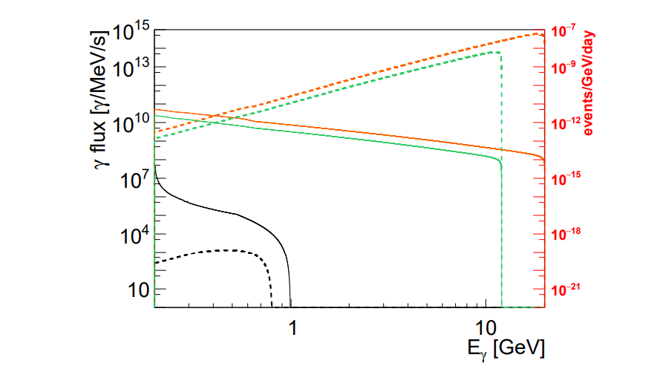



WIMP’s at accelerators
Muon collider
Photon beam flux
Scattered $γ^{′}s$
RAL
JLab12/JLab20
$$ρ_{χ}=1000 GeV/cm^{3}$$
$$ρ_{χ}=0.3 GeV/cm^{3}$$
20

Slide 21
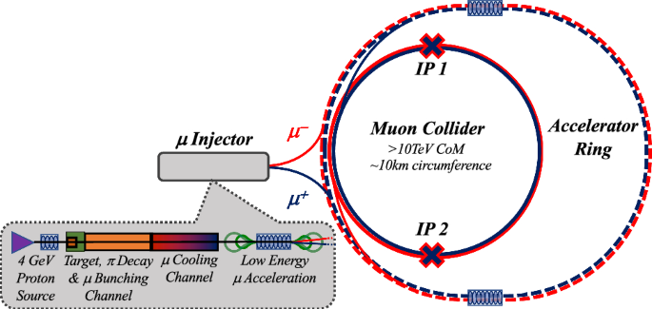

Muon collider as DM “weather” monitor
21

Slide 22
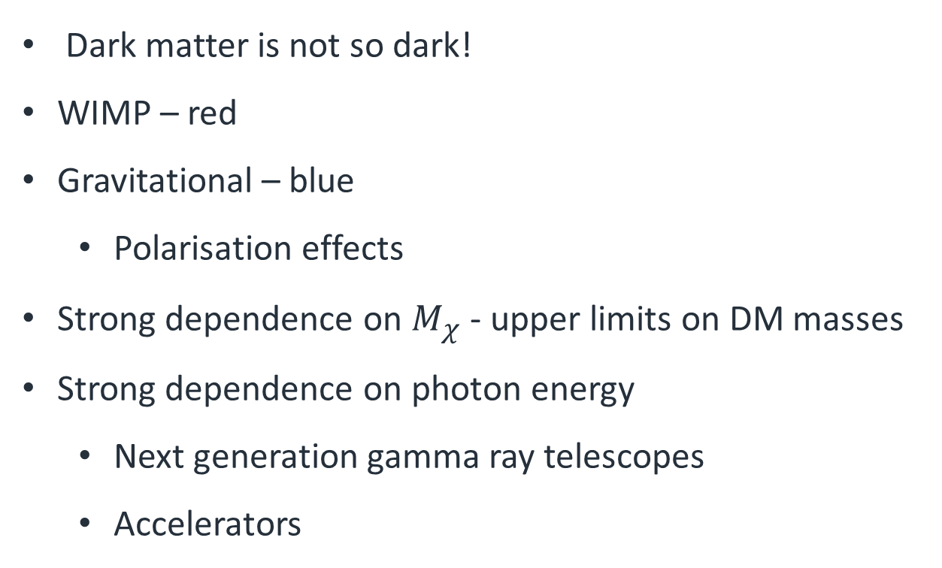
Conclusion
Dark matter is not so dark!
WIMP – red
Gravitational – blue
Polarisation effects
Strong dependence on $M_{χ}$ - upper limits on DM masses
Strong dependence on photon energy
Next generation gamma ray telescopes
Accelerators
22

Slide 23
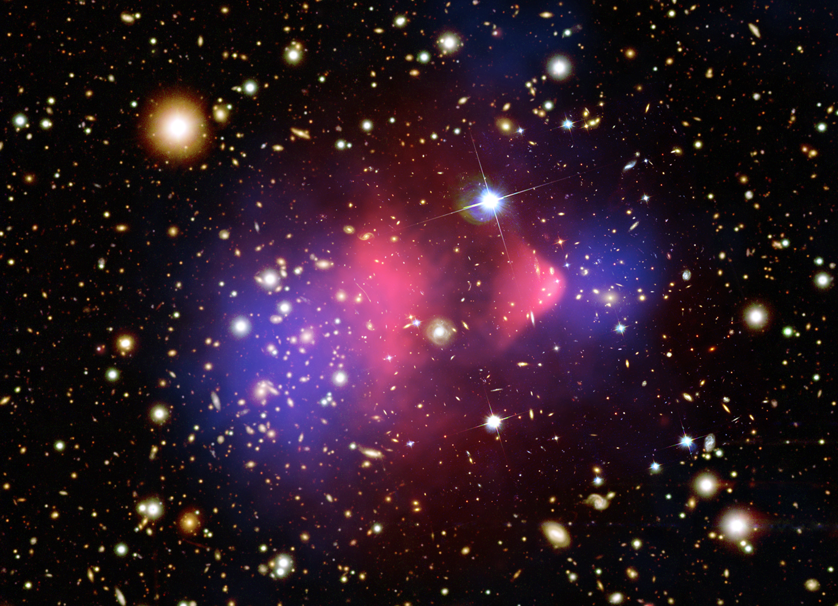
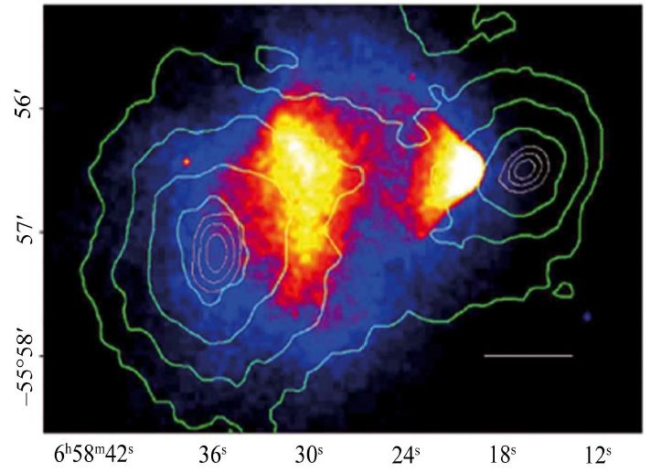
The Bullet Cluster – A smoking gun for dark matter
23

Slide 24
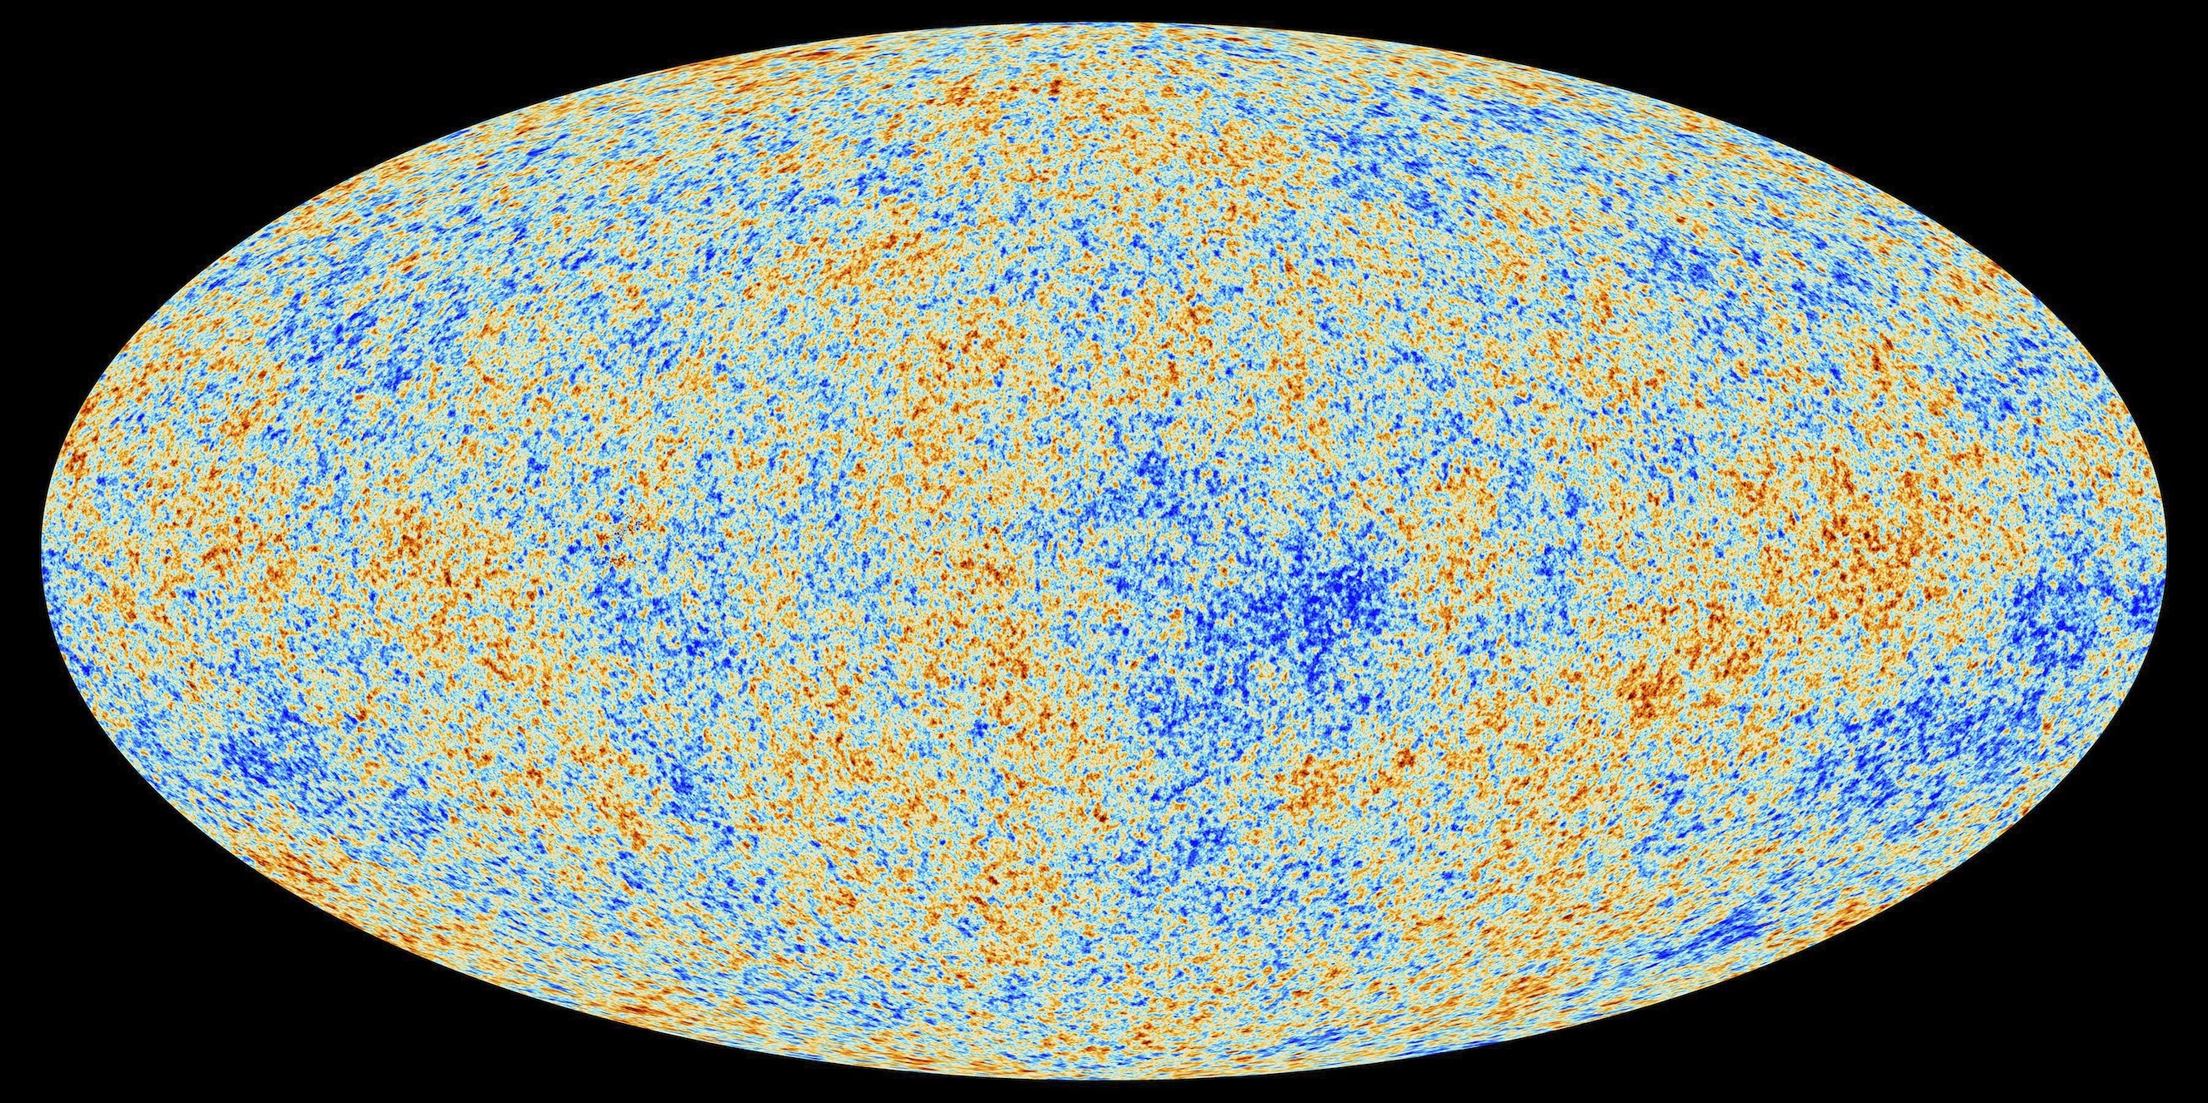
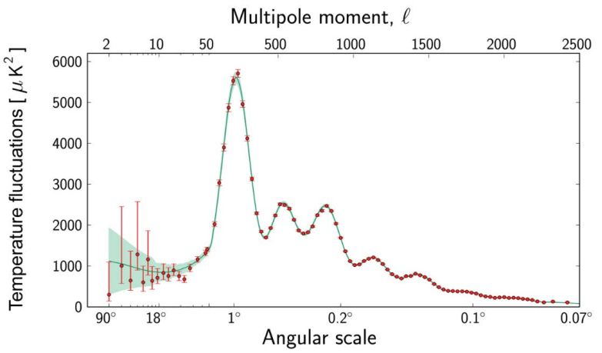
Cosmic microwave background radiation
24

Slide 25
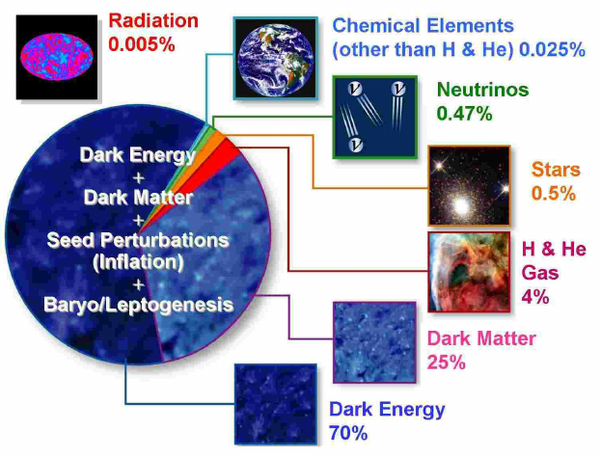
The standard model of cosmology
25

Slide 26
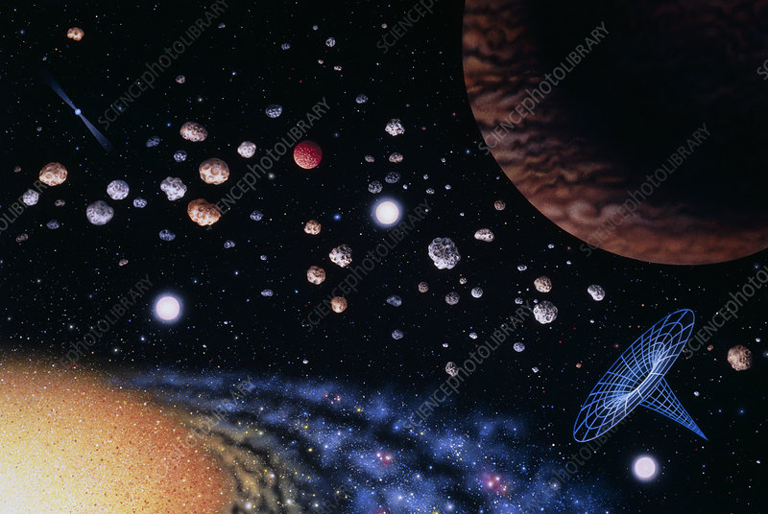
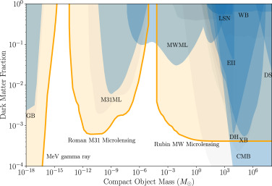

Macho’s?
MAssive Compact Halo Object (MACHO)
$$M_{χ}∼<1M_{⊙}$$
26

Slide 27
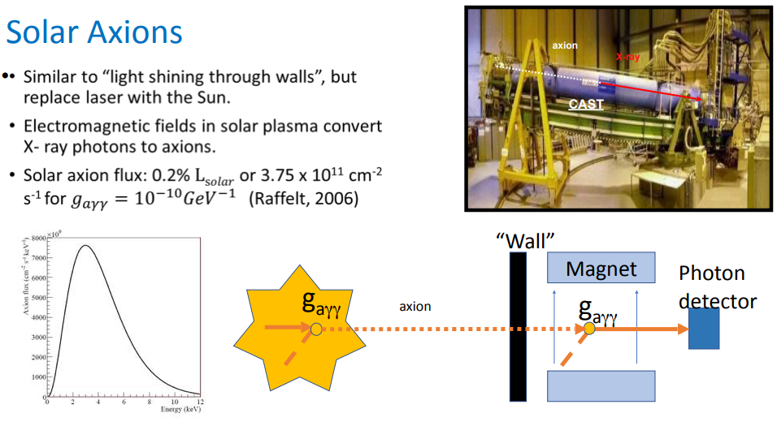

Solar Axions
$$M_{χ}∼1 μeV$$

Slide 28
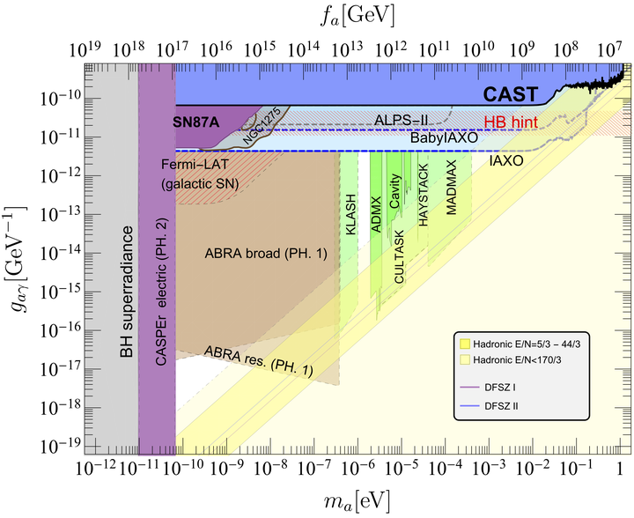

Axions?
28

Slide 29
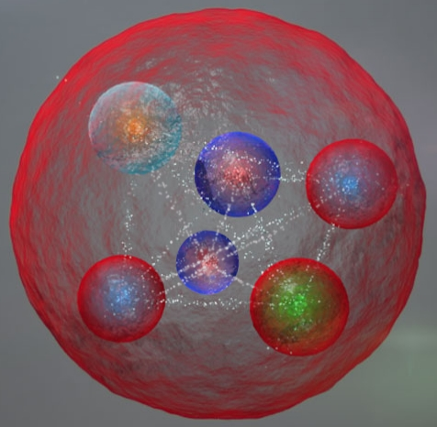
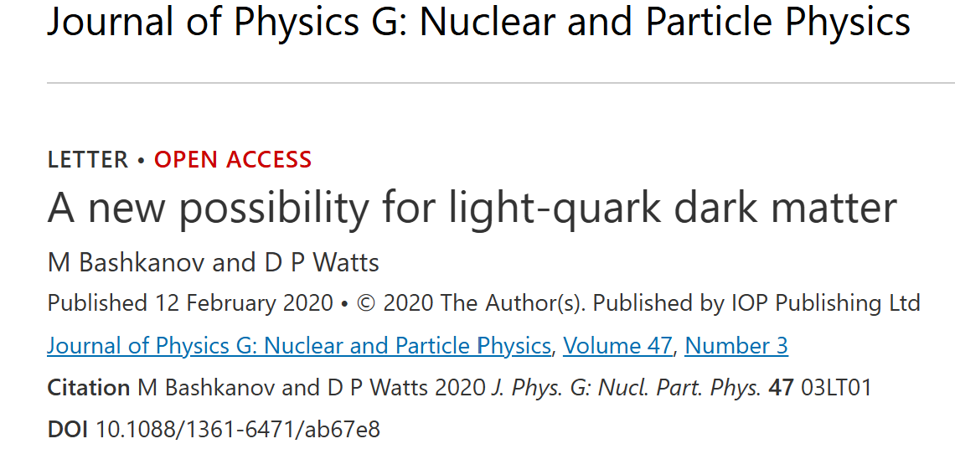
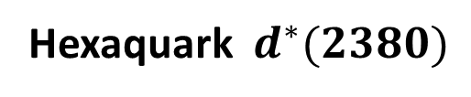
Hexaquark dark matter
I(J^{p}) = 0(3⁺)
Hexaquark $d^{∗}(2380)$
u
u
u
d
d
d
Smaller than proton
Hexaquarks in BEC
29

Slide 30
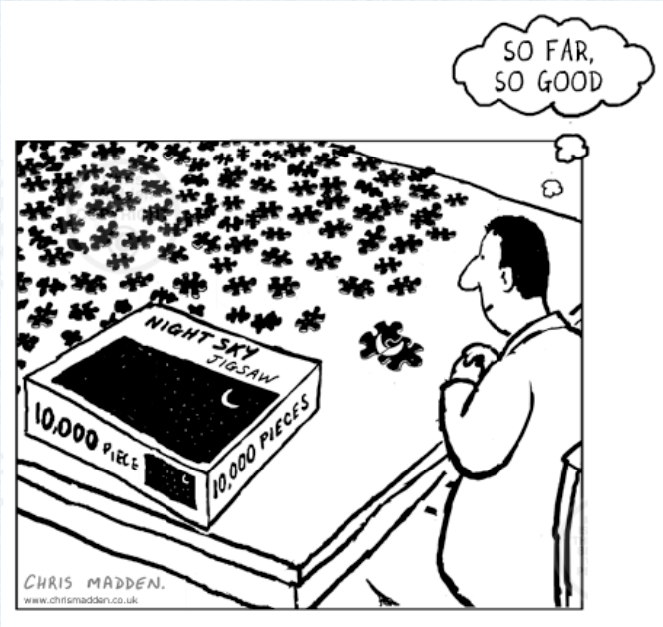
Dark matter – too many options

