Slide 1




The Structure of N~126 Nuclei
IoP Nuclear Physics Conference 2026
13/04/26

Slide 2
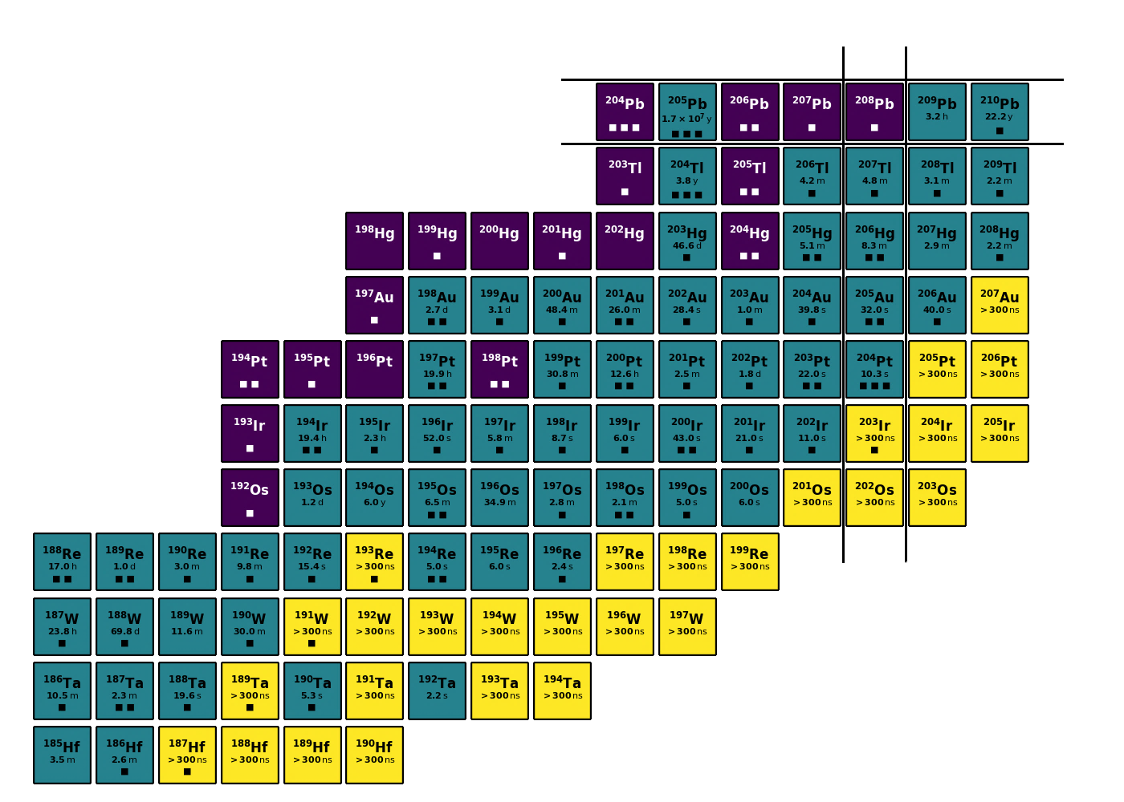
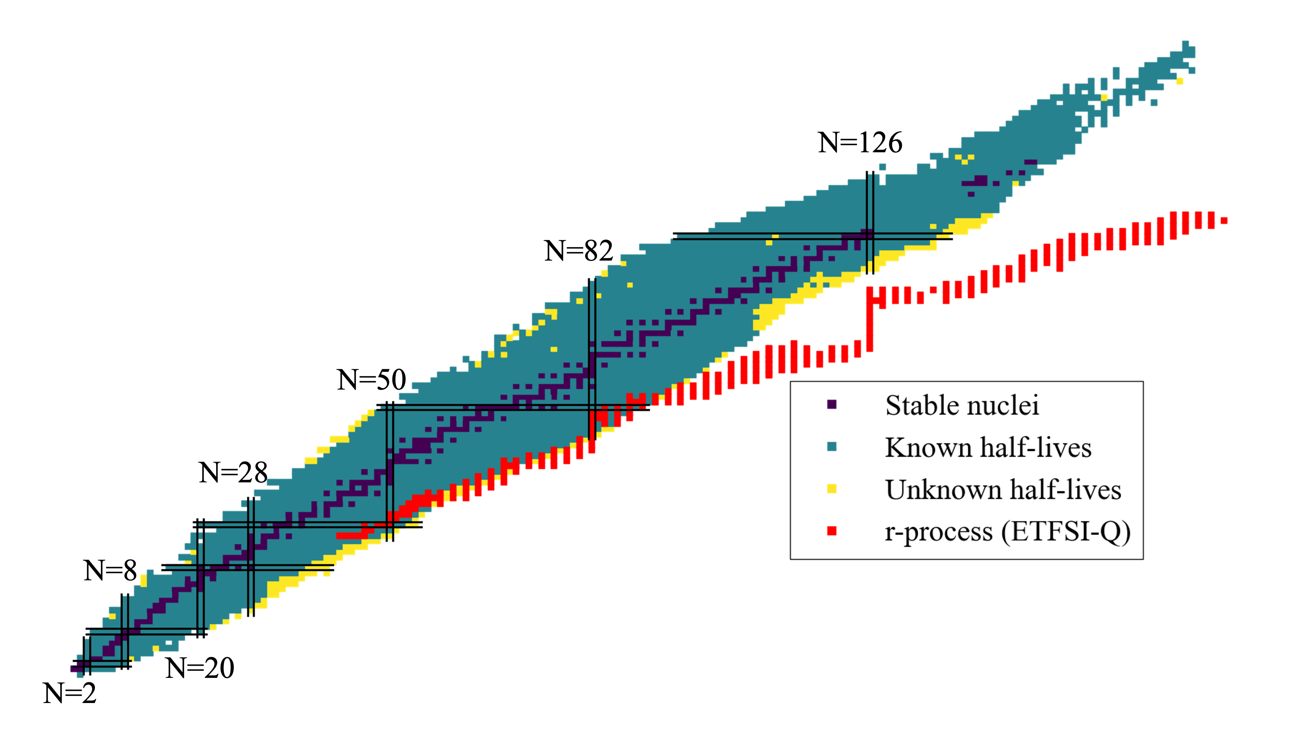
Motivation
Following on from RISING Campaign at GSI 2006
This Experiment performed at GSI in May 2022

Slide 3
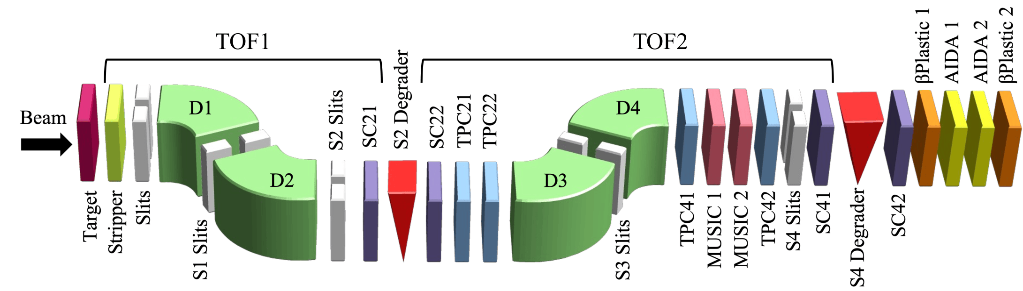
Setup: Fragment Separator
Ions of Interest Implanted
²⁰⁸Pb Beam at 1 GeV/u
⁹Be Target of 2512 mg/cm²
Degraders: Slow Ions for Identification and Implantation
Time Projection Chamber (TPC): Position
²⁰³Ir setting: 20.7 hours
Scintillators (SC): Time of Flight
Multi-Sampling Ionisation Chamber (MUSIC): Energy Loss
²⁰²Os setting: 84.4 hours

Slide 4
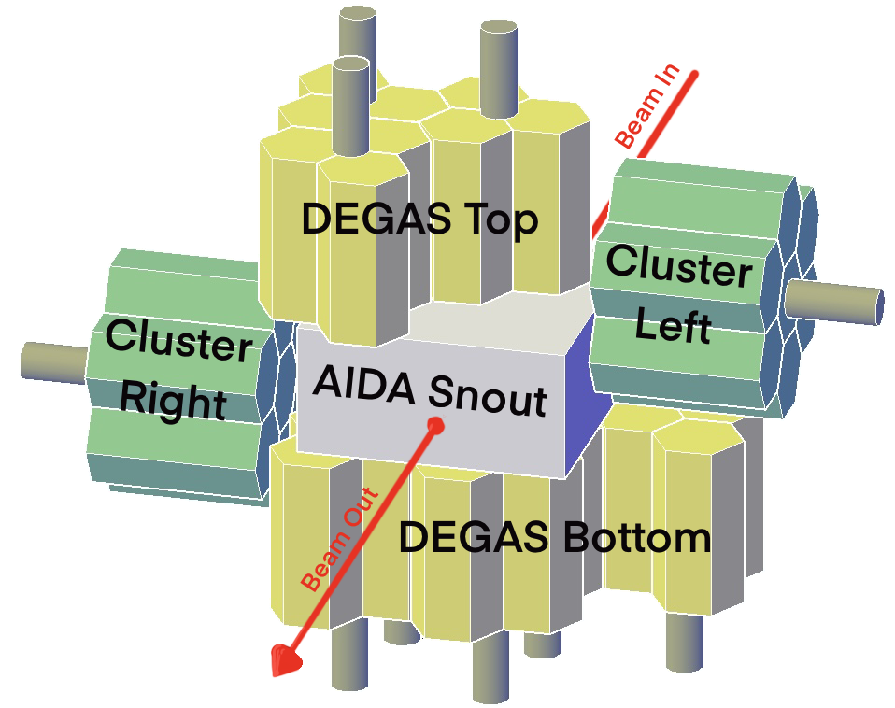
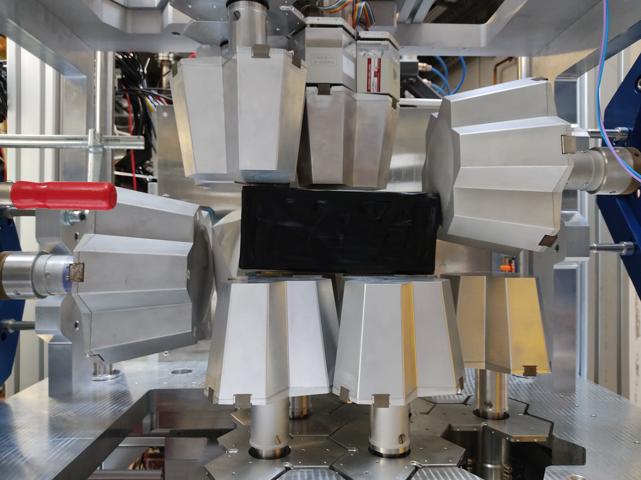
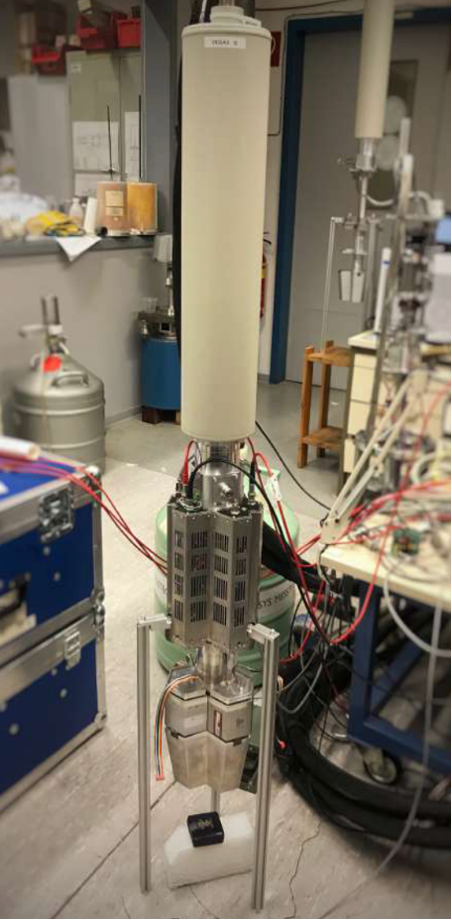
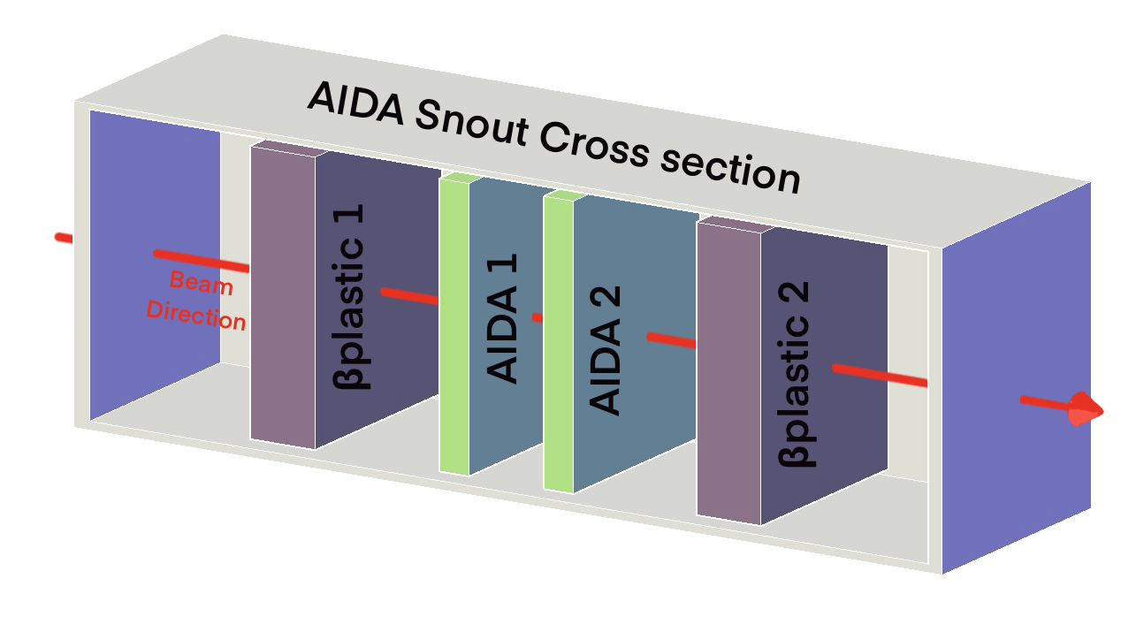
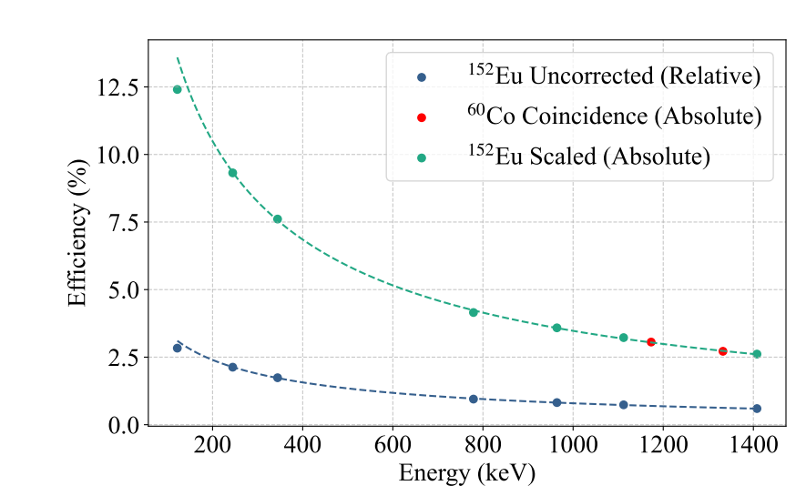
Setup: Gamma-Ray Detection
First use of DEGAS detectors

Slide 5
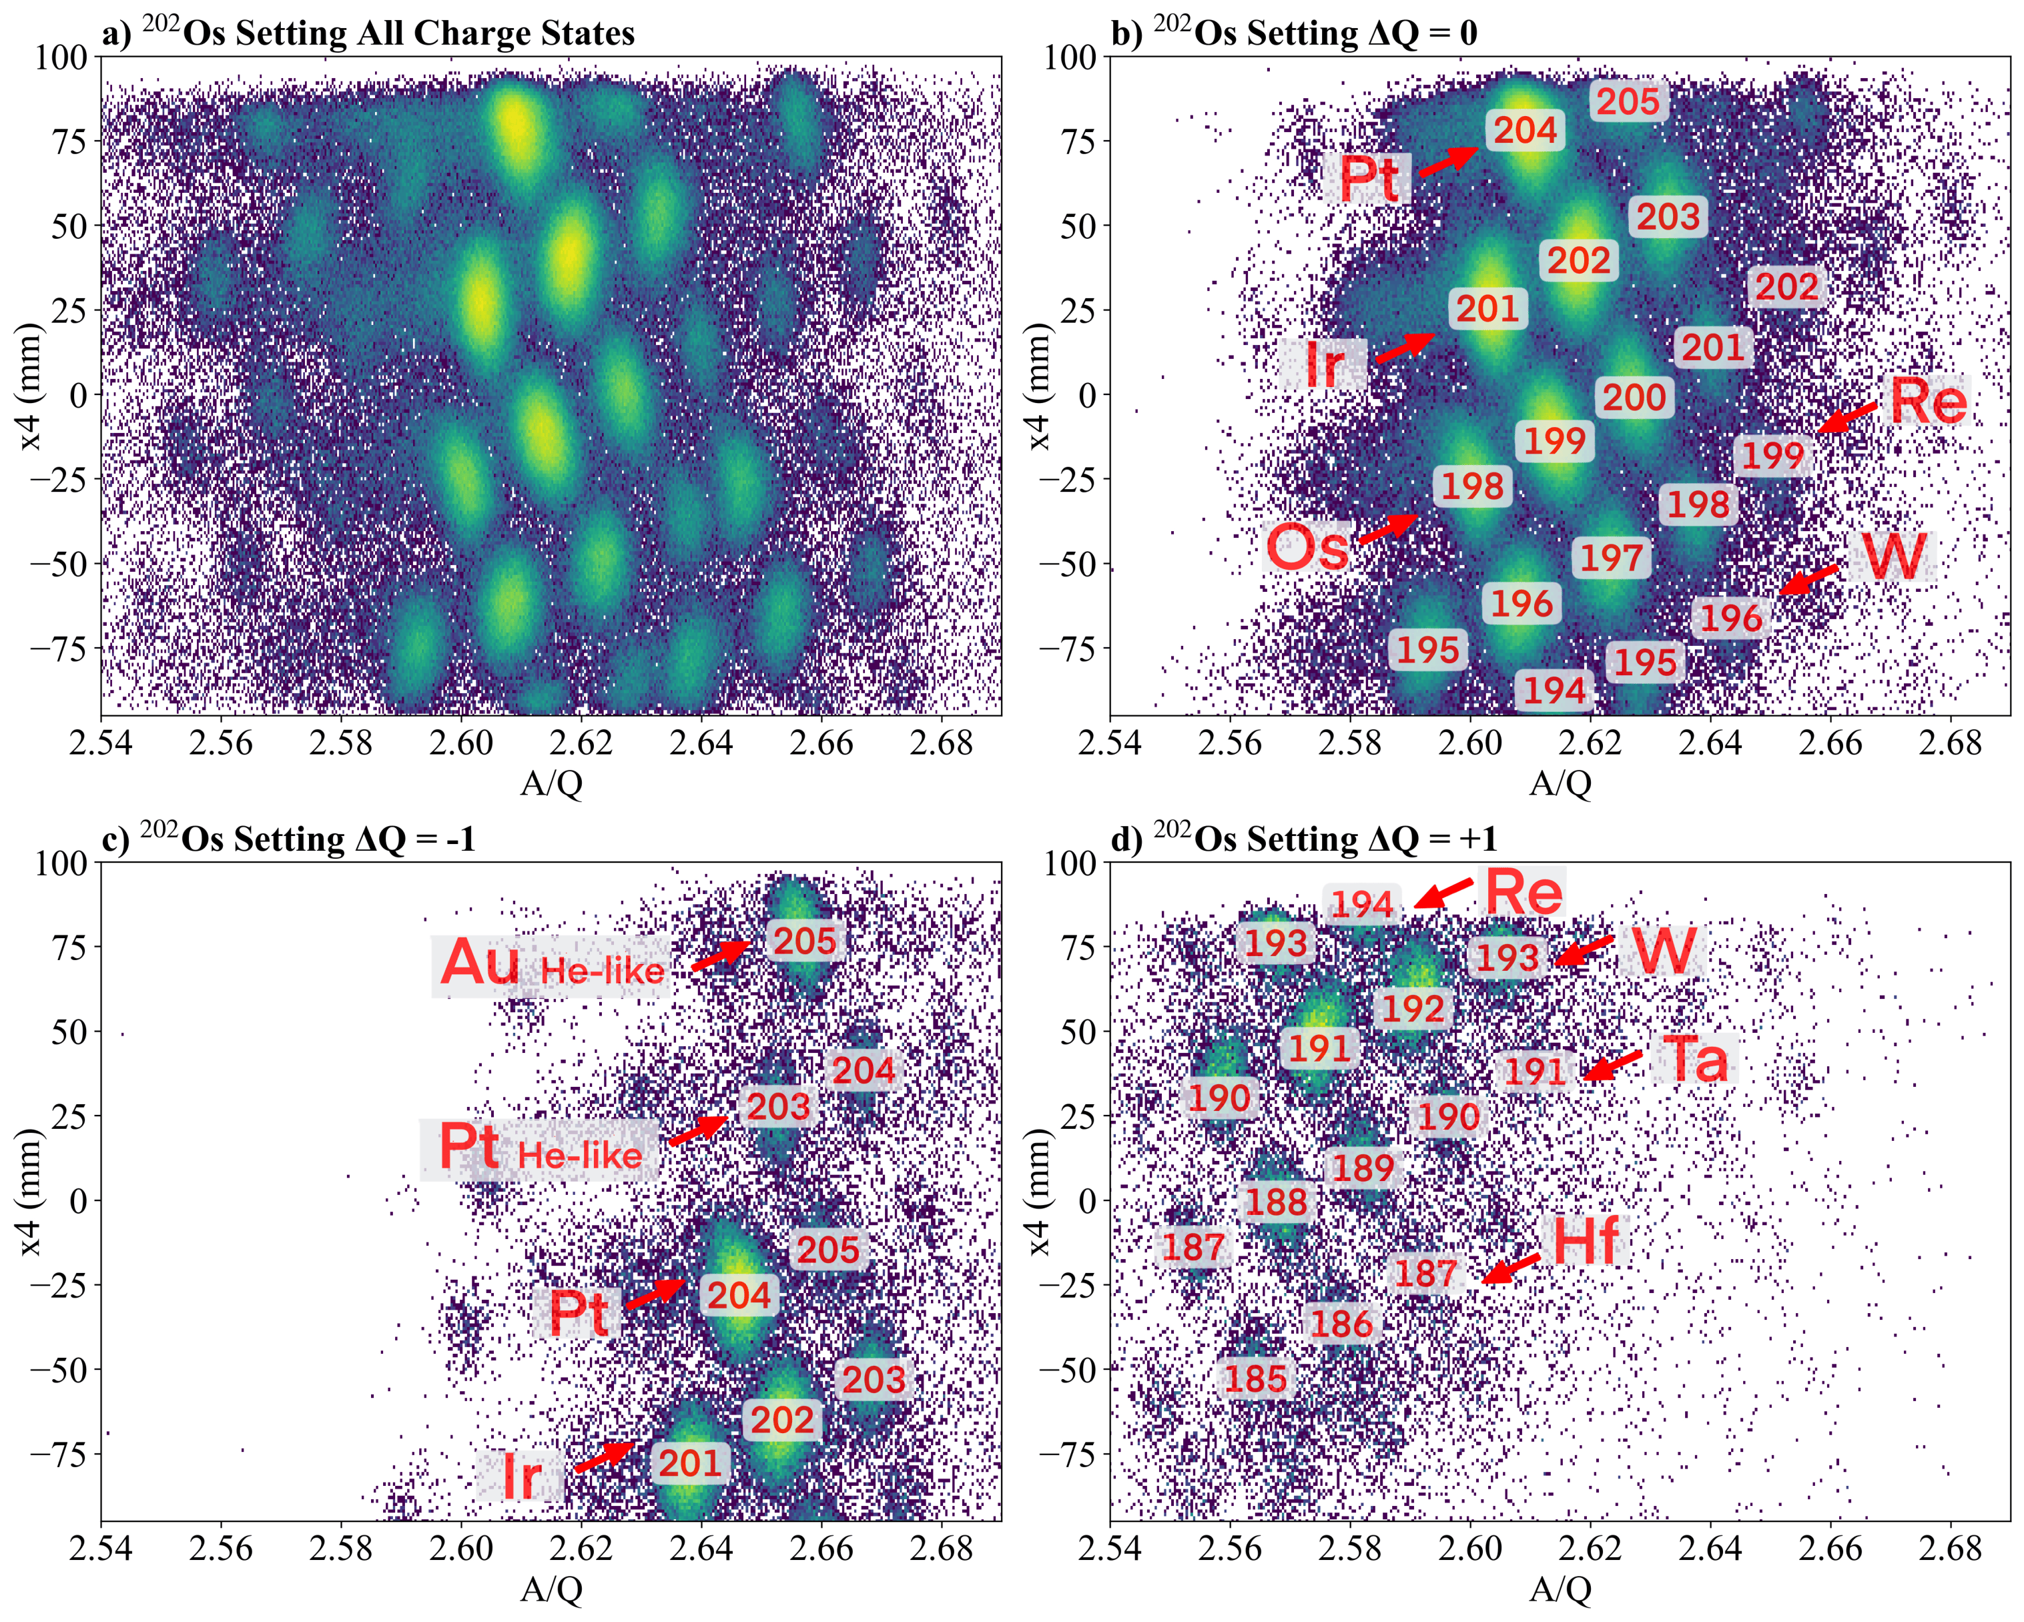
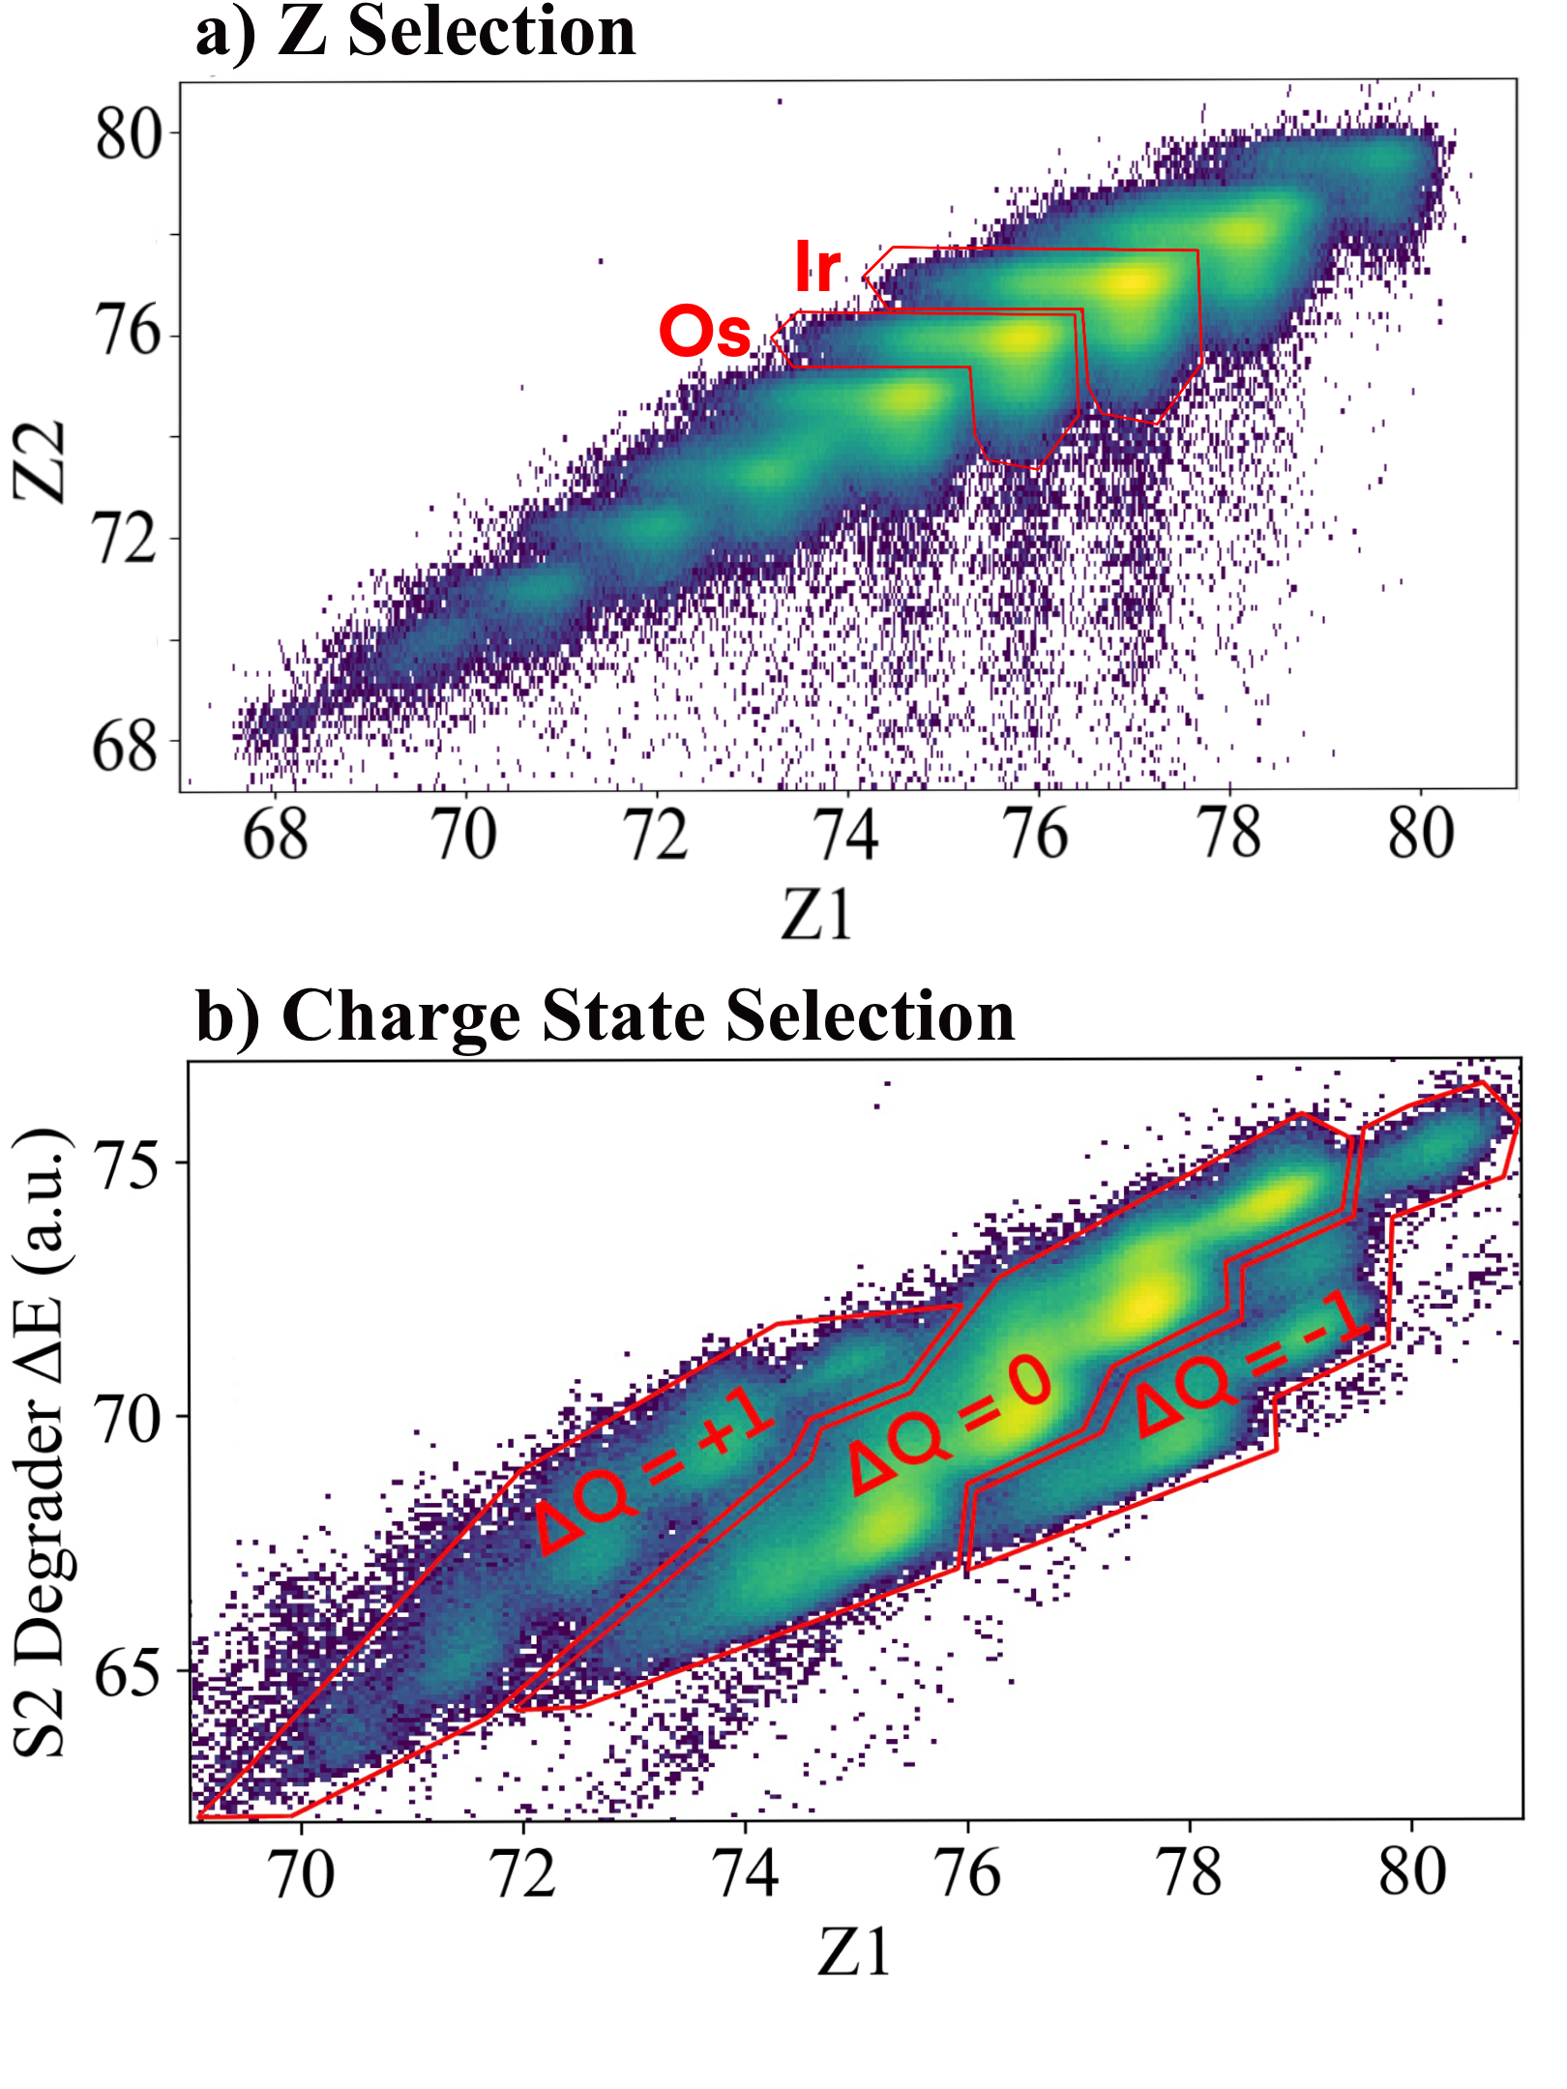
Identification
∆Q=0: Ion maintains the same number of electrons throughout FRS
∆Q=-1: Ion picks up an electron during flight
∆Q=+1: Ion loses an electron during flight

Slide 6

N=126 Nuclei

Slide 7
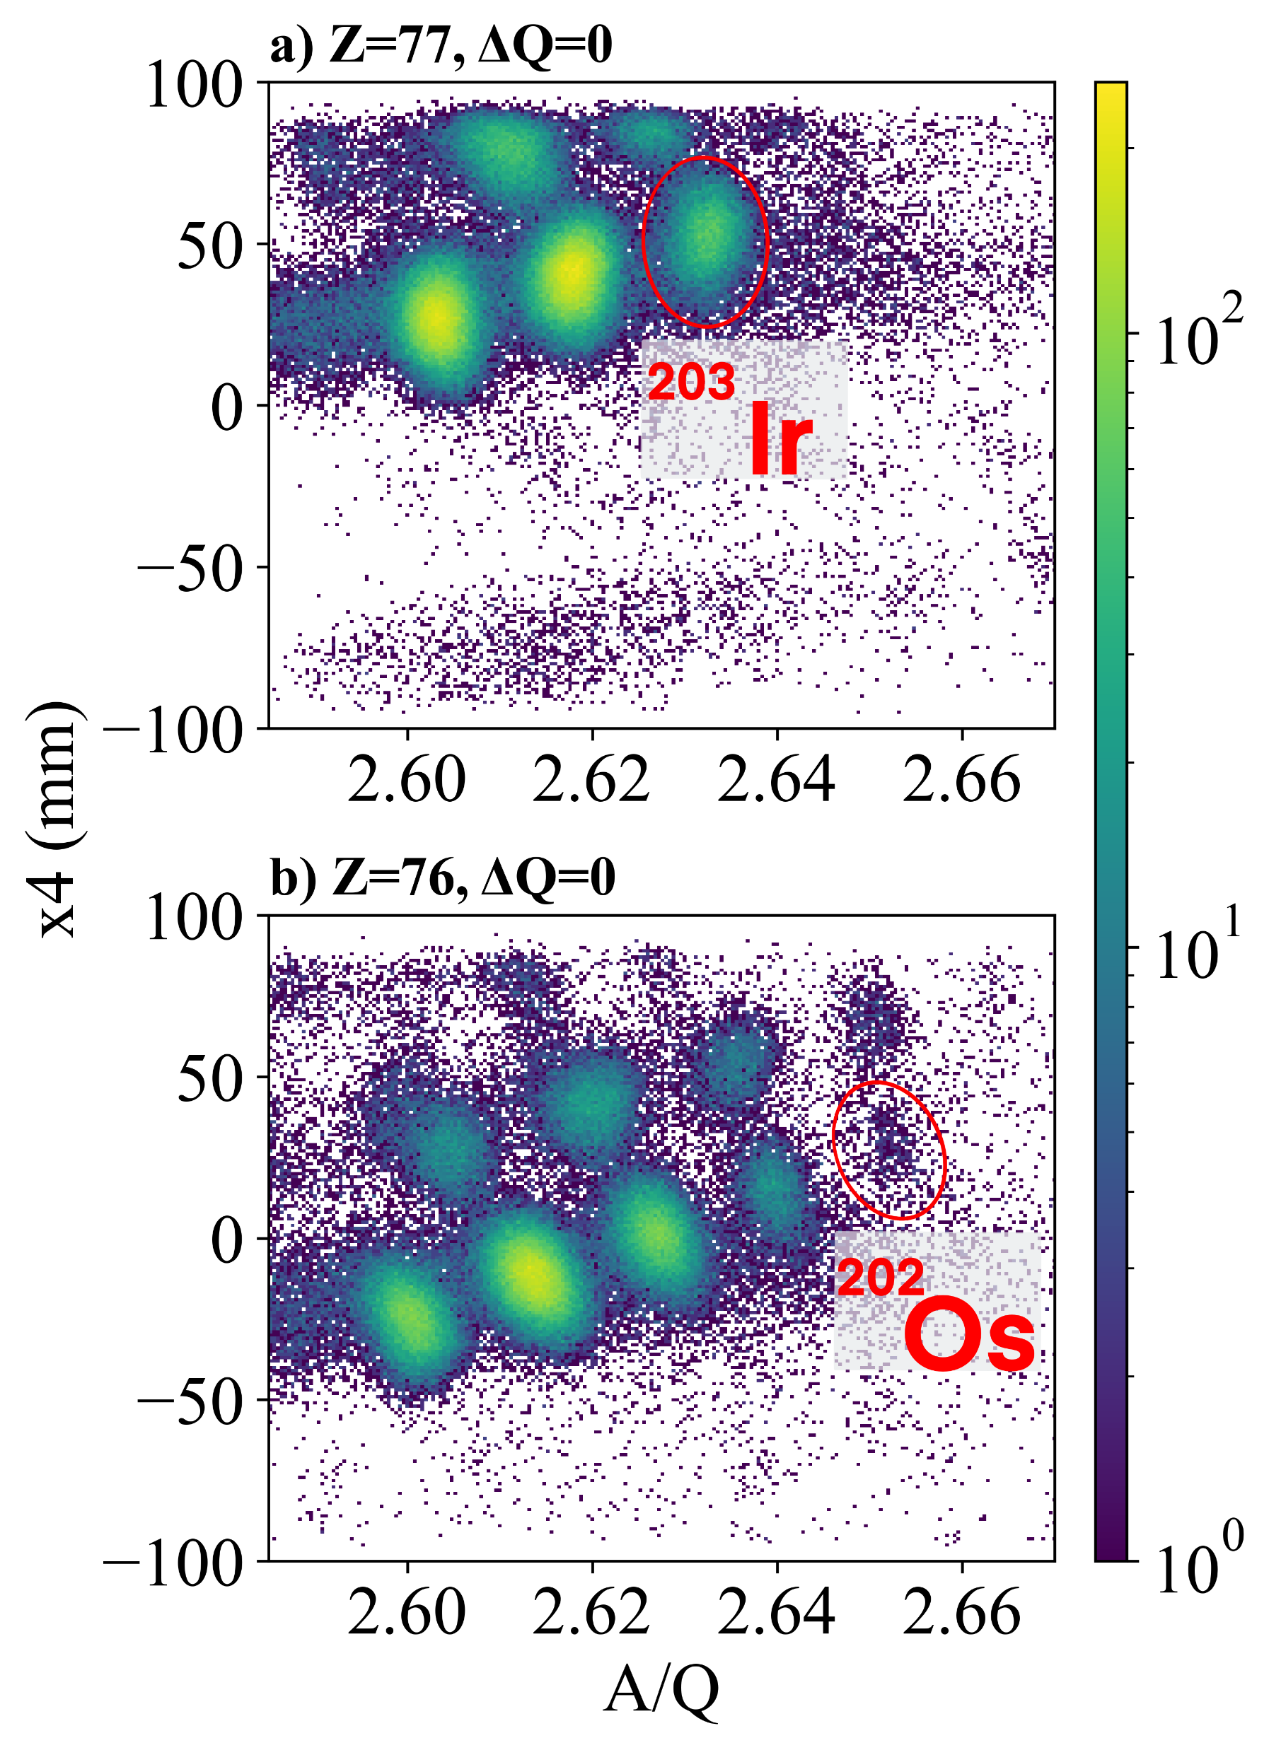
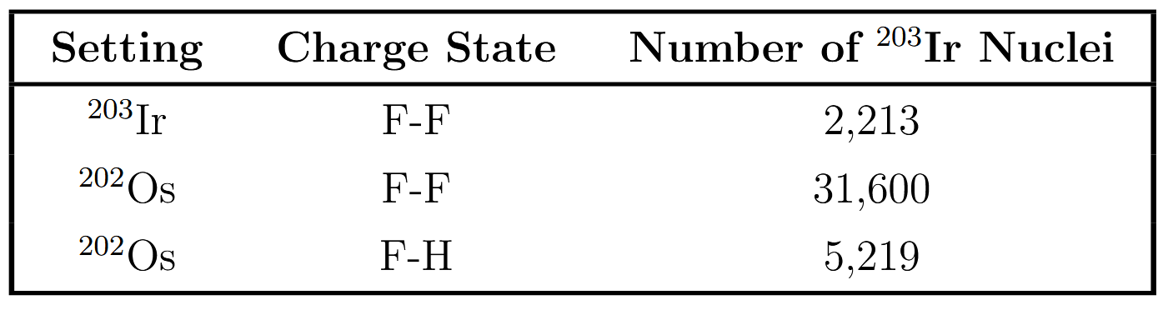
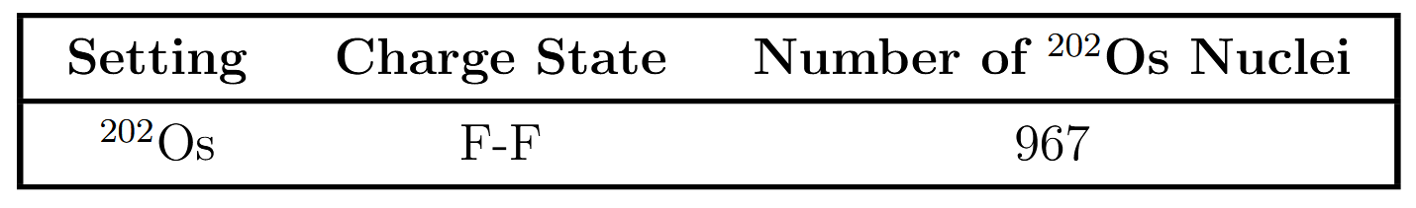
N=126 Nuclei: ²⁰³Ir and ²⁰²Os
²⁰³Ir
RISING: ~8,000 nuclei
This Experiment:
~39,000 nuclei
²⁰²Os
RISING: ~20 nuclei
This Experiment:
~970 nuclei

Slide 8
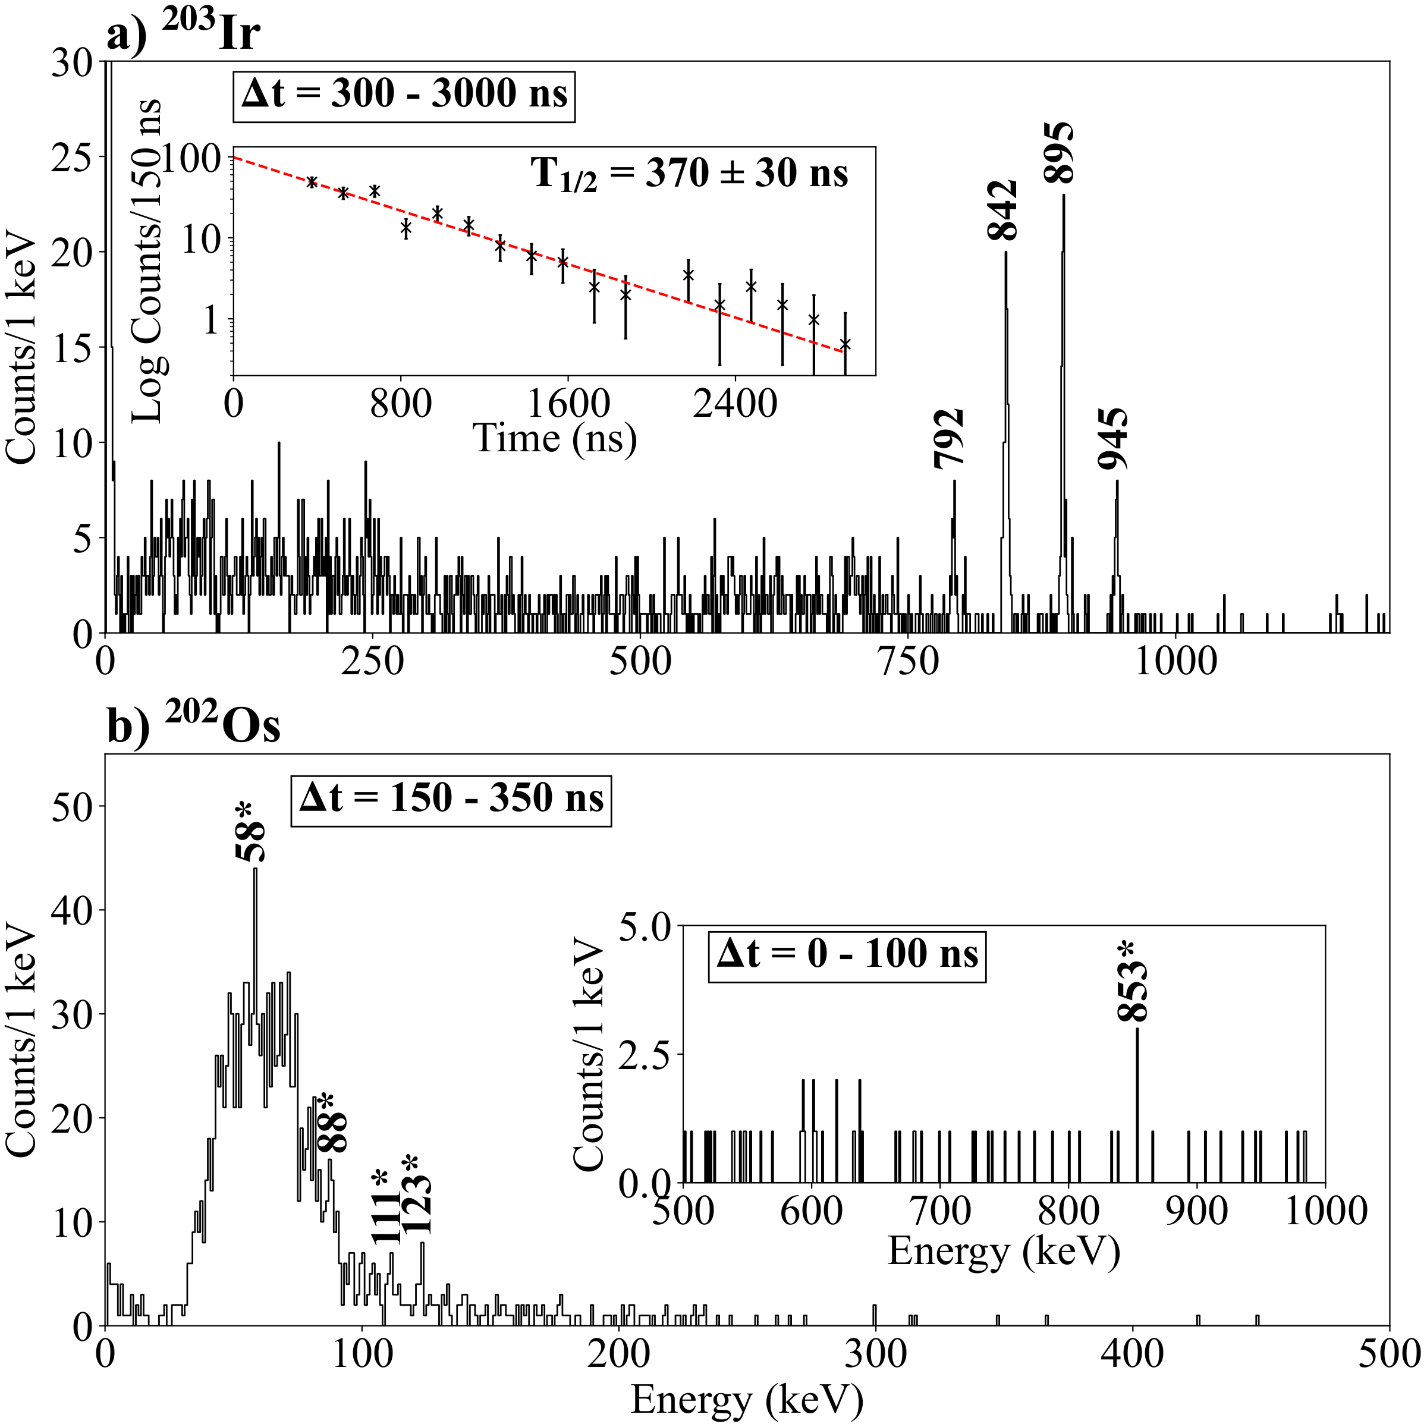
N=126 Nuclei: Gamma-Ray Spectroscopy
Two transitions were observed for the first time
Isomeric Half-Life
RISING: 798(350) ns
This Exp.: 370(30) ns
First gamma spectroscopy of ²⁰²Os
Several tentatively observed transitions

Slide 9
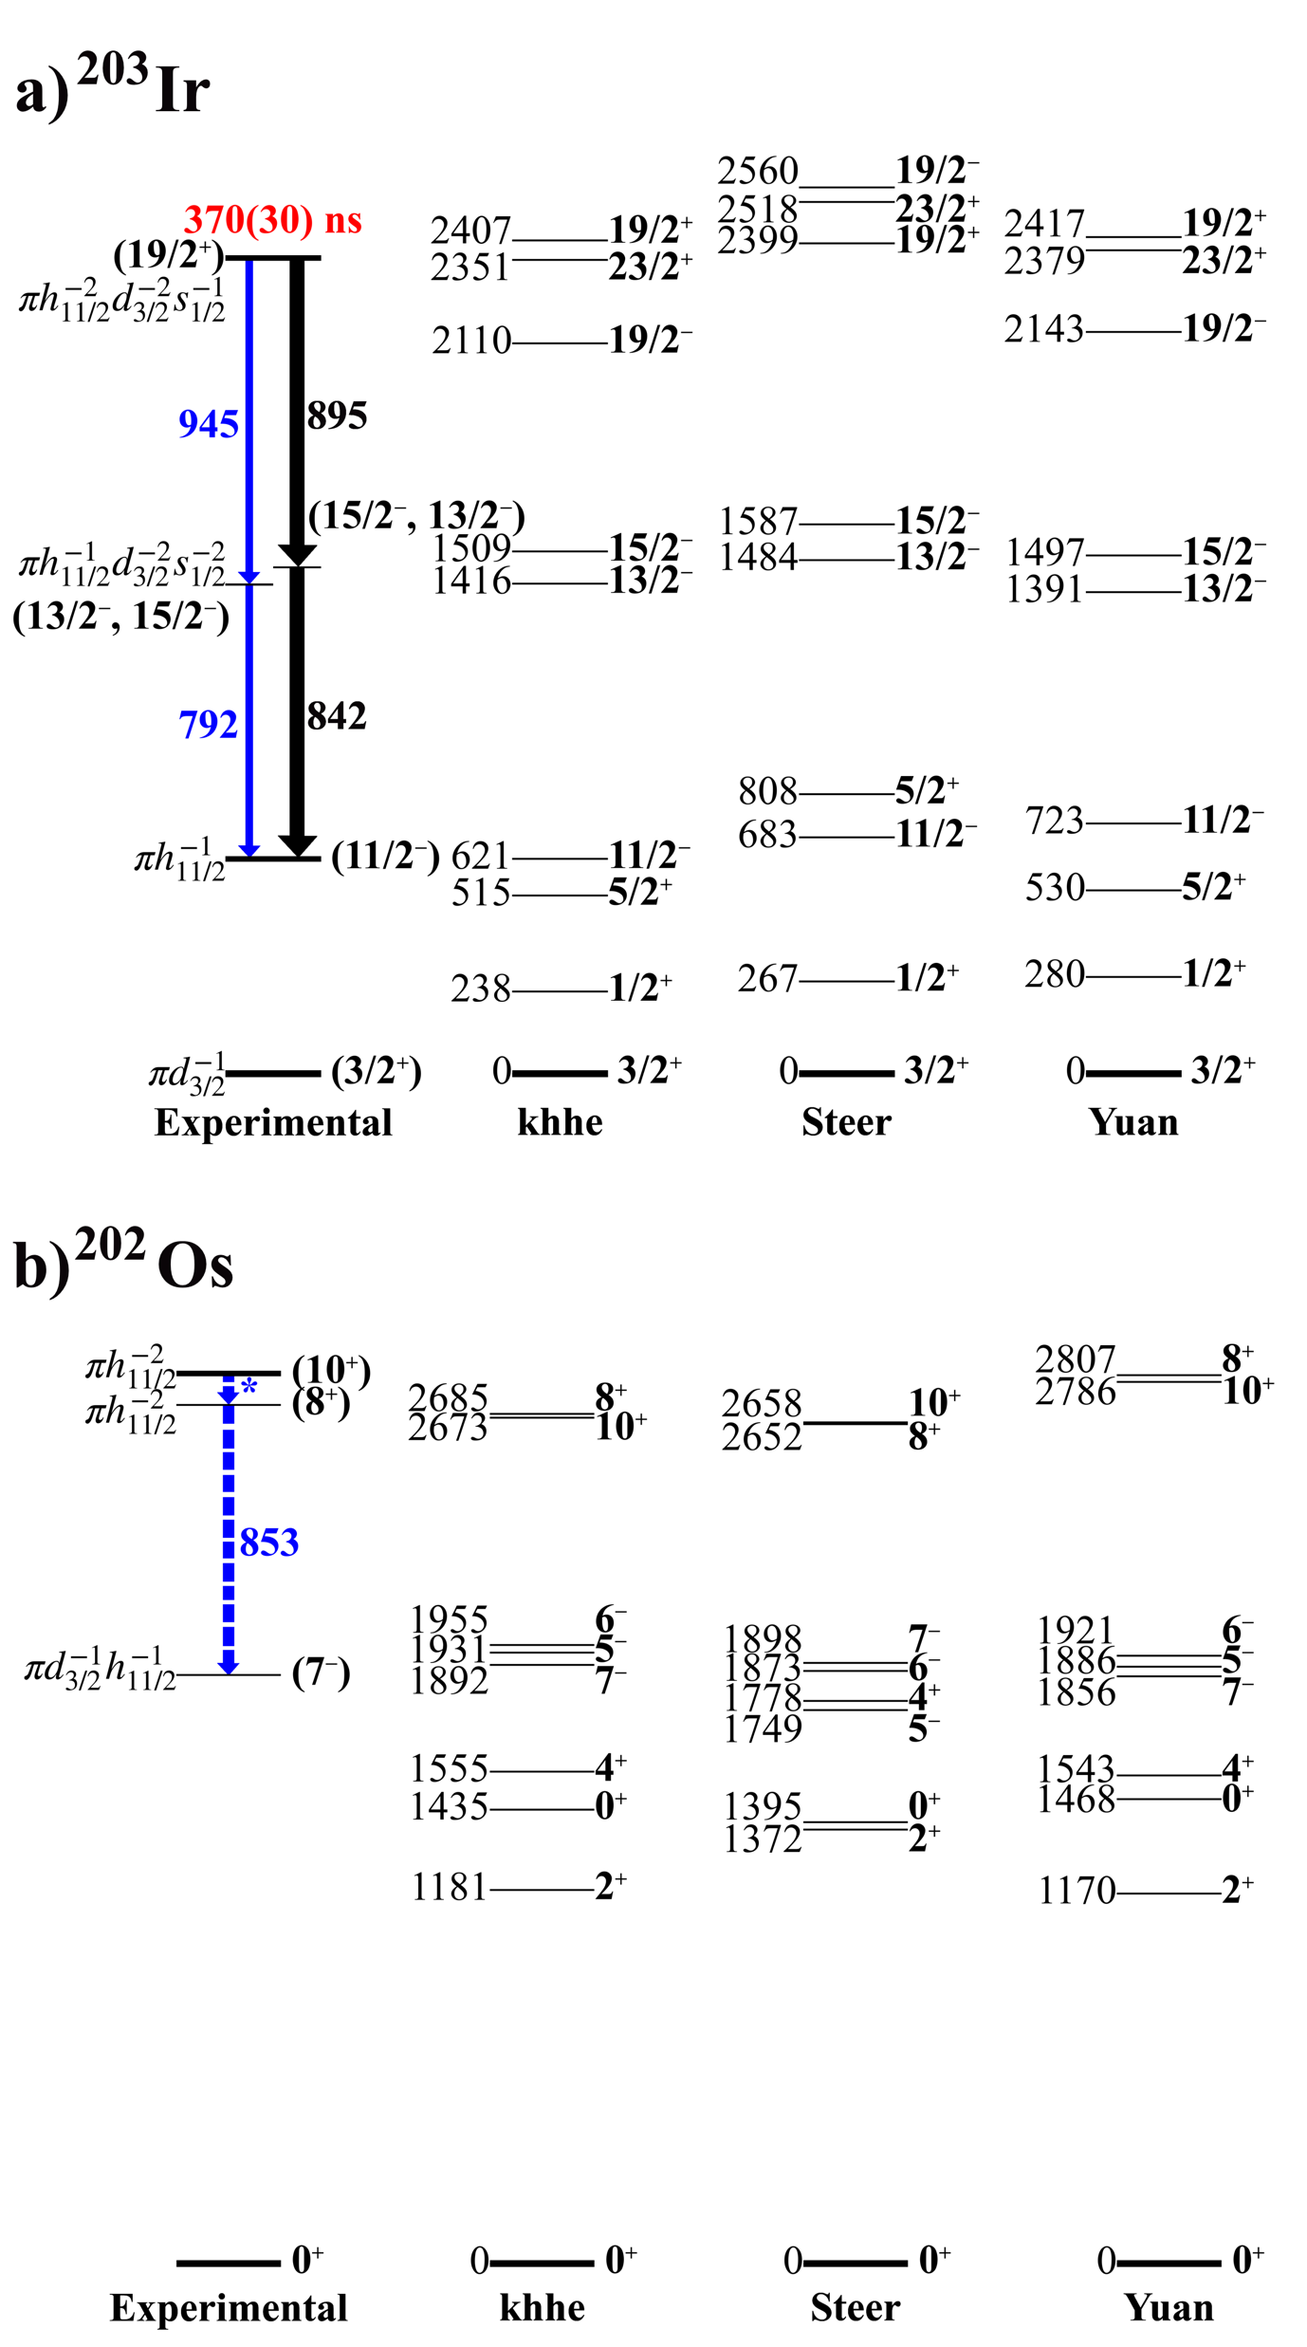
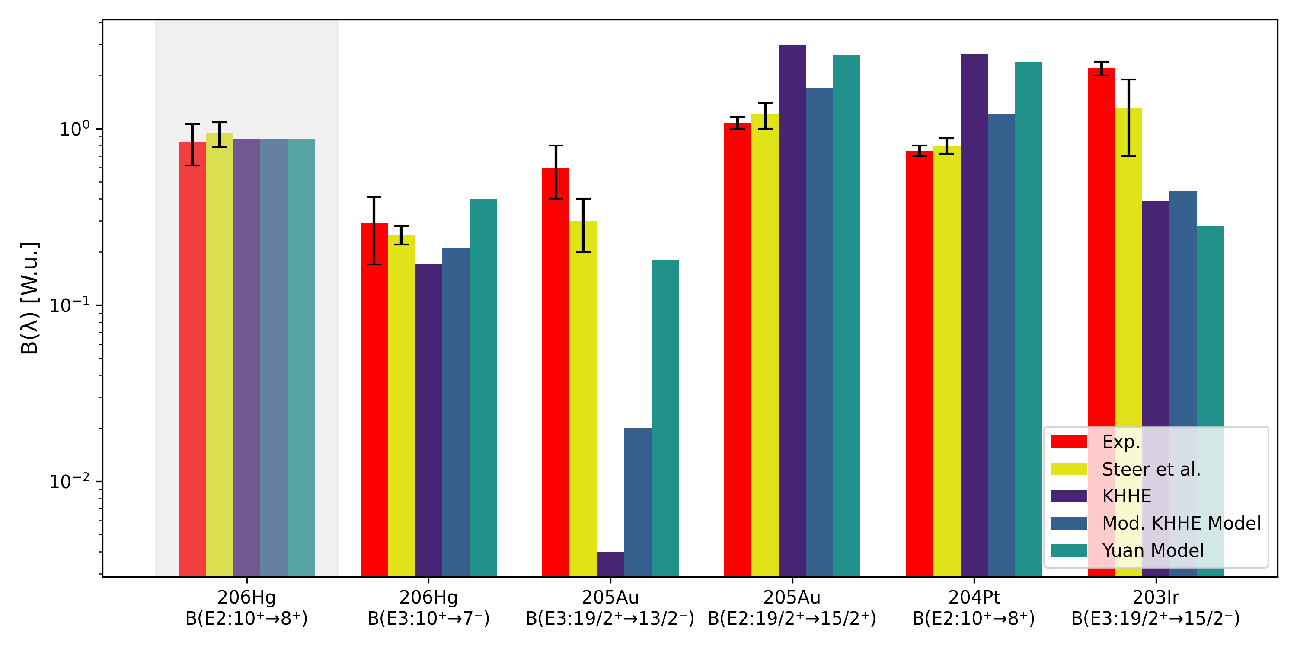
N=126 Nuclei: ²⁰³Ir

Slide 10
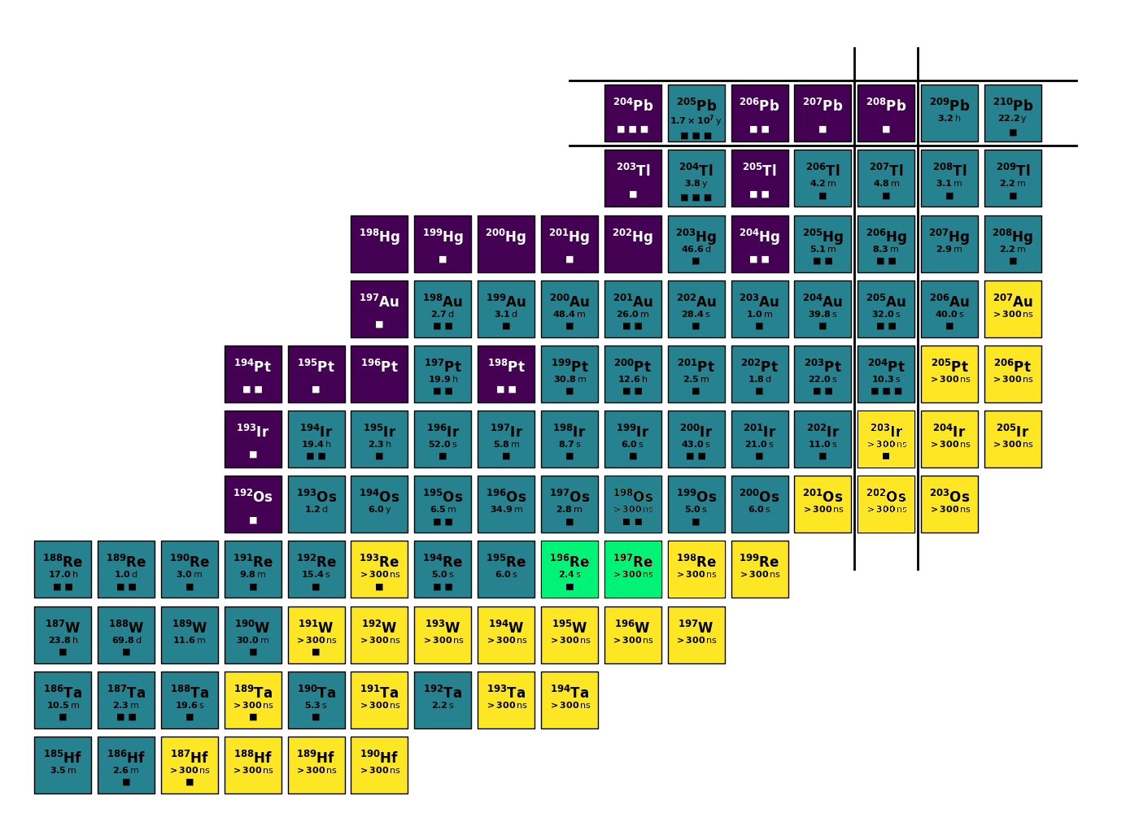
rhenium isotopes
?

Slide 11
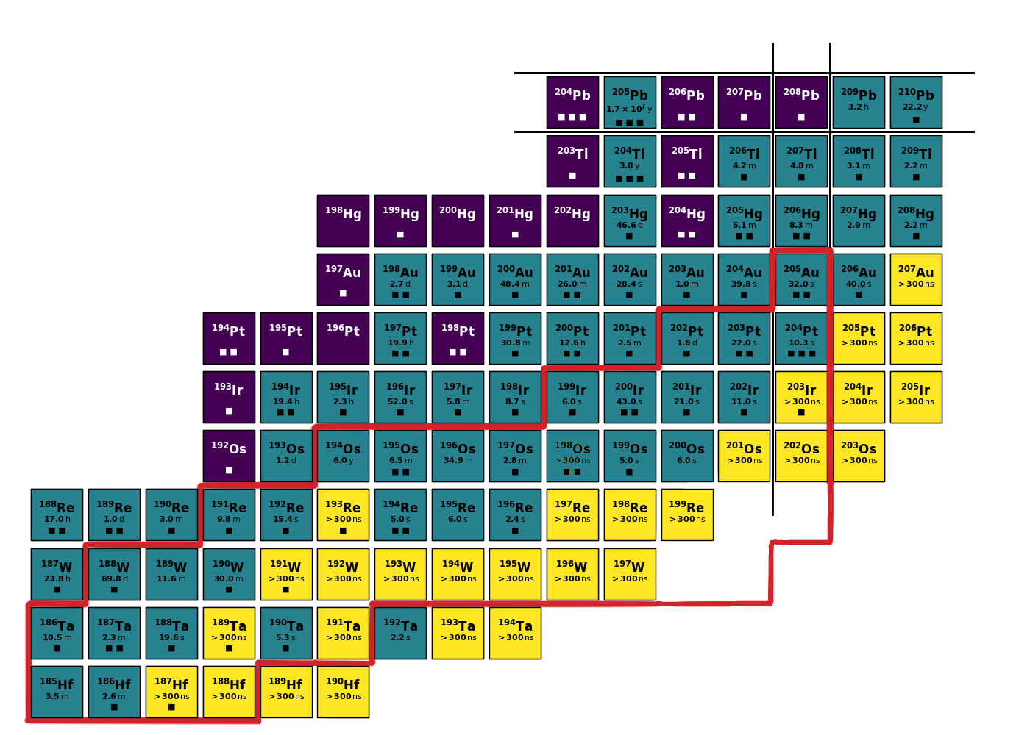
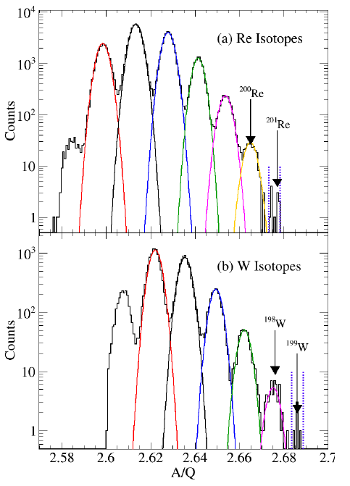
Newly Discovered Nuclei
Preliminary
²⁰⁰Re
²⁰¹Re
¹⁹⁸W
¹⁹⁹W
Four newly discovered nuclei!
S.K. Singh et al. In preparation

Slide 12
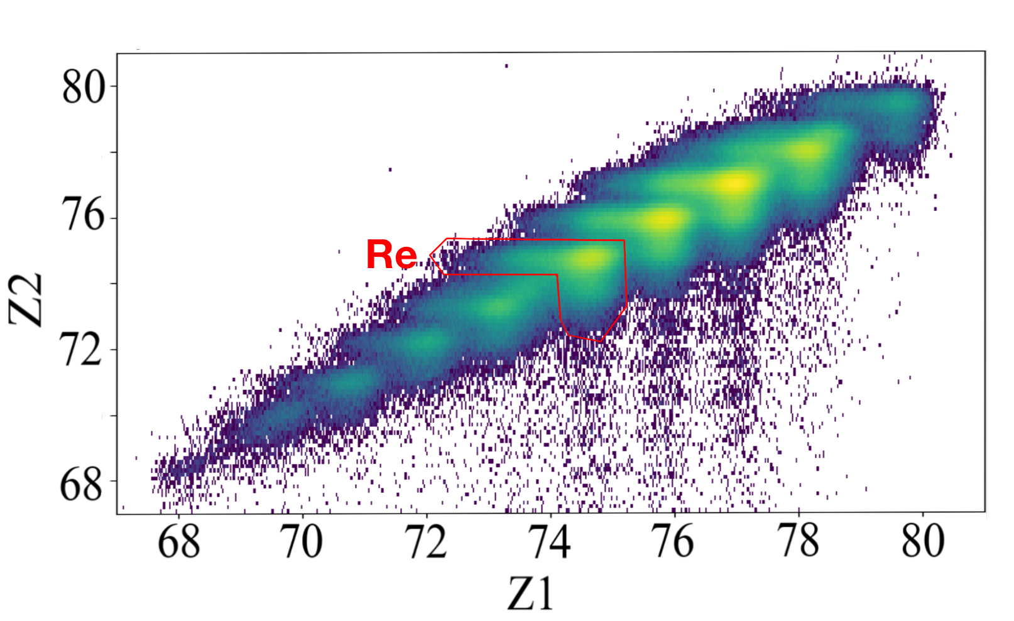
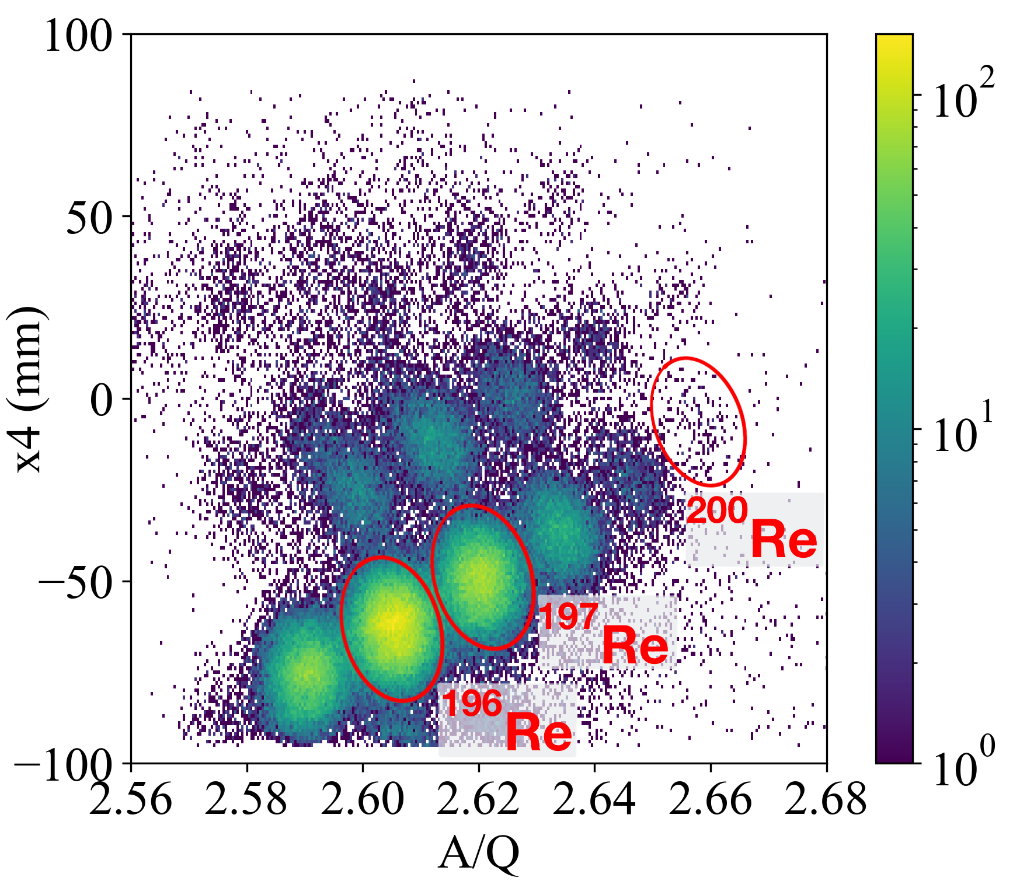
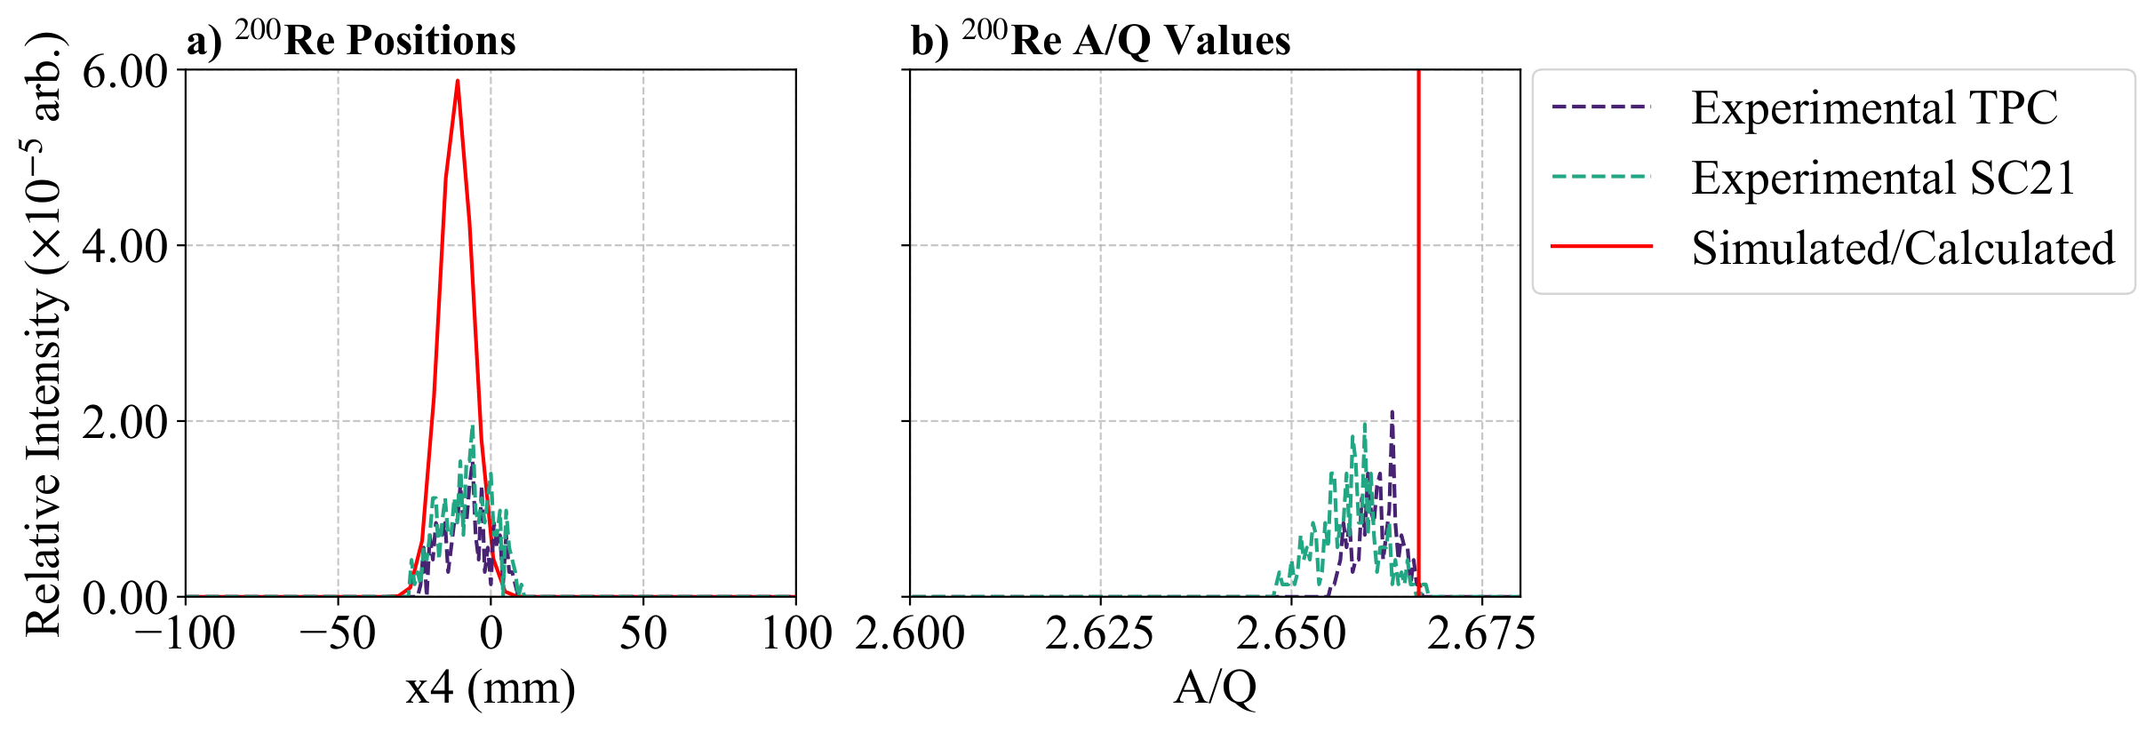
Rhenium Isotopes: ^{196,197,200}Re
¹⁹⁶Re
RISING: 14,000
This Experiment: 61,000
¹⁹⁷Re
RISING: 5,500
This Experiment: 37,000
²⁰⁰Re
This Experiment: ~200

Slide 13
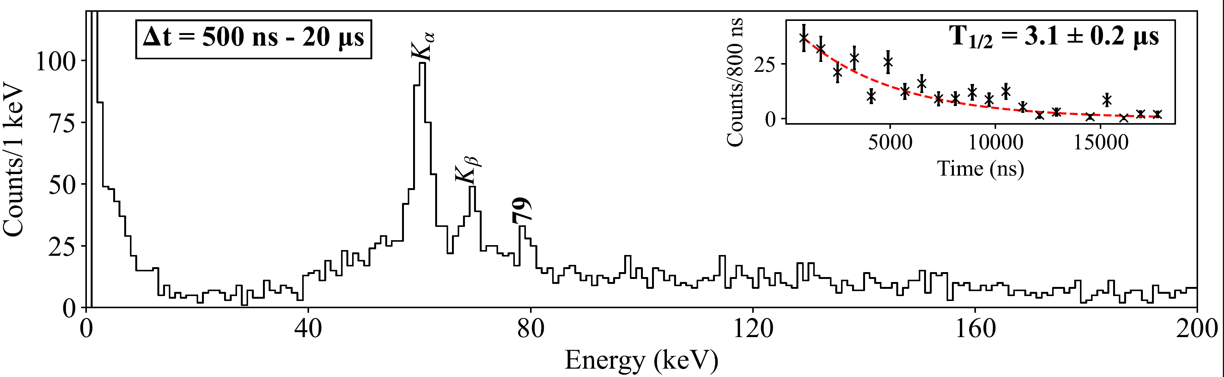
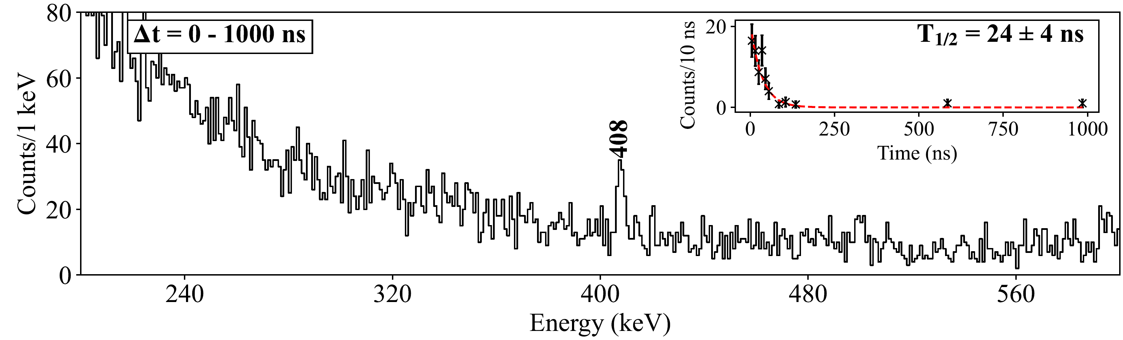
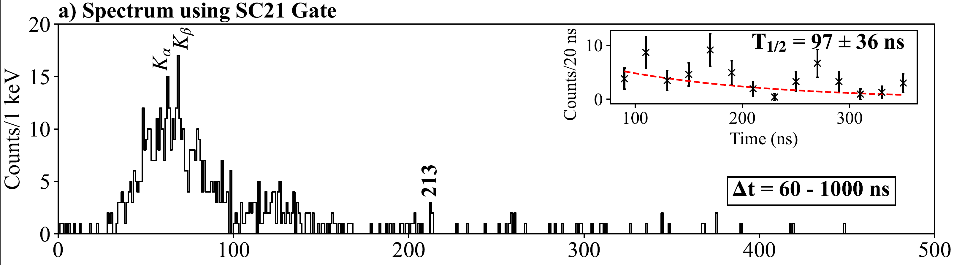
Rhenium Isotopes: Gamma-Ray Spectroscopy
K_{α} K_{β} X-rays observed in RISING campaign with half-life of 3.6(6) μs
¹⁹⁶Re
79 keV transition observed for first time
New combined half-life 3.1(2) μs
Preliminary
¹⁹⁷Re
First spectroscopic measurement
408 keV transition observed for first time
Short half-life (<30 ns)
²⁰⁰Re
First spectroscopic measurement
213 keV transition observed for first time with K_{α} K_{β} X-rays

Slide 14
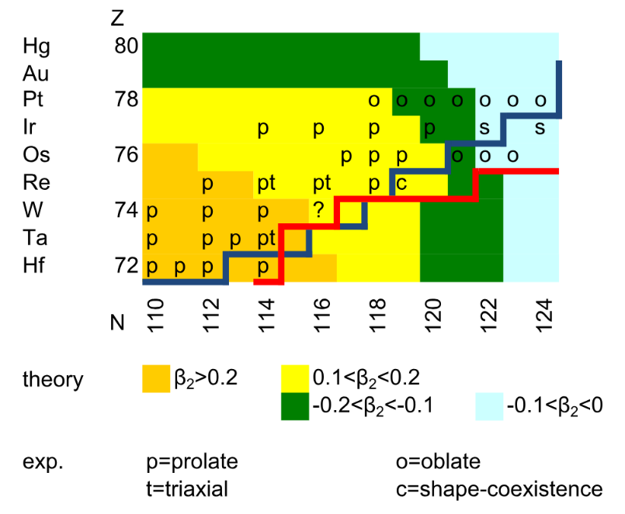
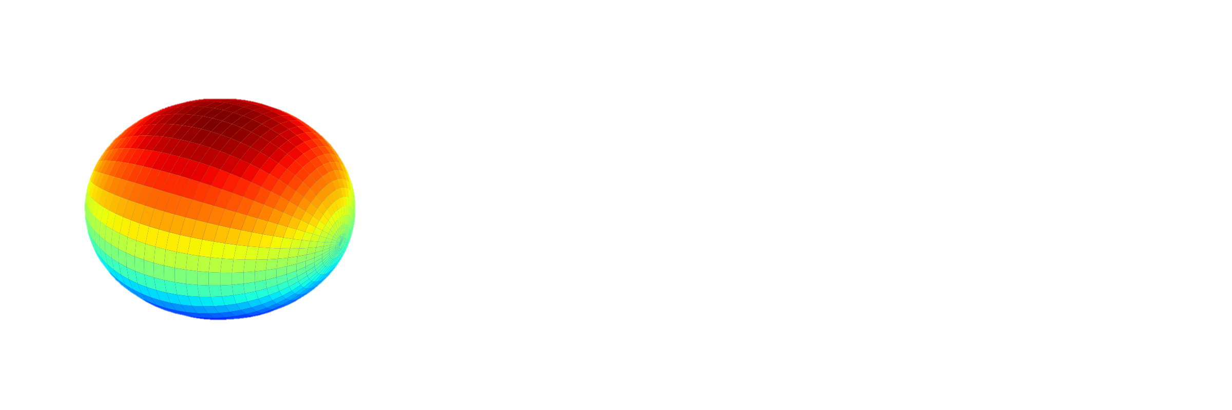
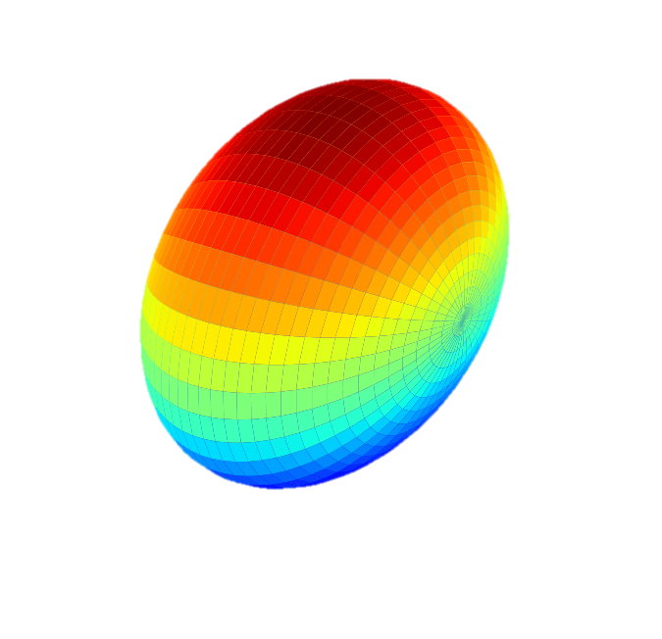

Rhenium Isotopes: Shape Transition Area
¹⁹⁶Re
¹⁹⁷Re
²⁰⁰Re
Consistent with behaviour of ^{192,193,194}Re
Behaviour changes
B(E2) similar to shell-model calculations
G. G. Kiss and Z. Podolyak (2024)
Prolate? But predicted to be oblate.
Oblate predicted
Spherical predicted
ONGOING WORK

Slide 15
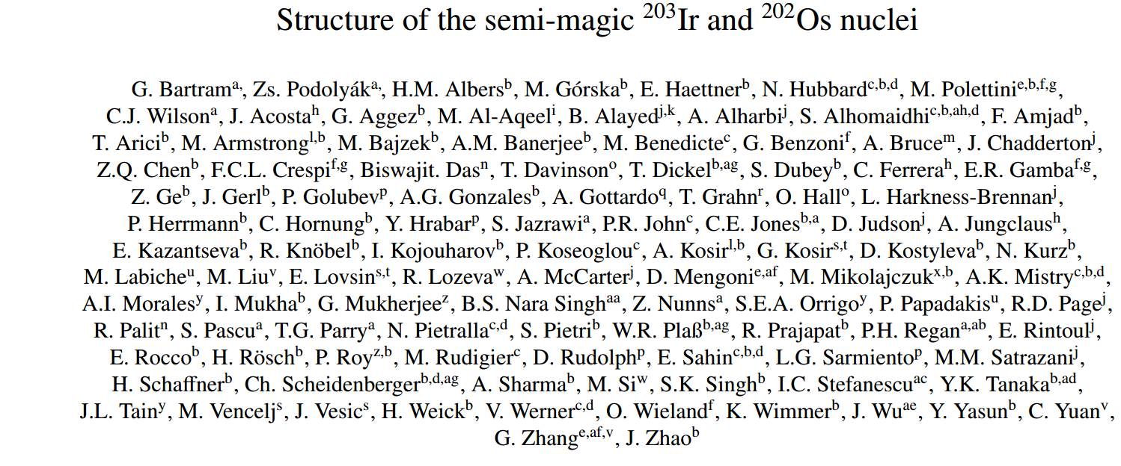
Thanks to all collaborators and contributors!
Under review for Physics Letters B
Production cross-sections of neutron-rich isotopes near N=126 from 1000 MeV/u 208-Pb on 9-Be: To be submitted to PRC by S.K. Singh et al.
Prolate-oblate-spherical shape transition in rhenium isotopes: Manuscript in preparation

Slide 16

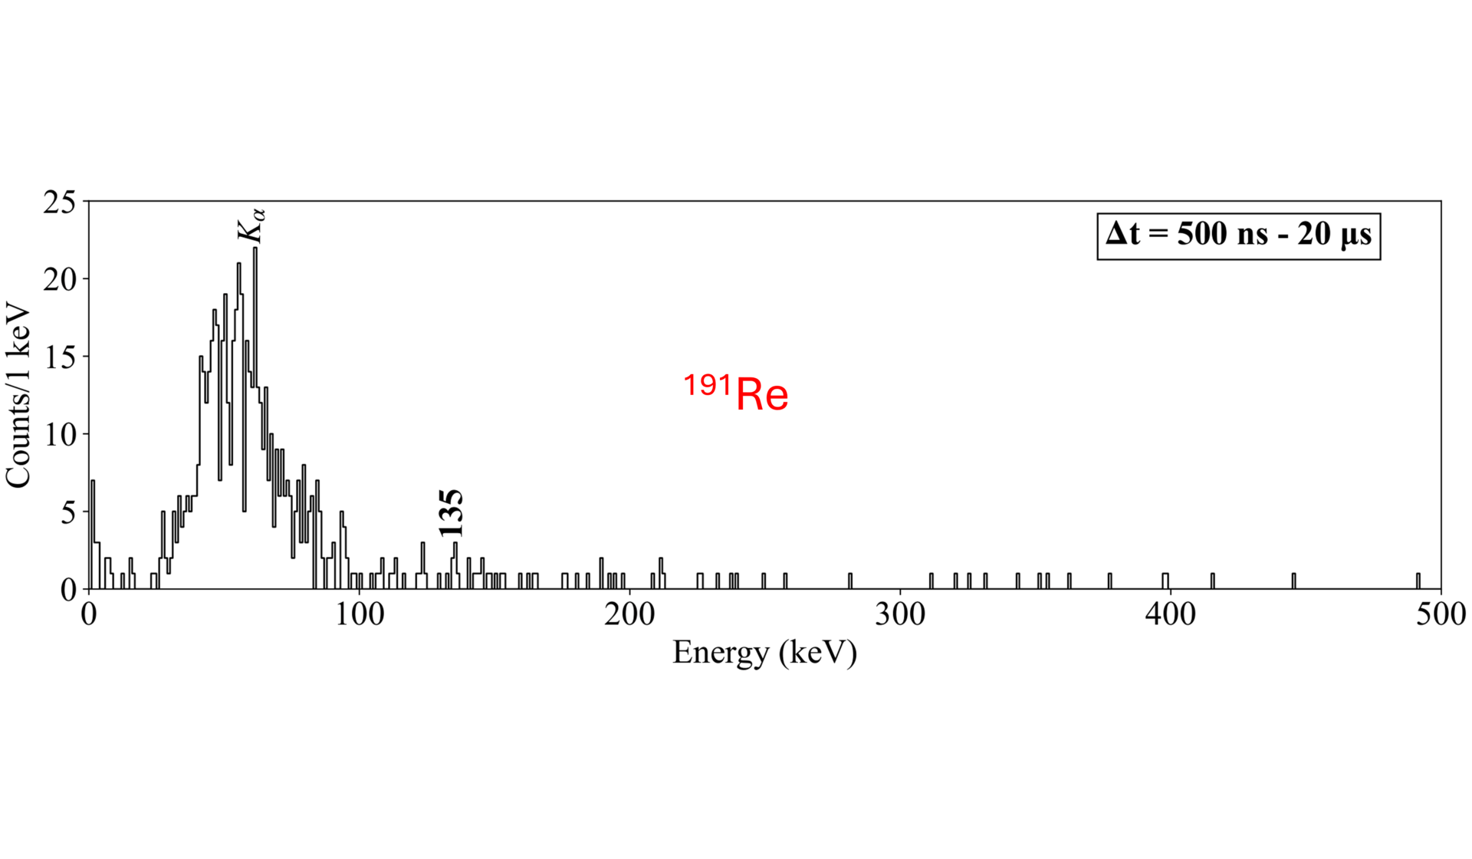
Any Questions?

Slide 17
Extra slides

Slide 18
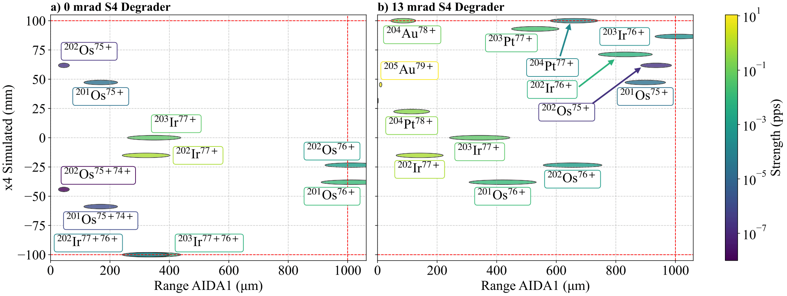
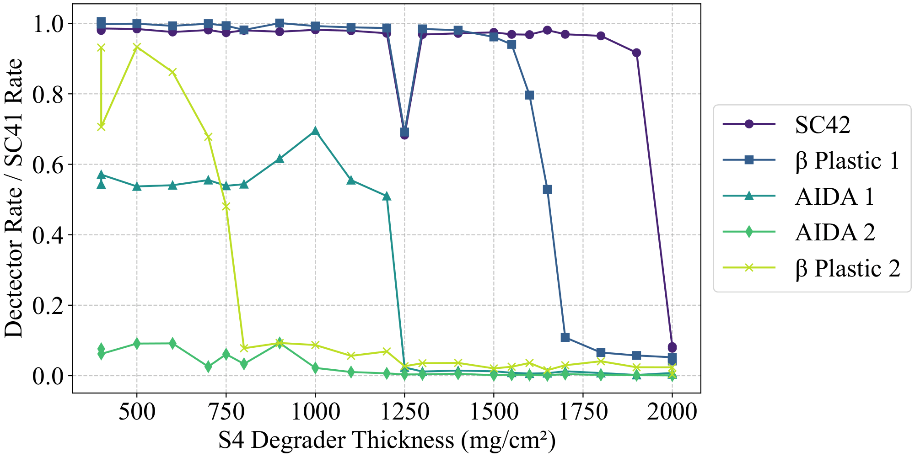
Setup: Fragment Separator (Extra)
²⁰⁸Pb: 982 mg/cm² from plot
+1081 mg/cm² from 13 mrad wedge = 2063 mg/cm²
LISE++ :-89 mg/cm² offset
²⁰³Ir setting: 3450 – 89 = 3361 mg/cm²
²⁰²Os setting: 3700 – 89 = 3611 mg/cm²

Slide 19
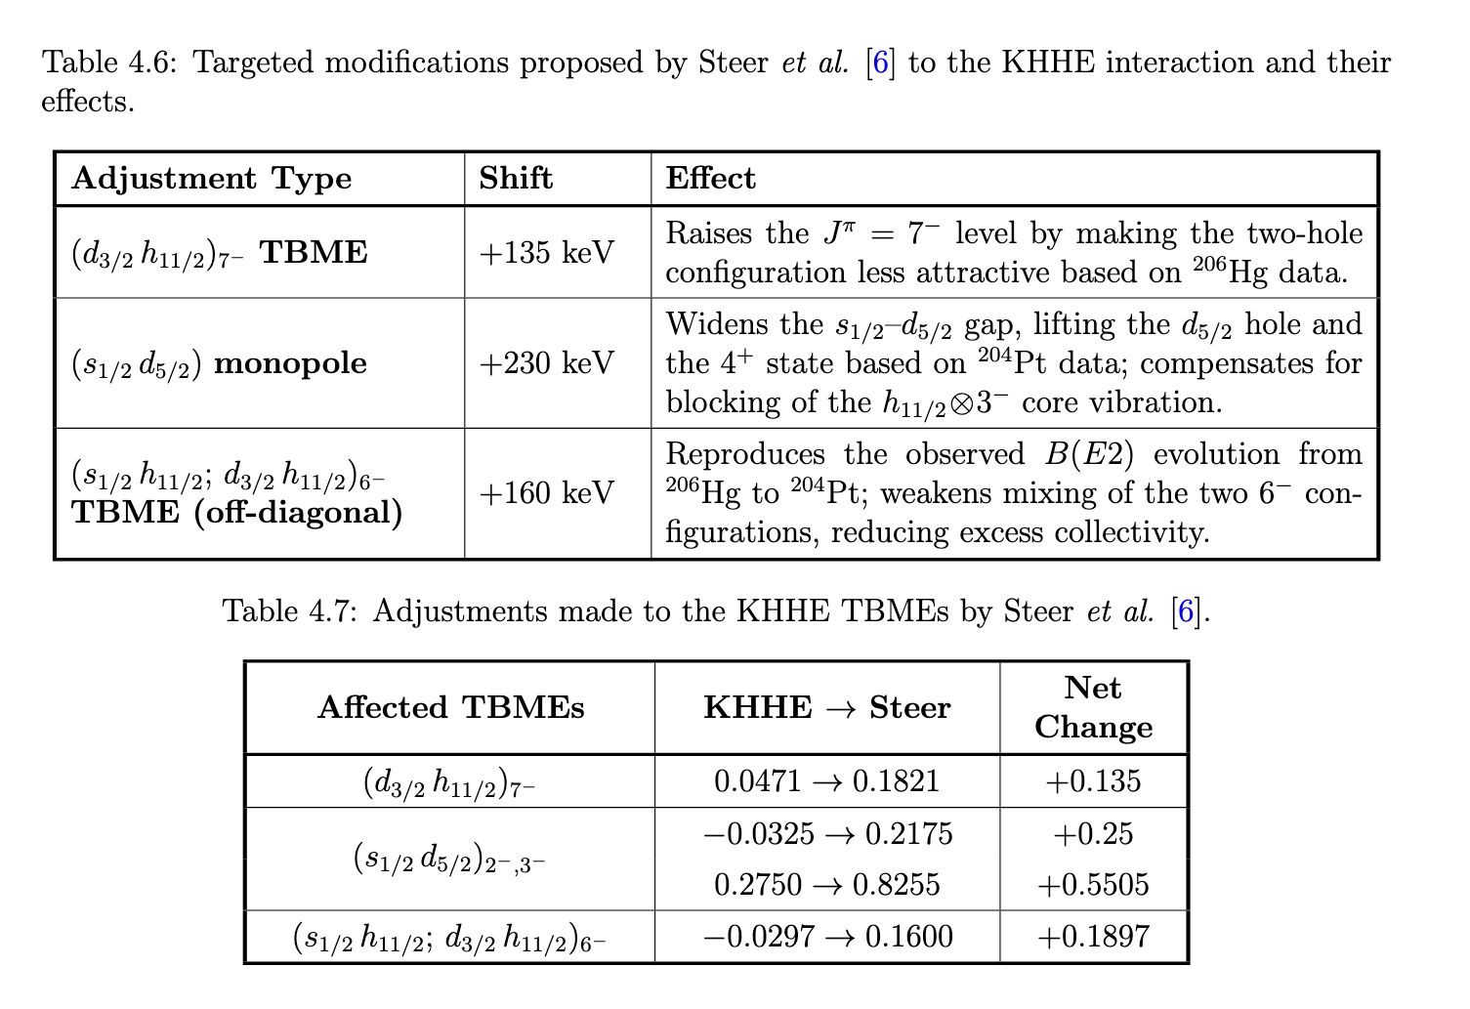
Shell Model Steer (Extra)

Slide 20
N=126 Nuclei: ²⁰²Os (Extra)
Steer model predicts the 10⁺ state above 8⁺
Expect one low-energy transition and one high-energy transition

Slide 21
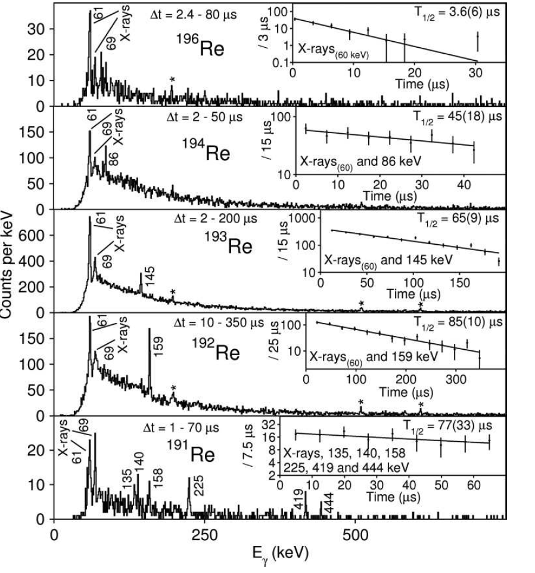
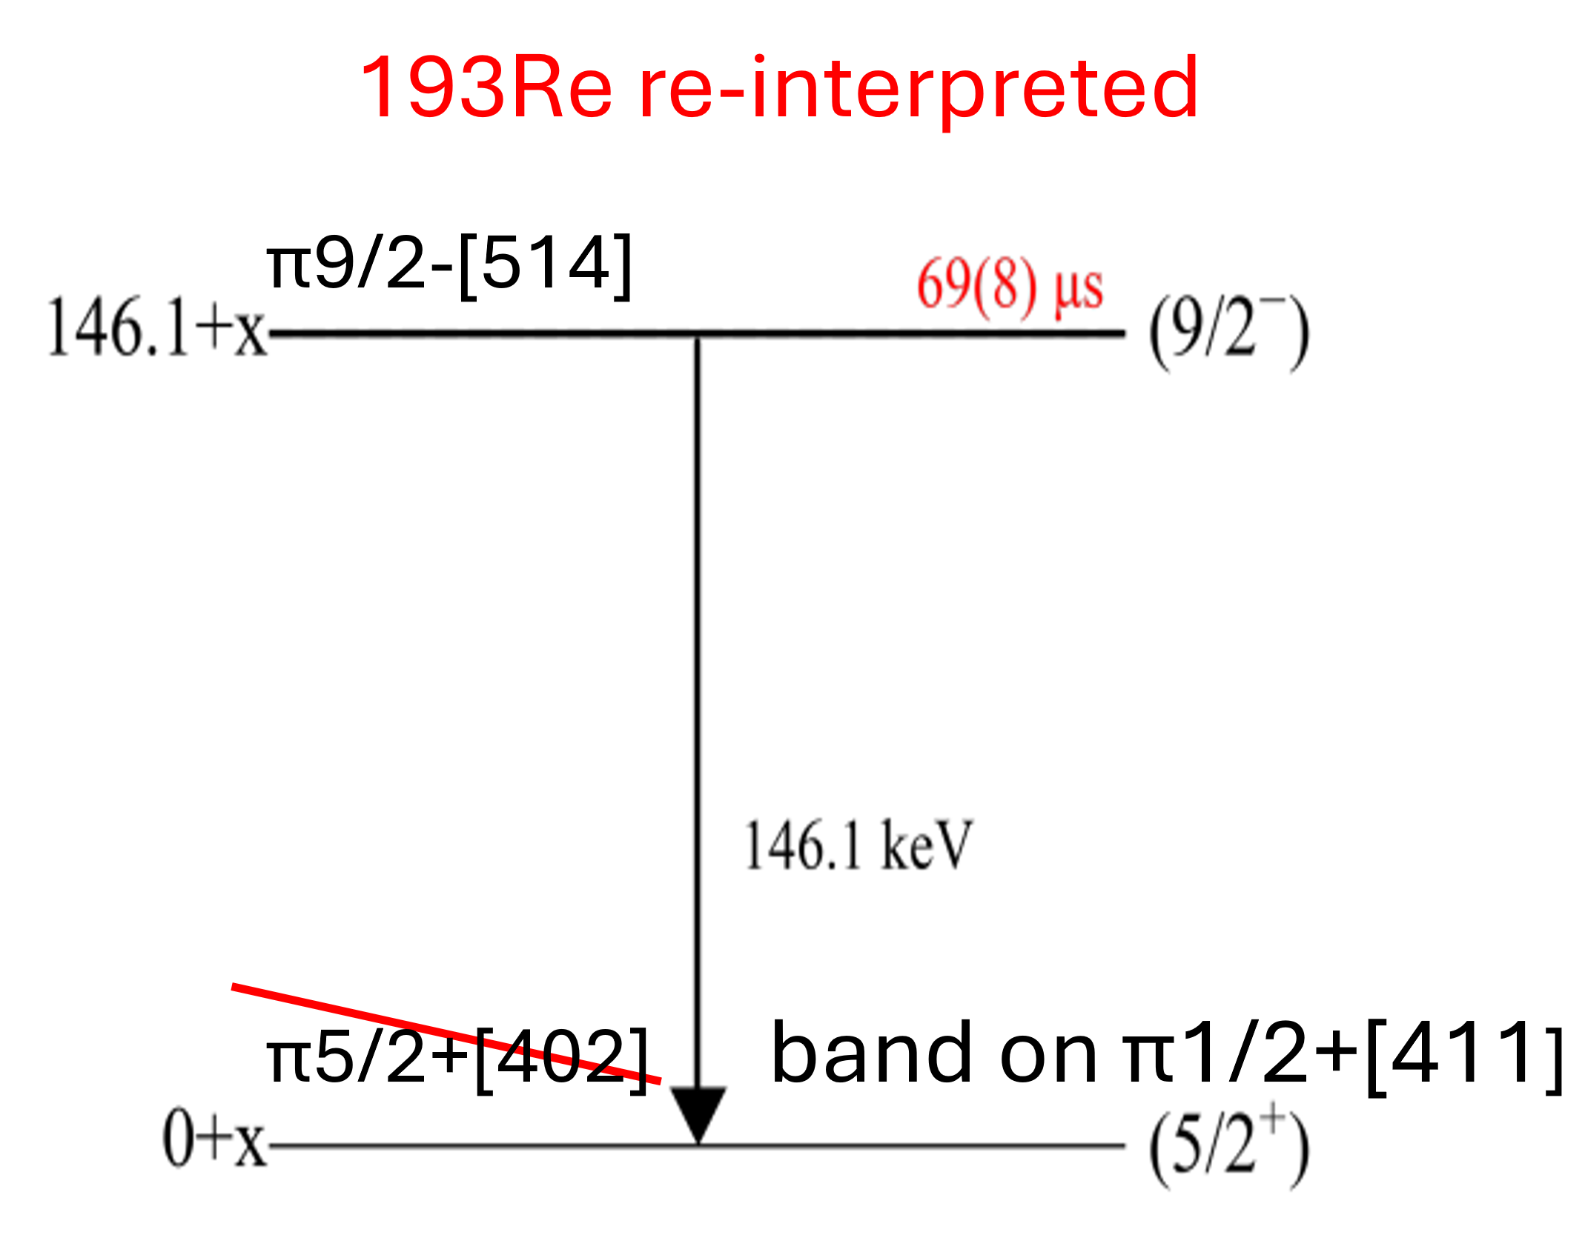
Rhenium: Prolate?(Extra)
¹⁹⁶Re: Characteristic rhenium K_{α} and K_{β} rays are
observed following the decay through an unobserved highly
converted transition.
Large number of possible two quasi-particle states – hard to model

Slide 22
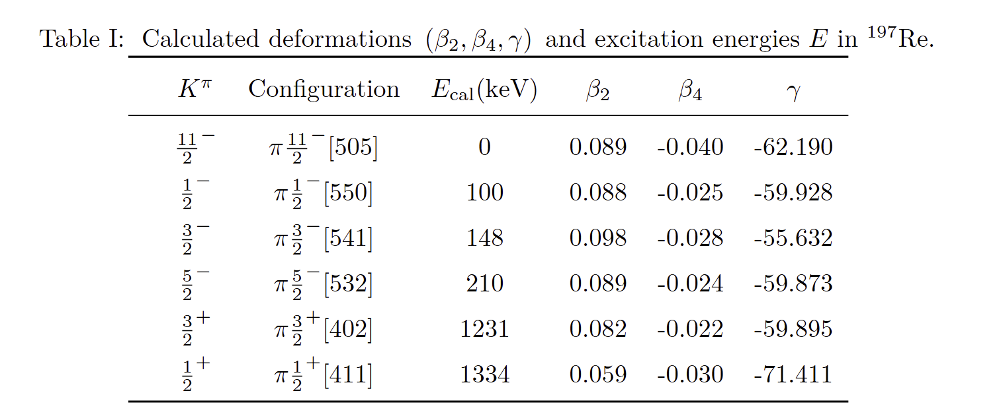
Rhenium: ¹⁹⁷Re, ²⁰⁰Re (Extra)
From Furong Xu, Changfeng Jiao and Runyan Dong
²⁰⁰Re
Exp.: B(E2)=0.14 W.u
KHHE: E(2-) =80 keV, B(E2) = 1.3 W.u
Steer: E(2-) 133 keV= B(E2) = 0.7 W.u
Other isomers predicted…
P. Mo”ller (2016): β₂: −0.105 β₄: −0.019

Slide 23
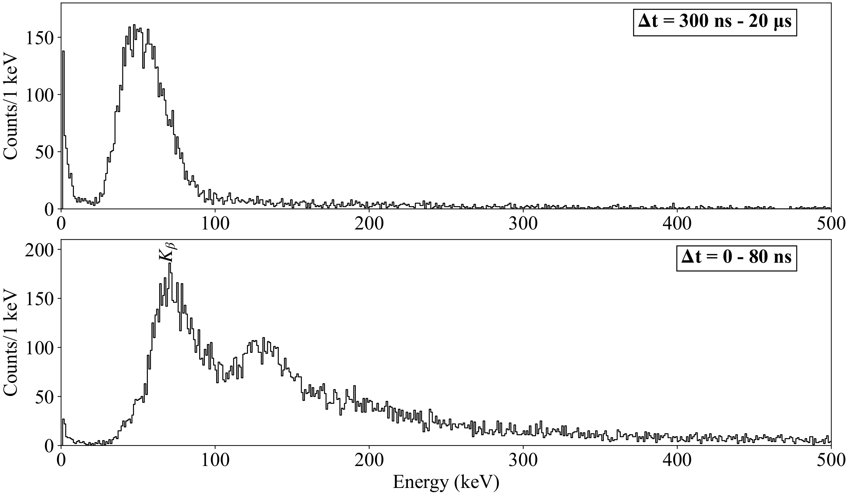
¹⁹⁵Re (Extra)
¹⁹⁵Re

Slide 24
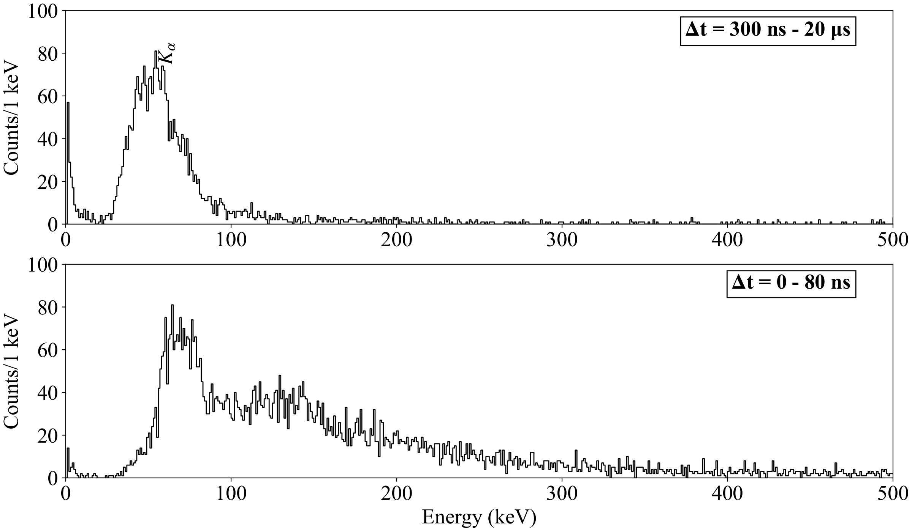
¹⁹⁸Re (Extra)
¹⁹⁸Re

Slide 25
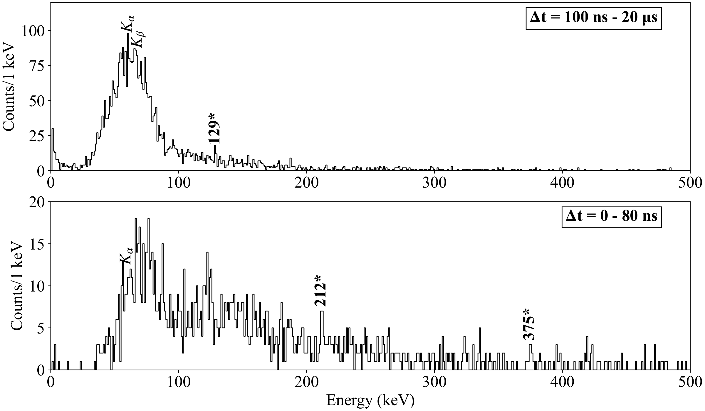
¹⁹⁹Re (Extra)
¹⁹⁹Re

Slide 26
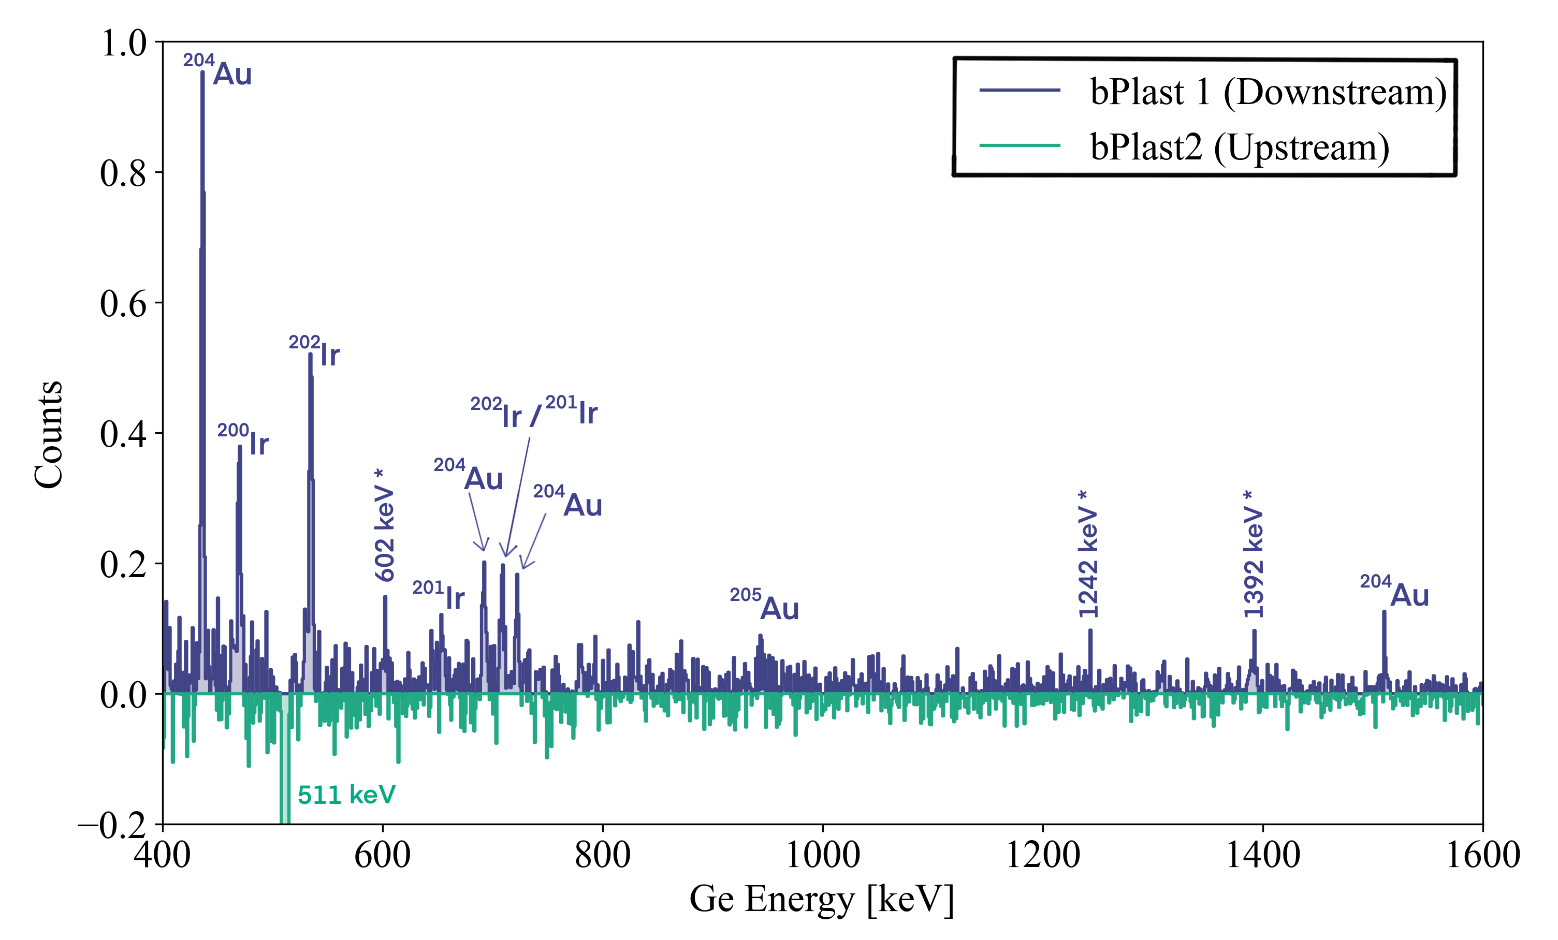
Beta-Decays (Extra)

