Slide 1
Transforming Inorganic Scintillators into Nuclear Spectrometers
Dr Joseph O'Neill
IOP Nuclear Physics Conference 2026
13th-15th April 2026 | University of Brighton

Slide 2
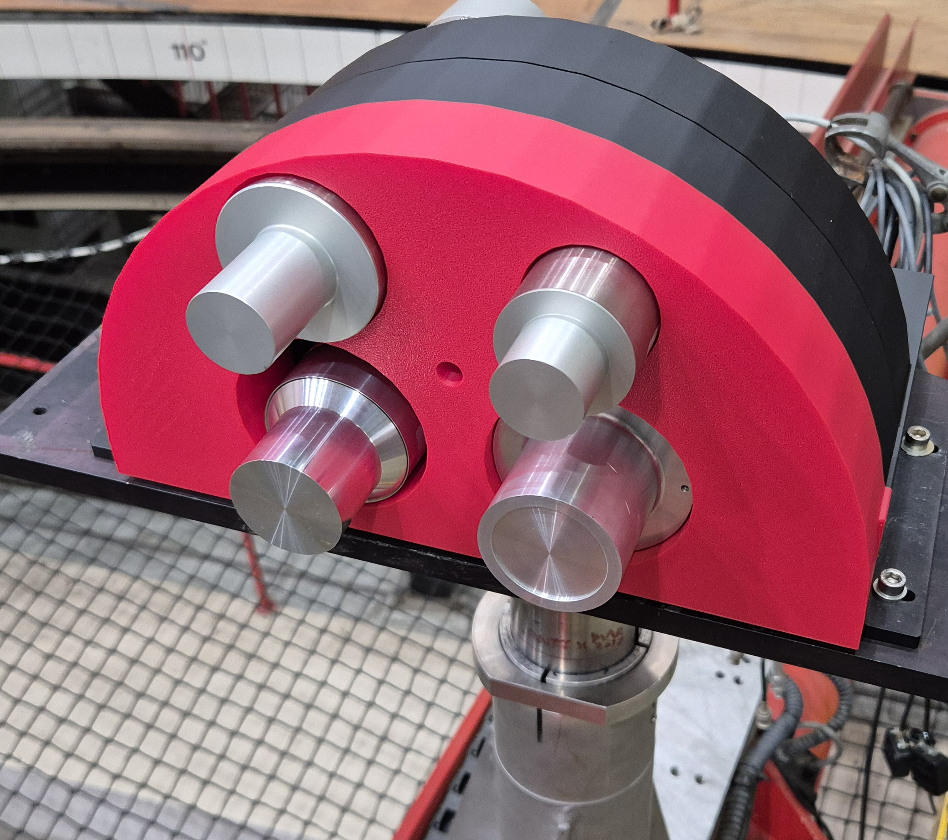
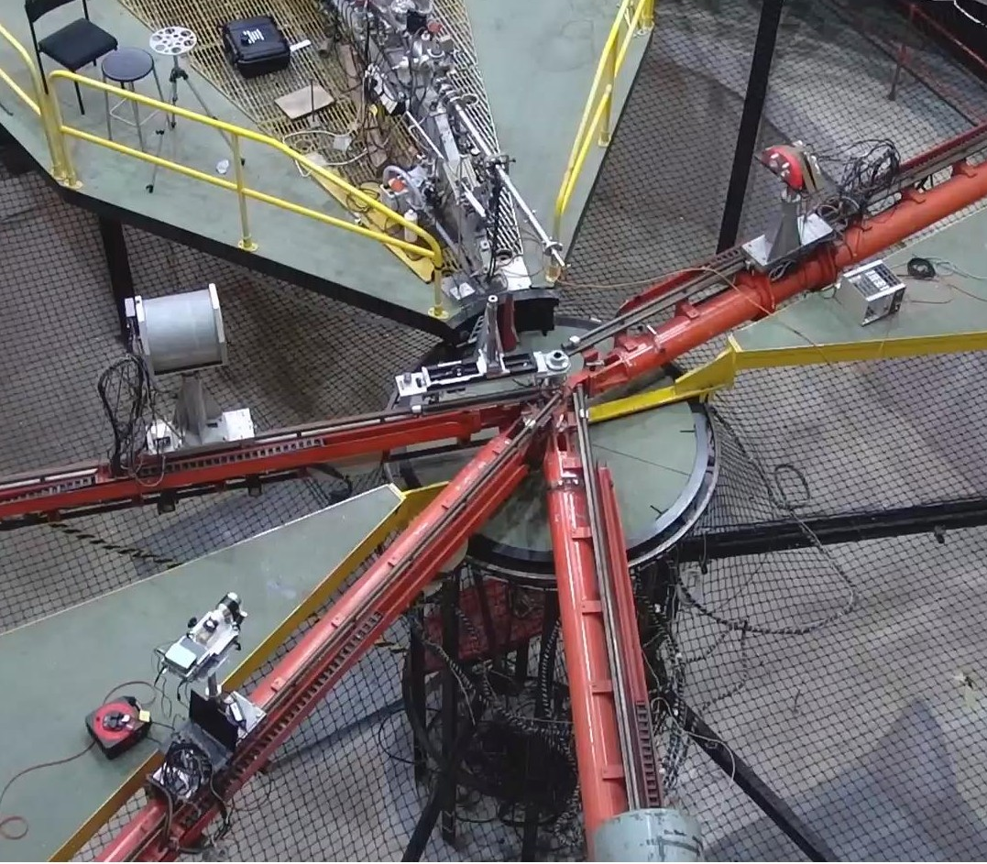
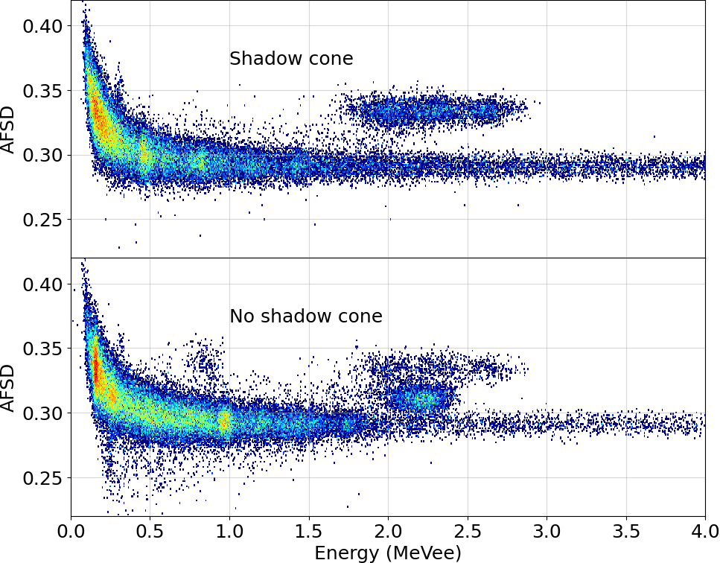
Overview
PSD explanation
LaX₃ introduction
AFSD explanation
Measurements at NPL low scatter facility
CeBr₃ extra data!
LaX₃
Beamline

Slide 3
Waveform Analysis

Slide 4
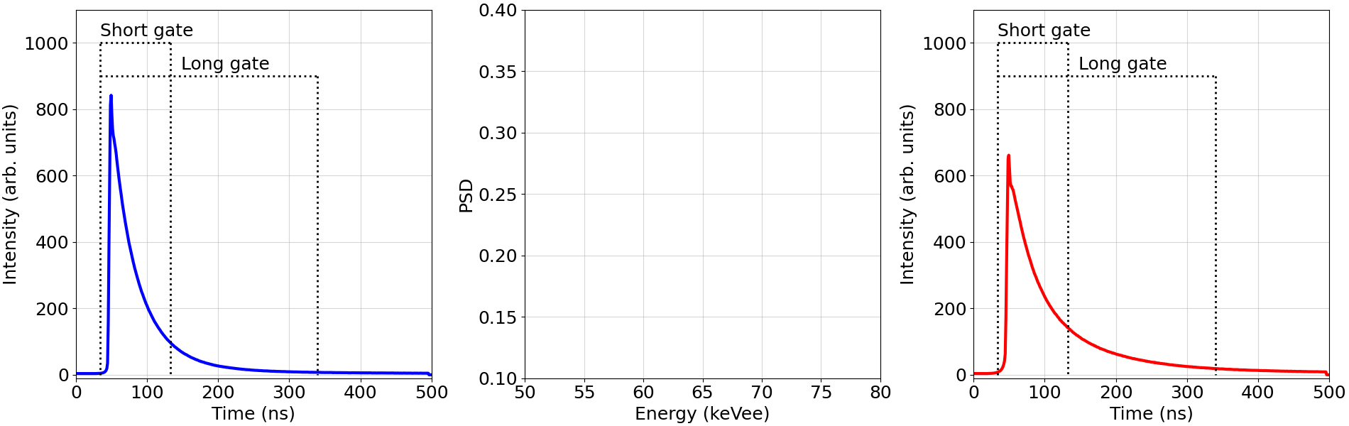
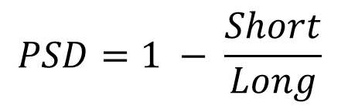
Pulse Shape Discrimination – Charge Integration
Charge integrated pulse shape discrimination (PSD)
Exploits the differences in the time characteristics of scintillators
E.g. two types of GAGG(Ce) scintillator’s response to a 662 keV gamma ray
= 29,000
= 34,500
= 28,300
= 39,500
$$PSD=1 − \frac{Short}{Long}$$
Total = 63,500
PSD = 0.15
Total = 67,800
PSD = 0.28

Slide 5
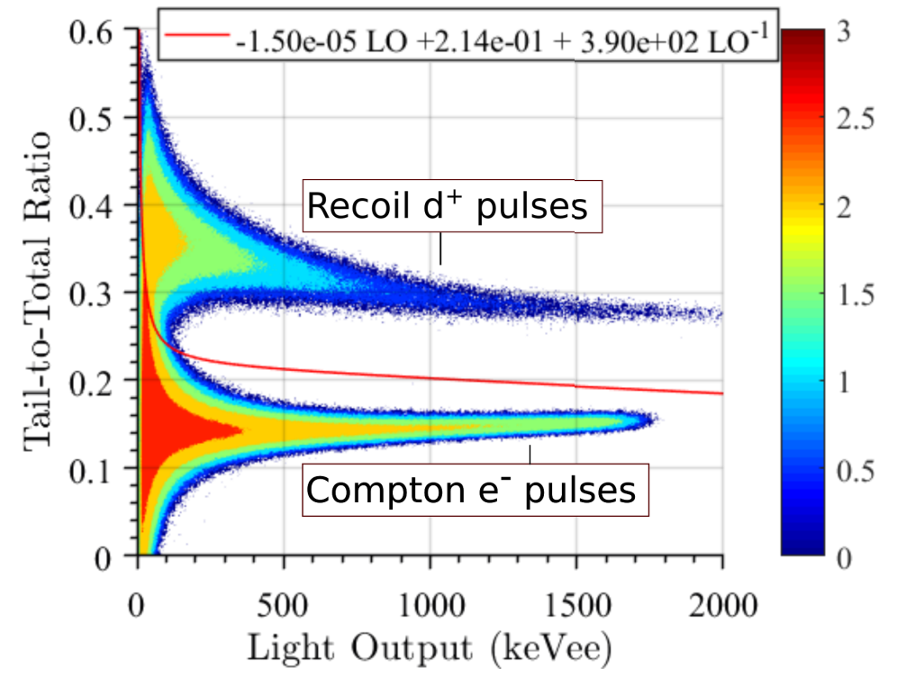
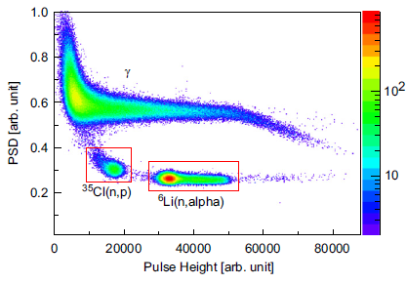
PSD – Particle Species Discrimination
Scintillation waveforms can be dependent on the instigating radiation species
Deuterated stilbene
CLYC(Ce)
Gaughan, N., et al. "Characterization of stilbene-d12 for neutron spectroscopy without time of flight." Nuclear Instruments and Methods in Physics Research Section A: Accelerators, Spectrometers, Detectors and Associated Equipment 1018 (2021): 165822.
Cieślak, Michał J., Kelum AA Gamage, and Robert Glover. "Critical review of scintillating crystals for neutron detection." Crystals 9.9 (2019): 480.

Slide 6
LaX₃(Ce) Scintillators

Slide 7
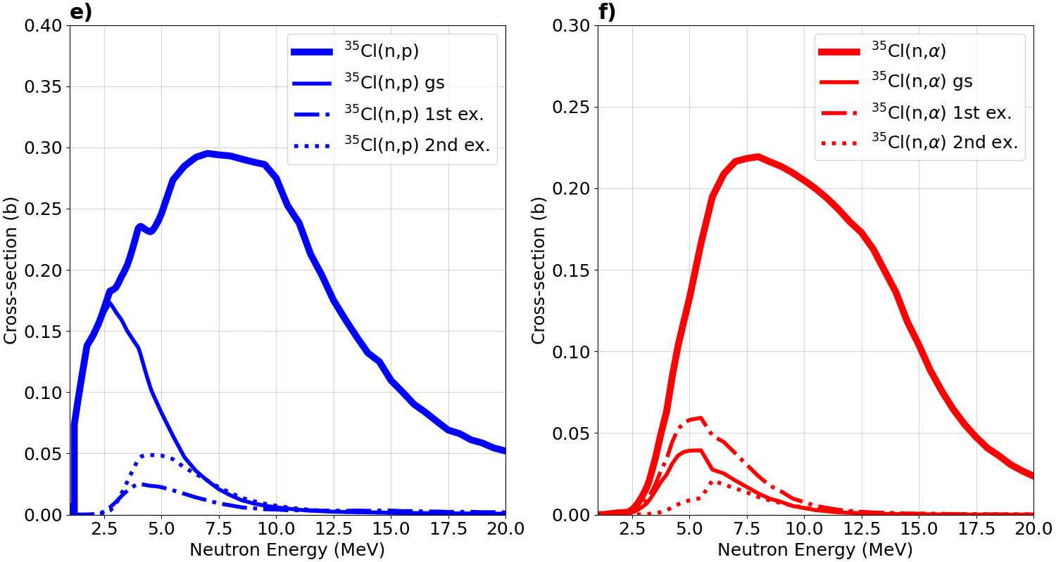
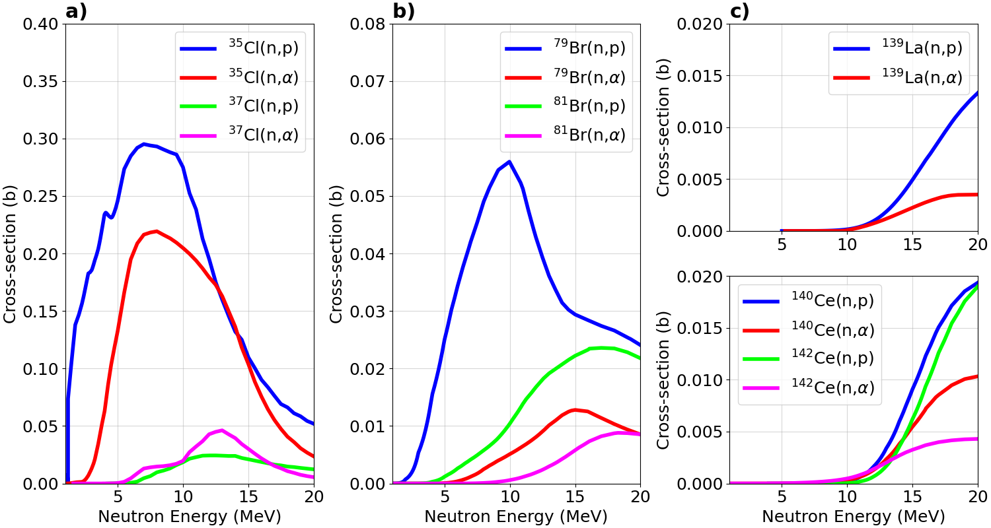
LaX₃ – Cross Sections
(n,p) and (n,α) cross sections align well with energy ranges significant for security and energy (14.1 MeV)
Recent measurements have indicated that the Cl cross sections are well overestimated (Kuvin 2020)
Br data are incomplete
NEA High Priority Request List for Nuclear Data

Slide 8
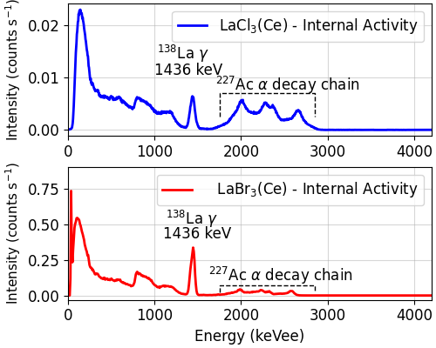
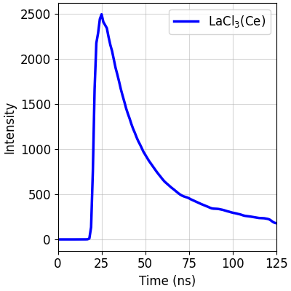
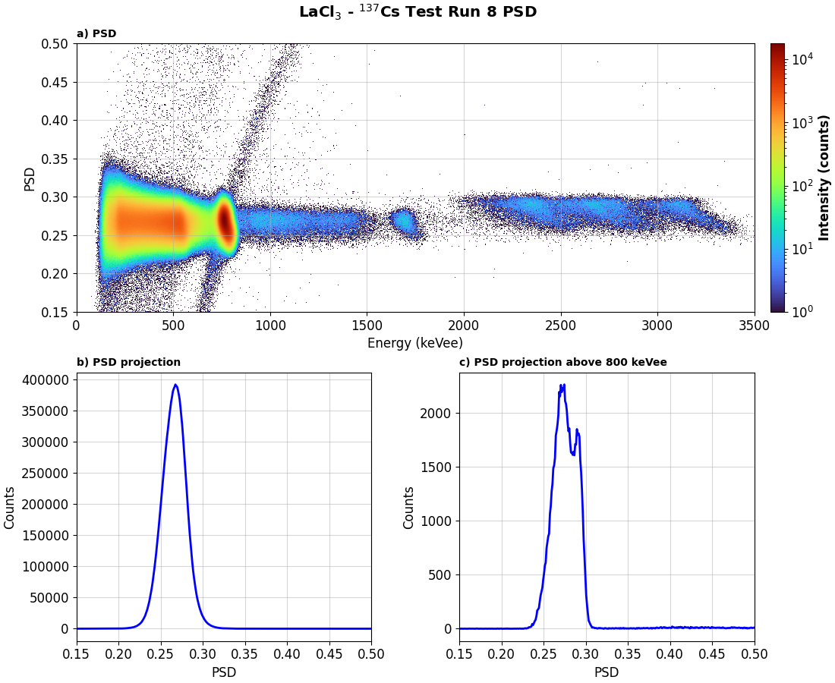
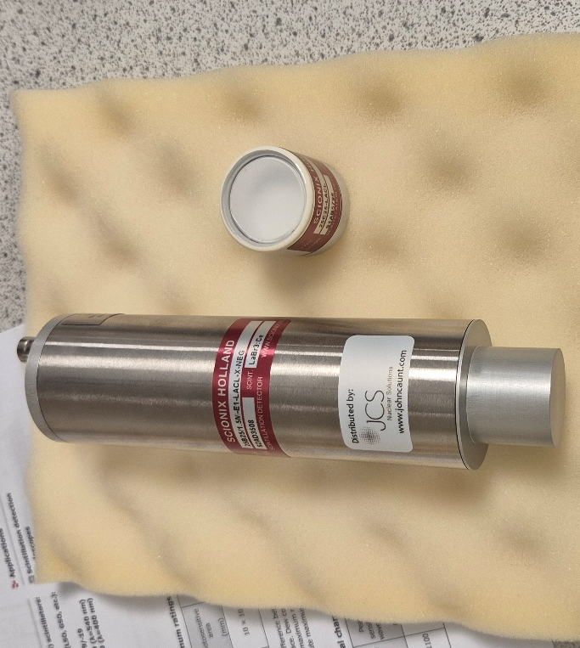
LaX₃ – Scintillators
LaX₃(X = Cl, Br) scintillators doped with Ce³⁺ have high energy resolution (2-4% at 662 keV), fast decay time (~30 ns) and have dual mode sensitivity (γ+n)
Hygroscopic and non-trivial internal activity from La decay and Ac contamination
Used in a range of facilities and instruments e.g. FATIMA, GRIFFIN etc.

Slide 9
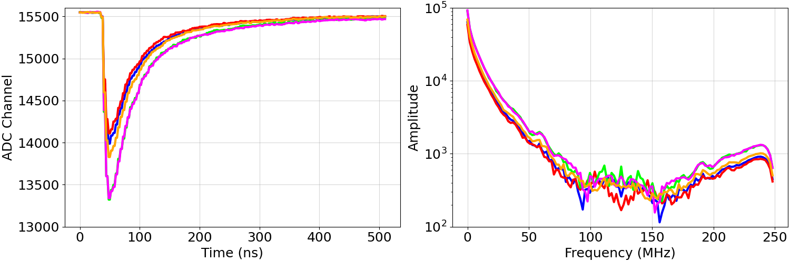
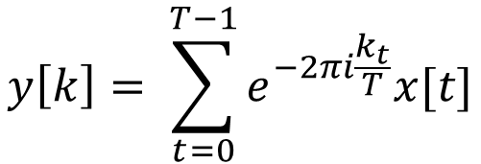
PSD – Amplitude Frequency Shape Discrimination
Waveforms are passed through a fast Fourier transform
Charge integration then applied with frequency gates
For implementation “live”, this is more computationally intensive than PSD
$$y\left[k\right]= \sum_{t=0}^{T−1}{e^{−2πi\frac{k_{t}}{T}}x[t]}$$

Slide 10
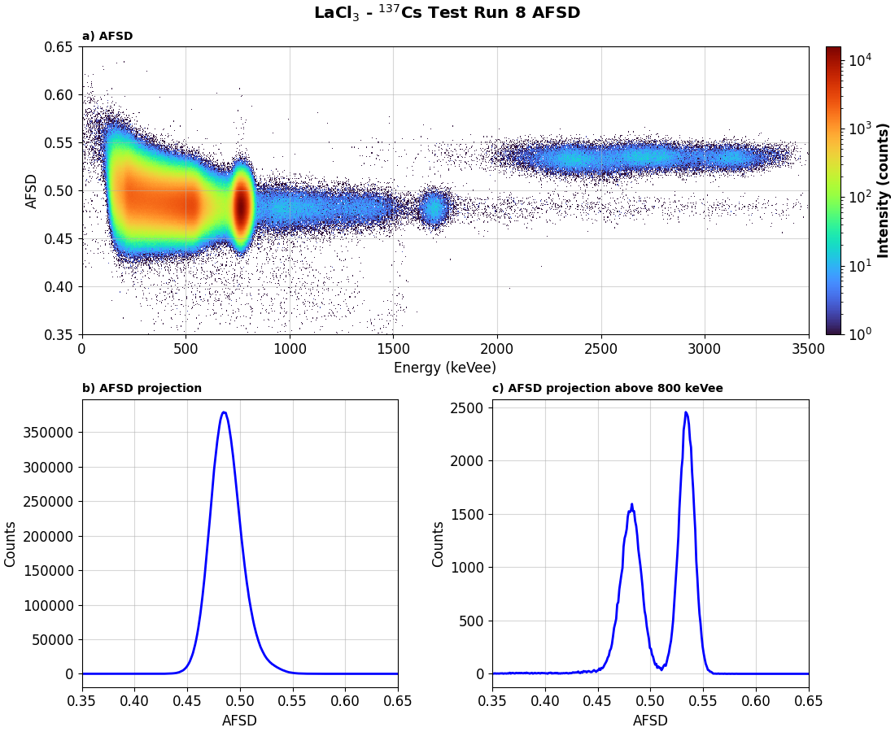
AFSD - Example
LaCl₃(Ce) response to internal activity and a ¹³⁷Cs source

Slide 11
NPL Neutron Facility

Slide 12
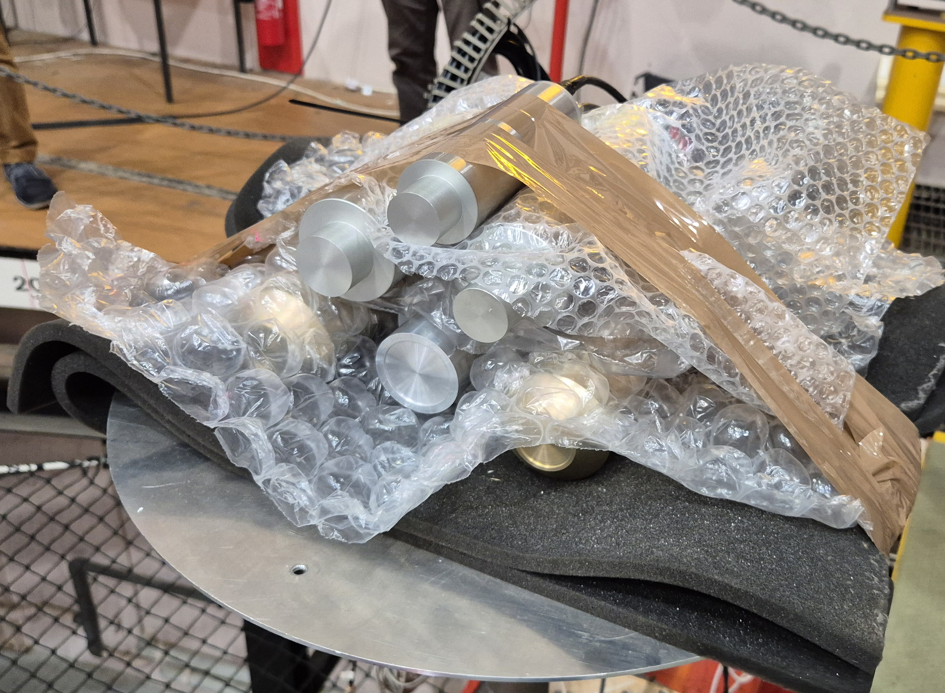
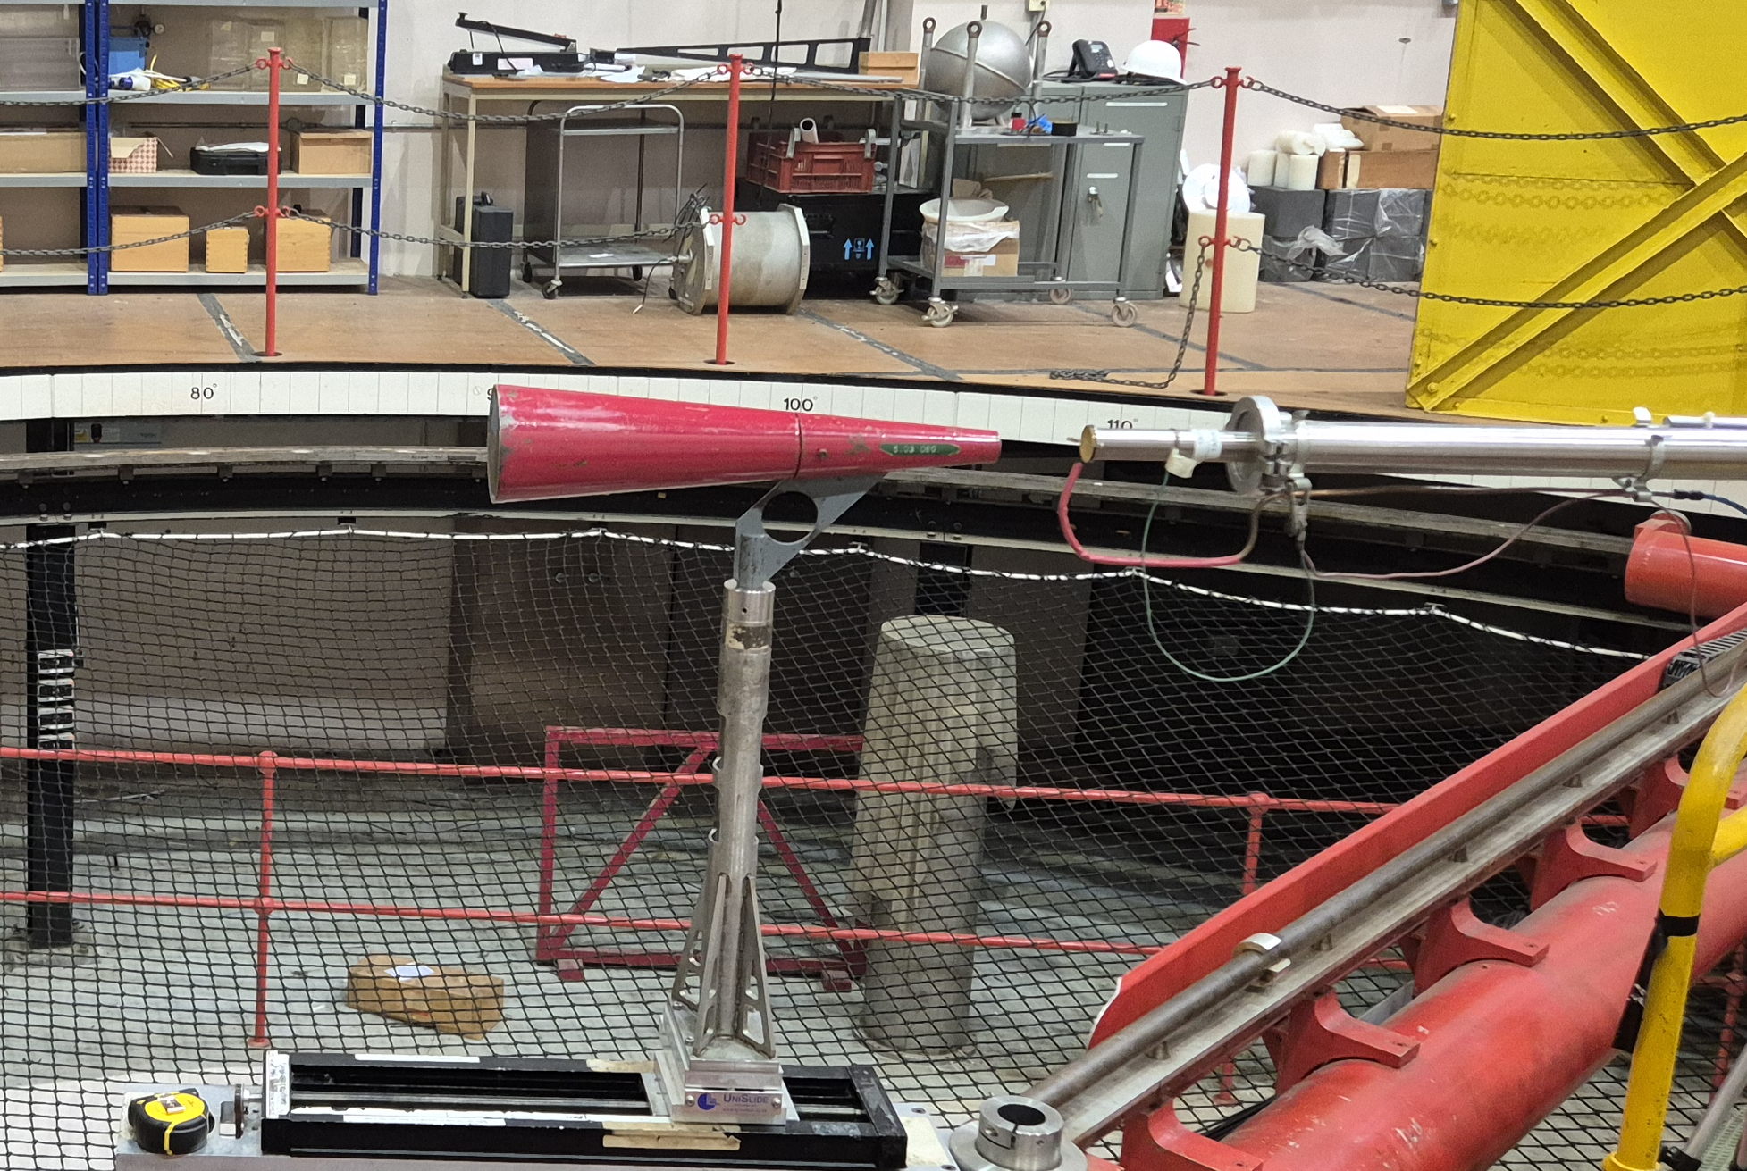
LaX₃ – Initial Measurements
Measurements taken with "unoptimised" holder
With and without shadow cone to check scattering contribution
LaCl₃ – 2.5 MeV neutrons

Slide 13
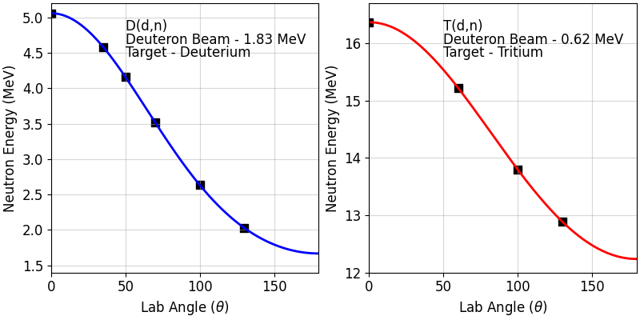
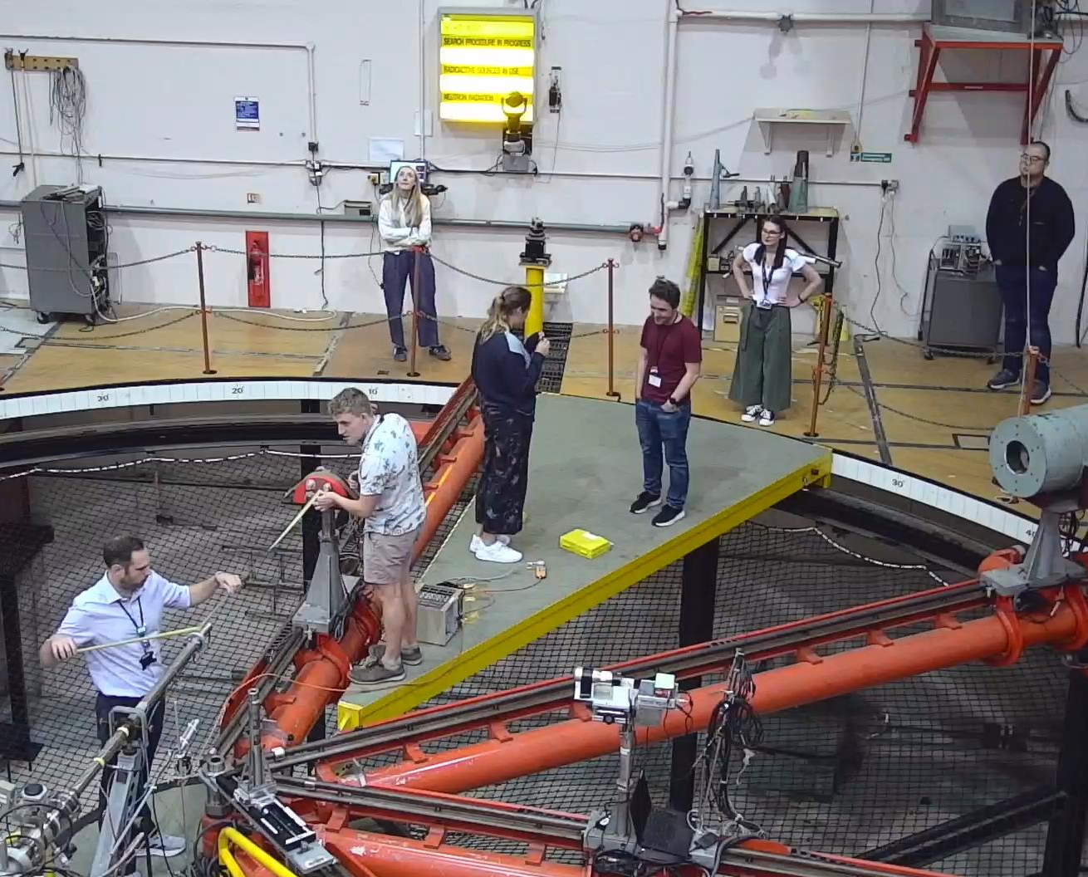
NPL Beam Campaign - Overview
Measurements taken at the NPL low-scatter facility in July 2025
Deuteron beams impinged on deuterieum and tritium targets
A range of monoenergetic neutron energies accessed by varying the beam energy and detector position
Beamline
LaX₃

Slide 14
LaCl₃ and LaBr₃
NPL Neutron Facility
Results

Slide 15
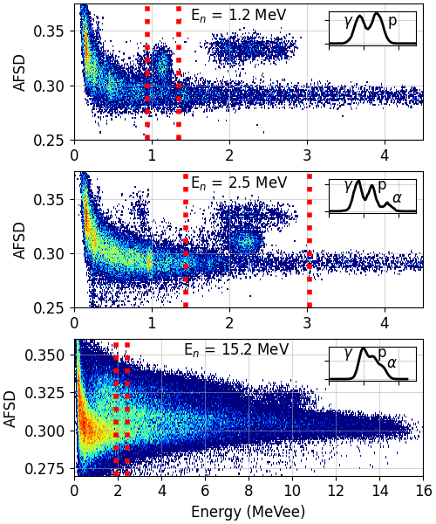
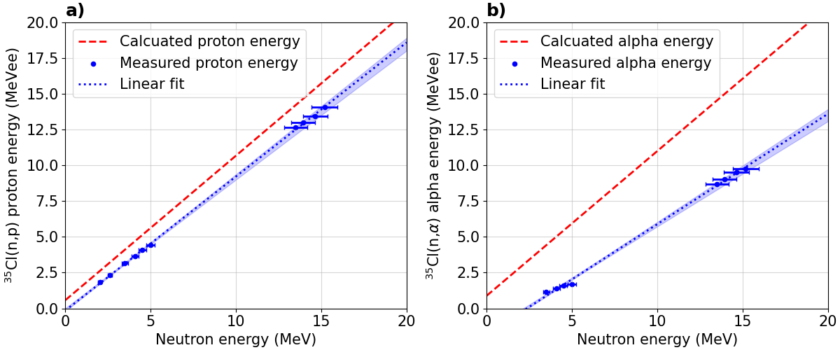
LaCl₃(Ce) Results
AFSD improves separation by a factor of 2
(n,p) and (n,α) peaks observed across all energies
Linear response indicates neutron spectroscopy potential

Slide 16
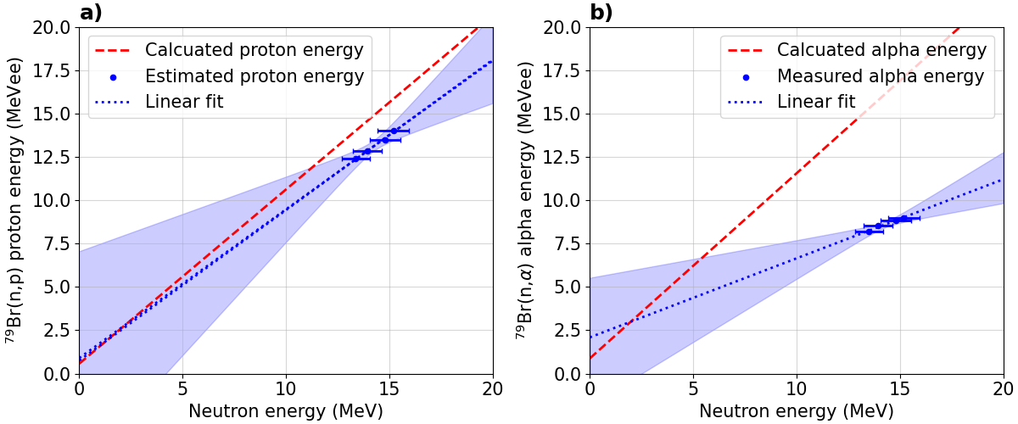
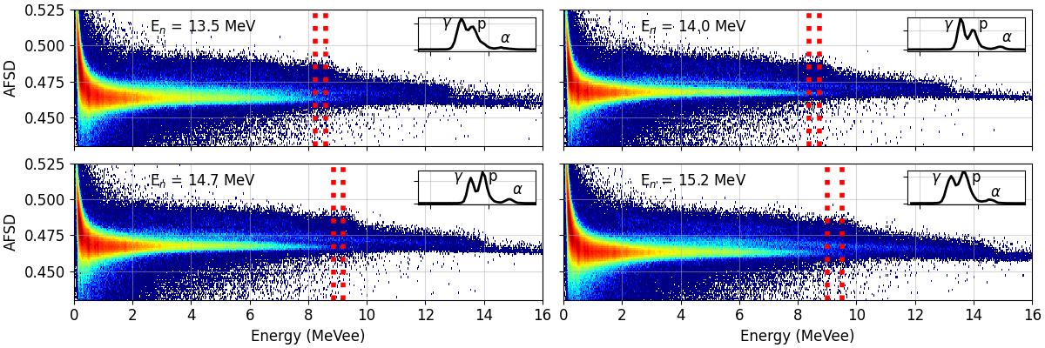
LaBr₃(Ce) Results
Due to lower cross section in the E_{n}=1-5 MeV energy range, no clear response
At higher energies, broad γ, proton and α distributions with α peaks
Proton distributions appear to be spread across many excited states

Slide 17
CeBr₃
NPL Neutron Facility

Slide 18
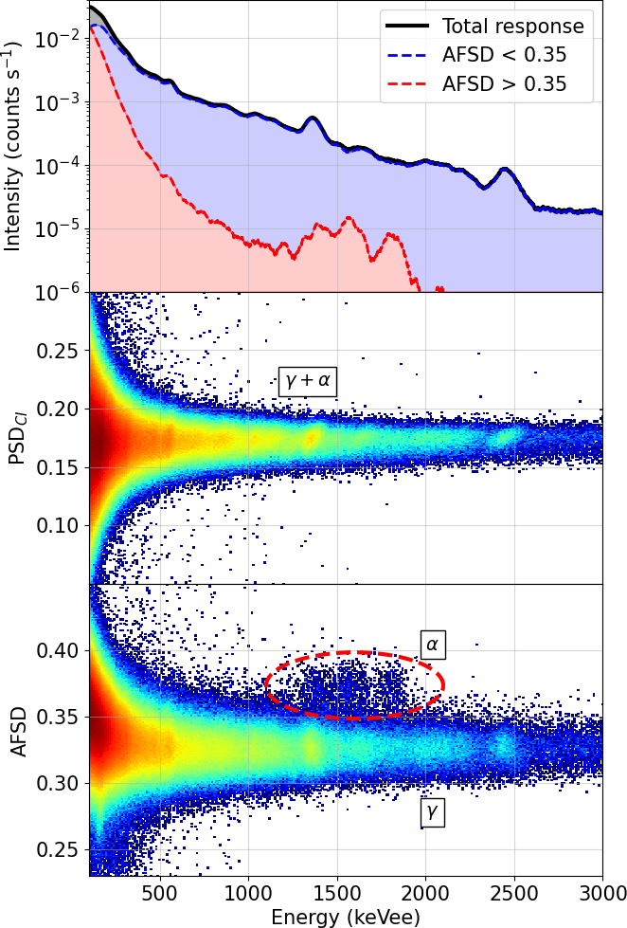
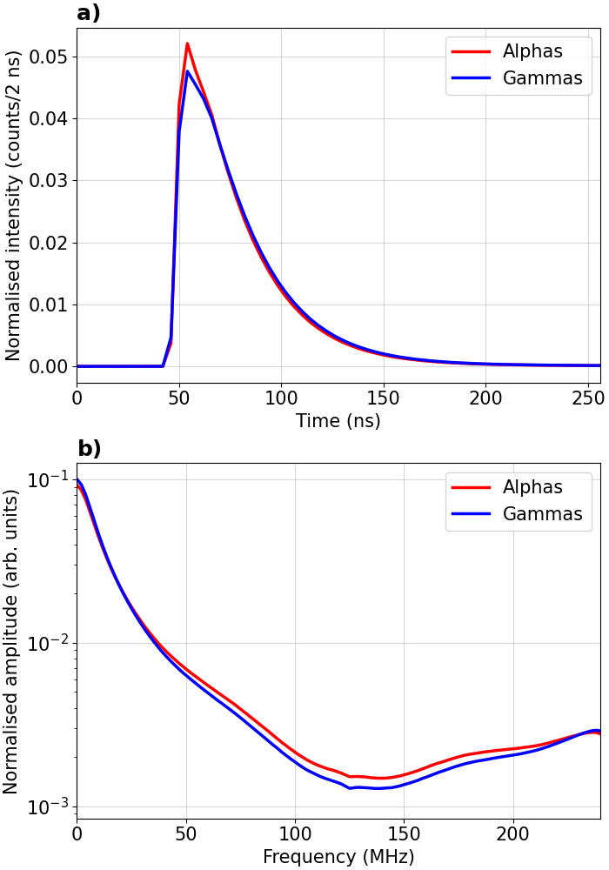
CeBr₃ AFSD Performance
CeBr₃ scintillators have benefits over LaX₃ materials, but have no reported PSD capability
AFSD method allows us to separate the low levels of Ac contamination in the internal spectra

Slide 19
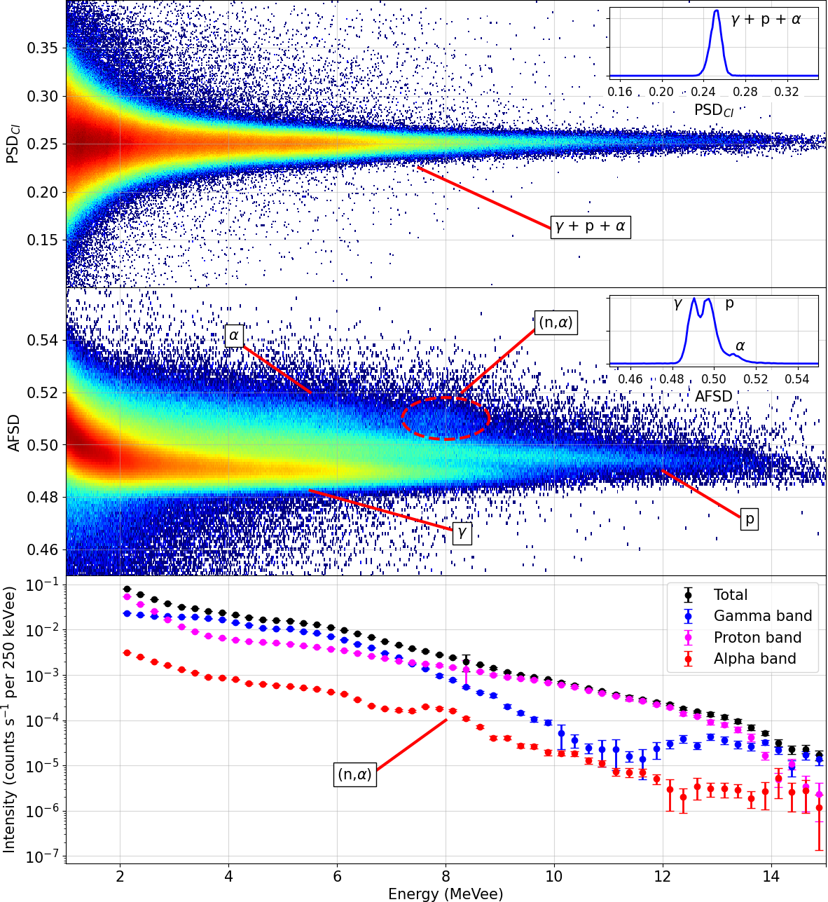
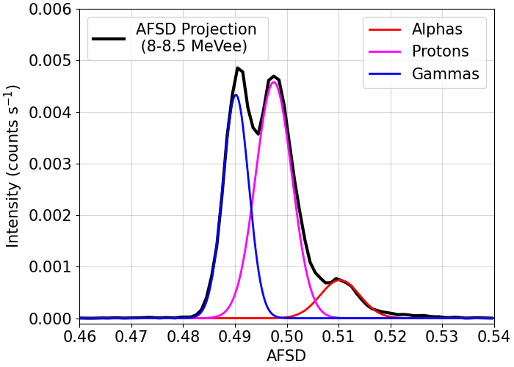
CeBr₃ Results
Measurements taken during LaX₃ beam test with CeBr3
T(d,n) measurements yield clear proton and alpha bands
CeBr₃ can function as neutron detector, or neutron contributions can be accounted for

Slide 20
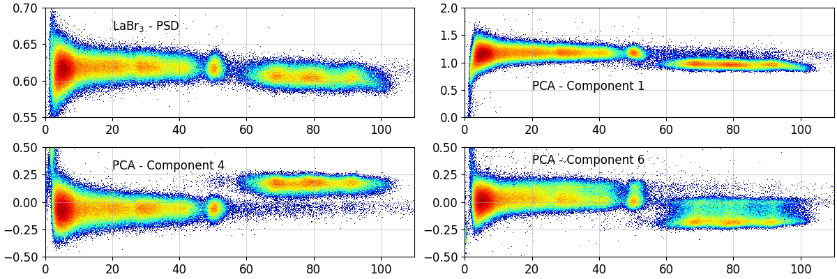
Other Analysis Methods
Implementation of different methods onto FPGA systems
Optimising parameters: windowing functions, normalisation, zero padding
Principal component analysis, ML, fitting decays, combinations of different methods etc.

Slide 21
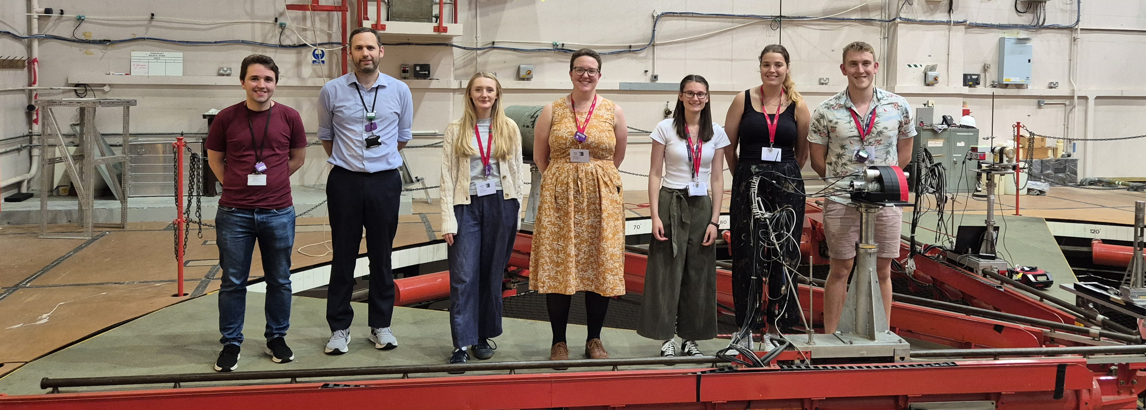
Thanks for listening!
Thanks to everyone who assisted in this work: Jacob Heery, Jack Henderson, Naomi Gadsby, Giuseppe Lorusso, Mike Bunce, Matt Taggart, Gemma Wilson, Abdul Alshammari, Gee Bartram, Chris Cousins, Katie Garrett, Connor O’Shea, Ed O’Sullivan, Sifa Poulton, David Thomas, Toby Wolverson and Renjie Wu

Slide 22
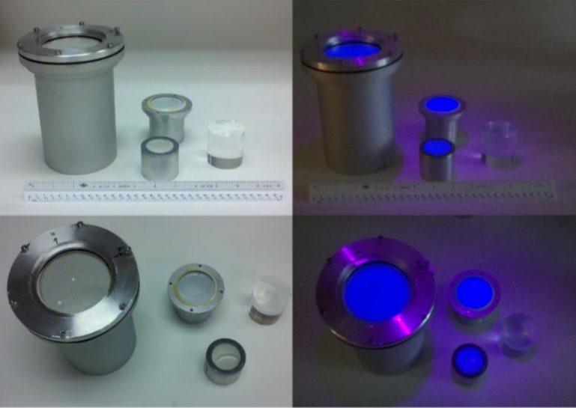

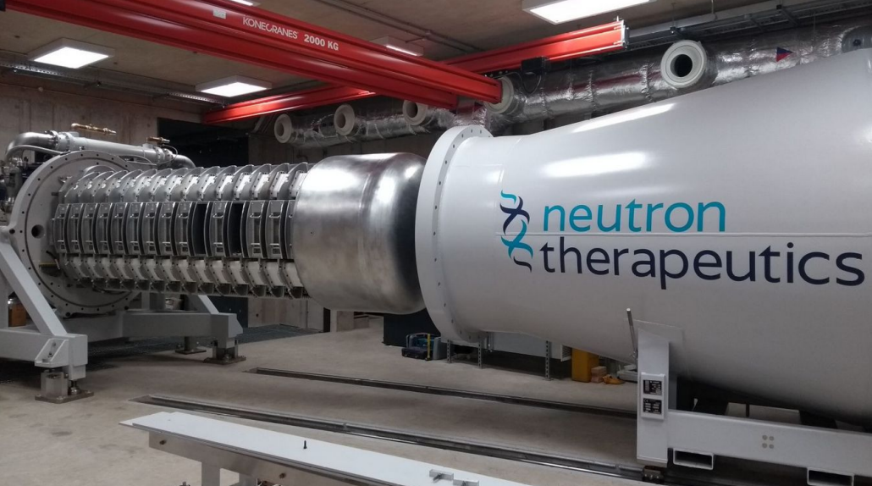
PhD Opportunity
Development of Scintillator-Based Neutron Detectors
Explore neutron sensitive organic and inorganic scintillators, with the opportunity to utilise the UoB’s accelerator facilities (cyclotron and neutron irradiation facility )
Investigate current waveform analysis methods, with the view of improving materials’ capability to distinguish between gamma and neutron induced scintillation
Develop the university’s capacity to produce scintillation materials and detectors
To apply, please reach out to j.oneill.3@bham.ac.uk

Slide 23


LaX3 paper published recently in NIM A
Any questions?

Slide 24
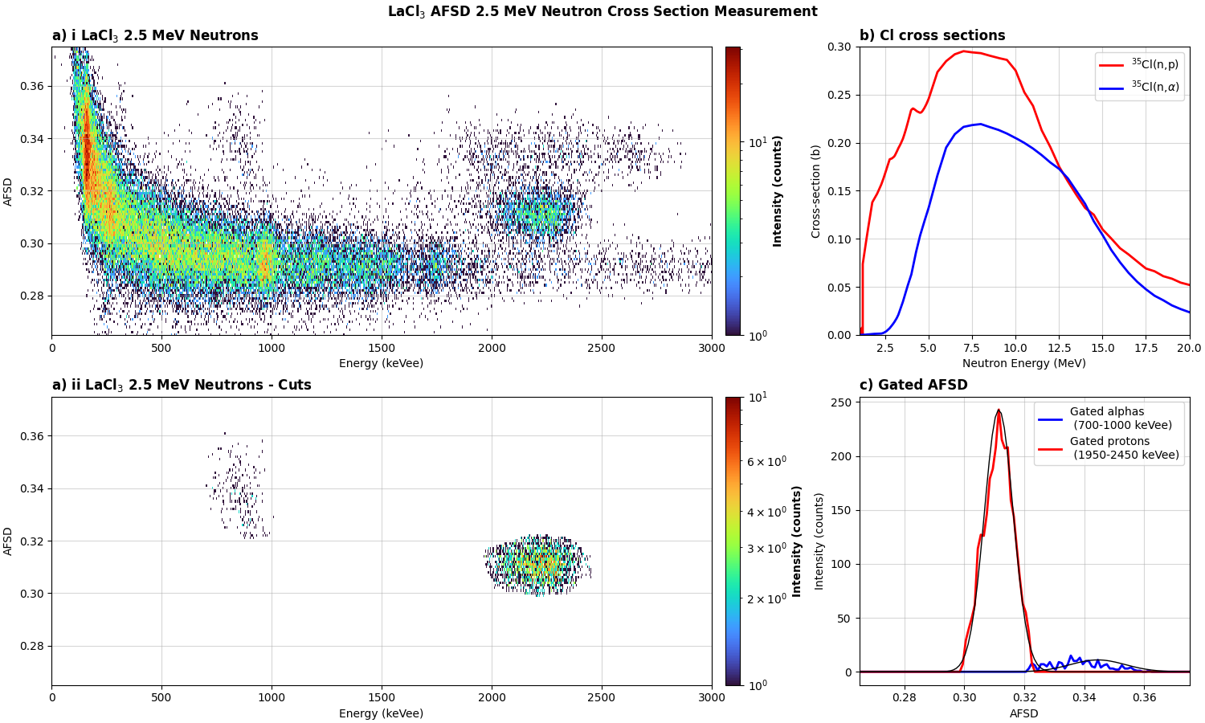
LaCl₃(Ce) Results – Future Cross Section Work
One of the key focuses of the NEA High Priority Request List for Nuclear Data
Ratio from theory = 0.0186
Ratio from measurement = 0.085(6)
In agreement with recent work

Slide 25
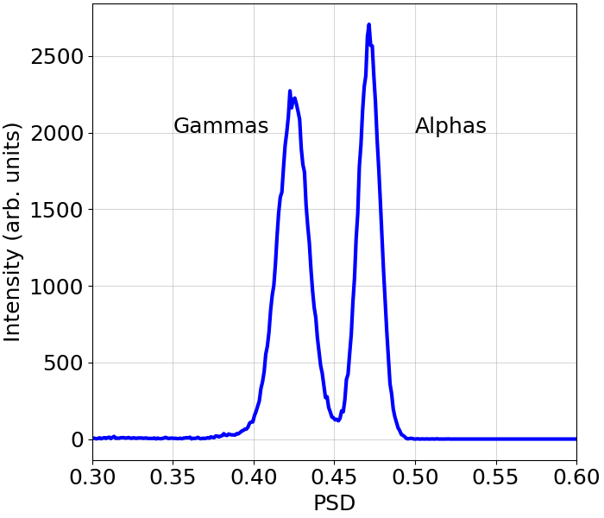
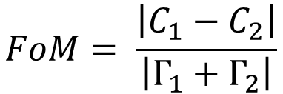
PSD – Quantifying
LaCl₃ internal activity
PSD methods are quantified via the Figure of Merit (FoM)
Improvement in FoM achieved via reducing FWHM of each population, and increasing the separation
C_{a}
C_{g}
$$FoM= \frac{\left|C_{1}−C_{2}\right|}{\left|Γ_{1}+Γ_{2}\right|}$$
Γ_{a}
Γ_{g}

Slide 26
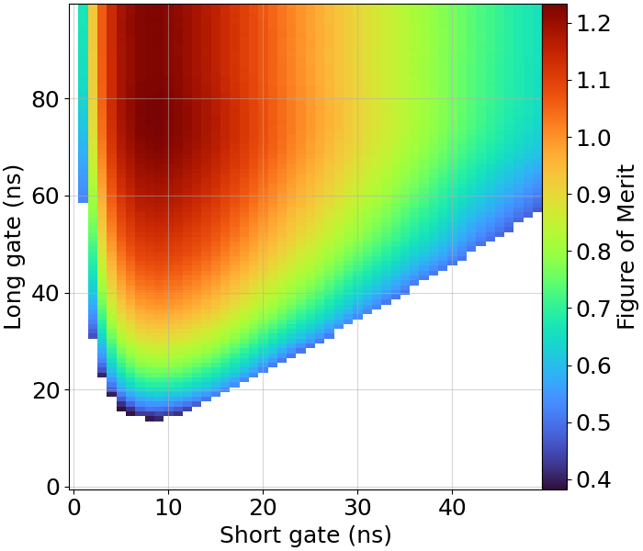
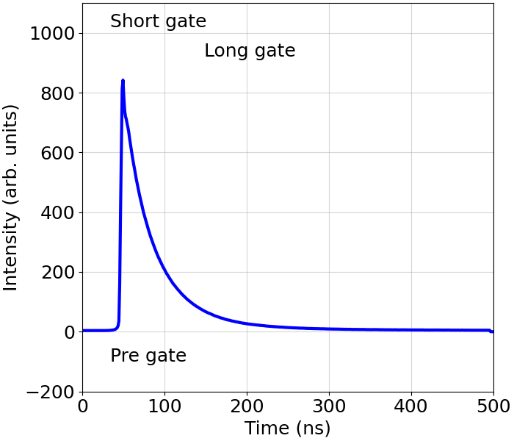
PSD – Optimising
Variables currently being varied
Pre-gate
Short gate
Long gate

Slide 27
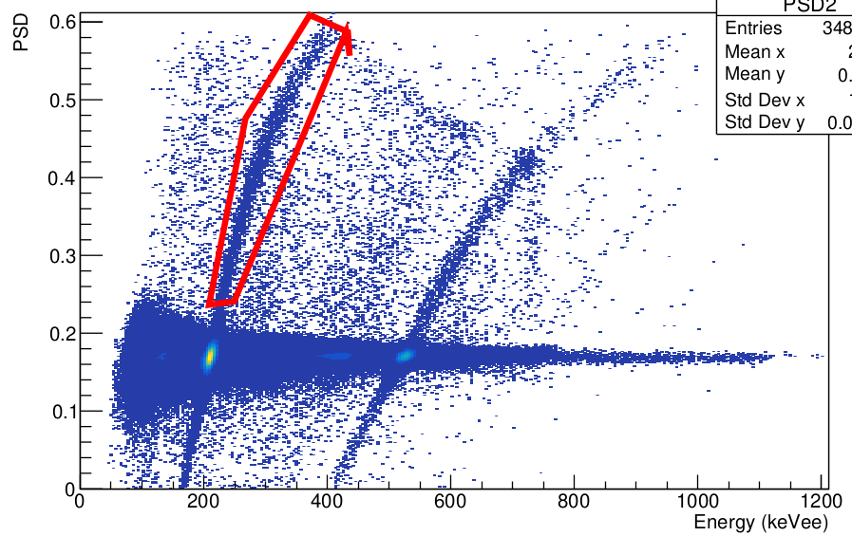
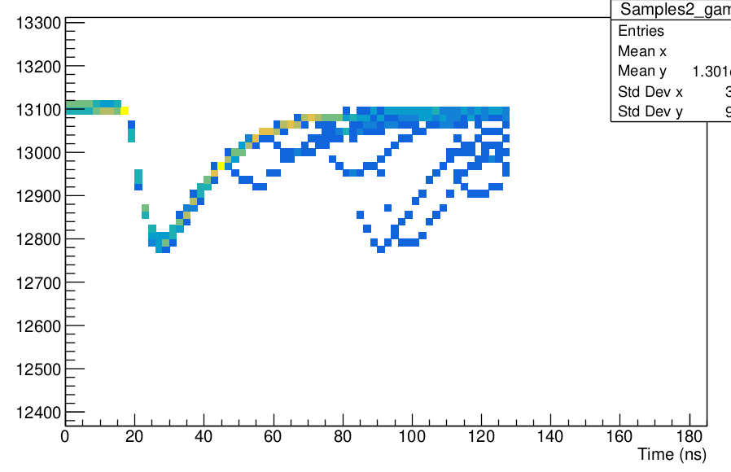
^{Pileup check}

Slide 28
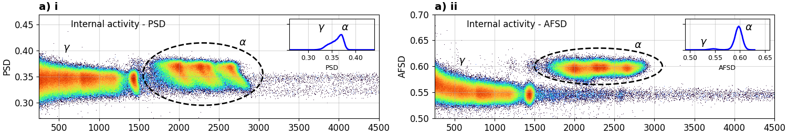
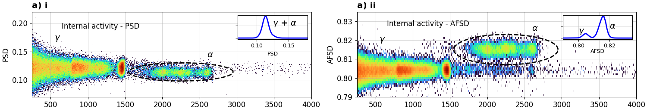
AFSD – More Examples
LaCl₃(Ce) PSD FoM = 0.5(1) AFSD FoM = 1.41(1)
LaBr₃(Ce) PSD FoM = ??? AFSD FoM = 1.130(1)

Slide 29
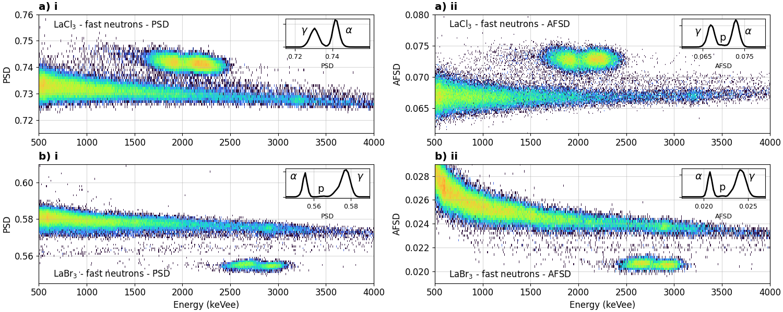
AFSD – Even More Examples (SiPMs)
AFSD not always an improvement from PSD – materials do have a “limit” of separation

Slide 30
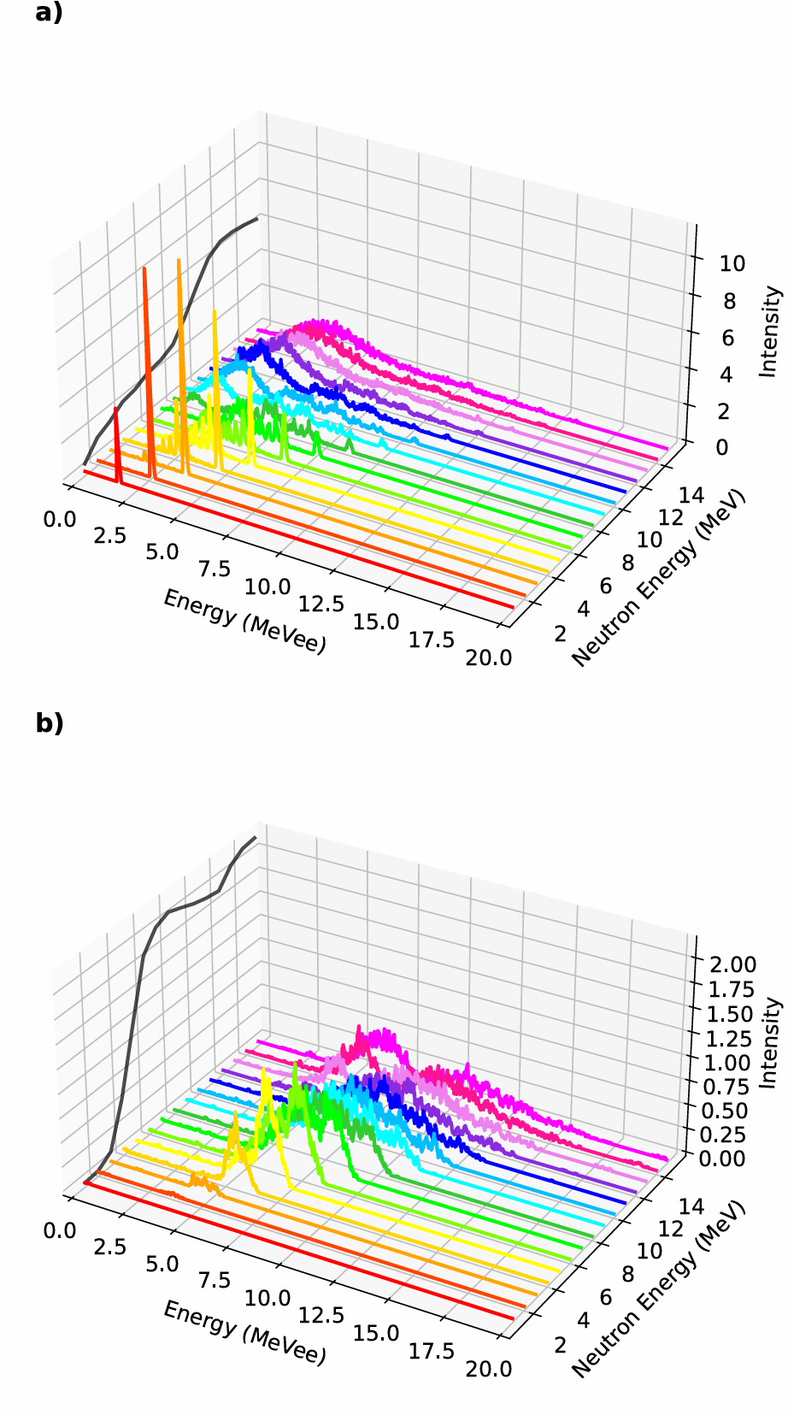
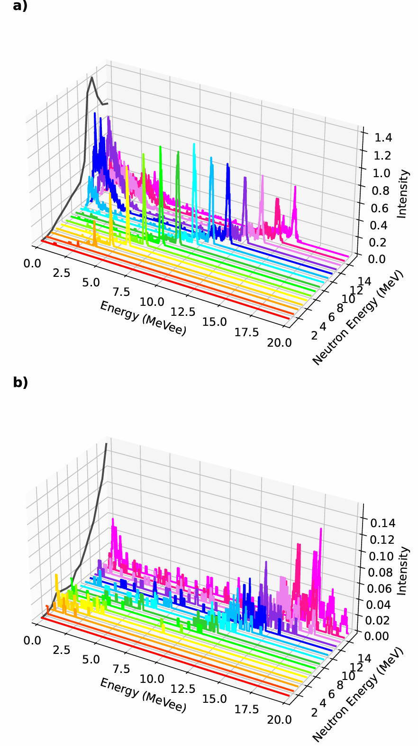
Simulations
Geant4 – energy dependence on proton and alpha gated responses
LaCl₃ response shows contributions from different states and reaction channels
LaBr₃ data is dependent on ENDF-VIII – prediction less confident in p channels
LaBr₃ – proton response
LaBr₃ – alpha response
LaCl₃ – proton response
LaCl₃ – alpha response

Slide 31
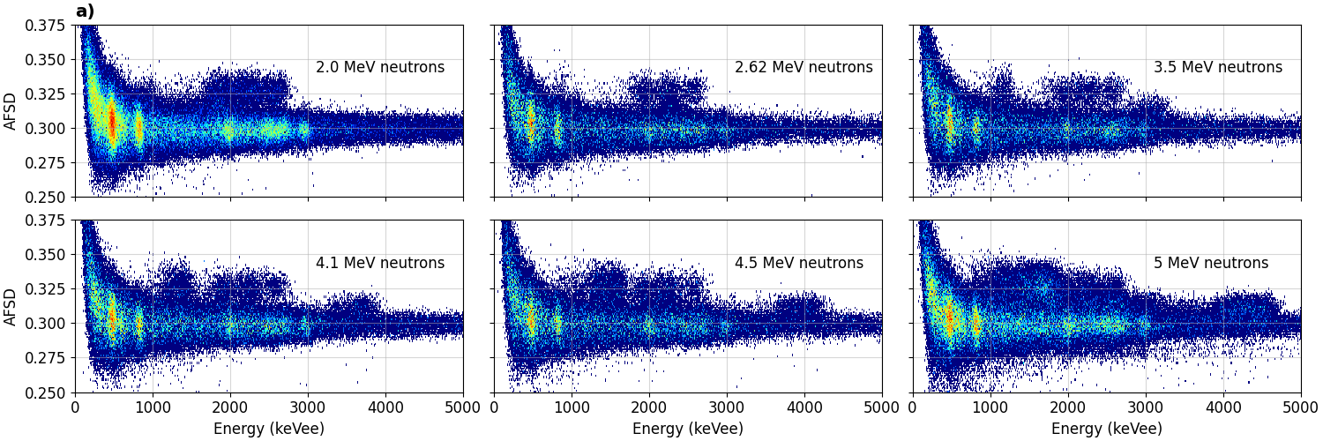
LaCl₃(Ce) Results - D(d,n)
Gain optimised for high energy signals
Noticeable impact on AFSD performance, especially for lower energy signals

Slide 32
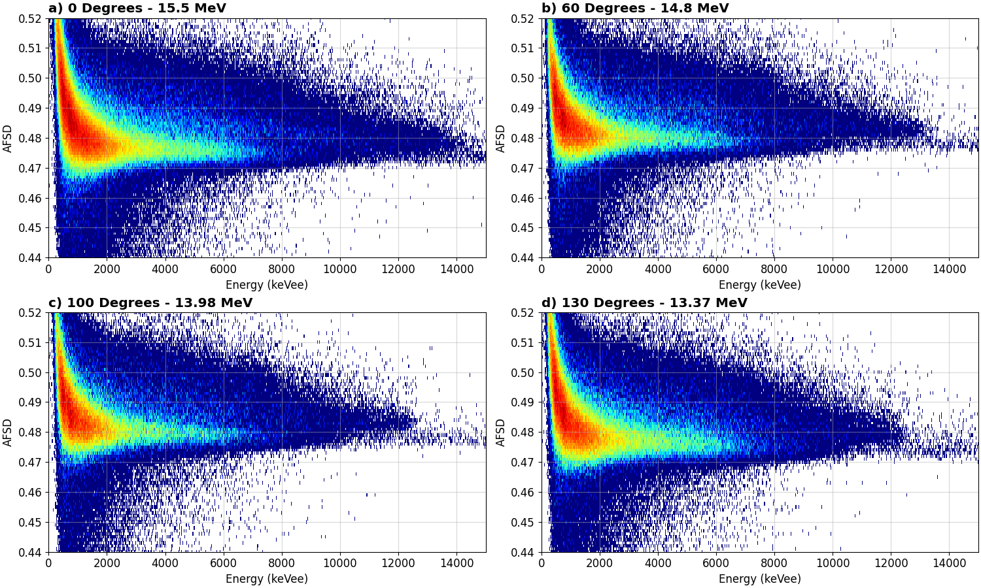
LaCl₃(Ce) Results - T(d,n)

