Slide 1





A Compact Multimode Detector for the Decommissioning of Irradiated Graphite
Nia Hunter
IOP Nuclear Physics Conference
Monday 13th April 2026

Slide 2

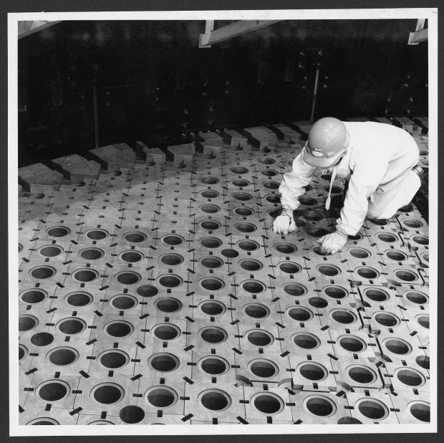
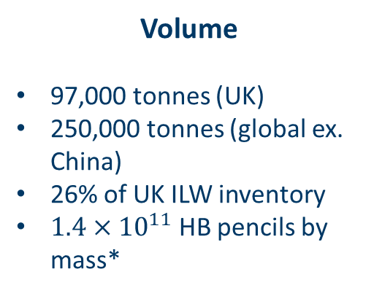
Let’s Talk About Graphite!
Volume
97,000 tonnes (UK)
250,000 tonnes (global ex. China)
26% of UK ILW inventory
$1.4×{10}^{11}$ HB pencils by mass*
Source: https://nda.blog.gov.uk/were-excited-to-see-new-concepts-emerging/
2
*extremely dubious calculation, estimates vary
Notes:
Gas cooled (Magnox, AGR, RBMK) and HTGR, pebble bed
26% by volume

Slide 3
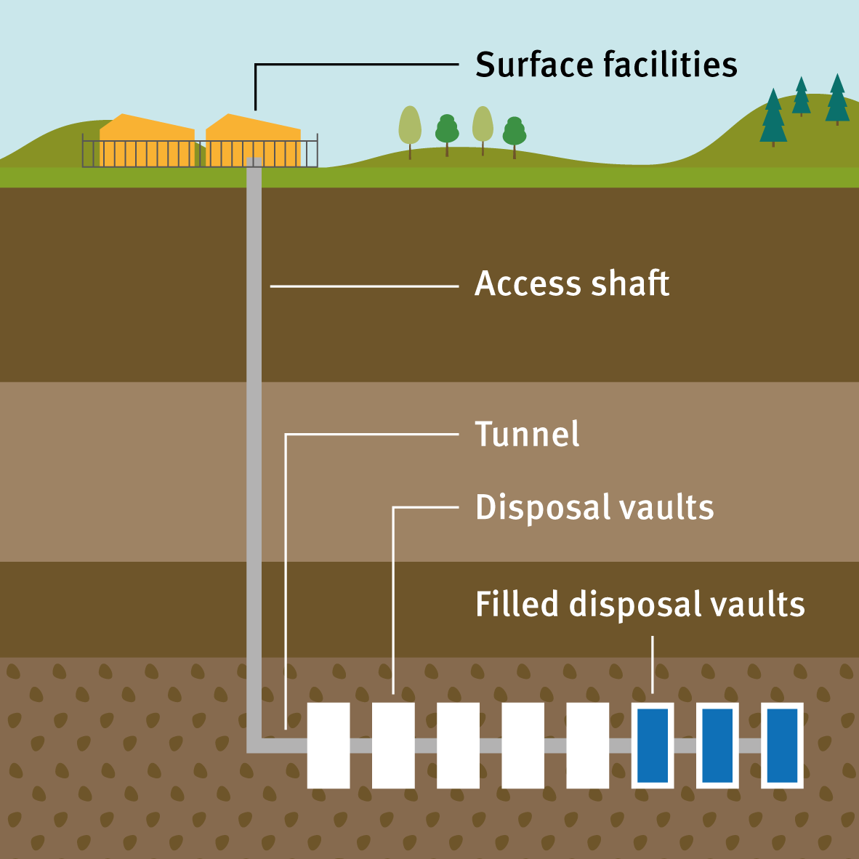
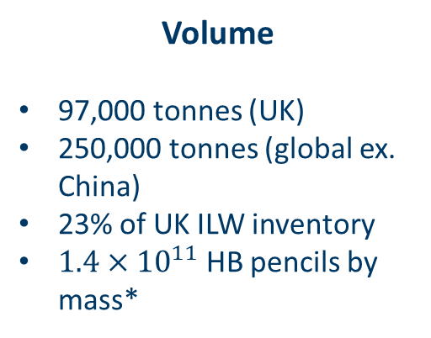
Let’s Talk About Graphite!
Volume
97,000 tonnes (UK)
250,000 tonnes (global ex. China)
23% of UK ILW inventory
$1.4×{10}^{11}$ HB pencils by mass*
Management
Deep geological disposal
Thermal/chemical decontamination
Radionuclide recovery
Reuse
  Graphite electrodes
  Future reactors
  Shielding in HAW containers
Source: https://environmentagency.blog.gov.uk/2019/02/04/deep-thinking-regulating-geological-disposal/
2
*extremely dubious calculation, estimates vary

Slide 4
Let’s Talk About Graphite!
Volume
97,000 tonnes (UK)
250,000 tonnes (global ex. China)
23% of UK ILW inventory
$1.4×{10}^{11}$ HB pencils by mass*
Management
Deep geological disposal
Thermal/chemical decontamination
Radionuclide recovery
Reuse
  Graphite electrodes
  Future reactors
  Shielding in HAW containers
Characteristics
Radionuclide inventory
Specific activity
Physical properties
Methods of characterisation
  Trepanning samples
  Simulations (activation modelling, physical characteristic modelling, crack propagation etc.)
2
*extremely dubious calculation, estimates vary
Notes:
Key limitation in characterization technology – can’t sample the whole thing! Activation models have proven to be unreliable. Physical models stronger

Slide 5
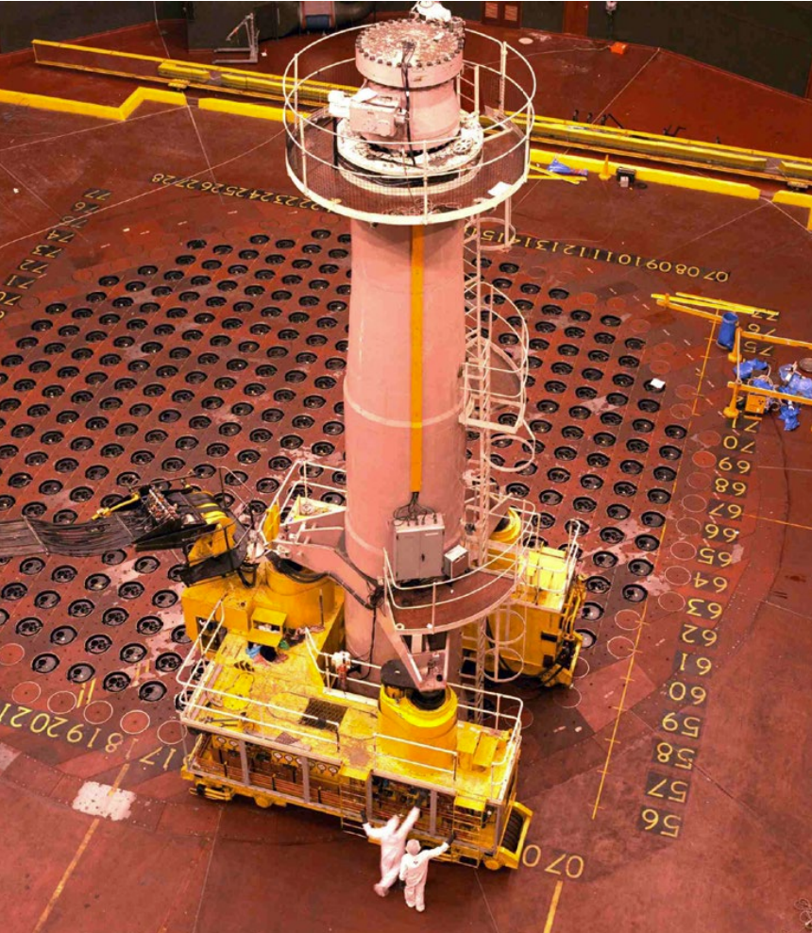
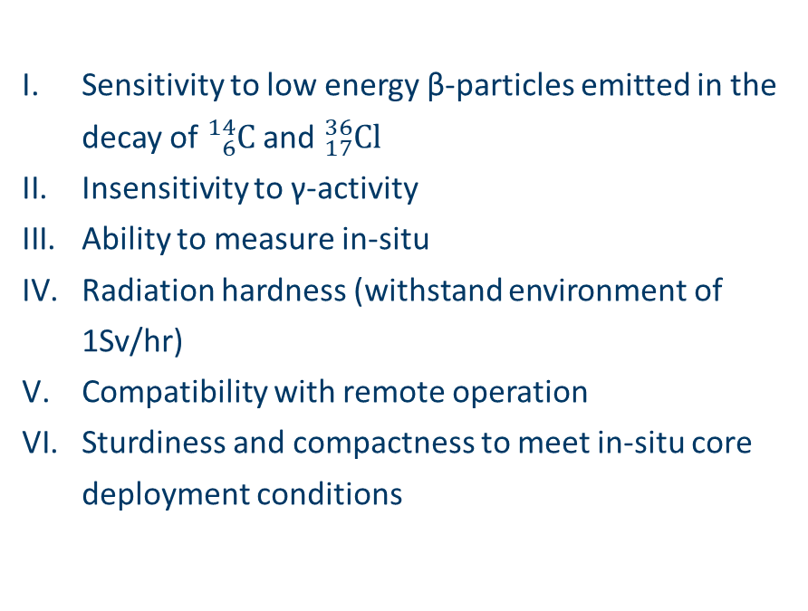
Project Outline
Design Requirements
Sensitivity to low energy β-particles emitted in the decay of ${}_{6}^{14}C$and ${}_{17}^{36}{Cl}$
Insensitivity to γ-activity
Ability to measure in-situ
Radiation hardness (withstand environment of 1Sv/hr)
Compatibility with remote operation
Sturdiness and compactness to meet in-situ core deployment conditions
Source: https://ukinventory.nda.gov.uk/wp-content/uploads/2014/01/Fact-sheet-operating-a-nuclear-power-reactor.pdf
3
Notes:
Filling the gap

Slide 6
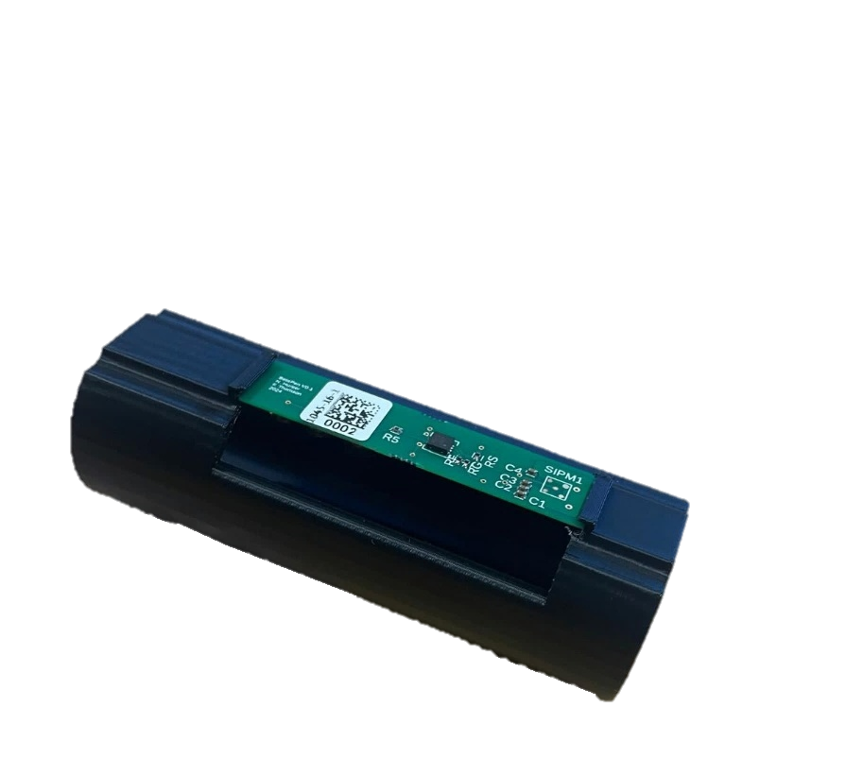
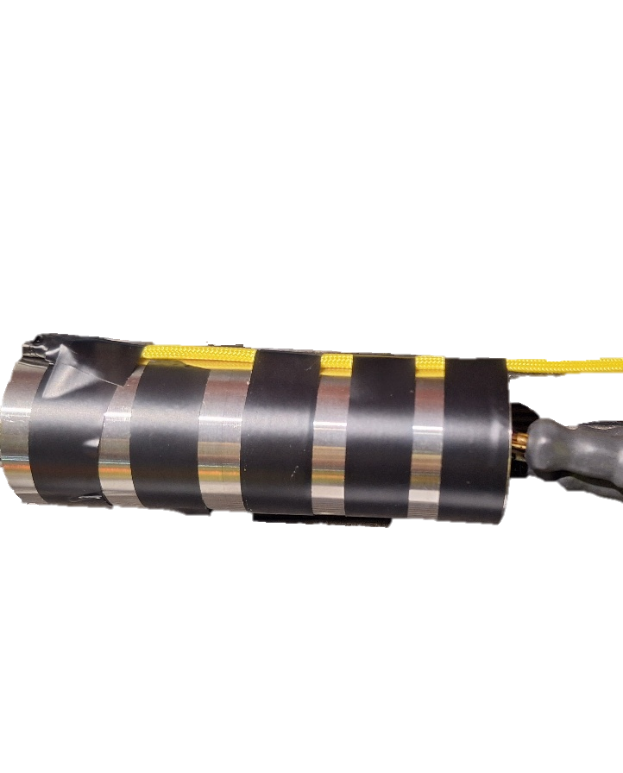
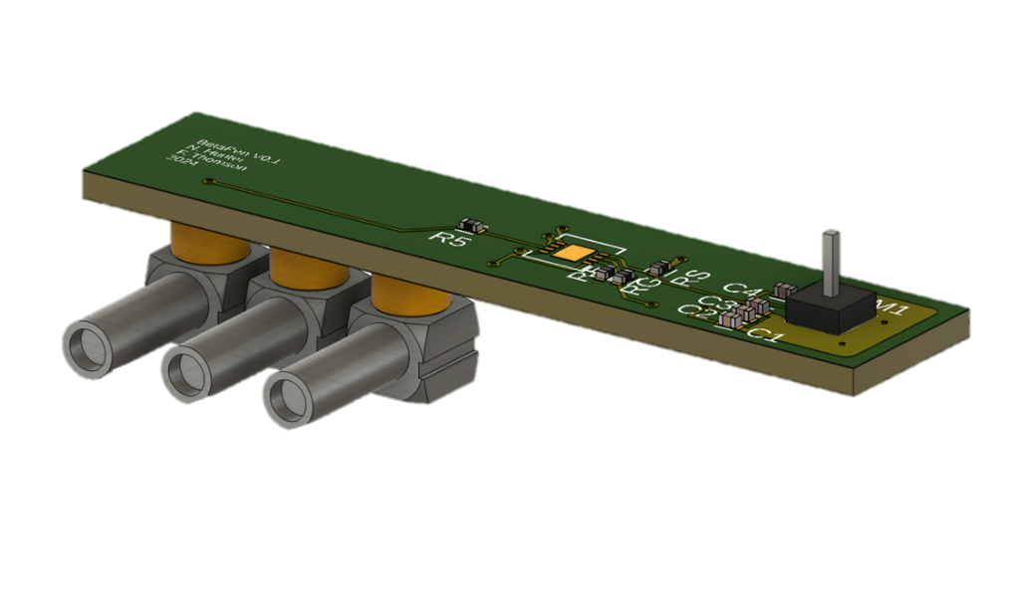
Simulation & Design
PCB: SiPM power and signal amplification
Internal housing: 3D printed PLA
External housing: Stainless steel
Crystal: optically coupled to SiPM, light-tight seal
Cabling: coaxial cable for power and signal transmission
4
Notes:
GEANT4 simulations, crystal size/shape selections, PCB design

Slide 7

Trawsfynydd Experiment
NRS ‘lead and learn’ site for reactor dismantling
April 2022 joint trepanning exercise on SS1
Test measurement of detectors performed in SS1, organized with NRS and NDA support
Measurements taken in standpipes H09 (core center) and Q13 (core periphery) at 0.25m intervals
Two detectors tested (⌀ 2mm and 0.6 × 0.6mm crystal)
Concurrent gamma measurement taken using AMP100
5
Source: https://www.nuclearsectorjobs.co.uk/careers/news/potential_for_600_new_jobs_at_old_trawsfynydd_nuclear_site/

Slide 8
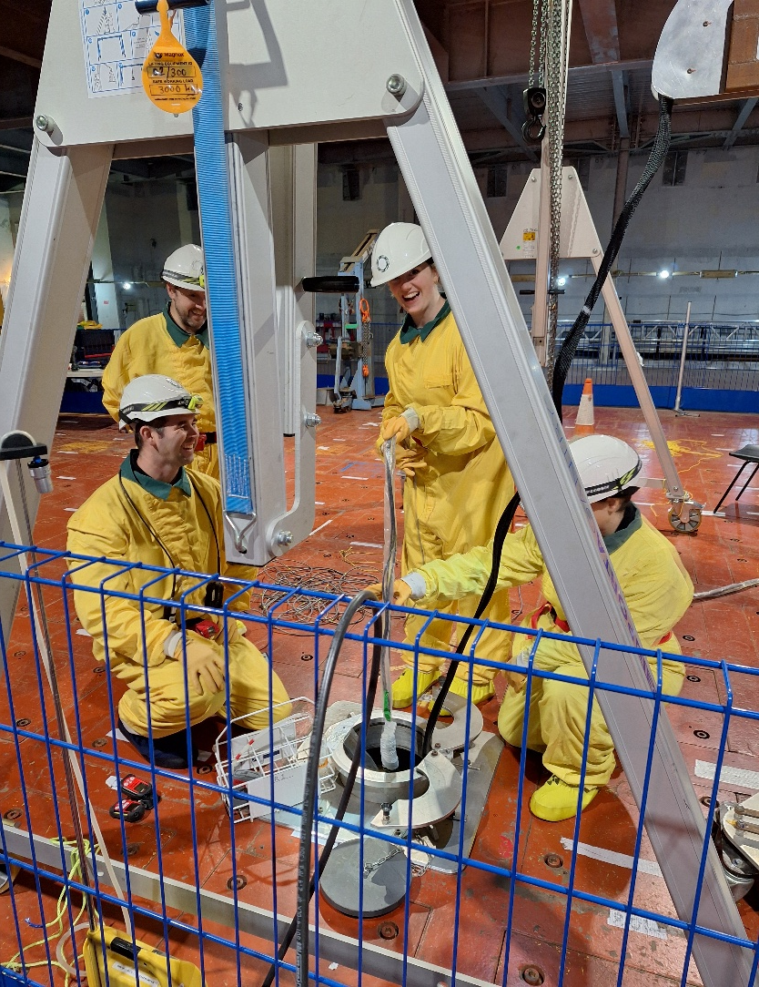
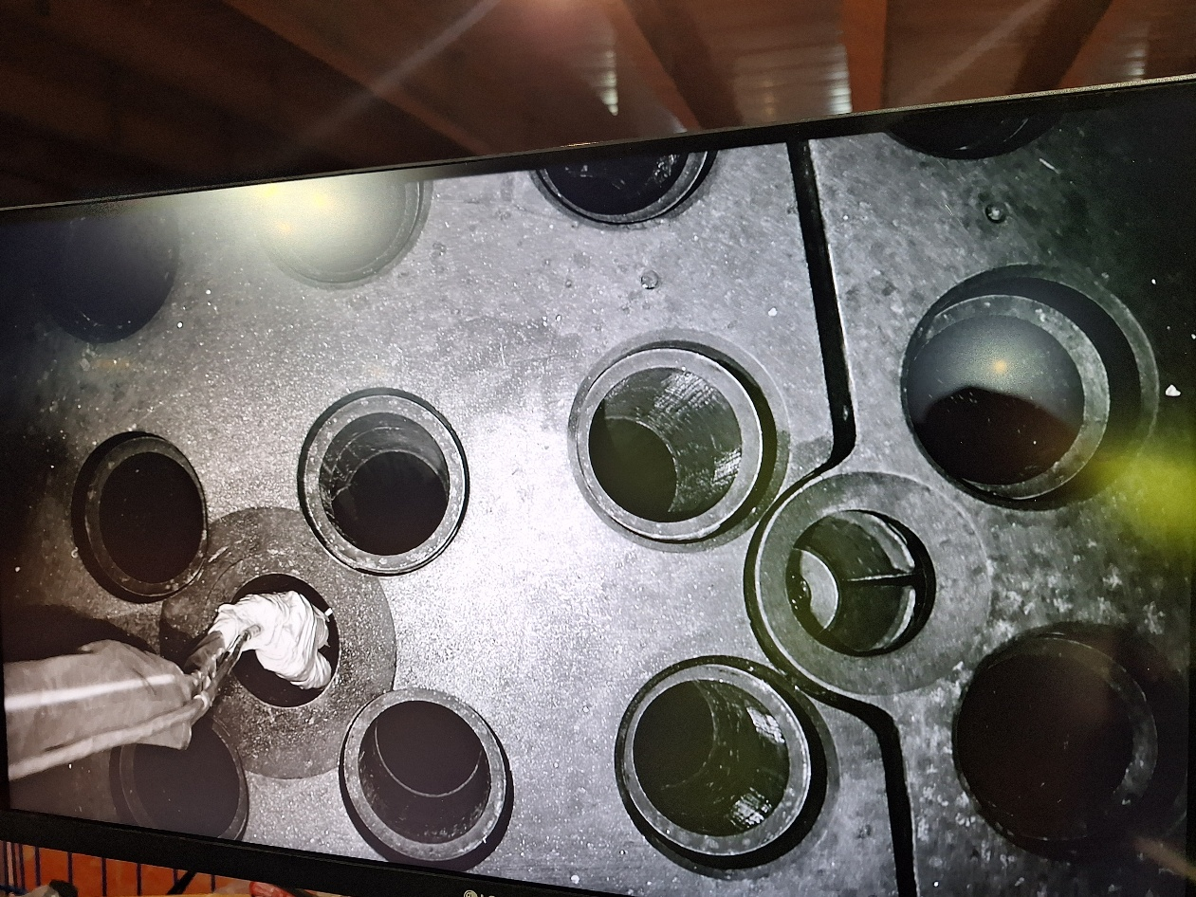
Trawsfynydd Experiment
6
Notes:
Standpipes Q13 and H09 enclosures removed, C1 area establishes on site with relevant controls
Detector was secured to AMP100 (<3 tape) and lowered into the standpipe and into the X hole directly beneath the standpipe (as shown)
Distance from surface measured using taped intervals on cables and monitored via camera
Measurements taken every 0.25m going down the pipe

Slide 9
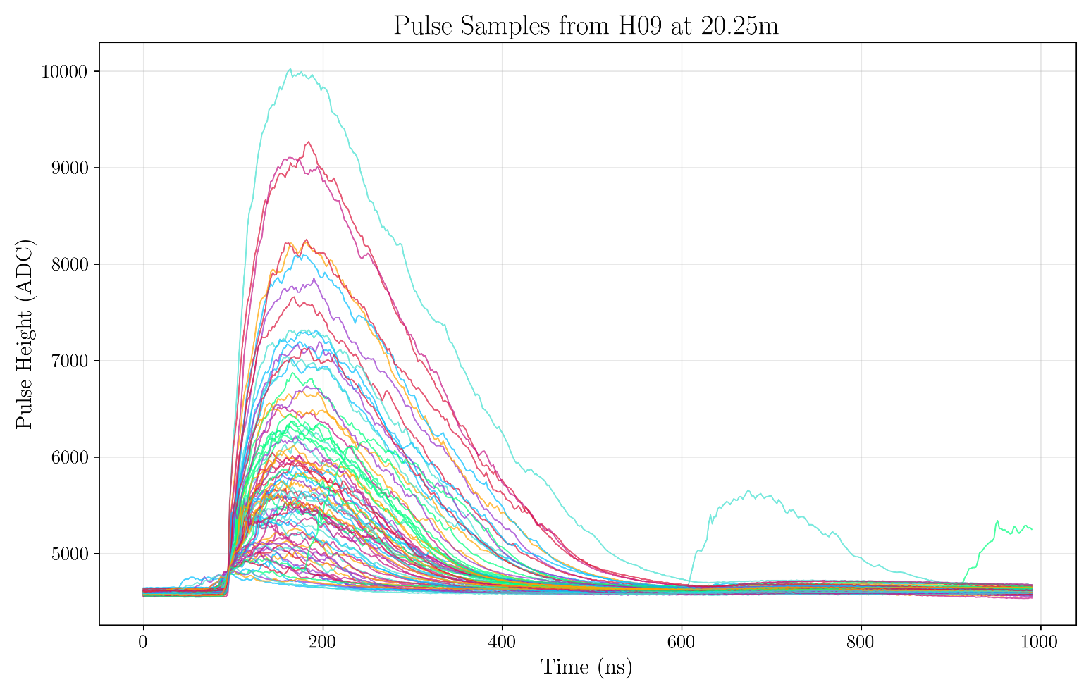
Results & Analysis
Isolating Scintillator Pulses
Scintillator pulses show clear and characteristic pulse shapes.
Expected SiPM artefacts (afterpulsing, crosstalk) and background noise are visible in the raw signals.
True scintillation pulses can be distinguished from false/artefact pulses using targeted windowing and pulse-shape selection based on:
  Skewness
  Kurtosis
  FWHM
  Rise/fall time
  Roughness
  Peak amplitude
  SNR
7
Notes:
RT = 10% peak -> 90% peak; FT opposite
Skewness = measure of asymmetry, third standardized moment
Kurtosis = measure of tailedness, fourth standardized moment
Roughness = jaggyness, second derivative
SNR = signal to noise ratio (noise estimated by baseline
FWHM = full width at half maximum height

Slide 10
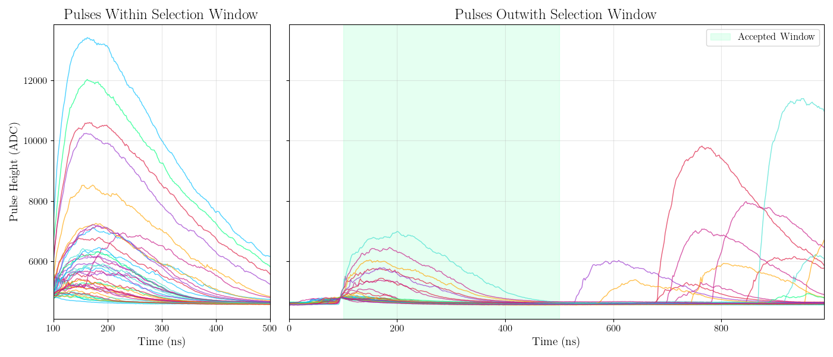
Results & Analysis
8
Notes:
Time window 100-500ns based on scintillator characteristics (400ns window from rising edge)
Cuts afterpulsing

Slide 11
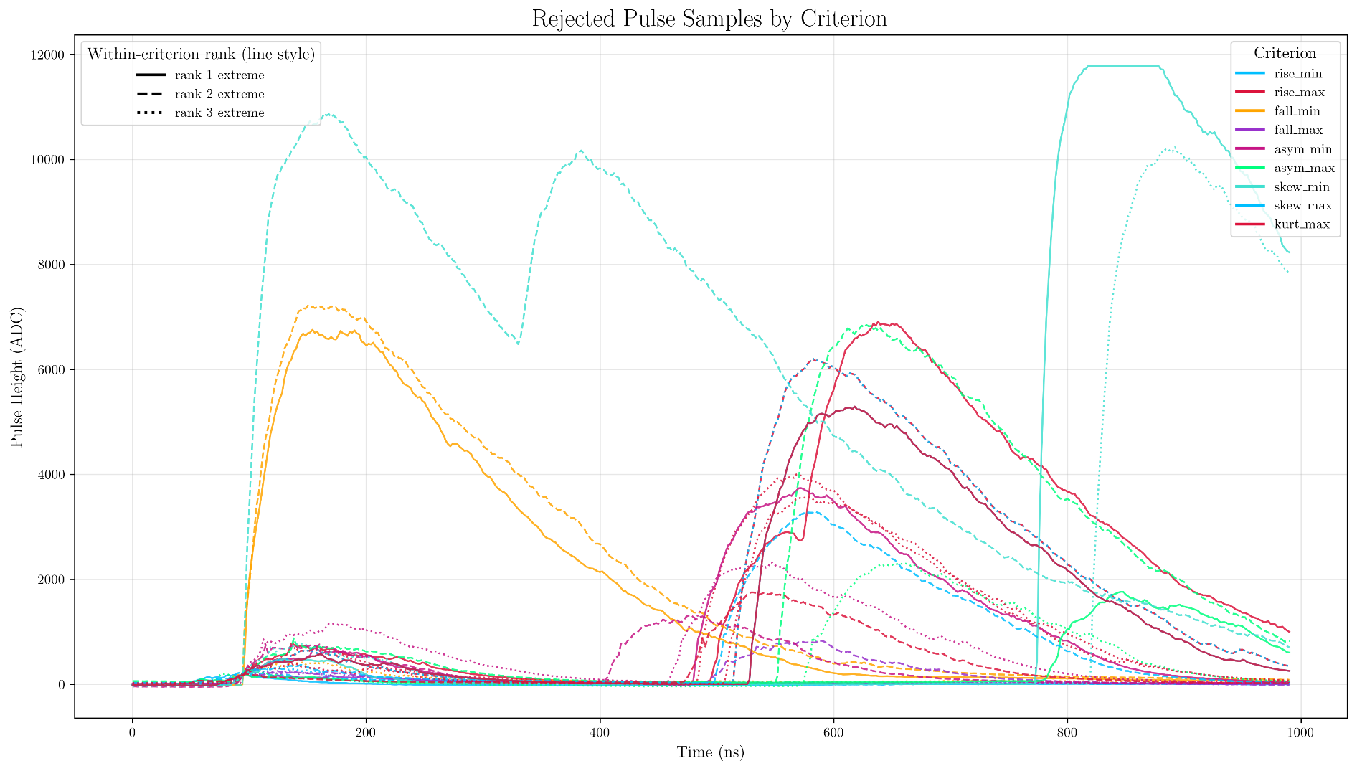
Results & Analysis
9
Notes:
More shape/timing cuts
Can see a lot of afterpulsing is removed in this way – many pulses are rejected on multiple fronts, so the thresholds are probably overly comprehensive (but not particularly computationally difficult so may as well go for it)
Some double pulsing also removed (crosstalk/degradation of signal)
Lots of low amplitude noisy stuff from the cables

Slide 12
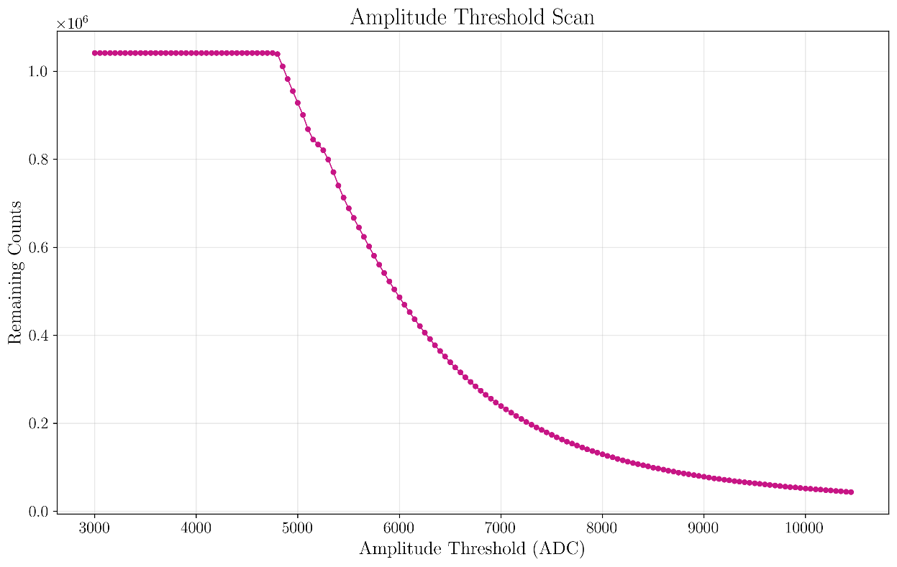
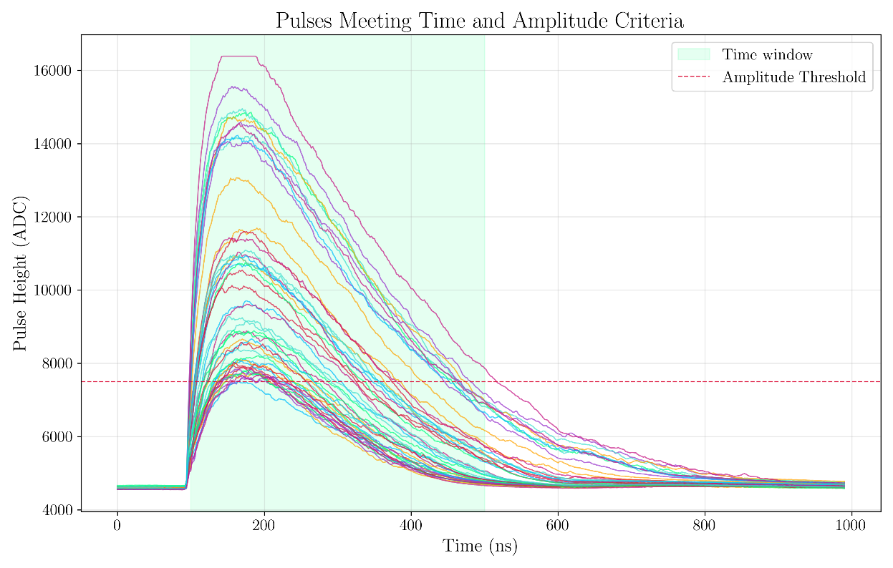
Results & Analysis
10
Notes:
- Amplitude threshold dynamically changed and plotted to identify where it ‘knees’ – this is where we get out of the dense low amplitude region and into region with fewer events per ADC
bin, likely more representative of scintillation pulses.
- Resulting filtered pulses are looking a bit more like we would expect

Slide 13
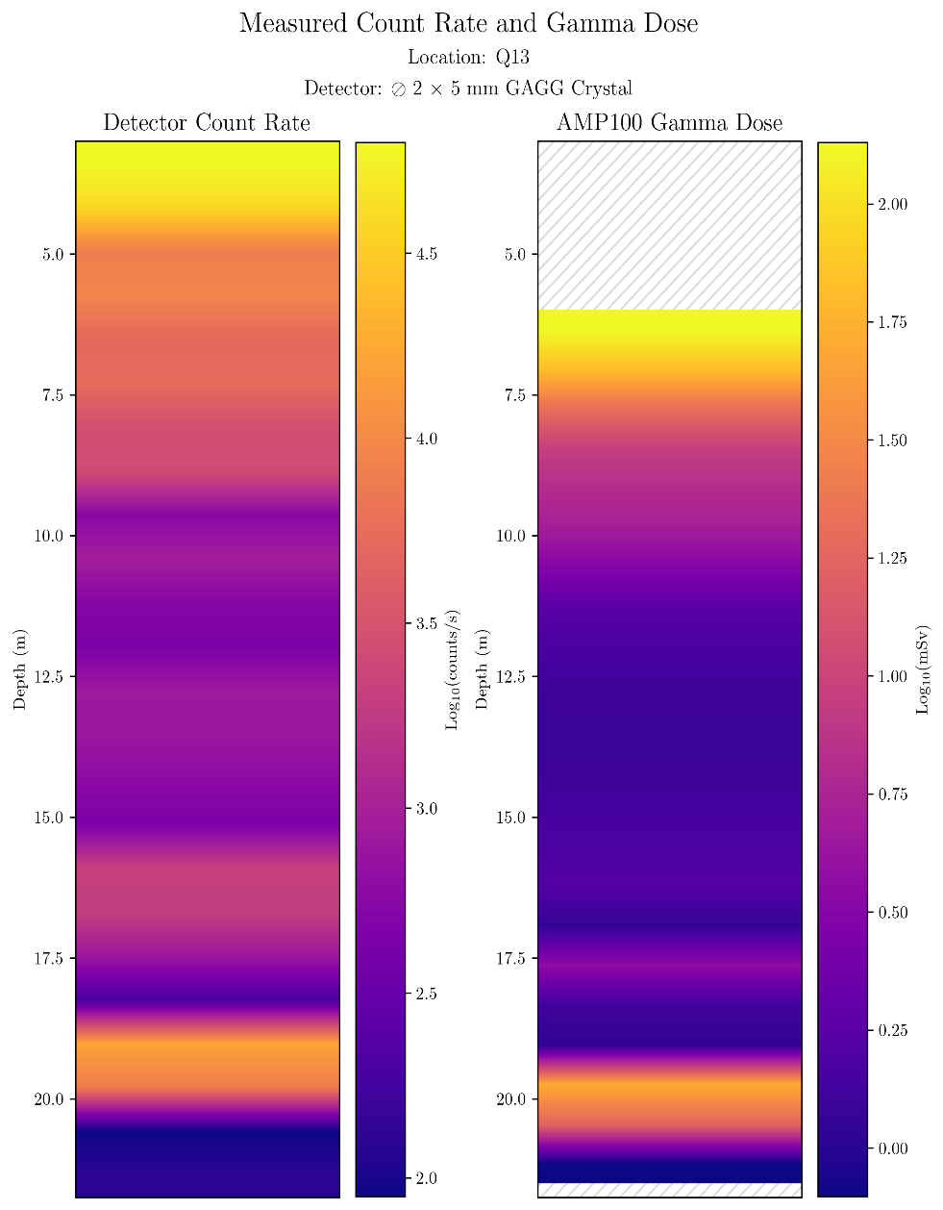
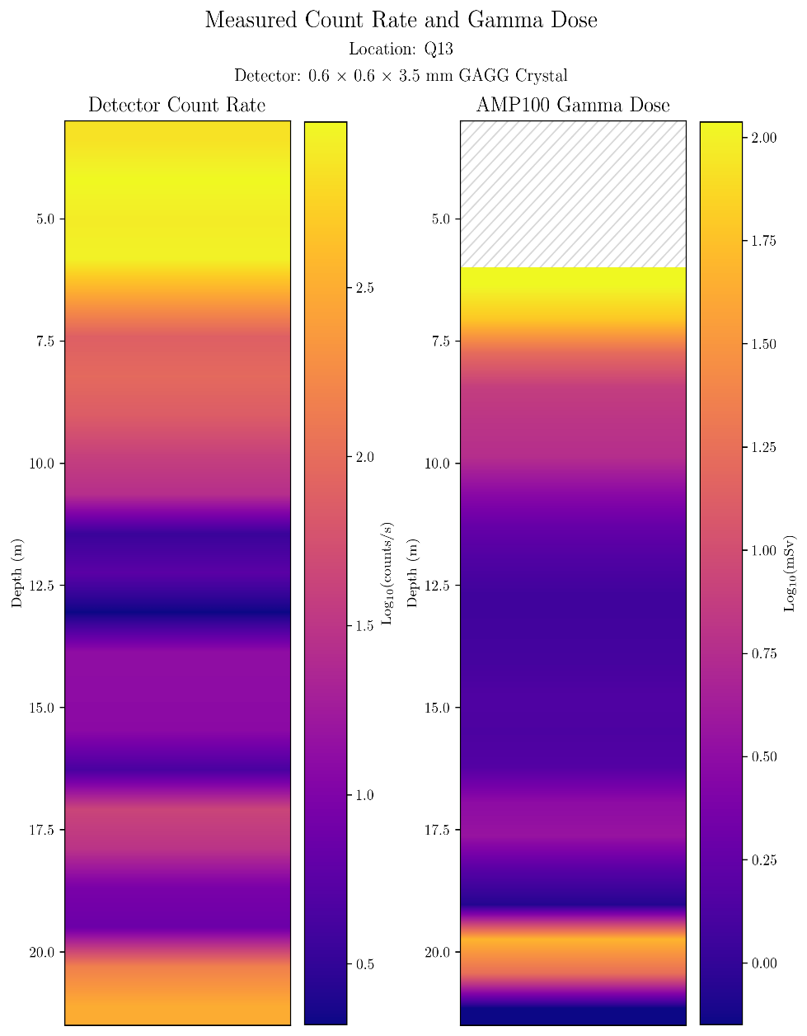
Results & Analysis
]
11
Notes:
Count rate graphs going down the channel with large (left) and small (right) crystal, alongside gamma measurement.
Can see banding that roughly aligns, but more importantly also differences in the banding that may indicate stronger beta signal
Analysis of the spectra is required to ascertain exactly what is going on here

Slide 14
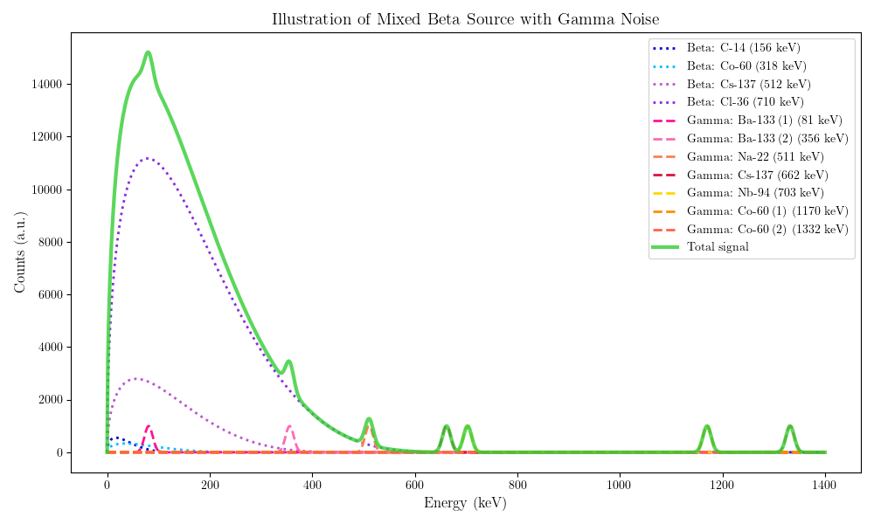
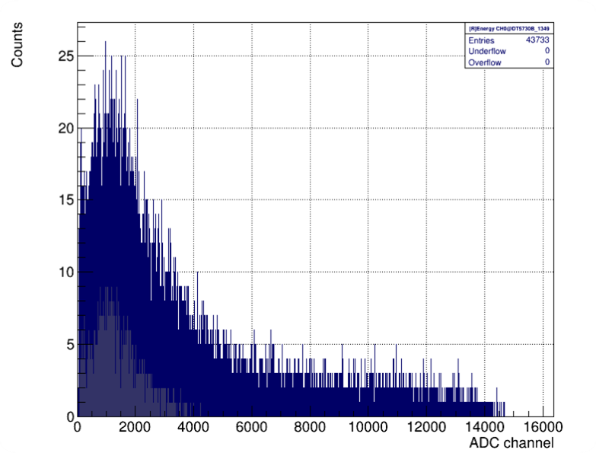
Results & Analysis
]
12
Notes:
Raw spectrum
Illustration of what is probably behind it

Slide 15
Results & Analysis
Spectral Analysis
Measured spectra contain a mixed signal with some weighting (β/γ, low/high energy)
Possible to isolate signals from individual sources using machine learning
  Simulate measured spectra with detector and a range of mixed sources
  Random source mixing, large dataset
  Apply neural network to identify percentage mixing of sources and gamma contamination
]
12
Notes:
How can we deconvolve this mixed spectrum into the component parts?
Simulated data in GEANT4, undergoing testing currently

Slide 16

Future Outlook
A soft-beta detector for characterizing irradiated graphite has been developed and tested in-situ at Trawsfynydd
Testing pathways have been established with NRS for future R&D interests
Data analysis shows:
  Presence of scintillator signals corresponding to radiation detection
  Count rate variations across channels, crystal size, and relative to gamma dose data
Future steps include:
  Enable conversion from counts to dose through targeted testing
  Expand energy spectrum analysis to identify isotopic markers
  Compare spectra to reference data from trepanning campaign
  Test third prototype against characterised irradiated graphite sources
Nia Hunter
n.hunter.1@research.gla.ac.uk

