Slide 1


Detecting water in spent nuclear fuel using the prompt neutron capture reaction on hydrogen
Brendan Green, Kartikey Mathur, Andrew Kennedy, Damilola Folley, Stephen Croft, David Hambley, Robert Mills and Malcolm Joyce
IOP Nuclear Physics Conference
Brighton

Slide 2
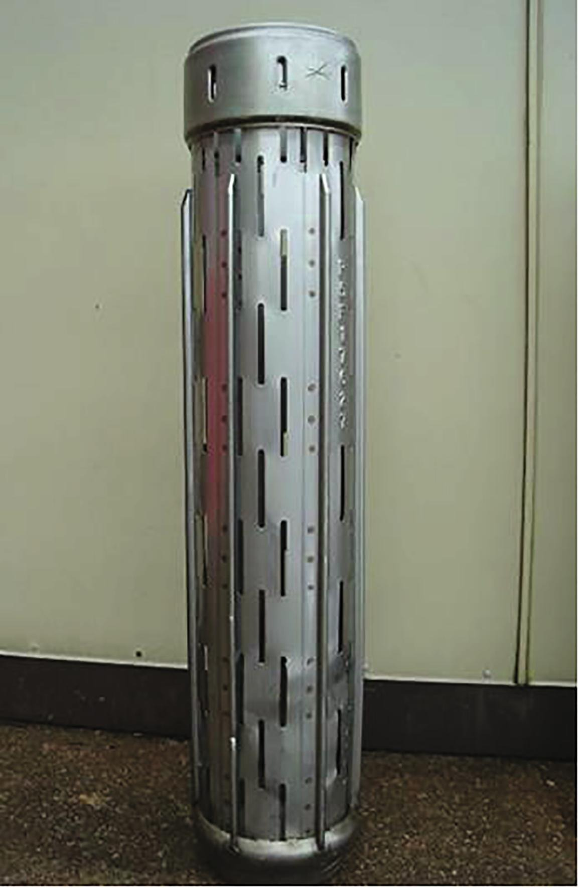
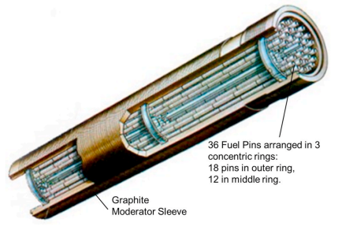
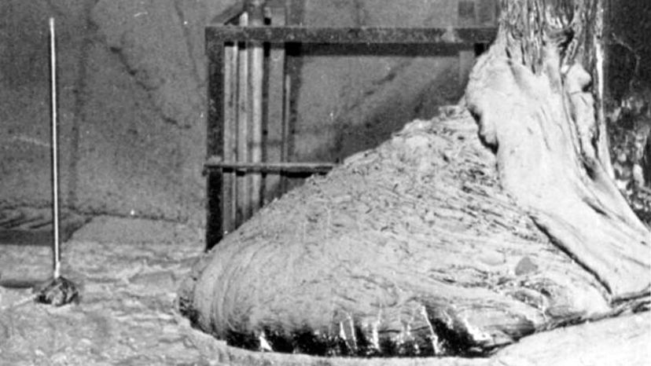
Background
Water in Spent Nuclear Fuel (SNF) is detrimental to long term storage stability
  Radiolysis and corrosion
  Criticality
The primary focus is the extensive spent fuel storage in the UK
Potential application to large fuel debris such as Chernobyl due to observed variations in neutron emissions
Images: Top Left – Cutaway of AGR fuel element (M. A. Barker, M. S. Adam, P. Little, R. Mills, S. Morgan, and F. E. Woodman, Progress in Nuclear Energy, vol. 153, p. 104433, 2022, doi: https://doi.org/10.1016/j.pnucene.2022.104433.) Top Right – Slotted AGR fuel can (G. Machin et al., Nuclear Engineering and Design, vol. 371, p. 110939, 2021, doi.org/10.1016/j.nucengdes.2020.110939), Bottom - Chernobyl ‘elephant’s' foot’ (T. Kitagaki, V. A. Krasnov, and A. Ikeda-Ohno, Journal of Nuclear Materials, vol. 576, p. 154224, 2023, doi: 10.1016/j.jnucmat.2022.154224.)

Slide 3
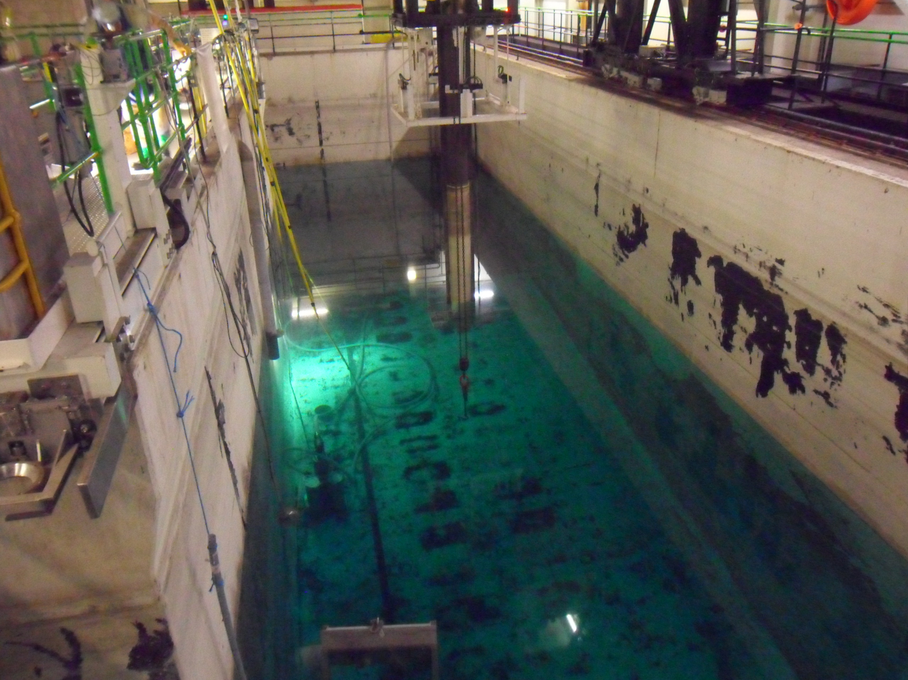
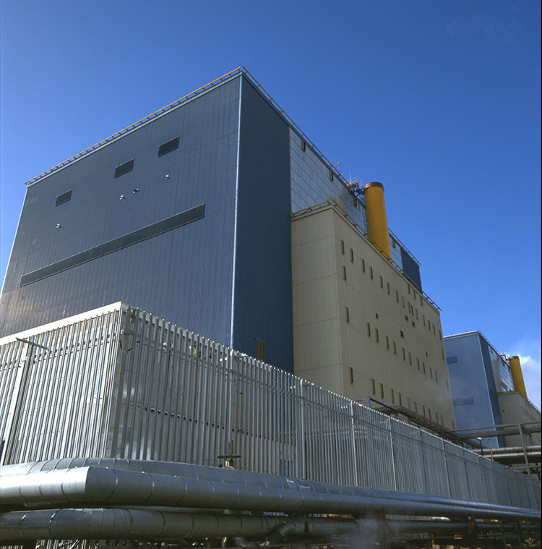
Scope of the issue
̴6000 tonnes of SNF in reactor or storage in the UK
  A further 770 tonnes to be produced by the current fleet
  Mostly advanced gas cooled reactor (AGR) fuel
New investment in UK nuclear exacerbates this issue
References: [1] NDA 2022 UK Radioactive Material Inventory, [2] Spent Nuclear Fuel and Reprocessing Waste Inventory, PNNL.
Images: Left – Hinkley point fuel pond draining (credit Magnox Ltd), Right – Hinkley Point B (credit UK NDA)

Slide 4
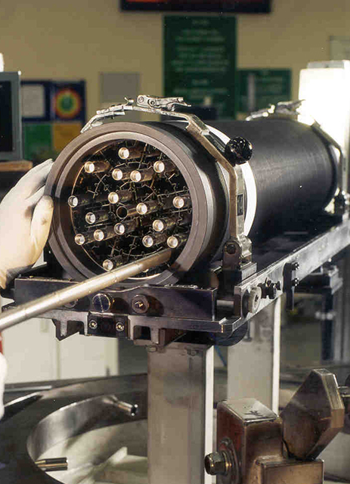
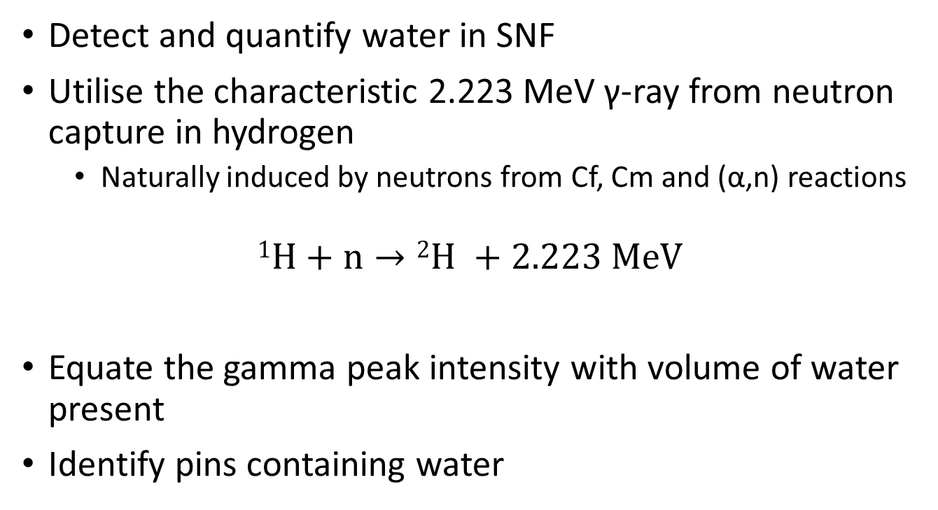
Project goals
Detect and quantify water in SNF
Utilise the characteristic 2.223 MeV γ-ray from neutron capture in hydrogen
  Naturally induced by neutrons from Cf, Cm and (α,n) reactions
$$1H+n→{2H}^{ }+2.223 MeV$$
Equate the gamma peak intensity with volume of water present
Identify pins containing water
Image: AGR fuel assembly being loaded with fuel pins (credit UK NDA)
Reference: [3] C. Binnersley et al., Progress in Nuclear Energy, vol. 145, p. 104110, 2022, doi: 10.1016/j.pnucene.2021.104110.,

Slide 5
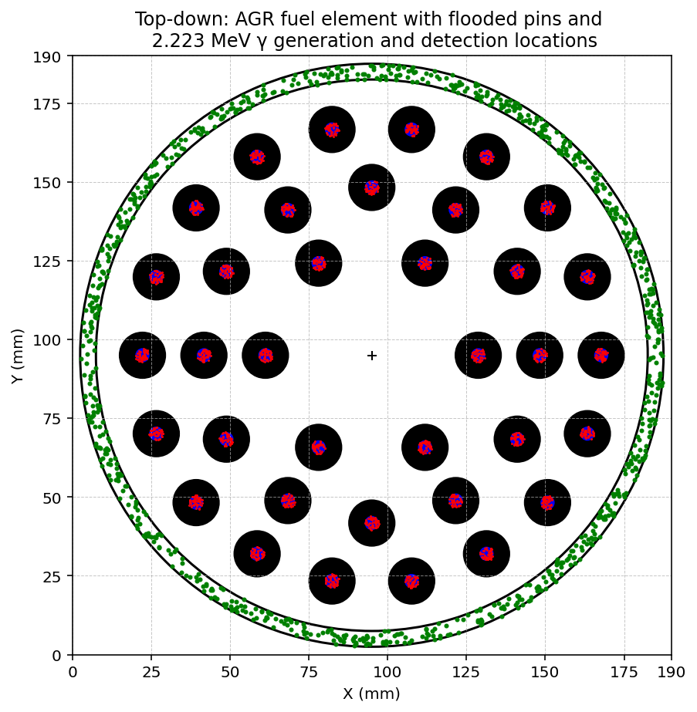
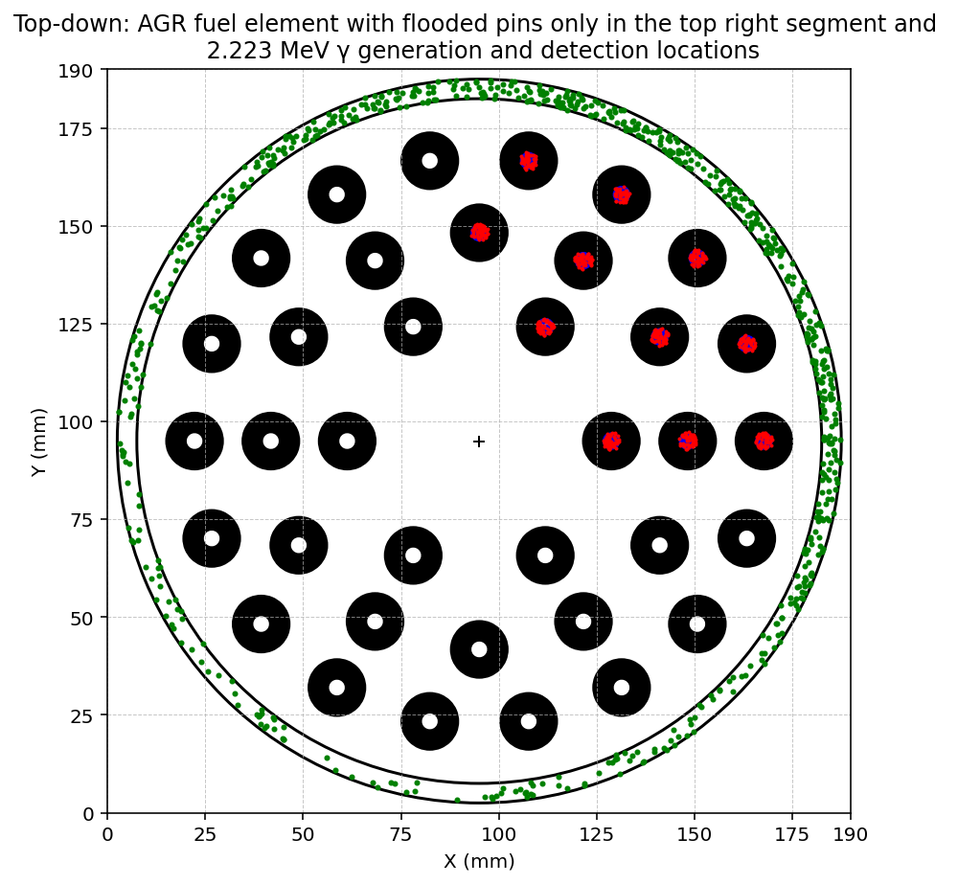
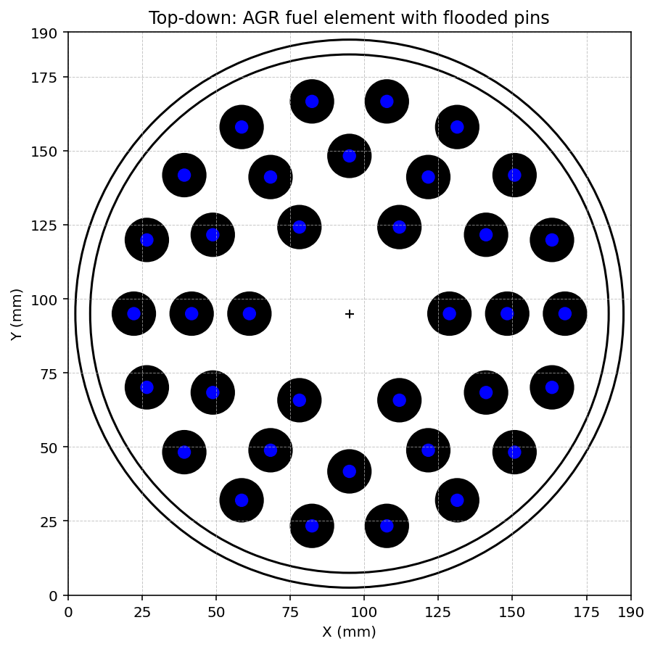
Simulated detection of water within fuel pins
Initial basic simulations using a solid continuous detector volume
(n,γ) capture reactions in hydrogen were recorded
Legend: Black = SNF, blue = waterlogged pins, red = generated 2.2 MeV γ, green = recorded 2.2 MeV γ

Slide 6
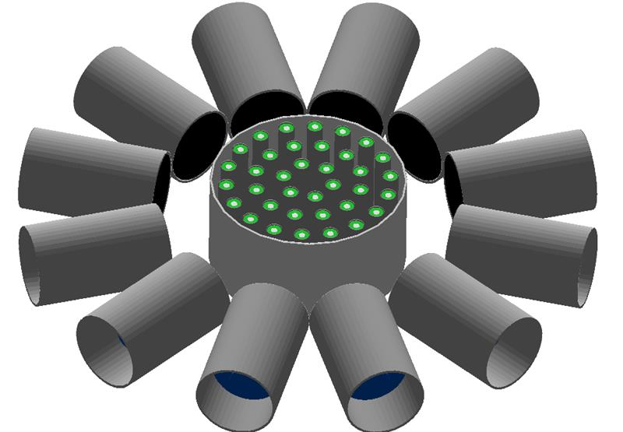
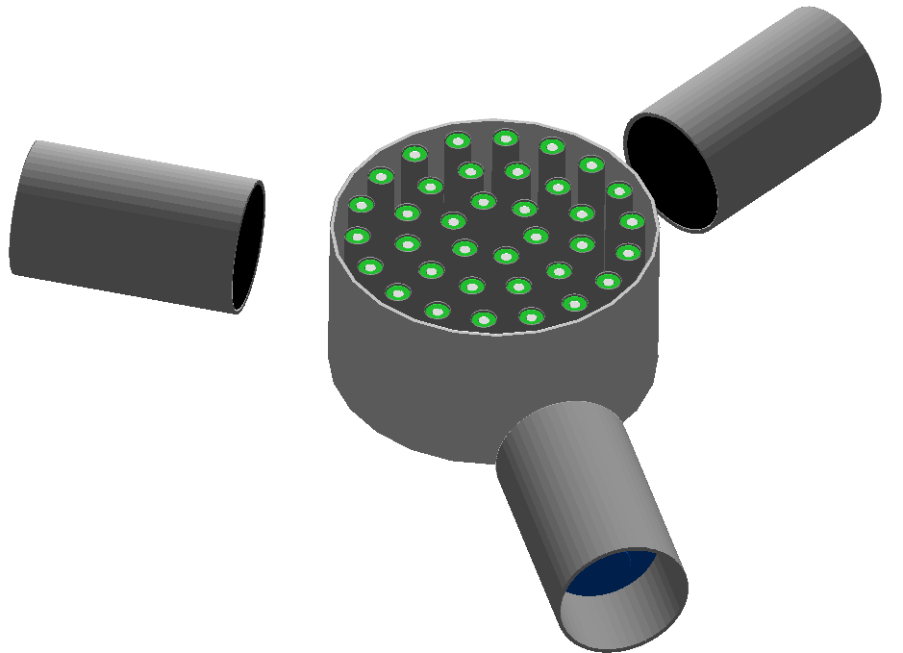
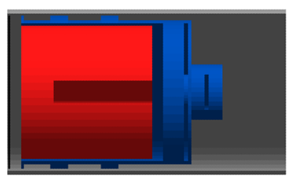
Simulations
Simulations run in GEANT4
Modelling the real reverse electrode germanium (REGe) that have been used experimentally
2.223 MeV γ source to speed up simulations
12 detectors
  Measure a 360º spectrum while only running the simulation once
  Risk of scattering between detectors
3 detectors
  More measurements to get 360º picture
  Closer to experimental setup
The two different simulated detector arrangements
Cross section of REGe detector. The crystal (red) is held by an aluminium holder (blue) and both are encapsulated by an aluminium housing and carbon window.

Slide 7
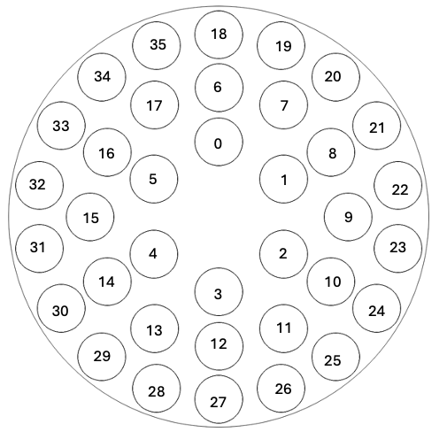
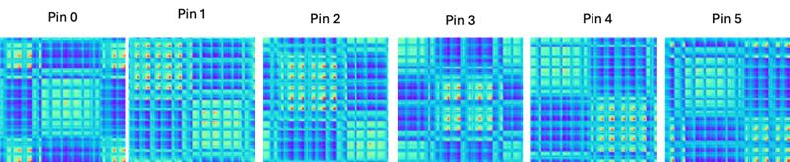
Machine learning model
Variation between spectra due to 2.223 MeV γ generation location is limited
Converting spectra to images allows them to be processed by a machine learning model
Markov Transition Field (MTF)
  Typically for encoding time series but in this case encodes an energy spectrum
  Preserves temporal transition dynamics

Slide 8
Machine learning model
Once the model had undergone some training, test spectra were generated.
The gamma source was varied in volume and the number of γ-rays simulated was varied.
Predicted pin | Actual Pin | Flooding length (cm) | No. of events
0 | 0 | 5 | 700k
4 | 4 | 4 | 900k
5 | 9 | 5 | 900k
13 | 12 | 3 | 1M
25 | 13 | 5 | 900k
29 | 20 | 3 | 800k
30 | 31 | 5 | 700k
35 | 35 | 4 | 1M

Slide 9
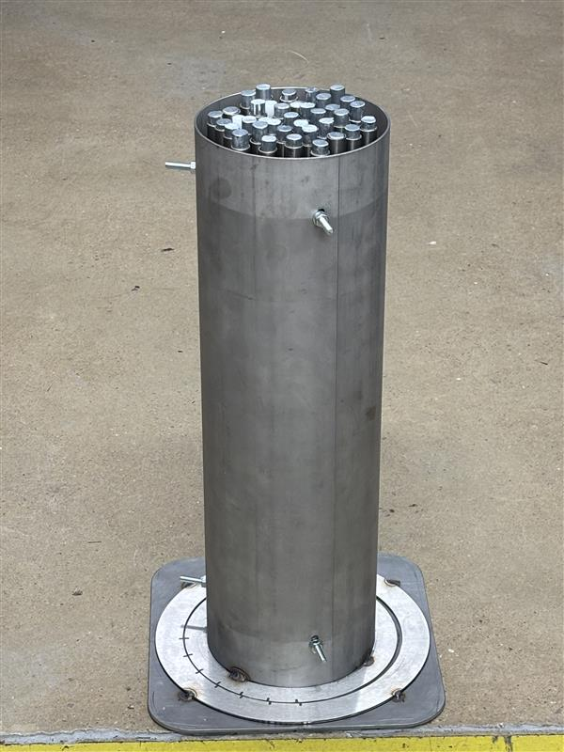
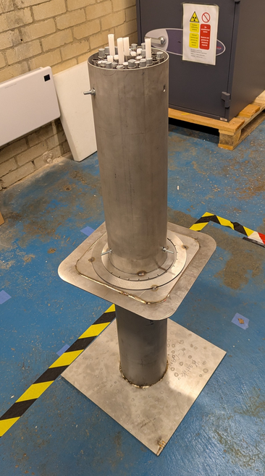
Experimental work – mock slotted can
A mock slotted has been manufactured
  Initial arrangement uses only one AGR fuel element worth of rods
  Provides a regular, symmetrical arrangement of pins
  Ease of adjustment and allows correlation between “waterlogged” pin position and spectral response
  Simpler starting point than the real world

Slide 10
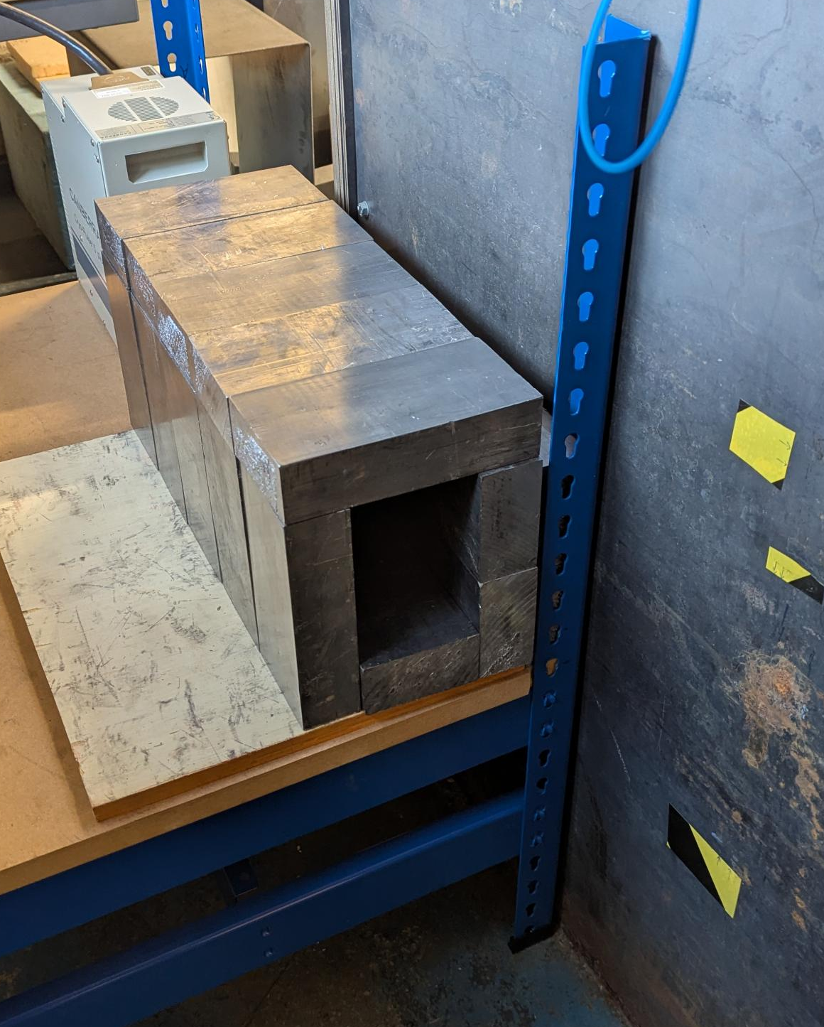
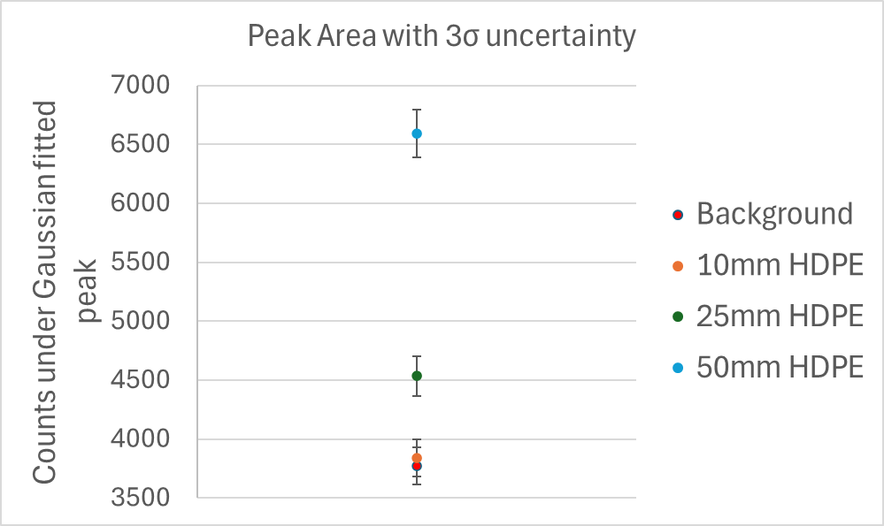
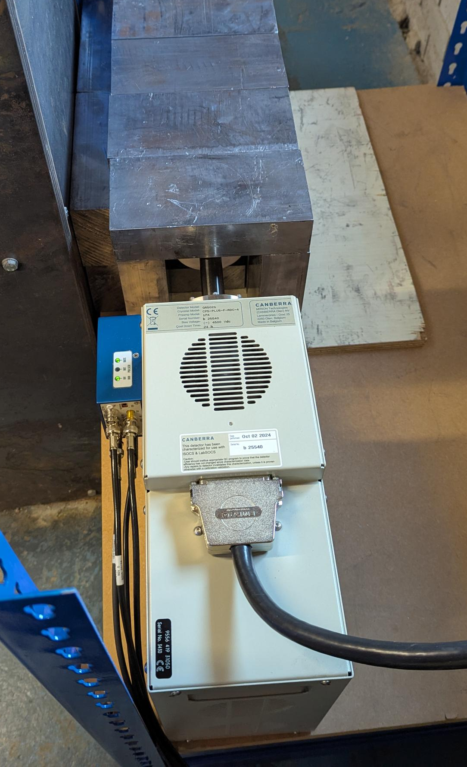
Experimental work – neutron source
²⁵²Cf neutron source surrounded by water and steel
Inherent need for detector shielding from activation in the tank
Good enough to distinguish blocks of HDPE
Active source position
Mechanically cooled REGe

Slide 11
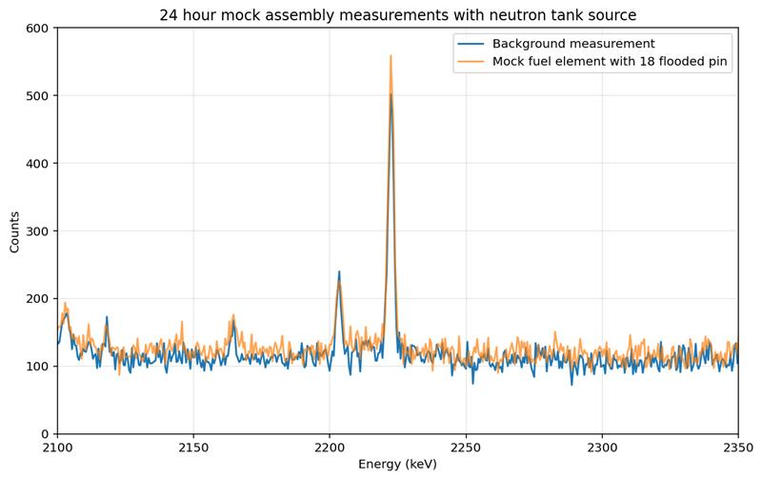
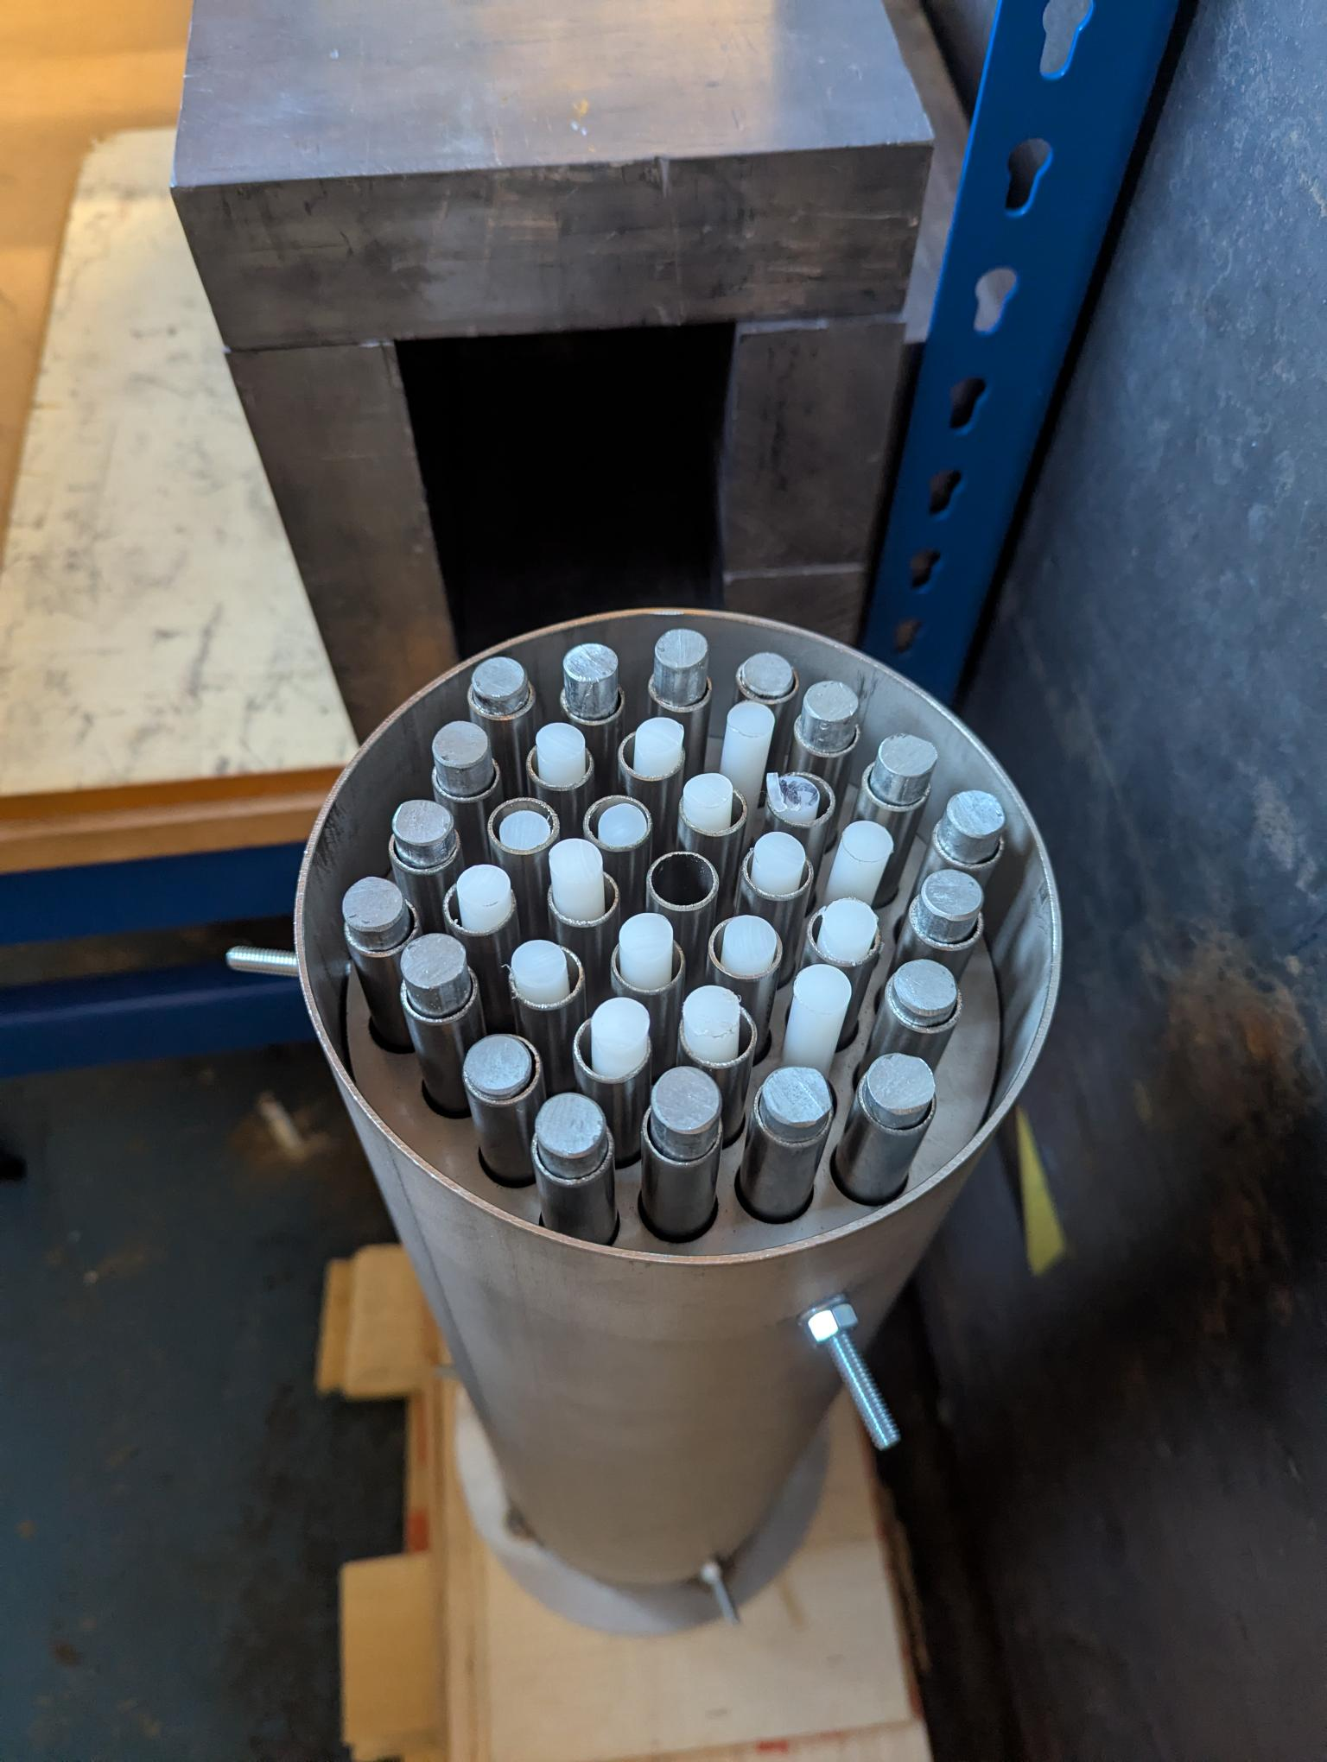
Experimental work – mock slotted can
Measurable difference between background and fuel element
Indistinguishable for trace quantities or even single flooded pins
Counting time should be reduced
 | Background measurement | Slotted can measurement
Peak value | 502 | 559
Peak area | 1912 | 2130

Slide 12
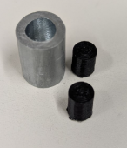
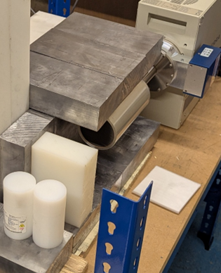
New neutron sources
No inherent shielding or moderation
  Therefore, no interference from external 2.223 MeV γ-rays
To be placed inside the mock fuel element
A limited number of HDPE rods will be used
Zinc holder for source capsules
Mock source capsules

Slide 13
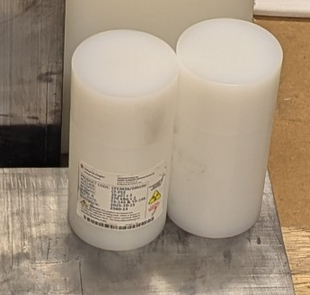
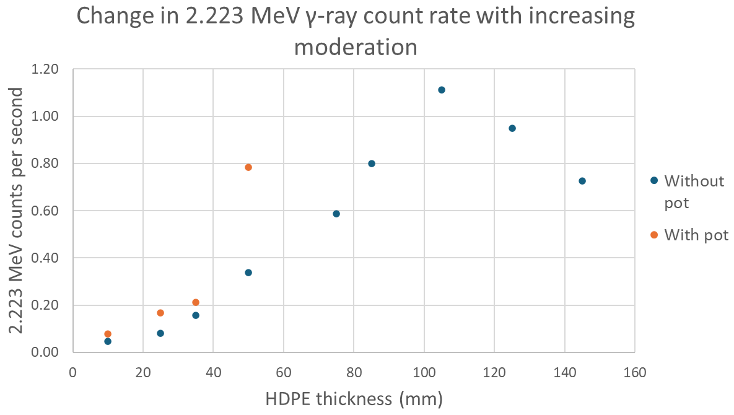
New neutron sources – moderation effects
Non-linearity between quantity of hydrogen and the 2.223 MeV γ-ray peak.
When ²⁵²Cf sources were left in their HDPE container, there was a significant increase in the 2.223 MeV γ peak.
The challenge is to understand the thermalisation effect of the assembly prior to neutron interaction with the water
HDPE pots, each containing 2x 370 kBq ²⁵²Cf sources. Approximately 10 mm wall thickness.

Slide 14
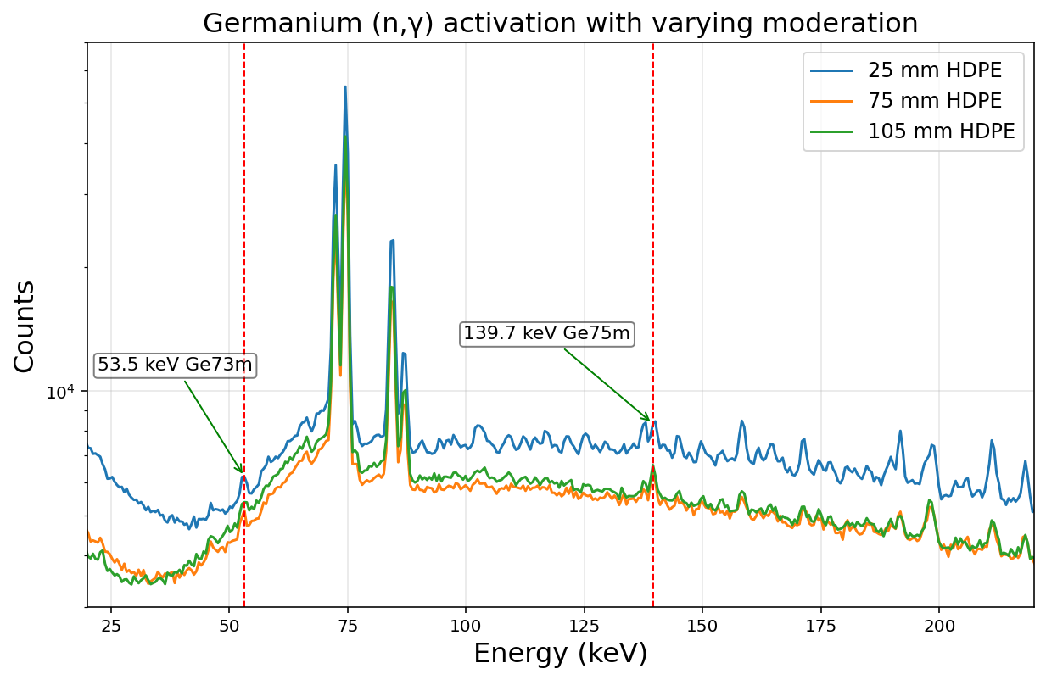
Detector shielding challenge
Limit neutrons incident on the detector
Prompt germanium peaks are a good reference to determine efficacy of detector shielding
Utilising graphite to scatter and thermalise neutrons

Slide 15
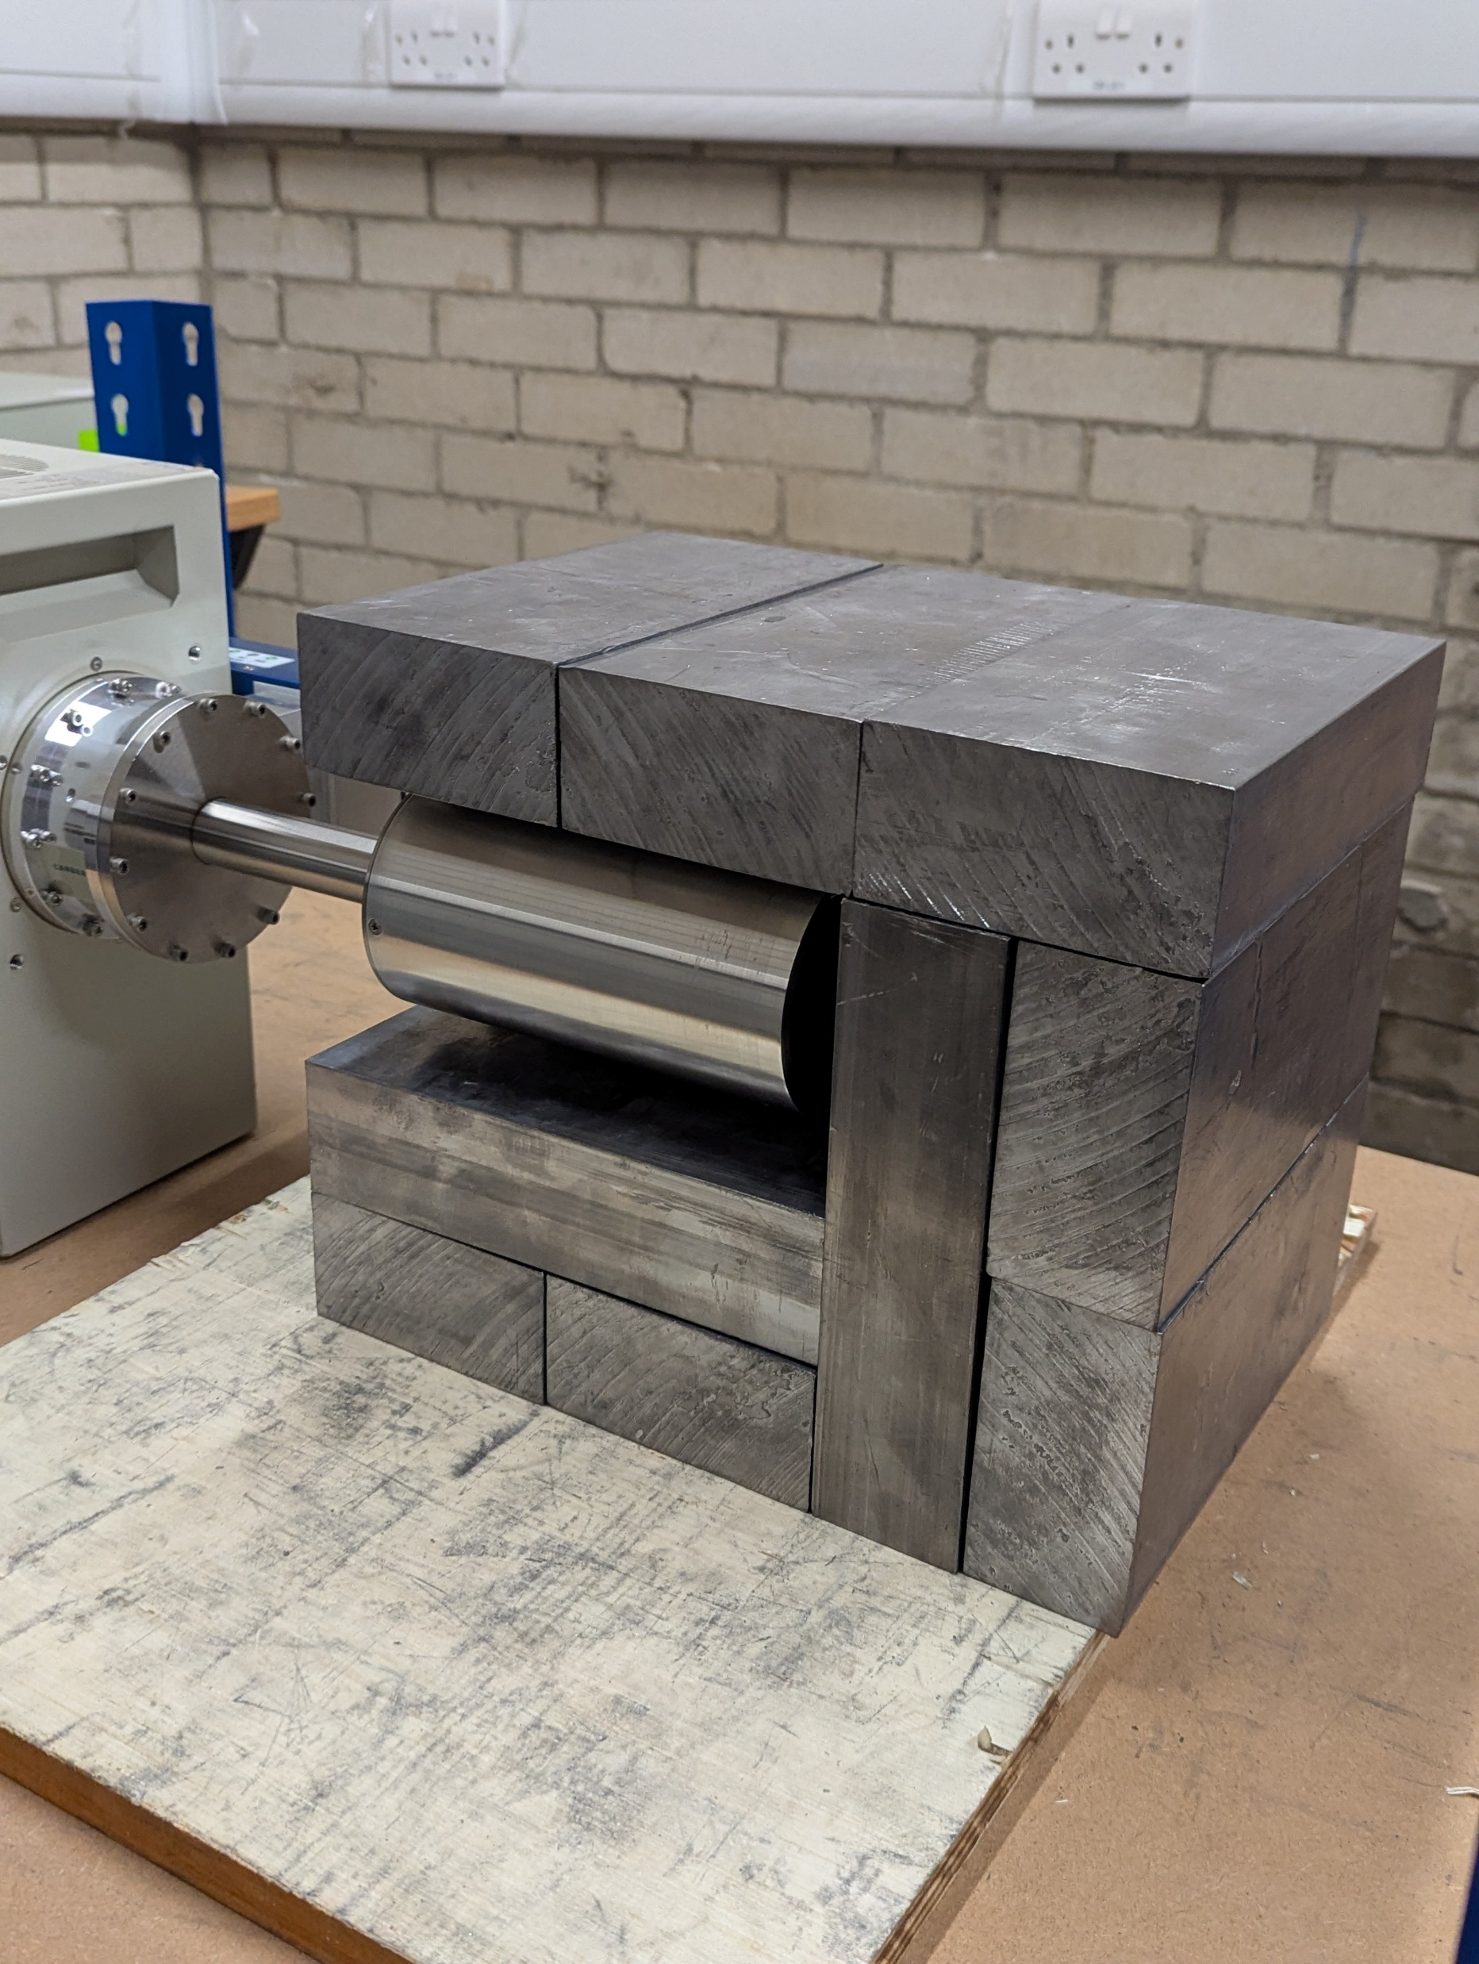
Current and future work
Further development of machine learning model to improve accuracy and reliability.
Reintroduction of neutron source term in simulations with the assistance of variance reduction methods.
Applying the machine learning model to real measurements.
Comparison to some real world spent fuel.

Slide 16
Thank you for listening
PhD kindly funded and supported by the NDA
Co-authors Kartikey Mathur, Andrew Kennedy and Damilola Folley funded by the UKRI under grant EP/X038327/1 “C-GANE”
Academic supervisors: Malcolm Joyce and Stephen Croft
Industrial supervisor: Robert Mills (UKNNL)

Slide 17
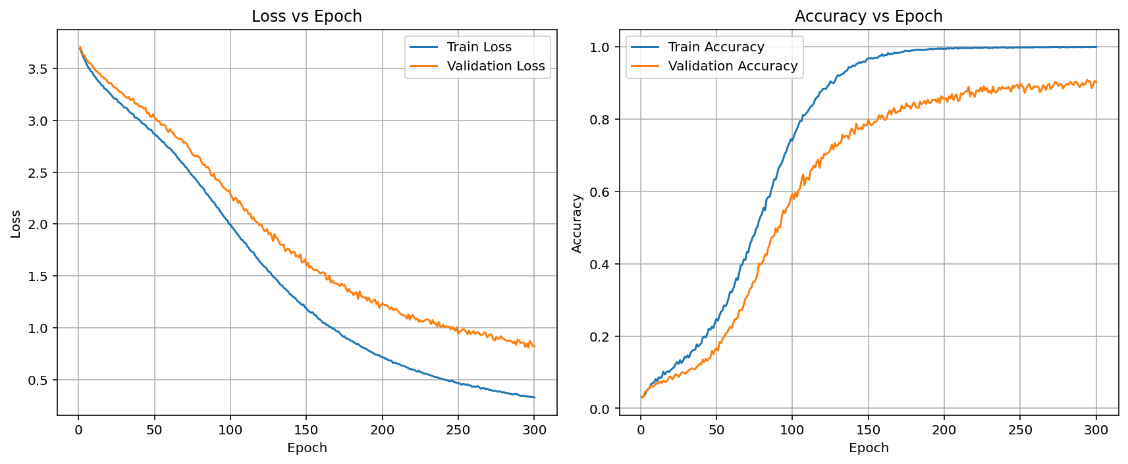
Appendix 1: Model Training

Slide 18
Appendix 2: Basic model parameters
Parameter | Value | Note(s)
Model | RESNET
Optimiser | Standard gradient descent | Takes learning rate and weight decay as inputs
Learning rate | 4 x 10⁻⁵
Weight decay | 1 x 10⁻³
Loss function criteria | Cross-entropy loss

