Slide 1
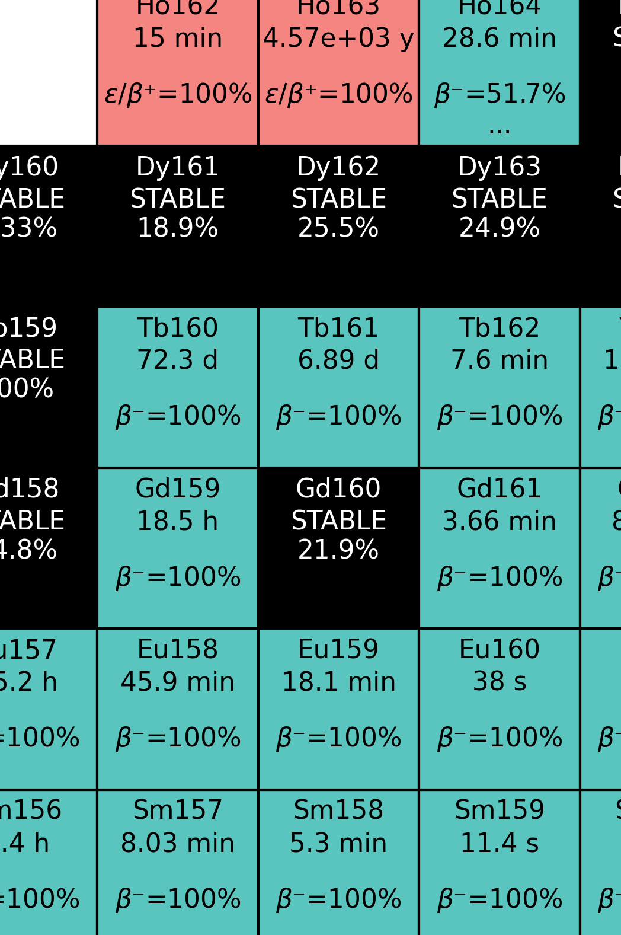

Optimisation of ¹⁶¹Tb Production at HF-ADNeF
Max Conroy
IOP Nuclear Physics Conference 2026
13/04/26
Contact: m.j.conroy@pgr.bham.ac.uk

Slide 2
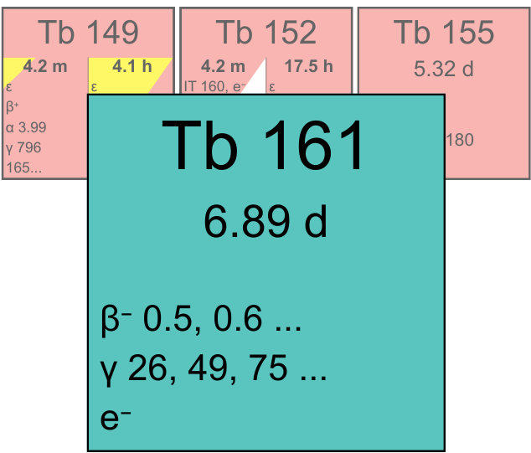
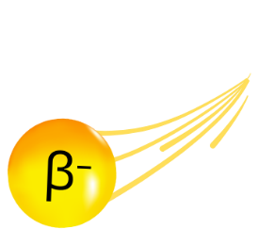
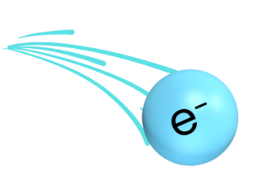
¹⁶¹Tb: a theranostic isotope
Key properties of ¹⁶¹Tb:
Therapeutic beta emission
Range ~300 μm
Large Auger component
Range <1 μm
75 keV gamma ray
Suitable for SPECT
Can be paired with other Tb isotopes for maximum theranostic potential.
γ
Notes:
Alpha, PET, SPECT
It is a promising, novel medical isotope (research studies it has been used in). First proposed for medical use in ...
Mainly a therapeutic isotope, due to high beta dose. When linked to a biologically relevant molecule, delivers dose to cancer cells locally.
Use case similar to 177Lu, suitable for prostate cancer treatment, particularly in cases of metastasis. Additional auger component deals extra damage to cancer, even more locally.
Finally, patient can be scanned during treatment to confirm localisation of dose, using 75 keV gamma - suitable for SPECT.
Another key reason for terbium-161's high potential is its synergy with other isotopes. Forms part of the Tb "quartet", along with 149, 152 and 155. (Research what these other isotopes are used for).
ADD DETAILS ON ENERGY AND RANGE OF BETA/AUGER

Slide 3
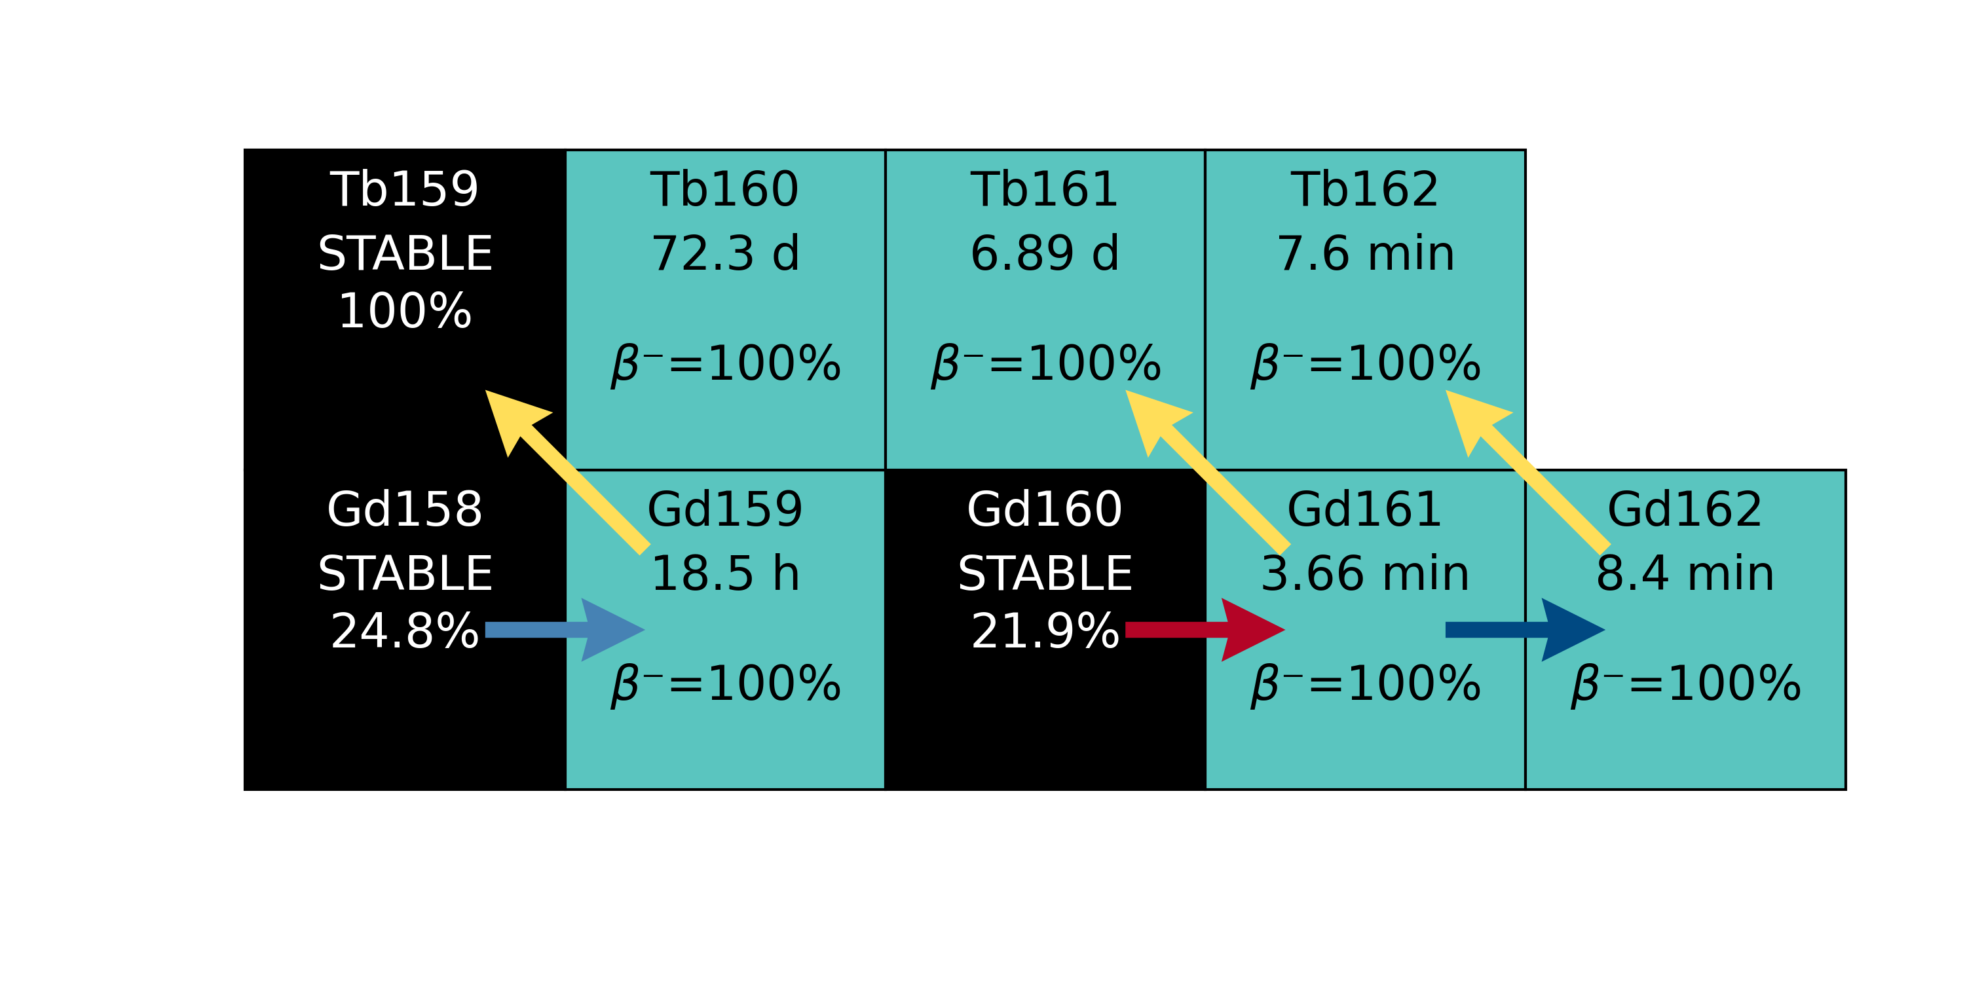
¹⁶¹Tb: a theranostic isotope
Production: ¹⁶⁰Gd(n,γ) followed by beta decay:
…
Notes:
Production is simple in theory, neutron activating 160Gd to form 161Gd, D decays to 161Tb with a 4 minute half life.
This would typically need to be done with an enriched Gd160 target, to prevent the production of Gd159, which decays to Tb159. Also, double activation of Gd161 can lead to some contamination.

Slide 4
¹⁶¹Tb: a theranostic isotope
Production: ¹⁶⁰Gd(n,γ) followed by beta decay:
Conventionally produced in nuclear research reactors.
…
Notes:
Conventionally, isotopes like these would be produced in nuclear research reactors.

Slide 5
¹⁶¹Tb: a theranostic isotope
Production: ¹⁶⁰Gd(n,γ) followed by beta decay:
Conventionally produced in nuclear research reactors.
Alternatively, could this isotope be produced on a smaller, local scale using accelerator-driven neutron sources?
…
Notes:
The question we are asking, is it feasible to produce 161Tb on a smaller, local scale, using accelerator-driven neutron sources instead?

Slide 6
¹⁶¹Tb: a theranostic isotope
Production: ¹⁶⁰Gd(n,γ) followed by beta decay:
Conventionally produced in nuclear research reactors.
Alternatively, could this isotope be produced on a smaller, local scale using accelerator-driven neutron sources?
…
Three main investigations:
Optimising ¹⁶¹Tb activity
Effect of enrichment on final product
Measure spectrum-averaged cross sections (SACS) of relevant reactions.
Notes:
This work has three main investigations:
Optimise 161Tb final activity at HF-ADNeF
Investigate the necessity for enrichment
Experimentally measure SACS for the relevant reactions

Slide 7
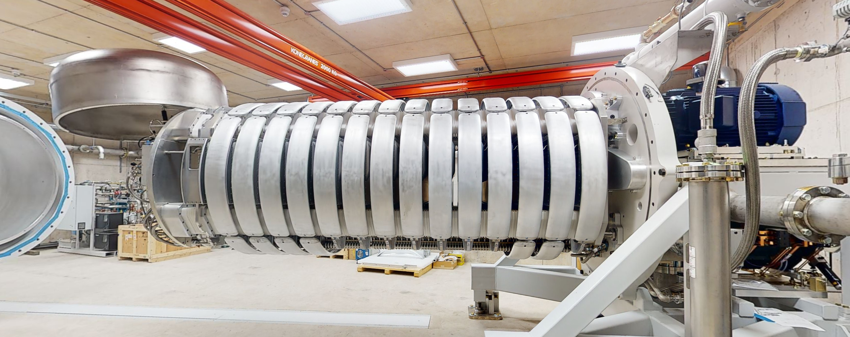
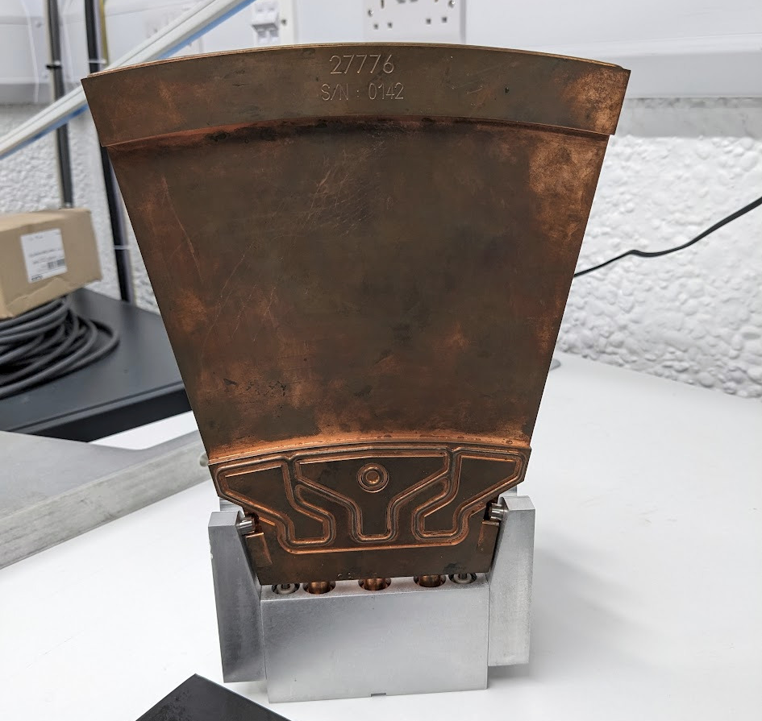
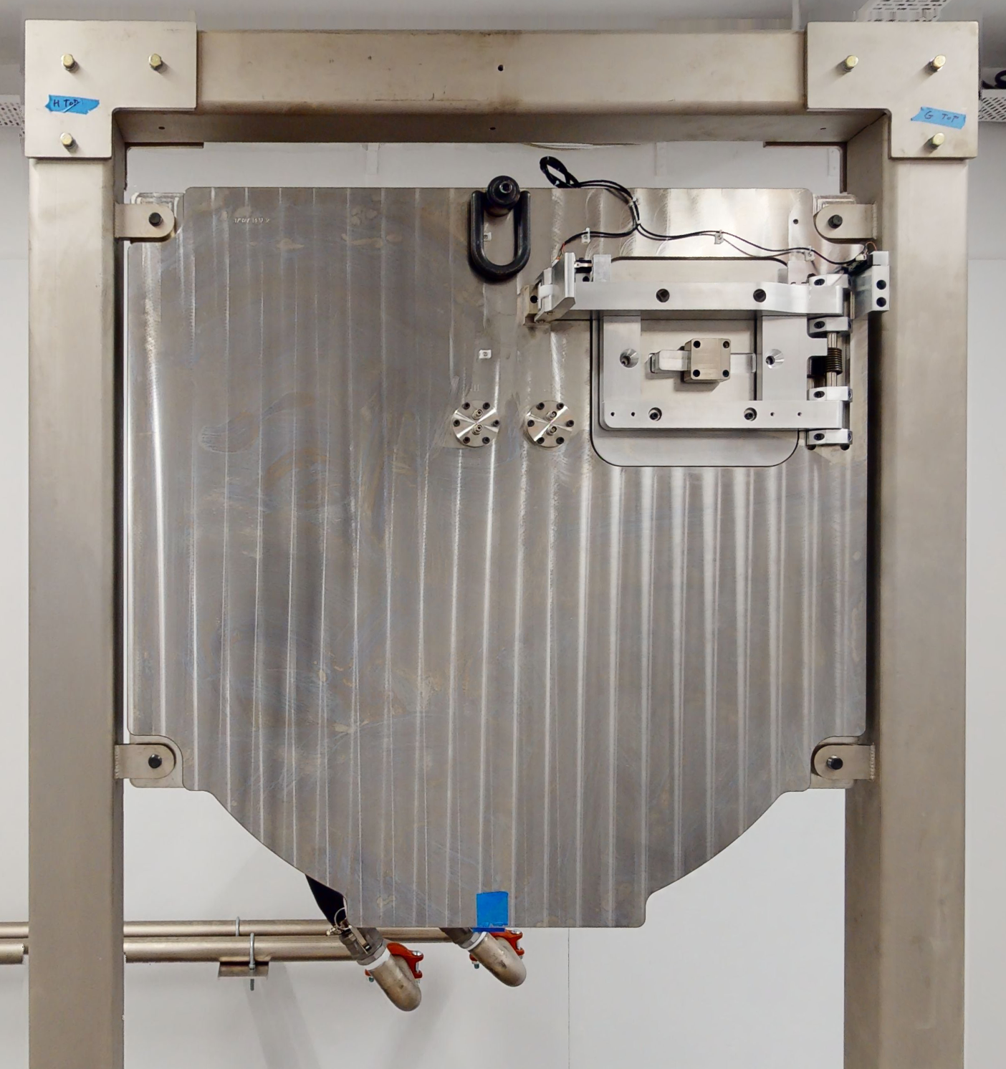
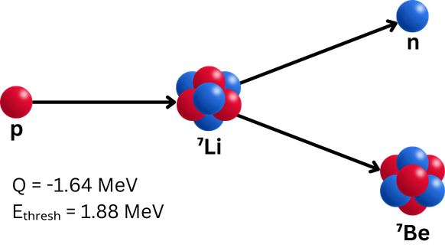
High Flux Accelerator-Driven Neutron Facility
Hyperion type linear accelerator, up to 2.6 MeV protons at currents > 30 mA.
Proton beam incident upon lithium target, formed of 16 rotating water-cooled petals.
Neutron flux > 10¹² n cm² s⁻¹.
1
~1 m
~13 cm
2
3
Notes:
UoB facility, consisting of a 2.6 MV electrostatic accelerator, which accelerates protons onto a lithium target at currents > 30 mA.
Lithium is bonded to copper petals, which are water cooled and rotate to disperse the energy.
Neutrons are produced via the reaction shown here, and fluxes in excess of 10^12 can be acheived.

Slide 8

OpenMC Simulation
Created a custom neutron source term for OpenMC simulations.
Neutron spectra produced by source term:
Notes:
Unfortunately, there have been quite a few teething problems with the facility, so we have been without experimental facilities for 16 months.
Therefore, this work has mainly been through simulations.
A versitile simulation framework has been designed in OpenMC. This consists of a neutron source term, which samples from measured differential cross section data. This gives us a verifible distribution of neutrons produced in the lithium layer, which can be compared to current experimental data.

Slide 9
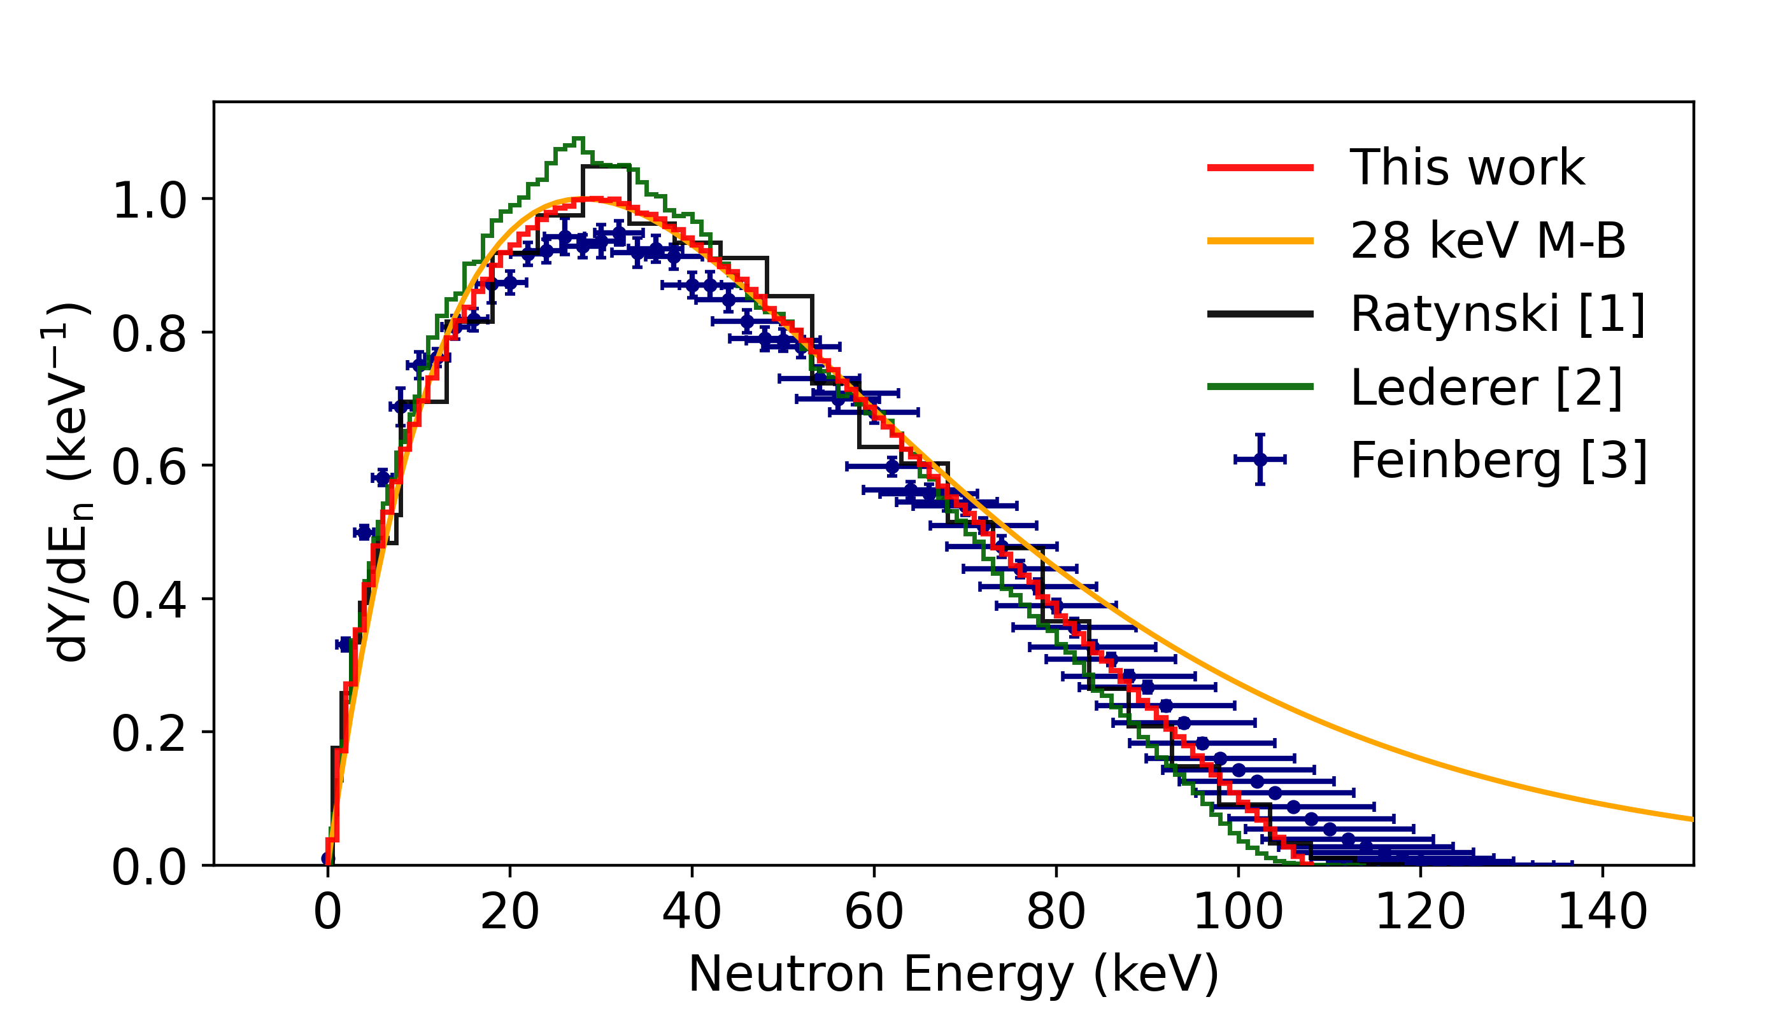
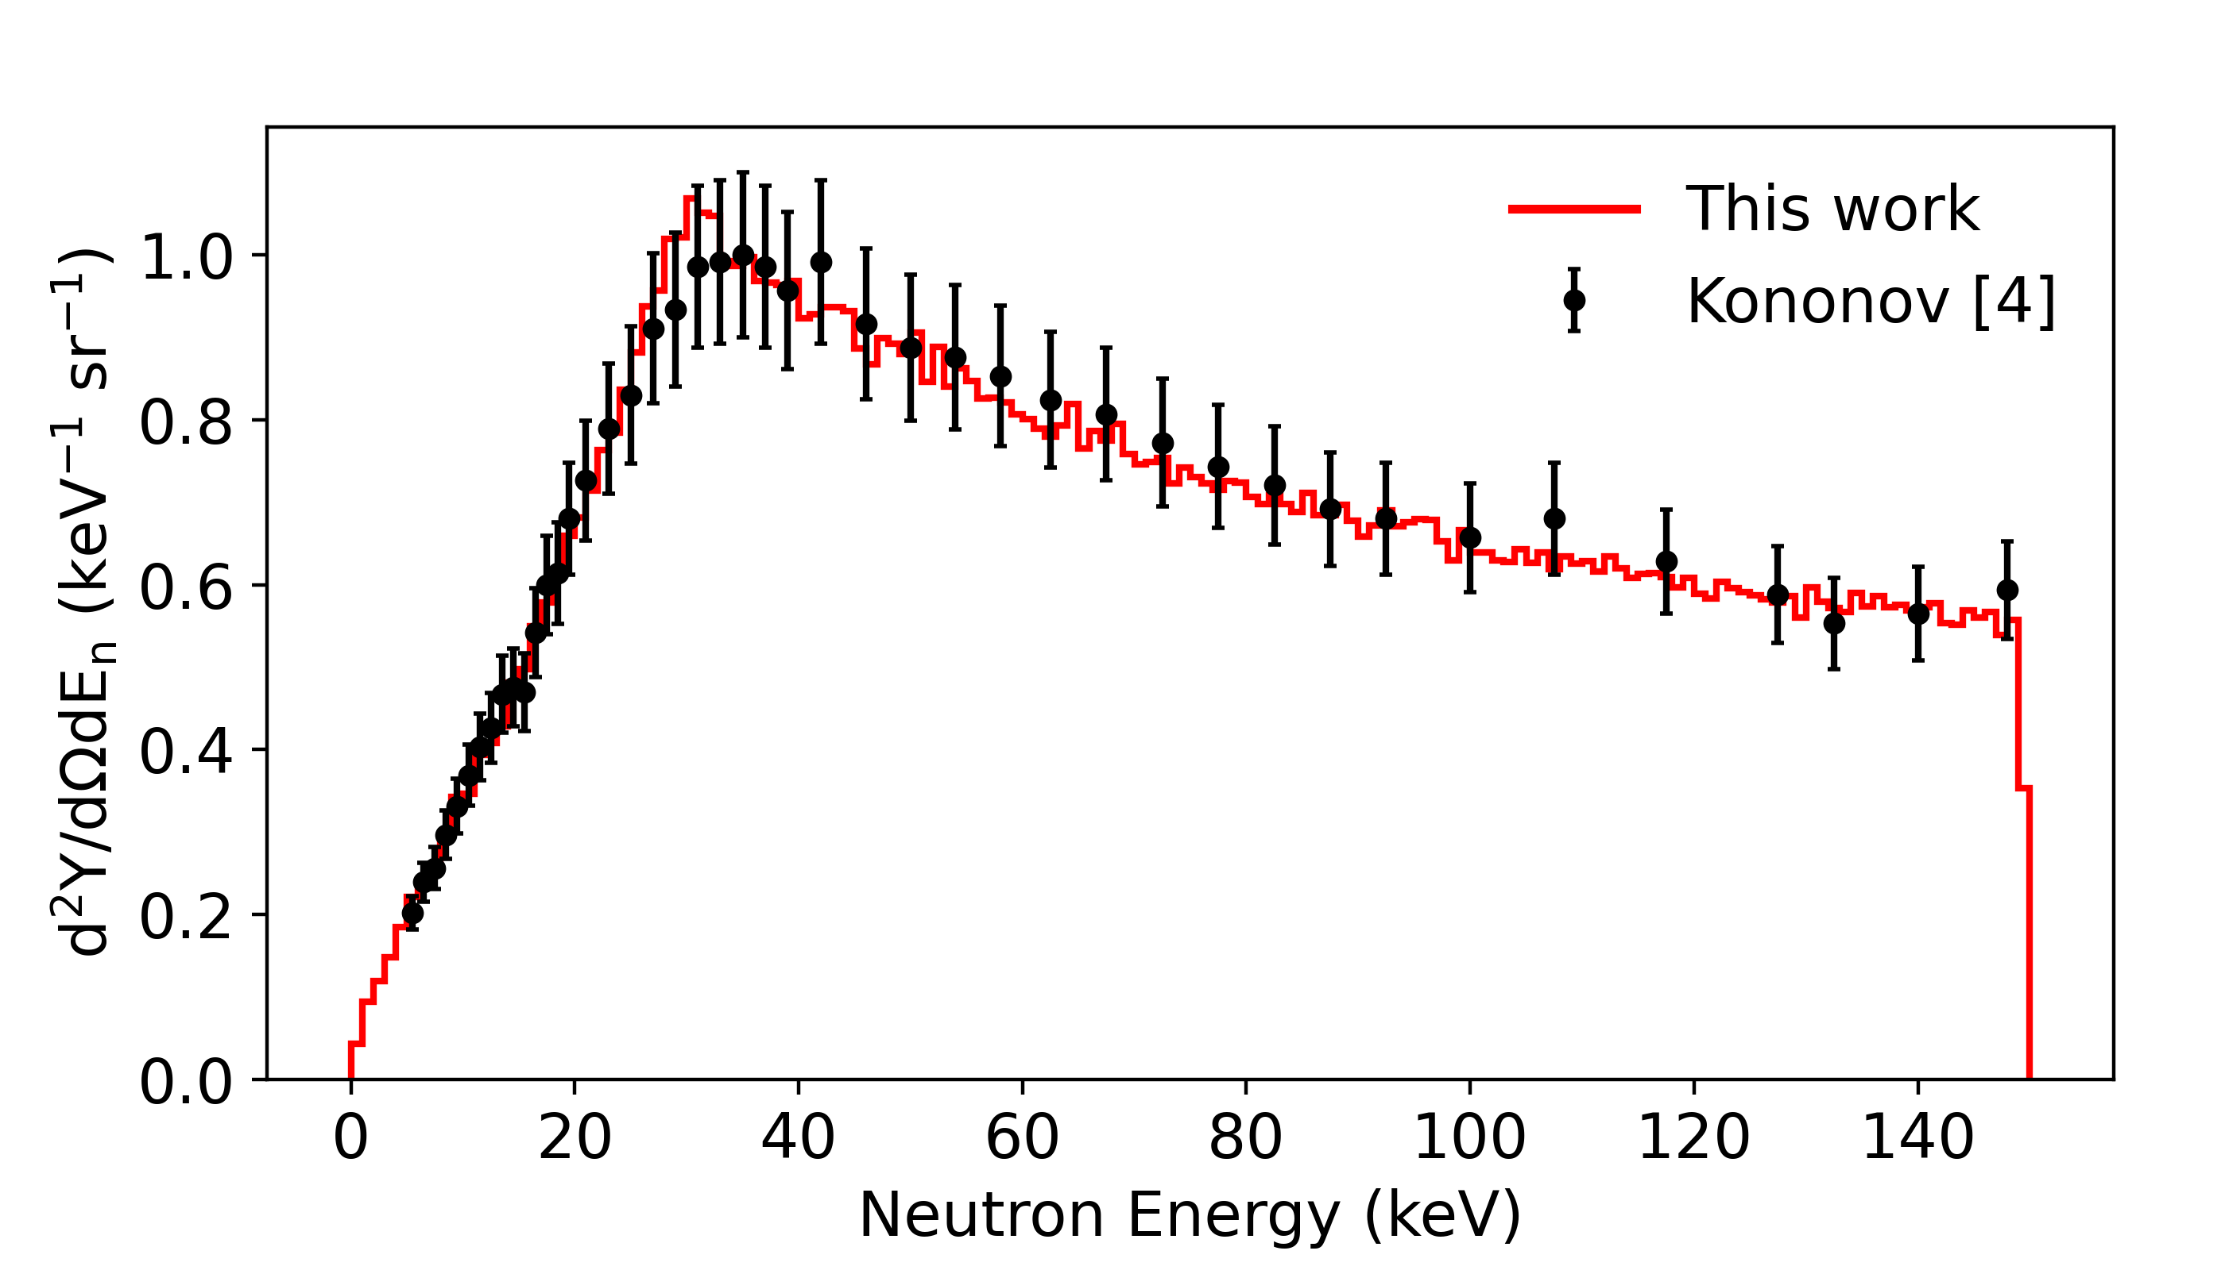
OpenMC Simulation
Validation possible at certain energies, using existing data:
Created a custom neutron source term for OpenMC simulations.
Total yield at
1.912 MeV:
Neutron spectra produced by source term:
0-degree yield at
1.94 MeV:
1) W. Ratynski, F. Käppeler, Neutron capture cross section of 197Au: A standard for stellar nucleosynthesis, 1988
2) C. Lederer et. al., Definition of a standard neutron field with the 7Li(p,n)7Be reaction, 2012
3) G. Feinberg et. al., Quasistellar neutrons from the 7Li(p,n)7Be reaction with an energy-broadened proton beam, 2012
4) V.N. Kononov, Absolte yield and spectrum of neutrons from the 7Li(p,n)7Be reaction, 1977
Notes:
Unfortunately, there have been quite a few teething problems with the facility, so we have been without experimental facilities for 16 months.
Therefore, this work has mainly been through simulations.
A versitile simulation framework has been designed in OpenMC. This consists of a neutron source term, which samples from measured differential cross section data. This gives us a verifible distribution of neutrons produced in the lithium layer, which can be compared to current experimental data.

Slide 10
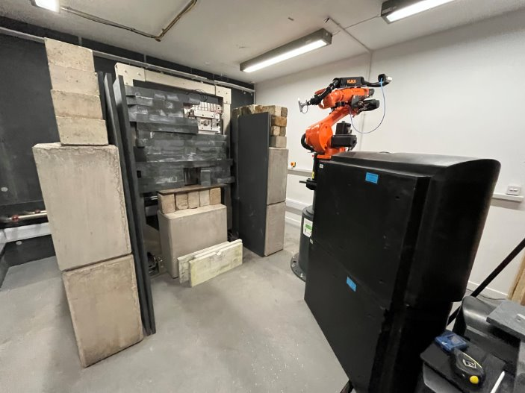
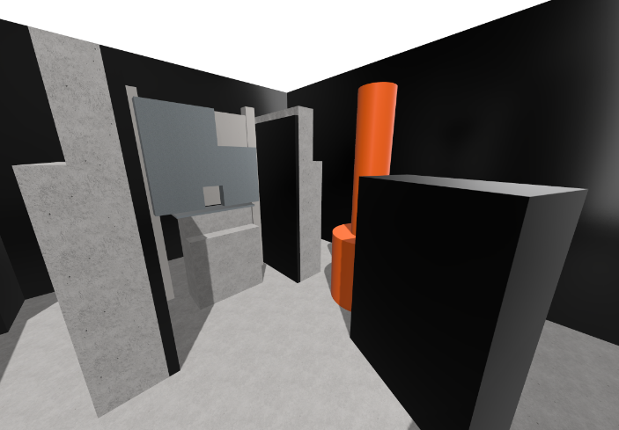
OpenMC Simulation
3D CAD of target and surroundings built in OpenMC.
Photograph
CAD model
Notes:
These neutrons are then transported through an accurate 3D model of the facility. This has been modelled natively in OpenMC, and is as accurate as possible.

Slide 11
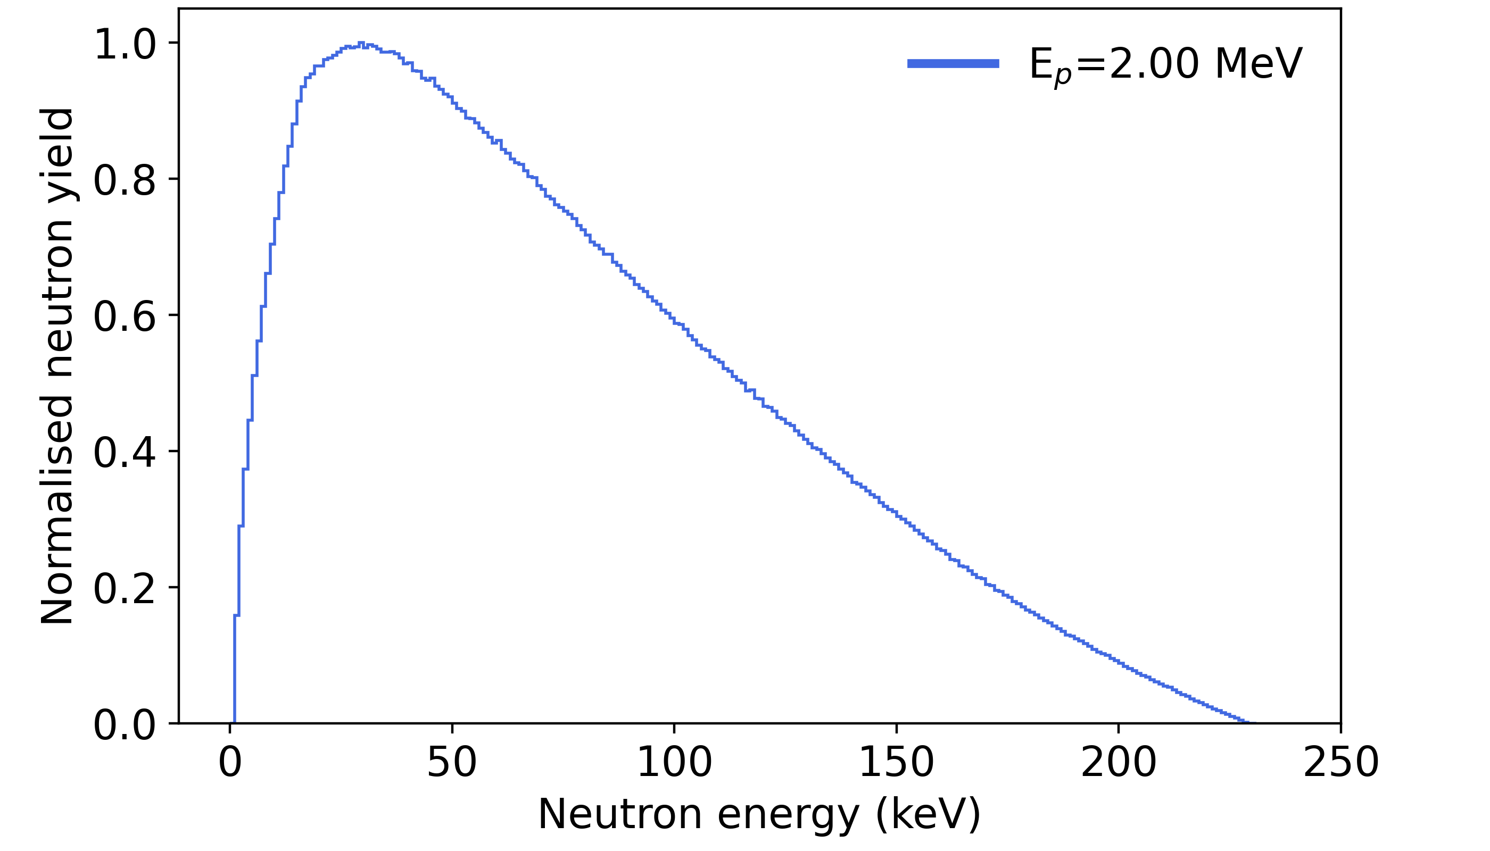
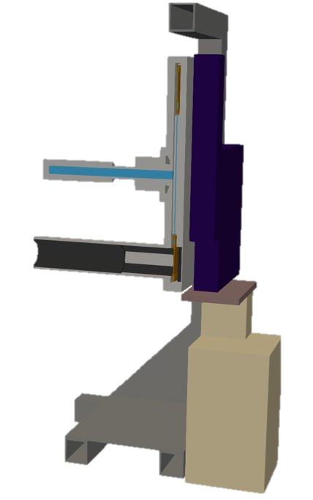
OpenMC Simulation
Unattenuated neutron spectrum:
Lithium
Copper
Water
Graphite
Titanium
Vacuum
Proton beam
Resonances in titanium (n, total) cross section lead to significant attenuation of the neutron spectrum.
Notes:
This is particularly important, because of some of the geometry involved. The model on the left is of the target vessel. This contains layers of copper, water, graphite, and most importantly, titanium. The (n,total) cross section of Ti is very high in the epithermal region, with significant resonances. This leads our nice, smooth neutron spectrum to be "chopped up", due to neutrons scattering in the Ti.
For medical isotope production, not a huge issue, but important to know.

Slide 12
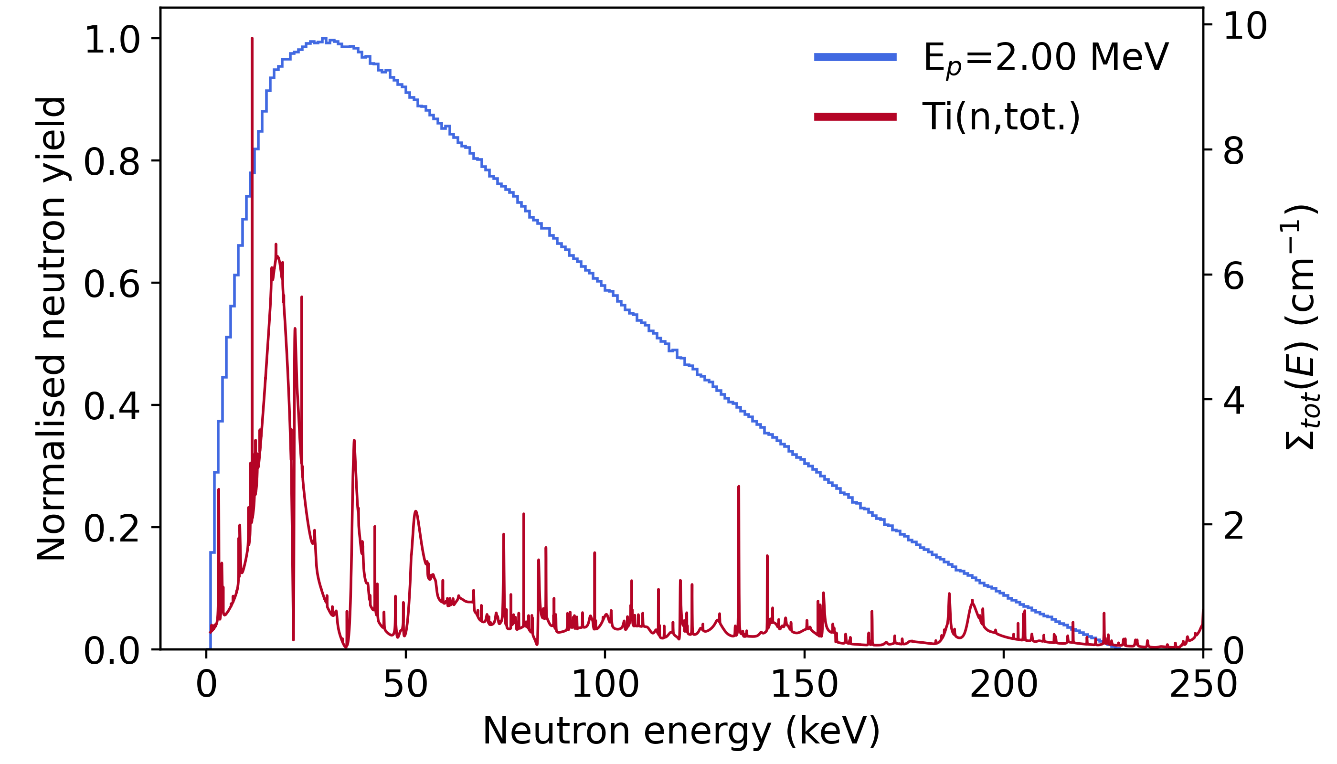
OpenMC Simulation
Unattenuated neutron spectrum:
Lithium
Copper
Water
Graphite
Titanium
Vacuum
Resonances in titanium (n, total) cross section lead to significant attenuation of the neutron spectrum.
Notes:
This is particularly important, because of some of the geometry involved. The model on the left is of the target vessel. This contains layers of copper, water, graphite, and most importantly, titanium. The (n,total) cross section of Ti is very high in the epithermal region, with significant resonances. This leads our nice, smooth neutron spectrum to be "chopped up", due to neutrons scattering in the Ti.
For medical isotope production, not a huge issue, but important to know.

Slide 13
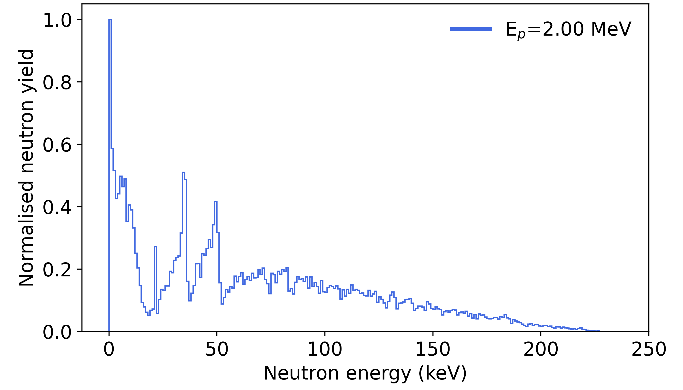
OpenMC Simulation
Unattenuated neutron spectrum:
Lithium
Copper
Water
Graphite
Titanium
Vacuum
Neutron spectrum attenuated by titanium:
Resonances in titanium (n, total) cross section lead to significant attenuation of the neutron spectrum.
Notes:
This is particularly important, because of some of the geometry involved. The model on the left is of the target vessel. This contains layers of copper, water, graphite, and most importantly, titanium. The (n,total) cross section of Ti is very high in the epithermal region, with significant resonances. This leads our nice, smooth neutron spectrum to be "chopped up", due to neutrons scattering in the Ti.
For medical isotope production, not a huge issue, but important to know.

Slide 14
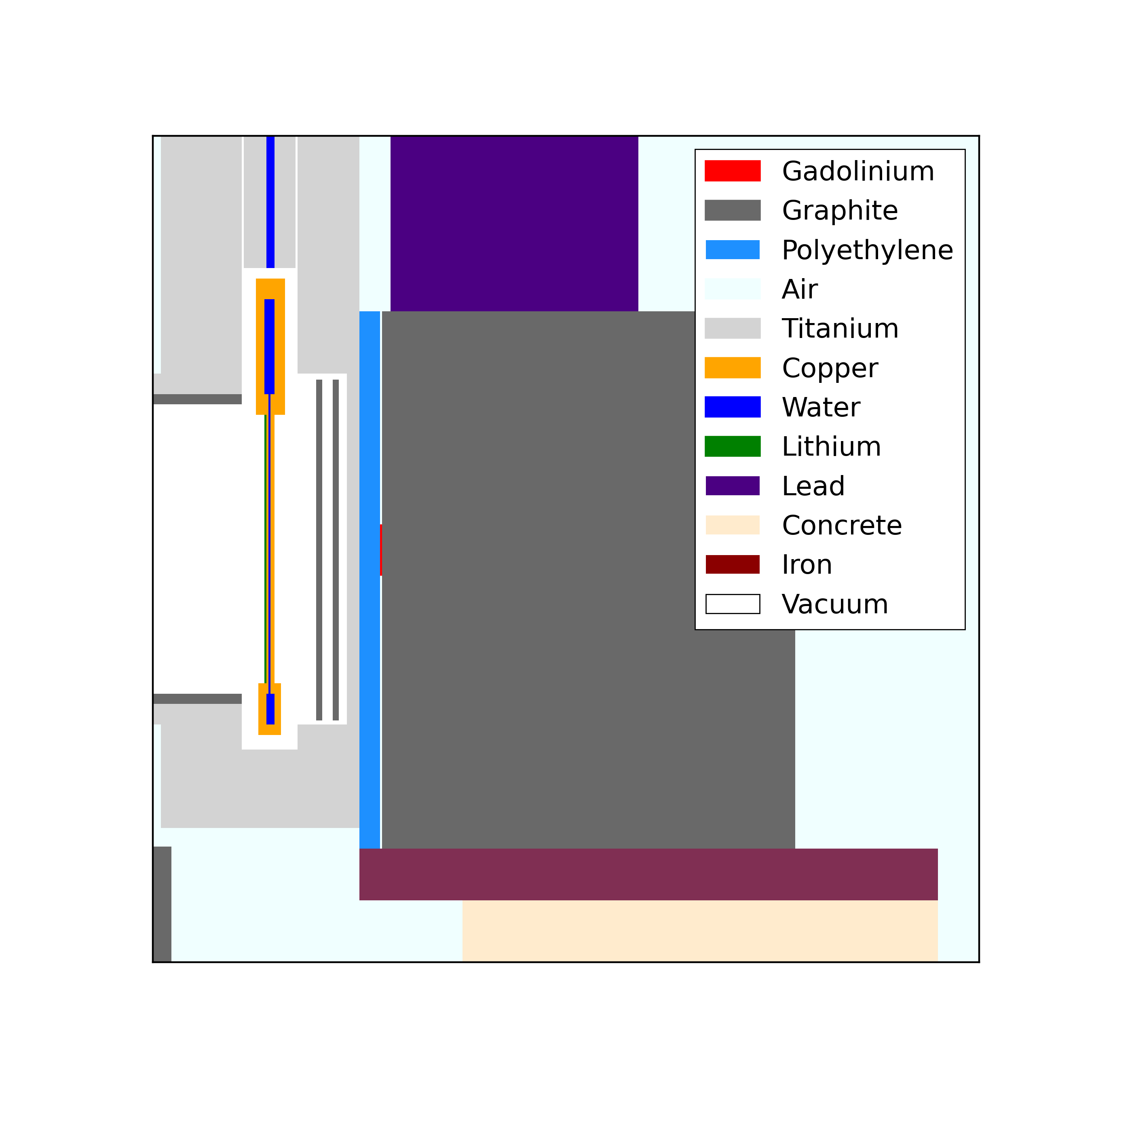
Activity optimisation: Method
Target: natural Gd foil (2.5 x 2.5 x 0.1 cm)
Simulated irradiation: 1 hour at maximum neutron flux (2.6 MeV, 33 mA proton beam)
Completed 81 permutations of moderator and reflector geometries to find optimal configuration.
Explored graphite and polyethylene as mod/ref materials.
n
Notes:
For the investigations to optimise activity, started with a natural Gd foil.
The simulated irradiation was at 2.6 MeV, with a 33 mA proton beam, which allows for the maximum total flux.
I then added systematic permutations of material, before and after the foil, to act as a moderator and reflector combination. These calculations were run on the UoB HPC service, BlueBear.

Slide 15
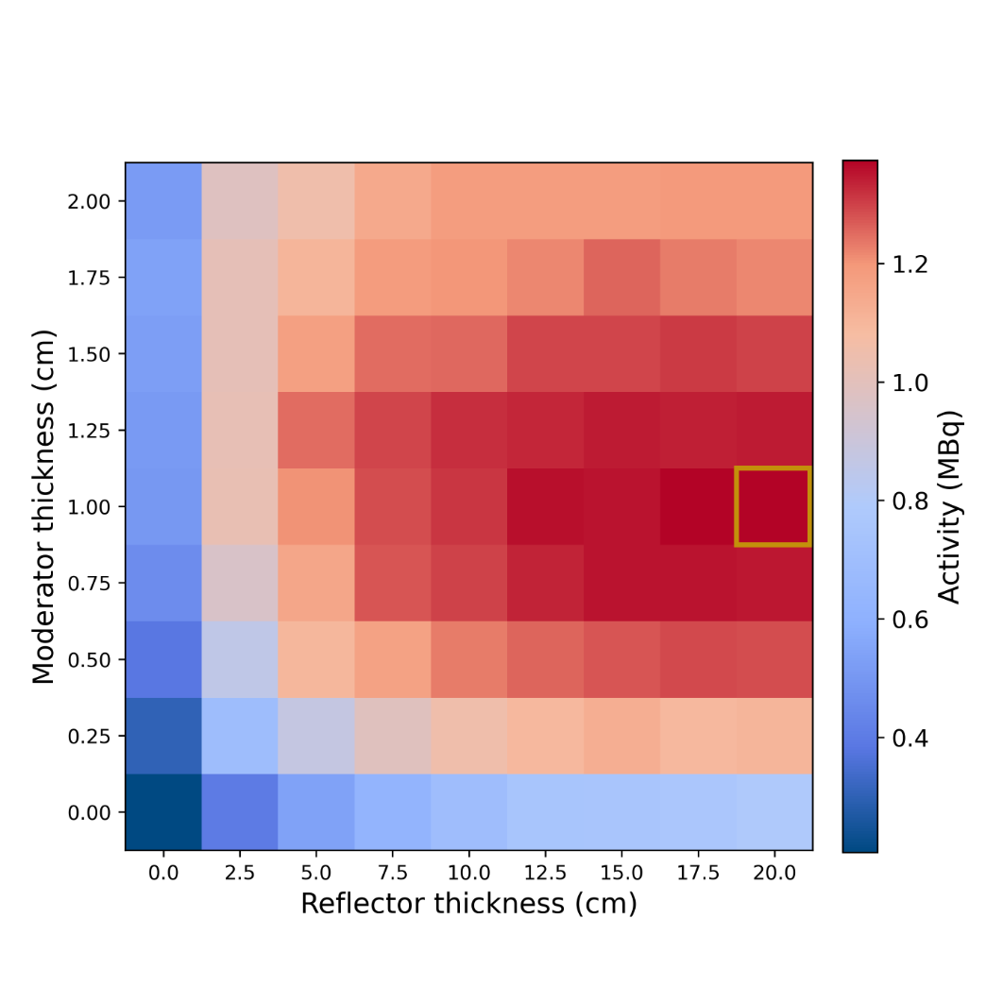
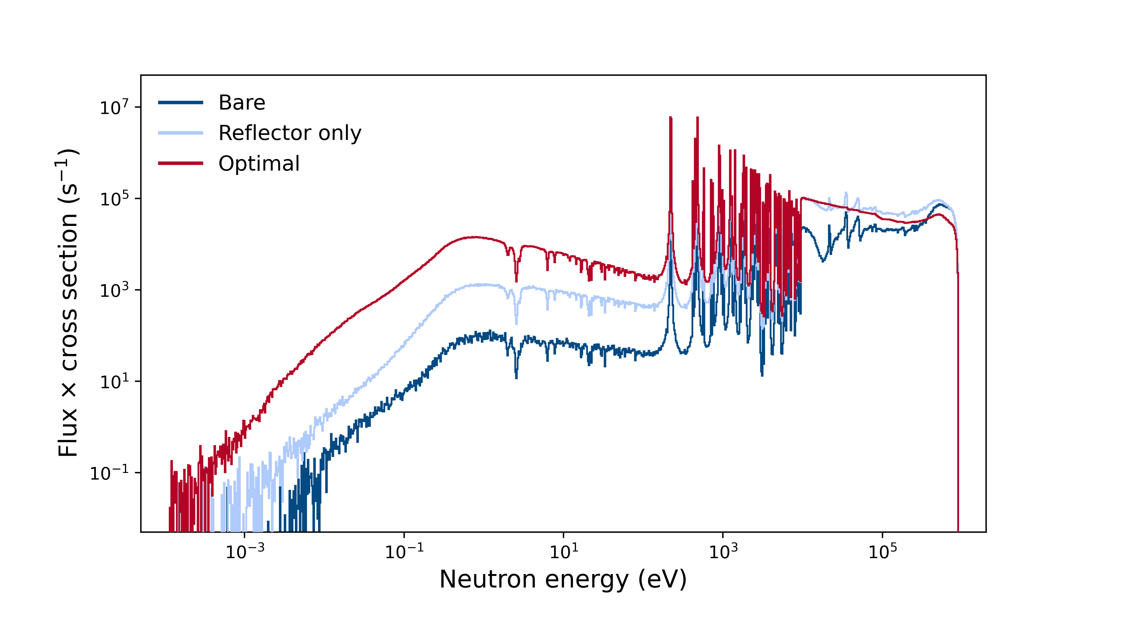
Activity optimisation: Results
Up to a 6x increase in activity with an optimal moderator-reflector combination.
Optimal
Bare
Reflector only
Notes:
Comparing the activities of no mod/ref, just a ref, and both, we can see that we are able to achieve over a 6x improvement in activity.
We can see the effect on the flux, weighted by the cross section, as the low-energy neutrons are increased, where the cross section is much larger.

Slide 16
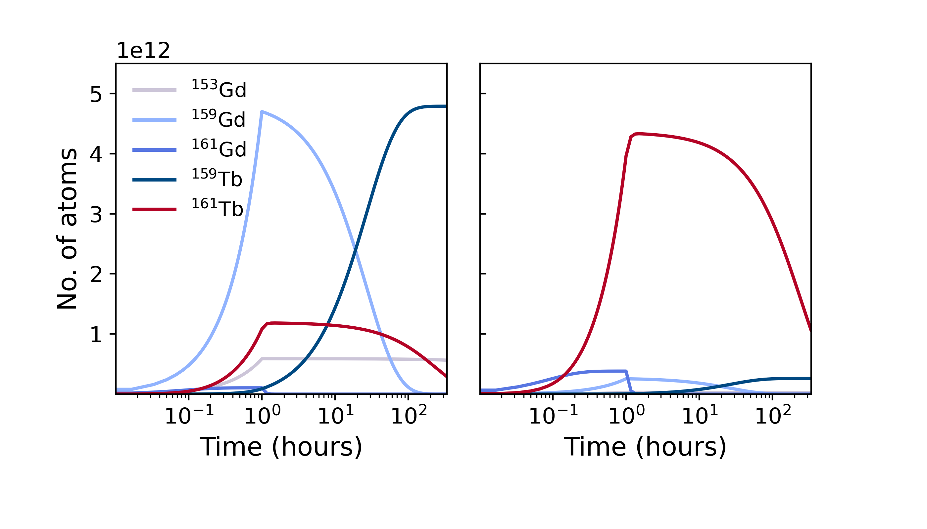
The effect of an enriched target
Natural Gd
98% enriched ¹⁶⁰Gd
~4x increase in ¹⁶¹Tb production
~18x decrease in ¹⁵⁹Tb production
Notes:
High activity is good, but in nuclear medicine we are also concerned with the quality of the product.
Using a natural foil results in a final product that very quickly begins to deteriorate. As we have produced Gd159, with an 18 hour half life, this leads to a build up of Tb159.
If we are able to perform a chemical separation almost imediately after irradiation, this can mitigate the effect. Seen in atom plots.
Alternatively, we need to use an enriched foil. The effect of this is clearly shown, with a 4x increase in 161Tb production and an 18x decrease in 159Tb production.

Slide 17
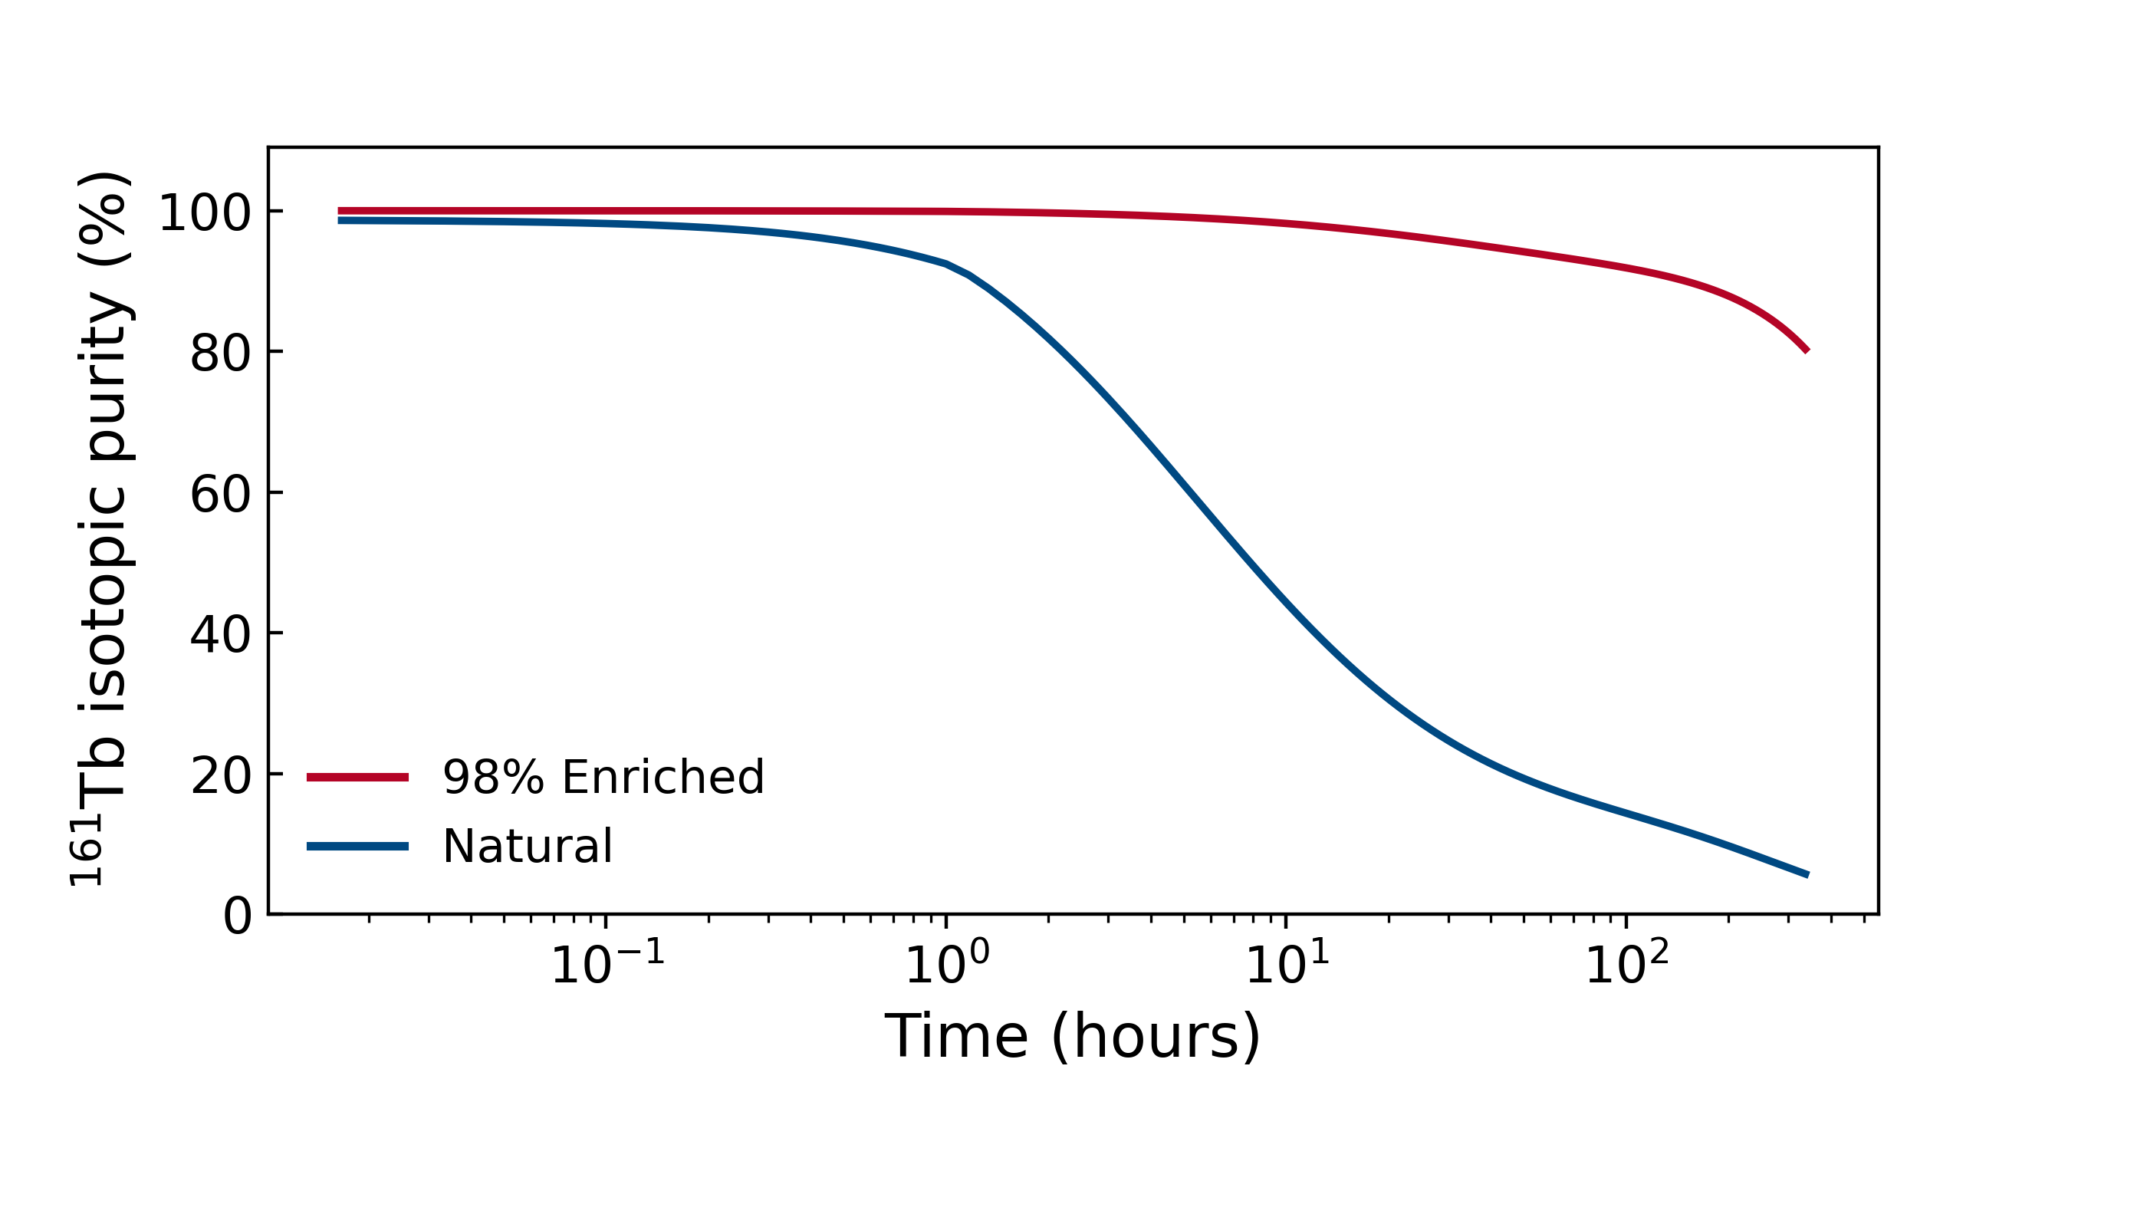
The effect of an enriched target
Natural Gd
98% enriched ¹⁶⁰Gd
~4x increase in ¹⁶¹Tb production
~18x decrease in ¹⁵⁹Tb production
Natural: presence of other Gd isotopes leads to a large number of impurities, in particular ¹⁵⁹Tb.
Enriched: strongly suppresses impurity production, yielding higher specific activity.
Notes:
The need to separate early is also shown in the plot of isotopic (161) purity. Assuming a perfect chemical separation of Tb from Gd, an enriched foil gives us a far longer time period which can pass before separation, before the product would be too poor to use. NEED SOME INFORMATION ON THIS FOR QUESTIONS.

Slide 18
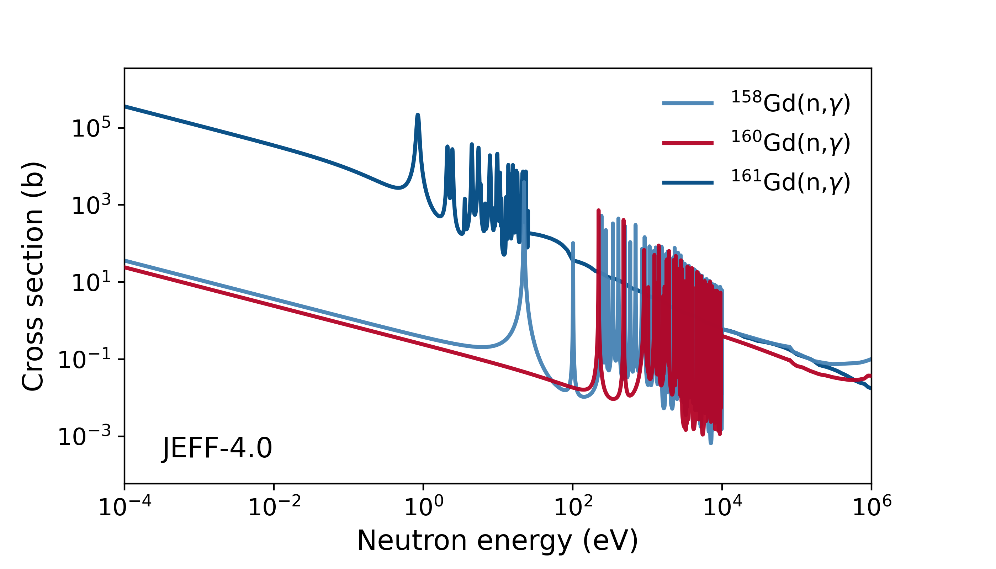
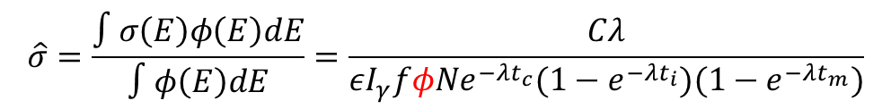
Future work: SACS measurements
Contribute to understanding of nuclear data:
HF-ADNeF neutrons from 0 - 0.9 MeV
Can irradiate and perform gamma spectroscopy to experimentally determine SACS
Requires accurate neutron flux knowledge, from simulation
$$\hat{σ}=\frac{∫σ\left(E\right)φ\left(E\right)dE}{∫φ\left(E\right)dE}=\frac{Cλ}{εI_{γ}fφNe^{−λt_{c}}(1−e^{−λt_{i}})(1−e^{−λt_{m}})}$$
Simulated flux
Notes:
Finally, we plan to do experimental work. This will involve measuring spectrum-averaged cross sections over the HF-ADNeF energy range. This requires an accurate knowledge of the flux, which we get from the simulation. Therefore important for simulation to be as accurate as possible.

Slide 19
Conclusion and Future Work
Developed and validated an OpenMC simulation of UoB’s HF-ADNeF
Demonstrated up to 5 MBq of ¹⁶¹Tb can be produced at HF-ADNeF, using an enriched foil target
Aim to experimentally produce ¹⁶¹Tb, and measure spectrum-averaged cross sections for relevant reactions
Work with local radiochemists to separate and analyse final product quality

Slide 20


Thank you to...
Dr Tony Price¹, Professor Carl Wheldon¹, Dr Luigi Capponi^{2,} Dr Robert Mills²
¹School of Physics and Astronomy, University of Birmingham, UK
²United Kingdom National Nuclear Laboratory, UK
This work was partially funded by the Hawkesworth fund, University of Birmingham and UKNNL’s Medical Radionuclide Science core science theme. The simulations described in this presentation were performed using the University of Birmingham's BlueBEAR HPC service.

