Slide 1

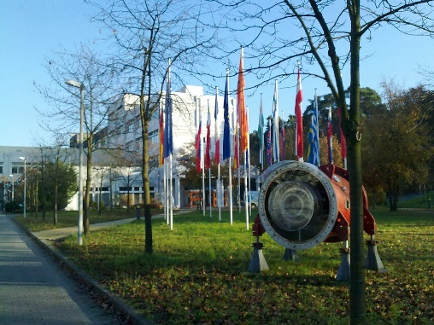
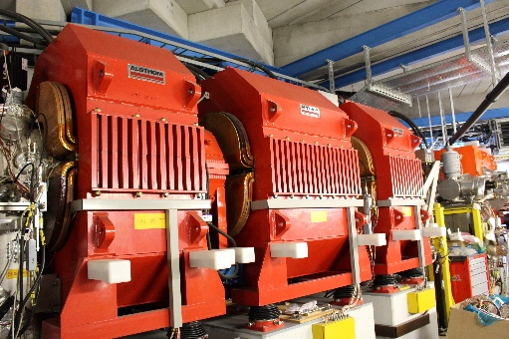
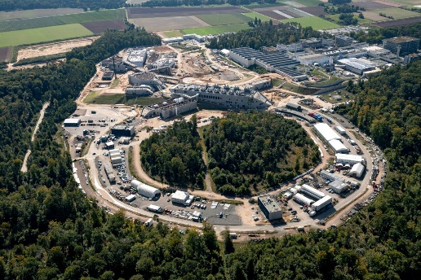
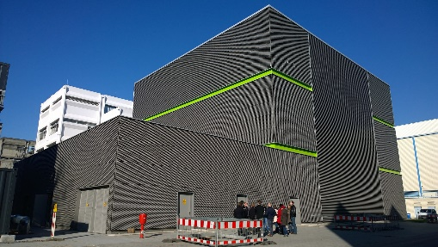
GSI Helmholtz Center
for Heavy Ion Research
Extending the Chart of
Nuclides:
How to Create New
(Super)Heavy Nuclei
Sophia Heinz
GSI, and Universities Gießen and Marburg
Brighton, April 13, 2026

Slide 2
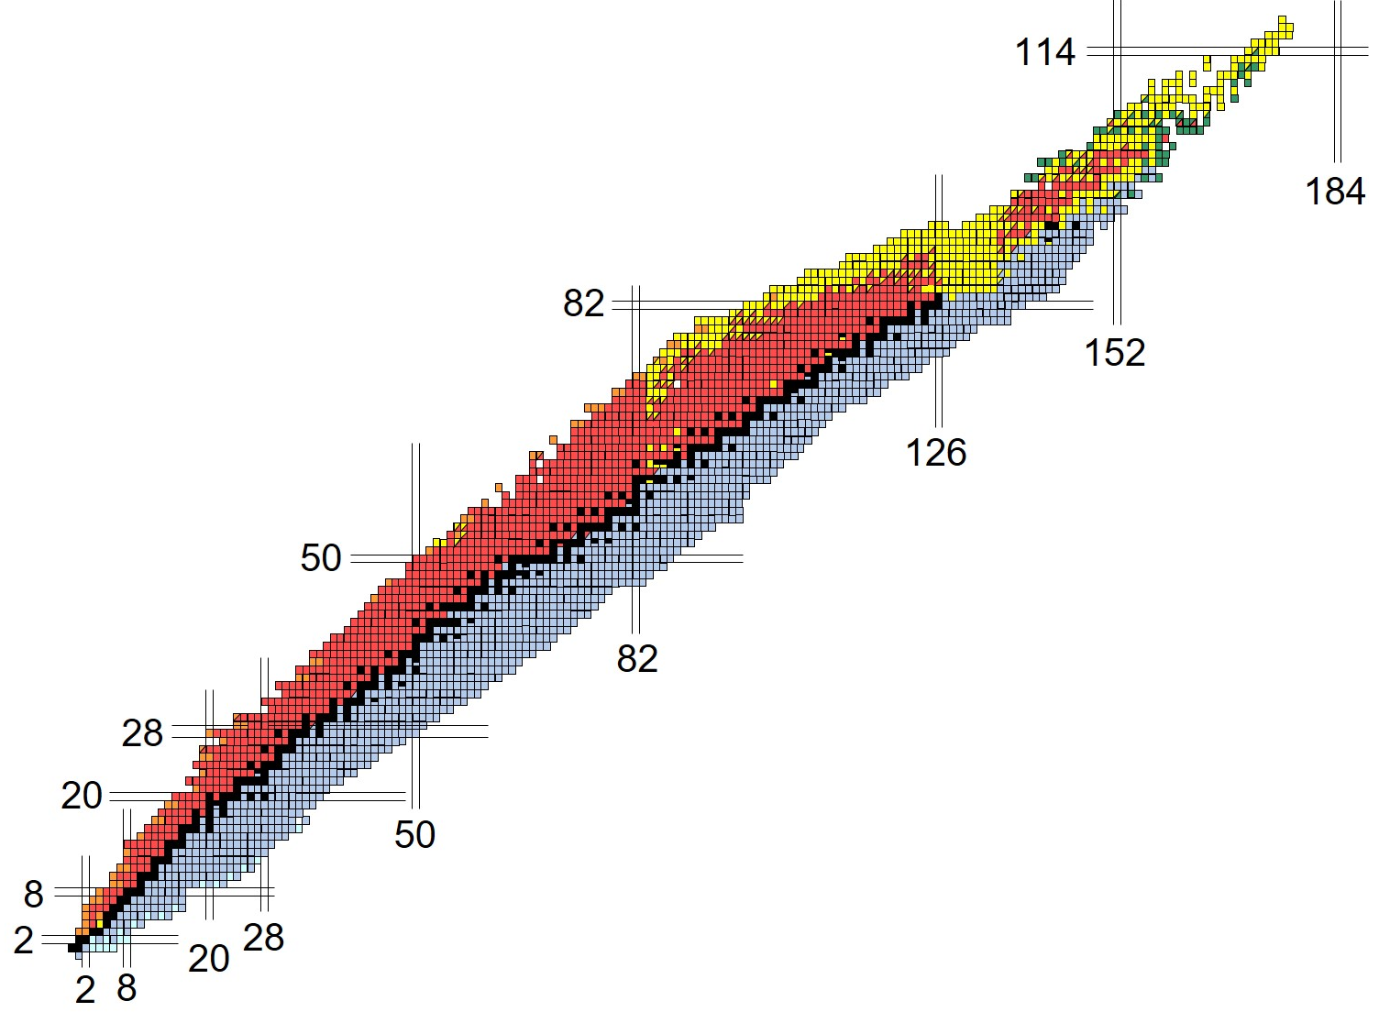
The Chart of Nuclides (2025)
118 elements ▪ ~3300 known isotopes ▪ ~4000 more predicted
fission barrier
B_{f} = 0
proton dripline (S_{p} = 0)
neutron dripline (S_{n} = 0)

Slide 3
Why do we Create Exotic Nuclei?
Upper limit of Z?
„Island of Stability“?
Proton radioactivity
r - process nuclei
Neutron skin
New magic numbers
Halo nuclei

Slide 4
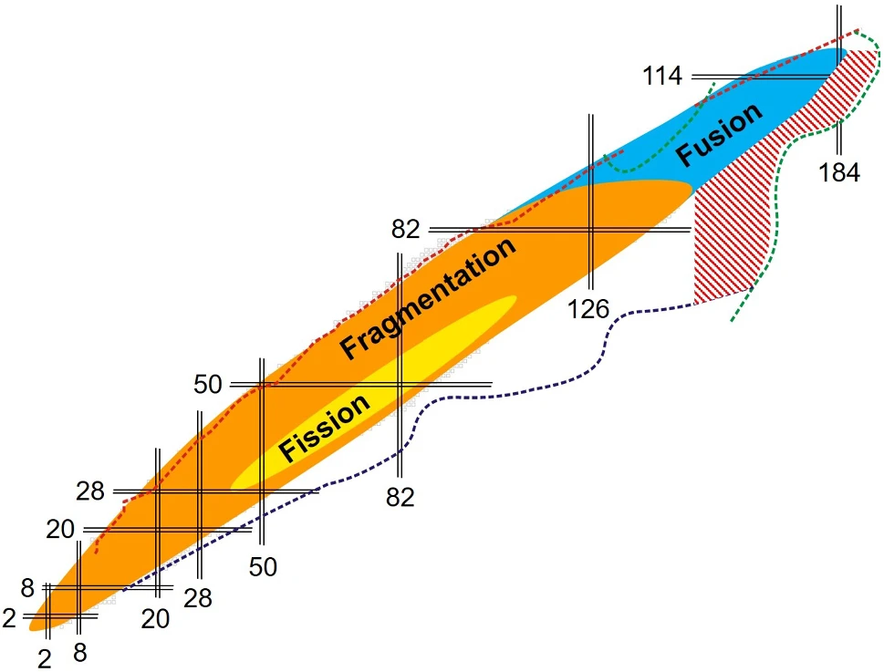
How do we Create Exotic Nuclei?
Fusion ▪ Fission ▪ Fragmentation
Out of reach in F/F/F:
n-rich transuranics and
superheavy nuclei

Slide 5
Multinucleon Transfer (MNT) Reactions
Heavy ion collisions @ Coulomb barrier energies (~ 5 MeV/nucleon)
Sticking,
Nucleon exchange
Fusion
Compound
Nucleus (CN)
Quasi-fission
Time scale: (10⁻²¹ - 10⁻²⁰) s
Projectile-like
MNT product
Target-like
MNT product

Slide 6
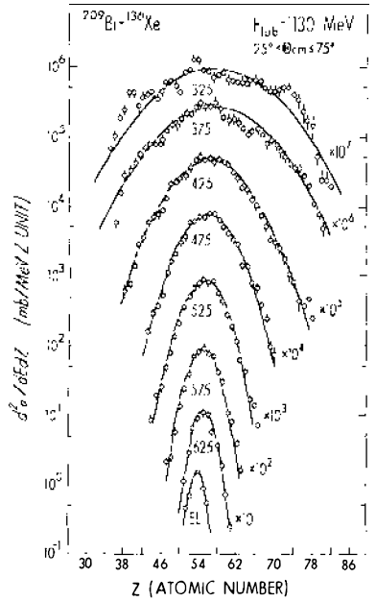
Properties and Kinematics of MNT Products
¹³⁶Xe + ²⁰⁹Bi
325
► wide A and Z distributions
375
► wide angular distributions
425
475
► wide energy distributions
cross-section / (mb / MeV Z) unit
525
► strong or full dissipation of
kinetic energy
575
625
E_{cm}
atomic number Z

Slide 7
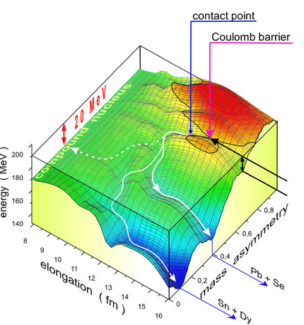
The Potential Energy Surface (PES)
The PES shapes reaction pathways and their cross-sections
⁴⁸Ca + ²⁴⁸Cm PES
E* = 20 MeV
V. Zagrebaev, W. Greiner
J. Phys. G, 34 (2007) 1
CN
QF
QF
valleys @
double-magic nuclei
valley @ mass symmetry

Slide 8
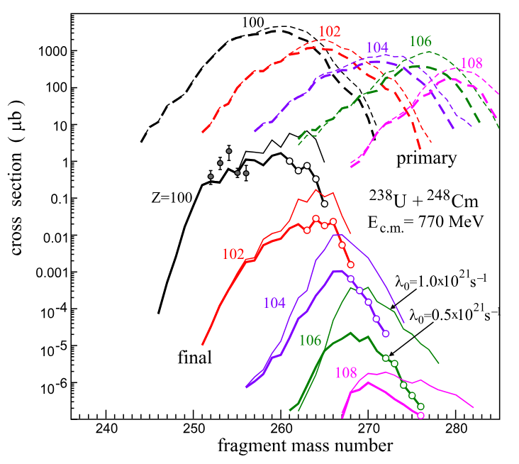
Calculated MNT Cross-sections for Z>100
Langevin model results for ²³⁸U + ²⁴⁸Cm @ Coulomb barrier
(V.I. Zagrebaev and W. Greiner)
primary MNT products
residual MNT products
1 nb = ~1000 nuclei / day
Z > 103 → σ < 1 nb

Slide 9
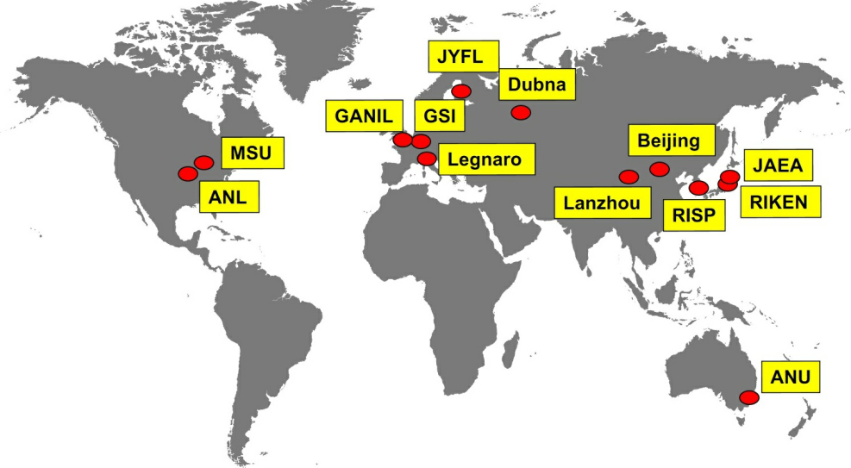
Study of MNT Reactions Worldwide
Exploration of separation and detection techniques
Investigation of various collision systems and beam energies

Slide 10
MNT Reactions at the Velocity Filter SHIP
Separator for Heavy Ion Reaction Products (SHIP) @ GSI
Detection
Separation
10³ pps
10¹² pps

Slide 11
MNT Reactions @ SHIP
► In-flight separation of forward emitted MNT products
► angular efficiency: 0.5 %
► Implantation in a focal plane silicon detector
► Identification by decay tagging (α decay, fission)
► lowest measured cross-section: 0.5 nanobarn

Slide 12
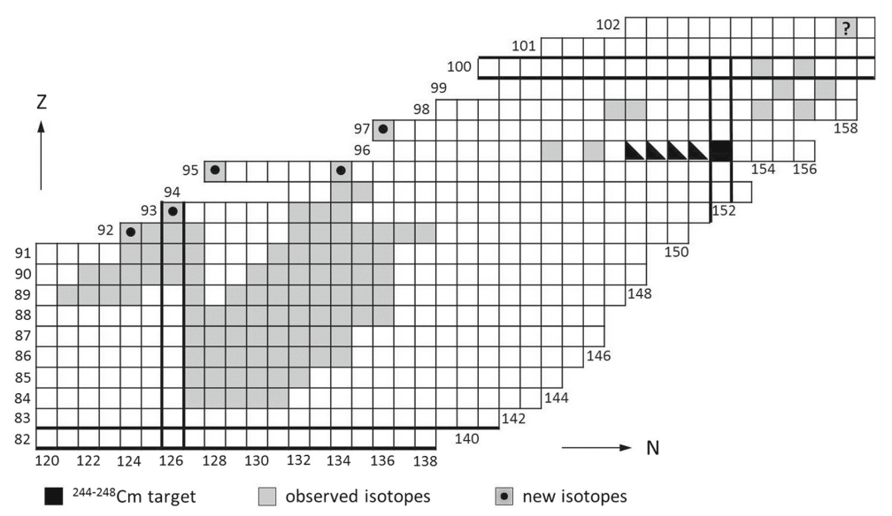
Experimental Results from SHIP
MNT products observed in ⁴⁸Ca + ²⁴⁸Cm collisions

Slide 13
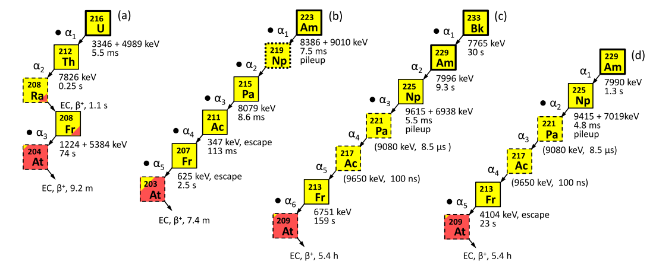
Discovery of New Z 92 Isotopes
>
► Highest-Z nuclei discovered to date in MNT reactions
(H.M. Devaraja et al., PLB 748 (2015)199)

Slide 14
Observation of ²⁶⁰No (Z = 102)
²⁶⁰No was not a newly discovered nucleus, but ..
► lowest measured MNT cross-section so far:
σ ≈ 0.5 nb (3 events observed)
► farthest above target MNT product observed so far:
6 protons + 6 neutrons above ²⁴⁸Cm target
(H.M. Devaraja et al., Eur. Phys. J. A 55 (2019) 25)

Slide 15
Summary and Outlook
► MNT reactions offer the possibility to synthesize neutron-rich (super)heavy nuclei
► Advantages of MNT reactions:
- occur also in very heavy systems, providing many neutrons and protons
- a vast region of nuclei is populated in the same experiment
► Disadvantage of MNT reactions: wide angular and energy distributions
► Expected cross-sections of new (super)heavy MNT products: << 1 μb
- lowest MNT cross-section measured to date: 0.5 nb
- synthesis of new MNT products up to Z ≈ 108 appears feasible
► Current activities:
- Investigation of different separation and detection techniques
- Study of different projectile-target combinations and beam energies

