Slide 1
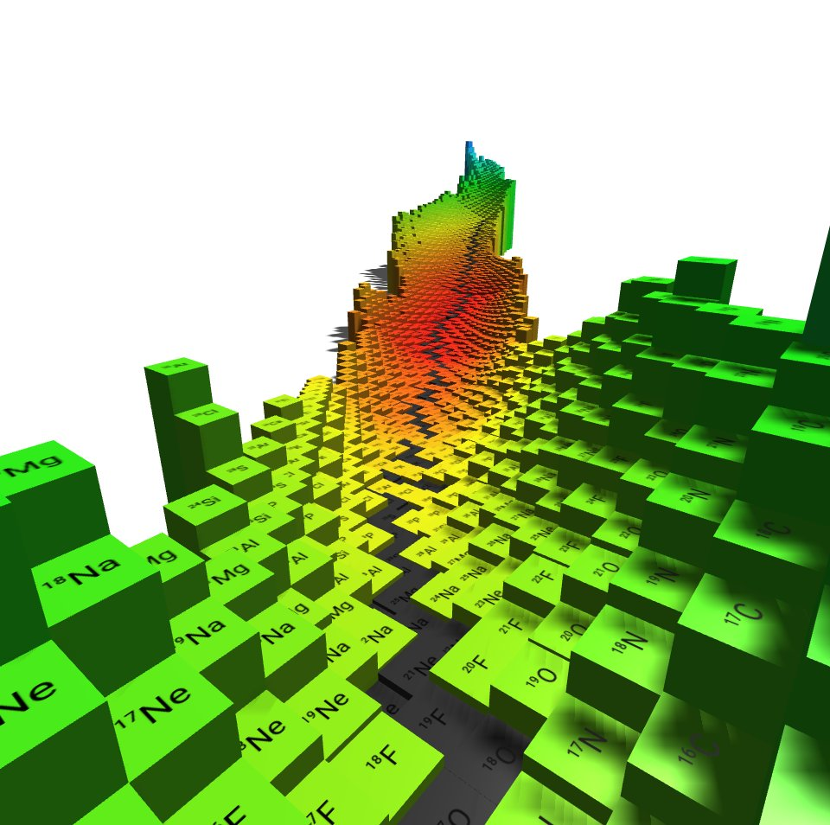



Were the Superheavy Elements Made in Nature?
Ani Aprahamian
  Institute for Structure & Nuclear Astrophysics
  University of Notre Dame
Notes:
IOP Nuclear Physics Conference…Where are the limits of the chart of nuclides?
Good Morning..it is a pleasure to be here at this IOP Nuclear physics conference…today, I will talk about whether the superheavy elements were made in nature?
Typically..when you put a question mark? The answer is NO…but I hope to convince you that the answer is potentially a resounding YES!

Slide 2
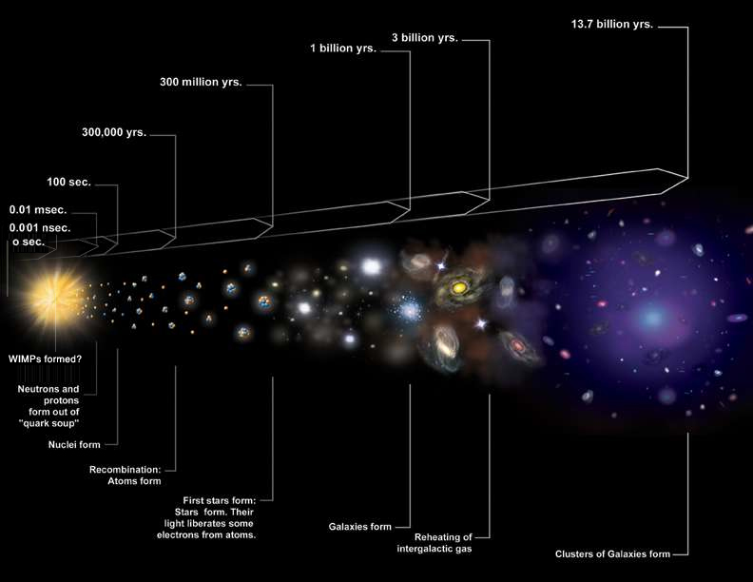
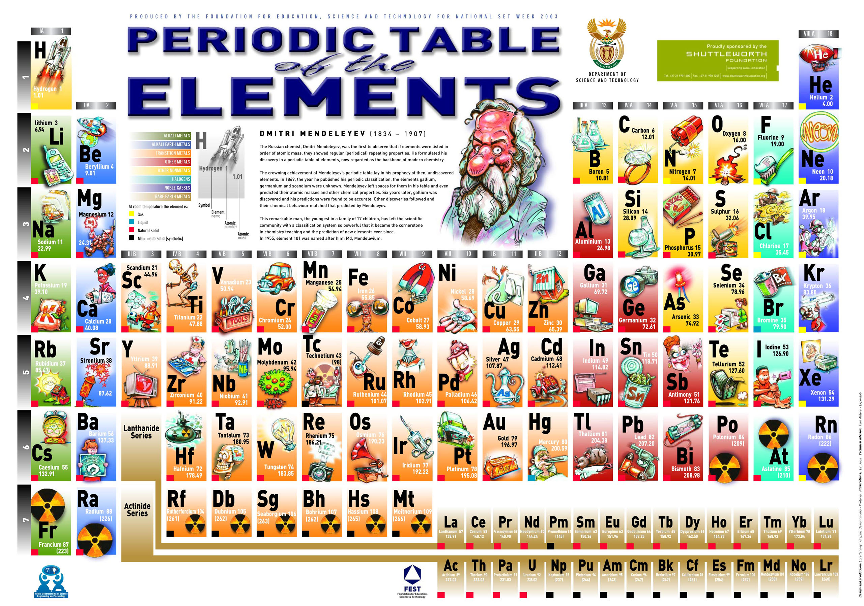
Notes:
THE TIME LINE OF THE UNIVERSE….SHORTLY AFTER THE BIG BANG…NeUTRONS AND PROTONS FORM…THE PRIMORDIAL ELEMENTS…STARS…
THE EVOLUTION OF STARS TO THE PRESENT DAY SYSNTHESIS OF THE ELEMENTS AS WE KNOW IT TODAY…
JWST launched in December of 2021
Chemical evolution

Slide 3
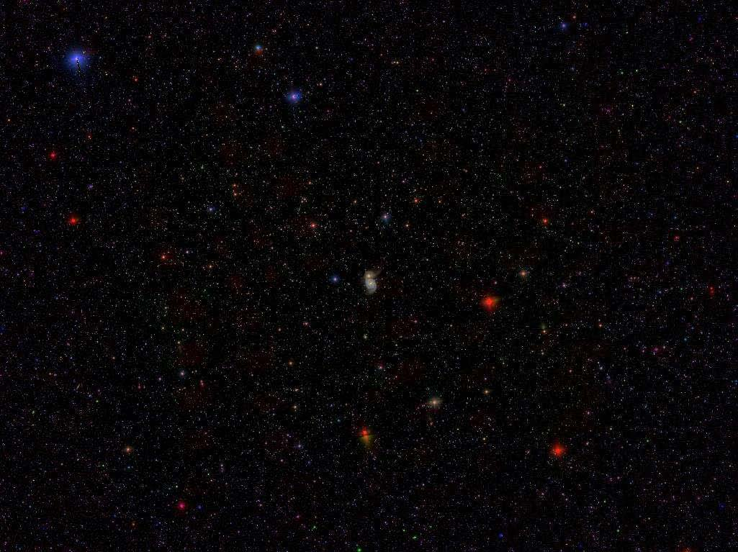
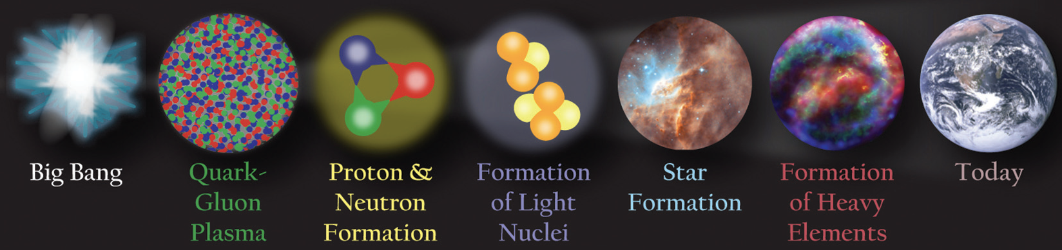
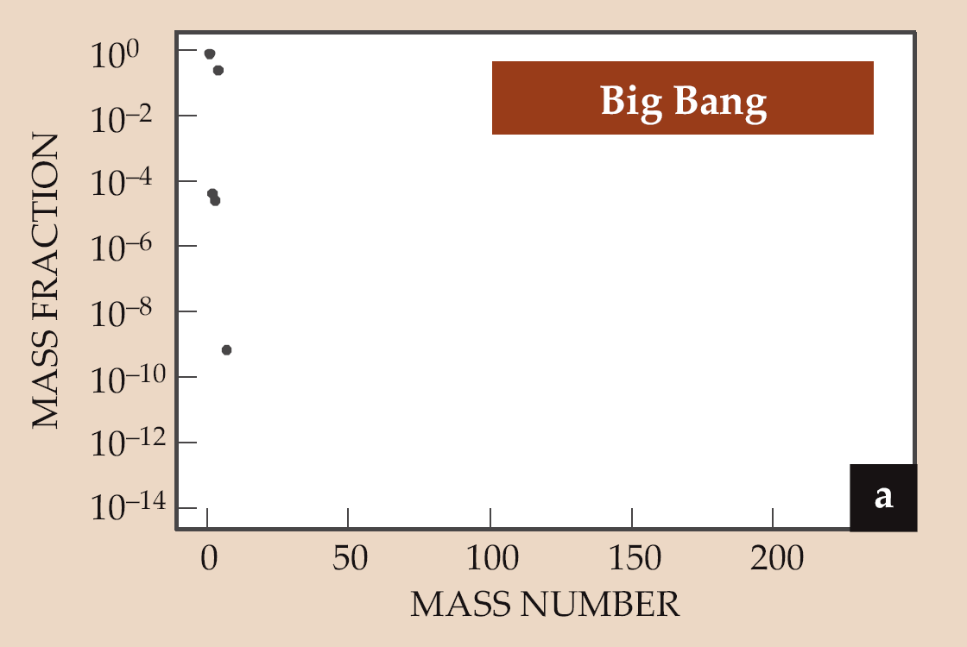

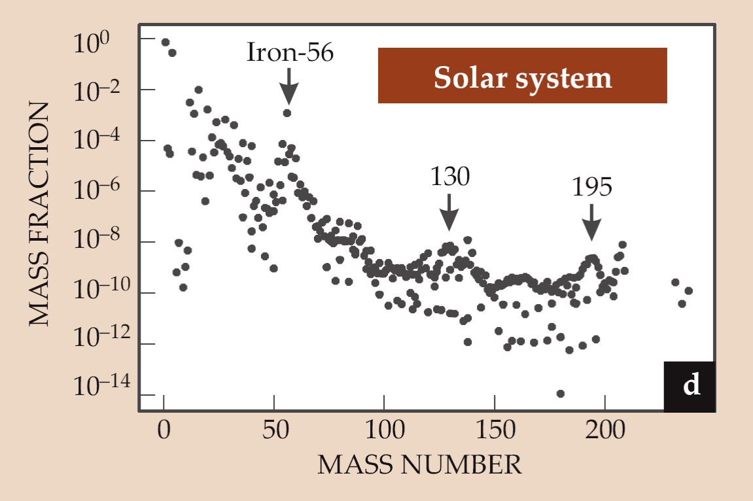
How were elements Fe to U made?
Wiescher
Schatz
s-process
r-process
Notes:
5% of the energy distribution of the universe…..Over 99.9 percent of the mass of all the universe comes from the nuclei found at the center of every atom. These nuclei are made of protons and neutrons that themselves formed a few microseconds after the big bang as the primordial liquid known as quark-gluon plasma cooled and condensed. Entire history of the universe entangled with the nuclear physics….Welll we know what the nuclear physics has to be….neutron induced and prominent features that can be related to nuclear physics
Use..observed abundance pattern to understand….process…

Slide 4
How were elements Fe to U made?
one of 11 greatest unanswered questions for the 21st century
How did the basic building blocks of the universe originate?
How expansive is the material world?
Where are the boundaries?
How do we determine the limits

Slide 5
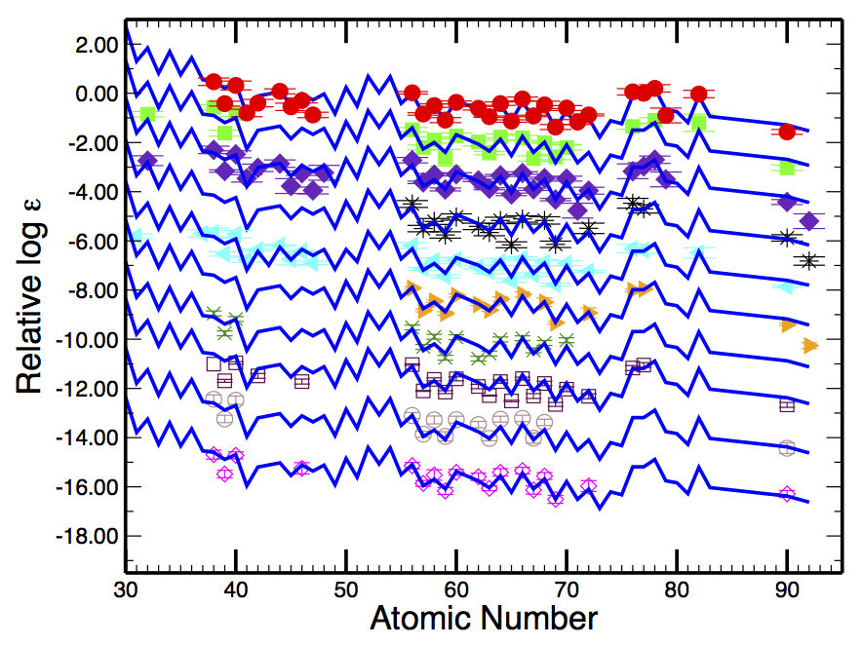
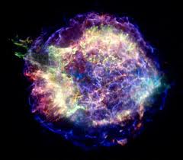
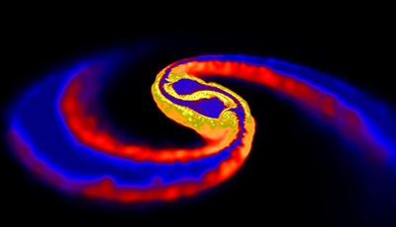
r-process
Explosive
Cowan et al. 2011
Origin of more than 50% of all the elements beyond iron
Site of r-process is still one of open challenges in all of physics today
Temperature, density as a function of time, initial compositions, neutrons
Notes:
We had two popular scenarios…the issues were we know what physics has to take place! Neutron capture processes….
Core collapse supernovae…did not get up to the actinides…ran out of neutrons
Mergers…expected to get all the way up to actinides…frequency of mergers was an issue…
The signatures are robust from observers…indicating a unique source…even in ancient dwarf galaxies
Compact object mergers…

Slide 6
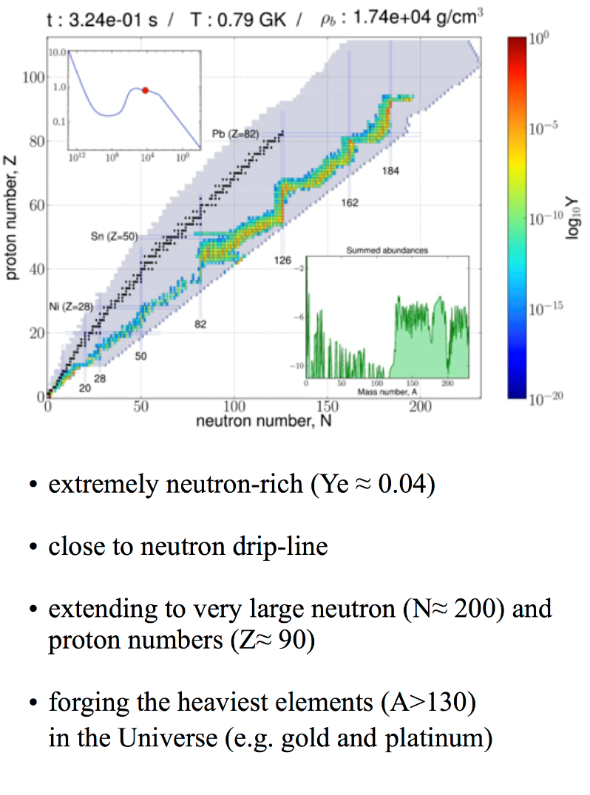

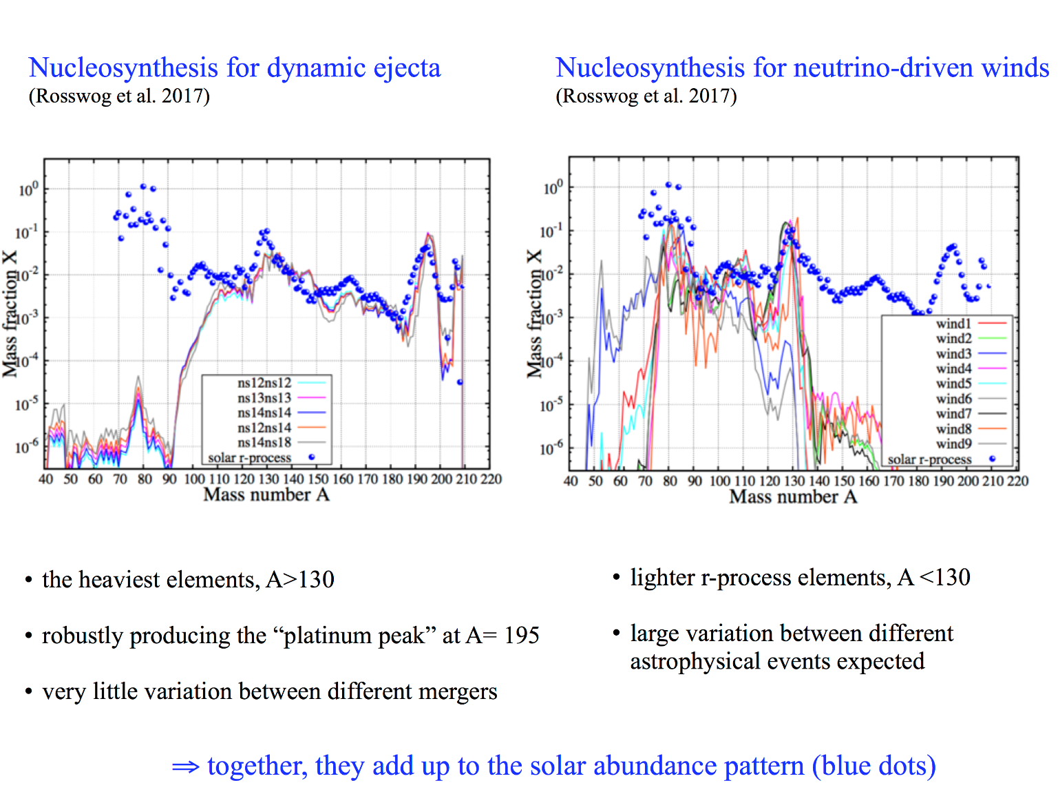
where is the site of the r-process?
Merging neutron stars versus core collapse supernovae, gravitational wave detection identified neutron star mergers as a source of the very heavy elements!

Slide 7
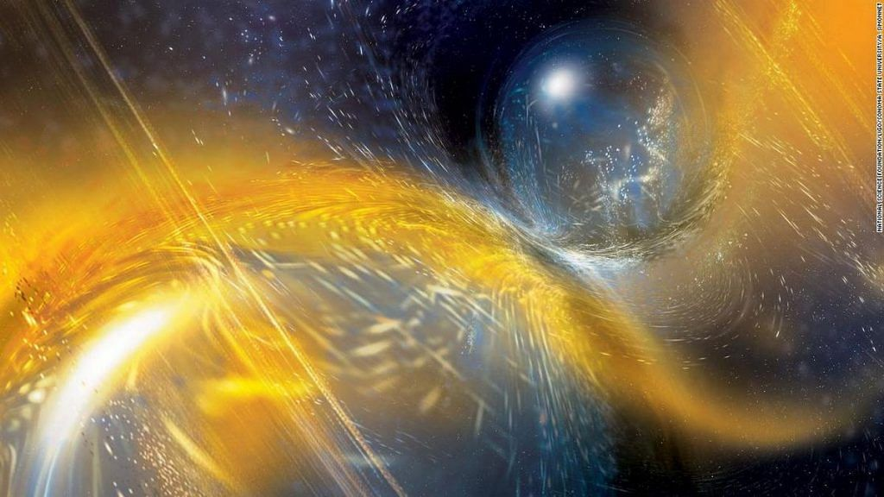
GW170817 + 70 Electromagnetic transients
Notes:
Only 4He and neutrons present….mergers or core collapse supernova…massive stars >8 solar mass
Alpha,n,n …r-process
Alpha, alpha, n
Alpha, alpha, alpha….handicapped by coulomb barrier

Slide 8
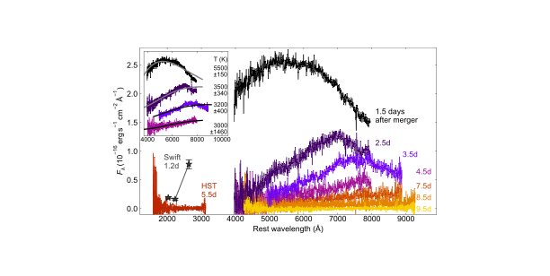
Lu visible signatures go into the IR
James Webb Dec. 2021
Does the r-process make the actinides?
Fission

Slide 9
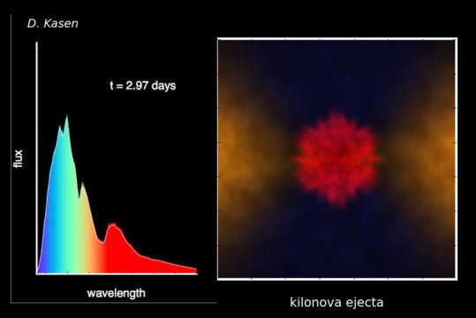
GW170817 +
70 Electromagnetic Transients
Implications for nuclear physics
LIGO, VIRGO, GAGRA began new observation run on May 24, 2023
Notes:
Question arise…..establish that a merger is a potential site for the r-process….

Slide 10
Actinides…Superheavies?
Notes:
What are the superheavy elements?
Are there more elements?

Slide 11


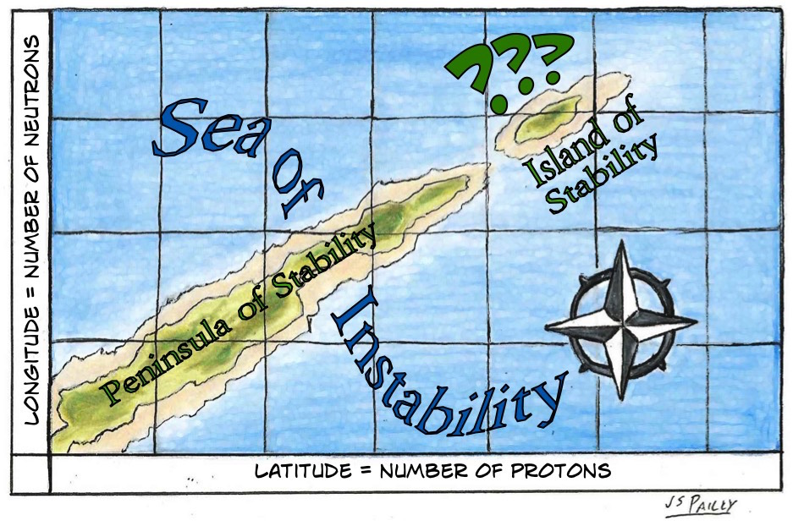
Glenn Seaborg as Head of the AEC
Seaborg received the Nobel price in 1951 for the for the “discoveries in the chemistry of the transuranium elements” (plutonium) and pushed for heavier element searches!

Slide 12
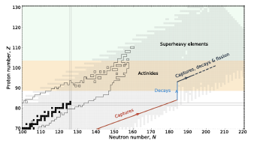

Slide 13
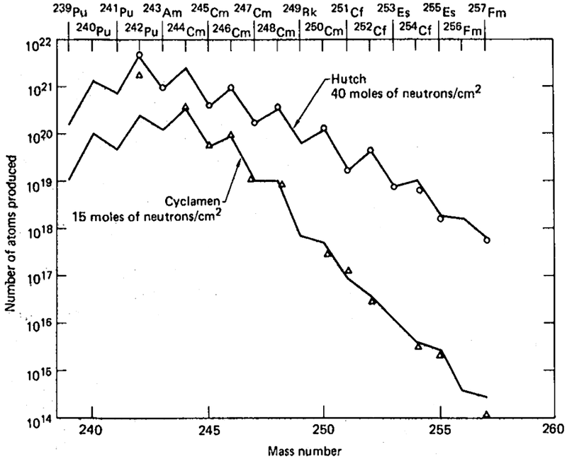
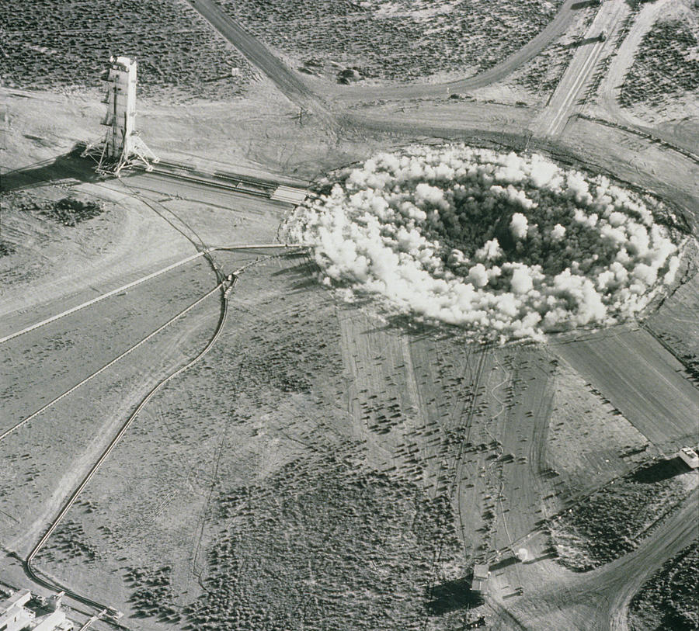
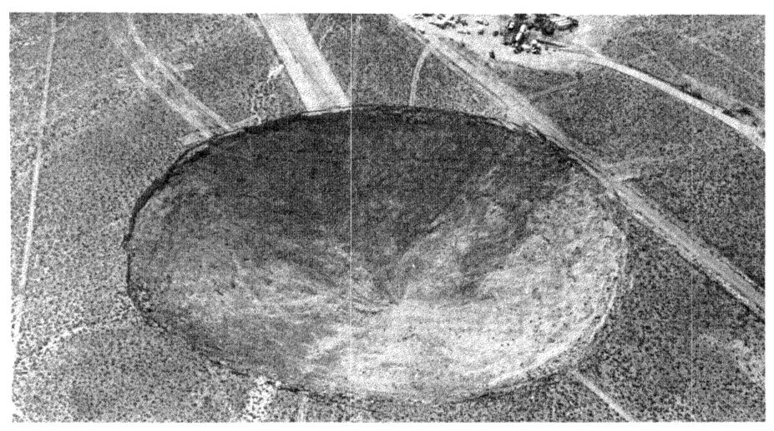
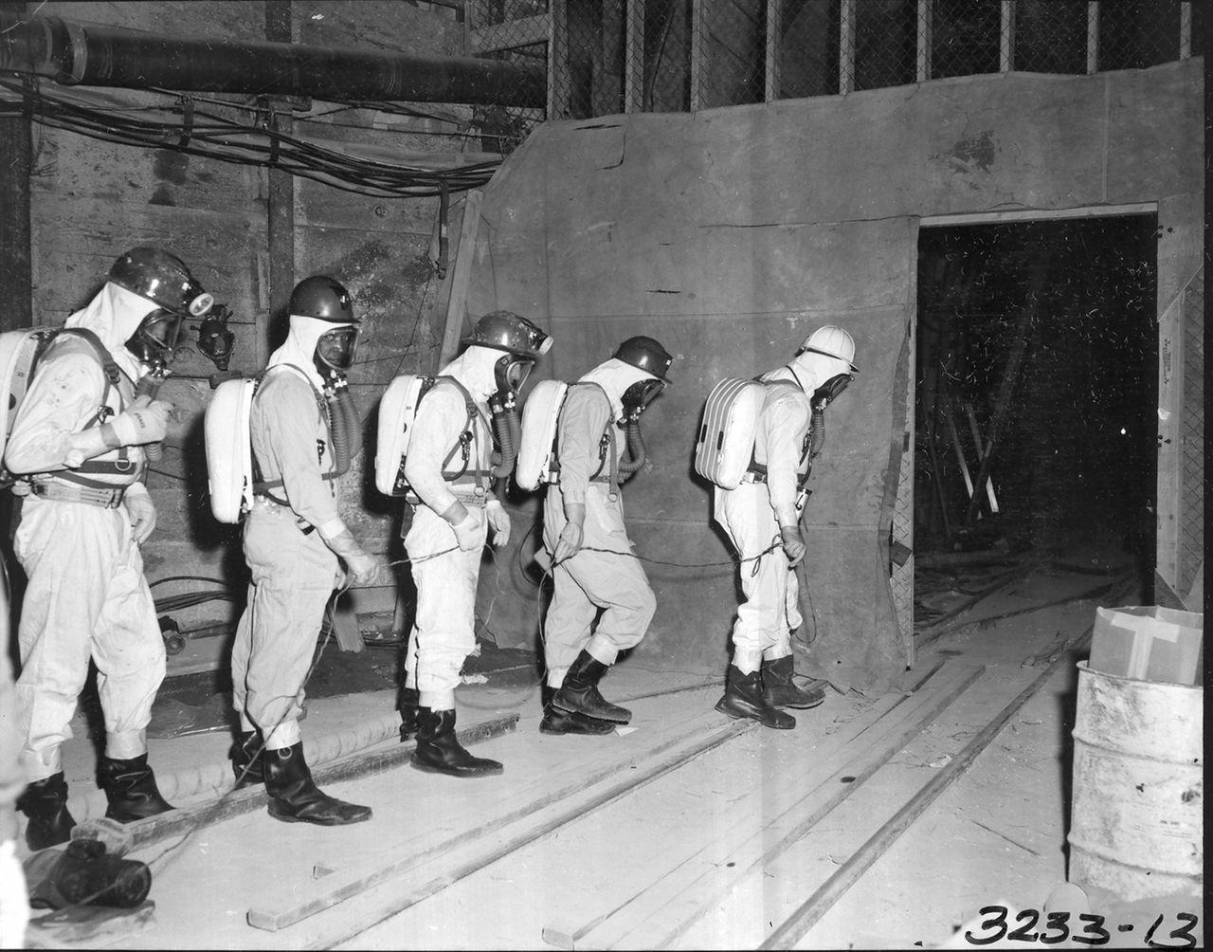
Underground Tests
Between 1962 and 1969 and codenamed Anacostia (5.2 kilotons, 1962), Kennebec (<5 kilotons, 1963), Par (38 kilotons, 1964), Barbel (<20 kilotons, 1964), Tweed (<20 kilotons, 1965), Cyclamen (13 kilotons, 1966), Kankakee (20-200 kilotons, 1966), Vulcan (25 kilotons, 1966),
and the biggest one Hutch (~200 kilotons, 1969).
These tests proved more successful with regards to the search of new elements, despite rock melting. Hundreds of kilograms of rock samples were collected and tested.

Slide 14
r-process idea from weapons tests: B²FH
Reviews of Modern Physics 29(4), 547 (1957)
Z=99 Es
Z=100 Fm
R. Hoff, August 21, 1978
Neutron star: 10⁴³ or 10⁴¹ neutrons/cm²
Notes:
As you heard from Michael Wiescher….nuclear astrophysics and nuclear physics advanced due to the weapons developments and tests….
Es/Fm thought to exist in the natural reactor cave but decayed away….

Slide 15
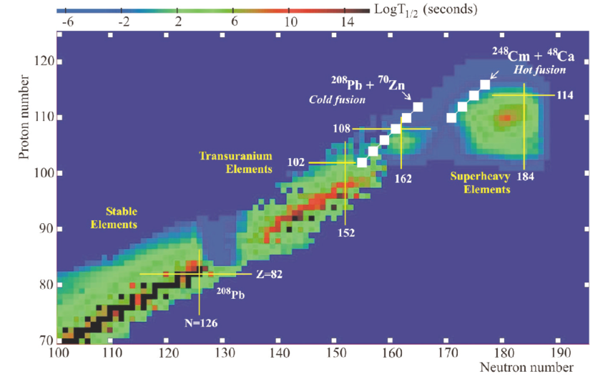
Y. Oganessian

Slide 16
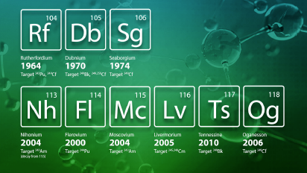


Slide 17
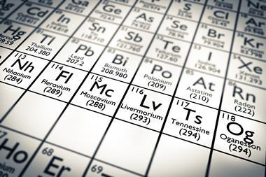
Collaboration
LLNL
JINR
ORNL
RIKEN
Z=120
From ⁴⁸Ca induced reactions
Z=174
Notes:
Are there elements beyond 118?
High luminosity accelerators
High efficiency recoil separators

Slide 18
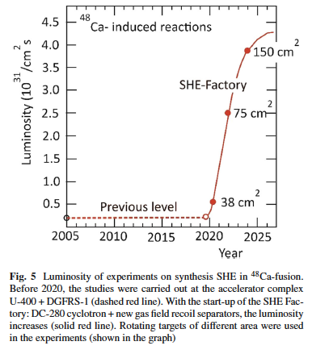
JINR: Dubna
Progress at SHE-Factory

Slide 19
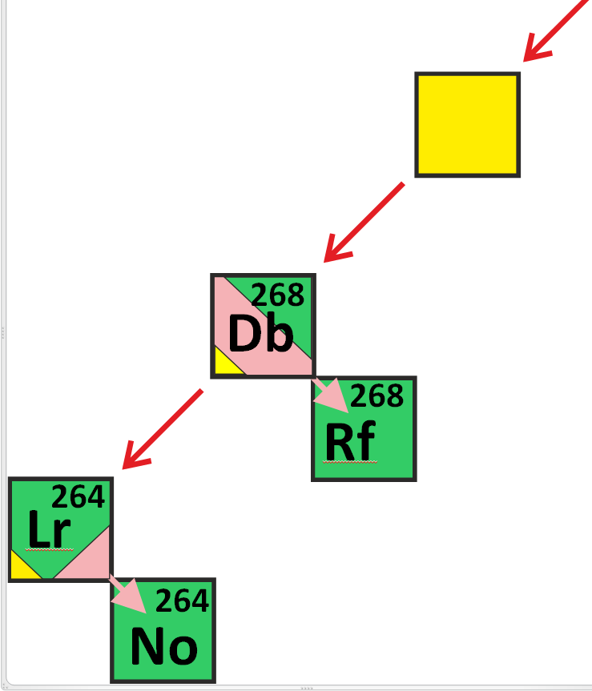
272
Bh
α₅
105
EC
(T_{1/2} )_{exp} = 28.3 h
T_{1/2} (α₆) _{exp} = 16 h
~50%
α₆
T_{EC} ≈ 2-10 h
T_{SF} ≈ 1 s
T_{SF} ≈ 0.2 h
Modes of the spontaneous fission
T_{SF} ≈ 0.1 s
Yuri Oganessian. International Conference “Heaviest Nuclei and Atoms” Apr.25-30, 2023, Yerevan

Slide 20
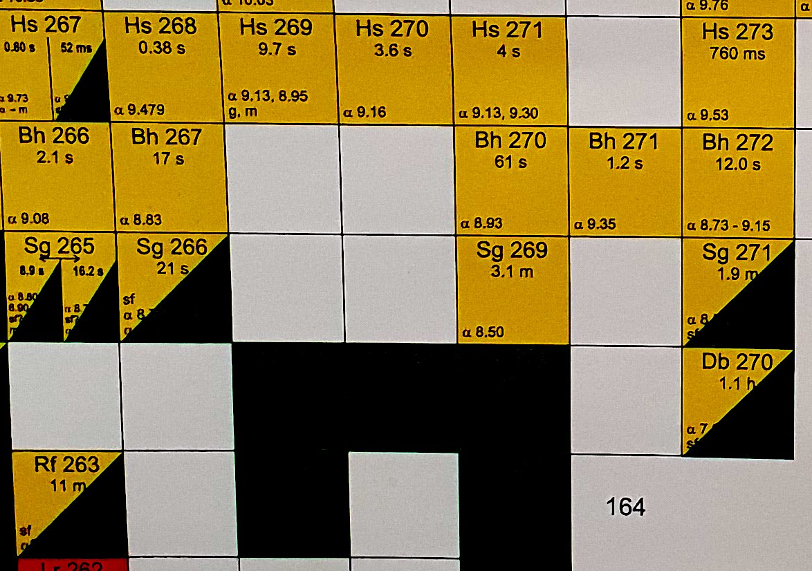
232Th + 48Ca → 280Ds*
New nuclei ²⁷⁶Ds, ²⁷²Hs, ²⁶⁸Sg
New isotope ²⁷⁵Ds, confirmation for ²⁷¹Hs, ²⁶⁷Sg, and ²⁶³Rf
First observation of transition to the mainland
275Ds
5n
276Ds
4n
new
new
Yuri Oganessian. International Conference “Heaviest Nuclei and Atoms” Apr.25-30, 2023, Yerevan
conf
new
conf
new
125 new decay chains
New isotopes
Connect to mainland
conf

Slide 21
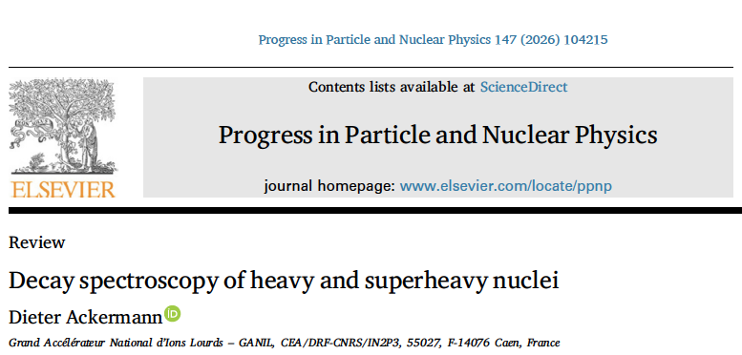
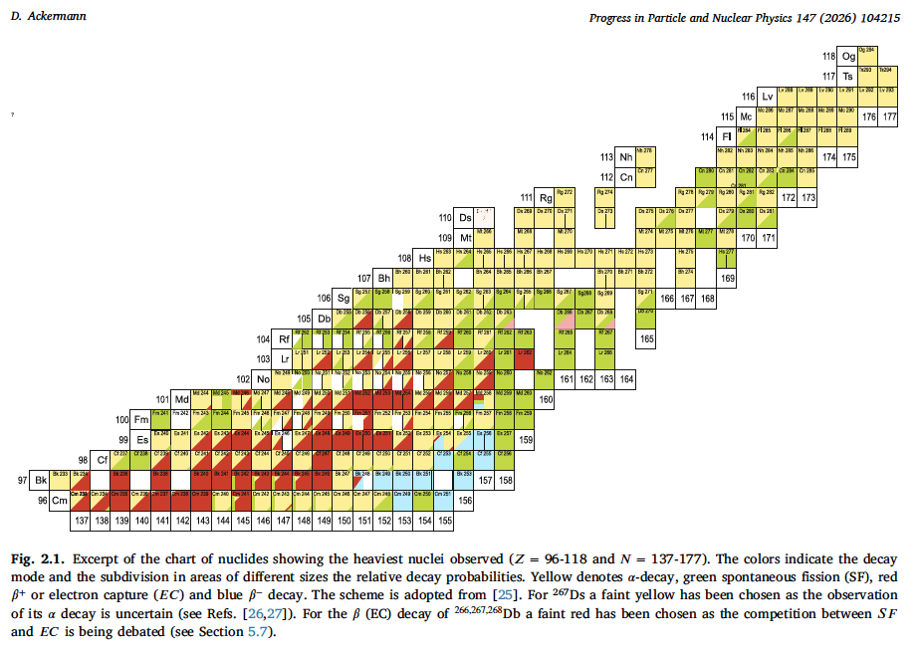
Yellow: alpha decay
Green: SF
Red: β+ or EC
Blue: β-

Slide 22
Are superheavy elements produced in the r-process?
Notes:
Blinnikov mentioned the Lattimer and Schramm….predictions….some of these questions have been answered now..from Dubna

Slide 23
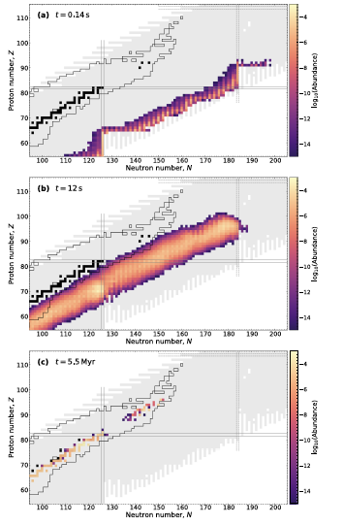
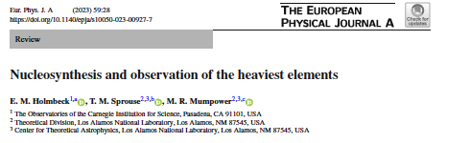
Snapshots of Simulations
Input is limited to what we know

Slide 24
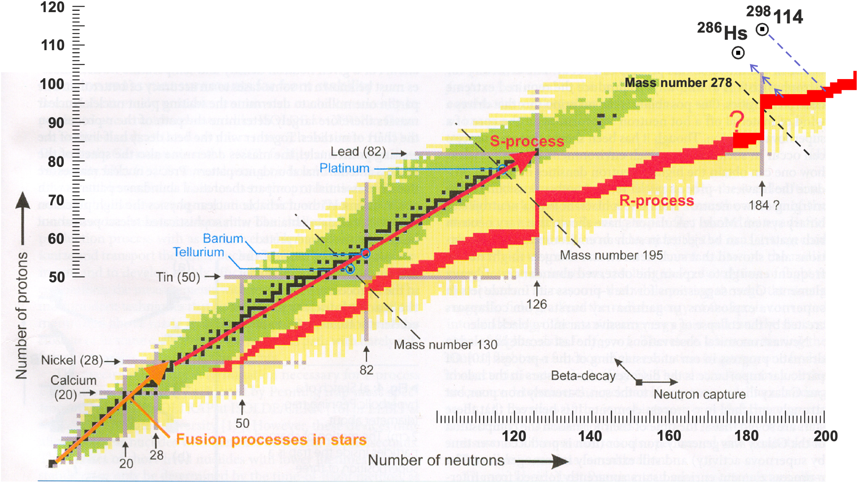
Z=114
Fl
Z=108
E. M. Holmbeck, European Physical Journal A, 59:28 (2023)

Slide 25
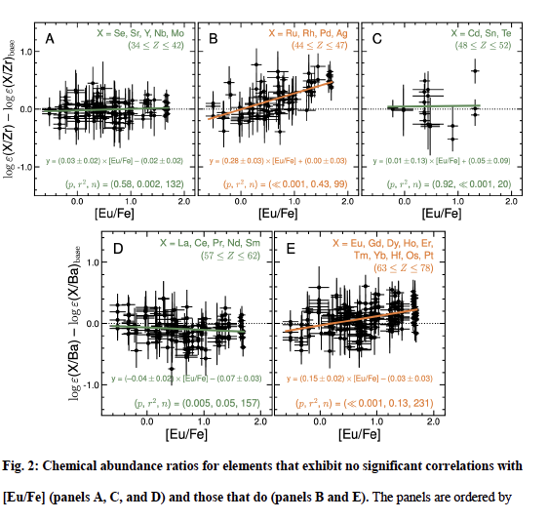

Recent observations of r-process enhanced stars
Science 382, No.6675, Dec. 2023
Ru, Rh, Pd, Ag
A>260 (110+ 150) were made in the r-process
Eu, Gd, Dy, Ho, Er,
Tm, Yb, Hf, Os, Pt
Fission recycling!

Slide 26
Open Challenges to Nuclear Physics
resulting from the neutron star merger
Aprahamian
NuPECC in Sept. 2021
Fission

Slide 27
Figure by Mumpower

Slide 28
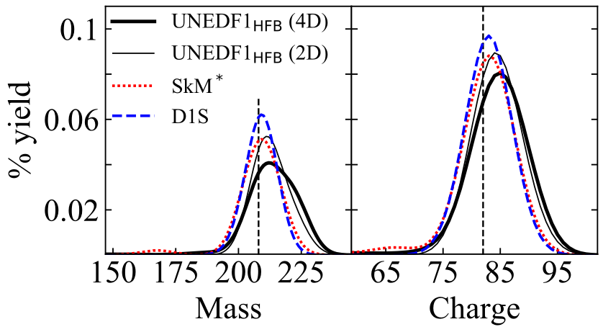
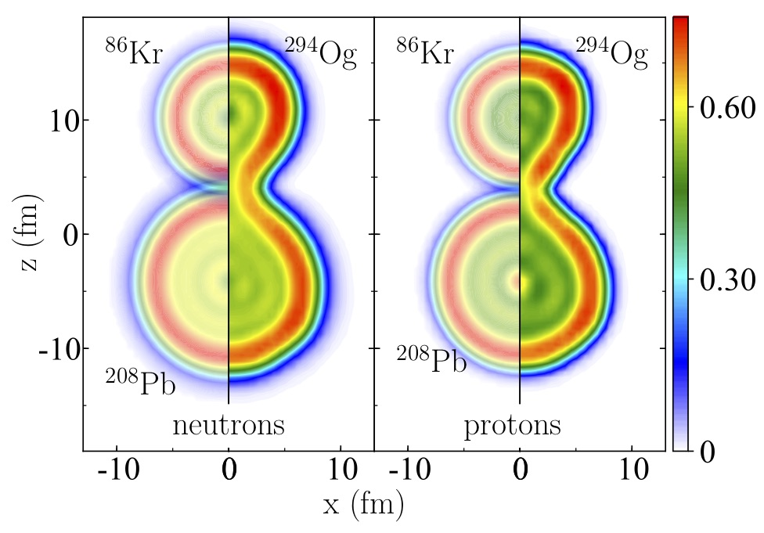
Cluster decay becomes the main fission mode
294Og→ 208Pb+86Kr₅₀
Z. Matheson et al., Phys. Rev. C 99, 041304(R) (2019)
Robust prediction: extremely asymmetric fission
Courtesy of W. Nazarewicz

Slide 29
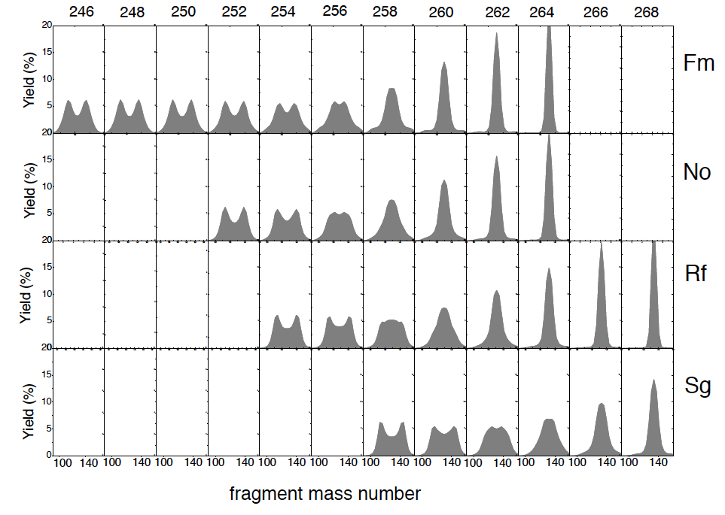
Discovery of mass-symmetric spontaneous fission of ²⁵⁸Fm: Z=2^{x}50 N=2^{x}79
Magic numbers
Z=50 & N=82
in nuclear fission
E. K. Hulet et al., PRL 56, 313 (1986)
Calc. N. Carjan, 2015
260
Yuri Oganessian. International Conference “Heaviest Nuclei and Atoms” Apr.25-30, 2023, Yerevan

Slide 30
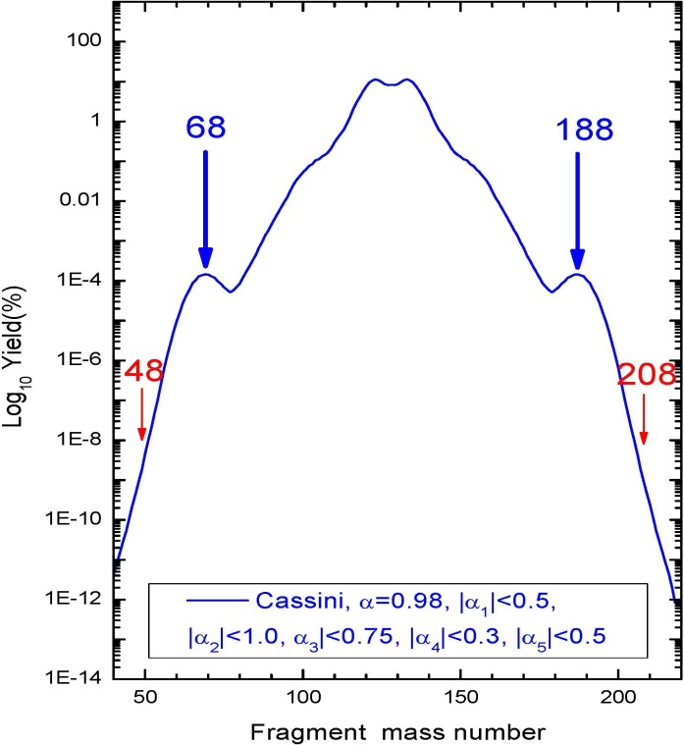
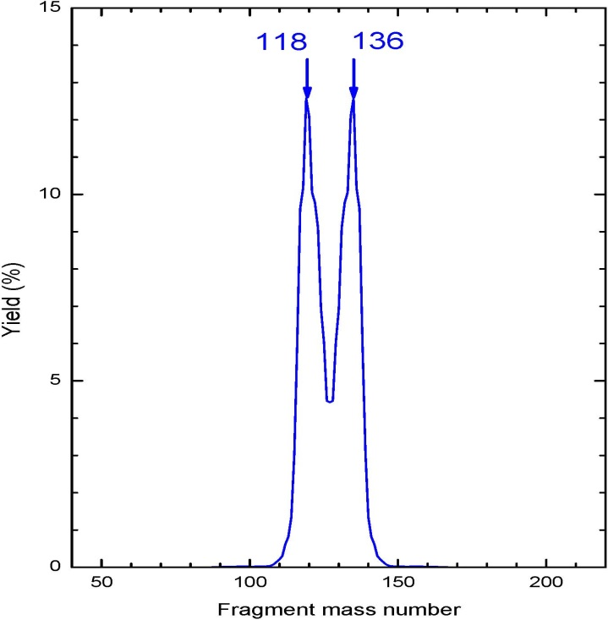
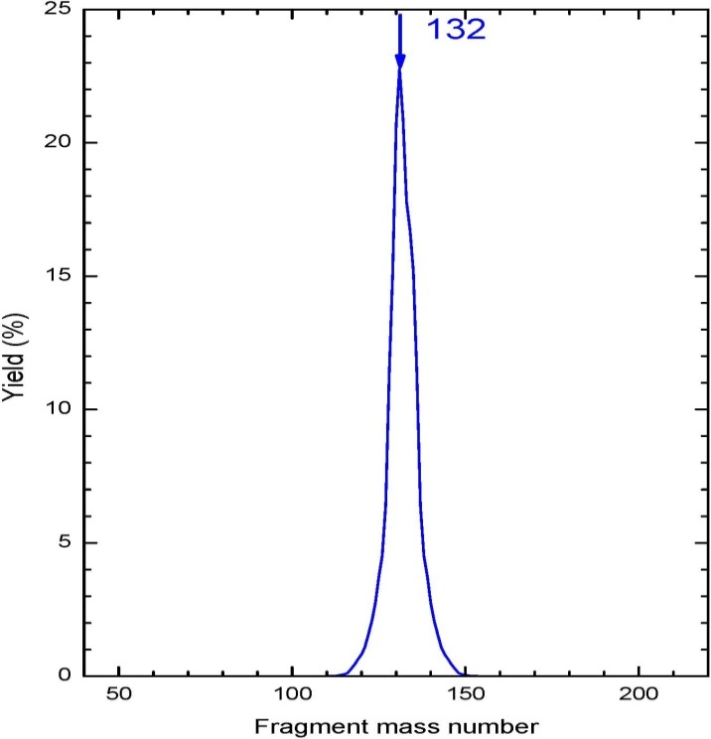
2
The three fission patterns of Nobelium
predicted by the pre-scission model
0
-2
Log₁₀ Yield(%)
-4
Yield(%)
-6
-8
-10
10
-12
Yield(%)
-14
50
100
150
200
20
5
Fragment mass number
15
Super-asymmetric ²⁵⁶No
7 amu
0
10
50
100
150
200
Fragment mass number
5
Regular asymmetric ²⁵⁴No
0
50
100
150
200
Fragment mass number
Super-symmetric ²⁶⁴No

Slide 31
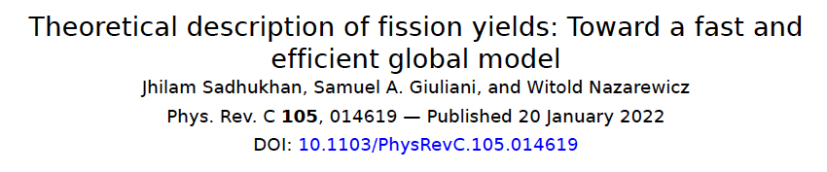
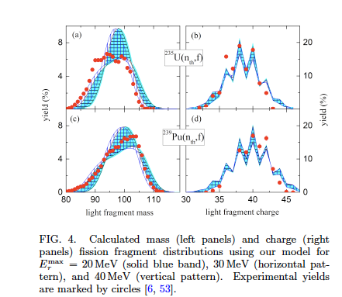
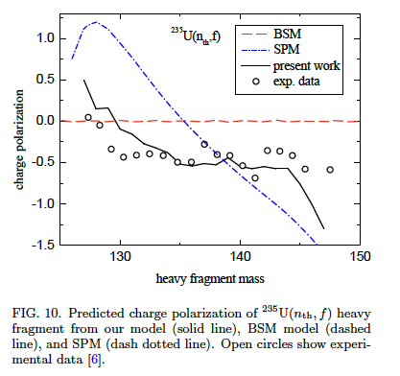
Notes:
Scission point models
Brownian motion models

Slide 32


Conclusion: Superheavies are probably made in the r-process!
Did the merger indeed make the actinides?
How far did the nucleosynthesis go?
What is the role of fission ?
What type of fission?
Fission (?): LLNL – ND- LBNL-JINR Dubna
Bomb debris from environmental tests of nuclear weapons
NIF experiments
LBL
Thank you for your attention!

