Slide 1




Fission studies using quasi-free scattering reactions in
Inverse kinematics
IOP Nuclear Physics Conference
Brighton, April 13-15 2026
J. Benlliure
Instituto de Física Corpuscular (CSIC – Univ. Valencia)

Slide 2

Why still fission?
One of the most interesting and challenging processes in nuclear physics
Fission has implications in many different domains:
- Nuclear structure at large deformation.
Dynamics of highly excited nuclear matter.
Nuclear astrophysics: r process.
Production of RIBs and super-heavies.
Energy.
Radiotracers for medical use.
Lisa Meitner and Otto Hahn
1938
A conceptually complicated process:
- Largest scale collective motion in nuclei.
Interplay between intrinsic and collective degrees
of freedom.
Governed by macroscopic and microscopic components
in the nuclear potential.
A difficult experimental characterization:
Atomic number of fission fragments only at reach in
inverse kinematics.
Full identification of both fission fragments only
achieved not so long ago.
José Benlliure
IOP-NPC Brighton, April 2026

Slide 3
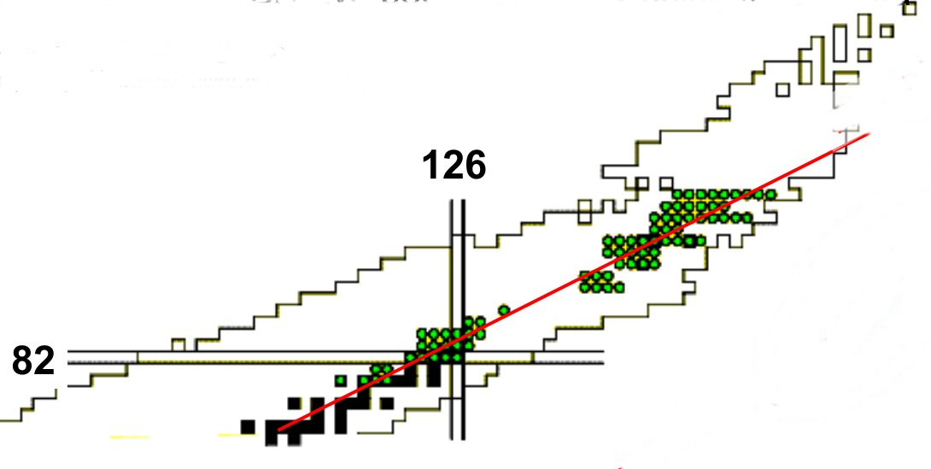
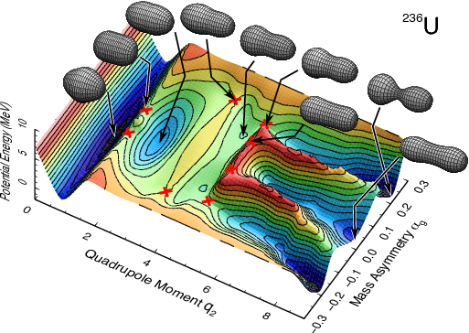
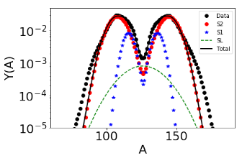
The potential energy surface
Observables and measurements
Fission barriers
Fission fragments yields (A or Z)
Potential surface in deformation and mass asymmetry
Fission probabilities
A and Z distribution of fission fragments
Fission modes → role of shell effects.
José Benlliure
IOP-NPC Brighton, April 2026

Slide 4
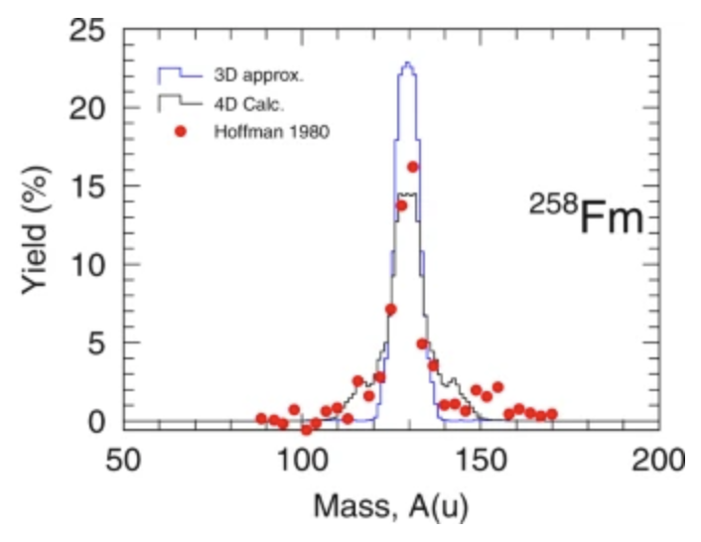
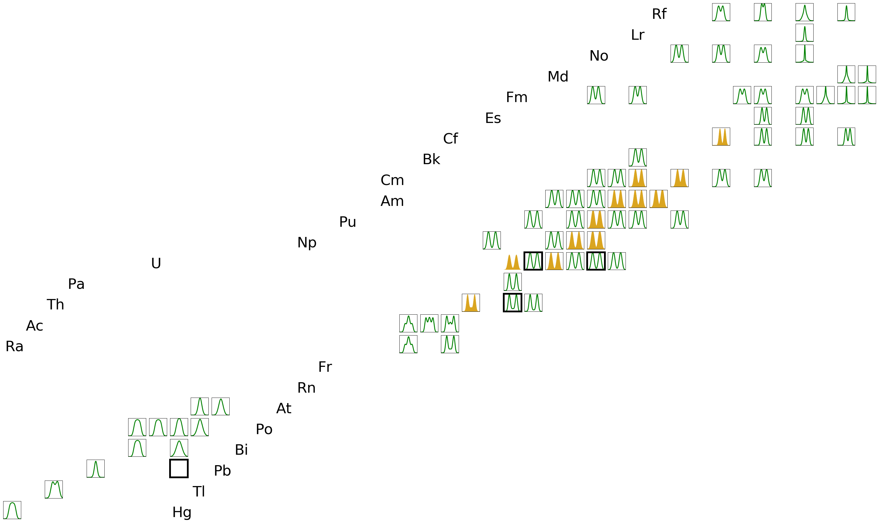
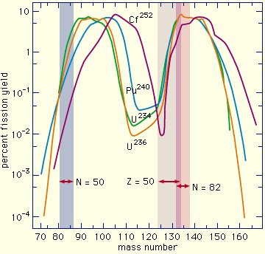
The potential energy surface
Fission yields and structural effects in the potential energy surface
Before 2000
Mostly mass distributions.
A distribution
A&Z_{light} distribution
K.S. Krane Introductory Nuclear Physics,
John Willey & sons, inc 1988
Asymmetric yields in actinides and narrow distributions around ²⁵⁸Fm explained by the dominant role of spherical shells N = 82 and Z = 50.
José Benlliure
IOP-NPC Brighton, April 2026

Slide 5
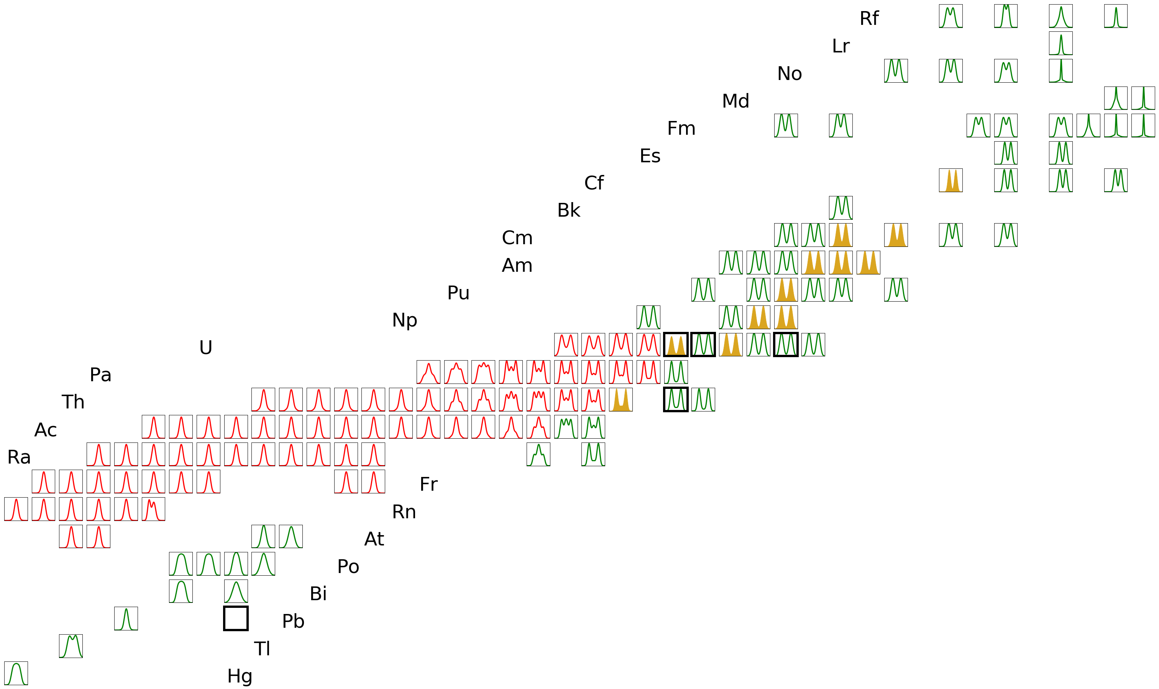
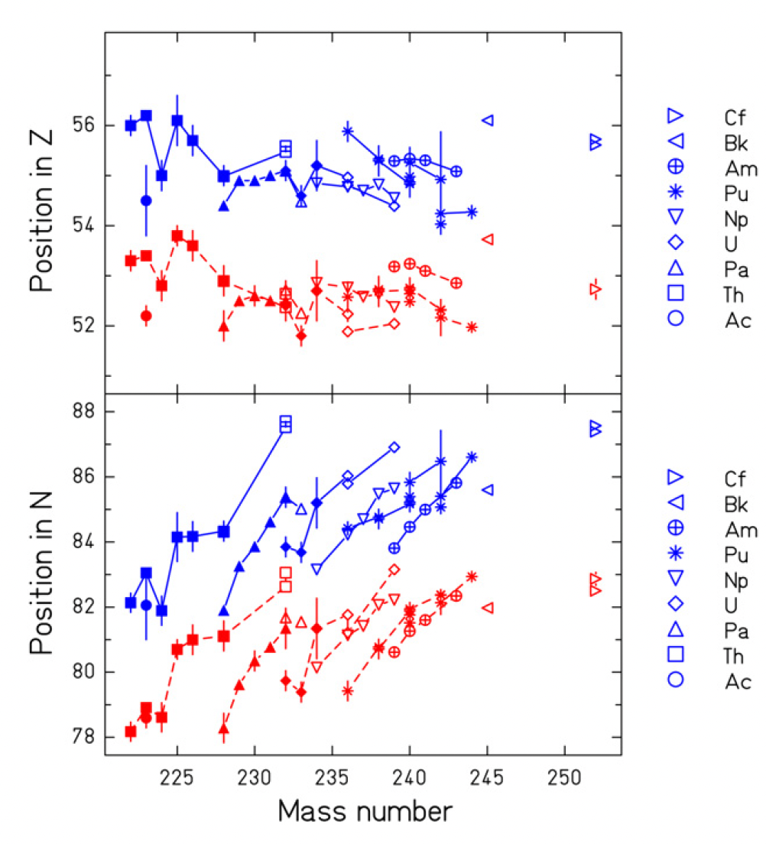
The potential energy surface
Fission yields and structural effects in the potential energy surface
Year 2000
First complete measurement of fission Z-yields
in inverse kinematic experiments at GSI.
K.-H. Schmidt et al. NPA (2000)
A distribution
A&Z_{light} distribution
Z distribution
The systematic measurement of charge distributions shows a dominant role of protons for Z_{H}~52-55, in contradiction with previous interpretations.
José Benlliure
IOP-NPC Brighton, April 2026

Slide 6

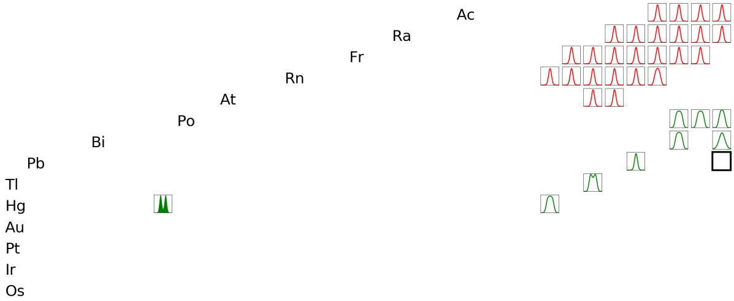
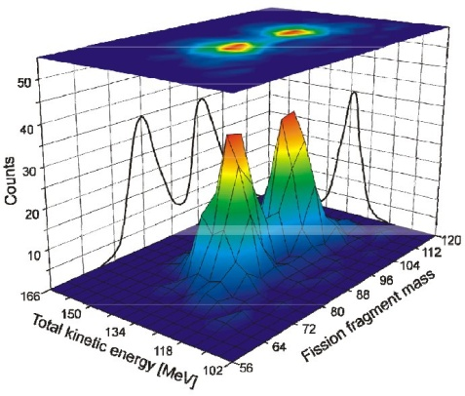
The potential energy surface
Fission yields and structural effects in the potential energy surface
Year 2010
Unexpected asymmetric fission of ¹⁸⁰Hg measured in β-delayed fission at Isolde (2x⁹⁰Zr₅₀).
A. Andreyev et al. PRL 105, 252502 (2010)
L. Ghys et al., PRC 90, 044305 (2014)
A distribution
A&Z_{light} distribution
Z distribution
¹⁸⁰Hg
José Benlliure
IOP-NPC Brighton, April 2026

Slide 7
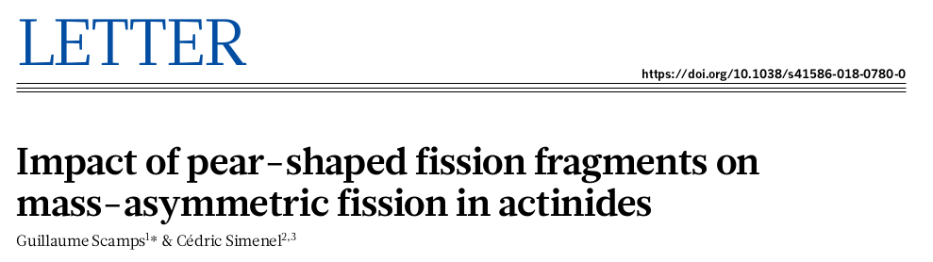
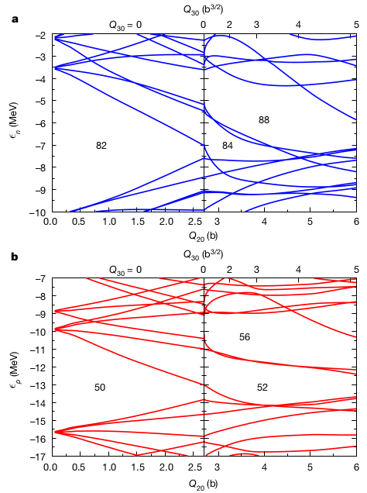
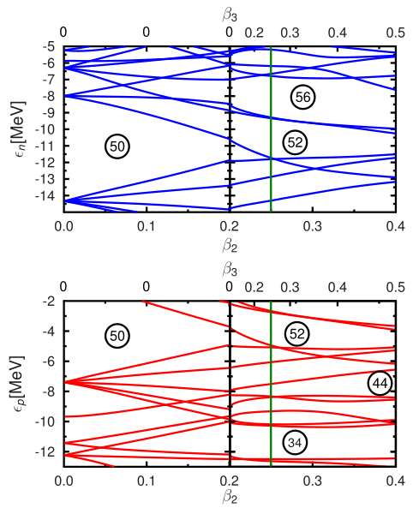
The potential energy surface
Fission yields and structural effects in the potential energy surface
Year 2018
G. Scamps and C. Simenel PRC 105, 041602 (2019)
Actinides
Pre-actinides
neutrons
Octupole deformed proton shells around Z=52-56 explain the strong role of Z_{H}~54 configurations in the Z-yields of actinides and together with N=88 will favor the formation of ¹⁴⁴Ba.
Octupole deformed neutron shells at N=52-56 or Z=34 also would explain the asymmetric fission of ¹⁸⁰Hg into ¹⁰⁰Ru₅₆ + ⁸⁰Kr₄₄
protons
José Benlliure
IOP-NPC Brighton, April 2026

Slide 8
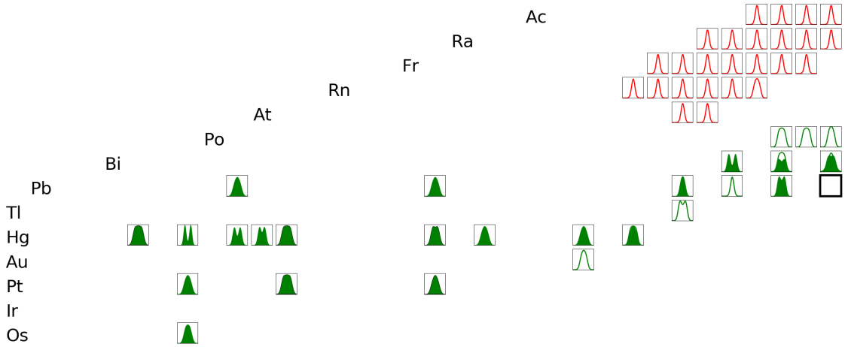
The potential energy surface
Fission yields and structural effects in the potential energy surface
Since 2018
Intense experimental program using measuring A-yields in
fusion-fission and transfer reactions at GANIL, JAEA, ANU,...
C. Schmitt et al. PRL 126, 132502 (2021)
B.M. Swinton et al., PRC 102, 054611 (2020)
E. Prasad et al., PLB 811, 135941 (2020)
I. Tsekhanovich et al., PLB 790, 583 (2019)
A. Bogachev et al. PRC 104, 024623 (2021)
E.M. Kozulin et al., PRC 105, 014607 (2022)
A distribution
A&Z_{light} distribution
Z distribution
A distribution
A&Z_{light} distribution
Z distribution
Mass yields measurements in pre-actinides confirmed the asymmetry around ¹⁸⁰Hg due to the neutron shell gap N_{H}~56 with . However, some works indicated the dominant role of Z_{L}~36 over the neutron shells.
Combined measurements of the A and Z fission yields are required to fully understand the role of the different shell gaps.
José Benlliure
IOP-NPC Brighton, April 2026

Slide 9
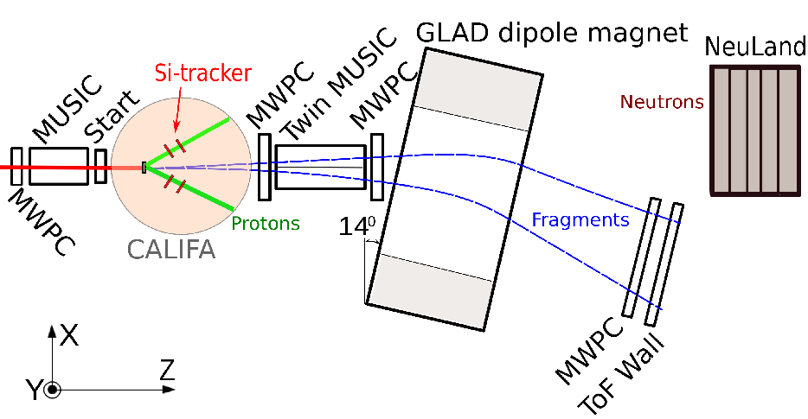
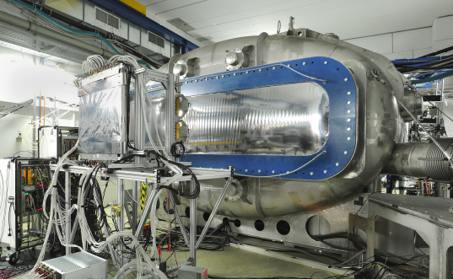
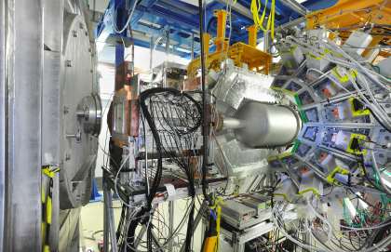
Complete measurements in inverse kinematics: R3B@FAIR
Complete identification in A, Z of both fission fragments, TKE, gammas and neutrons
Coulex and nucleon knockout
Setup capabilities
MUSIC, ToF-wall (σ_{ToF}~40 ps) and MWPCs (σ_{x}~200 μm): fission fragments ΔZ~0.37, ΔA~0.55
CALIFA and Si-tracker: protons and γ’s, pos. resol. 75 μm energy resolution. protons(gammas) 1% (5% @ 1 MeV),
Neuland: neutrons energy and multiplicity.
José Benlliure
IOP-NPC Brighton, April 2026

Slide 10
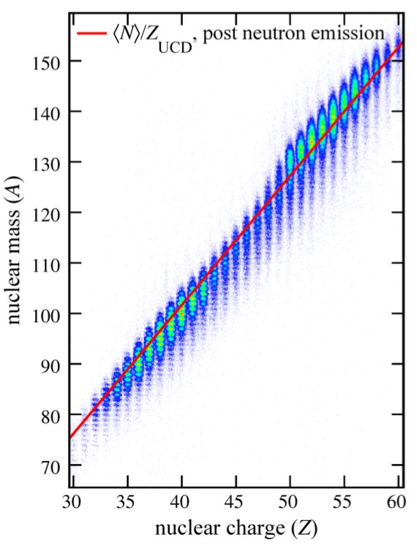
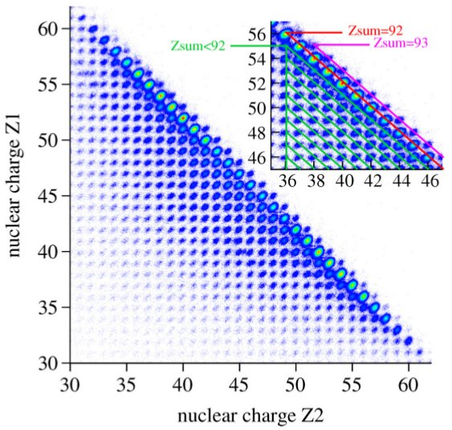
Complete measurements in inverse kinematics: R3B@FAIR
Complete identification of both fission fragments
For the first time both fission fragments were
identified by their atomic and mass numbers. Their
velocities were also determined with good accuracy.
ΔZ~0.4
ΔA~0.6
E. Pellereau et al., Phys. Rev. C 95, 054603 (2017)
J.L. Rodriguez et al., Phys. Rev. C 91, 064616 (2015)
José Benlliure
IOP-NPC Brighton, April 2026

Slide 11

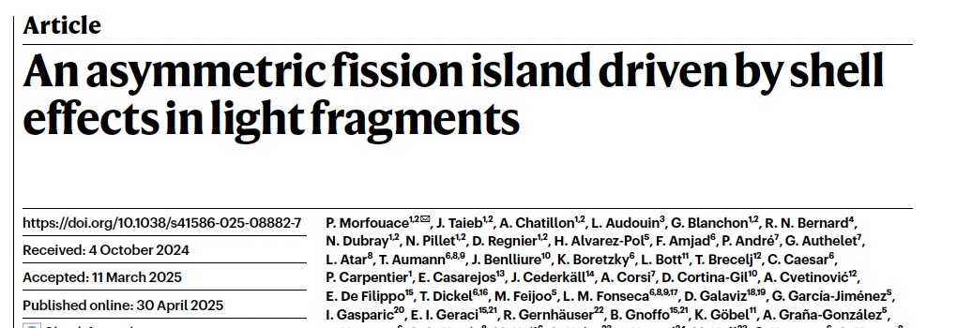
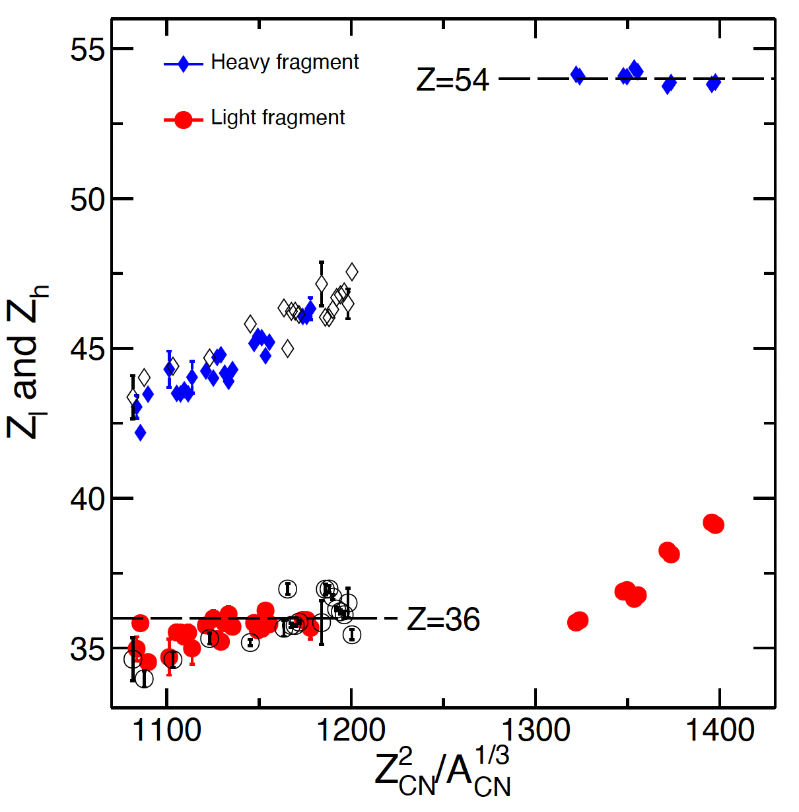
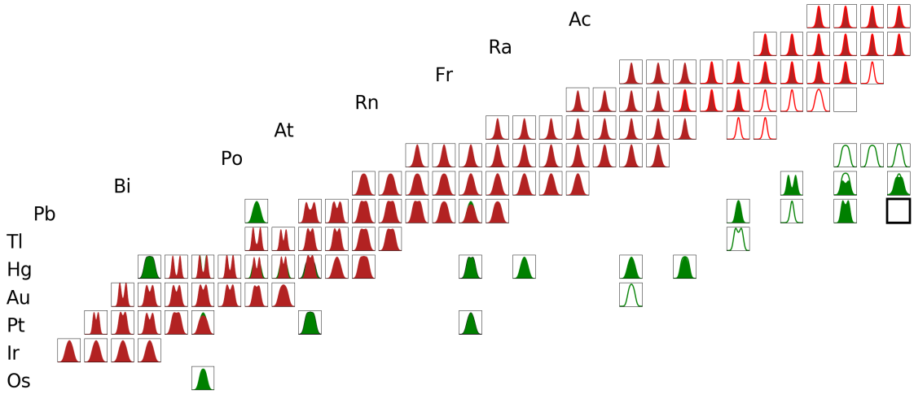
Complete measurements in inverse kinematics: R3B@FAIR
Fission yields and structural effects in the potential energy surface
Year 2025 (SOFIA@R3B - Coulex)
A distribution
A&Z_{light} distribution
Z distribution
A&Z distribution
Z_{H}~54
The SOFIA campaign in 2021 enabled the measured yields of fissioning nuclei to increase by 40%. These systematic measurements definitively confirm the role of the deformed shell at Z_{L}=36.
Z_{L}~36
José Benlliure
IOP-NPC Brighton, April 2026

Slide 12
Complete measurements in inverse kinematics: R3B@FAIR
Fission yields and structural effects in the potential energy surface
The investigation of the potential energy surface in fission during the last 20 years has focused on the role of deformed closed shells while the initial explanation of the asymmetric yields in fission was originally attributed to the spherical closed shells.
Year 2000
Year 2025
K.S. Krane Introductory Nuclear Physics,
John Willey & sons, inc 1988
P. Morfouace et al., Nature 641, 339 (2025)
Z_{H}~54
Z_{L}~36
Do spherical and neutron shells still have a role to play in fission?
José Benlliure
IOP-NPC Brighton, April 2026

Slide 13
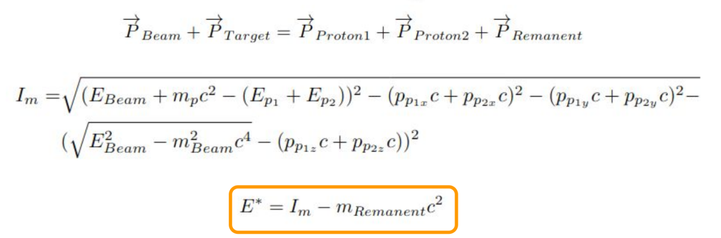
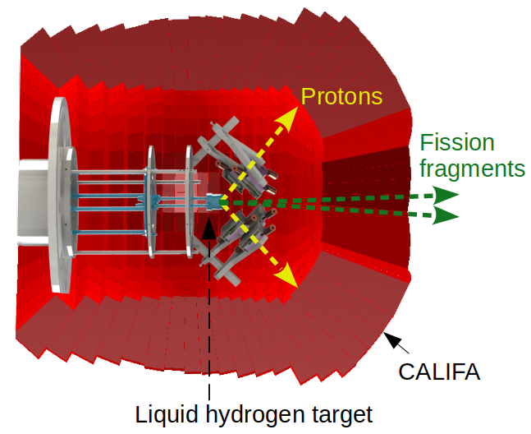
Complete measurements in inverse kinematics: R3B@FAIR
QFS-induced fission of 238U @ 540A MeV
(p,2p) fission
Emitted proton
Quasi-free scattering on protons provides the excitation energy of the fissioning system from the reconstruction of the missing energy measuring the momenta of the two outgoing protons.
Fast heavy
nucleus
Scattered proton
Emitted neutron
(p,pn) fission
Fast heavy
nucleus
Scattered proton
(p,p’) fission
Quasi-free scattering on neutrons or inelastic proton scattering can also provide some information on the excitation energy from the masses of the two final fragments .
Fast heavy
nucleus
José Benlliure
Scattered proton
IOP-NPC Brighton, April 2026

Slide 14
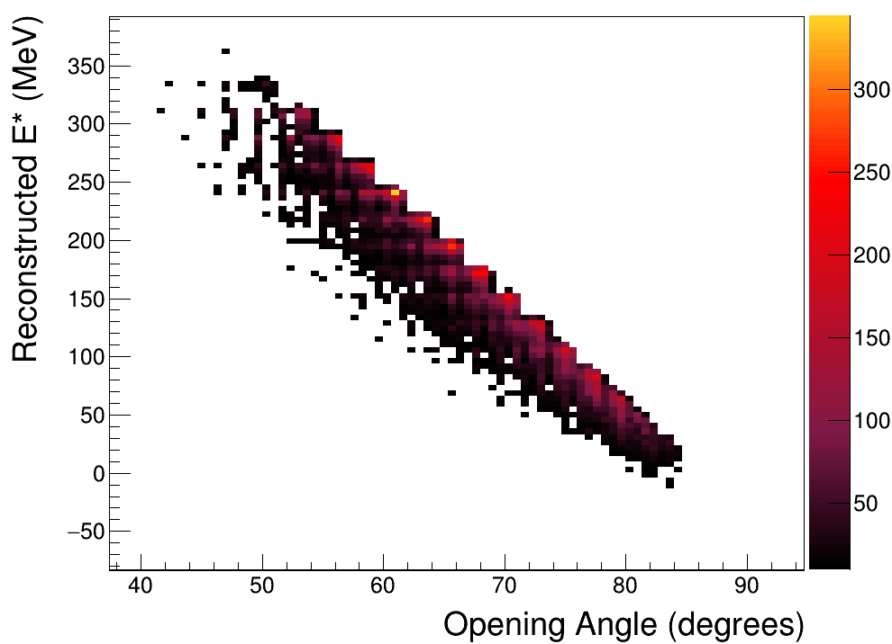
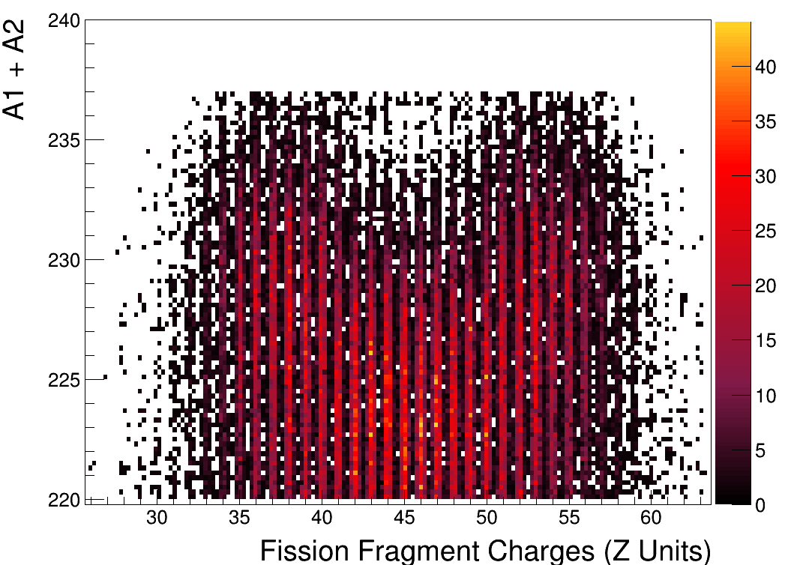
QFS-induced fission of 238U @ 540A MeV
Excitation energy from missing mass
Z₁ + Z₂ = 91
E*
Missing mass was obtained for QFS ²³⁸U(p,2p).
A1+A2 of the final fission fragments shows a good sensitivity to the excitation.
Gabriel García PhD, USC
José Benlliure
IOP-NPC Brighton, April 2026

Slide 15
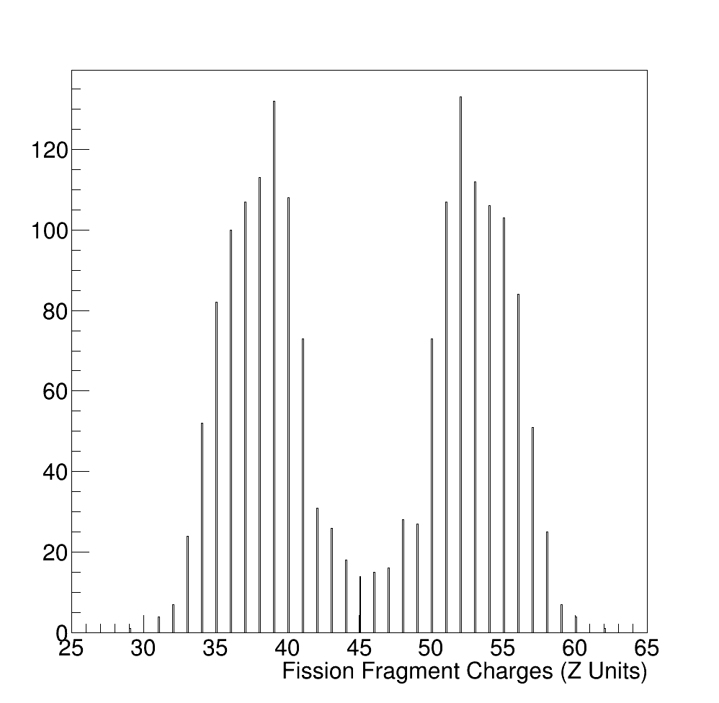
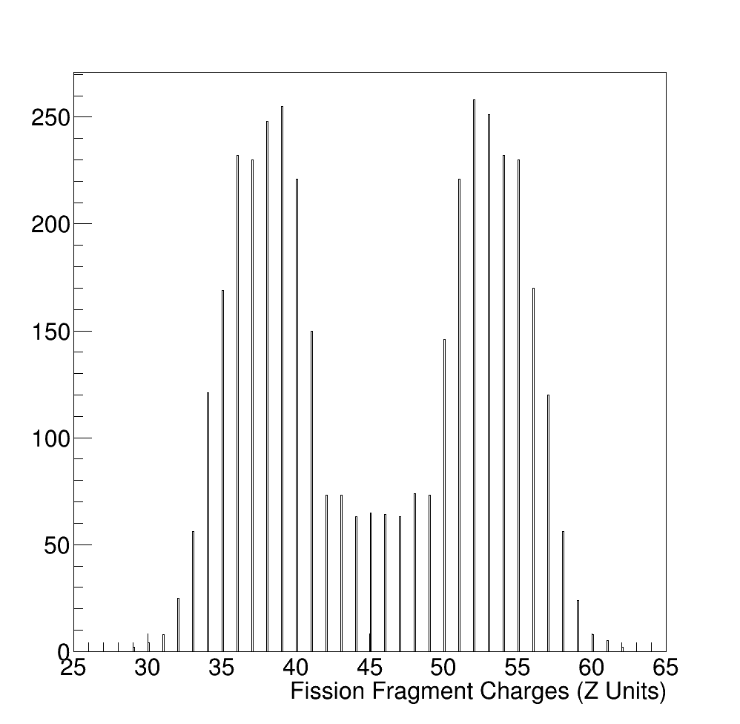
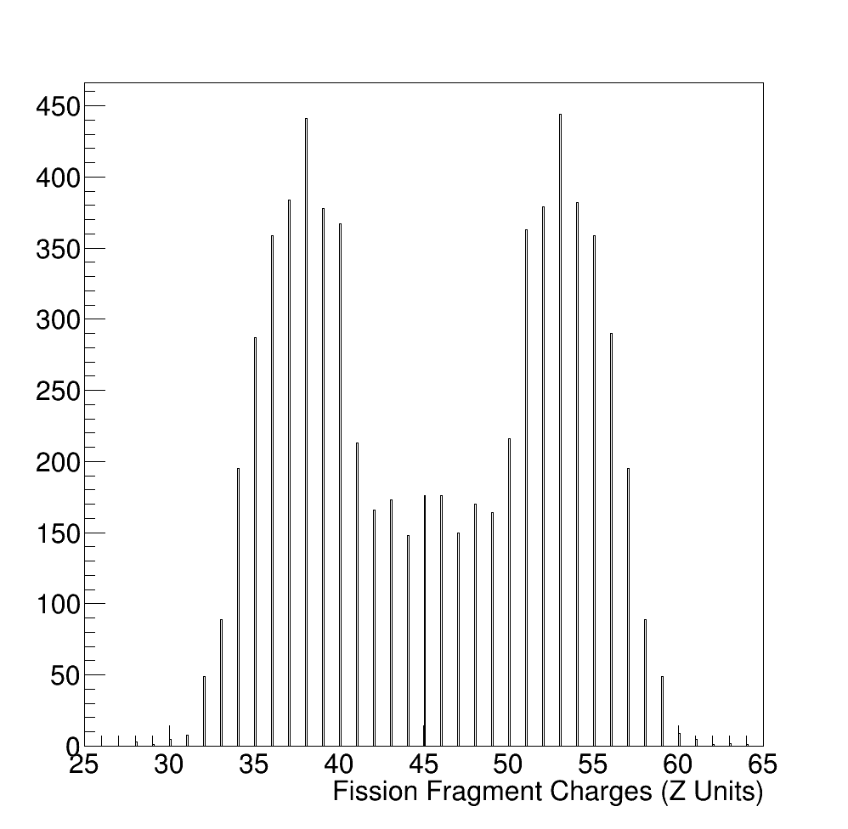
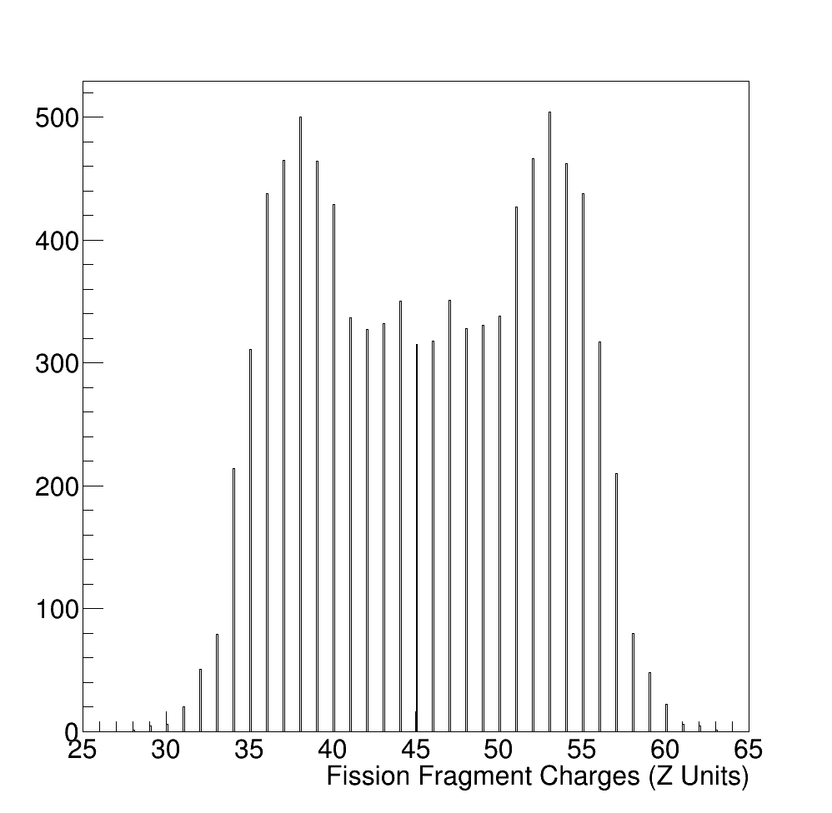
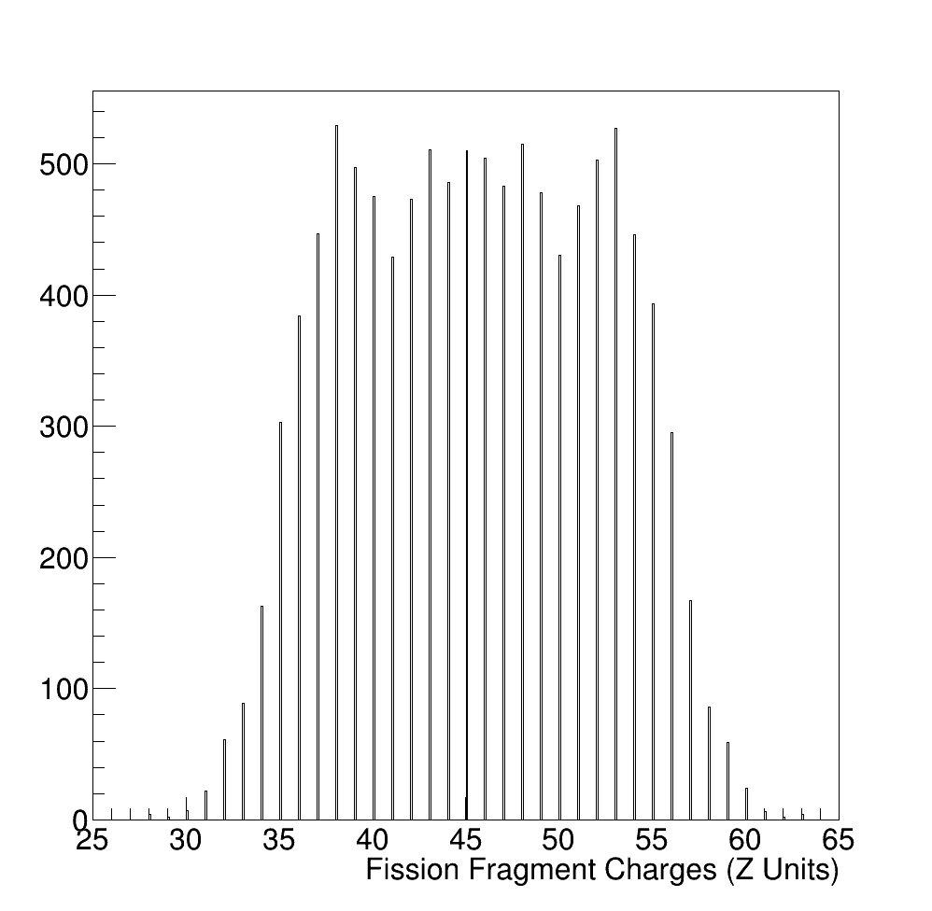
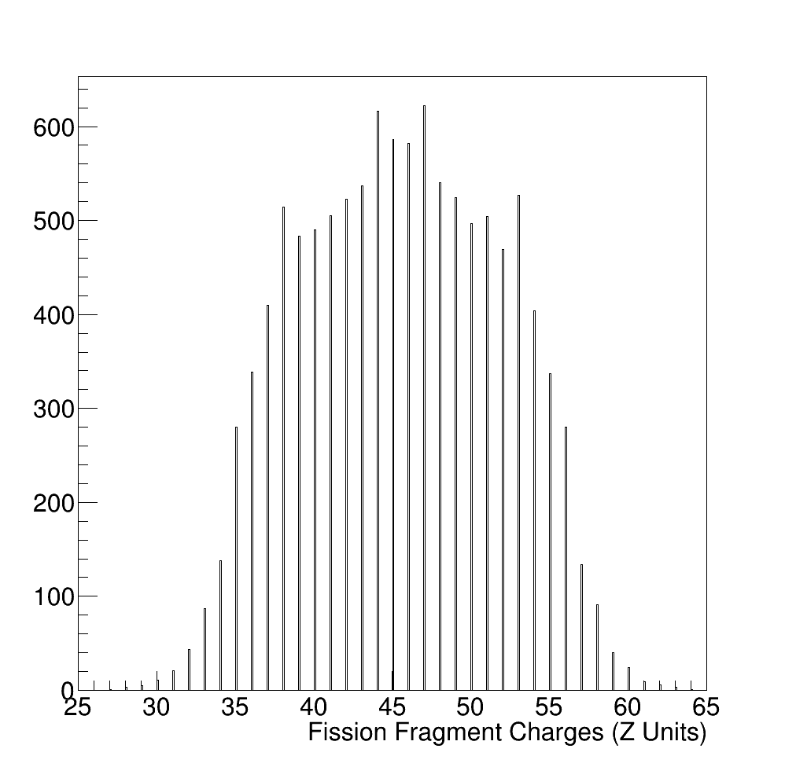
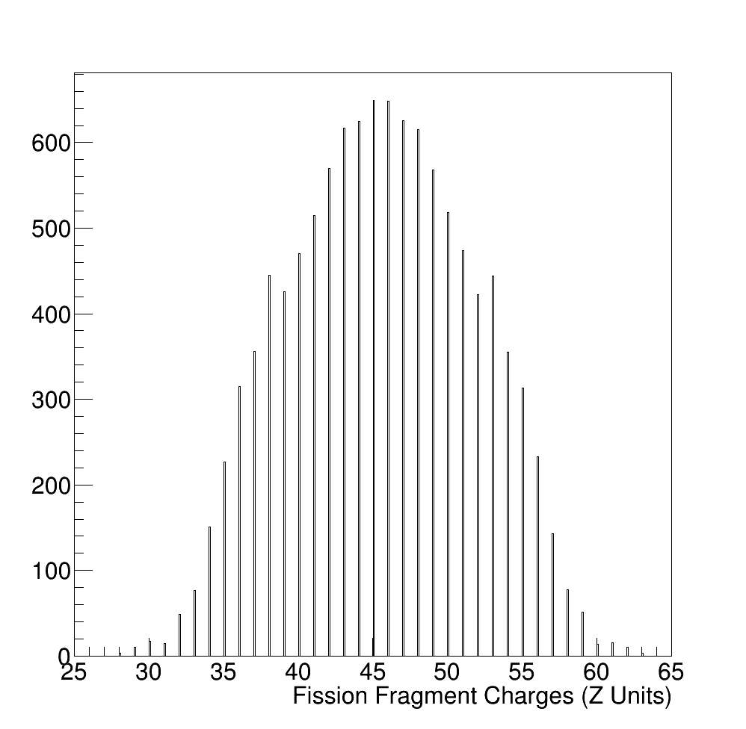
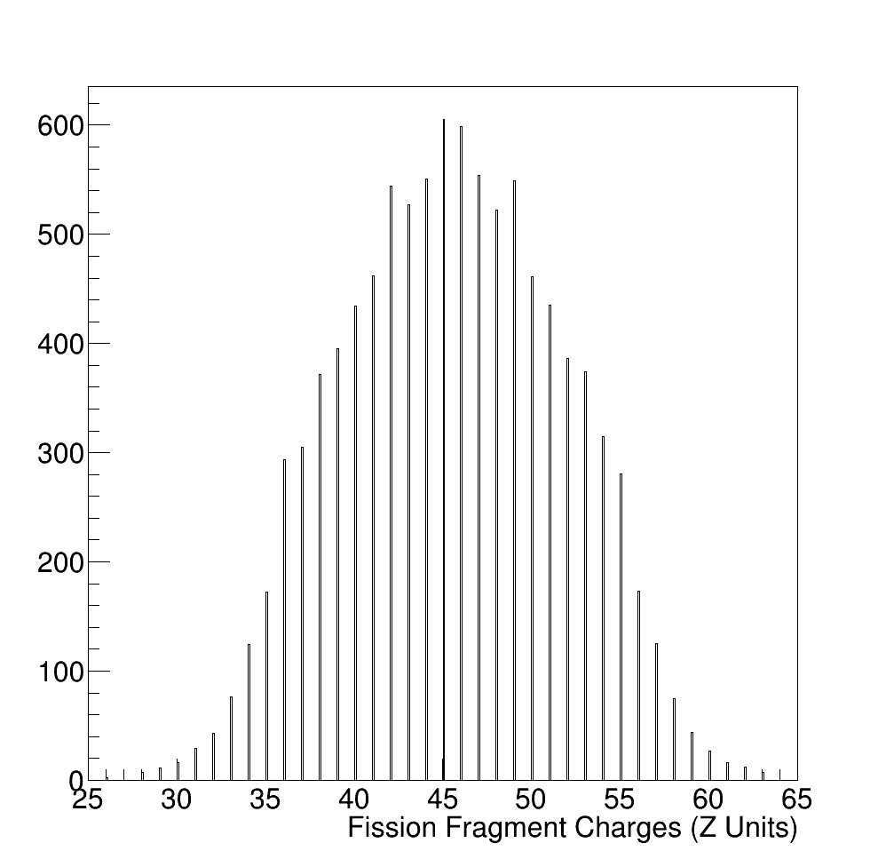
Evolution of the fission yields with the excitation energy
Damping of shell effects with the excitation energy
A₁+A₂=235
E*~8 MeV
A₁+A₂=233
E*~17 MeV
A₁+A₂=231
E*~33 MeV
A₁+A₂=229
E*~50 MeV
A₁+A₂=227
E*~65 MeV
A₁+A₂=225
E*~80 MeV
A₁+A₂=223
E*~100 MeV
A₁+A₂=221
E*~120 MeV
José Benlliure
Gabriel García PhD, USC
IOP-NPC Brighton, April 2026

Slide 16
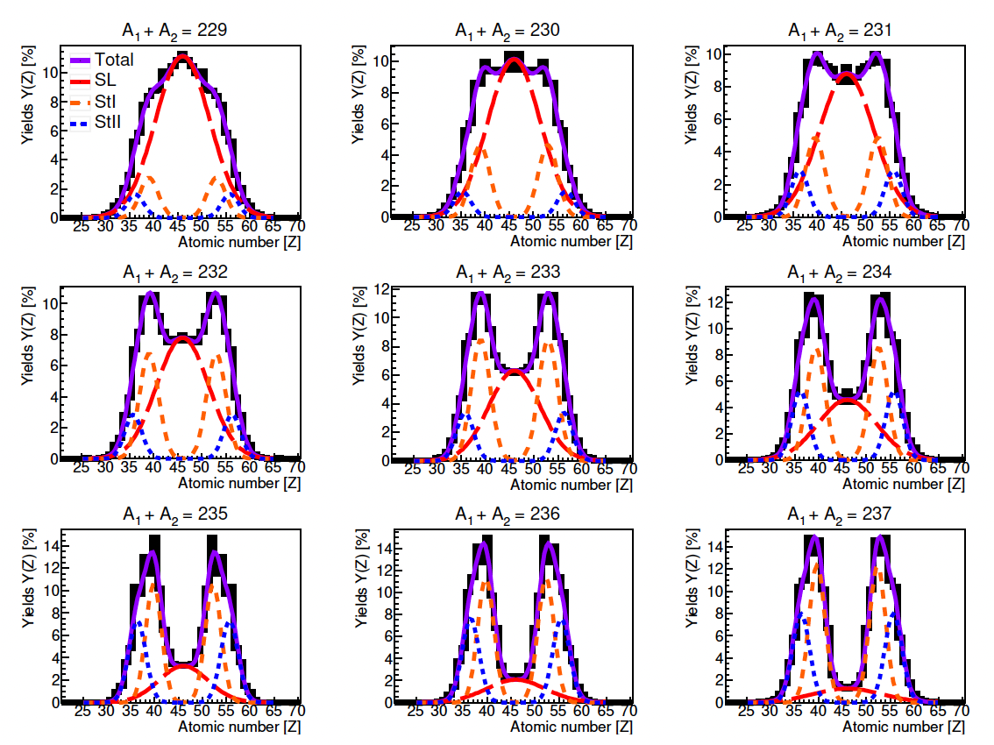
Evolution of the fission yields with the excitation energy
Evolution of fission modes in Z-yields with the excitation energy
José Benlliure
Antía Graña PhD, USC
IOP-NPC Brighton, April 2026

Slide 17
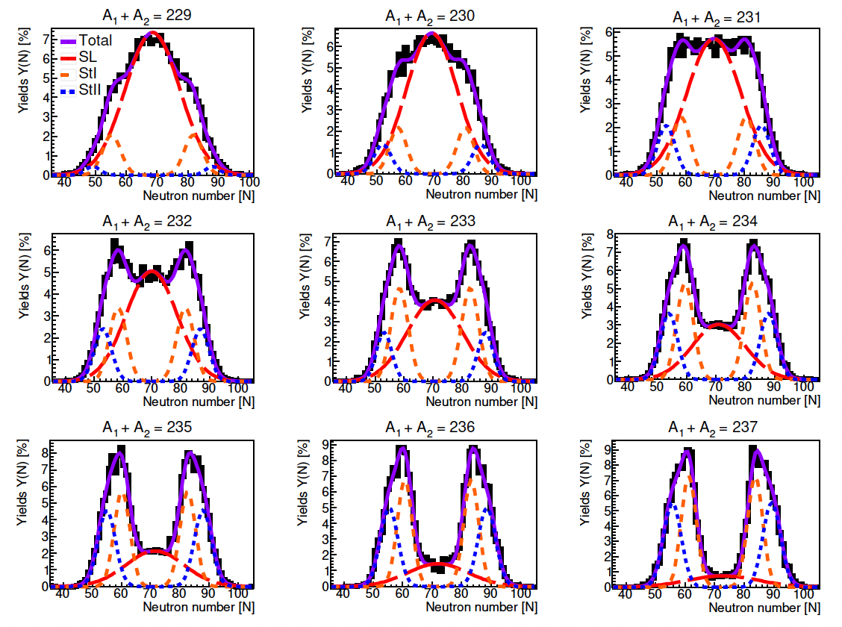
Evolution of the fission yields with the excitation energy
Evolution of fission modes in N-yields with the excitation energy
José Benlliure
Antía Graña PhD, USC
IOP-NPC Brighton, April 2026

Slide 18
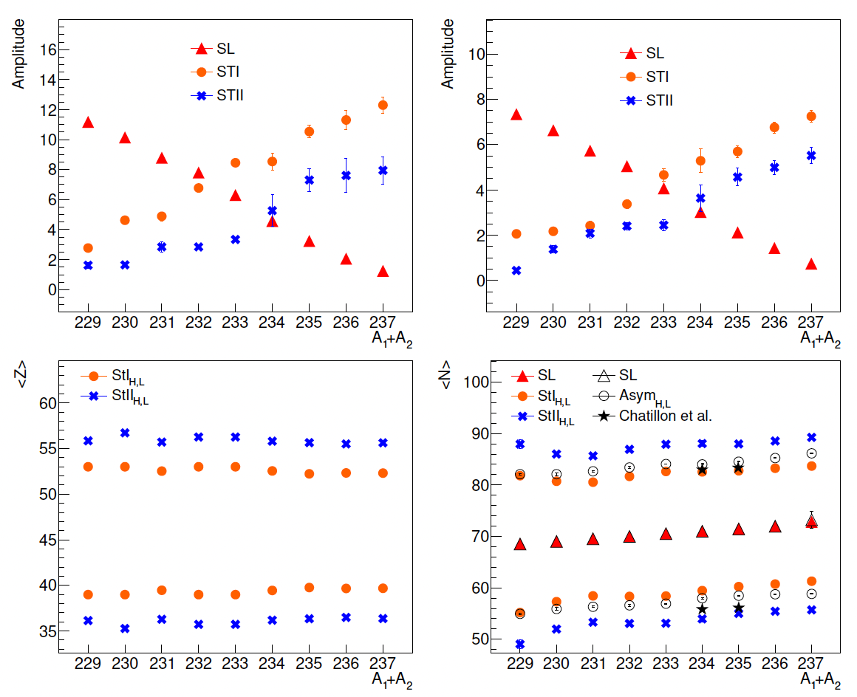
Fission yields and shell effects
Z-yields
N-yields
symmetric
asymmetric
E*
Fission yields are dominated by deformed shells at Z~54, N~84, and Z~56, N~89.
The dumping with energy of both proton (Z=52-56), and neutron (N=82-86) shells seems to be similar
Antía Graña PhD, USC
José Benlliure
IOP-NPC Brighton, April 2026

Slide 19
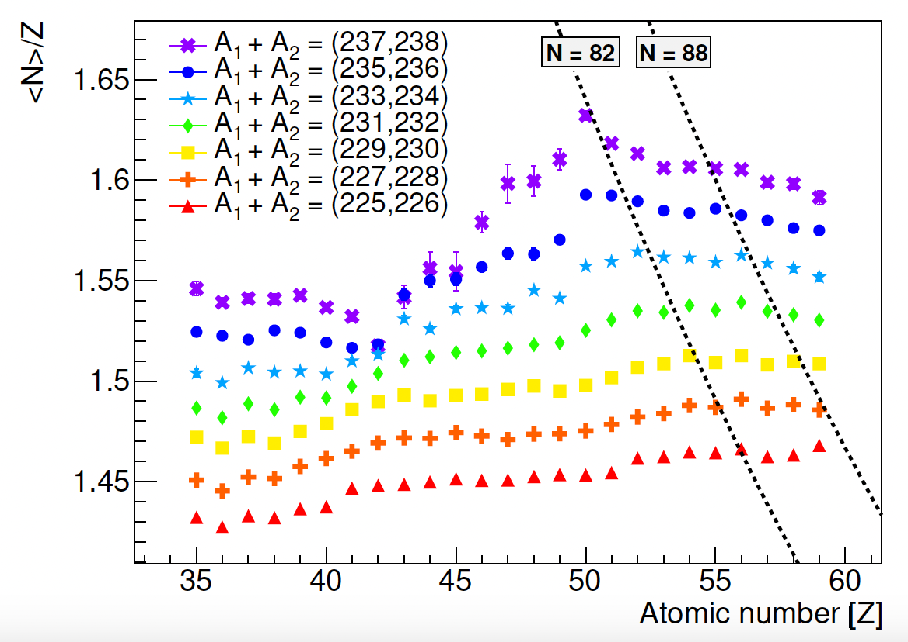
Fission yields and shell effects
Evolution of the neutron excess with the excitation energy
Z₁ + Z₂ = 92
Preliminary
E*
¹³²Sn
²³⁸U
¹⁰⁶Mo
Polarization (neutron-excess) seems to be driven by the closed shell Z=50.
The evolution of the neutron excess with energy reflects the energy sharing between the fragments.
José Benlliure
Antía Graña PhD, USC
IOP-NPC Brighton, April 2026

Slide 20
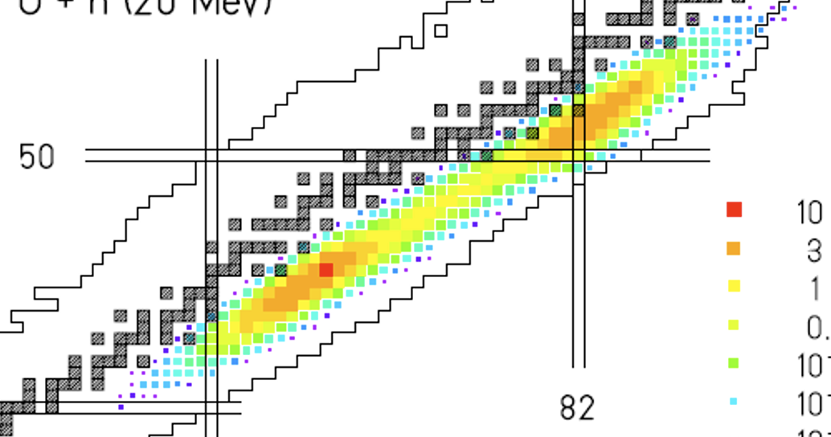
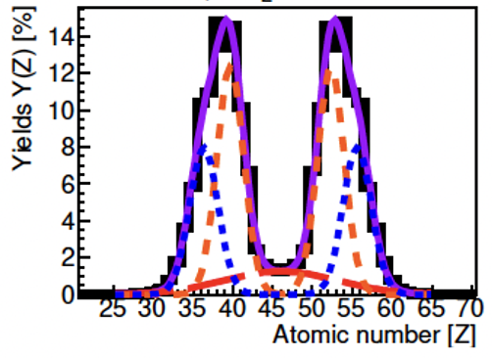
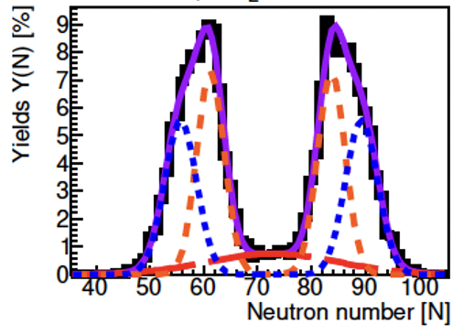
Fission yields and shell effects
Two-dimensional analysis of the fission yields
N/Z=1,57
N/Z=1,61
N/Z=1,64
Z=50, N=82
Z~52, N~84
Z~56, N~88
The one-dimensional projection of the fission yields (Z or N) prevents to observe the spherical shell.
A two-dimensional analysis or a N/Z projection shows the co-existence of spherical and deformed shells.
José Benlliure
IOP-NPC Brighton, April 2026

Slide 21
First access to fission of neutron-rich nuclei at FAIR
All existing information on fission yields corresponds to stable or neutron-deficient
nuclei.
A yields
A&Z_{light} yields
Z dyields
A&Z yields
Valley of stability
José Benlliure
IOP-NPC Brighton, April 2026

Slide 22
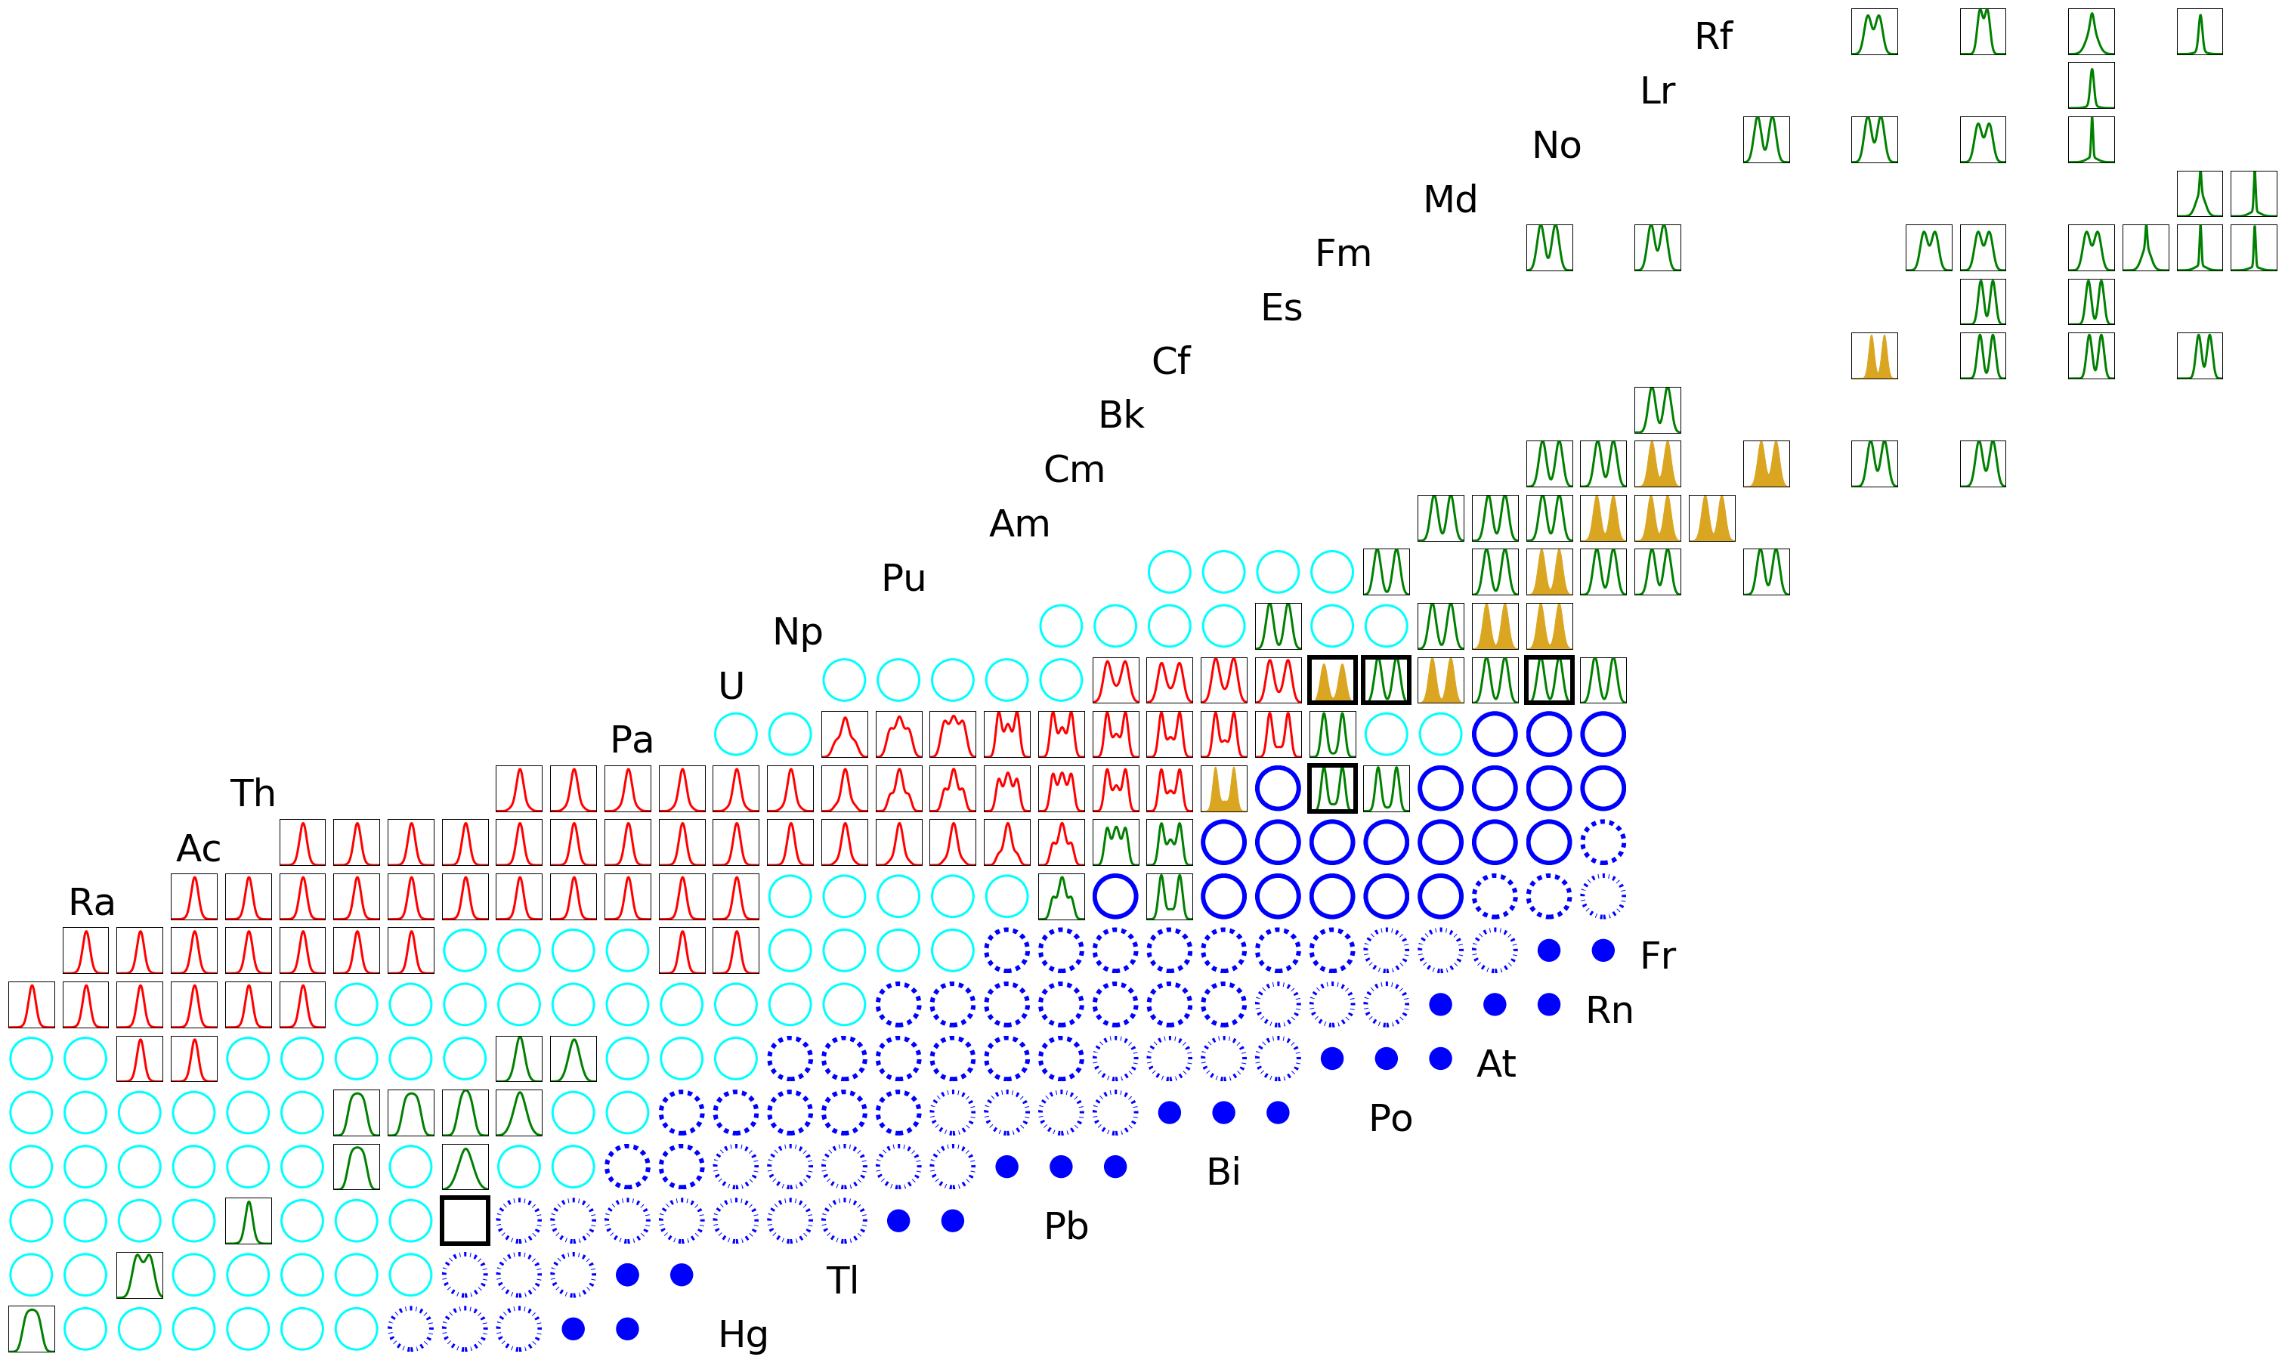
First access to fission of neutron-rich nuclei at FAIR
FAIR will offer a unique possibility to investigate fission with neutron-rich nuclei.
Early Science 5 10⁹ s⁻¹
First Science 2 10¹⁰ s⁻¹
Full FAIR 5 10¹¹ s⁻¹
Full FAIR (Coulex)
José Benlliure
IOP-NPC Brighton, April 2026

Slide 23
Summary
Important experimental and theoretical progress has been achieved during the last years on the investigation of shell effects in the potential governing the fission process .
- The major role of octupole deformed proton shells has been shown (Z~36 and Z~52-56).
- The dominant role of proton or neutron shells is still under debate.
Inverse kinematics represents a real breakthrough in the experimental investigation of fission.
- The SOFIA/R3B experiment has allowed for the first time the complete identification in atomic and mass number
of both fission fragments.
- A complete mapping of the island of asymmetric fission in pre-actinides has been obtained.
Quasi-free proton scattering induced fission on ²³⁸U at R3B has opened access to the excitation energy of the fissioning nuclei providing information on the damping of shell effects.
The N and Z fission yields (1D) can be described in terms of deformed shells Z~52, N~84 and Z~56, N~88. The neutron excess of the fission fragments shows, however, a clear role of the spherical shells at Z=50 and N=82.
Only a 2D analysis (A,Z) of the fission shows the co-existence of spherical and deformed shells.
FAIR will offer a unique possibility to investigate fission with neutron-rich nuclei.
José Benlliure
IOP-NPC Brighton, April 2026

Slide 24
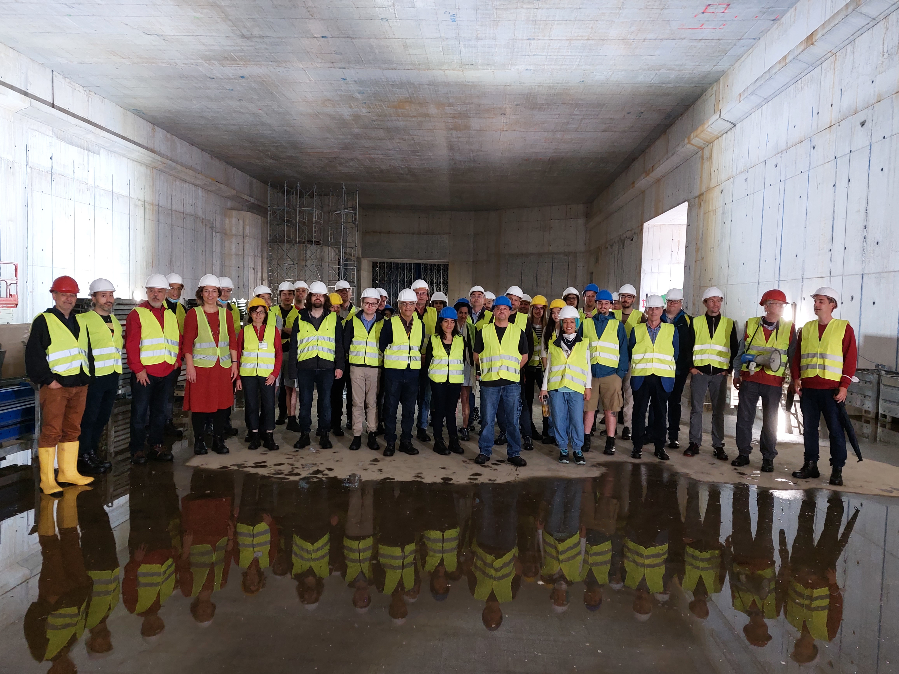



The R3B collaboration
PhD students at USC: Antía Graña and Gabriel García
José Benlliure
IOP-NPC Brighton, April 2026

Slide 25
Back-up
José Benlliure
ND2025, Madrid, June 2025

Slide 26
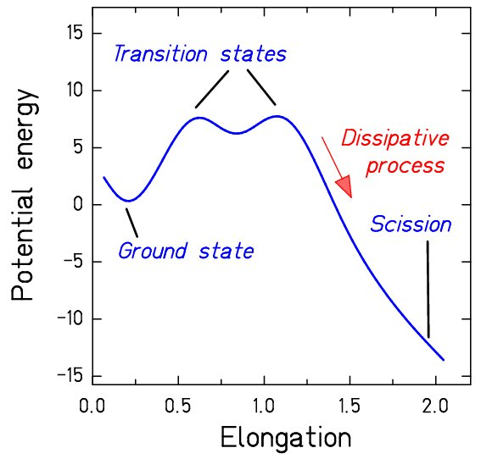
Fissison in a nutshell
Static properties:
the potential energy surface
Dynamics
Transient
time
Potential surface in deformation and mass asymmetry
→ Role of shell effects at large deformation.
Coupling between intrinsic and collective
degrees of freedom
José Benlliure
IOP-NPC Brighton, April 2026

Slide 27
Experimental breakthrough: inverse kinematics
The kinematical boost of both fission fragments is the only methodology providing their complete identification.
Observables:
Fission cross sections.
N and Z fission yields.
- Total kinetic energies.
Neutrons and γ’s in coincidence
Fast heavy
nucleus
Nucleus at rest
Compound nucleus in flight
Reaction mechanisms:
Fusion (well defined CN, energy threshold, stable beams).
Transfer (well defined CN, energy scan, stable beams).
Coulex (unstable beams, no energy scan).
Quasi-free knock-out (unstable beams, energy scan).
Spallation (high energies, unknown CN).
José Benlliure
IOP-NPC Brighton, April 2026

Slide 28
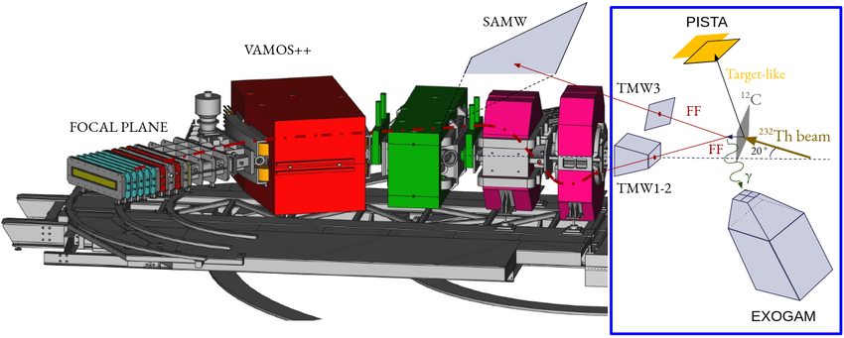
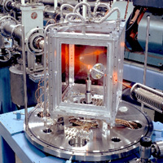
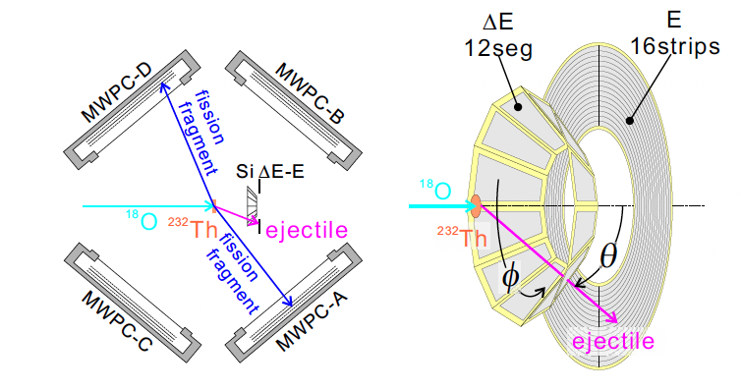
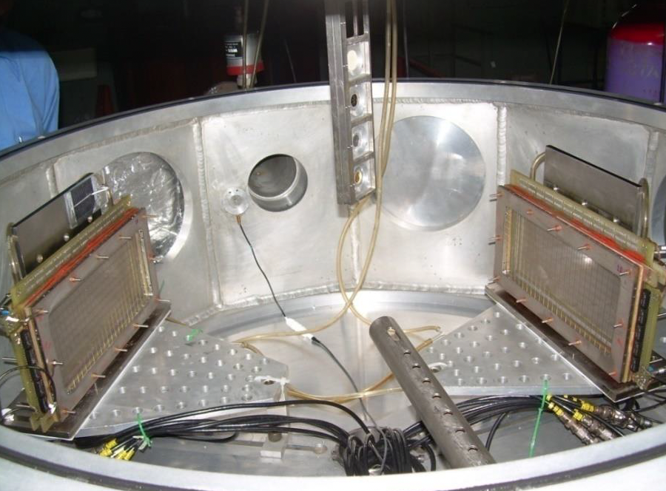
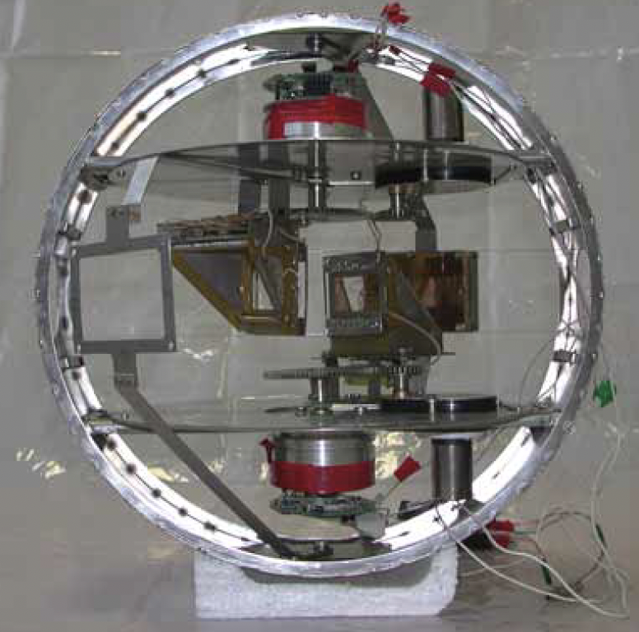
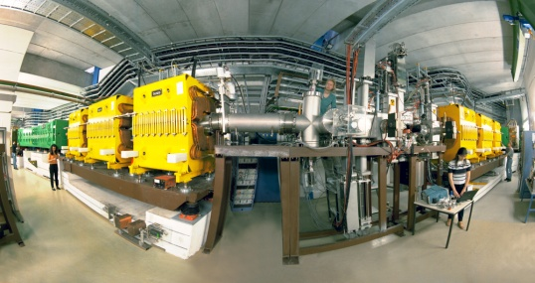



Experimental breakthrough: inverse kinematics
The kinematical boost of both fission fragments is the only methodology providing their complete identification.
VAMOS@GANIL
Fusion/transfer: 2A & 1Z
CUBE@ANU
Fusion: 2A
JAEA
Fusion/transfer: 2A
BARC/VECC
Fusion: 2A
CORSET@Dubna
Fusion: 2A
Fast heavy
nucleus
Nucleus at rest
Compound nucleus in flight
The fragmentation of ²³⁸U nuclei at relativistic energies
makes it possible to investigate the fission of a huge number of heavy non stable nuclei.
GSI: relativistic energies
FRS: Coulex: 1A & 1Z
SOFIA: Coulex: 2A & 2Z
José Benlliure
Schmidt: Coulex: 2Z
IOP-NPC Brighton, April 2026

Slide 29


QFS-induced fission of 238U @ 540A MeV
Identification of the fission fragments
Z=36
Resolution in atomic number:
ΔZ = 0.38 (FWHM)
Resolution in mass number:
ΔA/A = 0,9%
0.8 (FWHM) A=88
1.2 (FWHM) A = 132
Typical competing
experiments:
σ_{A} ~ 3-4 mass units
Antía Graña PhD, USC
José Benlliure

