Slide 1
UKAEA
The Path to Commercial Fusion Energy
Dr Chantal Shand, Applied Radiation Technology Group Leader

Slide 2






The benefits
Continuous supply
Fusion will provide reliable baseload power
No CO2
The only waste products are small amounts of helium
Less radiotoxic waste than fission
Only structural material becomes radioactive in fusion
Abundant fuels
Deuterium can be extracted from seawater and tritium will be produced inside the machine
Safe
There is no risk of a runaway reaction with fusion

Slide 3
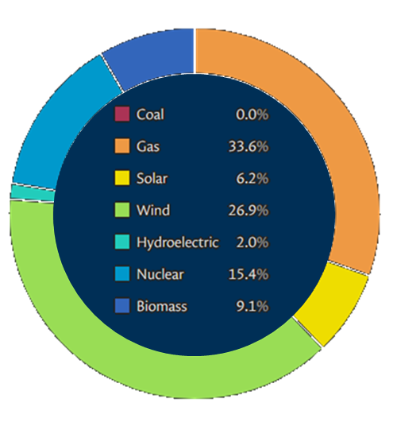




Why is fusion energy needed?
2025 Energy Mix
Climate crisis
Catastrophic ecosystem collapse
Ocean heat reached a record high for the 9th consecutive year in 2025
Economic vulnerability
Destruction and damage costs trillions annually.
Fossil fuel supply is vulnerable to geopolitical shocks and import dependencies.
Health crisis
Air pollution from fossil combustion damages cardiovascular and respiratory systems leading to disease and reduced life expectancy.
https://grid.iamkate.com/ accessed 02/04/2026
Net zero goals
The final coal-fired power station in the UK closed 30 September 2024
Fusion reactions release 4 million times more energy than chemical reactions from burning fossil fuels.
Notes:
Global warming accelerated between 2015-2025 more than the previous decade
Ocean heat reached a record high for the 9th consecutive year in 2025
Extreme weather events are becoming more frequent and more severe

Slide 4


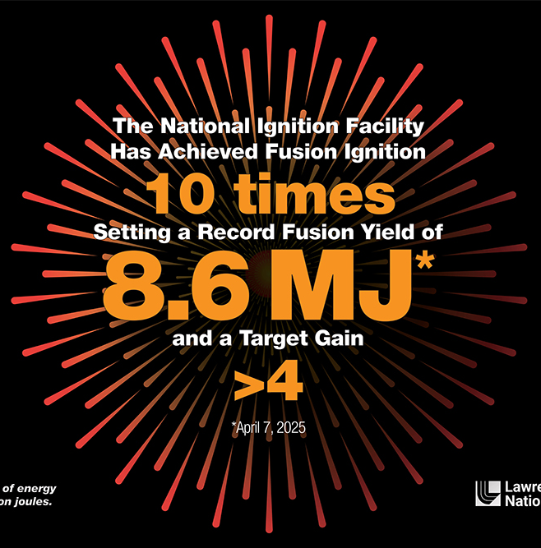
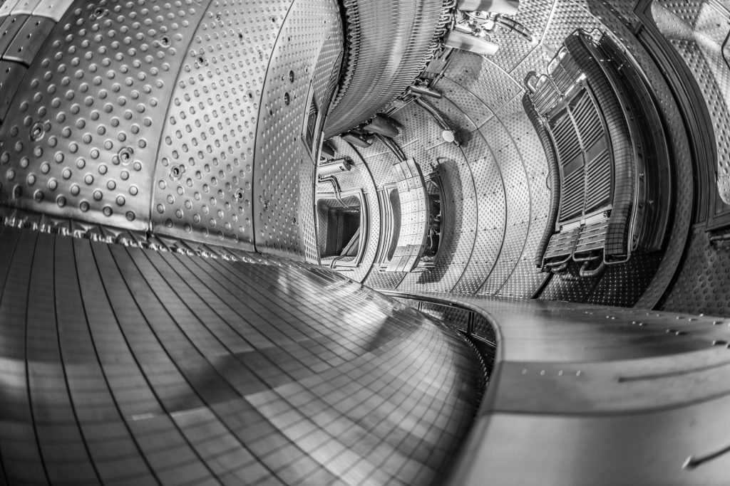

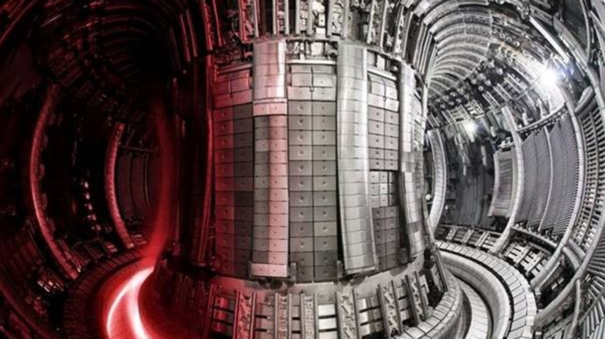
Growing technical readiness
2022 and 2024
2025
National Ignition Facility (NIF)
WEST Tokamak
Fusion ignition producing more energy from a target than the laser energy delivered to it, enhancing the prospects for inertial fusion energy.
Plasma duration
world record in a tokamak with a plasma lasting ~ 22 minutes at a temperature of 50 million degrees Celsius, crucial for ITER operations.
2024
Joint European Torus (JET)
Fusion energy
set a world record producing 69 MJ in a single 5-second deuterium-tritium (D-T) pulse using only 0.2 mg of fuel.

Slide 5
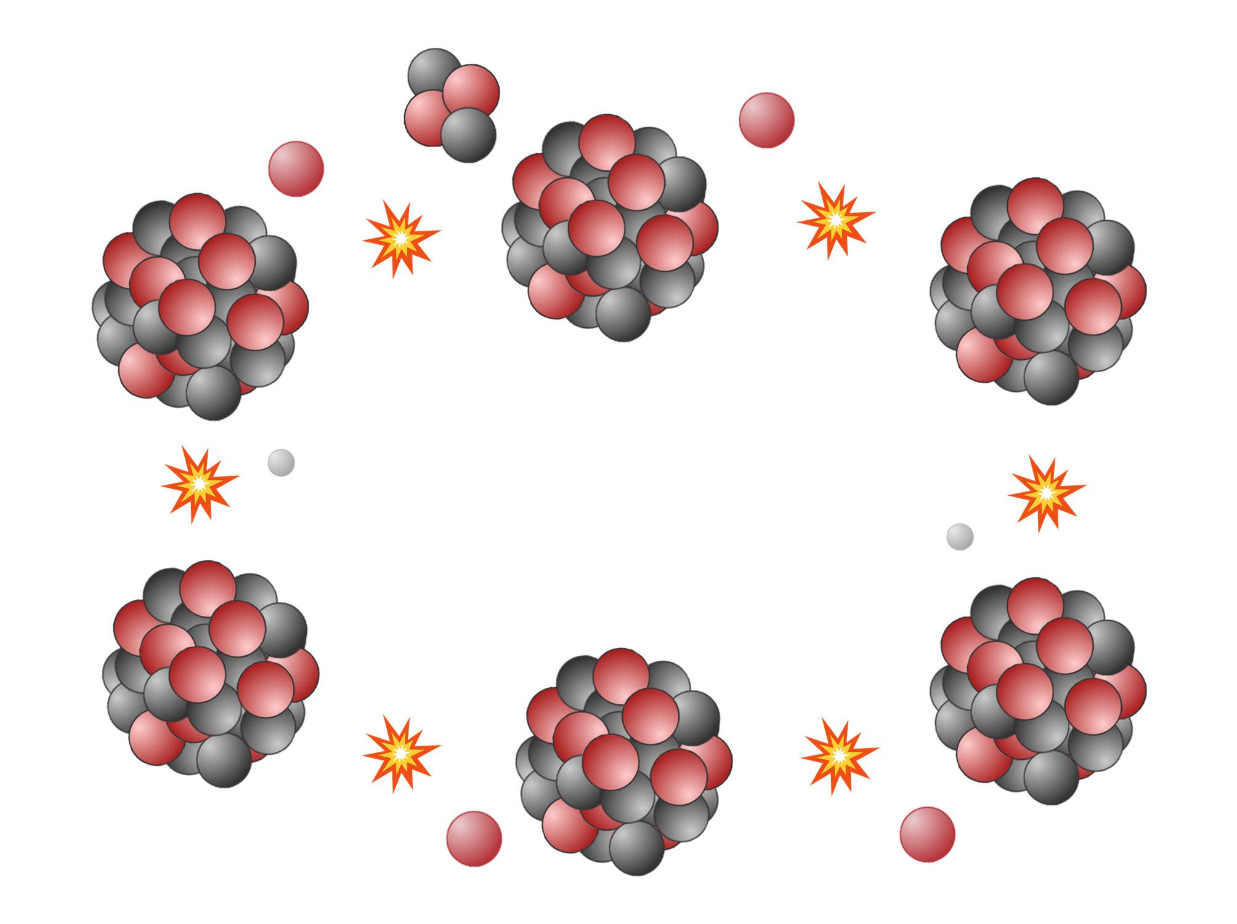
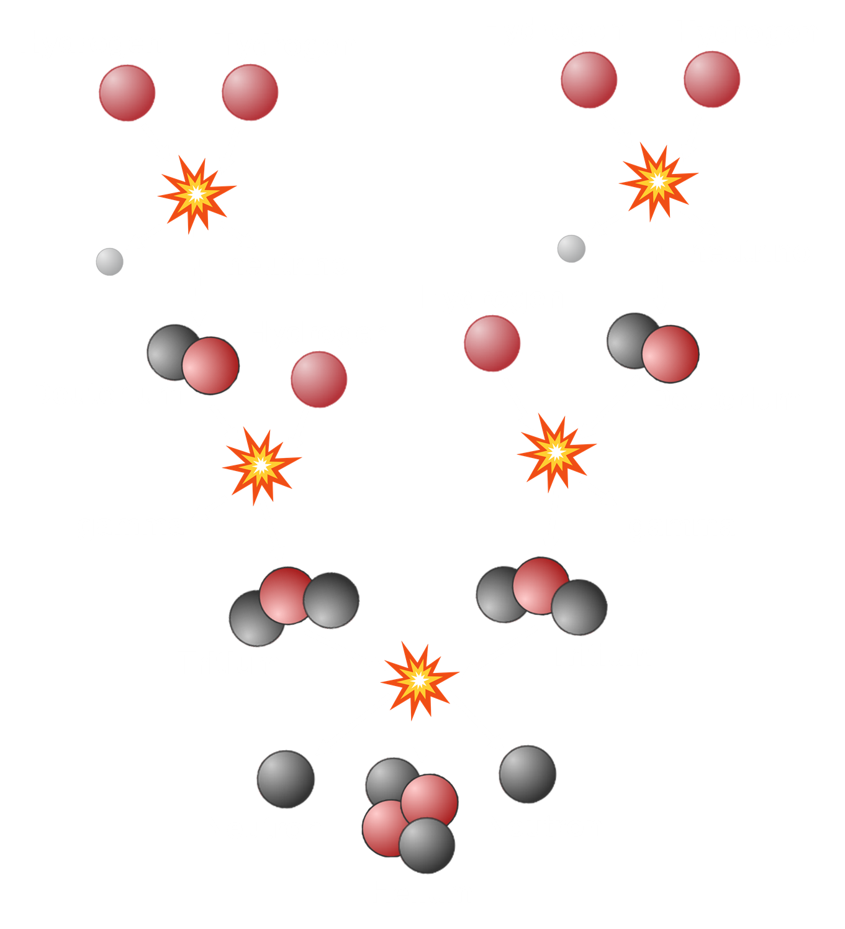
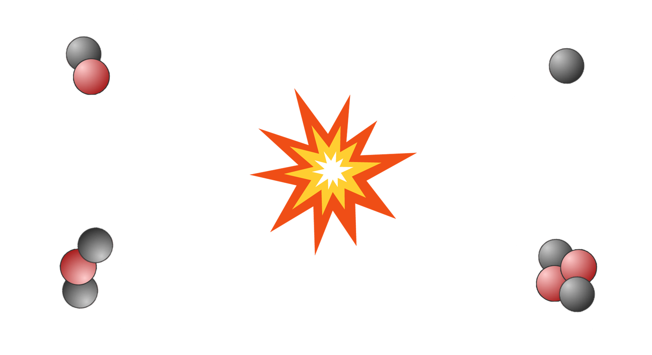

What is fusion energy?
The Sun
p-p chain
CNO cycle
In fusion machines

Slide 6
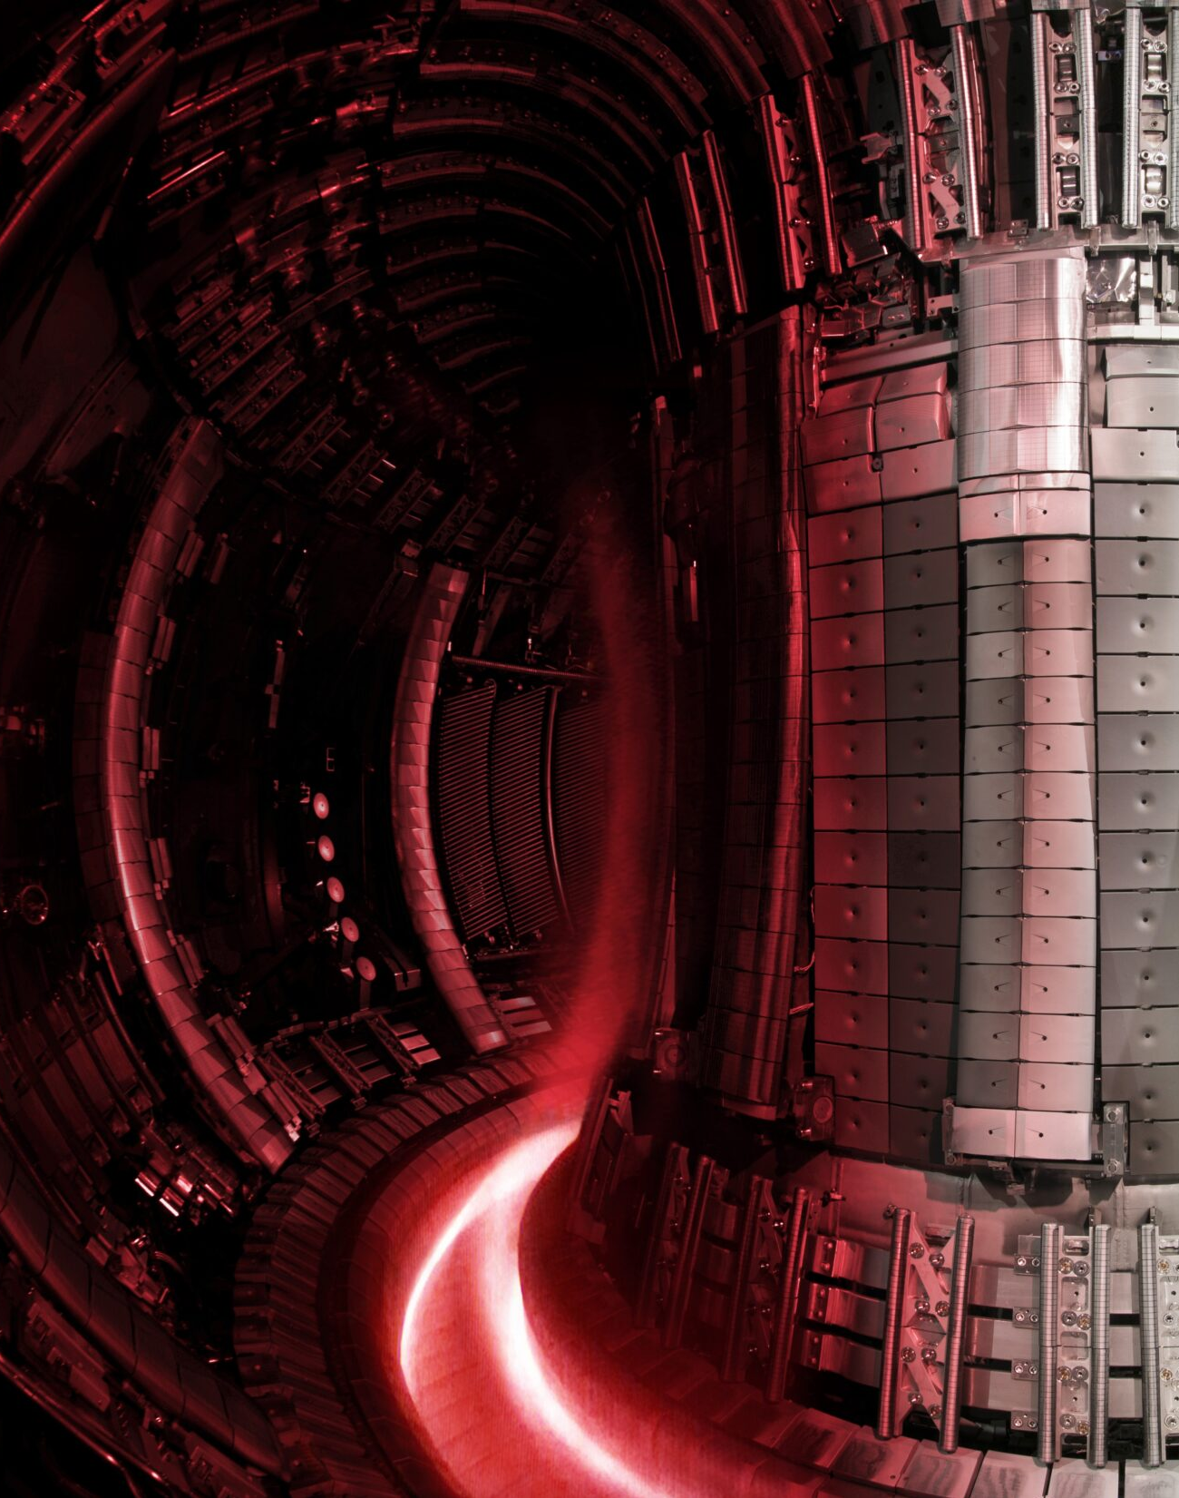




TEMPERATURE
Up to 10 times hotter than the Sun’s core
DENSITY
1 million times less dense than the air we breathe
69 MJ PLASMA POWER
CONFINEMENT TIME
Currently on the order of
1 second

Slide 7


Slide 8




2024-2026: the fusion landscape
Over 40 private fusion companies >£4B in capital, industry growing globally.
The UK Fusion Strategy
(published March 2026)
to accelerate growth of the fusion industry, grow supply chains and skills, and position the UK as a global leader in commercial fusion. Sets out the roadmap for the deployment of a prototype power plant (STEP).
Magnetic confinement fusion
Inertial confinement fusion
Magnetized target fusion
https://www.fusionindustryassociation.org/

Slide 9
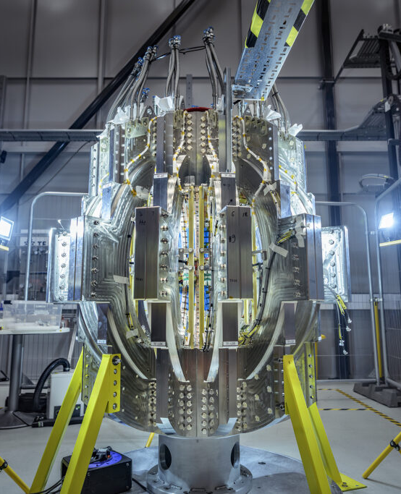
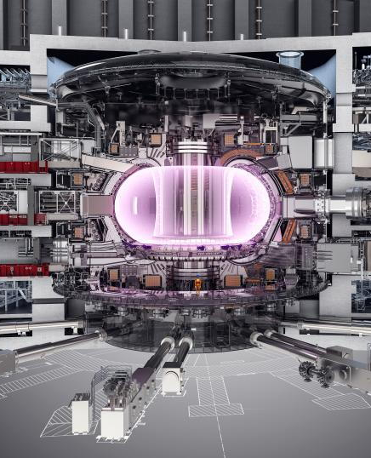


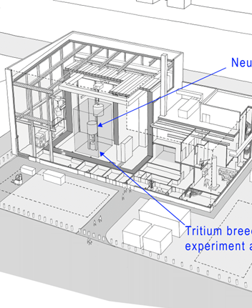
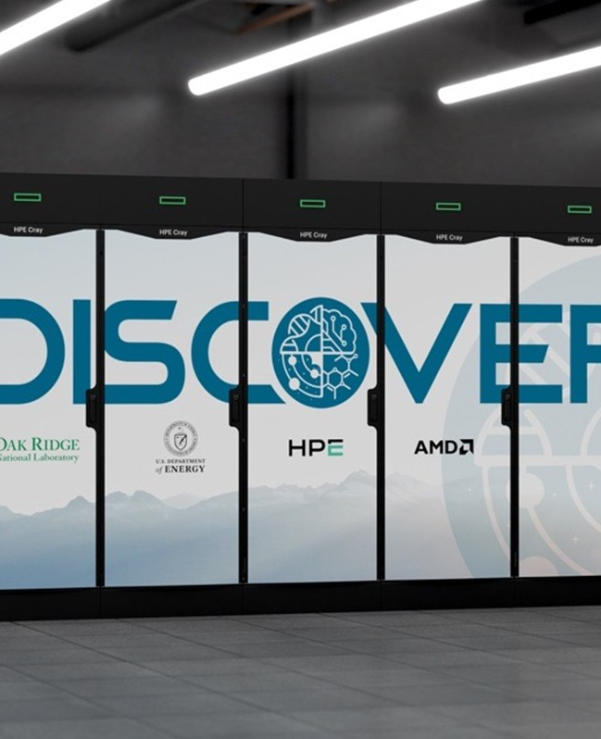
What’s the problem?
Fusion’s challenge has shifted to the integration of complex multi-physics systems into mature technologies that can be deployed at scale – not fundamental physics.
High temperature superconducting magnets
would enable smaller, lower cost, and faster to build reactors
e.g. CFS, Tokamak Energy
Advanced diagnostics and plasma control
core enabler of deployment, reliability, economic viability, and regulation.
e.g. ITER, UKAEA
Materials, fuel cycles and plant integration
required to transition from demonstrating fusion to deploying fusion power plants.
e.g. UKAEA, CEA
AI, high performance computing and modelling
an accelerator of fusion science and design optimisation, scalable across fusion concepts
e.g. PPPL, ORNL

Slide 10
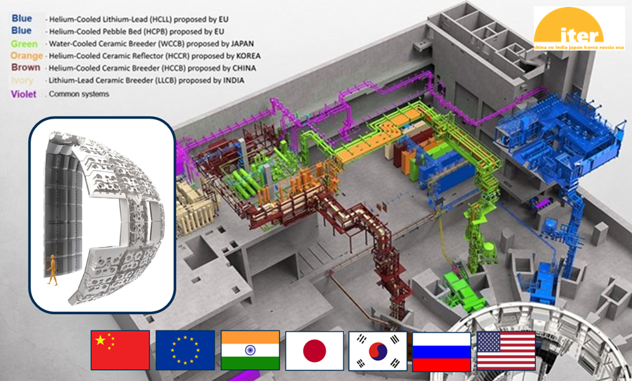

Focus on the fuel cycle
During later stages of ITER operation, some of the blanket modules will be replaced with specialized modules to test materials for tritium breeding concepts.
£200 million Lithium Breeding Tritium Innovation (LIBRTI) programme aiming to demonstrate controlled and predictable tritium breeding.

Slide 11
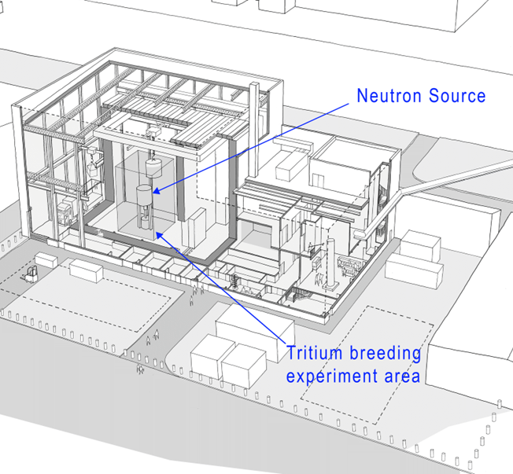
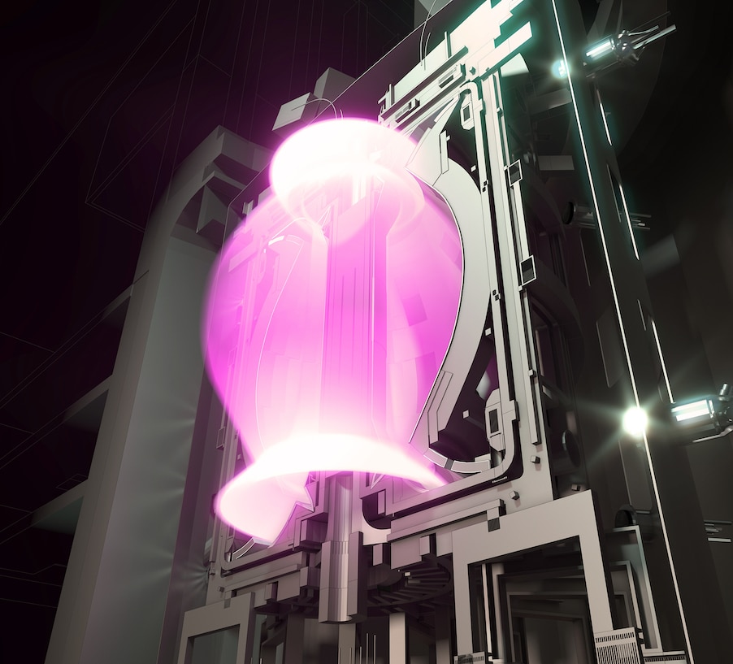
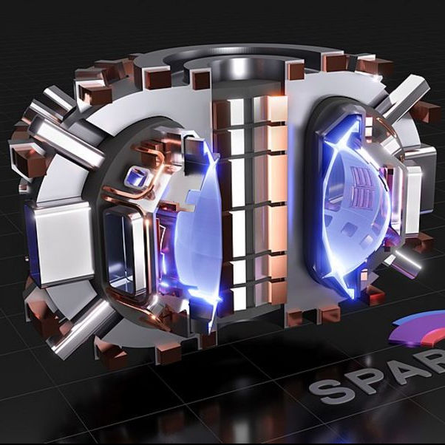
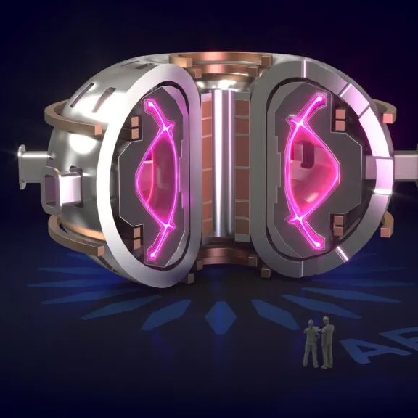
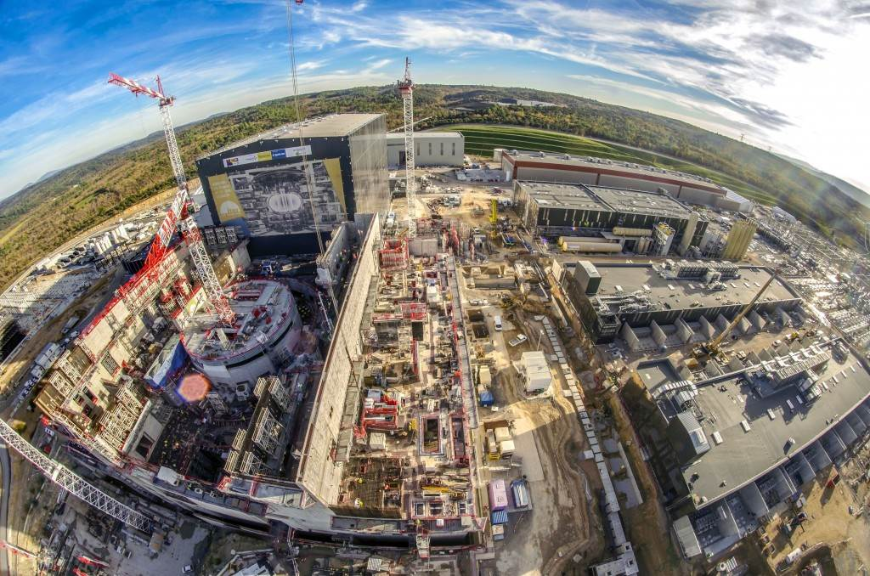
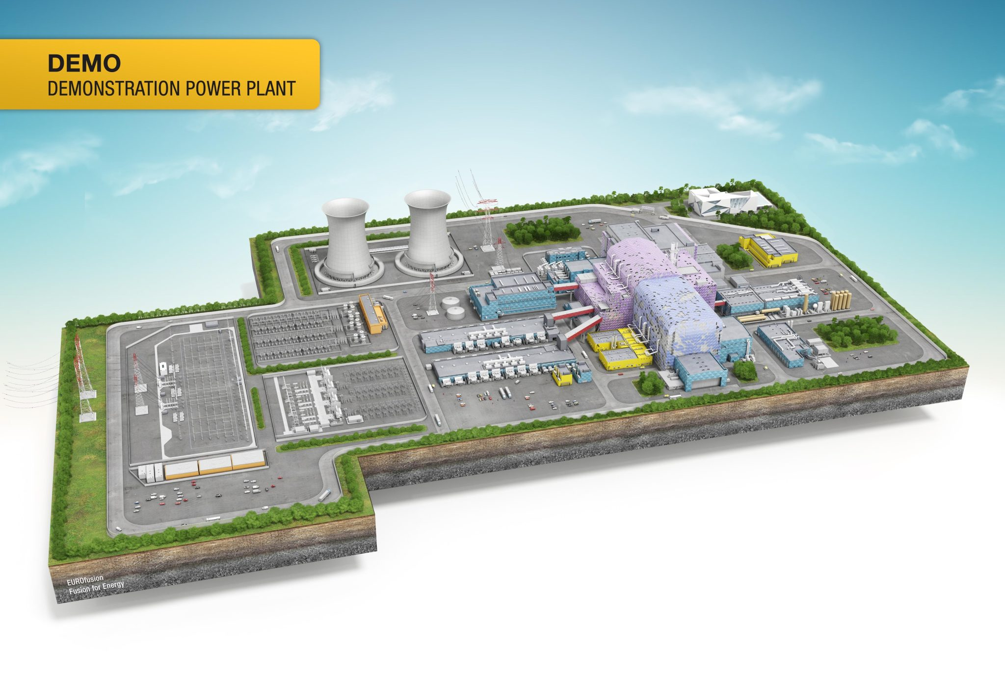
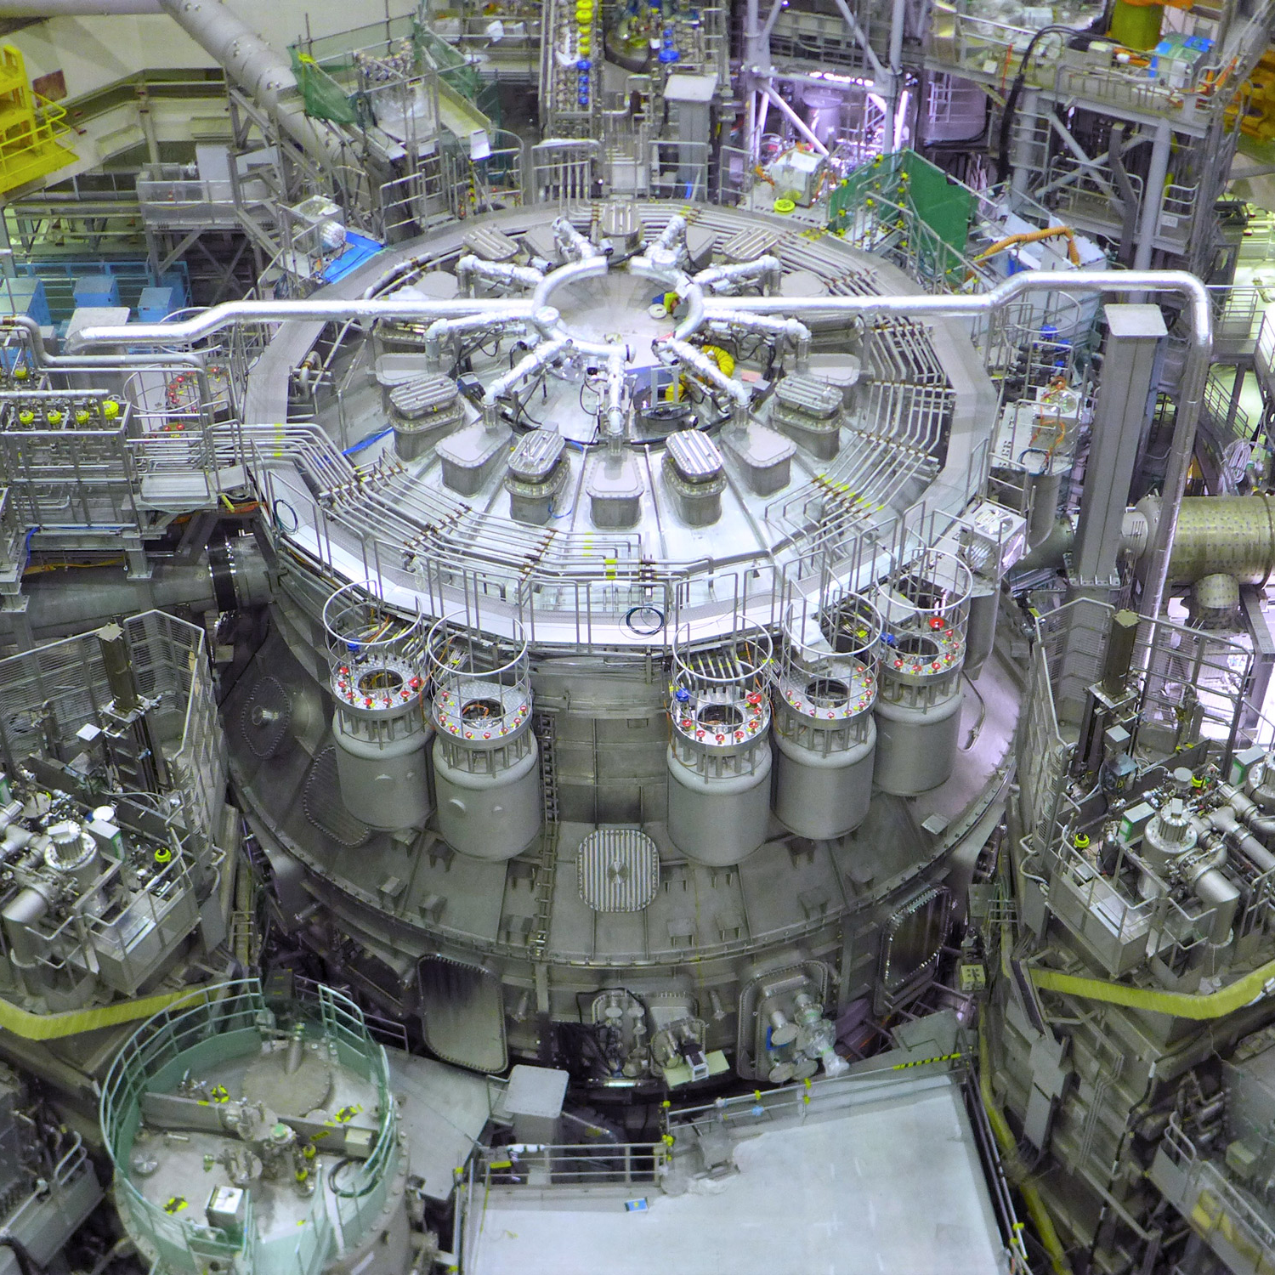
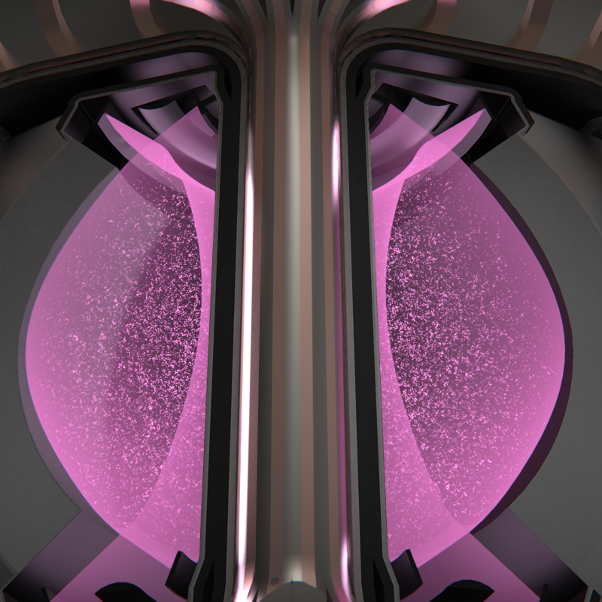
The timeline for fusion energy
LIBRTI: opening as a user facility
STEP: operating a prototype plant
2026
2030s
2035
2050s
2029
2040
CFS: SPARC with HTS magnets operational
CFS: ARC power plant operational
ITER: routinely producing 500 MW fusion power
European DEMO: putting fusion power on the grid
Not exhaustive!
Roadmaps anticipate scaling rapidly through the 2040s if early milestones are met.
JT-60SA: high power experiments
Tokamak Energy: Fusion Pilot Plant operational

Slide 12



Summary
Fusion works, the challenge is integrating complex multi-physics systems into mature technologies
The benefits make fusion power plants critical in achieving international efforts towards net-zero and beyond.
Fusion requires concurrent, not sequential, progress in science, engineering, regulation, and markets to meet climate relevant timelines
If fusion meets its milestones, commercial systems could be deployed in the 2030s and scale rapidly in the 2040s, contributing meaningfully to global decarbonisation.
Fusion is one of the most dynamic and interesting fields of research for a multitude of disciplines:
careers.ukaea.uk/current-vacancies/
Thank you for listening!

