Slide 1
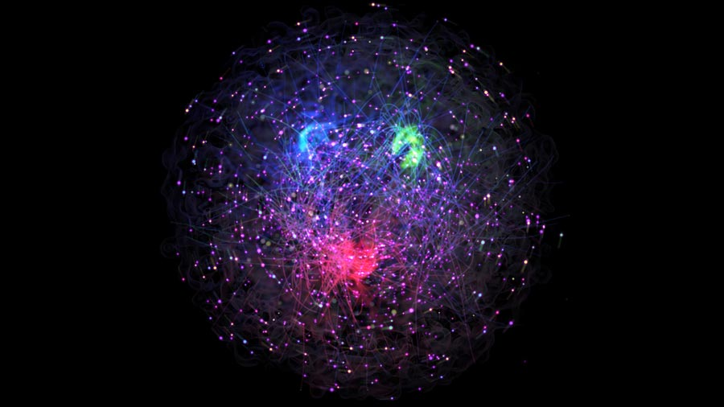
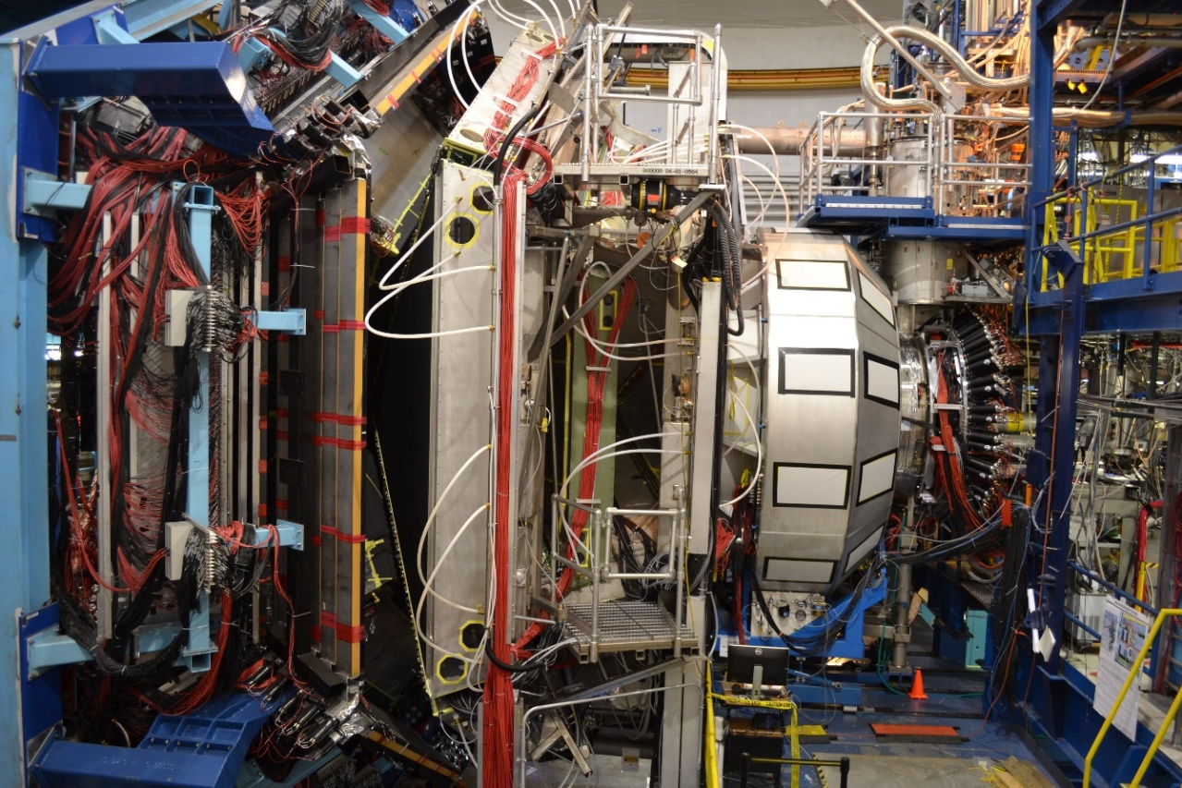
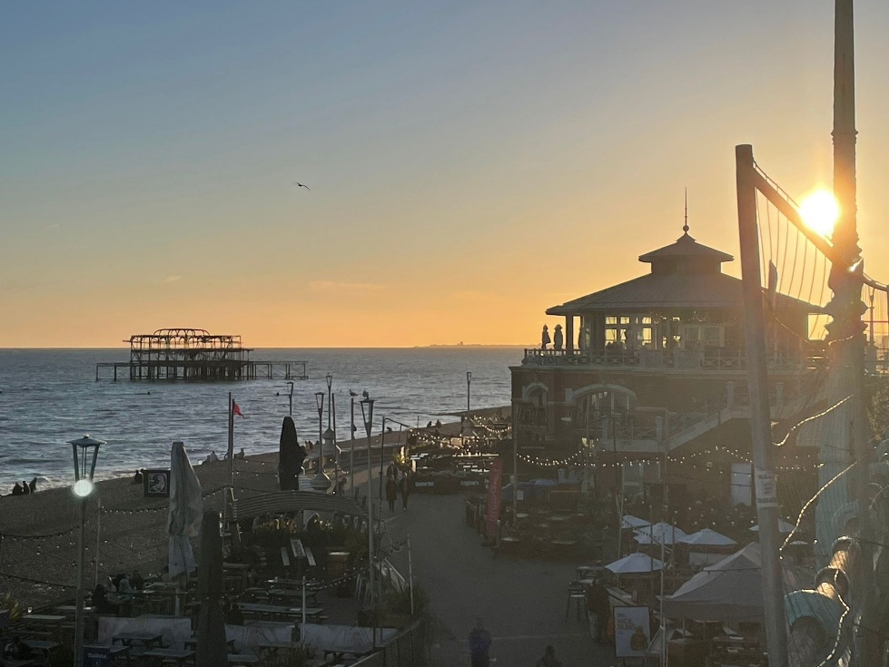
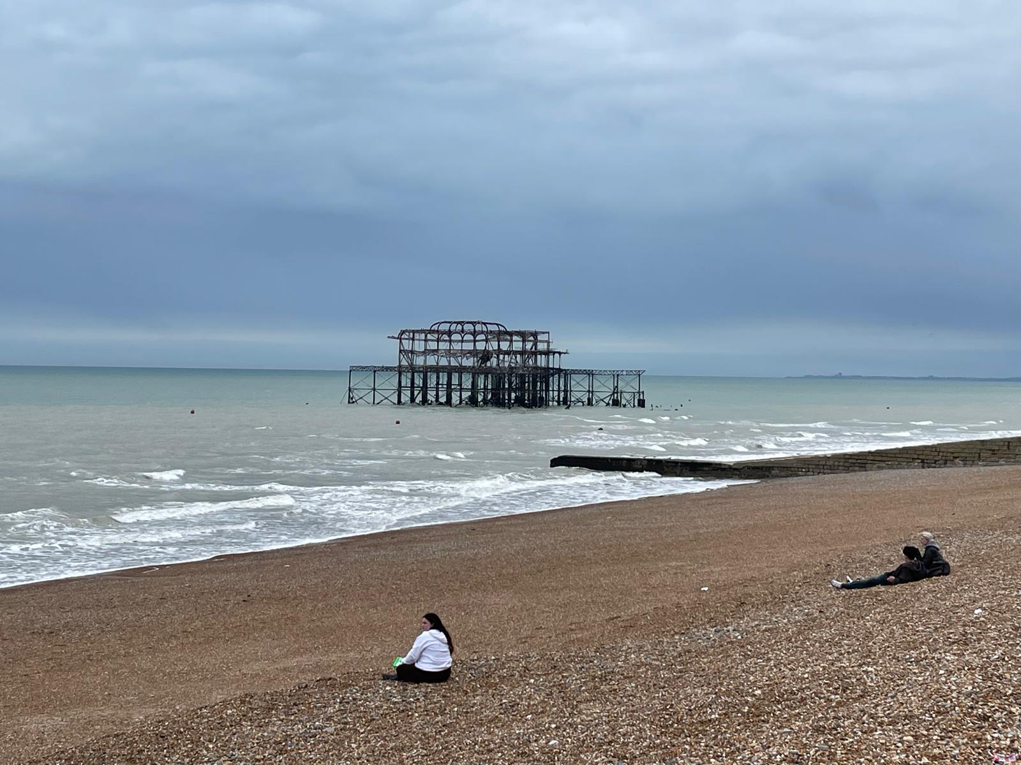
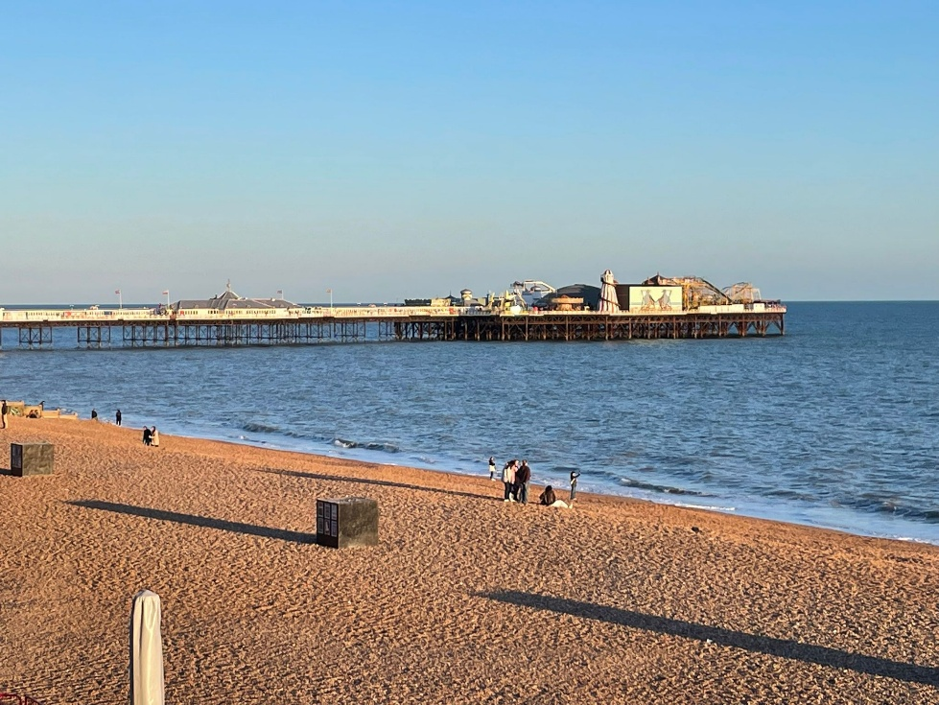


Unveiling nucleon structure through measurements of Generalized Parton Distributions
Silvia Niccolai (IJCLab, France), for the CLAS Collaboration
IOP Nuclear Physics Conference
Brighton (UK), 15/4/2026

Slide 2
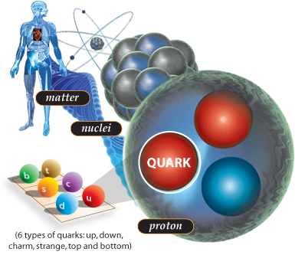
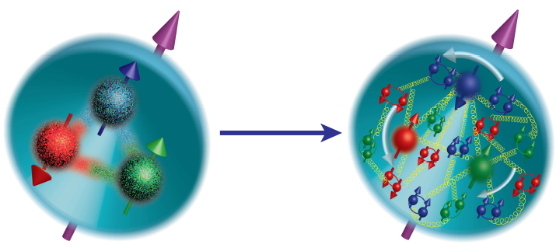
Exploring the partonic structure of the nucleon
Protons and neutrons are the building blocks of atomic nuclei
Nucleons provide ~99% of the mass of the visible universe
Quarks are very light, gluons are massless
~99% of nucleon mass must arise from the dynamics and interactions between its constituents
Quantum Chromodynamics (QCD)
But QCD is still unsolved in the non-perturbative regime
Matter
Nuclei
GLUONS
How do the QCD degrees of freedom relate to the hadrons we observe?
How do the spin and the mass of the nucleon emerge from the dynamics of its constituents?
Nucleon
Increasing resolution of the probe
→ electron-nucleon scattering is the tool to address these fundamental questions
2

Slide 3
Electron scattering: the ideal tool to study nucleon structure
Electrons are structureless and interact only electromagnetically via the exchange of virtual photons
Resolution of the probe: Q² = -(k-k’)²
  1956: Elastic scattering ep→e’p’ (Hofstadter, Nobel Prize 1961)
Low
Q²
e(k)
e’(k’)
The proton is not a point-like object
Measurement of charge distributions of the proton: Electromagnetic form factors F₁(t), F₂(t)
Quark distribution in transverse position
γ∗ (t=Q²)
p
p’
  1967: Deep inelastic scattering (DIS) ep→e’X (Friedman, Kendall, Taylor, Nobel Prize 1990)
e(k)
e’(k’)
Discovery of the quarks (or “partons”)
Measurement of the momentum and spin distributions of the partons: Parton Distribution Functions (PDF) q(x), Δq(x)
Quark distribution in longitudinal momentum
γ∗ (Q²)
High
Q²
x
X
p
3

Slide 4
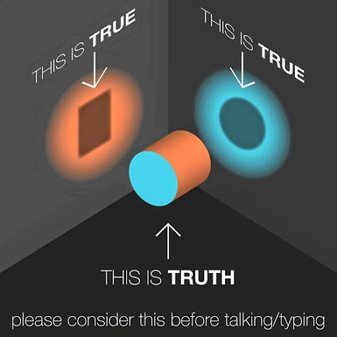
Electron-proton scattering: towards a multi-dimensional picture
4

Slide 5
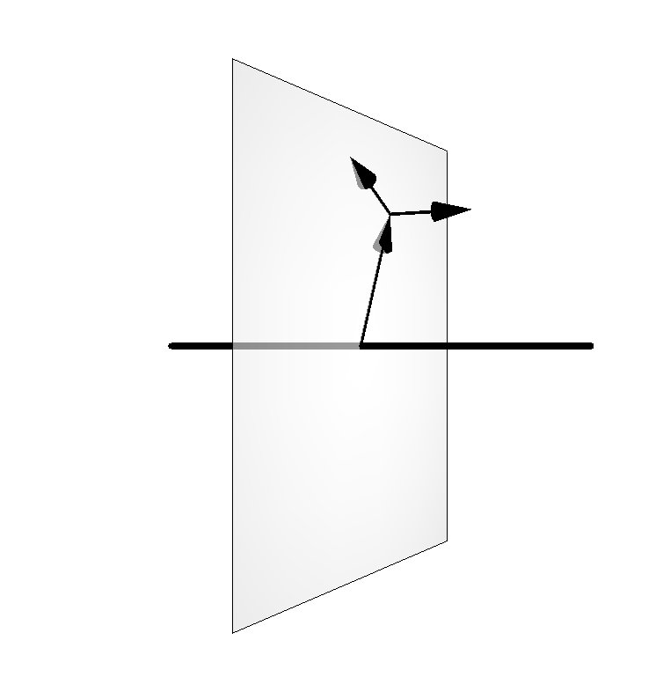



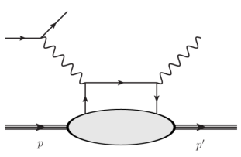
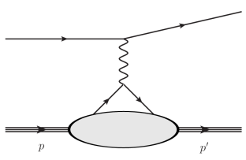
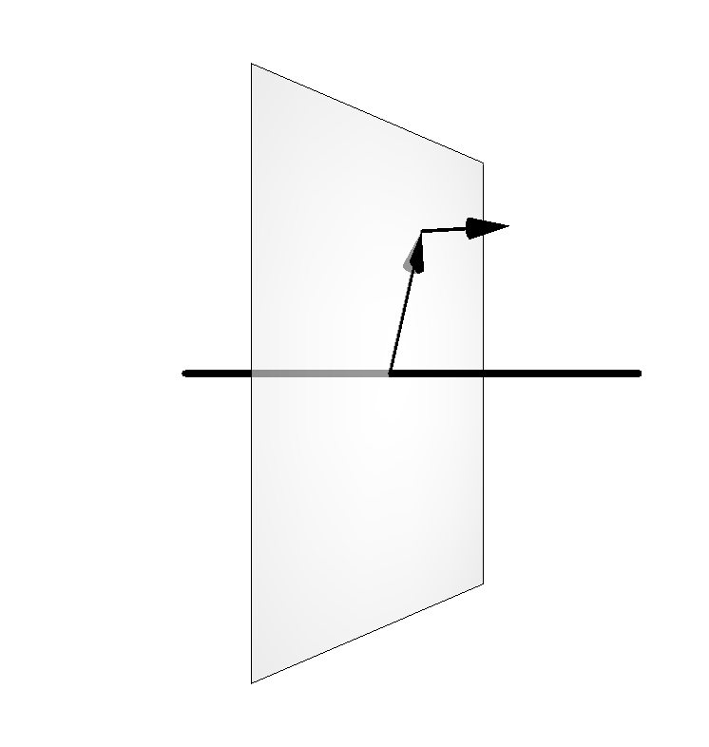
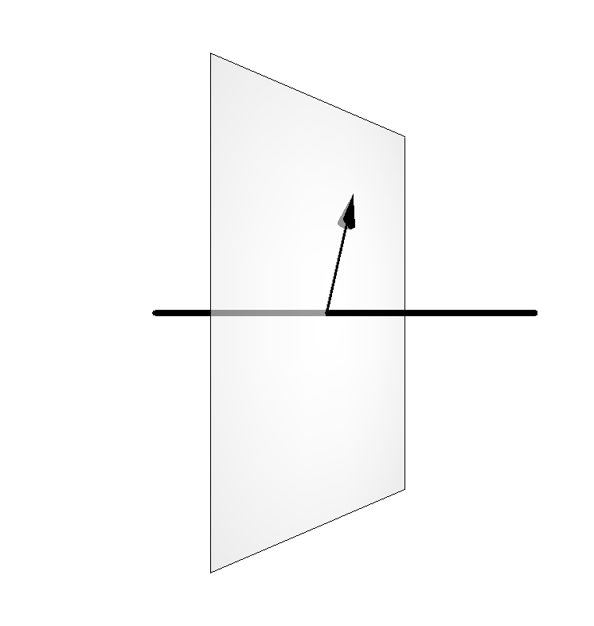

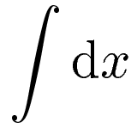

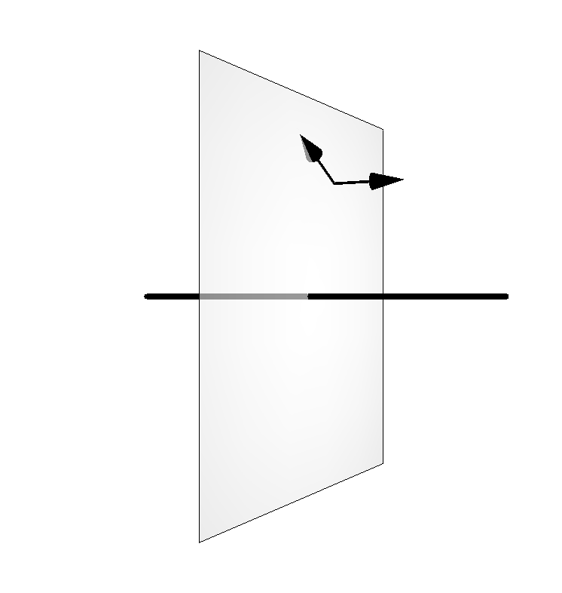
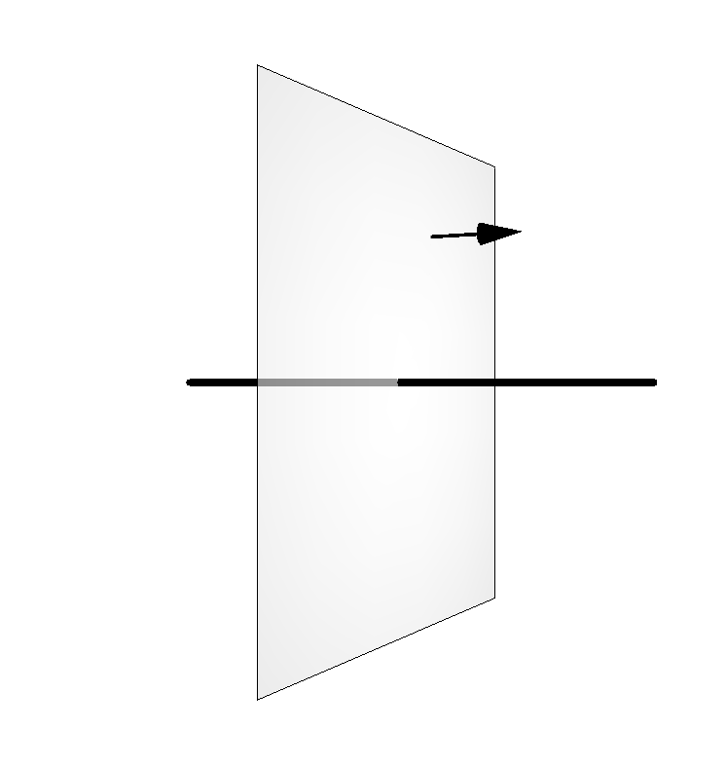
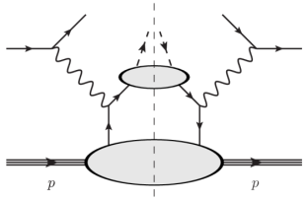
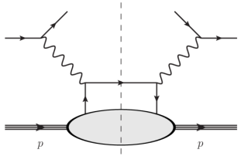
Longitudinal momentum
Multi-dimensional mapping of the nucleon
Transverse momentum
Impact parameter
Elastic Scattering
DVCS et al.
GPDs
FFs
GTMDs
TMDs
PDFs
A complete picture of nucleon structure requires the measurement of all these distributions
SIDIS
DIS
5

Slide 6
Longitudinal momentum
Multi-dimensional mapping of the nucleon
Transverse momentum
Impact parameter
DVCS et al.
Nucleon tomography
GPDs
GTMDs
Quark angular momentum (Ji’s sum rule)
Generalized Parton Distributions:
fully correlated parton distributions in both coordinate and longitudinal momentum space
linked to FFs and PDFs
Accessible in exclusive reactions
Nucleon spin: ½ = ½ ΔΣ + ΔL + ΔG
Intrinsic spin of the quarks ½ ΔΣ ≈ 30%
Intrinsic spin on the gluons ΔG ≈ 20%
Orbital angular momentum of the quarks ΔL ?
6

Slide 7
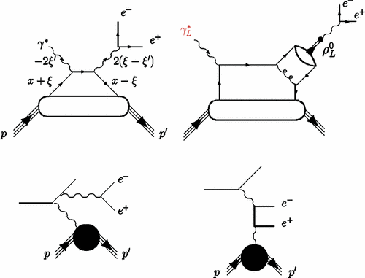
Exclusive reactions giving access to GPDs
(γ)
DVCS
Quark GPDs
x dependence
Quark GPDs
Gluon GPDs
(TCS), DDVCS
M
Universality of GPDs
DVMP
Quark GPDs,
Transversity GPDs
Gluon GPDs
7

Slide 8
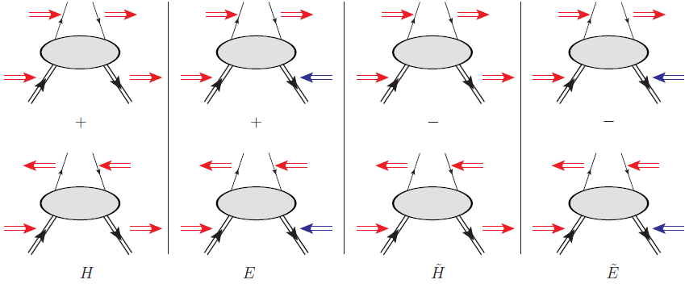
Deeply Virtual Compton Scattering and GPDs
e’
γ
Q²= - (e-e’)²
x_{B} = Q²/2Mν ν=E_{e}-E_{e’}
x+ξ, x-ξ longitudinal momentum fractions
t = Δ² = (p-p’)²
ξ ≅ x_{B}/(2-x_{B})
t
e
γ*
(Q²)
factorization
x+ξ
x-ξ
« Handbag » factorization, valid
in the Bjorken regime
(high Q² and ν, fixed x_{B}), t<<Q²
~
~
H, E, H, E (x,ξ,t)
N(p)
N(p’)
GPDs: Fourier transforms of non-local, non-diagonal QCD operators
4 GPDs for each quark flavor
(leading-order, leading twist, quark-helicity is conserved)
Vector
Tensor
Axial-vector
Ps.scalar
conserve nucleon spin
flip nucleon spin
8

Slide 9
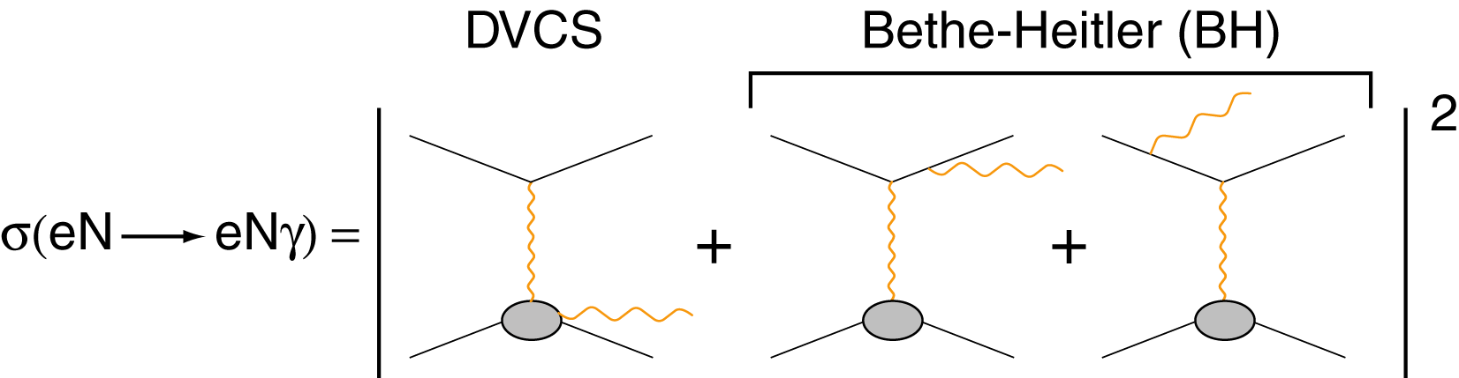
Accessing GPDs through DVCS: from GPDs to Compton Form Factors
Proton
Neutron
Polarized beam, unpolarized target:
ImH_{p}
~
ImE_{n}
Δσ_{LU}~ sinφ Im{F₁H + ξ(F₁+F₂)H -kF₂E}
γ
~
Unpolarized beam, longitudinal target:
ImH_{p}, ImH_{p}
e’
~
ImH_{n}
φ
Δσ_{UL} ~ sinφ Im{F₁H+ξ(F₁+F₂)(H + x_{B}/2E)}
e
Polarized beam, longitudinal target:
~
ReH_{p}, ReH_{p}
N’
~
Δσ_{LL} ~ (A+Bcosφ) Re{F₁H+ξ(F₁+F₂)(H + x_{B}/2E)}
ReH_{n}
Unpolarized beam, transverse target:
ImH_{p}, ImE_{p}
Δσ_{UT} ~ cosφ sin(φ_{s}−φ)Im{k(F₂H – F₁E) }
ImH_{n}
The extraction of quark CFF requires measurements of several DVCS observables on both proton and neutron targets
Unpolarized b. and t., different lepton charges:
ReH_{p}
~
ReE_{n}
Δσ_{C} ~ cosφ Re{F₁H + ξ(F₁+F₂)H -kF₂E}
9

Slide 10
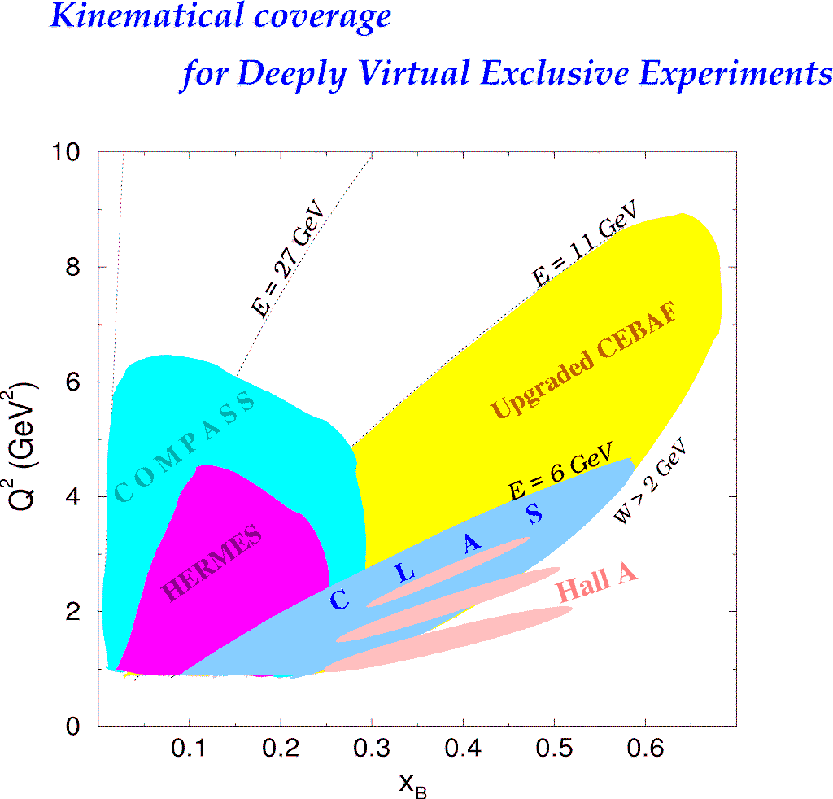
DVCS experiments worldwide
JLAB
Hall A
CLAS (Hall B)
p,n-DVCS, Beam-pol. CS
p-DVCS, BSA,lTSA,DSA,CS
Beam charge
asymmetry
DESY
CERN
COMPASS
p-DVCS CS,BSA,BCA, tTSA,lTSA,DSA
HERMES
H1/ZEUS
Beam spin
asymmetry
p-DVCS,BSA,BCA,
tTSA,lTSA,DSA
p-DVCS,CS,BCA
Transverse target spin asymmetry
CLAS, HERMES: first observation of DVCS-BH interference in the beam-spin asymmetry (2001)
Hall A: test of scaling for DVCS (2006)
Beam-spin and tr. target spin asymmetry
Longitudinal target spin asymmetry
Beam-spin and long. target spin asymmetry
10

Slide 11
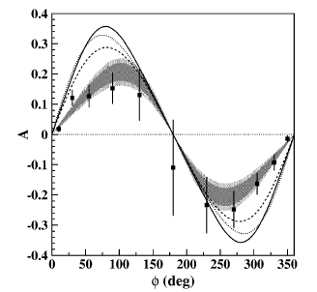
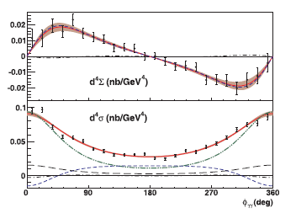
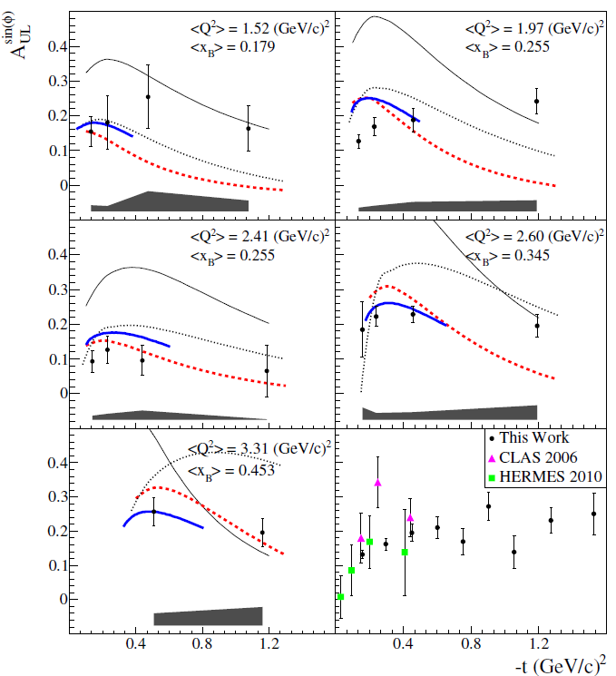
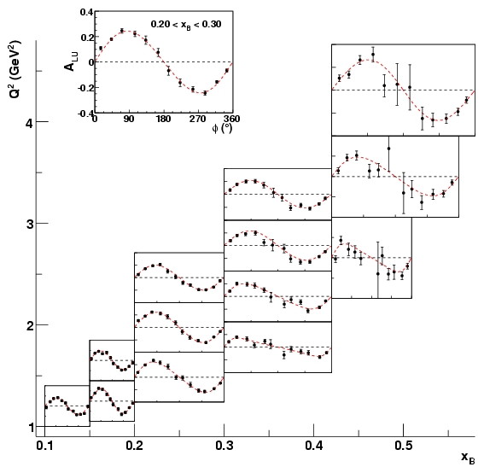
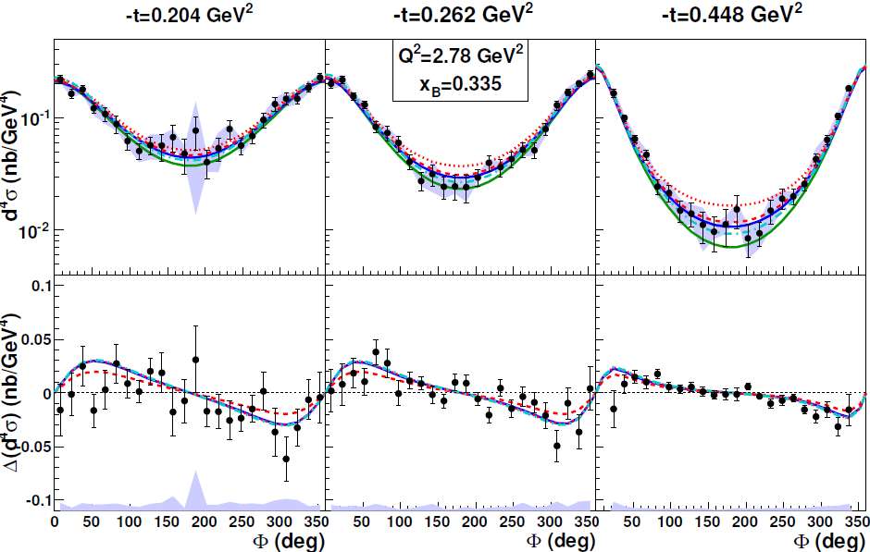
« First generation » of DVCS results from JLab @ 6 GeV
BSA, CLAS
Cross section, Hall A
TSA, CLAS
TSA, CLAS
BSA, CLAS
Cross section, CLAS
11

Slide 12
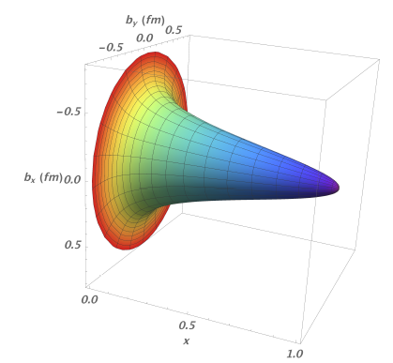
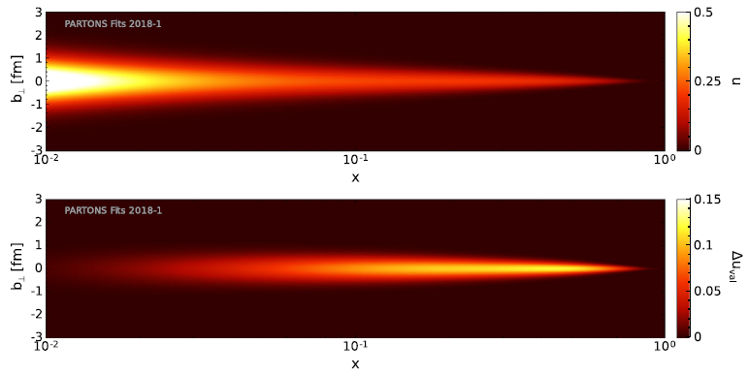
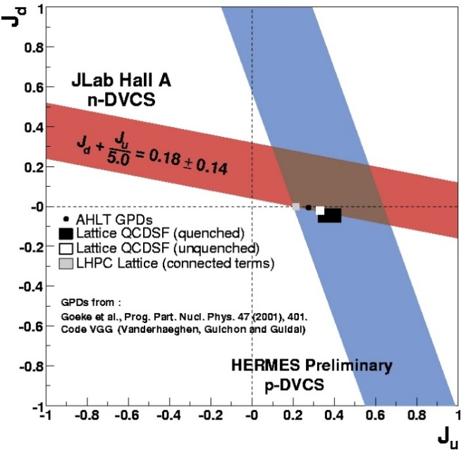
What have we learned from the first generation of DVCS results?
From H-only fit of DVCS BSA and cross section from CLAS@6 GeV (model dependent): an insight in the pressure distribution in the proton
Proton tomography from local fits to HERMES, CLAS, and Hall-A data (ImH + model dependent assumptions for x dependence)
Proton tomography from global fits to HERMES, CLAS, Hall-A, and COMPASS data (PARTONS framework), LO/LT analysis relying on dispersion relations and constraints from PDF and FF data
CLAS6 uncertainties
Projected CLAS12 uncertainties
Uncertainties using previous data
V. Burkert, L. Elouadrhiri, F.X. Girod, Nature 557 (2018)
3
The longitudinal polarization distribution versus position of valence u quarks was also extracted
Model-dependent extraction of J_{u}, J_{d} combining HERMES results of pDVCS on transversely polarized target with nDVCS results from Hall A on helicity-polarized cross-section differences
High-momentum quarks (valence) are at the core of the nucleon, low-momentum quarks (sea) spread to its periphery
H. Moutarde, P. Sznajder, J. Wagner, Eur. Phys. J. C (2018)
R. Dupré, M. Guidal, M.Vanderhaeghen, PRD95 (2017)
« Visualizing the proton »
Movie by R. Milner, R. Ent, R. Yoshida
https://www.youtube.com/watch?v=G-9I0buDi4s
12

Slide 13
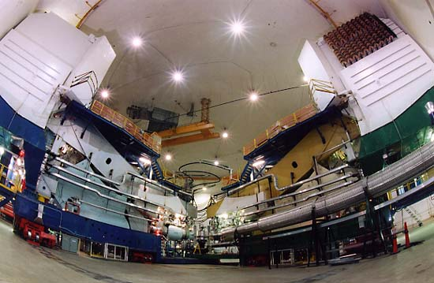
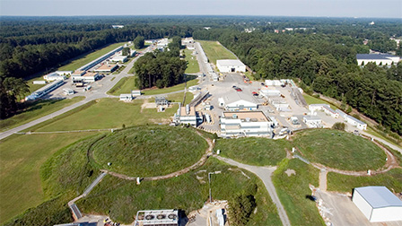
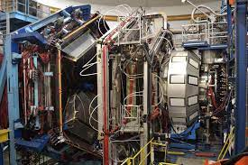
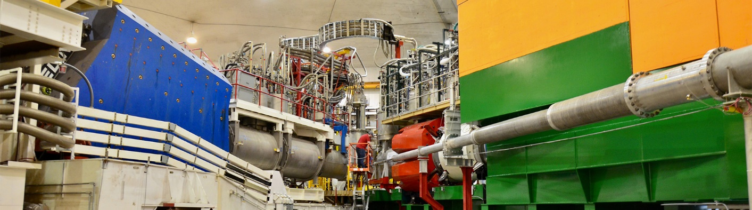
Jefferson Lab at 12 GeV
Hall A
HRS: High Resolution Spectrometer
A
B
C
Continuos Electron Beam Accelerator Facility (CEBAF)
• Up to 12 GeV continuous polarized electron beam
• Two anti-parallel linacs, with recirculating arcs on both ends
• 4 experimental halls, 3 devoted to nucleon-structure studies
Hall B – CLAS12
Complementarity of the setups in the Halls A/C and B
Hall A/C: high luminosity → precision, small kinematic coverage, eγ topology
Hall B (CLAS12): lower luminosity, large kinematic coverage, fully exclusive final state
An extensive experimental program focused on DVCS and GPDs is underway
Hall C
HMS: High Momentum Spectrometer
SHMS: Super High Momentum Spectrometer
13

Slide 14
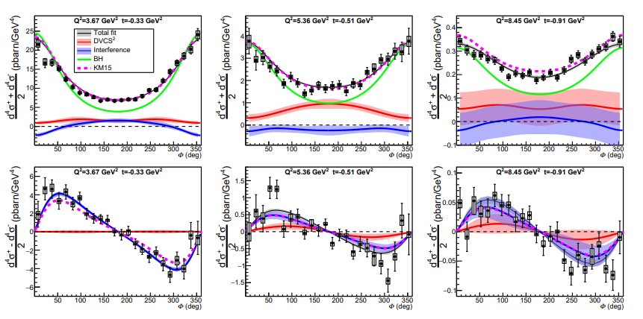
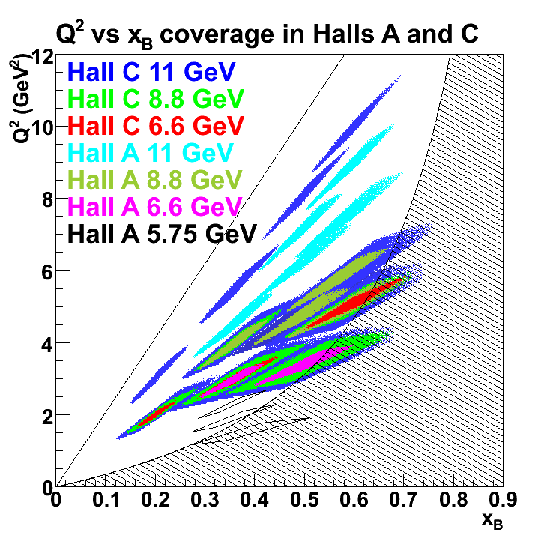
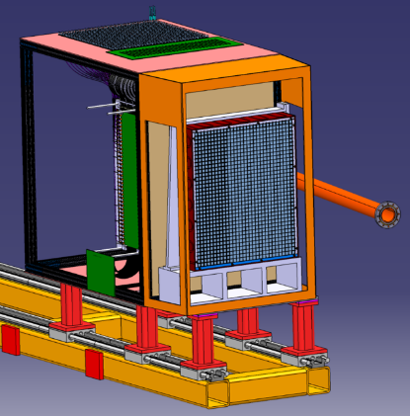
Hall-A and Hall C: high-precision cross sections for DVCS on the proton at different beam energies
→
ep→eγ(p)
x_{B}=0.36
x_{B}=0.48
x_{B}=0.60
Neutral Particle
Spectrometer (NPS)
pDVCS in Hall C with NPS
Experiment completed in May 2024
3 beam energies
Data are being calibrated
pDVCS in Hall A (first 12 GeV experiment at JLab):
High precision DVCS cross sections up to large x_{B}, for 3 beam energies
Separation of Interference, BH, and DVCS² terms
Sensitivity to all 4 Compton Form Factors
F. Georges et al., PRL 128 (2022)
14

Slide 15
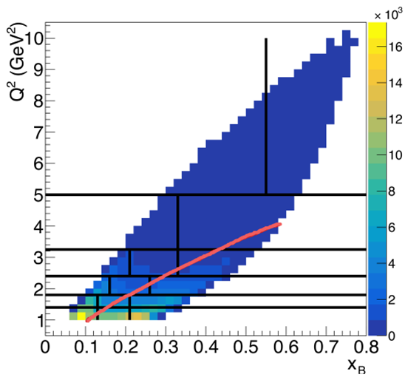
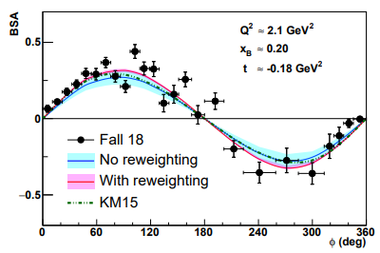
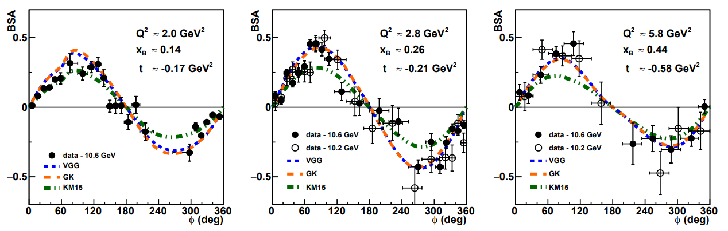
CLAS12: beam spin asymmetry for DVCS on the proton
→
ep→epγ
Polarized beam (86%) with energy 10.6 GeV
Unpolarized LH2 target
64 kinematical bins (Q², x_{B}, -t)
Many kinematics never covered before
In previously measured kinematics, the new data are in good agreement with existing data and improve the precision of GPD fits
6 GeV
~
Δσ_{LU}~ sinφ Im{F₁H + ξ(F₁+F₂)H -kF₂E}
Examples of kinematics only accessible with ~10.6-GeV beam
G. Christiaens et al. (CLAS), PRL 130 (2023)
15

Slide 16
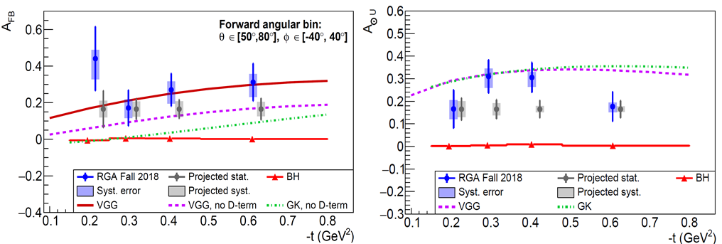


First measurement of Timelike Compton Scattering (CLAS12)
γp→γ*p→(e’)e⁺e⁻p
P. Chatagnon, S.N. et al. (CLAS), PRL 127 (2021)
~
~
~ cosφ Re{F₁H + ξ(F₁+F₂)H -kF₂E}
~ sinφ Im{F₁H + ξ(F₁+F₂)H -kF₂E}
Quasi-real photo-production (Q²~0)
Forward-backward asymmetry: sensitive to the real part of the CFF → direct access to the Energy-Momentum Form Factor d_{q}(t) that relates to the mechanical properties of the nucleon (quark pressure distribution)
Beam helicity asymmetry: access to the imaginary part of the CFF in the same way as in DVCS → universality of GPDs
Limits: very small cross section → high luminosity is necessary for a precise measurement
Imminent doubling of statistics thanks to data reprocessing with improved reconstruction (projections: gray points)
16

Slide 17
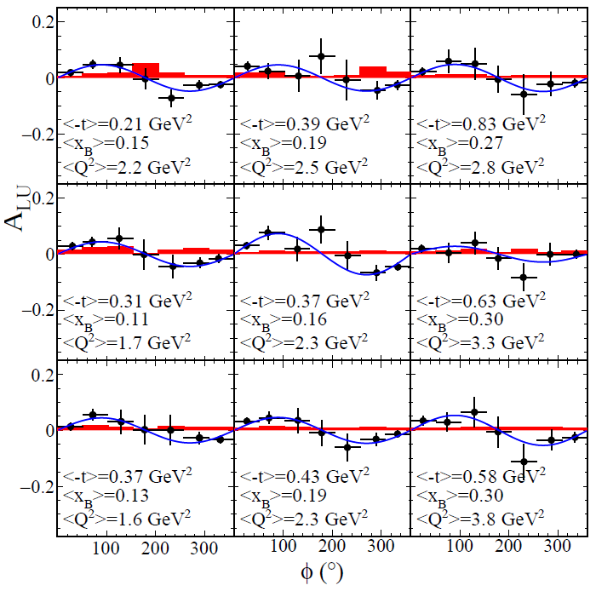
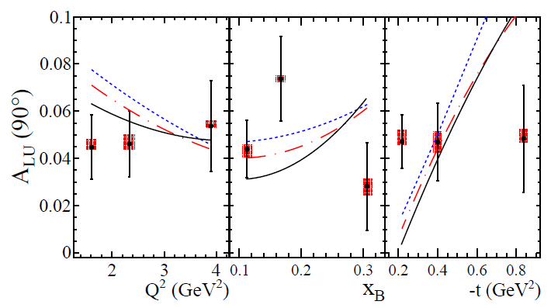
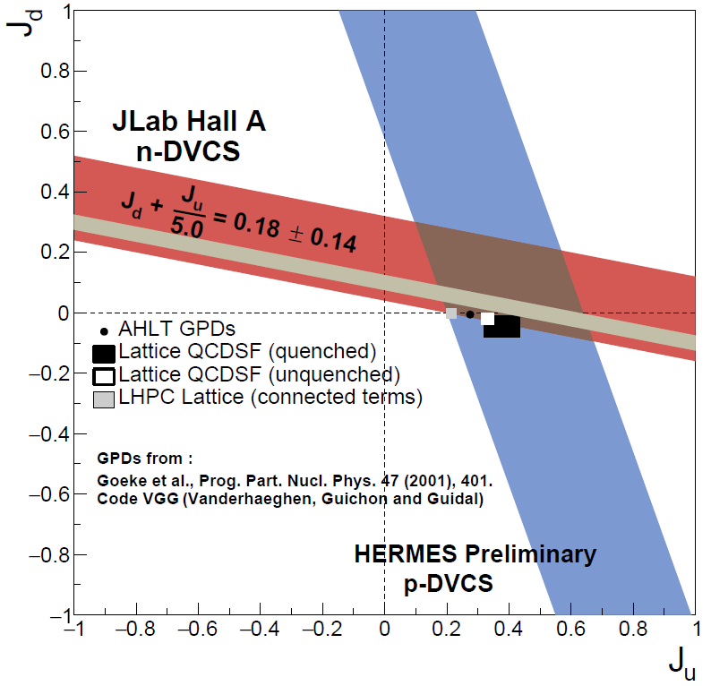
First-time measurement of BSA for nDVCS with detection of the active neutron (CLAS12)
→
ed→enγ(p)
~
Δσ_{LU}~ sinφ Im{F₁H + ξ(F₁+F₂)H -kF₂E}
-t bins
J_{u} = 0.35 J_{d} = 0.05
J_{u} = −0.2 J_{d} = 0.15
J_{u} = −0.45 J_{d} = 0.2
VGG model predictions
« VGG »: M. Vanderhaeghen, P. Guichon, and M. Guidal, PRD 60 (1999)
x_{B} bins
A. Hobart, S.N. et al (CLAS), PRL 133 (2024)
CLAS12 nDVCS
(model dependent)
Q² bins
17

Slide 18
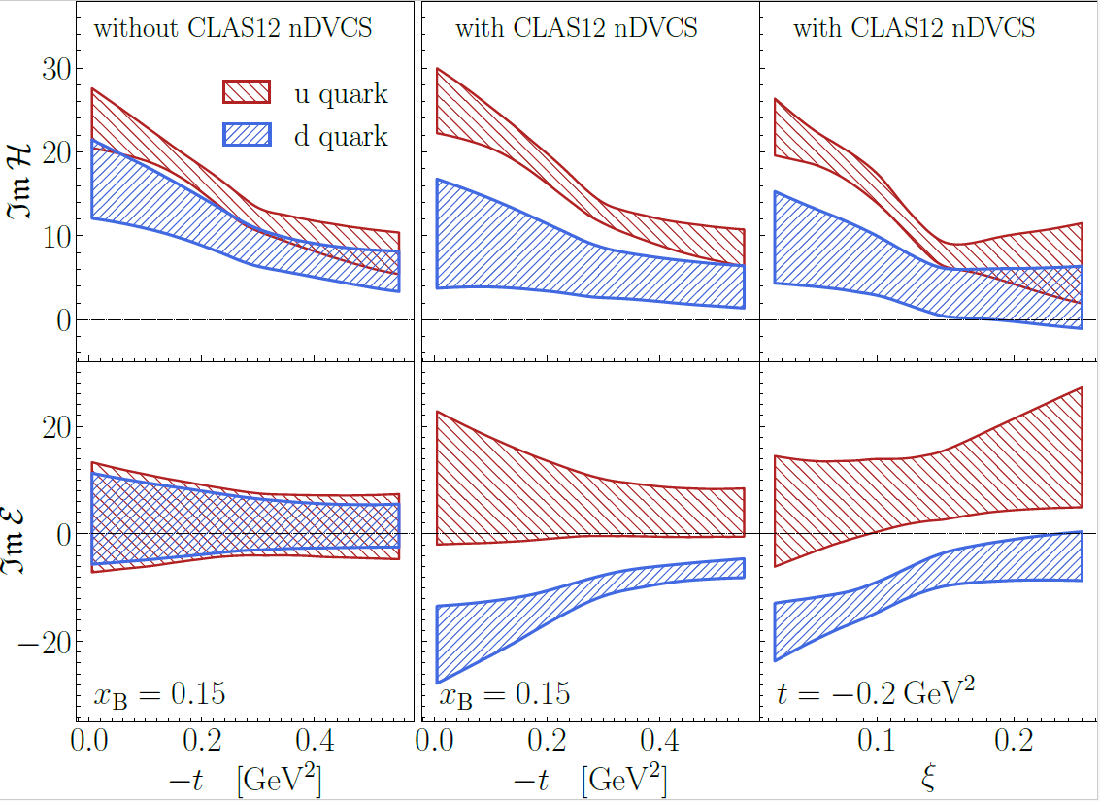
Flavor separation of CFFs using the CLAS12 p,n DVCS data
Global fits of CFF using neural networks (K. Kumericki et al., JHEP 07, 073531 (2011); M. Cuic, K. Kumericki, et al., Phys. Rev. Lett. 533 125, 232005 (2020)).
Data used: CLAS6 and HERMES pDVCS observables, CLAS12 pDVCS BSA and nDVCS BSA
Same extraction method applied to nDVCS Hall-A 6-GeV data: flavor separation only for ImH
The CLAS12 nDVCS data allow the quark-flavor separation of both ImH and ImE
18

Slide 19
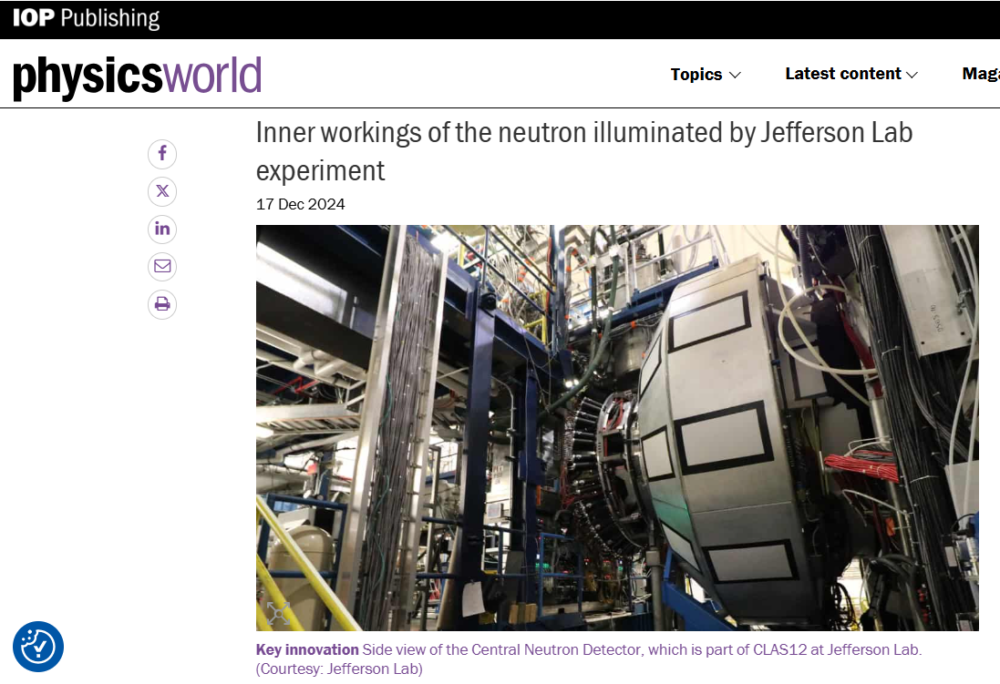
https://physicsworld.com/a/inner-workings-of-the-neutron-illuminated-by-jefferson-lab-experiment/
19

Slide 20
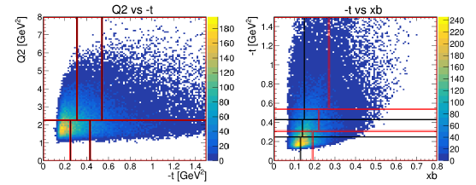
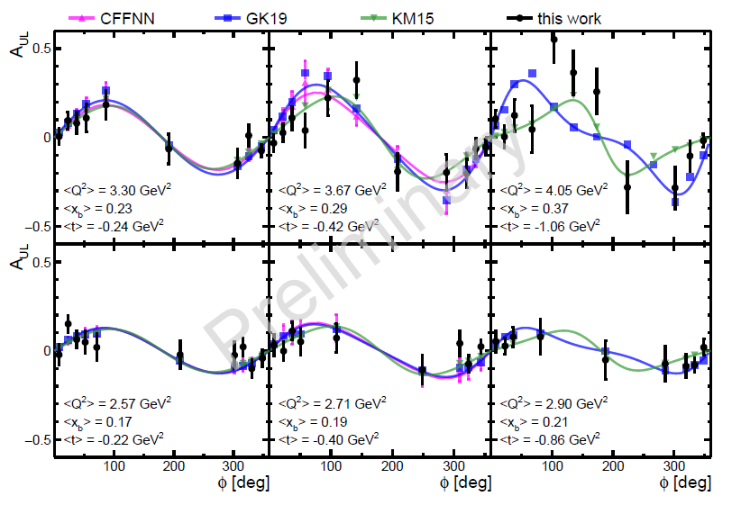
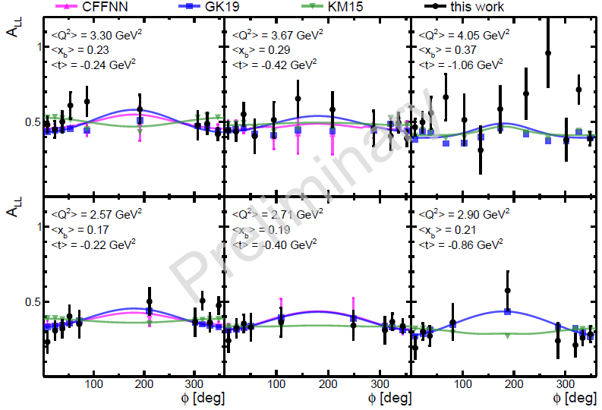
pDVCS on longitudinally polarized NH3 target: TSA & DSA
→
→
ep→epγ
Longitudinally polarized NH3 and ND3 target
Data taken in 2022-2023
Analysis on nDVCS TSA and DSA also ongoing
Analysis of ~30% of the collected data
Work by S. Polcher
Double Spin Asymmetry
Target Spin Asymmetry
~
~
Δσ_{UL} ~ sinφ Im{F₁H+ξ(F₁+F₂)(H + x_{B}/2E)}
Δσ_{LL} ~ (A+Bcosφ) Re{F₁H+ξ(F₁+F₂)(H + x_{B}/2E)}
20

Slide 21
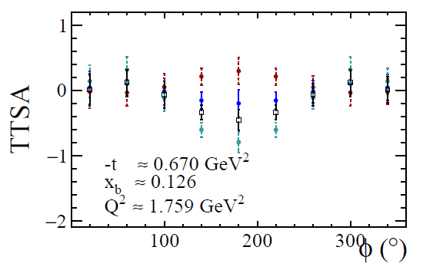

In preparation: pDVCS on transversely polarized target with CLAS12
→
→
pDVCS on a transverse target is complementary to nDVCS for its sensitivity to the GPD E
Projections for pDVCS
100 days of beam time
L = 5 x10³³ cm⁻² s⁻¹
VGG model: different values of J_{u}, J_{d}
ep→epγ
Δσ_{UT} ~ cosφsin(φ_{s}−φ)Im{k(F₂H – F₁E) }
J_{u} = 0.5, J_{d} = 0.1
J_{u} = −0.5, J_{d} = −0.1
J_{u} = 0.2, J_{d} = 0
Dynamically polarized NH3 (5T/1K) target
A new magnet to maximize the acceptance
A chicane of magnets to compensate the bending of the beam electrons by the holding magnet
A recoil detector (3 layers of µRwell + scintillator panel)
Proposal recently approved with A rating
Experiment will run in ~4 years
Black points: HERMES data
21

Slide 22

Impact of projected pDVCS TTSA from CLAS12 on CFF extraction
Uncertainty on ImE will be reduced by a factor of ~3
Preliminary analysis by M. Higuera Angulo using the GEPARD framework https://gepard.phy.hr/
22

Slide 23

Perspectives: DDVCS, the gateway to the full kinematic mapping of GPDs
DVCS Δσ, BSA
DVCS
σ, DSA, BCA
Thanks to the virtuality of the final photon, Q’², DDVCS allows a unique direct access to GPDs at x ≠ ±ξ, which is fundamental for their modeling
Experimental challenges:
Small cross section (300 times less than DVCS)
Need to detect muons
CLAS12 upgrade:
“μCLAS12” for DDVCS and J/ψ
ep→e’p’µ⁺µ⁻ at L~10³⁷ cm⁻²s⁻¹
New tracker, calorimeter, shielding
23

Slide 24


Perspectives: polarized positrons beam for Jefferson Lab
Physics Motivations:
• Two-photon physics
• Generalized parton distributions
• Neutral and charged current DIS
• Charm production
• Neutral electroweak coupling
• Light Dark Matter search
• Charged Lepton Flavor Violation
EPJ A Topical Issue about "An experimental program with positron beams at Jefferson lab“, Eur. Phys. J. A 58 (2022)
5 positron-based proposals, two of which on DVCS (CLAS12, Hall C) Conditionally Approved by JLab PAC
Measured only by HERMES (low statistics)
Never measured
PePPO: proof-of-principle for a polarized positron beam
PRL 116 (2016) 214801
Model predictions for 2 out of the 3 proposed pDVCS observables
R&D ongoing
Possible timeline: >2034
Impact of positron pDVCS projected data on the extraction of ReH via global fits: major reduction of uncertainties
24

Slide 25



The future: GPDs with ePIC@EIC - sea quarks and gluons in 3D
+ Roman Pots for very foward region (low-t)
Gluon tomography
25

Slide 26
Conclusions/outlook
GPDs are a unique tool to explore the structure of the nucleon:
  3D quark/gluon imaging of the nucleon
  orbital angular momentum carried by quarks
  pressure distribution
Fitting methods allow extraction of CFFs (→ GPDs) from DVCS observables → several p-DVCS and n-DVCS observables are needed, covering a wide phase space
A first set of results on DVCS observables was obtained from HERMES, CLAS and Hall-A at 6 GeV
First tomographic interpretations of the quarks in the proton from DVCS
Insight in the pressure distribution in the proton
JLab@12 GeV is the optimal facility to perform GPD experiments in the valence region
DVCS, TCS, and DVMP experiments on both proton and neutron (polarized and unpolarized) are ongoing in 3 of the 4 Halls at JLab@12 GeV, and a wealth of new results are being released.
This will lead to, with the help of theorists and phenomenologists:
GPD extraction, quarks’ spatial densities, flavor separation, quarks’ orbital angular momentum, chiral-odd GPDs, transition GPDs
JLab upgrade perspectives (CLAS12 hi-lumi, positron beam) → completion of the GPD program in the valence regime
Longer term perspectives: EIC for GPDs in the sea-quark/gluon regime
26

Slide 27

« Visualizing the proton » (R. Milner, R. Ent, R. Yoshida)
Filmmaking by Chris Boebel, Joe McMaster, and James LaPlante
https://www.youtube.com/watch?v=G-9I0buDi4s

