Slide 1



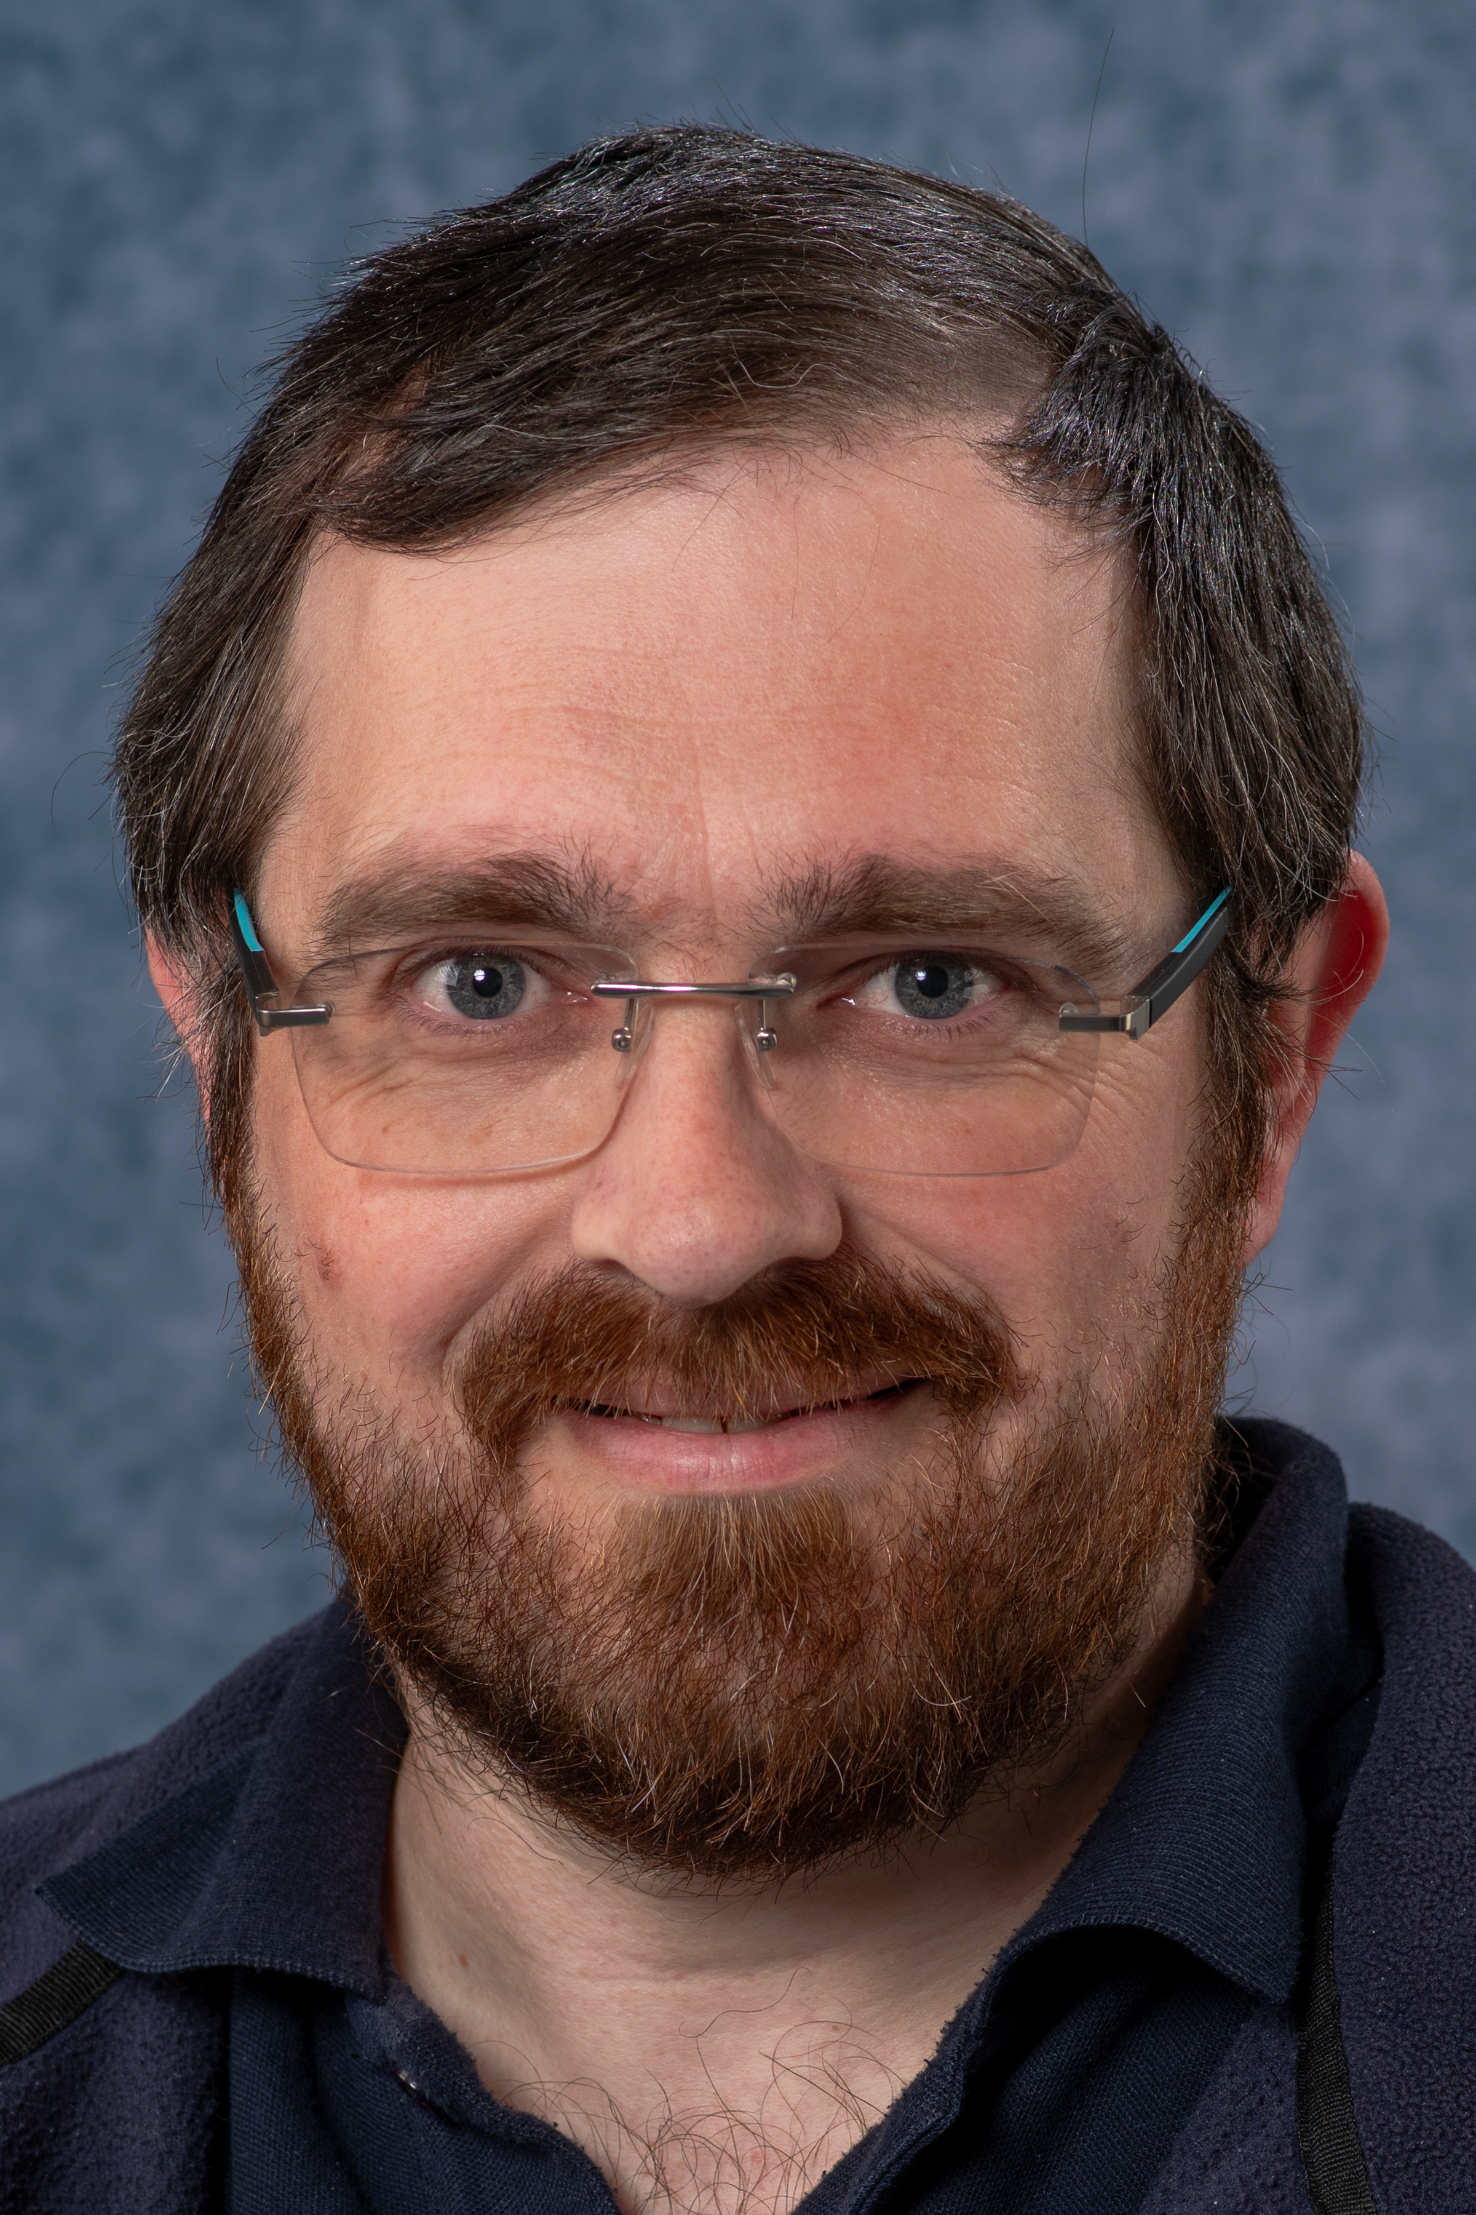
ISIS Detector Systems Front Line Support
Simon Moorby
14th August 2025
Notes:
Introduce myself

Slide 2
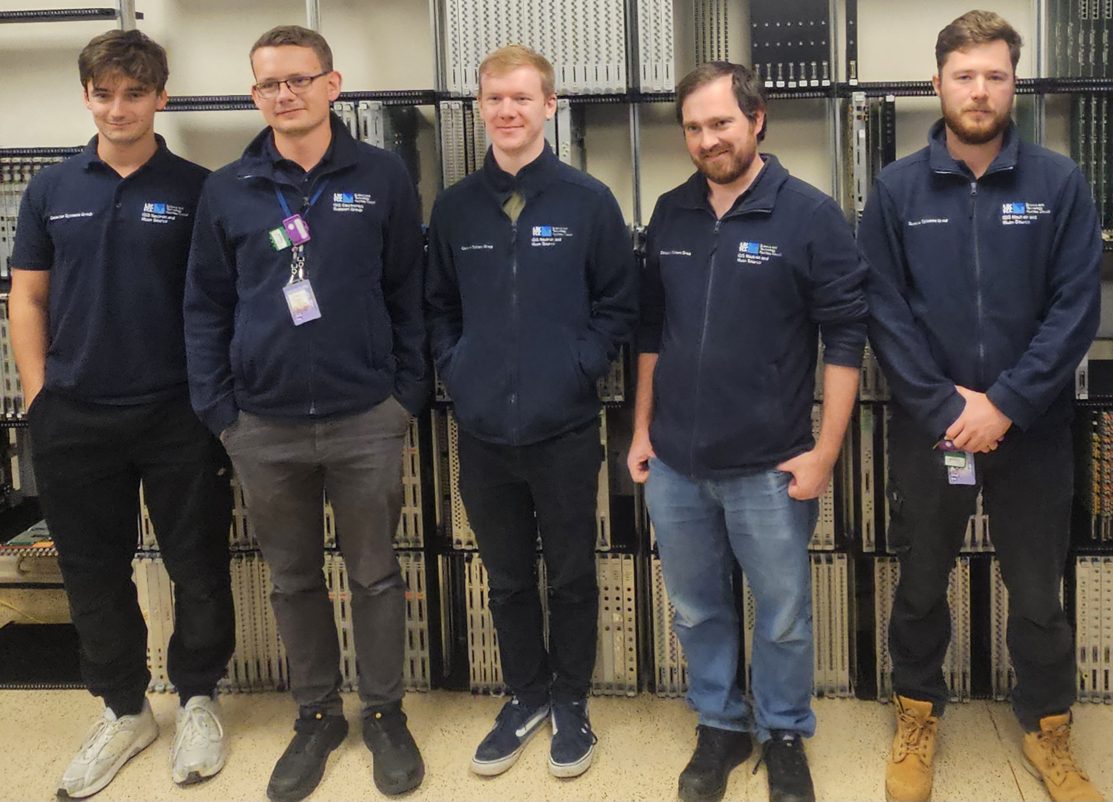
The Team
FLS team comprises of: (left to right in photo)
Josh D, Jack, Will, Myself, Chad.
Assistance when required is provided by Dave, Piers, Kelvin and Josh P.
We also supervise apprentices in FLS to give them a good all round learning experience.
Notes:
Introduce team I manage
FLS is only part of there role - development and testing
customer/section leader for Josh P

Slide 3
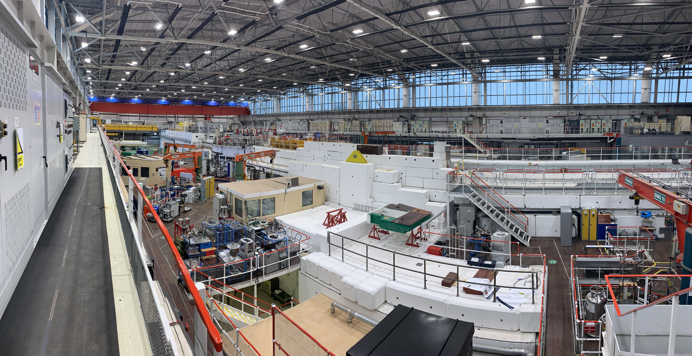
Main functions of the Front Line Support
Installation & commissioning of new systems
Periodic upgrades of existing systems
Maintenance, fault finding & repair of boards, crates, fan trays & power supplies
DAE circuits & systems on 38 ISIS Instruments comprises of over 2000 DAE and Detector Electronics PCBs in 146 crates.
Responsible for >360 HT cards, >66 HT crates, >56 Eurocard crates and 100’s of Eurocards.
(>15 CAEN discriminator cards and crates too)
The rest of the group focuses on PCB circuit design, layout & development , component & board procurement and programmable logic firmware design & development including test systems.
Notes:
Install commissioning new systems
Upgrades
Maintenance
responsible for a large amount of kit thousands of PCB’s and hundreds of crates spread around 38 instruments and test/assembly areas.
Rest of team (6) are focused on PCB design , procurement, firmware and testing.

Slide 4
Printed Circuit Board Data
The pie chart shows the percentage of the 2090 DAE boards we currently look after that are in service, working spares or faulty.
The new boards have recently arrived and have not undergone any more than a visual inspection and entry into our SharePoint Quality Management System.
Test required section is for boards that have not finished being tested to the required standard, but no faults have been found.
Notes:
Number of boards has decreased recently as we’ve disposed of unrepairable, obsolete or no longer required items (after salvaging value reusable connectors)

Slide 5
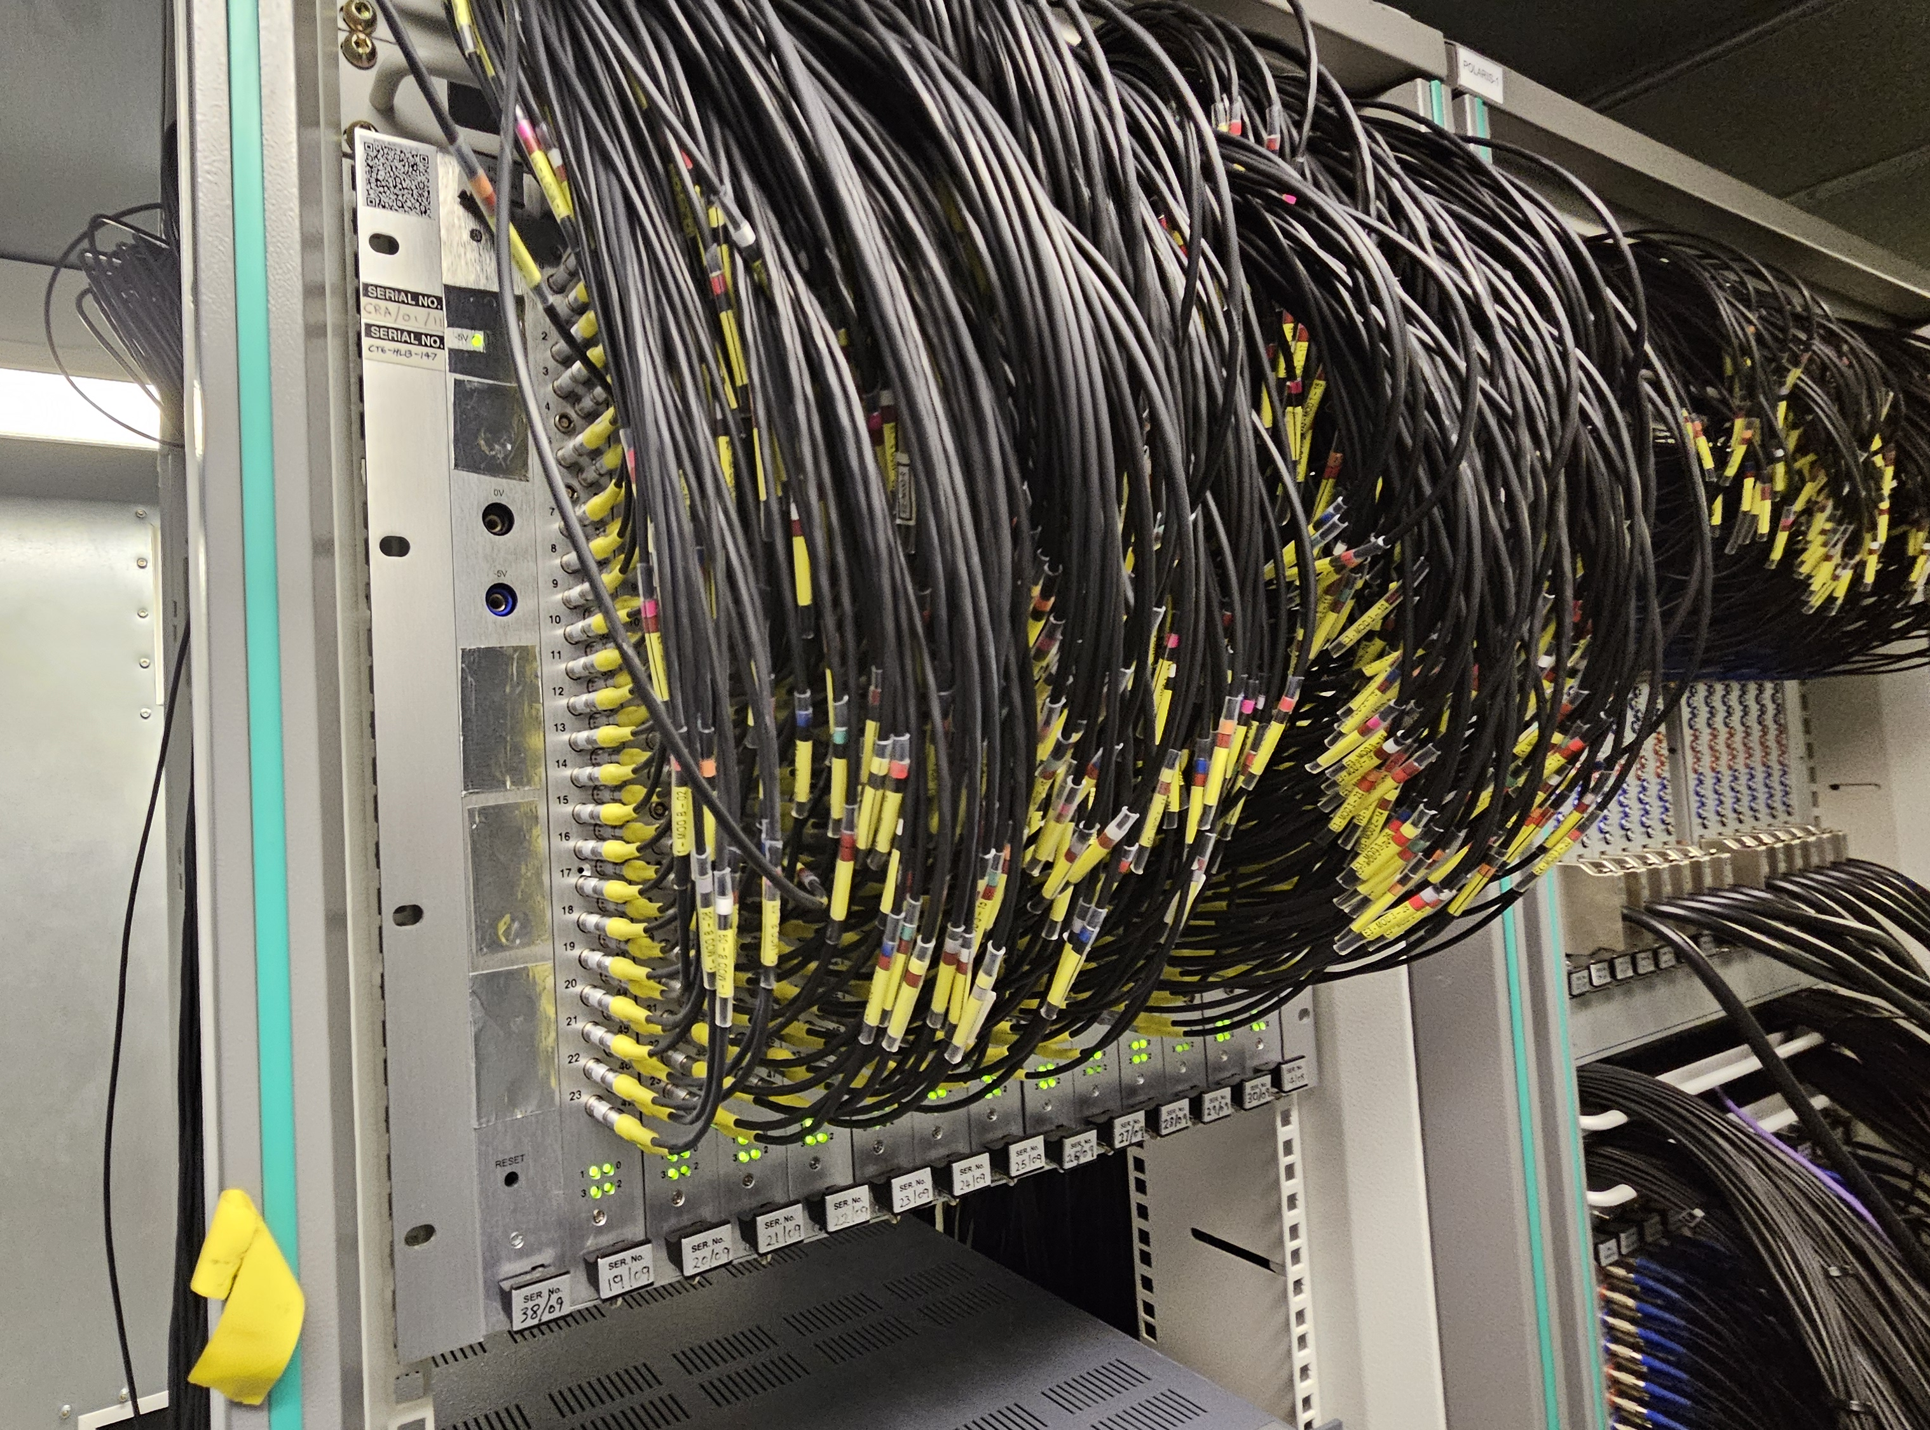
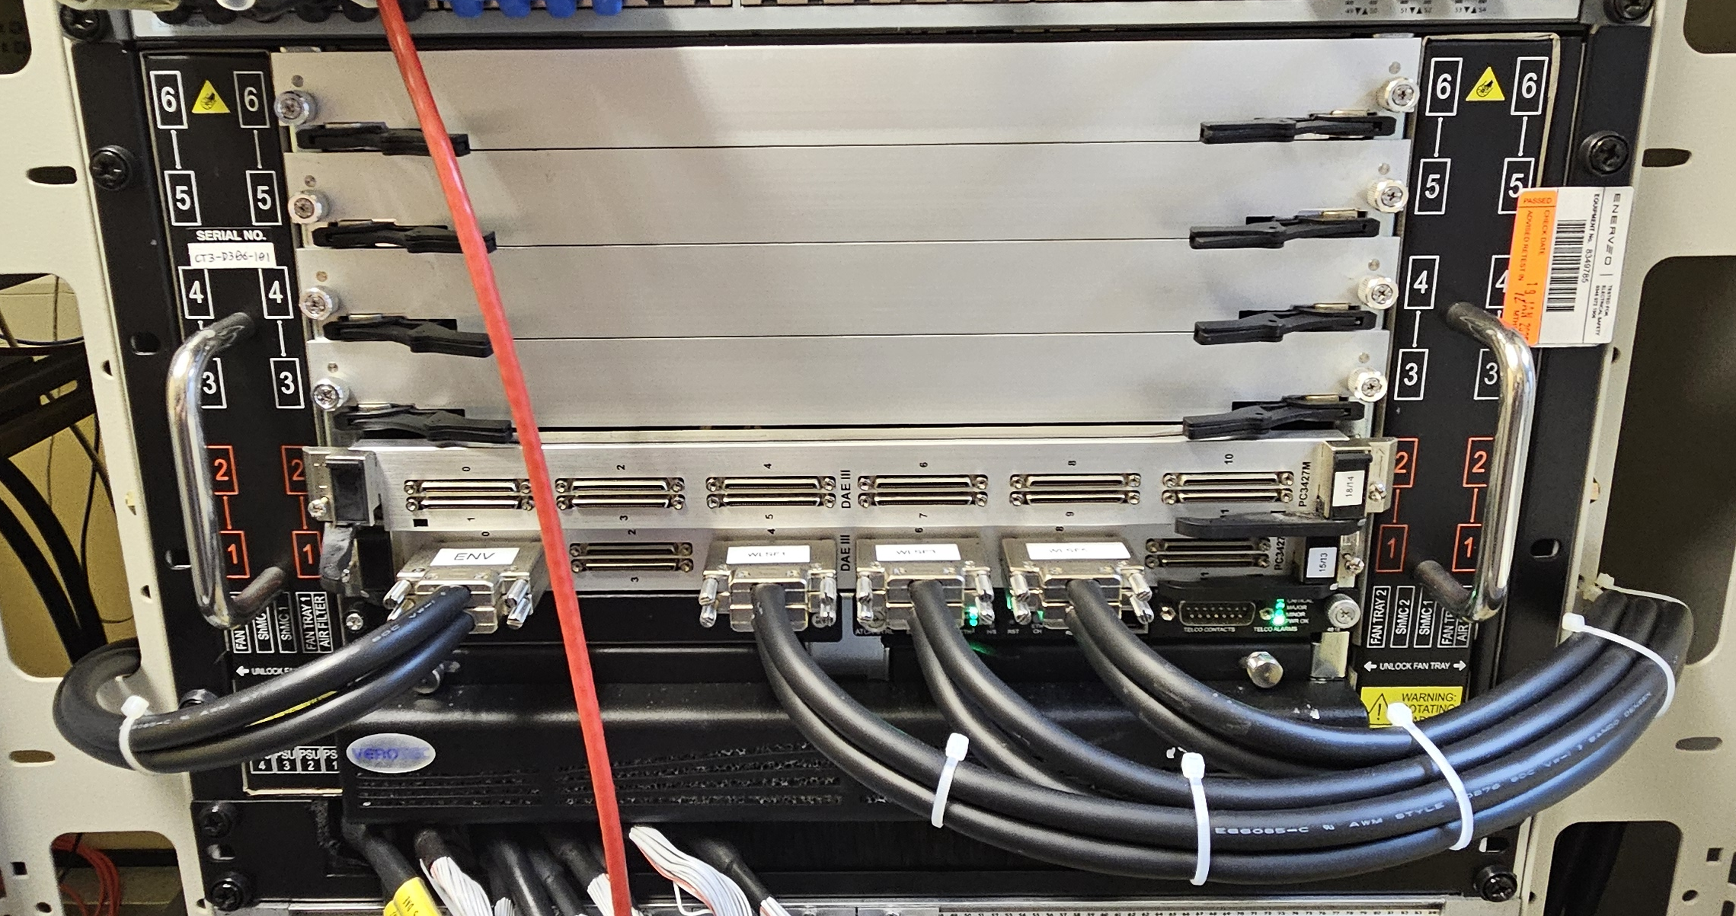
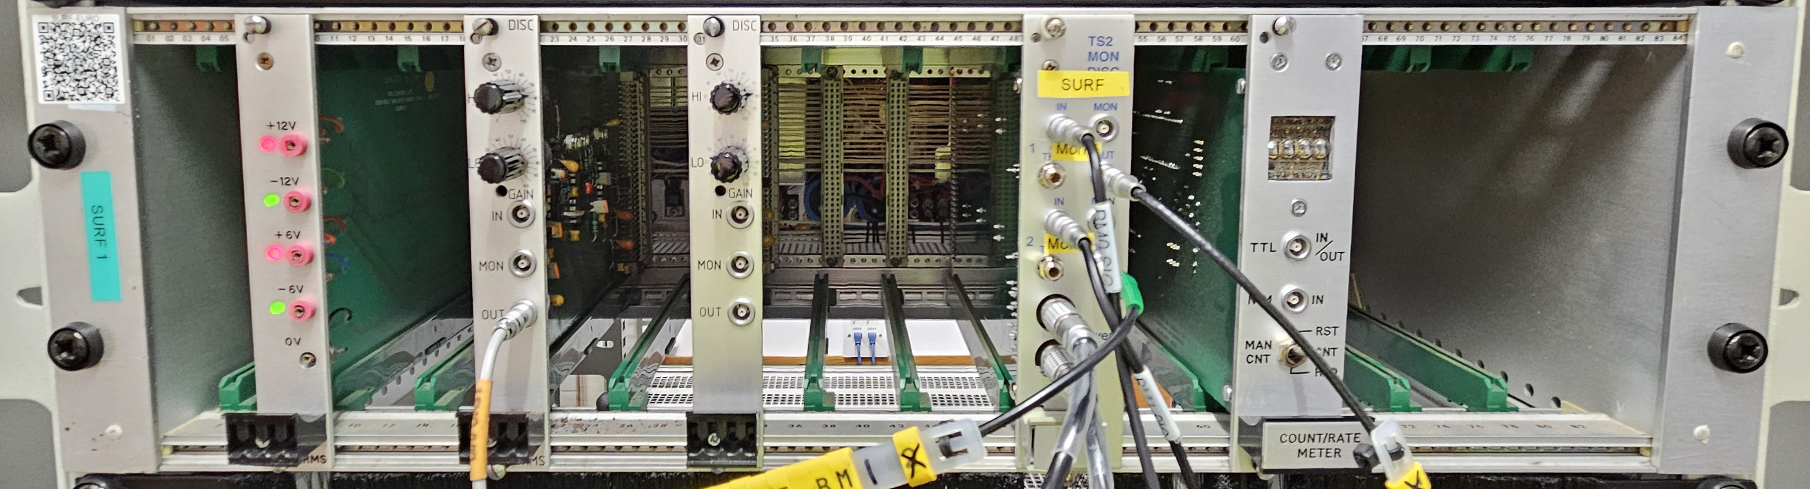
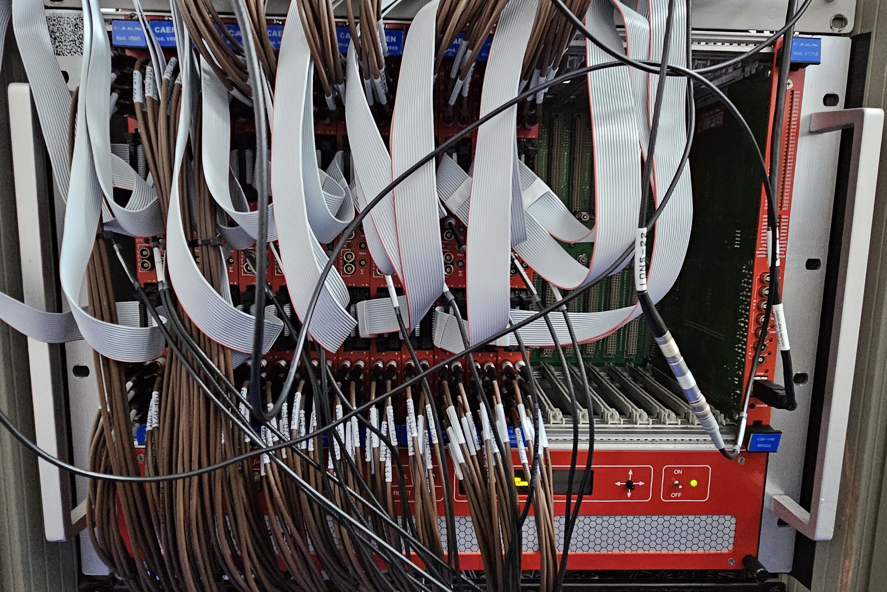
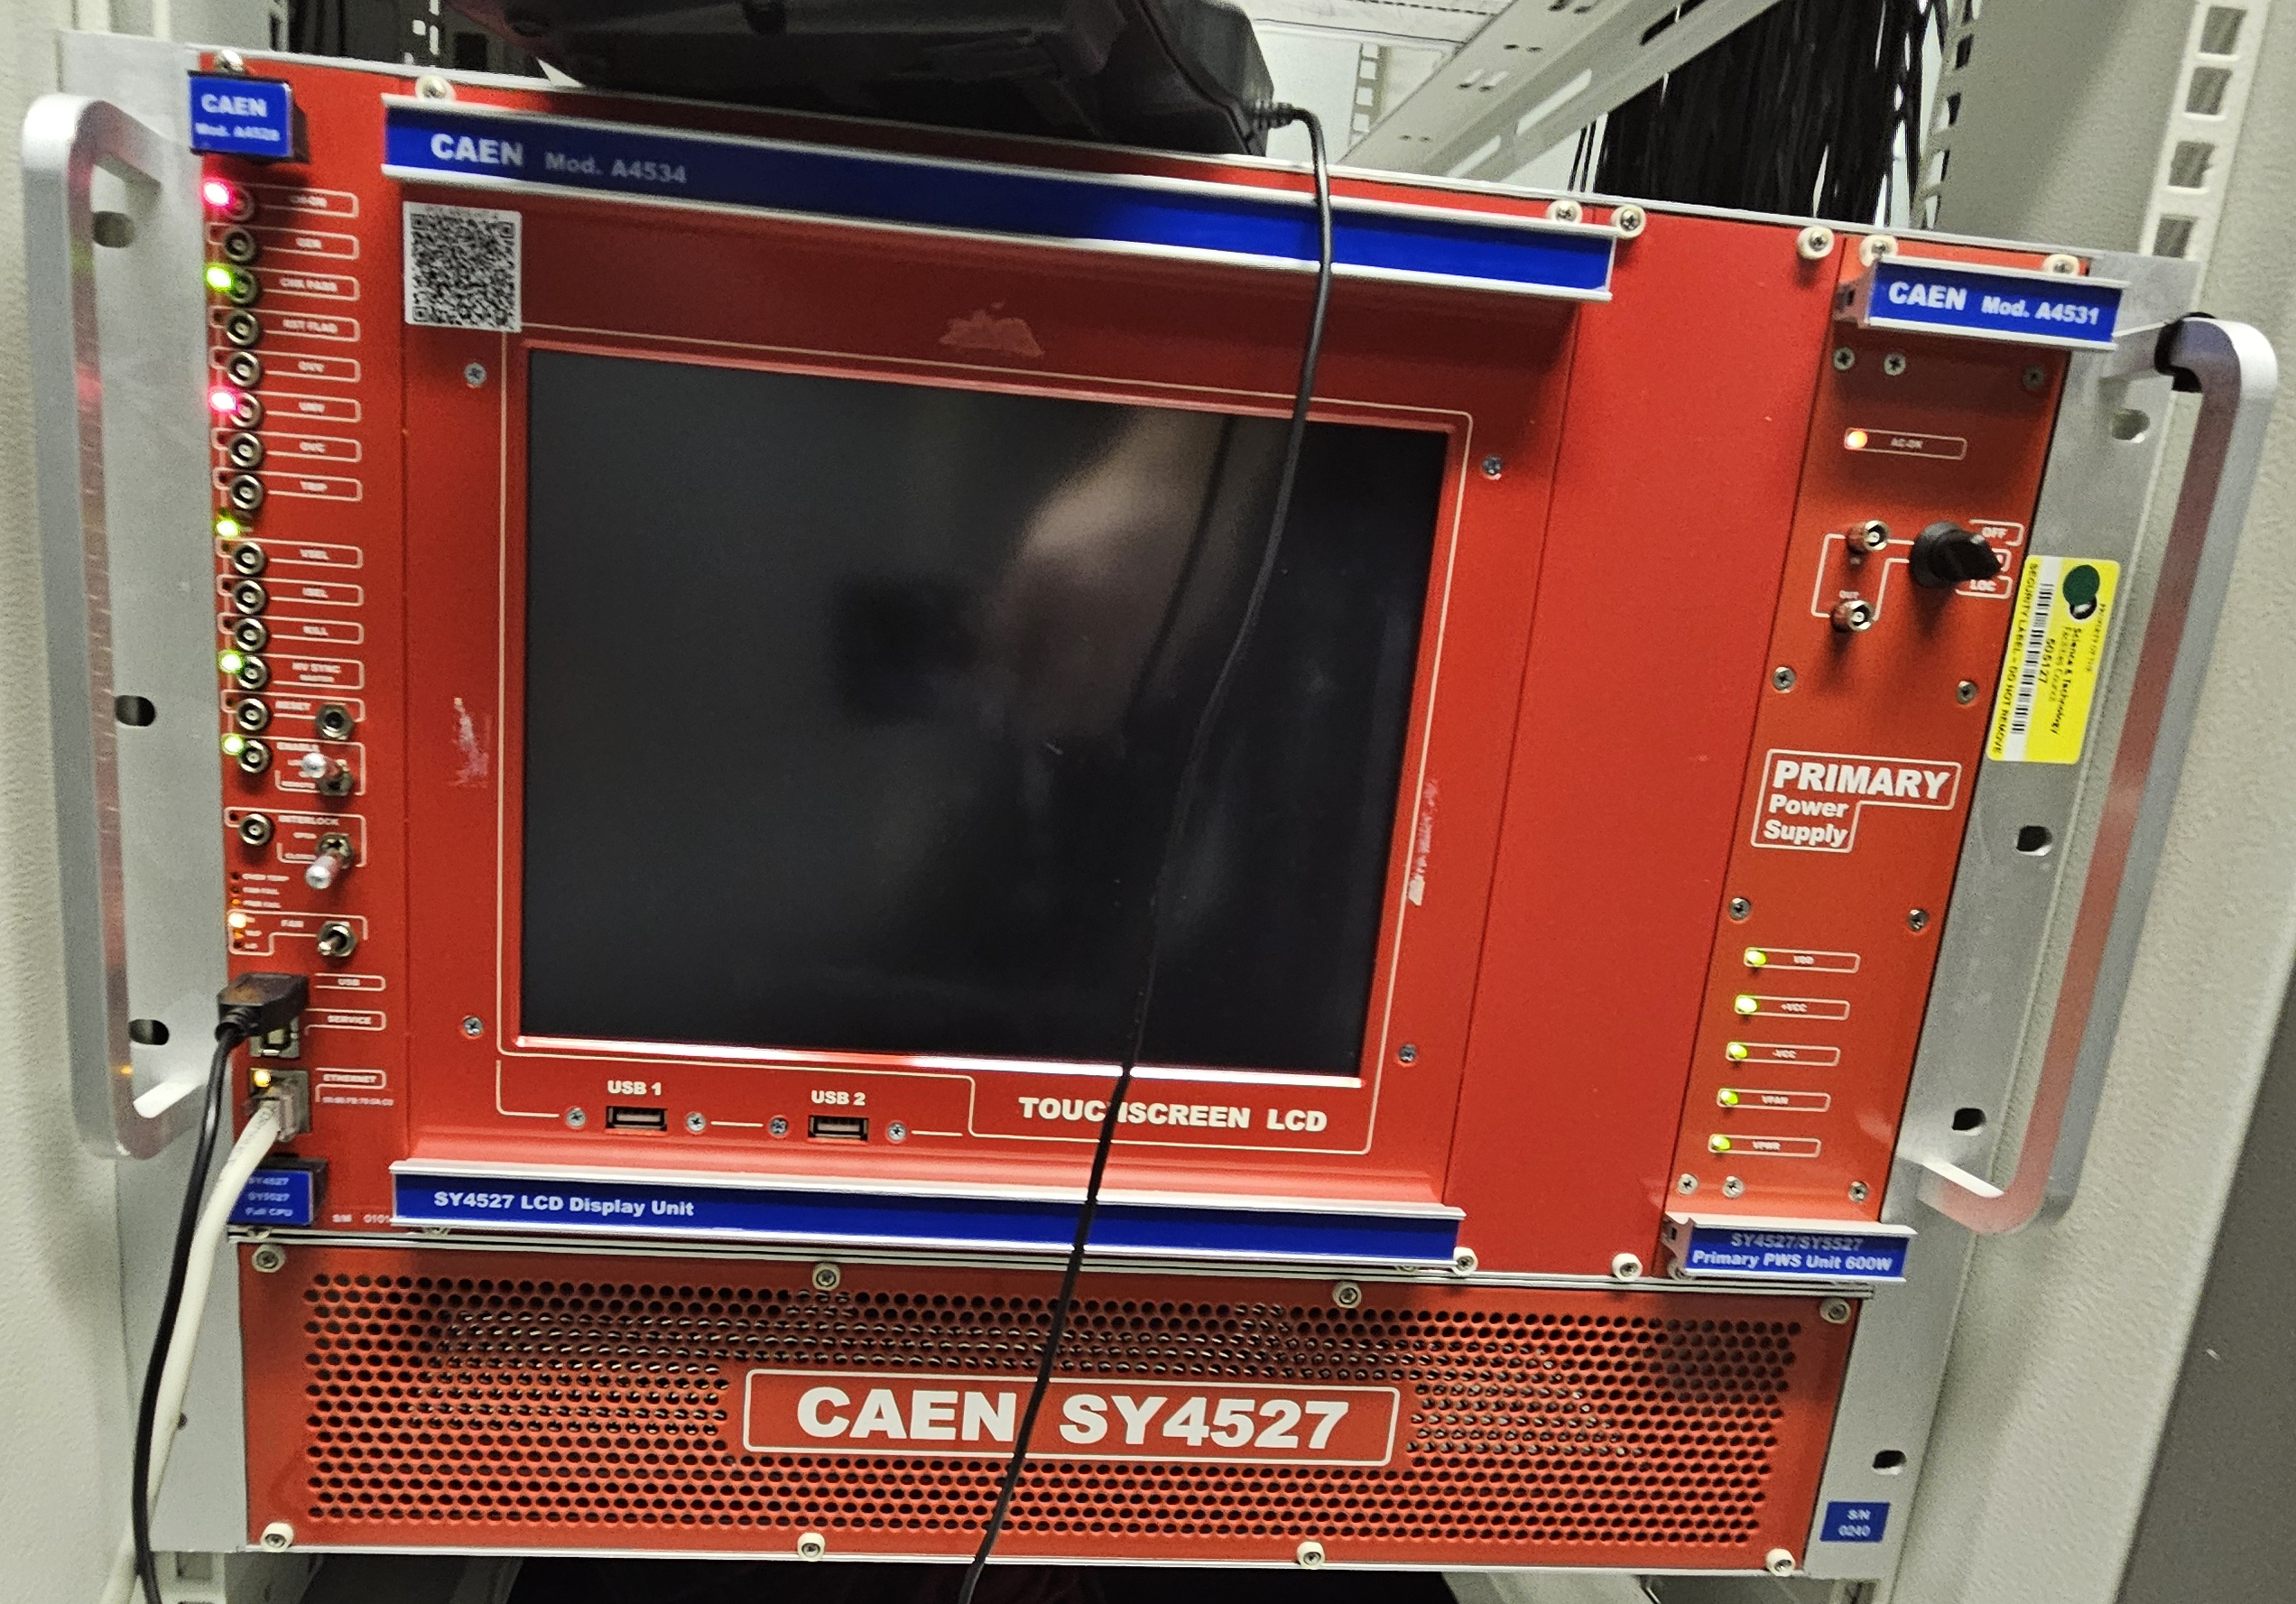
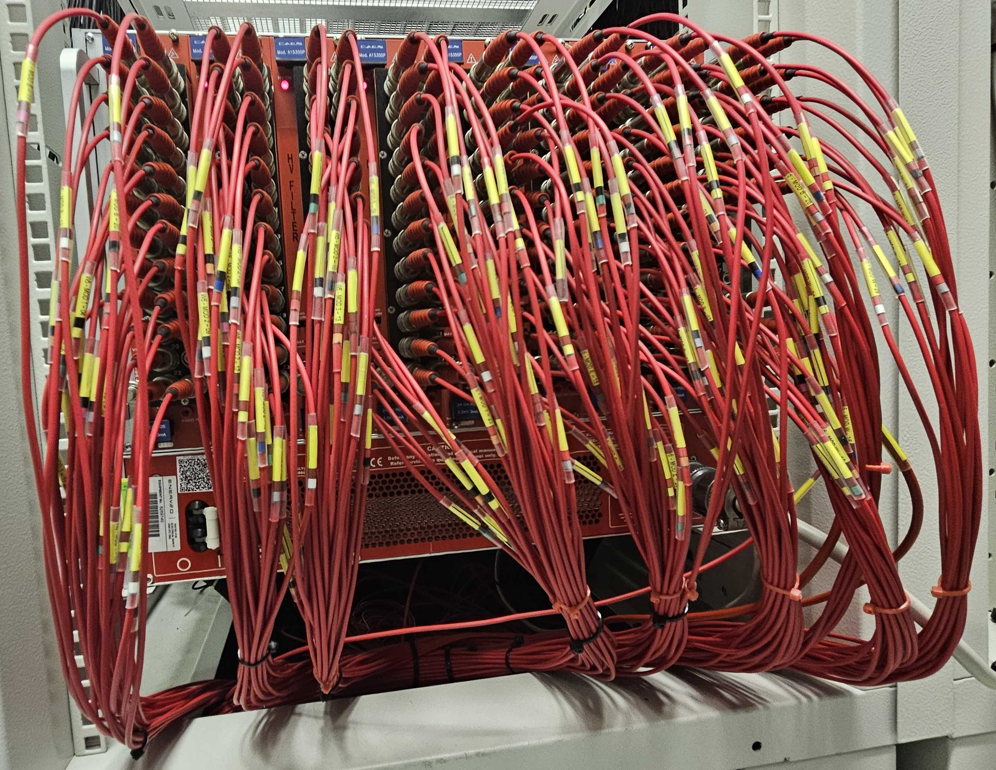
What we support
DAE-II crates
DAE3 crates
Euro crates
Muon Discriminators
HT crates (front and rear view)
Notes:
IESG Merged with detector group in 2022 and with that we expanded the electronics we support originally it was just the DAE-II systems with FE electronics and LV dist Detector crates and dae3 detector crates.
now includes euro crate which take in monitor or detector signals and feed to the FE interfaces, muon discriminator crates (both of which do some pre DAE processing and/or signal conversion)
HT (high voltage) crates – one shown here is a CAEN which is the majority however there are some lecroy systems which we are actively replacing due to them being obsolete and being local setting only.

Slide 6
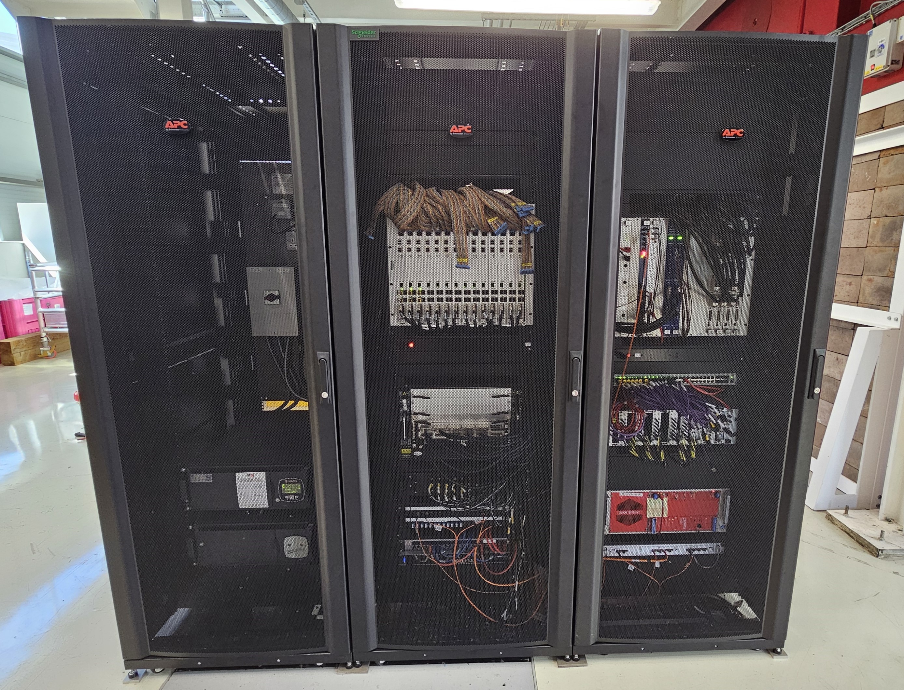
Install and Commissioning
A recent example of our installation and commissioning work was with the IMAT detector upgrade.
14 Wavelength Shifting Fiber detectors were installed in the blockhouse.
Required new cabling to be made and routed, new and additional DAE hardware and a change of racks to enable all of this to fit.
Worked closely with other groups both during planning and installation to enable us to keep to the tight schedule.
This had to be completed during two short shutdowns and one cycle.
Notes:
Example Imat, new additional WLSF detectors in block house – new cables with test, routed, dae electronics, racks.
Source tests to commission – find and fix faults before finishing of install and final commissioning with beam after radiation surveys. Waste screening and reuse/recycle/disposal.
installation checklists to ensure consistency
Close work with other ISIS groups in order to complete to a tight schedule during beam shutdowns and one cycle the instrument did not run.
Also in window of opportunity due to other large project works in the vicinity (HRPD decommission next slide)

Slide 7
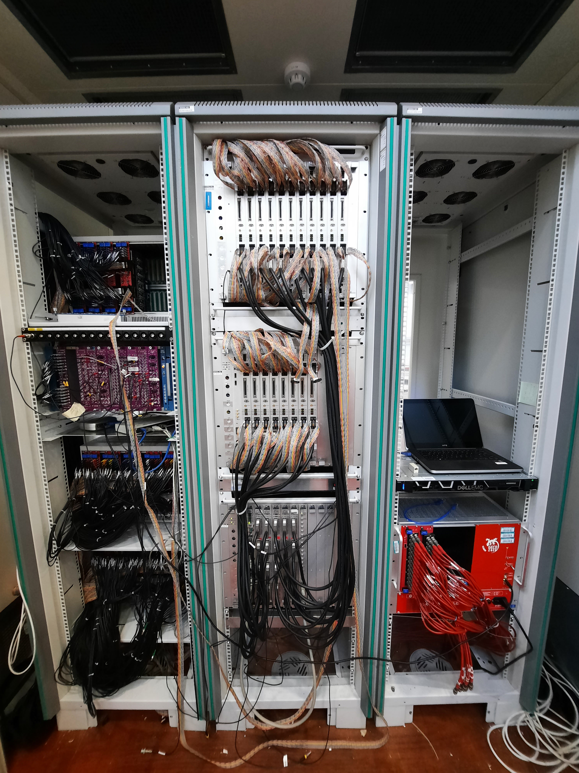
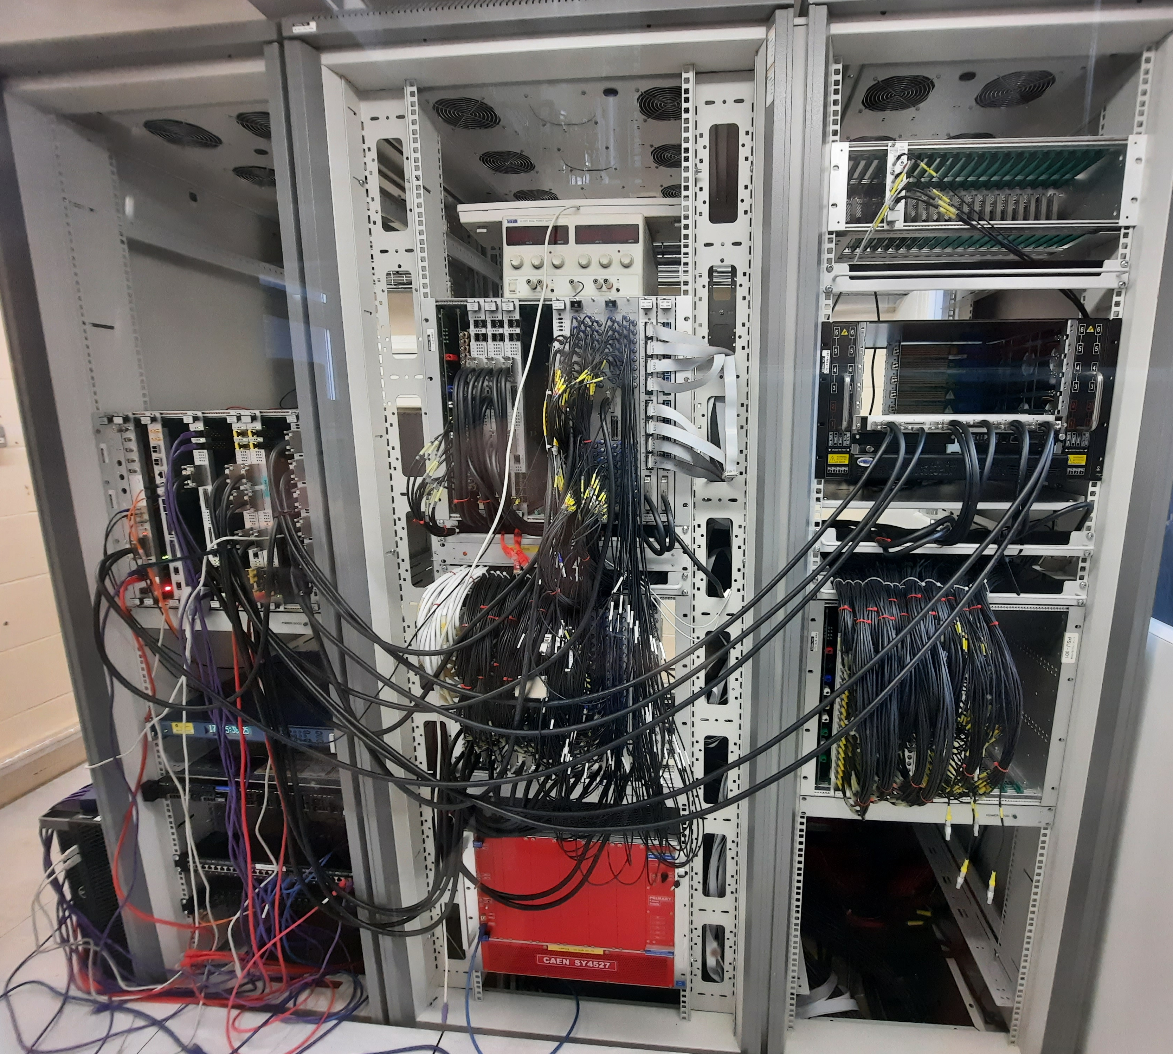
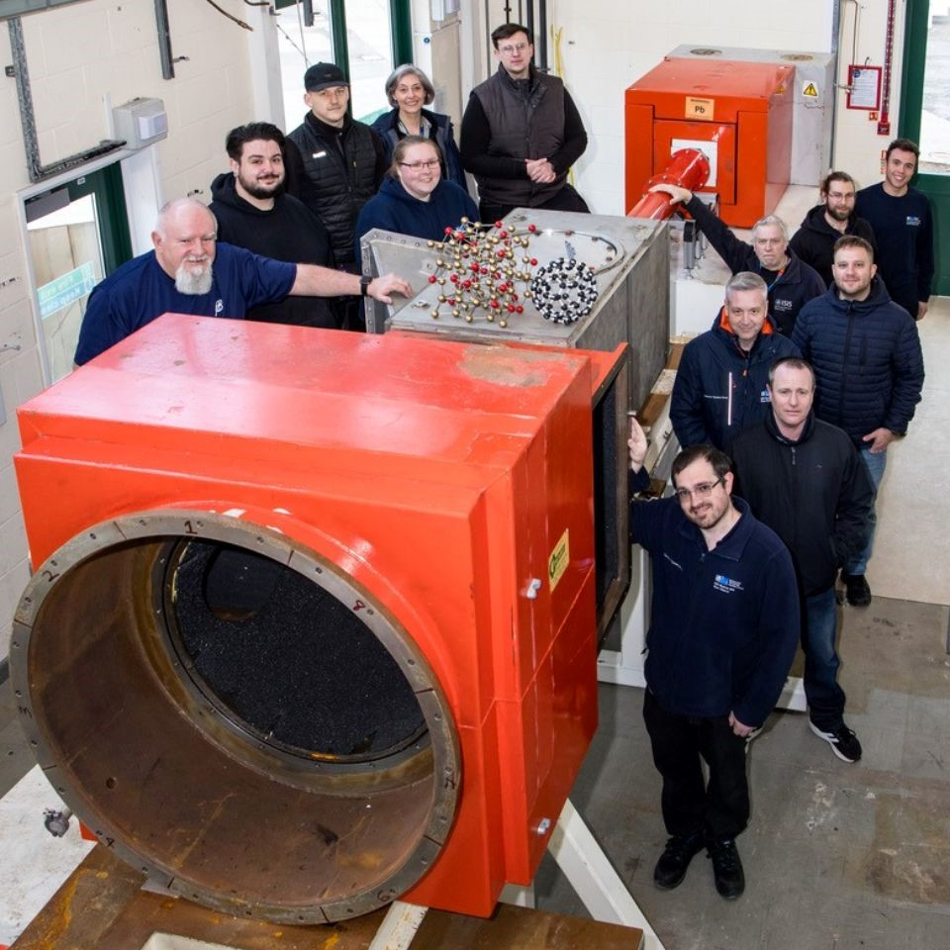
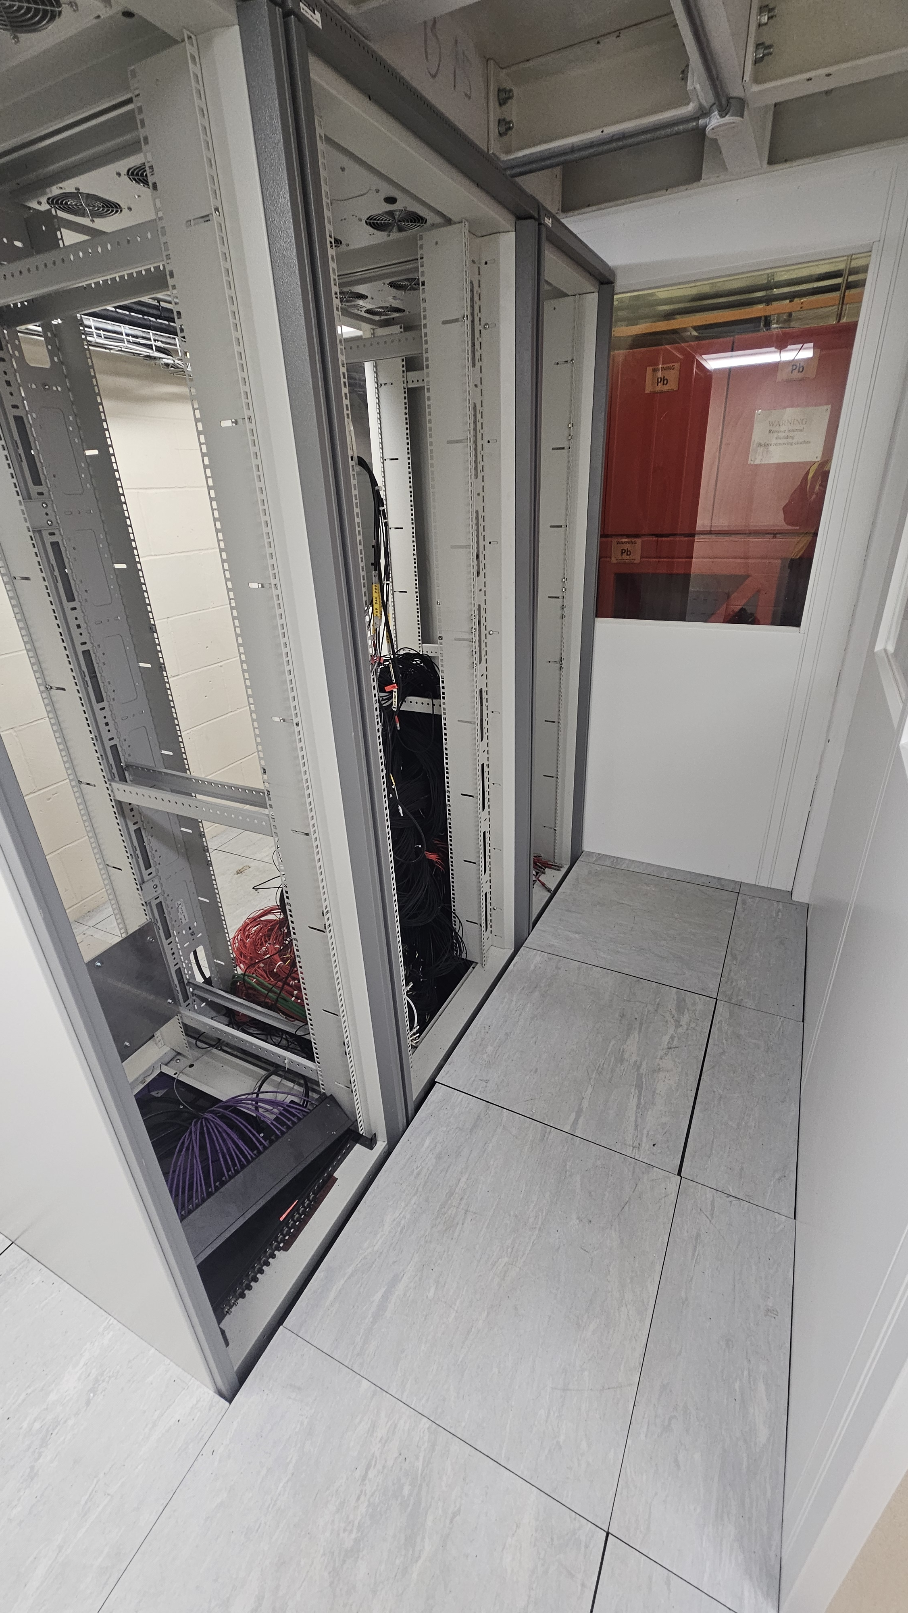
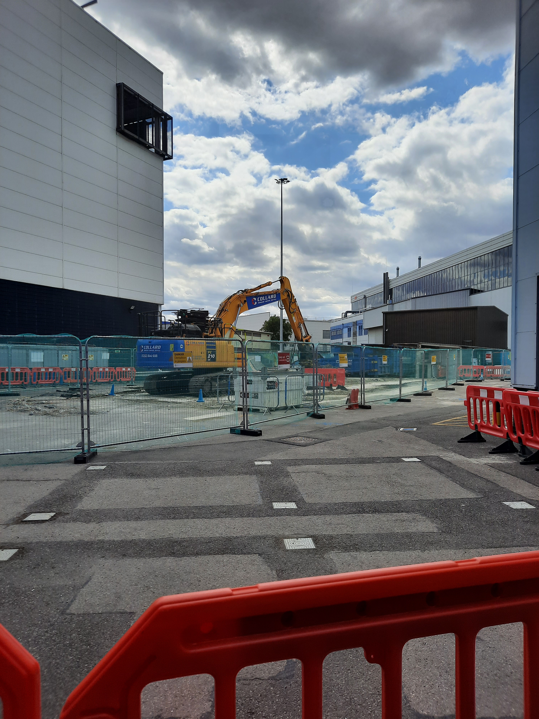
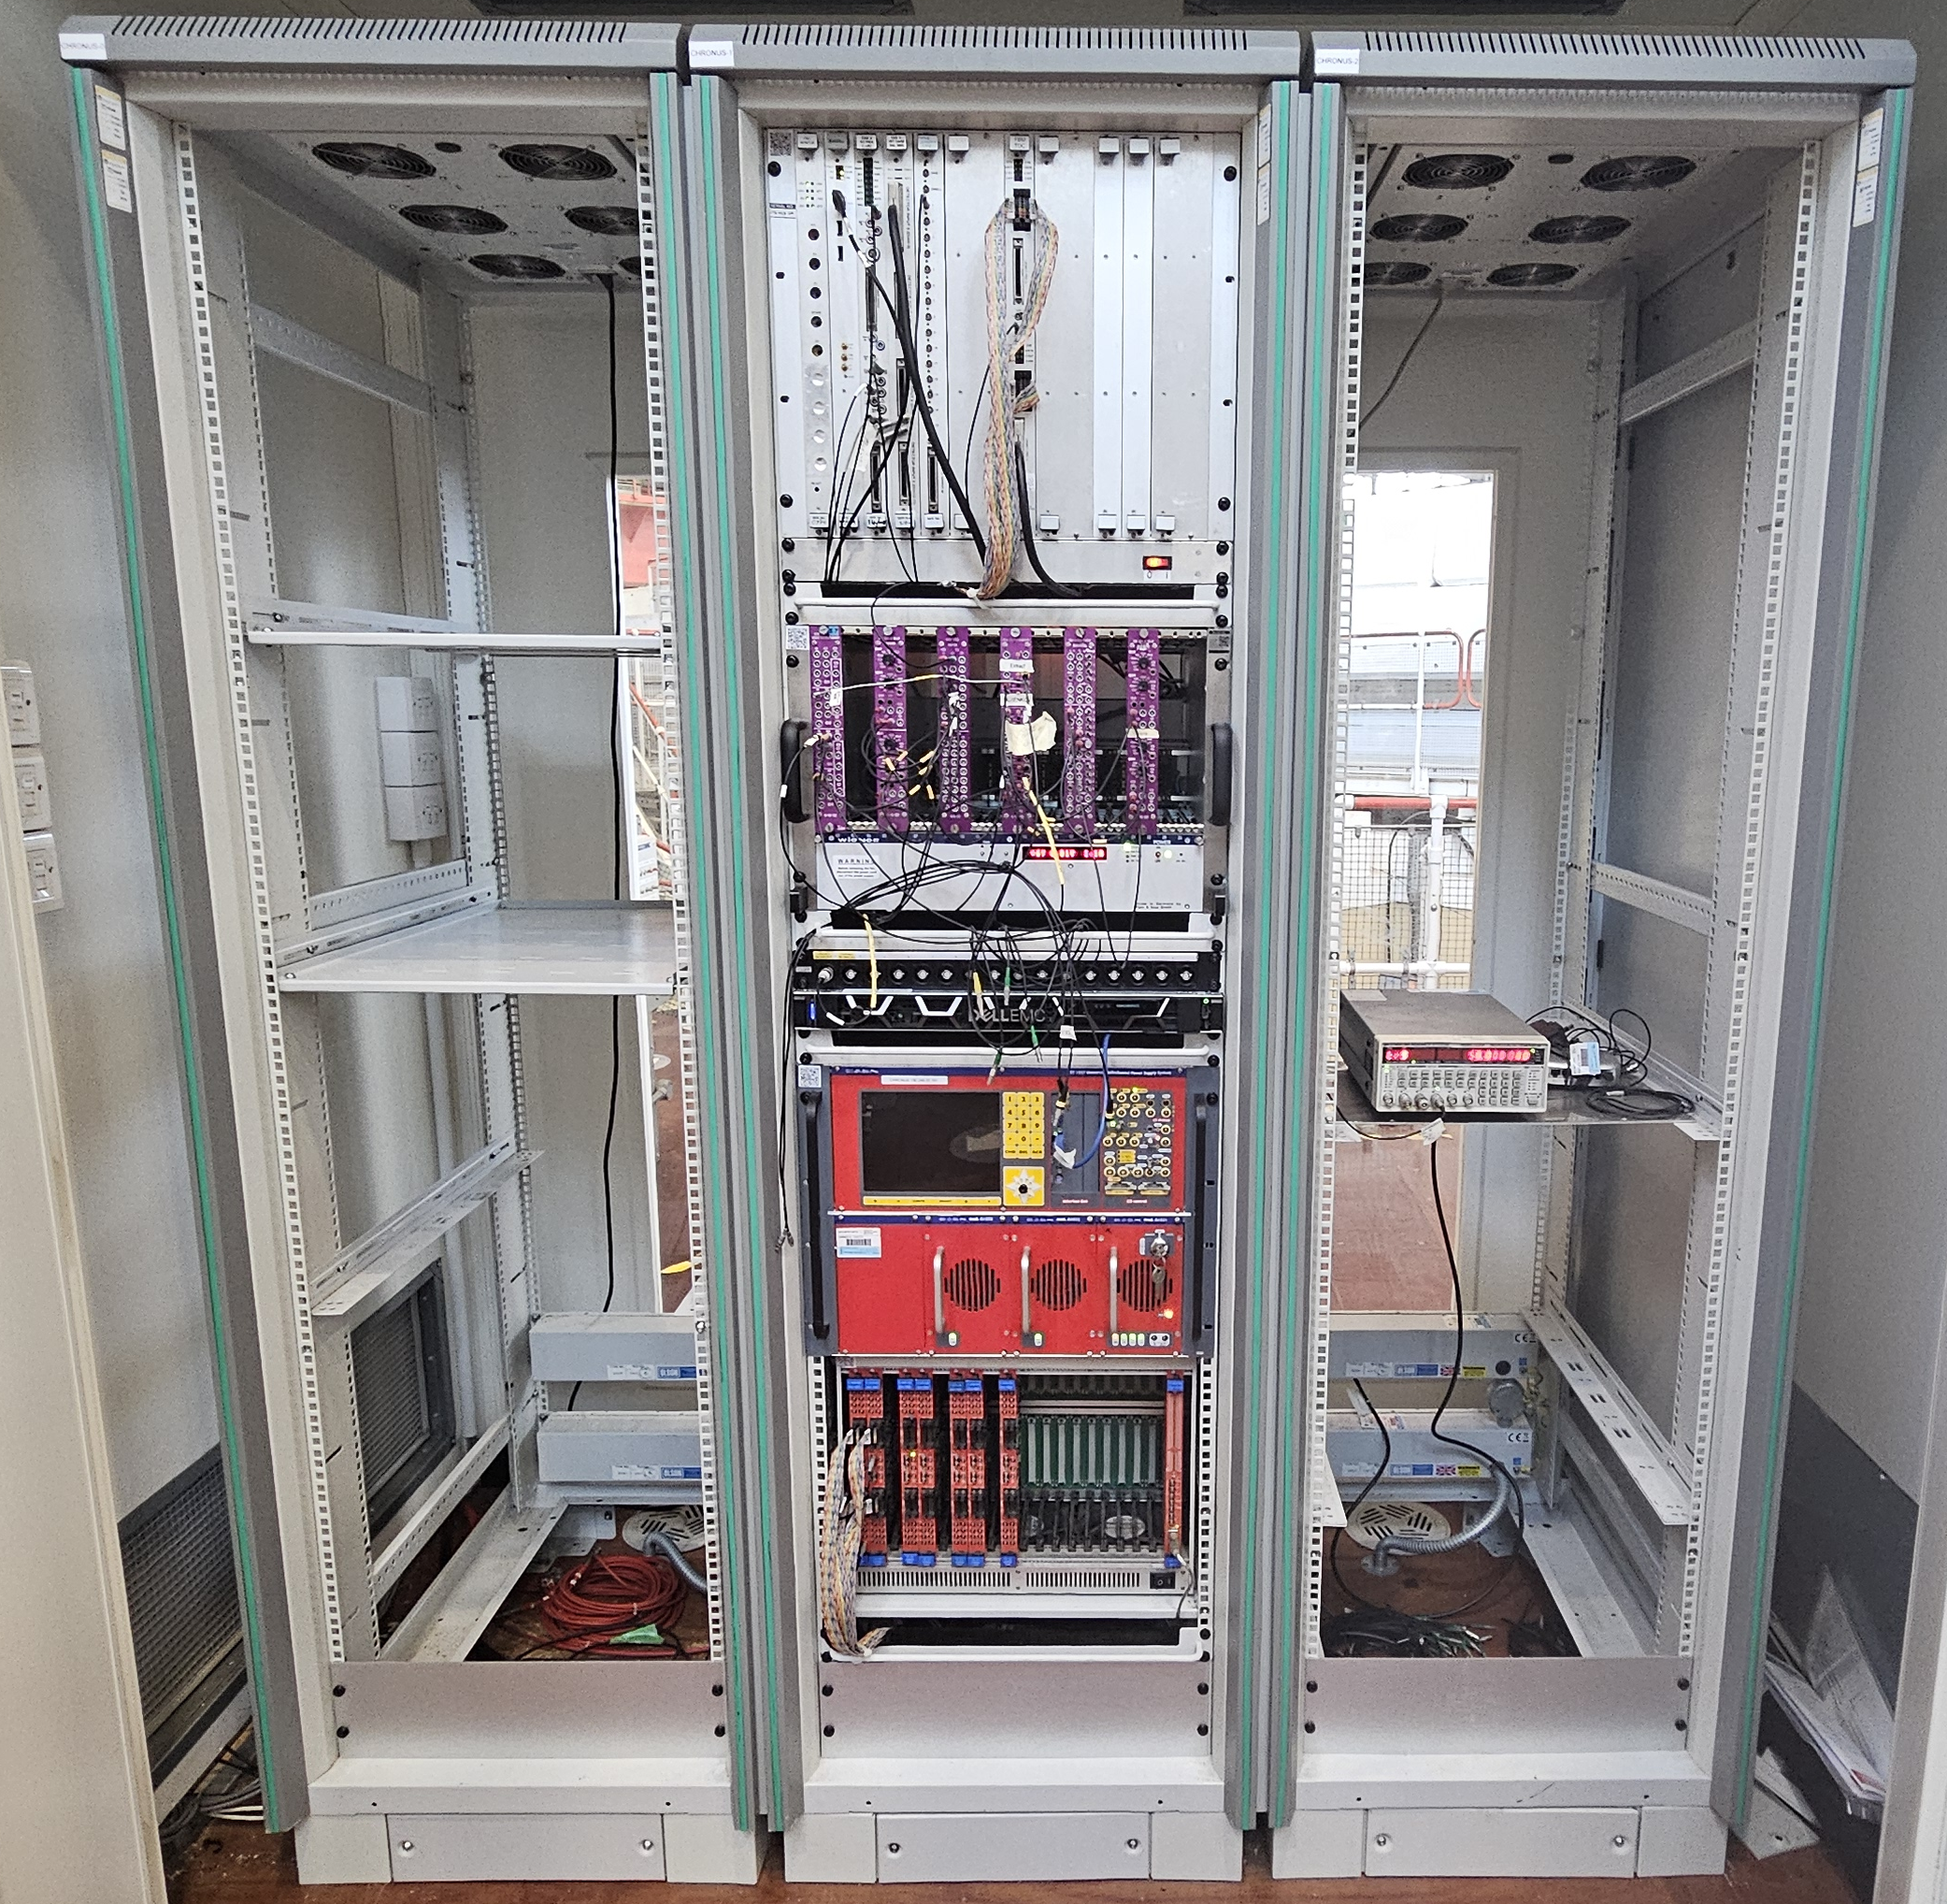
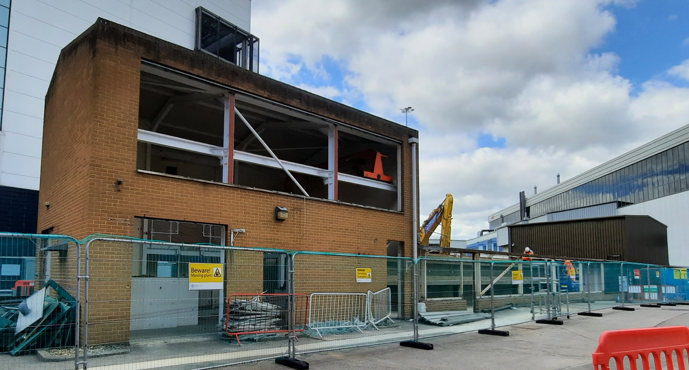
CHRONUS
De-Commissioning
BEFORE
HRPD fully decommissioned for HRPD-X
CHRONUS main detector decommissioned for experimental analysis
NOW
Notes:
Additional training for working on CDM areas.
Repurpose reusable items, recycle, disposal, etc.

Slide 8
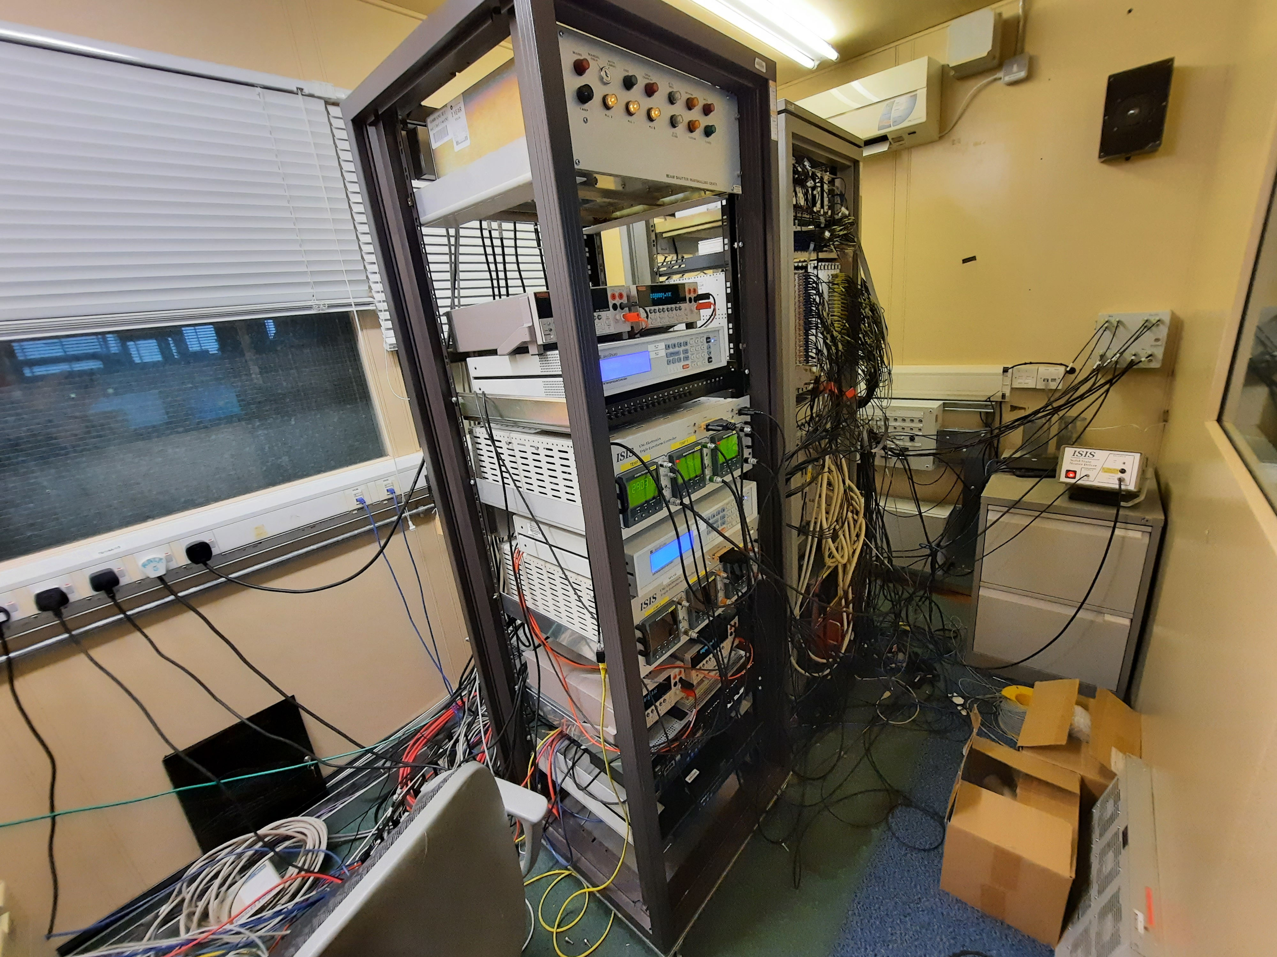
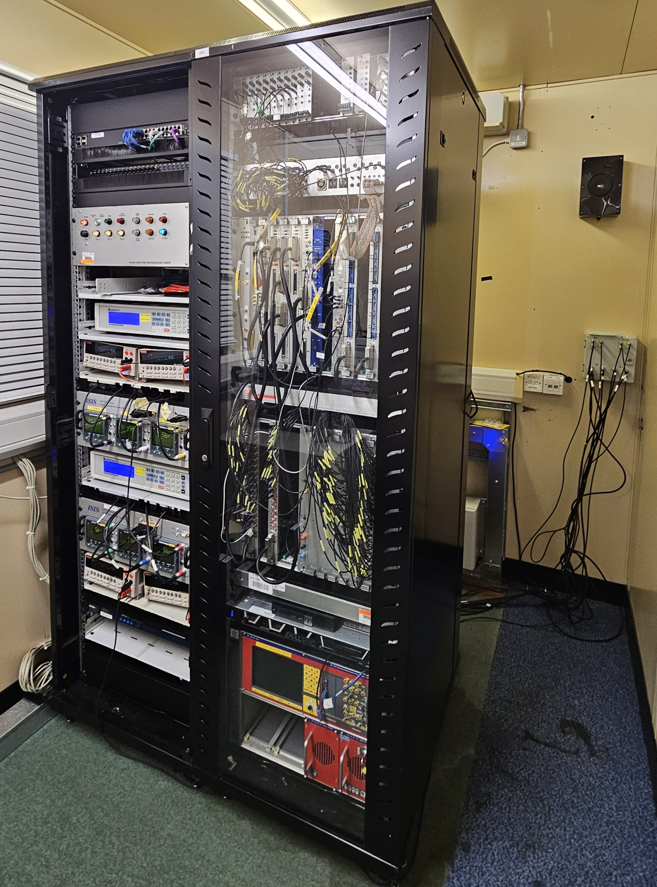
IRIS was tidied to allow better maintenance to occur and reduce the safety hazard of the cables.
Maintenance
BEFORE
We carry out routine checks and maintenance on our systems. This is to ensure that the Instrument can remain operation and safe to use and access.
We have a start up procedure to ensure all Instruments are ready prior to a cycle start, the different checks completed are tracked via an excel sheet.
I am managing Instrument reviews to ensure that all Instruments DAE systems are to an agreed acceptable standard. Any issues found can then be scheduled to be resolved during future shutdown(s), safety issues can also be raised to be addressed urgently.
NOW
Notes:
Check every instrument at startup of cycles ensure everything operational inc quiet counts of the detectors. Prior to cycle start date.
Mention use of Microsoft Planner to keep track of current and future shutdown tasks – agreed and scheduled + reviewed at group shutdown meetings.
Instrument reviews to ensure all instruments kept upto acceptable standard (can schedule resolutions in shutdowns)

Slide 9
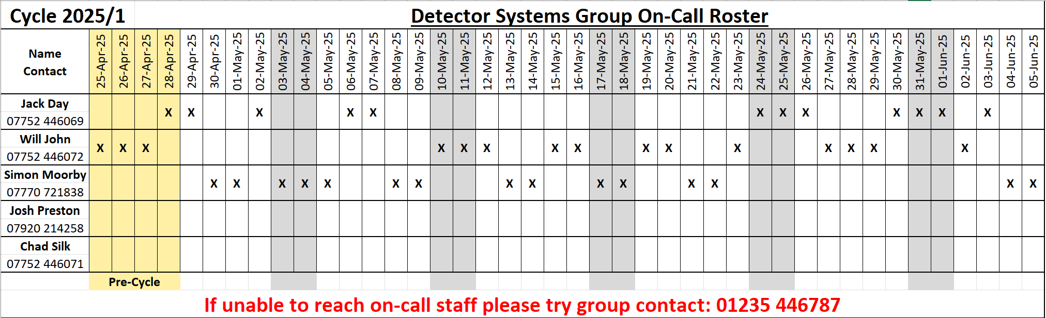
Callouts and On-Call
During standard work hours it is whoever can respond quickest from the team.
We have less experienced staff shadow on these to build up on-the-job training/experience so they can recognize, fault find and fix issues on their own in the future.
I manage the rota for On-Call support, which is offered for out of hours to ensure 24/7 support during ISIS cycles and the weekend prior to the start.
Notes:
Offer support 24/7 during cycle and weekend prior to cycle.
On call (out of hours) Under 1hour out of hours response time, in work hours we typically respond withing 20mins) as it is our very top priority to keep ISIS instruments operational.
Mention Teams, email, telephone and in-person contact method

Slide 10
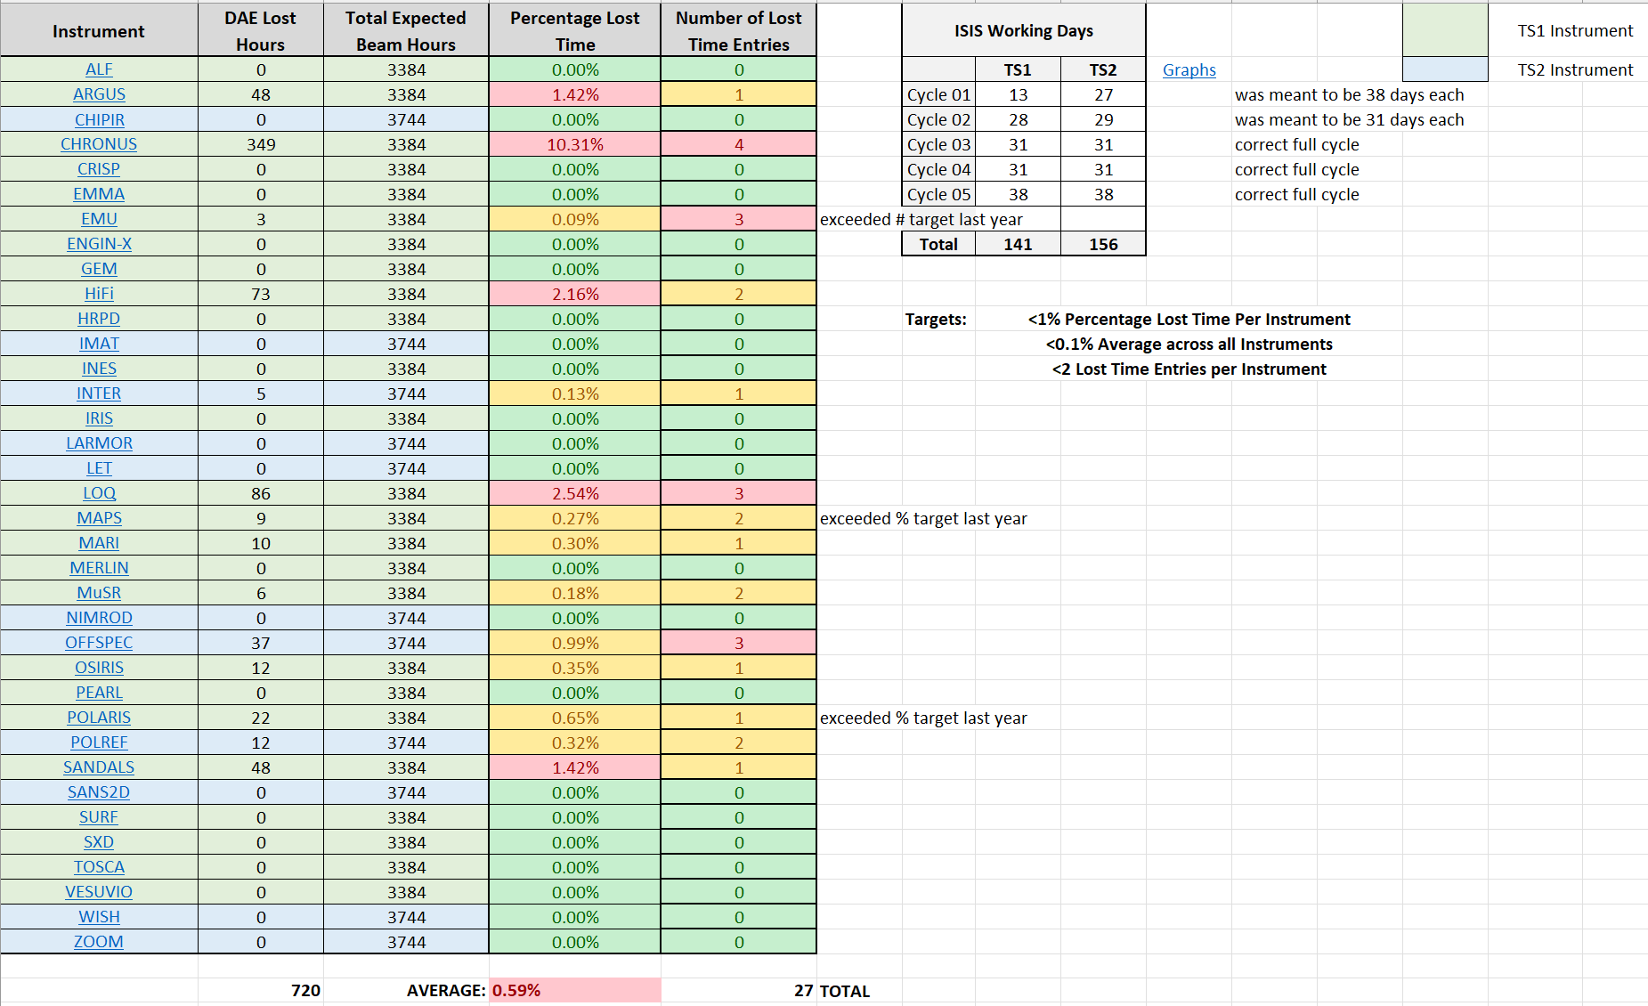
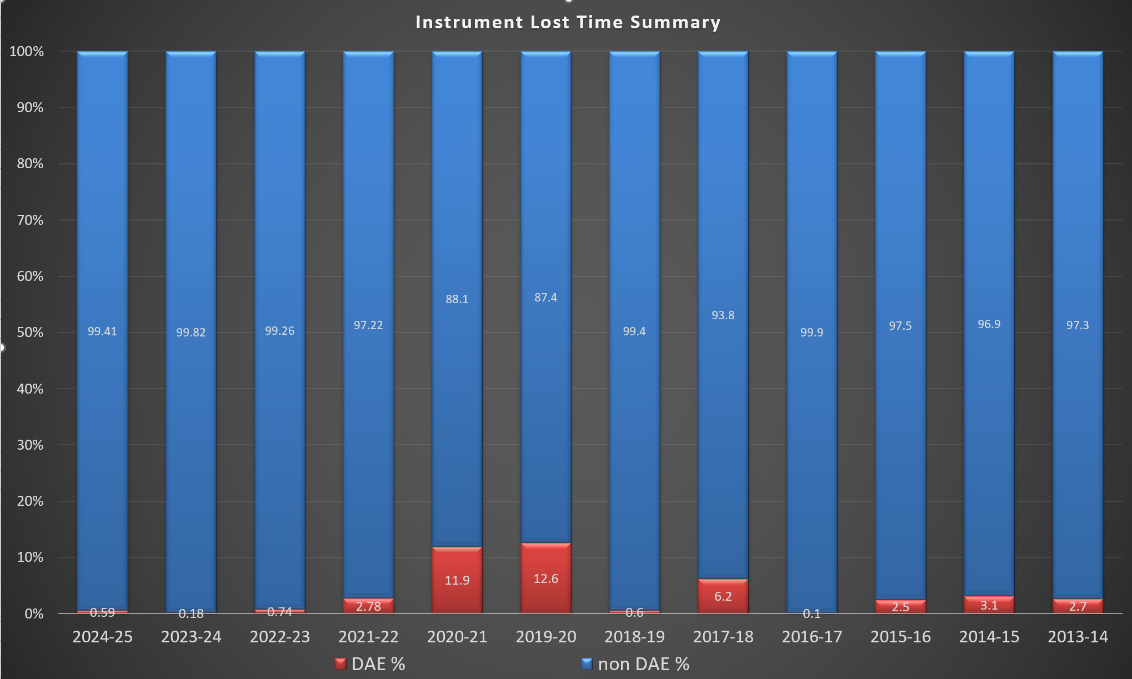
Callouts continued
Callouts are tracked in two ways.
Event Log, this is a record of every callout and instrument change our group do, allowing us to see common themes / failures, this is particularly useful for intermittent faults.
Lost Time Reports, these are submitted by the Instrument Scientists to the scheduler system to enable tracking of beam time lost and which group is responsible for that lost beam time.
I represent the DSG at the ISIS Instrument Discussion Group meetings where LTR’s are discussed.
I keep track of all the LTR’s per year that are due to our group.
Tight targets highlights instruments that may need focused work.
Notes:
Event log - As can see if problem reoccurs & what was done to resolve last time.
Worth noting that over last 3 years we are responsible for significantly more kit when we mergered with detector group (HT,euro and discriminators) show improment – bar chart shows historical data and that for last 3 years have done very well – have very tight limits (prior to 22 use to be 5% of all down time now should be less than 1% per instrument with an average of less that 0.1 across all inst and no more than 2 separate reports) aim is of course to have as small a number as reasonably possible.

Slide 11
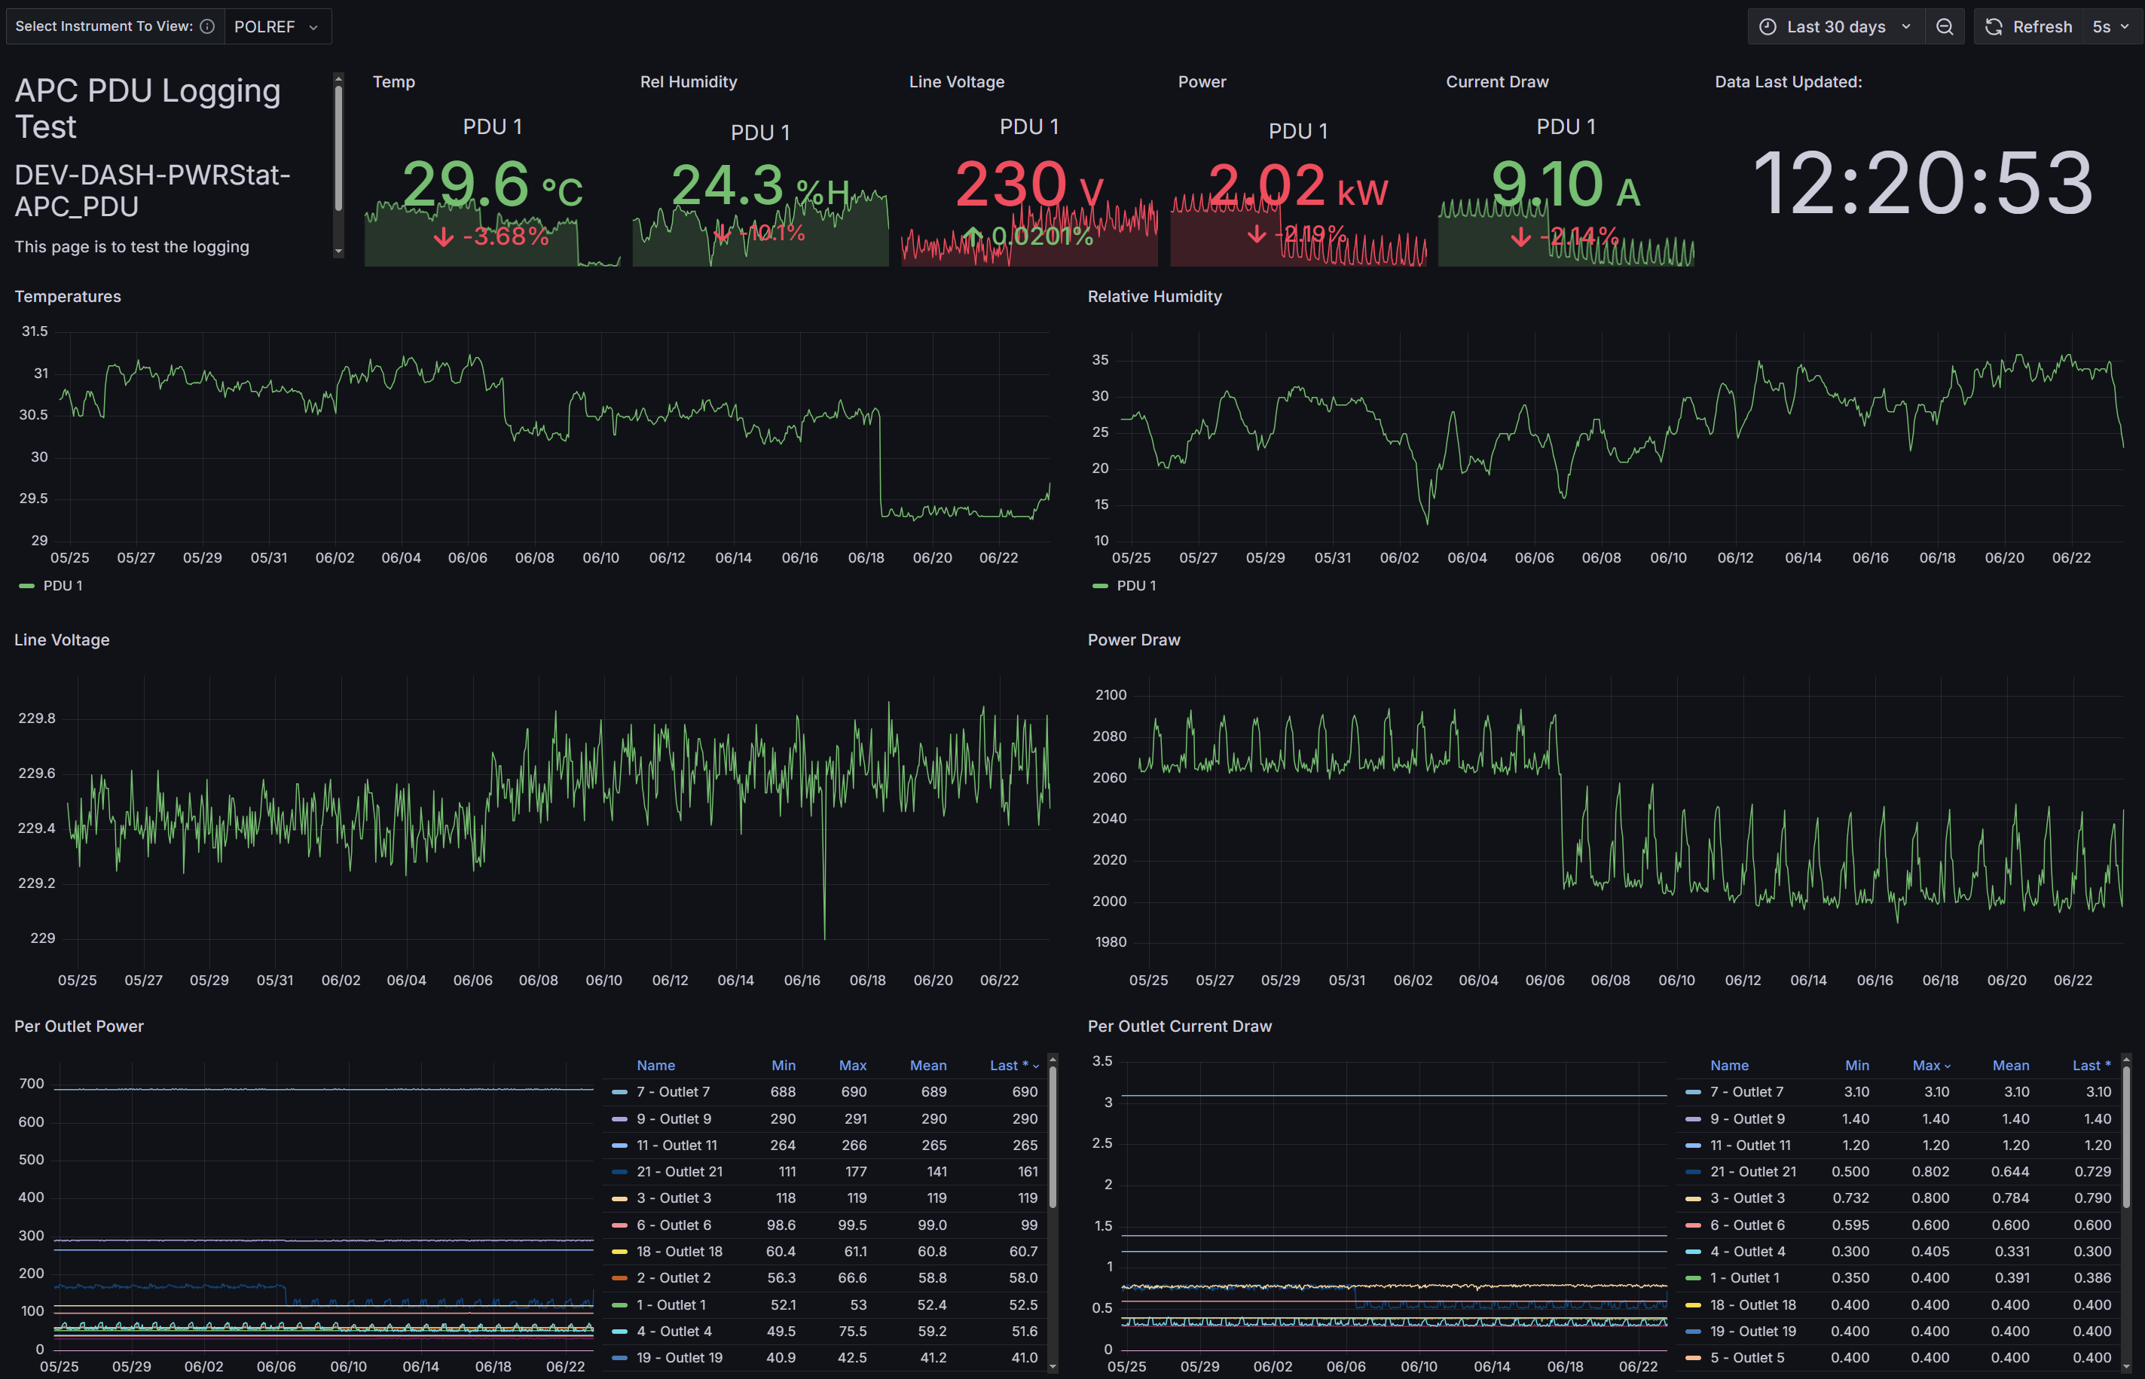
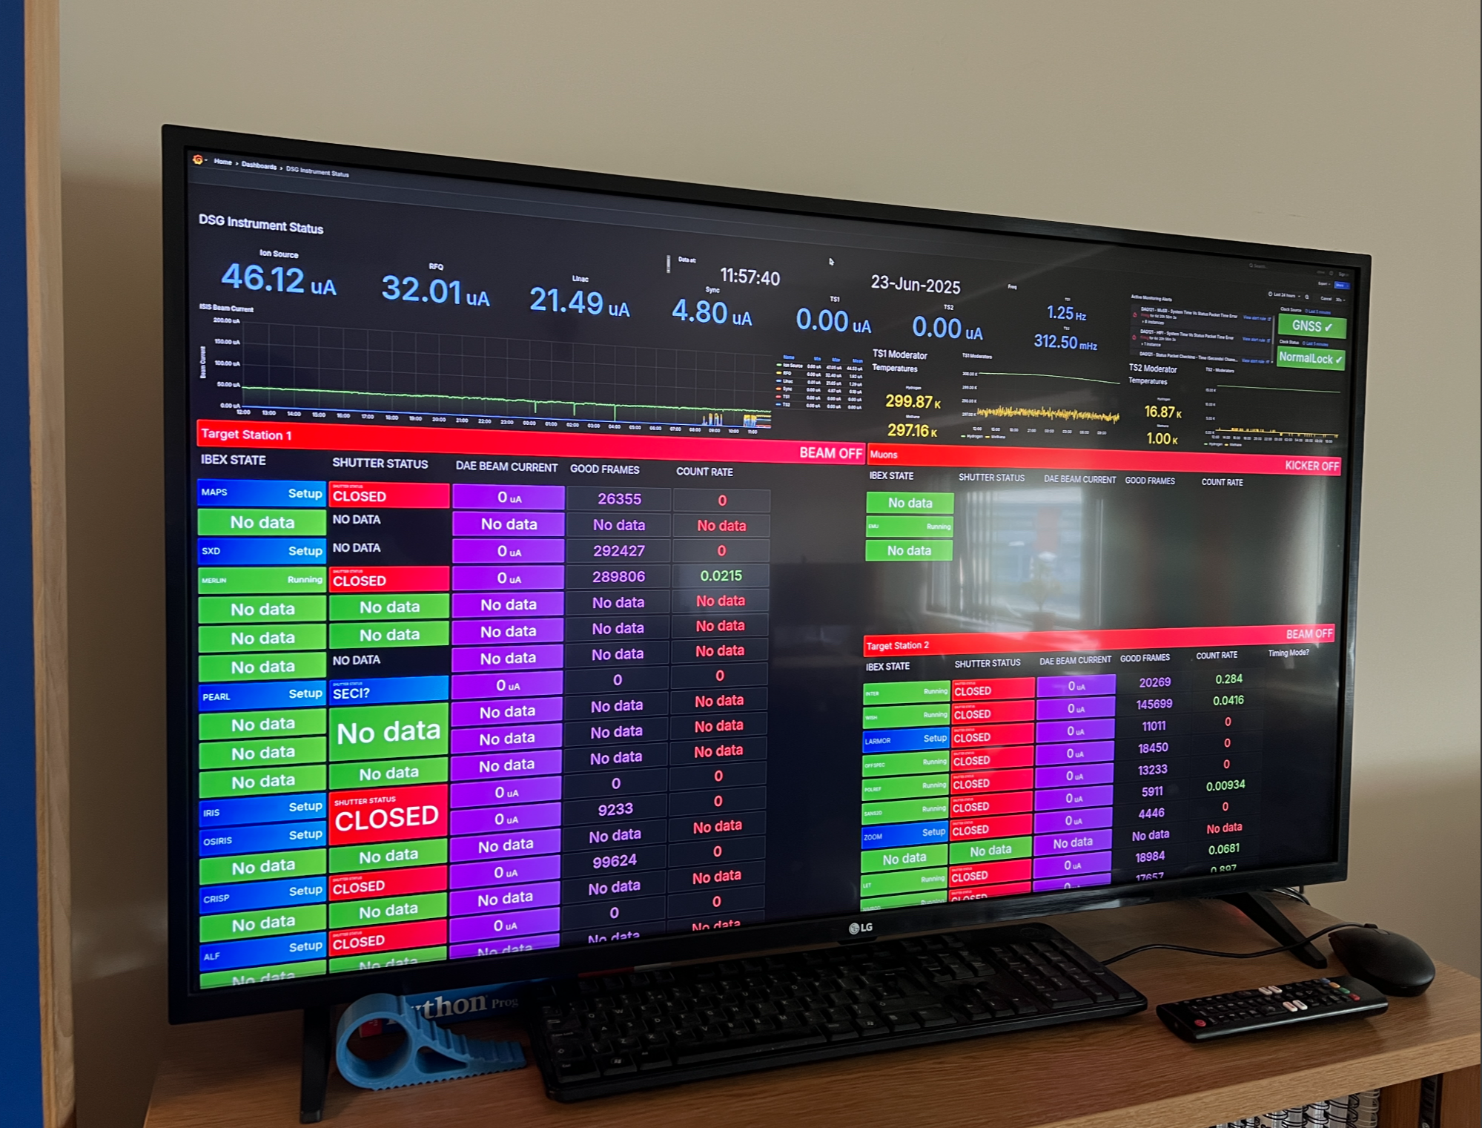
Environment - Logging and alerting
Using Grafana to plot various environmental information and to send email alerts when thresholds are reached.
Previously used Jakarta power and temperature monitoring kit
Now using APC smart PDU’s to monitor power consumption and remote power off.
Inhouse designed PCBs also now have current/temperature and humidity sensors to feed into this system.
Reading the status of instruments and beam information is shown on monitors in the office.
Notes:
Using Grafana to plot various environmental information and to send email alerts when thresholds are reached.
Our old way was using Jakarta power and temperature monitoring kit on some instruments which was fairly clunky and not particularly accurate as the time resolution was low.
Now we are using APC smart PDU’s currently on 4 instruments but will expand to all upgrades and new instruments this gives more detailed current/power use and also allows for remotely powering items of kit off.
Our inhouse designed PCBs also now have current/temperature and humidity sensors to feed into this system.
Reading the status of instruments and beam information is shown on a monitor in the office this allows us to keep an eye on what is happening and can assist to see if a problem is affecting multiple instruments quickly.

Slide 12
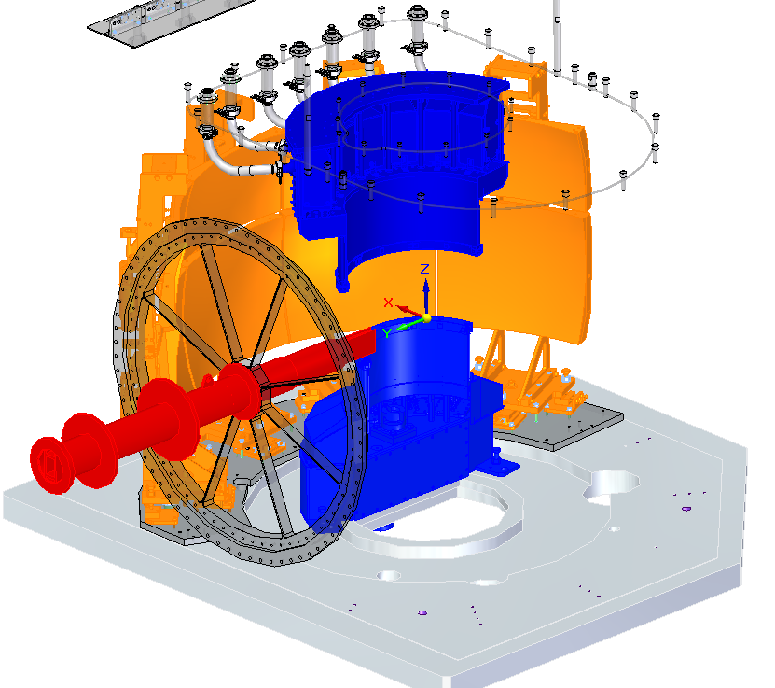
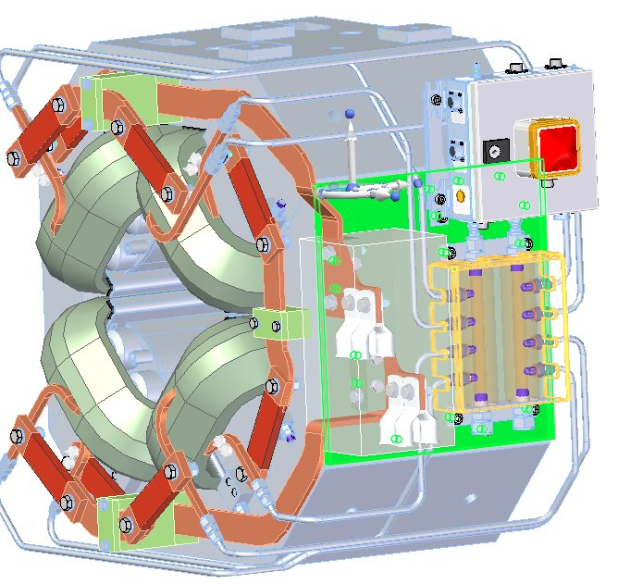
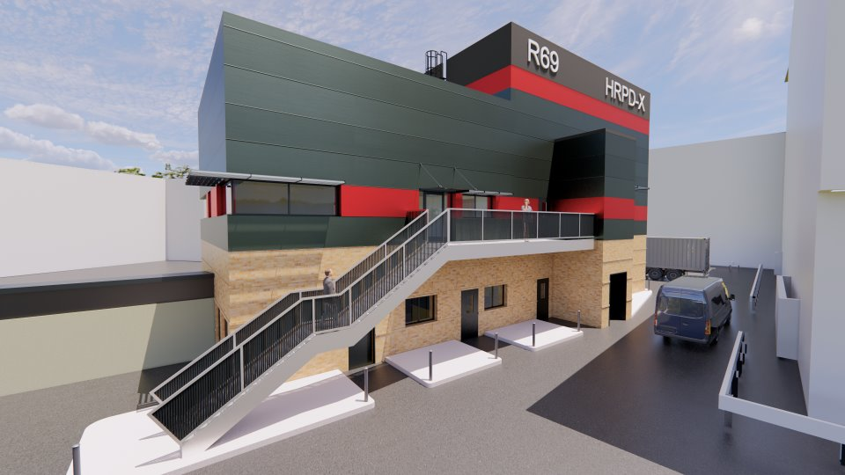
Future Work
OSIRIS CAD SA (orange) & new detectors (blue).
Near future (1-2 years):
OSIRIS Silicon Analyzer detector upgrade
TOF/PPP/GPS distribution upgrade
SuperMuSR
HRPD-X
New crate designs ongoing. Installation across multiple Instruments expected 2026-27.
SuperMuSR detector CAD
Within next 5 years
SANDALS 2
Mushroom
EMAP
WISH 2
TOSCA+
LMX
OSIRIS guide
HRPD-X new building design
Notes:
near future – detector requirements, new electronic requirements, new crates requirements, cabling, rack layout, electric/power requirements, cooling requirements, building/room layout.
Endeavour program 4 new 5 upgrades £87Mil – these are all in varying stages of development work
Beyond – A second ISIS? Other facilities Instruments?

Slide 13
Final Comments / Summary
I have been in this role for many years and during this time it has expanded and evolved, we support many individual Instruments with the majority of development work also feeding in to improving our designs and FLS.
Requirements keep expanding as new Instruments designed and built or upgraded.
I manage lots of different functions in order to meet our goals, which requires not only good processes but excellent liaison with different ISIS groups and Instrument scientists so that all expectations are aligned.
Introduced Instrument reviews and installation checklists to improve and maintain high standards.
Obsolescence issues of aging kit (PCBs, PSUs etc).
More complex and compact designs.
Notes:
Role – use to be just DAE2 systems with FE electronics now covers many different systems, most of the development work also goes into improving the FLS
Obsolescence issues - aging kit and some we had issues from get go (wish ADC’s) PSU’s other board designs mainly due to components on them no longer being available and alternatives not being able to fit due to design requirements.
Science driven upgrades to detectors, but also electronics to get the most from there data or for new techniques that are being developed.
Other roles I do are health and safety related, PCB rework, testing, housekeeping, training – RecSoc
I enjoy this job and the variety of work it entails, both the management and the practical sides.
mentioning that this has not included the large amount of work by the group for pcb and firmware design and testing, health and safety and other QMS items. Which all feed into this project. (Josh P is representing the Customer and assists at directing us to the highest priority tasks.

Slide 14





Thank You
Any Questions?
Science and Technology Facilities Council
@STFC_matters
Science and Technology Facilities Council
Notes:
The abstract pattern can be removed or repositioned if required. Be careful to ‘Send to Back’ so that it does not obscure any important information.

Slide 15
DESIGN of this presentation :
INTRO Slide (ME)
INTRO FLS team (needs refining)
Main functions (What FLS entails)
Picture EXAMPLES OF DAE2 DAE3 and more recent HT, Euro + general Rack (get of sharepoint)
Install and Commissioning new equipment (IMAT example)
Maintenance (IRIS as example) – shutdown planners and management of that (+start up sheet and quiet counts)
Call outs and oncall rota (24/7 during cycles and weekend prior)(my management of it) and LTR
QMS (board pie chart and crate spares)
Environment logging (historic and APC’s) and status of instruments shown in office (Grafana shots)
Future work - Osiris, hrpdx, super musr
upcoming endeavour work list (#new and significant upgrades)
Overall Summary – mentioning that this has not included the large amount of work by the group for pcb and firmware design and testing, health and safety and other QMS items. Which all feed into this project. (Josh P is representing the Customer and assists at directing us to the highest priority tasks.
How role has changed. Started at a C – but now increased over the years Onle DAE2 now much more. Didn’t do callouts, upgrades due to age – more complicated obselecence issues psues etc some always had issues like wish adcs – each instrument unique in some way 38 scattered (video with speed up to convey how we get to inst (during summery or FLS )
Shorten to bullet points with me saying the majority of the text I have now.

