Slide 1
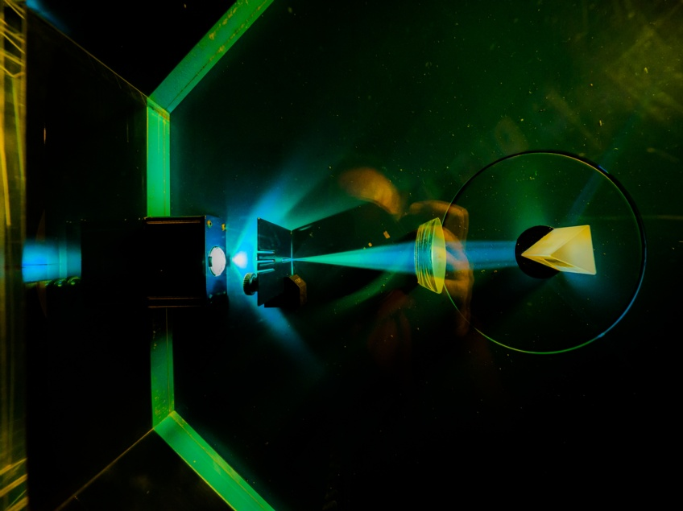


Electronic System Design Group
Management Update
14 August
Group Meeting, 30 July 2025
CR12 & Zoom
Image © STFC Alan Ford
Notes:
To edit the background image, select ‘Format’ from the PowerPoint menu and ‘Slide Background’ from the drop-down menu. Within the new list of options that appears on the right of the screen, select the ‘File’ button under ‘Insert picture from’ and select your image from your file browser. Please remove or amend the image credit if you are using a different image to the one provided.

Slide 2
The New ESDG Agenda System (1)
Indico
  Open-source agenda-management system
  Developed by CERN
  Introduction to Indico
STFC has a local Indico installation
  In which there is now an ESDG area
    Future ESDG Group Meeting agendas will be posted here
    Link to previous web pages
    Available for other ESDG meetings
  Advantages include: searchable

Slide 3
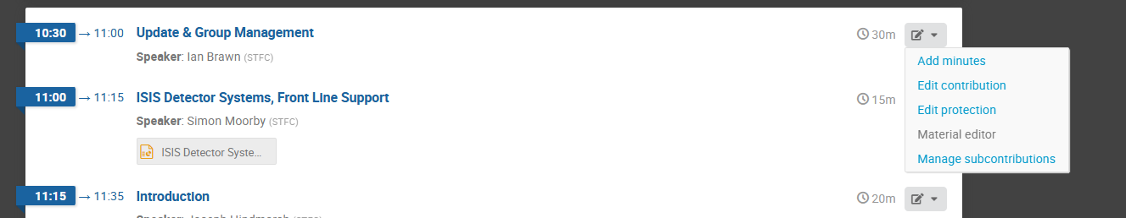
The New ESDG Agenda System (2)
Presenters need to create an Indico account
Uploading files:
Events can be created in ESDG area using Create Event button
  If you don’t see the button, talk to me

Slide 4
Group Organisation
Ian Brawn
Ronnie Brumfitt
Joseph Hindmarsh
Weiming Qian
Kelvin Gascoyne
Takamasa Awai
John Holden
William John
Simon Moorby
Zhen Ha Ng
Geoffrey Betts
Matt Roberts
Peter Furey-Duffin
Chad Silk
Joshua Davies
Mohamed Siyad
Saeed Taghavi
Dave Templeman
Piers Coode
Jack Day
Martin Torbet
John Coughlan
Adam Barcock
Sooraj Pradeep
Hajira Bazaz
Berk Bilgin
Willis Chiu
Ronnie Adoma
Summer students
  Willis Chiu
  Ronnie Adoma
September
  Welcome Lucie Sharpe
  Say goodbye to Takamasa

Slide 5
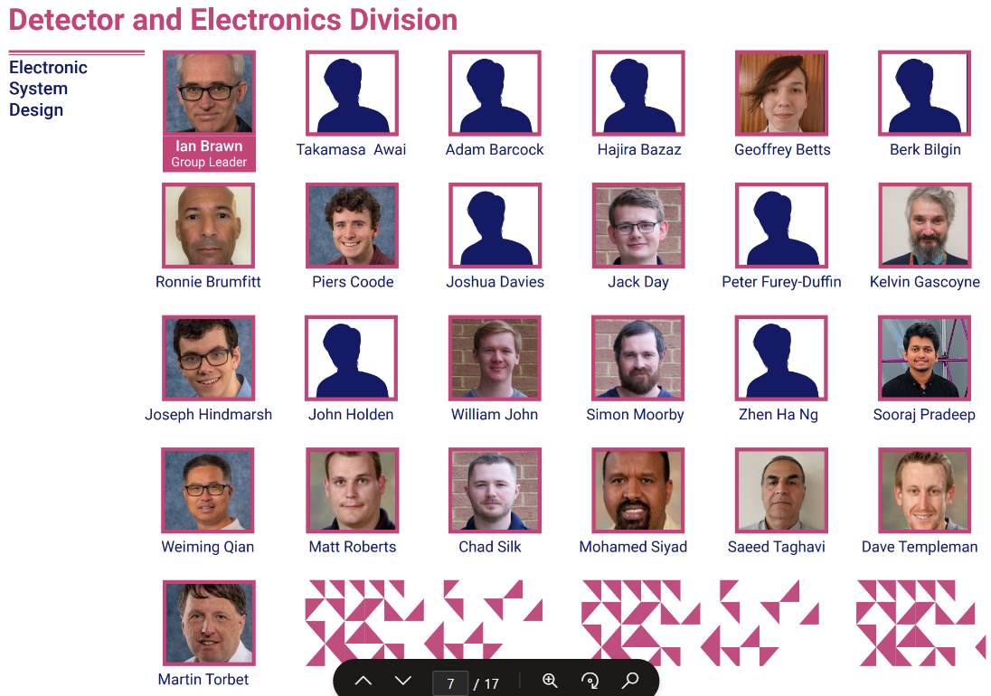
Departmental Organogram
From Dept. Organogram
Portrait sessions
  1st Wednesday of month
  9:30—12:30
  R3 Photo Studio, G32
Photos for
  Organogram
  Passport
  VISA

Slide 6
Projects 2025–26
Slightly Approximate
Fully employed
Doesn’t include NOP
  NQCC
  CfI
Notes:
Numbers from
H:\ESDG_business\EffortProfiles\EffortProfile_Projection_2025_d3

Slide 7
ESDG Accommodation in R68
R68
2.19
2.21
2.22
2.23
2.24
2.25
Stair
Well
2.28
2.29
2.30
2.31
2.32
Lab 2
Lab 1
IB
JH
AB
MS+
PFD
ST
SP
JH
ZN
WQ
GB
WC
MR
TA
HB
Stair
Well
BB
RA
Technology
SERVERS
2.15
2.14
MSC
TR3
2.10
MSC
TR1
MSC
TR2
2.09
2.08
Lift
RALSP
Lab
RALSP
Office
RALSP
Office
RALSP
Office
RALSP
Office
Thank you to those who have moved around this summer
Still planning to acquire 2nd desk for 2.24
  Awaiting new furniture supply contract (September?)
  Space currently occupied by various equipment & cases

Slide 8
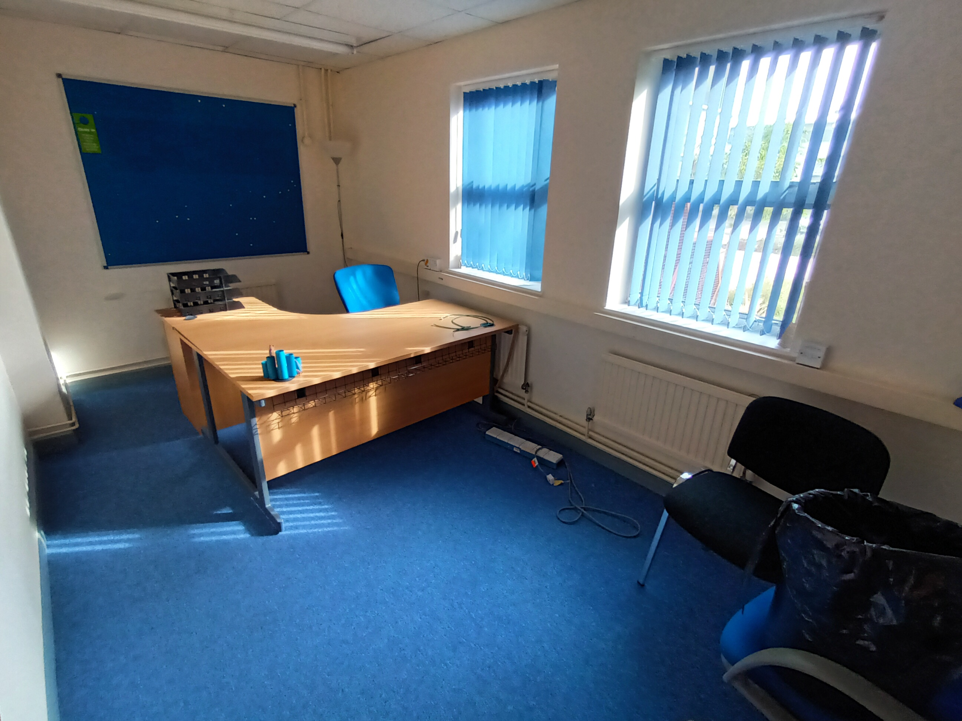
ESDG Accommodation in R66
Acquired storage space in R66 G07
  (North edge of sight)
  On condition of keeping desk free for use if required
To do:
  Install shelves
  Populate

Slide 9

Oracle Fusion
Not yet a tremendous success
Issue include
  Purchase orders can no longer be split across multiple budgets
  26 August is classed as working day when calculating A/L
  A/L sometimes gets automatically approved by Line Manager
    Line Manager sees request made then withdrawn after a few minutes
    Requester sees leave approved
    Happened for some people some times
  OTL
    Please maintain a personal record for completion / correction in due course
Anything else?
  Consult Support, Known Issues; submit helpdesk request; let me know

Slide 10
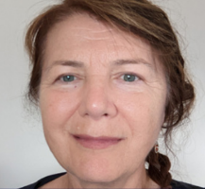
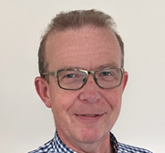
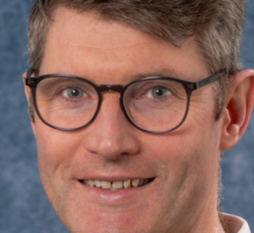
Transformation Programme
Improving Efficiency & Operating Costs
  Email from Keith Zimmerman, Chief Operating Officer, 24 July
Transformation programme
  Key threads
    Computing – Tom Griffin – Scientific Computing, DI & Hartree
    Engineering – Anna Orlowska – inc. electronics but focus is mechanics
Anna to step down as Director of TD
  TD Director → Marcus French
  Head of DED → Matt Wilson
→

Slide 11
Windows 11 & ESDG Servers
All 6 new servers now available
  te7korma.te.rl.ac.uk te7jalfrezi.te.rl.ac.uk
  te7masala.te.rl.ac.uk te7madras.te.rl.ac.uk
  te7tikka.te.rl.ac.uk te7vindaloo.te.rl.ac.uk
  AMD EPYC gen4 P series; 768 GB RAM
    3.25 GHz (overclock to 3.75 GHz)
  All run Rocky 8 except Vindaloo runs RHEL (for Sigrity)
Windows 11
  W10 Machines will start upgrading automatically from next Monday
  Might be more convenient to upgrade before this. More details
  Replacements for machines that can’t be upgraded will be rolled out once upgrades complete
Notes:
£68k

Slide 12


Teams
The move from Zoom to Teams is approaching
  TD likely to be 1st department to move over
    1st September for phones only
Longer term
  Time to start moving meetings & chats from Zoom to Teams
Individual cases for retaining Zoom can be made

Slide 13

BSI Audit & Competency Records
Ded was audited by BSI 23 July
  Focus included ESDG
One Opportunity for Improvement identified:
  “ORACLE Fusion has not carried over staff’s qualifications and professional memberships. All staff need to update this information [….]”
  Deadline: November 2025
Fusion
  Me→Show More →
  Add: qualifications, professional memberships & relevant training courses
    Everything that shows you are qualified to do what you do
  This information can still be seen in UKSBS, by your Line Manager (but not you!)
Always save certificates for all training courses

Slide 14
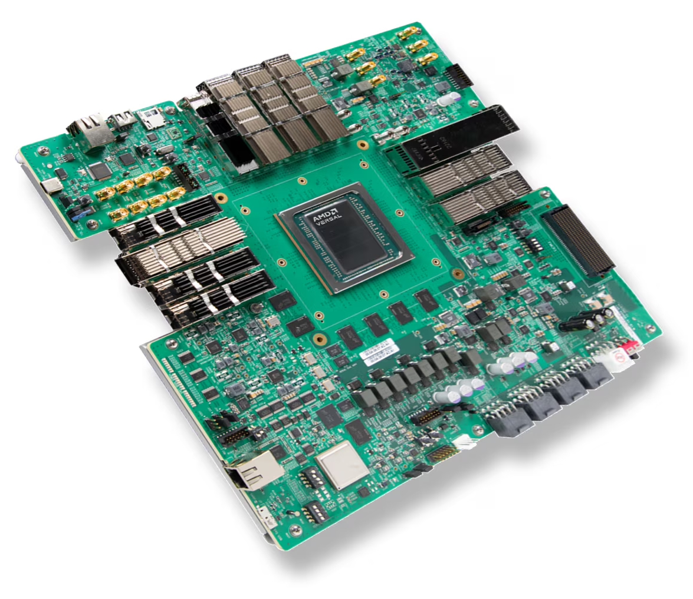
Capital Items
Offered £50k for dev boards
  Very good result considering constraints & server purchase
Short list being drawn up
  Target Xilinx Versal boards
But new capital threshold = £25k
AMD Xilinx VPK180
(Versal Premium)

Slide 15

Xilinx Licenses &Training
Xilinx Licences & Training credits renewed
  After significant delay, partly because I queried cost increase
Purchased:
  4 Floating licenses for ESDG
  1 Floating license for IESG
  40 Training Credits for ESDG (20 fewer than last year)
  Bundled into Xilinx Productivity Agreement for discount
Licenses received; not yet training credits

Slide 16
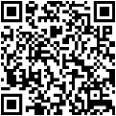
Who’s Representing YOU?
Good Health and Safety (H&S) management relies on the support and commitment of all staff to make our workplaces safe.
TU Health and Safety Reps represent all staff, not just TU members.
If you have any H&S concerns that you think are not being properly dealt with, please contact any of these reps; your input will be treated in the strictest confidence.
Representative | UNION | Contact extension/e-mail
Daresbury Laboratory (DL)
Mark Hancock- | Prospect | 3980 / mark.hancock@stfc.ac.uk
David Holder | Prospect | 3120 / david.holder@stfc.ac.uk
Rutherford Appleton Laboratory (RAL)
Charles Ballard | Prospect | 7721 / charles.ballard@stfc.ac.uk
Joel Kurati | Prospect | 5156 / joel-stephen-prabhakar.kurati@stfc.ac.uk
Michael Hirsch | Prospect | 7145 / michael.hirsch@stfc.ac.uk
Andrew Seville | Prospect | 5689 / andrew.seville@stfc.ac.uk
Stephen Bell | Prospect | 5416 / stephen.bell@stfc.ac.uk
David McGarry | Prospect | 4453 / dave.mcGarry@stfc.ac.uk
Adrian Coveney | Prospect | 6516 /adrian.coveney@stfc.ac.uk
Royal Observatory Edinburgh (ROE)
Chris Waring | Prospect | 9368 / chris.waring@stfc.ac.uk
Katherine Morris | Prospect | 9386 / katherine.morris@stfc.ac.uk
STFC SHE Information
Further detail can be
obtained from your
local SHE Group
Issued July 2025

Slide 17
Upcoming Meetings
Meeting | Date | Start Time | Location
ESDG Group Meeting | Thursday 28 August | 10:30 am | CR03
ESDG Group Meeting | Thursday 25 September | 10:30 am | CR03
ESDG Group Meeting | Thursday 30 October | 9:30 am | CR03
ESDG Group Meeting | Thursday 27 November | 10:30 am | CR03

Slide 18






AOB
technologysi.stfc.ac.uk
@STFC_matters
Science and Technology Facilities Council
Science and Technology Facilities Council
Notes:
The abstract pattern can be removed or repositioned if required. Be careful to ‘Send to Back’ so that it does not obscure any important information.

