Slide 1
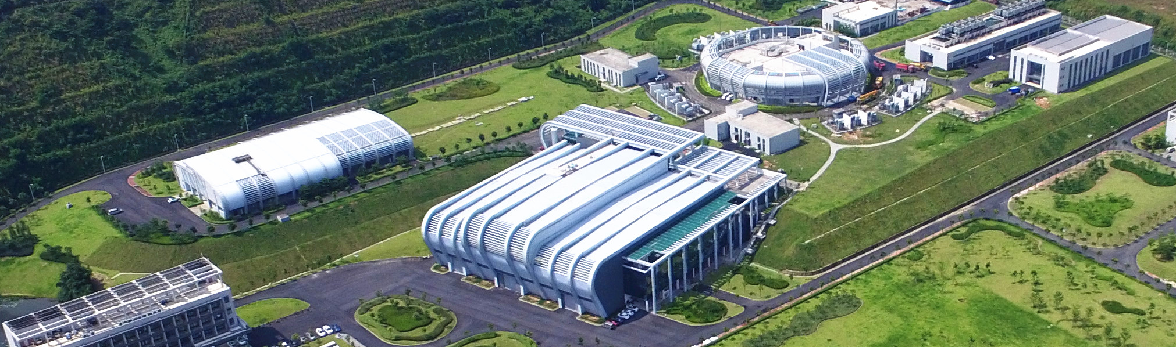

Design considerations of prototype magnets for the CSNS FFAG
Han Wenjie Deng Changdong
China Spallation Neutron Source, Institute of High Energy Physics, Chinese Academy of Sciences
2025.7.24

Slide 2
Outline
Physics Requirements of FFAG Magnet
2D Design for FFAG magnet
3D Design for FFAG magnet
Key technologies for prototype

Slide 3
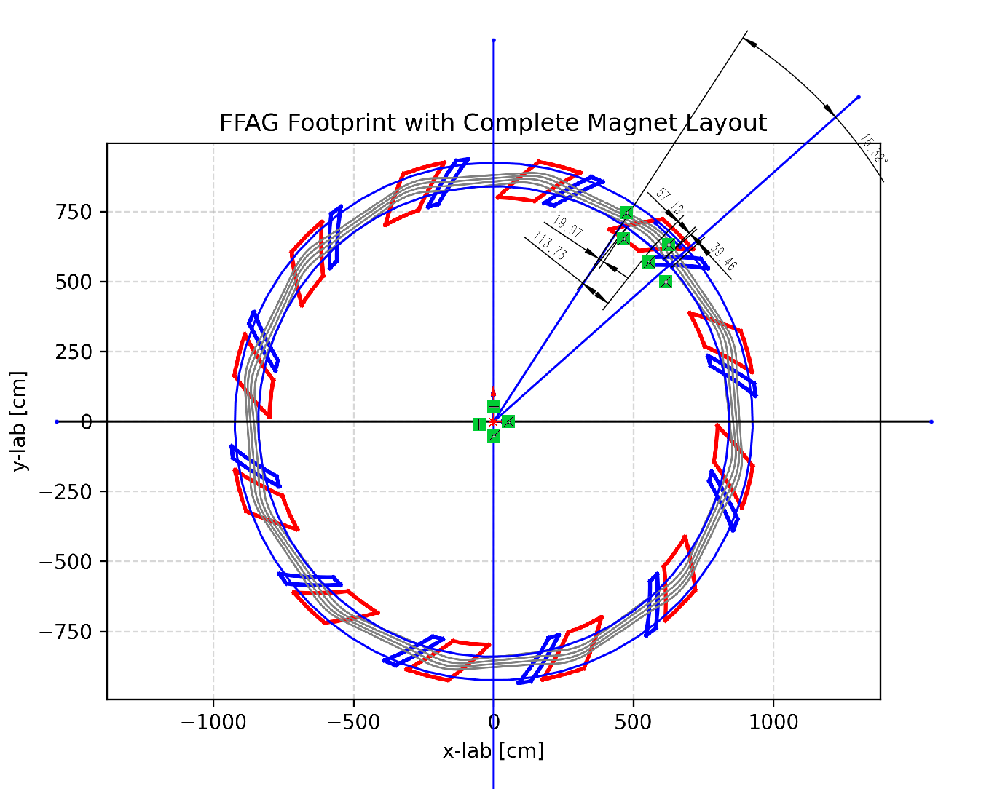
Physics Requirements of FFAG Magnet
The FFAG magnet consists of 12 cells, with a maximum magnetic field of 1.56 T.
Parameter
Peak magnet (F) | 1.56
Peak magnet (D) | 0.67
Field index (k) | 5.728±0.1
Spiral angle ζ (deg) | 32
Radius (m) | 10.98/12.00
Gap(mm) | 170/270
Number of cells | 12

Slide 4
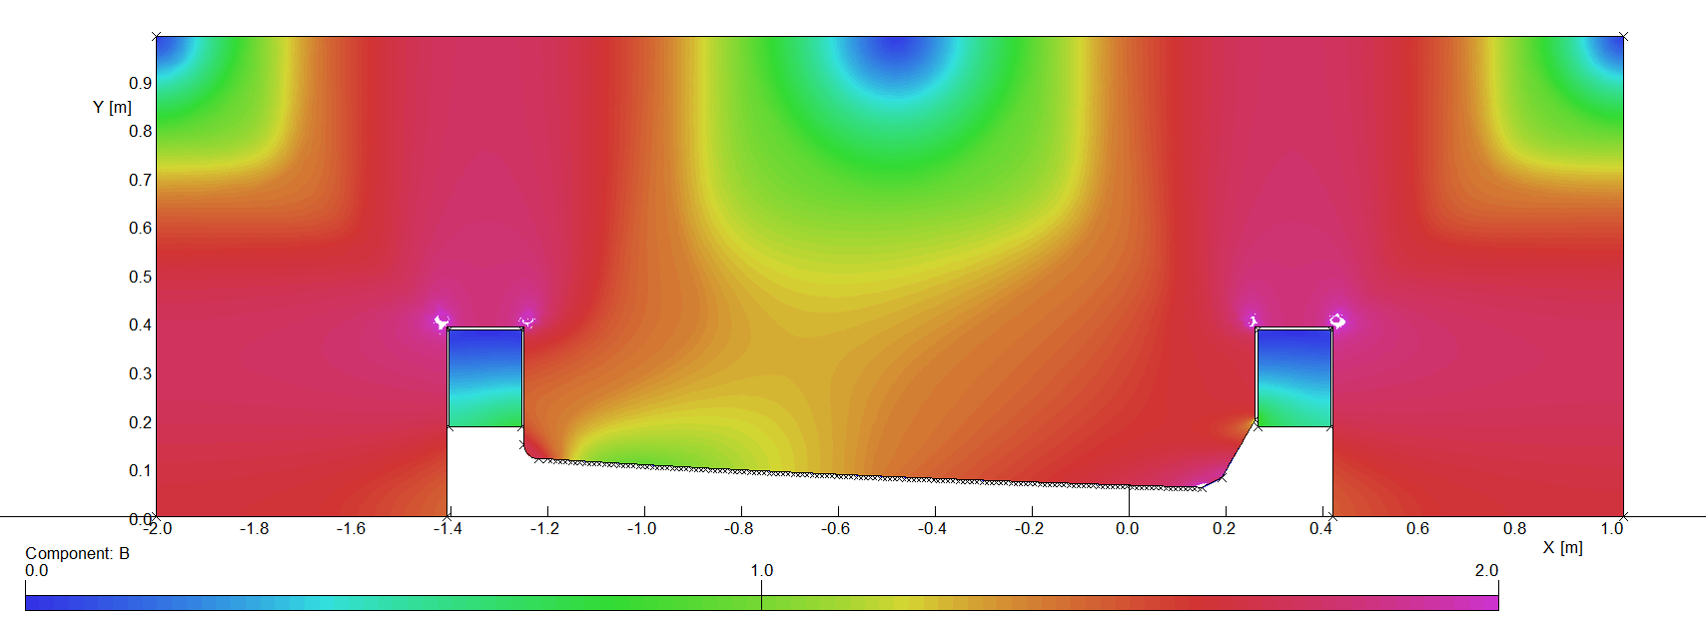
The scheme of FFAG Magnet
Constant gap or variation gap?
Trim coil
Constant gap
variation gap
constant K value with small adjustable value(within ±0.2)
low current for trim coil(<10A), self-cooling for
trim coil
The trim coil would not occupy additional space
bad edge field coefficient (edge optimization is necessary)
complex trim coil structure, but it can adopt a simple runway-type structure
lower k variation caused by the changed k value
an adjustable K value
A relatively good edge field coefficient
Complex coil structure
Complex water cooling structure
independent power supply with high current
The coil would occupy additional space resulting in higher energy consuming especially for high field with large gap
It is also necessary to adjust the drived curent and the shielding when the magnetic field is high
Notes:
New requirements for change in k values are added

Slide 5
Why we choose the variation gap scheme
A relatively lower adjustable of k values (5.728±0.1)
The requirements of the gap for the beam is 130mm, if we use the constant magnet scheme, the core gap will exceed 200mm, which will significantly increase energy consumption and the cost
The variation of the magnet gap is large enough to install the trim coil
The maximum magnetic field will be ＞1.56T(maybe higher), We think the coils would form a local saturation region and it will bring a nonlinear effect, when changing magnetic field, which requires a lot of time to measure it
For the edge field coefficient, it is difficult to optimize them, We will reserve the amount of processing and modify the edge trimming by the measuring results. We also adopt a replaceable pole in case of failure.
Once we have identified the pole shape, we can confirm the magnet process with only two or three iterations in mass production
Benefit from the software update of OPERA, the mesh generation and the simulation speed has raised a lot than that in opera15. The speed of edge field optimization will be greatly improved.

Slide 6
Preliminary parameter of FFAG Magnet

Slide 7
outline
Physics Requirements of FFAG Magnet
2D Design for FFAG magnet
3D Design for FFAG magnet
Key technologies for prototype

Slide 8
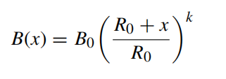
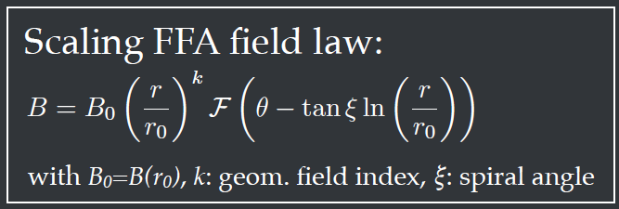
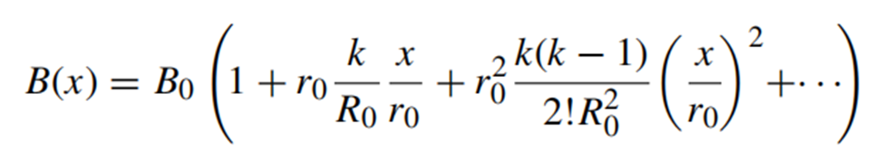
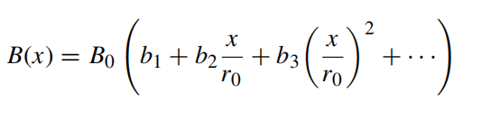
The central magnetic field
Theoretically magnetic field requirements
Taylor Expansion
Octupole
Quadrupolar
Sextupole
Taylor's expansion to the octupole can limit the fitting error of the theoretical magnetic field error to within 0.01%
Notes:
In 2D design, the magnetic field is derived from multipole expansions. The FFAG magnet must meet precise physics requirements. The magnetic field is defined using a Taylor expansion, incorporating dipole, quadrupole, sextupole, and octupole components. Taylor's expansion to the octapole can limit the fitting error of the theoretical magnetic field error to within 0.01%

Slide 9
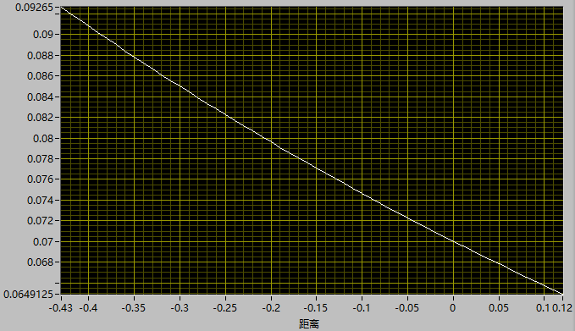
2D Polar Equation
Dipole
y=R
Quadrupole
xy=R²/2
Sextupole
(x³ - 3xy²)/3= R³/3
Octupole
(x³y - 3xy³)/6= R⁴/6
Polar equation
B₀ (Y)+ G₁(XY)+ G₂(x³ - 3xy²)/3+ G₃ (x³Y - 3xy³)/6 =H₀*B₀
The value of Y is based on each X to get the polar curve
Notes:
The polar equation combines these terms with coefficients B₀ (Y)+ G₁(XY)+ G₂(x³ - 3xy²)/3+ G₃ (x³Y - 3xy³)/4 =H₀*B₀, ensuring the field aligns with theoretical models. However, practical deviations arise due to saturation effects, necessitating careful compensation during design.

Slide 10
2D optimization
two step compensation to Increase the magnetic field of 12m and implement the compact design
The magnetic yoke field is mostly at 1.8T, near the saturated field
Current coefficient：1.07
flat coil reducing the magnet size along Z axis
The shape of the polar face is modified, and the size of the magnet is optimized
The initial core weight is more than 50 tons, currently about 35 tons
Notes:
More effort would be adopted to reduce the total weight

Slide 11
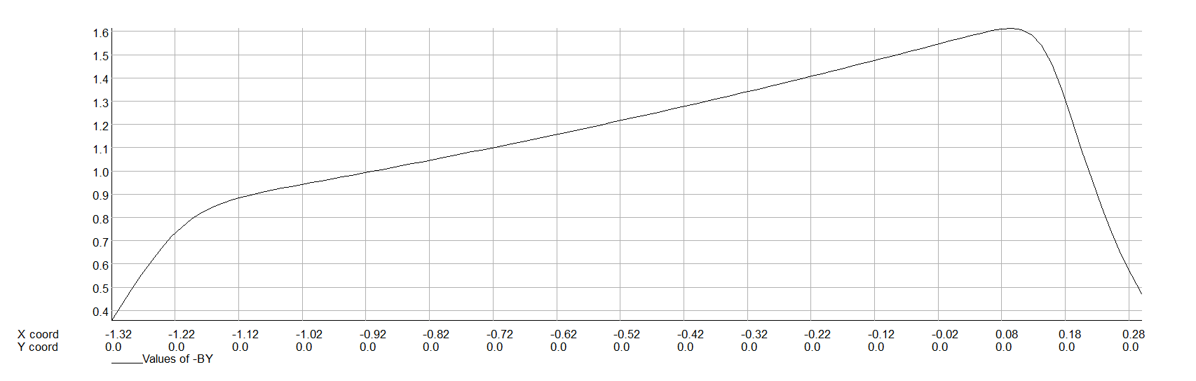
2D magnetic field
12m
BH curve
10.98m
Good field region：10.98-12
Pole expansion size： -280mm，260mm(~2*gap)
The Actual pole width：10.7-12.25
Pole width：1550mm
Notes:
from this curve，it can be seen that The good field region is approaching The field inflection point，The designed magnet is relatively compact

Slide 12
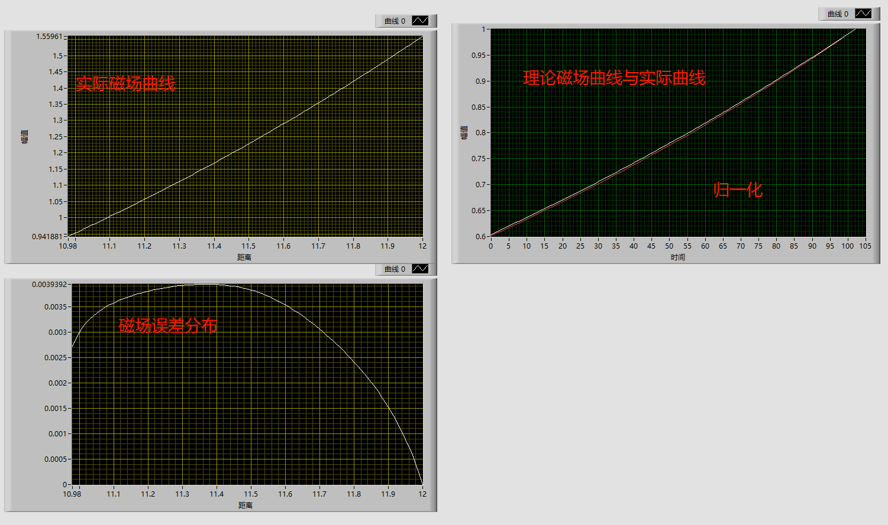
未补偿前磁场误差分布
2D design without optimization
actual curve
Theoretical curve and actual curve
normalized
The magnetic field error is smaller than the previous design (1.66T, 0.8% field error )
error distribution

Slide 13
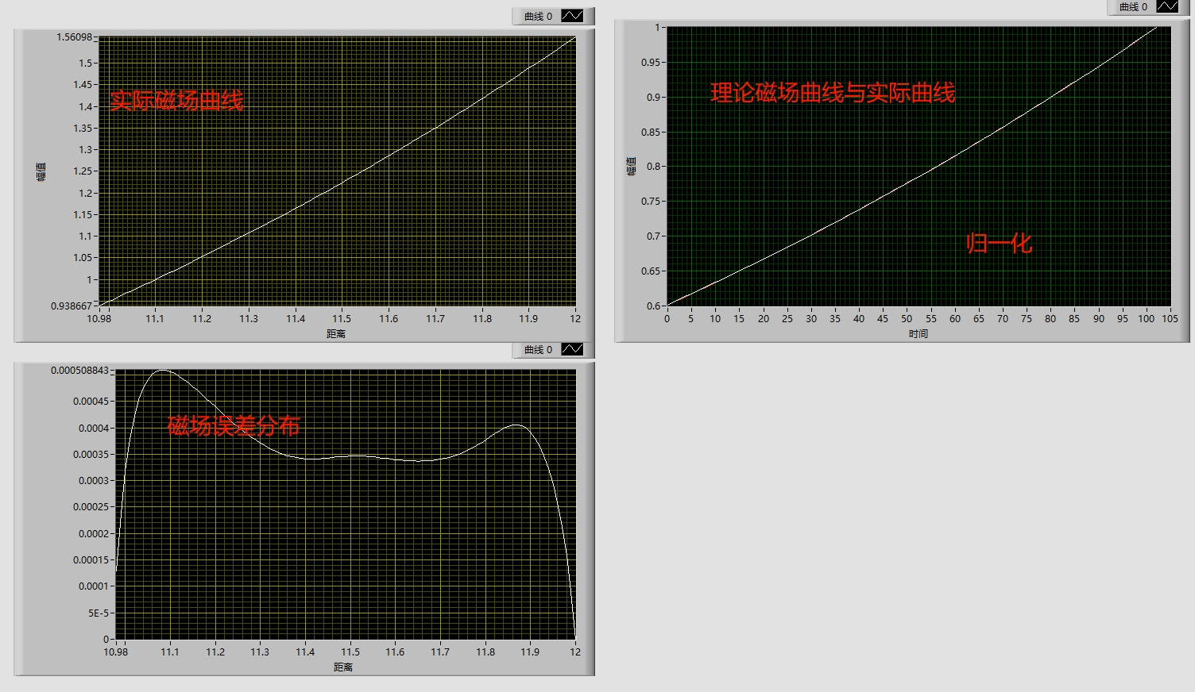
补偿后磁场误差分布
2D design with optimization
actual curve
Theoretical curve and actual curve
normalized
error distribution
The magnetic field error is about 0.05%
Notes:
With optimization the error of magnetic field reduce a lot

Slide 14
outline
Physics Requirements of FFAG Magnet
2D Design for FFAG magnet
3D Design for FFAG magnet
Key technologies for prototype

Slide 15
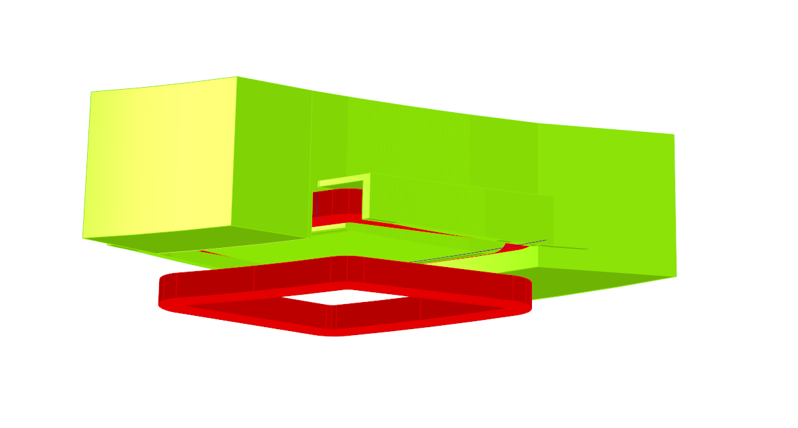
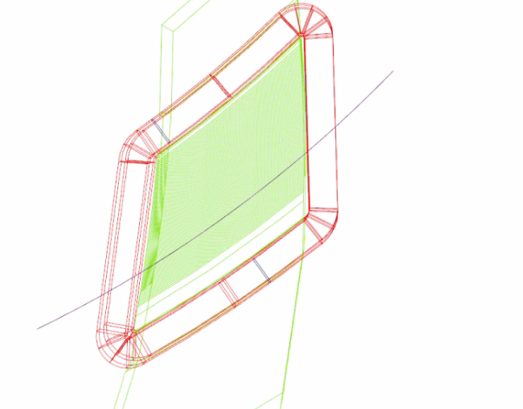
3D Design
The process of modelling and optimizing are：
Model the coils and iron in Opera 3D with TOSCA
Parametric modeling for later optimization
Separate padding on the entrance and exit to determine the center of the magnetic field
End shielding and edge trimming make the edge field factor consistent
Notes:
Moving to 3D, we modeled coils and iron cores in Opera 3D using TOSCA. Key steps included parametric modeling, edge shielding, and pole profiling to mitigate saturation. Separate optimization of entrance and exit fields ensured magnetic center consistency. The spiral angle, sector boundaries, and reference radius were critical parameters in shaping the field.

Slide 16
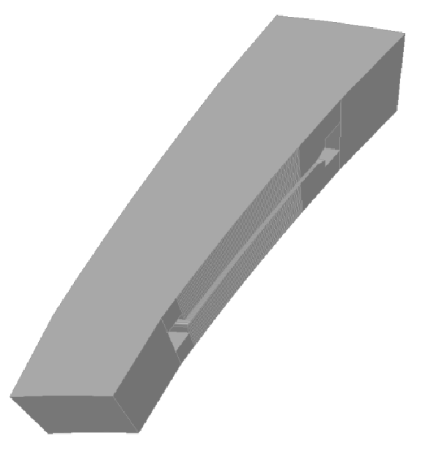
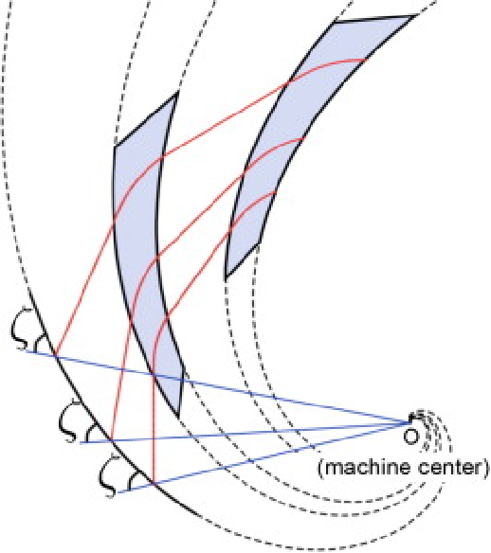





The Pole Boundary
Spiral line equation
$r=r_{0}$exp(($θ)/tanξ$)
Boundary equation
$r=r_{0}$exp(($θ−θ_{0})/tanξ$)
$$θ_{0}$$
Sector angle
$$ξ$$
Spiral angle
$$r_{0}$$
Reference radius
Notes:
The initial magnetic pole boundary adopts the ideal spiral line by changing the Sector angle Determine the left and right boundaries

Slide 17
The optimization goal
The optimization goal of 3D design
The integrated field meets the physical requirements
The magnetic center should be the theoretical center
The Spiral Angle should be the set value
The edge field coefficients should be consistent at different radius
Notes:
Challenges in 3D include edge field discrepancies and saturation at different radii. Our optimization goals are:
The integrated field meets the physical requirements
The magnetic center should be the theoretical center
The Spiral Angle should be the set value
The edge field coefficients should be consistent at different radius

Slide 18
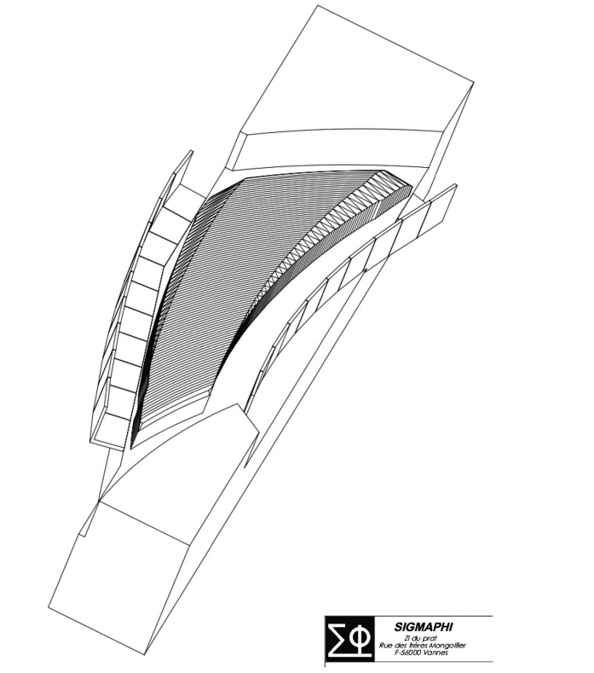
3D设计优化方式
The Polar optimization
Central position optimization: changes the initial value of the spiral Angle
Integral magnetic field optimization: modify the screw Angle
Edge field optimization: modify the end champing
Build complex surfaces with triangles
3D design is under going…….
Notes:
I need to integrate these code at a few times

Slide 19
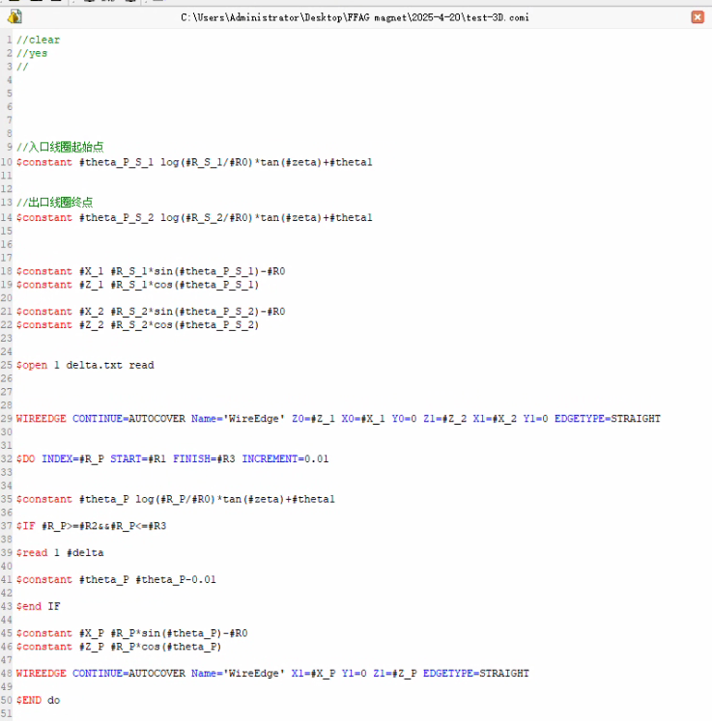
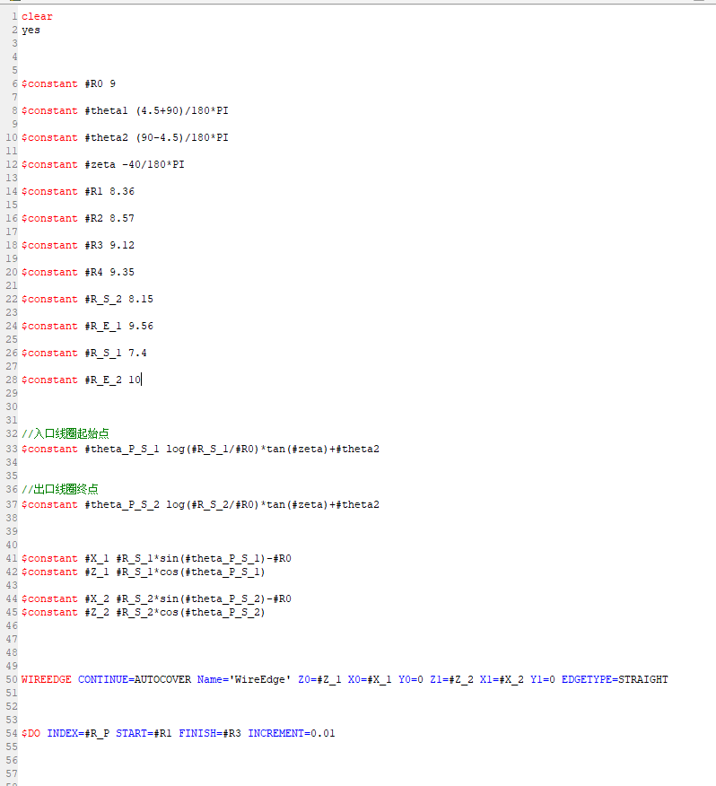
The design code
Full parametric modeling improves optimization efficiency
Parametric modeling of coil code
Magnet pole modeling code
The edge trimimg is parameterizing with triangle code
Integrat these code is undergoing….

Slide 20
3D设计优化方式
The trimming coil design
Field index (k):5.428±0.1
Trimming coil is necessary to realize the change of k values
The quantity of the trimming coil: about 20
The layout of the coil:same spacing or distance spacing
the compensation strategy of the trimming coil
F. Meot, et al., An Alternative Design for the RACCAM Magnet with Distributed Conductors, PAC09,

Slide 21
outline
Physics Requirements of FFAG Magnet
2D Design for FFAG magnet
3D Design for FFAG magnet
Key technologies for prototype magnet

Slide 22
Key technology 1
  Magnet design
  Full parametric modeling and optimization, realize the complex polar shape in 2D/3D design, including the processing and adjustment of the spiral Angle
  The modeling and adjustment of the irregular coil
  Parametric modeling of the complex surface trimming
  the trimming coil design and the optimization strategy
  The magnet shape optimization to avoid interference between equipment and reduce the total weight

Slide 23
Key technology 2
  Magnet machining
  The machining precision and cost, control of large workpiece complex surfaces;
  Reduce the influence of installation error
  The production, layout and assembly of the trimming coil
  Large size complex coil winding process and error suppression
  The magnet pole adopts annealing to guarabtee the material properties and the core use the common DT4C material
  For the complex trimming coil, it should be careful to ensure the coil winding accuracy and the coil pouring accuracy
Notes:
极面采用退火工艺，磁极仅采用普通DT4板材

Slide 24
Key technology 3
  Magnetic field measurement
  The removable pole will be adopted to secondary processing for magnetic poles, according to the actual magnetic field measurement and data analysis results
  The spiral angle and edge field coefficient are very important to improve the stability of the beam, and the core will be modified to ensure the magnetic measurements results
  The field shield board should be included throughout the magnetic edge field correction process, and it would be adjusted to achieve the constant coefficient of the edge field
  The current adjustment strategy of the trim coil will be confirmed by the measurement results
Notes:
极面采用退火工艺，磁极仅采用普通DT4板材

Slide 25
Thank you for your attention

Slide 26
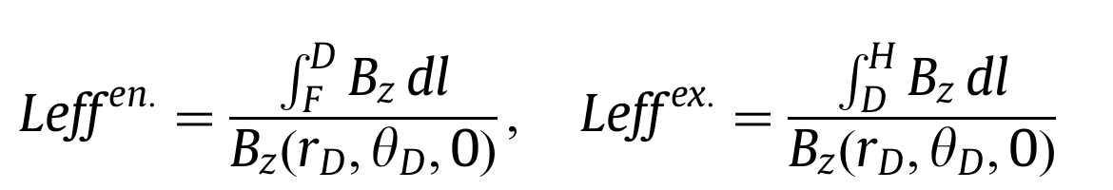
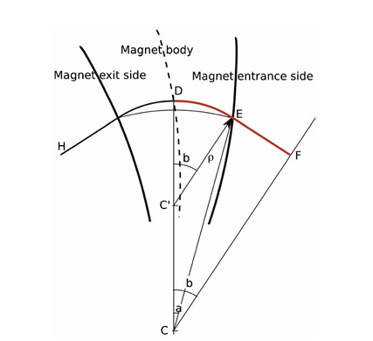
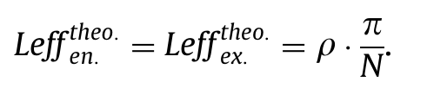
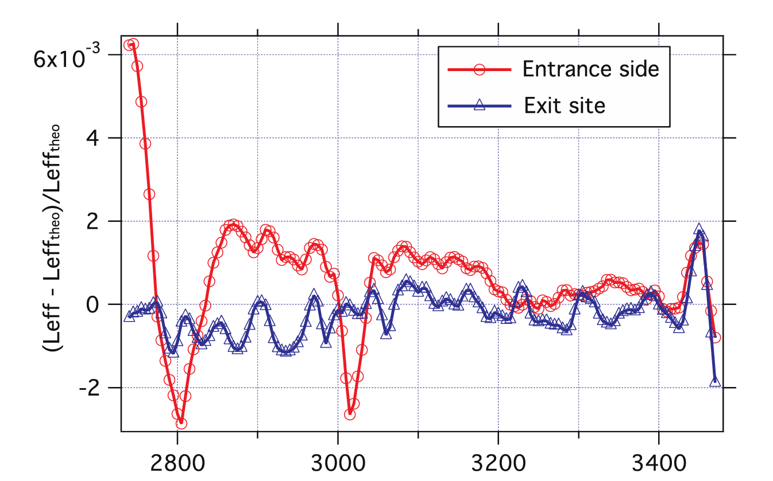

The optimization of magnetic center and efficient length
The integral line use the particle trajectory path(H-G-D-E-F)
The entrance field and the exit field
The goal of optimization
G
From Sigmaphi RACCAM
Bending radius
Notes:
The integral line uses the particle trajectory path(H-G-D-E-F). The integral trajectory adopts the theoretical particle trajectory. The integral magnetic field trajectory at the inlet is HGD, and the integral magnetic field trajectory at the outlet is DEF. The optimization objective is The effective lengths of the inlet and outlet meet the physical requirements. The following figure shows the effective lengths optimized by sigmaphi RACCAM，

Slide 27
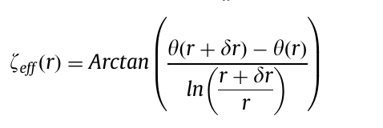
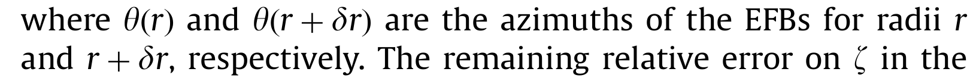
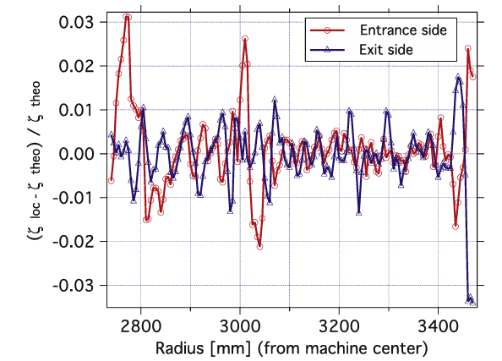
Evaluation of the Spiral Angle of the magnetic field
The integral line use the particle trajectory path(H-G-D-E-F)
The Spiral Angle of Magnetic field is
G
From Sigmaphi RACCAM
Bending radius
Notes:
The integral line uses the particle trajectory path(H-G-D-E-F). The integral trajectory adopts the theoretical particle trajectory. The integral magnetic field trajectory at the inlet is HGD, and the integral magnetic field trajectory at the outlet is DEF. The optimization objective is The helix angles of the inlet and outlet magnetic fields are consistent with the theoretical helix angles. The following figure shows the effective length optimized by sigmaphi RACCAM

Slide 28
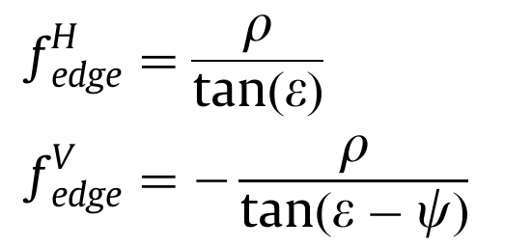
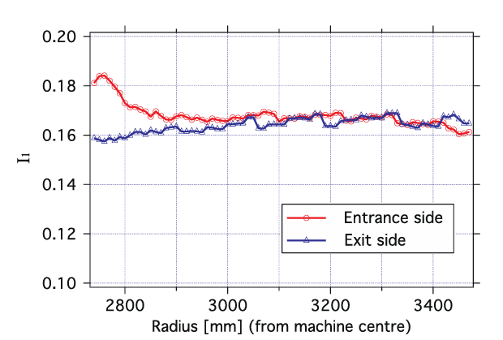
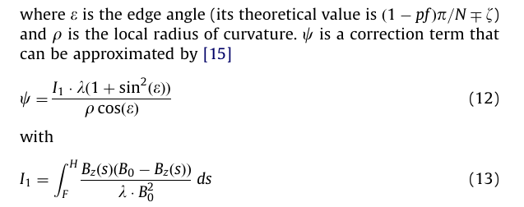
Fringe field
The focal length of the thin lens is given, in horizontal and vertical planes is
From Sigmaphi RACCAM
I1 should be constant in different radius
Notes:
Edge magnetic field is a key indicator in magnet design，The focal length of the thin lens is given, in horizontal and vertical planes is
，通过计算可以得到磁铁的边缘场因子，边缘场的优化目标为不同半径下的边缘场因子需要一致
The edge field factor of the magnet can be obtained through calculation. The optimization objective of the edge field is that the edge field factors at different radii need to be consistent，右图是Sigmaphi RACCAM的边缘场因子，在入口与出口处的边缘场因子需要一致

