Slide 1
PyFFAG, a high intensity simulation code for FFAG
Kai Zhou

Slide 2
0. overview of the PyFFAG code
PyFFAG Beam Dynamics Simulation Code
  Written in Python, with core solvers JIT-compiled by Numba (near C++ speed)
  Closed orbit, working point, and Twiss parameters calculating
  MPI-based parallel multi-particle tracking
  2.5D Space charge effect modeling with FFT-accelerated PIC method
  Multi-turn painting injection

Slide 3
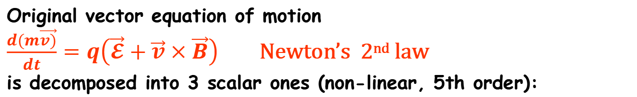
1. Equations of motion
Equations of motion in cylindrical coordinate system
with independent variable t - time
Original vector equation of motion
$\frac{d(m\vec{v)}}{dt}=q\left(\vec{𝓔}+\vec{v}×\vec{B}\right)$ Newton’s 2nd law
is decomposed into 3 scalar ones (non-linear, 5th order):
radial
axial
azimuthal

Slide 4
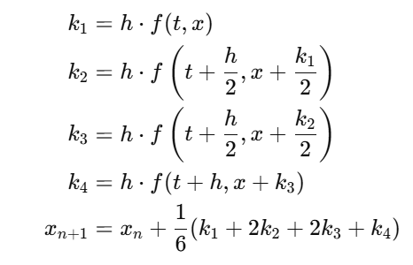
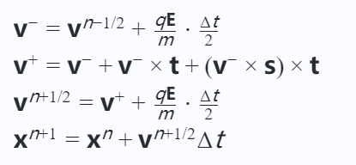
2. solver: 4th-order Runge-Kutta and Boris Pushing
4th-order Runge-Kutta
Boris Pushing
 | 4th order Runge-Kutta | Boris pushing
Integration accuracy | 4th-order | 2nd-order
Energy conservation | Not symplectic | Symplectic (energy stable)
computation costs for each step | 4 function evaluations | 2 function evaluations

Slide 5
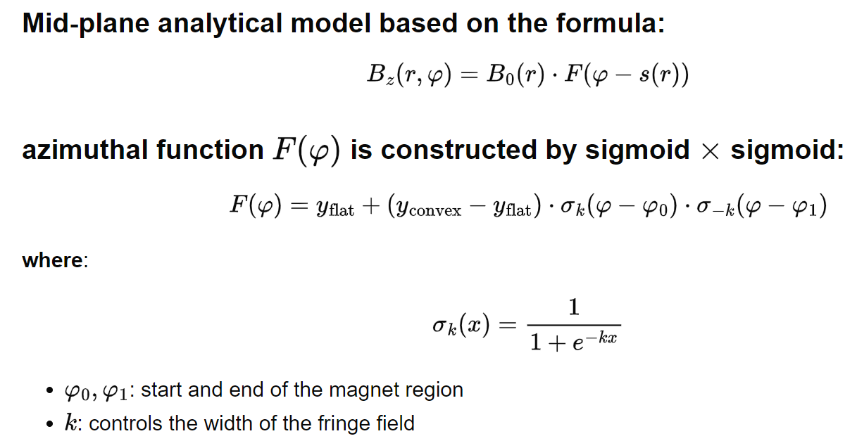
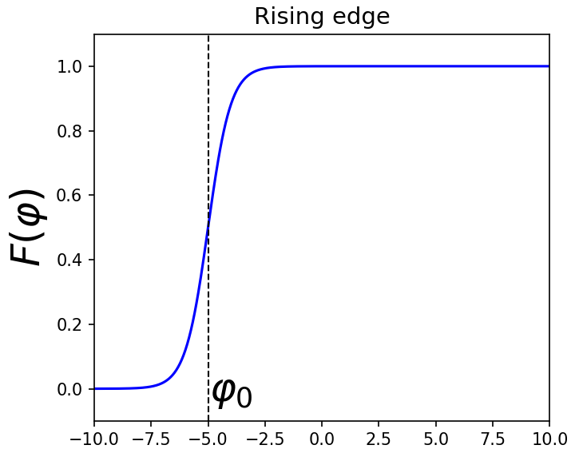
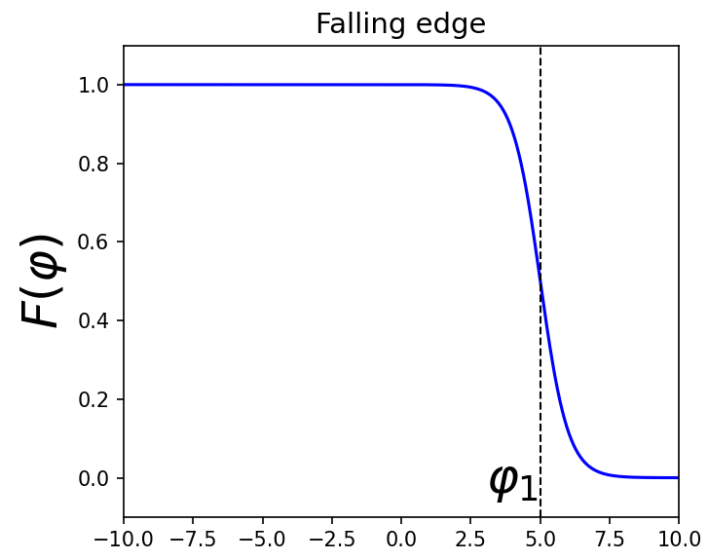
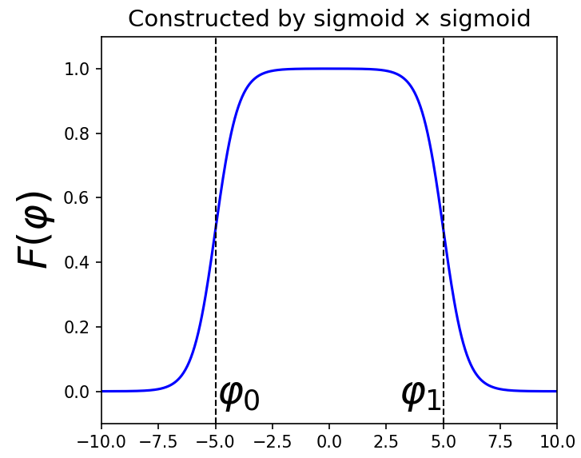
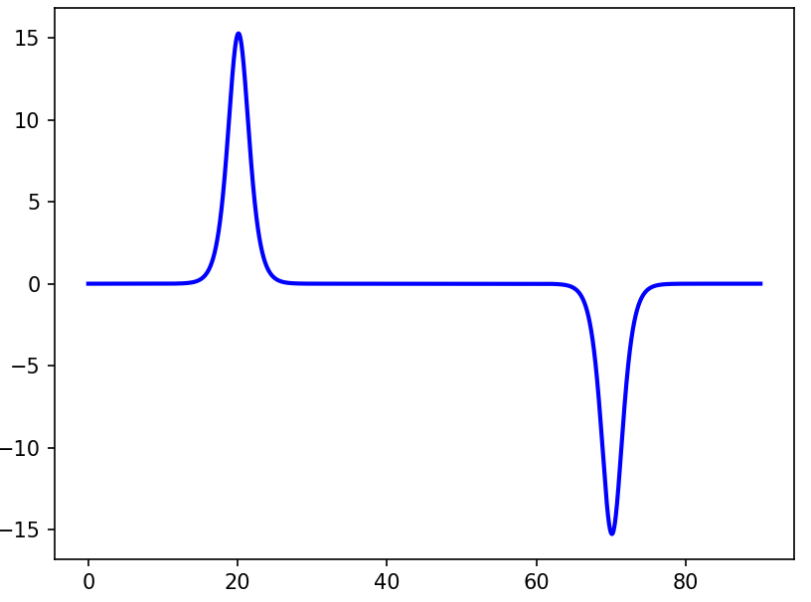
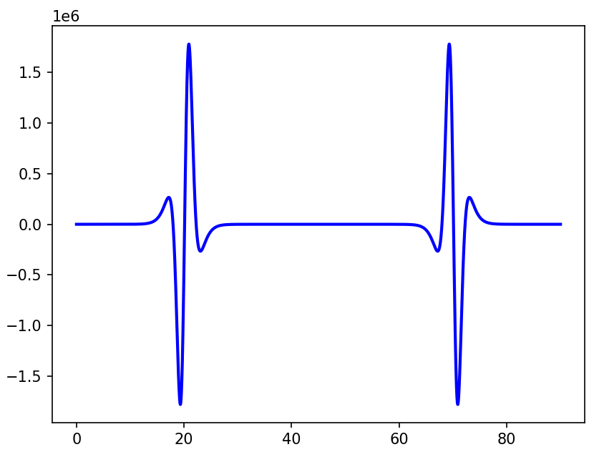
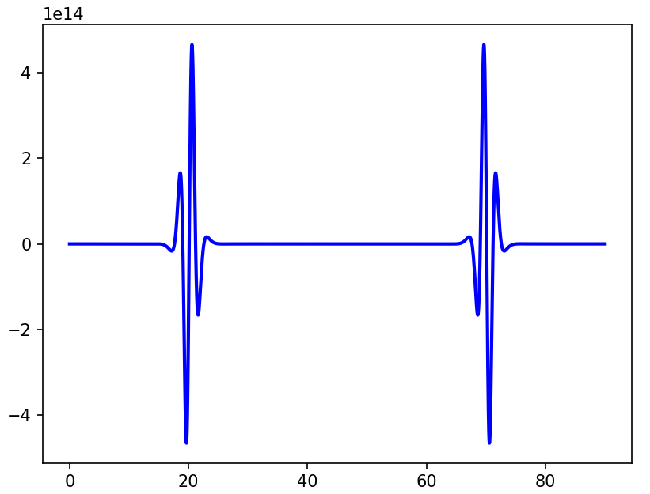
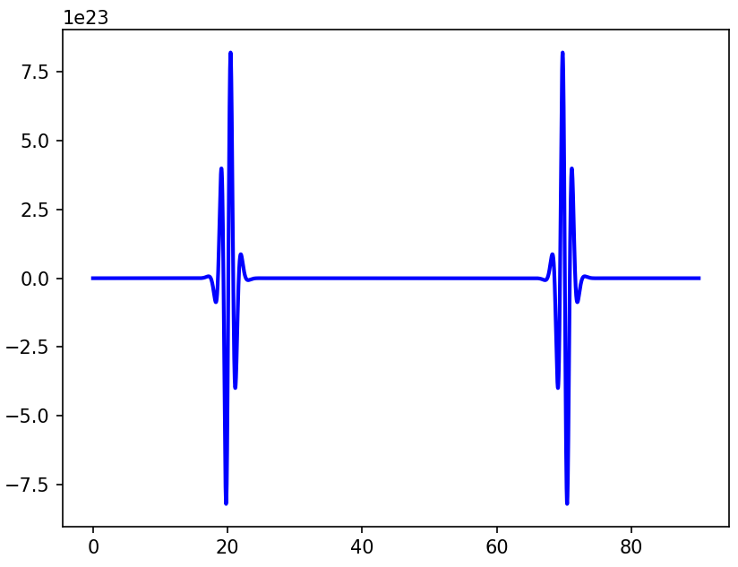
3. apply magnetic field
Advantages of sigmoid
Sigmoid derivatives are still polynomial of Sigmoid → analytically expressible, no numerical differentiation errors
Field values computed directly from formula → no interpolation errors
higher-order derivatives

Slide 6
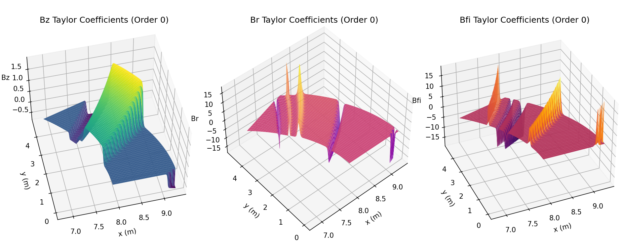
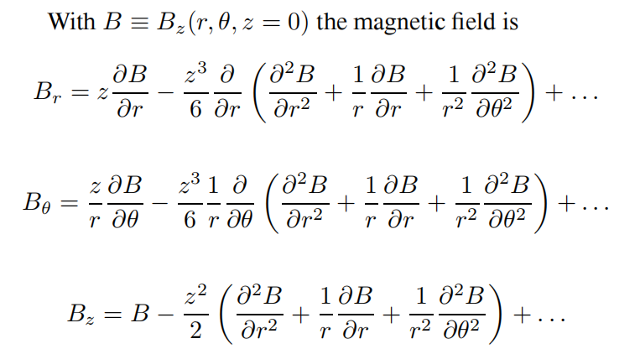
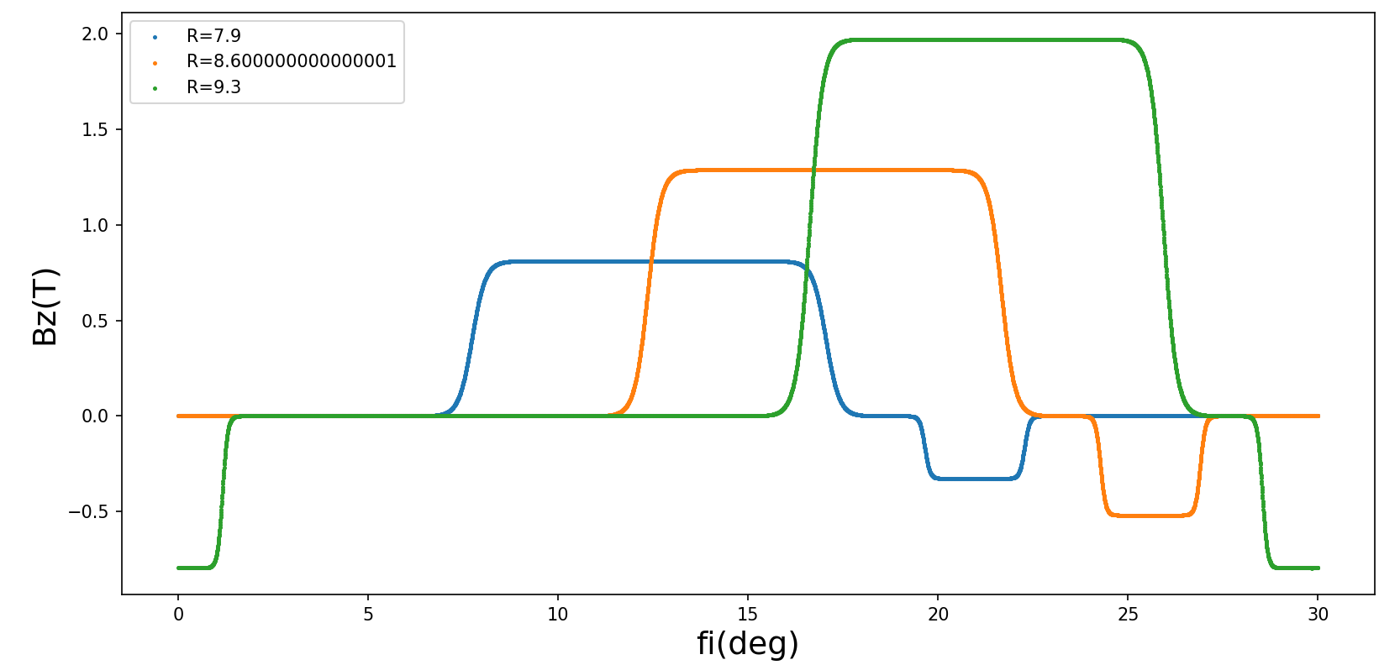
3. apply magnetic field
Off-midplane field expansion using Taylor series
The expansion includes nonlinear terms up to 5th order.

Slide 7
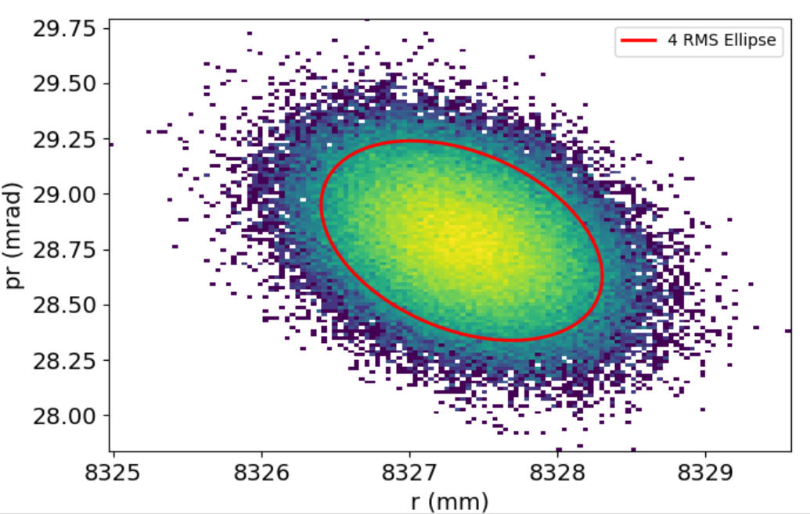
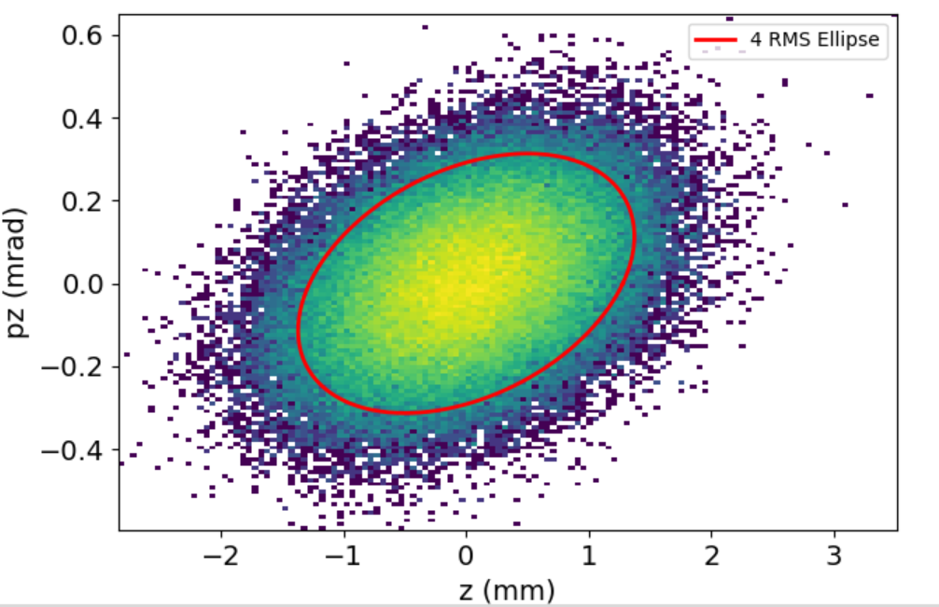
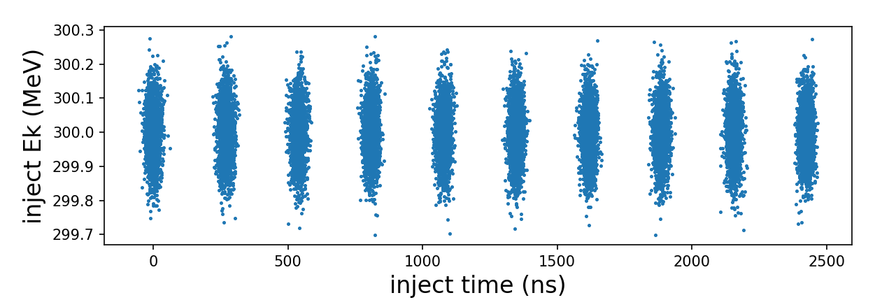
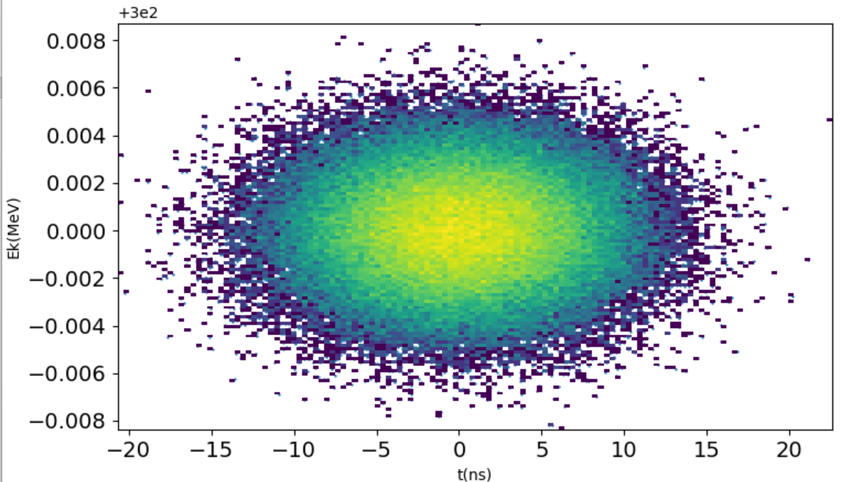
5. painting injection
method to apply painting injection:
1. generate multiple bunches at the beginning of the simulation
2. assign injection time for each bunches and particles according to the orbital peroid and length of the bunch
3. Apply transverse offsets to sub-bunches using painting curves
4. once the current time exceed the assigned injection time of a particle , we inject and start tracking this particle

Slide 8
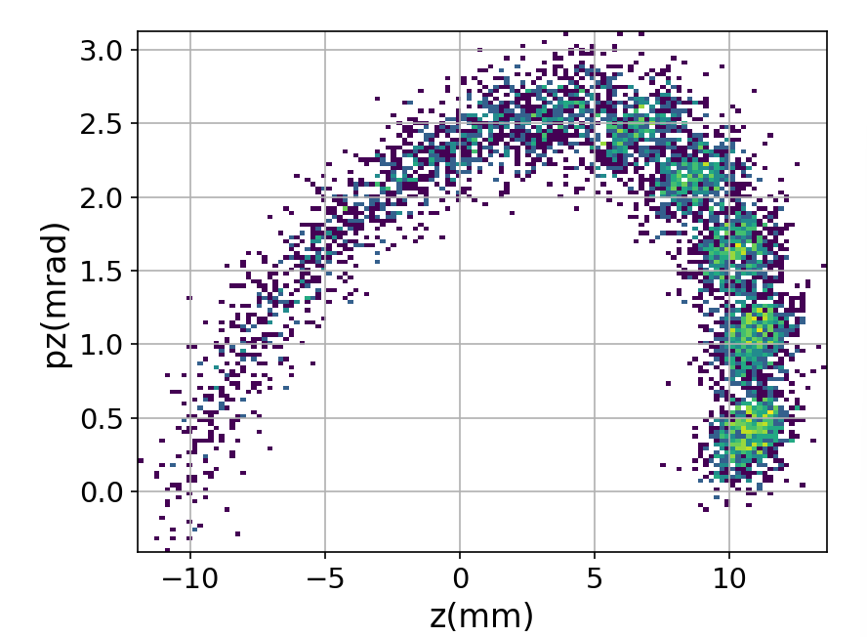
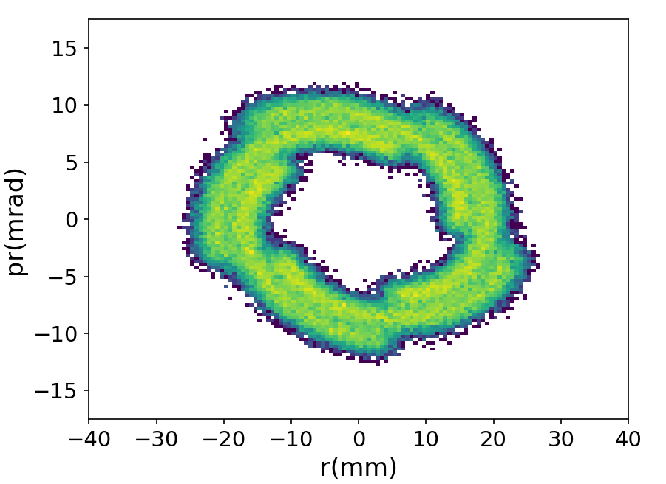
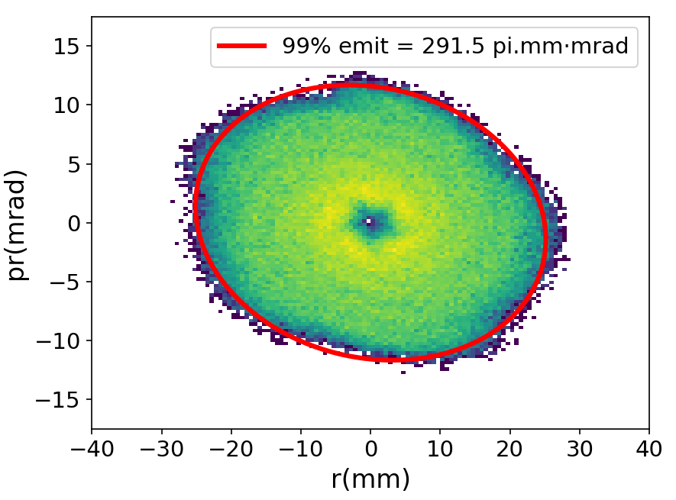
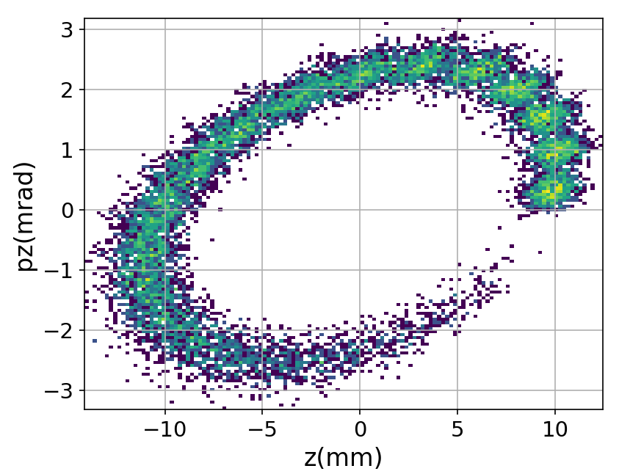
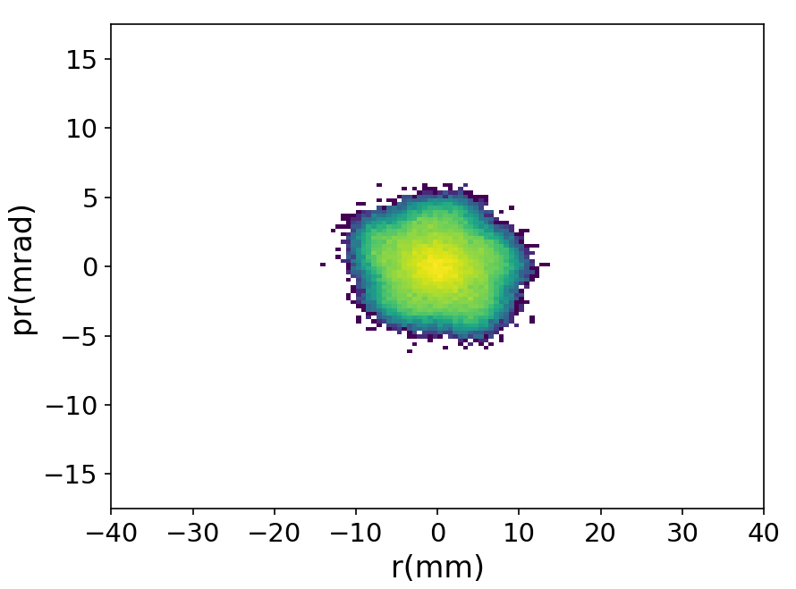
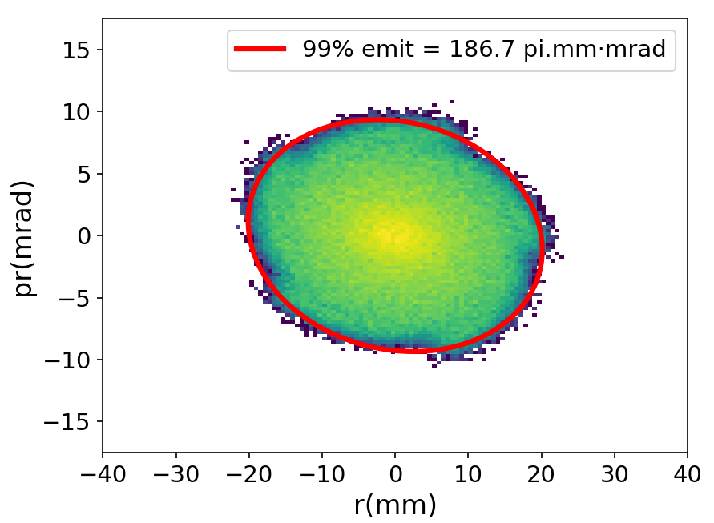
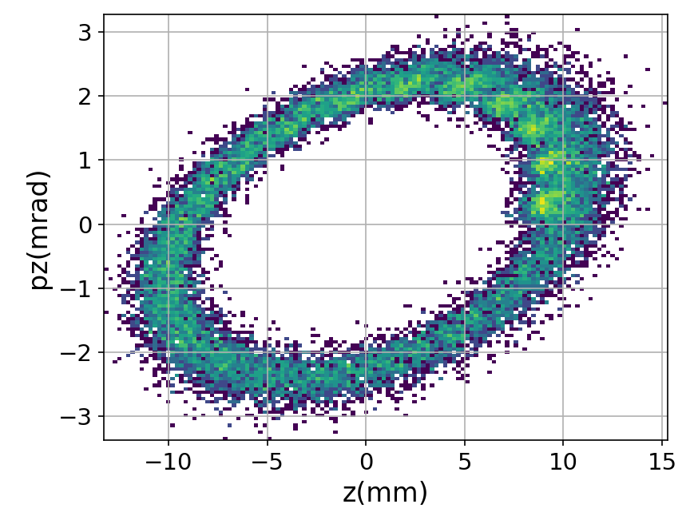
5. painting injection
Outside-inside painting
Inside-outside painting
Accumulation of sub-bunches during painting

Slide 9
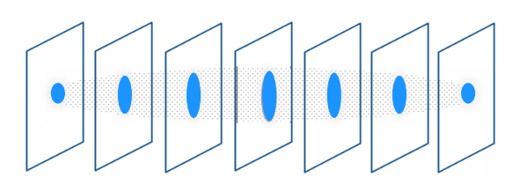
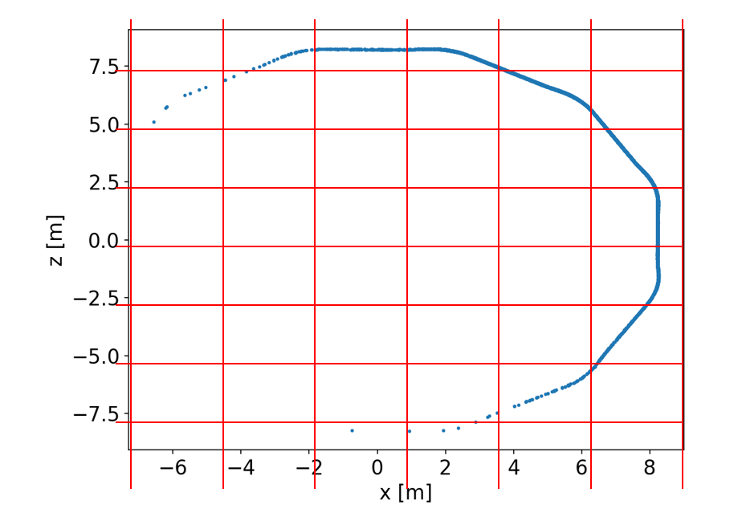
6. space charge
Initial implementation based on 3D space charge, found to be unsuitable for long, ring-like beam distributions
FFT requires uniform and rectangular grids, if we used uniform 3D grids, most of the grids are empty and invalid, and will cause large error
We current use 2.5D space charge model with φ-slice decomposition to better adapted to the geometry of the beam
2D mesh in the transverse plane, and 1D bins in the longitudial plane, better adapted to the beam geometry
3D mesh cannot adapted to the beam geometry, many empty grids.

Slide 10
6. space charge
Apply 2.5D space charge
Transverse charge distribution is binned onto single 2D grid
transverse potential and electric field is obtained with 2D FFT Poisson solver
longitudinal electric field is obtained with 1D Poisson solver
the conversion from cylindrcal coordinate to nature coordinate should be treated carefully, since FFAG has no fixed closed orbit
z
dismatch of the slices in the cylindrical coordinate
z
r
r
match of the center of the slices in the nature coordinate
z
z
x
fi
x

Slide 11
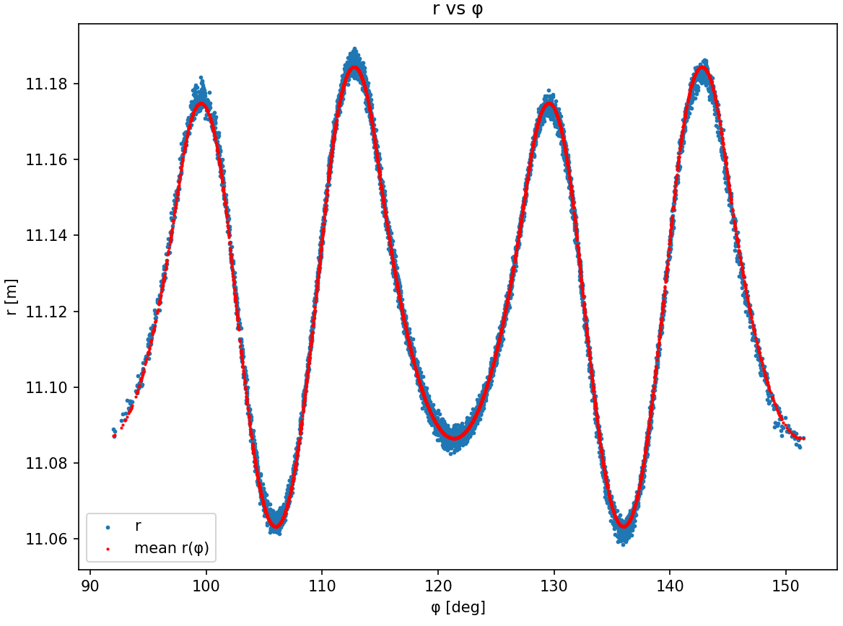
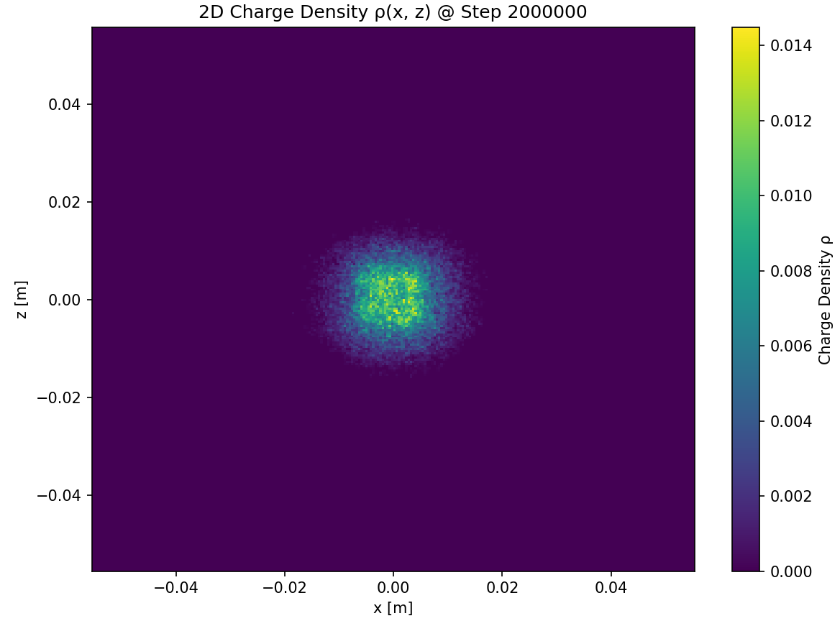
6. space charge
coordinate convert from cylindrical to nature coordinate:
using the closed orbit of the mean kinetic nergy of the bunch

Slide 12
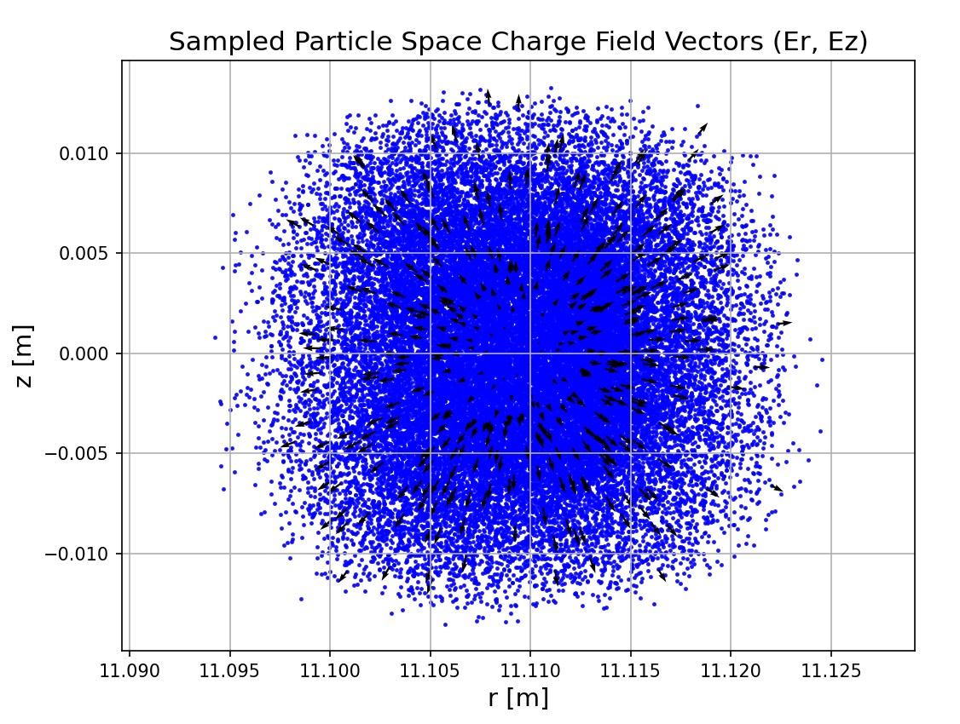
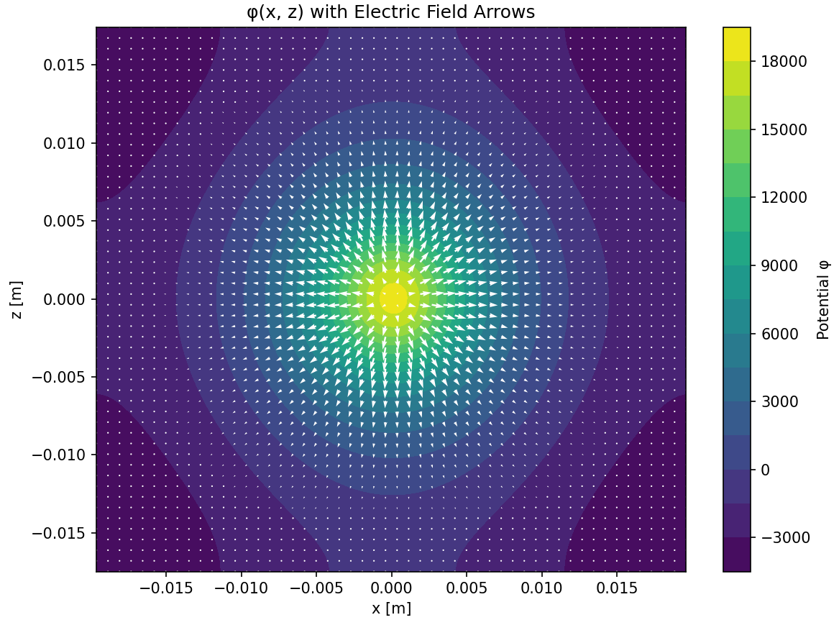
6. space charge
potential and electric fields on the grid
electric fields on the particles

Slide 13
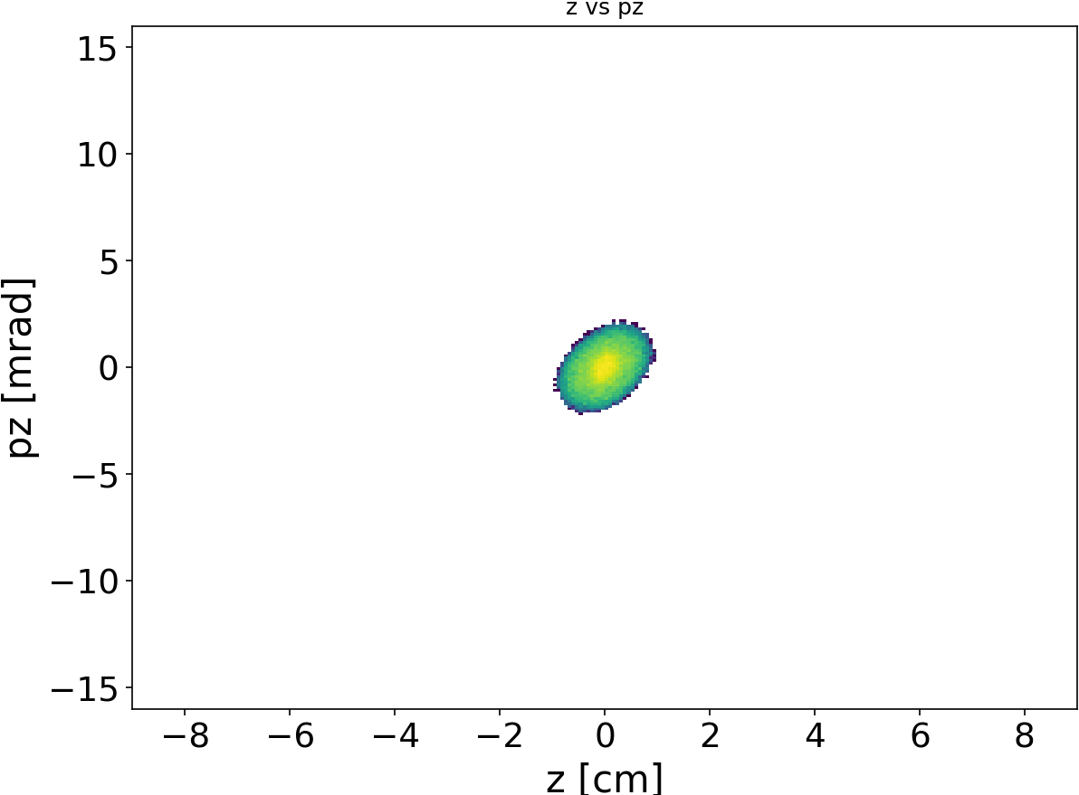
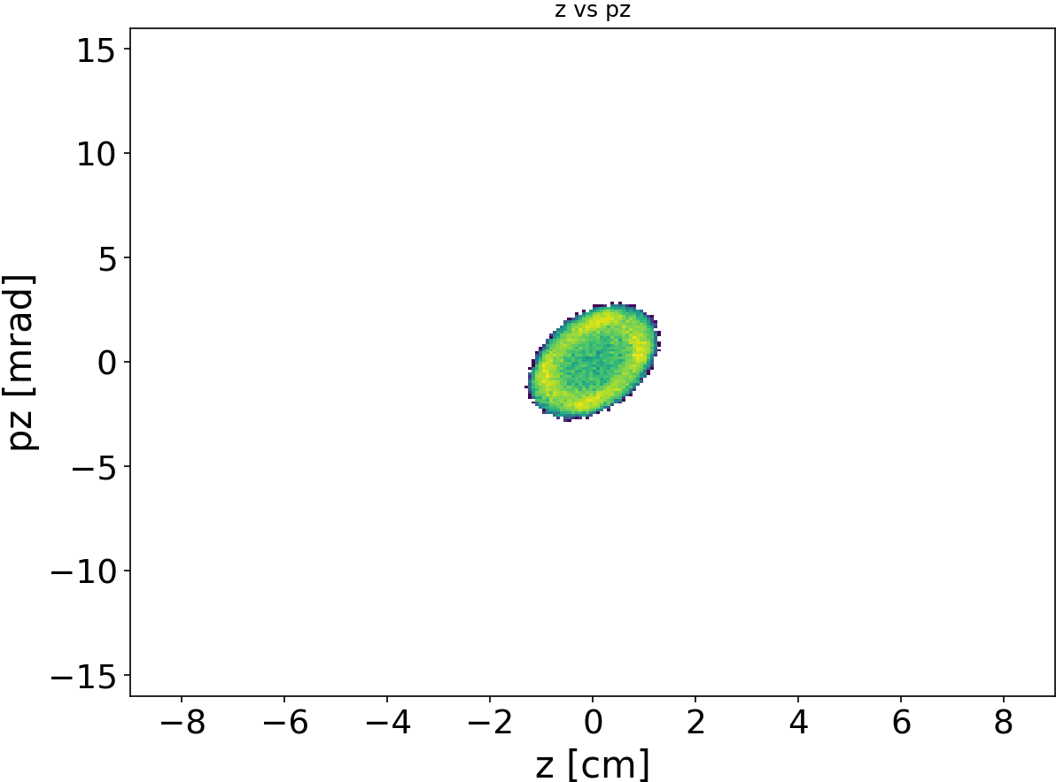

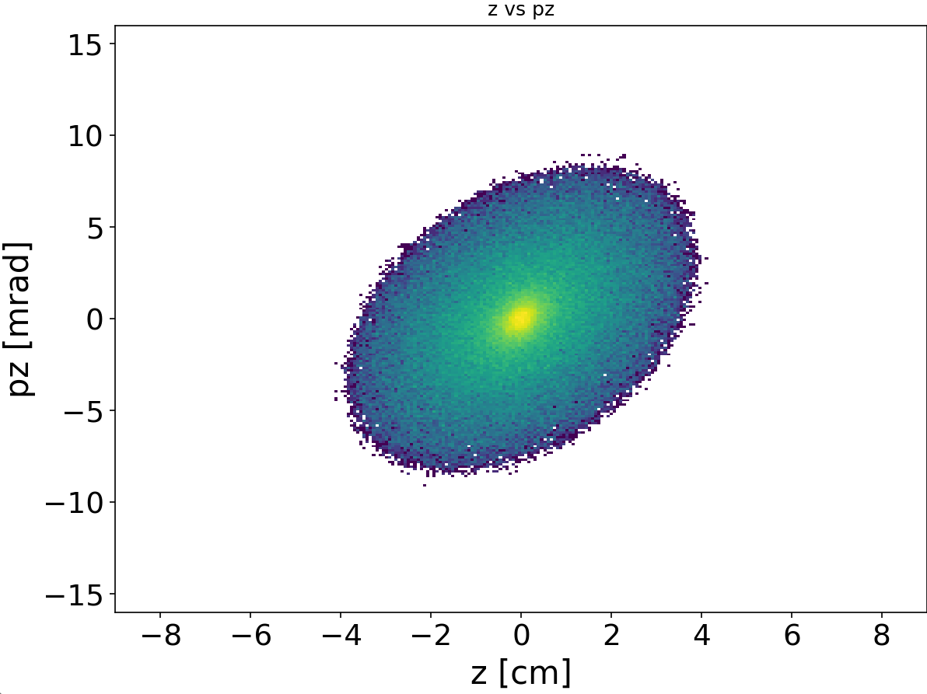
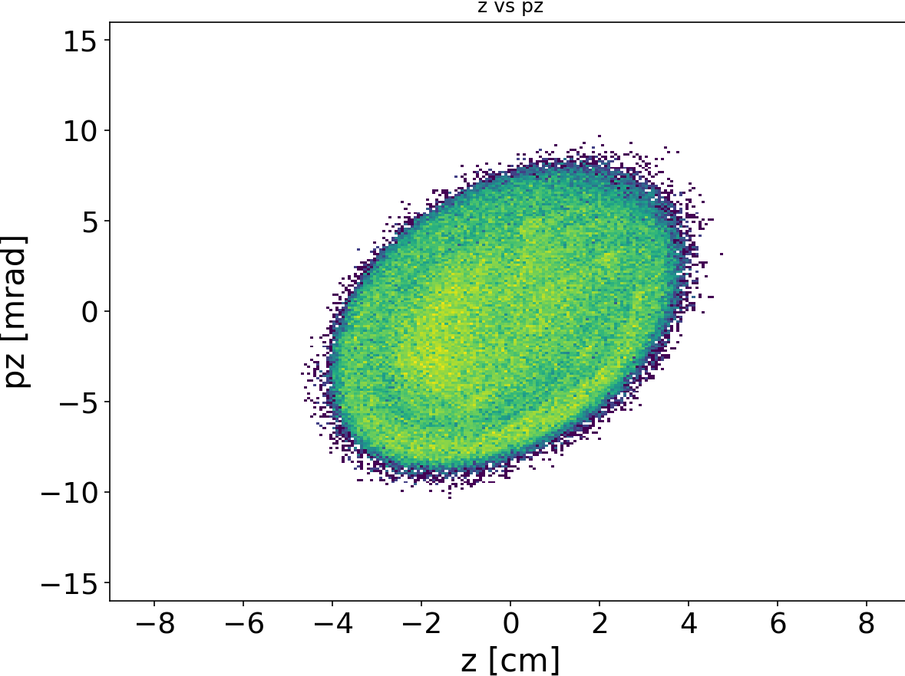

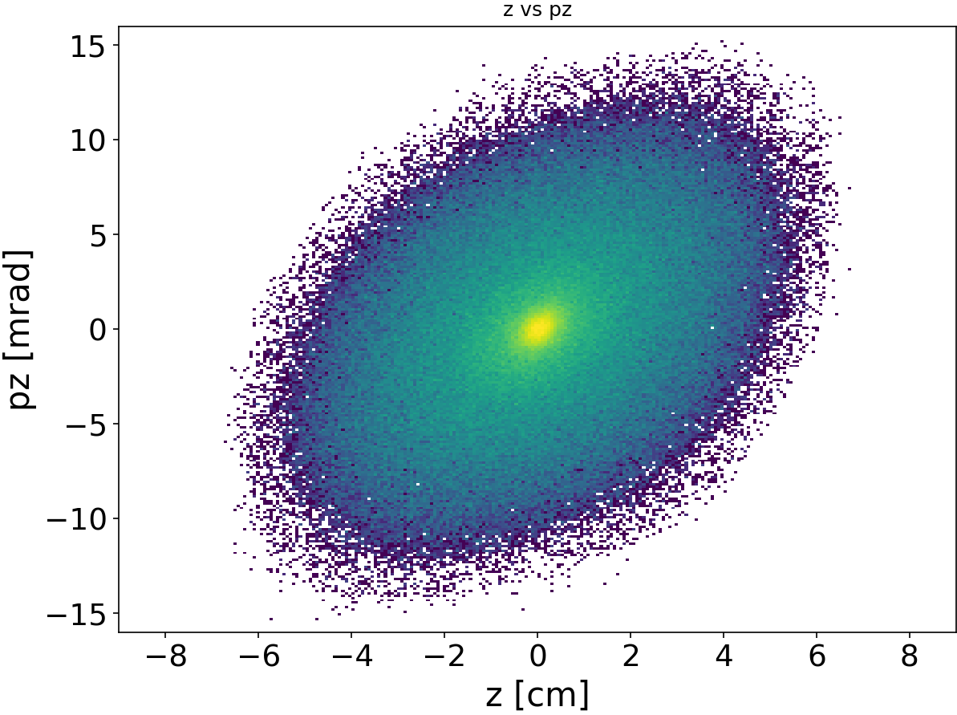
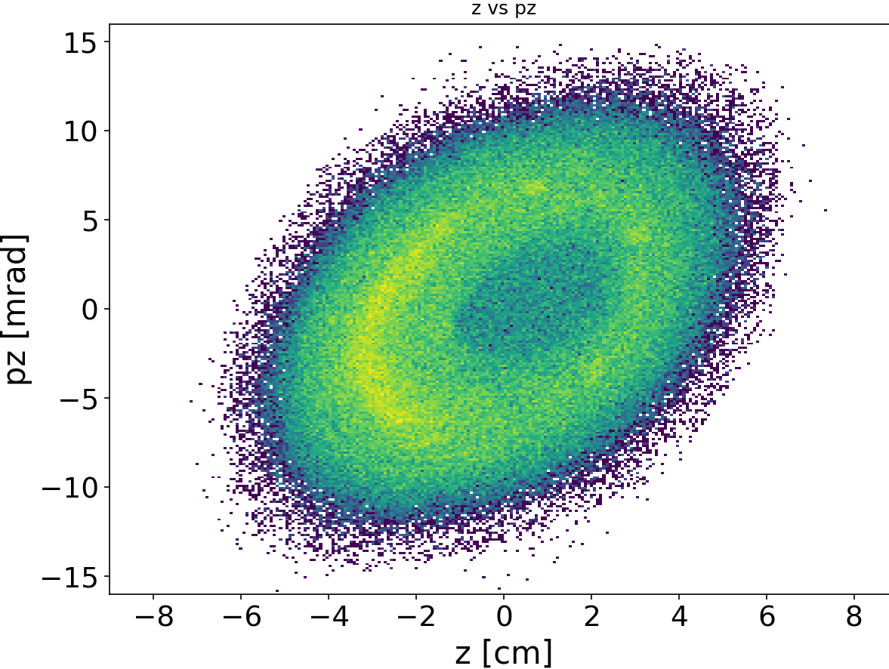
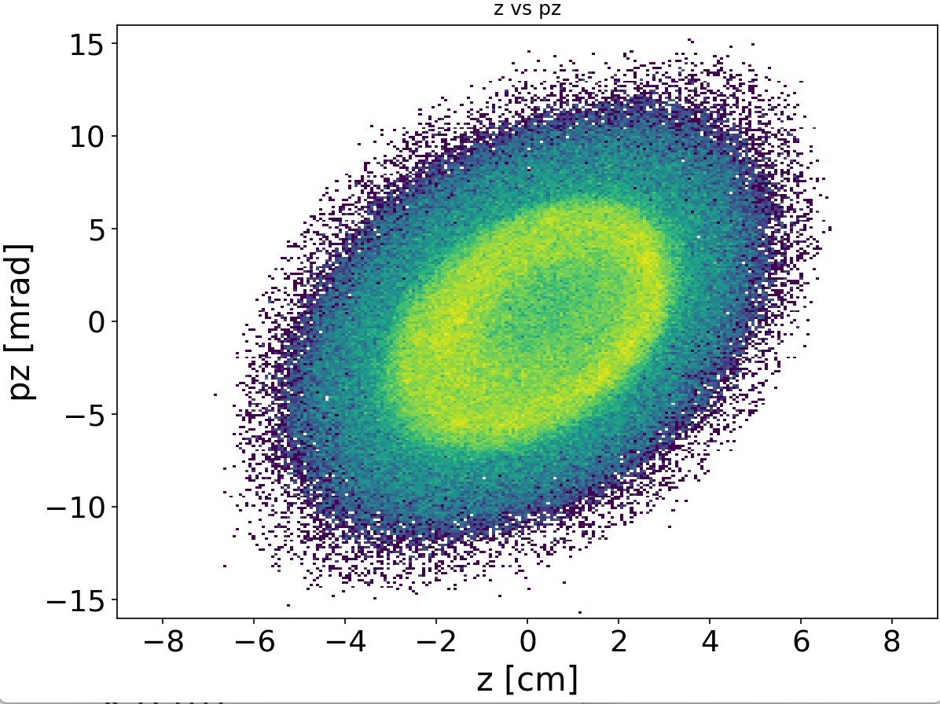
6. space charge
without painting
inside-outside painting, curve 1
inside-outside painting, curve 2
paint injection with space charge, z-pz plane
100 turns
500 turns
1000 turns

Slide 14
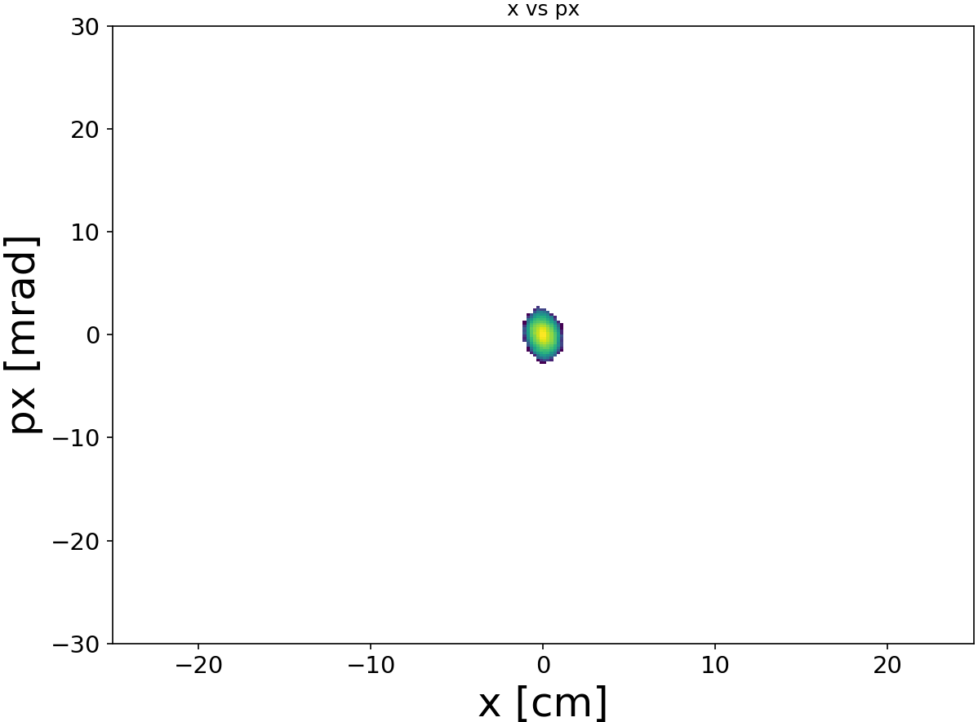
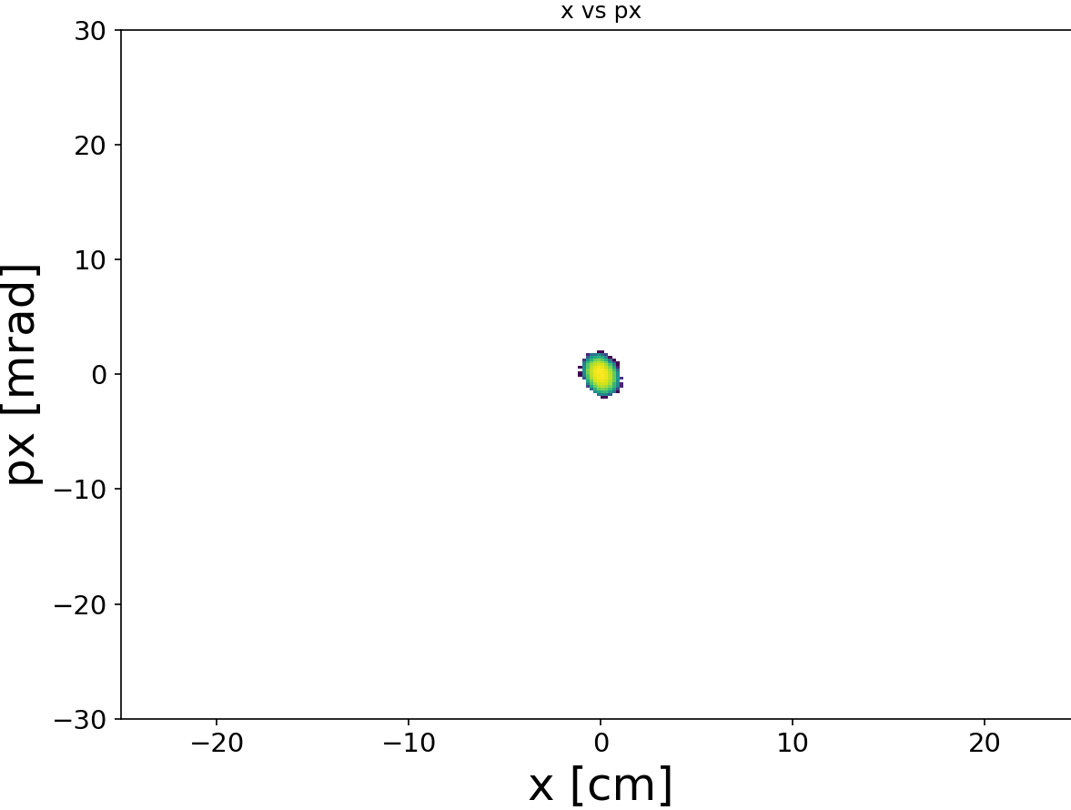

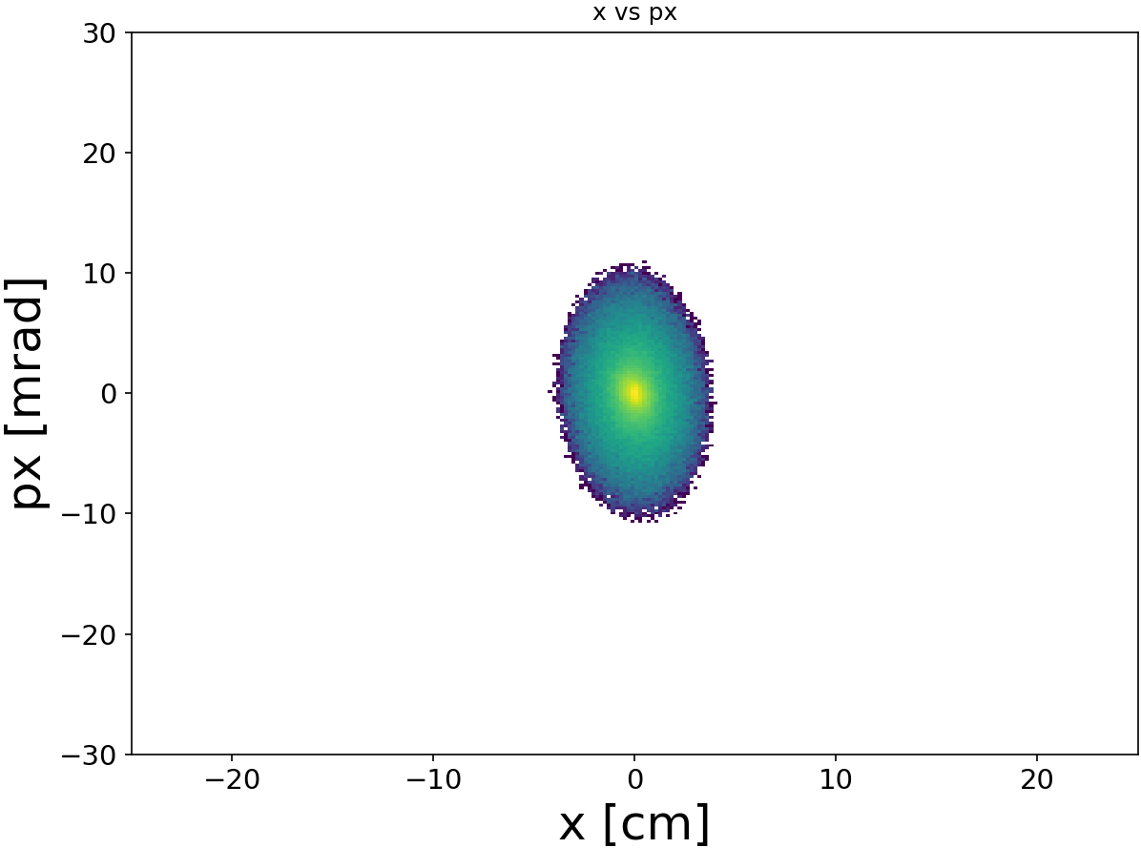
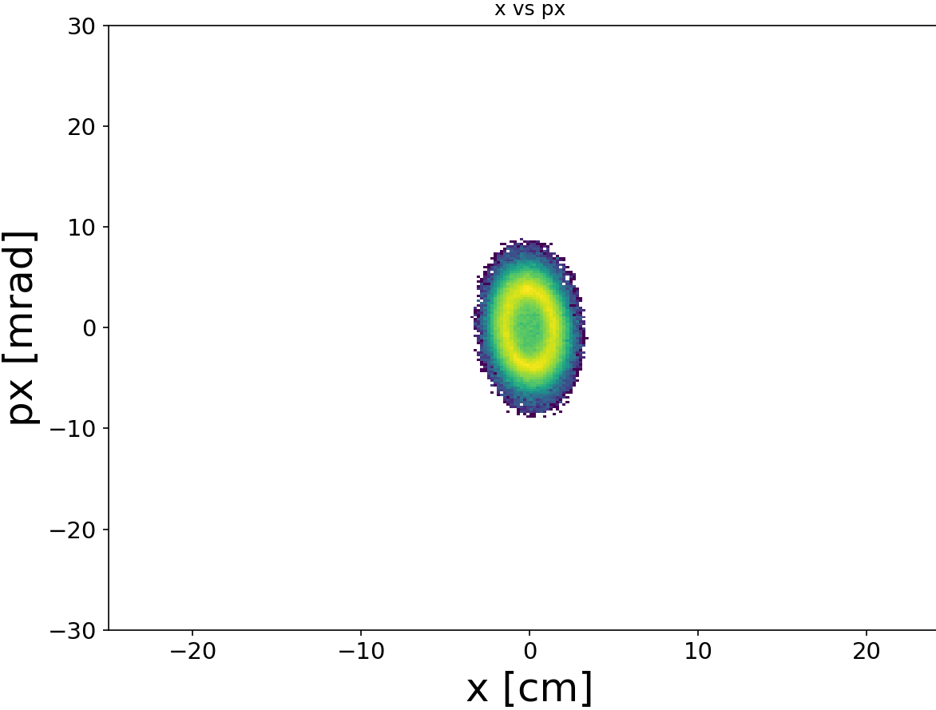
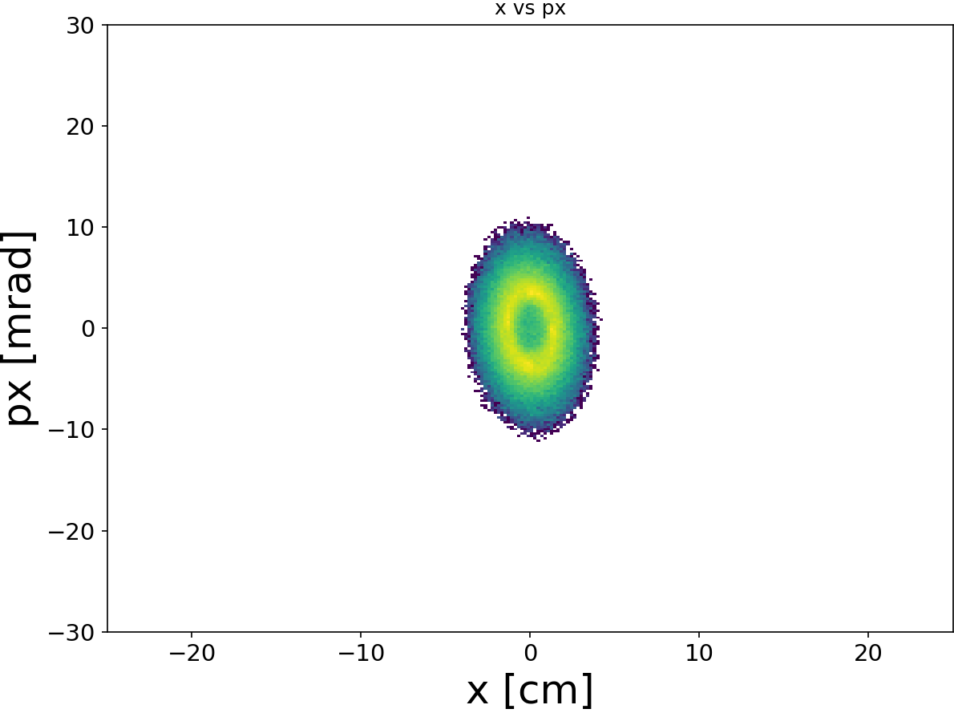
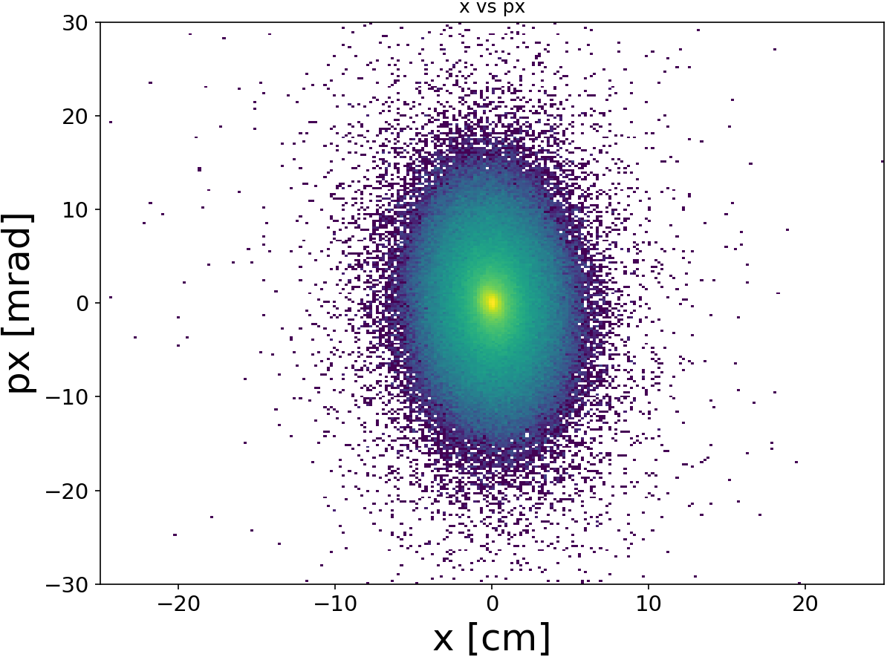
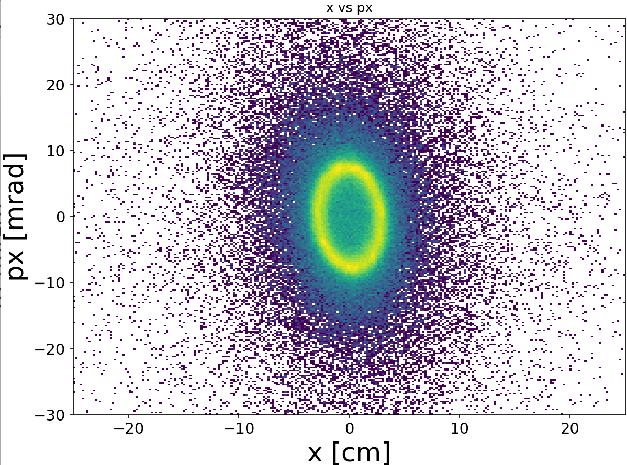
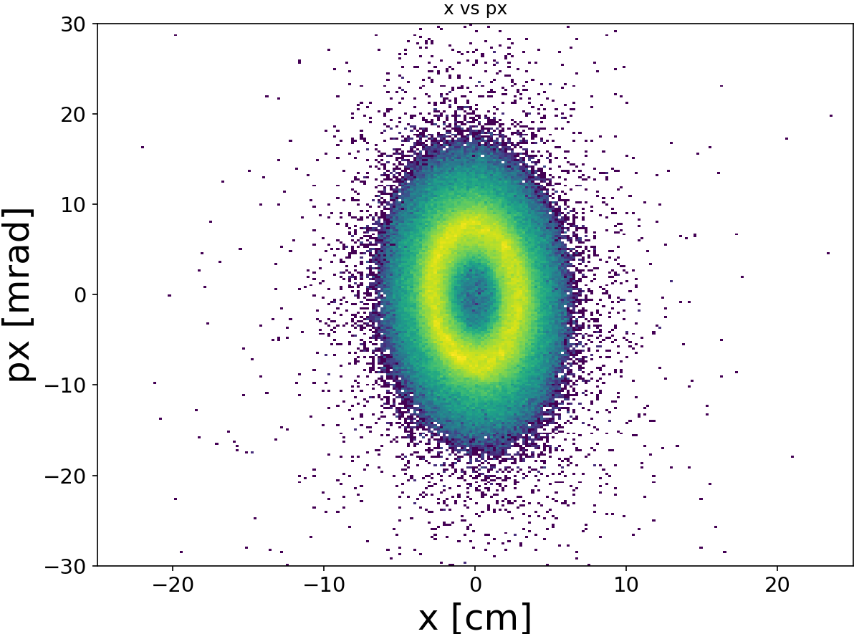
6. space charge
without painting
inside-outside painting, curve 1
inside-outside painting, curve 2
paint injection with space charge, r-pr plane
100 turns
500 turns
1000 turns

Slide 15
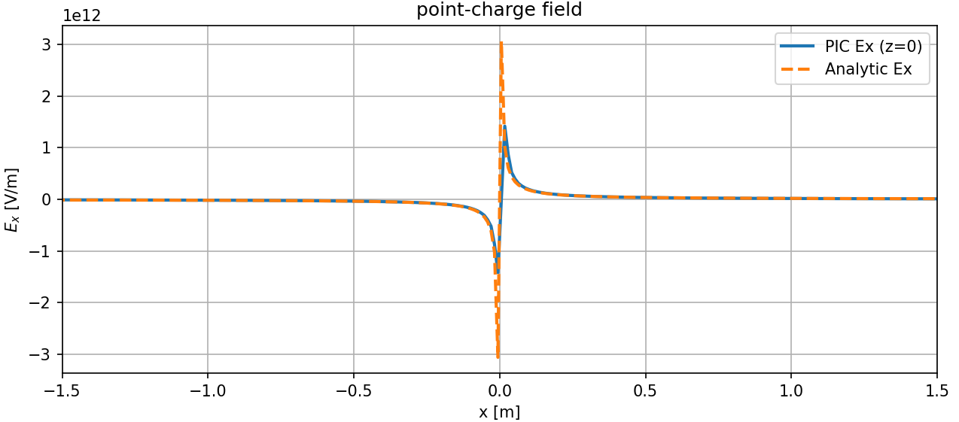
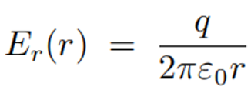

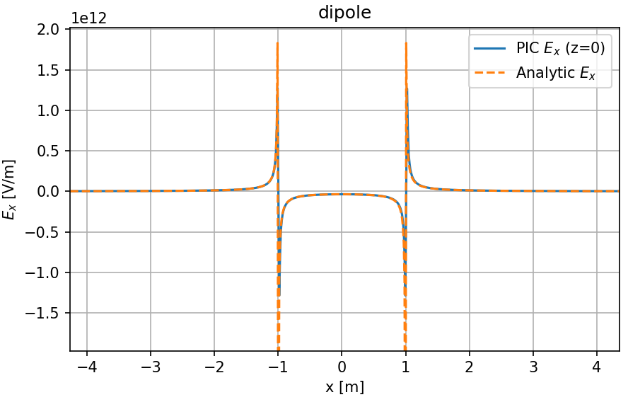
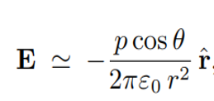

6. space charge
Comparison of space charge electric fields with theoretical solutions (2D)
Results from PIC-FFT solver agree well with theoretical solutions

Slide 16









6. space charge

Slide 17

6. space charge
Bench mark of the space charge
preliminary benchmark has been done using short bunch (straight) with PyORBIT
the beachmark using long bunch（ring - like） with PyORBIT is still under going
since we cannot build a FFAG lattice in PyORBIT, so we are now building a synchrotron lattice in PyFFAG, and compare the results with PyORBIT (on going)

Slide 18





7. bench mark with Zgoubi （without SC）
Zgoubi Qr = 2.916, Qz = 1.944
PyFFAG Qr = 2.919, Qz = 1.945
phase space after tracking for 600 turns : PyFFAG (green) and Zgoubi (red)

Slide 19



7. bench mark with Zgoubi （without SC）
PyFFAG
Zgoubi
twiss functions : PyFFAG and Zgoubi

Slide 20
8. summary
1）The main features of the program — including space charge effects and painting injection — have been nearly implemented.
2）The code is now capable of simulating the beam dynamics of high-intensity scaling FFAG accelerators
3) Benchmarking and validation are still in progress.

Slide 21
thank you for listenling

