Slide 1
Simulation code benchmarking
Carl Jolly, D. Kelliher, JB Lagrange,
S. Machida, C. Rogers.
24/07/2025

Slide 2
Motivation
We have used 4 simulation codes to design the FETS-FFA:
  FixField – Developed by JB Lagrange for the KURNS FFA → Magnet design.
  OPAL – Originally a cyclotron code developed at PSI → Injection/painting design.
  Scode (Simpsons) – Developed by Shinji Machida → Optics design.
  Zgoubi – Multipurpose code Developed by François Méot → Orbit correction.
The benchmarking is intended as an integration test of each code to reveal any differences between the codes or bugs.
Note that this work was carried out early in the design process of the FETS FFA.

Slide 3
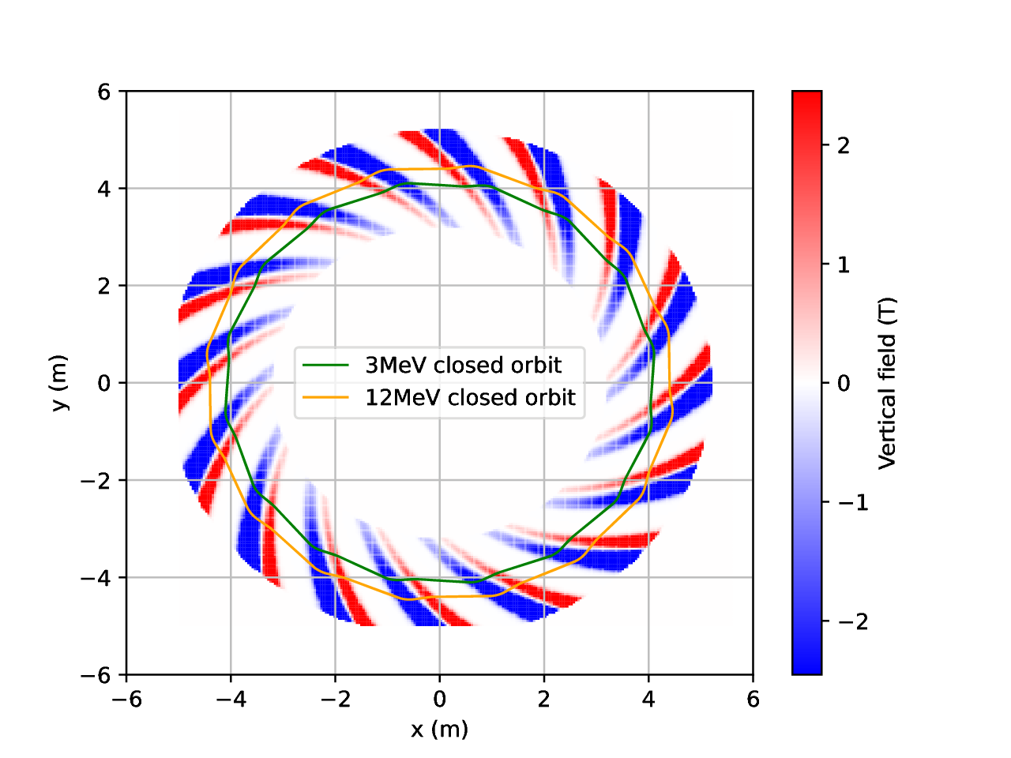
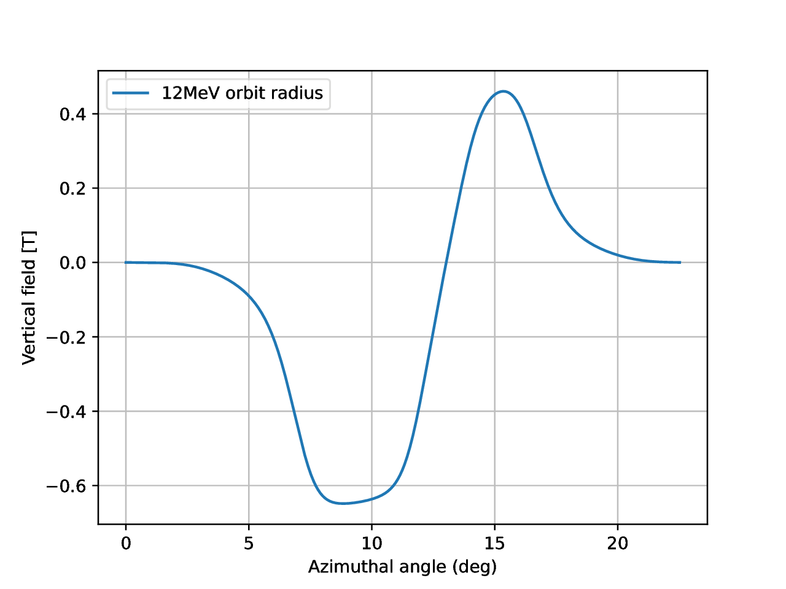
Benchmark lattice
(Radial extents of the magnets are exaggerated.)
Top down view of the benchmark FFA lattice.
Chosen to be representative of the final design.
16 cell symmetric FD spiral FFA.
The fringe fields are modelled using an Enge function with 4 coefficients.
Azimuthal Field profile.

Slide 4
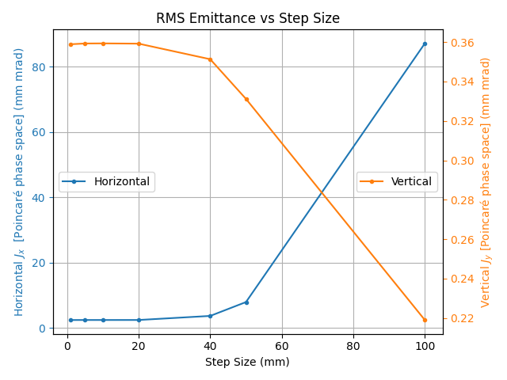
Simulation parameters
Step size set at 10mm.
4th order expansion off the mid-plane.
The FD ratio and k value adjusted so each code produces the same tune.
Code | FD ratio | k value
FixField | 1.29 | 7.72
OPAL* | 1.30 | 7.72
Scode | 1.29 | 7.71
Zgoubi | 1.29 | 7.72

Slide 5
Simulation parameters
Step size set at 10mm.
4th order expansion off the mid-plane.
The FD ratio and k value adjusted so each code produces the same tune.
Code | FD ratio | k value
FixField | 1.29 | 7.72
OPAL* | 1.30 | 7.72
Scode | 1.29 | 7.71
Zgoubi | 1.29 | 7.72
*The length of the drifts in OPAL are adjusted slightly such that OPAL produces a field equivalent to the other codes.
→An example of a potential bug revealed by benchmarking studies.

Slide 6
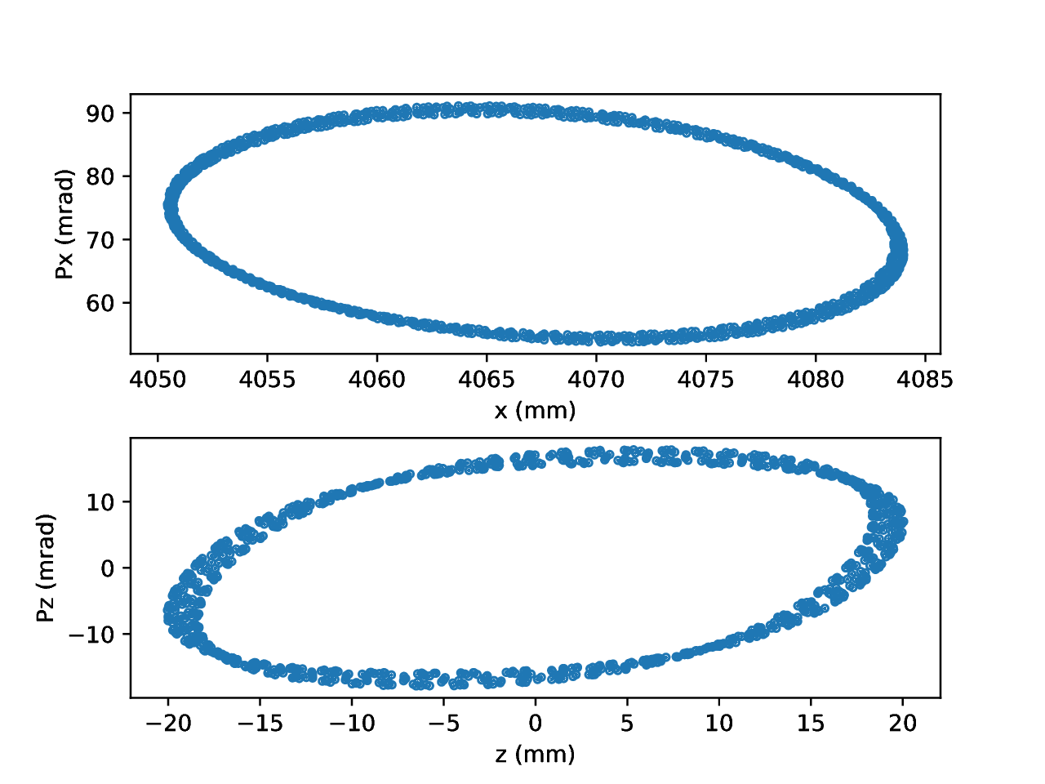
Benchmarking metric
In particular, the benchmark lattice should probe the behaviour of each code for the highly non-linear field in the FETS FFA magnet.
Each should predict an approximately similar detuning with amplitude and predict a roughly similar dynamic aperture (DA).
Expect the dynamic aperture to be limited by the detuning with amplitude from the octupole field component.
Horizontal and vertical phase spaces near the dynamic aperture limit, calculated with OPAL.

Slide 7
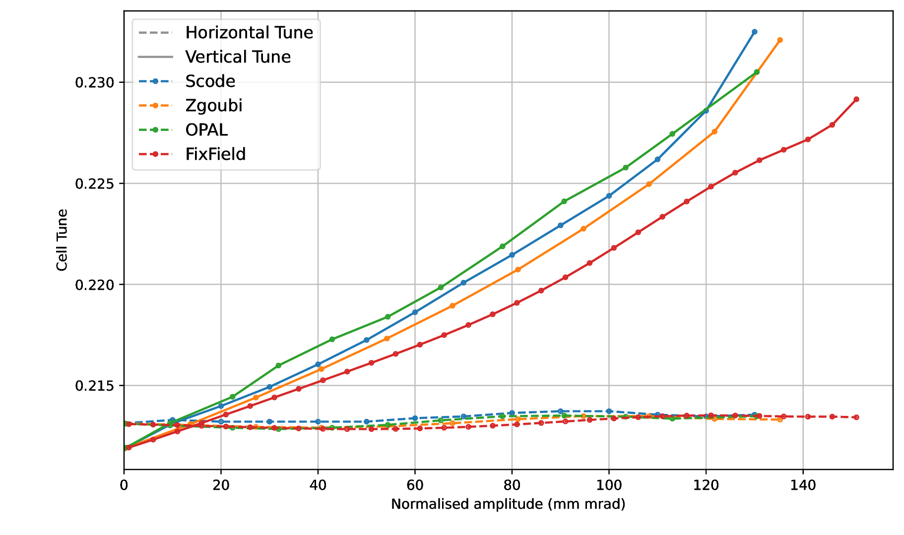
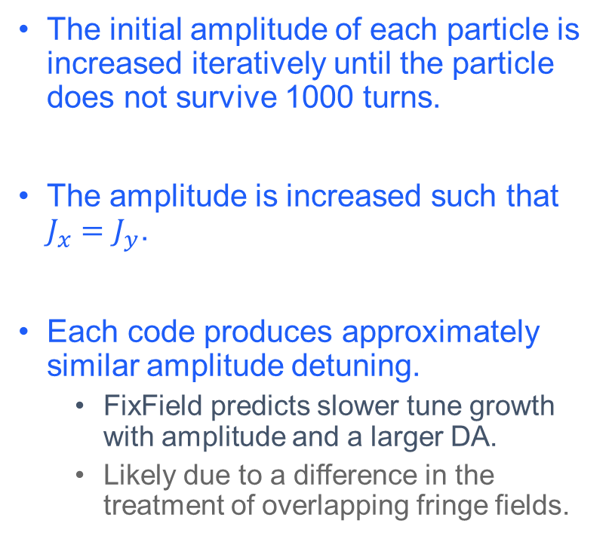
Amplitude detuning
The initial amplitude of each particle is increased iteratively until the particle does not survive 1000 turns.
The amplitude is increased such that $J_{x}=J_{y}$.
Each code produces approximately similar amplitude detuning.
  FixField predicts slower tune growth with amplitude and a larger DA.
  Likely due to a difference in the treatment of overlapping fringe fields.

Slide 8
FFA space charge simulations
Both OPAL and Scode have space charge solvers but there is some difficulty applying them to an FFA simulation.
  OPAL’s 3D solver was originally intended for cyclotrons, the whole domain needs to be covered by the computation grid
  → leads to an impractically large computation grid.
  Scode has a “2.5D-like” solver similarly to synchrotron simulation codes
  → However, like OPAL scode tracks particles in time, this leads to a coordinate transformation between the tracking a space charge calculation steps.

Slide 9
FFA space charge simulations
Both OPAL and Scode have space charge solvers but there is some difficulty applying them to an FFA simulation.
  OPAL’s 3D solver was originally intended for cyclotrons, the whole machine needs to be covered by the computation grid.
  → Leads to an impractically large computation grid.

Slide 10
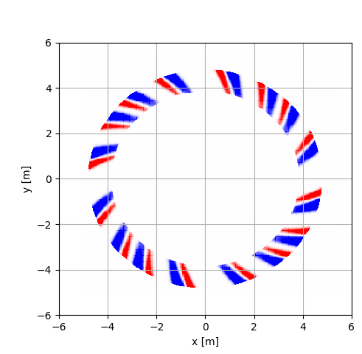
FFA space charge simulations
Both OPAL and Scode have space charge solvers but there is some difficulty applying them to an FFA simulation.
  OPAL’s 3D solver was originally intended for cyclotrons, the whole machine needs to be covered by the computation grid.
  Leads to an impractically large computation grid.
  A 2.5D space charge solver could be ideal.
The beam could cover a significant portion of the ring.

Slide 11
FFA space charge simulations
Synchrotron simulations solve this problem by using a 2.5D solver.
  Tracking particles with matrices with distance as the independent variable makes this easier since the space charge solve and tracking happen in the same coordinate system
  This is not the case for OPAL as it tracks particles through time in a global coordinate system.

Slide 12
FFA space charge simulations
Synchrotron simulations solve this problem by using a 2.5D solver.
  Tracking particles with matrices with distance as the independent variable makes this easier since the space charger and tracking happen in the same coordinate system
  This is not the case for OPAL as it tracks particles through time in a global coordinate system.
Global tracking coordinates
2.5D solver coordinates

Slide 13
Summary
Simulation code benchmarking was carried out early in the design process of FETS FFA.
The benchmarking exercise revealed a few bugs in some of the simulation codes which were then fixed.
After the fixes, the four simulation codes predict approximately consistent detuning with amplitude.
  Its important that the 4 simulations predict similar amplitude dependant tune shifts as this provides the ultimate limit on the dynamic aperture in FETS FFA.

