Slide 1
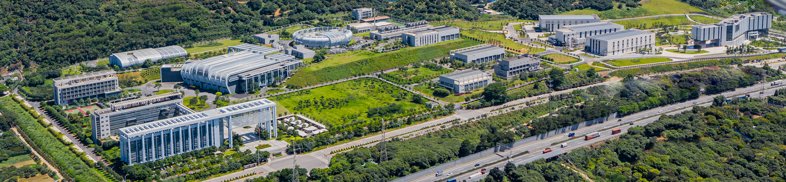
Report of Dongguan Branch
The Introduction to CSNS and Its Upgrade Project CSNS-II
Sheng Wang
Institute of High Energy Physics, CAS
ISIS, UK，July. 23, 2025

Slide 2
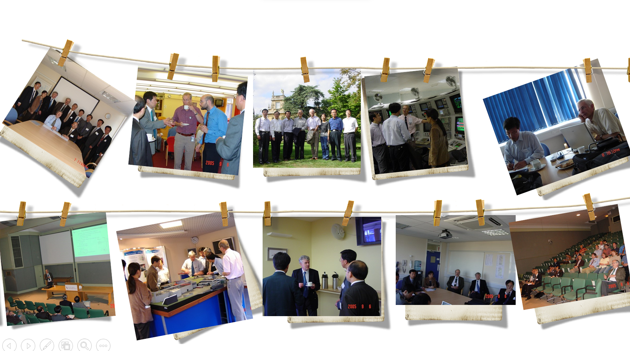
20 years ago …

Slide 3
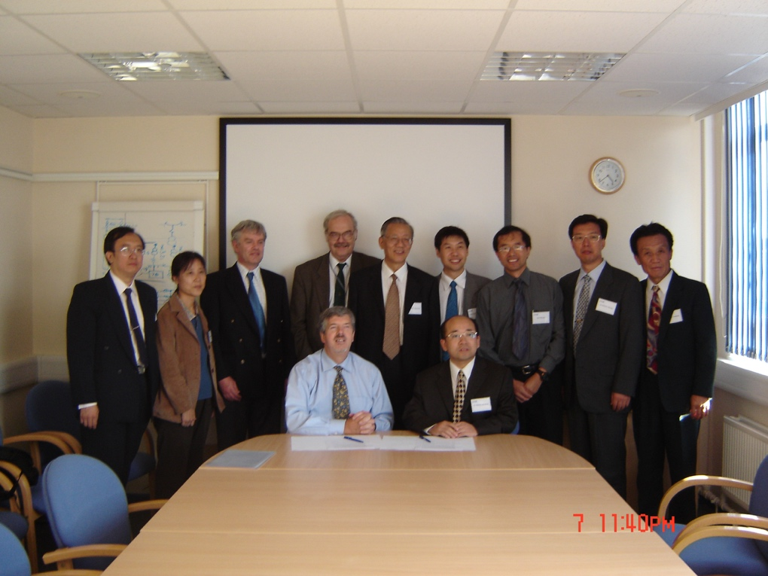
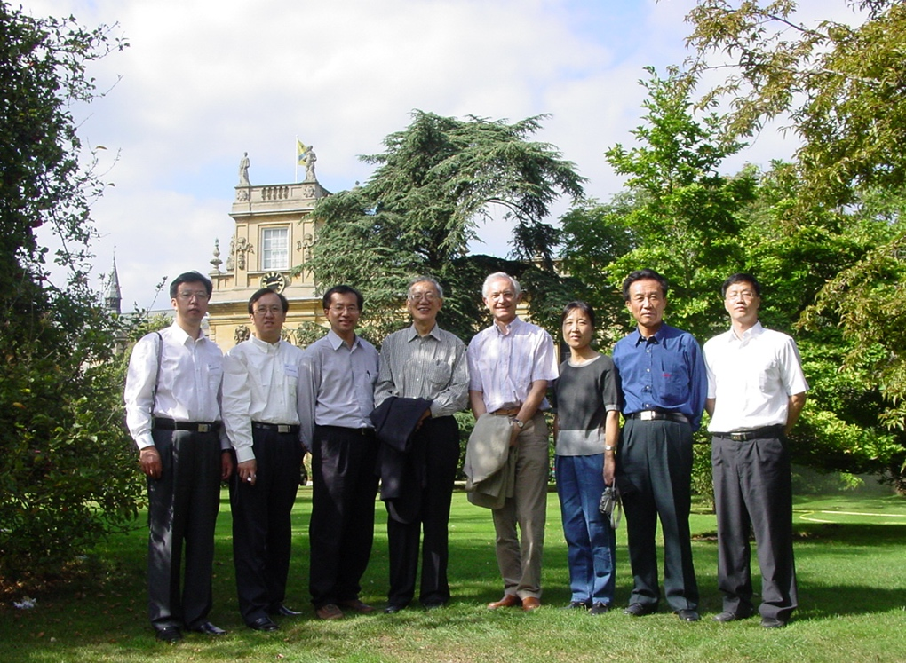
Cherished Memories

Slide 4
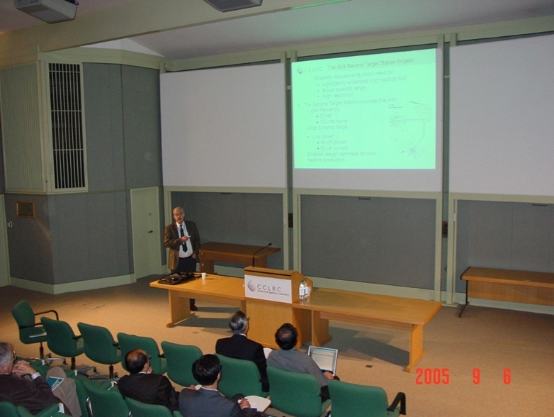
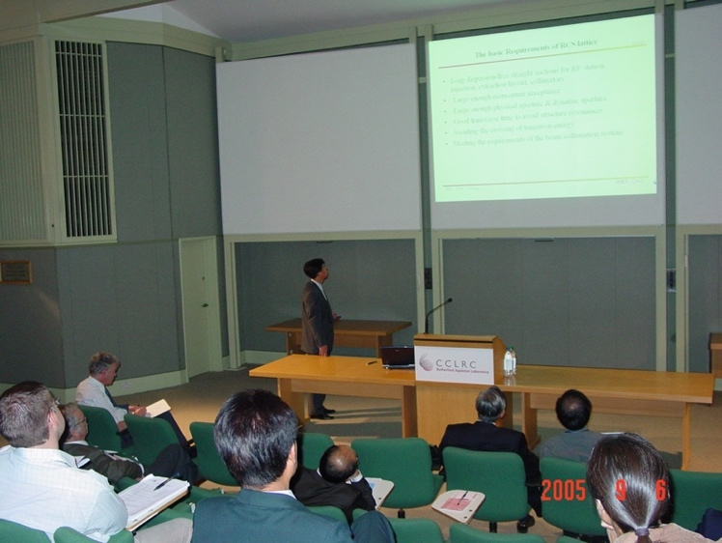
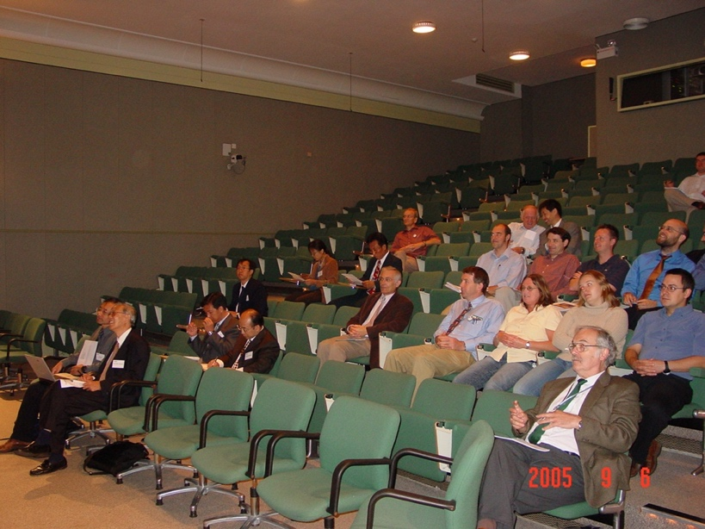
Cherished Memories

Slide 5
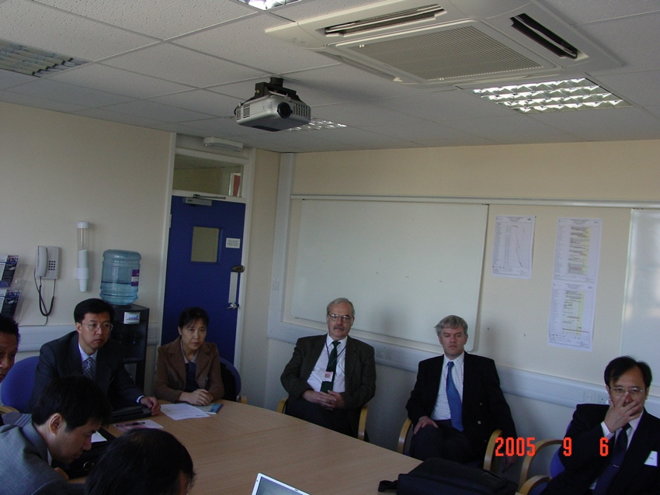
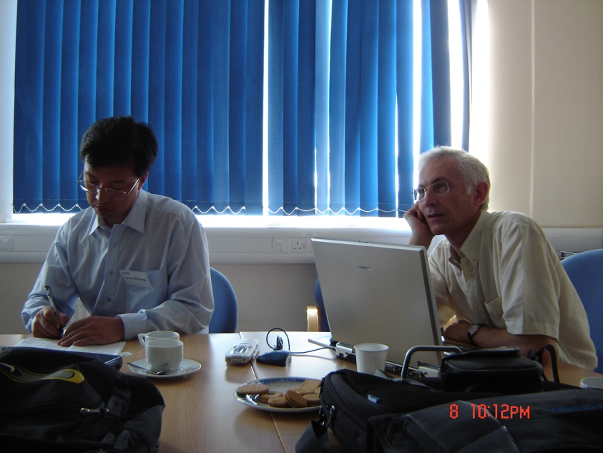
Cherished Memories

Slide 6
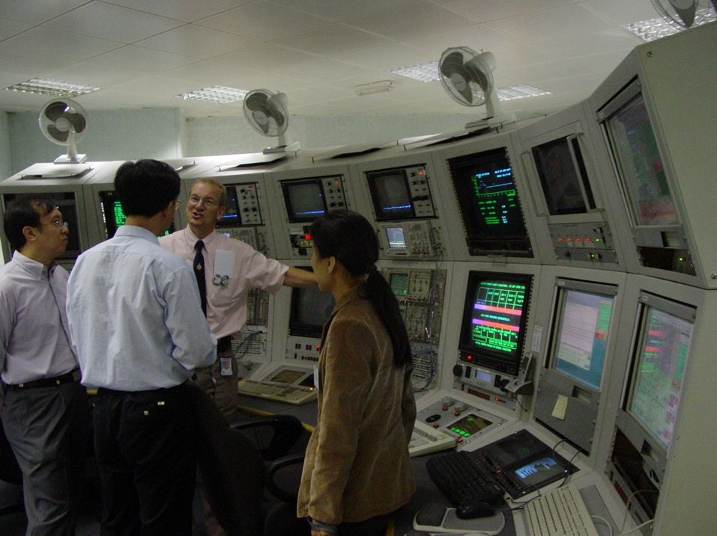
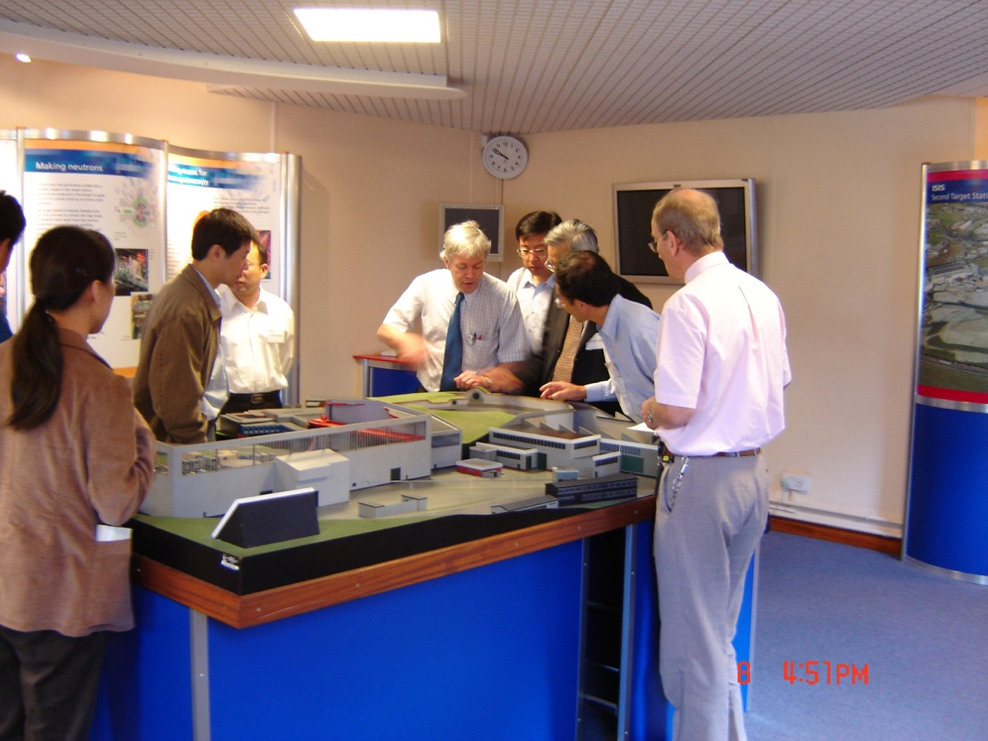
Cherished Memories

Slide 7
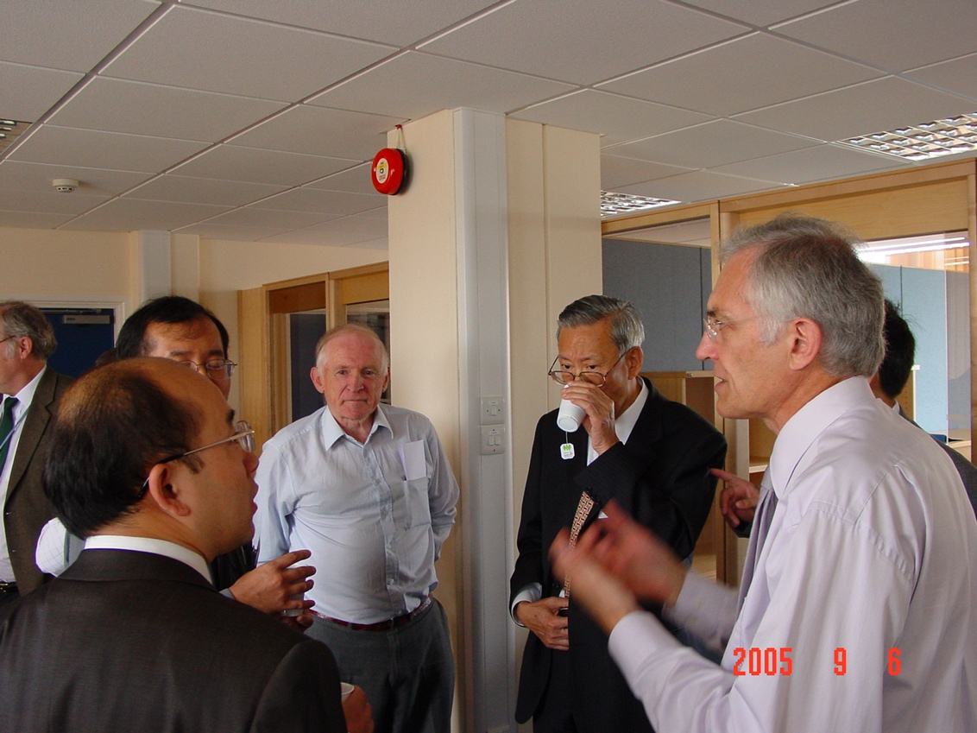
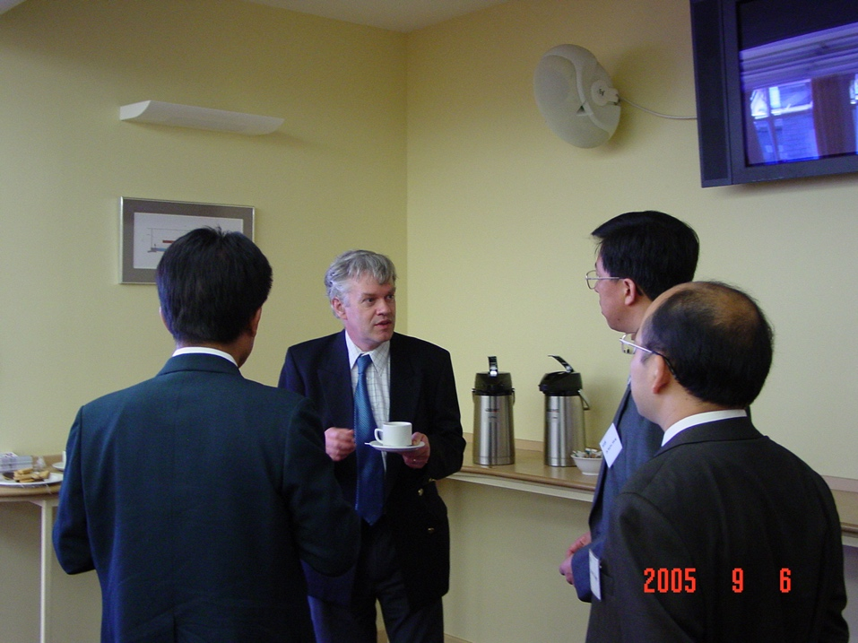
Cherished Memories

Slide 8

Outline
A brief introduction to IHEP
The status of CSNS
The Upgrade project CSNS-II
Tech. transferring and proton beam utilization
Strategic Roadmap
Summary
Notes:
增加一页光源？

Slide 9
Outline
A brief introduction to IHEP
The status of CSNS
The Upgrade project CSNS-II
Tech. transferring and proton beam utilization
Summary

Slide 10
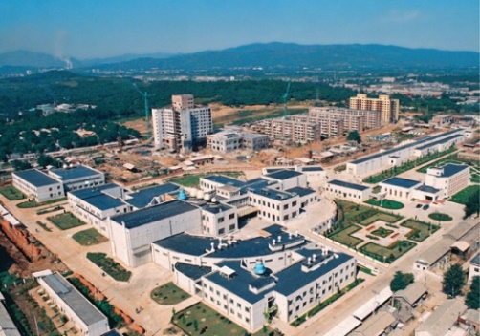
IHEP
Staff: ~1600
Funding:~0.5B$
1950
1953
1958
1973
Institute of Modern Physics
Institute of Physics
Institute of Atomic Energy
Institute of High Energy Physics
IHEP’ real start is from the construction of Beijing Electron Position Collider (BEPC) in 1980’s, and now is a large and comprehensive center for HEP and multidisciplinary research
Frontiers of Basic Science
Strategic High-Tech
Multi-disciplinary research
Particle & Astro-particle Physics
Accelerator Physics
and Technologies
Radiation Technologies
and Applications
Accelerator-based HEP Experiments
Particle Astrophysics & Neutrino Experiments
Particle Detection and Electronics
Particle Physics Theory
High Luminosity Electron Accelerators
High Intensity Proton Accelerators
Applied Research and Technology Transfer
Synchrotron Radiation & Applications
Neutron Scattering & Applications
Nuclear Analytical Techniques & Applications
Three Pillars: Basic science research, Technology R&D, Facility Construction and Management
10

Slide 11

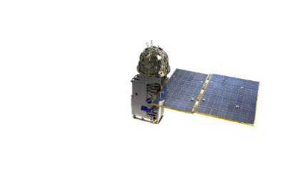
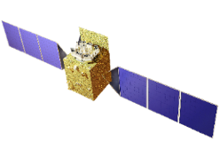
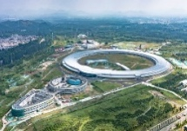
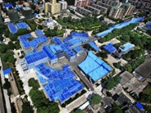
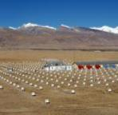
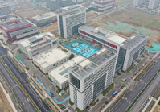
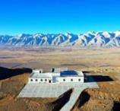
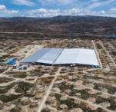
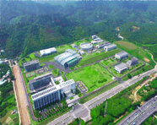
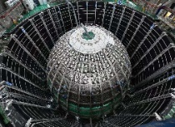
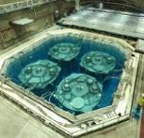
Large Science Facilities at IHEP
Gravitational wave Electromagnetic Counterpart All-sky Monitor (GECAM)
Insight Hard X-ray Modulation Telescope (HXMT)
Huairou Campus
High Energy Photon Source (HEPS)
IHEP，Beijing Campus
Beijing Electron-Positron Collider (BEPC)
YBJ International Cosmic Ray Observatory (retirement)
Jinan Branch
Ali CMB Polarization Telescope (AliCPT-1)
Large High-Altitude Air Shower Observatory (LHAASO)
Jiangmen Underground Neutrino Observatory (JUNO)
Daya Bay Neutrino Experiment(Daya Bay)
(retirement)
Dongguan Branch
China Spallation Neutron Source (CSNS)

Slide 12
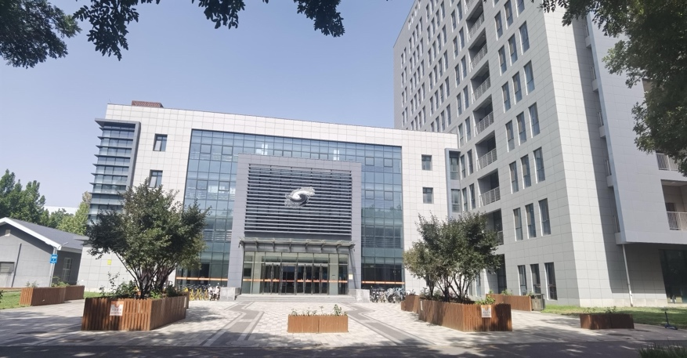
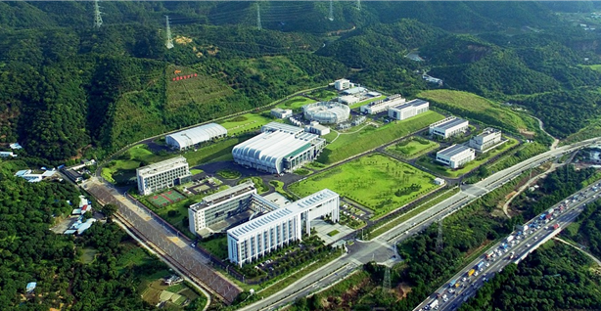
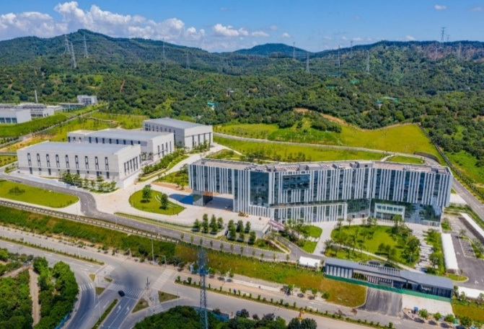
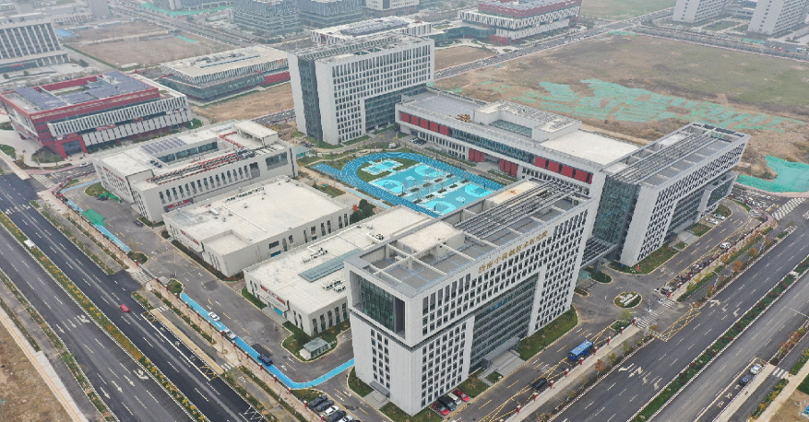
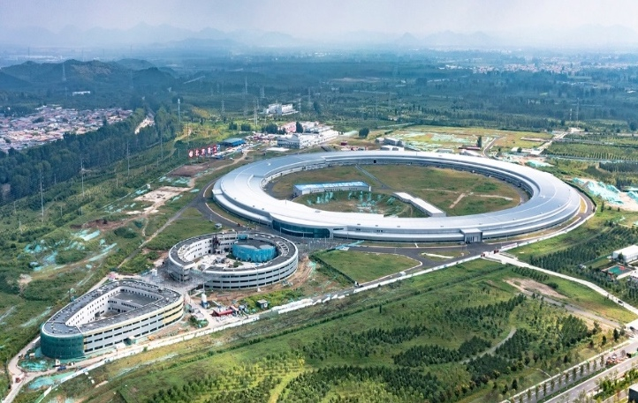
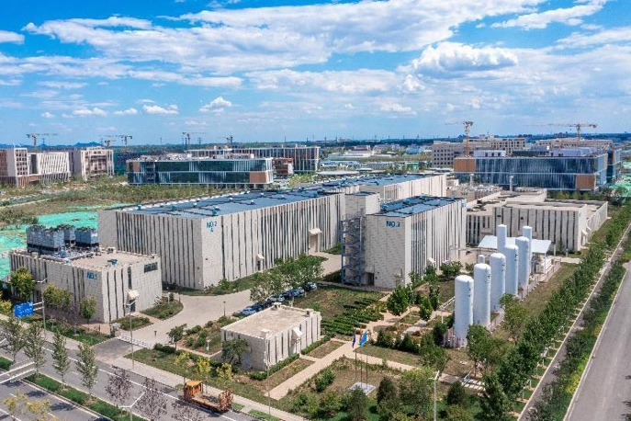
IHEP Campus Development and Improvement
IHEP Yuquan Campus, Beijing City
CSNS & SAPS Pre-Research, Dongguan Campus, Guangdong Province
Jinan Campus, Shandong Province
HEPS & PAPS, Huairou Campus, Beijng City

Slide 13
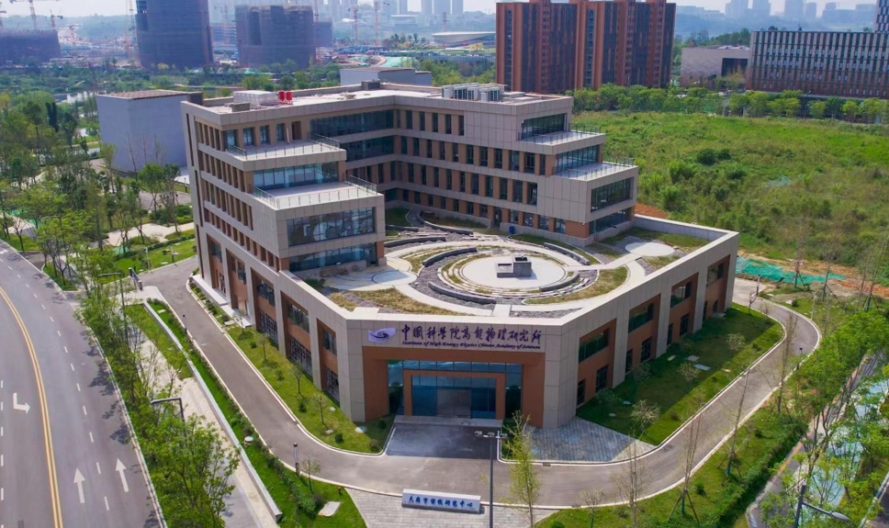
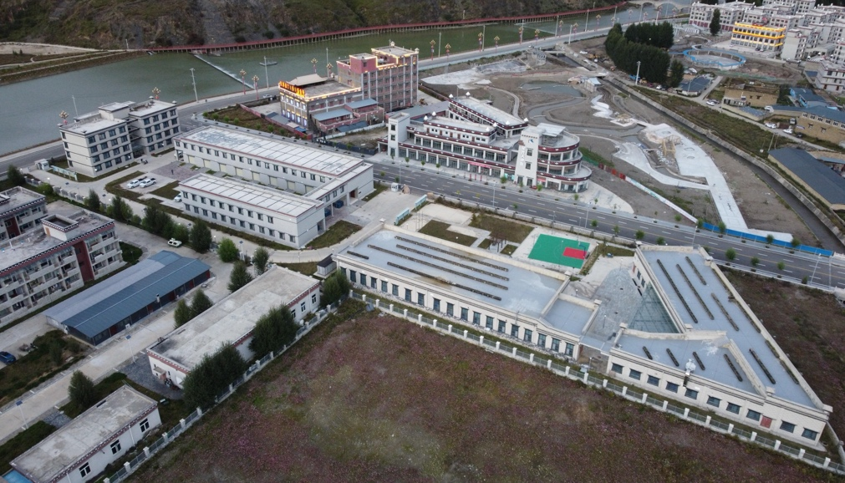
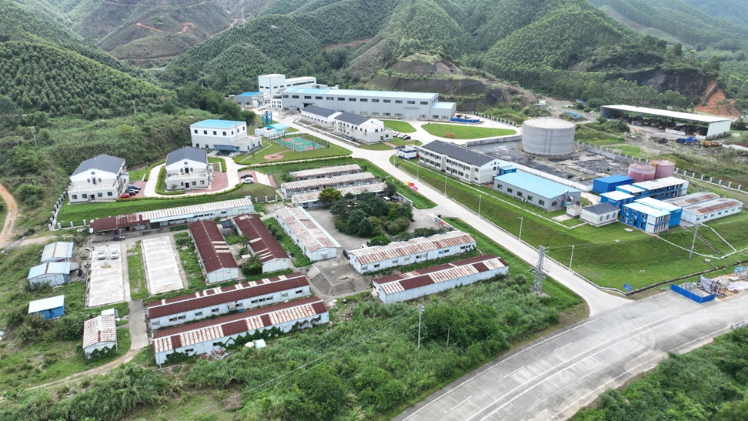
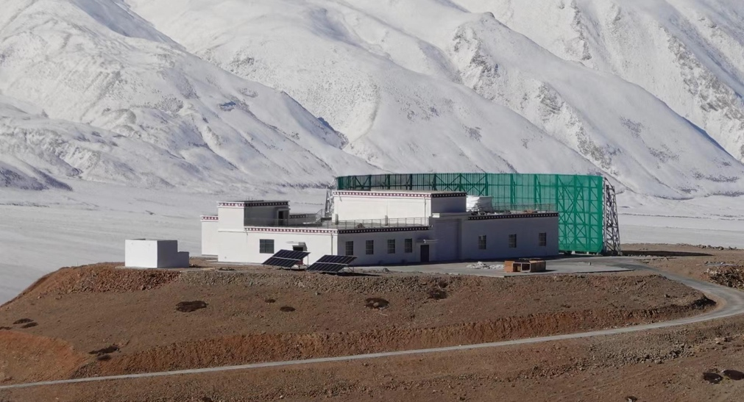
IHEP Campus
TIANFU Cosmic Ray Research Center, Chengdu, Sichuan
LHAASO measurement and control base
JUNO Experiment Campus
AliCPT-1 Experiment Campus

Slide 14
Outline
A brief introduction to IHEP
The status of CSNS
The Upgrade project CSNS-II
Tech. transferring and proton beam utilization
Summary

Slide 15
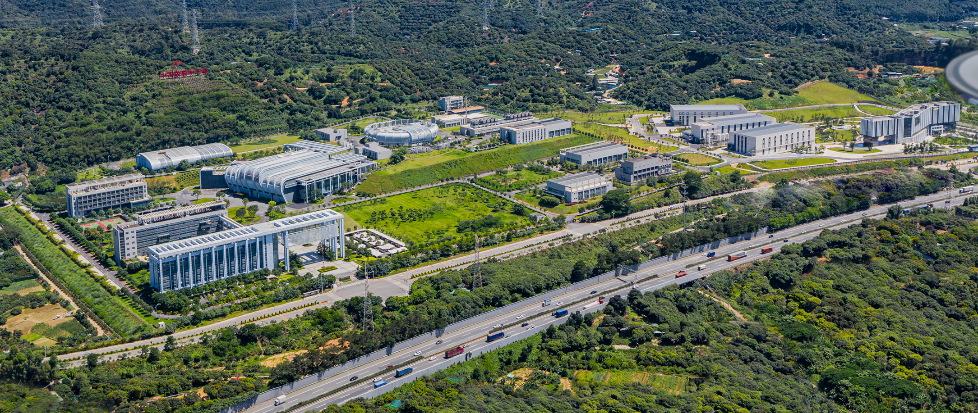
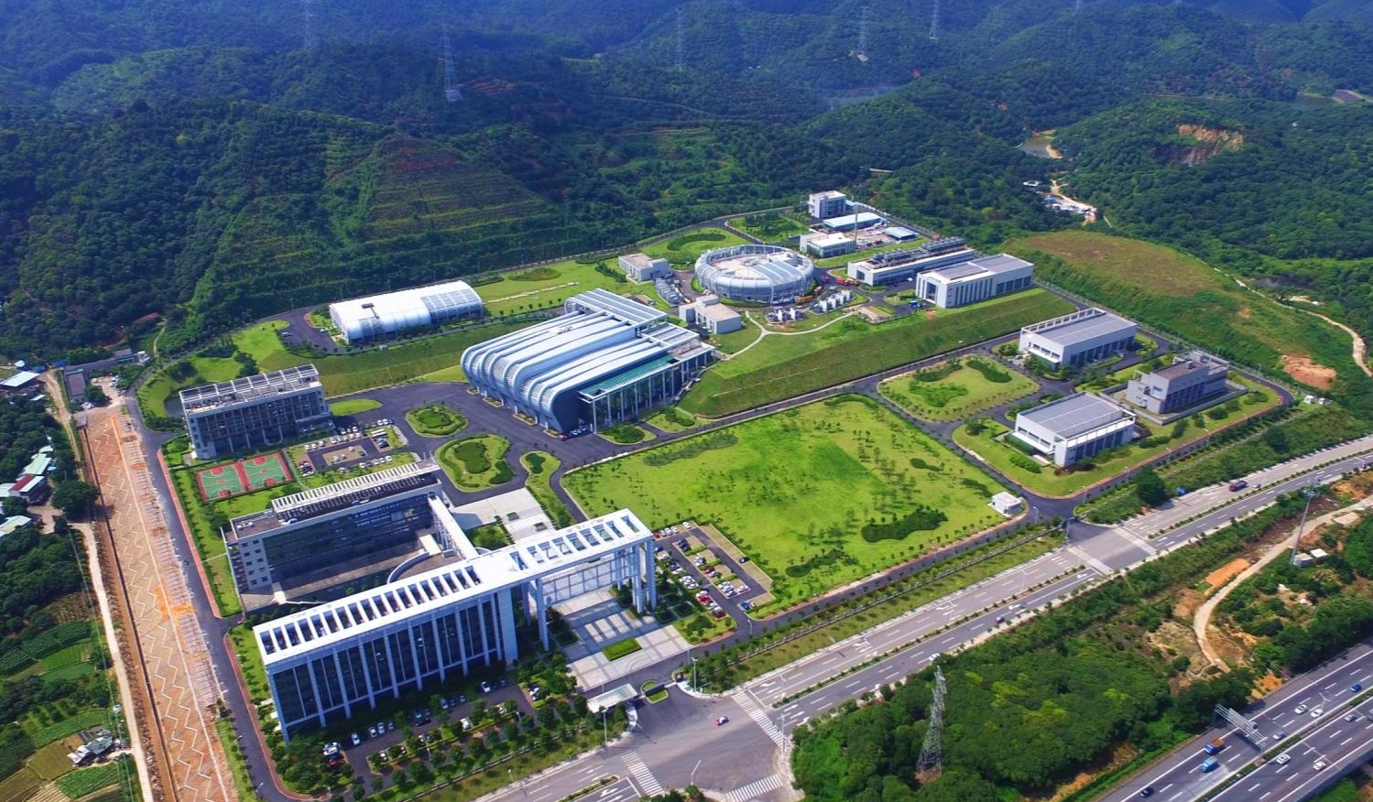

CSNS campus
Proposed at year of 2000
Budget: about 2.2 B CNY
Construction started at Sep. 2011, and finished at Mar. 2018
User program started in Oct. 2018
Beam power increased from 20kW to 170kW
Operation with long user hours and high availability
11 neutron instruments and in user program
Aug. 2024
Aug. 28, 2017
Before ground breaking, May 9, 2009

Slide 16
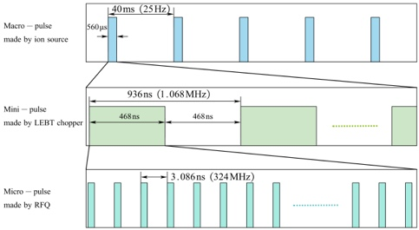
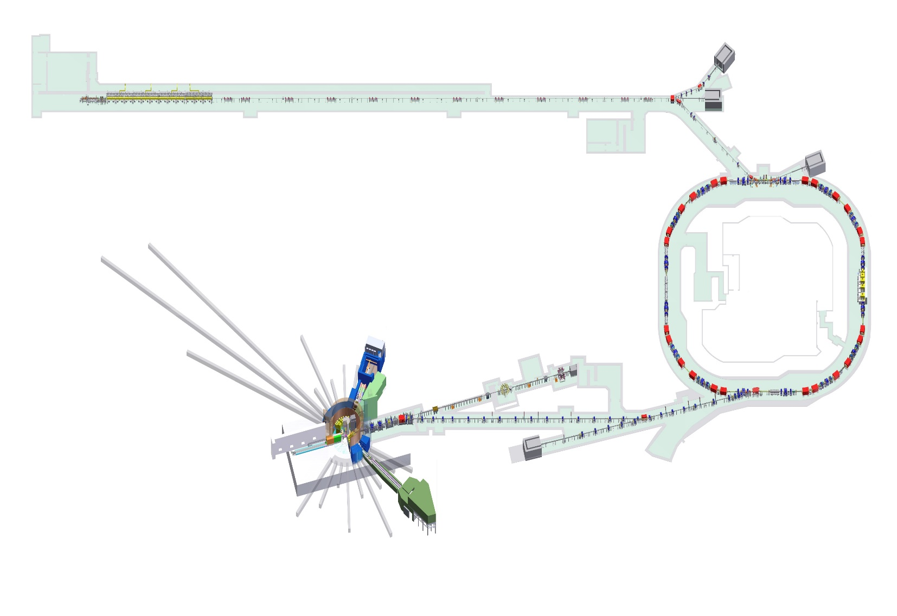
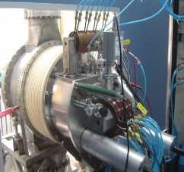
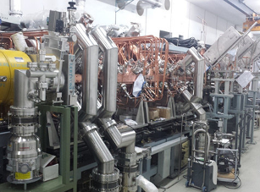
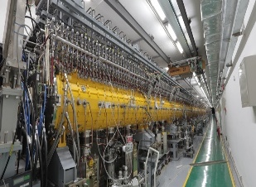
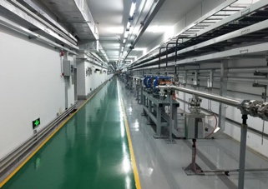
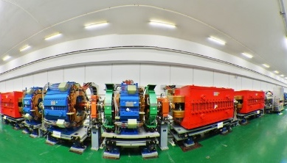
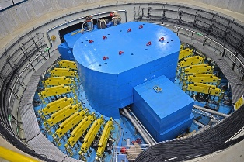
CSNS Facility
0.05 MeV
3 MeV
80 MeV
Ion Source
LEBT
RFQ
MEBT
DTL
LRBT
Beam Power on target [kW] | 100
Proton energy [GeV] | 1.6
Average beam current [uA] | 62.5
Pulse repetition rate [Hz] | 25
Linac energy [MeV] | 80
Linac type | NC
Linac RF frequency [MHz] | 324
Macropulse duty factor | 1.05
RCS circumference [m] | 228
RCS harmonic number | 2
1.6 GeV RCS
RTBT
Target

Slide 17
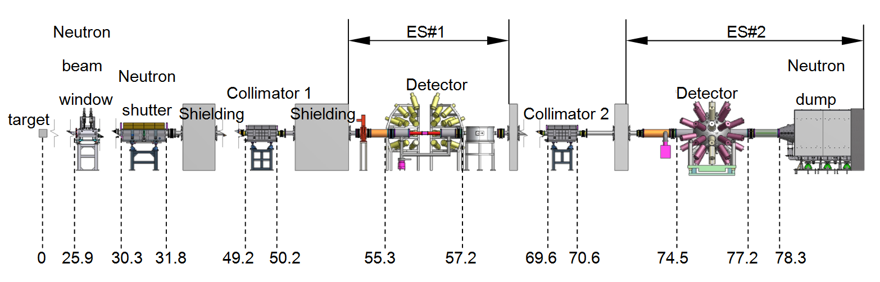
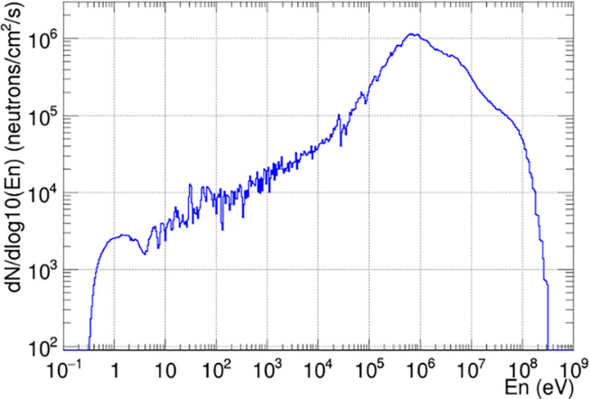
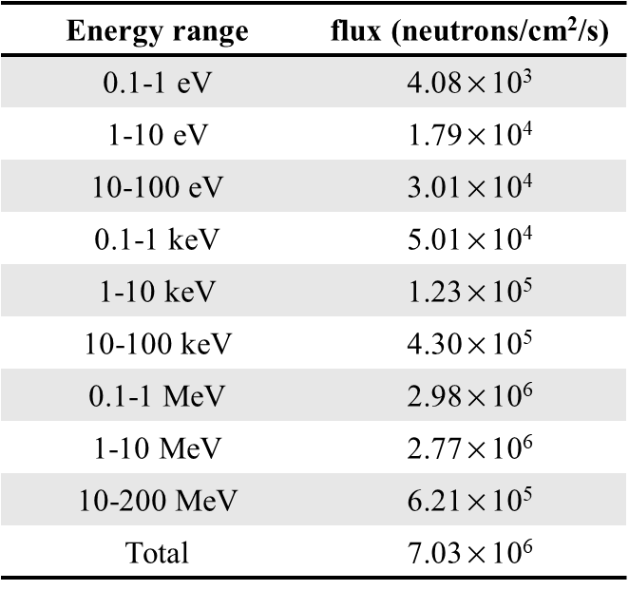
Back-n White neutron source
Layout of the Back-n
neutron
The back-streaming neutrons are leading to the Back-n tunnel
The ES#1: 55m
ES#2: 70m
Thermal neutrons to 300 MeV.
The highest neutron flux: 1E7 n/cm²/s.
different neutron beam spots and fluxes can be obtained by using different collimator
Neutron energy spectrum

Slide 18
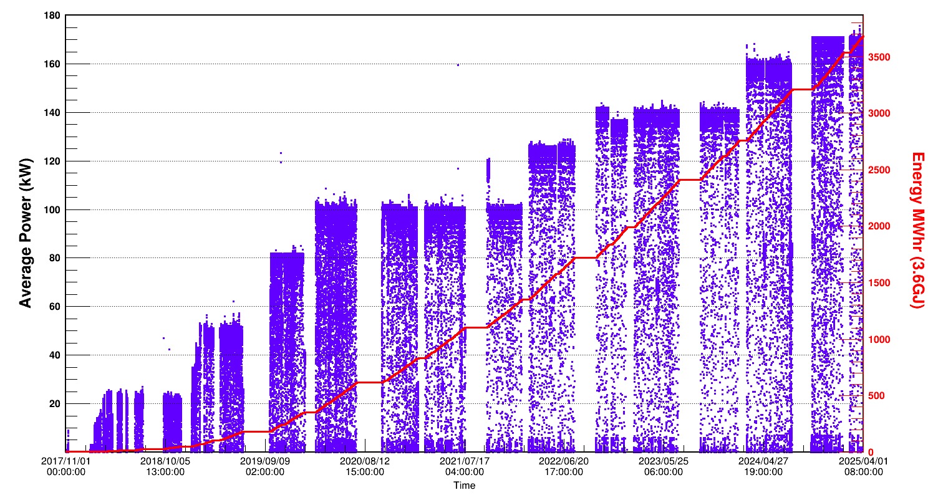
CSNS Beam Power History
170kW
160kW
140kW
125kW
100kW
80kW

Slide 19
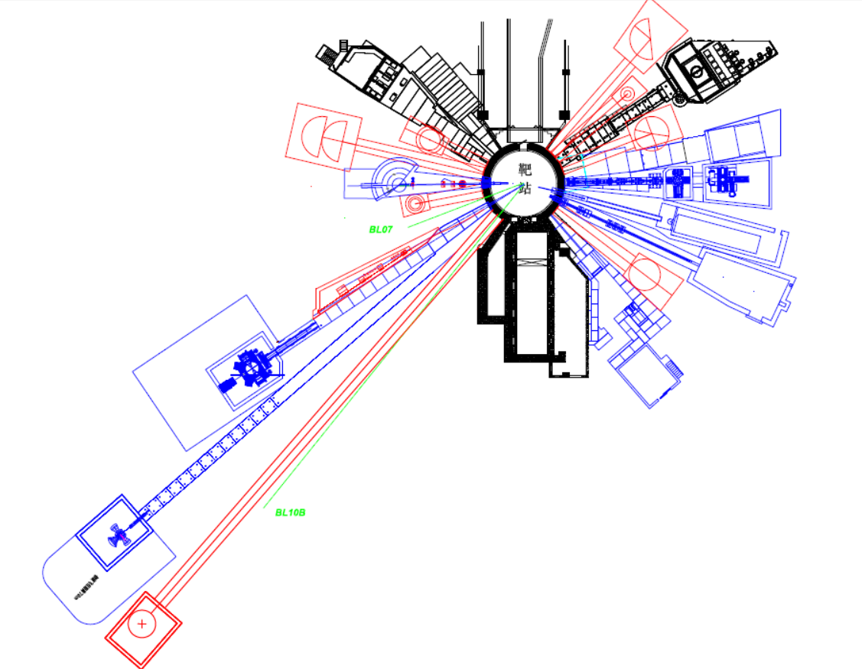
Neutron Instruments
BL16: Multiple Physics Instrument
BL15: High Pressure Diffractometer
BL14: Very small angle neutron scattering
BL13: Energy resolved neutron imaging
BL11: Atmosphere Neutron Irradiation
BL05: High energy inelastic spectrometer
BL08: Engineering Material Diffractometer
BL09: High resolution Diffractometer
3 phase-I instruments
8 cooperative neutron instruments
5 in user program
3 in trail user operation

Slide 20
User Program
https://user.csns.ihep.ac.cn (in both Chinese and English）
Registration user: 8000+ (130+ abroad)
A total of over 2,000 projects from ~240 units were completed, with industry users comprising approximately 10% of the total.
Two rounds of proposal calls each year
User proposal VS. Proposal proved
User publication
20

Slide 21
Research Areas
University：～45%
Research institution：～49%
Enterprise：～6%

Slide 22


International Collaborations
Signed collaboration agreements with 11 institutions
Helmholtz-Zentrum Berlin (Germany)
ISIS Neutron and Muon Source (UK)
European Spallation Source (Sweden)
Paul Scherrer Institute (Switzerland)
Australian Nuclear Science and Technology Organization (Australia) ...
Accepted 86 oversea user proposals
Oxford University (UK)
University of Texas at Arlington (US)
Linköping University (Sweden)
Western University (Canada), etc
22

Slide 23








Examples of Industry Application
Before service
After service
Residual stress of high-speed train wheels
Vehicle battery: inhomogeneity exists during charge and dis-charge
23

Slide 24

Examples of Cutting-edge Fundamental Scientific Research
Ultrastrong steel alloy with high fracture toughness，Science 2020，368, 1347-1352
Carbon dioxide capture molecular sieve，Science, 2021,373,315-320
long-range ordered porous carbon crystals produced from C60，Nature 2023, 614, 95
Decoupling the air sensitivity of Na-layered oxides， Science 2024, 385, 744
CSNS Back-n beamline for nuclear data measurement:
Neutron cross section (fission, capture, etc.) measurement
~55 nuclei have been measured
²³²Th(n, f) cross section in 1-300 MeV
Key cross sections for Thorium Molten Salt Reactor and ADS
The highest energy region of the experimental nuclear reaction database EXFOR.
24

Slide 25
Outline
A brief introduction to IHEP
The status of CSNS
The Upgrade project CSNS-II
Tech. transferring and proton beam utilization
Summary

Slide 26


China Spallation Neutron Source-II
Linac
Project Budget: 2.9 B CNY
Funded by central and Guangdong local government
Design and R&D completed
Construction: 2024.1~2029.10
（5 years and 9 months）
Linac upgrade from 80MeV to 300MeV
Rep. rate (Hz)
Beam power upgrade to 500kW
Rapid Cycling
Synchrotron
(25Hz)
靶站
Replacement of Target for 500kW proton
谱仪
9 new neutron instruments
Proton & muon
Experimental station
11+9

Slide 27
Beam Power Upgrade （two-step）
1. Linac（80MeV）+ RCS upgrade 150~200kW（the first step）
  New dual harmonic RF system
  Adding AC trim quadrupoles, sextupoles and octupoles
  New injection region
2. Linac （300MeV+）+ upgraded RCS 500kW (the second step)
  SC linac to 300MeV
  Upgrade the power supplies for main magnets
27

Slide 28


The Front End of CSNS Accelerator
Double-slit
scanner
RFQ accelerator
H⁻ ion source
Focusing solenoid
H- ion source, LEBT, chopper, RFQ
The LEBT has 3 solenoids, initially designed for the former penning ion source.
The penning source has been replaced by RF-driven H⁻ ion source in Sep. of 2021.
The ion source current is up to 60mA, and throttled to the required value.
New LEBT and new RFQ for CSNS-II is under construction and test in the lab.

Slide 29

RF Driven H- Ion Source
Typical operation parameter
The RF ion source installed in the tunnel
 | CSNS service | Test bench study
Peak RF-power | 31 kW | 25~40kW
H2 flow rate | 21 SCCM | 18~24 SCCM
Repetition rate | 25 Hz | 25 Hz
Plasma pulse width | 680 μs | 500~1000μs
Beam pulse width | 498 μs | 100~600 μs
H- peak current | 37 mA | 50~60mA
Cs reservoir temp | 80~87C | 77~120℃
Service cycle | >330days
Beam energy | 50 keV | 50 keV
Norm. RMS emitt. | Not measured | 0.31π@60mA

Slide 30

Operational Status of RF H- Source
CN New year
Vacuum kept
Summer
Maintenance
CN New year
Vacuum kept
Summer
Maintenance
Target power
1 sample/min
No part changed,
Rinse, re-assemble
IS study
I.S. RF power
1 sample/s
Ion source, 2021.9-2022.7 run cycle,
310 days accumulated, 100% availability
Ion source, 2022.8-2023.07 run cycle,
323 days accumulated, 100% availability
~330 days in
2023-2024 run cycle

Slide 31

New LEBT for CSNS-II
Parameters | CSNS LEBT | CSNS-II LEBT
Length | 1668mm | 738mm
Inner diameter | 138mm | 64mm
RFQ inlet current | ~40mA | 60mA
RMS Emitt. @RFQ inlet | 0.307@37mA | 0.24@52mA
Num. of solenoids | 3 | 2
Length of solenoids | 240mm | 127mm
Stripped proton removal | No deflection | 1.8 degree（3.6 to H-）
Chopper length | 50mm | 27mm
Chopper voltage | 3.8~5kV | 6~8kV

Slide 32



Linac Upgrade
The tunnel reserved is 92m.
The energy gain >2.4MeV/m
 | CSNS | CSNS-Ⅱ
Particle species | H⁻ | H⁻
Pulse repitition frequency(Hz) | 25 | 25+25
Linac beam energy (MeV) | 80 | 300
Average current(μA) | 62.5 | 625
Peak current (mA) | 15 | 50
Pulse width(μs) | 500 | 500
Special requirements;
Energy jitter <0.04%
Energy spread: <0.03%
High availability (>97%)

Slide 33



Horizontal testing
See Huachang’s report
cryostat
Vaccum
system
Alignment
system
coupler
Eacc:
1# 12.8MV/m
2# 15.2MV/m
Valve box
The successful integration of the cryostat and the completion of the high-power conditioning process for the couplers mark significant milestones.
Horizontal testing yielded promising results with a maximum gradient of 15.2 MV/m and a static heat load of 16.3 W.
Further measurements are required to accurately determine the dynamic heat load.
33

Slide 34





6-cell Elliptical cavity
648 MHz 6-cell Elliptical Cavity
parameter | design
Frequency(MHz) | 648
TTF@β_{g} | 0.7
β_{g} | 0.62
E_{p}/E_{acc} | 2.53
B_{p}/E_{acc}(mT/(MV/m)2 | 5.45
R/Q（Ω） | 309
G（Ω） | 177
Beam tube diameter（mm) | 105/120
Cell-cell coupling（%） | 1.35
E_{acc}(MV/m) | 14
mechanical structure of prototype ellipsoidal cavity
BCP and HPR
The flatness of the electric field is 97.9%.
During testing, the highest gradient reaches 21.7 MV/m
34

Slide 35


324MHz SSPA for Spoke Cavity
Combiner 2:1
6-1/8” Coaxial cable
RF output 300kW
PA modules:
32*12kW
Quick-plug
Pre-driver
Combiner 2:1
Power –splitter
1:8
Monitoring and
control system
Combiner 8:1
DC power supply
Quick-plug
300kW
Total foot print: 3m²

Slide 36





Prototype of Solid-state Modulator

Slide 37

648MHz Klystron
648MHz Klystron Specifications
Operating Frequency
Band Width(1dB)
Peak Power
RF Pulse Width
Repetition Rate
Efficiency
Gain
Cathode Voltage
648MHz
±0.5MHz
>1.2MW
1.2ms
50 Hz
>50%
>45dB
<105kV

Slide 38


Debuncher System
Two Debuncher cavities:
DBUNCH-1 reduces beam energy jitter
DBUNCH-2 controls energy spread
Parameters | Value
Beam Energy at the End of SC Linac | 300 MeV
Repetition Frequency | 50Hz
Debuncher Cavity-1 Frequency | 648 MHz
Debuncher Cavity-1 Aperture | 70 mm
Debuncher Cavity-1 ETL | 3.3 MV
Debuncher Cavity-2 Frequency | 648 MHz
Debuncher Cavity-2 Aperture | 70 mm
Debuncher-Cavity-2 ETL | 1.0 MV
Reducing Ratio of Momentum Jitter | 77.3%
Minimum ∆P/P at the end of Linac (99.5%) | 0.35‰

Slide 39



Challenges of LINAC SRF LLRF
Challenges at CSNS-II LINAC LLRF
  Higher Amp/phase stability requirement: ±0.3%, ±0.3° compared to ±1%, ±1° at CSNS
  Higher beam loading effects(>30mA)
  Large quantity:Several tens of LLRFs, several hundred of hardware, and several thousand parameters
  Disturbances from ripple in high voltage
  Long-term stable running is required
Ripple from HV at Debuncher phase
(>±2°，PI Feedback on)
High beam loading
Ripple of high voltage

Slide 40



RCS Design
  Arcs: Triplet cells as achromatic insertion
  Straights: Triplet, 3.85×2+11 m long drifts at each straight
  Gap of Dipole : 160mm
  Max. Aper. Of Quadrupoles: 265mm

Slide 41

RCS Injection
Injection component layout. BC1~BC4：Fixed orbit bump magnets，BH1~BH4：horizontal painting bumpers，BV1~BV4：vertical painting bumpers，ISEP1&2: septum

Slide 42


Accelerator physics design for CSNS-II
New idea: chicane bump and horizontal painting bump are combined into one bump which make the chicane bump "move“. The horizontal painting is performed by using the position and angle scanning at the same time.
Advantages:
Peak temperature of the stripping foil can be greatly reduced.
Both correlated and anti-correlated painting can be performed.
The edge focusing effect of bump magnets is greatly reduced
The difficulty of large aperture of the injection port and transport line required by angular scanning is solved.
It saves a set of bump magnets and is easier to optimize the layout of the injection system.

Slide 43



Upgrade of RCS Injection System
CSNS-II Injection
Installing…
dismantling
CSNS Injection
Jun. 20- Aug.31

Slide 44



MA Cavity
1.8m 3 gaps water-cooling cavity with external diameter 850mm MA rings
2 cavity were put into operation in 2022 and 2023
Gradient >50kV/m on second hormonic mode ( 15% duty factor )
Gradient >25kV/m on fundamental hormonic mode ( 50% duty factor )
Cavity impedance is stable after long-term operation ( variation < 3% )
30kV/gap
90kV / cavity
2022.09
2023.08

Slide 45

Neutron Instruments for CSNS-II
1.6 GeV proton
Location | Instrument
BL01 | Small Angle Neutron Scattering
BL02 | Multiple Purpose Reflectometer
BL03 | Liquids Neutron Reflectometer
BL04 | Cold Neutron Inelastic Spectrometer
BL05 | High Energy Direct Geometery Inelastic Spectrometer
BL06 | Molecular Vibrational Spectrometer
BL07 | Reserved
BL08 | Engineering Material Diffracmeter
BL08A | Neutron Technology Testing Station
BL09 | High-resolution Neutron Powder Diffractometer
BL10 | Neutron Backscattering Spectrometer
BL10A | Reserved
BL11 | Atmosphere Neutron lrradiation Spectrometer
BL12 | Neutron Physics and Application Instrument
BL13 | Energy-resolved Neutron lmaging Instrument
BL14 | Very Small Angle Neutron Scattering Instrument
BL15 | High Pressure Neutron Diffractometer
BL16 | Multi-Physics Instrument
BL17 | Elastic Diffuse Scatting Spectrometer
BL18 | General Purpose Powder Diffractometer
BL19 | Single Crystal Neutron Diffractometer
BL20 | PolArized Chopper Spectrometer
BLUE——Day-one Instruments
BLACK——Cooperative Instruments
RED——CSNS-II Instruments
PINK——Reserved

Slide 46
Application Area of CSNS-II
The existing instruments cover some structural applications
The Phase II spectrometers will cover the majority of user demands in various fields, enabling characterization of structures and dynamic measurements.
1eV
Molecule
Vibration
100meV
Crystal field
Dynamics
(Inelastic)
10meV
Spin wave
Liquid motion
Lattice
vibration
1meV
Election-phonon coupling
100meV
Molecule motion
10meV
Biology Diffusion
Critical phenomena
1meV
Amorphous
Structure
(Elastic)
Residual Stress
alloy
MOF
polymer
protein
CSNS phase-1 Inst.
powder
Liquid Film
Magnetic
Film
Cooperation&CSNS-II inst.
Single crystal
10⁻⁴
10⁻³
10⁻²
10⁻¹
1
10¹
10²
(nm⁻¹)

Slide 47

Utilization of High Energy Proton beam
A rotated scatter is used to extract the proton beam from RCS before main beam extraction. A energy degrader in beamline is used to adjust the proton energy in 0.8-1.6 GeV.
Two test terminals, a control room and detector test area will be constructed in hall.
Five advanced measurement devices for measurements of proton energy, position, T0 signal and beam-spot and flux monitor.
Scatter
Detector | Parameter name | Value
T0 Trigger | Time resolution | ≤1ns
Telescope device | Layer number | 6
 | Pos. resolution | ≤ 10μm
Energy measurement | Det. size | 2cm*2cm
 | Energy range | 0.8~1.6GeV
Beam spot measurement | Pos. resolution | 150μm
Flux measurement | Det. size | ≥10mm×10mm
 | Range | 1-10000

Slide 48

Muon Experimental Station
Proton Beam
SMBT
SMT2
NMBT
DMBT
Waste Target
NMT
Reserved
SMT1
Control room
Water Cooling system (underground)
DMT2 Reserved
DMT1 Reserved
Sampling room

Slide 49
Progress in Target development
The neutronics performance of the Target-Moderator-Reflector (TMR) assembly has been analyzed. The TMR are optimized for the high neutron efficiency of the target station. The abnormal cases (loss of the coolant accident, unexpected power outage..) are evaluated under 500kW.
The target system has completed the development of zirconium coated tungsten target plate and operated in CSNS.
The moderator and the reflector are about to complete the manufacturing process review, and will move on to the product manufacturing stage.
The engineering design of cooling water system has basically completed. The deuteration platform is being constructed to evaluate the efficiency of the deuteration efficiency of resin.
The cryogenic system has completed the bidding process for the 3 kW@20 K helium refrigerator. Performance and stability tests of the test cold box were successfully carried out.
Physics design of Muon Source has been reviewed by the International Review Committee and the engineering design has been finished.

Slide 50




Progress in Target development
The W-Ta-Zr coating techniques have been developed and this sandwich structure plates have been operated in CSNS TS successfully.
Optimize the welding parameters of the moderator and reflector vessels. The manufacturing process review will be completed in this month.
TMR design for the high neutron efficiency of TS
W-Zr and W-Ta-Zr target plates
TIG Welding for reflector vessel
Notes:
Zirconium
Tantalum
Temperature of Isostatic Pressing
ZrW forms brittle phases

Slide 51




Progress in Spectrometer Development
Physical Design have been completed, and Neutron devices under development.
9 Neutron Instruments
1 Muon station
1 Proton station
Neutron Detector
3He PSD array, Scintillator, Ceramic GEM, nMCP and Imaging detector coupled with Timepix4 camera.
Neutron optics
neutron guide, bulk insert system, secondary shutter, nonmagnetic slit
Chopper
T0 chopper, Disk chopper and Pulse sharping chopper

Slide 52





CSNS-II New Buildings
Linac and Cryogenic Building（CSNS-II）
Temporary Storage Hall for Solid Radioactive Waste
Neutron Backscattering Spectrometer Hall
Muon and High-energy Proton Beam Experimental Hall
User Laboratories Hall

Slide 53





Progress of Civil Engineering
Notes:
Radioactive waste temporary storage hall

Slide 54
CSNS-II CPM
During the construction period, the open operation is minimally impacted due to the implementation of a well-planned installation and commissioning plan.
2029.10
construction completion
2024.9
Construction
started
2024.12
Neutron Backscattering Spectrometer Hall completed
2025.11
Linac and Cryogenic Building completed
2026.7
High-energy Proton Beam Experimental Hall completed
2024 | 2025 | 2026 | 2027 | 2028 | 2029
2024.1
Initial approval
2025.7
Injection device Installation
2025.12
Beam Power=200kW
2029.1
Instruments commissioning
2029.7
Beam Power=300kW
From Jul to Sep every year(except 2028),
Equipment Installation
2027.7~2028.4
Shut Down time for installation
2028.12
Complete Installation
Plans to maintain user operation almost unaffected during CSNS II construction
54

Slide 55
Outline
A brief introduction to IHEP
The status of CSNS
The Upgrade project CSNS-II
Tech. transferring and proton beam utilization
Summary

Slide 56




Technology Transfer: development of BNCT
Accelerator based neutron source + boron-based drugs
Binary targeted and cell-level precision radiotherapy combined with drugs
Test facility: RFQ+Lithium target，developed at the CSNS campus, used for cell and animal test
boron-based drugs
t
Thermal neutron
Thermal
neutron
t

Slide 57



D-BNCT02 Clinical Facility
Delivered to Dongguan People’s Hospital
Installation and accelerator commissioning completed
Clinical trials will start soon
Clinical treatment will start in 2026
57
57

Slide 58


Production of α Isotopes using CSNS Linac
Rep. rate:
25 50Hz
Beam energy:
80 300MeV
Beam power:
5 100kW@25Hz
80 MeV H⁻ DTL+SC LINAC （300MeV）
1.6 GeV
25 Hz
Ra-223、Ac-225、Pb-212，etc

Slide 59
Outline
A brief introduction to IHEP
The status of CSNS
The Upgrade project CSNS-II
Tech. transferring and proton beam utilization
Strategic Roadmap
Summary

Slide 60

Southern Advanced Photon Source（SAPS）
The 4th generation medium-energy (3.5GeV) diffraction-limited storage ring
Attosecond coherent pulses Embedded with SAPS
SAPS will be located next to CSNS（Neutron technique + X-ray technique）
SAPS research and test platform finished
R&D on key techniques
Plans to start construction during next 5 years
The proposed SAPS
SAPS platform
CSNS
60

Slide 61


Post-CSNS-II Plan

Slide 62
Summary
CSNS (China Spallation Neutron Source) opened to users in 2018. Currently, CSNS operates at 170 kW with high availability, reliability.
Some nuclear physics experiments were conducted utilizing Back-n.
CSNS-II has already begun construction, aiming to increase the beam power to 500 kW. It will also involve the development of more neutron spectrometers, as well as muon and high-energy proton experimental stations.
In addition to neutron scattering applications, other beam utilizations based on the CSNS accelerator are currently underway or planned for development.

Slide 63
Thank you for your attention!

