Slide 1
Stripping Foil Studies
Hayley Cavanagh
CSNS Meeting – 23rd July 2025

Slide 2
Outline
Introduction and Motivation
Aluminium Oxide Foils
Carbon Foils
Diamond Foils
Future…

Slide 3
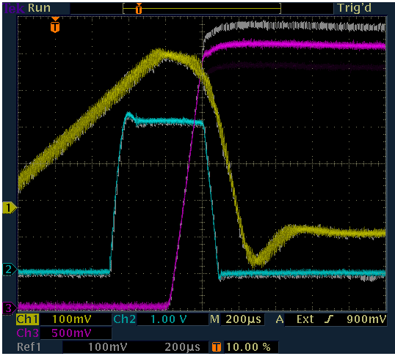
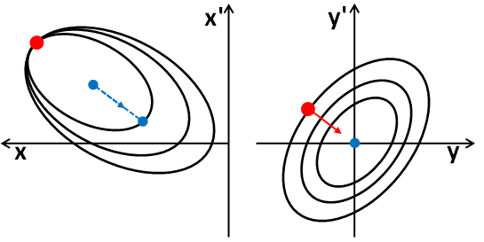
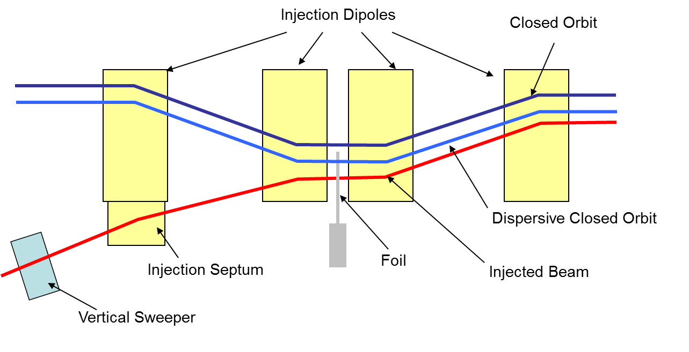
Introduction and Motivation
  Multi-turn charge exchange injection at 70 MeV
  Accelerator upgrades
Inject high intensity beam, up to 3x10¹³ ppp, in 200 µs (~133 turns)
65 mm horizontal bump
Horizontal painting with failing sinusoidal main magnet field
Vertical painting with programmable dipole
200 µs
Beam Intensity
Vertical Sweeper
Injection Dipole

Slide 4
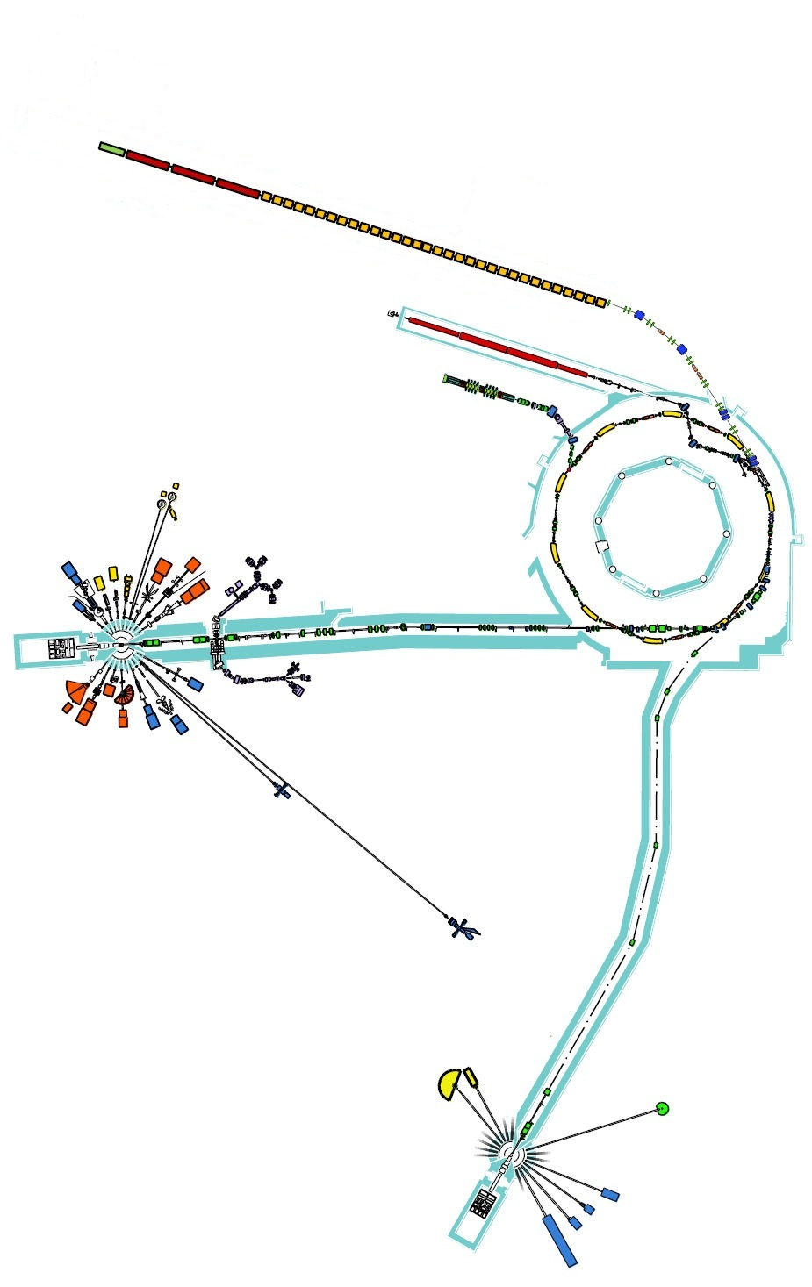
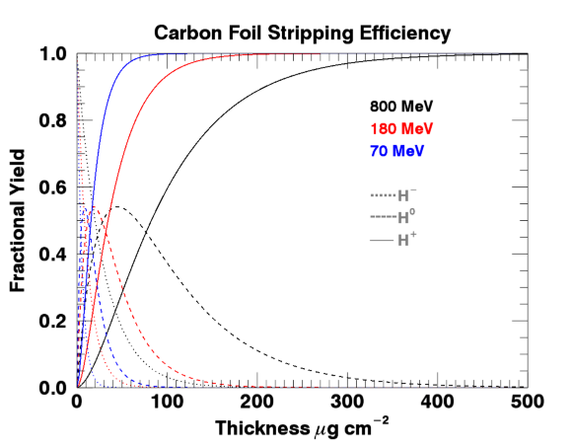
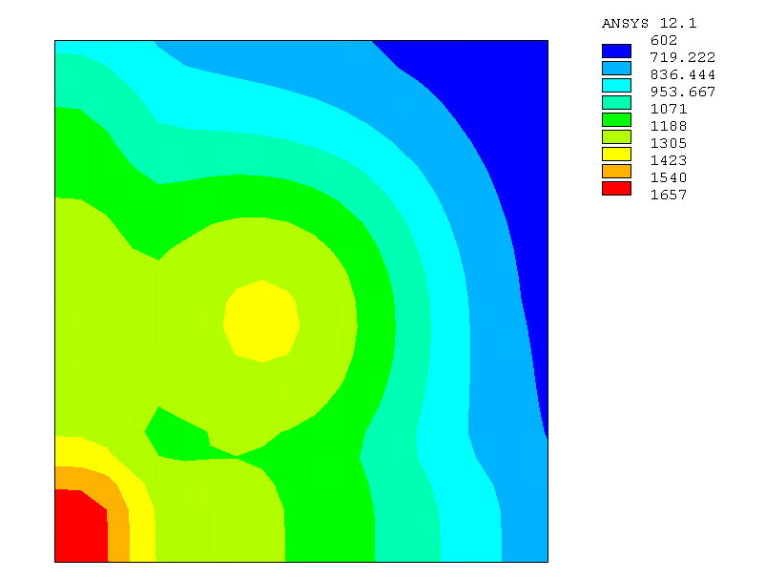
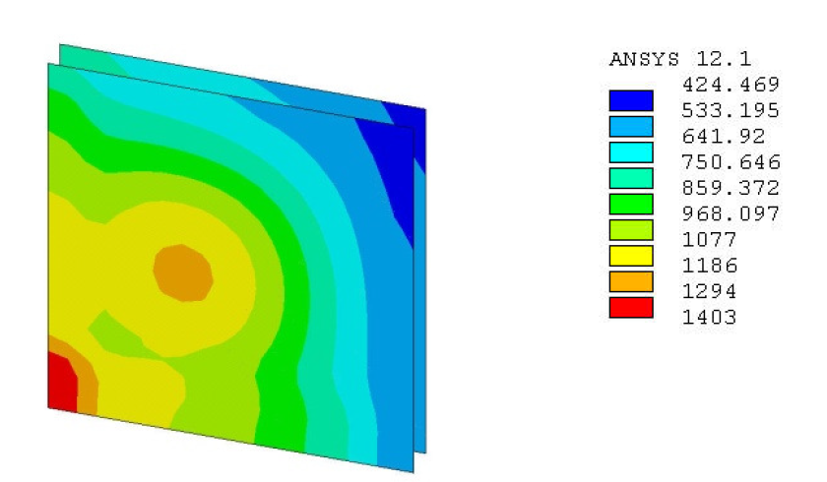
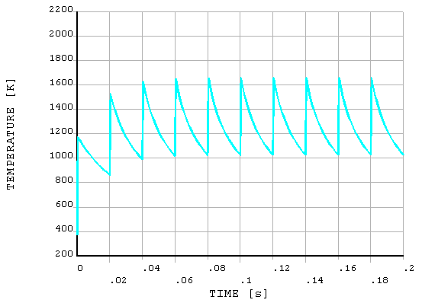
Introduction and Motivation
  Multi-turn charge exchange injection at 70 MeV
  Accelerator upgrades
Initial studies as part of 180 MeV injection project showed that aluminium oxide foils used on ISIS at 70 MeV would not withstand expected temperatures
Proposed 180 MeV Linac
70 MeV Linac
800 MeV
RCS
Considered carbon foils as a good compromise material between maximising stripping efficiency and minimising beam scattering and foil temperatures

Slide 5
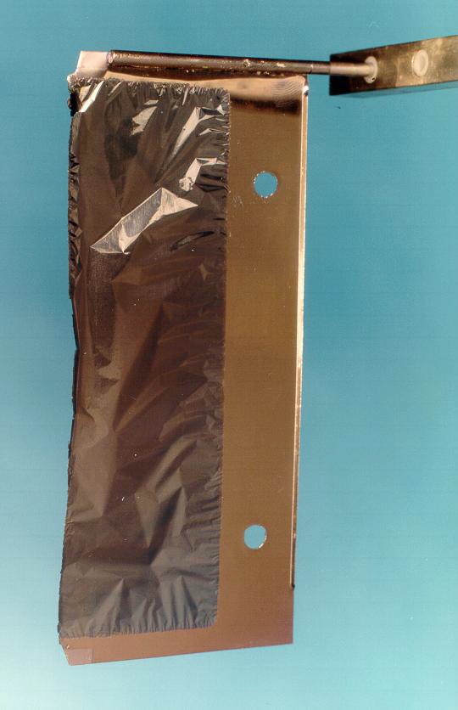
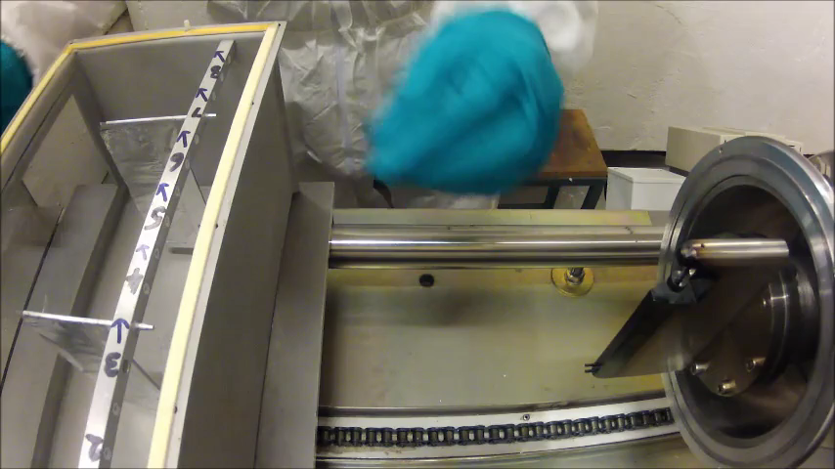
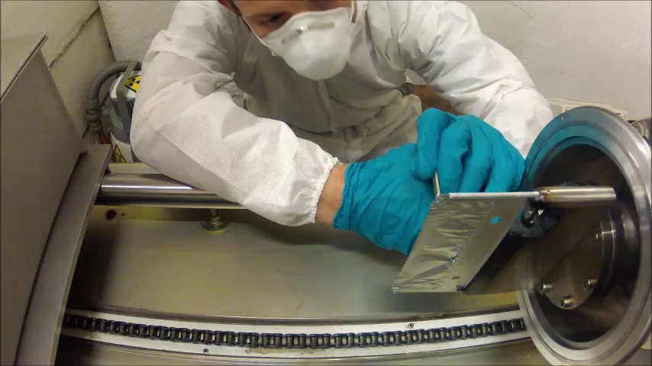
Aluminium Oxide Foils
Al₂O₃ foils were manufactured ‘in-house’, taking ≈20 hrs per foil, however ≈90% foils failed before last stage of manufacture
The foils were very fragile and needed to be cut when installed to reduce tension
The bottom leading corner was left connected, the bottom edge and half height were released from the frame, ≈75% failure on installation
Cut during production
Mounting foil
Cutting foil
Cut when installed

Slide 6
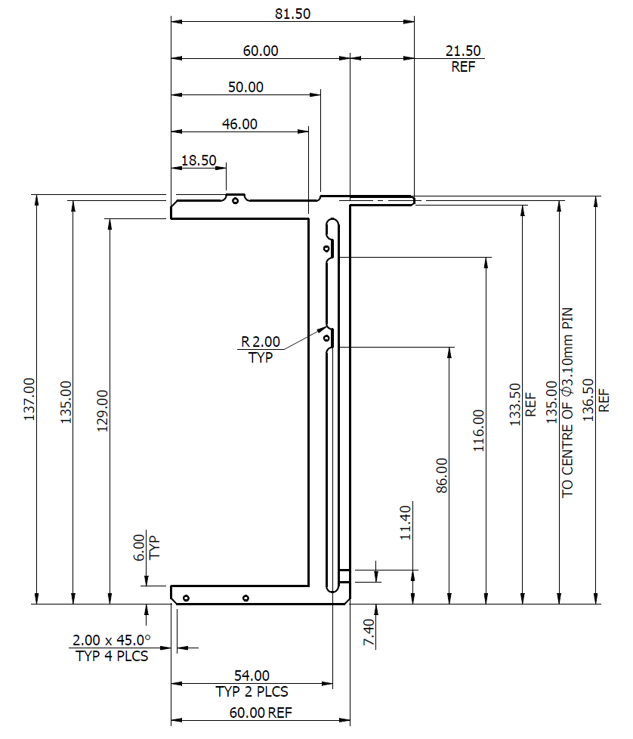
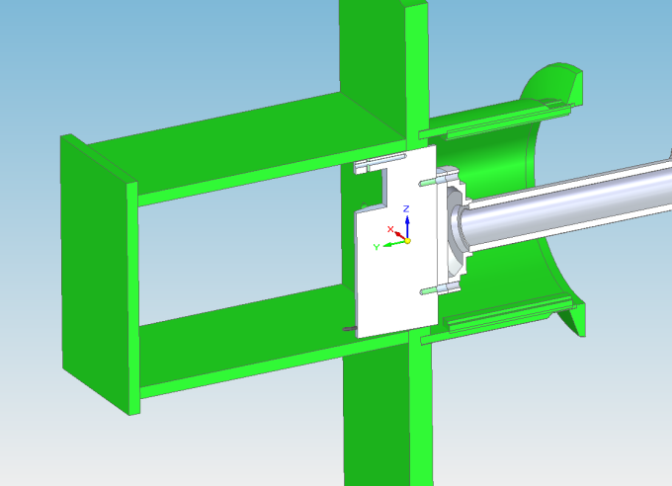
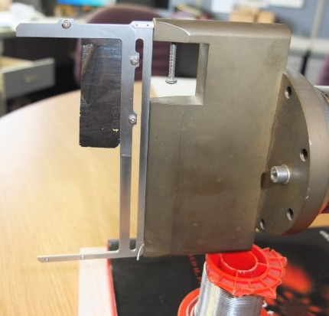
Carbon Foils
  Other labs: J-Parc, CERN, CSNS
  Tests and developments (fibres, annealing, residual nuclei, graphene, electron gun, aerogels)
  Operations
Communicated with other labs using DLC/HBC foils, J-Parc, CERN PSB, CSNS (2016!)
Design and manufacture new foil bracket
Test mounting of small CSNS foil on spare foil change mechanism
Mounting pin hole
Motor drive
Guide slot

Slide 7
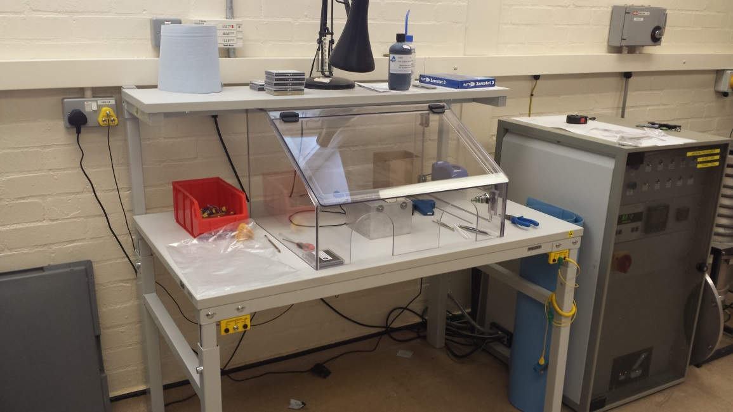
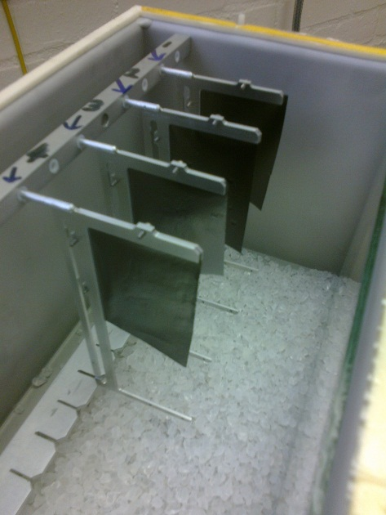
Carbon Foils
  Other labs: J-Parc, CERN, CSNS
  Tests and developments (fibres, annealing) and operations
Developed mounting area in R52 foil preparation laboratory
Successfully mounted larger 60 x 40 mm DLC foils for machine physics, but experienced curling under beam
Perspex shield to reduce air flow
Anti-static guard and anti-static gun
60 mm
40 mm
Aluminium positioning jig

Slide 8
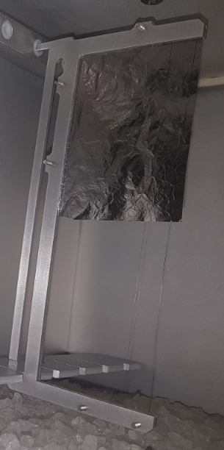
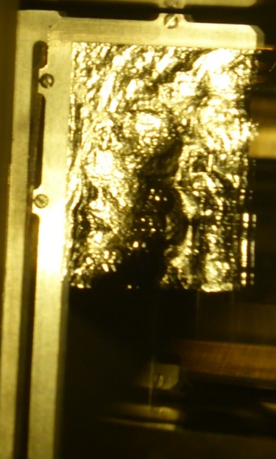
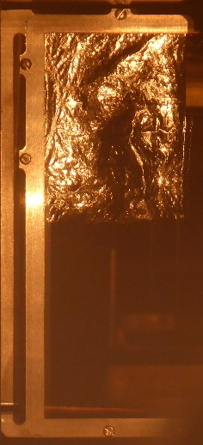
Carbon Foils
  Other labs: J-Parc, CERN, CSNS
  Tests and developments (fibres, annealing) and operations
SiC fibres
Annealing
Averaged ~100 mAh/foil, so use x2/cycle
10 µm carbon fibres, Aquadag and clamped
Varied arrangement and number of fibres
70 MeV foil temperature ≈500 K so anneal at 670 K for 2 hrs (+2 hr ramp up and down)
DLC foils annealed at Micromatter 430-510 K for 2-4 hrs depending on foil condition…
DLC with fibres after 3, 15 and 117 mAh
Annealed foil after 0, 1.64 and 15 mAh

Slide 9

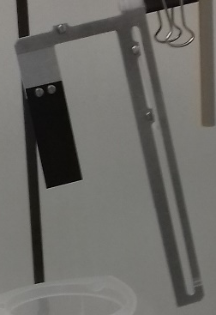
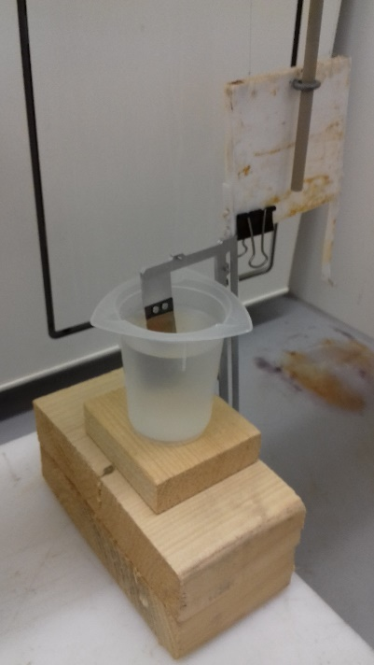
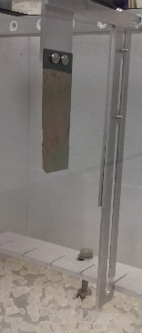
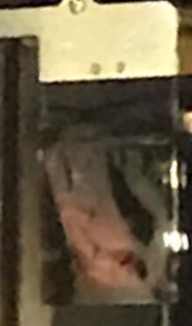
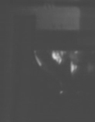
Diamond Foils
  SNS small/large size
  Operations since 2019
  Cardiff/Bristol/Diamond Materials
SNS produced 200 µg cm⁻² samples for ISIS machine physics
100 lines per inch, 5 µm, 55° corrugations
17 x 30 mm, no fibres, top edge support only
Modified frame and etched using RSE-111 (hydrofluoric, nitric and acetic acid)
OK for machine physics test, but too small for optimised operation
30 mm
17 mm
38 mm
17 mm
Remaining substrate
Instead test larger 30 x 50 mm 200 µg cm⁻² samples for use in operations
35 mm
Before etching
2 hours
Etched
30 mm

Slide 10
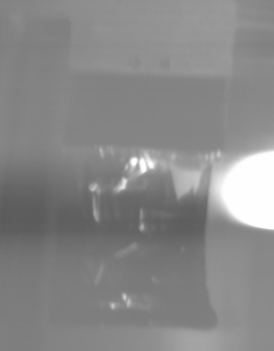
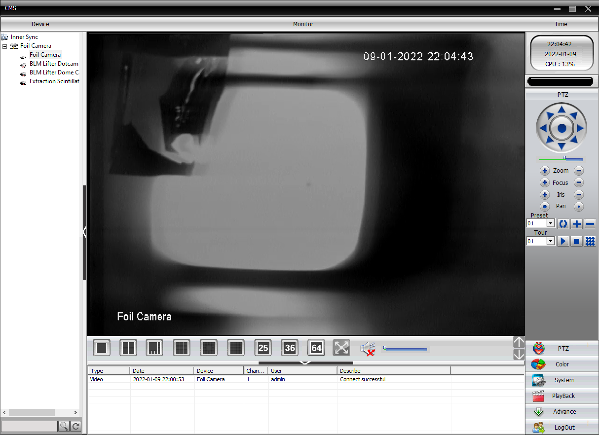
Diamond Foils
  SNS small/large size
  Operations since 2019
  Cardiff/Bristol/Diamond Materials
  SNS small/large size
  Operations since 2019
  Cardiff/Bristol/Diamond Materials
Date | mAh per foil | Notes
25th November 2019 | 610 | Tear observed top right corner
20th August 2020 | 440 | Change before start-up, new cycles added before long shutdown
8th December 2020 | 426 | Beam loss, possible foil hole? (Unnecessary - beam issue was R5VD1)
9th January 2022 | 327 | Was withdrawn to storage for long shutdown, but observed large hole on inspection before cycle
24th January 2024 | 592 | Losses fine, some curling observed. Good time to change – crew, HP and OPI changes
27th January 2025 | 717 | Losses fine, some curling observed. Good time to change – crew and HP familiarity
Average 520 mAh

Slide 11



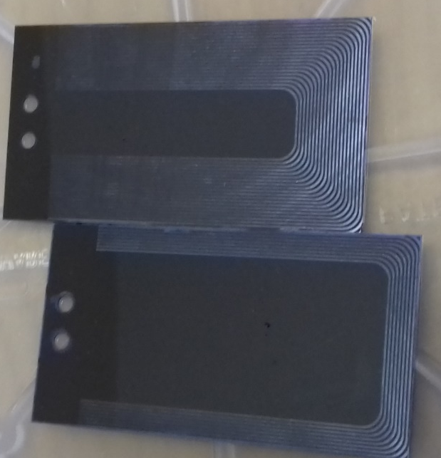
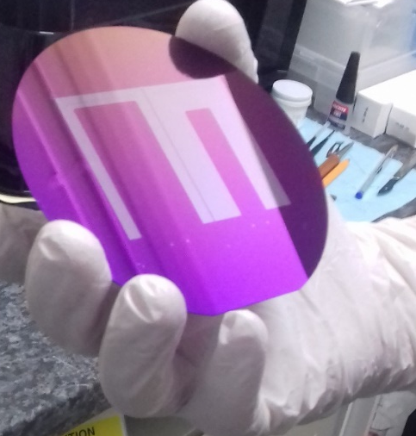
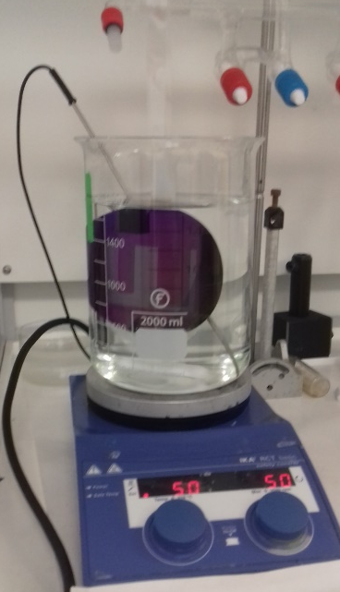


Diamond Foils
  SNS small/large size
  Operations since 2019
  Cardiff/Bristol/Diamond Materials
Look for other nano-crystalline foil producers…
CLF/SciTech producing corrugated silicon substrates
  Define own pattern/radius

Slide 12
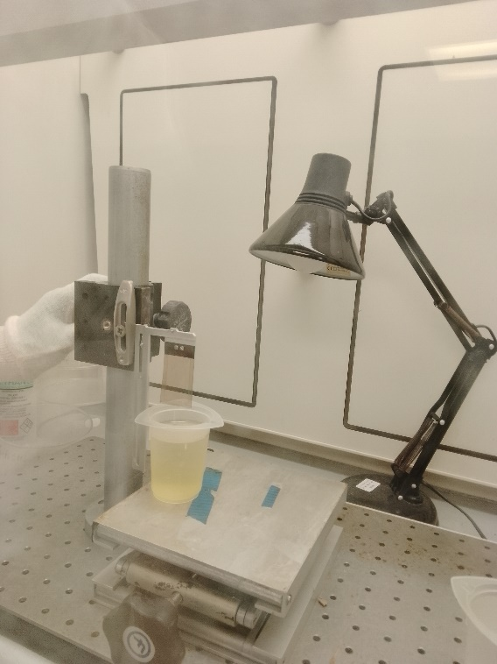
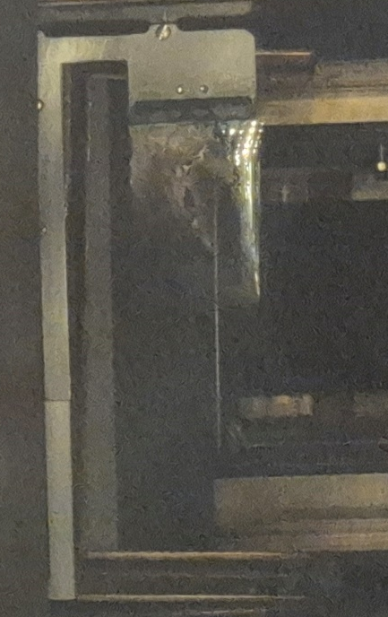
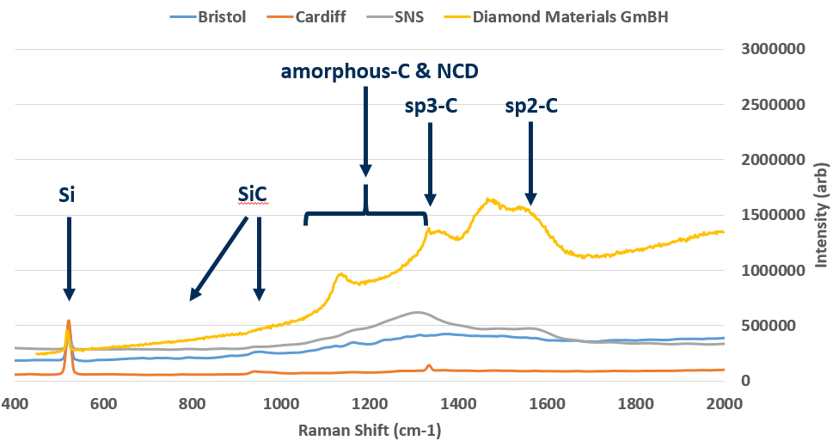
Diamond Foils
  SNS small/large size
  Operations since 2019
  Cardiff/Bristol/Diamond Materials
Did SEM and Raman spectroscopy to compare samples from Cardiff/Bristol/Diamond Materials to compare to SNS sample
Sample from Diamond Materials installed on ISIS on 27th January 2025, 355 mAh total

Slide 13
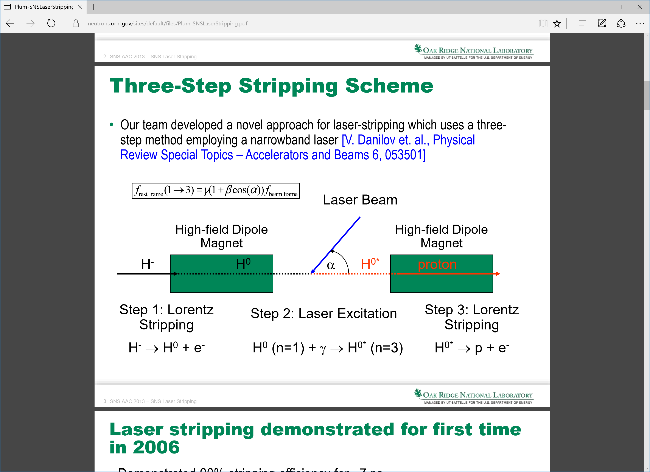
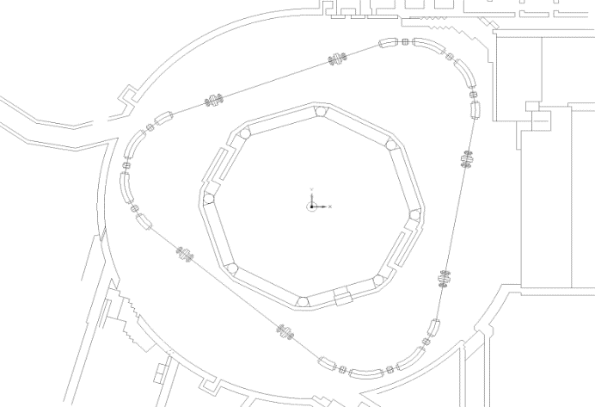
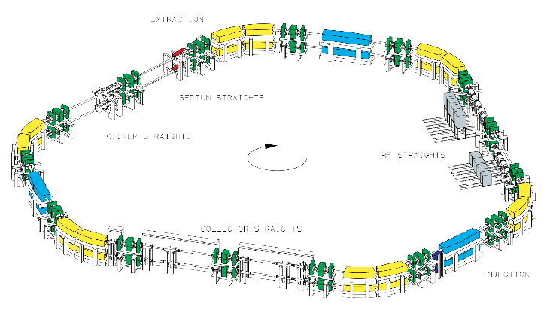
Future
  ISIS-II Options
400 MeV injection into RCS
Control temperature and lifetime by minimising re-circulations
1.2 GeV injection into AR
SNS mount foil at 30° to spread heat over foil and prevent graphitisation
H- injection with laser stripping?
Remove physical foil, reduce scattering
Difficult to achieve long pulse length
Optimised direct proton injection?
Curved foils?
Foil carousel?
Injection
Extraction
RCS in ISIS Hall
ESS AR in ISIS Hall

Slide 14
Summary
Introduction and Motivation
Aluminium Oxide Foils
Carbon Foils
Diamond Foils
Future…

Slide 15
Publications and Acknowledgements
IPAC ‘11: Stripping Foil Simulations for ISIS Injection Upgrades, H.V. Smith, B. Jones, D.J. Adams, C.M. Warsop
IPAC ‘12: Simulation of Double Layer Carbon Stripping Foils For ISIS Injection Upgrades, H.V. Smith, B. Jones, D.J. Adams, C.M. Warsop, Y. Irie, T. Takeda
HB 2014: An Overview of the Preparation and Characteristics of the ISIS Stripping Foil, H.V. Smith, B. Jones
IPAC ‘16: Initial Experience with Carbon Stripping Foils at ISIS, B. Jones, H.V. Smith, D.J. Adams
IPAC ‘17: Operation with Carbon Stripping Foils at ISIS, H.V. Cavanagh, B. Jones
IPAC ‘18: Progress with Carbon Stripping Foils at ISIS, B. Jones, H.V. Cavanagh
Publications
ISIS Vacuum Section: Geoff Matthews, Sunil Patel, Mark Waite
ISIS Injector: Mark Arnold, Nick Terzino
ISIS Diagnostics: Andy Chamberlain, Tony Kershaw, Chris Wilcox
ISIS Project Engineering: Matt Kearsley, Theodore Rutter, Phil Wise
ISIS Operations Crew: All!
ISIS Health Physics: Matt Harrall, David McGarry, John Moir, Paul Wright
ISIS Accelerator Physics: Dean Adams, Peter Griffin-Hicks, Bryan Jones, Ben Pine, Chris Warsop, Rob Williamson
ISIS Experimental Operations: James Taylor, James Tellam
CLF/SciTech Precision: Graham Arthur, Chris Spindloe, Dave Haddock
University of Bristol: Paul May
University of Cardiff: Soumen Mandal, Oliver Williams
Diamond Materials: Christoph Wild
Ridgeway Technology: Richard Bodkin
Research Complex at Harwell: Michal Klosowski, Sara Mosca
CERN: Klaus Hanke, Bettina Mikulec, Wim Weterings
SNS: Sarah Cousineau, Nicholas Evans, Mike Plum, Leslie Wilson
J-Parc: Hiroyuki Harada, Hideaki Hotchi, Yoshiro Irie, Isao Sugai, Yasuhiro Takeda
CSNS: Ming-Yang Huang, Jia-Xin Chen, Jie-Bing Yu, Ling Kang
FNAL: Dave Johnson
Acknowledgements
Thank you,
Any questions?

