Slide 1
Topics about CSNS RCS

Slide 2
RF Shield Impedance
Huang, L. et al. Source of instability in the rapid cycling synchrotron of the China spallation neutron source. Eur. Phys. J. Plus 140, 71 (2025). https://doi.org/10.1140/epjp/s13360-025-05997-8

Slide 3
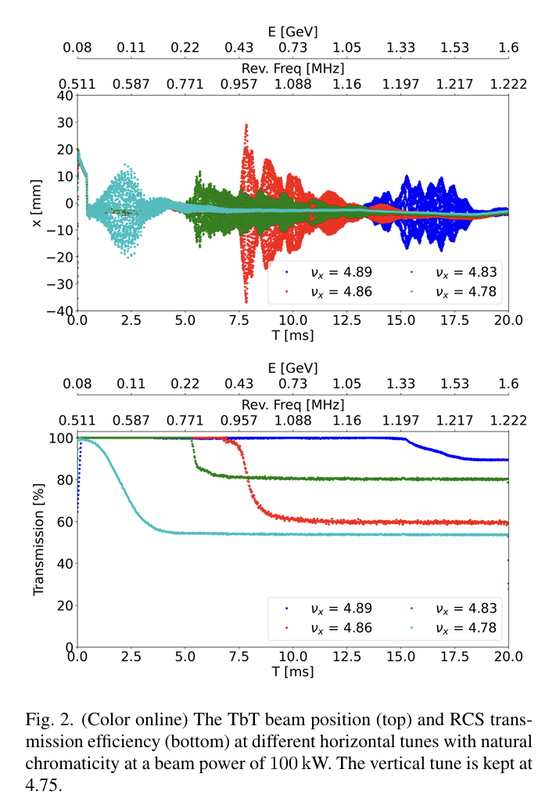
Background
Instability Observed
  Transverse coupled-bunch instability (TCBI) at ~50 kW.
  Frequency: ~0.13 MHz (linked to RF shield on ceramic chambers).
Challenge
  Traditional models underestimate impedance.
  Current mitigation (tune/chromaticity tuning) reaches limits.

Slide 4
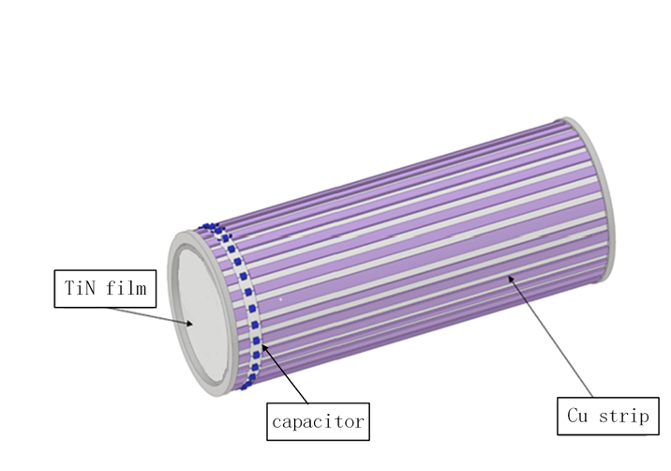
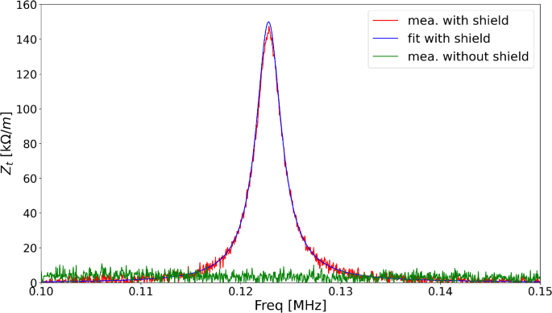
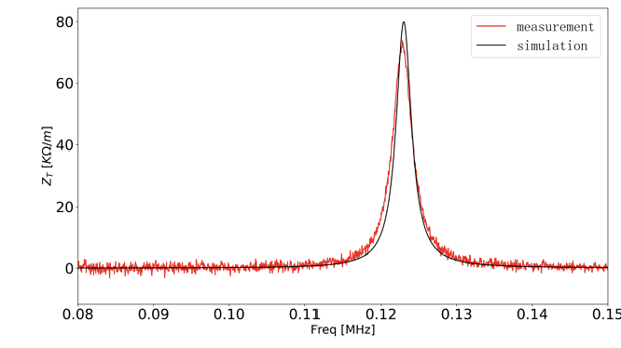
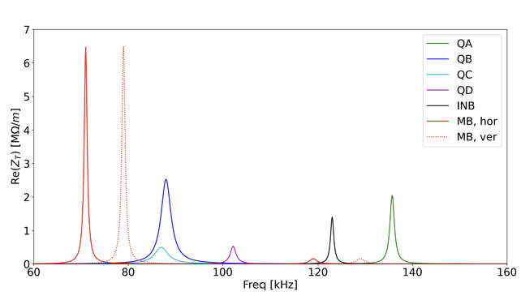
Experimental & Simulation Evidence
Bench Measurements
  Loop method confirms 0.123 MHz resonance.
  RF shield removal eliminates resonance → Root cause identified.
CST Simulations
  Reproduce resonance via tetrahedral mesh .
  All 6 chamber types exhibit 70–150 kHz resonances.
  MB-type chamber: Highest impedance (6 MΩ/m).

Slide 5
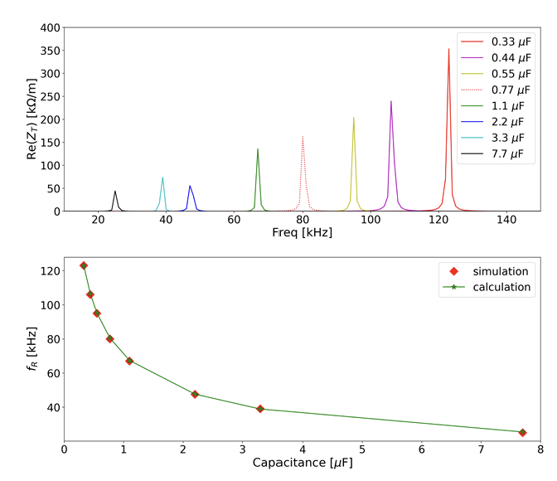
Impedance Reduction Strategy
Key Lever
  Capacitance tuning: Larger C ↓ resonance frequency & impedance .
  Trade-off: Capacitor voltage stress (max 314 V in injection magnets).
Future Work
  Experimental validation of capacitor optimization.
  Magnet yoke effects (e.g., MB chamber: +35 kHz shift).
  Theoretical modeling of beam-impedance interaction.

Slide 6
How to deal with the instability now
  Many mitigation methods are being considered.
  AC Sextuples have been used to increase the chromaticity (-4,-8) to (-9,-9)
  Longitudinal bunch painting can also help with reducing the TCBI
  Octupole magnets have been installed to increase Landau damping .
  Tune below 0.5, such as (4.3, 5.3), (5.29, 5.32).
  BxB feedback will be firstly developed, and further intra-bunch feedback.
  RF shield structure and capacitance will be optimized.

Slide 7
Simulation Codes

Slide 8
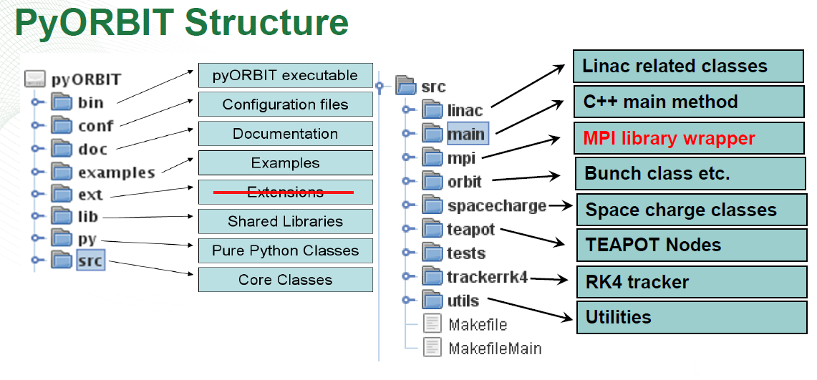
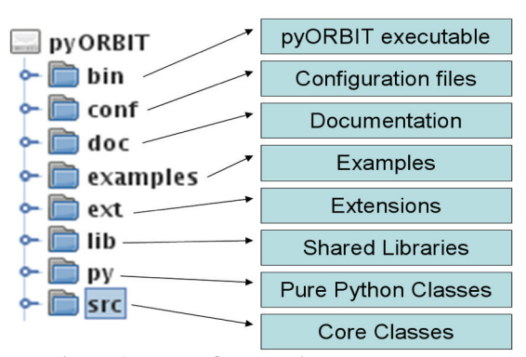
Introduction about PyORBIT
PyORBIT is an open-source program that extends and improves upon the ORBIT code originally developed for the Spallation Neutron Source in U.S.
PyORBIT employs both C++ and Python: C++ handles the computationally intensive tasks, while Python wraps these calculations into accelerator elements and serves as the scripting layer.
Strengths: an active user community and excellent computational performance.
Challenge: the two-tier architecture makes debugging more difficult.

Slide 9
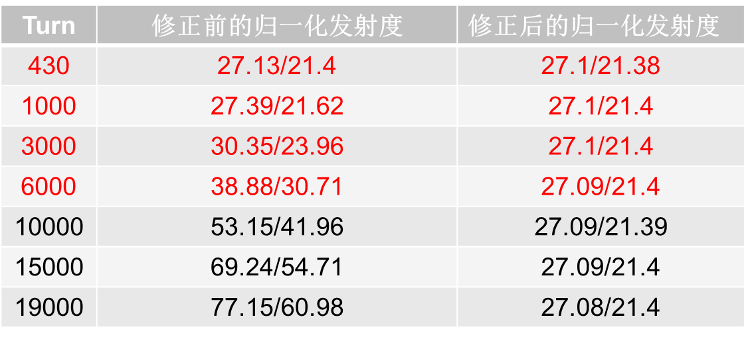
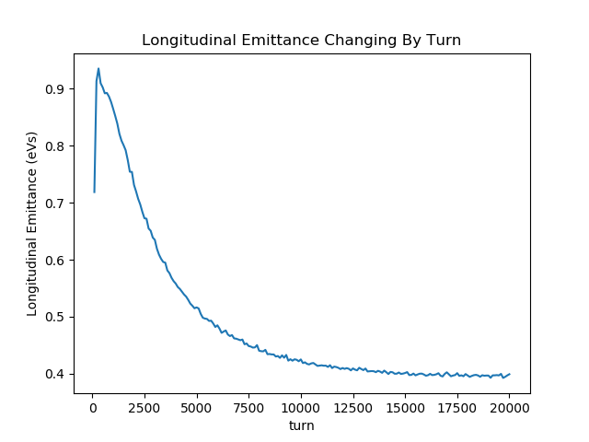
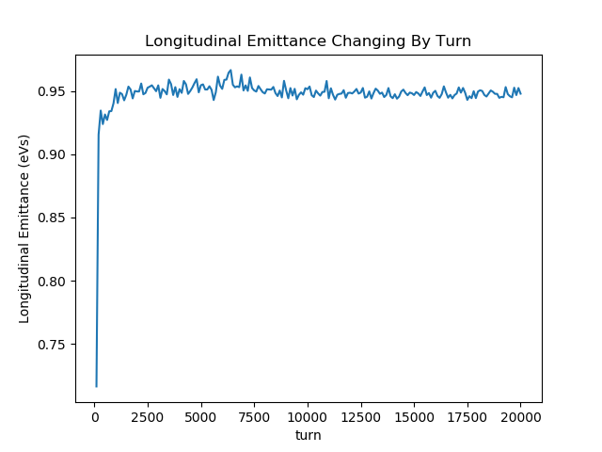


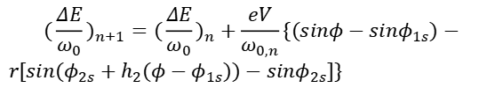
Code benchmark for RCS
Modifications to the RF-cavity model for the acceleration stage
Correction of the transverse angular-spread calculation
$$x^{′}=\frac{p_{x}}{p_{s}}$$
$$x_{1}^{′}=\frac{γ_{0}β_{0}}{γ_{1}β_{1}}x_{0}^{′}$$
  Acceleration-induced change in angular spread
  Longitudinal cyclotron-frequency correction
$$(\frac{ΔE}{ω_{0}})_{n+1}=(\frac{ΔE}{ω_{0}})_{n}+\frac{eV}{ω_{0,n}}\{(sinφ−sinφ_{1s})−$$
$r[sin(φ_{2s}+h_{2}(φ−φ_{1s}))−sinφ_{2s}]\}$
Before correction
After
correction
The variation in cyclotron frequency within the RCS cannot be neglected.

Slide 10
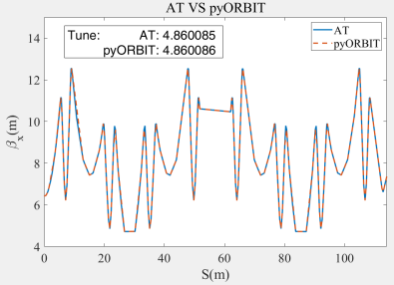
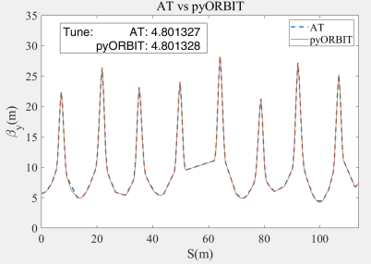
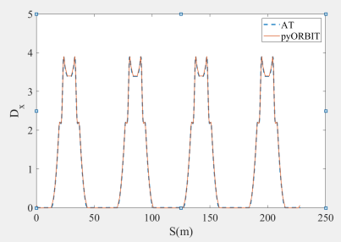
Code benchmark for RCS
Comparison of linear optics calculations between AT and PyORBIT
Comparison of linear lattice parameters between AT and PyORBIT; from left to right: horizontal beta function, vertical beta function, and dispersion function.
The results are in perfect agreement.

Slide 11
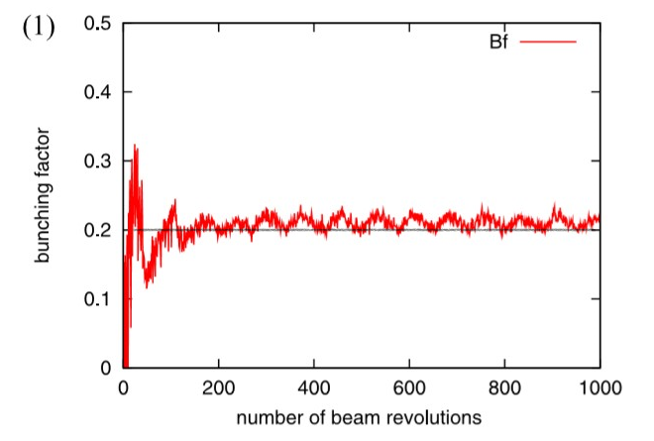
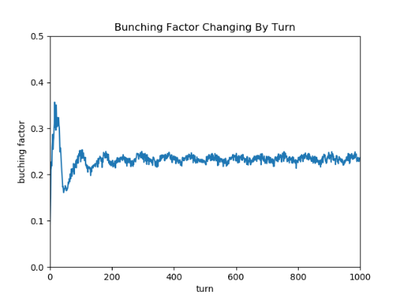
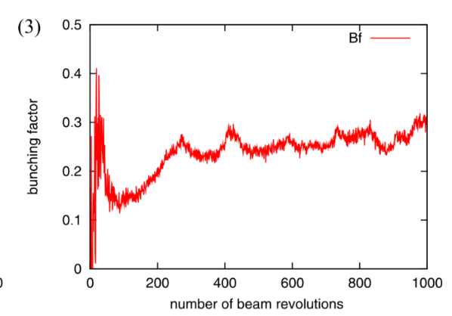
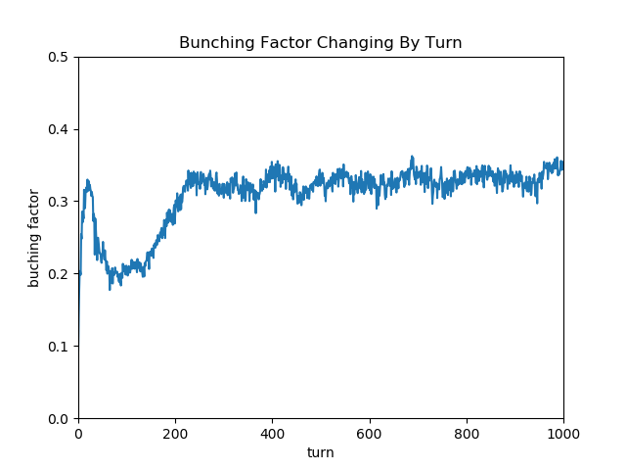
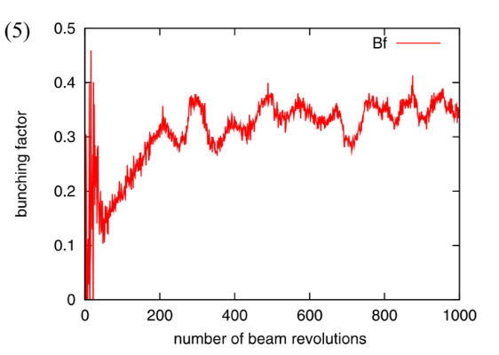
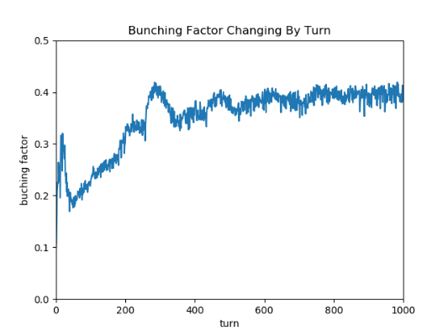
Code benchmark for RCS
Dual-harmonic acceleration – comparison with J-PARC measurement results
1) Under single-harmonic conditions only
Injection Time | 500μs（234Turn）
Chopper Duty | 30%
E_{k} | 181MeV
Momentum Dispersion(rms) | ±0.5‰
RFV (H2) | 68KV(Fixed)
J-PARC
PyORBIT
3) With the second-harmonic cavity voltage set to 50 % of the fundamental and a −0.2 % momentum offset at injection
5) Second-harmonic cavity voltage set to 80 % of the fundamental, with a –0.2 % momentum offset at injection.

Slide 12
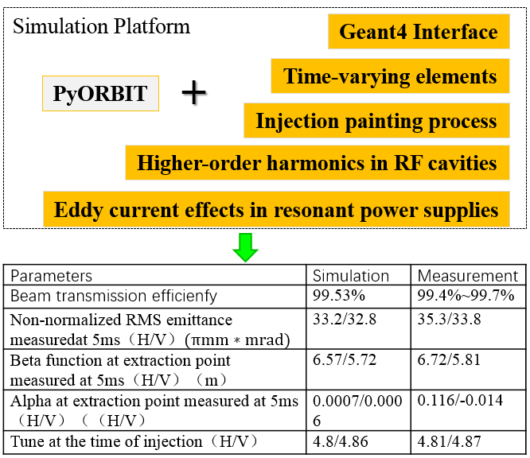
Customized Packages
To simulate TCBI, PyORBIT requires several enhancements;
Only the peak of the beam spectrum and the peak of the impedance are retained; the influence of the longitudinal phase is omitted;
Multiturn/multi-bunch simulation will consume lots of resources

Slide 13
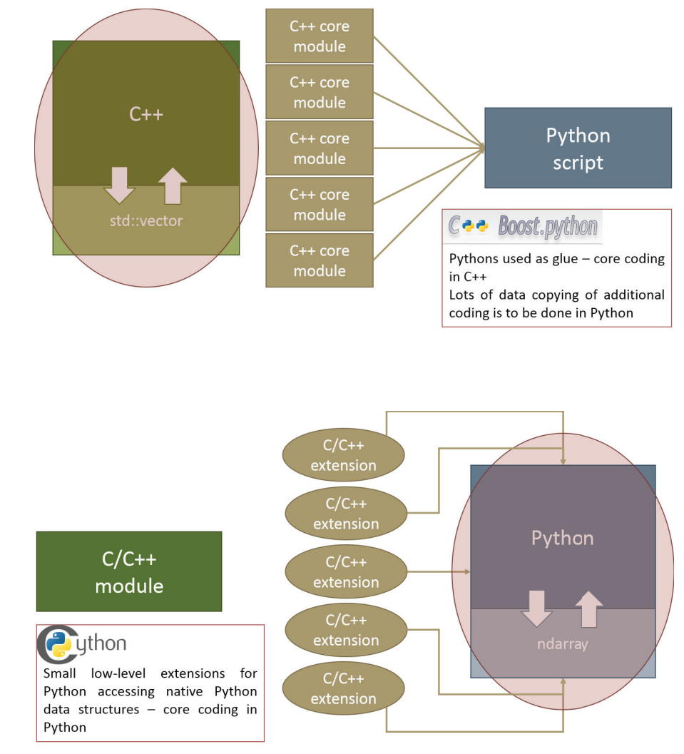
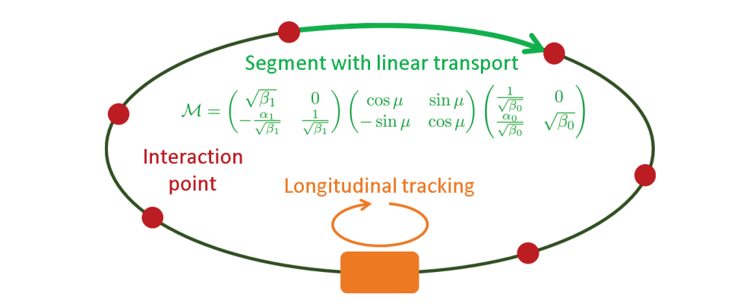
PyHEADTAIL
PyORBIT
Pros：
Space charge calculation；
detailed elements’ models；
Has been checked in CSNS RCS
Cons：
The instability not agree with the experiment
PyHEADTAIL
Pros：
The calculation of instability has been checked in many facilities
Cons：
“One turn map” narrows its usage
PyORBIT
PyHEADTAIL

Slide 14
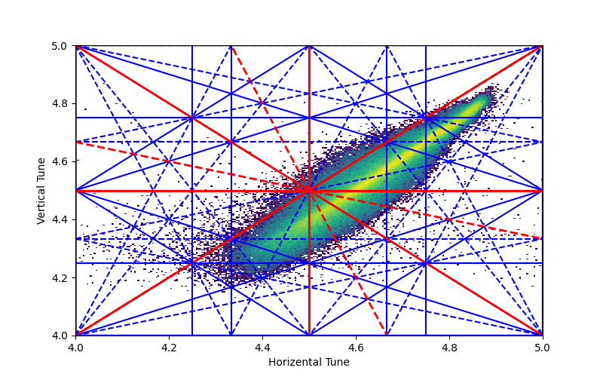
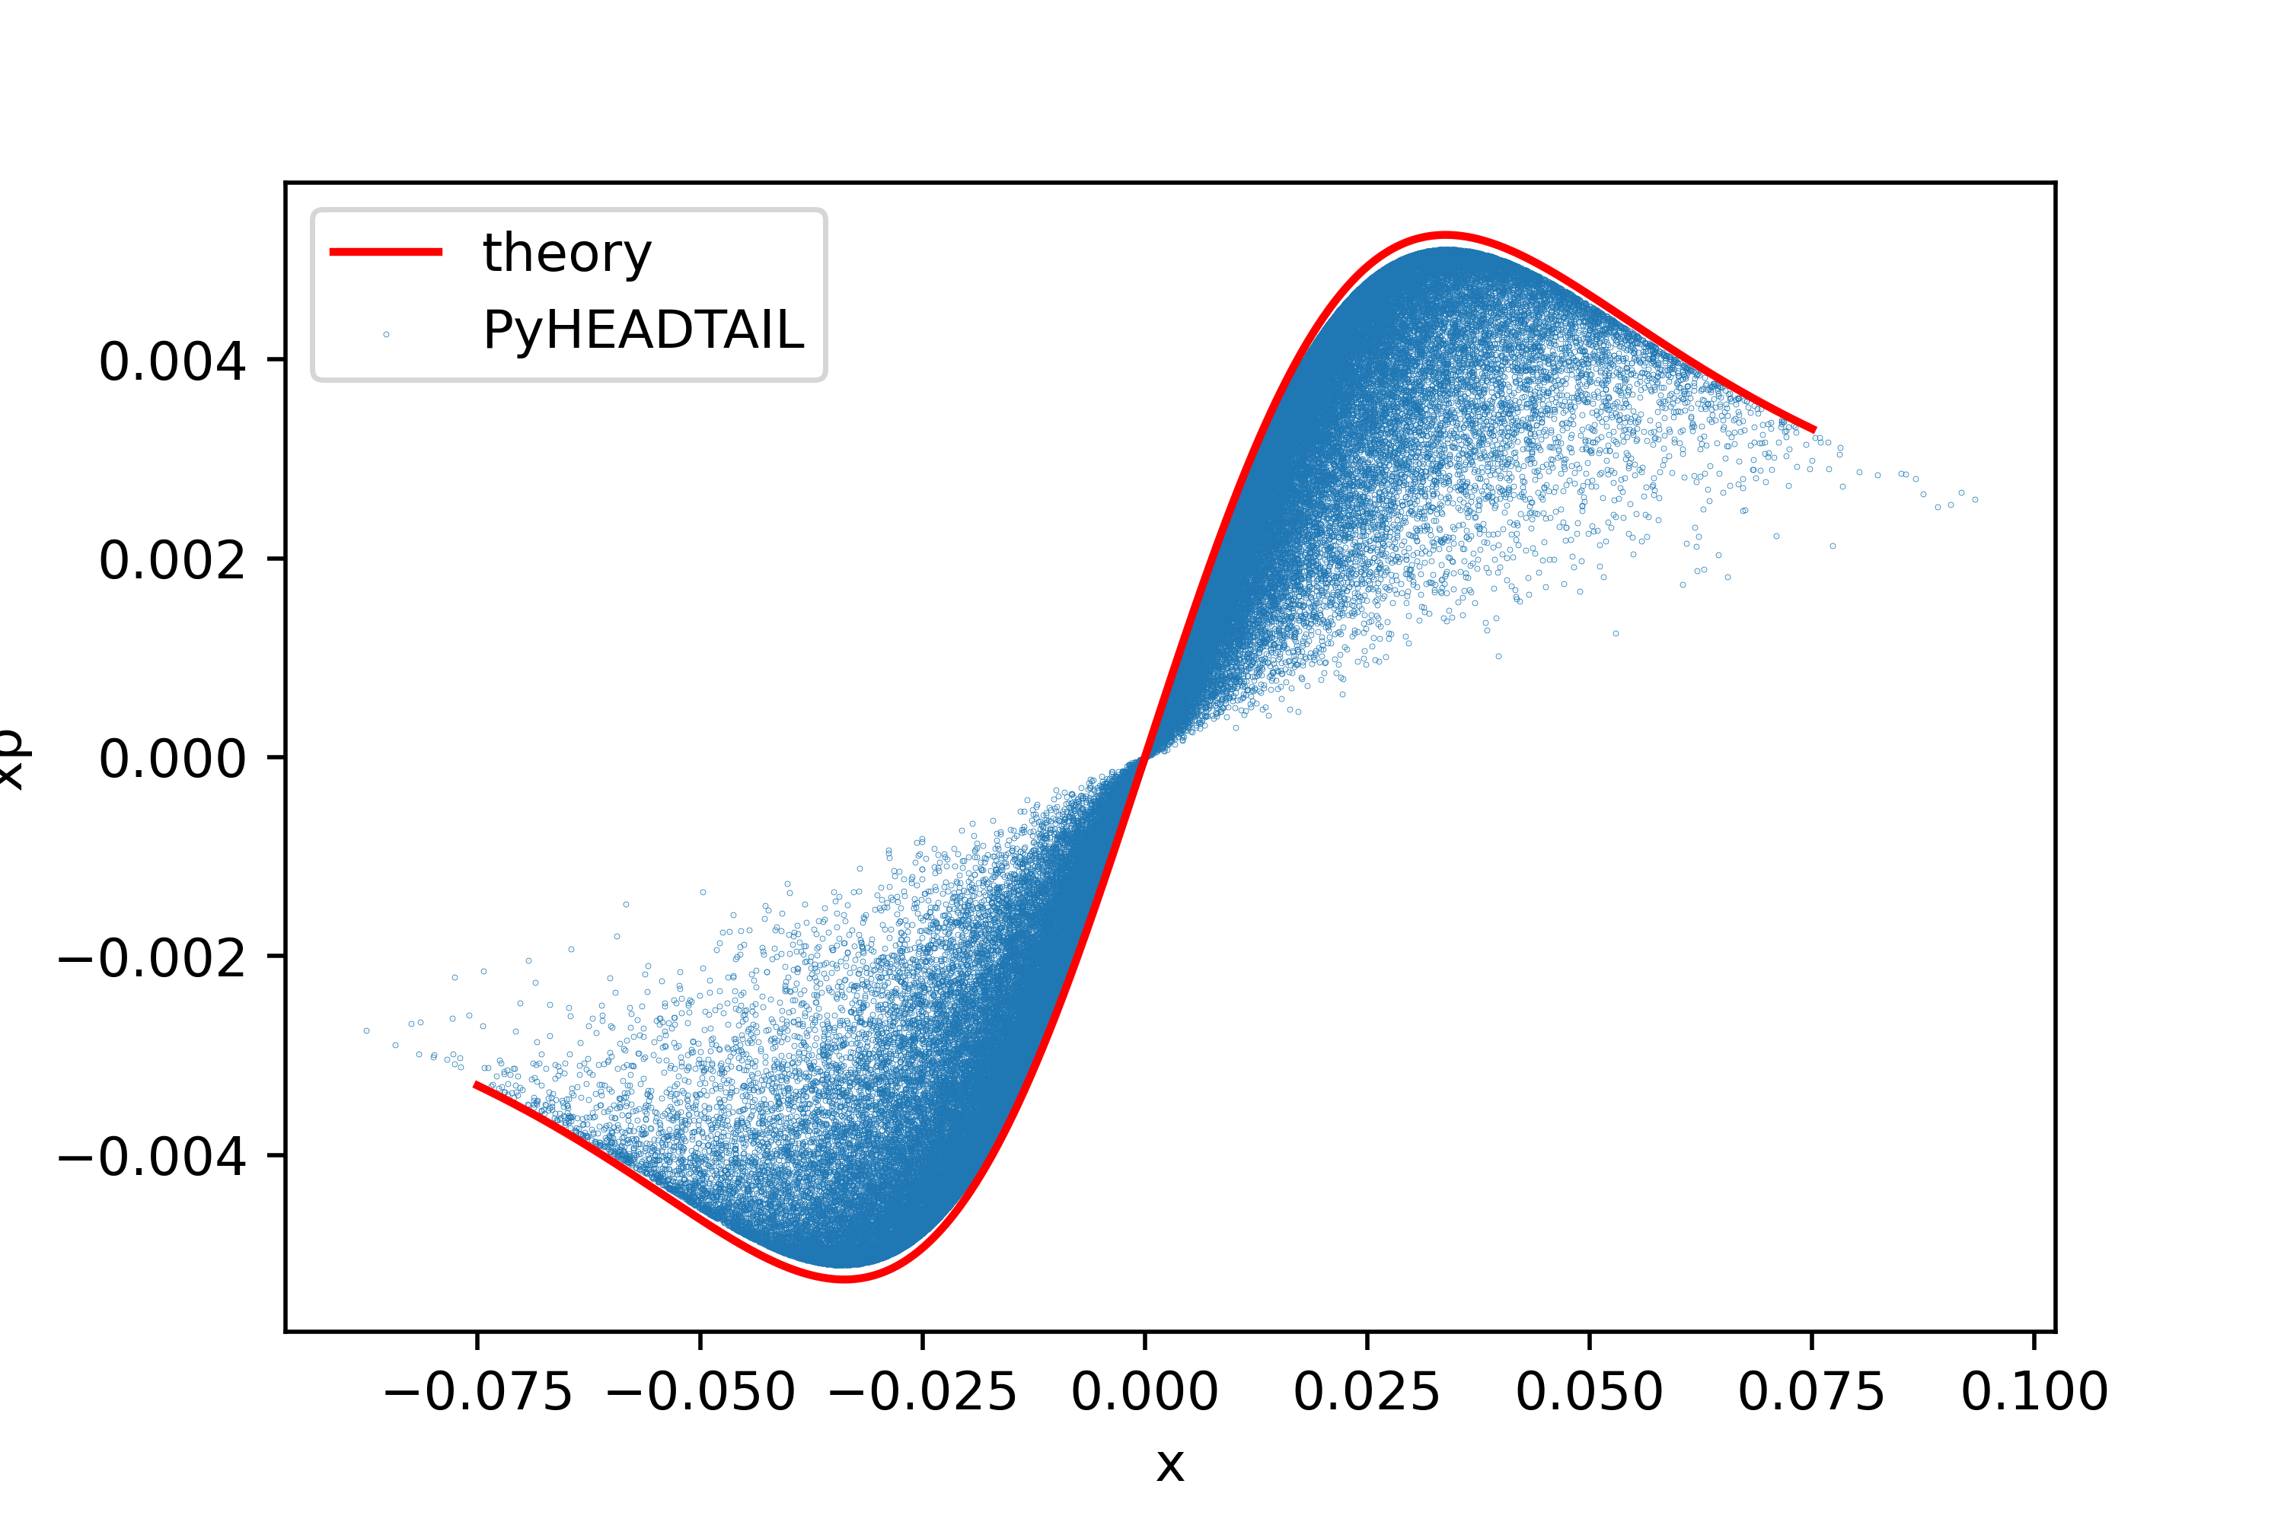
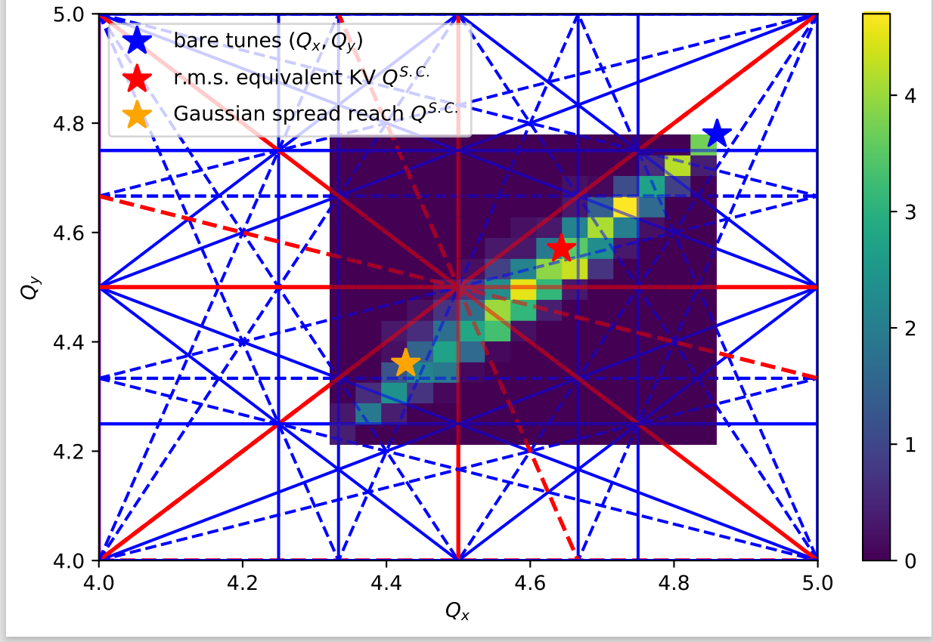
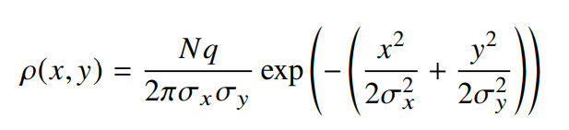
Benchmark again
PyHEADTAIL vs Formula
PyORBIT
Tune footprint
Kick force
PyHEADTAIL

Slide 15
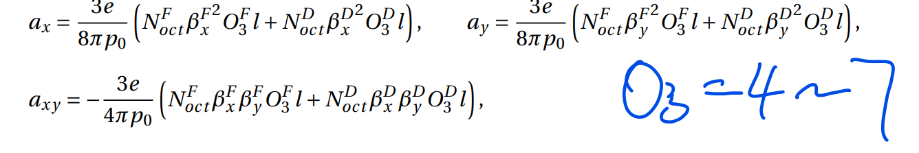
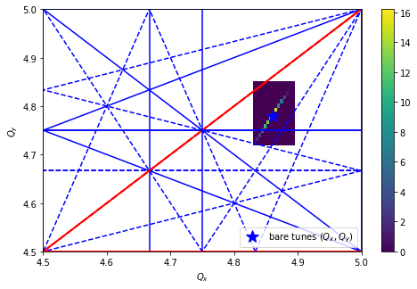
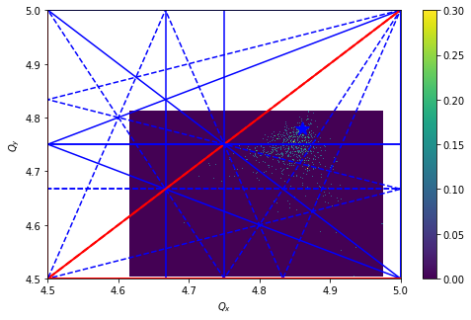
Benchmark again
Without O3
WithO3

Slide 16
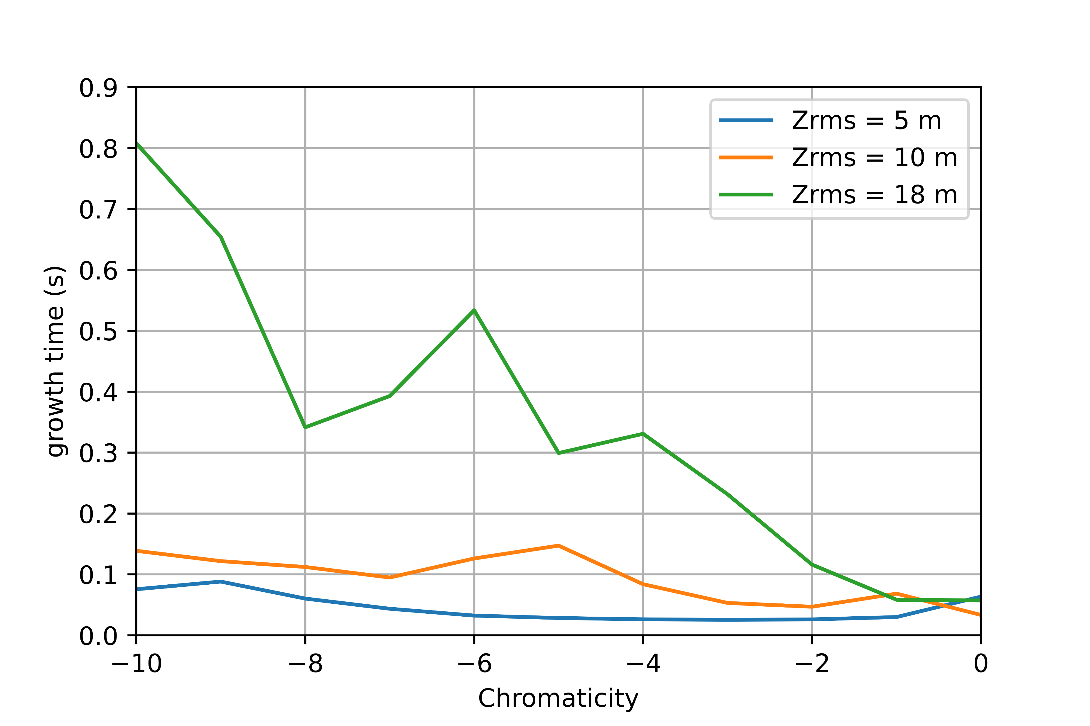
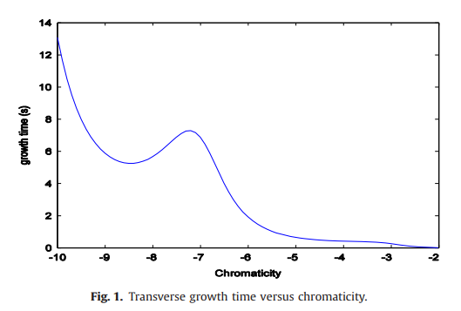
Benchmark again
Resistance wall is used (stainless steel)
Z_rms =18 m is consistent with the trend of results calculated in the literature
Also the theoretical calculation in 0 mode can meet the simulation results.

Slide 17
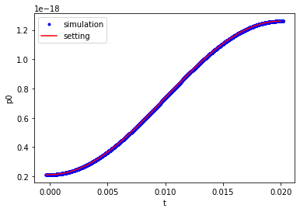
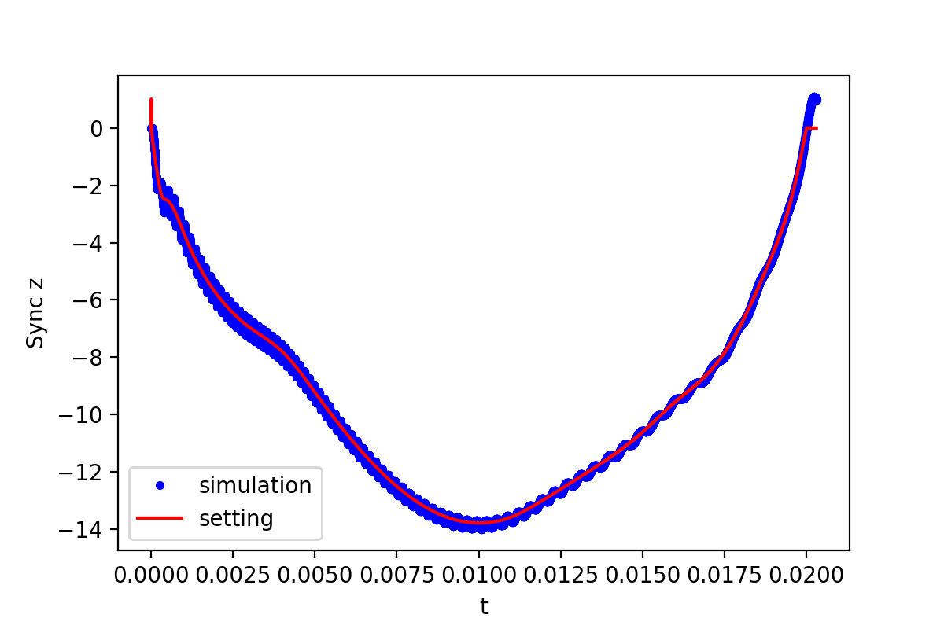
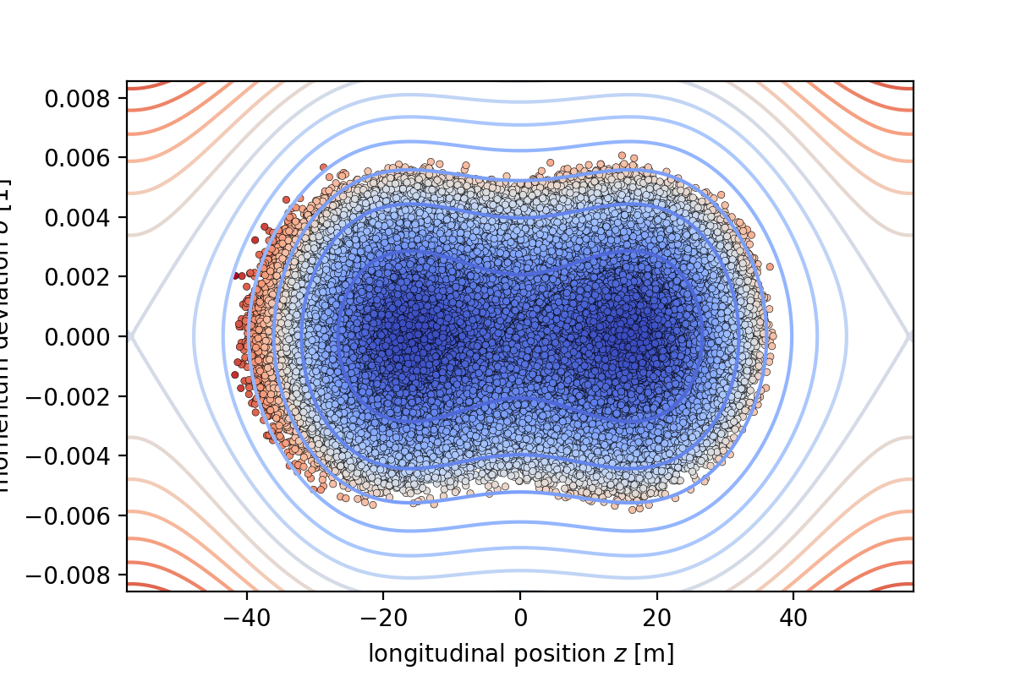
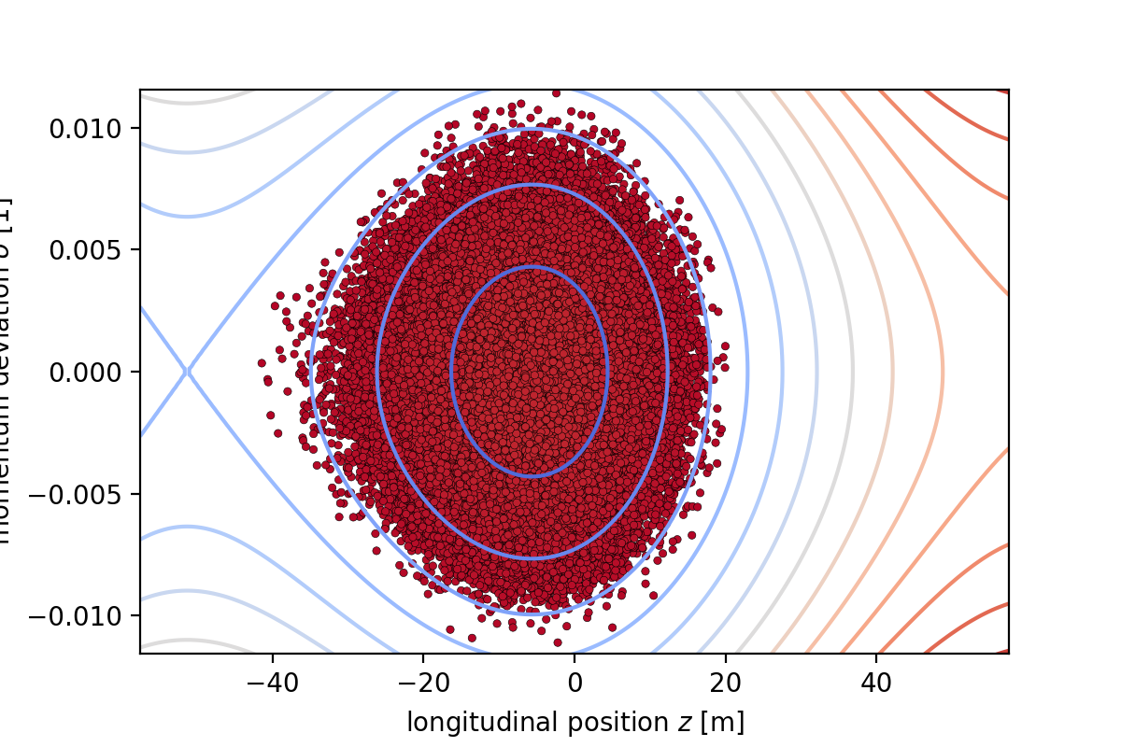
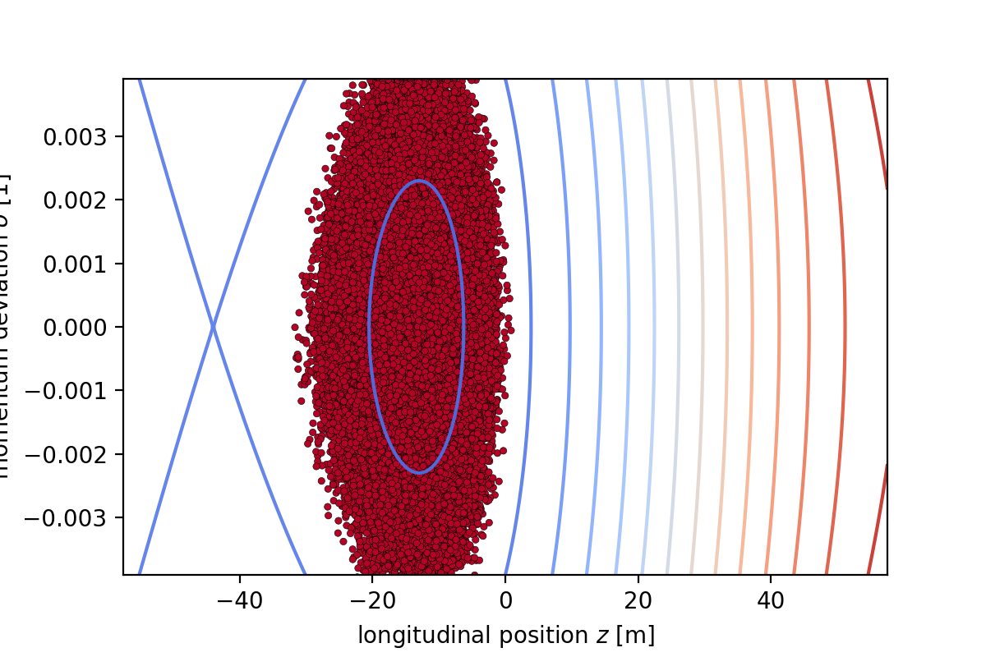
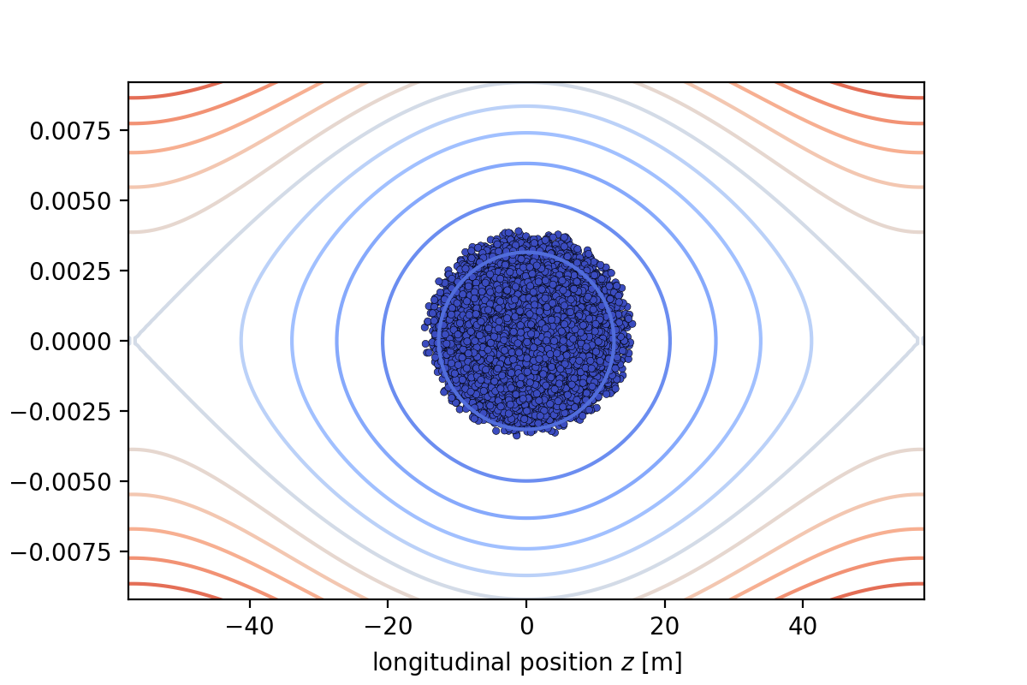
Benchmark again
Sychrontron phase
Energy gain
Dual Harmonic phase space
Single Harmonic phase space （1000,10000,20000 turn）

Slide 18
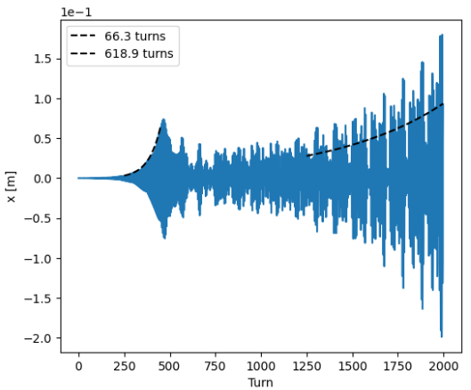
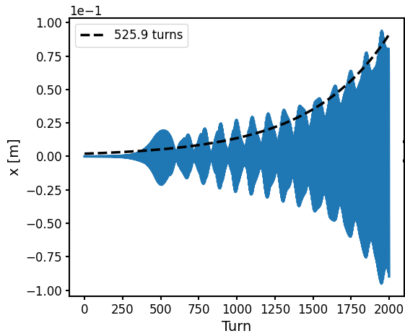
Simulation Results
PyORBIT
PyHEADTAIL
Both codes can reproduce the machine observations, but PyHEADTAIL requires impedance values roughly one order of magnitude higher than nominal to match the data.

Slide 19
Thank you!

