Slide 1
Experiments at ISIS
Carl Jolly, D. Kelliher, JB Lagrange, A. Letchford,
S. Machida, D. Posthuma de Boer, C. Rogers, A. Seville.
22/07/2025

Slide 2
Contents
Beam loss during beam stacking – RF knockout:
  RF knockout mechanism.
  Confirmation of RF knockout.
  Demonstration of mitigating the beam loss caused by RF knockout.
Extracting a stacked beam – capture into an RF bucket:
  Why are we interested in adiabatic capture techniques?
  Initial experimental results from ISIS experiments.
  Latest work.

Slide 3
ISIS Synchrotron as a tool for FFAs
Of course for usual operations the ISIS main magnet field ramps up as the beam accelerates over 10ms.
We can set ISIS to Storage Ring Mode (SRM) where the main magnets produce a constant field at the injection energy.
  A beam can be stored for 10ms in this mode.
Allows us to study the coasting beam in ISIS, certain features of beam stacking and various RF capture techniques.
ISIS’s RF cavities are placed symmetrically in 6 of the 10 super periods.
  The dispersion is non-zero at the cavity locations → important for testing RF knockout.

Slide 4
Reminder – Beam Stacking
Energy
Inject beam 1
Time

Slide 5
Reminder – Beam Stacking
Energy
Accelerate
Inject beam 1
Time

Slide 6
Reminder – Beam Stacking
Energy
Debunch
Accelerate
Inject beam 1
Time

Slide 7
Reminder – Beam Stacking
Energy
Debunch
Debunch
Accelerate
Accelerate
Inject beam 1
Inject beam 2
Time

Slide 8
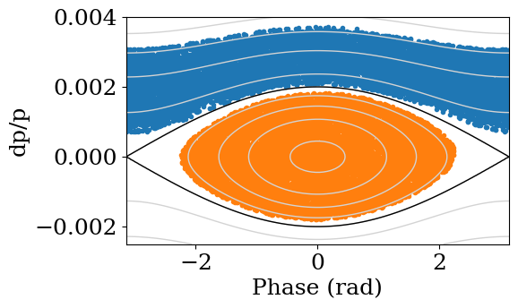
Reminder – Beam Stacking
Energy
Debunch
Debunch
Accelerate
Accelerate
Inject beam 1
Inject beam 2
Time
From David K’s simulation

Slide 9
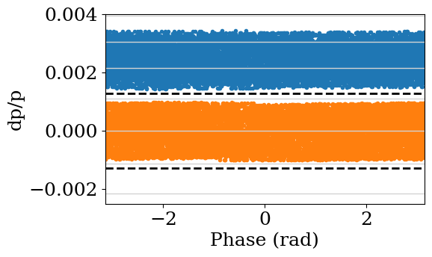
Reminder – Beam Stacking
Energy
Debunch
Debunch
Accelerate
Accelerate
Inject beam 1
Inject beam 2
Time
From David K’s simulation

Slide 10
Source of beam loss during beam stacking – KURNS 2023
Energy
At the experiment at KURNS in 2023 we noticed loss at this point in the beam stacking process.
Debunch
T. Uesugi - Beam Stacking Experiment at a Fixed Field Alternating Gradient Accelerator
Accelerate
Accelerate
Inject beam 1
Inject beam 2
Time

Slide 11

Loss mechanism → RF knockout
Generally, the orbit in an FFA is dispersive.
Every time the particle gains energy from the cavity, its closed orbit moves because of the finite dispersion.
  Equivalent to an instantaneous, horizontal displacement when passing the cavity.
If these displacements synchronise with the horizontal tune then they could build up turn by turn.

Slide 12
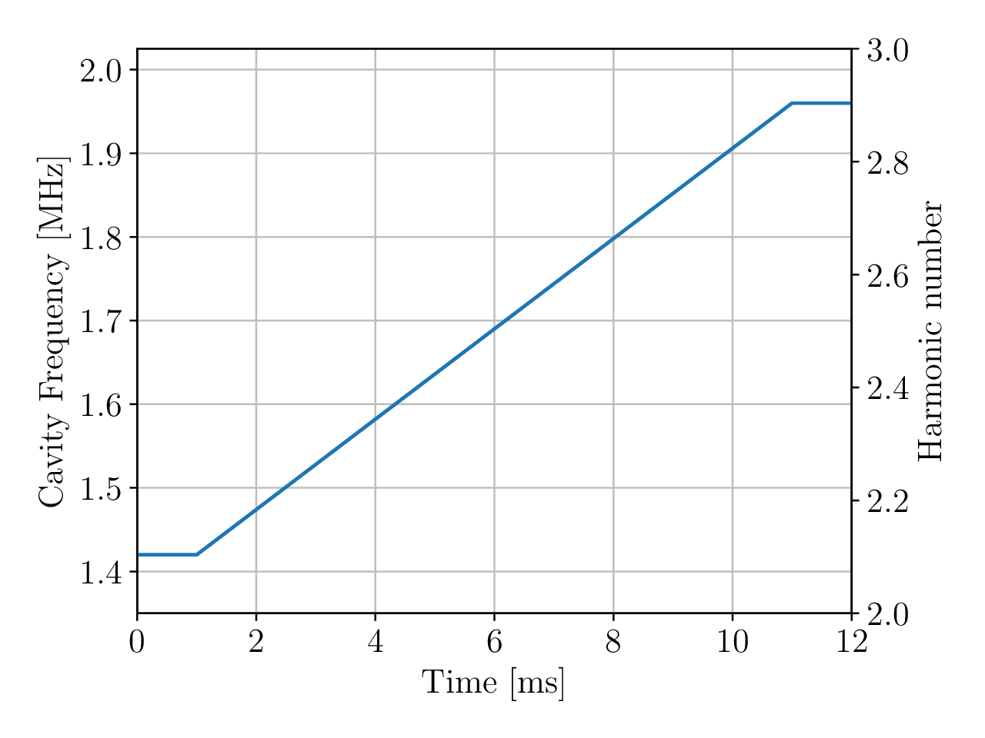


How to actually test this?
Beam stacking can only be done in FFAs* but RF knockout can still be studied in ISIS:
  Storage ring mode with a single RF cavity available.
  Inject a coasting beam.
  Ramp the RF through a wide frequency range to simulate the beam stacking RF program.
*Or machines with a large aperture like the ISR
2.9*$ω_{rev}$
2.1*$ω_{rev}$

Slide 13
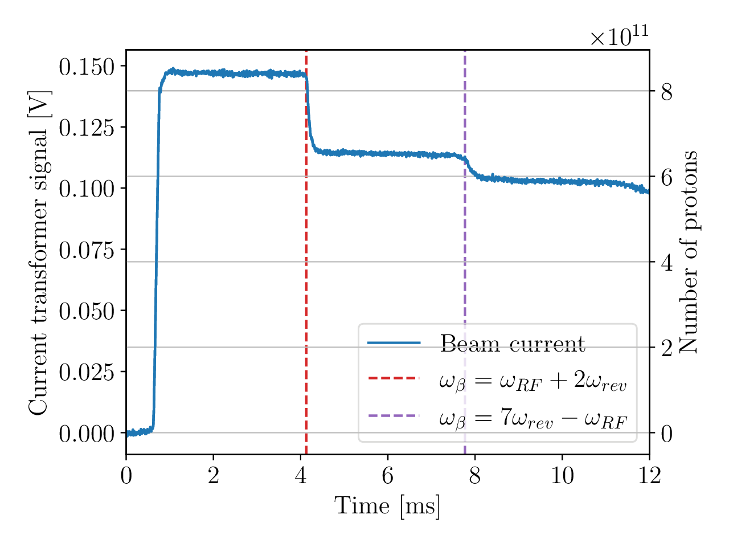
Initial test in June 2024
Loss from the coasting beam when the RF passed through the RF knockout frequency.
In this case a single cavity was used – analogous with the beam stacking experiment in 2023.

Slide 14
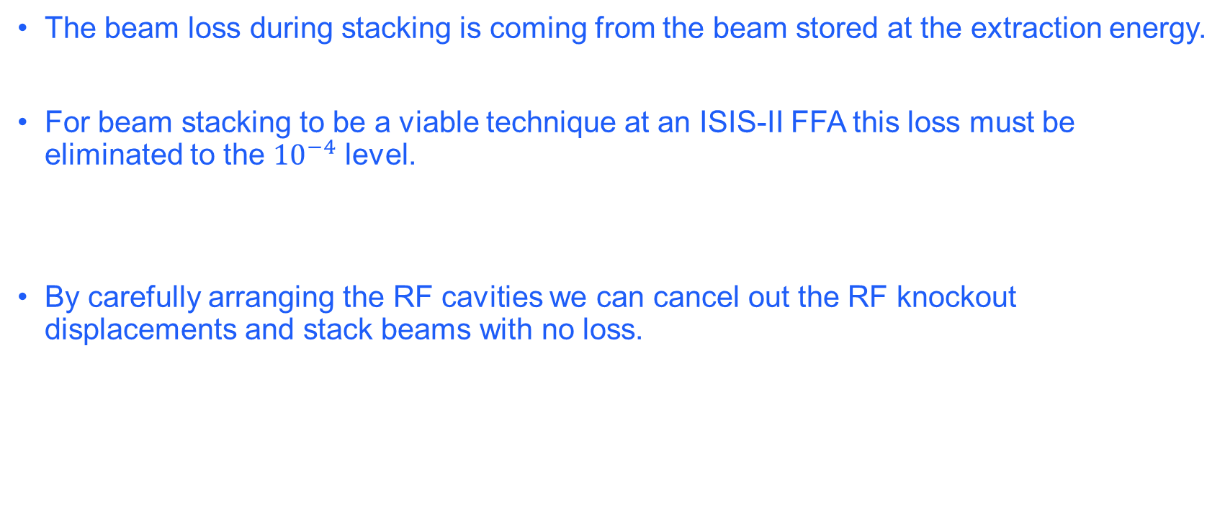
Avoiding the loss
The beam loss during stacking is coming from the beam stored at the extraction energy.
For beam stacking to be a viable technique at an ISIS-II FFA this loss must be eliminated to the ${10}^{−4}$ level.
By carefully arranging the RF cavities we can cancel out the RF knockout displacements and stack beams with no loss.

Slide 15
Cancelling the RF knockout displacements
By placing two cavities at symmetric points in the ring – for example on opposite sides – the RF knockout displacements can be cancelled

Slide 16
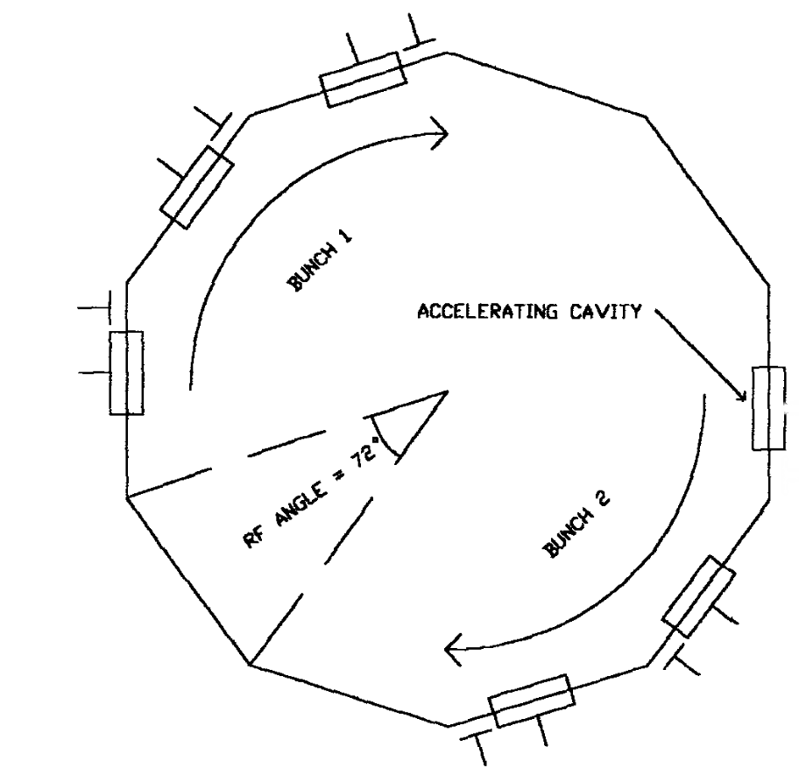
Cancelling the RF knockout displacements
By placing two cavities at symmetric points in the ring – for example on opposite sides – the RF knockout displacements can be cancelled.
ISIS RF cavity positions
By applying equal voltages to these two opposite cavities we can cancel out the betatron oscillation driven by RF knockout.
Only some of the RF knockout oscillations are cancelled → depending on the mode number.

Slide 17
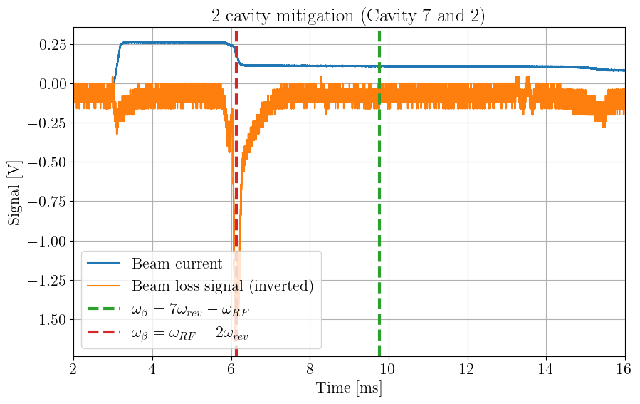
Experimental results – raw data
This RFKO condition is not cancelled.
This one is cancelled

Slide 18
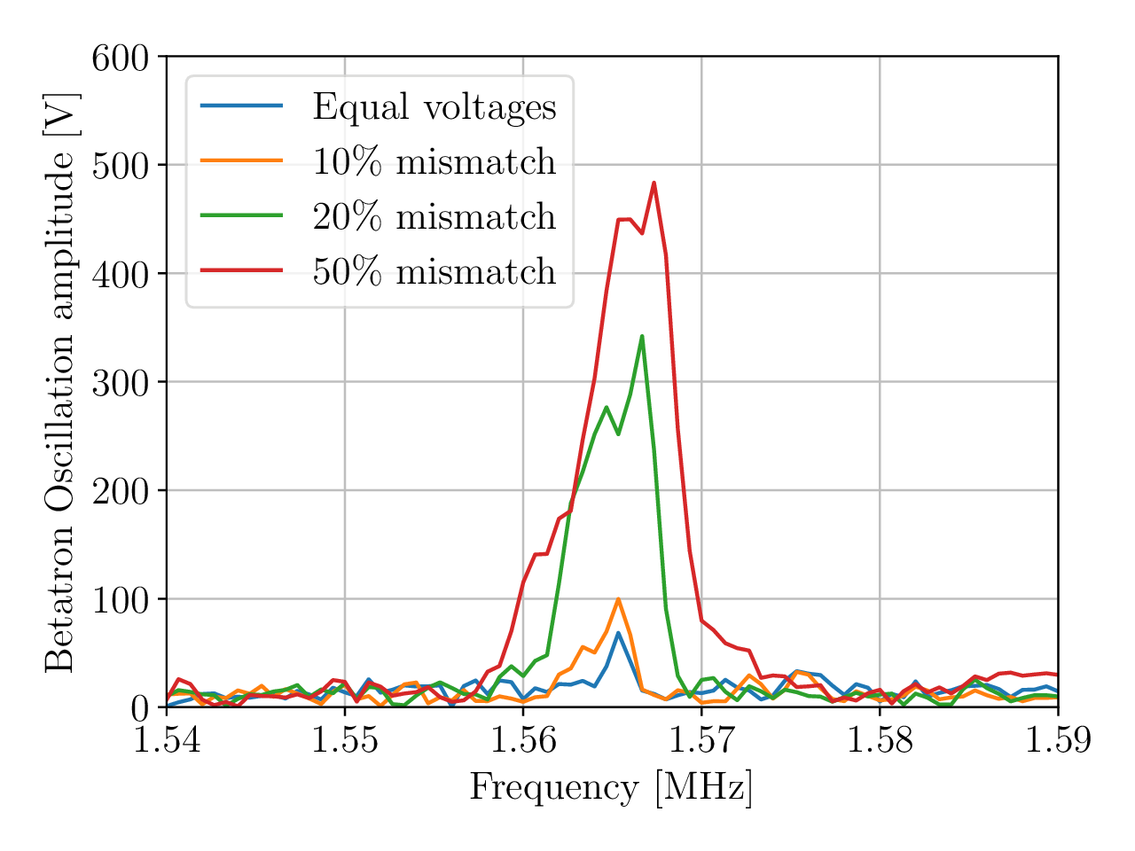
Experimental results
As the two voltage from the two cavities becomes more unequal, the RF knockout displacements return.
  Still a small kick even with equal voltages → probably because of the error in the gap volts.
  Does not depend on the phase advance.
    → But it does not cancel every RFKO condition.

Slide 19
Conclusions – RF knockout experiments
RF knockout is a major problem for beam stacking in a high intensity machine.
The experiments with ISIS have confirmed RF knockout as the source of beam loss in the 2023 beam stacking experiment.
We have shown that it is possible to eliminate the loss from RF knockout.
  The method with opposite cavities creates an RF knockout free frequency range large enough for a beam stacking RF program.
We have also studied other schemes for cancelling the RF knockout displacements.
  Not included here in the interest of time.

Slide 20
Extracting a stacked beam
The beam is coasting at the end of stacking → No beam free time for the extraction kicker rise time.

Slide 21
Extracting a stacked beam
The beam is coasting at the end of stacking → No beam free time for the extraction kicker rise time.
To create a gap for the extraction kicker we could capture the beam into a bucket.
  The capture must be with minimal loss as this beam could have 2-4 times the intensity at injection.
A barrier bucket could be another option – not studied yet.
Longitudinal phase space of the beam immediately after stacking.

Slide 22
Adiabatic capture studies with ISIS
These studies are not only relevant to the FFA.
One of the main drivers of loss in ISIS is trapping. → During injection the beam is captured into the RF bucket non-adiabatically.
Studying adiabatic and non adiabatic capture in SRM could help us to better understand this process as well as develop the analysis tools such as longitudinal tomography.
  This an ongoing project…

Slide 23
Adiabatic capture studies with ISIS -- Goal
To explore the effect of different RF voltage ramps on the longitudinal distribution and ultimately the beam loss.
Compare the coasting beam emittance before and after capture with Schottky signals and tomography.
Develop our analysis tools such as longitudinal tomography and Schottky.
First machine physics session was conducted in December 2024.

Slide 24
Adiabatic capture studies with ISIS -- Goal
To explore the effect of different RF voltage ramps on the longitudinal distribution and ultimately the loss from the capture beam.
Compare the coasting beam emittance before and after capture with Schottky signals and tomography.
Develop our analysis tools such as longitudinal tomography and Schottky.
First machine physics session was conducted in December 2024.
  We were able to get some good results. Some beam loss during the capture which we believe can be tuned out.
  The experiments were largely exploratory → we now know what we need to change and what problems we need to fix.
  A longitudinal instability is making Schottky signals tricky to measure.

Slide 25
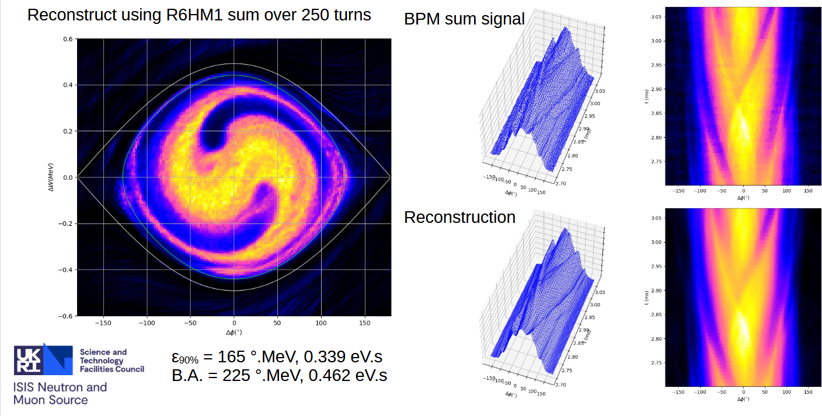
Initial experimental results – 1ms linear ramp (~2 synchrotron oscillations)
Analysis from Alan Letchford

Slide 26
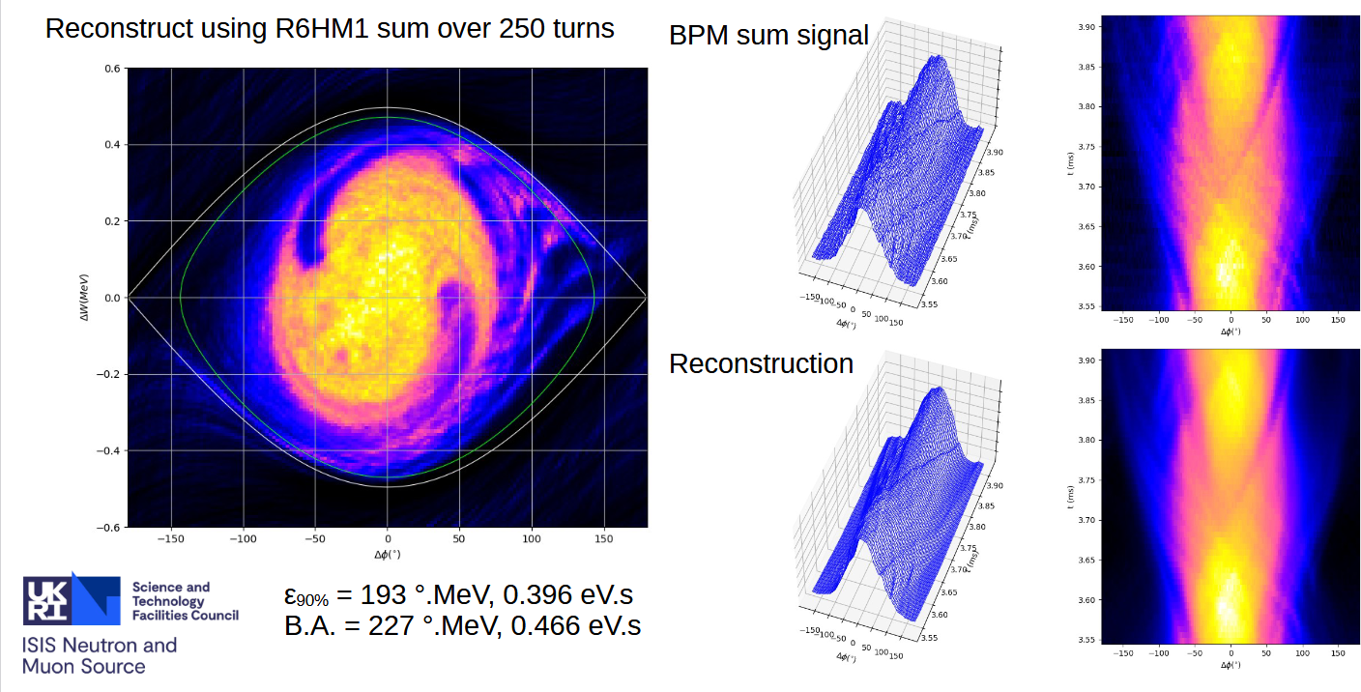
Initial experimental results – 1ms iso-adiabatic ramp (~2 synchrotron oscillations)
Analysis from Alan Letchford

Slide 27
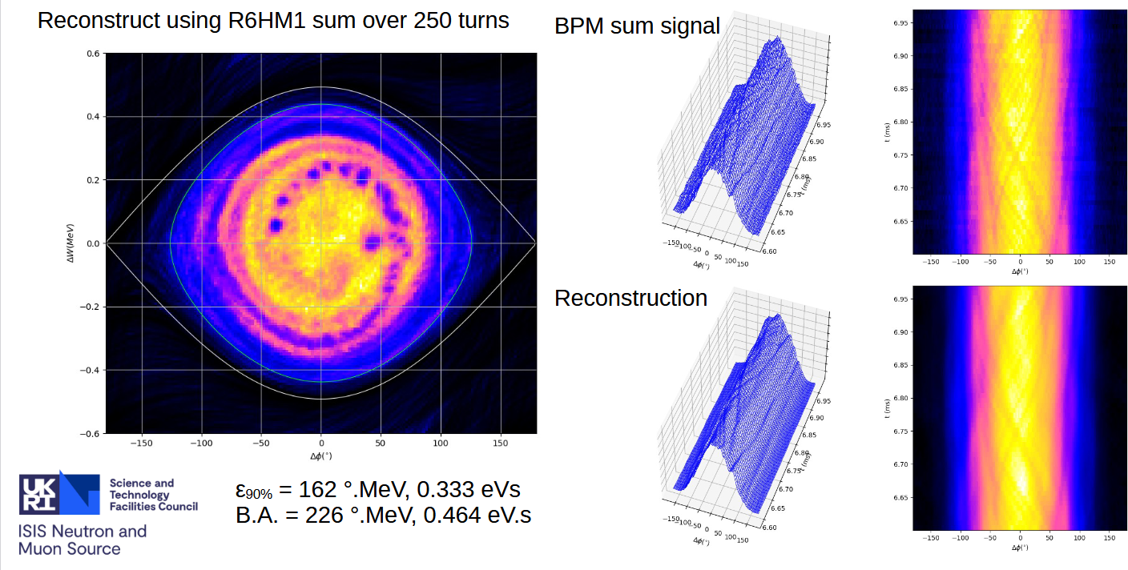
Initial experimental results – 5ms linear ramp (~10 synchrotron oscillations)
Analysis from Alan Letchford

Slide 28
Next steps
We had a second machine physics session on Saturday the 29th to continue this work.
We changed some settings on the RF systems and we were able to capture a low intensity beam without loss.
The data has not been analysed yet…

Slide 29
Summary
ISIS’s storage ring mode has been an excellent tool to study some elements of FFA beam dynamics.
We’ve shown experimentally that the loss from RF knockout can be mitigated to enable the beam stacking to be used in an ISIS-II FFA.
We’ve begun to study various methods of capturing a coasting beam.

