Slide 1
FETS FFA RF STATUS
Rob Mathieson, Ian Gardner, Bradley Kirk et al.
RAL

Slide 2
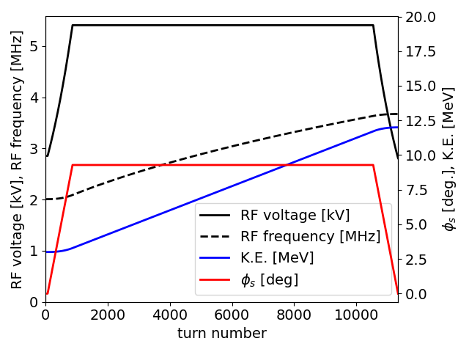
RF Parameters
Parameter | Specification for Prototyping
Energy range | 3 –12 MeV
Harmonic | 2
RF frequency | 2.0 – 3.7 MHz
Peak RF Voltage | 6kV
Re-bunching Voltage | 20kV h=1 (0.9 MHz)
Repetition Rate (Burst) | 100Hz (+)
Acceleration Time | 8ms
Approximate Aperture | 700 x 52 mm
Accelerate in 8 ms and test beam stacking
(Current work is for FETS FFA – ISIS-II is different problem)

Slide 3
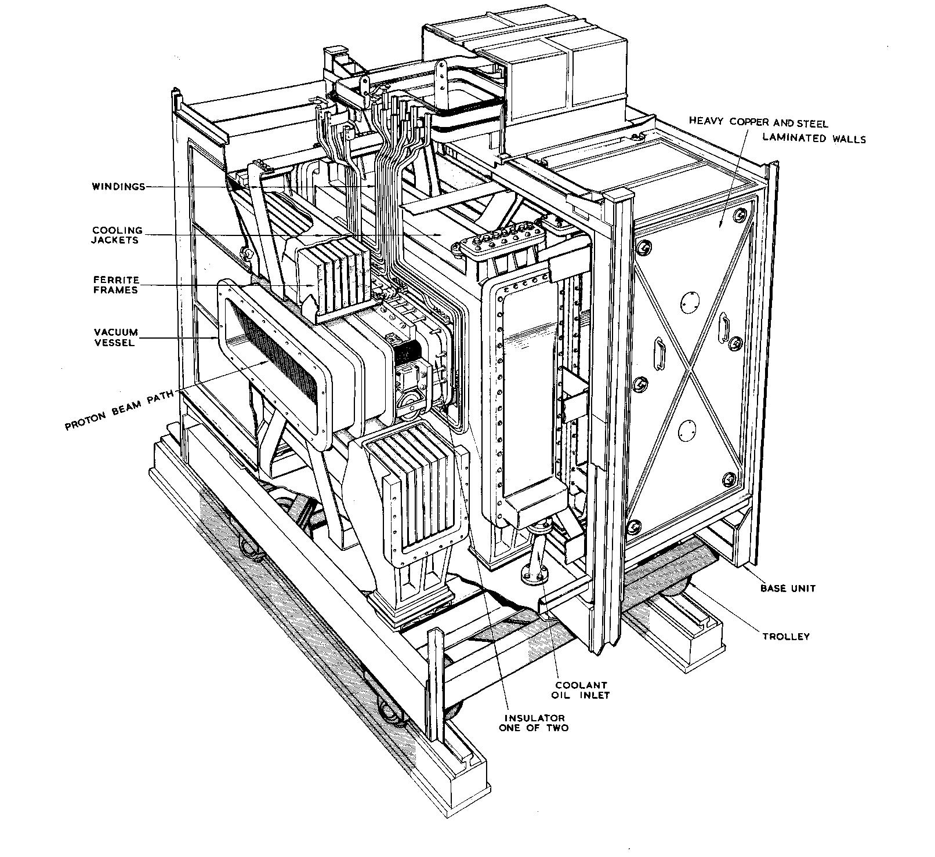
Options Considered
Drift Tube
  Resonators not in stray magnetic fields
  Higher harmonic needed
  Missing bunches & chopped injection needed
Ferrite Cavity plus Fixed Frequency re-buncher
  Low power for cavity but tuning system needs power
  Recovery time concern (2 ms) for 100 Hz operation
Magnetic Alloy Cavity plus Fixed Frequency re-buncher or possibly just 2 MA cavities
  Good recovery time
  No tuning system
  Higher power needed for cavity + Linear Amp.
Cutaway view of Nimrod RF Cavity

Slide 4
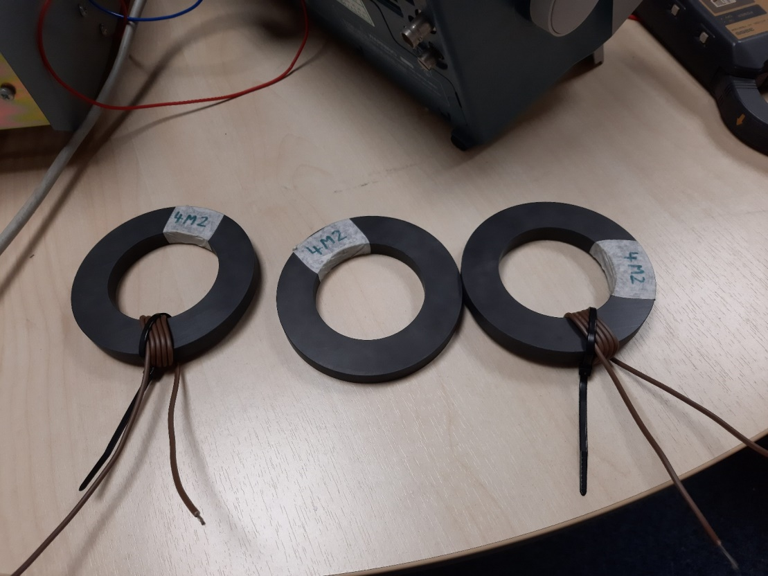
Two Gap Ferrite Cavity
Bias Input
Azimuthal length < 1 m
Three ferrites tested GF5, 8C15 & 4M2 - 4M2 selected
Estimated RF power with 4M2 Ferrite ~ 6 kW + tuner power
Recovery time a concern for 100Hz operation (2ms)

Slide 5
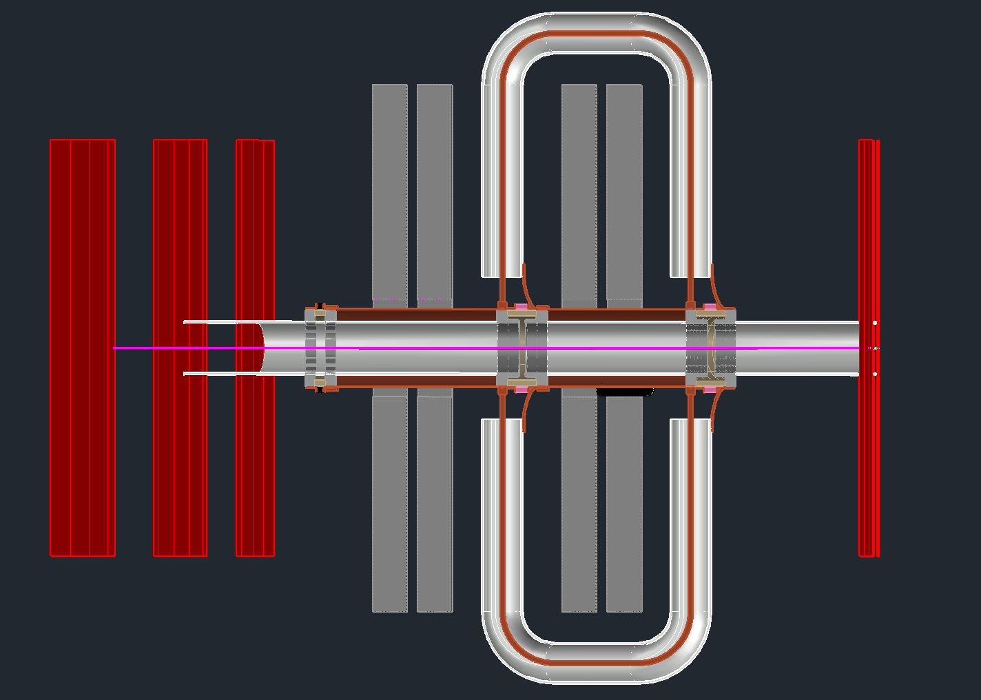
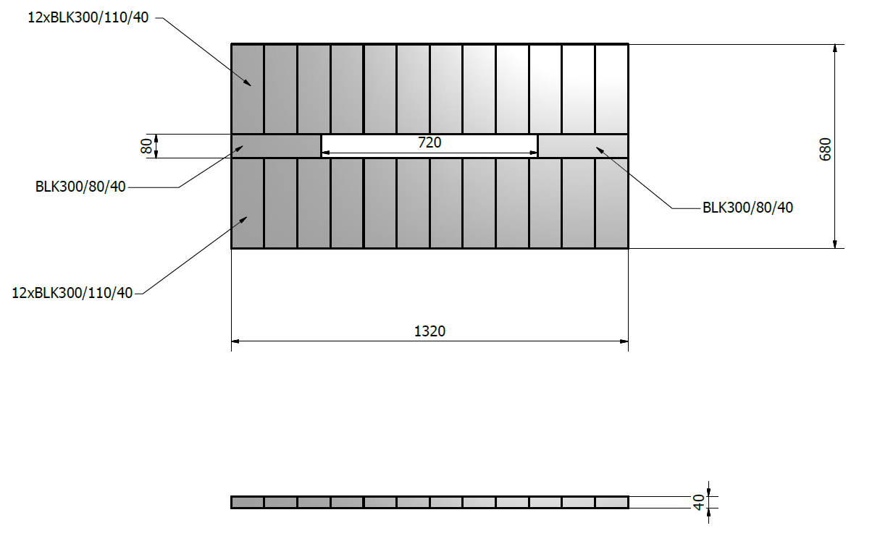
FETS FFA Cavity using 4M2 Ferrite
Bias Input
3kV / Gap
Overall length ~0.4 m

Slide 6
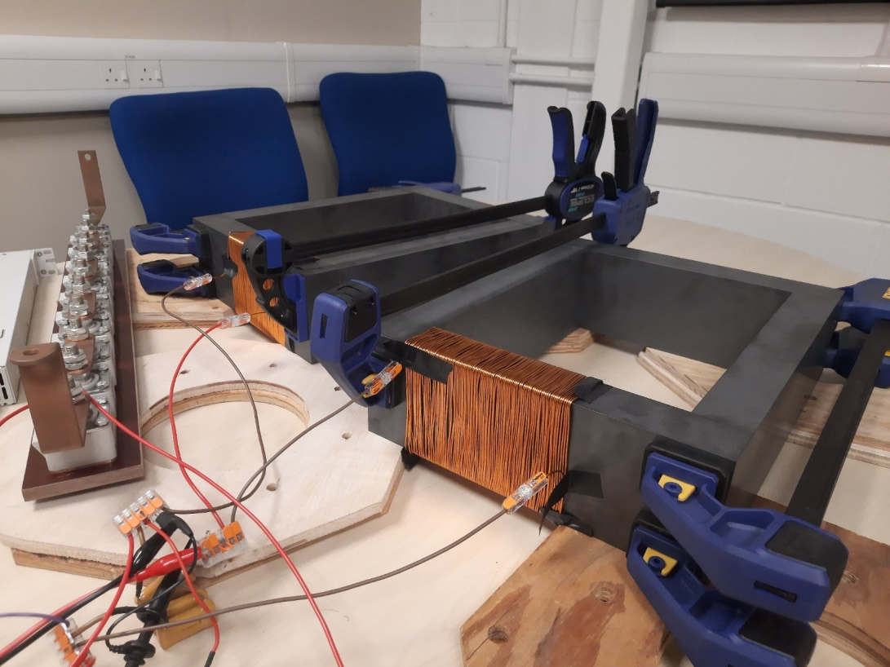
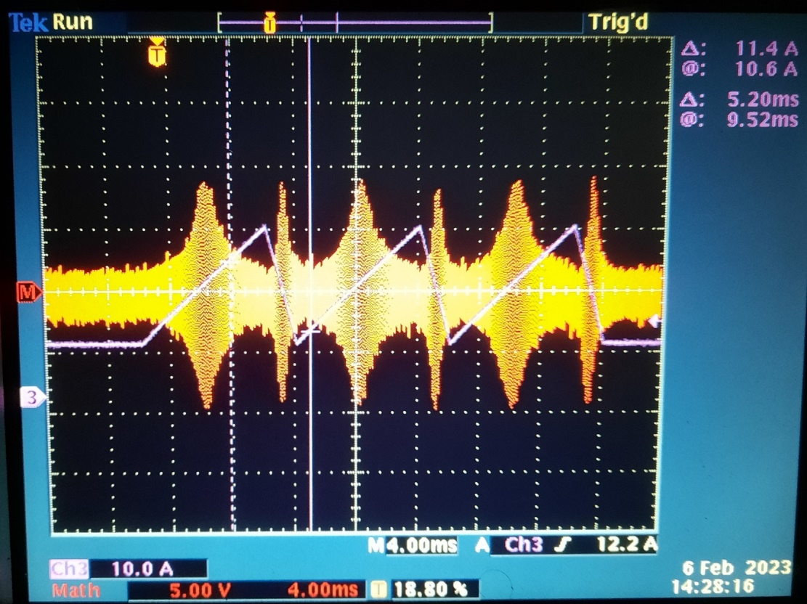
FETS FFA Cavity using 4M2 Ferrite
4M2 Sample Ferrite Frames
  Tender Exercise November 2021
  First 8 blocks arrived December 2022
  Further blocks short lead time pending approval
Initial tests confirm material performance
  Q ≈ 100 at RF frequencies
  Some evidence of magnetisation from production
Bias winding requires peak of 2800 Amp turns for Δf/f₀
  Tests confirm recovery time achievable
  Multiple bias turns may be considered
Further tests required with full frame design

Slide 7
MAGNETIC ALLOY SAMPLE TESTING

Slide 8
FETS 8 Core MA Cavity with Water Cooling Plates (initial design)
Cu
Insulation
0.94 m
MA
Al
Gap
Vacuum
0.3 m
Beam ~12 in
Cu MA Cu
Cu may be replaced by Nickel plated mild steel.
6 kV peak gap voltage over 1-6 MHz
Brf limited to 0.1 T in MA from cooling

Slide 9
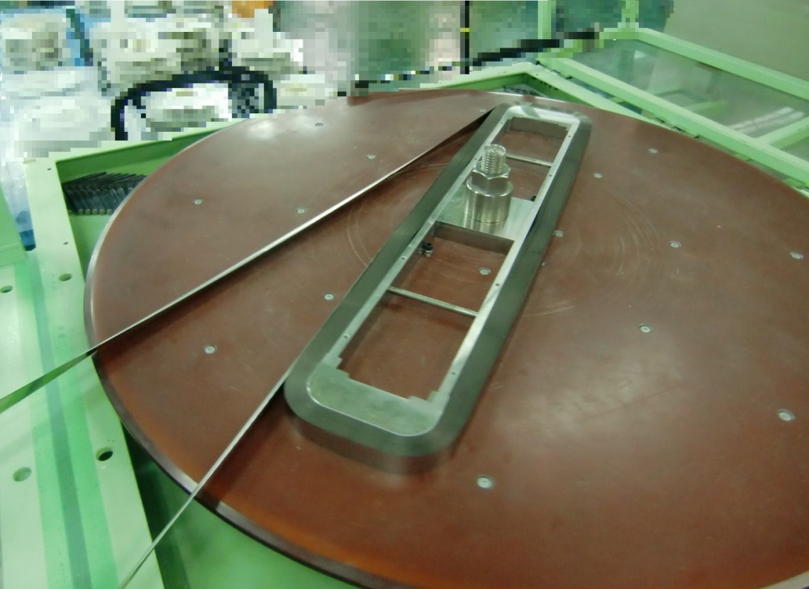
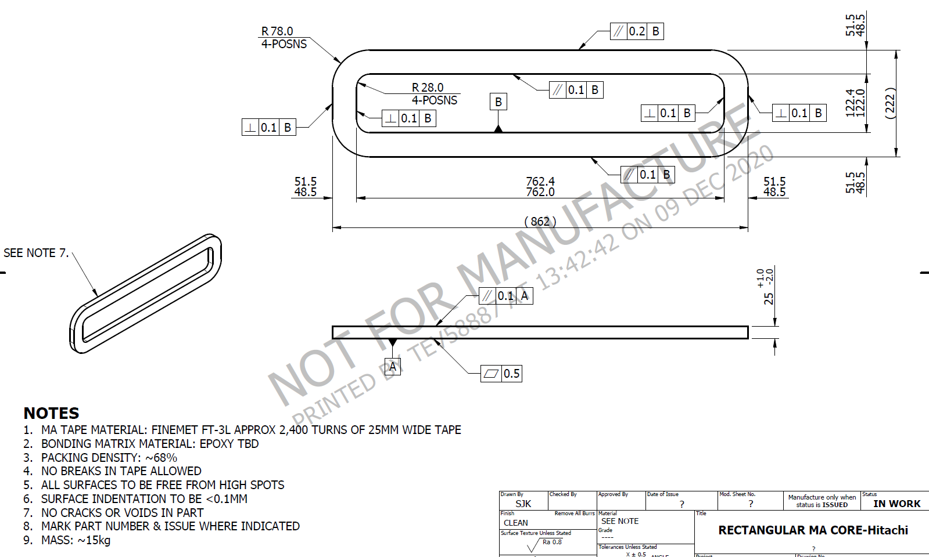
Sample Cores ordered from MagDev & Hitachi
  First Cores arrived Nov 2021
  Special agreement required from KEK for Hitachi
Hitachi core winder

Slide 10
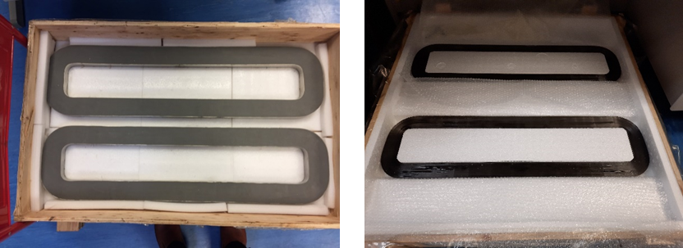
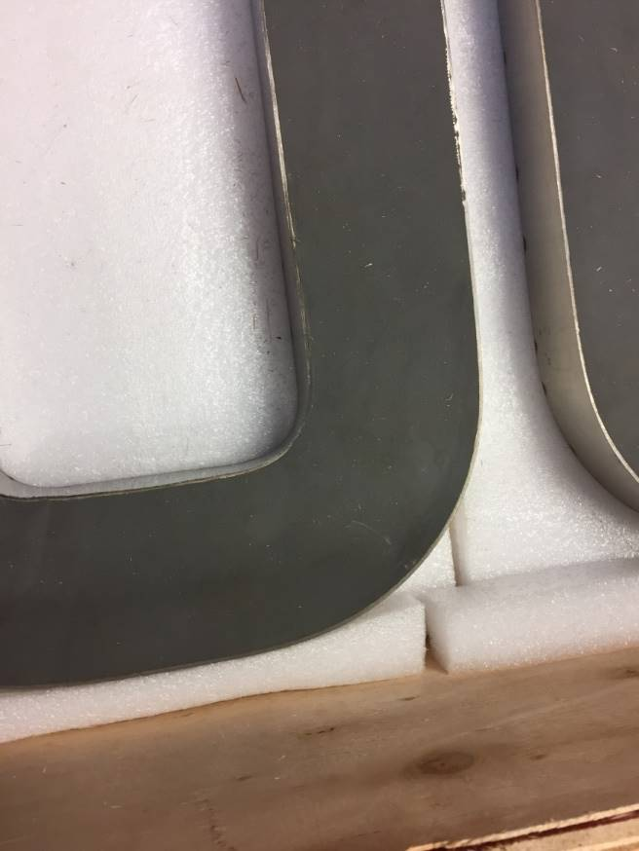
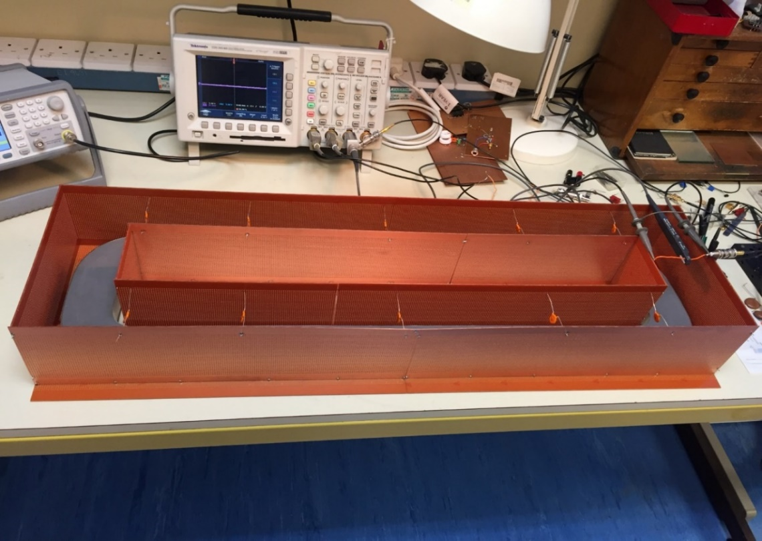
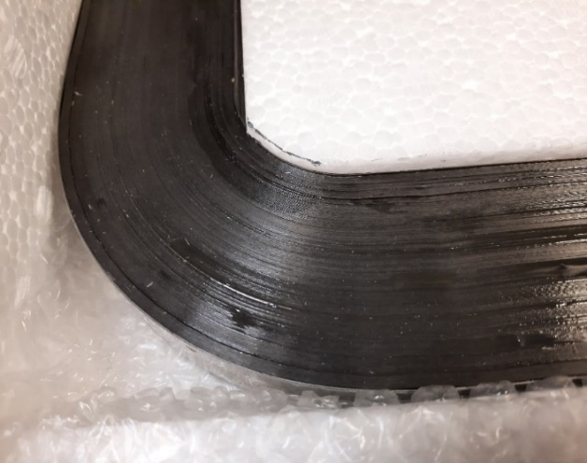
Low Power Test Set-Up
1K107 Potted
FT3L Epoxy coated

Slide 11
MagDev 1K107 Core Measurements
Measured with 75 V peak per core (Design voltage 750 V per core).
RF Power for 8 core cavity at 6 kV peak 110 - 150 kW
Consider using 2 cavities at ½ voltage ~38 kW each, meaning no Tuning system and wideband for fast modulations

Slide 12
Hitachi FT3L Core Measurements
Measured with 100 V peak per core
RF Power for 8 core cavity at 6 kV peak 50 - 65 kW
Consider using 2 cavities at ½ voltage ~16 kW each, meaning no Tuning system and wideband for fast modulations

Slide 13
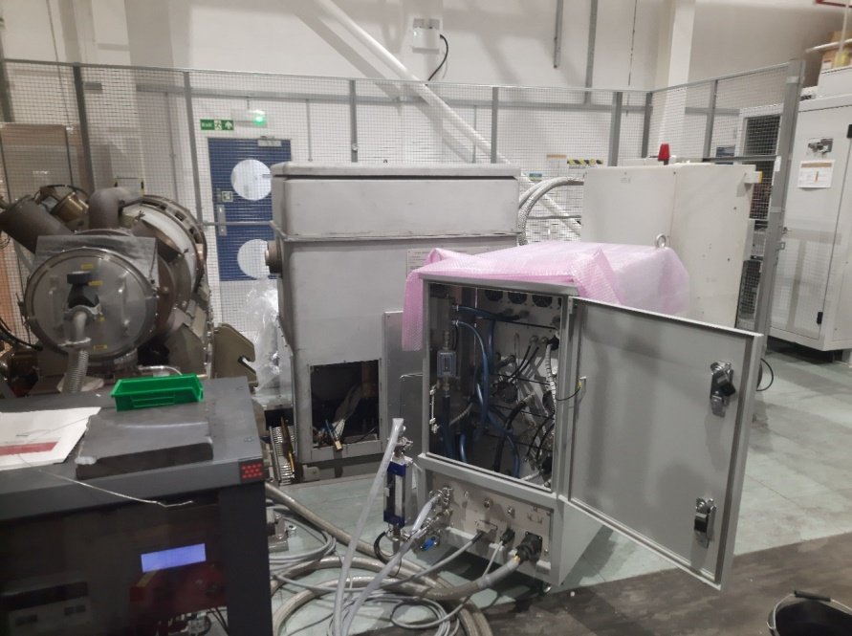
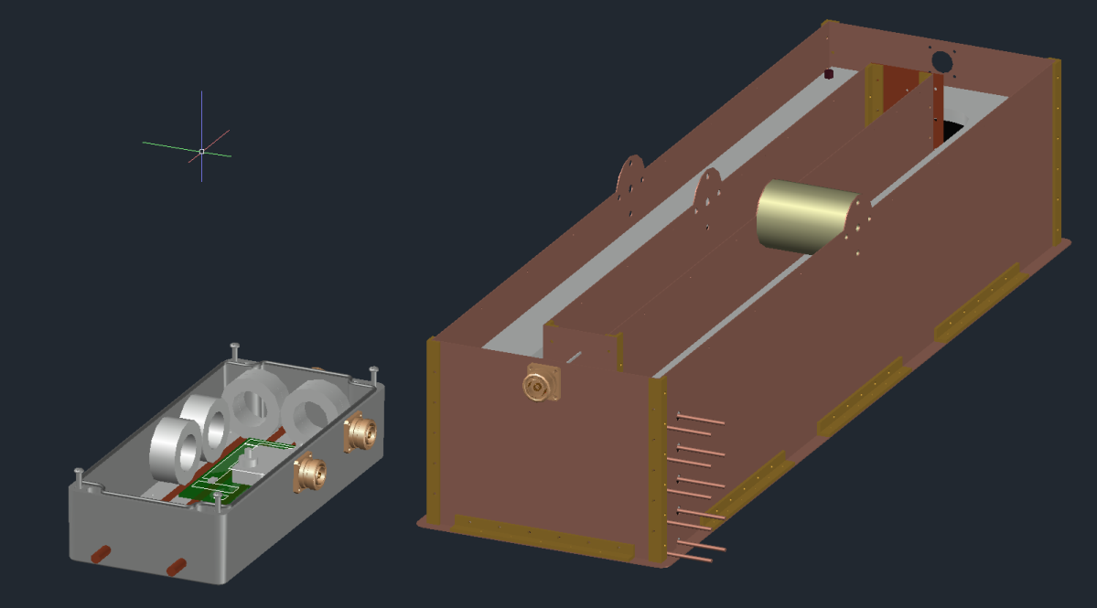
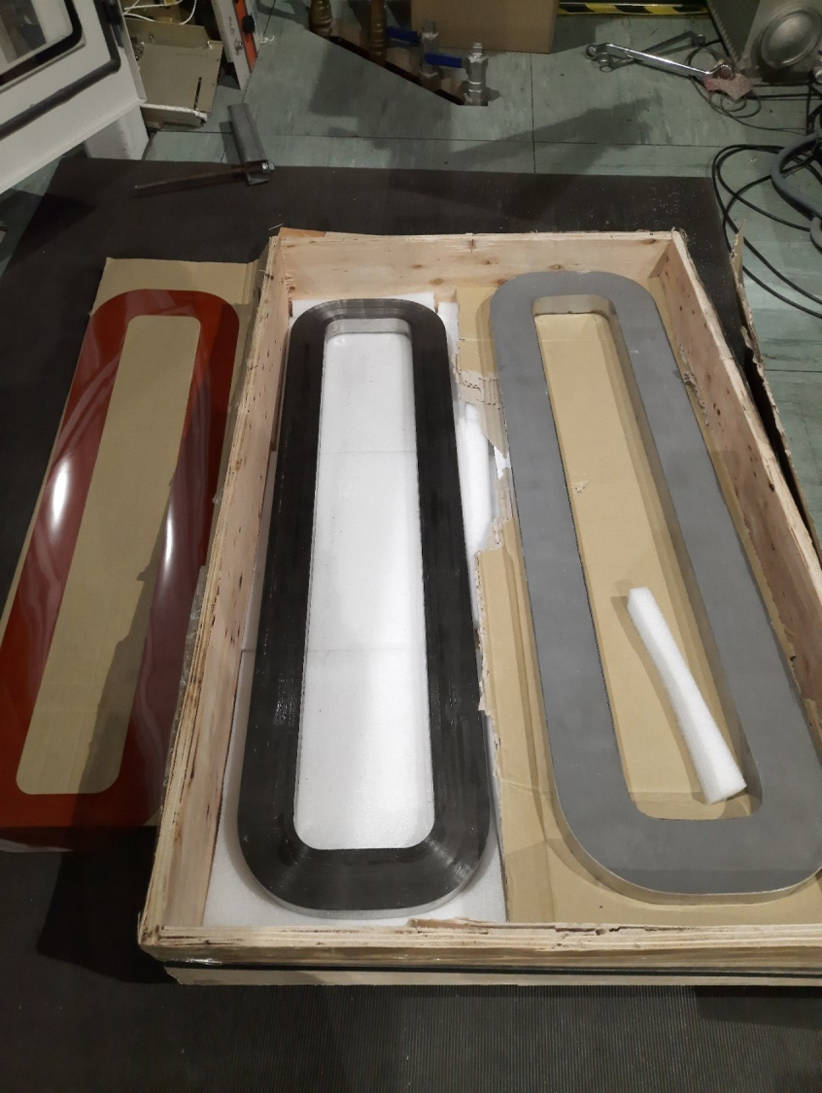
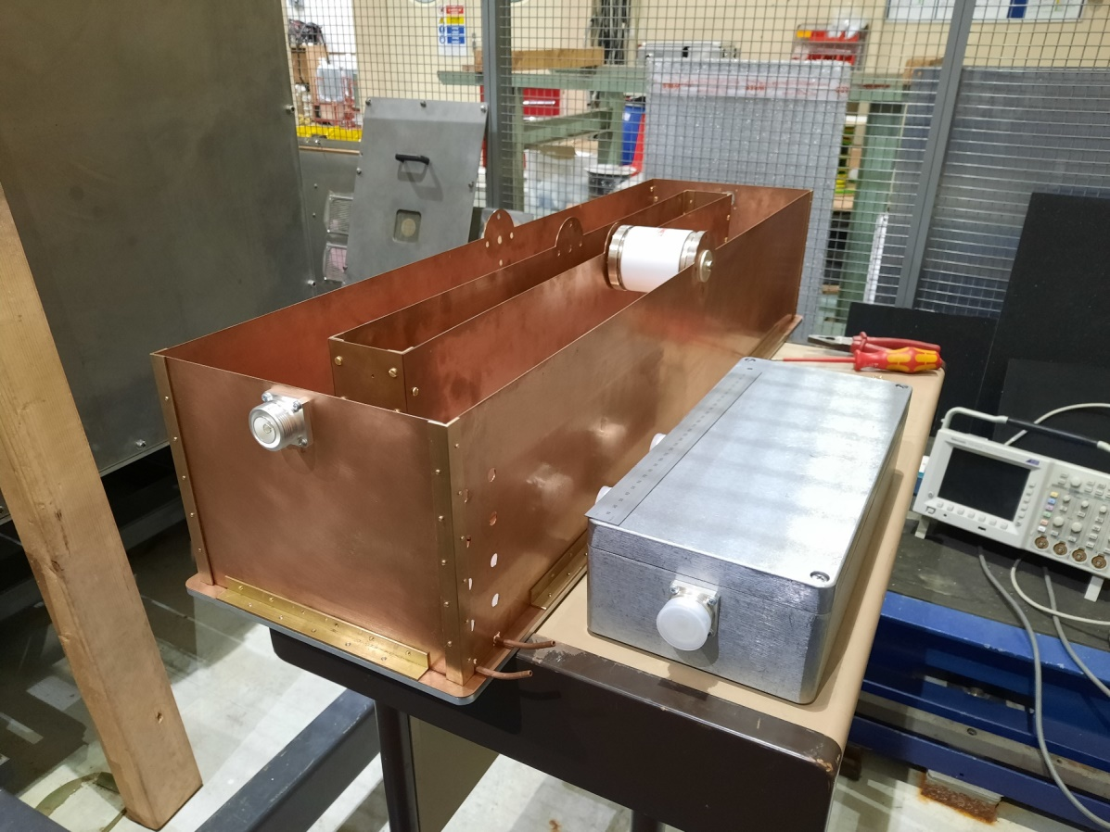
3kW Test SSA
6kW Combiner & Test Cavity
FT3L and 1K107 Test Cores

Slide 14
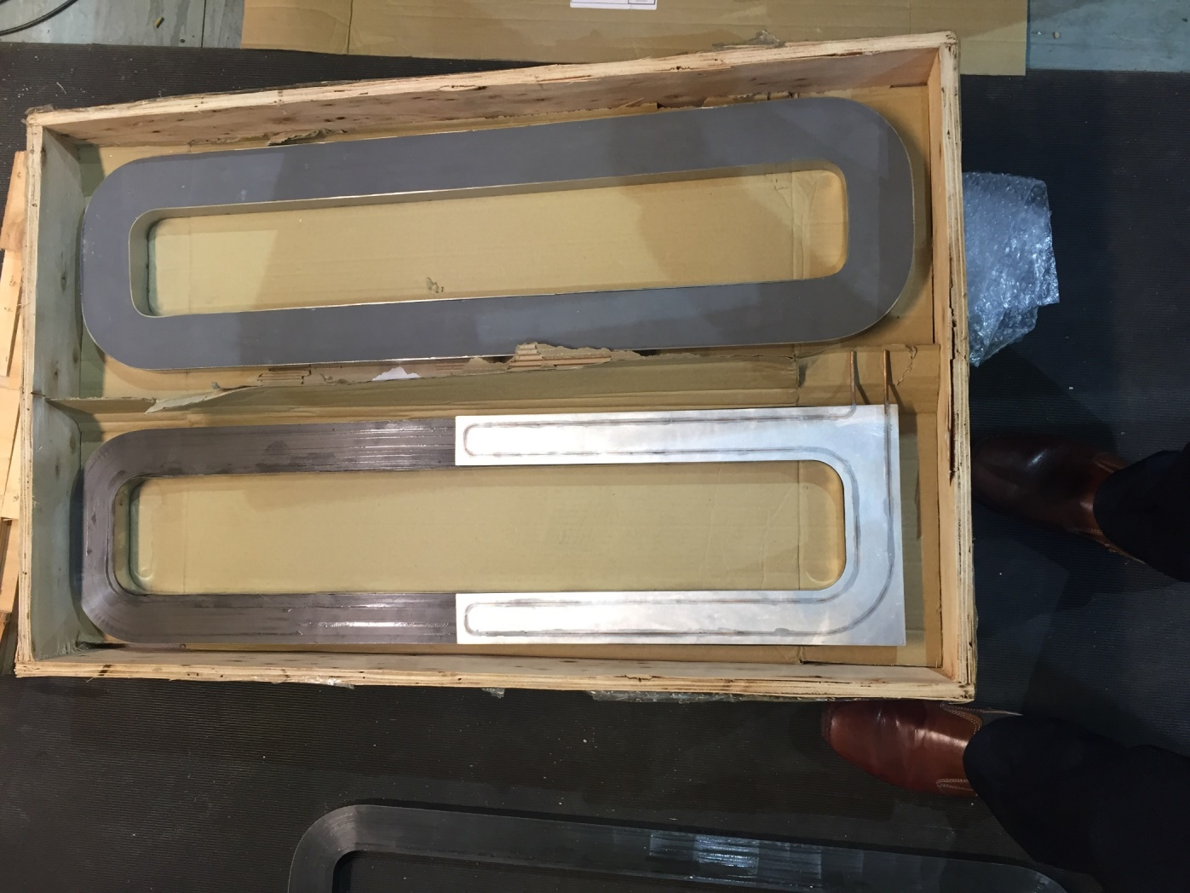
Initial MA Cooling Plate Design
Cooling plates made in two pieces
Teflon sheet separators
Power tests to measure the cooling

Slide 15
 | Ferrite | MA
RF Power req. for 6kV | 6kW | 35kW
Amplifier | Solid State Class B (or A) | Large SS/ Small Vacuum Tube Class A or AB Push-pull
Bias Required | Yes Likely ~35kW | No
Est. Wallplug Power (ignoring plant) | ~45kW (Class B) ~60kW (Class A) | ~140kW (A Vac. Tube) ~100kW (B p-p Vac. Tube)
Proximity to Magnetic Fields | µ_{r}≈140, absorbed into bias | Problematic µ_{r}≈4000
Rep Rate 100Hz+ | Possible | No recovery
Bunch Stacking | Possible 10kV burst on two cavities? | Possible 10kV burst on two cavities?
LLRF | Simple but wide band Tuning system needed | Simple (little beam loading)

Slide 16
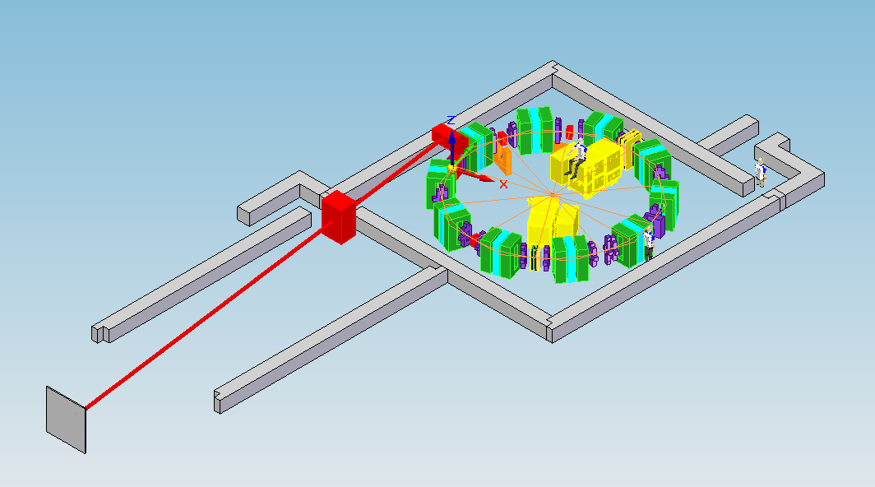
Concluding
Either technology looks feasible to meet cavity specification
  Two cavity option may work in both cases for Acceleration & Re-bunching
Further work
  Power tests to full flux
      750V/core for 8 core cavity -> ~6kW across single core)
  μ dependency on stray B field
  Thermal tests
  Refinement of CST simulations
      Benchmarking
      Non-isotropic permeability & permittivity
Full System Spec – ferrite & MA
  Proceed to full prototype?

