Slide 1
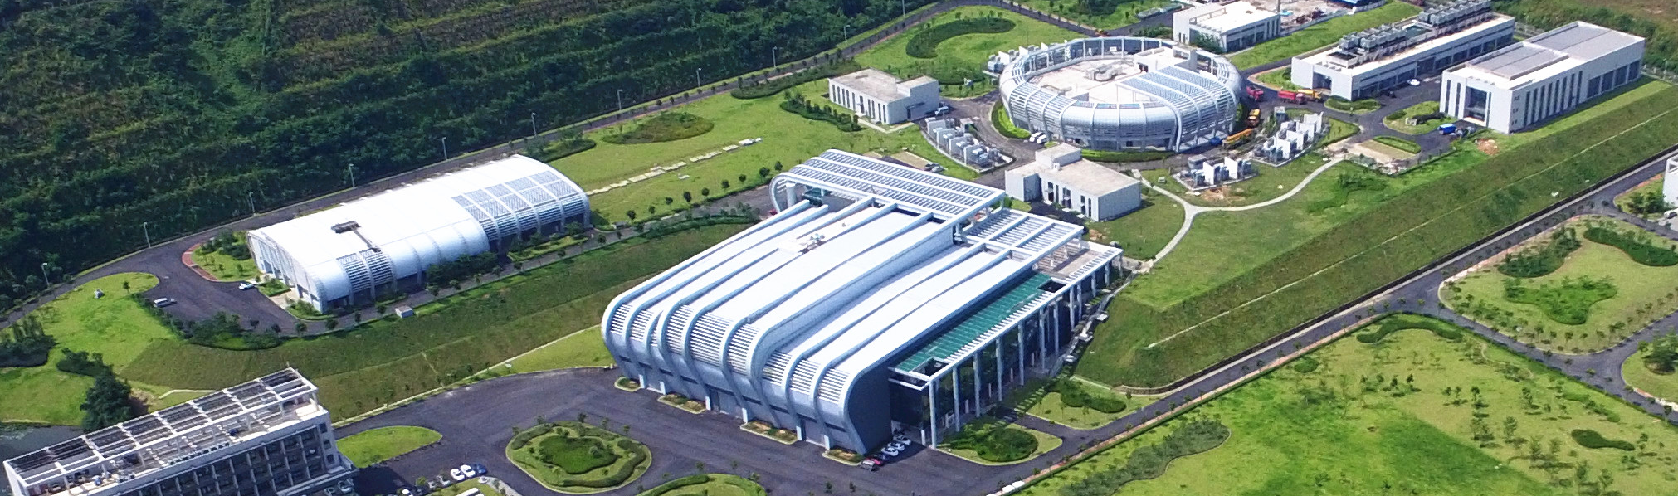

Design and Commissioning of the collimation system at CSNS
Shouyan Xu
Spallation Neutron Source Science Centre, IHEP

Slide 2
Contents
1
Introduction to CSNS/RCS
2
Transverse collimator at CSNS/RCS
3
The design of the transverse collimator at CSNS-II/RCS
4
Design and commissioning of the momentum collimator
5
Collimator for FFAG

Slide 3
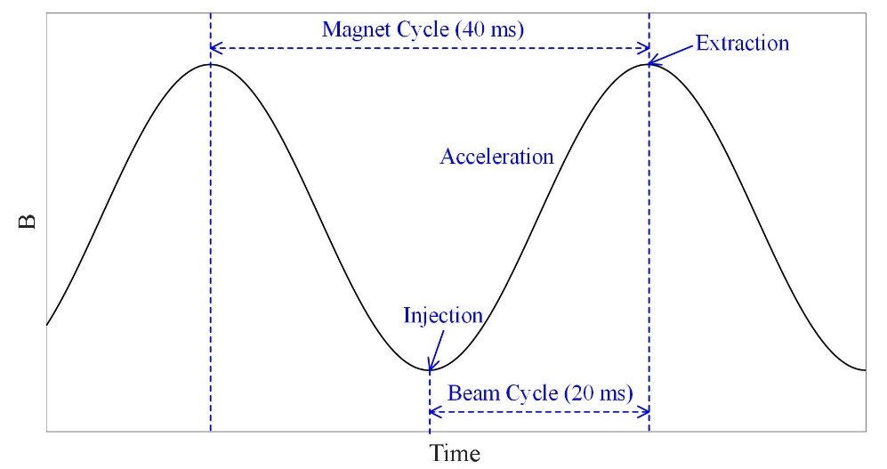
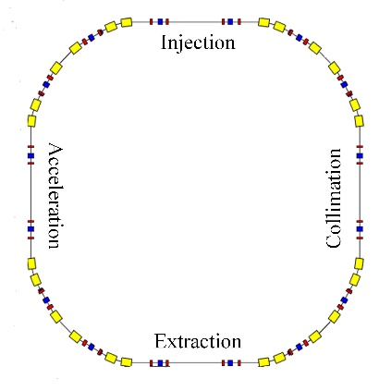
1. Introduction to CSNS/RCS
 | CSNS | CSNS@200kW | CSNS-II
Output Beam Power [kW] | 100 | 200 | 500
Injection Energy [MeV] | 80 | 80 | 300
Extraction Energy [GeV] | 1.6 | 1.6 | 1.6
Pulse repetition rate [Hz] | 25 | 25 | 25
Ramping Pattern | Sinusoidal | Sinusoidal | Sinusoidal
Acceleration Time [ms] | 20 | 20 | 20
Circumference [m] | 227.92 | 227.92 | 227.92
Nominal Betatron Tunes (H/V) | (4.86, 4.80) | (4.86, 4.80) | (4.86, 4.80)
Natural Chromaticity | -4.0/-8.2 | -4.0/-8.2 | -4.0/-8.2
Ring Acceptance [πmm-mrad] | 540 | 540 | 540
Harmonic Number | 2 | 2 | 2
Second harmonic RF | No | Yes | Yes
Number of Particles per Pulse | 1.56×10¹³ | 3.12×10¹³ | 7.80×10¹³
Space-Chare Tune Shift | -0.28 | -0.37 | -0.19
The schematic diagram of the magnetic field waveform
The schematic layout of the RCS

Slide 4
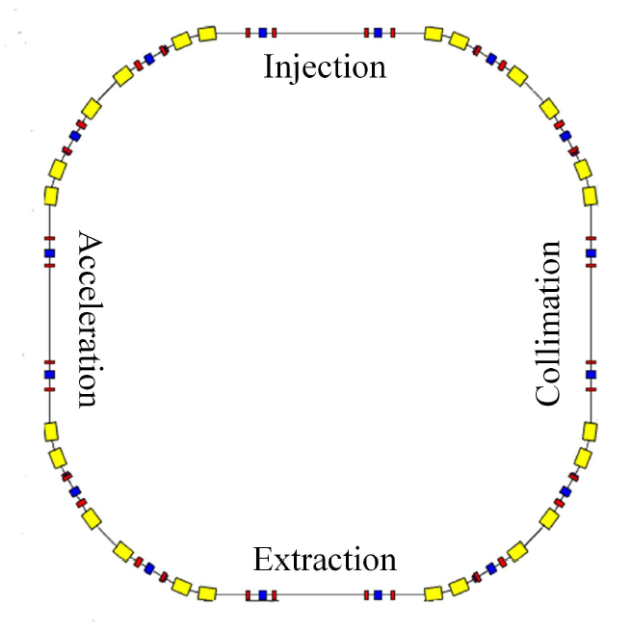
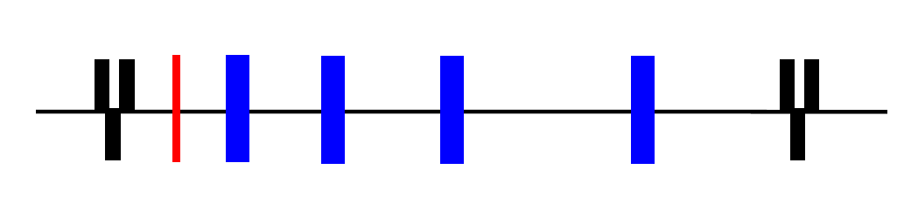
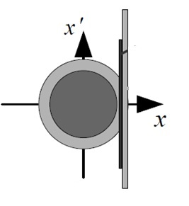
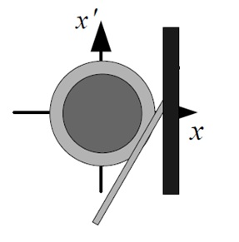
2. Transverse collimator at CSNS/RCS
The design of the transverse collimation system
—Two stage collimation system
Quadrupole magnets
Secondary collimators
Quadrupole magnets
Primary collimator
Halo particles are scattered.
Collect the scattered particles.

Slide 5
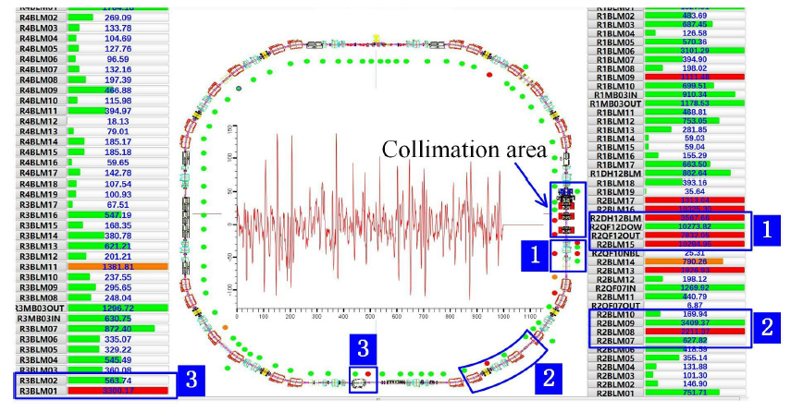
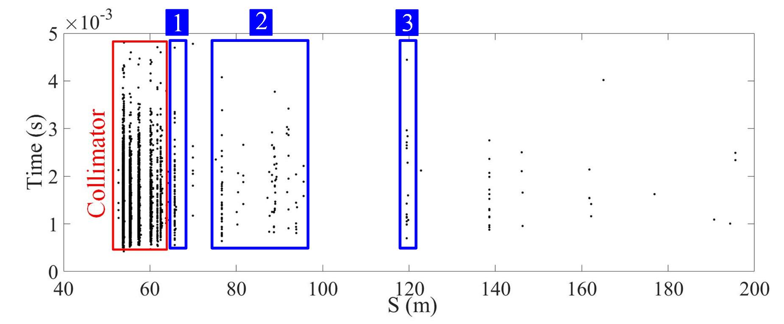
2. Transverse collimator at CSNS/RCS
Commissioning of the transverse collimation system
Three beam loss points outside the collimation area.

Slide 6
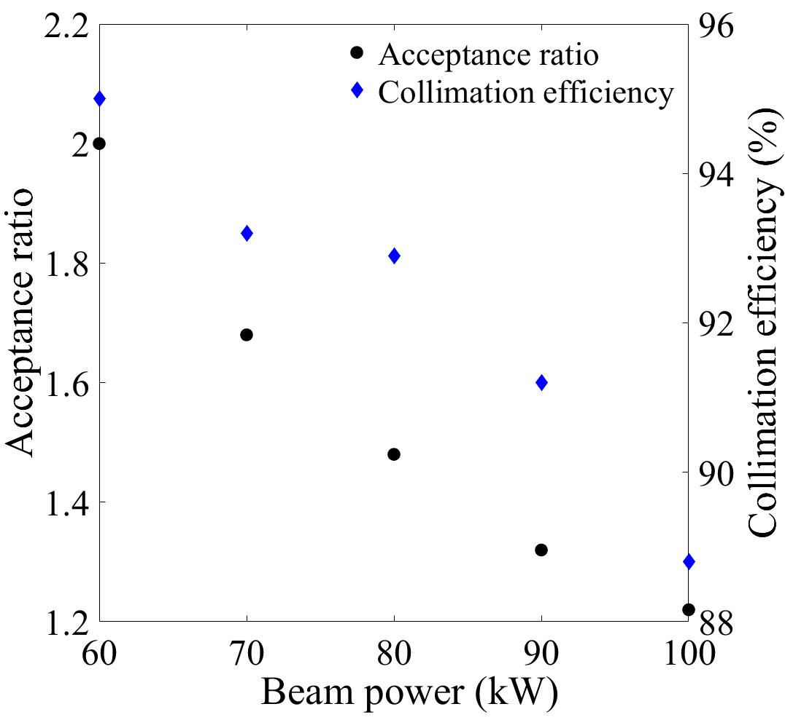
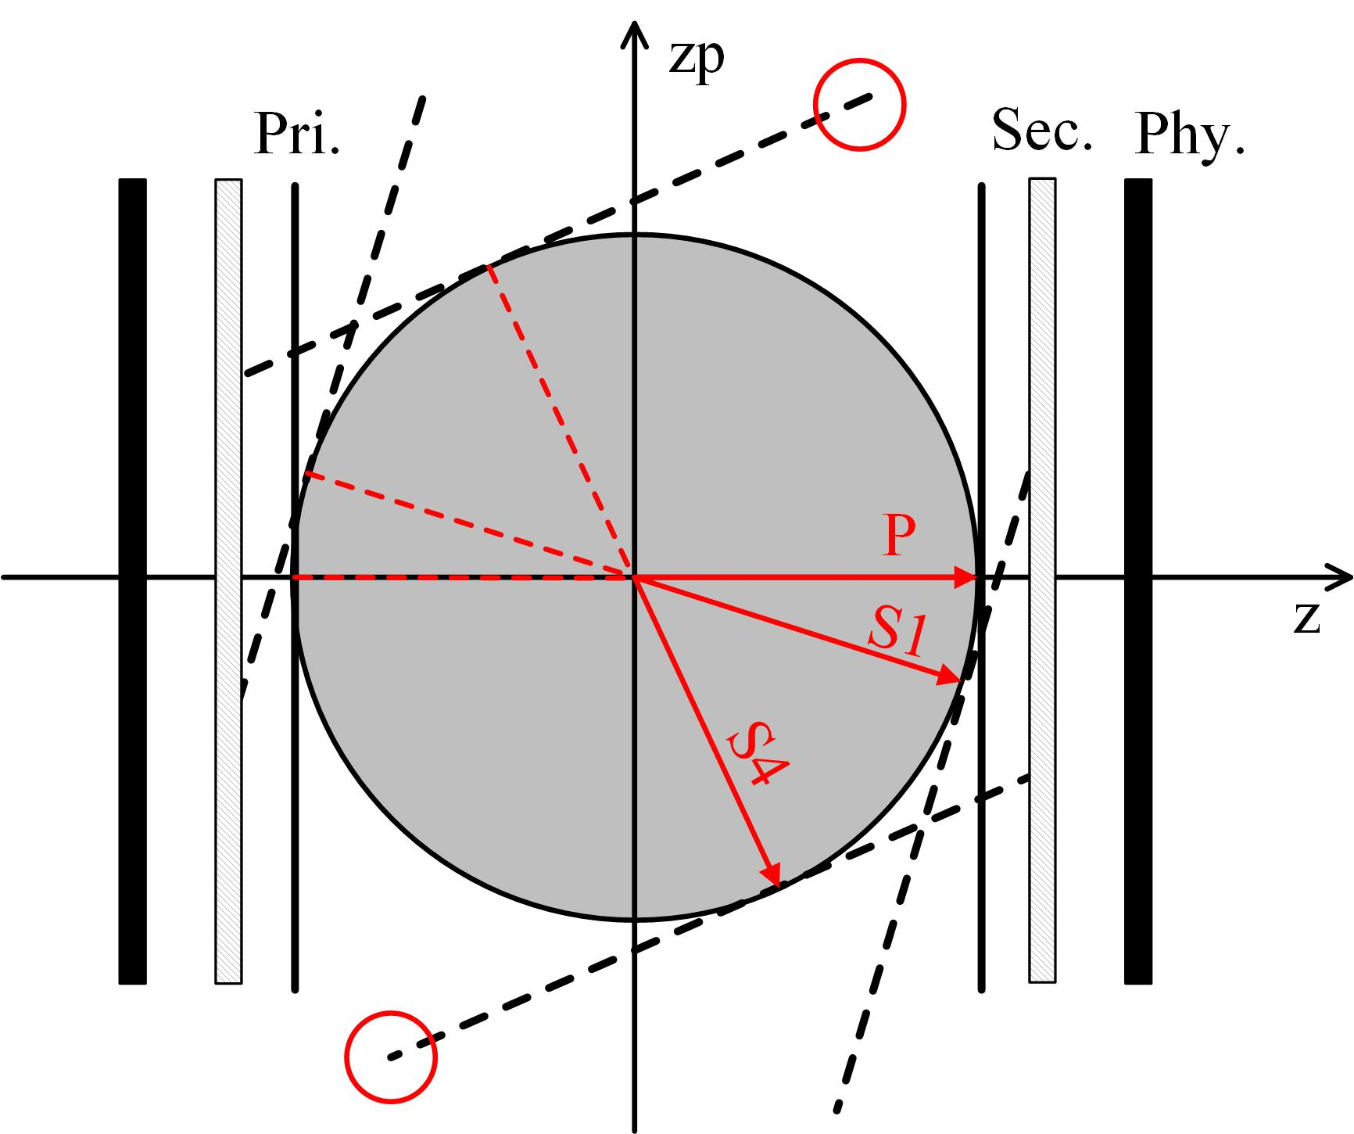
2. Transverse collimator at CSNS/RCS
Analysis of the low collimation efficiency
1. The phase advances between the primary and secondary collimators are inadequate.
（21°，22°）
（62°，67°）
（9°，9°）
（38°，41°）
2. The small gap between the physical acceptance and the collimator acceptance is another factor that influences the collimations efficiency.

Slide 7
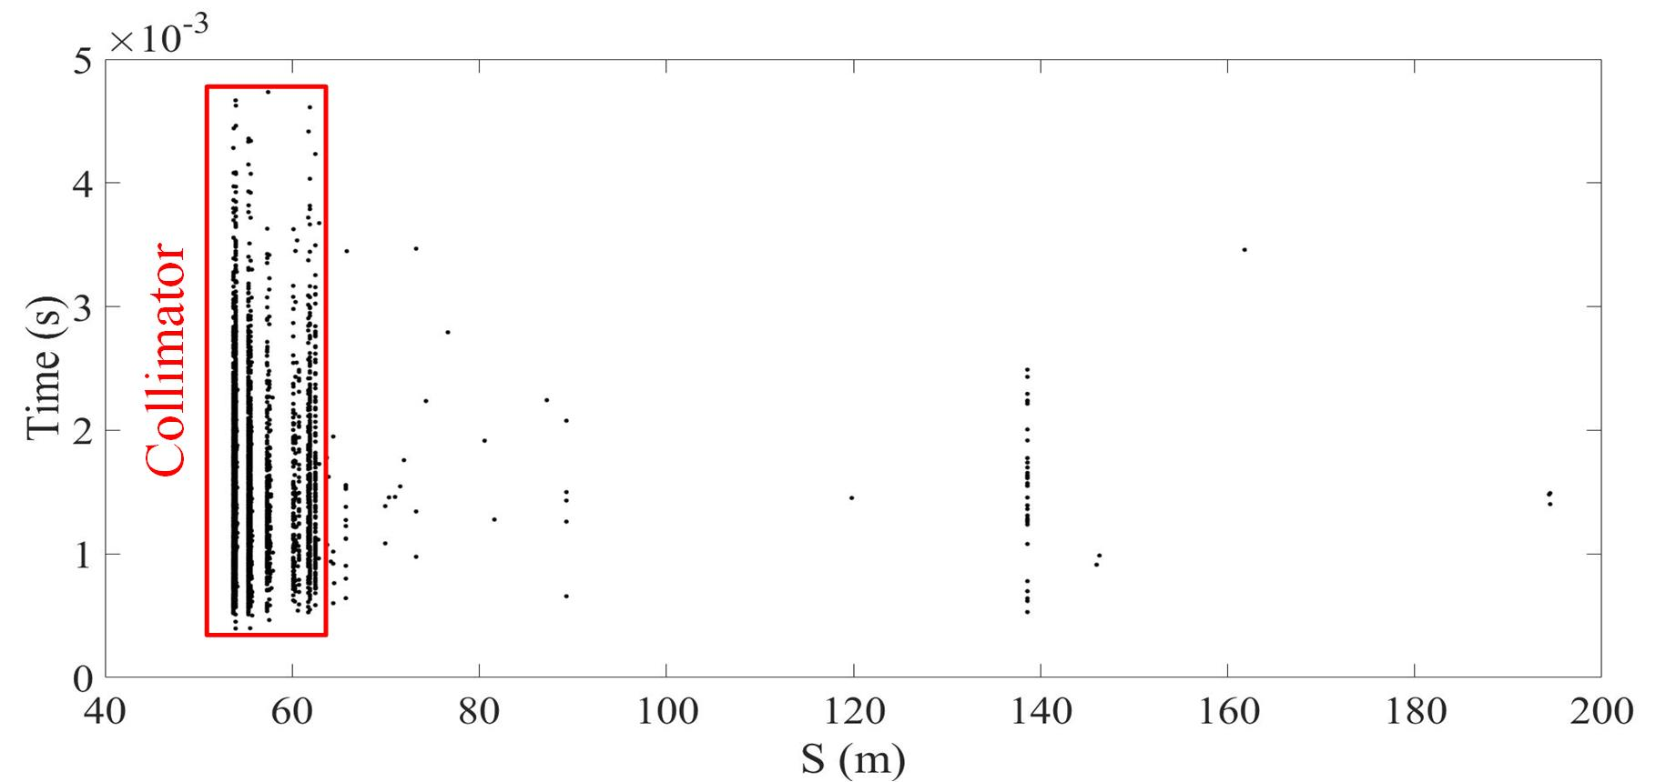
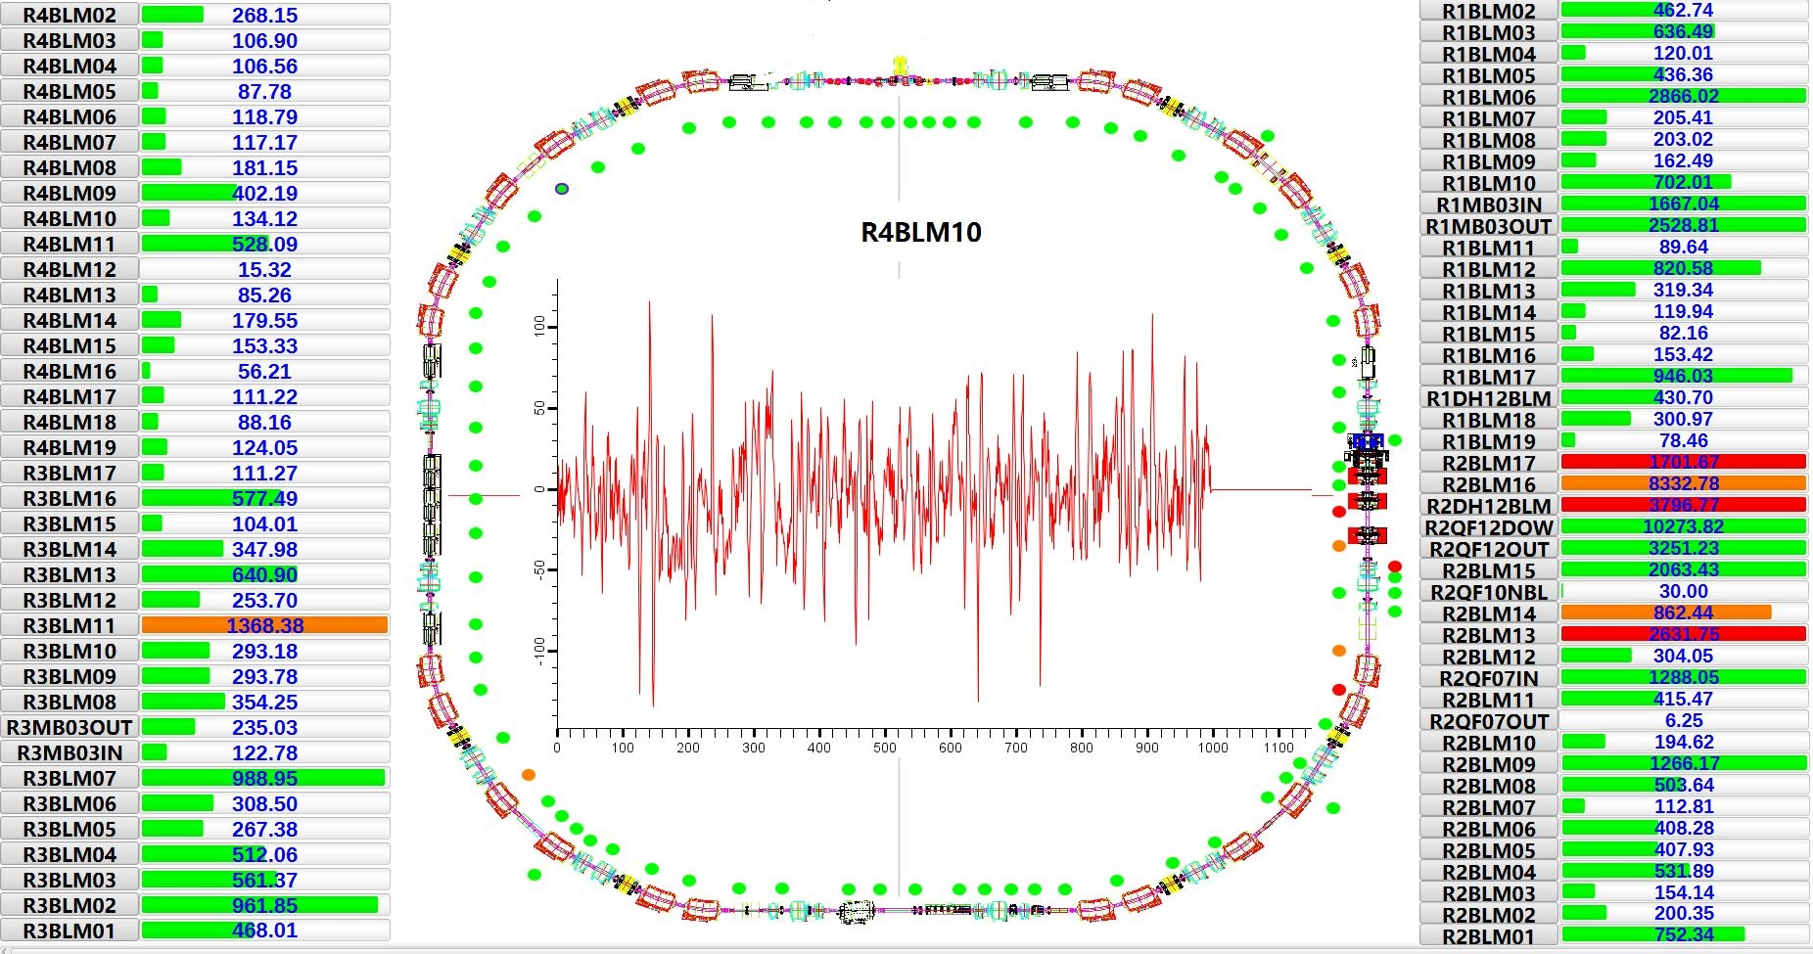
2. Transverse collimator at CSNS/RCS
Transverse collimation system optimization at CSNS/RCS
—Change to single-stage collimation system
Remove

Slide 8
3. Design of the transverse collimator at CSNS-II/RCS
The design of the transverse collimation system
 | CSNS | CSNS-II
Output Beam Power [kW] | 100 | 500
Injection Energy [MeV] | 80 | 300
Extraction Energy [GeV] | 1.6 | 1.6
Pulse repetition rate [Hz] | 25 | 25
Ramping Pattern | Sinusoidal | Sinusoidal
Acceleration Time [ms] | 20 | 20
Circumference [m] | 227.92 | 227.92
Natural Chromaticity | -4.0/-8.2 | -4.0/-8.2
Ring Acceptance [πmm-mrad] | 540 | 540
Harmonic Number | 2 | 2
Second harmonic RF | No | Yes
Number of Particles per Pulse | 1.56×10¹³ | 7.80×10¹³
Space-Chare Tune Shift | -0.28 | -0.19

Slide 9
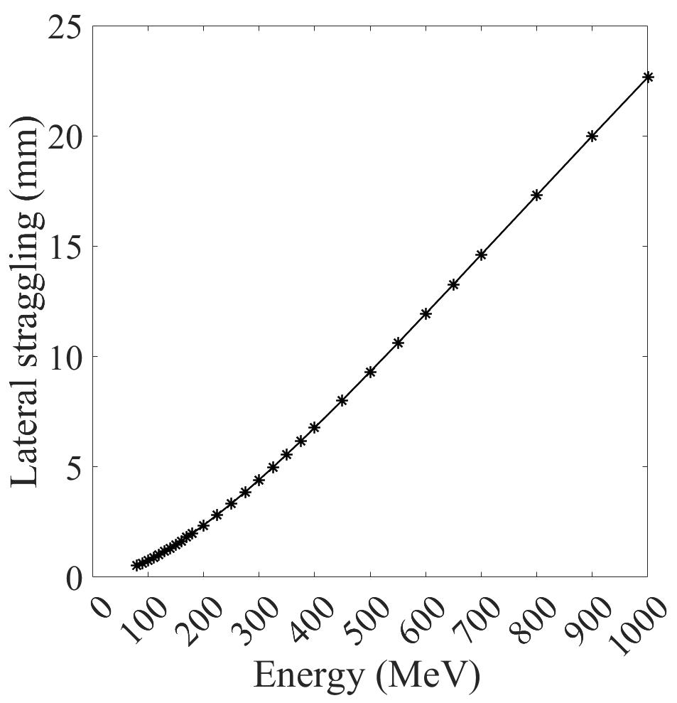
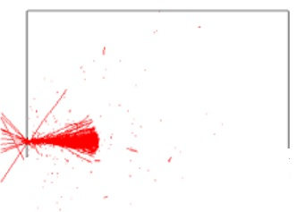
3. Design of the transverse collimator at CSNS-II/RCS
The challenges in the design of the CSNS-II RCS transverse collimator:
With the injection energy increased to 300 MeV and the lost particle energy approximately 350 MeV, the absorption efficiency for such high energy particles is low for the single-stage collimation scheme.
There is insufficient phase shift to ensure the collimation efficiency for the two-stage collimation scheme.
（21°，22°）
（62°，67°）
（9°，9°）
（38°，41°）
Lateral straggling causes some particles that collide with the collimator blocks to escape from the inner edge.

Slide 10
3. Design of the transverse collimator at CSNS-II/RCS
The design of the transverse collimation system
—Unconventional single-stage collimation system
1. The collimator system consists of five stages of absorption blocks.
2. The first stage designed to directly absorb halo particles.
3. Particles scattered by the first block are furtherly collected by the following blocks.
4. All the blocks are movable in transverse direction.
Absorb particles ejected from the front block
Acceptance: ~450πmmmrad
Block to directly absorb the halo particles;
Acceptance: ~400πmmmrad
Physical acceptance: 540πmmmrad

Slide 11
3. Design of the transverse collimator at CSNS-II/RCS
The simulation results
Down stream magnets
Block-1
Block-2
Block-3
Block-4
Block-5
Shield
Position | Ration | Power
Block-1 | 50.2% | 200 W
Block-2 | 18.1% | 72 W
Block-3 | 15.0% | 60 W
Block-4 | 8.4% | 33 W
Block-5 | 2.7% | 11 W
Shield | 4.5% | 18 W
Downstream magnets | 0.6% | 2.4 W
Other place | 0.6% | 2.4 W

Slide 12
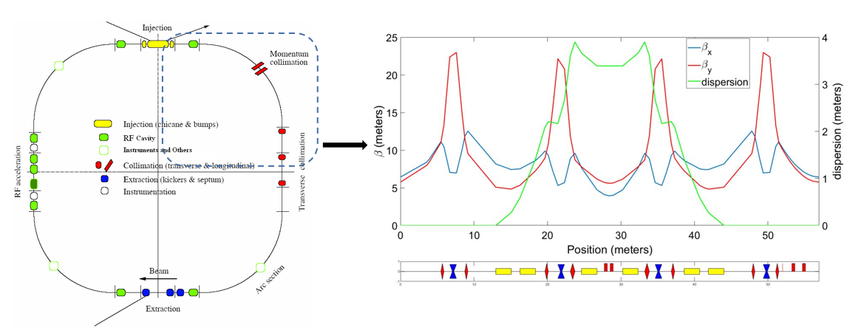
4. The momentum collimator at CSNS
The design of the momentum collimation system
 | CSNS | CSNS@200kW | CSNS-II
Output Beam Power [kW] | 100 | 200 | 500
Injection Energy [MeV] | 80 | 80 | 300
Extraction Energy [GeV] | 1.6 | 1.6 | 1.6
Pulse repetition rate [Hz] | 25 | 25 | 25
Ramping Pattern | Sinusoidal | Sinusoidal | Sinusoidal
Acceleration Time [ms] | 20 | 20 | 20
Circumference [m] | 227.92 | 227.92 | 227.92
Nominal Betatron Tunes (H/V) | (4.86, 4.80) | (4.86, 4.80) | (4.86, 4.80)
Natural Chromaticity | -4.0/-8.2 | -4.0/-8.2 | -4.0/-8.2
Ring Acceptance [πmm-mrad] | 540 | 540 | 540
Harmonic Number | 2 | 2 | 2
Second harmonic RF | No | Yes | Yes
Number of Particles per Pulse | 1.56×10¹³ | 3.12×10¹³ | 7.80×10¹³
Space-Chare Tune Shift | -0.28 | -0.37 | -0.19

Slide 13
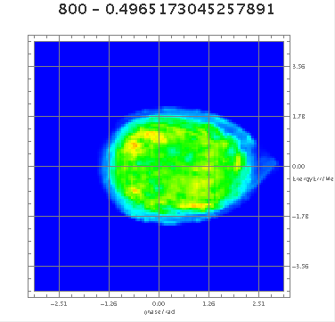
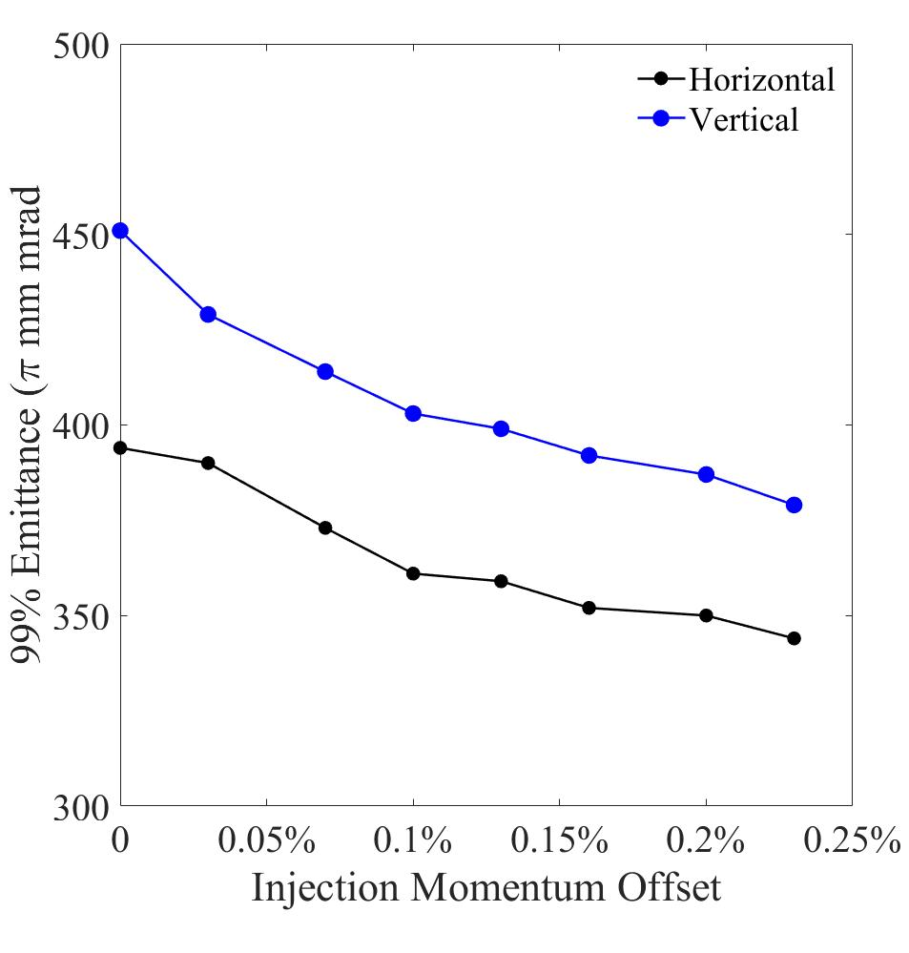
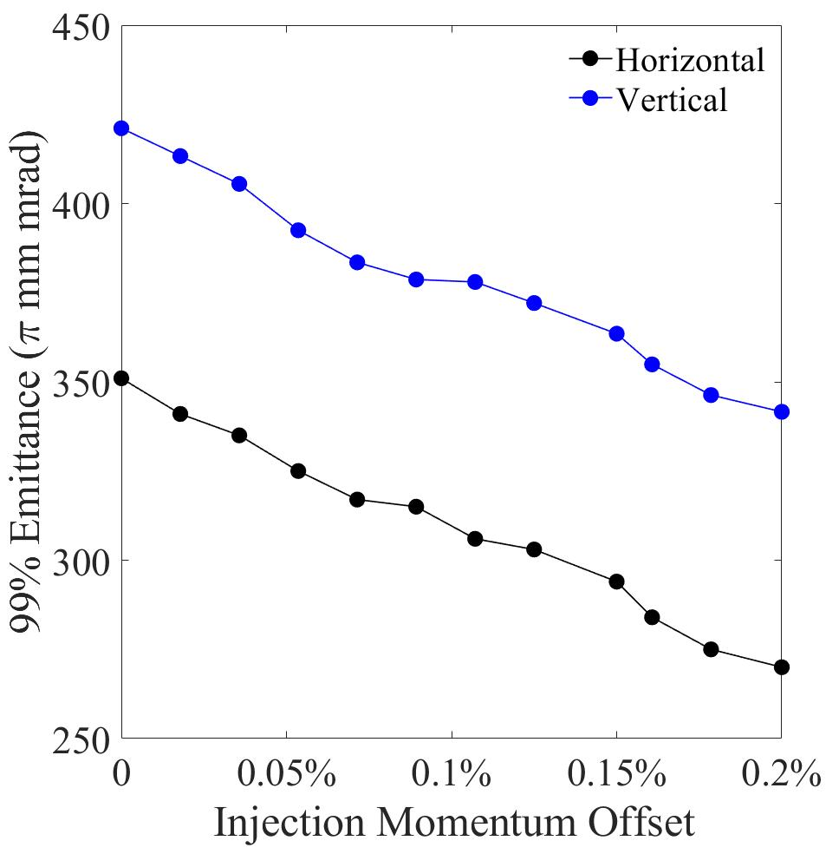
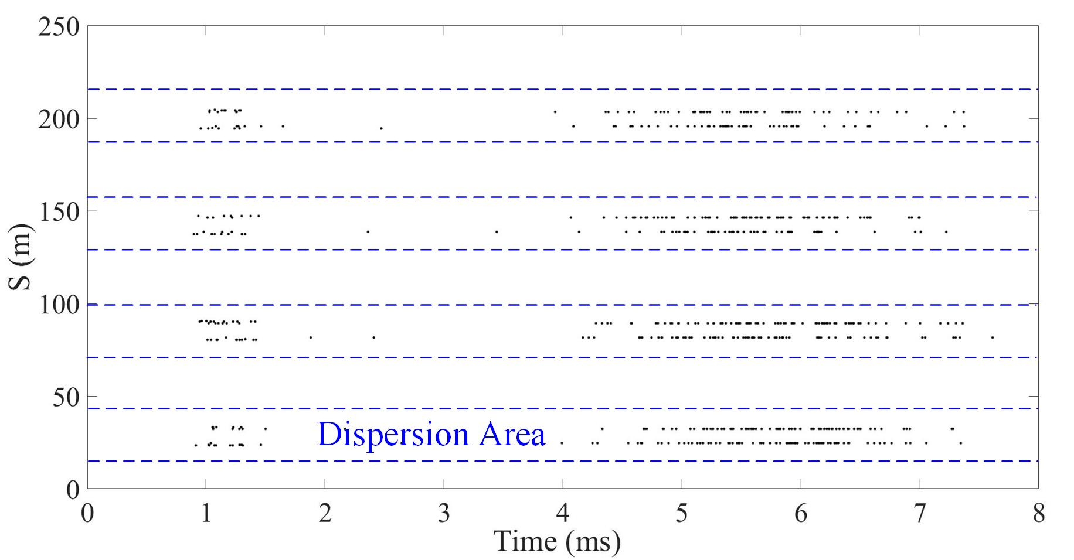
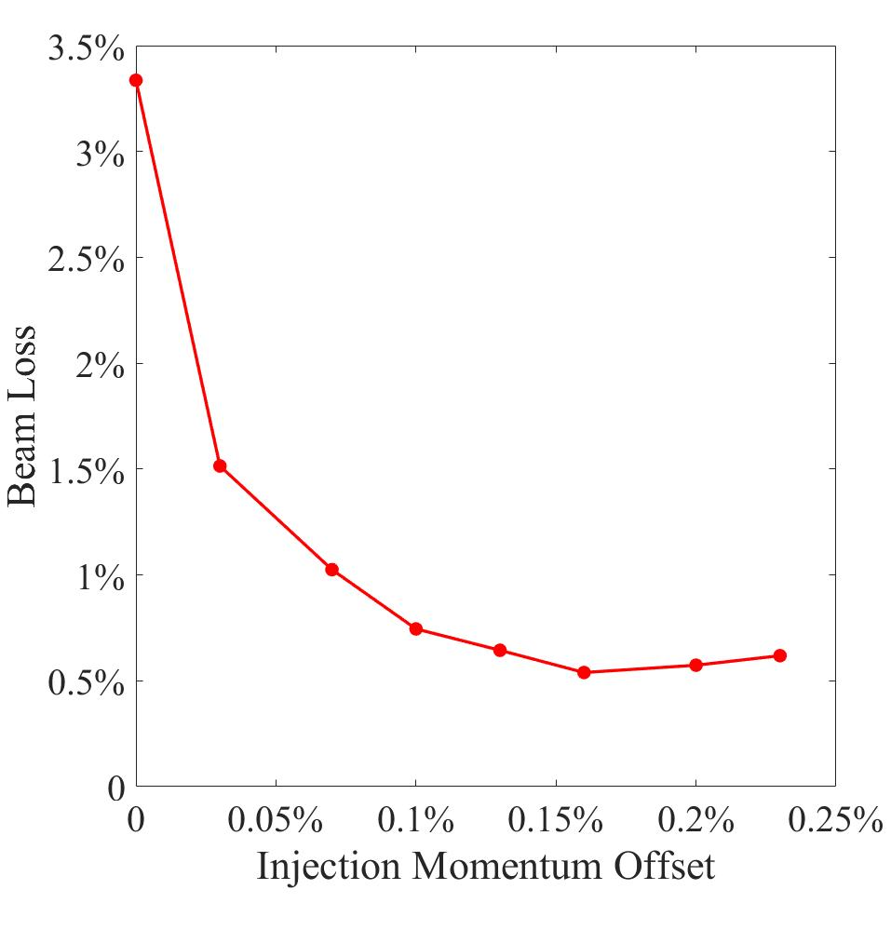
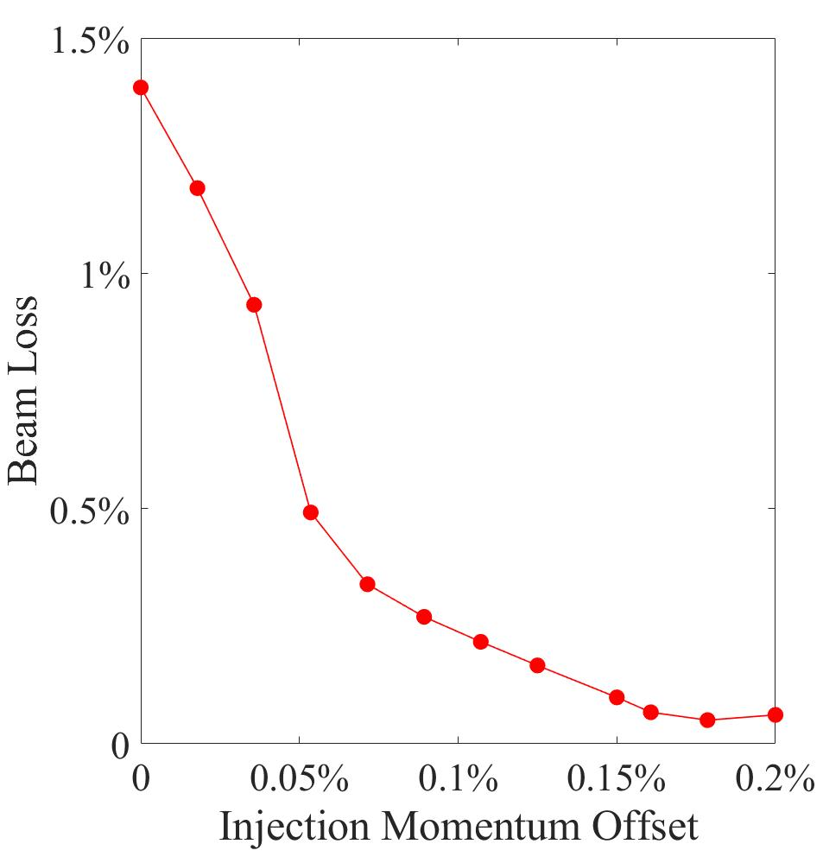
4. The momentum collimator at CSNS
Beam loss in longitudinal plane
CSNS@200k
CSNS-II
Longitudinal painting is widely used to reduce space charge effects.
Beam losses in longitudinal plane.

Slide 14
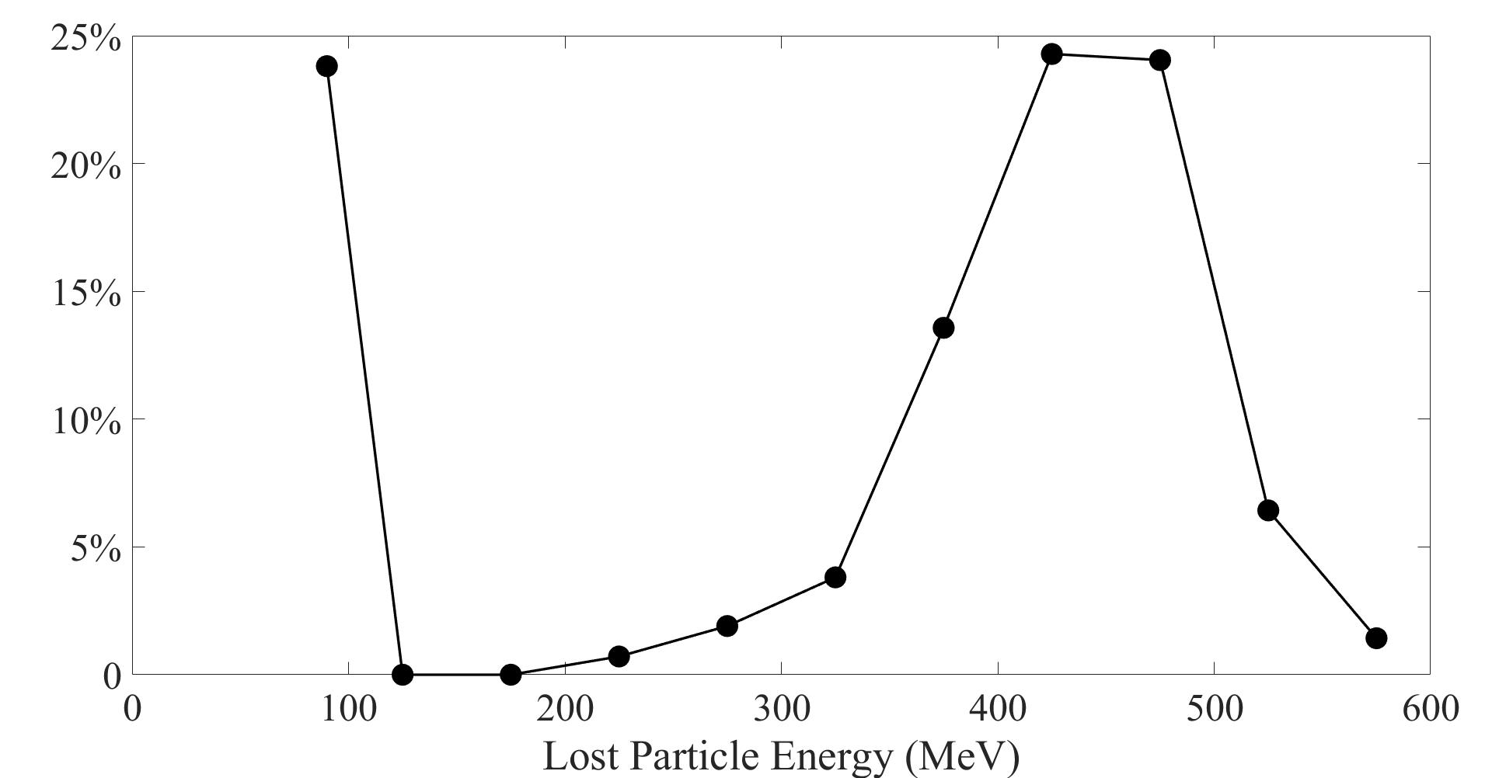
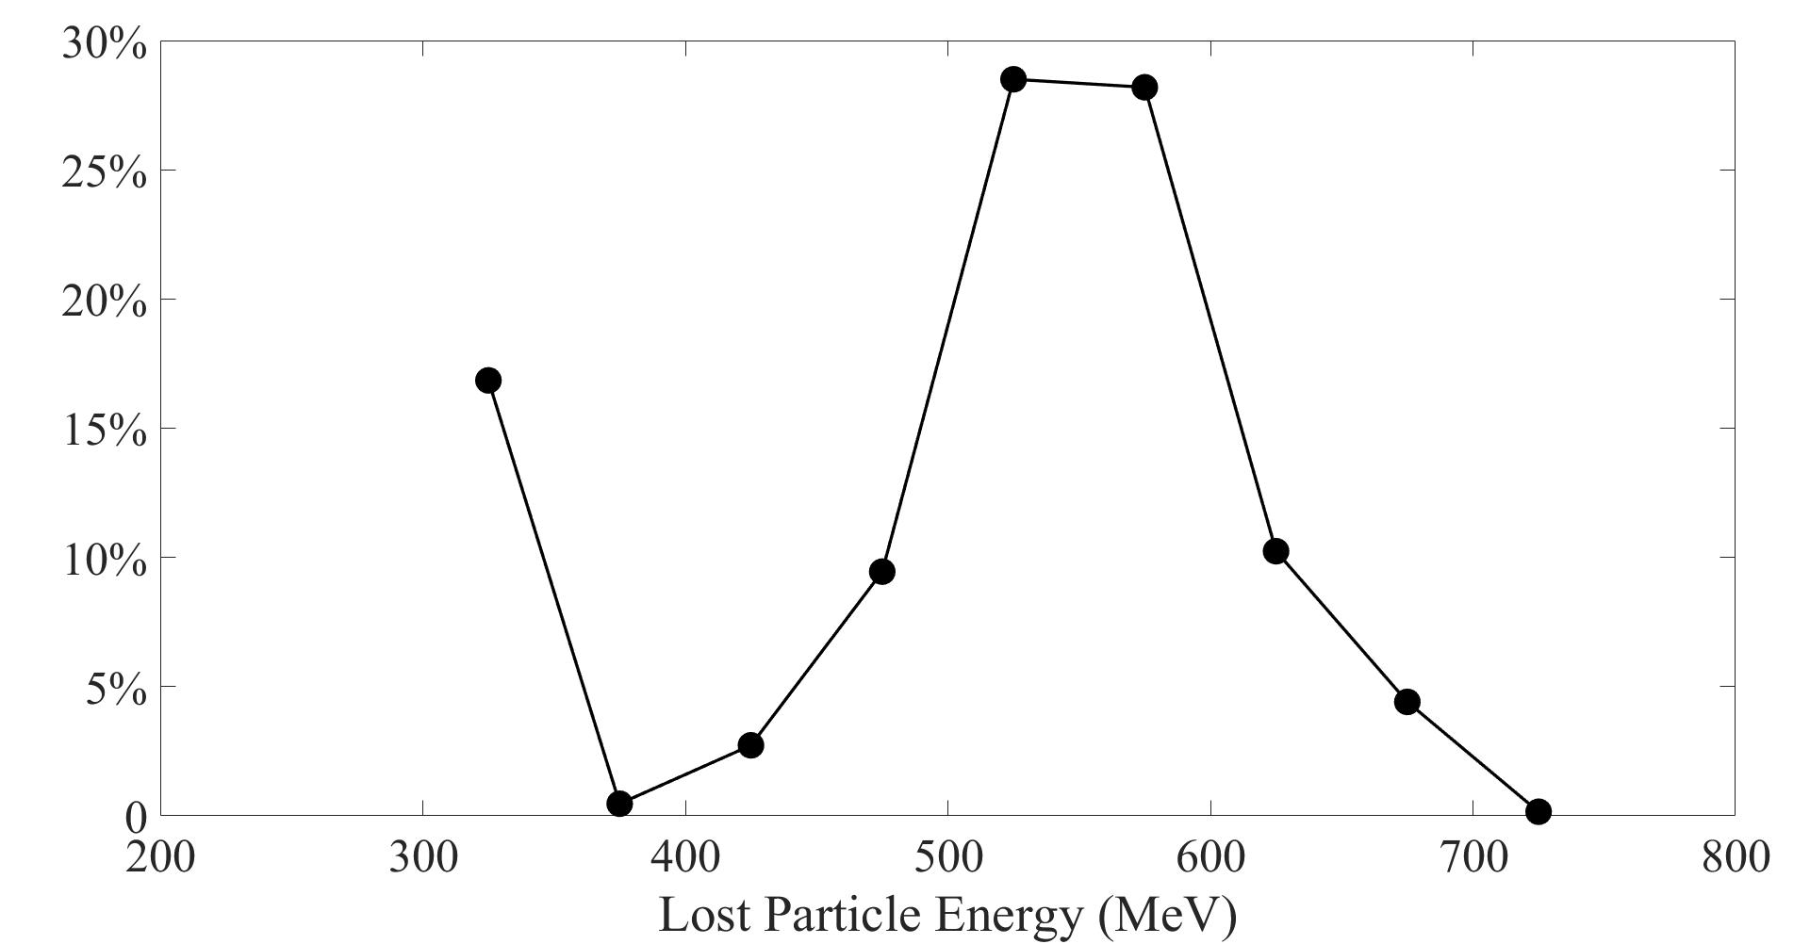
4. The momentum collimator at CSNS
CSNS@200kW
Beam loss mechanisms in longitudinal plane：
Rapid acceleration, and large acceleration phase
Capture process
The closure of the harmonic RF cavity voltage process
Energy jitter of the injection energy beam
CSNS-II

Slide 15
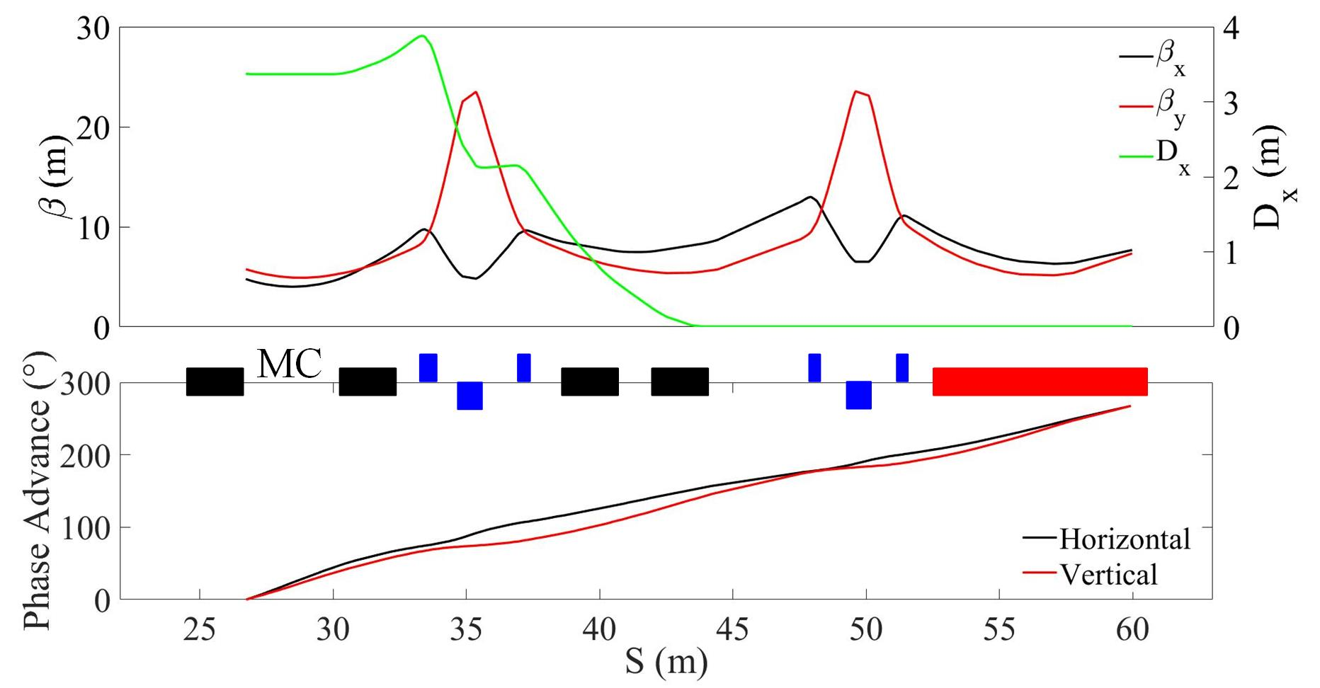
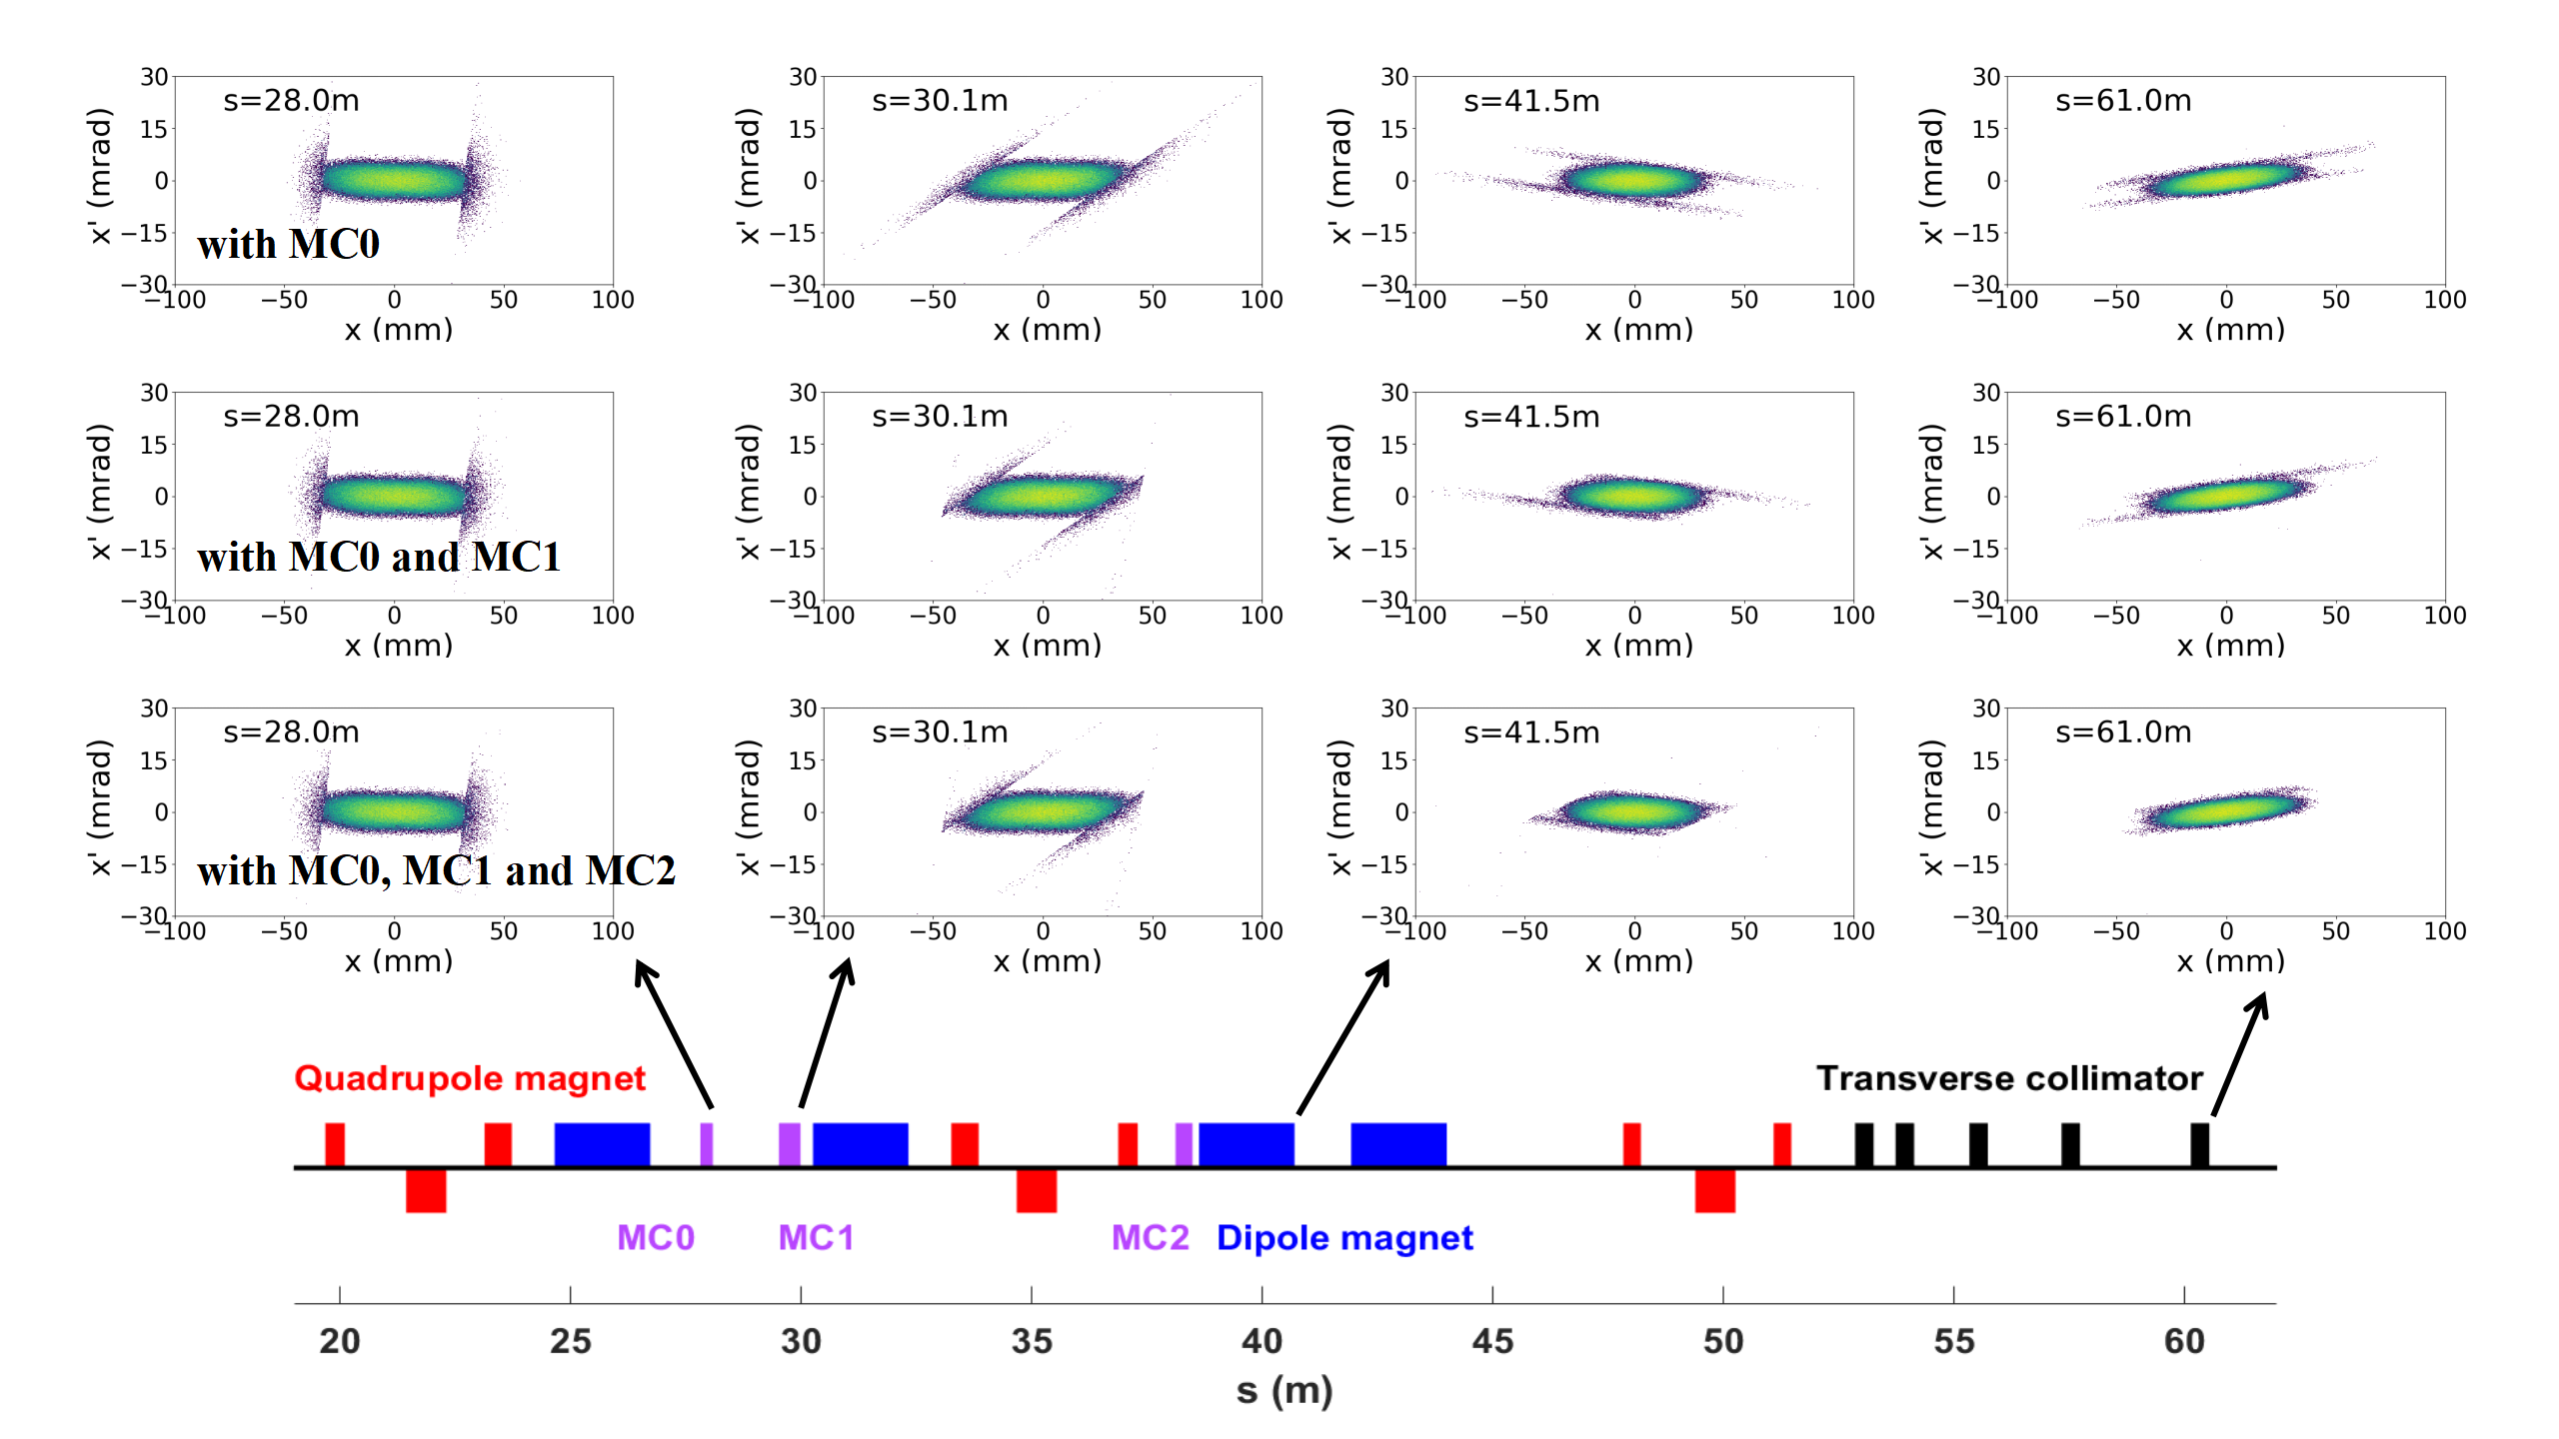
4. The momentum collimator at CSNS
Two-stage collimation scheme：
The phase advances are insufficient when the secondary collimators are situated within the designated 3.5-meter space.
When the secondary collimators are cross magnets, a large number of particles are lost between the collimator blocks.
The wide range of lost particle energy is another challenge, because it is difficult in selecting the appropriate material and thickness for the primary collimator.

Slide 16
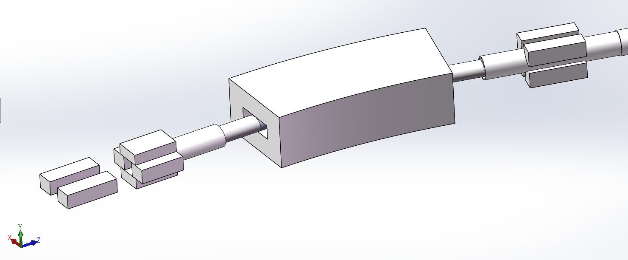
4. The momentum collimator at CSNS
The design of the momentum collimation system
To overcome the disadvantages of small phase advance and the large energy range of lost particles in the two-stage collimation scheme, an unconventional single-stage momentum collimation scheme was proposed.
Collimator system is placed in the reserved 3.5-metre-long space without crossing magnetic cells to reduce beam losses on the magnets and vacuum box between the two collimator units.

Slide 17
4. The momentum collimator at CSNS
The design of the momentum collimation system
 | C | Fe | Cu | Pb | W
Density (g/cm³) | 2.25 | 7.87 | 8.92 | 11.34 | 19.35
Stopping Rang of 300MeV proton (mm) | 255.9 | 93.4 | 85.8 | 88.9 | 50.7
Stopping Rang of 700MeV proton (mm) | 974.1 | 350.4 | 321.1 | 326.6 | 186.7
Lateral straggling value of 300MeV proton (mm) | 5.8 | 4.5 | 4.4 | 7.8 | 4.2
Lateral straggling value of 700MeV proton (mm) | 19.6 | 15.0 | 14.6 | 25.2 | 13.7
Melting point (℃) | 3850 | 1538 | 1083 | 327 | 3400
Thermal conductivity (W/(m*K)) | 151 | 85 | 401 | 35 | 180
Comparison of different materials

Slide 18
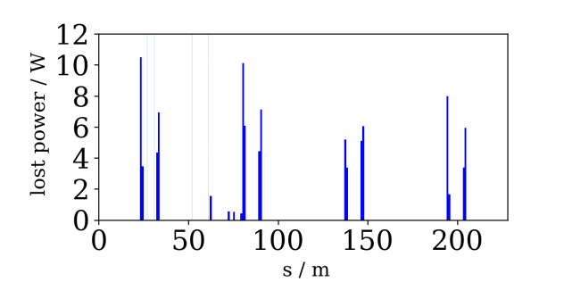
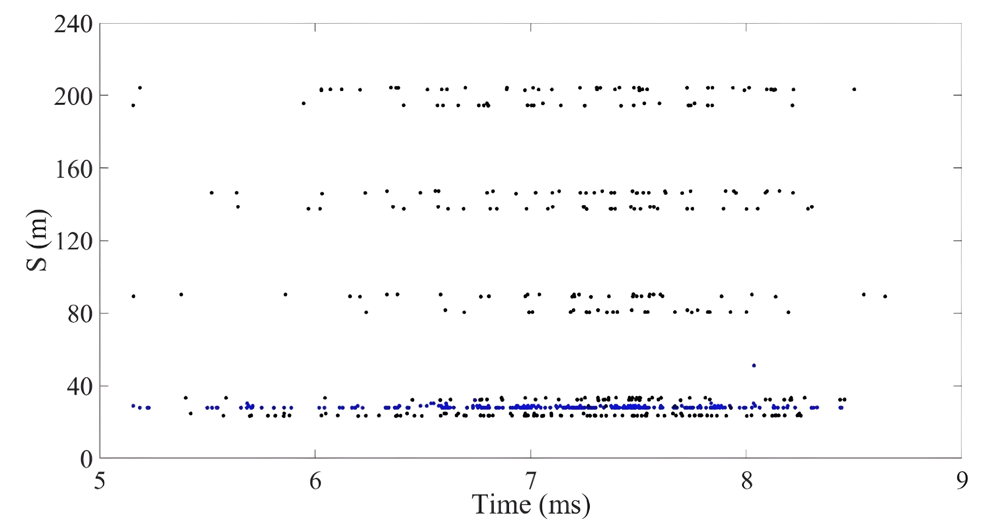
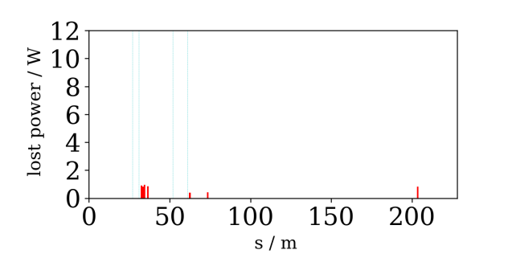
4. The momentum collimator at CSNS
Simulation results

Slide 19
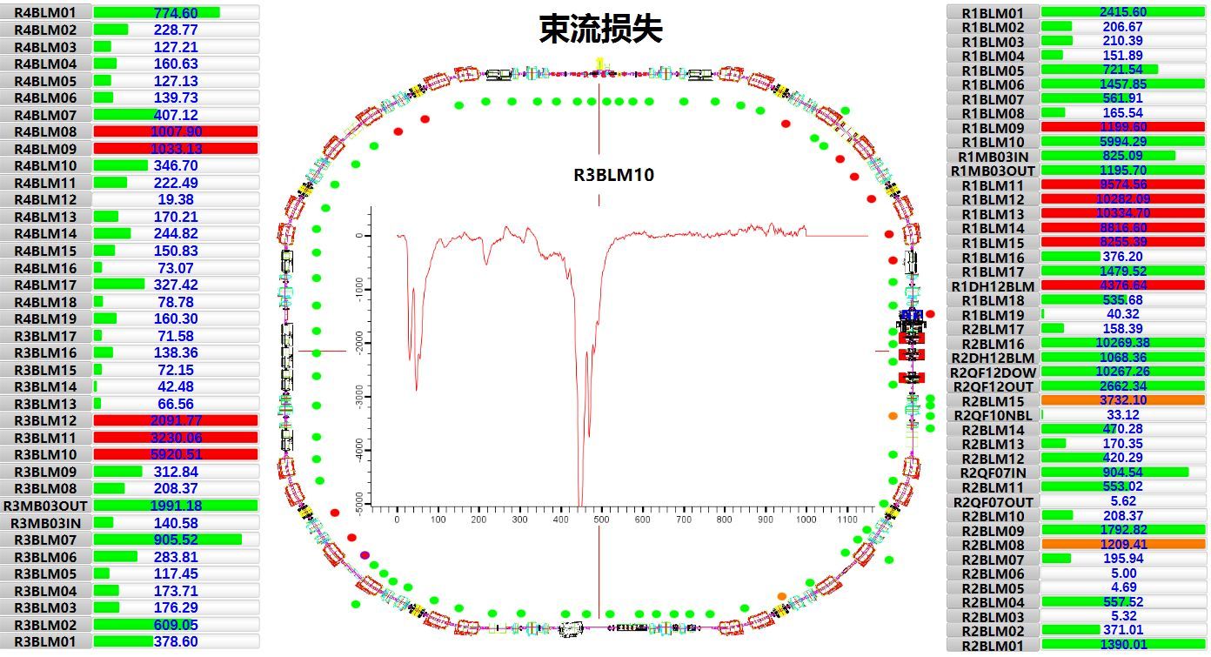
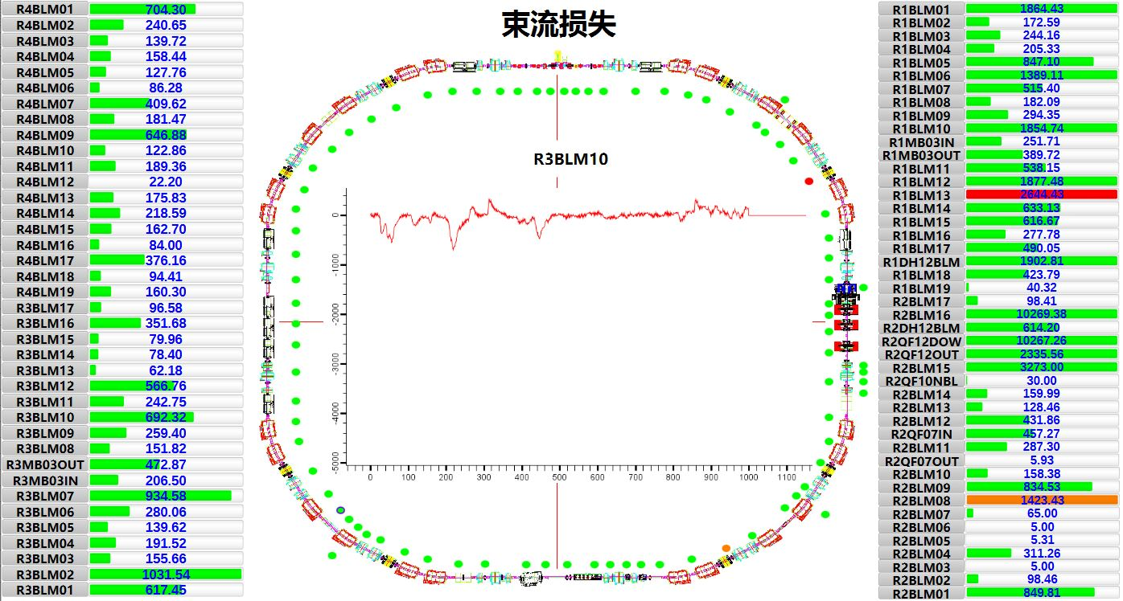
4. The momentum collimator at CSNS
Beam commissioning
BLM signal along the RCS without (left) and with (right) the momentum collimator at the beam power of 170 kW, with the injection energy of 80 MeV.

Slide 20
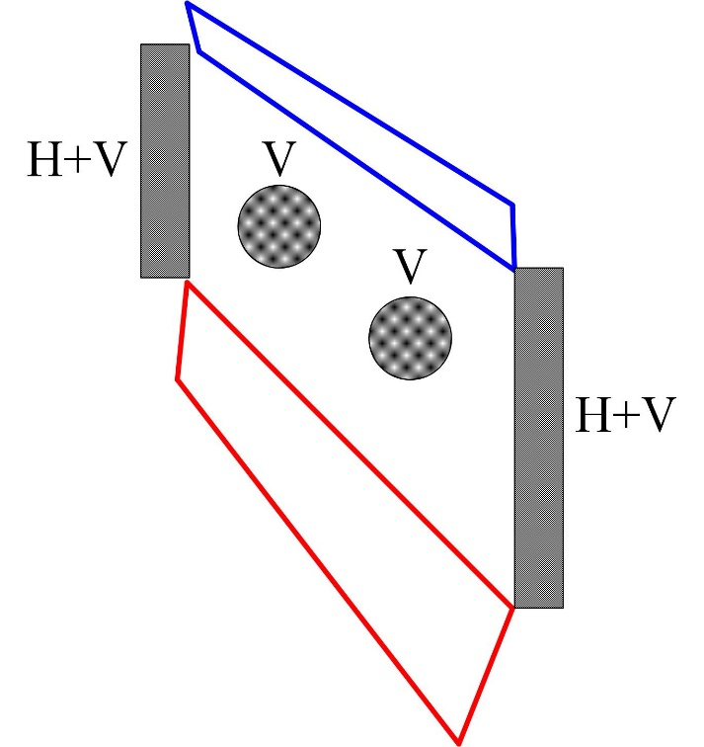
5. Collimator for FFAG
Challenge for FFAG collimation design (300MeV~600MeV)
1、Space is compact.
Absorption blocks and shielding considered together.
2、Shielding is challenging for the energy range of 300 MeV to 600 MeV of lost particles.
Materials with low neutron yield.
3、Full-period collimation in the horizontal direction is unachievable.
Pre-collimation is applied in the horizontal direction.

Slide 21
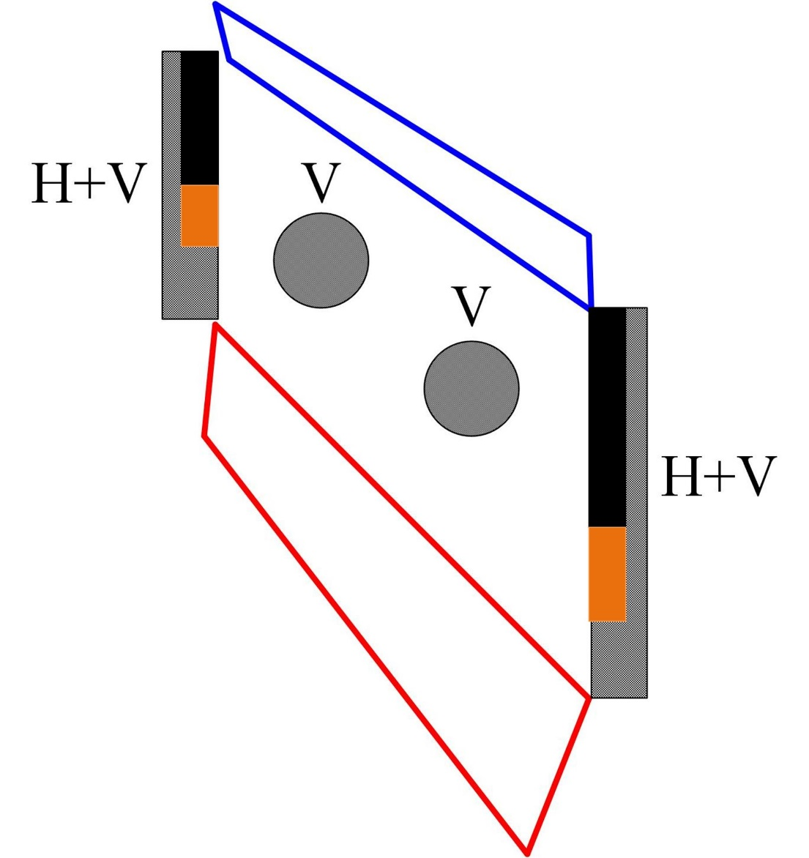
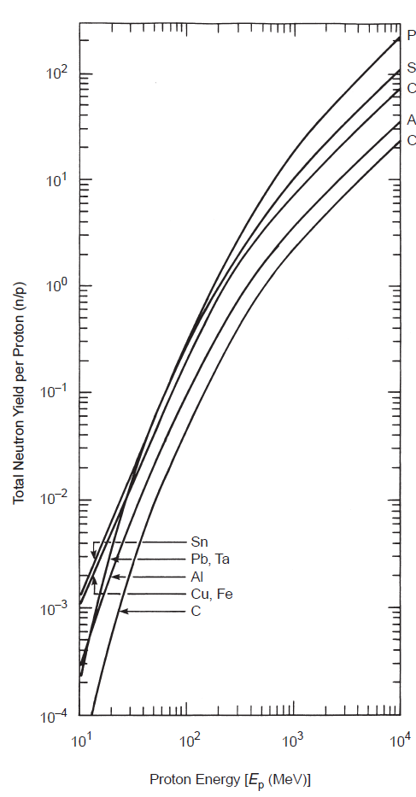
Material of blocks
1、B1 and B4 employ a combination of graphite and copper for absorption.
B1: 450mm of graphite combined with 150mm of copper；
B4: 900mm of graphite combined with 300mm of copper；
2、B2、B3 employ Aluminum.
B1
B2
Neutron yield
B3
Projected range
 | 300MeV | 600MeV
Graphite | 256mm | 772mm
Iron | 93.4mm | 278mm
Copper | 85.8mm | 255mm
Tungsten | 50.7mm | 148mm
Tantalum | 59.0mm | 173mm
Lead | 88.9mm | 260mm
Al | 243mm | 728mm
B4

Slide 22
Summary and discussion
1、In a synchrotron, the beam emittance increases slowly, and halo particles hit the collimator at very small impact depths. The single-stage collimation scheme, which directly absorb halo particles, exhibits low collimation efficiency.
2、The two-stage collimation method is widely used. However, two-stage collimation method require a large phase advance. CSNS/RCS is cannot meet the phase advance requirement.
（21°，22°）
（62°，67°）
（9°，9°）
（38°，41°）

Slide 23
Summary and discussion
3. We use unconventional single-stage collimation scheme, for both transvers collimator and momentum collimator.
Absorb particles ejected from the front block
Acceptance: ~450πmmmrad
Block to directly absorb the halo particles;
Acceptance: ~400πmmmrad
Physical acceptance: 540πmmmrad
4. This scheme has been verified in the CSNS beam commissioning.
How about in CSNS-II/RCS with higher injection energy remains to be verified by the beam, but simulation results show that the collimation efficiency is very high.
5. In FFAG, space is tighter. There is not enough space for shielding.
Should we use collimator to localize beam loss? Or, just let the halo particles lose along the machine?

Slide 24
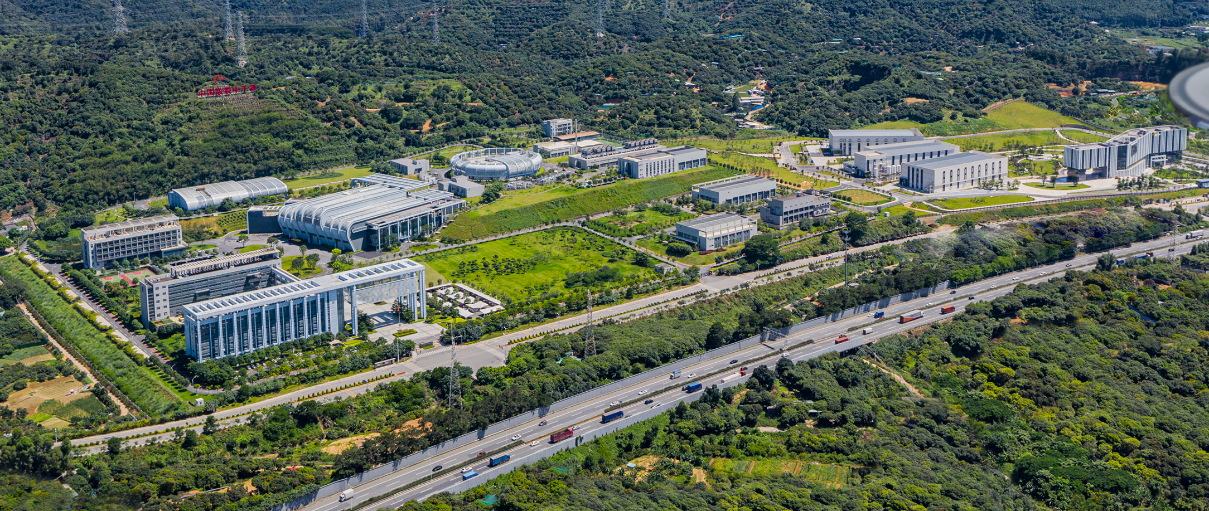
Thank you !

