Slide 1
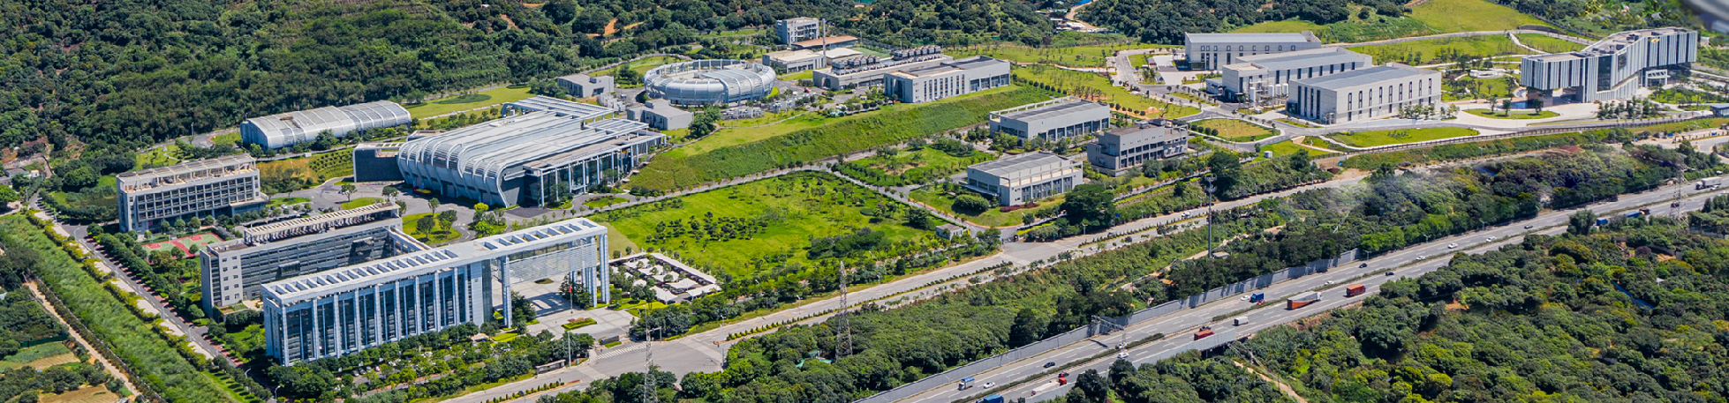



Report of Dongguan Branch
Study on longitudinal beam dynamics and RF system of the FFAG
Hanyang Liu & Jian Wu
China Spallation Neutron Source
Notes:
Hello, I’m Hanyang Liu, it’s my pleasure to share with you the study on longitudinal beam dynamics and RF system of the FFAG at CSNS.

Slide 2

Outline
Longitudinal beam dynamics study
Introduction to the requirements of the RF system
The design of the RF system
Research foundation
Preliminary design
Future work
2
Notes:
This is the overview of my presentation

Slide 3
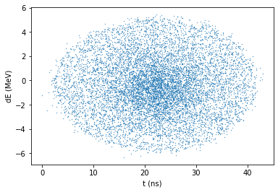
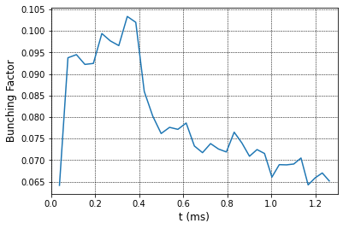
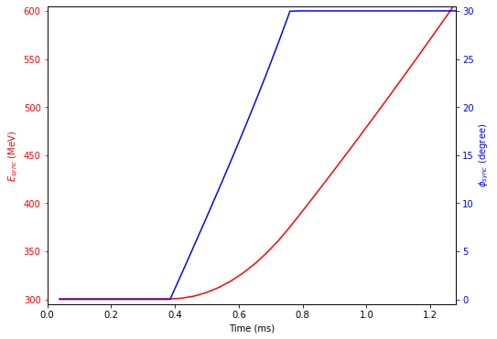
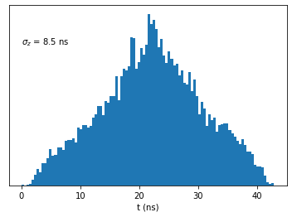
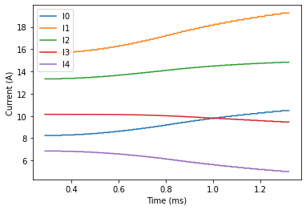
1. Beam dynamics design for short bunch (basic design)
Main parameters used
Harmonic number | 1
RF frequency (MHz) | 2.598-3.163
Transition gamma | 2.50959
RF voltage per turn (kV) | 300 (100 during injection)
Synchronous phase (°) | 30
Acceleration time (turn/ms) | 3500/1.26
Chopper duty | 0.8
Simulation Results
3
Notes:
First, I'll introduce the study of longitudinal beam dynamics. To meet the neutron-source user requirement, the rms bunch length must not exceed 10 ns. So, this design mainly aims to achieve a short bunch to enhance experimental precision and efficiency for the users.
The key parameters used for simulation are summarized in this table. A RF voltage of 300 kV per turn, combined with a 30° synchrony phase, ensures the adiabatic variation of phase space during acceleration. An 80% chopper duty cycle is chosen to minimize the extracted bunch length in this simulation.
The bunching factor consistently is about 0.1 during injection and 0.065 close to extraction. The rms bunch lengths are 8.6 ns, which can meet the requirement.

Slide 4
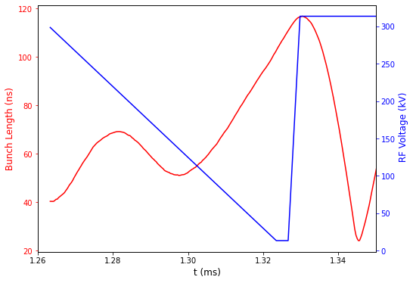
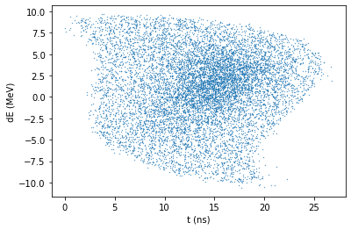
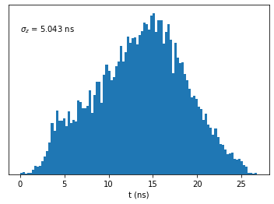
1. Beam dynamics design for short bunch(fast rotation)
To further satisfy the end-user requirement ( ~5 ns), a fast bunch rotation process has been proposed before extraction.
4
Notes:
However, since the original user specification called for ~5 ns, we have introduced an additional fast bunch rotation process after acceleration to further enhance the instrument’s measurement precision. After ramp-down and rapid ramp-up of the RF cavity voltage, the bunch can be compressed to about 5 ns rms.

Slide 5
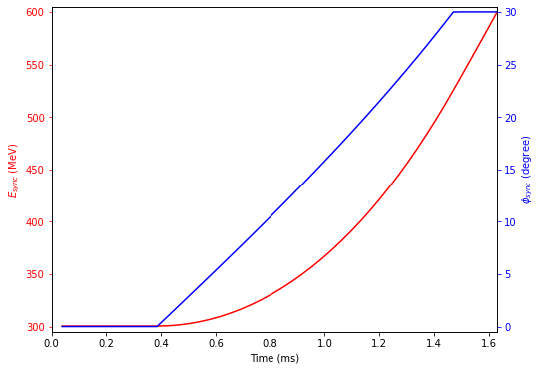
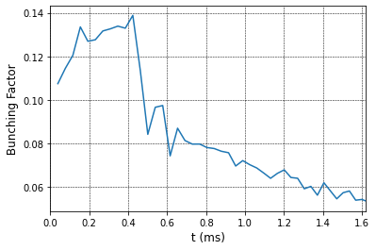
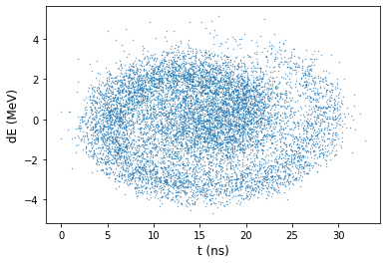
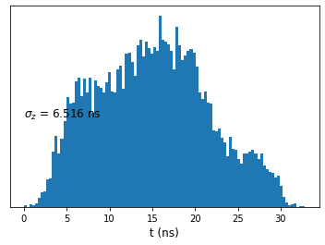
1. Beam dynamics design for short bunch(dual harmonic)
V_h1= 300kV
V_h2= 150kV
Phi2 = -2*phi_s
With dual harmonic, the bunching factor during injection is improved by 40 %;
Dynamically adjusting the phase of the second harmonic during acceleration can compress the bunch length.
However, given the budget, adding an extra cavity is not being considered for now.
5
Notes:
Following advice from ISIS experts, I also modeled the dual-harmonic design and the results are indeed encouraging. Thanks to the longitudinal manipulation provided by the second harmonic, the bunching factor at injection can be boosted by more than 40 %. And during acceleration, dynamically sweeping the phase of the second harmonic further compresses the bunch to about 6.5 ns rms.
However, given the present budget, we have no plans to add an extra cavity to supply the second harmonic. The existing cavity, limited by its power density, cannot simultaneously deliver the required voltages for both the fundamental (H1) and the second harmonic (H2) at high repetition rates—this is precisely the issue we will discuss next.

Slide 6
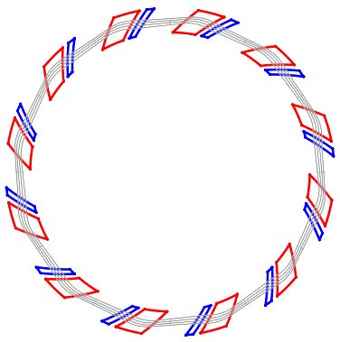
2. Requirements for RF systems
Two straight sections (both 1.8 m length)
used for installation of RF cavities
Main RF parameters
Energy range (MeV) | 300~600
Harmonic number | 1
RF frequency (MHz) | 2.598-3.163
Core material | Magnetic alloy
Cavity length (m) | < 1.8
Number of cavities | 2
Number of gaps per cavity | 3
RF voltage per gap (kV) | 50
Acceleration gradient (kV/m) | > 83
RF voltage per turn (kV) | 300
Synchronous phase (°) | 30
Acceleration time (ms) | 1.3
Repetition rate (Hz) | 25
Amp.
RF cavity
RF cavity
Amp.
Schematic view of the FFAG
6
Notes:
So according to the beam dynamics design, the RF system should provide a total of 300 kV RF voltage for beam acceleration. In FFAG we have set aside two straight sections for installation of two RF cavities, each with a length of 1.8 meters. This figure shows the schematic view of the FFAG. The right table presents the key parameters of the RF system. In our design, each cavity contains three acceleration gaps, with each gap designed to provide a 50 kV RF voltage. Therefore, the acceleration gradient of the cavity must exceed 83 kV/m. In addition, the RF system must operate over a wideband frequency range. To meet these requirements, we must employ the MA.

Slide 7
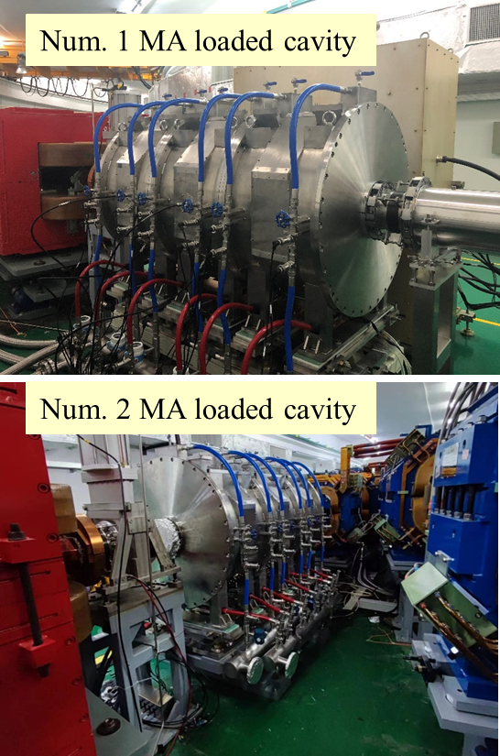
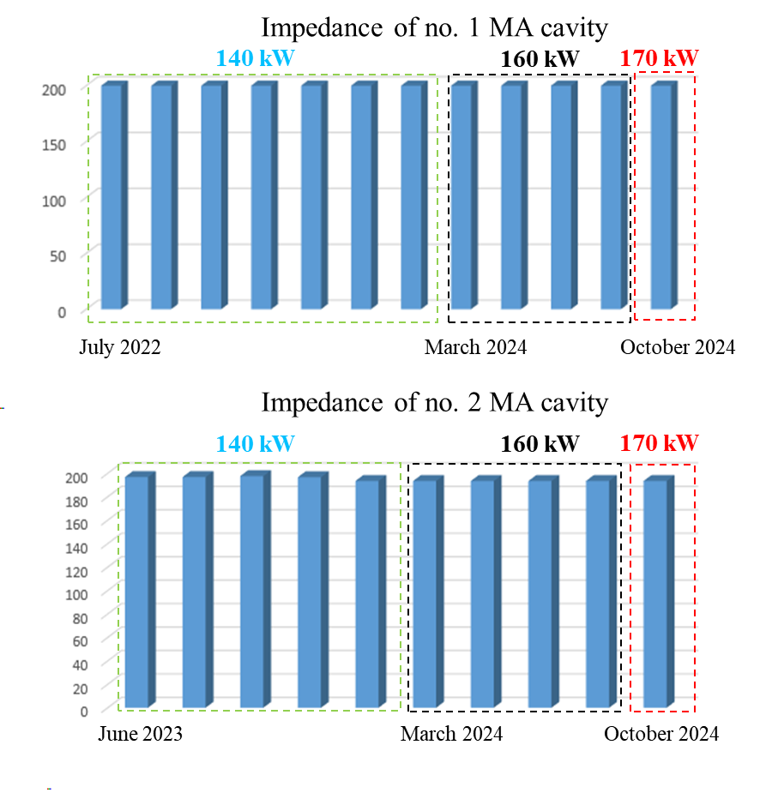
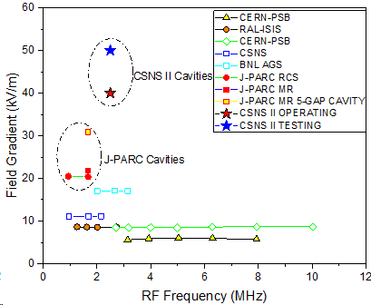
3. Foundations of high gradient and wideband RF system
RF cavity loaded by magnetic alloy (MA) cores
  High accelerating gradients (short length), wideband and tuneless operation
  High-gradient and wideband MA cavities have been successfully developed for CSNS RCS
    Peak gradient of 50 kV/m and an operating frequency of 1-5 MHz.
    Two MA cavities have been operating stably for over 10,000 hours.
Impedance of Num. 1 MA cavity
Impedance of Num. 2 MA cavity
7
Notes:
Because this type of cavity exhibits significant advantages, including high acceleration gradients, wideband and tuneless operation. Currently, we have successfully developed high-gradient MA cavities for CSNS. The cavity achieves a peak acceleration gradient of 50 kV/m within a broad frequency range. To date, two MA cavities have achieved stable operation for over 10,000 hours.

Slide 8
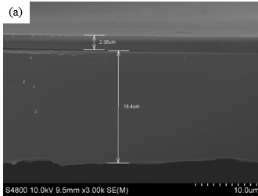
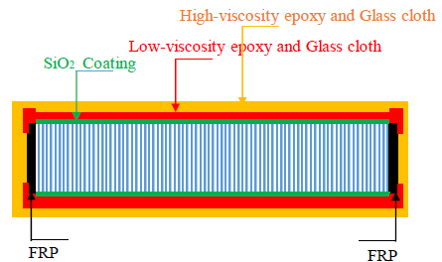
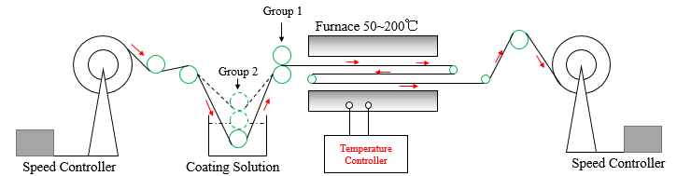
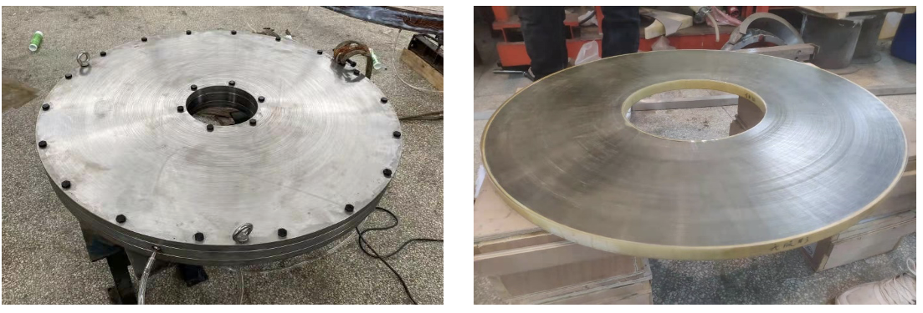
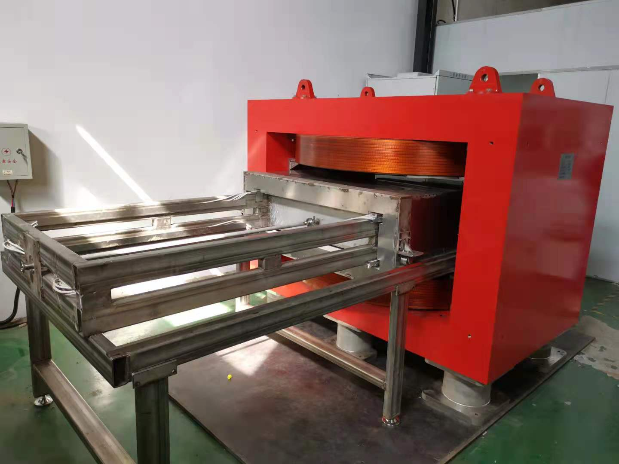
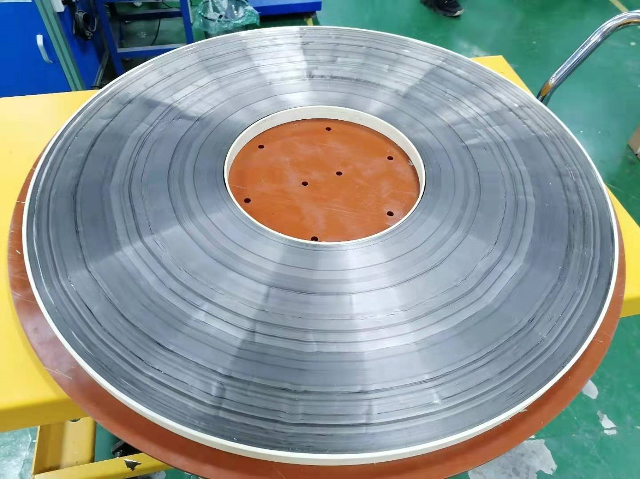
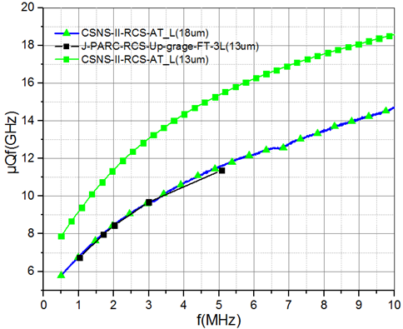
Key technologies for developing MA cores
Micron-level high-insulation and low-stress inorganic coating
Low-stress waterproof packaging process
2 μm insulation coating
> 200 Vdc
Package structure
Winding and annealing for large-sized MA core
Curing fixture
High-performance MA core: achieving a relatively high level internationally
in-house developed transverse magnetic annealing furnace
316mm
850mm
μQf product
Low vacuum environment + fixture
Ensure the adoption of direct water cooling to deal with high power density
The key technologies of insulation, waterproofing, and annealing
provide a solid foundation for the development of large-sized, racetrack-shaped MA cores for FFAG
8
Notes:
One of the key factors for this stability is the breakthroughs we have made in MA core development. The first is the development of a high-insulation, low-stress inorganic coating, with a 2-micron coating achieving a withstand voltage of over 200 volts.
The second is the advancement of annealing processes for large-scale MA cores. These processes have enabled the production of high-performance MA cores with an outer diameter of 850 mm, achieving an international competitive level.
Furthermore, we have developed a low-stress, waterproof packaging technology, which enables the adoption of direct water cooling for high cooling efficiency.
These key technologies provide a solid foundation for us to develop the large-sized, racetrack-shaped MA cores for FFAG.

Slide 9
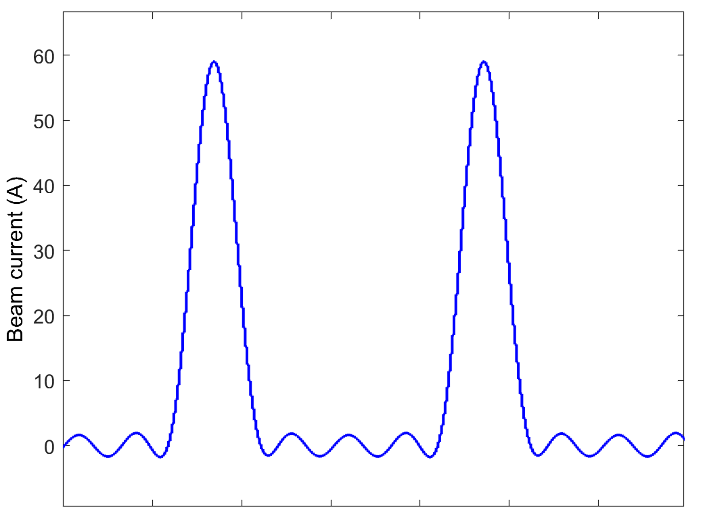
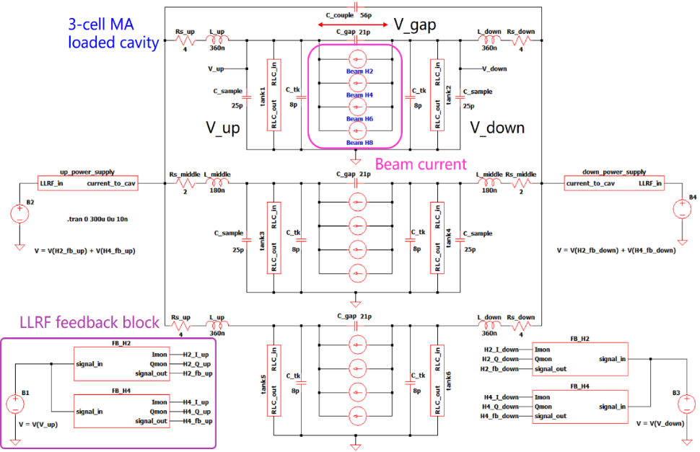
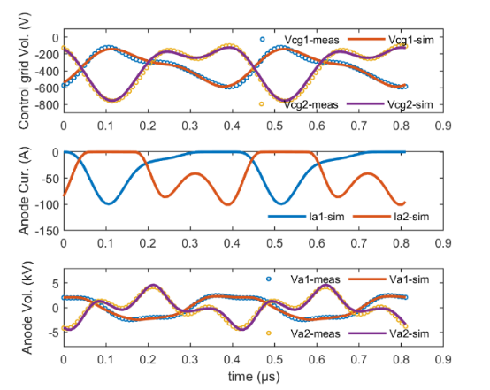
Method for studying beam loading effect
Development of a system-level model to quantify the beam-RF system interaction ^{[1]}
  Beam Loading Effect: Significant in high-intensity synchrotrons
    Peak beam current: ~60 A (CSNS FFA), > 50 A (J-PRAC@1 MW)
    Heavy beam loading severely deteriorates RF system operation
  System-Level Model: MA-loaded cavity + tetrode tube + LLRF + beam
    Accurately simulates heavy beam loading in CSNS RCS, enabling precise analysis of RF operation
    Practical tool for optimizing RF systems in high-intensity synchrotrons
This method can quantify the beam loading effect and thus offer a practical tool for RF system optimization
[1] Analyzing Vacuum Tube Operation for a Wideband Cavity Using a Circuit Simulator, IEEE Transactions on Nuclear Science, 71 (11), 2339-2349, 2024
9
Notes:
The second major foundation is the development of an operation analysis model for the RF system, including the MA-loaded cavity, tetrode tube, LLRF system, and beam, which can reproduce RF operation under beam loading. Through systematic analysis, we have gained a comprehensive understanding of RF system design under high-intensity conditions.
This method can also offer a strong theoretical basis for designing the RF system in FFAG.

Slide 10
4. Preliminary design of MA core for FFAG
The inner dimensions of core should have enough horizontal aperture. The mean radius varies by 0.78 m.
The outer dimensions of core are limited by the size of furnace.
The 25 mm thickness of core is a common specification.
1700
25
Inner dimensions of core 940 (H) × 260 (V) mm
Outer dimensions of core 1700 (H) × 950 (V) mm
Core thickness
25 mm
1000
940
260
10
Notes:
Based on these foundations, we have initiated the preliminary design of the RF system. We began with the design of the MA core's dimensions. To ensure enough space for the beam's spatial requirements, the horizontal aperture needs to exceed 0.78 meters. Considering the thickness of the vacuum chamber, we have finalized the inner dimensions at 940 by 260 millimeters. The outer dimensions of the core are constrained by the size of the furnace, so we have set them at 1700 by 950 millimeters. As for the thickness, we have opted for 25 millimeters, which is the standard specification.

Slide 11
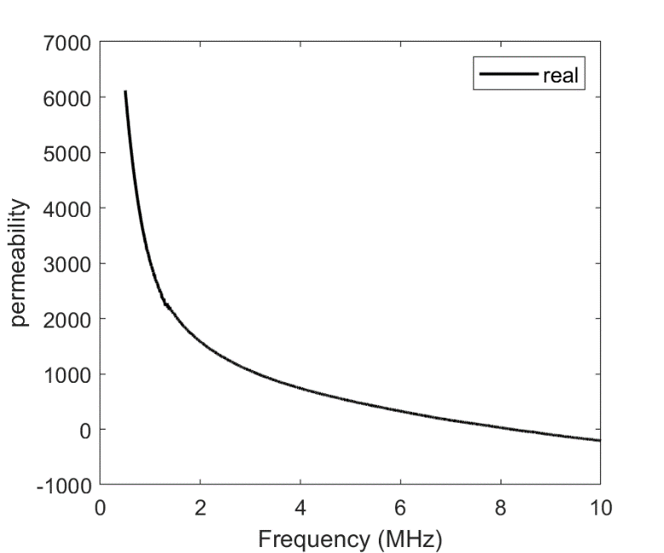
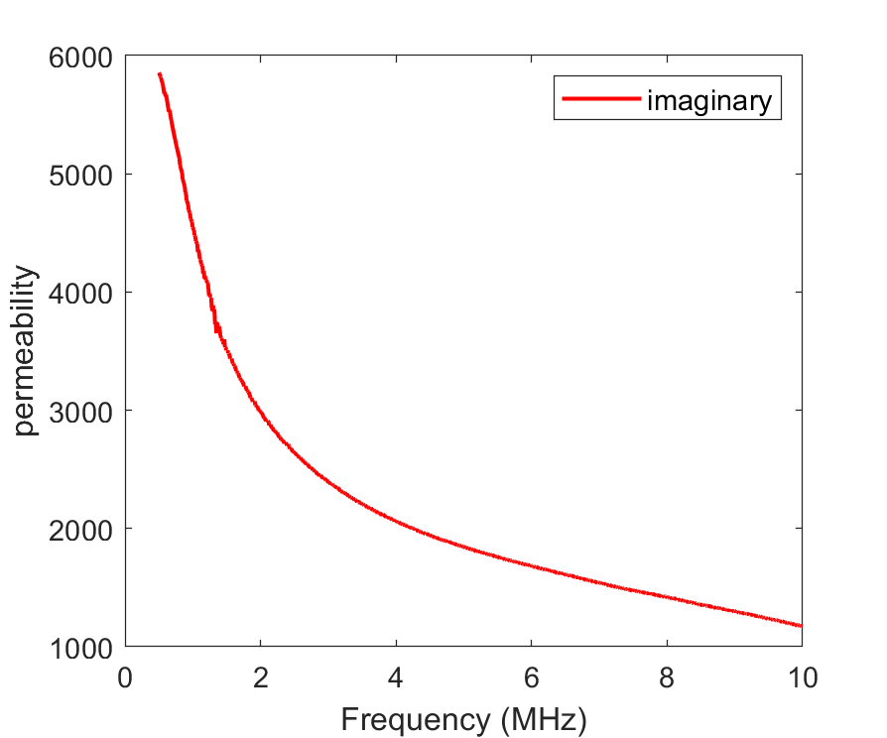
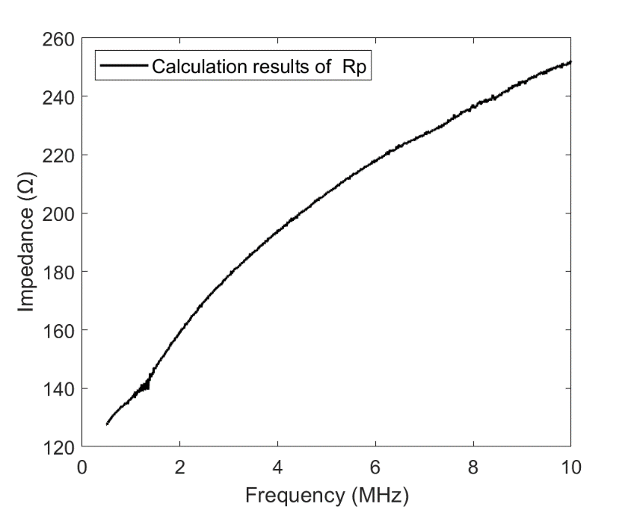











Estimation of core impedance
Measurements of the core used in CSNS RCS
Equations for racetrack core impedance calculation
$$Z=fμ_{0}\left(μ^{′′}+jμ^{′}\right)t\ln{\frac{\overline{r_{1}}}{\overline{r_{0}}}}$$
$$\overline{r_{1}}=l_{1}/2π$$
$$R_{p}=fμ_{0}\frac{μ^{′2}+μ^{′′2}}{μ^{′′}}t\ln{\frac{\overline{r_{1}}}{\overline{r_{0}}}}$$
$$\overline{r_{0}}=l_{0}/2π$$
$$μ^{′}$$
$$μ^{′′}$$
real part
$μ_{0}$: permeability of vacuum
$f$: frequency
$μ=μ^{′}$- $jμ^{′′}$: magnetic permeability
$t$: thickness
$\overline{r_{1}}$ and $\overline{r_{0}}$: equivalent outter and inner radius
l₁
l₀
11

Slide 12
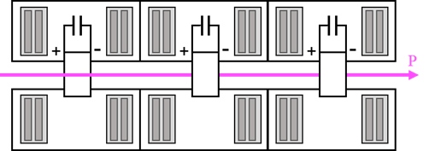
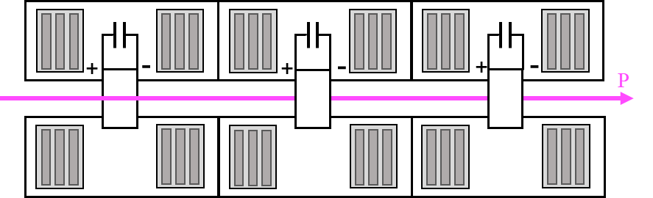
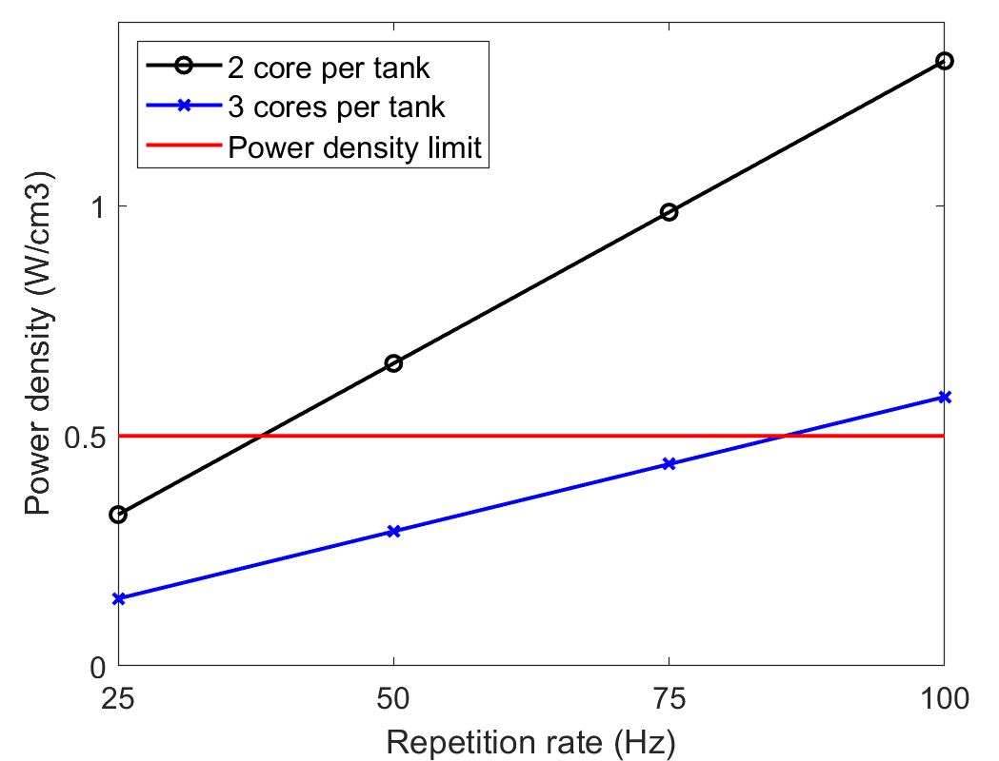


Power density in the core
V_{gap}: 50 kV
$$power=\frac{V^{2}}{{2R}_{P}}$$
$$power_density=\frac{power}{volume}$$
The volume of the core: ~3.13 × 10⁴ cm³
Case 1: 2 core per tank
Case 2: 3 cores per tank
tank
Comparison of power density in the core under two different cases
tank
1434 mm
1800 mm
Power density: 0.657 W/cm³ at 50 Hz repetition rate
can work under 25 Hz
Power density: 0.438 W/cm³ at 75 Hz repetition rate
Suitable for 25~ 50 Hz operation
Will be adopted
The power density limited at 0.5 W/cm³
The power density is limited by the surface temperature of the magnetic core; excessive power will burn out the packaging.
12
Notes:
After finalizing the MA core dimensions, we estimated the impedance based on the existing core's parameters using these equations. The impedance results are shown in this figure. Using these impedance values, we proceeded to calculate the power density in the core. It is important to note that different configurations result in varying power density. Here, we have proposed two primary configurations: the first involves installing two MA cores per tank, while the second is three MA cores per tank. The power density calculation results, presented in this figure, indicate that Case 1 cannot operate at a 50 Hz repetition rate, whereas Case 2 can support a repetition rate up to 75 Hz. Consequently, we will adopt Case 2 for the cavity design in the future.

Slide 13
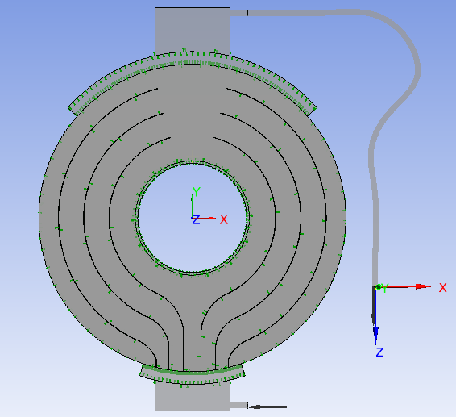
Future work for cavity design
Develop a larger furnace for 1700 (H) × 950 (V) mm MA core production
Fluid thermodynamic simulation
Direct water cooling adopted to deal with 0.5 W/cm³ power density in core
Highly efficient cooling structure design
Design of the structure’s insulating gap
Need a larger one
Fluid thermodynamic simulation for MA-loaded cavity of CSNS RCS ^{[1]}
[1] Design and verification of a high-gradient and high-power 2nd harmonic cavity for the China Spallation Neutron Source upgrade project, Rev. Sci. Instrum
13
Notes:
The above contents outline the preliminary design of the MA cavity, and this slide introduces our future work plan. First, we need to upgrade the annealing furnace to meet the production requirements of larger-scale MA cores. Second, since the power density of the MA cores reaches 0.5 W/cm³, we will adopt direct water cooling for thermal management. To achieve this, we will conduct detailed fluid-thermal simulations and design a highly efficient cooling structure. In this regard, we have already established a simulation platform and performed precise analysis on the MA cavity of CSNS, which lays the groundwork for the fluid-thermal simulations of the FFAG cavity. Finally, we will also carry out the design of the structure’s insulating gap.

Slide 14
Thank you for your attention!

