Slide 1
Design and study of the spiral focusing structure for FFAG at CSNS
Speaker: Bin Wu
Institute of High Energy Physics (IHEP). Chinese Academy of Sciences
China Spallation Neutron Source (CSNS)
July 21,2025 UK ISIS

Slide 2
Outline
Background introduction
Response to the Comments
Review the previous lattice parameters
Lattice study by full parameters scan
New lattice by multi-objective optimization
Nonlinear Analysis
Summary

Slide 3
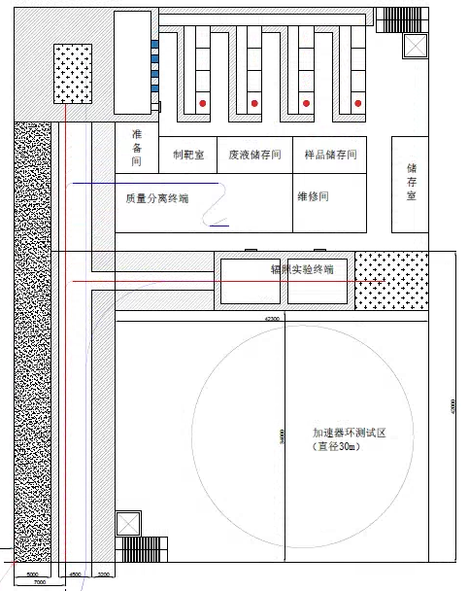

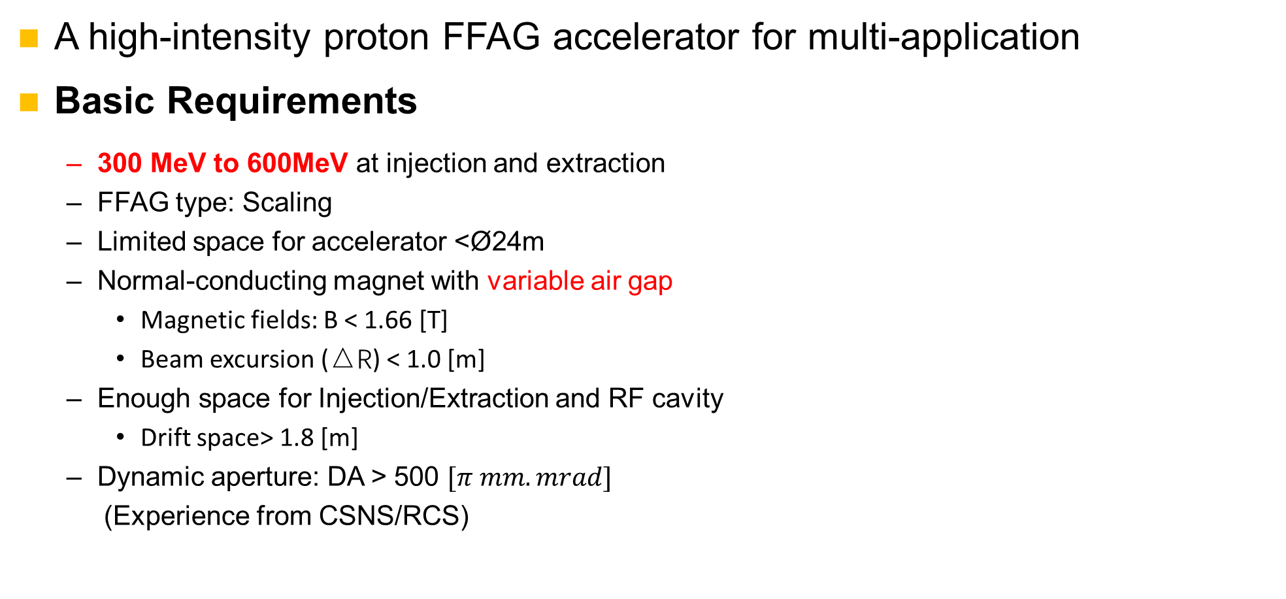
Background introduction
A high-intensity proton FFAG accelerator for multi-application
Basic Requirements
  300 MeV to 600MeV at injection and extraction
  FFAG type: Scaling
  Limited space for accelerator <Ø24m
  Normal-conducting magnet with variable air gap
    Magnetic fields: B < 1.66 [T]
    Beam excursion (△R) < 1.0 [m]
  Enough space for Injection/Extraction and RF cavity
    Drift space> 1.8 [m]
  Dynamic aperture: DA > 500 $[π mm.mrad]$
  (Experience from CSNS/RCS)
CSNS Linac End Experimental Hall (Under Construction)

Slide 4
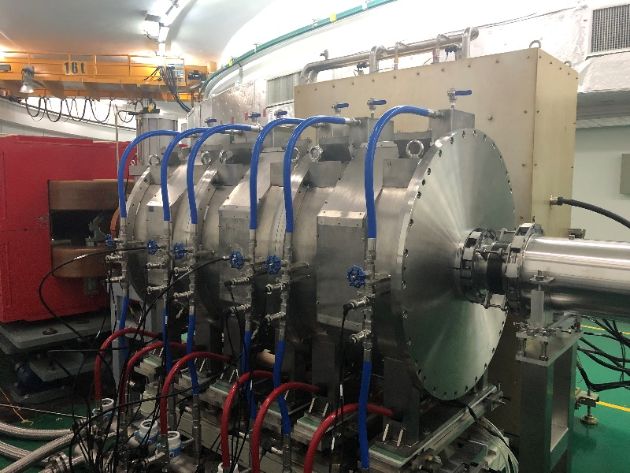
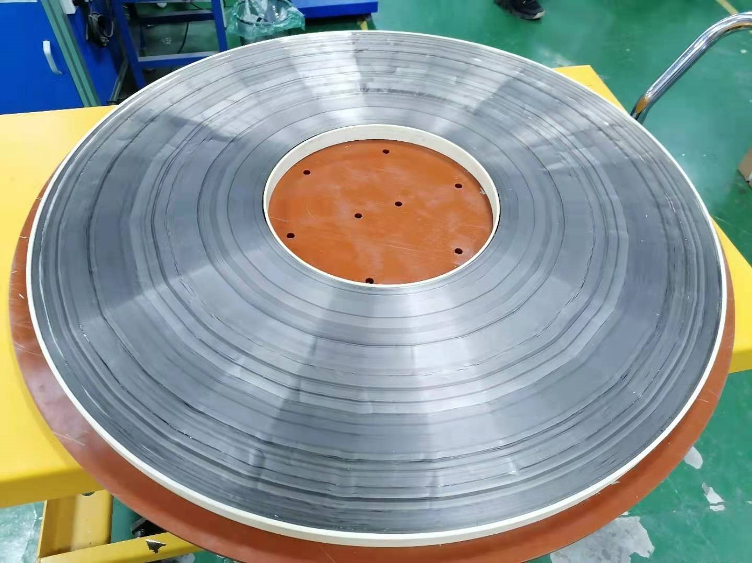
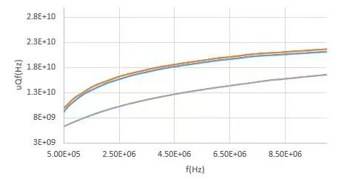
Response to the Comments
Q:Is the drift space of 1.8 m enough? How do they get this value of 1.8 m?
  Based on the current accelerating-gradient of the MA loaded cavity and the propose of injection and extraction system
  Now 50kV/m is achieved with the cavity length of 1.8m, a gradient breakthrough of 70kV/m over a 1.8m length is feasible after upgrading the MA material performance and RF power supplier system
  The injection and extraction requirements will be detailed in the next report by Dr. Huang.
The MA loaded cavity operating in
CSNS/RCS over 15000 hours
High performance MA core
with large size
New MA material with higher uQf
850mm
1.8m

Slide 5
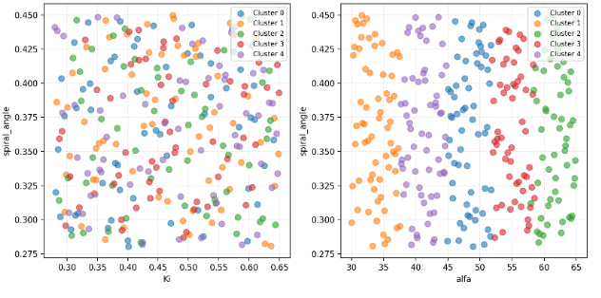
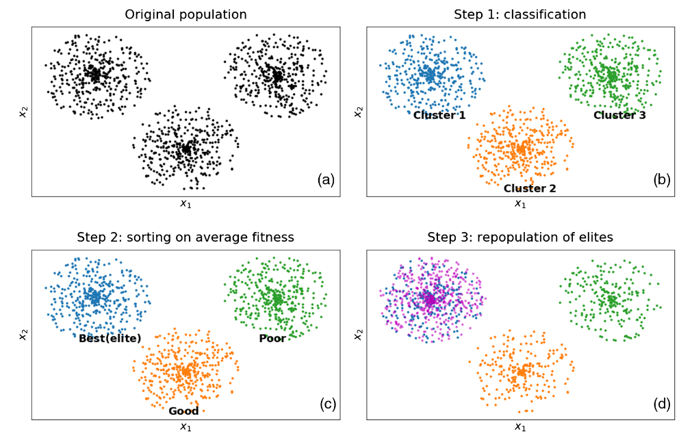
Response to the Comments
Q:The GA algorithm seems interesting, but I do not understand the figure of page 4.
  The clustering distribution of lattice parameters in the algorithm iteration process
  Step 1: Lattice parameter of different individuals are clustered by similarity
  Step 2: Calculating the average fitness for each cluster to select the elite, and generate new individuals near the elite
  Important component of our developed multi-objective optimization algorithm, which can accelerate convergence while avoiding local optima
Parameters space for generation=1
Elite generation strategy for proximity

Slide 6
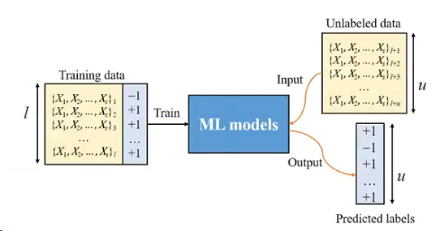
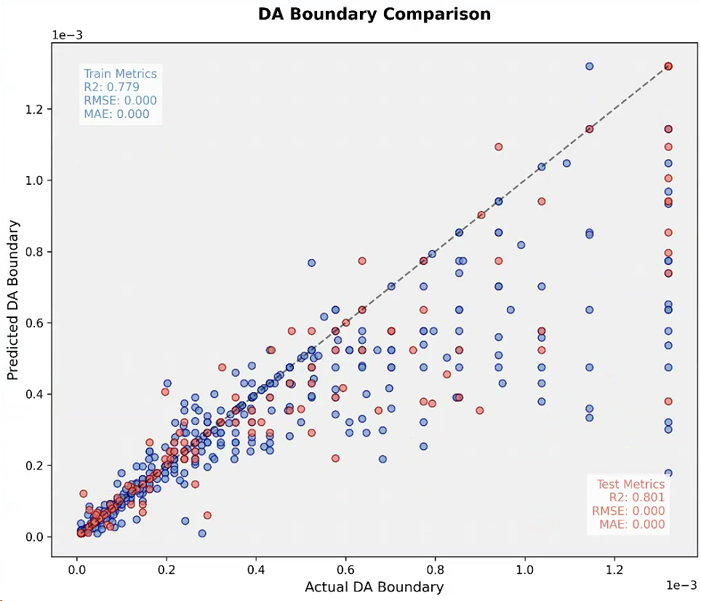
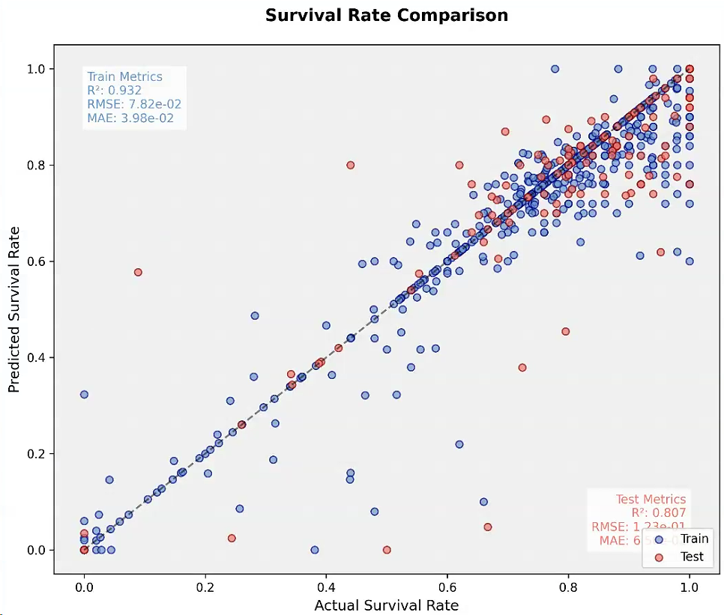
Response to the Comments
Q:Rapid DA calculation is an interesting idea. We should discuss it more at the future meetings.
  Machine learning for rapid DA calculation by tracking few turns of particles and collect trajectory data and survival labels
  Its generalization ability is still relatively weak and insufficient for accurately calculating new lattice DA. How to improve the model‘s generalization ability？
Labeled data
Data need to be
prepared in advance

Slide 7


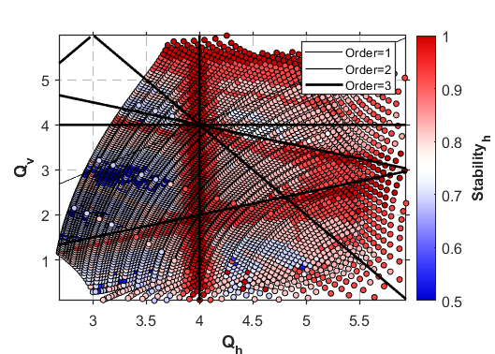
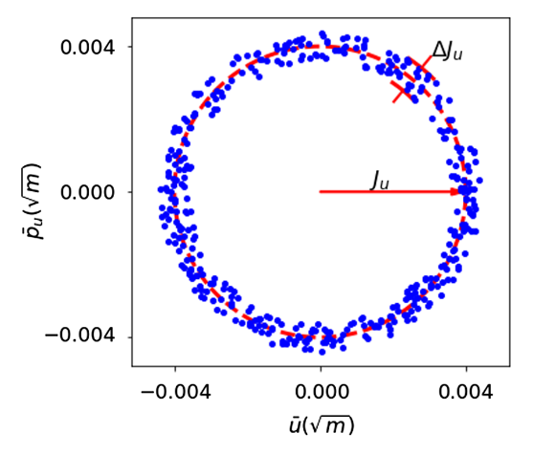
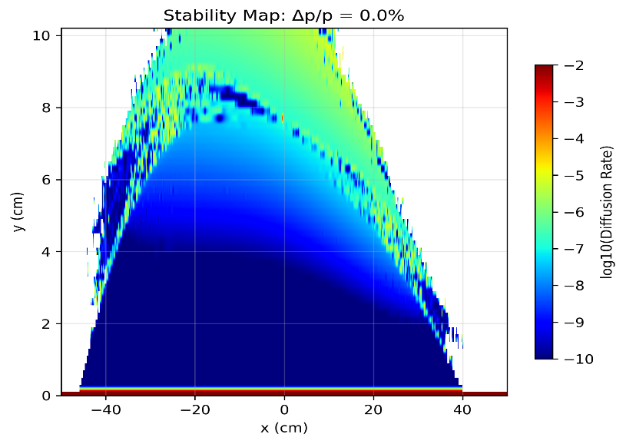


Response to the Comments
A stability indicator to indirectly calculate DA
  Calculation method: Comparison between the particle's oscillation amplitude range in normalized phase space and the initial amplitude. A few tracking turns, highly efficient.
Collecting data from these tracking particles for FMA analysis (Frequency Map Analysis, widely used in light source design), calculating their tune footprint and tune diffusion rates.
Important indicators for high intensity FFA as the bunch with large emittance is needed
Tune footprint:$∆Q=\left\langle Q_{v}\right\rangle −min⁡(Q_{v})$
15 positions for Tracking
Tune Diffusion Rate: $D=\log_{10}{{(∆Q}_{h}^{2}+{∆Q}_{v}^{2})}$

Slide 8
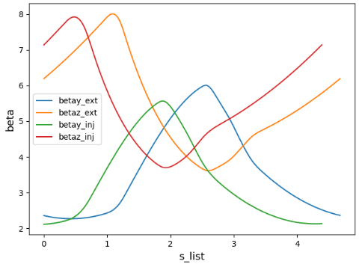
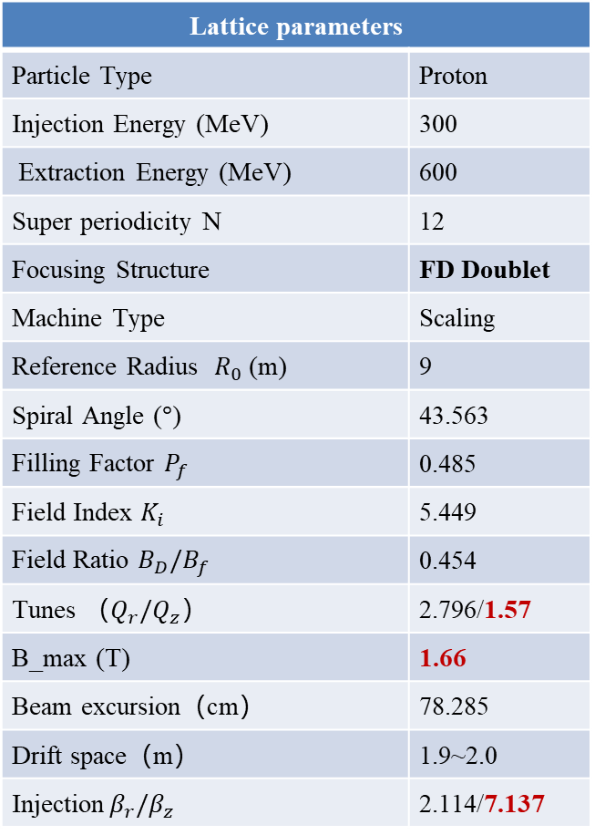
Review to the previous lattice parameters
Lattice parameters
Particle Type | Proton
Injection Energy (MeV) | 300
Extraction Energy (MeV) | 600
Super periodicity N | 12
Focusing Structure | FD Doublet
Machine Type | Scaling
Reference Radius $R_{0}$ (m) | 9
Spiral Angle ($°$) | 43.563
Filling Factor $P_{f}$ | 0.485
Field Index $K_{i}$ | 5.449
Field Ratio $B_{D}/B_{f}$ | 0.454
Tunes （$Q_{r}/Q_{z}$） | 2.796/1.57
B_max (T) | 1.66
Beam excursion（cm） | 78.285
Drift space（m） | 1.9~2.0
Injection${ β}_{r}/β_{z}$ | 2.114/7.137
Magnet vertical aperture: Half air Gap=6cm
Beta Functions at Injection/Extraction per Cell
6cm
No consideration to the tune footprint and diffusion rate issues
Vertical Tune : Too small, Beta Function: Large → Injection difficulties
Magnetic field strength B_max approaches critical value
  Need to reselect lattice parameters
  Increase machine circumference to reduce B_max, R=9m→12m
New problem: At R0=12m, F magnet width approaches 2m, causing manufacturing difficulties for vacuum chamber：Deformation is large
  Option 1: Increase period number: N=12 → 14/16?
  Option 2: Split F magnet into two parts: FD → FDF

Slide 9
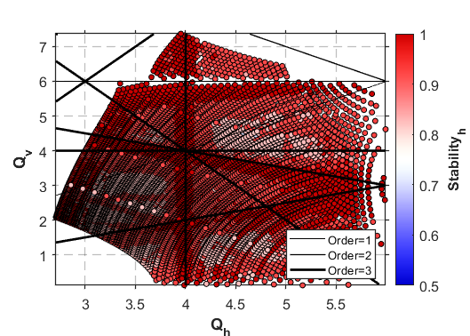
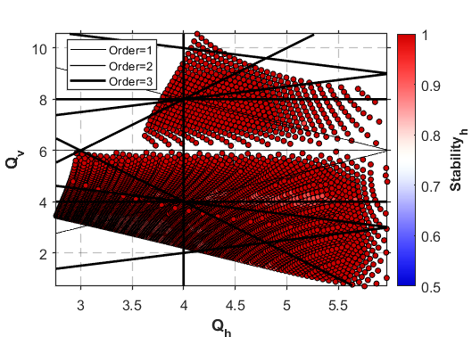
Option 1: FD structure→ Increase period number
Full Parameters scan for FD structure under 12m radius conditions
  The magnet spiral angle is closely related to lattice stability (12 cells as an example)
Spiral angle trade-off: Higher spiral angle improves vertical tune but reduces beam stability（Consistent with Dr.M. Topp-Mugglestone's research conclusions）. Maximum spiral angle should not exceed 45°.
3rd-order resonance dominance: Particle stability is more sensitive to 3rd-order resonances than 1st/2nd order.
Spiral angle=30°
Spiral angle=40°
Spiral angle=50°

Slide 10
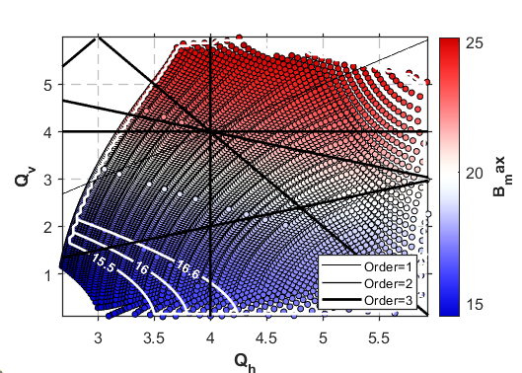
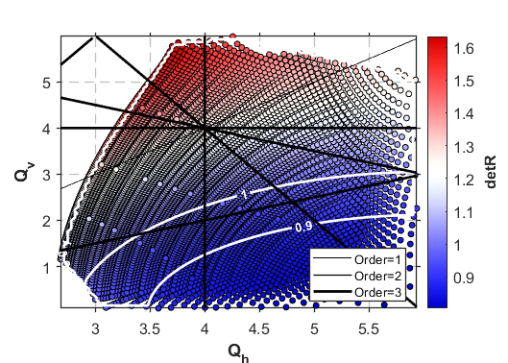
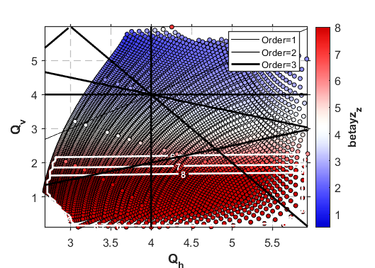
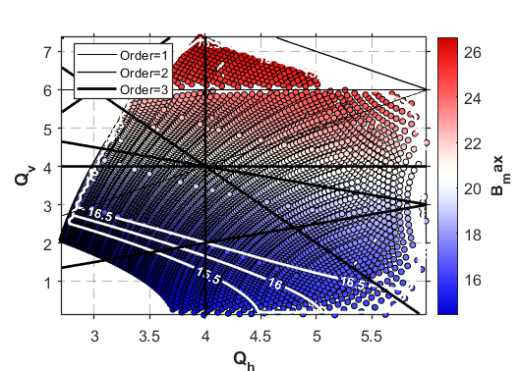
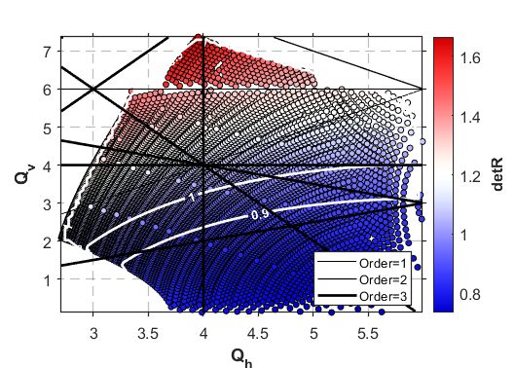
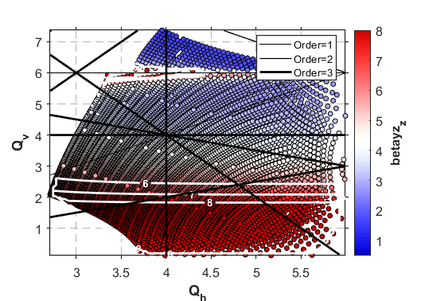
Tunes limited by $B_{max}<1.66T$ , $∆R<1$ , $β_{z}<6$
N=12, Spiral angle=30 degree
N=12,Spiral angle=40 degree
Almost no tunes satisfy all three conditions simultaneously.
Very limited tunes available, but ΔR approaches 1m limit.

Slide 11
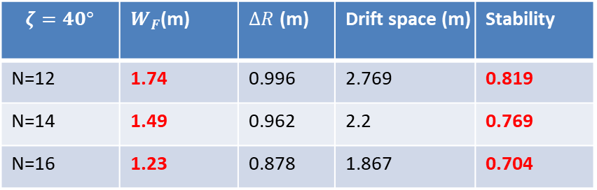
Feasible solutions for N=12,14,16
No solutions for N=12,14,16 when Spiral angle=30 degree
Spiral angle=40 degree (Feasible solutions marked in orange)
N=12
N=14
N=16
Average value of the objectives for feasible solutions
$$ζ=40°$$ | $W_{F}$(m) | $∆R$ (m) | Drift space (m) | Stability
N=12 | 1.74 | 0.996 | 2.769 | 0.819
N=14 | 1.49 | 0.962 | 2.2 | 0.769
N=16 | 1.23 | 0.878 | 1.867 | 0.704
More periods = better stability but compressed drift space
Magnet width smaller: N=16, Vacuum chamber manufacturing becomes feasible.
N=16 recommendation: Best choice from F-section width and stability

Slide 12
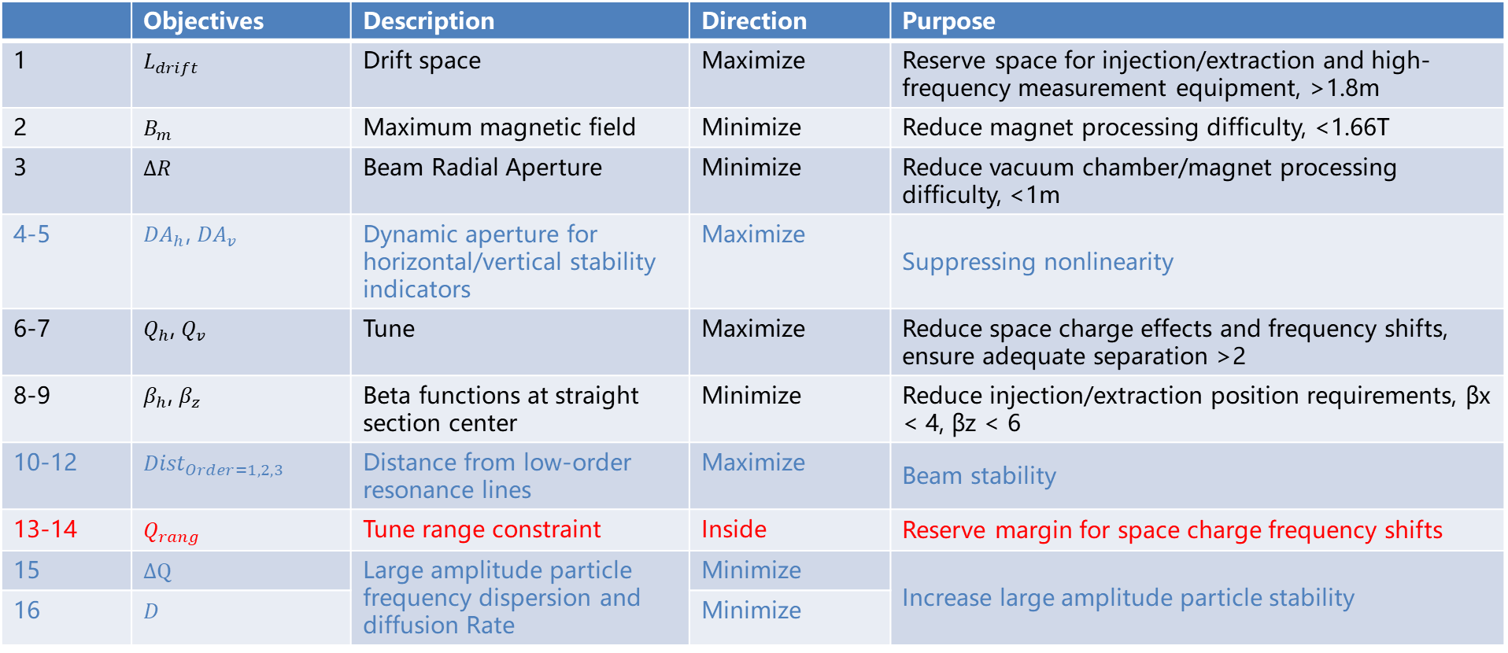
Other Constraint conditions
Space charge considerations: Tune fractional parts constrained to [0.2, 0.35] or [0.65, 0.8] to avoid integer/half-integer resonances.(Based on RCS experience, not sure if it's appropriate for FFA design?)
 | Objectives | Description | Direction | Purpose
1 | $L_{drift}$ | Drift space | Maximize | Reserve space for injection/extraction and high-frequency measurement equipment, >1.8m
2 | $B_{m}$ | Maximum magnetic field | Minimize | Reduce magnet processing difficulty, <1.66T
3 | $∆R$ | Beam Radial Aperture | Minimize | Reduce vacuum chamber/magnet processing difficulty, <1m
4-5 | ${DA}_{h}$, ${DA}_{v}$ | Dynamic aperture for horizontal/vertical stability indicators | Maximize | Suppressing nonlinearity
6-7 | $Q_{h}$, $Q_{v}$ | Tune | Maximize | Reduce space charge effects and frequency shifts, ensure adequate separation >2
8-9 | $β_{h}$, $β_{z}$ | Beta functions at straight section center | Minimize | Reduce injection/extraction position requirements, βx < 4, βz < 6
10-12 | ${Dist}_{Order=1,2,3}$ | Distance from low-order resonance lines | Maximize | Beam stability
13-14 | $Q_{rang}$ | Tune range constraint | Inside | Reserve margin for space charge frequency shifts
15 | $∆Q$ | Large amplitude particle frequency dispersion and diffusion Rate | Minimize | Increase large amplitude particle stability
16 | $D$ |  | Minimize

Slide 13
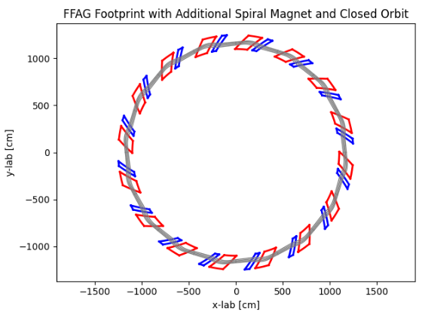
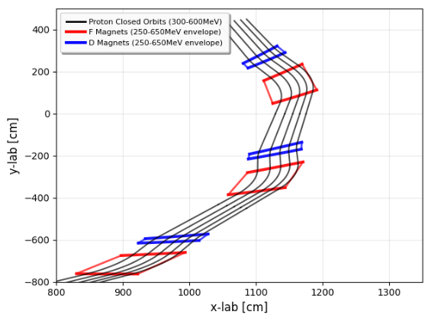
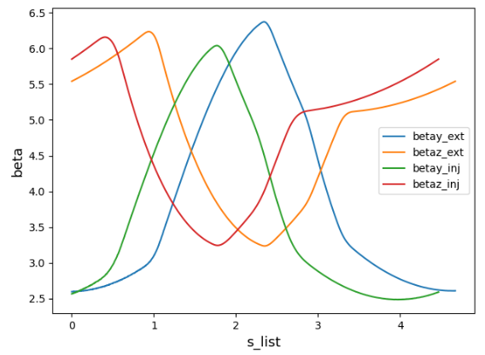
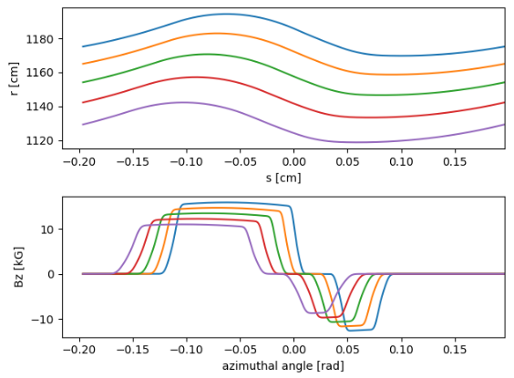
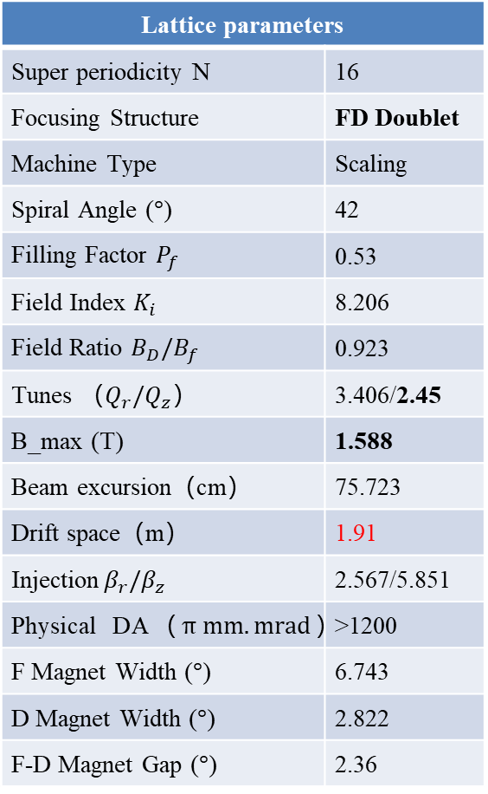
FD Lattice parameters optimized by enhanced NSGA-II
FD lattice solution meeting all requirements except for tunes
Lattice parameters
Super periodicity N | 16
Focusing Structure | FD Doublet
Machine Type | Scaling
Spiral Angle ($°$) | 42
Filling Factor $P_{f}$ | 0.53
Field Index $K_{i}$ | 8.206
Field Ratio $B_{D}/B_{f}$ | 0.923
Tunes （$Q_{r}/Q_{z}$） | 3.406/2.45
B_max (T) | 1.588
Beam excursion（cm） | 75.723
Drift space（m） | 1.91
Injection${ β}_{r}/β_{z}$ | 2.567/5.851
Physical DA（$π mm.mrad$） | >1200
F Magnet Width ($°$) | 6.743
D Magnet Width ($°$) | 2.822
F-D Magnet Gap ($°$) | 2.36
Beta Functions at Injection/Extraction per Cell
Fractional parts not in [0.2, 0.35] or [0.65, 0.8]
Tune diffusion rate is low
within magnet aperture
Vertical tune variation: 1.5~2.7 within magnet aperture
6cm
1Qx-2Qy=0
Closed orbits and Magnetic Field Distribution
Large Amplitude Particle FMA Analysis
Significant particle loss at 3rd-order resonance lines

Slide 14
Nonlinear Analysis for particles with large amplitude
Particle loss mechanisms:
  Loss happened primarily in vertical space
  Resonance sensitivity: 3rd-order (most sensitive) and 5th-order resonances dominate
  Loss pattern: Particles lost when approaching resonance lines
Y_offset=-31cm Z_offset=4.5
Y_offset=-40cm Z_offset=2
Orde=5, 2Qx-3Qy=0
Orde=3, 1Qx-2Qy=0

Slide 15
Option 2: FDF → Split F magnet into two parts
FDF with N=12, Much better situation than FD case, we have more choice and easy to find optimal solutions when the spiral angle comes to 40 degree
No need to think about N=14,16 with more magnets
N=16, FD, spiral angle=40°
N=12,FDF,Spiral angle=40°

Slide 16
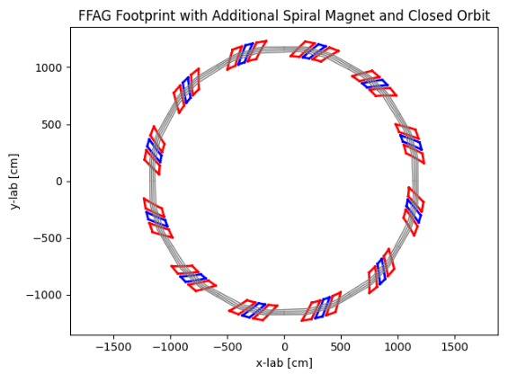
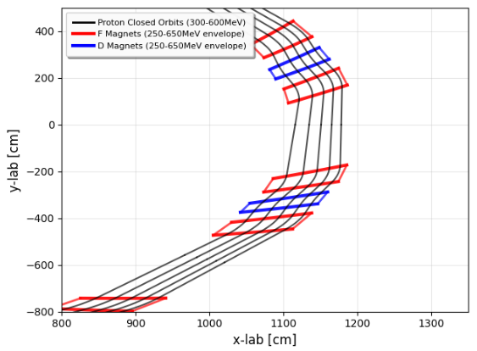
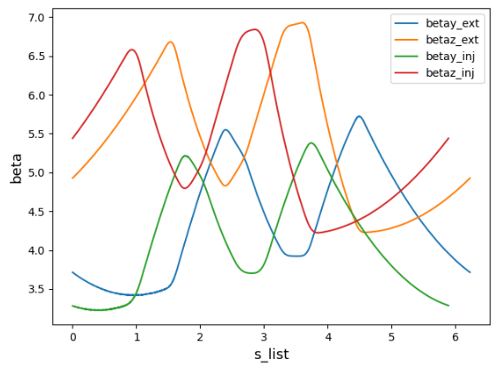
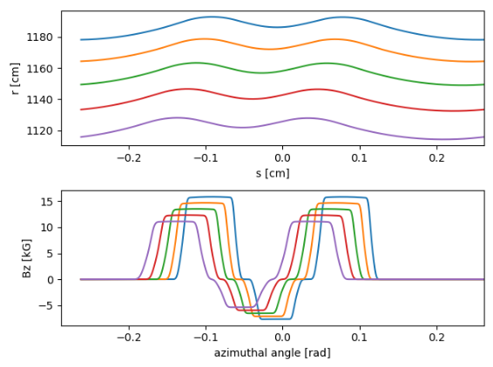
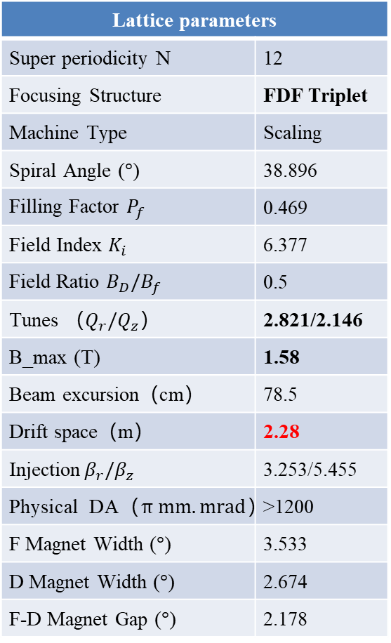
FDF Lattice parameters optimized by enhanced NSGA-II
Lattice parameters
Super periodicity N | 12
Focusing Structure | FDF Triplet
Machine Type | Scaling
Spiral Angle ($°$) | 38.896
Filling Factor $P_{f}$ | 0.469
Field Index $K_{i}$ | 6.377
Field Ratio $B_{D}/B_{f}$ | 0.5
Tunes （$Q_{r}/Q_{z}$） | 2.821/2.146
B_max (T) | 1.58
Beam excursion（cm） | 78.5
Drift space（m） | 2.28
Injection${ β}_{r}/β_{z}$ | 3.253/5.455
Physical DA（$π mm.mrad$） | >1200
F Magnet Width ($°$) | 3.533
D Magnet Width ($°$) | 2.674
F-D Magnet Gap ($°$) | 2.178
FDF lattice solution meeting all requirements except for tunes
Beta Functions at Injection/Extraction per Cell
Fractional parts not in [0.2, 0.35] or [0.65, 0.8]
Tune diffusion rate is low
within magnet aperture
Vertical tune variation: 2.0~2.4 within magnet aperture
6cm
Closed orbits and Magnetic Field Distribution
Large Amplitude Particle FMA Analysis

Slide 17
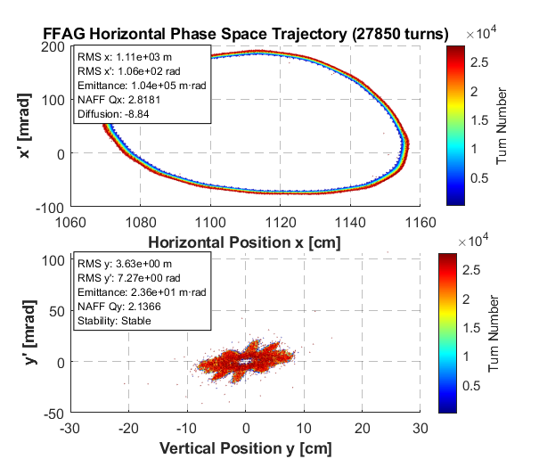
Nonlinear Analysis for particles with large amplitude
Particle loss mechanisms:
  Loss direction: Primarily in vertical plane
  Resonance sensitivity: 5th-order resonances dominate
  Loss pattern: Particles lost when approaching resonance lines and tracking sufficient turns
Y_offset=-44.4cm Z_offset=2.9cm
Y_offset=-28.8cm Z_offset=10.2cm
Orde=5, 2Qx+3Qy=12
Orde=5, 1Qx+4Qy=12

Slide 18
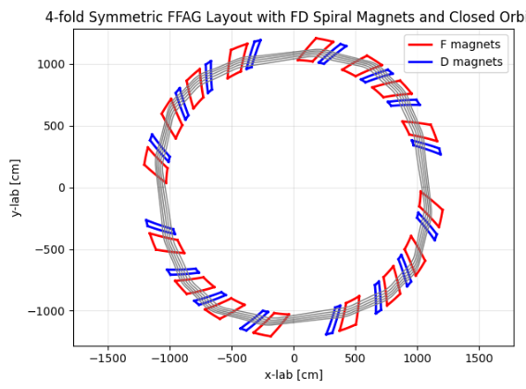
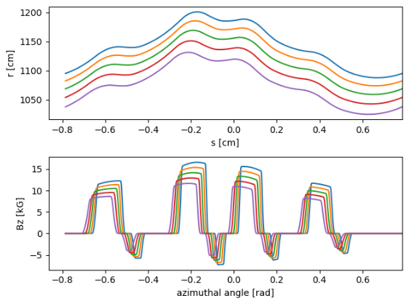
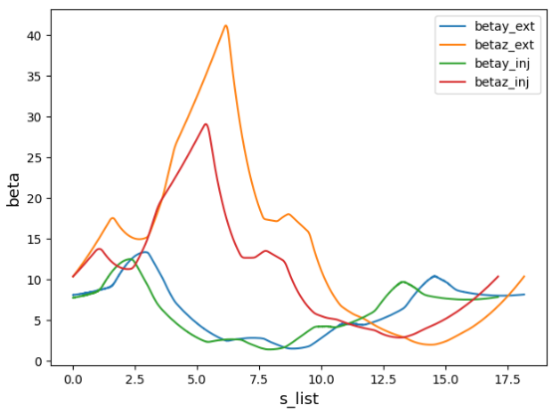
Summary
Problem identification: Reviewed previous lattice parameters, identified issues, proposed 3 key indicators for mitigating nonlinear effects
Solution comparison: 16-period FD vs 12-period FDF schemes provided. Main differences: Drift space length and stability - FDF offers more options: Better vertical stability and longer drift space
Future consideration: Injection scheme highly coupled with lattice parameters – further optimizing with injection constraints（Detail Discussion in Dr. Huang’s report）
16-Period FD 4-fold Scheme Investigation: Preliminary exploration for increased drift space
Unexpected behavior: Closed orbit shows clear increase-then-decrease pattern
Vertical beta values extremely large
Optimization update needed: βmax should be added as constraint in optimization algorithm

Slide 19
Thank you for your attention

Slide 20
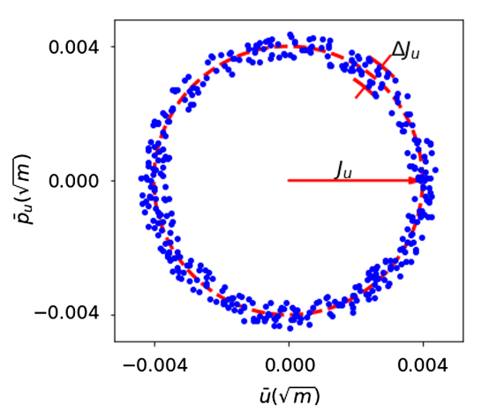
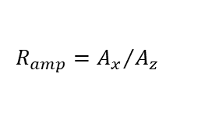
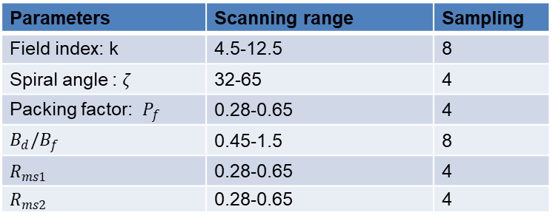

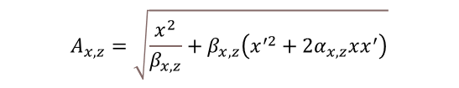


Back up： Model training data collection
Perform a coarse grid scan of Lattice parameters, collecting survival status and the first 2 turns of four-dimensional phase space trajectory data for particles with different emittances at each complete lattice revolution
  Requirement: the lattice must have a closed orbit
  Satisfy the stability condition： Tr|M|<2
  Complete collection will take approximately 2 weeks
Feature engineering: Extract stability indicators related to stabilities from trajectory data, 23 indicators in total
  Phase space topology: horizontal and vertical normalized average amplitudes
  Resonance mechanisms: Define the distance from particle oscillation frequency
  to the first 5 orders of resonance lines
  Closed Orbit Distortion (COD)
  Optical coupling
Parameters | Scanning range | Sampling
Field index: k | 4.5-12.5 | 8
Spiral angle : $ζ$ | 32-65 | 4
Packing factor: $P_{f}$ | 0.28-0.65 | 4
$B_{d}/B_{f}$ | 0.45-1.5 | 8
$R_{ms1}$ | 0.28-0.65 | 4
$R_{ms2}$ | 0.28-0.65 | 4
$$X=\frac{x}{\sqrt{β_{x}}}, P_{X}=\sqrt{β_{x}}p_{x}+α_{x}\frac{x}{\sqrt{β_{x}}}$$
$$A_{x,z}=\sqrt{\frac{x^{2}}{β_{x,z}}+β_{x,z}\left(x^{′2}+2α_{x,z}xx^{′}\right)}$$
$$d_{n}=\min_{m,l,p} \left\{\frac{\left|mQ_{x}+lQ_{z}−p\right|}{\sqrt{m^{2}+l^{2}}}\right\},n=1,2,...,5$$
$$R_{amp}={A_{x}}/{A_{z}}$$
$$Q_{couple}=Q_{x}⋅Q_{z}$$

Slide 21
Back up： Feature Engineering, Model Training, and Optimal Model Selection
Used a hierarchical framework to analyze how physical mechanisms affect particle stability, identifying 10 key features
  Evaluated basic physical mechanisms individually, using random forest models to test how well each type predicts particle stability
  Analyzed how physical mechanisms work together by testing combinations of the better-performing mechanisms
  Identified the most important individual features using random forest importance scores
Trained models using features as inputs to predict whether particles would be lost
Tested several models (Random Forest, Neural Networks, XGBoost, SVM) and selected Random Forest as the best performer based on cross-validation
Integrated the model to evaluate and optimize DA

Slide 22
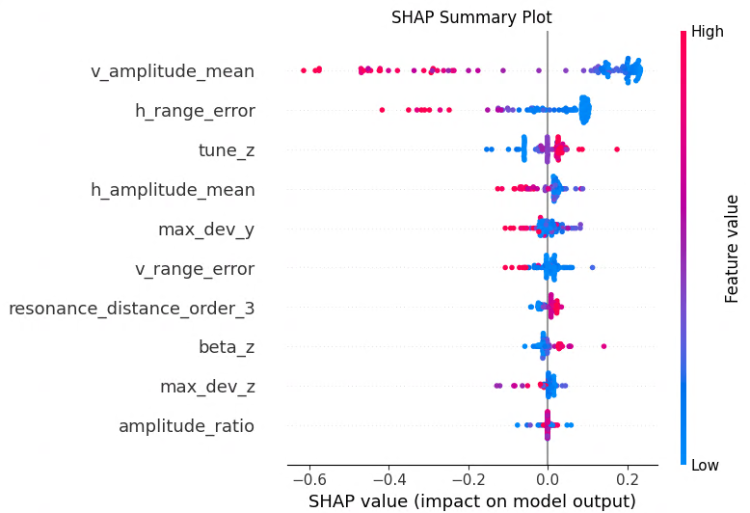
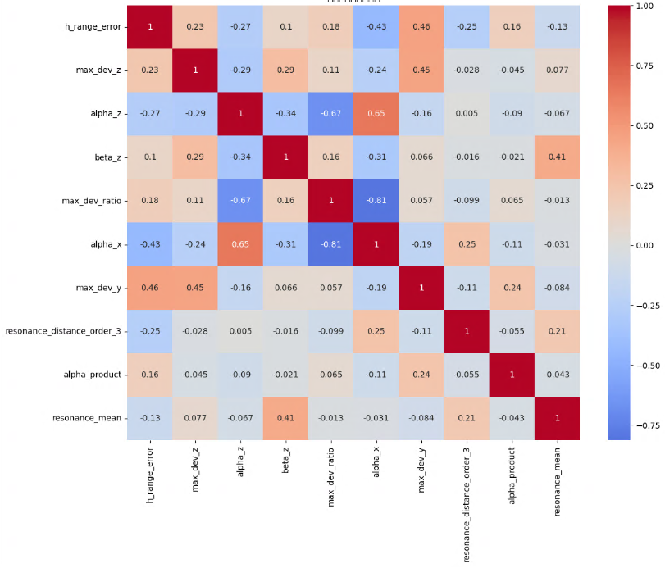
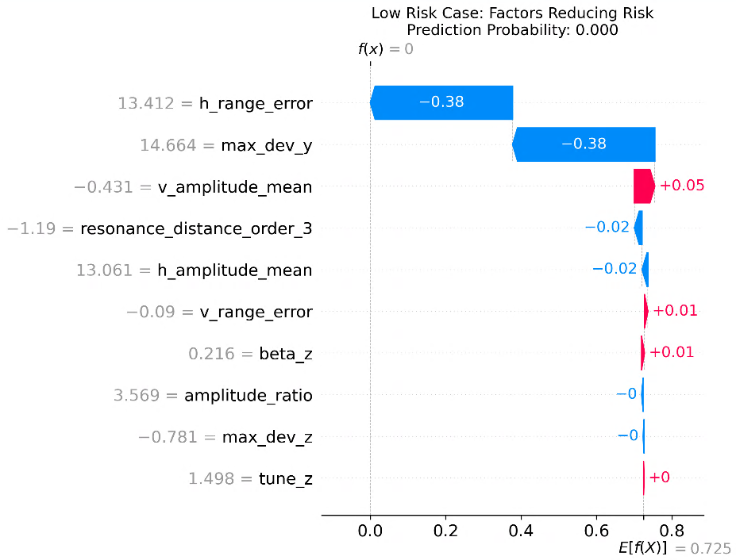
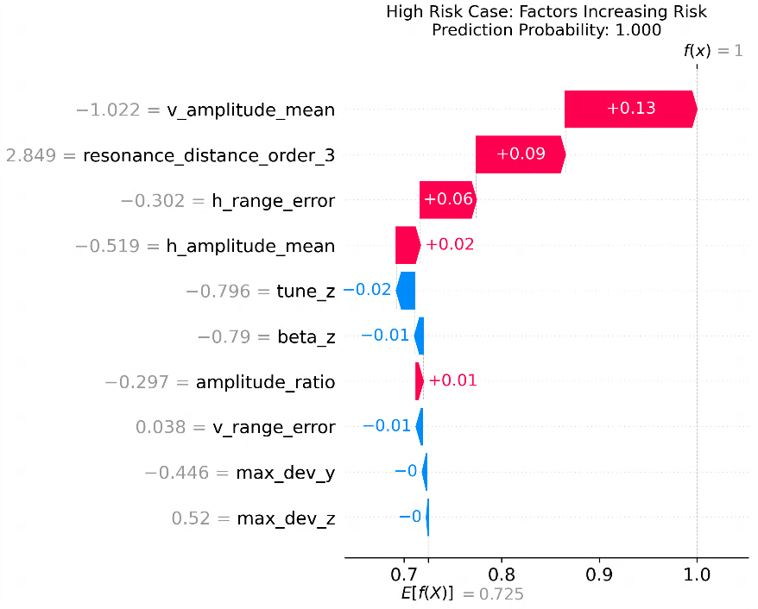
Back up：Model Interpretation
Used SHAP analysis to calculate how much each input feature contributes to model decisions
For example, when using the Random Forest model for prediction, model interpretation found that phase space topology-related features had the greatest contribution, indicating that particle instability mainly comes from high-order nonlinearity in the magnetic field, rather than resonance effects
Feature Engineering
Feature Importance Ranking
Global Model Interpretation
Local Model Interpretation

Slide 23
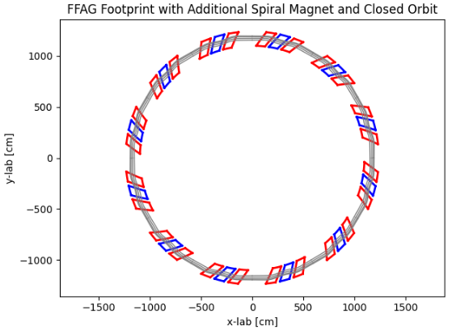
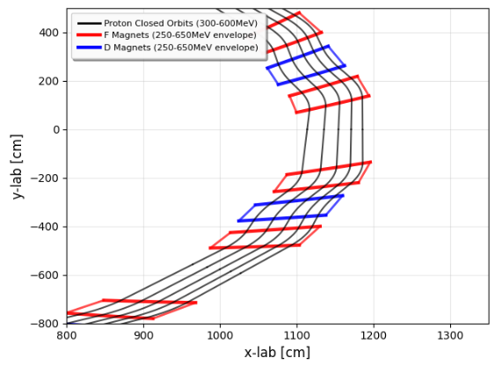
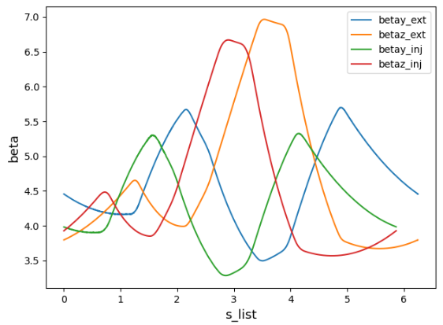


FDF Lattice parameters
Lattice parameters
Super periodicity N | 12
Focusing Structure | FDF Triplet
Machine Type | Scaling
Spiral Angle ($°$) | 32.142
Filling Factor $P_{f}$ | 0.578
Field Index $K_{i}$ | 5.464
Field Ratio $B_{D}/B_{f}$ | 0.618
Tunes （$Q_{r}/Q_{z}$） | 2.656/2.587
B_max (T) | 1.61
Beam excursion（cm） | 88
Drift space（m） | 2.13
Injection${ β}_{r}/β_{z}$ | 3.982/3.927
Physical DA（$π mm.mrad$） | >1200
F Magnet Width ($°$) | 4.457
D Magnet Width ($°$) | 4.457
F-D Magnet Gap ($°$) | 1.987

Slide 24
Y_offset=30cm Z_offset=0.2cm
Y_offset=30cm Z_offset=6cm
Y_offset=30cm Z_offset=1cm

Slide 25




Enhanced NSGA-II optimization algorithm
Clustering integration: Added clustering between ranking and offspring generation to enhance solution quality.
Improving search diversity and efficiency:
History lattice parameters (Gen=i) | Fitness value(Gen=i)
(${Spi_angle}_{1},{alfa}_{1},⋯K_{1},{Bd/Bf}_{1}$) | {$B_{1},{∆R}_{1},⋯β_{1},{Stability}_{1}$}
(${Spi_angle}_{2},{alfa}_{2},⋯K_{1},{Bd/Bf}_{2}$) | {$B_{2},{∆R}_{2},⋯β_{2},{Stability}_{2}$}
(${Spi_angle}_{3},{alfa}_{3},⋯K_{3},{Bd/Bf}_{3}$) | {$B_{3},{∆R}_{3},⋯β_{3},{Stability}_{3}$}
$$⋯$$
(${Spi_angle}_{n},{alfa}_{n},⋯K_{1},{Bd/Bf}_{n}$) | {$B_{n},{∆R}_{n},⋯β_{n},{Stability}_{n}$}
After few generation
Using History solutions
K-means-Clusters (5)
Select elite clusters
Machine Learning Models
Repopulate individuals
Maintain diversity
Input
Output
Future work: Training surrogate models using optimization data to replace time-consuming physics simulations. Generalization challenges remain to be addressed.
History lattice parameters (Gen=i+1)
(${Spi_angle}_{1},{alfa}_{1},⋯K_{1},{Bd/Bf}_{1}$)
(${Spi_angle}_{2},{alfa}_{2},⋯K_{1},{Bd/Bf}_{2}$)
(${Spi_angle}_{3},{alfa}_{3},⋯K_{3},{Bd/Bf}_{3}$)
$$⋯$$
(${Spi_angle}_{n},{alfa}_{n},⋯K_{1},{Bd/Bf}_{n}$)
Fitness value(Gen=i+1)
{$B_{1},{∆R}_{1},⋯β_{1},{Stability}_{1}$}
{$B_{2},{∆R}_{2},⋯β_{2},{Stability}_{2}$}
{$B_{3},{∆R}_{3},⋯β_{3},{Stability}_{3}$}
{$B_{n},{∆R}_{n},⋯β_{n},{Stability}_{n}$}

Slide 26


Optimization Process (FD Lattice Example)
Convergence characteristics in lattice parameters, Population size: 300 individuals
Convergence characteristics in objectives space
Convergence time: ~100 generations

