Slide 1
Next steps, organisation

Slide 2
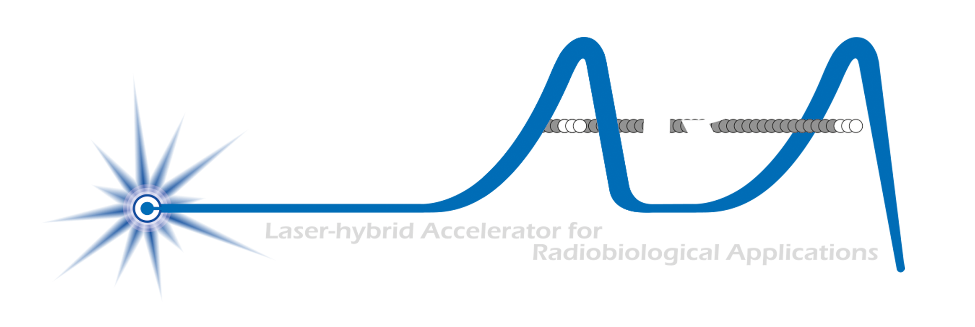
The LhARA initiative:
Deliver a systematic and definitive radiation biology programme
Prove the feasibility of laser-driven hybrid acceleration
Spin into curiosity-driven science
Lay the foundations for the transformation of ion beam therapy
automated, patient-specific proton and ion beam therapy

Slide 3
Review, discuss, agree
Resourcing model; portfolio approach:
Industrial partnership
Including entrepreneurial/venture capital
Philanthropic/Foundation
Research council:
UKRI, EU, ERC, …
Organisation and structure
Refresh:
“Branding”
Authorlist

Slide 4
Portfolio resourcing model
LhARA collaboation
Institutes
UKRI
EU/ERC
Industry partners
Philanthropists
Foundations
…
Agreed:
Communication:
Clear as crystal
To all stakeholders …
… with engagement from all of us!
Business plans:
LhARA business plan
Embodies common purpose
Business plan for each partner or stakeholder
Meets ambitions and KPIs of each partner

Slide 5
Re-affirm organisational structure
CCAP-TN-10
05Jun22

Slide 6

Agreed refresh of
Graphical presence(!)
Authorlist:
Circulate CDR and (re)invite all to sign
IB/EB chairs to organise

