Slide 1
Event series

Slide 2
Launch of LhARA Events Series
Development of LhARA Events Series/Program aimed to boost LhARA exposure and to attract donations/sponsorships
Upcoming Events:
LhARA: Particle Therapy Workshop
LhARA: End Station Workshop
LhARA: Plasma Lens Workshop
LhARA: RFI workshop
CNRS ICR: clinical peer-to-peer meeting
FRTP (Prague) – December 2025
LhARA Roadshow – universities across UK
The Royal Society Festival 2026
P.Price
17Jun25

Slide 3
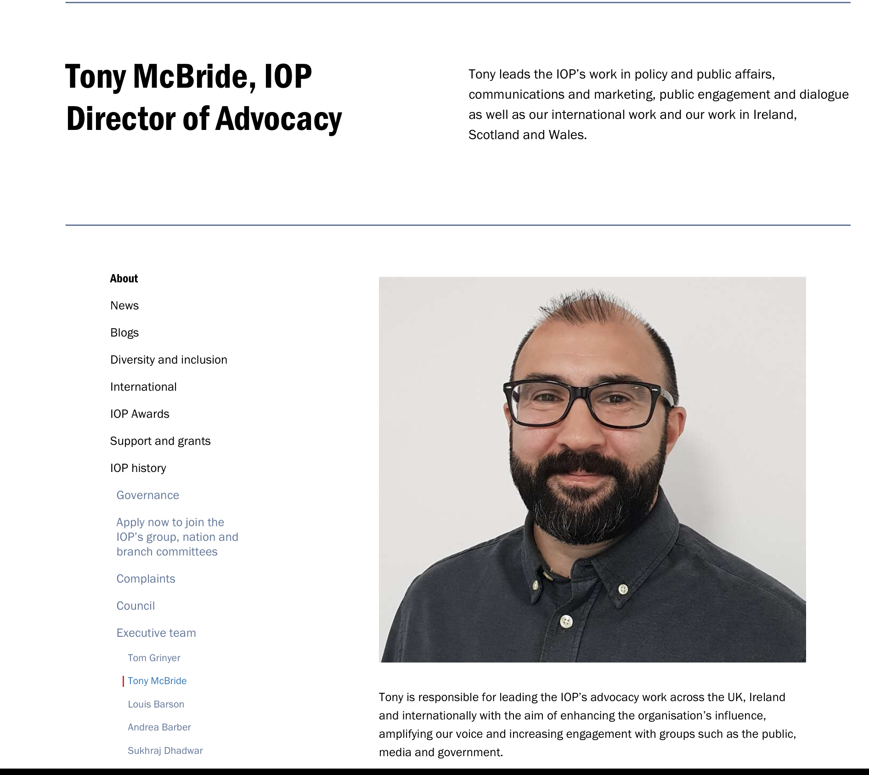
IoP Sponsored meeting series
IoP as coordinator
Reaching out to other professional boddies and stakeholders
Support for meetings as series

Slide 4
LhARA meeting series
“Particle therapy international meeting”
Targeting the pre-clinical/clinical researcher and clinical communities;
“Cylindrically-symmetric strong focusing of ion beams”
Targeting the laser-plasma and novel accelerator communities;
“Novel time-resolved and high-resolution imaging”
Targeting the developers of instrumentation and diagnostics necessary to understand the biology of radiation therapy; and
“Biology, measurement, simulation and interpretation of radiation biology”
Targeting the radiobiology community and the community developing conventional and AI-based biological simulation tools.

