Slide 1
Industrial engatement

Slide 2
… a note from the Macron event …
We had the opportunity to present the [LhARA] initiative to the Rt. Hon. Peter Kyle and the UK and French scientific delegations on the occasion of President Macron’s visit to Imperial. In his speech at the event, Peter Kyle emphasised the Government’s commitment to science and innovation to drive growth. The President made a compelling case for the development of instruments and eco-systems to create growth through co-creation, co-investment and intentional collaboration in science and innovation. We feel that our initiative is an ideal case study for the development of new co-investment mechanisms by which economic impact can be generated from front-rank multidisciplinary science. Our fruitful collaboration with the French CNRS was personally discussed by our team with President Macron and our key industrial partner, Leo Cancer Care, discussed our initiative with Peter Kyle.

Slide 3
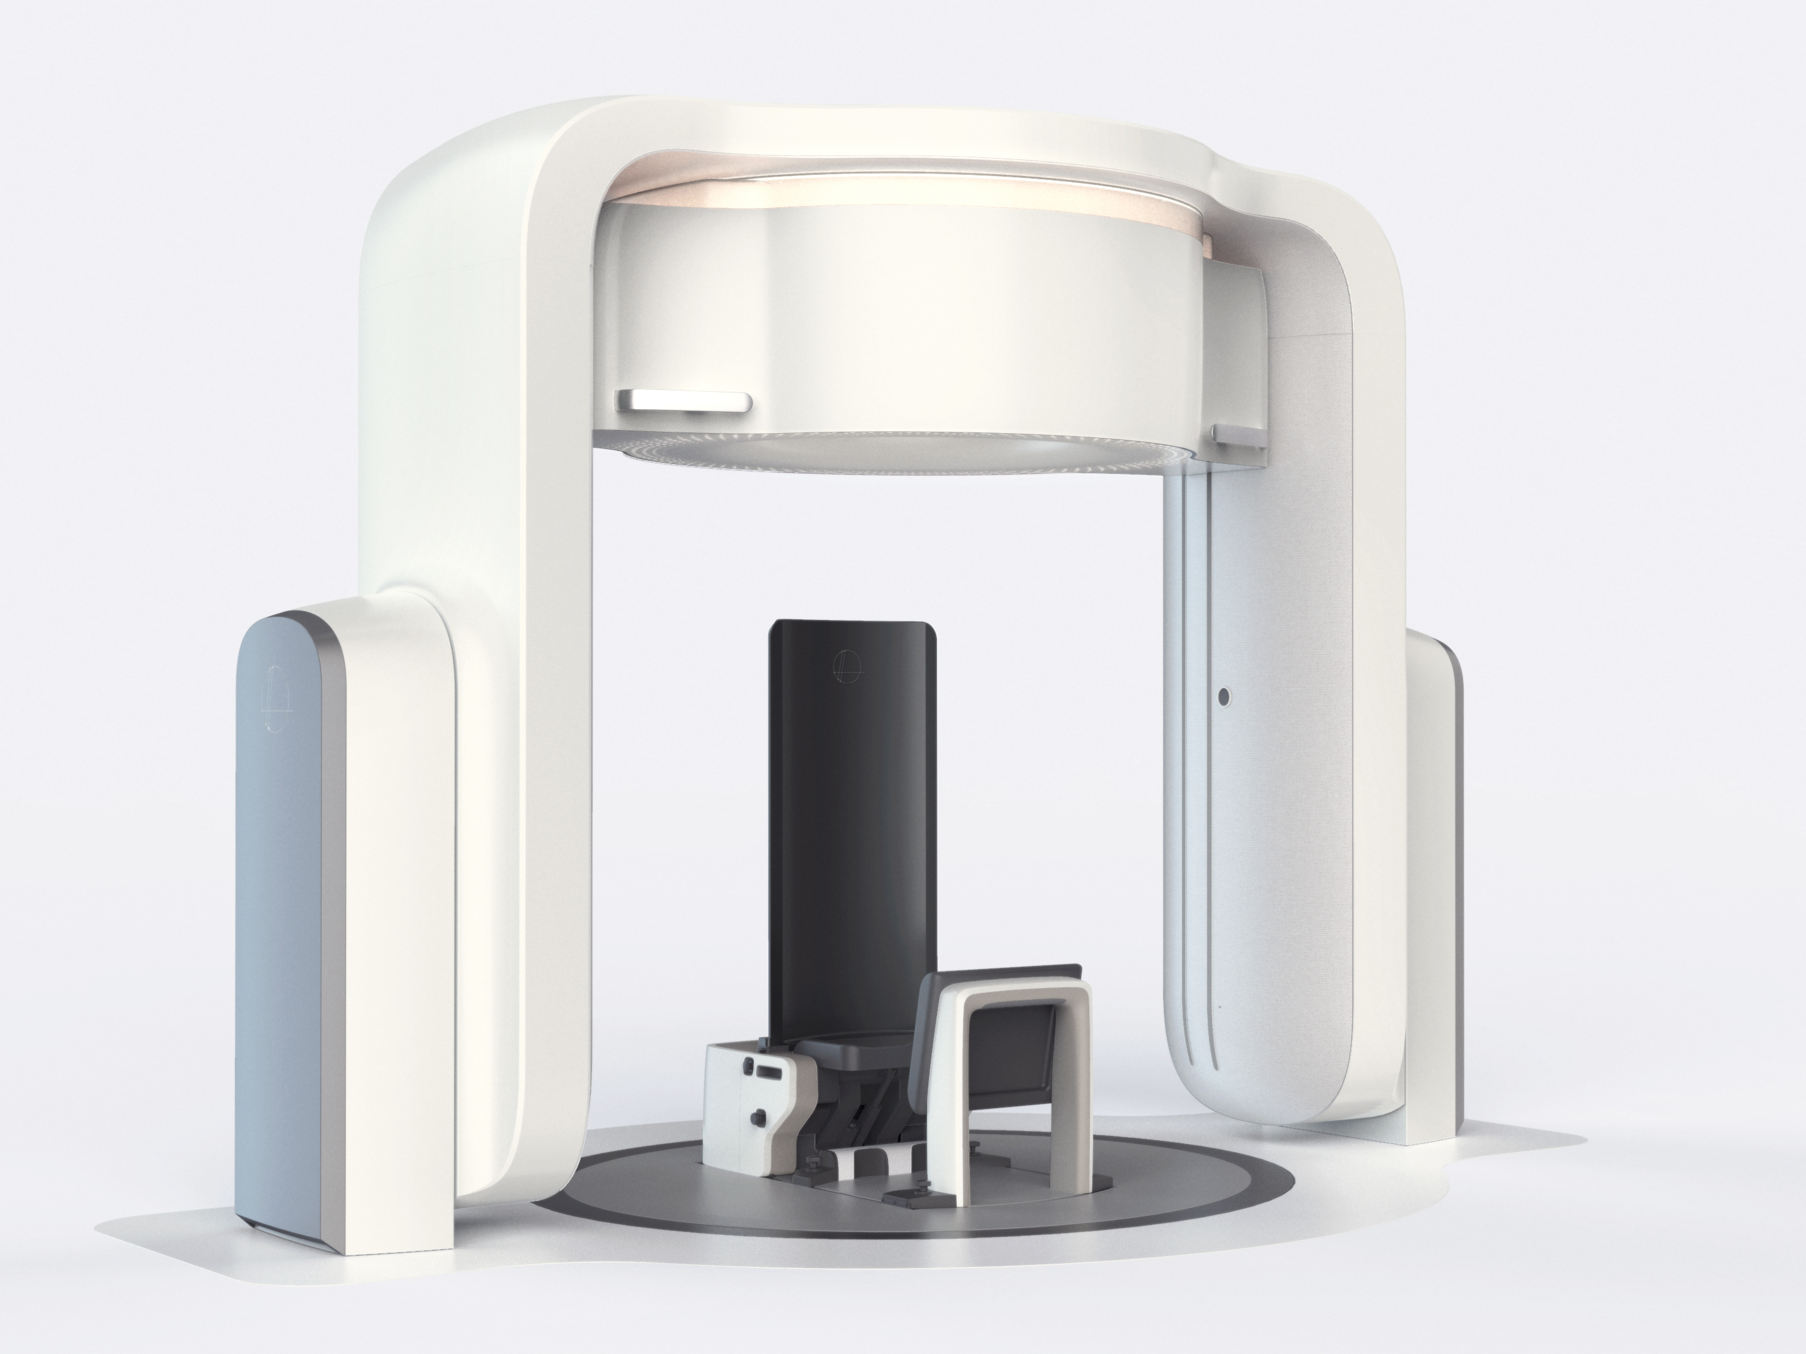

Industrial engagement
LhARA collaboation
Institutes
UKRI
EU/ERC
Industry partners
Philanthropists
Foundations
…

Slide 4
