Slide 1
LhARA initiative

Slide 2
Communication …
LhARA Royal Society Summer Science Exhibition 2026 Application
DEADLINE: 8 October 2025 at midnight.
Guidance and Examples:
Proposal Guidance: https://royalsociety.org/-/media/summer-science-exhibition/2025/call-for-proposals-2026/guidance-for-completing-your-proposal-2025.pdf
Examples: https://royalsociety.org/-/media/summer-science-exhibition/2025/call-for-proposals-2026/example-proposals.pdf
Case studies: https://royalsociety.org/-/media/summer-science-exhibition/2025/call-for-proposals-2026/summer-science-exhibition-case-studies.pd
With thanks to Will Shields

Slide 3
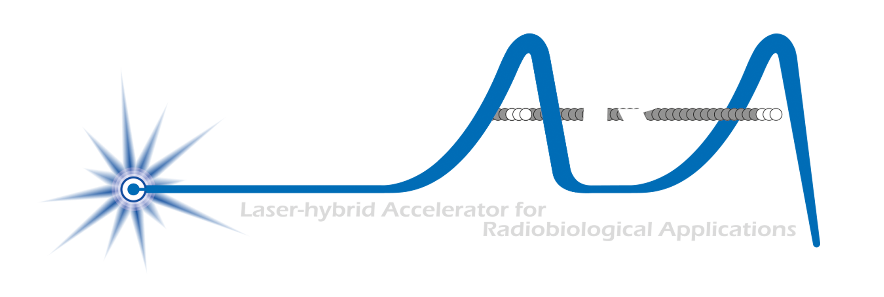
The LhARA initiative:
Deliver a systematic and definitive radiation biology programme
Prove the feasibility of laser-driven hybrid acceleration
Spin into curiosity-driven science
Lay the technological foundations for the transformation of PBT
automated, patient-specific proton and ion beam therapy

Slide 4
Radiotherapy; the challenge
Cancer: second most common cause of death globally
Radiotherapy indicated in half of all cancer patients
Significant growth in global demand anticipated:
14.1 million new cases in 2012 ⇢ 24.6 million by 2030
8.2 million cancer deaths in 2012 ⇢ 13.0 million by 2030
Scale-up in provision essential:
Projections above based on reported cases (i.e. high-income countries)
Opportunity: save 26.9 million lives in low/middle income countries by 2035
Provision on this scale requires:
Development of new and novel techniques … integrated in a
Cost-effective system to allow a distributed network of RT facilities
Atun, Lancet Oncol. 2015 Sep;16(10):1153-86

Slide 5
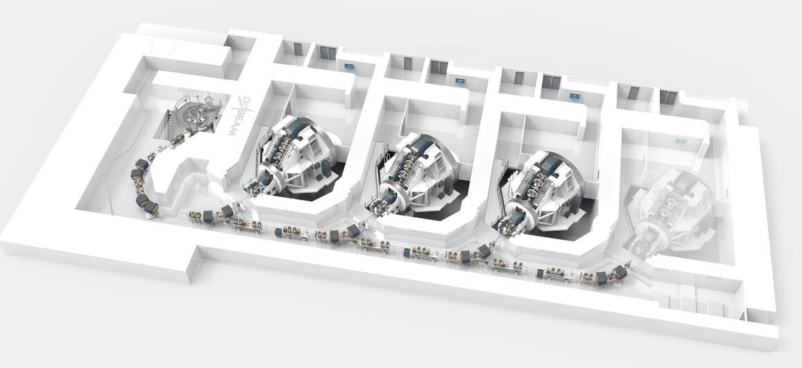
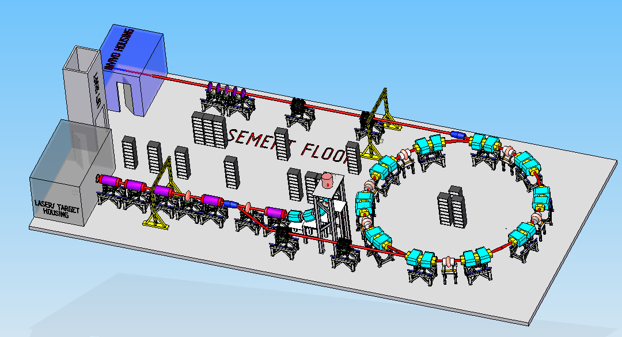
Particle beam therapy today
Cyclotron based:
Limitations:
Energy modulation
Instantaneous dose rate
Synchrotron based:
Limitiations:
Complexity
Instantaneous dose rate
⇒ reduce footprint, cost and complexity
‘PBT for the many’!
Christie Hospital Manchester
⇒ increase flexibility
optimize treatments
MedAustron Austria

Slide 6
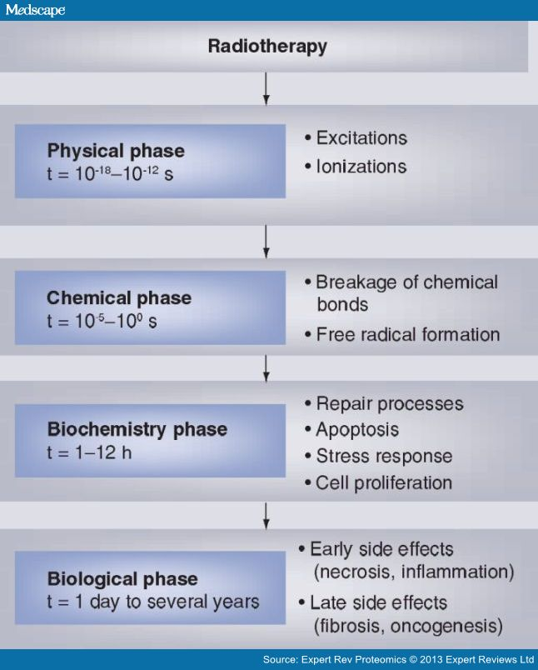
Radiobiology in new regimens
Time
domain
Space
domain
The ideally flexible beam facility can deliver it all!
⇒ substantial opportunity for a step-change in understanding!
Ion
species
Energy
Multidisciplinary approach essential
In combination and with chemo/immuno Therapies

Slide 7
Organisational structure
CCAP-TN-10
05Jun22

Slide 8
Opportunity:
Deliver a systematic and definitive radiation biology programme
Prove the feasibility of laser-driven hybrid acceleration
Spin into curiosity-driven science
Lay the technological foundations for the transformation of PBT
automated, patient-specific proton and ion beam therapy

