Slide 1
Introduction and goals

Slide 2
The LhARA Initiative

Slide 3
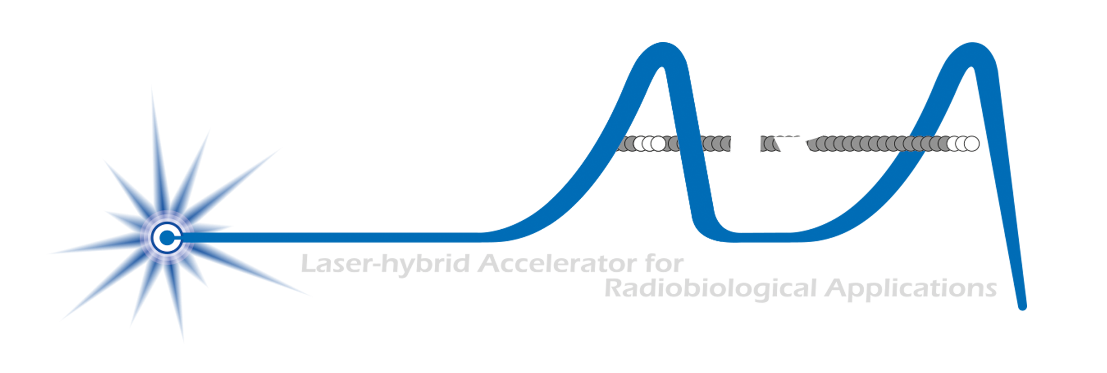
The LhARA initiative:
Deliver a systematic and definitive radiation biology programme
Prove the feasibility of laser-driven hybrid acceleration
Spin into curiosity-driven science
Lay the technological foundations for the transformation of PBT
automated, patient-specific proton and ion beam therapy

Slide 4
ITRF Preliminary Activity
UKRI Infrastructure Fund

Slide 5
October 2022
H. Owen; IAC 20Jul22
Project Board #1
07Nov22
Bliss, Long, Owen

Slide 7
Stage 1

Slide 8
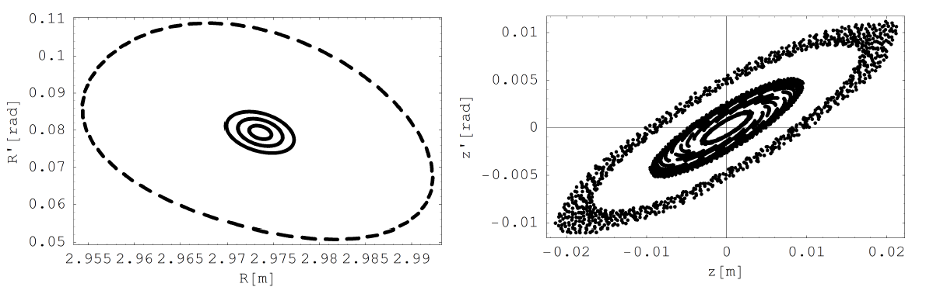
FFA optimised
Variable-energy FFA
Multi-ion capability
Single spiral design
Max field ~1.4 T
Tunable
3D tracking:
1, 2, 3 and 5σ

Slide 9
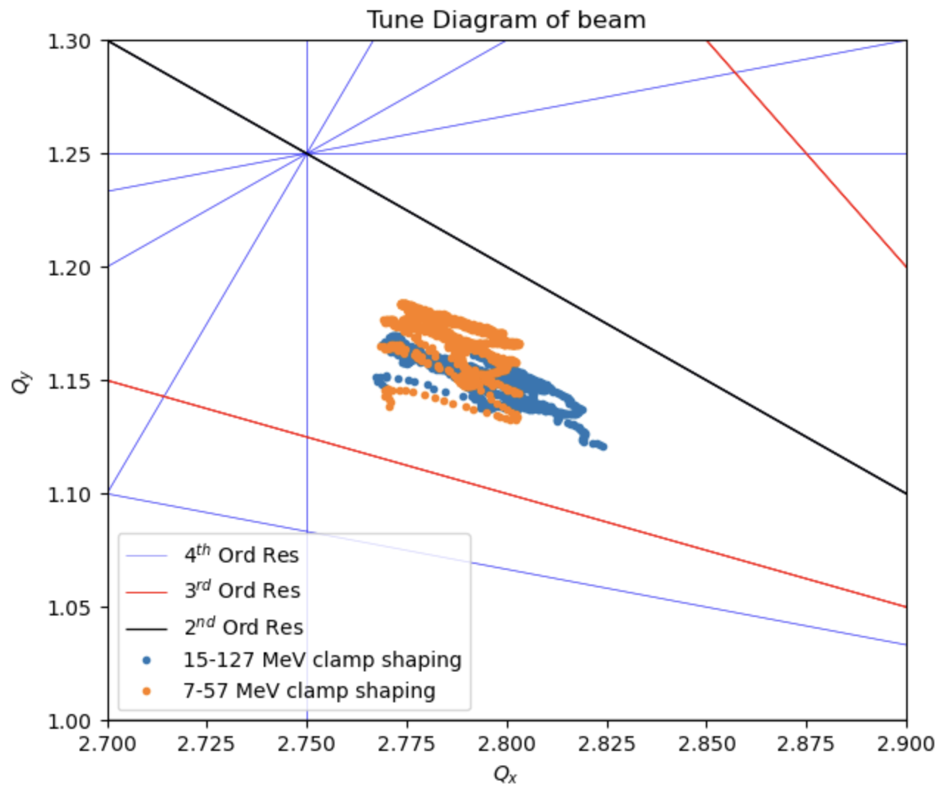
Tunes

Slide 10
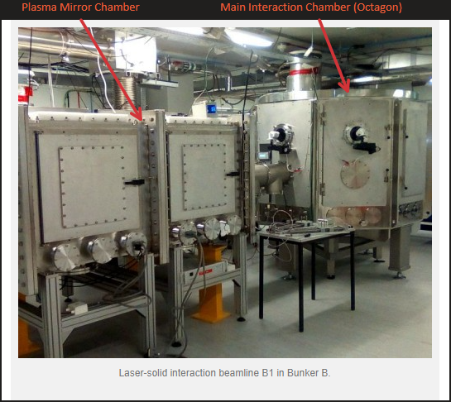
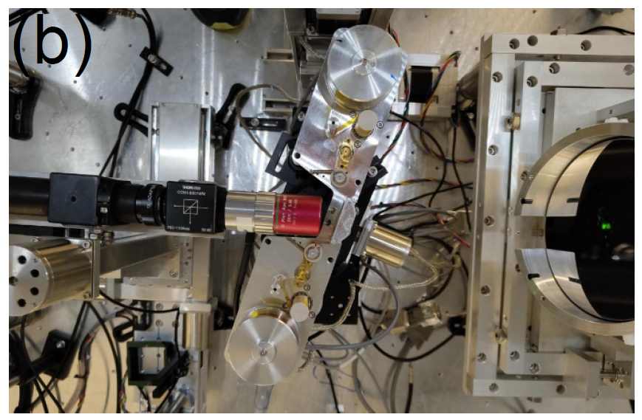
Source development

Slide 11

Plasma confinement

Slide 12

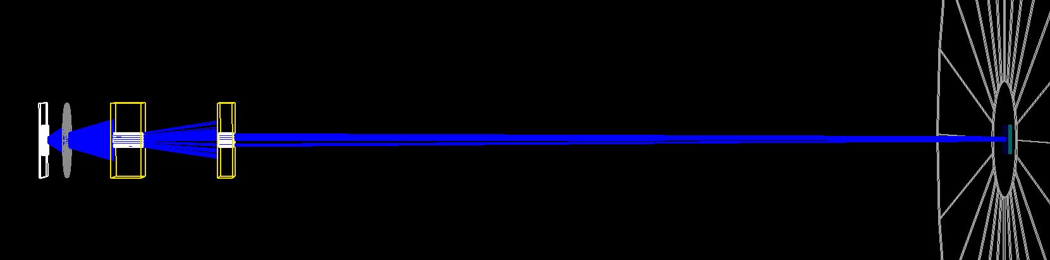
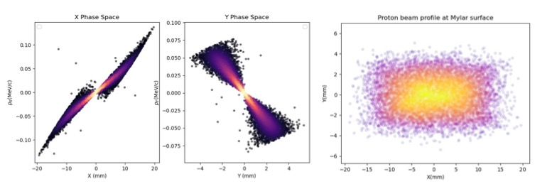
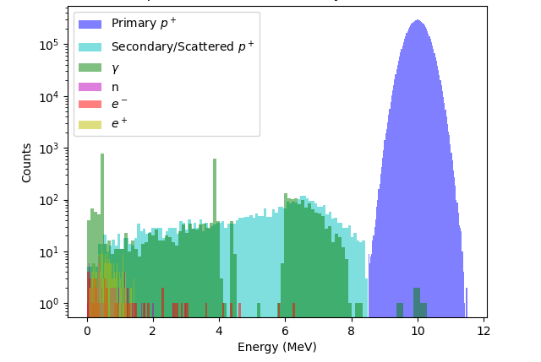
PoPLaR @ SCAPA

Slide 14
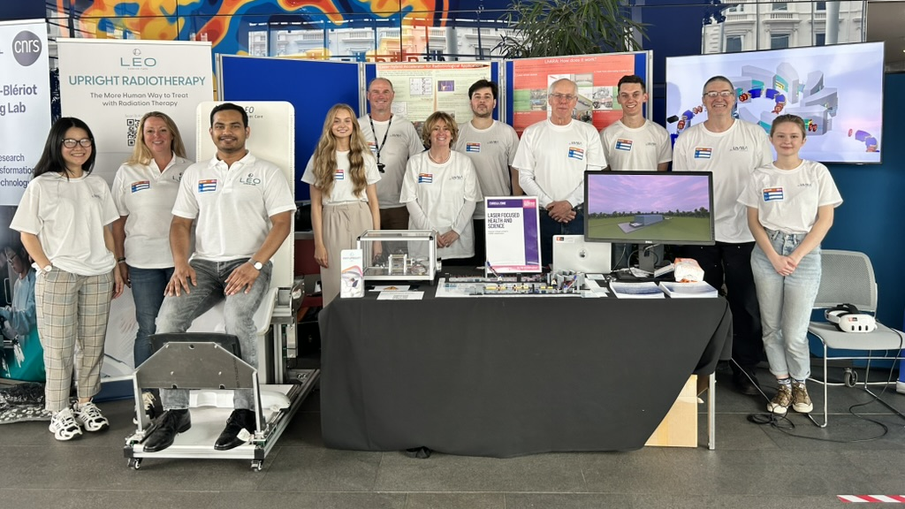
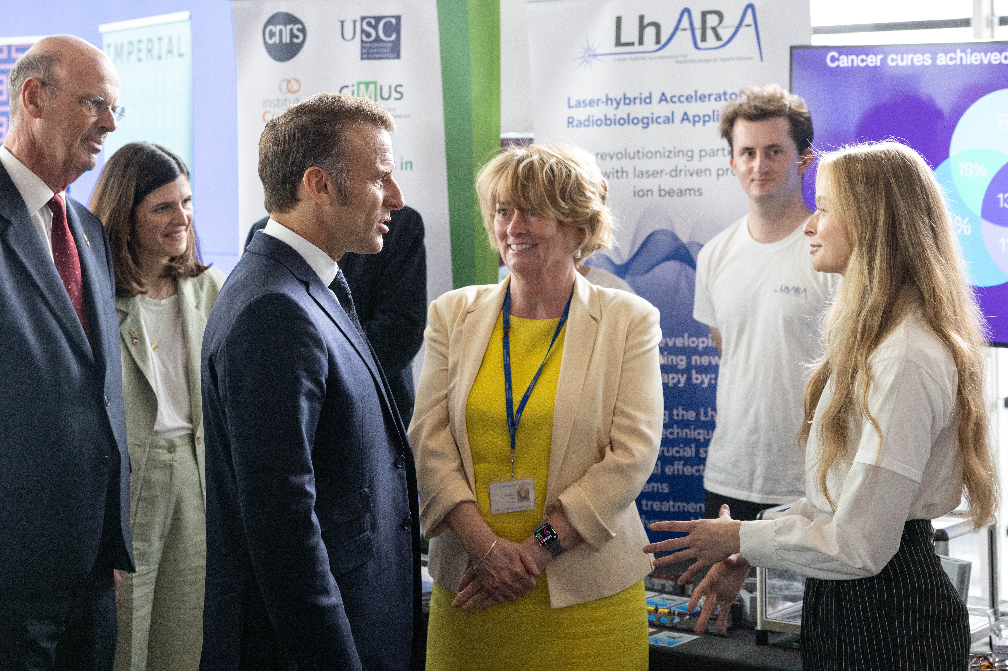
8/9Jun25; Imperial
Co-creation
ab initio!
09Jul25; Imperial

Slide 15
The LhARA Initiative
Going forward

Slide 16
Taking our initiative forward
Necessarily in a transition:
UKRI funding → portfolio resourcing model
Our strength:
A common purpose and clearly defined mission
The LhARA initiative:
Deliver a systematic and definitive radiation biology programme
Prove the feasibility of laser-driven hybrid acceleration
Spin into curiosity-driven science
Lay the technological foundations for the transformation of PBT
automated, patient-specific proton and ion beam therapy

Slide 17
Review, discuss, agree
Resourcing model; portfolio approach:
Industrial partnership
Including entrepreneurial/venture capital
Philanthropic/Foundation
Research council:
UKRI, EU, ERC, …
Organisation and structure
Refresh:
“Branding”
Authorlist

Slide 18
Resourcing model
Transition from “linear”, research-council based approach to multi-funder, “portfolio” approach …
Requires:
Communication:
Clear as crystal
To all stakeholders
Business plans:
LhARA business plan
Embodies common purpose
Business plan for each partner or stakeholder
Meets ambitions and KPIs of each partner
LhARA collaboation
Institutes
UKRI
EU/ERC
Industry partners
Philanthropists
Foundations
…

Slide 19
Resourcing model; business plans

Slide 20
Organisational structure
CCAP-TN-10
05Jun22

Slide 21

Refresh
Graphical presence(!)
Authorlist:
Circulate CDR and (re)invite all to sign
IB/EB chairs to organise

Slide 22
Multiple ion source & capture
Dosimetry, instrumentation image processing, fast feedback, control
Fundamental
radiobiology

