Slide 1
Stage 1 Simulation Update
Start-to-End Tracking Status and End Station Dose Modelling
19/09/25

Slide 2
Stage 1 Start-to-End Tracking
Objectives and Current Status
Overall Objective
Start-to-end simulation of LhARA Stage 1 from source to in-vitro end station for the range of LhARA’s configurations and the production of dose rate calculations from these simulated setups.
Status
Parametrised source beam (LhARALinearOptics) and modelling of transmission through the nozzle between the target room and stage 1 vacuum (Current transmission ~4.1%) (3M protons generated -> 123k transmitted to S1)
Solenoid equivalent Gabor lens matching for flexible beam sizes in the conventional range (3.0 – 1.0 cm)
Space charge tracking studies for beam sizes in the range of (3.0 – 2.0 cm)
Current Work
‘Look inside the envelope’ - beam delivery parameters beyond beam size
Uniformity, capture, losses, and dose …

Slide 3
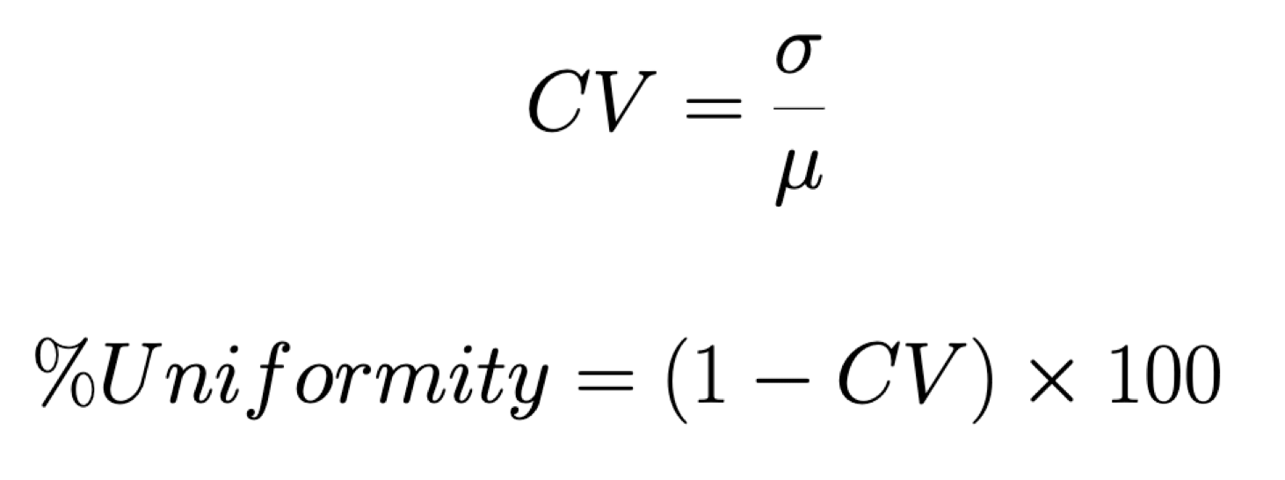
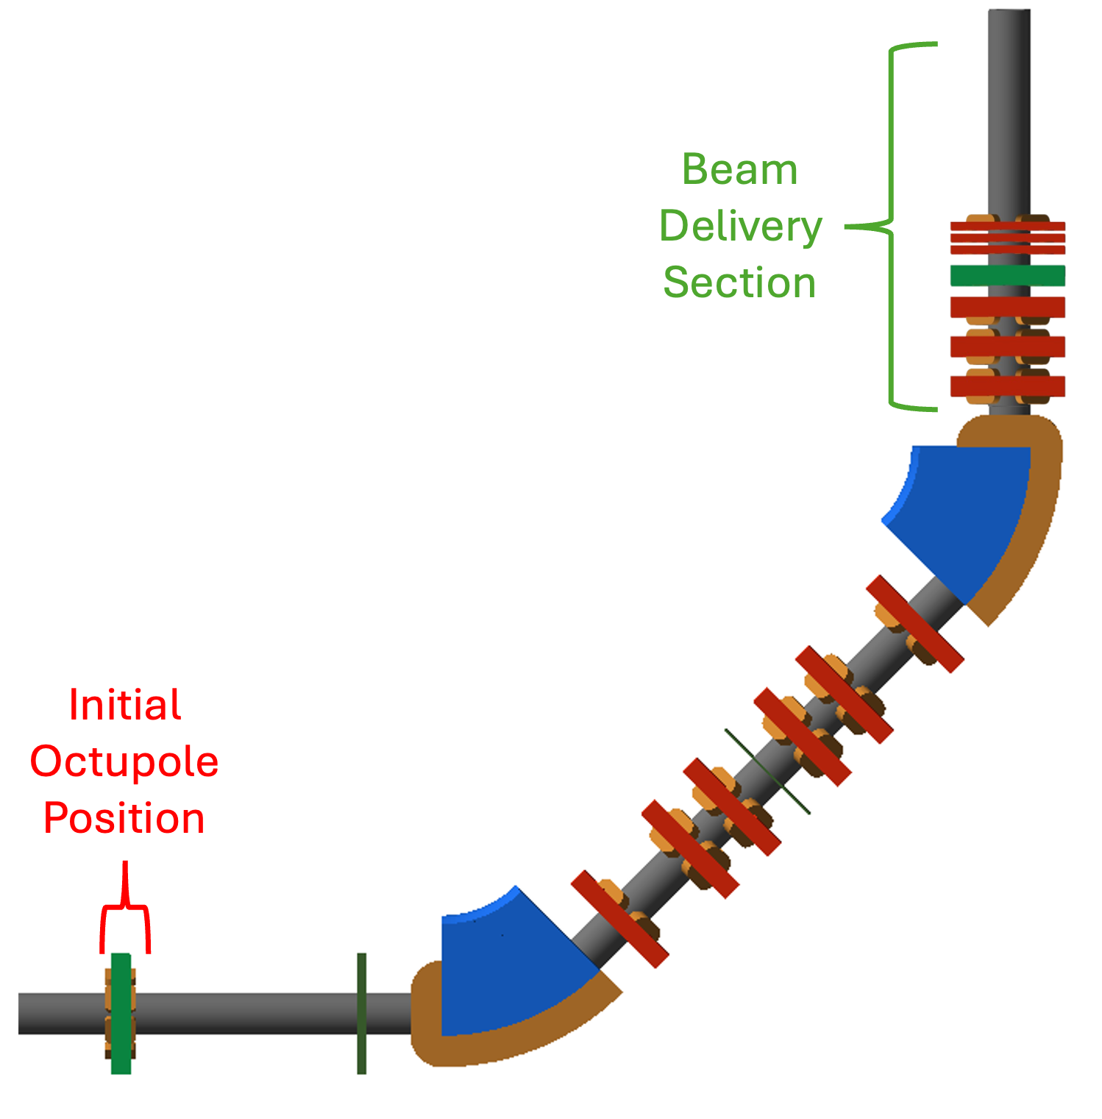
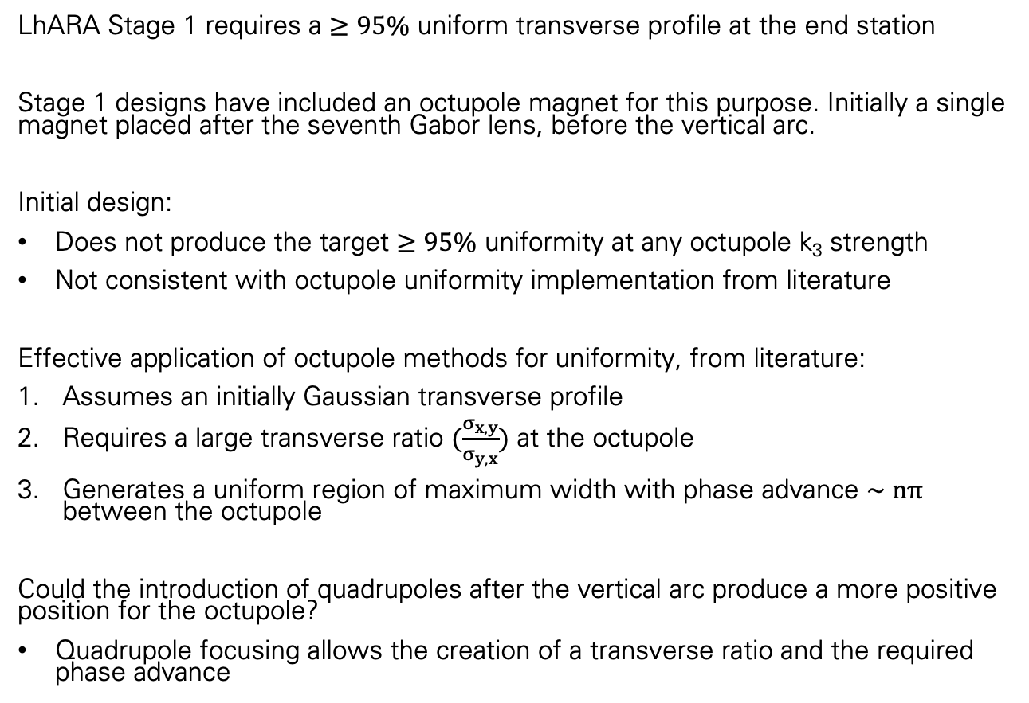
Stage 1 Start-to-End Tracking
Initial Octupole Design
LhARA Stage 1 requires a $≥95\%$ uniform transverse profile at the end station
Stage 1 designs have included an octupole magnet for this purpose. Initially a single magnet placed after the seventh Gabor lens, before the vertical arc.
Initial design:
Does not produce the target $≥95\%$ uniformity at any octupole k₃ strength
Not consistent with octupole uniformity implementation from literature
Effective application of octupole methods for uniformity, from literature:
Assumes an initially Gaussian transverse profile
Requires a large transverse ratio $(\frac{σ_{x, y}}{σ_{y, x}})$ at the octupole
Generates a uniform region of maximum width with phase advance $∼nπ$ between the octupole
Could the introduction of quadrupoles after the vertical arc produce a more positive position for the octupole?
Quadrupole focusing allows the creation of a transverse ratio and the required phase advance

Slide 4
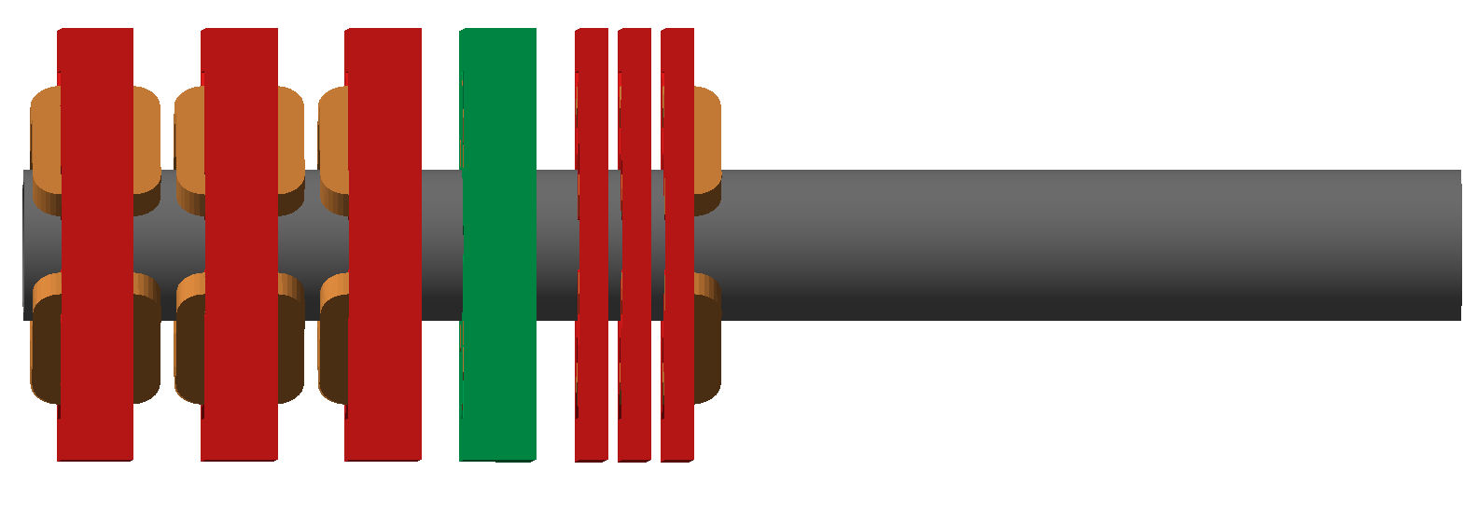
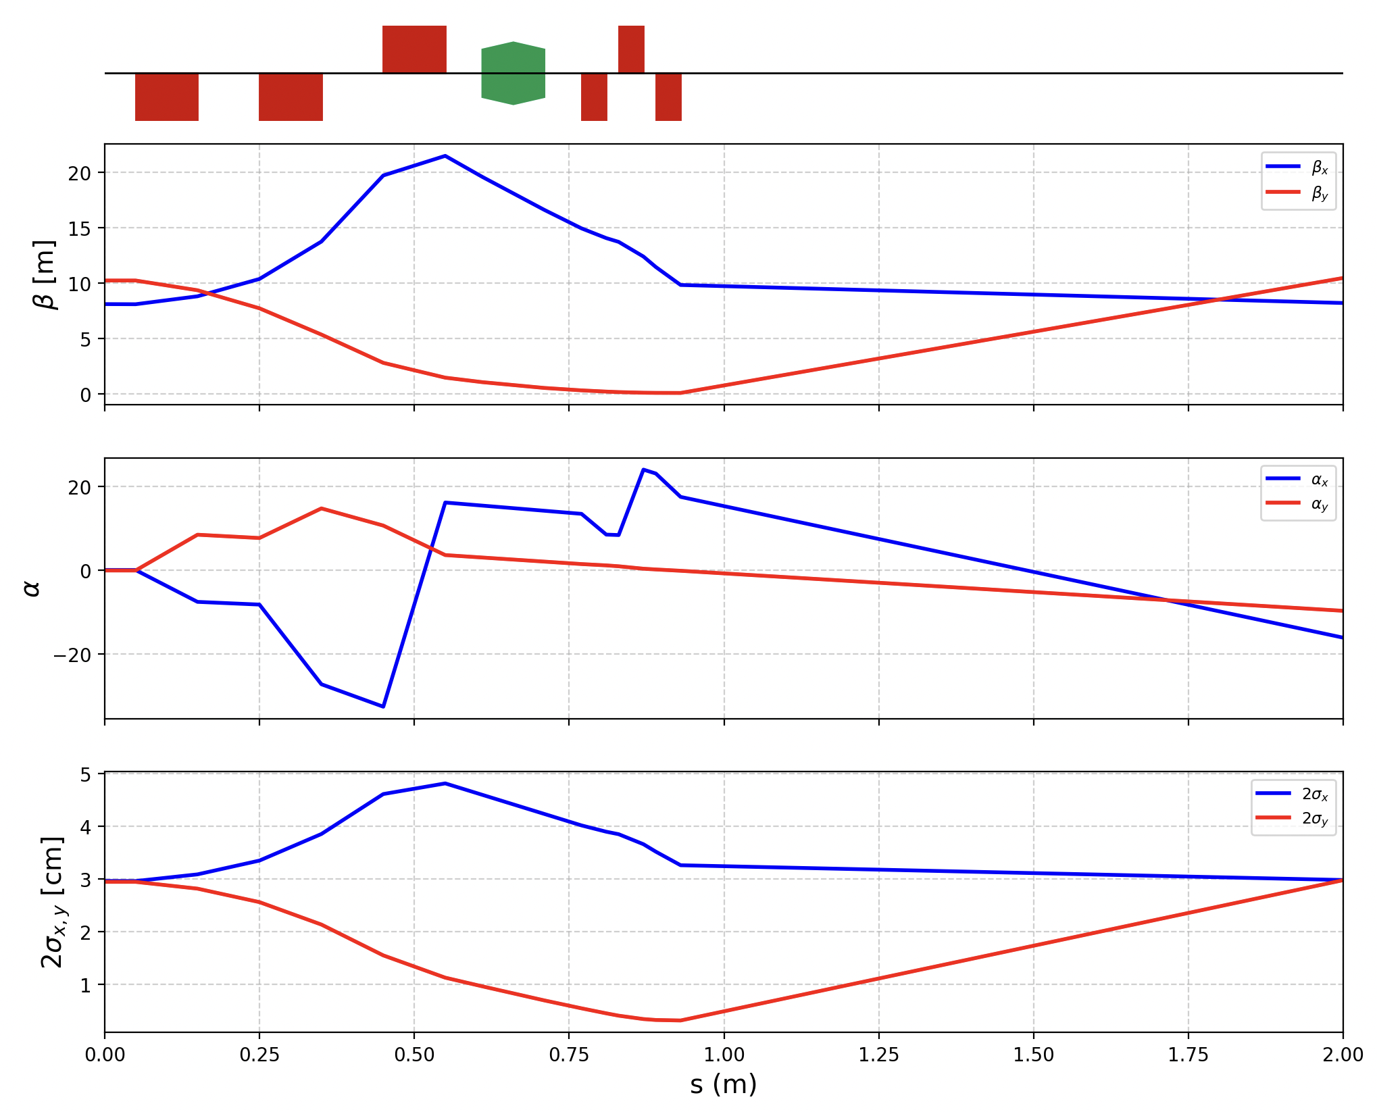
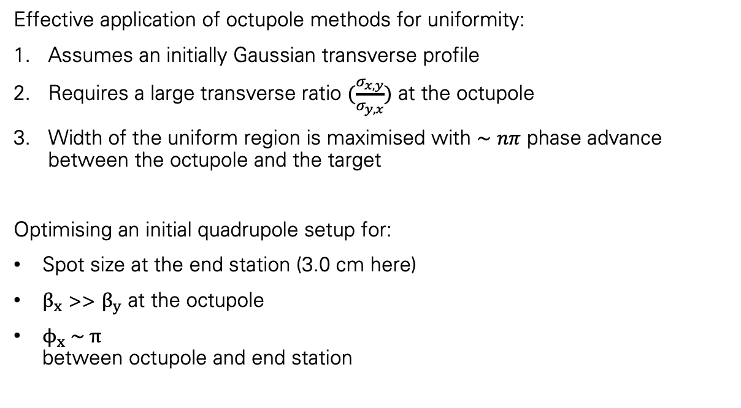
Stage 1 Start-to-End Tracking
Octupole Uniformity - Beam Delivery Designs and Matching
Effective application of octupole methods for uniformity:
Assumes an initially Gaussian transverse profile
Requires a large transverse ratio $(\frac{σ_{x, y}}{σ_{y, x}})$ at the octupole
Width of the uniform region is maximised with $∼nπ$ phase advance between the octupole and the target
Optimising an initial quadrupole setup for:
Spot size at the end station (3.0 cm here)
$β_{x}$ >> $β_{y}$ at the octupole
$ϕ_{x} \sim π$ between octupole and end station
S1 beam delivery in the BDSIM visualiser Quadrupoles in red, Octupole in green
Initial study of a single octupole worked into the beam delivery quadrupoles configuration CAN produce the linear optics conditions required, however…

Slide 5
Stage 1 Start-to-End Tracking
Beam Profile at the End Station
Beam profile entering Beam Delivery
The beam entering this section already looks very uniform, across almost the entire desired spot size (3.0 cm here)

Slide 6
Stage 1 Start-to-End Tracking
Beam Profile at the End Station
Beam profile entering Beam Delivery
If it still looks this way at the end station, with no beam delivery quads. Do we even need the octupole(s)?
The beam entering this section already looks very uniform, across almost the entire desired spot size (3.0 cm here)

Slide 7
Stage 1 Start-to-End Tracking
Beam Profile at the End Station
Beam profile entering Beam Delivery
Beam Profile at the S1 End Station
If it still looks this way at the end station, with no beam delivery quads. Do we even need the octupole(s)?
The beam entering this section already looks very uniform, across almost the entire desired spot size (3.0 cm here)
Unfortunately, the beam profile has changed significantly over 2.0 m of empty drift.
Why?

Slide 8
Stage 1 Start-to-End Tracking
Momentum Dependent Focusing at the End Station
Phase Space Correlations at the Exit of the Vertical Arc (3.0 cm Beam)
Phase Space Correlations at the Stage 1 End Station (3.0cm Beam)
Kinetic Energy-Position Relationship
Low energy particles more central
High energy particles in the outer extent

Slide 9
Stage 1 Start-to-End Tracking
Momentum Dependent Focusing at the End Station
Phase Space Correlations at the Exit of the Vertical Arc (2.0 cm Beam)
Phase Space Correlations at the Stage 1 End Station (2.0cm Beam)
The focusing is stronger as beam size decreases.
These effects are not present for monoenergetic beams, as expected, so these effects are the result of energy spread.
Identified as a chromatic effect through the arc quadrupoles.

Slide 10
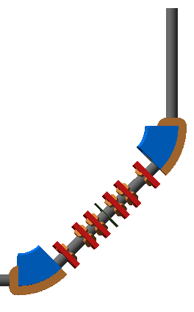
Stage 1 Start-to-End Tracking
Beam Profile Factors
Phase Space Correlations at the momentum cleaning collimator (no collimation simulated)
Upstream Factors Affecting the S1 Beam Profile
Momentum dependent focusing propagating after the vertical arc
Energy spread reduction by momentum cleaning collimation in the arc
Chromaticity correction in the vertical arc with new sextupole magnets (would require an increased arc length)
Where collimation would take place, the off-momentum particles are at the spatial extents of the y-axis, as designed.

Slide 11
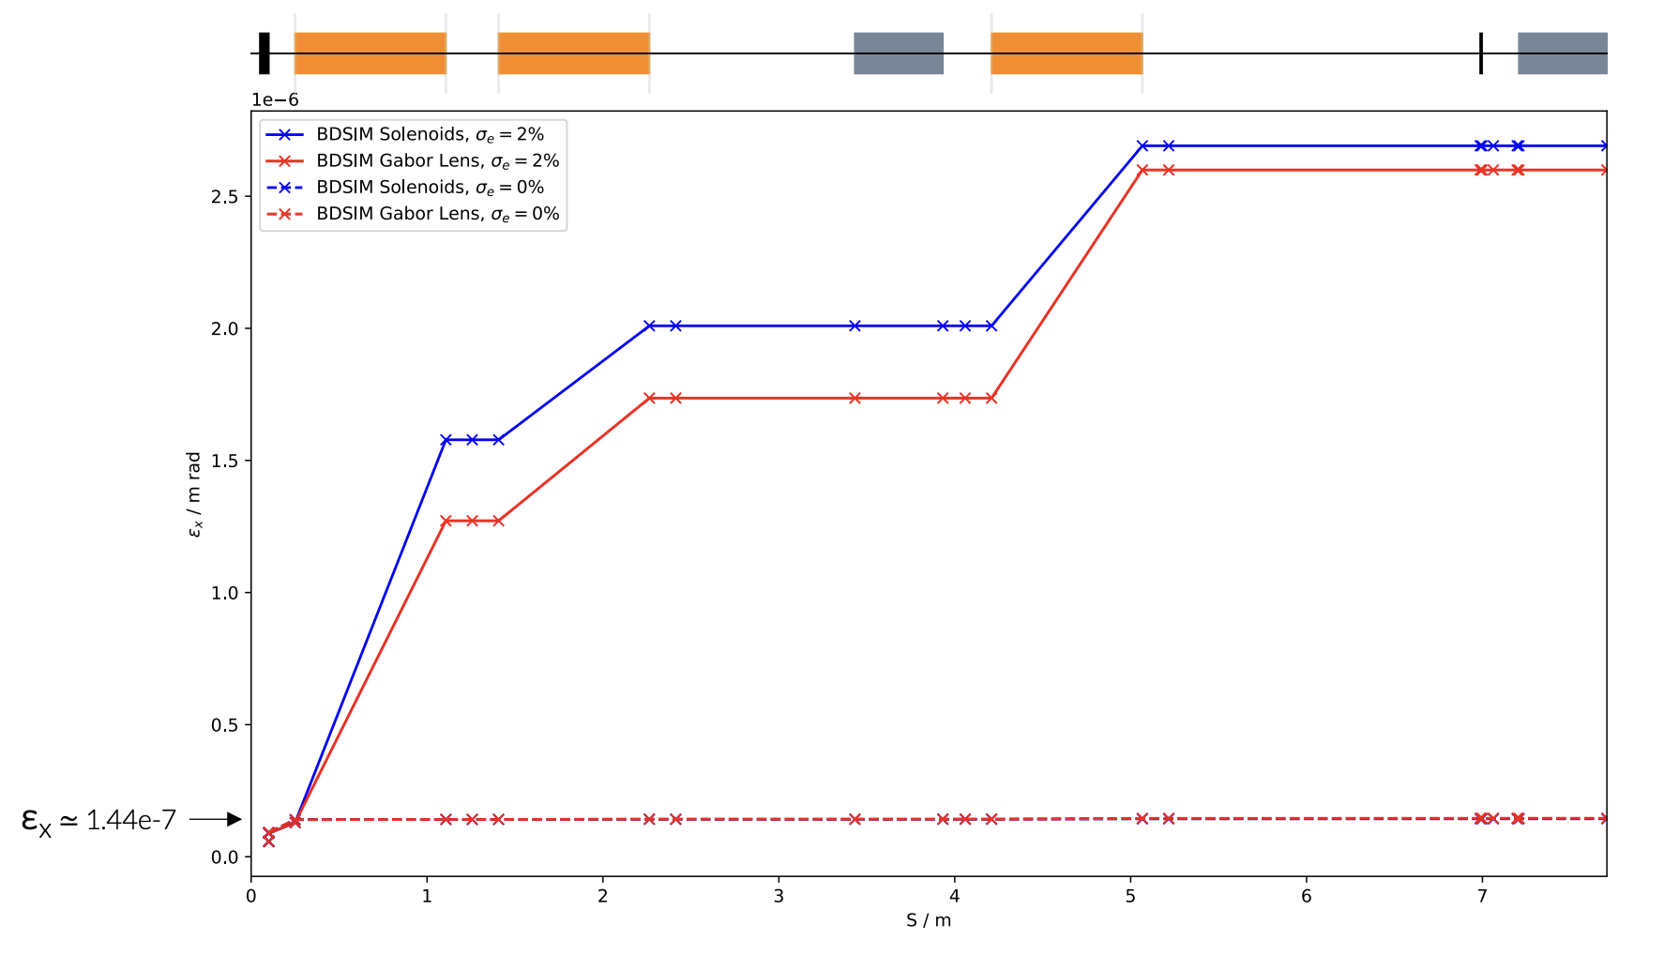
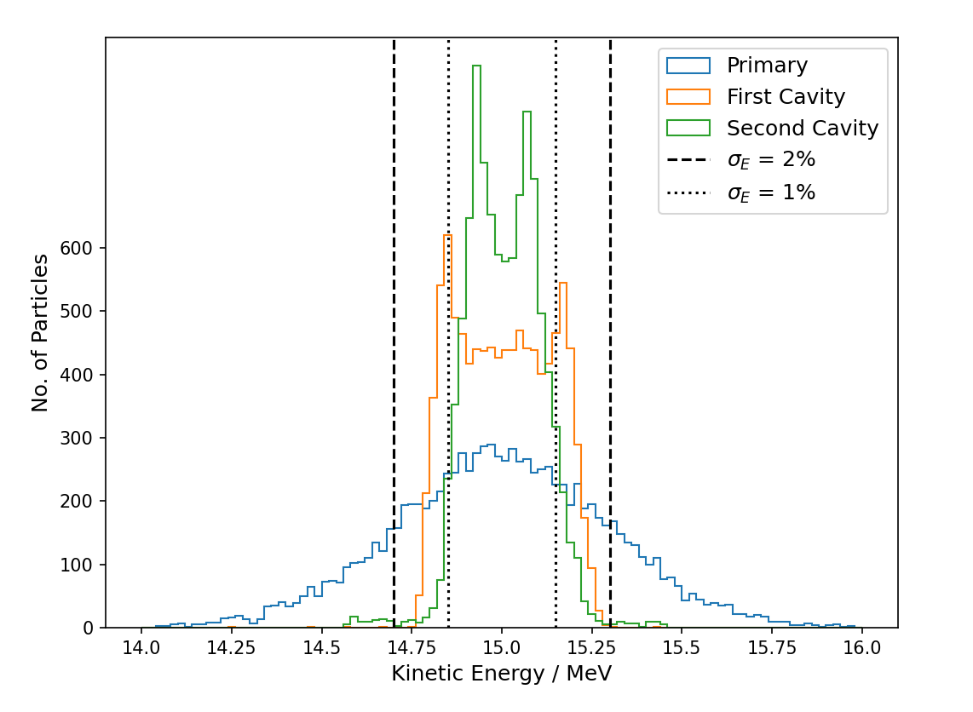
Stage 1 Start-to-End Tracking
Beam Profile Factors
Upstream Factors Affecting the S1 Beam Profile
Momentum dependent focusing propagating after the vertical arc
Energy spread reduction by momentum cleaning collimation in the arc
Chromaticity correction in the vertical arc with new sextupole magnets
Chromatic contribution to solenoid emittance growth
Energy spread control with RF cavities
Energy cleaning collimation after GL3
Top Right: Chromatic contribution of solenoids to emittance
Bottom Right: Results of JAI Student Project RF cavity design. Energy Spread from 2% to 0.68% with both S1 cavities.

Slide 12
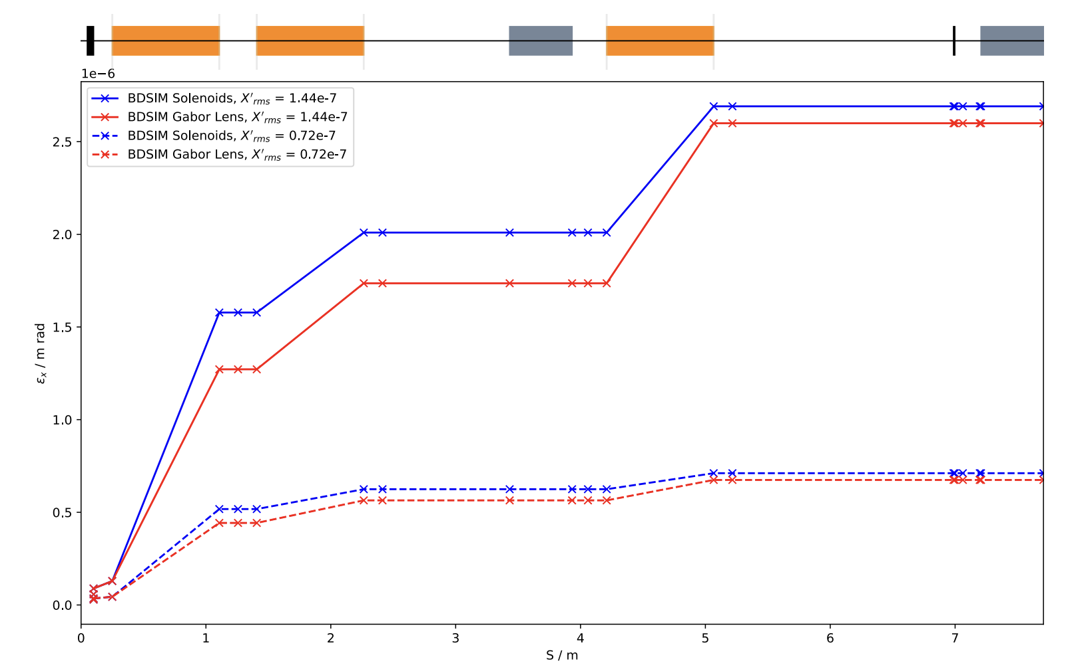
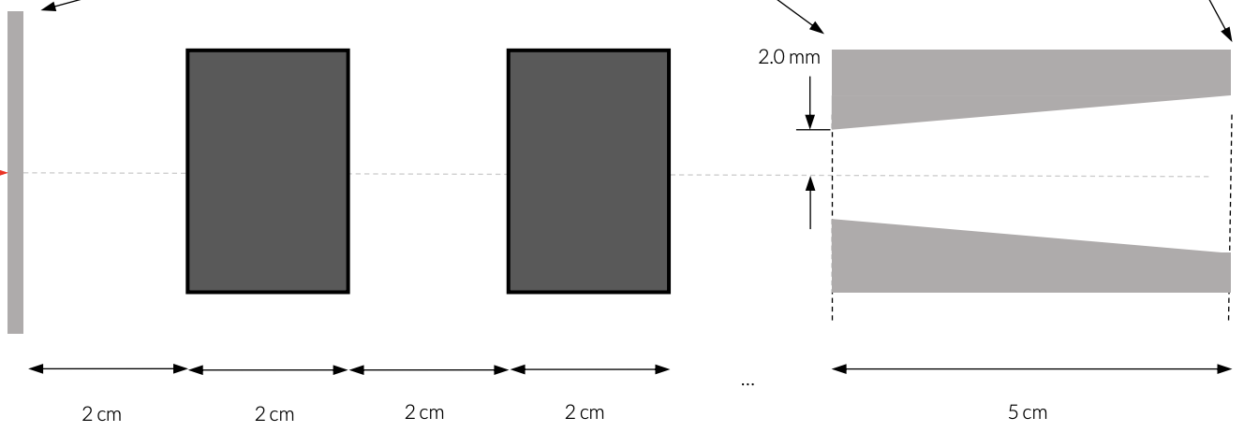
Stage 1 Start-to-End Tracking
Beam Profile Factors
Upstream Factors Affecting the S1 Beam Profile
Momentum dependent focusing propagating after the vertical arc
Energy spread reduction by momentum cleaning collimation in the arc
Chromaticity correction in the vertical arc with new sextupole magnets
Solenoid contribution to emittance growth
Energy spread control with RF cavities
Energy cleaning collimation after GL3
Source beam profile and emittance
Decreased initial emittance with source capture PMQs
Increased source profile (gaussian) capture with source capture PMQs

Slide 13
Stage 1 Start-to-End Tracking
Beam Profile Factors
Upstream Factors Affecting the S1 Beam Profile
Momentum dependent focusing propagating after the vertical arc
Energy spread reduction by momentum cleaning collimation in the arc
Chromaticity correction in the vertical arc with new sextupole magnets
Solenoid contribution to emittance growth
Energy spread control with RF cavities
Energy cleaning collimation after GL3
Source beam profile and emittance
Decreased initial emittance with source capture PMQs
Increased source profile (gaussian) capture with source capture PMQs
Current Work: Starting “Start-to-End” at the start
Optimisation of PMQ positions and lengths (integrated field)
Constrained by PMQ proximity to other components and fall in total transmission as distance of nozzle from target increases
Currently optimising for total transmission (capture of initial gaussian) but will also optimise for emittance leaving the nozzle

Slide 14
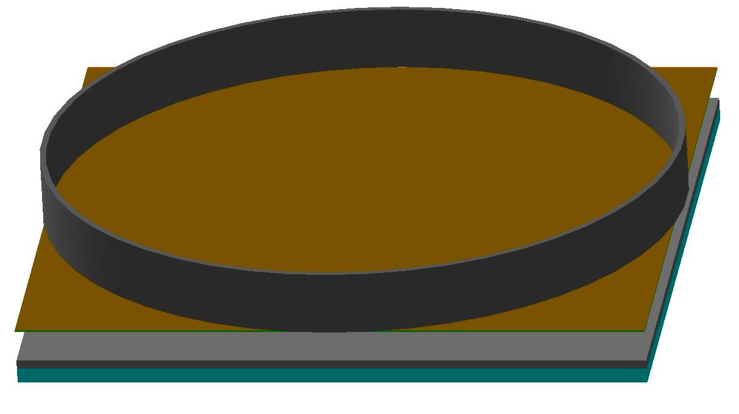
Stage 1 Dose Modelling
End Station Model and Method
An idealised dose model gives theoretical maximum dose values that function as a ‘gold standard’ to compare to in start-to-end tracking.
Beam
1.0 cm Gaussian beam of 10,000 Protons.
10, 12, 15 MeV beams both monoenergetic and with 2% energy spread
Straight into the End Station model (parallel beam)
Dose Calculation
"g4QGSP_BIC_EMZ” Physics list
Scoring mesh within the water volume, flush to the surface with a 2 mm length in z.
Radius of 2.65 mm to imitate a Markus Ion Chamber.
Dose per proton scaled by 10¹⁰ to represent the dose delivered by 10⁹ protons at a 10 Hz repetition rate.
Component | Length (mm) | Material
Drift | 10.0 | Stainless Steel
Vacuum Window | 0.075 | Mylar
Scintillating Fibre | 0.250 | Polystyrene
Air Gap | 5.0 | Air
Sample Container | 1.15 | Polystyrene
Water | 2.4 | Water

Slide 15
Stage 1 Dose Modelling
Proton Bragg Peak Comparison and Dose Rate Calculation
Bragg peaks fall where expected by LhARA design:
10 MeV well before the cell layer
12 MeV just before the cell layer
15 MeV well beyond the cell layer but still within the water volume, cell layer sees the proximal edge where the dose is more uniform.
Energy Spread
Not previously included in S1 dose modelling
Broadens all Bragg peaks
For 15 MeV, introducing energy spread has little effect on the dose rate, as the scoring region captures the entire Bragg peak in both cases.
Larger impact on 12 MeV dose rate as the higher energy particles deposit dose within the scoring region.
Proton Energy [MeV] | Dose Rate [Gy / s]
12 | 0.96 ± 0.05
12 ± 2% | 7.09 ± 0.20
15 | 121.93 ± 1.42
15 ± 2% | 123.69 ± 1.43
Model region shown begins at the entrance to the sample container lid and ends 2 mm into the water volume (the length of the scoring mesh).

Slide 16
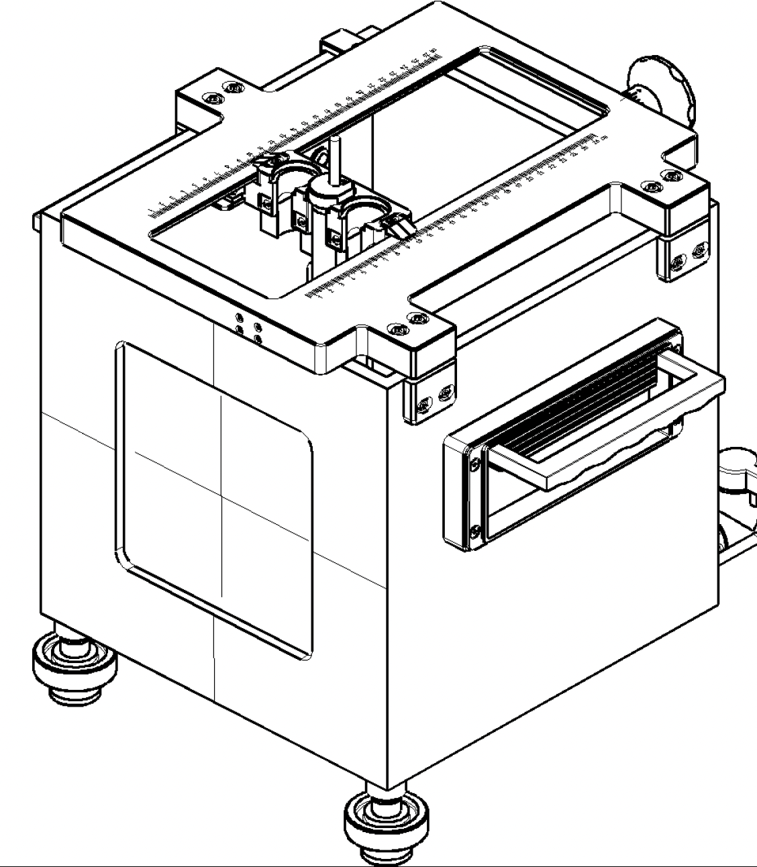
Stage 2 Dose Modelling
Method and Models for 127 MeV Protons and 33 MeV/u Carbon
Up to the air gap, the Stage 2 in-vitro end station entrance is of the same material and dimensions as Stage 1.
For Protons: The region after the air gap is modelled after a PTW T41023 Water Phantom (pictured right)
For Carbon Ions: The region after the air gap uses the stage 1 sample container model. If the full phantom model is used, no ions survive the phantom wall
Beam
1.0 mm parallel Gaussian beam of 10,000 Protons.
127 MeV Proton and 33 MeV/u Carbon beams (monoenergetic)
Dose Calculation
Markus Ion Chamber scoring mesh (2mm length, radius of 2.65mm) is used again.
For protons, the mesh is centred on the pristine Bragg peak depth. For carbon, the mesh is flush to the entrance of the water volume.
Dose per ion is scaled by the expected bunch (10⁹ for protons and 8.3 x 10⁷ for carbon) and to the 10 Hz repetition rate of the laser source.
Component | Length (mm) | Material
Drift | 10.0 | Stainless Steel
Vacuum Window | 0.075 | Mylar
Scintillating Fibre | 0.250 | Polystyrene
Air Gap | 50.0 | Air
Phantom Entrance Gap | 3.05 | Air
Phantom Entrance Wall | 6.95 | Plexiglass
Water | 130 | Water

Slide 17
Stage 2 Dose Modelling
Proton Bragg Peak and Dose Rate Calculation
Scoring mesh placed to capture the Pristine Bragg Peak in the water volume.
Calculated Dose rate: 96.7 ± 1.49 Gy / s
LhARA Documentation of previous modelling has a value of 156 Gy / s for the same end station setup
This was a result of a previous physics list which was limited to only EM processes which led to a much more intense Bragg peak with a higher dose deposited in the scoring region.
Region shown above is from the start of the phantom wall air gap through to the end of the water volume.

Slide 18
Stage 2 Dose Modelling
Carbon Bragg Peak and Dose Rate Calculation
Bragg peak fully captured in the water volume and fully within the MIC scoring mesh, cell layer sees the proximal edge where the dose is more uniform.
Calculated Dose rate: 837.50 ± 0.89 Gy / s
LhARA Documentation of previous modelling has a value of 730 Gy / s
The increase in the calculated dose in this case is likely due to less accurate mesh positioning in previous work
An identical model simulated with the old physics list: 851.84 ± 0.10 Gy / s
Model region shown is from the entrance to the sample container lid through to the end of the water volume.

Slide 19
Summary
Start-to-End Tracking Status and End Station Dose Modelling
Attempts to introduce octupole uniformity methods to the beam delivery section after the vertical arc are limited by what is likely an unrealistically uniform view of the beam profile entering this region.
Developments of start-to-end tracking of LhARA Stage 1 must be concerned with as far upstream as is yet to be fully optimised or understood.
Starting with the source capture to better define the initial beam distributions and divergence
Moving on to manipulations of energy spread with RF cavities and collimators through the GL matching sections
Dose modelling for LhARA Stage 1 and Stage 2 in-vitro end stations to provide “gold standard” profiles and dose rate calculations to compare with when complete source to end station tracking is carried out in future.
Impact of nominal 2% energy spread is limited as it has minimal effect on the proximal edge of the Bragg peak that would be seen by cell samples and the dose deposited in the mesh used for theoretical maximum dose calculations
Stage 1 Dose Rate Calculations remain consistent with previous LhARA documentation.
Stage 2 Dose Rates have been updated to those resulting from simulations with a full physics list

