Slide 1
LhARA FFA magnet design
19/09/25
Ta-Jen Kuo
Supervisor: Jaroslaw Pasternak, Jean-Baptiste Lagrange
Imperial College London, STFC

Slide 2
LhARA
Laser-hybrid Accelerator for Radiobiological Applications, dedicated to radiobiology research
Laser target: Up to 15 MeV proton beam at 10Hz
FFA: Variable extraction energy 15-127 MeV

Slide 3
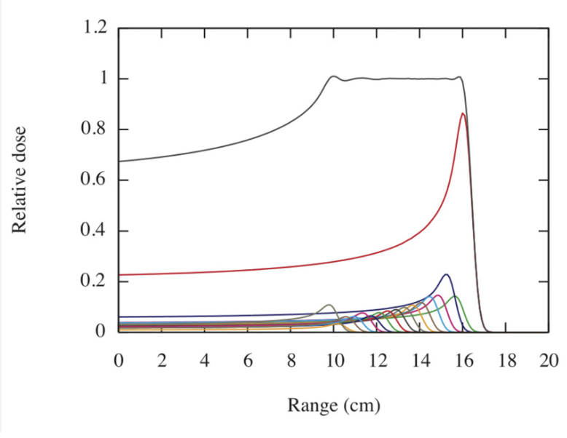
Variable extraction energy
Combine beams of different energy to
create a spread out Bragg peak
Injection energy and total B field
varied for different extraction energy
Verify behavior at 2 different extraction
energies 127 Mev and 57 MeV.

Slide 4
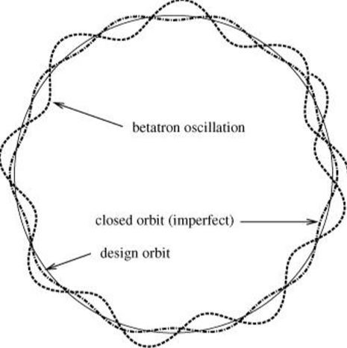
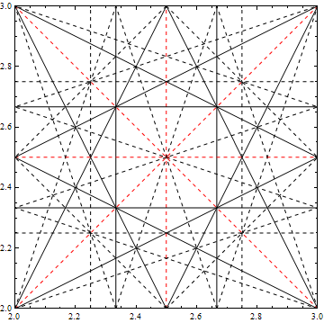
Betatron oscillation and tune
Particles oscillate around the designed orbit in the field
Tune is the number of betatron oscillations
per revolution. Avoid resonance tune points to
prevent beam loss

Slide 5
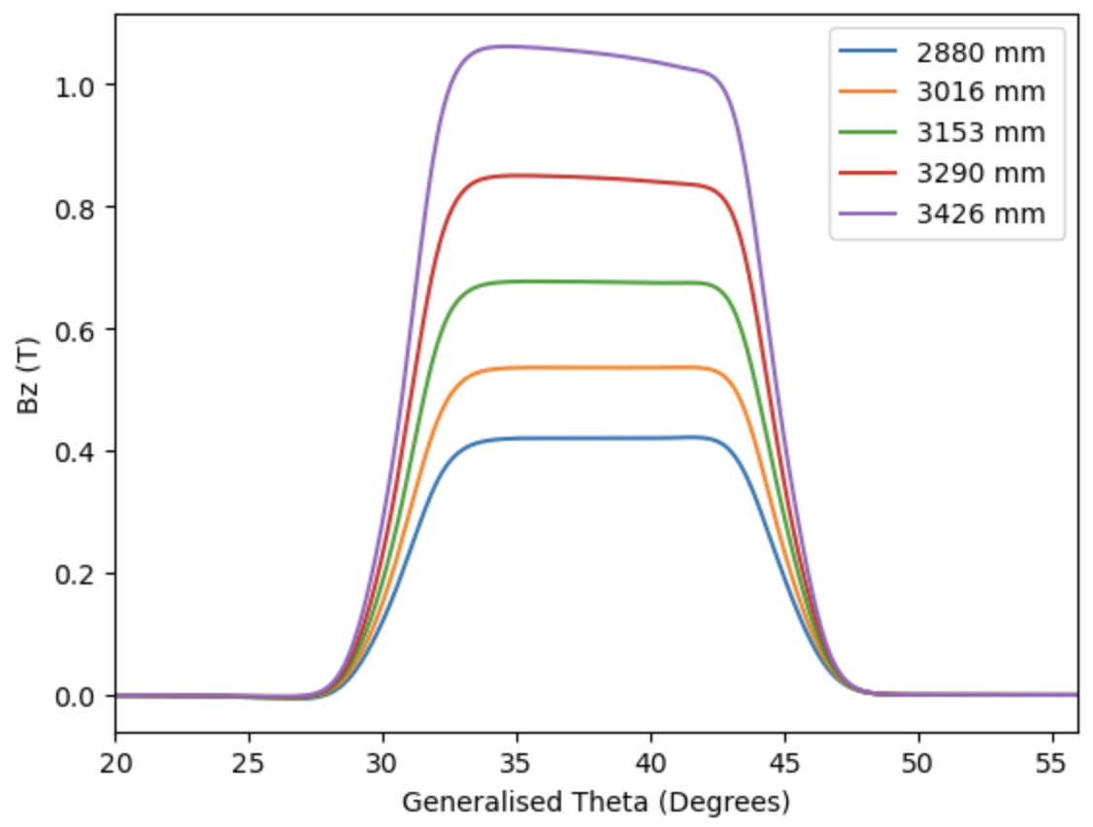
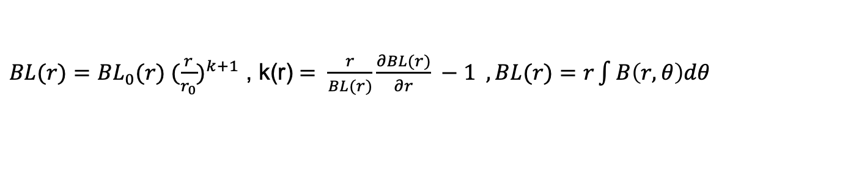
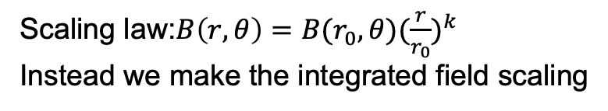
Integrated scaling law
Scaling law:$B\left(r,θ\right)=B(r_{0},{θ)(\frac{r}{r_{0}})}^{k}$
Instead we make the integrated field scaling
$BL(r)={BL}_{0}(r) {(\frac{r}{r_{0}})}^{k+1}$ , k(r) $= \frac{r}{BL(r)}\frac{∂BL(r)}{∂r} −1 ,BL(r)=r\int{B\left(r,θ\right)dθ }$
To first order the horizontal tune roughly constant
Vertical tune variation will need to be investigated later on

Slide 6
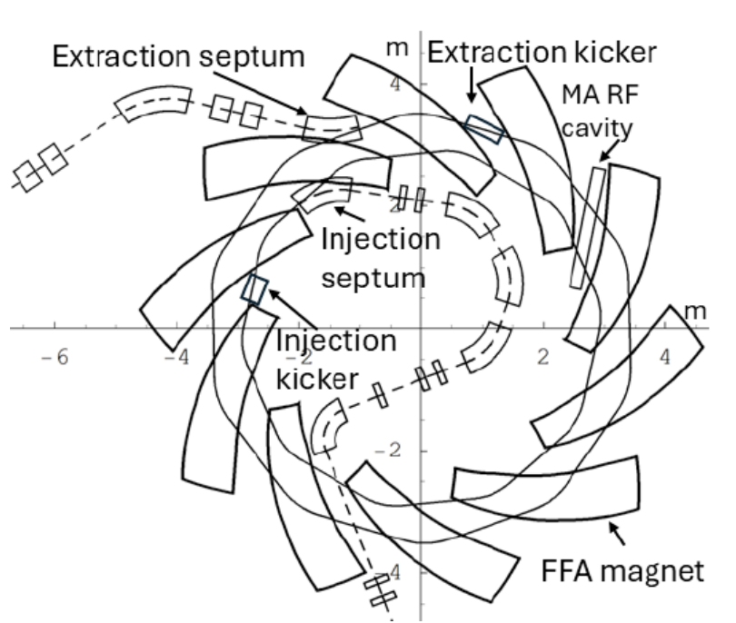
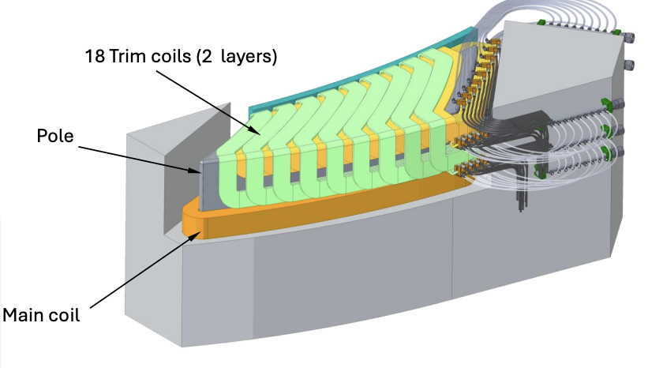
Geometry of the magnet
Combined function magnet, bends and focuses the beam
Spiral angle 53.9 degrees
10 fold symmetry
Field gradient generated by radially dependent trim coils, each with a different current setting
Clive Hill, Daresbury lab

Slide 7
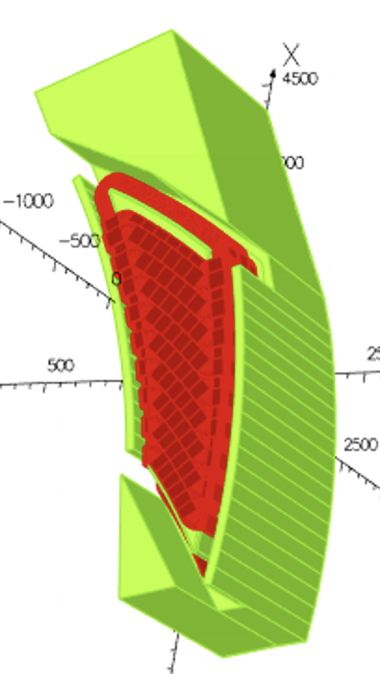
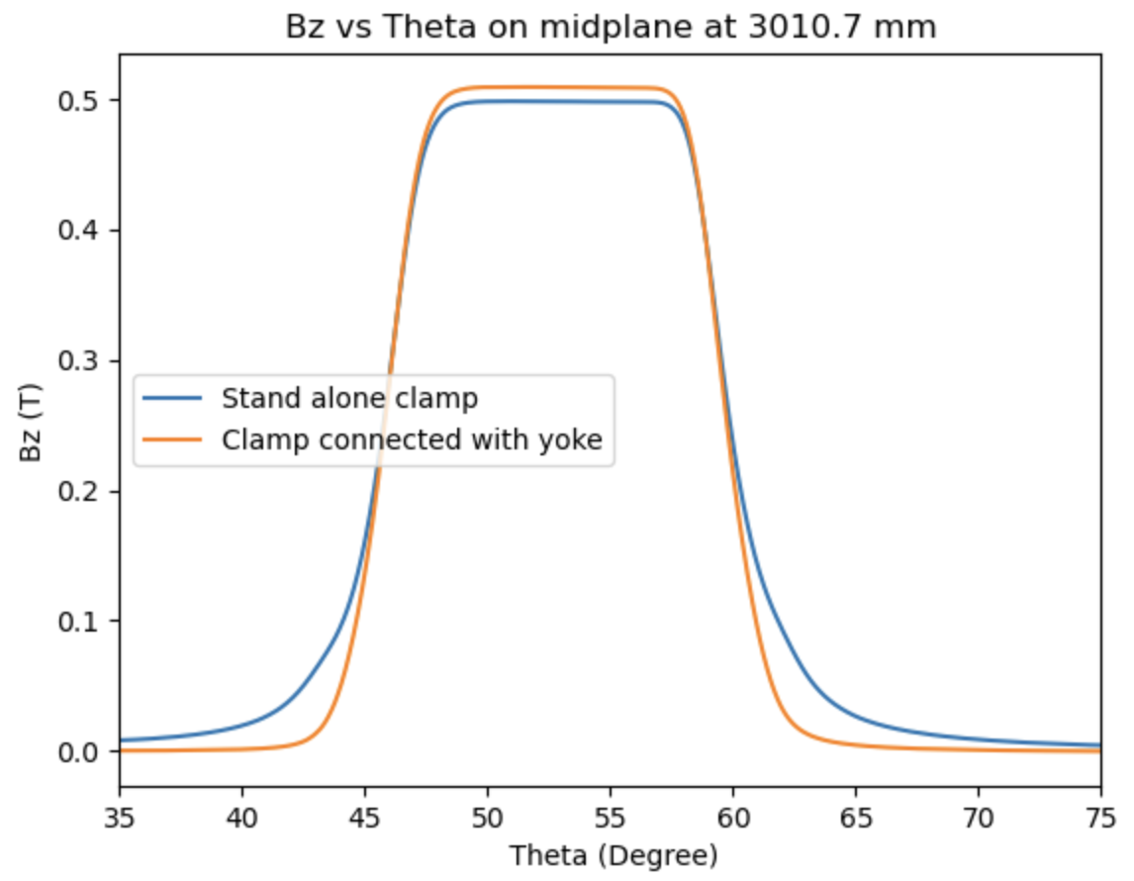
Geometry of the clamps
Clamps placed at constant angle away from the pole
Connected magnetically with the pole improves efficiency

Slide 8
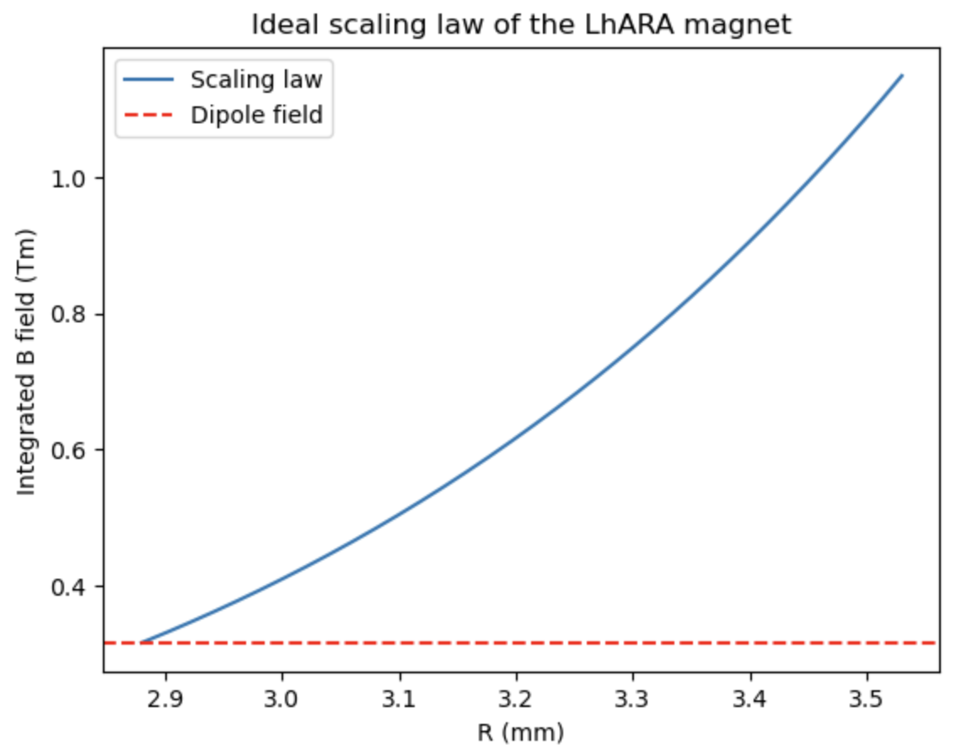
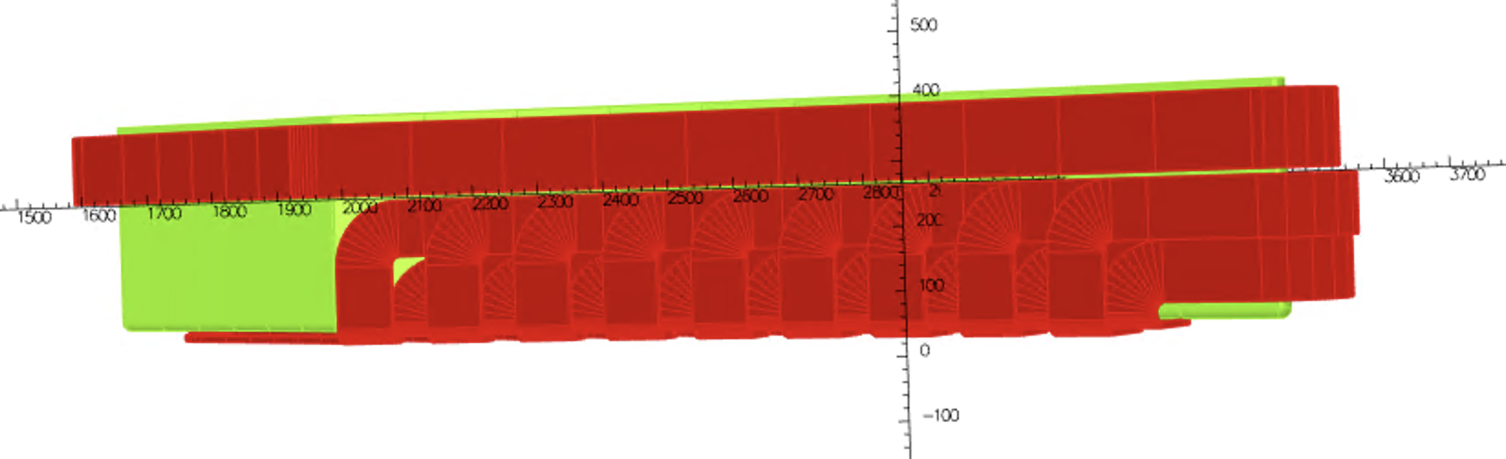
Radially dependent trim coils
A main coil provides the dipole field
Trim coils cross the pole face at different radius
Current settings adjusted for required gradient
Main coil
Trim coils
$$↑$$
$$↑$$
$$↑$$
(Shown without the clamps and yoke in this image)

Slide 9
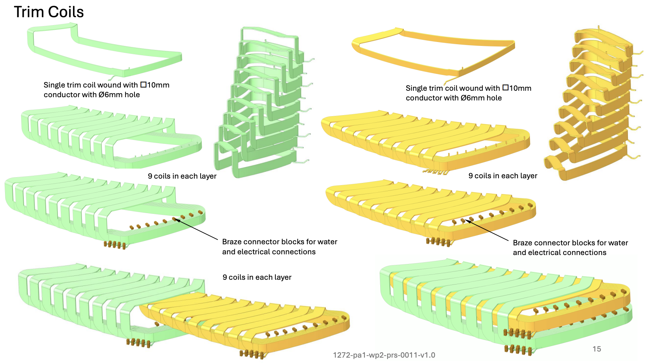
Geometry of trim coils stacked together
Returns stack longitudinally
Two vertical layers slot into one another
Clive Hill, Daresbury lab

Slide 10
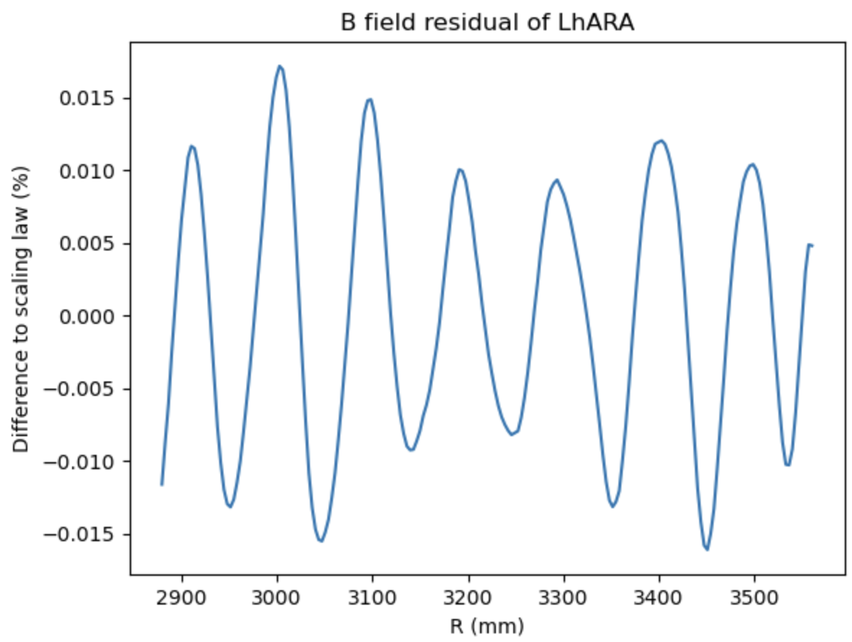
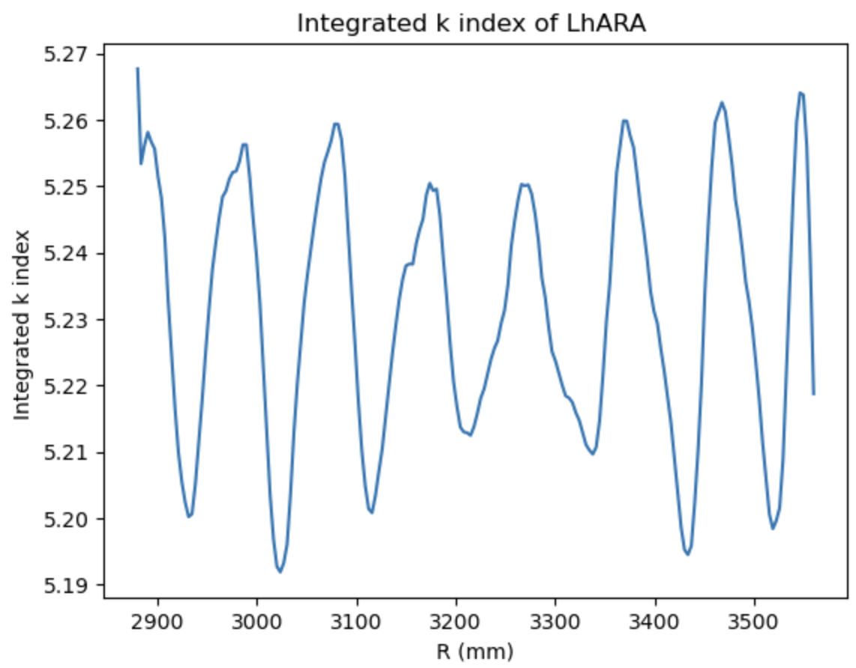

Field residual, 127 MeV extraction energy
$$BL={BL}_{0} {(\frac{r}{r_{0}})}^{k+1}$$
127 MeV extraction energy: BL₀ : 1.44 Tm , r₀ :3.477m, k : 5.23
Oscillation in residuals due to the discretization of trim coils

Slide 11
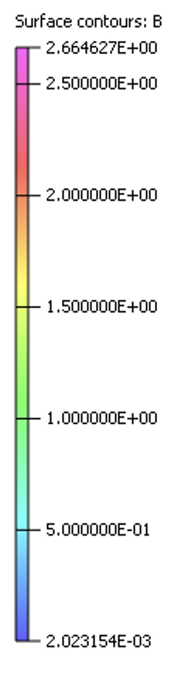
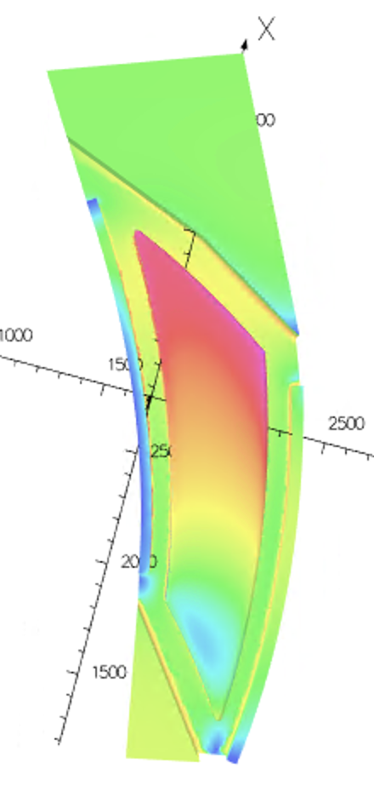
Saturation level
Part of the pole reaching 2.66T
Flat top of field distorted at higher radii due to
saturation and will have an impact on the tune
(Plotted in a coordinate that undoes the spiral angle)

Slide 12
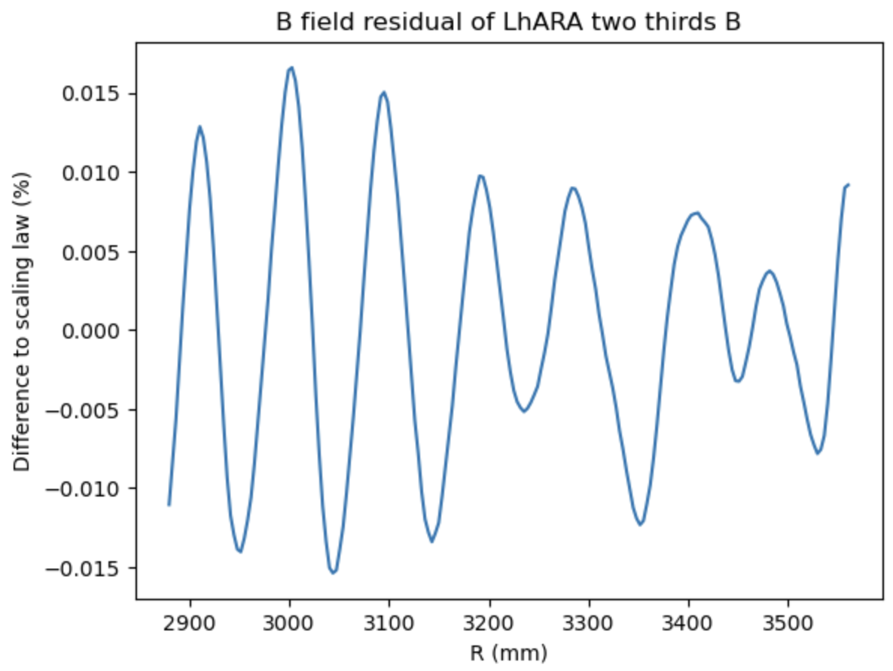
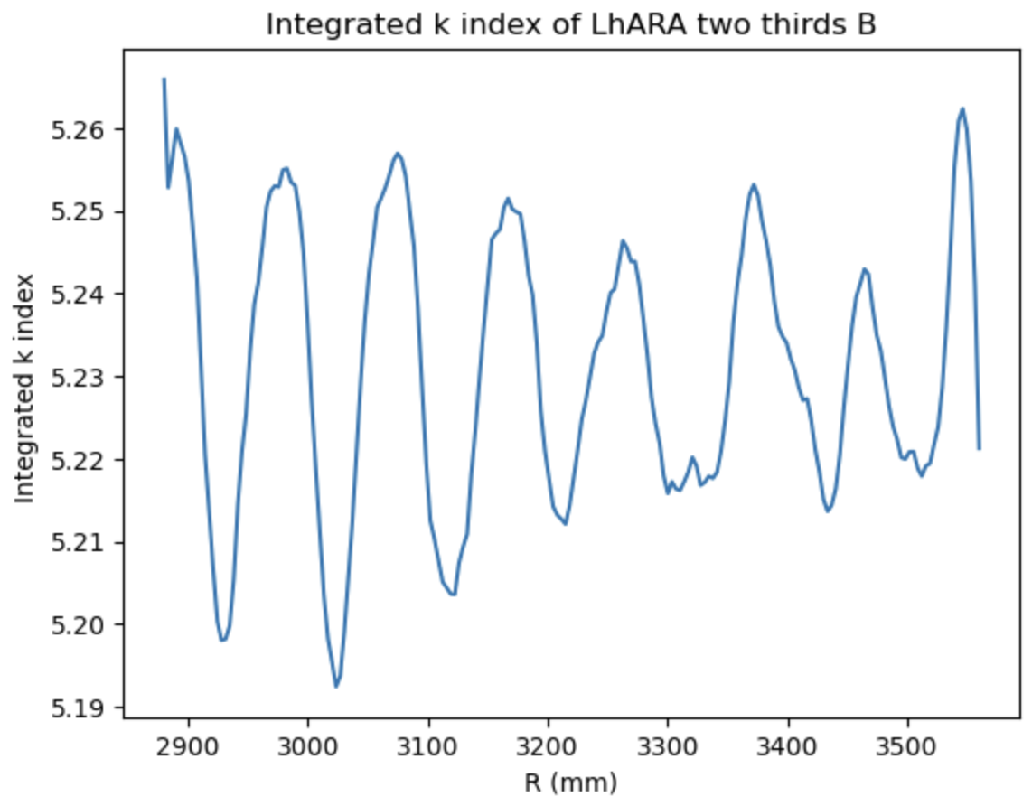
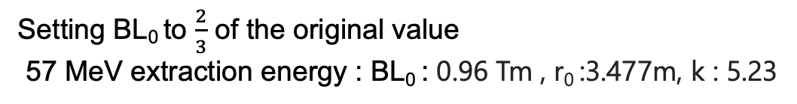

Field residual, 57 MeV extraction energy
Setting BL₀ to $\frac{2}{3}$ of the original value
57 MeV extraction energy : BL₀ : 0.96 Tm , r₀ :3.477m, k : 5.23
$$BL={BL}_{0} {(\frac{r}{r_{0}})}^{k+1}$$

Slide 13
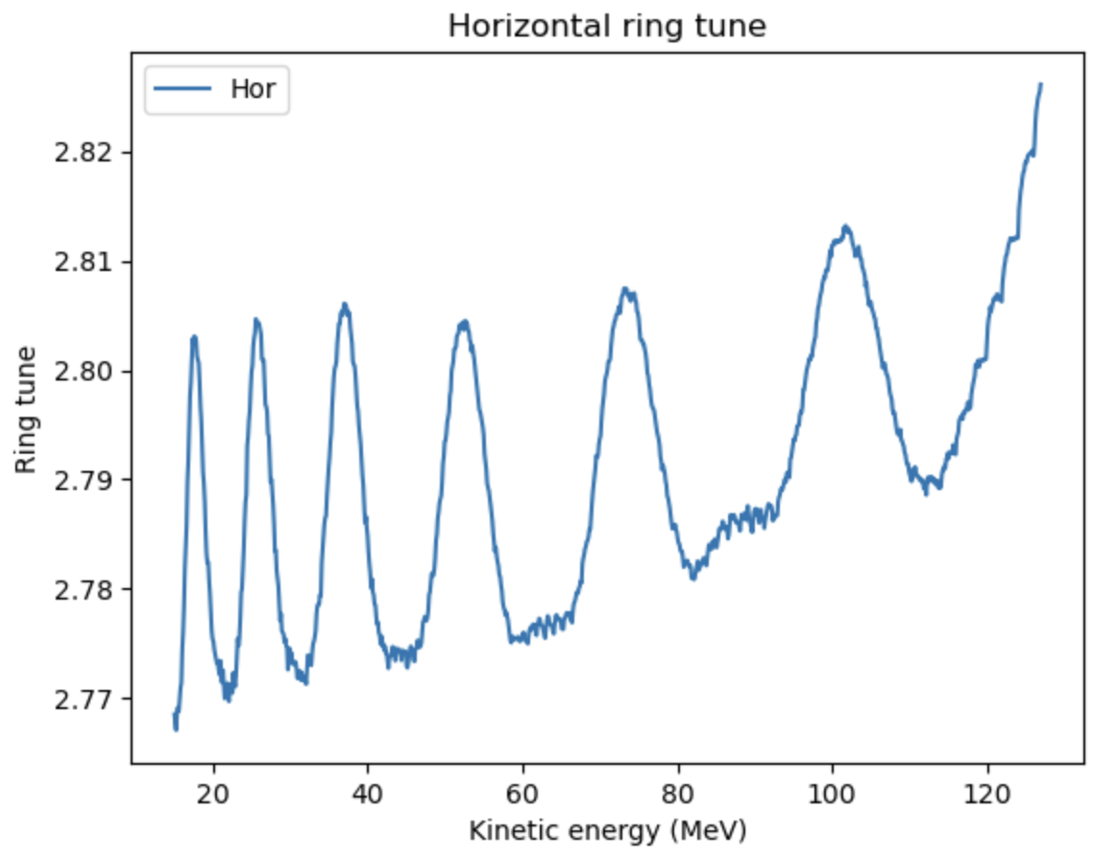
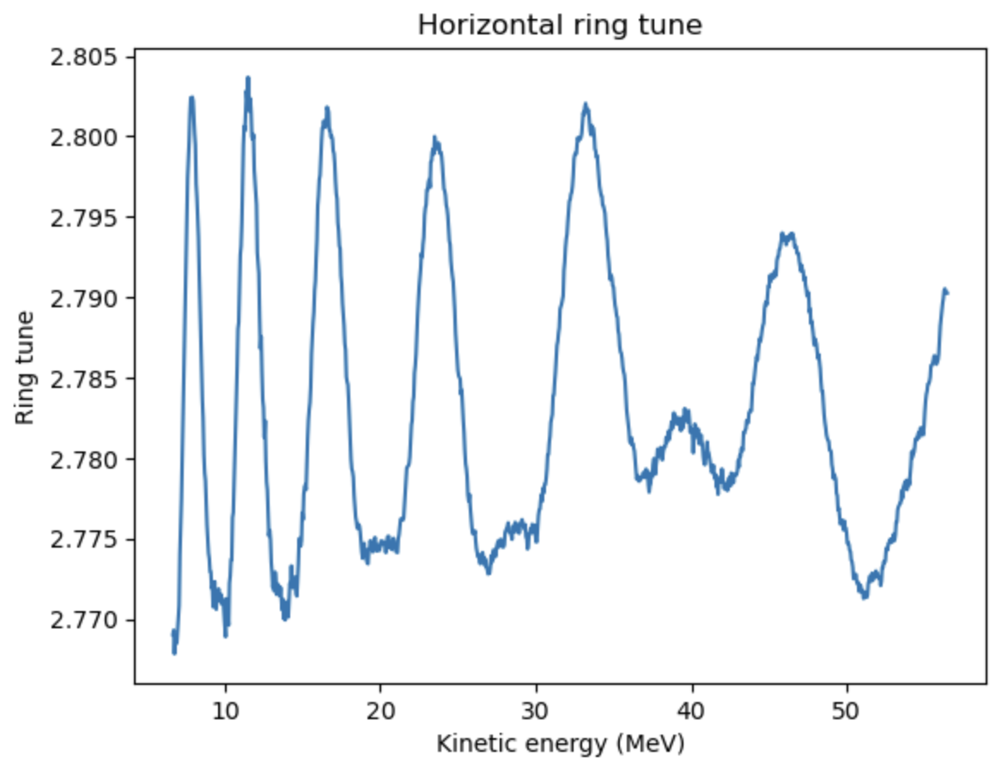
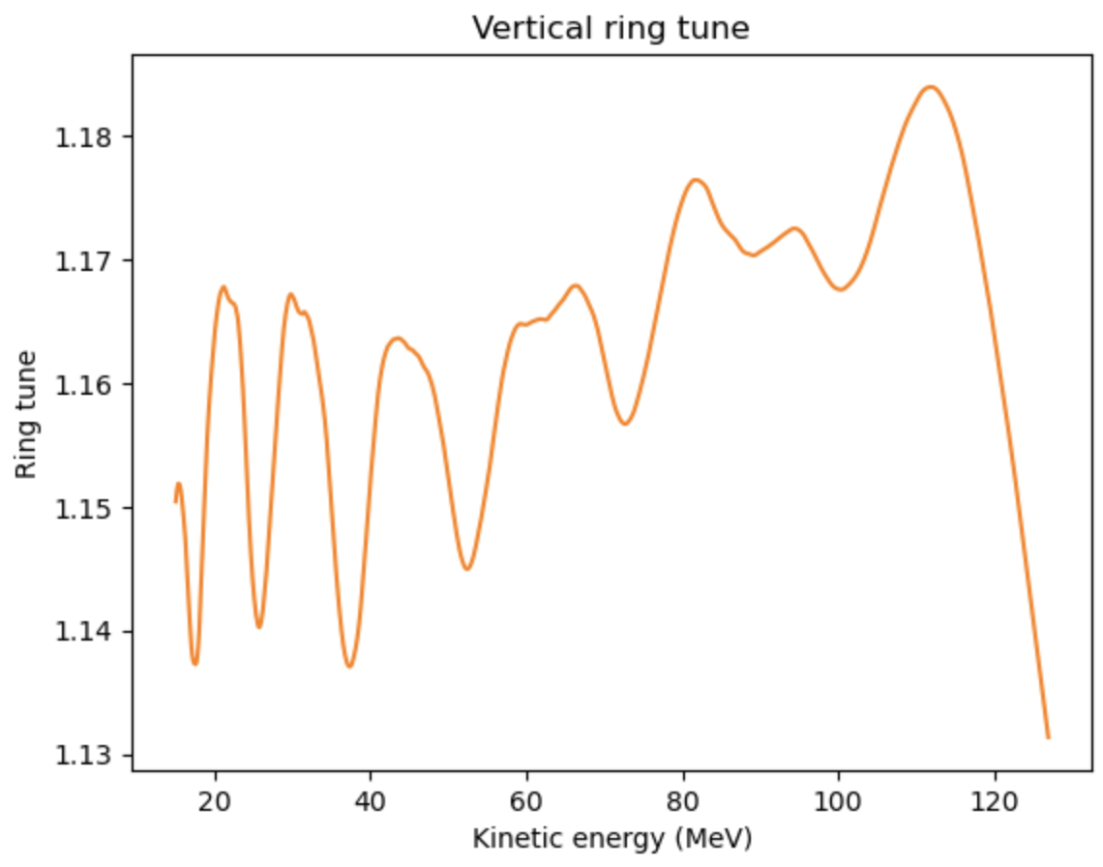
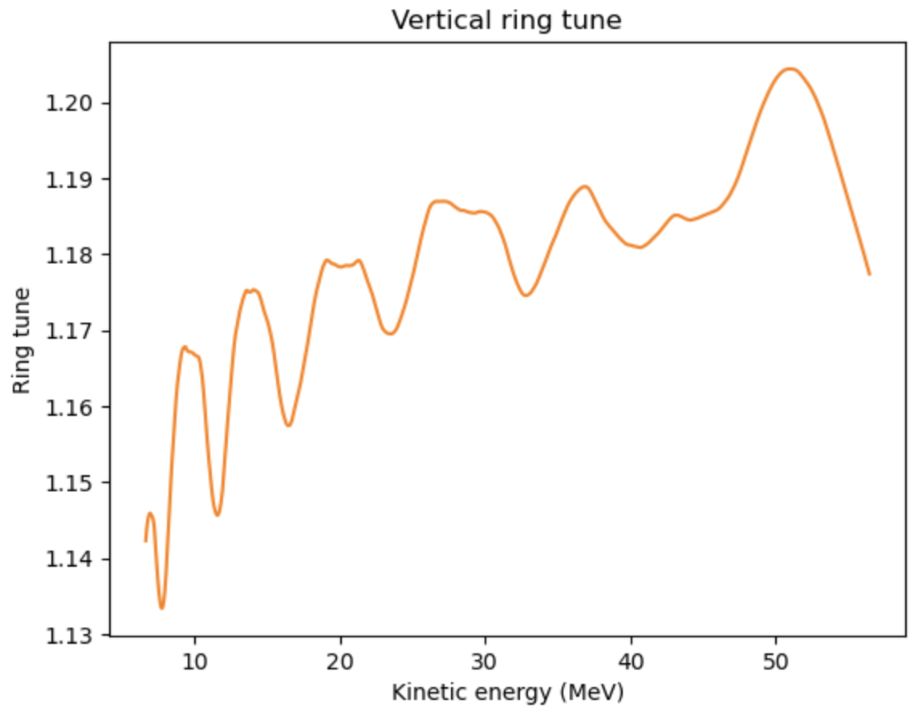
Ring tune
127 MeV extraction energy
57 MeV extraction energy
Some variation of horizontal
tune at 127 MeV
Vertical tune variation to be
minimized by shaping the field
clamps

Slide 14
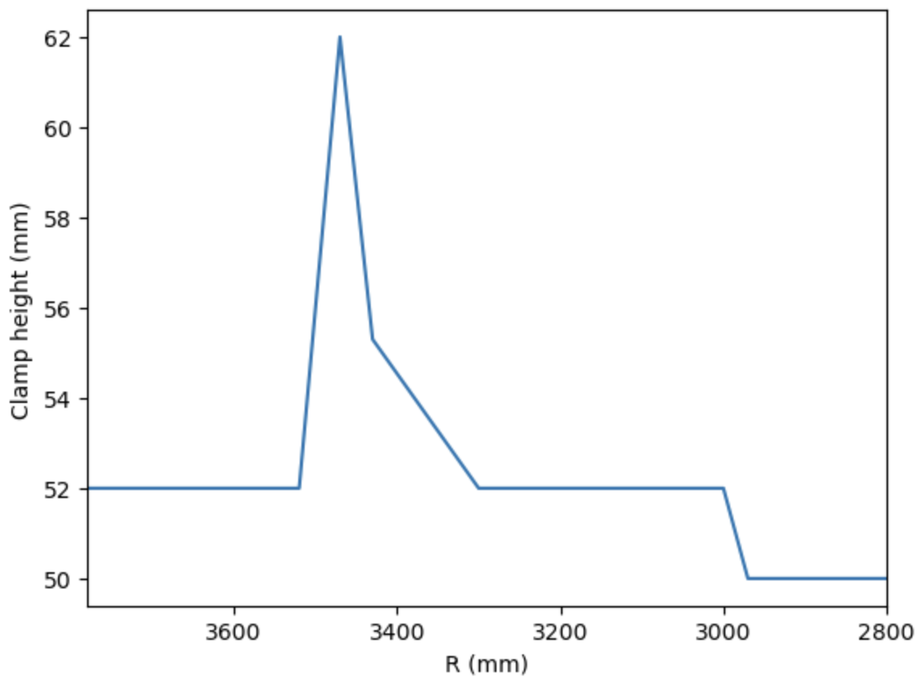
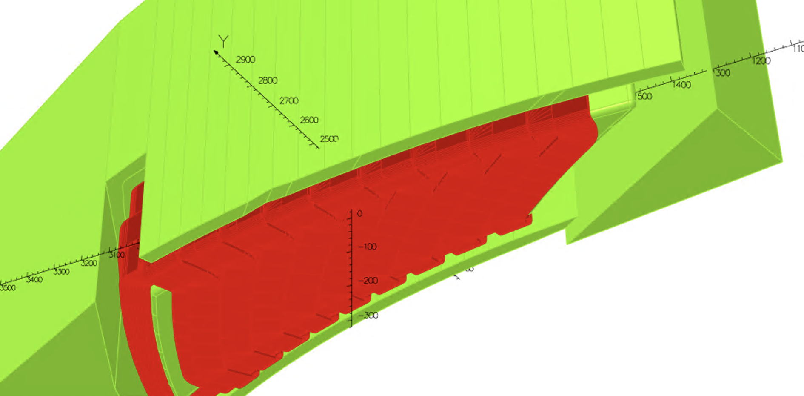
Clamp height optimisation
Vary the clamp height to achieve better tune spread. Iterations were done with tune
spread as the target.

Slide 15
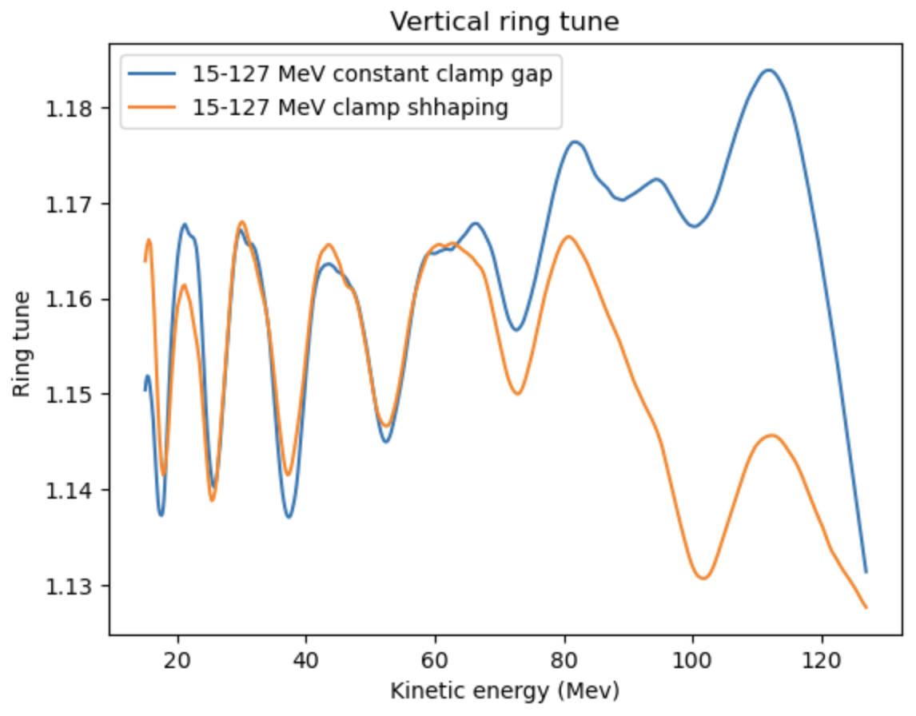
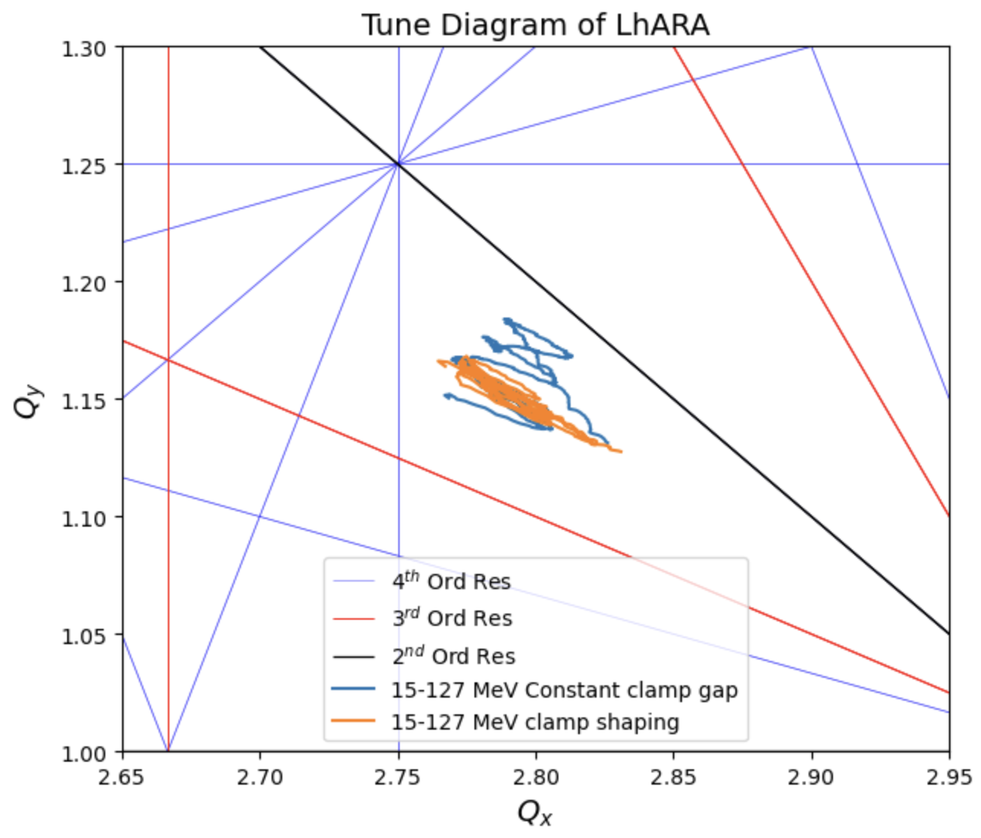
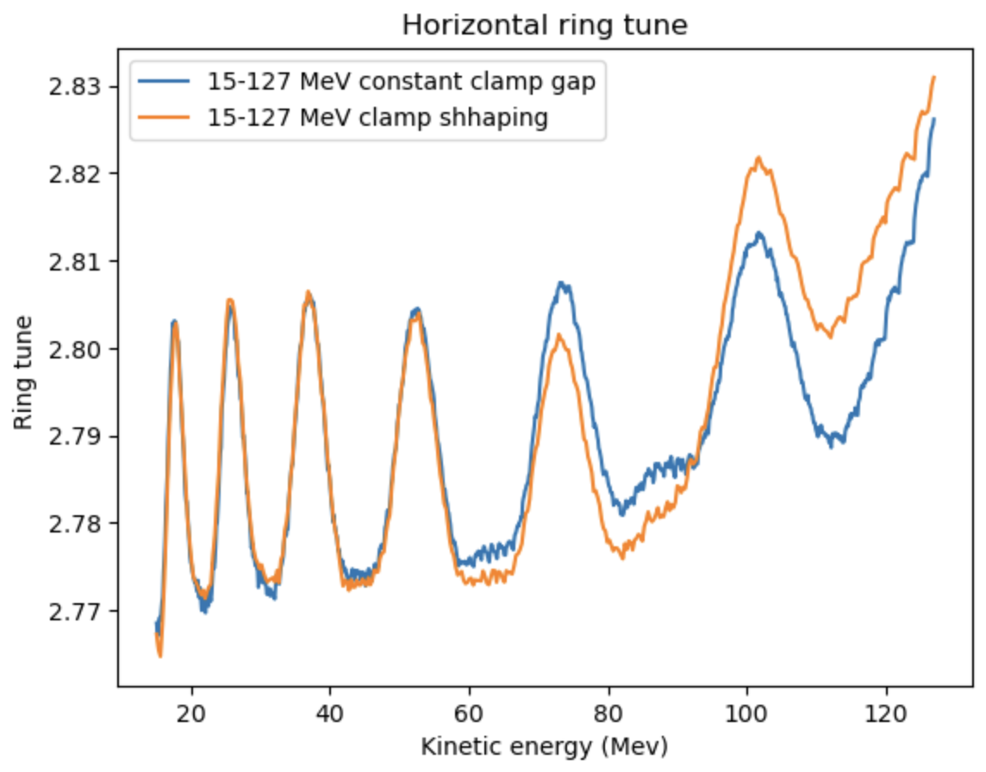
Ring tune, 127 MeV extraction energy
(Not all the resonances plotted are systematic)

Slide 16
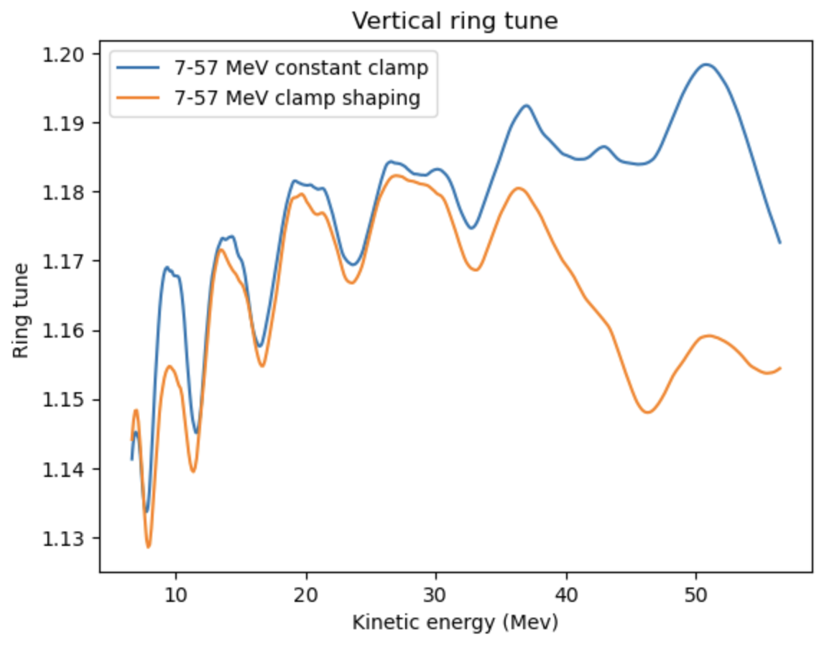
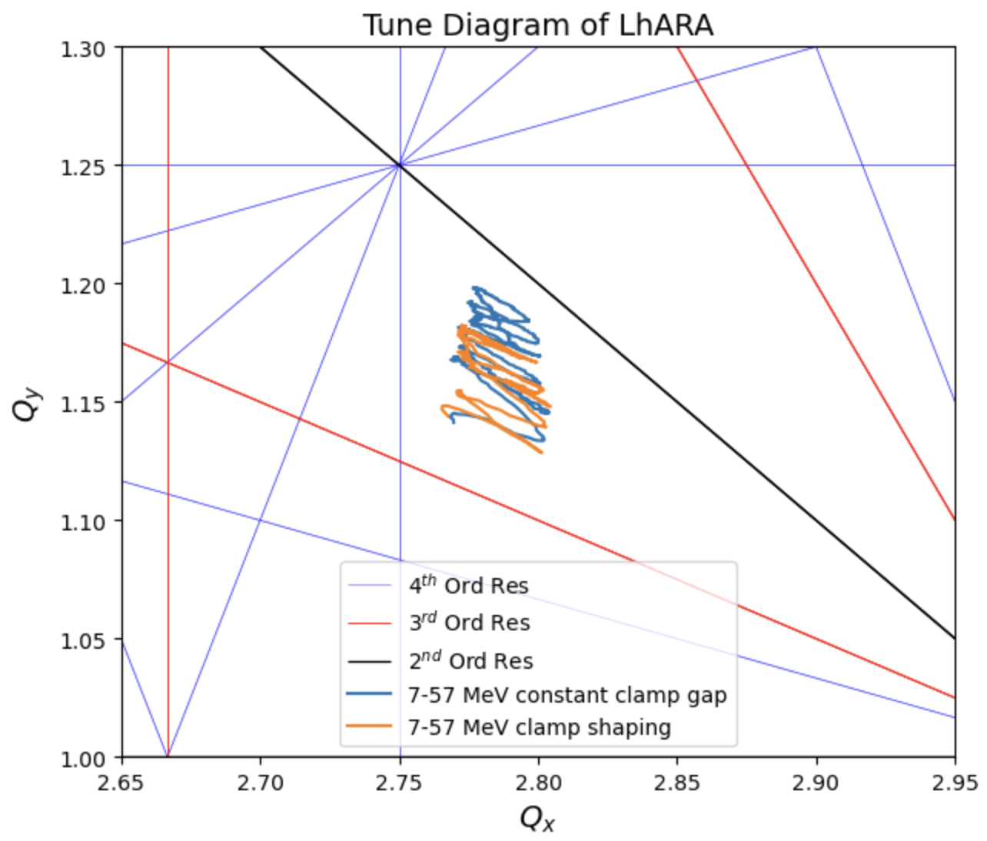
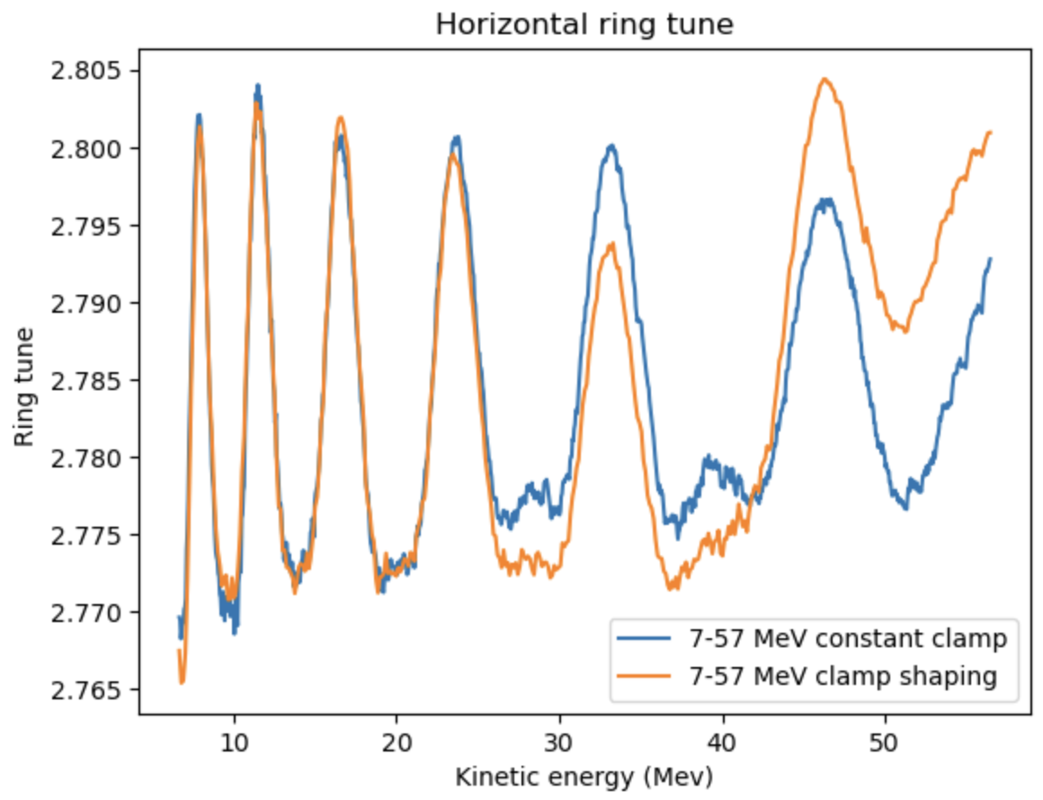
Ring tune, 57 MeV extraction energy

Slide 17
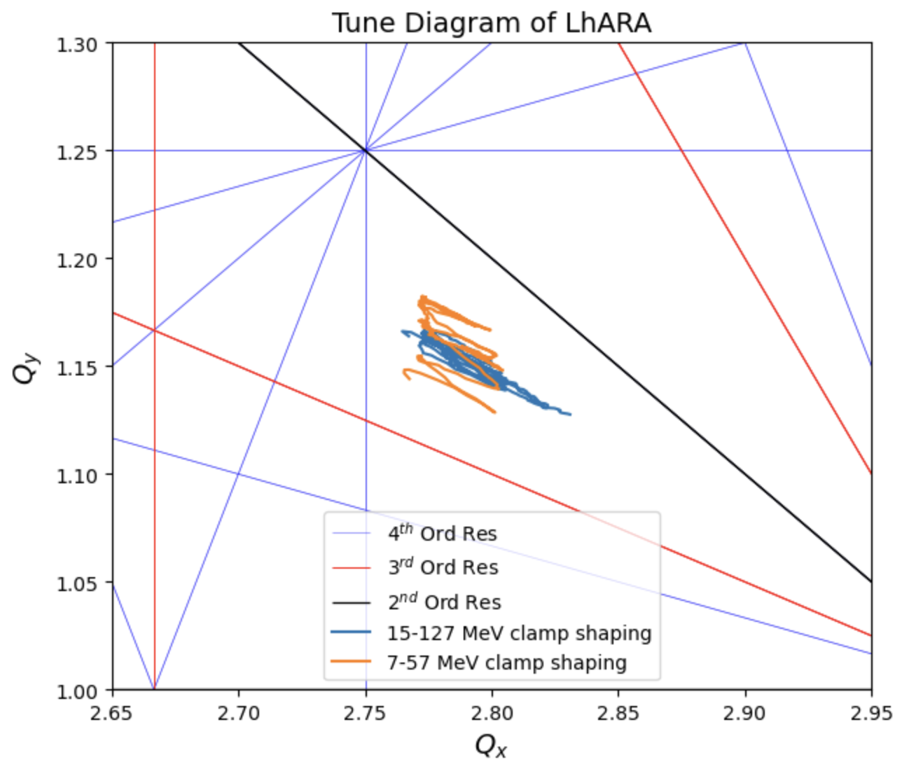
Final results

Slide 18
Trim |  |  |  | Main
Coil width | 0.01 | m |  | Coil width | 0.075 | m
Coil height | 0.0925 | m |  | Coil height | 0.117 | m
Coil area | 0.000648 | m^2 |  | Coil area | 0.006143 | m^2
Cu Resistivity | 1.68E-08 | Ohm.m |  | Cu Resistivity | 1.68E-08 | Ohm.m
Trimcoil | Length (m) | Current (AT) |  | Resistance (Ohm) |  | Power (W)
0 | 4.812 | 15013.86 |  | 1.32E-05 |  | 2.97E+03
1 | 2.37 | 5302.91 |  | 6.14E-05 |  | 1.73E+03
2 | 2.61 | 3923.03 |  | 6.77E-05 |  | 1.04E+03
3 | 2.85 | 3252.98 |  | 7.39E-05 |  | 7.82E+02
4 | 3.09 | 2733.86 |  | 8.02E-05 |  | 6.00E+02
5 | 3.33 | 2331.47 |  | 8.65E-05 |  | 4.70E+02
6 | 3.58 | 2004.73 |  | 9.28E-05 |  | 3.73E+02
7 | 3.82 | 1740.58 |  | 9.90E-05 |  | 3.00E+02
8 | 4.06 | 1515.34 |  | 1.05E-04 |  | 2.42E+02
9 | 4.30 | 1335.54 |  | 1.12E-04 |  | 1.99E+02
10 | 2.77 | 5302.91 |  | 7.20E-05 |  | 2.02E+03
11 | 3.02 | 3923.03 |  | 7.82E-05 |  | 1.20E+03
12 | 3.26 | 3252.98 |  | 8.45E-05 |  | 8.94E+02
13 | 3.50 | 2733.86 |  | 9.08E-05 |  | 6.78E+02
14 | 3.73 | 2331.47 |  | 9.69E-05 |  | 5.27E+02
15 | 3.98 | 2004.73 |  | 1.03E-04 |  | 4.15E+02
16 | 4.22 | 1740.58 |  | 1.10E-04 |  | 3.32E+02
17 | 4.46 | 1515.34 |  | 1.16E-04 |  | 2.66E+02
18 | 4.70 | 1335.54 |  | 1.22E-04 |  | 2.18E+02
 |  |  |  |  |  | Total Power (W)
 |  |  |  |  |  | 1.53E+04
Power estimate:
15.3 kw x 2 x 10
= 306 kW magnet power
for the whole ring

Slide 19
Conclusion
Working tune for two different extraction energies (57, 127 MeV) stay at the same point
Tune spread in both cases are small enough to avoid any resonance up to fourth order
LhARA FFA can provide any extraction energy between 15-127 MeV
10 Hz operation now but the FFA design can achieve 100s of Hz if laser source is capable

