Slide 1





Supersonic gas curtain-based in-vivo transverse beam profile monitoring for medical accelerators
Dr Narender Kumar
Research Coordinator

Slide 2


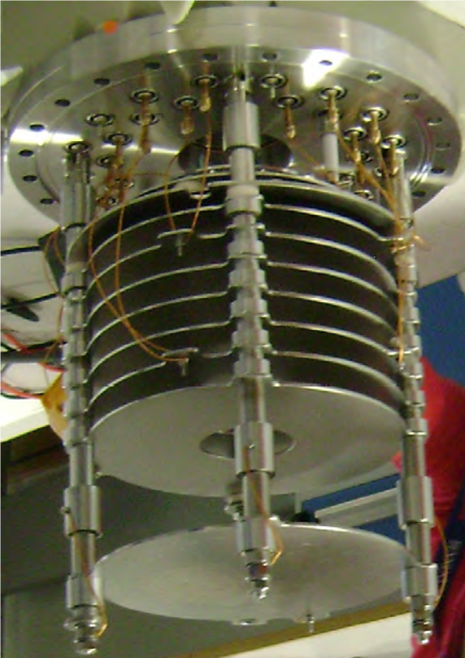
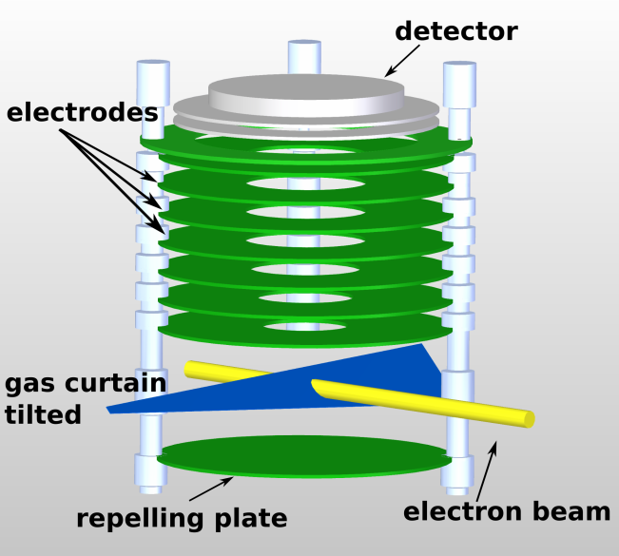
Background and R&D
Camera
Phosphor screen
Visible light
MCP
Ions extraction
Ionization
Primary Beam
Narender.Kumar@Cockcroft.ac.uk

Slide 3
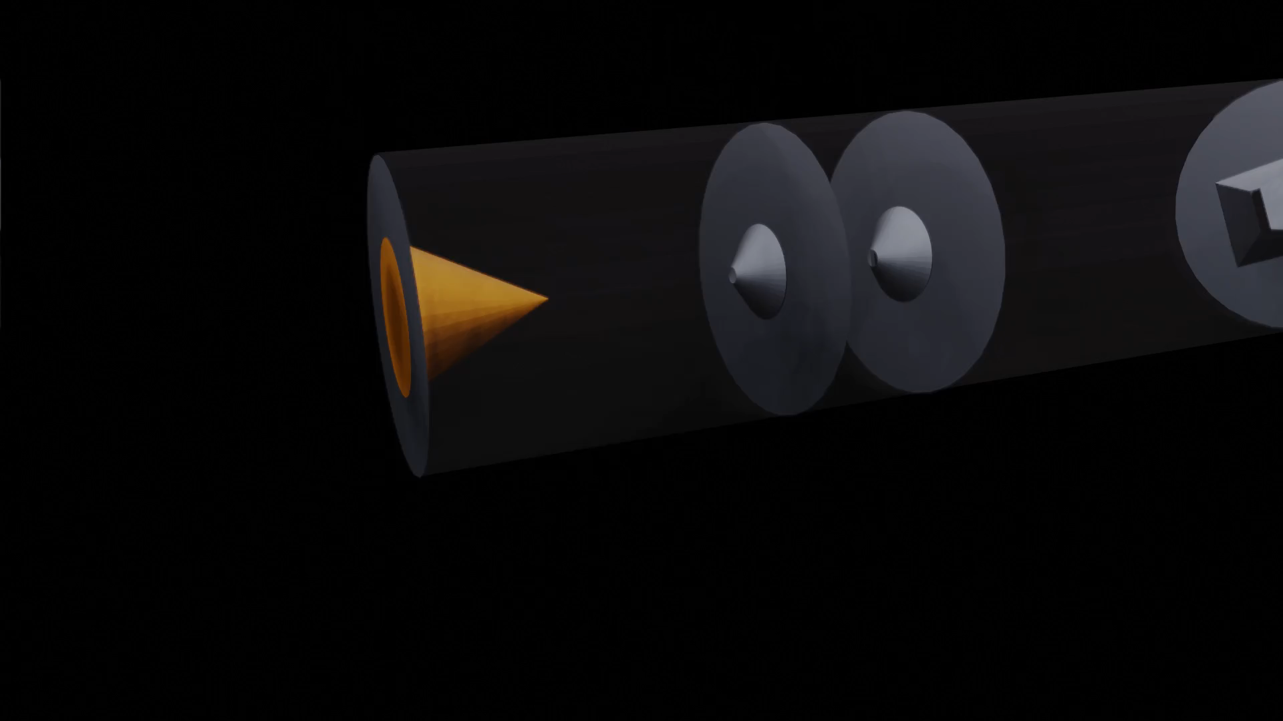
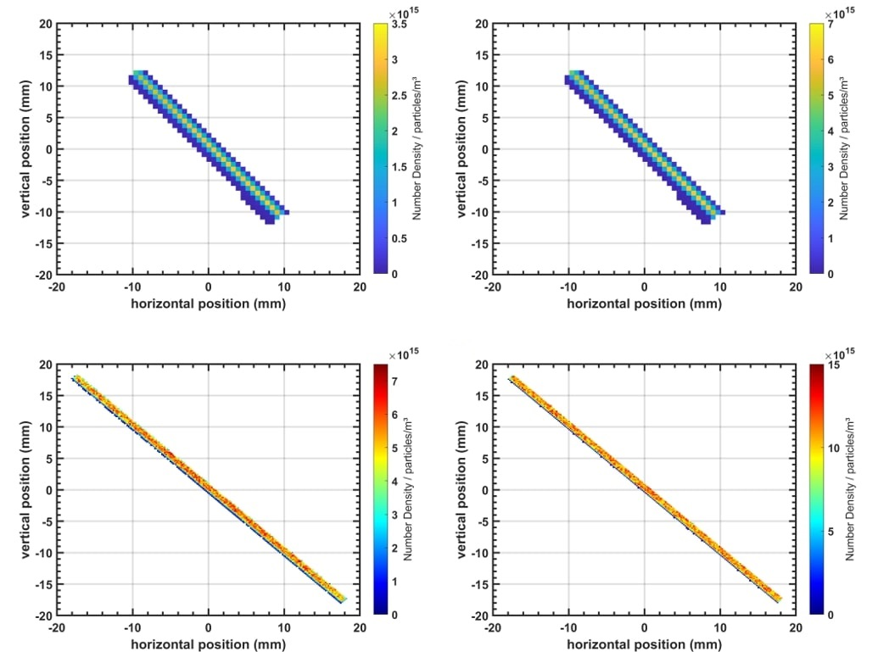
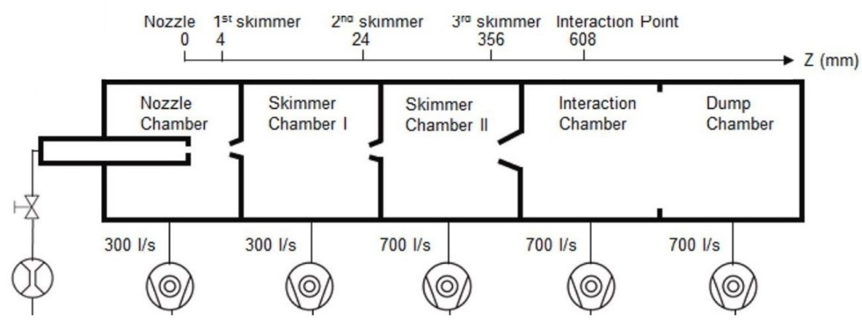
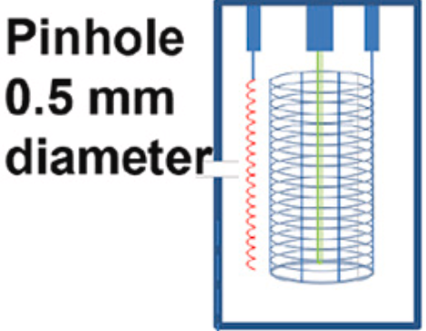
Background and R&D
Nitrogen
Argon
Gas jet shaping
Narender.Kumar@Cockcroft.ac.uk

Slide 4
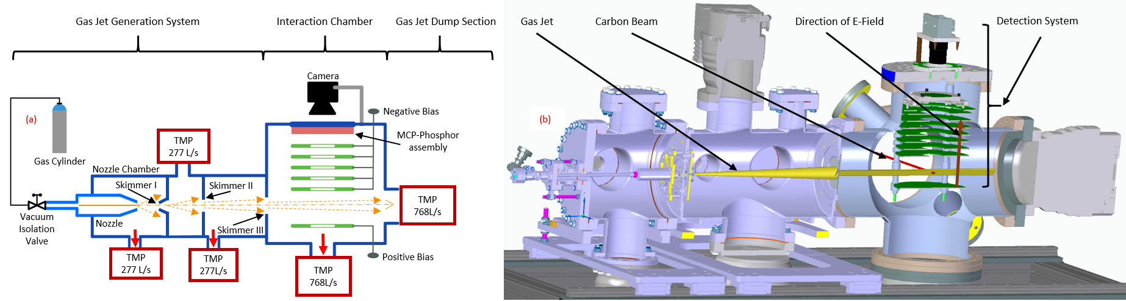
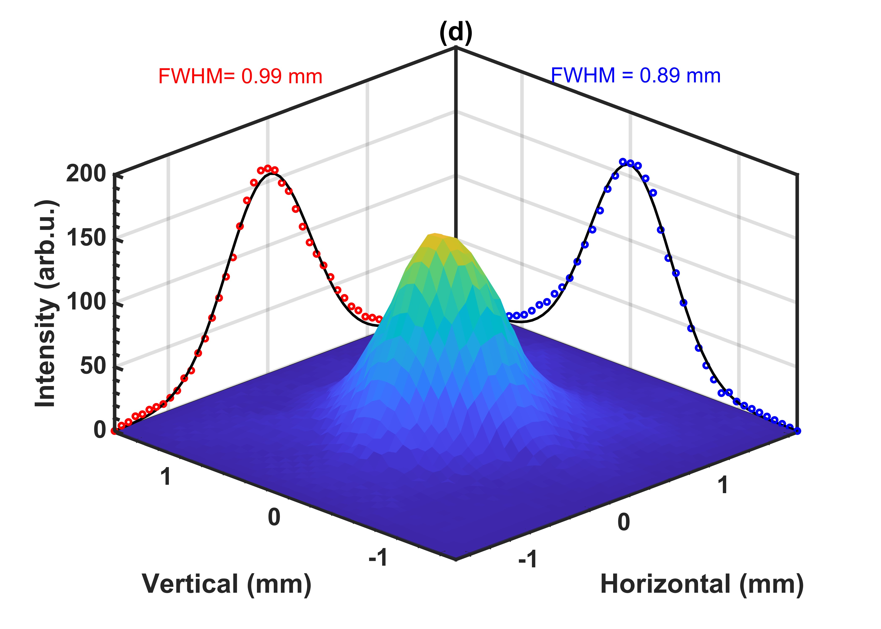
Supersonic Gas Curtain based real-time Ionization Profile Monitor
Status |  | Pressure (mbar)
Gas Jet | Beam | Nozzle Chamber | Skimmer Chamber (b/w 1st - 2nd) | Skimmer Chamber (b/w 2nd - 3rd) | Interaction Chamber
Off | Off | 3.98 × 10⁻⁰⁸ | 7.10 × 10⁻⁰⁹ | 3.00 × 10⁻⁰⁹ | 1.73 × 10⁻⁰⁸
On | Off | 4.84 × 10⁻⁰³ | 5.60 × 10⁻⁰⁶ | 4.60 × 10⁻⁰⁷ | 2.13 × 10⁻⁰⁸
On | On | 4.93 × 10⁻⁰³ | 5.60 × 10⁻⁰⁶ | 4.60 × 10⁻⁰⁷ | 2.16 × 10⁻⁰⁸
Narender.Kumar@Cockcroft.ac.uk

Slide 5
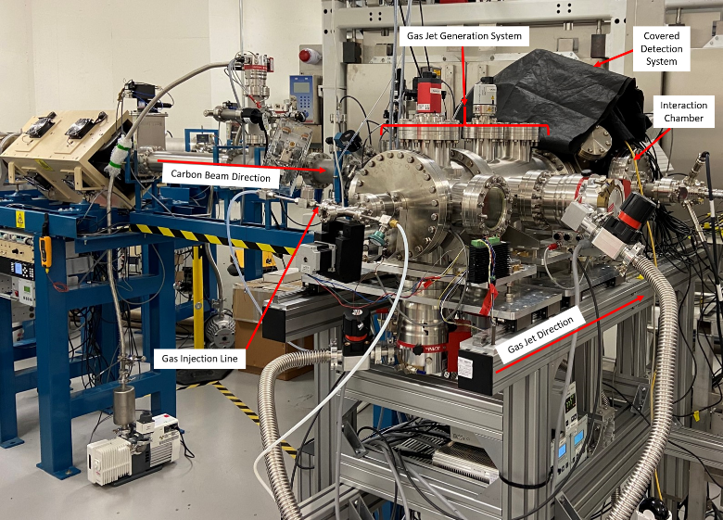
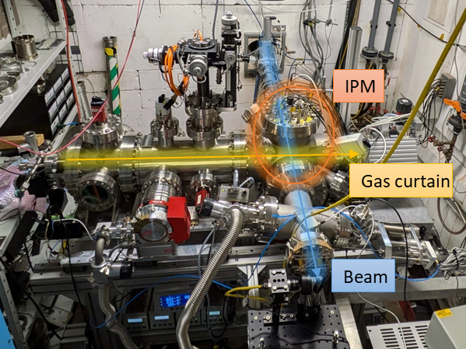
Proof-of-Concept Measurements
Pelletron Accelerator facility, Dalton Cumbrian Facility (DCF), United Kingdom
Beam Species | Charge state | Beam Energy (MeV) | Average Beam Current (nA) | Beam Size | Gas Curtain Species
Proton | +1 | 4-8 | 10-100 | Up to a few mm’s | Argon, Nitrogen
Carbon | +2, +3, +4, +5 | 12-24 | 2-100 | Up to a few mm’s | Argon, Nitrogen
MC40 Cyclotron Facility, University of Birmingham (UoB), United Kingdom
Beam Species | Charge state | Beam Energy (MeV) | Average Beam Current (nA) | Beam Size | Gas Curtain Species
Proton | +1 | 10.8- 28 | 2-72 | Up to a few mm’s | Argon, Nitrogen

Slide 6
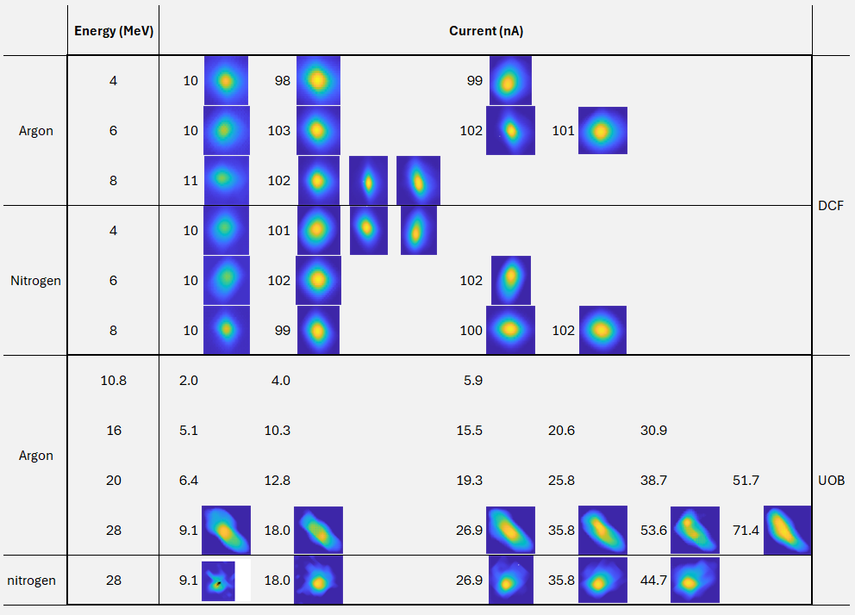
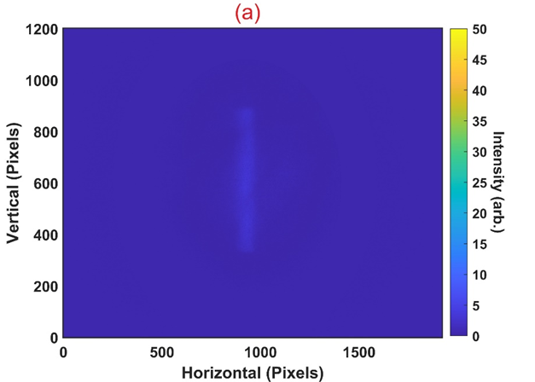

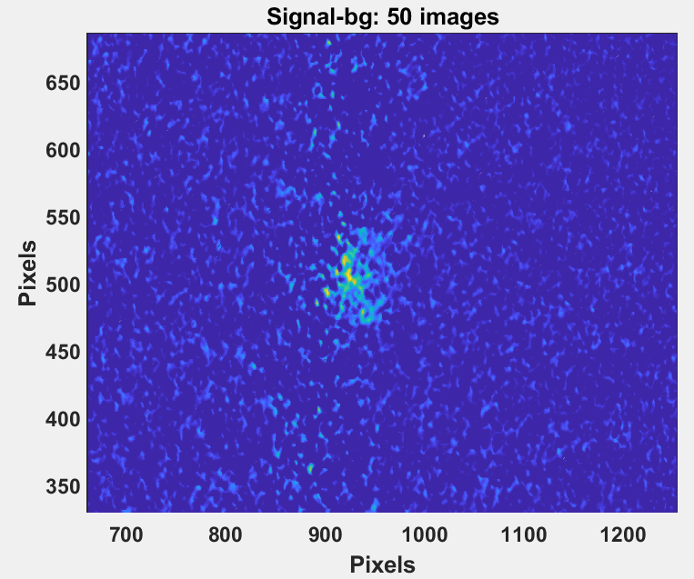
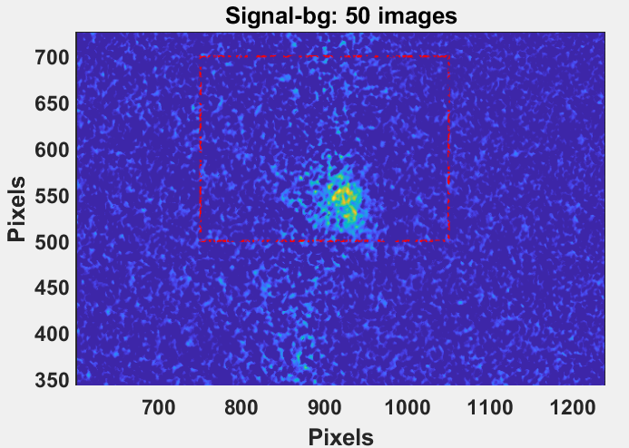
Proof-of-Concept Measurements
What is ideal for our device
Stable beam
Good vacuum (<10⁻⁸ mbar), Low noise
What is not ideal for our device
poor vacuum (10⁻⁷), strong background signal
Difficult to isolate noise
Narender.Kumar@Cockcroft.ac.uk

Slide 7
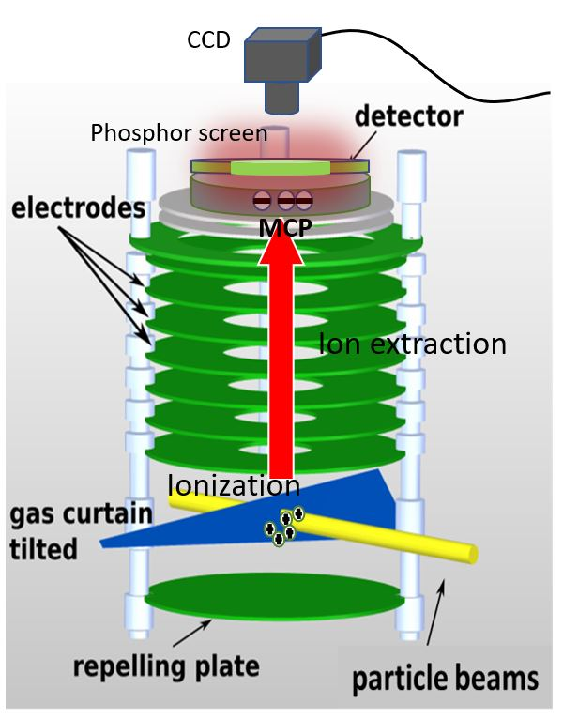
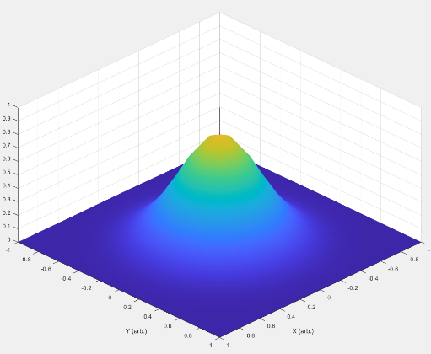
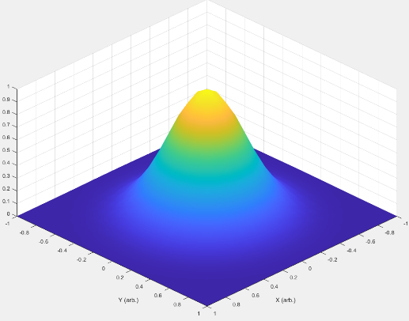
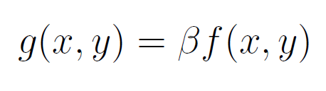


Evaluation of Detector Performance
Besides shape, the only quantitative number we get is total Counts (C) on pixels.
Imaged beam
count distribution $g(x,y)$
Assuming no distortion of profile during extraction
Input beam
flux distribution $f(x,y)$
Scaling factor
Probability of ionisation (function of energy)
Based on detector performance, a term was introduced Detection Limit (D)
Detector specific factors
Narender.Kumar@Cockcroft.ac.uk

Slide 8
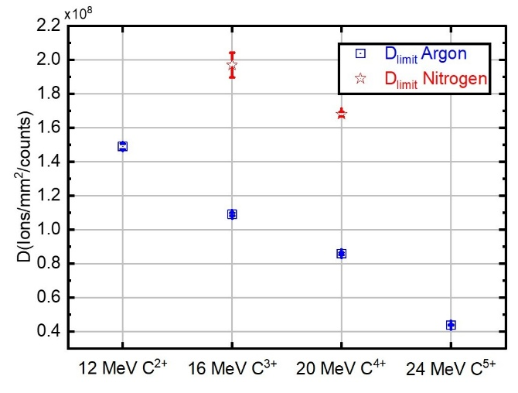
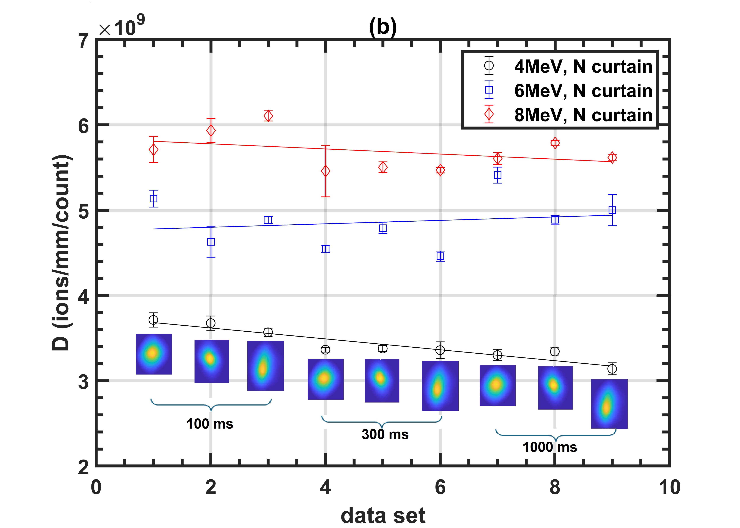
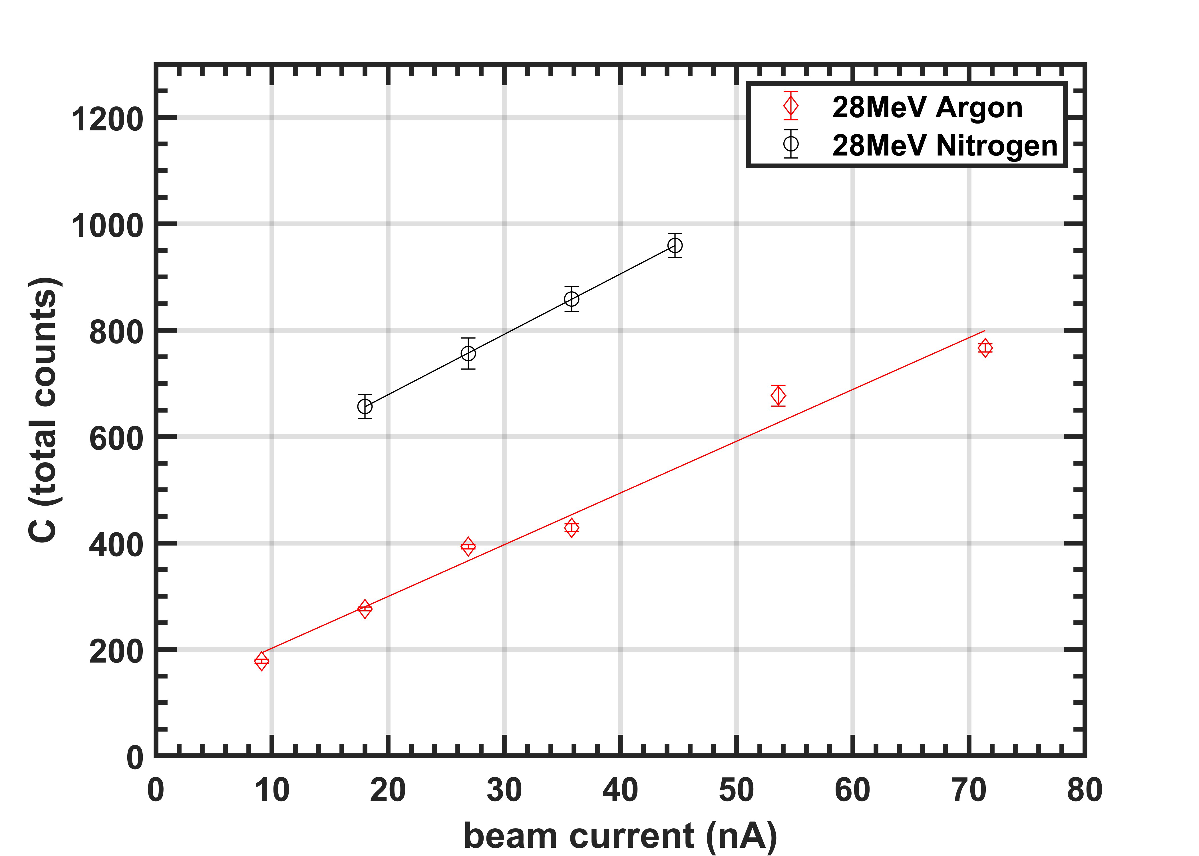
Performance of the Detector
Variation of gas
D values for 100nA beam current from DCF campaign
C variation for 28 MeV P-beam at different beam currents
Detection limit (D) variation with gas species (Ionization cross section) and gas density dependence
Detection limit (D) variation over energy (Bethe-Bloch Equation for energy loss)
Detection limit (D) stability over different integration time (dependent only on detector configuration)
Counts (C) linearity with Beam current (potential for ultra high dose rates (UHDR))
Narender.Kumar@Cockcroft.ac.uk

Slide 9
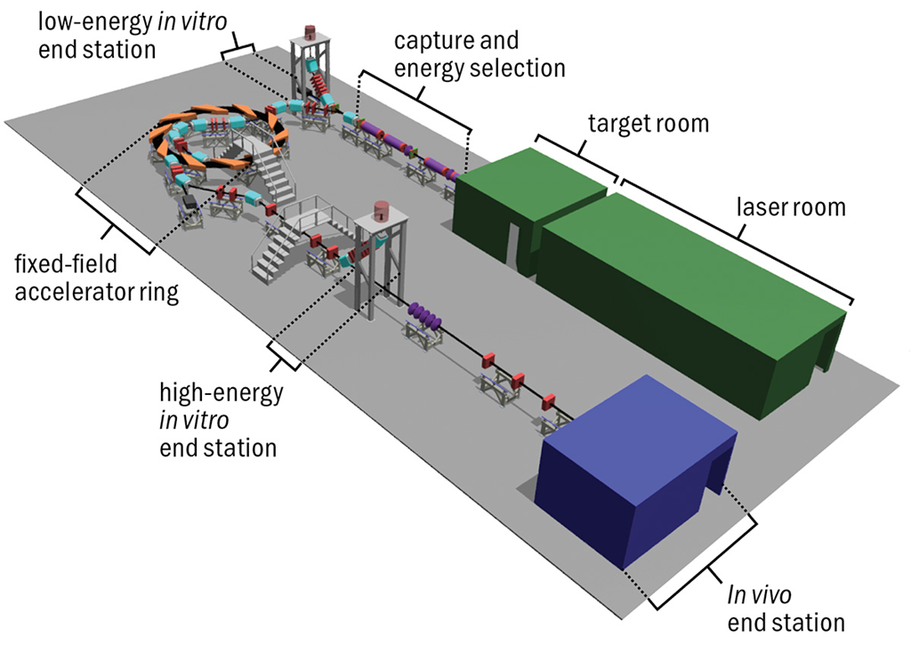
Summary of POC Measurements
Pelletron Accelerator facility, Dalton Cumbrian Facility (DCF), United Kingdom
 | P+ (12MeV) |  | P+ (15MeV) |  | P+ (127MeV) | C6+ (33.4MeV/u)
Instantaneous dose rate | 1.00 x 10⁹ |  | 1.80 x 10⁹ |  | 1.56 x 10¹⁰ | 9.70 x 10⁸ |  | ⬅ LhARA design baseline
pulse length (ns) | 7 |  | 7 |  | 41.5 | 75
Charge per laser shot (pC) | 100 |  | 100 |  | 100 | 100
ions per bunch (no.) | 6.24 x 10⁸ |  | 6.24 x 10⁸ |  | 6.24 x 10⁸ | 1.04 x 10⁸ |  | Calculated
pencil 1 mm (ions/sq.mm/bunch) | 7.95 x 10⁸ |  | 7.95 x 10⁸ |  | 7.95E x 10⁸ | 1.32 x 10⁸ |  | ⬅ Fluence
Pencil: 1 mm | Ar | N₂ | Ar | N₂ |  | Ar | N₂ | ⬅ Number of bunches required
 | 42 | 52 | 52 | 63 | x | 8 | 20
Based on POC Measurements at UoB
 | P+ (12MeV) |  | P+ (15MeV) |  | P+ (127MeV) | C6+ (33.4MeV/u)
Pencil: 1 mm | 0.17 | 0.21 | 0.21 | 0.26 | x | 0.03 | 0.08 | ⬅Number of bunches required
Narender.Kumar@Cockcroft.ac.uk

Slide 10
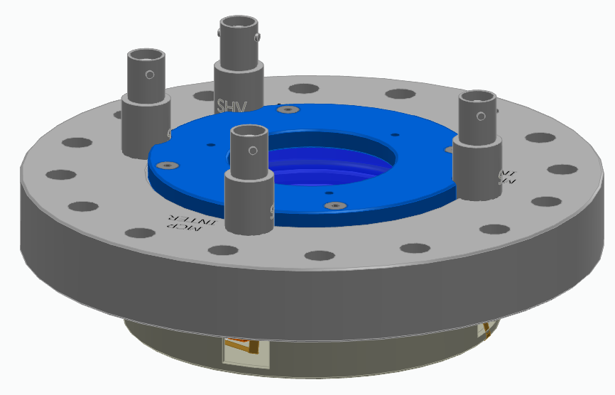
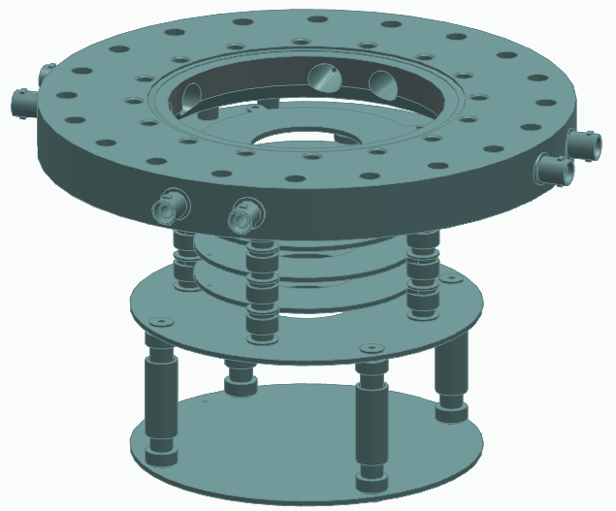
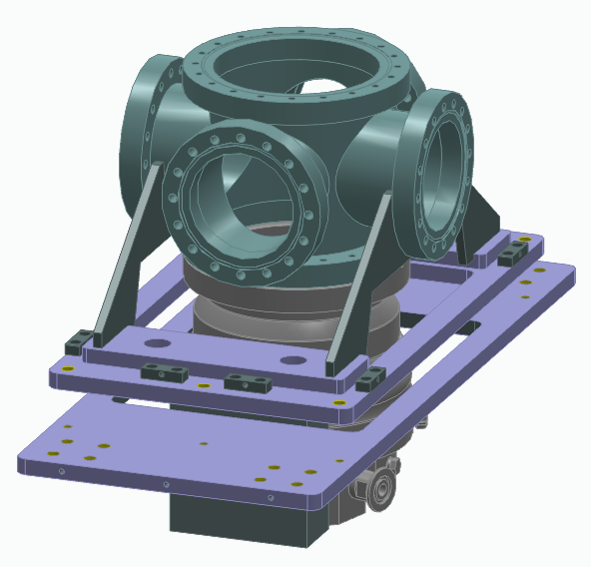
Outlook
More compact and flexible design for easier system integration.
Optimization of gas jet density at interaction point to meet vacuum requirements.
More experiments to identify gases with higher ionization cross-sections
Upgrade to extraction system for enhanced detection limit.
Detector
Extraction unit
Size Reduction: 25% along beam, 50% lateral to beam
Gain Improvement
 | Pessimistic | Optimistic | Actual tested at UoB
QE P43 | 1.2 | 1.4 | 1.3 | ⬅ Manufacturers datasheet
MCP Double chevron | 100 | 1000 | 80 | ⬅ Operation limited by poor vacuum
Effective ions extraction | 1 | 1-4 | - | ⬅ New Design being manufactured
Curtain thickness | 2 | 5 | - | Unchanged
Curtain density | 2 | 5 | 3 | ⬅ Z_{NS} optimization
 | 480 | 49700 | 240
Chamber and support structure
Narender.Kumar@Cockcroft.ac.uk

Slide 11
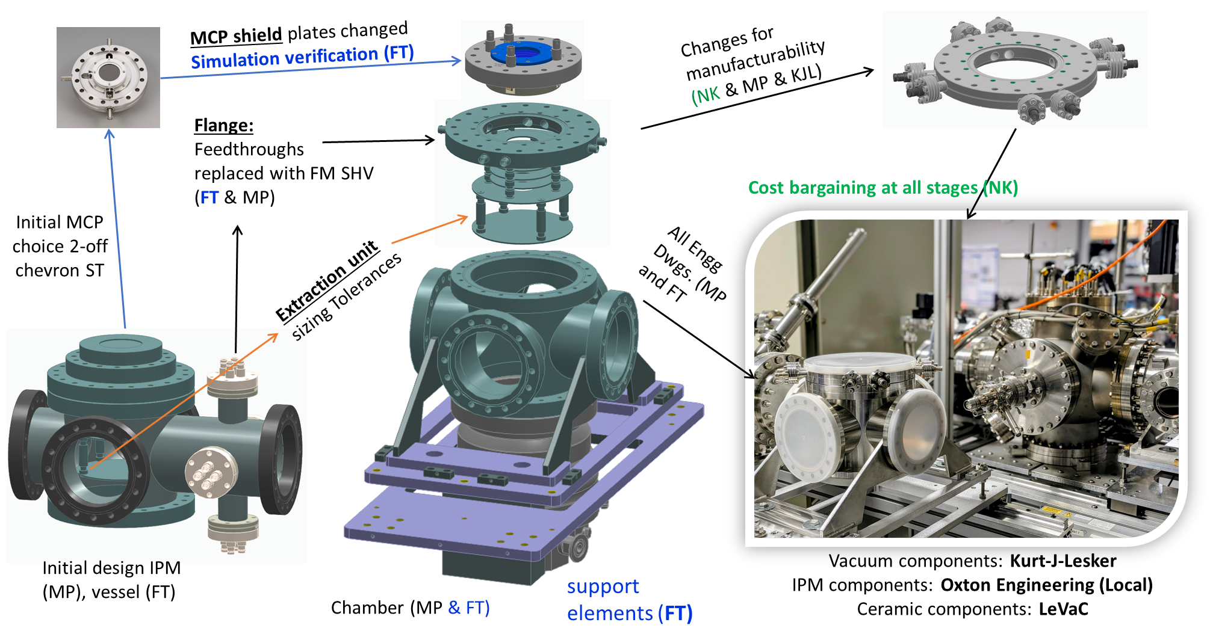
Outlook
Narender.Kumar@Cockcroft.ac.uk

Slide 12
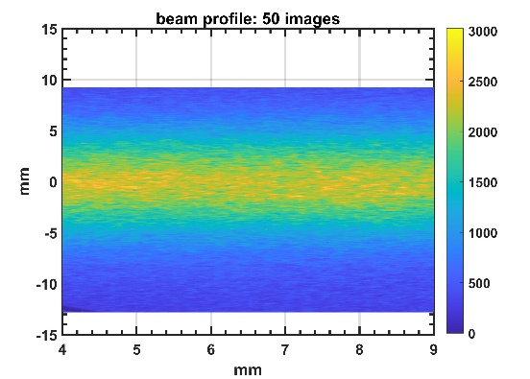
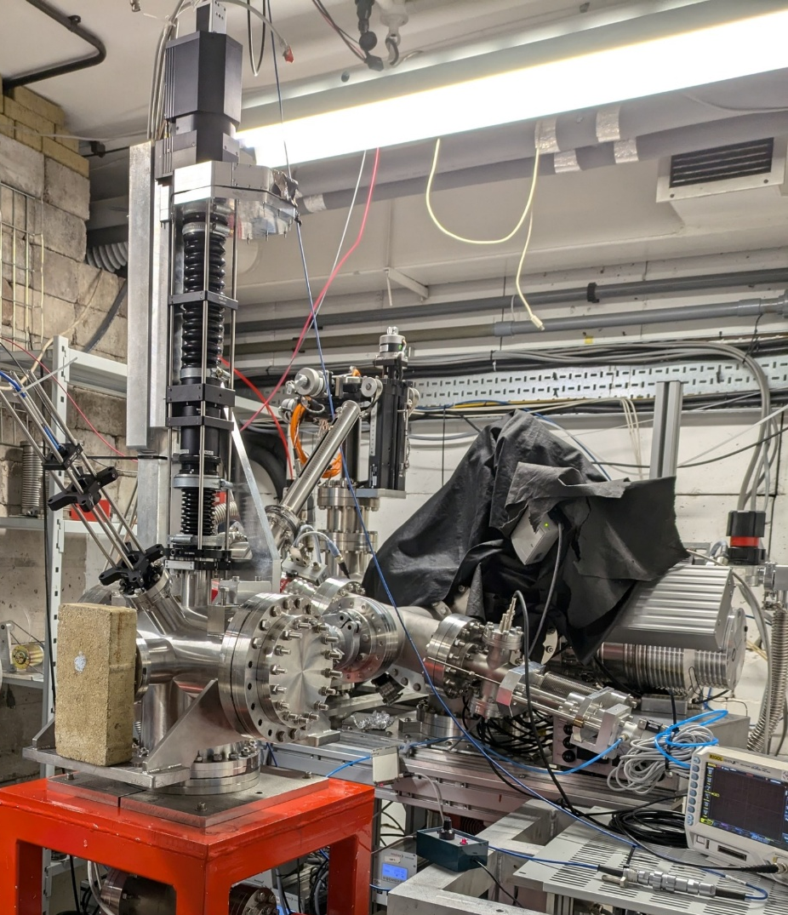
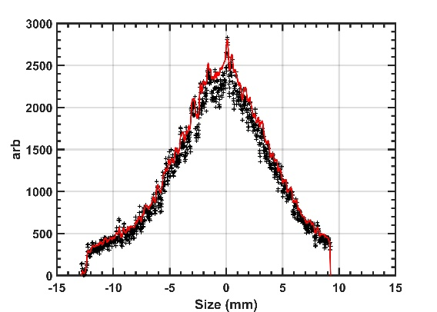
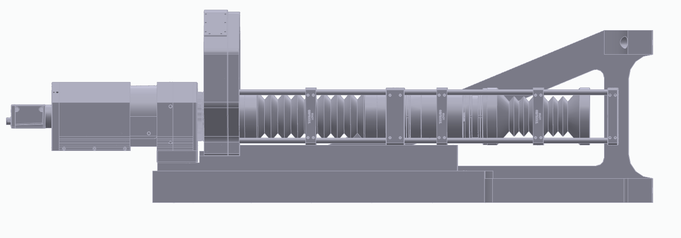
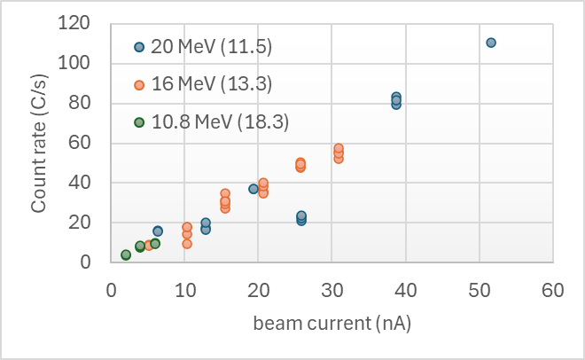
Optical Air Fluorescence Monitor
Apochromatic Triplet F= 600
Image Intensifier
Camera
Beam
Beam exit
25:7 imaging optics
Band pass Filter wheel
Aperture
Depth of field
AFM installed at MC40 cyclotron (August 2024)
Narender.Kumar@Cockcroft.ac.uk

Slide 13








Conclusions
Supersonic gas jet ionization profile monitor has successfully demonstrated capability for 2D transverse beam profile measurements with beams close to the requirements for ion beam cancer therapy.
The design is updated to improve the detection limit and easier integration possibility
POC measurements were carried out for OAFM successfully. More measurements (to be planned)
Last 18 months: 3 conference talks, 7 posters, 8 conference proceedings, 3 journal articles (under review), 3 journal articles (to be submitted soon).
Special thanks to the JetDose team: M. Patel, W. Butcher, F. Thesni M. P. and C. P. Welsch
Thanks to Dr. Andrew Smith (DCF) and Dr. Tony Price (UoB) for the assistance with the POC measurements
Narender.Kumar@Cockcroft.ac.uk

