Slide 1
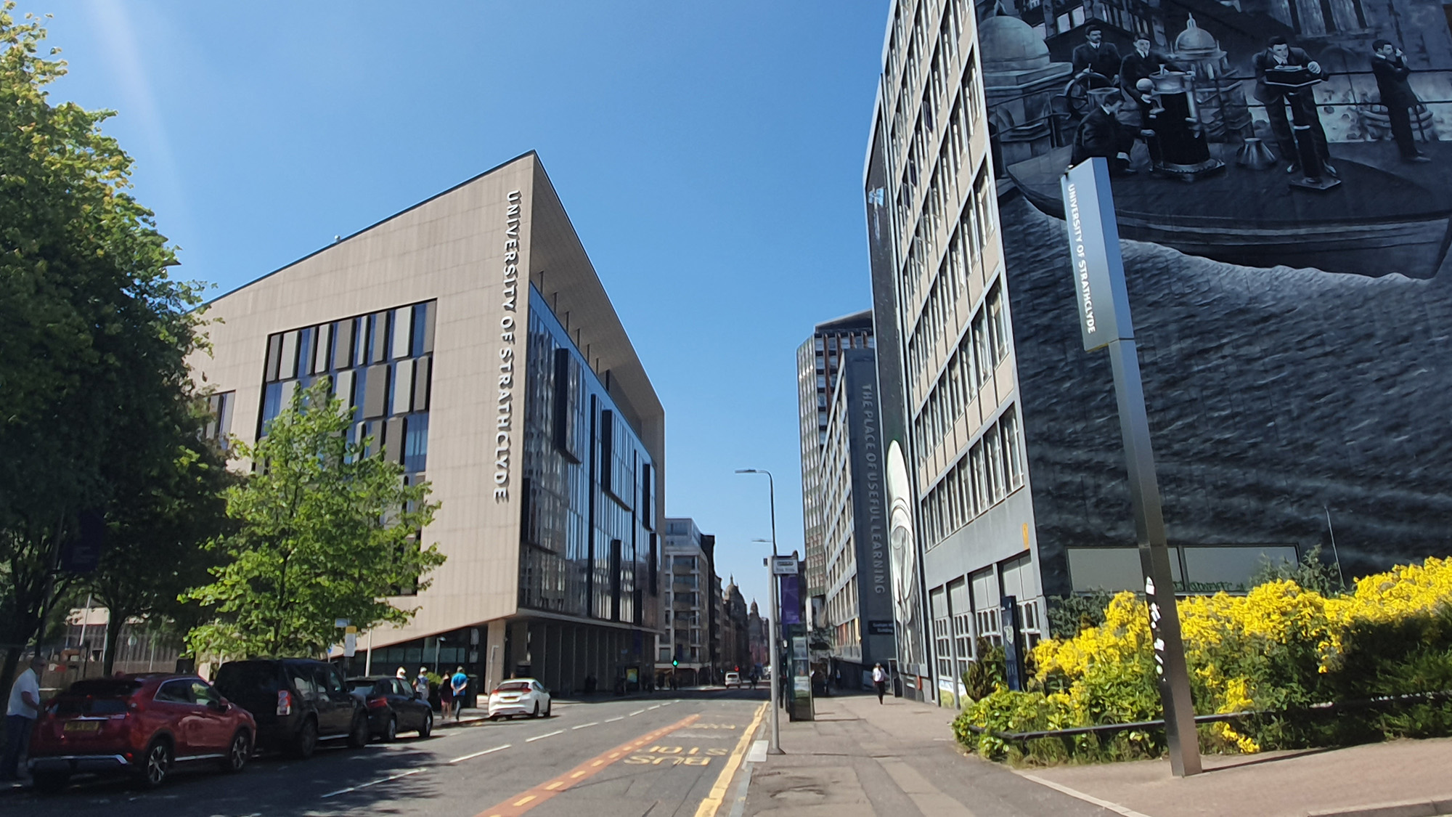

Progress Towards a Calibrated High Repetition-Rate Thomson Parabola Spectrometer
at SCAPA
B. C. Torrance¹, C. J. McQueen^{1,2}, R. Wilson¹, M. Alderton¹, E. J. Dolier¹, M. P. Peat¹, R. Nayli¹, M. King^{1,2}, R. J. Gray^{1,2}, and P. McKenna^{1,2}
¹SUPA Department of Physics, University of Strathclyde, Glasgow G4 0NG, UK
²The Cockcroft Institute, Sci-Tech Daresbury, Warrington WA4 4AD, UK
ben.torrance.2017@uni.strath.ac.uk
X THE PLACE OF USEFUL LEARNING
18/09/2025

Slide 2
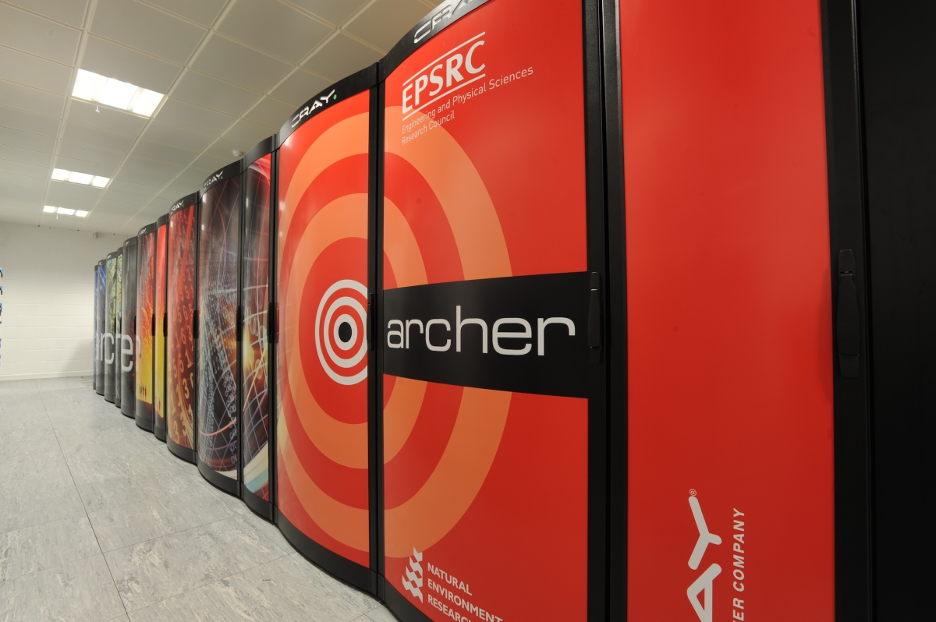
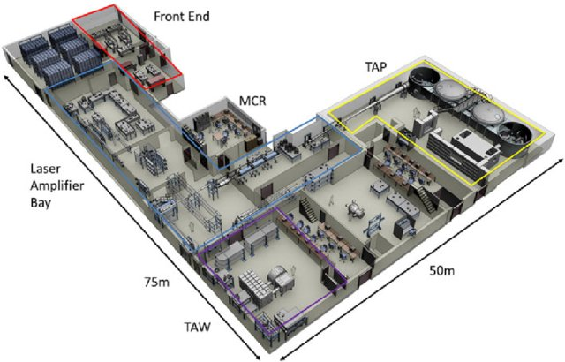
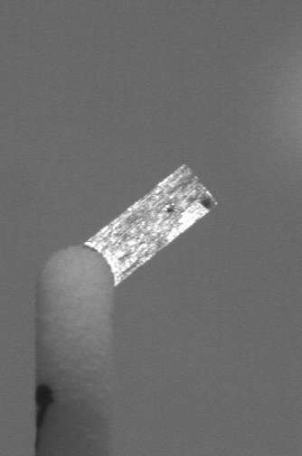
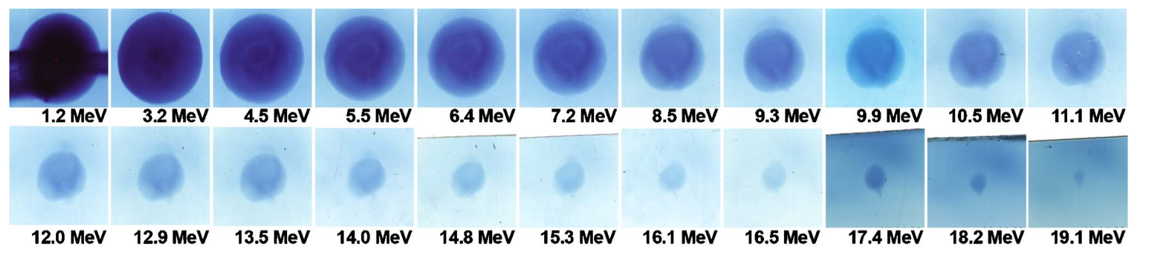
High Repetition Rate: Motivation & Challenges
Operating > 1 Hz has the potential for application for radiobiological research [1], and enabling statistical data-driven experimentation.
Includes, the use of machine-learning (ML) [2-4] and neural networks [5].
Developed a Thomson parabola spectrometer analysis code named ARISE: An Algorithm for Rapid Ion Spectrum Extraction, capable of operation >20 Hz.
Lasers
Targets
Diagnostics
Simulations/Computation
X THE UNIVERSITY OF STRATHCLYDE
Physics/dimensionally limited models/limited access to HPC
1 pulse/ 30 mins
Hand made targets
Film based/slow readout diagnostics
Mass manufacture, tape targets, liquid targets
[1]: G. Aymar et al. Frontiers in Physics, Medical Physics and Imaging, 8, 567738 (2020).
[2]: K. K. Swanson et al. Rev. Sci. Instrum. 93, 103547 (2022)
[3]: R. J. Shalloo et al. Nat. Commun. 11, 6355 (2020).
[4]: B. Loughran et al. High Power Laser Science and Engineering, 11, e35 (2023)
[5]: C. J. McQueen et al. A neural network-based synthetic diagnostic of laser-
accelerated proton spectra, (2024), (in draft)
Improved, more efficient models, wider access to HPC
10+ Hz
Scintillator based, 10+ Hz readout
18/01/2024
Notes:
Until recently, high-power low repetition rate systems have been the standard.
A number of Petawatt-class, high-repetition rate laser systems have since been developed [?] which are capable of repetition rates beyond 1 Hz.
Targetry and diagnostics must be capable of rivalling these rates.
Moved from single hand made targets -> mass manufactured tape/liquid targets
Diagnostics moved from 1 use IP, film-based diags -> HRR e.g. scintillator-based
Computation requires greater efficiency
As such, we have developed a Thomson parabola spectrometer analysis code named ARISE: An Algorithm for Rapid Ion Spectrum Extraction, capable of operation >20 Hz.

Slide 3
ARISE: An Algorithm
for Rapid Ion
Spectrum Extraction
ARISE code workflow:
X THE UNIVERSITY OF STRATHCLYDE
18/01/2024
Notes:
A configuration file is required for this code for various input parameters
Here we define the geometry of the TPS, field strengths, spatial calibrations, ion species we wish to look for etc.
Particle deflections are calculated based on deflection equations and then stored for access as this is the slowest section of the code
Images are then processed, cropped, background subtracted etc.
Particle data can then be extracted by applying the parabolas to the MCP images.

Slide 4
Code Performance
Testing of main processing stages performed over 200 previously generated experimental images.
Achieved a repetition rate >20 Hz as seen in figure (1).
X THE UNIVERSITY OF STRATHCLYDE
Commonly, analysis of multiple ion species required.
Tested scalability as number of species increases, shown in figure (2).
Fig. (1): Bar chart of the average time for the main processing stages of ARISE both with and without median filtering across 200 data points
Fig. (2): Comparison of average repetition rate across 200 shots as we increase the number of ions. Error bars correspond to standard deviation of the average time taken.
18/01/2024
Notes:
Involved performing various parameter scans.
We can also look at the total flux by integrating under the curve of our spectra
This gives us a picture where we can see a pretty general consensus for both E_{max} and the total flux.

Slide 5
Automatic Maximum
Energy Detection
How do we trust our automatic maximum energy detection?
Tested various methods, such as Thresholding, Least Squares Regression etc.
X THE UNIVERSITY OF STRATHCLYDE
Collected 15 random spectra, taking ‘Ground Truth Value’ for each, results seen in figure (3).
Table (1) shows typical error metrics such as Mean Absolute Error (MAE), Root Mean Squared Error (RMSE), etc.
Least Squares method performs well, within the standard deviation of the Ground Truth answers.
Fig. (3): Comparison of Emax values for 15 randomly sampled spectra extracted by least squares regression (blue circle) and our threshold cutoff method (red cross) against ground truth values
18/01/2024
Table (1): A table of metrics comparing the automatic detection methods.

Slide 6
TPS MCP/RCF Calibration
To calibrate our MCP we’ve begun taking the approach shown in Harres et al [1]:
Use half RCF stacks as shown in figure (4)..
Extract spectra from RCF and compare to MCP spectra seen in figure (5).
Compute scaling factors.
Fig. (4): Example half stack RCF for TPS calibration
X THE UNIVERSITY OF STRATHCLYDE
Use solid angles of RCF and of the pinhole of the TPS to calculate spectrum per steradian as seen in figure (6).
So far only performed with 2 RCF shots, more statistics required.
Fig. (6): Calibrated TPS spectra and RCF spectra per steradian
[1]: K. Harres et al, Rev. Sci. Instrum. 79, 093306 (2008).
Fig. (5): Corresponding RCF spectra and TPS spectra
18/01/2024

Slide 7






Summary & Next Steps
Presented our progress towards a calibrated HRR TPS at SCAPA.
Outlined steps taken for calibration work.
Next steps are more calibration shots to build statistics and implement calibration class to ARISE.
X THE UNIVERSITY OF STRATHCLYDE
18/01/2024

Slide 8
Thank You
Ben Torrance
ben.torrance.2017@uni.strath.ac.uk
X THE PLACE OF USEFUL LEARNING

