Slide 1
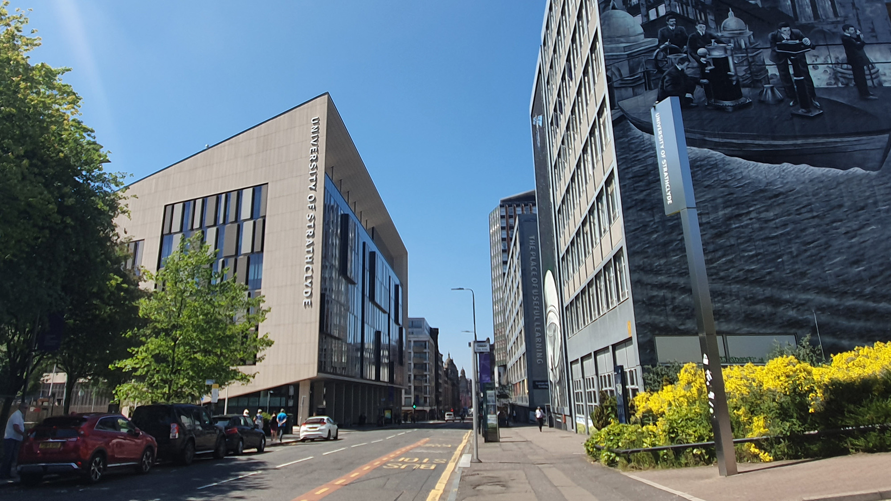

Developments for the PoPLaR Experiment at SCAPA
Bunker B
B. C. Torrance¹, R. Wilson¹, E. J. Dolier¹, C. J. McQueen^{1,2}, M. Alderton¹, M. P. Peat¹,
J. Patel^{1,3}, R. Nayli¹, M. King^{1,2}, R. J. Gray^{1,2}, and P. McKenna^{1,2}
¹SUPA Department of Physics, University of Strathclyde, Glasgow G4 0NG, UK
²The Cockcroft Institute, Sci-Tech Daresbury, Warrington WA4 4AD, UK
³Central Laser Facility, STFC Rutherford Appleton Laboratory, Harwell, Oxford, OX11 0QX,UK
ben.torrance.2017@uni.strath.ac.uk
X THE PLACE OF USEFUL LEARNING
18/09/2025

Slide 2
Talk Overview:
SCAPA Bunker B developments & current performance
Proof of Principle LhARA Radiobiology (PoPLaR) Experiment:
  Updated permanent magnet quadrupoles (PMQs) & Thomson parabola spectrometer (TPS) setup
  Preliminary Results: RCF & Lanex imager
Progress Towards a Calibrated High Repetition-Rate Thomson Parabola Spectrometer at SCAPA:
  High repetition rate: motivation & challenges
  ARISE: An Algorithm for Rapid Ion Spectrum Extraction
  TPS Calibration
X THE UNIVERSITY OF STRATHCLYDE
18/01/2024

Slide 3
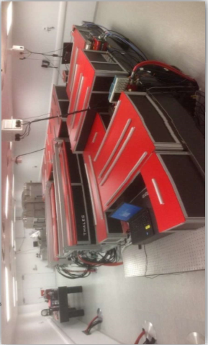
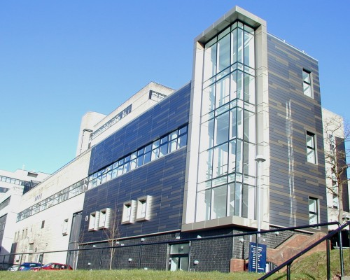
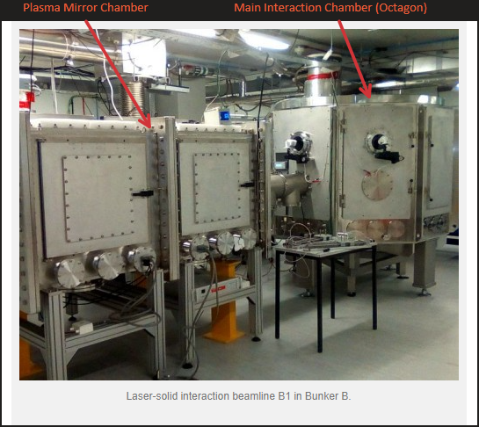
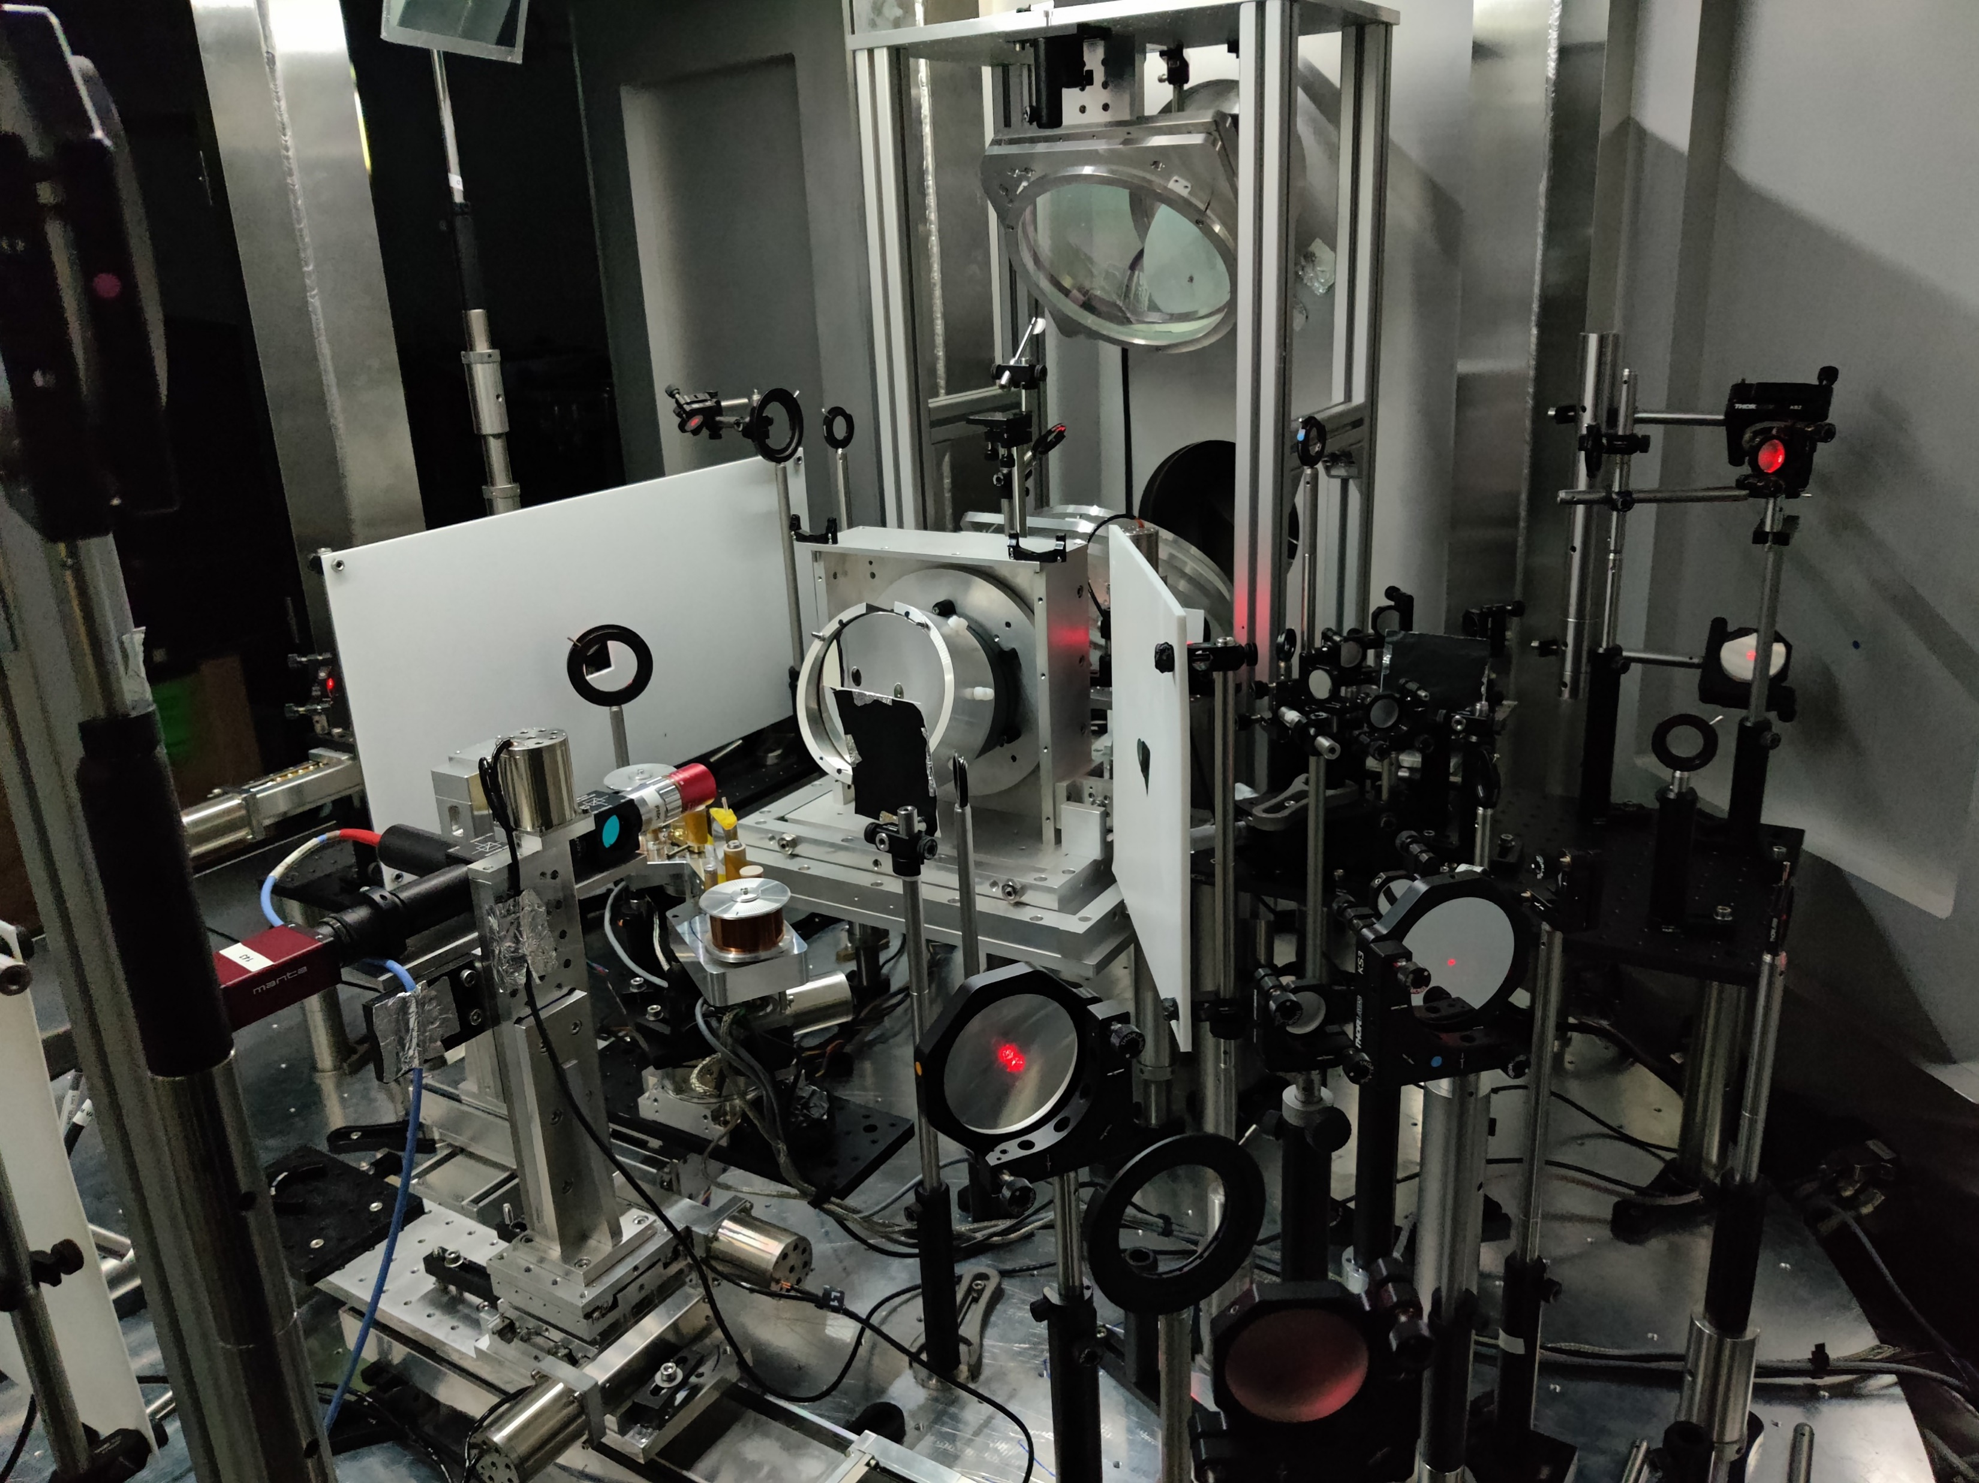
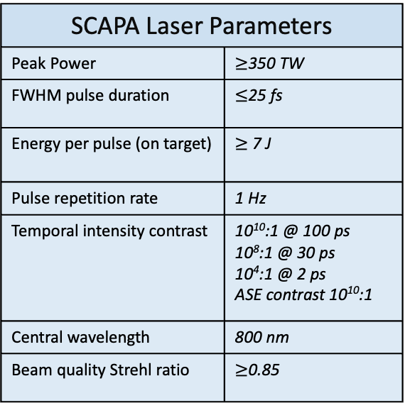
SCAPA: Scottish Centre for the Application of Plasma-based Accelerators
SCAPA Laser Parameters
Peak Power | $≥$350 TW
FWHM pulse duration | $≤$25 fs
Energy per pulse (on target) | $≥$ 7 J
Pulse repetition rate | 1 Hz
Temporal intensity contrast | 10¹⁰:1 @ 100 ps 10⁸:1 @ 30 ps 10⁴:1 @ 2 ps ASE contrast 10¹⁰:1
Central wavelength | 800 nm
Beam quality Strehl ratio | $≥$0.85
High power laser facility based in the University of Strathclyde.
Capable of delivering 350TW at high repetition rates (1Hz) [1].
Three experimental areas (A,B,C) with Bunker B dedicated to ion acceleration & HRR operation.
X THE UNIVERSITY OF STRATHCLYDE
[1]: S. M. Wiggins et al., SPIE, Apr. 2019
3
18/01/2024
18/01/2024

Slide 4
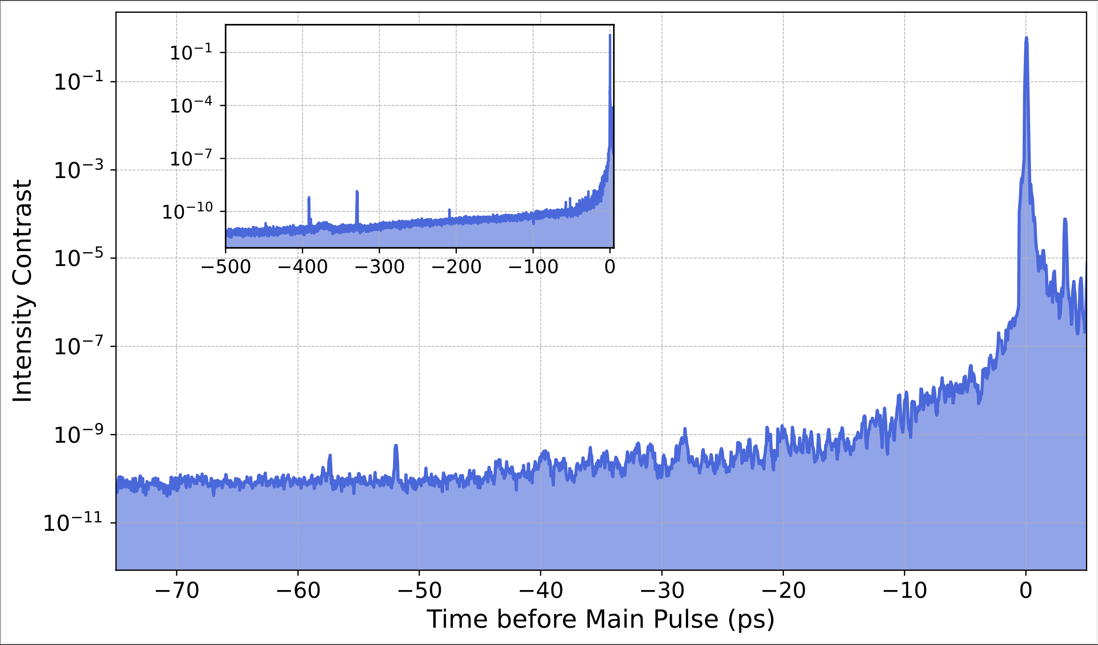
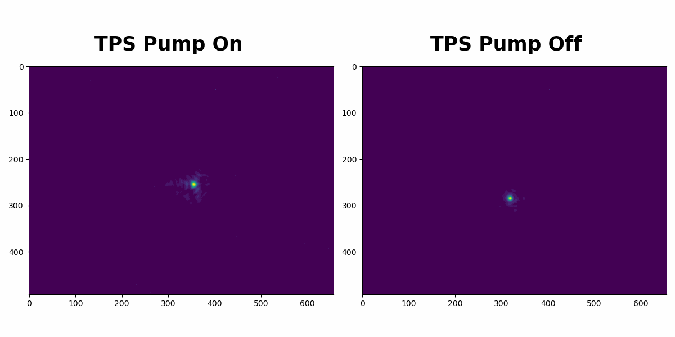
SCAPA Developments & Current Performance
Numerous developments have been made to Bunker B in the lead up to the Proof of Principle LhARA Radiobiology (PoPLaR) Experiment:
  Prepulse removal -> significantly improved temporal contrast, laser energy stability, and focal spot jitter.
X THE UNIVERSITY OF STRATHCLYDE
  Improved focal spot stability -> a std dev from the mean of around 1.46 µm (7.31 µrad) in x, and 2.26 µm (11.30 µrad) in y, equating to 1-2 spot diameters of jitter.
  Installed a new 50x objective lens on our focal spot camera -> better for spot optimisation.
4
18/01/2024
Notes:
Moving to the current performance of SCAPA:
On left we have the centroid position of our focal spot over 1000 shots relative to the nominal average position.
We see a spread of…
On the right, we have an example of one of our focal spots. This gave us a mean FWHM of 1.69 µm
Giving us an encircled energy of 23 %
We hope to improve on this through a rebuild of our objective lens setup moving from a 20x to a 50x mag lens, changing of the pellicle, and redesigning our HASO imaging line.

Slide 5
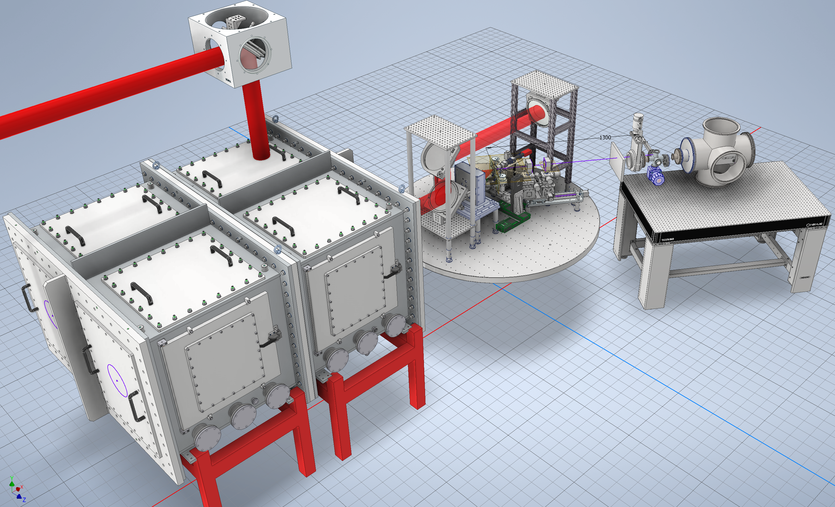
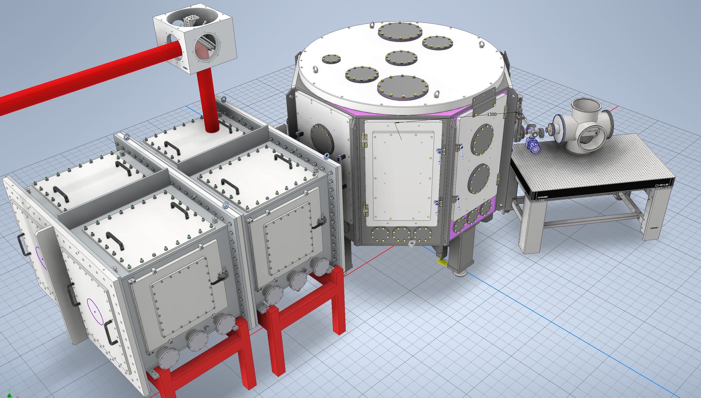
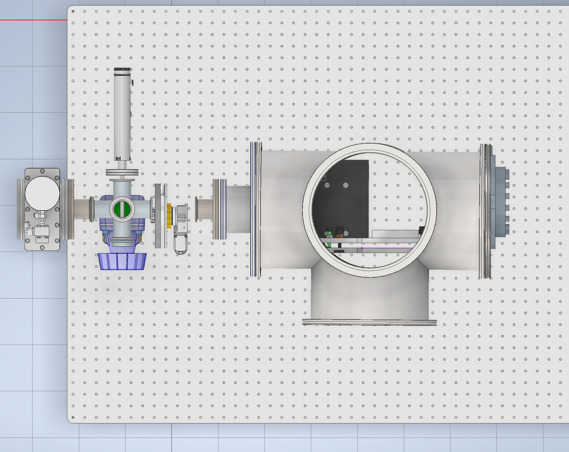
Proof of Principle LhARA Radiobiology (PoPLaR) Experiment
Retractable beam profiler
X THE UNIVERSITY OF STRATHCLYDE
Cell Irradiation End Station
Permanent Magnet Quadrupole (PMQ) System
Multi-position cell holder
Thomson Parabola Spectrometer
The design and addition of a capture beamline to Bunker B to guide and focus our laser-driven proton source to a cell irradiation end station.
5
Notes:
This is a CAD model of said experiment.
We plan to install a capture beamline to guide the proton source to a cell irradiation station
This will involve a permanent magnet quadrapole system as seen on left, and a cell irradiation end station which will sit at target normal in the TP line.
Very exciting application experiment for Bunker B

Slide 6
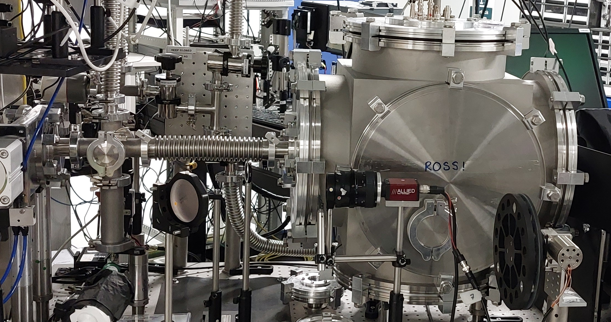
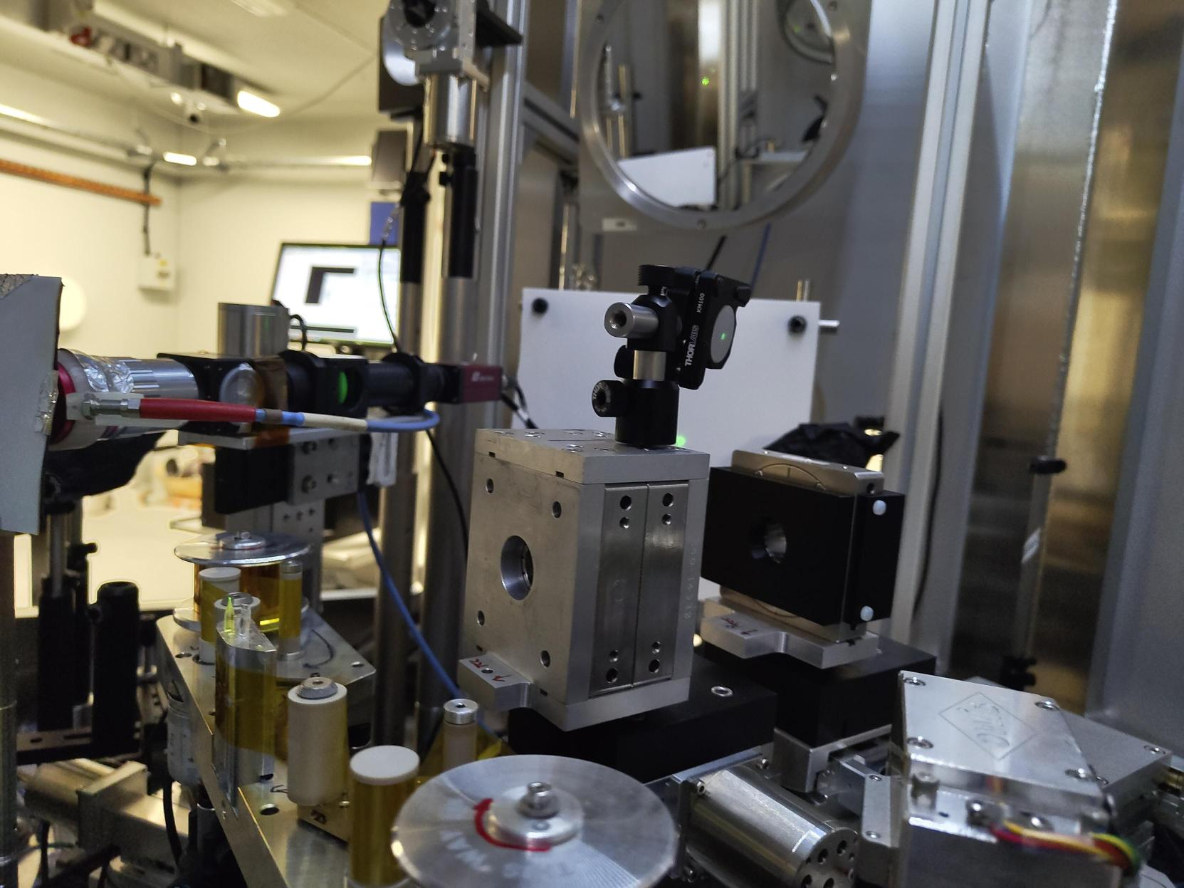
Updated PMQ and Thomson Parabola Spectrometer
TPS Chamber
6-way
Cross
X THE UNIVERSITY OF STRATHCLYDE
PMQ2
Target
PMQ1
Cell Wheel
Figure (1): Photograph of updated Thomson parabola ion spectrometer diagnostic setup
Figure (2): Photograph of PMQs aligned to the proton beam propagation axis (green dashed). NOTE: target slightly out of position in this photo.
Figure 1 shows the Thomson parabola ion spectrometer (TPS) housed in a larger, more stable chamber compatible with the cell irradiation setup and Lanex imaging system.
A forward going laser diode was aligned through the target along the proton beam propagation axis and the TPS.
This diode was used to align the PMQs to this axis as shown in figure 2.
6
Notes:
This is a CAD model of said experiment.
We plan to install a capture beamline to guide the proton source to a cell irradiation station
This will involve a permanent magnet quadrapole system as seen on left, and a cell irradiation end station which will sit at target normal in the TP line.
Very exciting application experiment for Bunker B

Slide 7
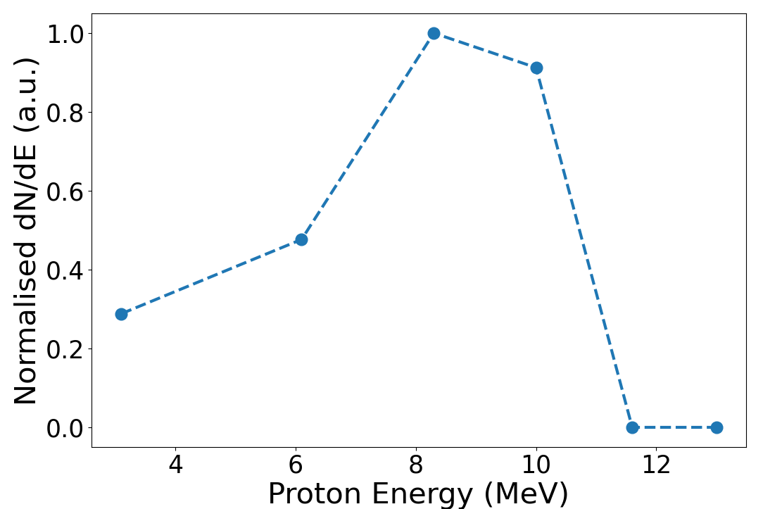

Focused Proton Beam RCF
Figure 4: RCF stack positioned at cell irradiation position.
Output proton beam from PMQs
Input proton beam to PMQs
PMQs
X THE UNIVERSITY OF STRATHCLYDE
Figure 3: RCF stack showing input proton beam before PMQs.
We successfully measured the focused proton beam outside the chamber at the cell irradiation position using an RCF stack, up to a maximum proton energy of $ε_{pmax}$ = 11.6 MeV, as shown in figure 4.
Figure 5 shows the corresponding RCF spectrum. Calibration still required to extract real proton numbers.
7
Figure 5: Corresponding normalised RCF spectrum.
Notes:
This is a CAD model of said experiment.
We plan to install a capture beamline to guide the proton source to a cell irradiation station
This will involve a permanent magnet quadrapole system as seen on left, and a cell irradiation end station which will sit at target normal in the TP line.
Very exciting application experiment for Bunker B

Slide 8
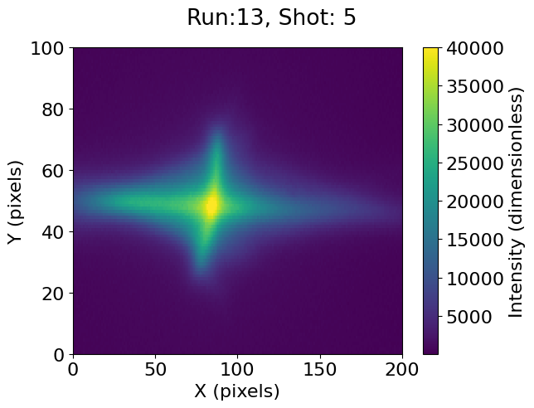
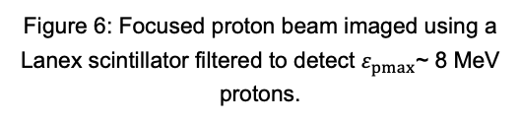
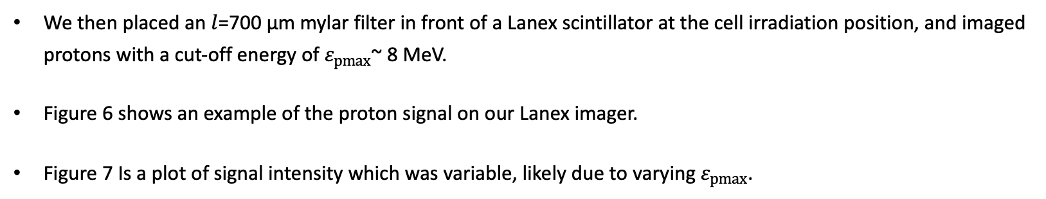
Focused Proton Beam Lanex Imager
X THE UNIVERSITY OF STRATHCLYDE
Figure 6: Focused proton beam imaged using a Lanex scintillator filtered to detect $ε_{pmax}$~ 8 MeV protons.
Figure 7: Normalised total light intensity on the Lanex scintillator as a function of shot number. Lines and shaded regions represent the median and ±1 std. dev. respectively.
We then placed an $l$=700 µm mylar filter in front of a Lanex scintillator at the cell irradiation position, and imaged protons with a cut-off energy of $ε_{pmax}$~ 8 MeV.
Figure 6 shows an example of the proton signal on our Lanex imager.
Figure 7 Is a plot of signal intensity which was variable, likely due to varying $ε_{pmax}$.
8
Notes:
This is a CAD model of said experiment.
We plan to install a capture beamline to guide the proton source to a cell irradiation station
This will involve a permanent magnet quadrapole system as seen on left, and a cell irradiation end station which will sit at target normal in the TP line.
Very exciting application experiment for Bunker B

Slide 9
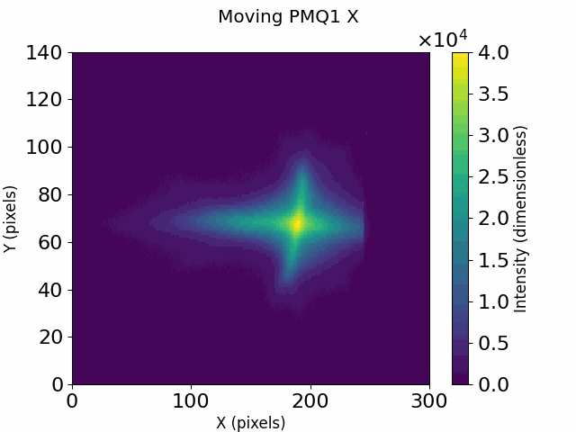
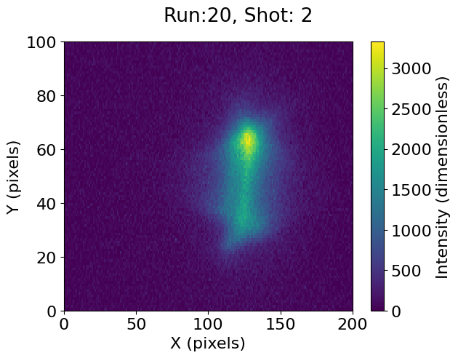
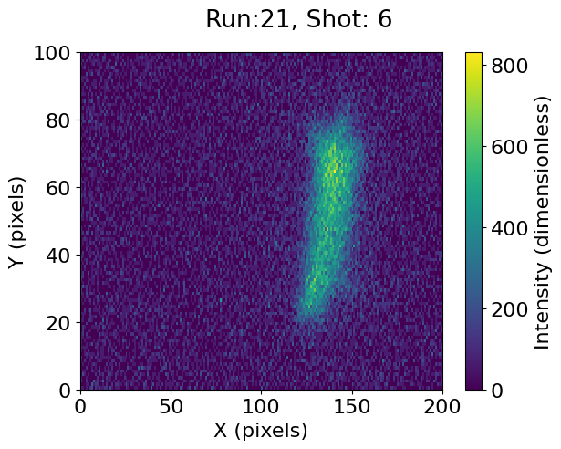
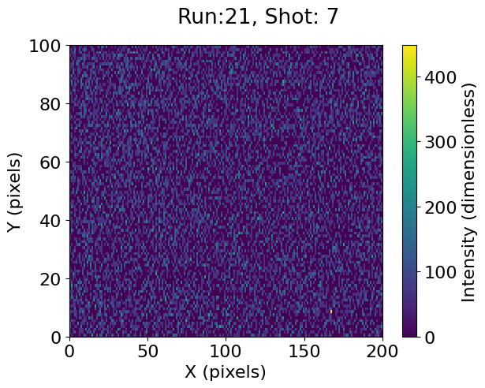

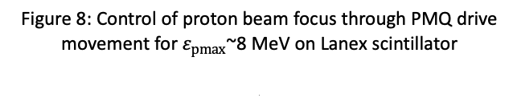


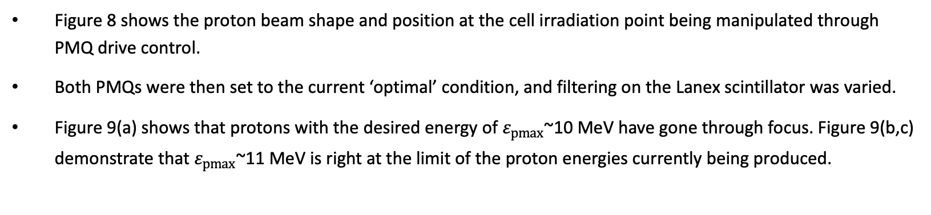

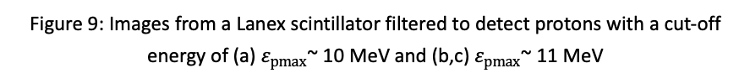
Control of Focused Proton Beam
(a)
(b)
(c)
$ε_{pmax}$~ 10 MeV
$ε_{pmax}$~ 11 MeV
$ε_{pmax}$~ 11 MeV
X THE UNIVERSITY OF STRATHCLYDE
$ε_{pmax}$~ 8 MeV
Figure 9: Images from a Lanex scintillator filtered to detect protons with a cut-off energy of (a) $ε_{pmax}$~ 10 MeV and (b,c) $ε_{pmax}$~ 11 MeV
Figure 8: Control of proton beam focus through PMQ drive movement for $ε_{pmax}$~8 MeV on Lanex scintillator
.
Figure 8 shows the proton beam shape and position at the cell irradiation point being manipulated through PMQ drive control.
Both PMQs were then set to the current ‘optimal’ condition, and filtering on the Lanex scintillator was varied.
Figure 9(a) shows that protons with the desired energy of $ε_{pmax}$~10 MeV have gone through focus. Figure 9(b,c) demonstrate that $ε_{pmax}$~11 MeV is right at the limit of the proton energies currently being produced.
9
Notes:
This is a CAD model of said experiment.
We plan to install a capture beamline to guide the proton source to a cell irradiation station
This will involve a permanent magnet quadrapole system as seen on left, and a cell irradiation end station which will sit at target normal in the TP line.
Very exciting application experiment for Bunker B

Slide 10
Update on Proposed Experiment Stages & Gateways
I. Design & Procurement
II. Assembly & Alignment
III. Source Characterisation:
16th – 28th June
IV. Radiobiology:
20th Oct – 7th Nov
Start of BP1 funding
Order of PMQ XYZ stage (5-7 week delivery)
Order of cell station vacuum parts (4 weeks delivery)
Manufacture of thin window [DONE]
Manufacture of Oxford cell station
(in progress)
Construction of the cell station (in progress)
Construction of updated TP beamline [DONE]
Definition of an offline alignment line [DONE]
Construction and offline alignment of PMQ setup [DONE]
Install of PMQ system in vacuum chamber [DONE]
Change of parabola
1/2 weeks of SCAPA beamtime
Laser Beamline alignment (0.5 days)
Source optimisation w/o PMQ (0.5 days)
PMQ transmission, activation and debris test (0.5 days)
Lanex/beam profiler measurement at end of beamline (1 day)
PMQ position optimisation (0.5 days)
RCF measurements through beamline (0.5 days)
Full cell assembly RCF measurement (0.5 days)
3 weeks of SCAPA beamtime
Laser Beamline alignment (0.5 days)
Final setup of Cell mount/rotation
Alterations to PMQ/target setup and PMQ linear stage issue.
Test change to setup based on previous experiment.
Source optimisation with PMQs (1 day)
Dosimetry and source stability measurements (2 days)
Cell irradiation (6.5 days) + regular dosimetry
X THE UNIVERSITY OF STRATHCLYDE
10
Notes:
This is a CAD model of said experiment.
We plan to install a capture beamline to guide the proton source to a cell irradiation station
This will involve a permanent magnet quadrapole system as seen on left, and a cell irradiation end station which will sit at target normal in the TP line.
Very exciting application experiment for Bunker B

Slide 11
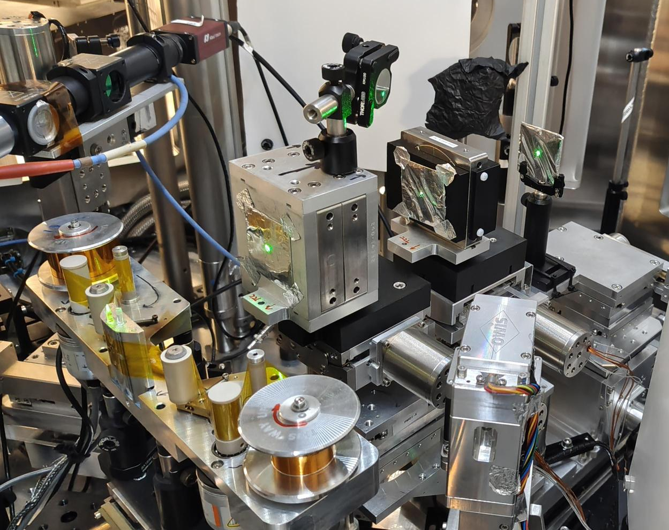
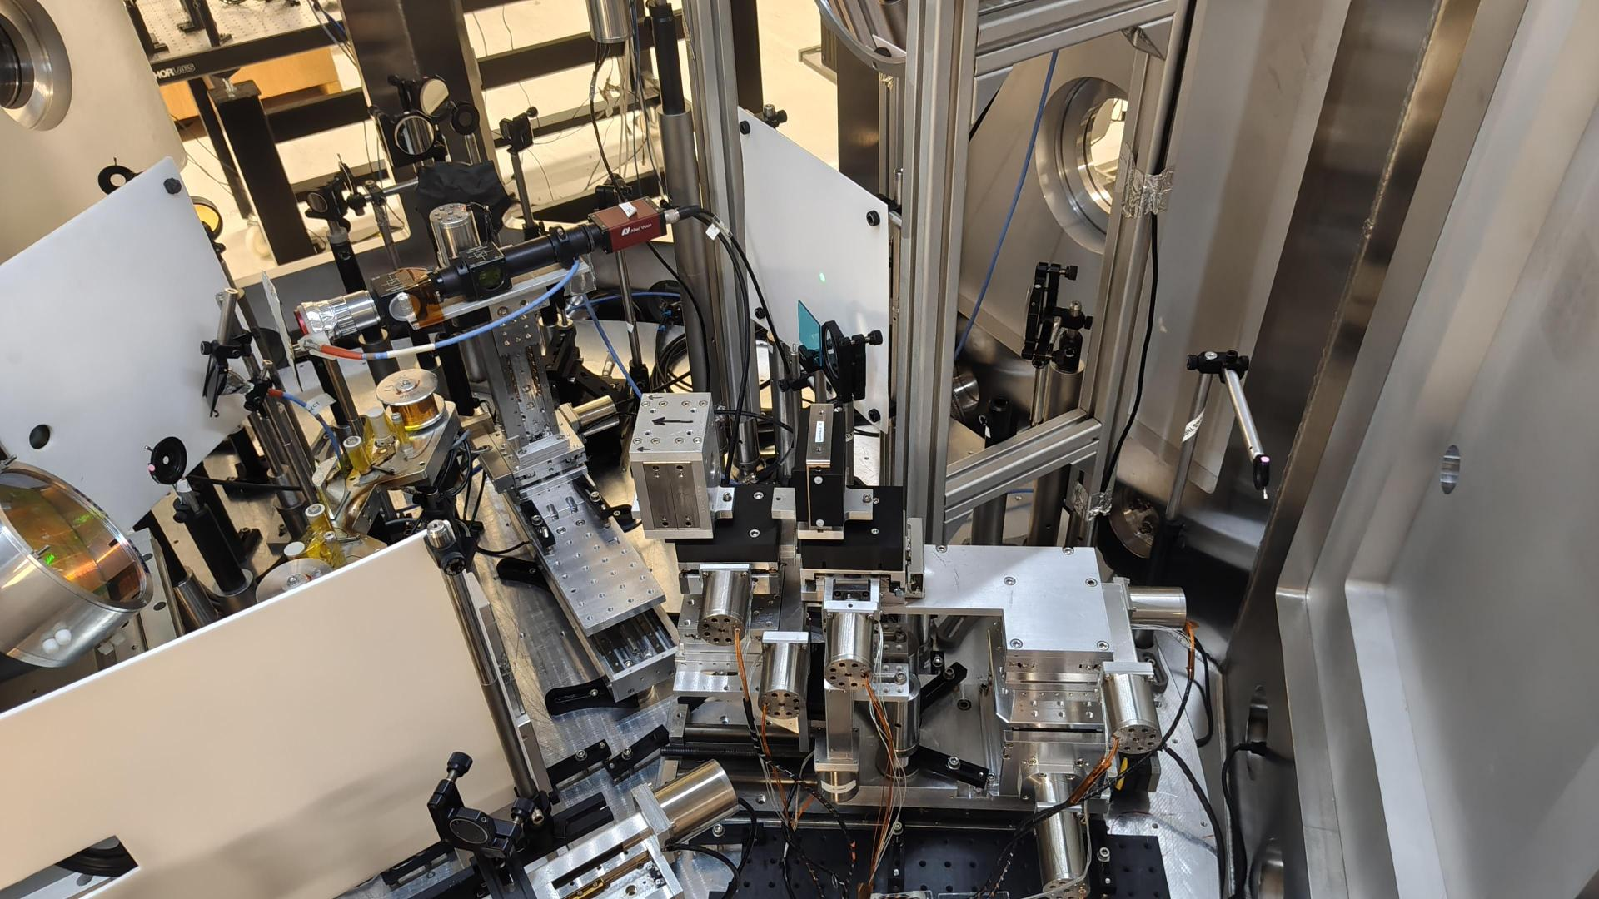
Required alterations identified after first PMQ beamtime
Based on quality of proton focus, we need to get the PMQs closer to target (currently limited to approx. 100 mm from target).
This is limited by i) our target vertical stage clashing with PMQ stages and ii) the PMQ1 mounting frame clashing with target mount.
Solutions have been identified for each but require significant effort.
X THE UNIVERSITY OF STRATHCLYDE
Identified an issue with the repeatability of the large linear stage that drives the PMQs IN/OUT.
A potential solution has been found, and two methods for confirming the drive is at the correct position, using reference wire imaging and confocal position sensor will be implemented.
11
Notes:
This is a CAD model of said experiment.
We plan to install a capture beamline to guide the proton source to a cell irradiation station
This will involve a permanent magnet quadrapole system as seen on left, and a cell irradiation end station which will sit at target normal in the TP line.
Very exciting application experiment for Bunker B

Slide 12
Key Next Steps
Roadmap to next beamtime (3 weeks in October )
Beamtime Aims: Improvement of PMQ focus, finally proton focus characterisation and first cell irradiation investigations.
i) Implement the required alterations to PMQ/target mounts to reduce distance between each.
X THE UNIVERSITY OF STRATHCLYDE
ii) Implement required alteration to PMQ large linear stage, add position referencing systems and test repeatability.
Aiming to complete before the start of October
iii) Final install and alignment of the cell rotation mount.
iv) Pre-calculation of the expected proton dose and discussion on irradiation shot plan with those involved.
12
Notes:
This is a CAD model of said experiment.
We plan to install a capture beamline to guide the proton source to a cell irradiation station
This will involve a permanent magnet quadrapole system as seen on left, and a cell irradiation end station which will sit at target normal in the TP line.
Very exciting application experiment for Bunker B

