Slide 1

Simulations for PoPLaR Phase 1
Presenter: Calvin Dyson
18th September 2025
LhARA 8th Collaboration Meeting,
Notes:
Welcome to the simulation of the LION beam with LLO
Calvin Dyson and work completed with

Slide 2
SCAPA Beamline
Vacuum
Air
RCF2
20mm
FQ (150T/m)
FQ (150 T/m)
RCF4
Mylar (50um)
RCF1
RCF3
20mm
40mm
20mm
110mm
100mm
120mm
420mm
LsrDrvn Source
705mm
40mm
20mm
Beamline End
Calvin Dyson - LhARA Collaboration Meeting
18/09/2025
2
18/09/2025

Slide 3
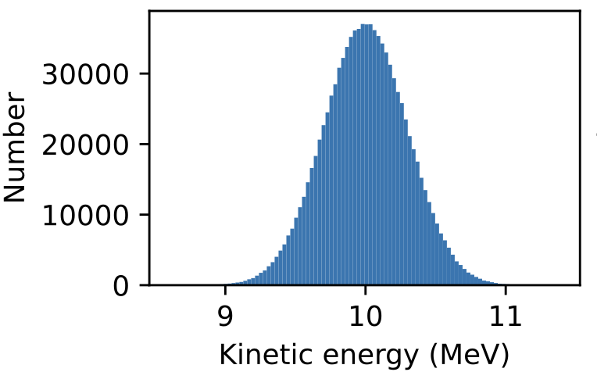
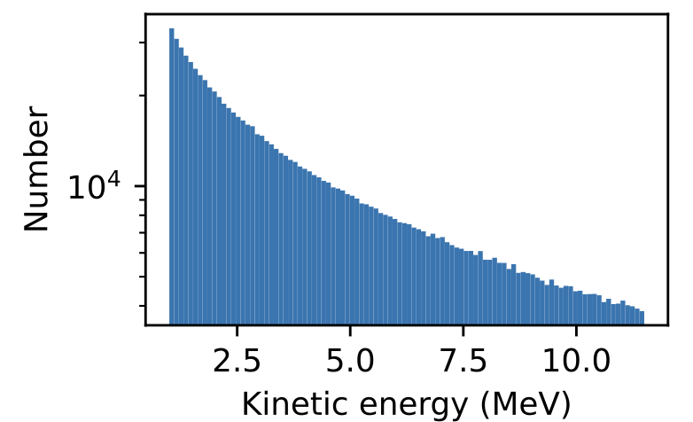
Simulation Model
Source Energy Spectra
Gaussian
Laser Driven
LhARA Collaboration Meeting
Calvin Dyson - LhARA Collaboration Meeting
3
18/09/2025
18/09/2025

Slide 4
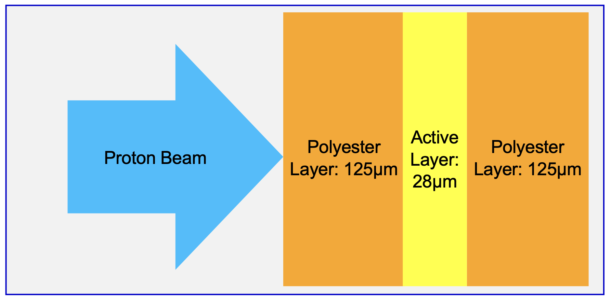
Simulation Model
RCF

Slide 5
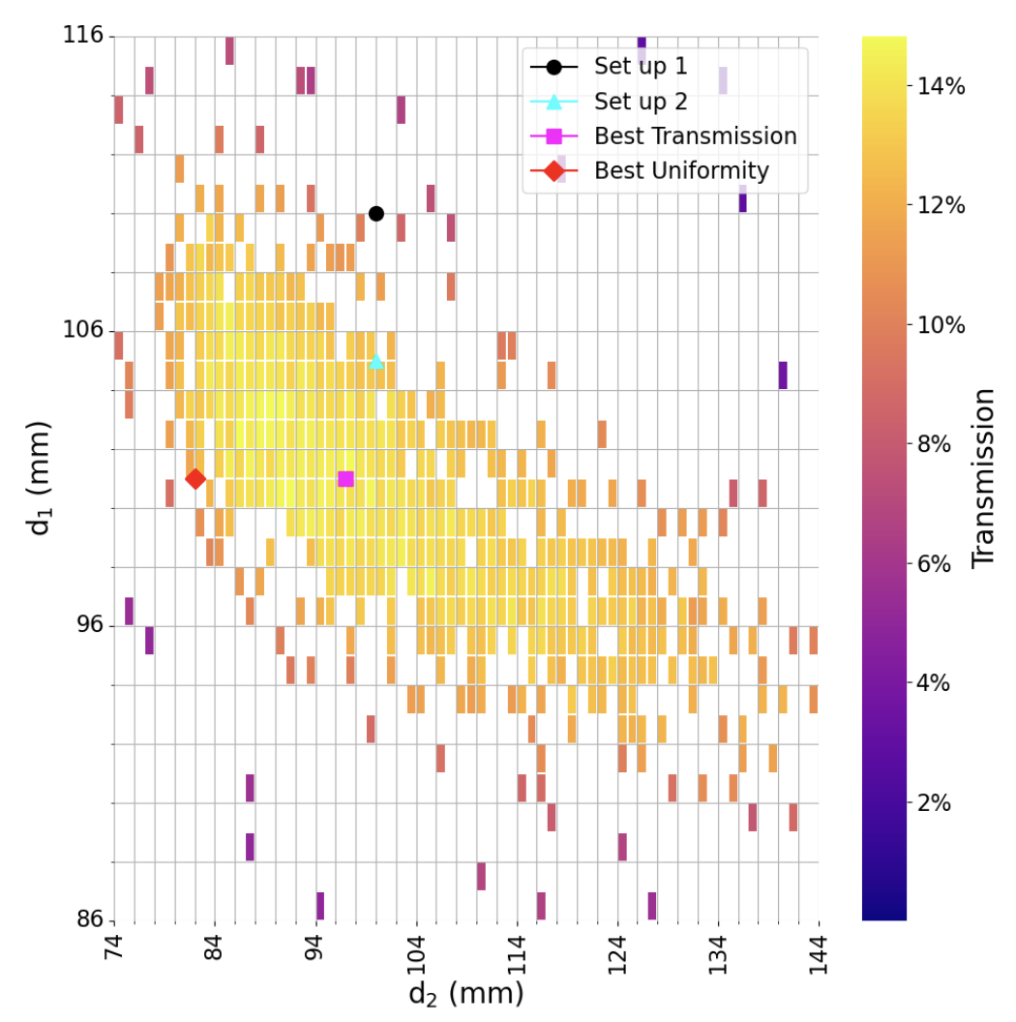
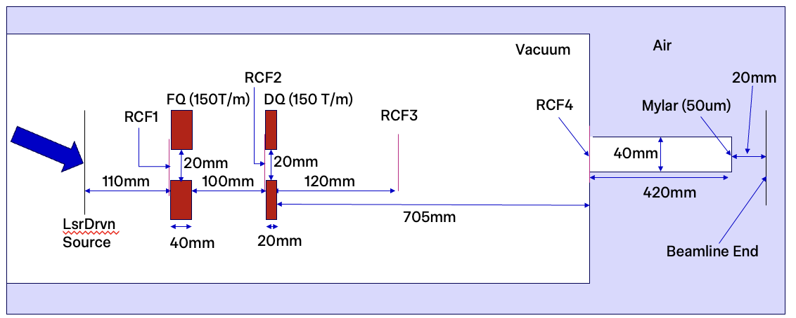
Pre-Phase 1
Optimising
PMQ Positions

Slide 6
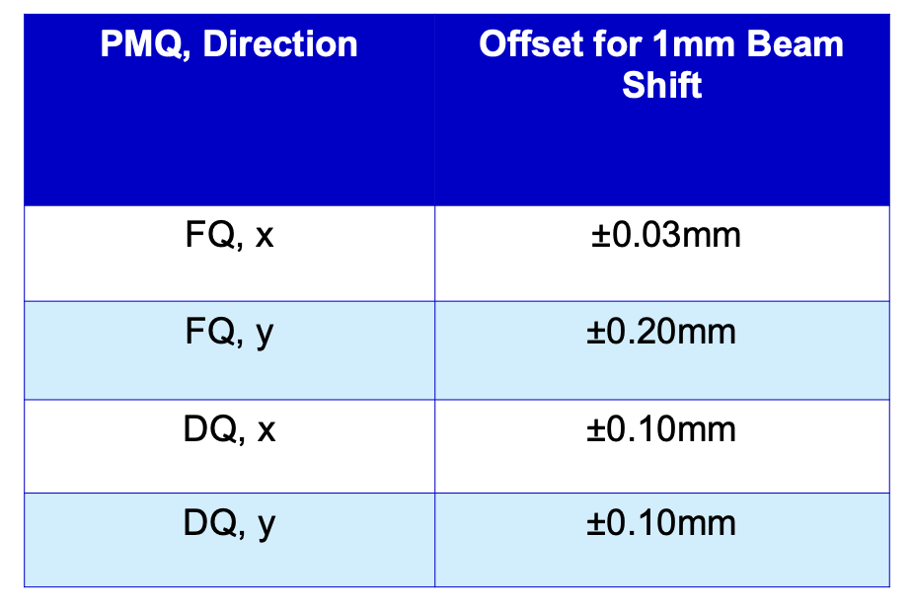
Pre-Phase 1
Sensitivity Testing

Slide 7
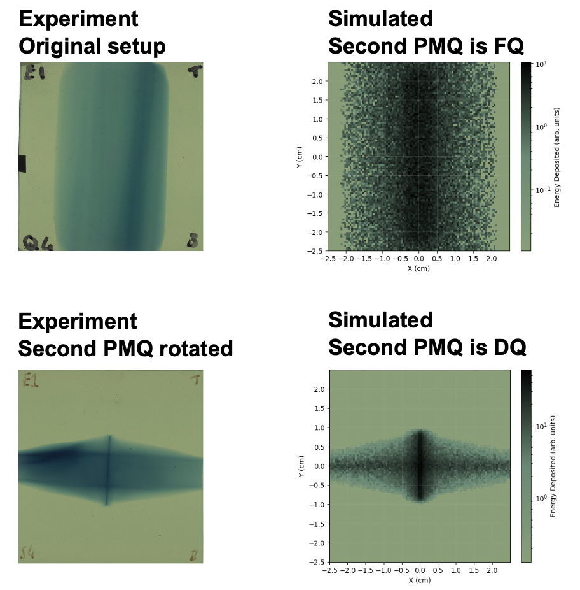
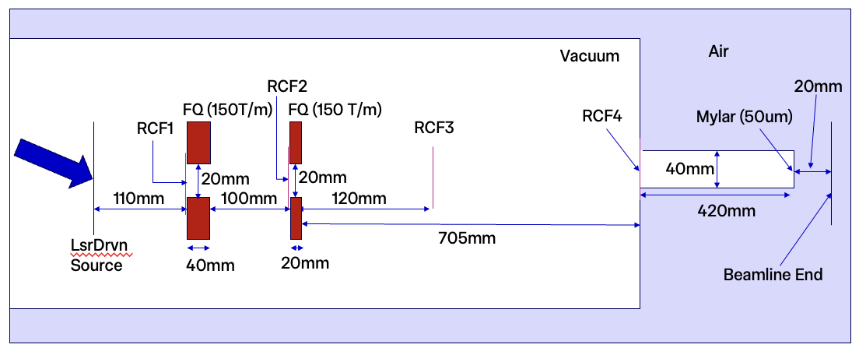
Phase 1
Quad Orientation

Slide 8
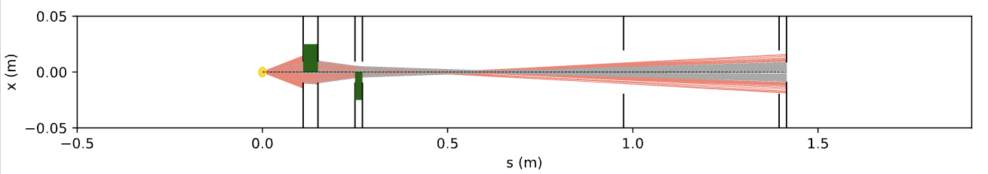
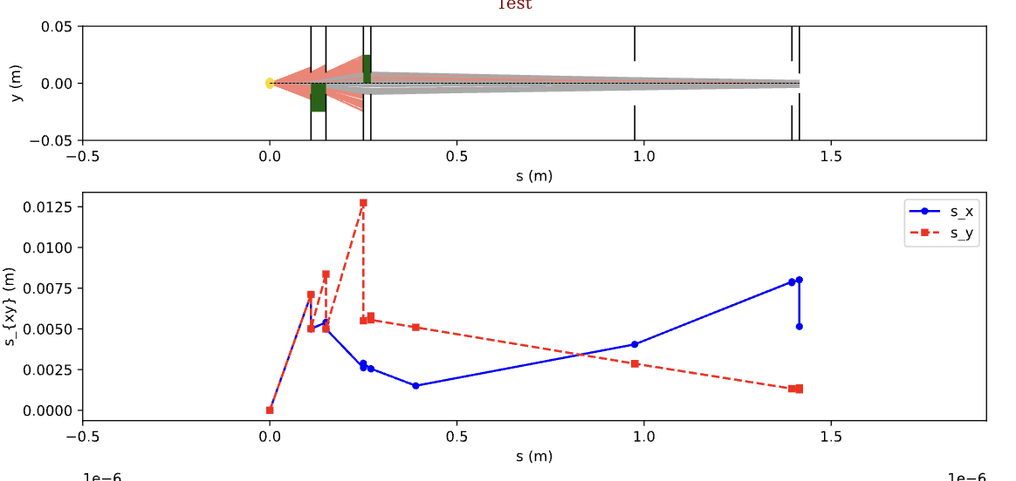
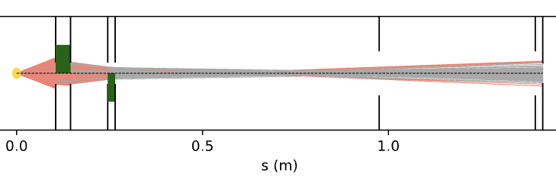
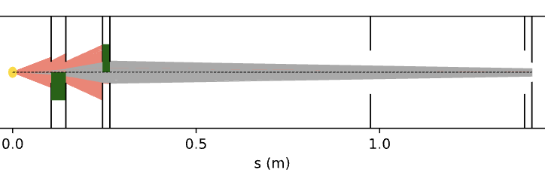
Phase 1
Set up 1
Quad Placement
Set up 2

Slide 9
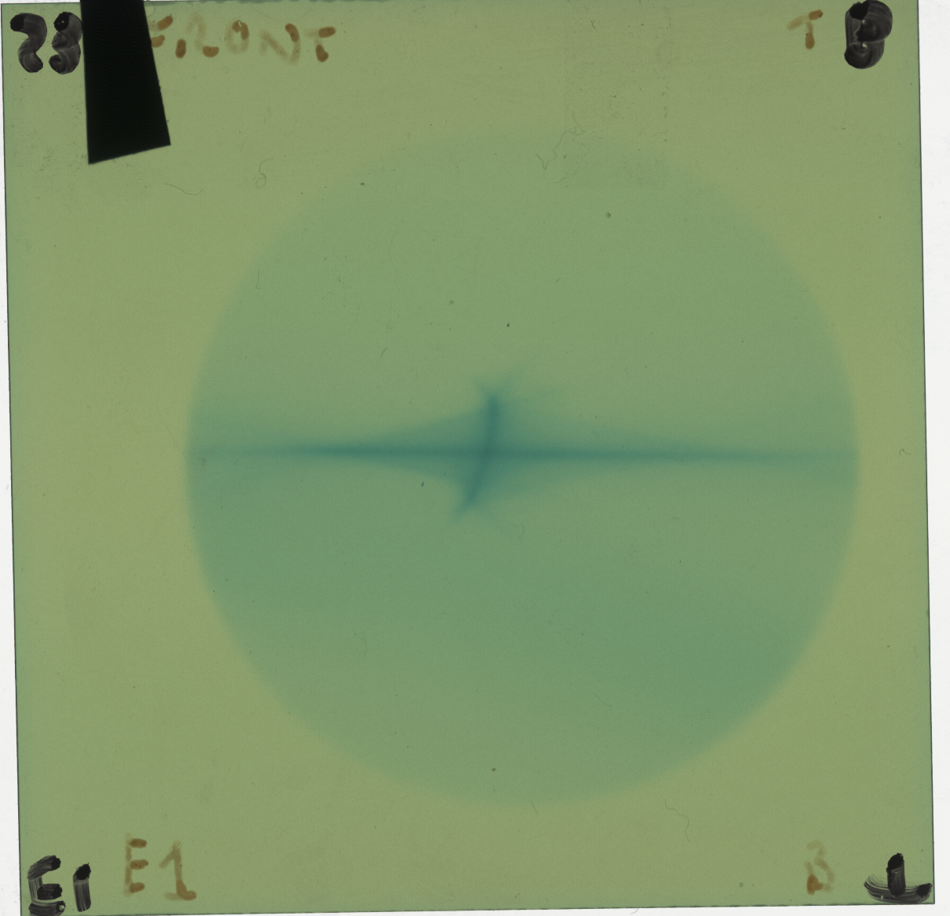
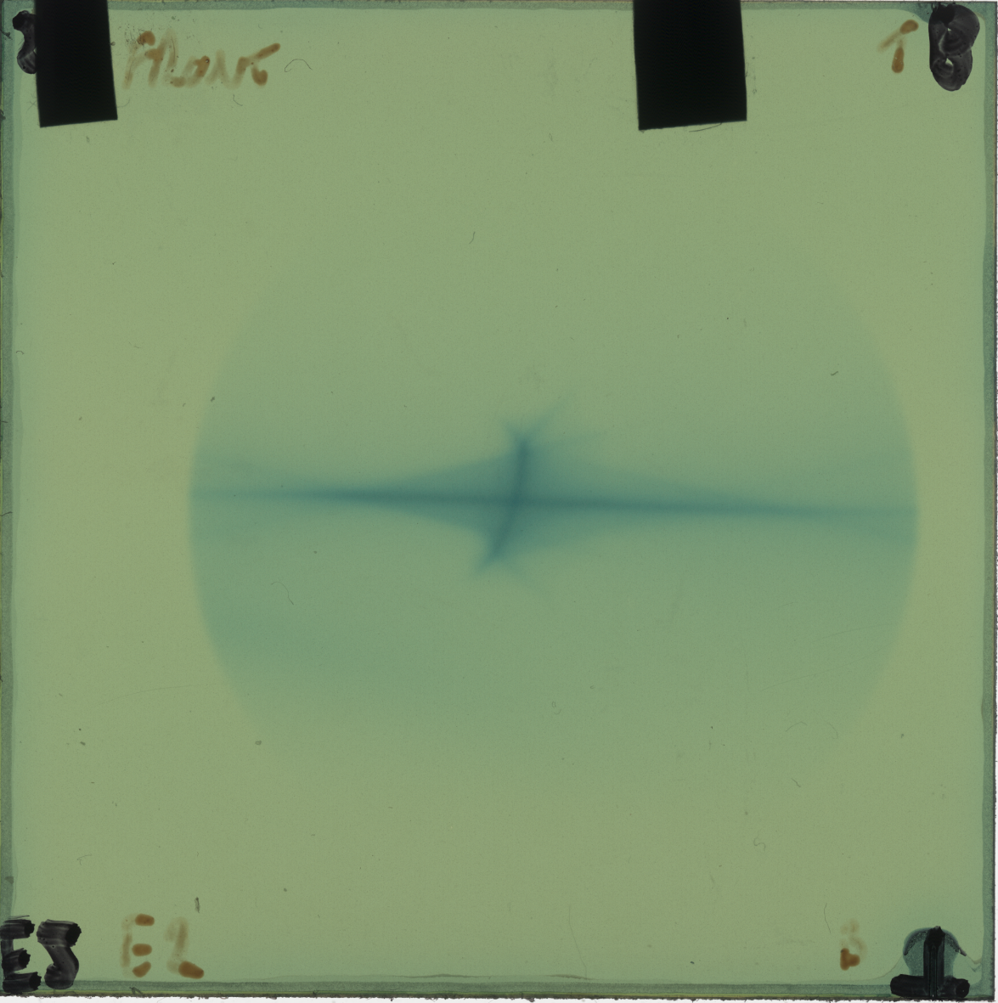
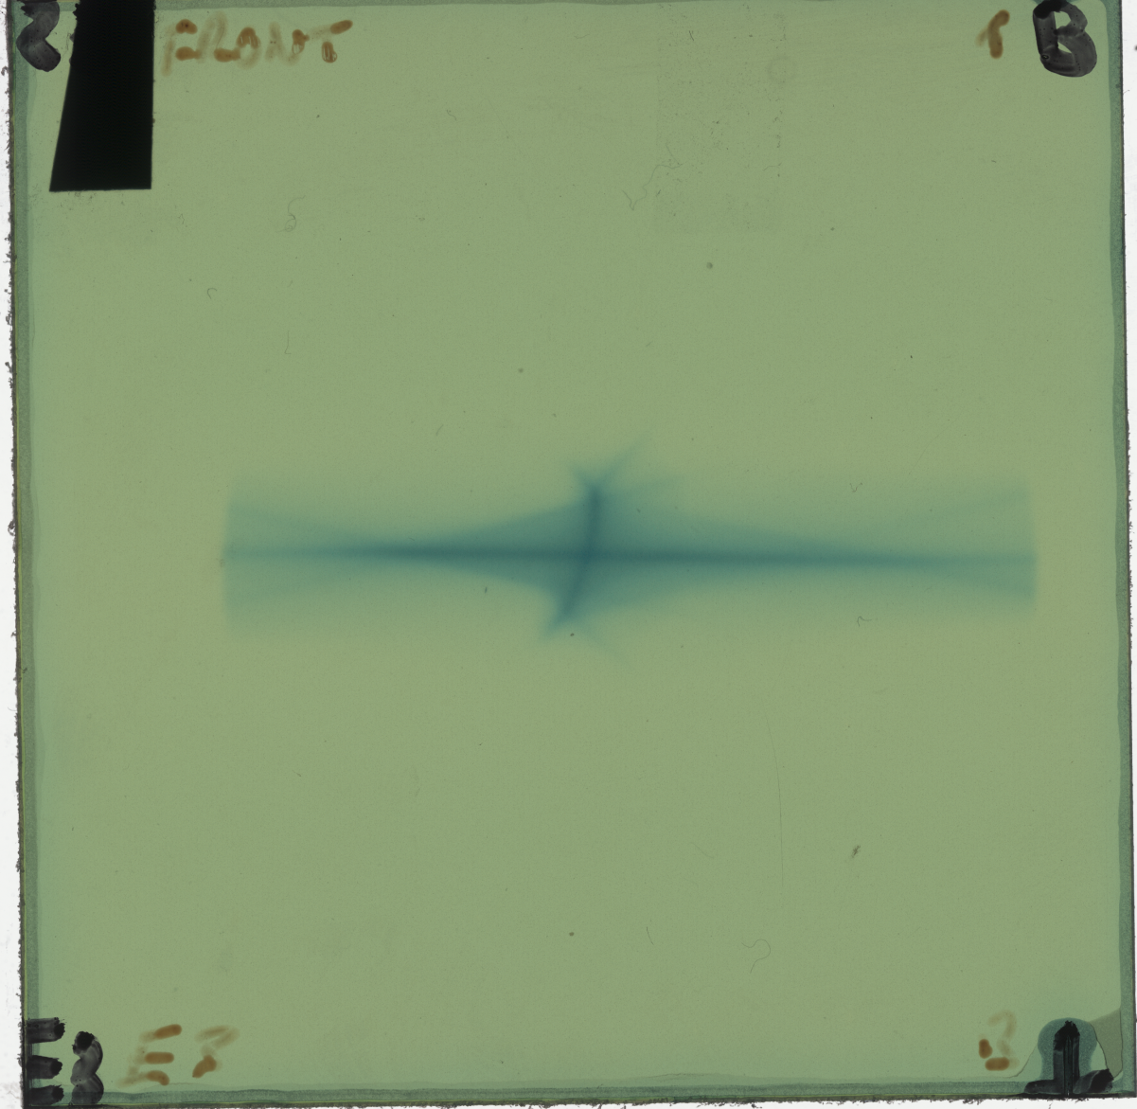
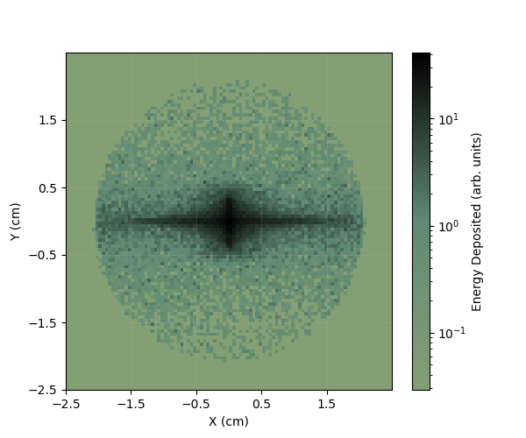
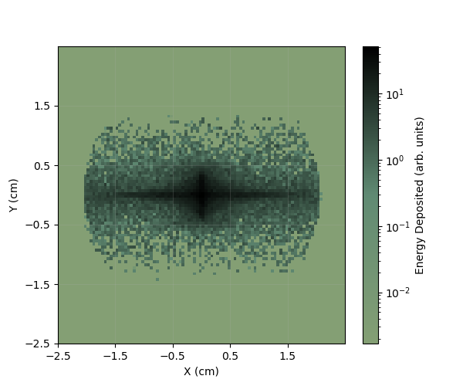
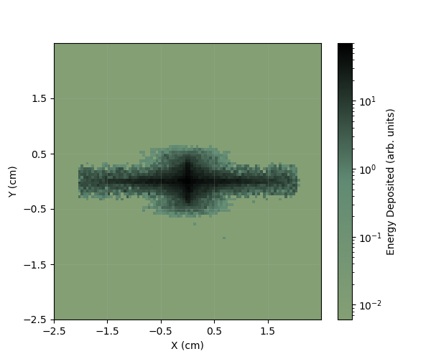
Phase 1
Comparison with Final RCF

Slide 10
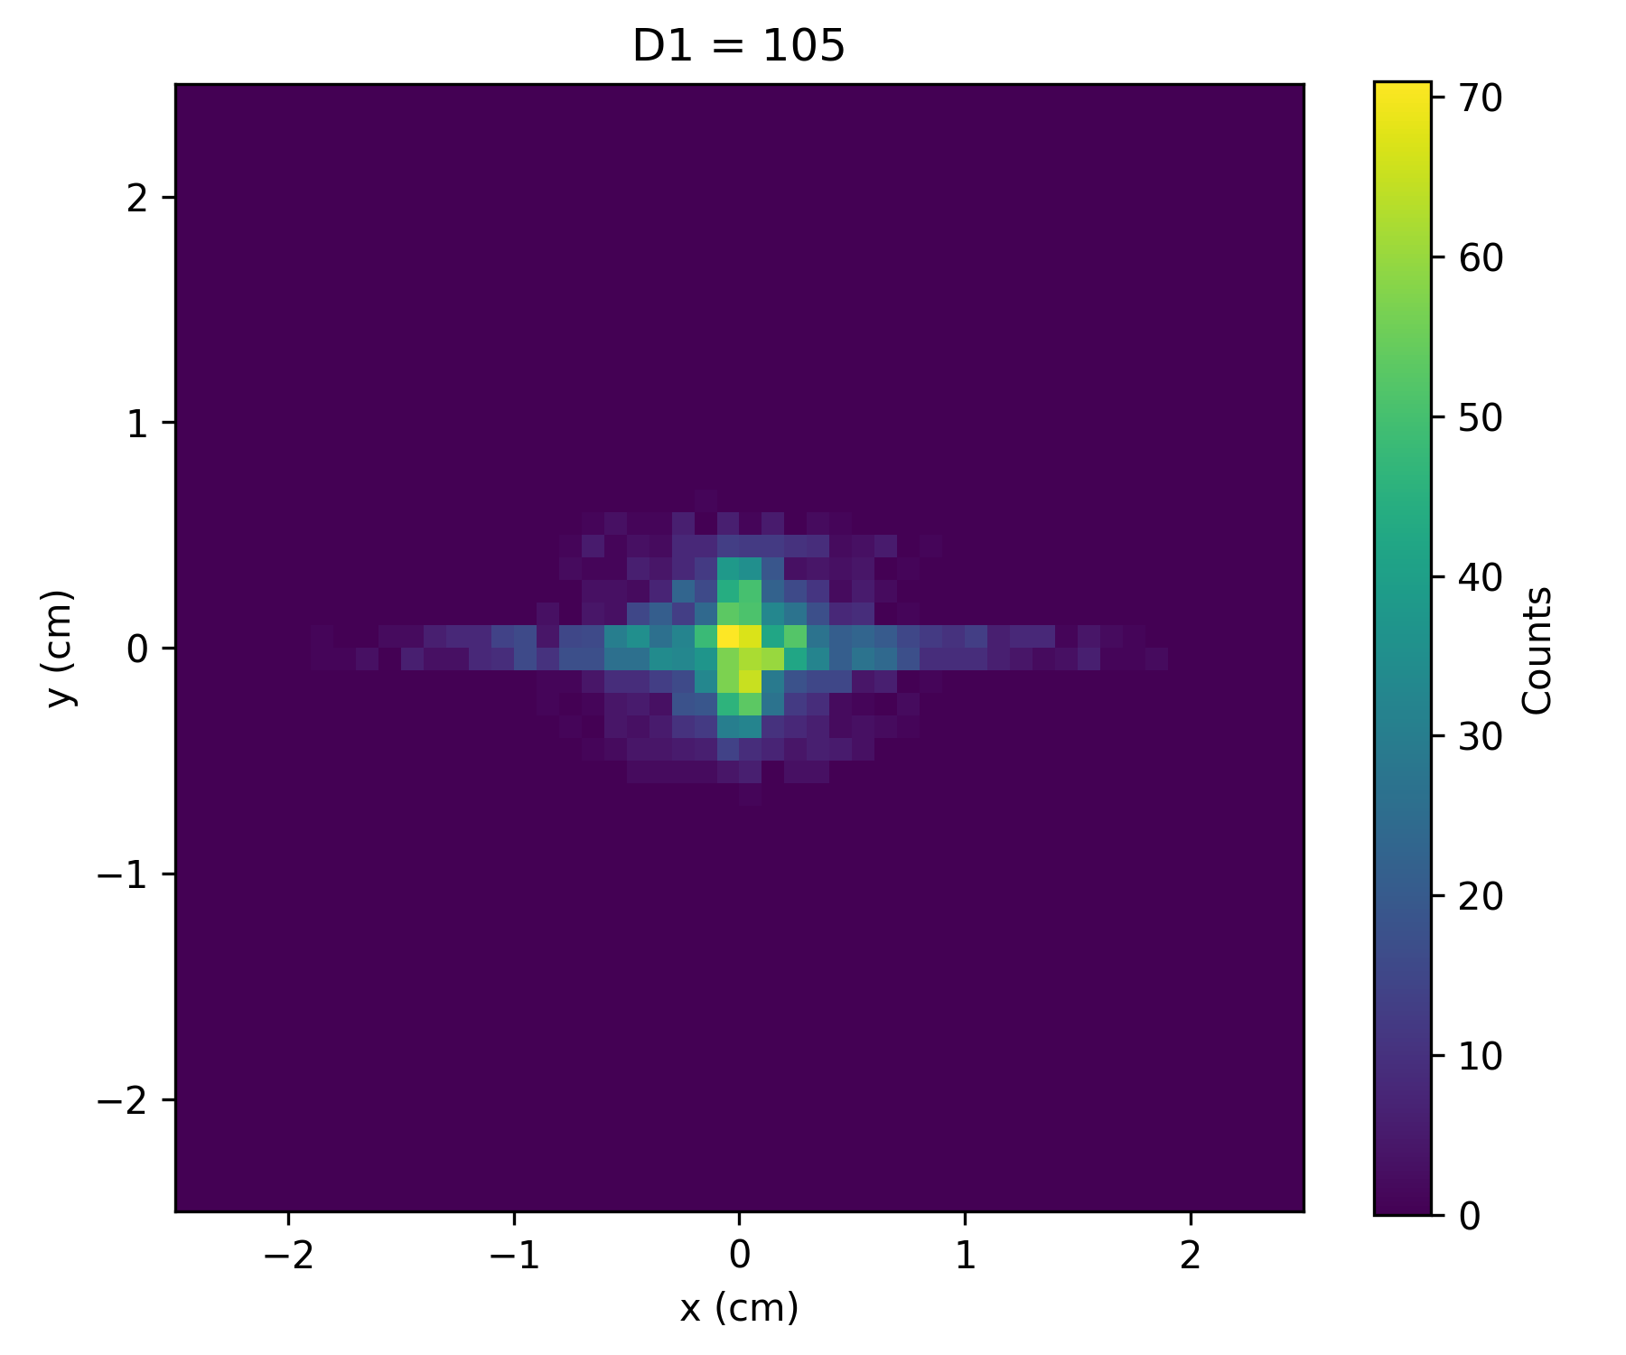
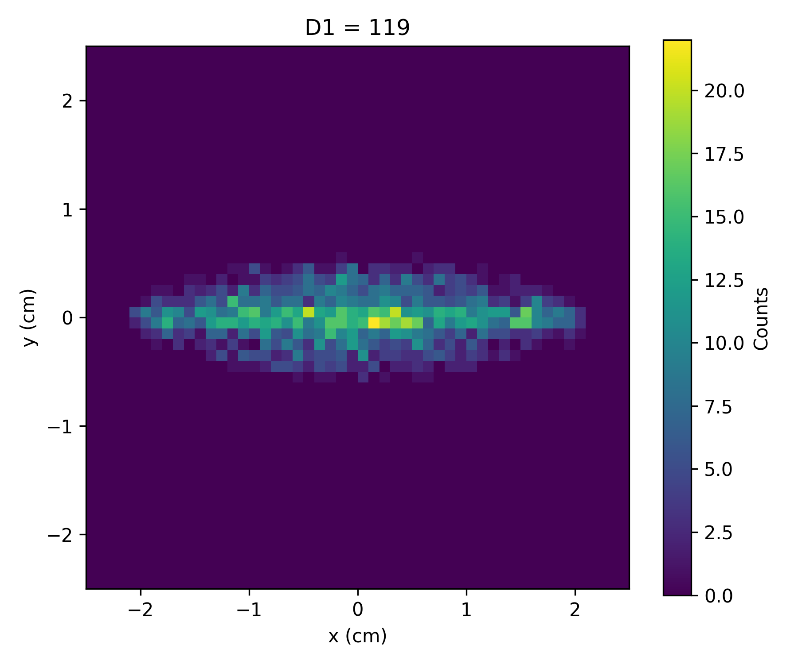
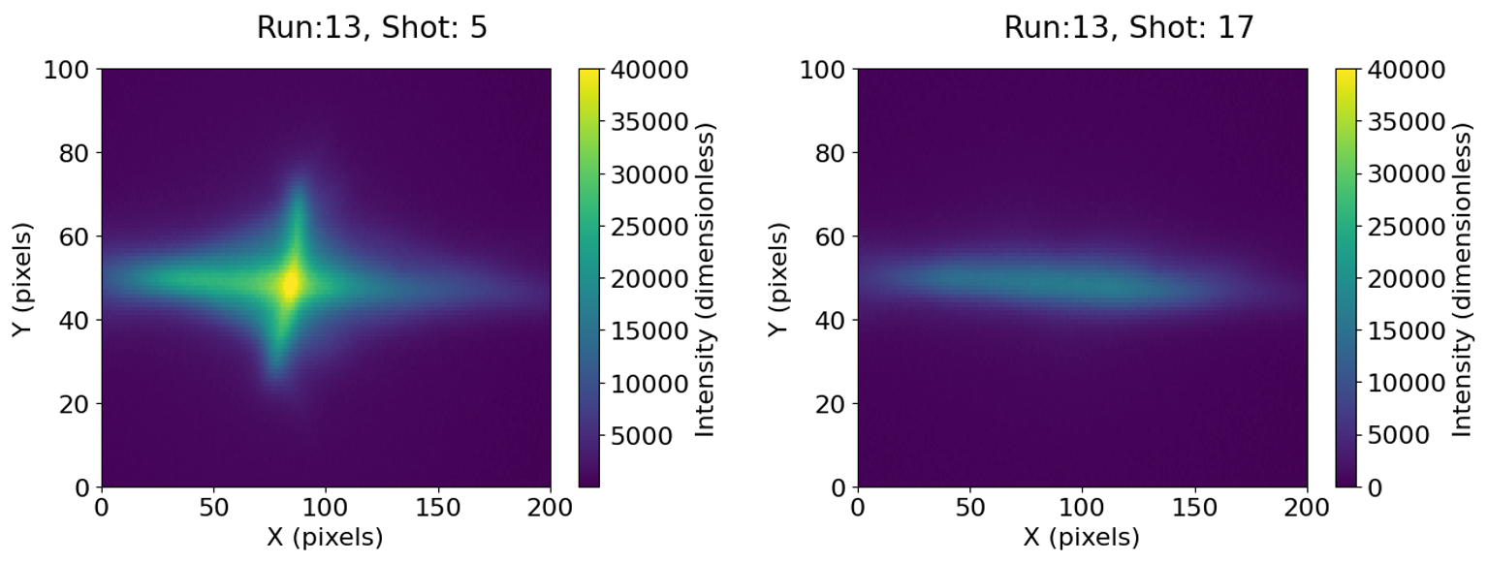
Phase 1
Comparison of Shift in Distance to First PMQ
~1cm

Slide 11
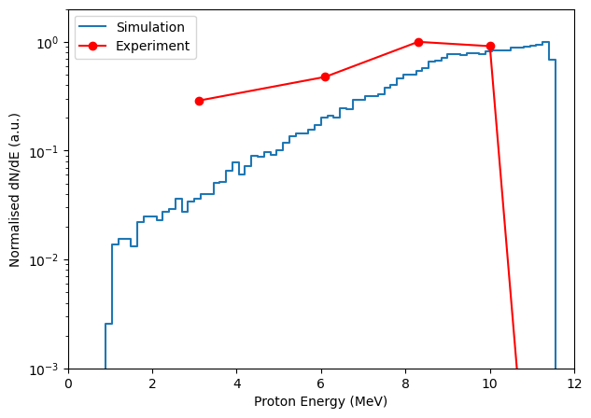
Phase 1
Comparison
to
Energy Spectrum
(Very Preliminary!!!)
~1cm

Slide 12
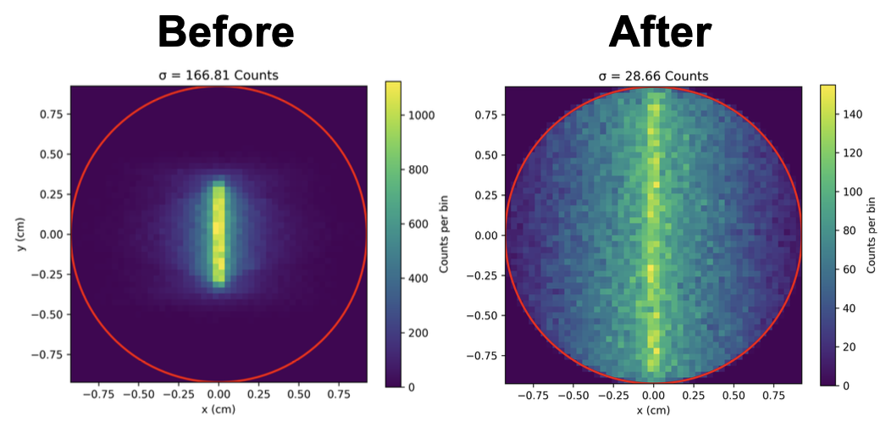
Post-Phase 1
Uniformity
~1cm

Slide 13
Conclusions and Future
10MeV Proton Delivery Achieved
Optimal PMQ positions found
Sensitivity of PMQs transverse position defined
Identified key problems in the beamline
Qualitative Consistency between Simulations and Experiment
Complete quantitative comparison
Improve angular dependence on energy at source
Indication of too few low energy particles at source…
Improve Beam Uniformity
Moving PMQ position improves uniformity
TOPAS simulations on the use of a scatterer
LhARA Collaboration Meeting
Calvin Dyson - LhARA Collaboration Meeting
13
07/04/2025
18/09/2025

Slide 14
Thank you
Simulations for PoPLaR
18/09/2025

Slide 15
Additional Slides
LhARA Collaboration Meeting
Calvin Dyson - LhARA Collaboration Meeting
15
18/09/2025

Slide 16
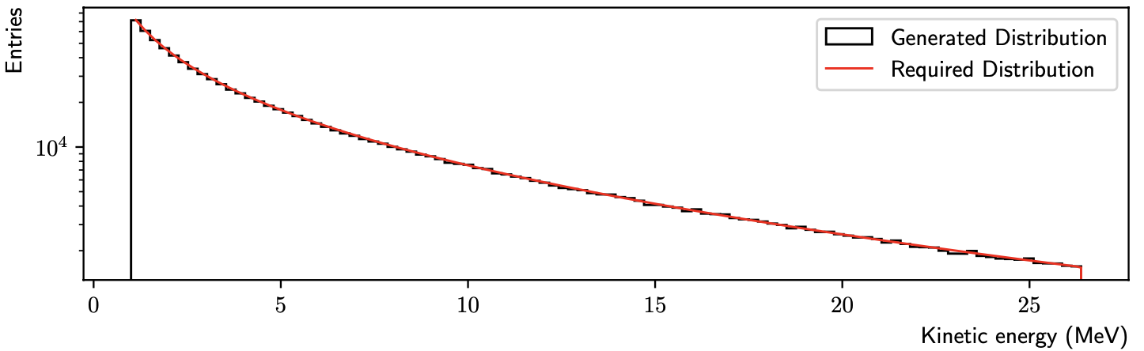
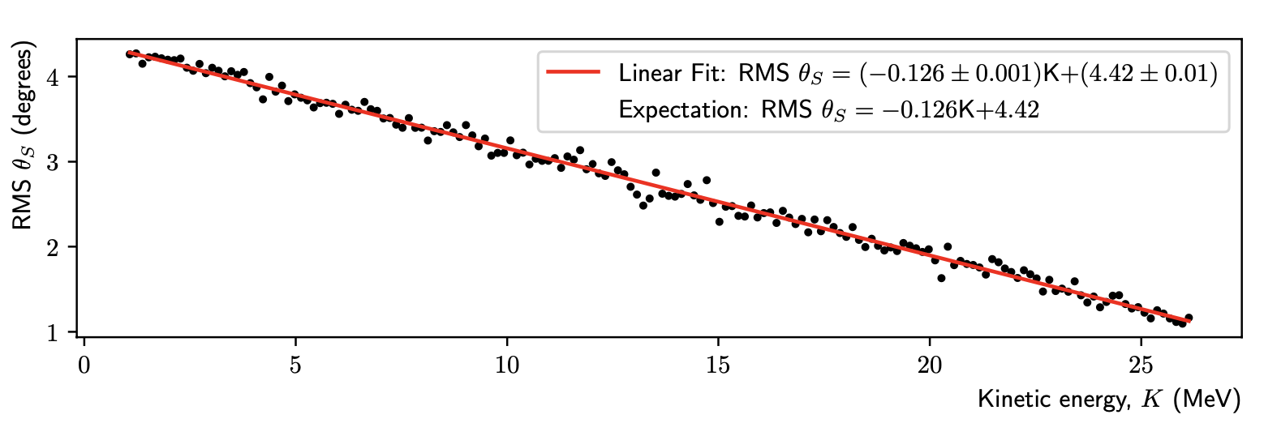
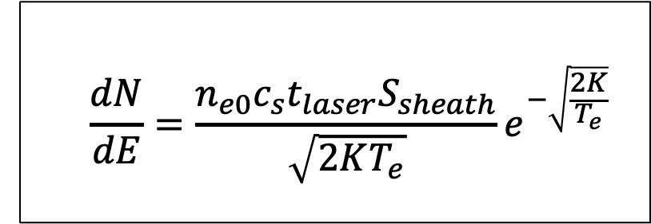
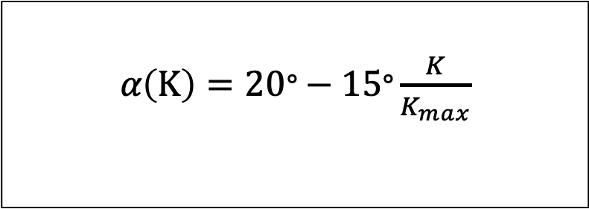
Simulation Model
Source
$$\frac{dN}{dE}=\frac{n_{e0}c_{s}t_{laser}S_{sheath}}{\sqrt{2KT_{e}}}e^{−\sqrt{\frac{2K}{T_{e}}}}$$
𝛼$\left(K\right)=20\text{°}−15\text{°}\frac{K}{K_{max}}$
N. Dover et al., “LhARA linear optics documentation,” 2024.
LhARA Collaboration Meeting
Calvin Dyson - LhARA Collaboration Meeting
16
18/09/2025
18/09/2025
Notes:
Typical TNSA energy spectrum looks like so with a rapid decrease with energy and then a cut-off at a max kinetic energy
The slope is given by this equation here, which is using a time-limited fluid-dynamical model
And the cut-off is given by considering laser pulse duration and other factors
Then uses inverse transform sampling to obtain the random energies in the spectra
This model requires the calculation of the electron temperature and that equation is given here
Symbols:
n_e0 – hot electron density
c_s – ion-acoustic velocity
t_laser – laser pulse duration
S_sheath – electron acceleration area
T_e – electron temp

