Slide 1

Simulation of LION Beam
Presenter: Calvin Dyson
Work in collaboration with Alfredo Fernadez Rodriguez and Xiangyi Chen
18th Septmeber 2025
LhARA 8th Collaboration Meeting
Notes:
Welcome to the simulation of the LION beam with LLO
Calvin Dyson and work completed with

Slide 2
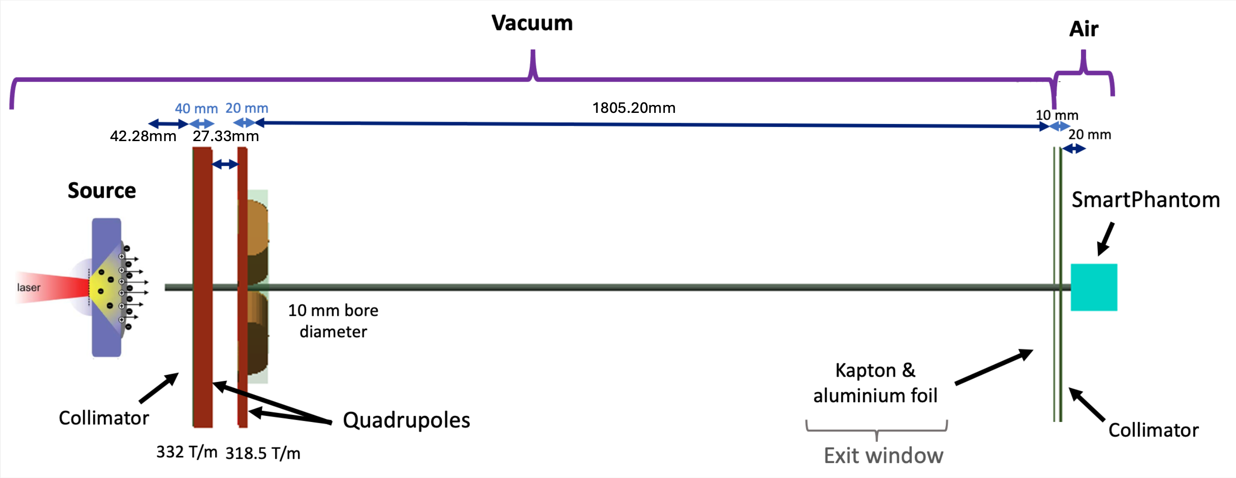
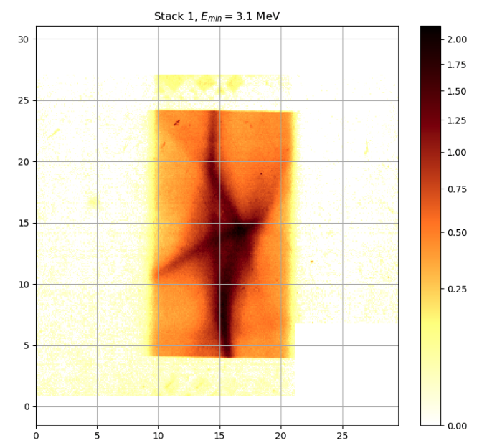
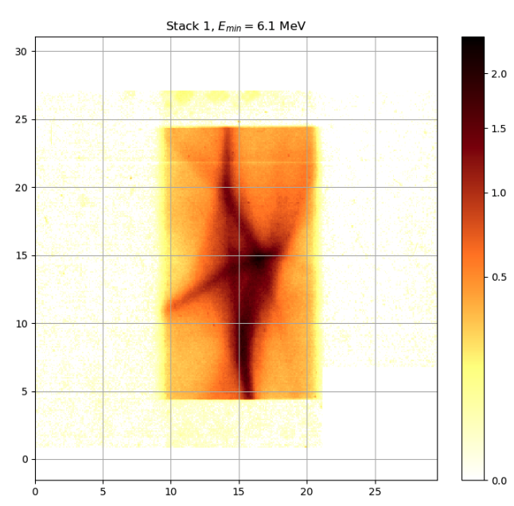
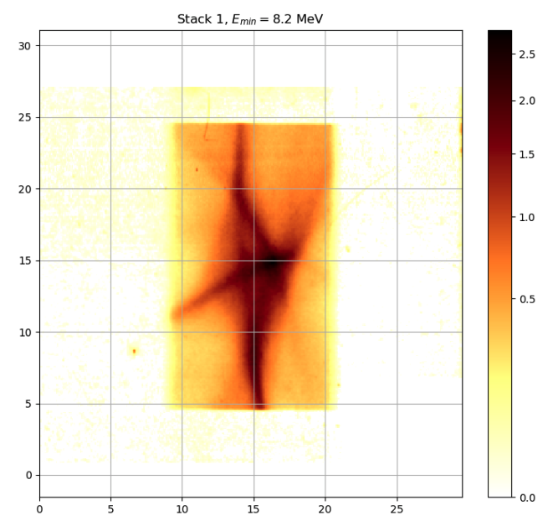
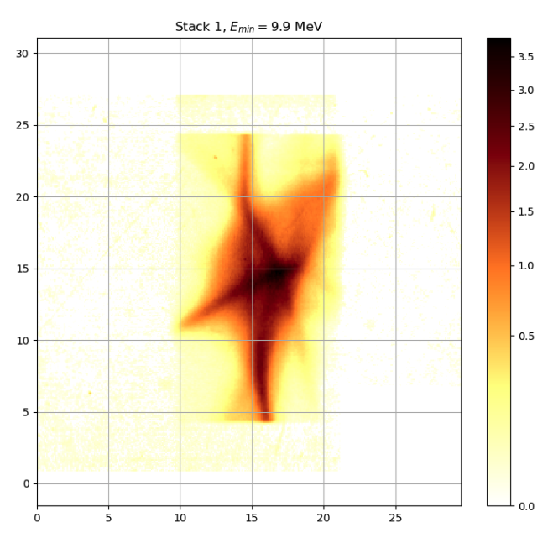
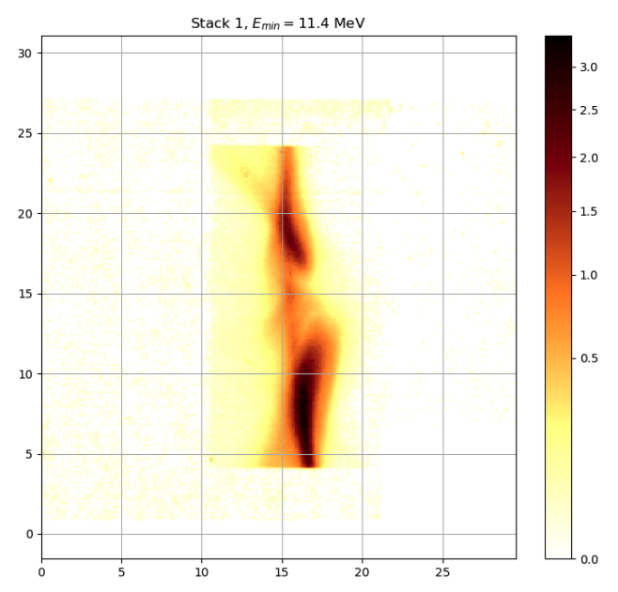
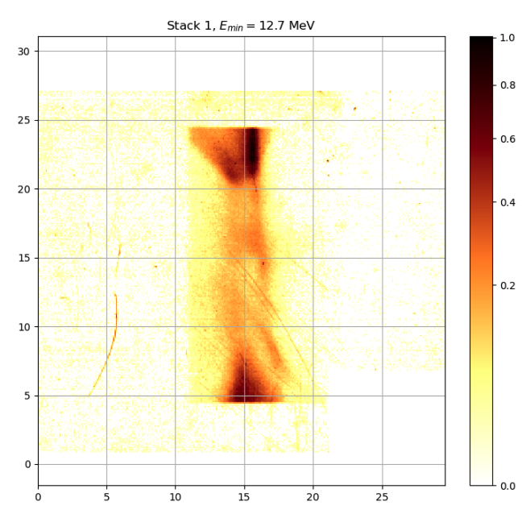
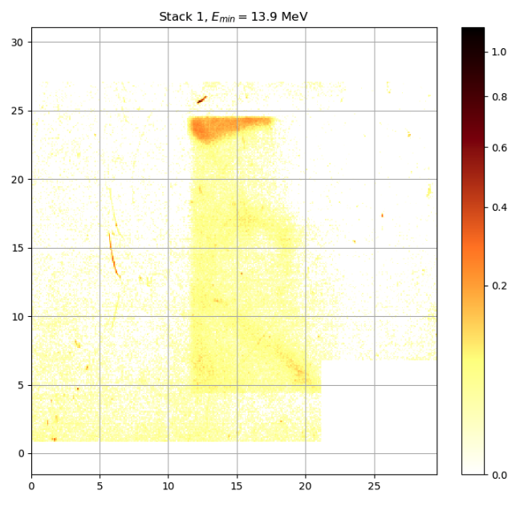







LION Beamline
1775.20mm
46.94mm
32.33mm
32.33mm
RCF Stacks
${\text{E}}_{\text{min}} \text{=} \text{3.1 }\text{MeV}$
${\text{E}}_{\text{min}} \text{=}\text{ 6}\text{.1 }\text{MeV}$
${\text{E}}_{\text{min}} \text{=}\text{ 8.2} \text{MeV}$
${\text{E}}_{\text{min}} \text{=}\text{ 9.9} \text{MeV}$
${\text{E}}_{\text{min}} \text{=}\text{ 11.4} \text{MeV}$
${\text{E}}_{\text{min}} \text{=} \text{12.7 }\text{MeV}$
${\text{E}}_{\text{min}} \text{=}\text{ 13.9} \text{MeV}$
LhARA Collaboration Meeting
Calvin Dyson - LhARA Collaboration Meeting
2

Slide 3
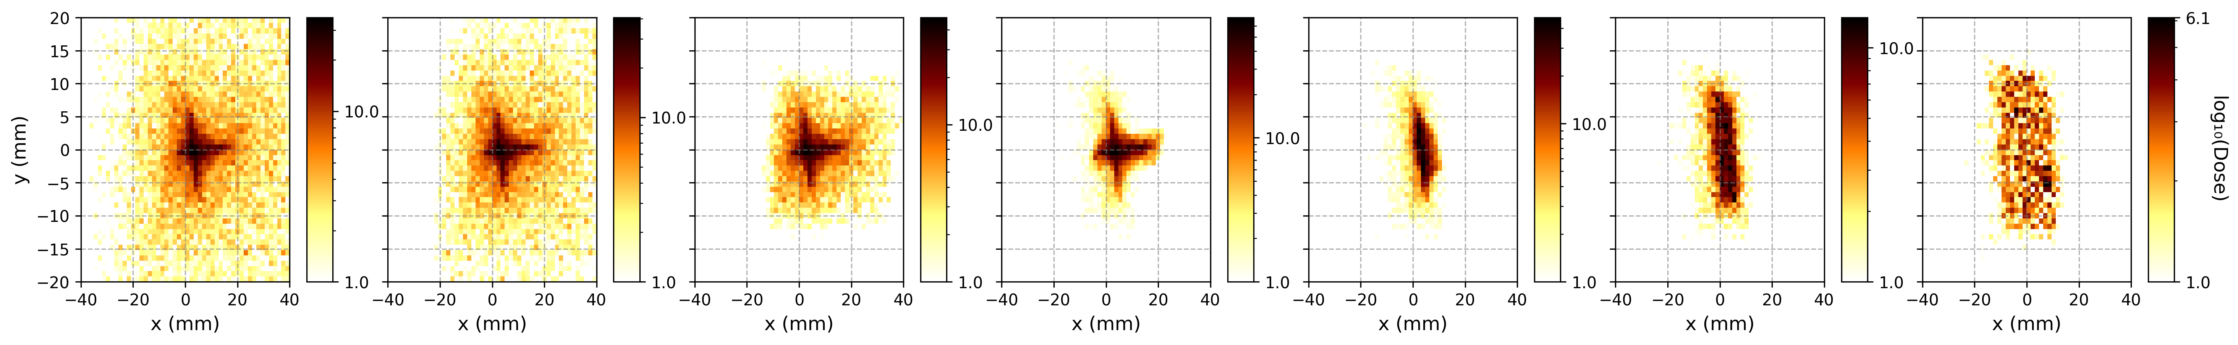







Focusing and Defocusing Quadrupole Combination Tilt
FQ: x = +0.1mm, $α$ = +0.004 rad, $β$ = 0.004 rad, $γ$ = -0.003 rad;
DQ: x = +0.1mm, $α$ = -0.004 rad,$β$ = 0.004 rad, $γ$ = -0.003 rad
Simulation of 1x10⁵ particles
Energy deposited (MeV)
Log(energy deposited (MeV))
${\text{E}}_{\text{min}} \text{=} \text{3.1 }\text{MeV}$
${\text{E}}_{\text{min}} \text{=}\text{ 6}\text{.1 }\text{MeV}$
${\text{E}}_{\text{min}} \text{=}\text{8.2} \text{MeV}$
${\text{E}}_{\text{min}} \text{=}\text{ 9.9} \text{MeV}$
${\text{E}}_{\text{min}} \text{=}\text{ 11.4} \text{MeV}$
${\text{E}}_{\text{min}} \text{=} \text{12.7 }\text{MeV}$
${\text{E}}_{\text{min}} \text{=}\text{ 13.9} \text{MeV}$
Key Observations:
Vertical central line visible
Vertical, curved section of star-shaped arm can be seen in the simulation
LhARA Collaboration Meeting
Calvin Dyson - LhARA Collaboration Meeting
3
Notes:
Finally after searching many different orientations and combinations, this combination appeared to recreate the RCF stack profile the best
Get the almost vertical line down the centre
Slight curve or bulge on the left
And conversion to rectangular shape for higher energies
To take this further we are considering employing Bayseian optimisation to search the parameter space more effectively
It is worth noting that these shifts and tilts are generally within the machine precision expected
Though it should be noted that these quads at a strength of 332T/m and 318.5T/m are much stronger than the ones employed at SCAPA

Slide 4
Plan for Bayesian Optimisation
Adapt the code used to optimise PMQ positions for PoPLaR
Use Normalised Cross Correlation as the optimisation metric
Process the RCF so that it is suitable for optimisation
Expand the setup to include all four windows

Slide 5
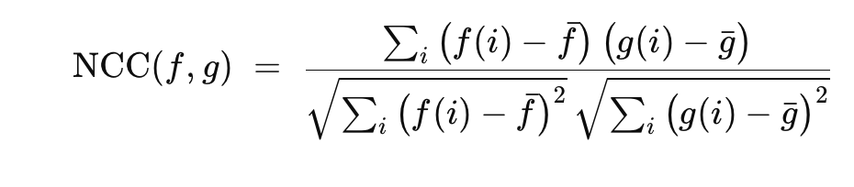
Normalised Cross Correlation (NCC)
Features
Range of -1 to 1:
• 1: Exact Match
• -1: Exact Opposite
Scale Invariant

Slide 6
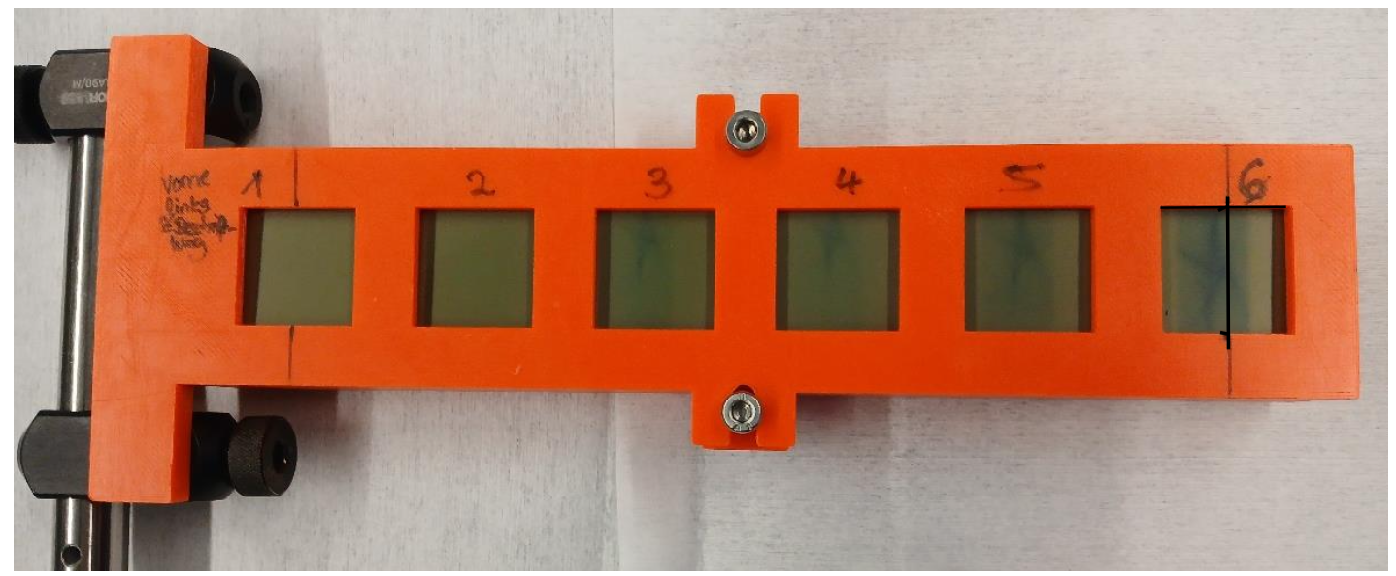
Expand to 4 windows
RCF in Scan
RCF in Holder
20MeV
20MeV
16MeV
12MeV

Slide 7
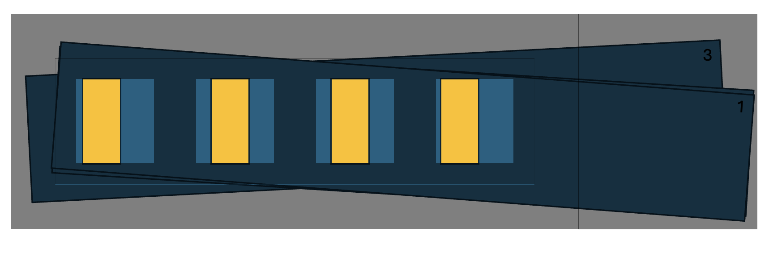
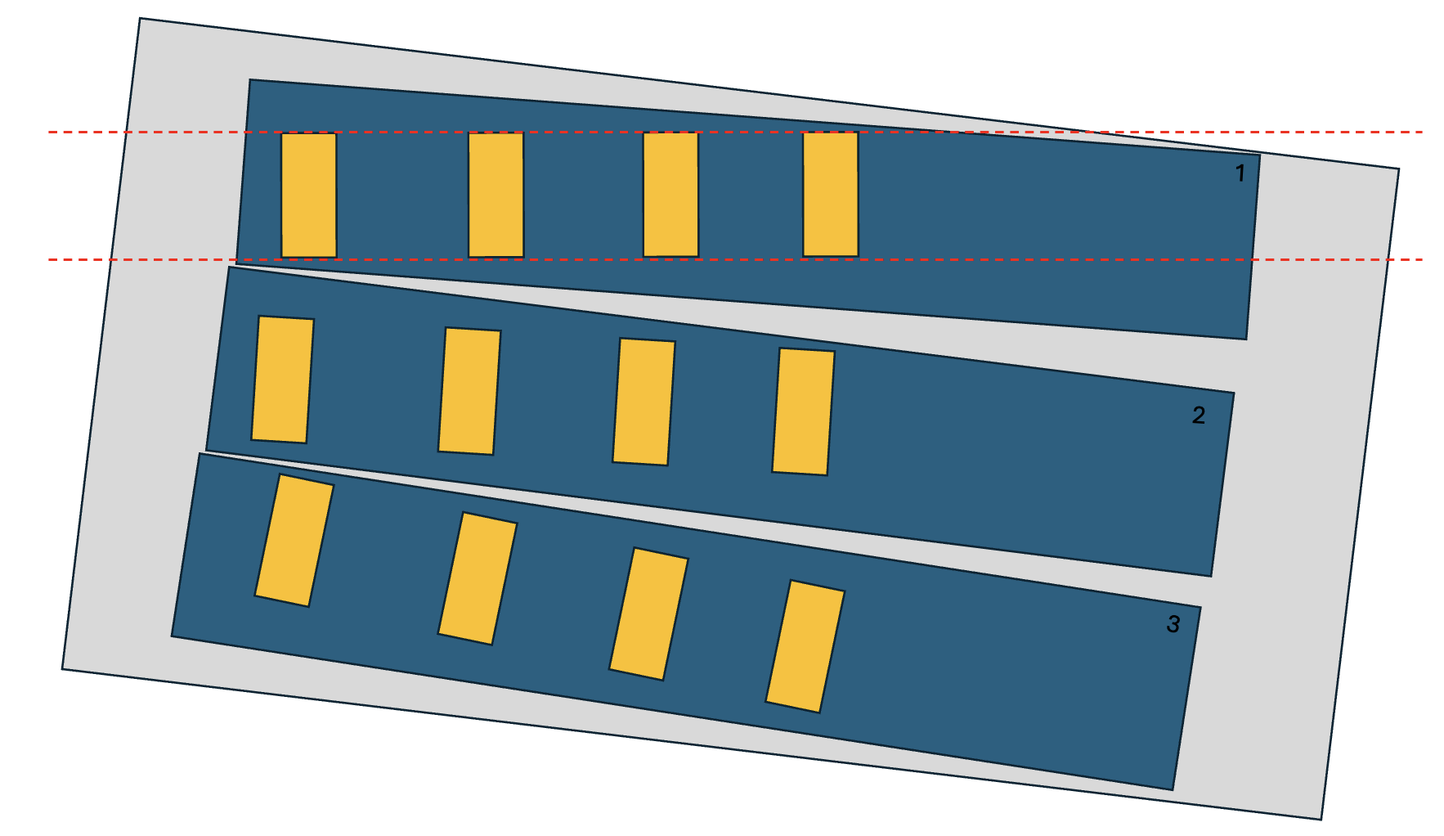
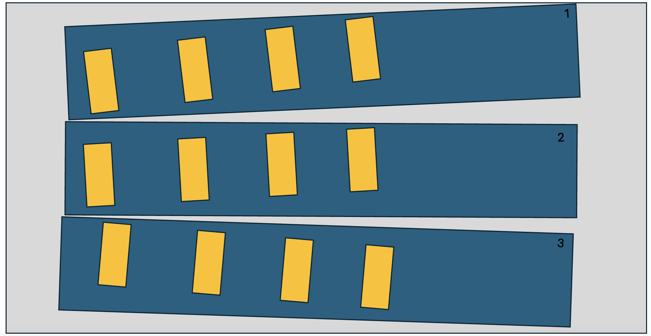
Correct for displacement of RCF
Vertical and Rotational alignment
Aligning the RCF to Windows of Holder
RCF in Holder
RCF in Scan

Slide 8
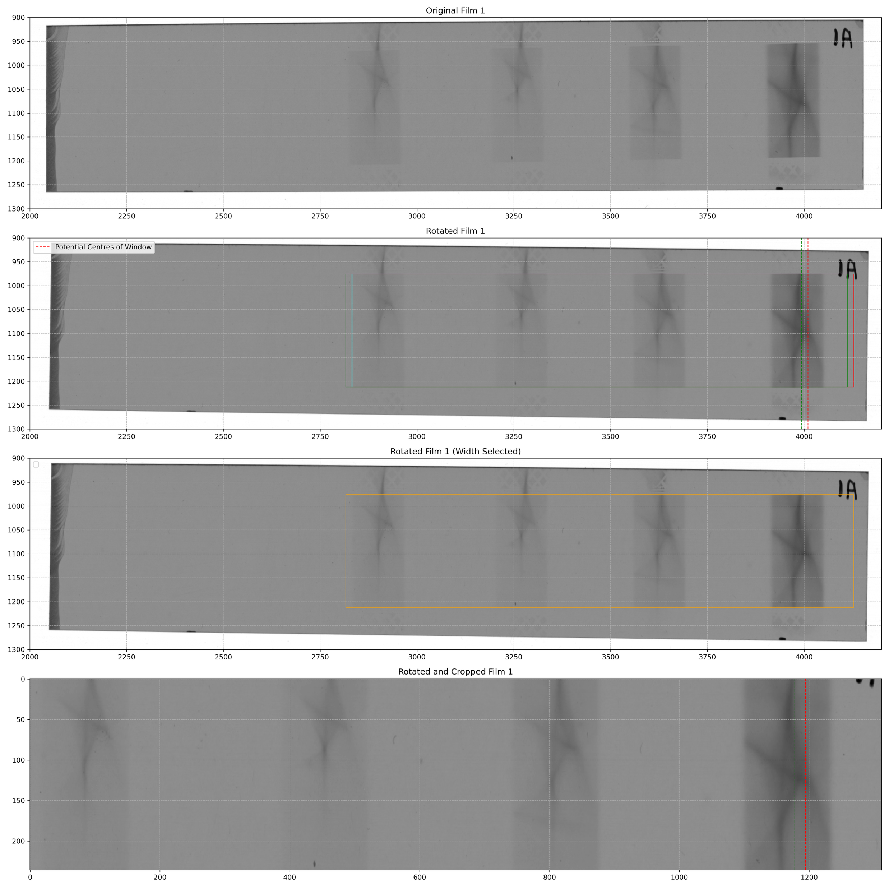
Correct displacement of RCF
Alignment and Cutting of Front Film
Horizontal Alignment – Front Film

Slide 9
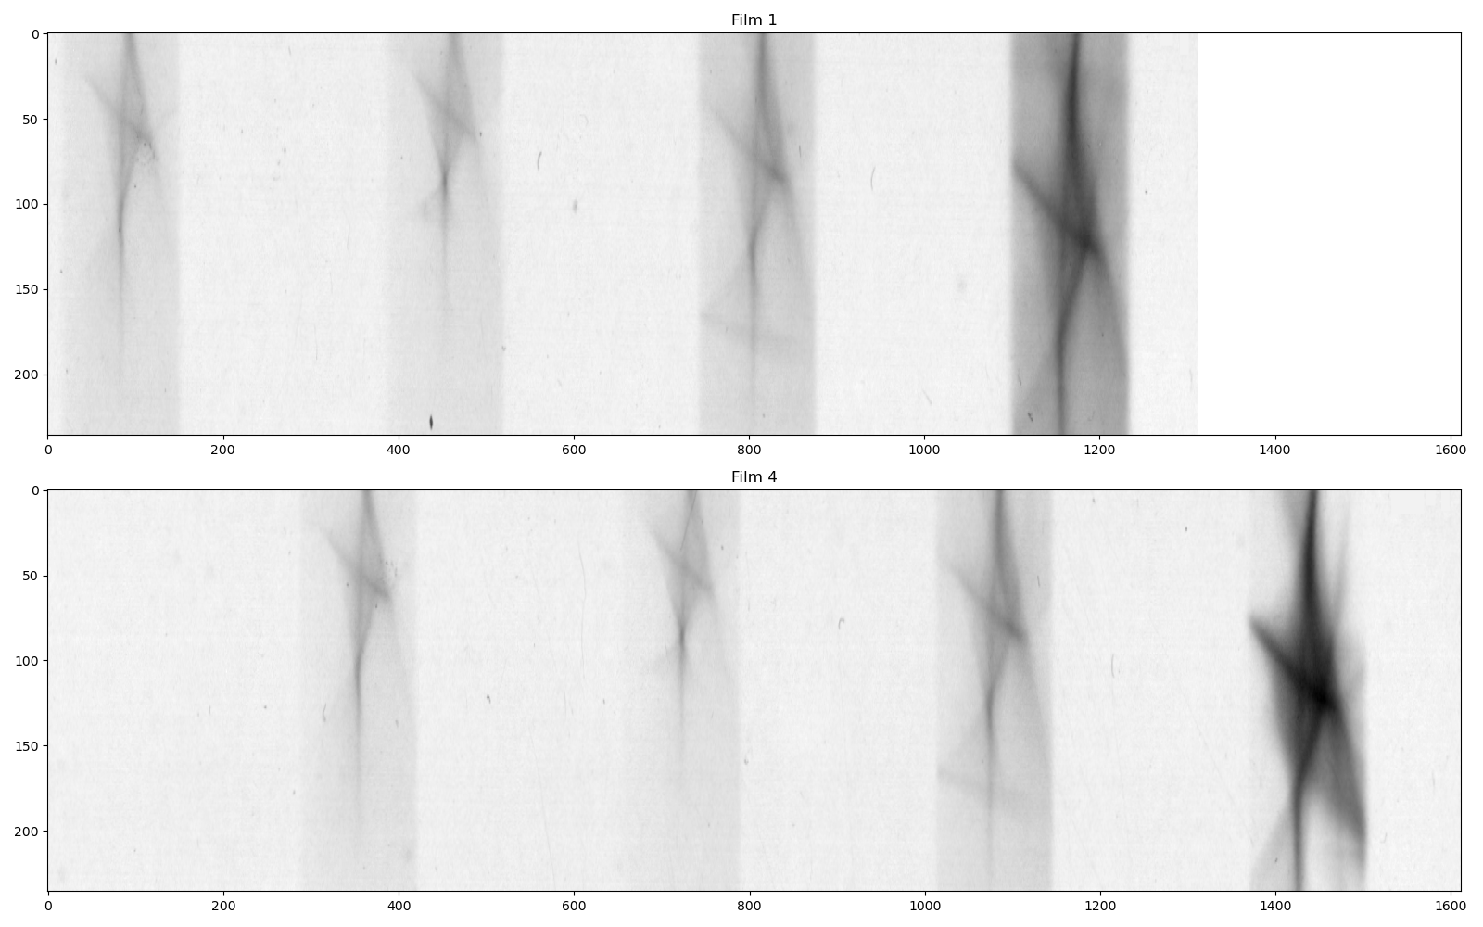
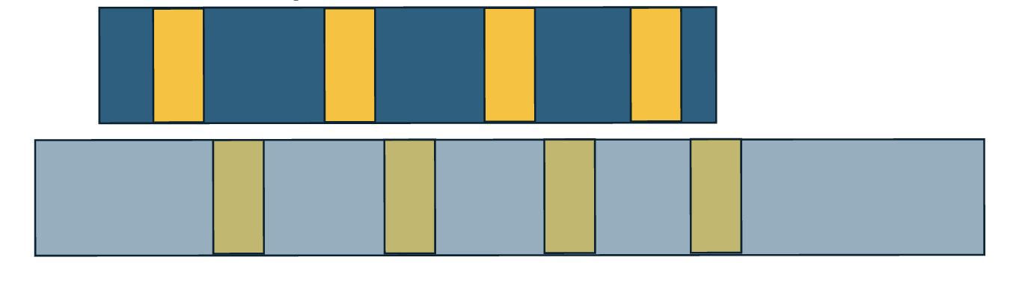
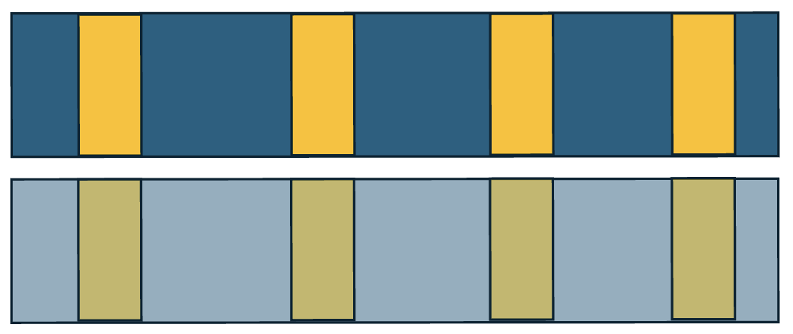
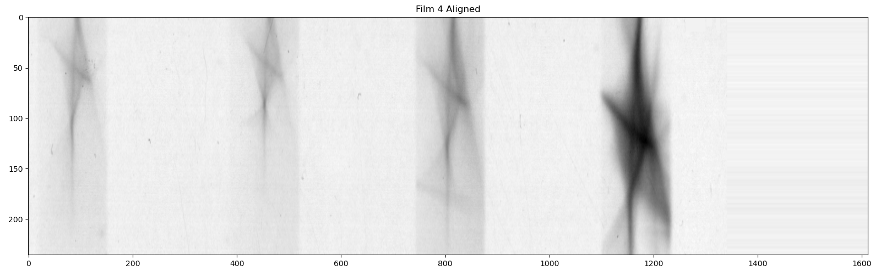
Correct displacement of RCF
Example of Film 4
Horizontal Alignment – Other Films
Cut Front Film vs Uncut Film
Aligned Film with Front Film

Slide 10
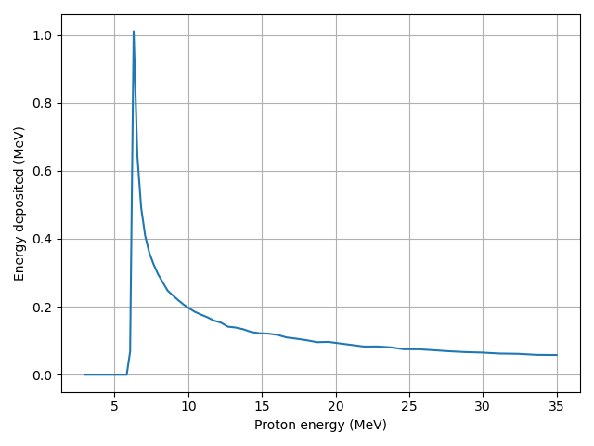
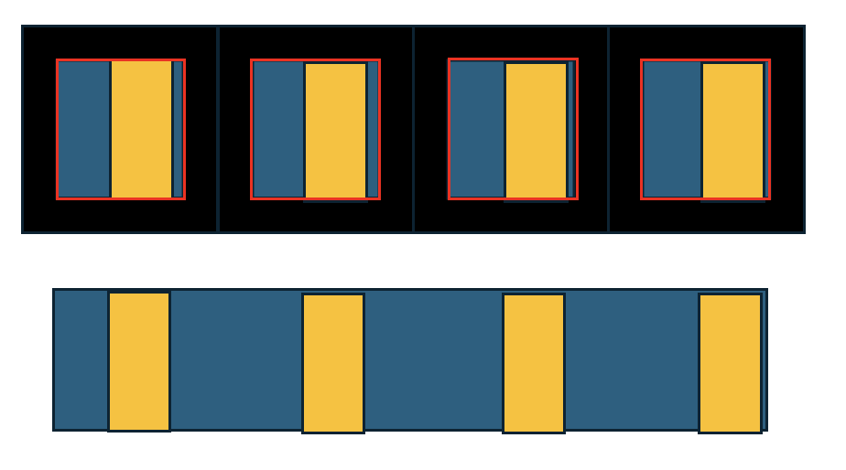
Generating the film in simulation
Basic Principle
20MeV
20MeV
16MeV
12MeV
Response Curve for Second Film

Slide 11
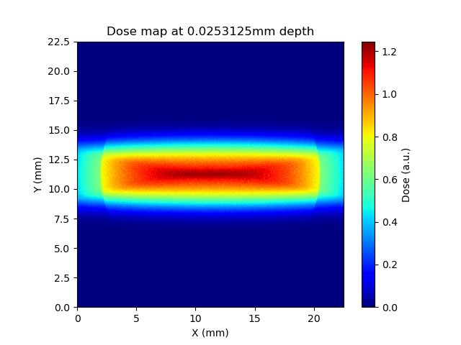
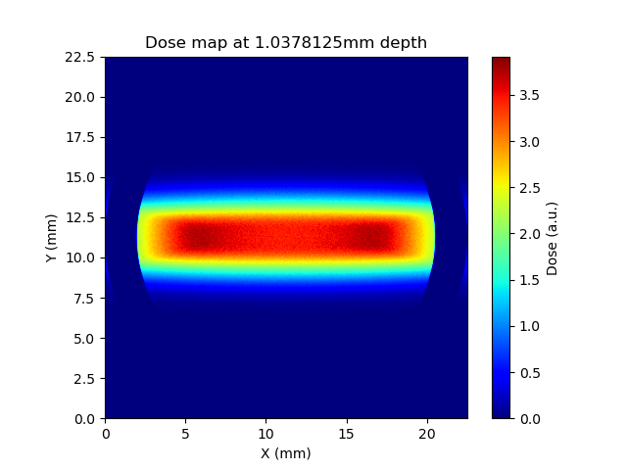
Generating the film in simulation
Chasing the split

Slide 12
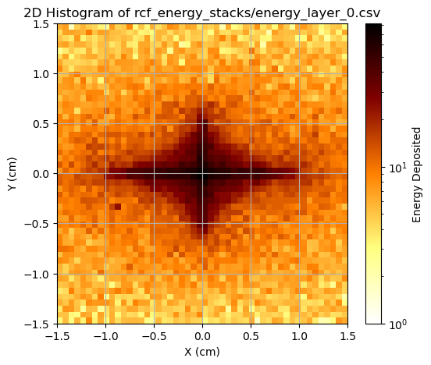
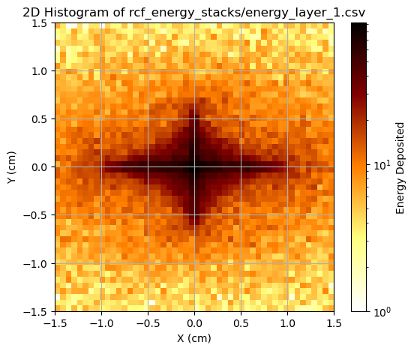
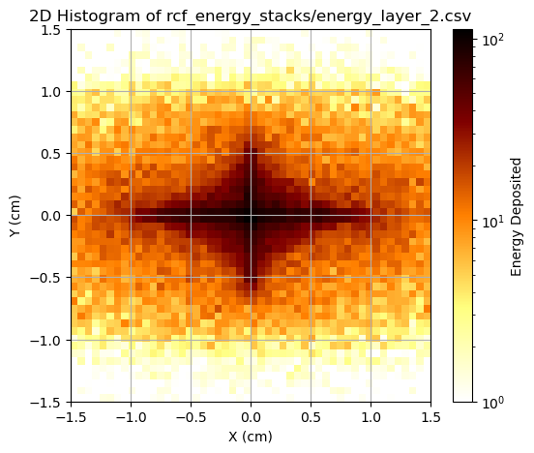
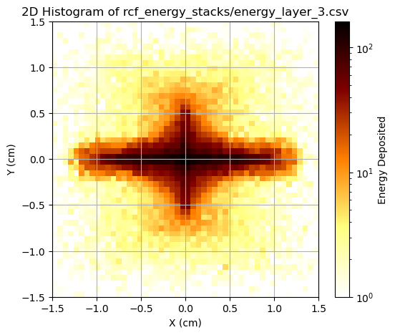
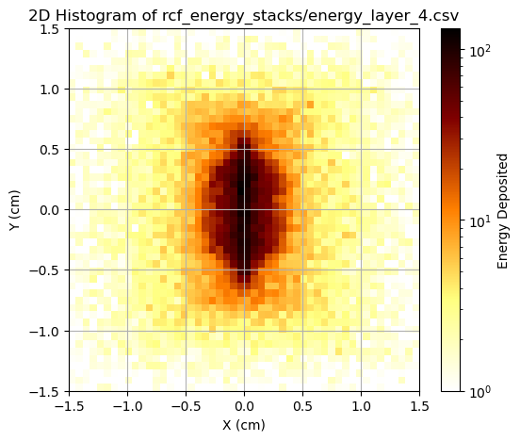
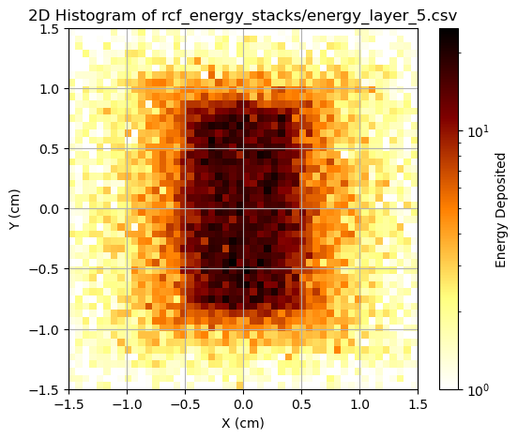
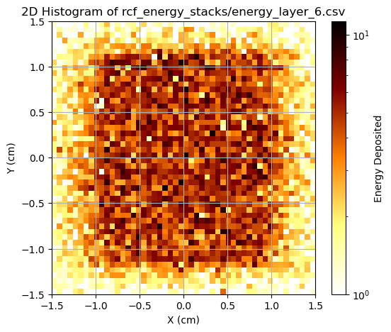
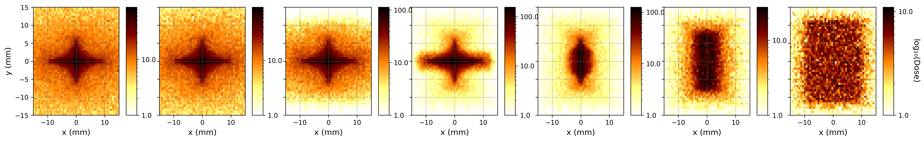
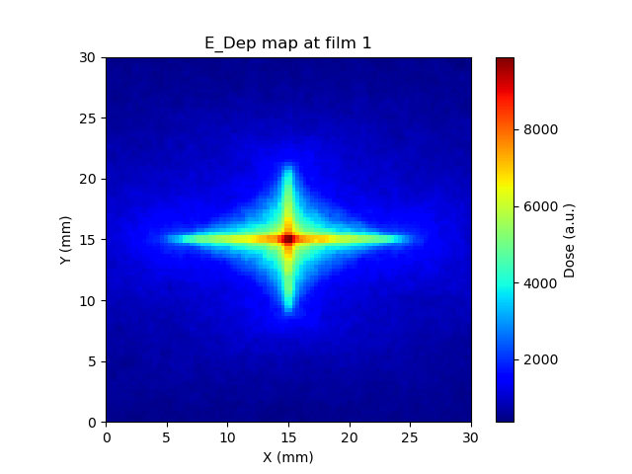
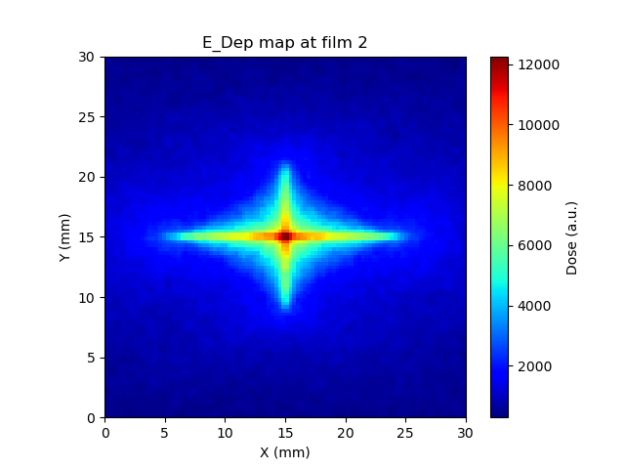
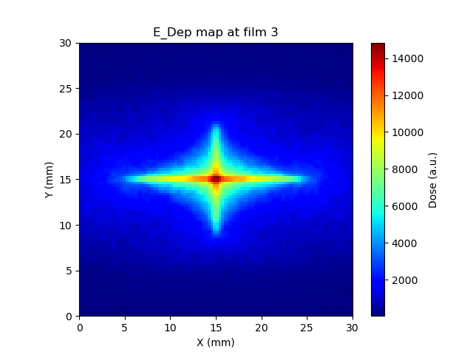
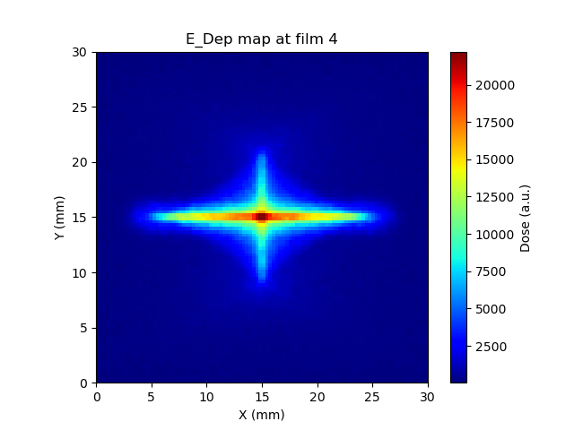
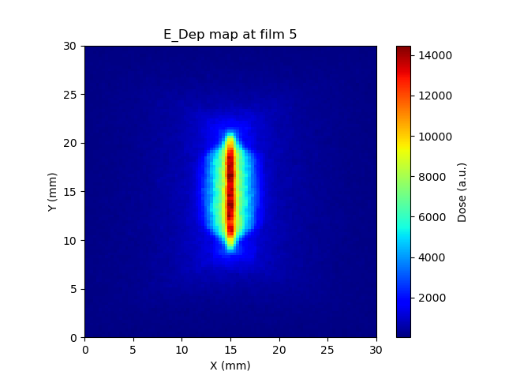
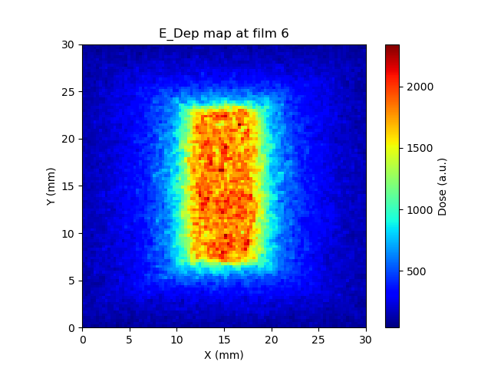
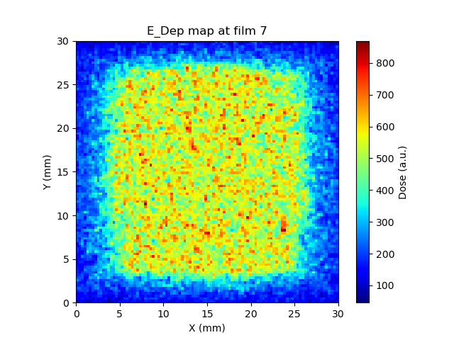
Generating the film in simulation
Chasing the split
Geant4
LLO (SRIM)
TOPAS

Slide 13
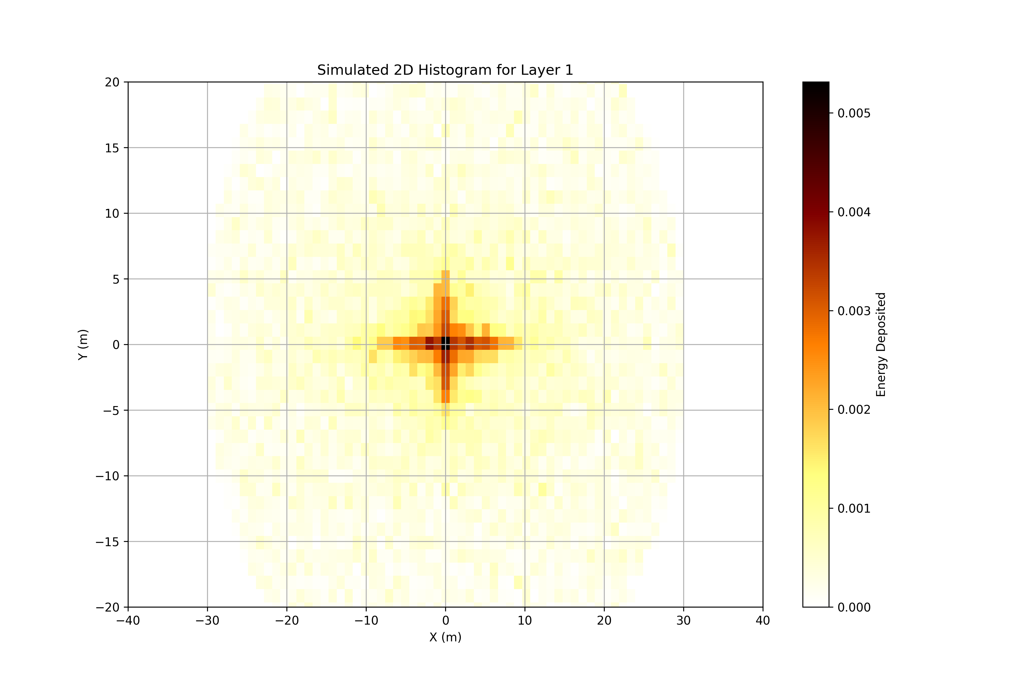
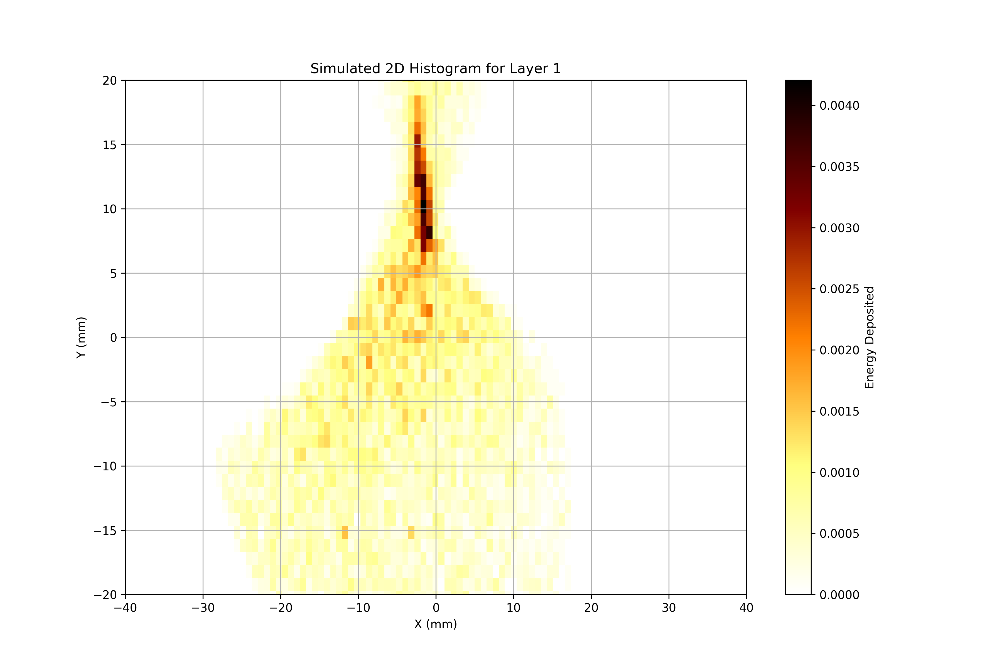
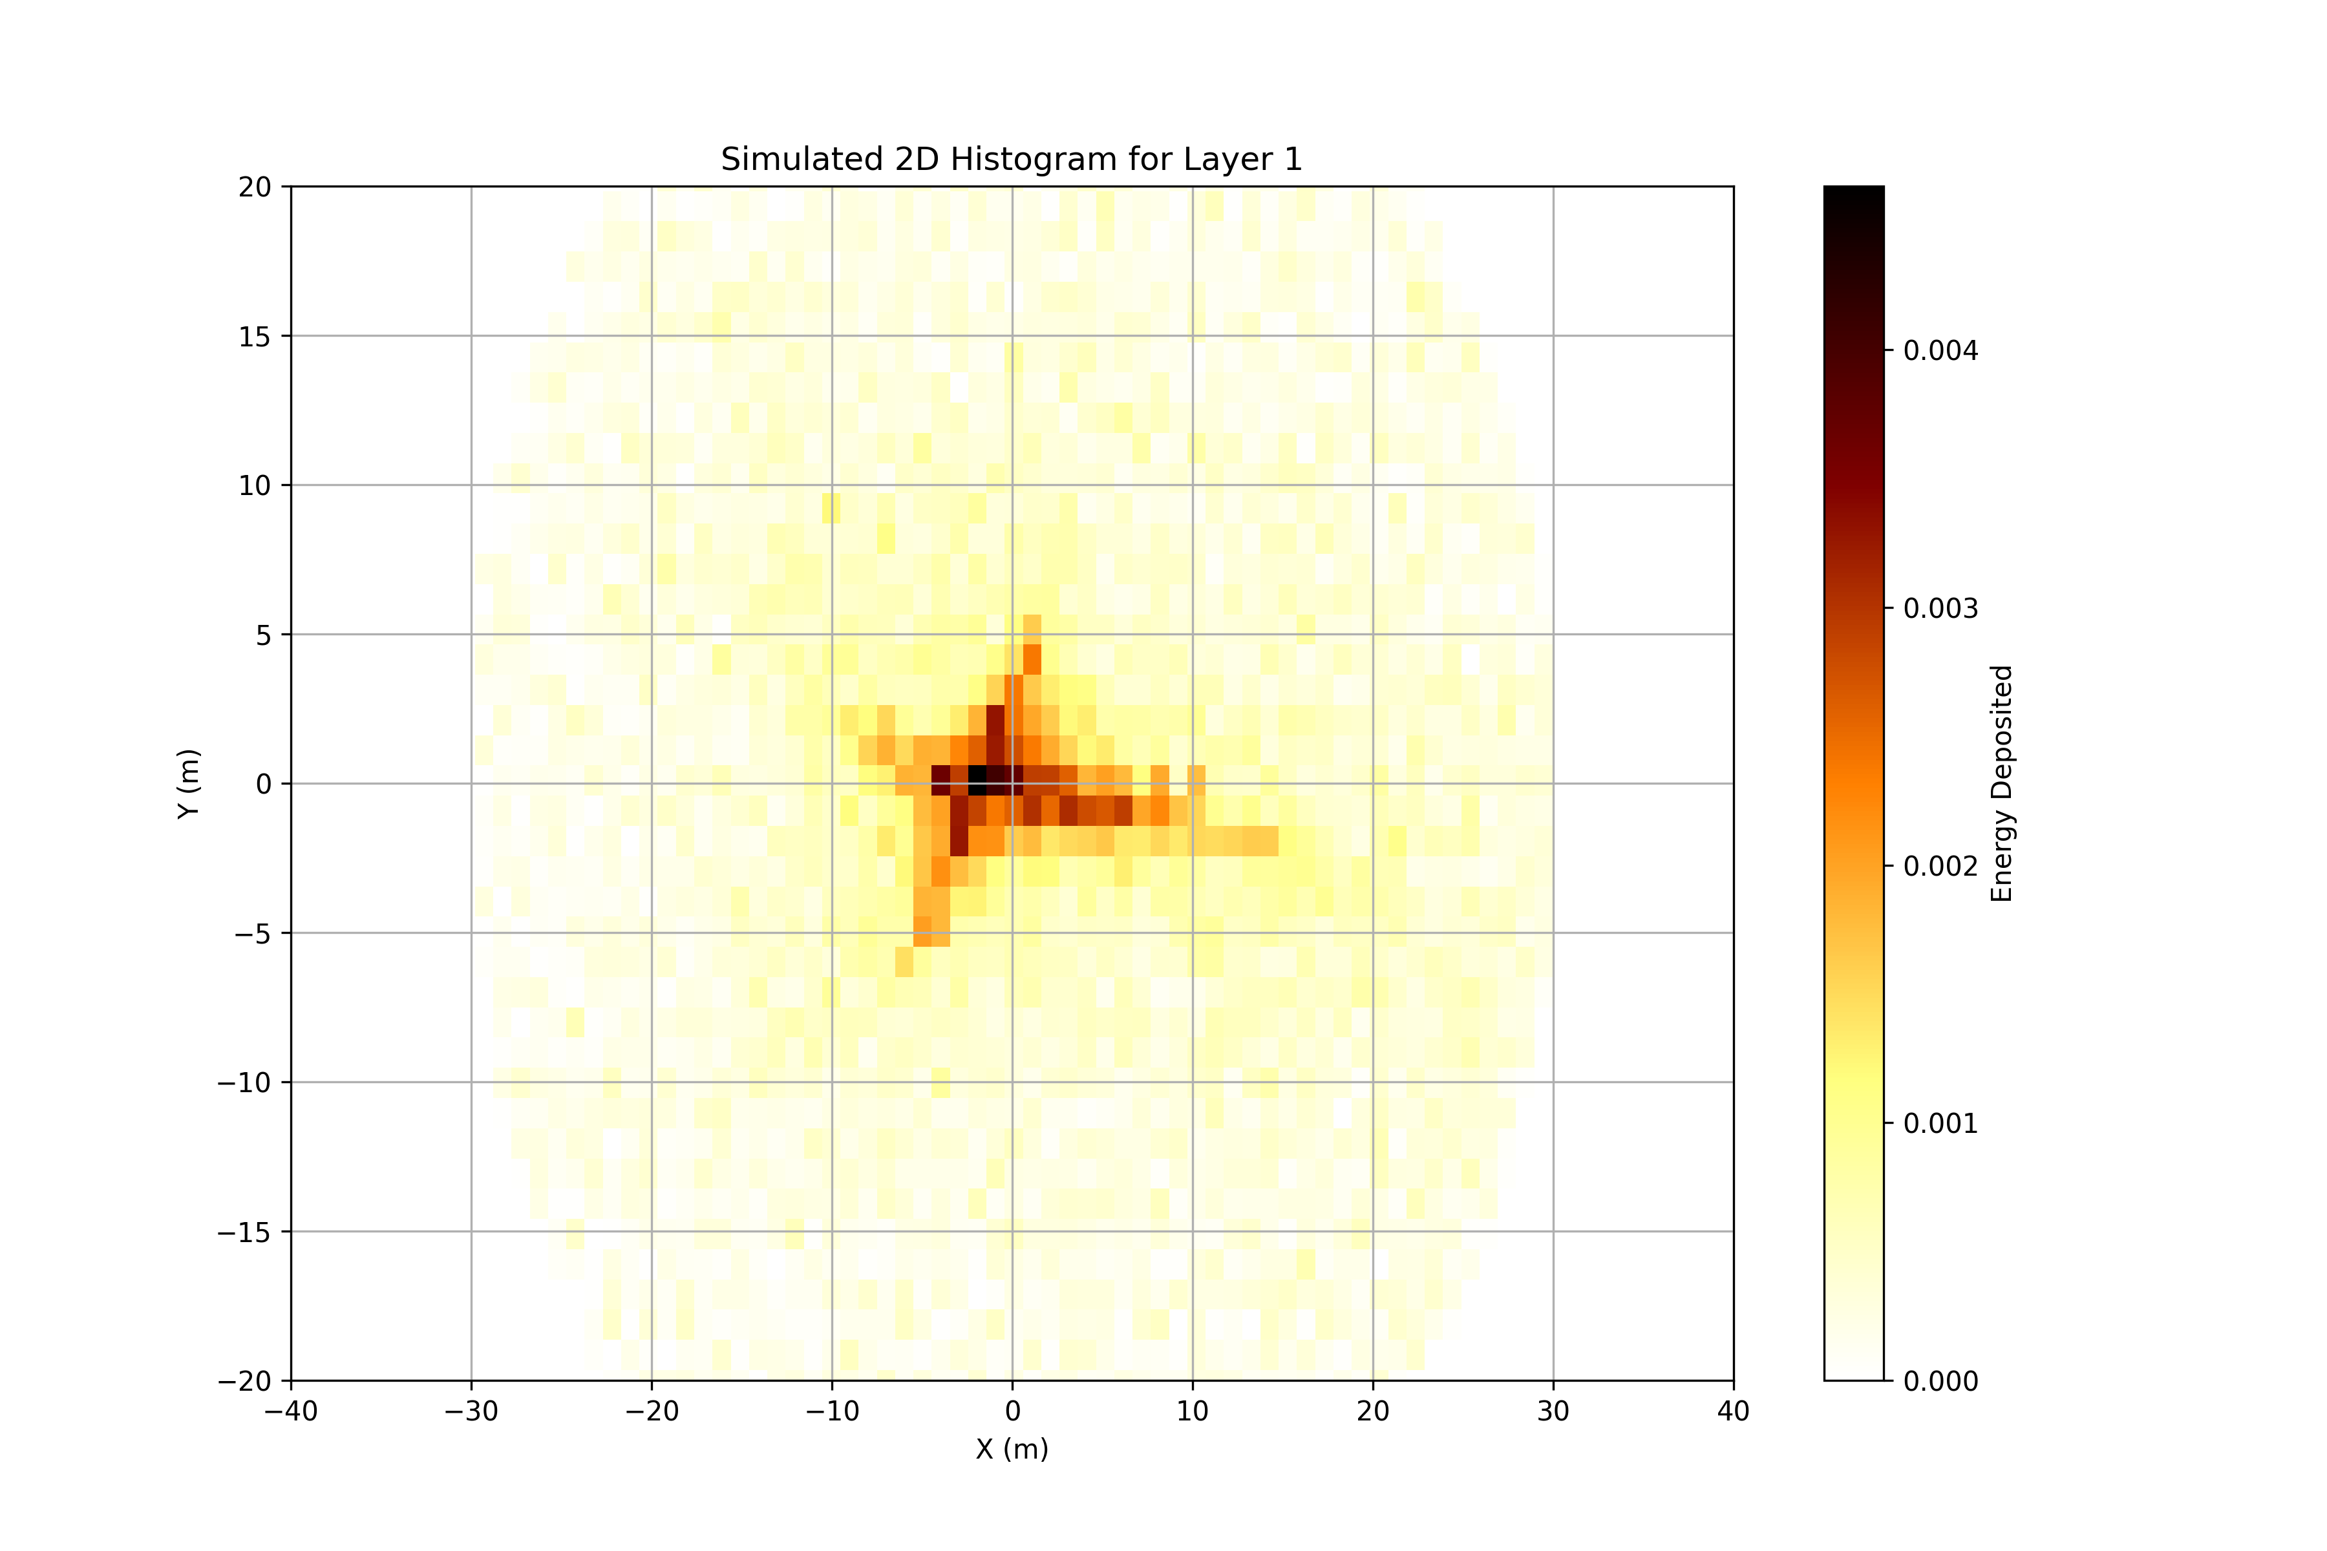
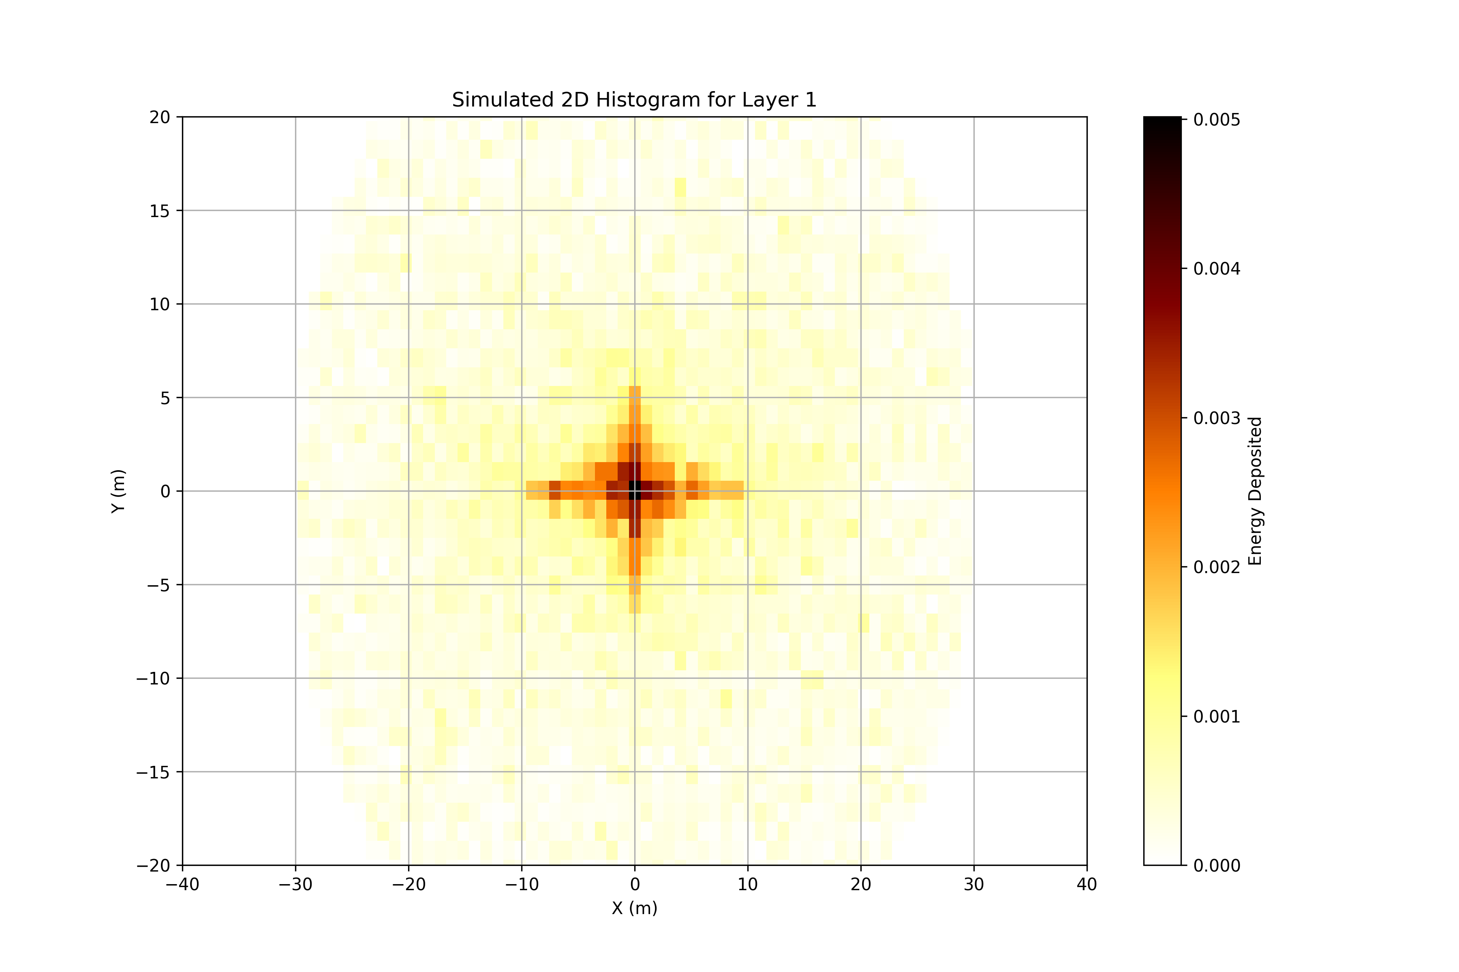
Testing the Optimisation
Compare with no displacement
6 Parameters
(Only tilts)
4 Parameters
(Only shifts)
Default
10 Parameters

Slide 14
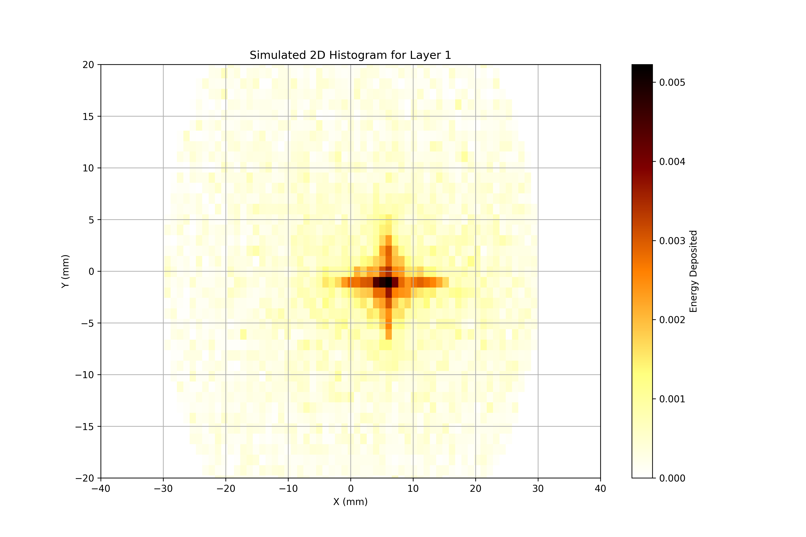
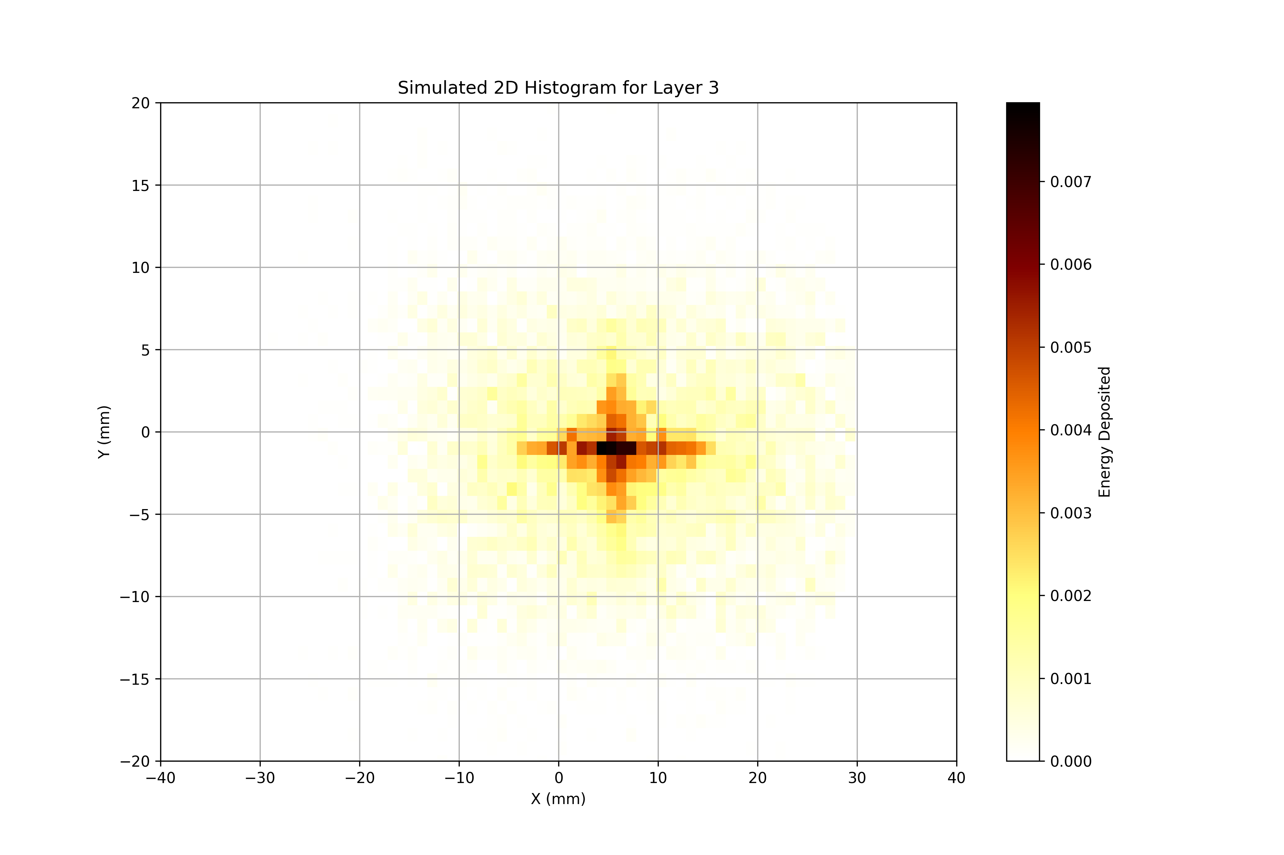
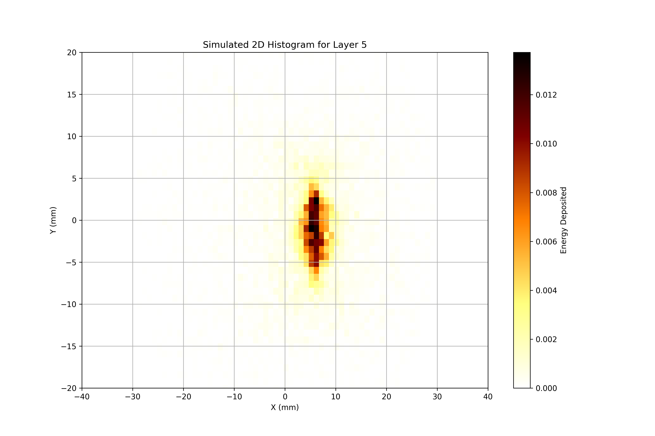
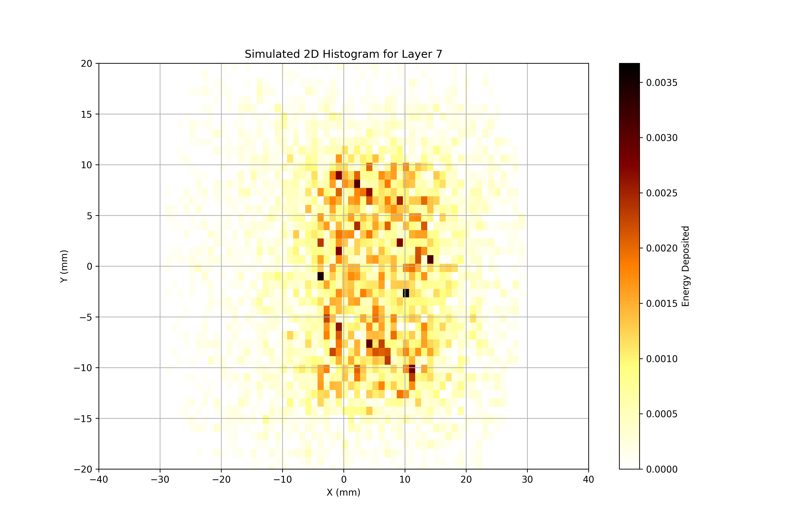


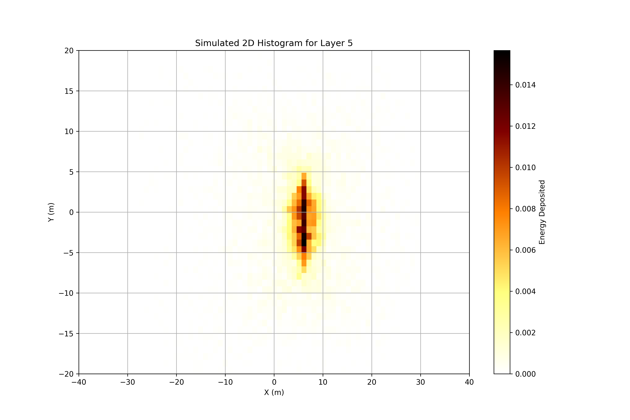
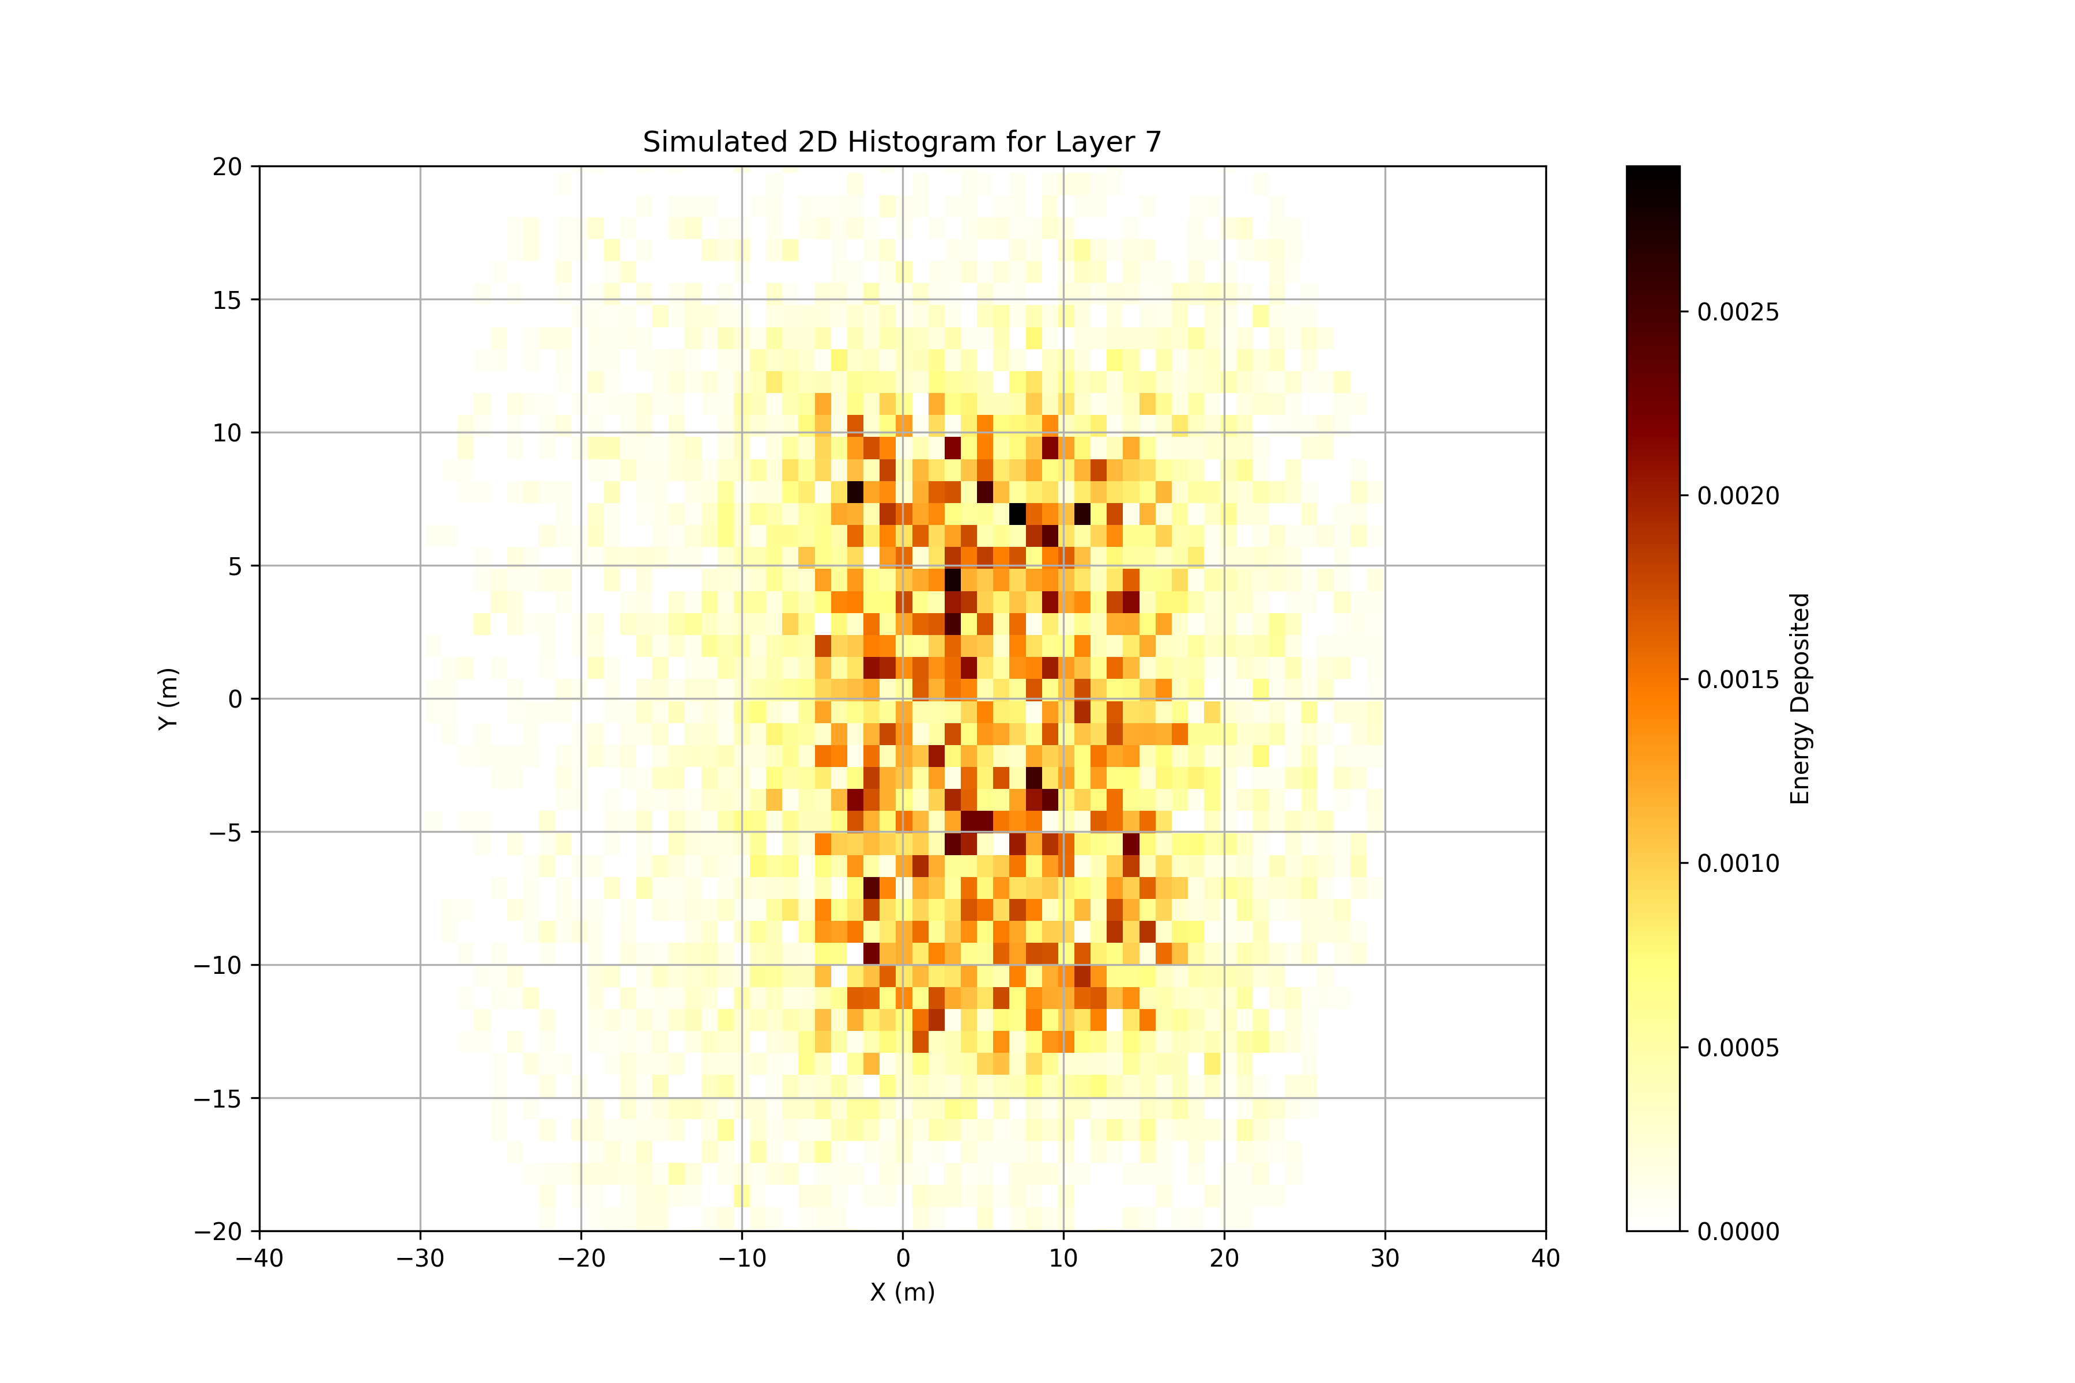
Testing the Optimisation
Compare with known displacement
X1: 0.08mm Y1: 0.08mm
Optimised to: X1: 0.029mm Y1: 0.0958mm X2:-0.1684mm Y2:0.009mm

Slide 15
Conclusions and Future
NCC implemented into the Bayesian optimisation process
Found degenerate solutions in optimisation
Investigate how degenerate
Inclusion of all 4 windows may remove this…
Optimisation struggles with more than 4 parameters(/inclusion of tilts)
Refine the search space
Run for more iterations
RCF aligned with the beamline axis
Warning for future RCF use: Be careful with placement and scanning
Geant4 Simulation of RCF complete
Did not show the desired split
Yet to be integrated into the optimisation loop
LhARA Collaboration Meeting
Calvin Dyson - LhARA Collaboration Meeting
15
07/04/2025
18/09/2025

Slide 16
Thank you
Simulation of LION Beam
07/04/2025

