Slide 1
Extreme field physics using intense lasers and particle beams
Bob Bingham
Central Laser Facility
STFC Rutherford Appleton Laboratory, Harwell, Oxfordshire OX11 0QX, UK
PPD Seminar
30th July 2025

Slide 2
Collaborators
STFC Rutherford Appleton Laboratory: J. Halliday, R. Trines, R Pattathil, C Hernandez-Gomez, J Collier.
University of Oxford: G. Gregori, E Los, F. Miniati, S. Sarkar, B. T. Huffman, A. Schekochihin, A. Bott,
K Beyer, G Morroco.
CERN: N. Charitonidis, P. Simon, A.-M. Goillot, I. Efthymiopoulos, V. Stergiou, A. E. Rahmoun, S. Burger.
AWE: T. Hodge.
Instituto Superior Técnico Universidade de Lisboa: P. Bilbao, F. Cruz, L. O. Silva, N. Lopes.
University of Rochester Laboratory for Laser Energetics: D. Haberberger, D. H. Froula.
Lawrence Livermore National Laboratory: H. Chen, R. A. Simpson, T. Ma.
Max Planck Institute for Nuclear Physics: B. Reville, T. Vieu, K Beyer.
University of Iceland: J. T. Gudmundsson.

Slide 3
Summary of Talk
Introduction to Extreme Photonics Application Centre (EPAC) and Vulcan 20-20
Pair plasma CERN Fireball Experiment.
Photon-photon scattering.
Photon-axion coupling.
Photon-gravitational wave coupling.
Plasmon-neutrino coupling.

Slide 4
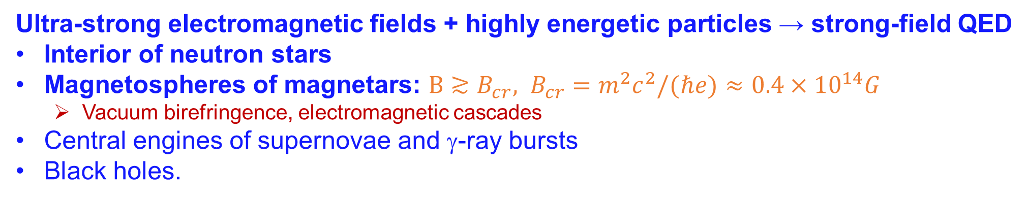
Strong Fields in Astrophysics
Ultra-strong electromagnetic fields + highly energetic particles → strong-field QED
Interior of neutron stars
Magnetospheres of magnetars: $B≳B_{cr}, B_{cr}=m^{2}c^{2}/(ℏe)≈0.4×{10}^{14}G$
  Vacuum birefringence, electromagnetic cascades
Central engines of supernovae and γ-ray bursts
Black holes.

Slide 5
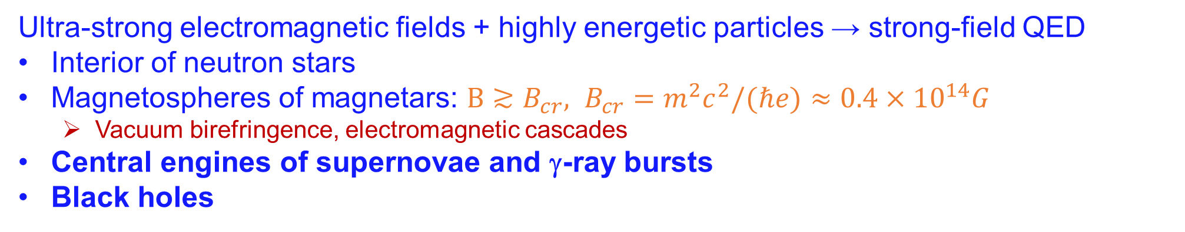
Extreme Fields in Astrophysics
Ultra-strong electromagnetic fields + highly energetic particles → strong-field QED
Interior of neutron stars
Magnetospheres of magnetars: $B≳B_{cr}, B_{cr}=m^{2}c^{2}/(ℏe)≈0.4×{10}^{14}G$
  Vacuum birefringence, electromagnetic cascades
Central engines of supernovae and γ-ray bursts
Black holes

Slide 6
Strong Fields in Plasmas

Slide 7
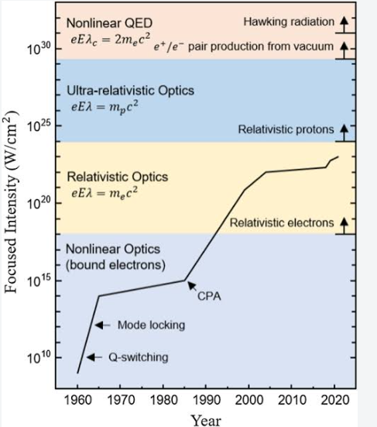


Extreme Field Physics
A Nobel Prize Effort!
RAL
Nonlinear QED: Schwinger limit

Slide 8
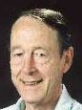
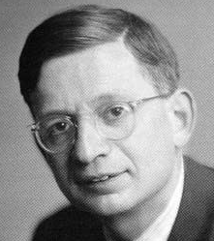
Strong-Field QED
Nonperturbative, strong-field QED is described by two dimensionless measures, and ,
of the strength of a plane wave with angular frequency and 4-potential
1.
governs the importance of multiple photons in the initial state, and characterizes the “mass shift”,
of a (quasi)electron in a “background “ electromagnetic wave (laser beam).
D.M. Volkov, Z. Phys. 94, 250 (1935), T.W.B. Kibble, Phys. Rev. 150, 1060 (1966)
[For electrons in metals, R. Peierls, Z. Phys. 80, 762 (1933),]
2.
governs the rate of “spontaneous” e⁺e⁻ pair creation (“sparking the vacuum”) in a wave probed by an electron with 4-momentum
NOTE: modern notation is η ≡ ξ and ≡ χ
The electric field of a focused TeraWatt laser appears critical to a
counterpropagating 50 GeV electron ⇒ SLAC Experiment E-144

Slide 9
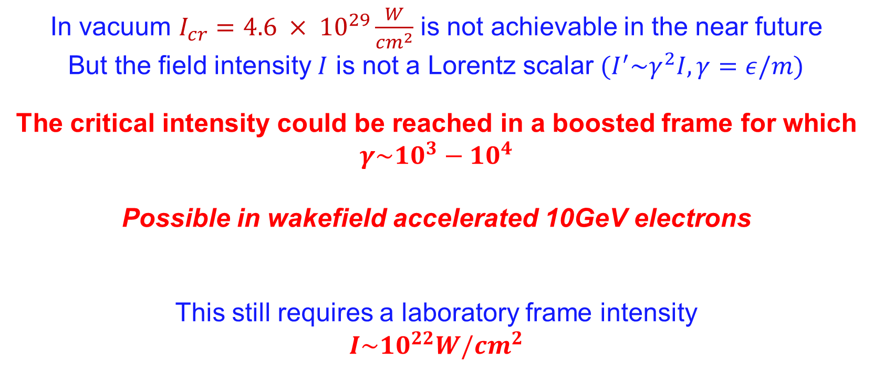
Can this be achieved ?
In vacuum $I_{cr}=4.6 × {10}^{29}\frac{W}{{cm}^{2}}$ is not achievable in the near future
But the field intensity $I$ is not a Lorentz scalar ${(I}^{′}\sim γ^{2}I, γ=ε/m)$
The critical intensity could be reached in a boosted frame for which
$$γ\sim {10}^{3}−{10}^{4}$$
Possible in wakefield accelerated 10GeV electrons
This still requires a laboratory frame intensity
$$I\sim {10}^{22}W/{cm}^{2}$$
An optical Petawatt system!

Slide 10

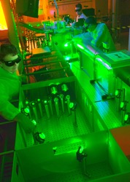


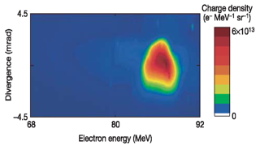


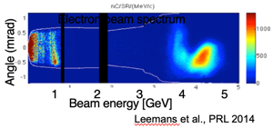
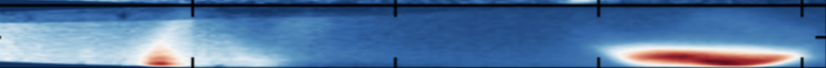
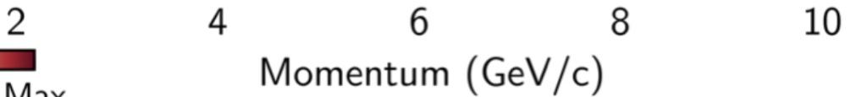
Laser-plasma accelerators go from 100 MeV to 10 GeV in two decades
2006 result: 40 TW laser, cm-scale plasma
2004-2024: A success story
1.1 GeV
<2.9%
<1 mrad
10-30 pC
2004 result: 10 TW laser, mm-scale plasma
~100 MeV
W.P. Leemans et al., Nature Physics 2, p696 (2006)
2014 result: 310 TW laser, 9 cm-scale plasma
~100 MeV
*S. Mangles et al., Nature 431, p535 (2004)
*J. Faure et al., Nature 431, p541 (2004)
C. G. R. Geddes et al., Nature,431, p538 (2004)
Experiment (spectrum)
Gonsalves et al., PRL 2019
2024 result: 30cm HOFI channel
https://arxiv.org/abs/2408.00740
2004
2006
2014
2019
2024
2019 result:
20cm HOFI channel
Beam energy [GeV]

Slide 11
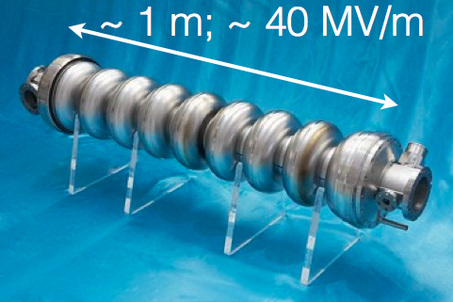
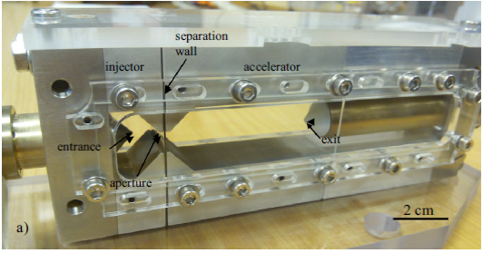
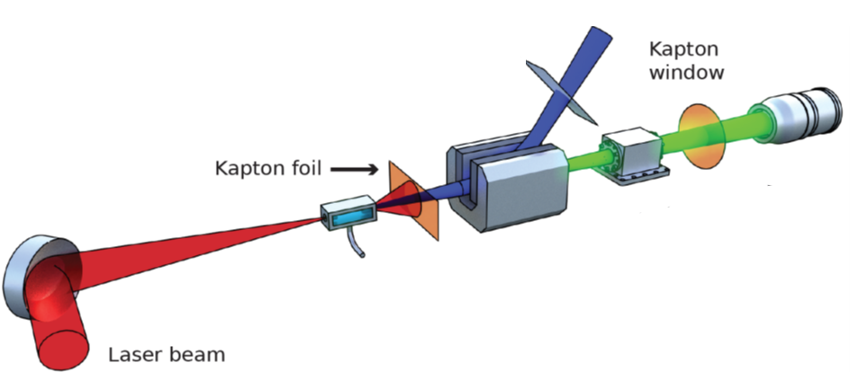
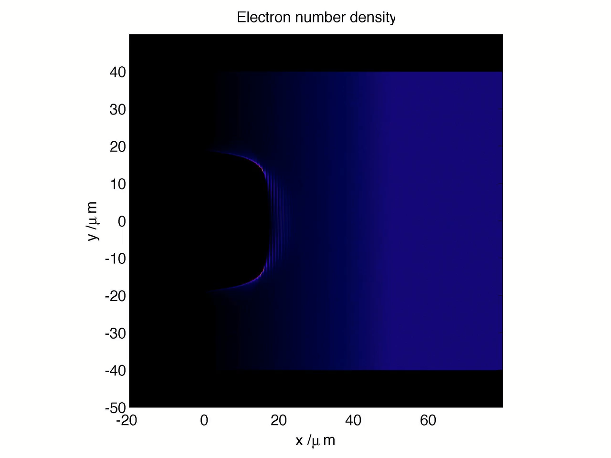

Miniature accelerators
Laser wakefield acceleration
cm-scale gas target
Intense laser driver
Multi-GeV electrons
~ 20 mm; ~ 100 GeV/m
High-gradient (100 GeV / m) based on plasmas
Generates extremely short (~fs) x-ray pulse with synchrotron-like radiation spectrum
1/γ
30 µm
Characteristic energy
Electron density map from PIC simulation of LWFA
Plasma accelerators can contribute to the next generation of light-sources and colliders
Notes:
One such way is to use high power lasers to create wakefields in a plasma – setting up field gradients that are 1000-10000 x larger than that in a conventional accelerator cavity
Focusing fields in the wake due to the ion core means that the electrons undergo undulations as they propagate – betatron emission (similar to synchrotron emission)

Slide 12
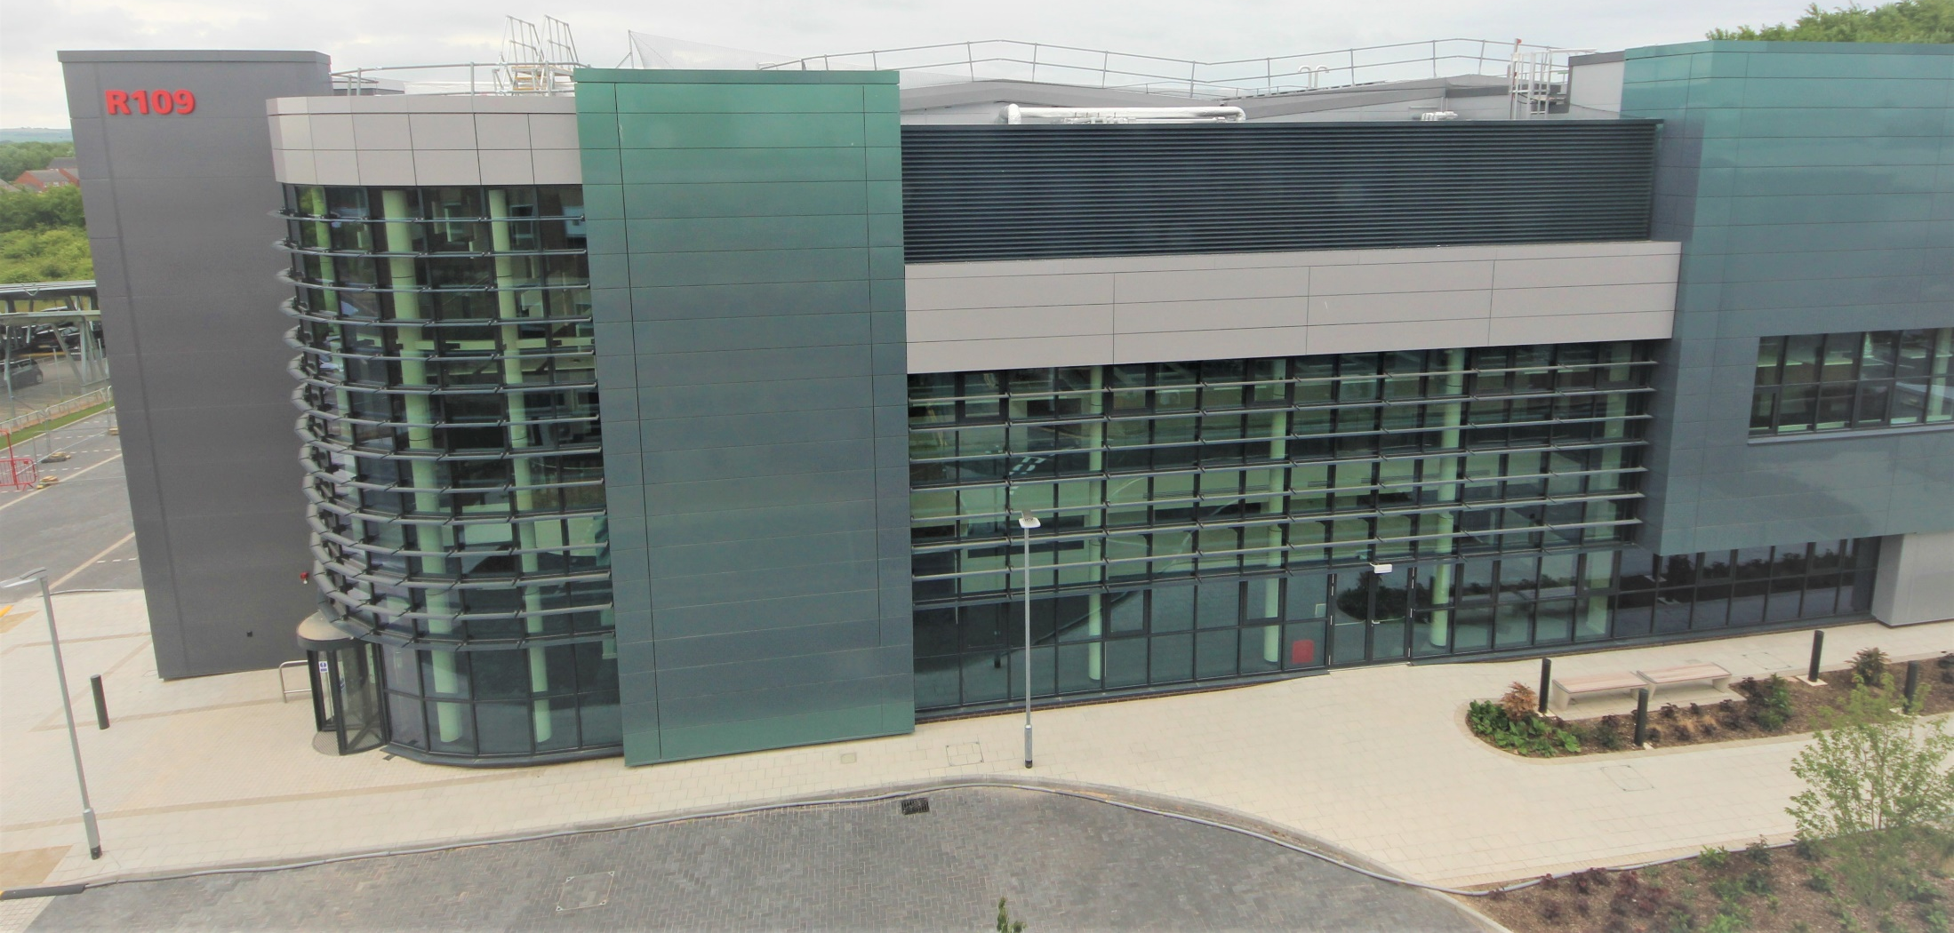
Extreme Photonics Applications Centre (EPAC)
A new £106M centre based on plasma accelerators
Will host a 1PW laser at 10Hz driving plasma accelerators
Designed for 10GeV electron beams and energetic protons, ions and secondary radiations
Exploit plasma accelerators for a range of applications in industry, medicine, defence, and security as well as for fundamental science
clf.stfc.ac.uk/Pages/EPAC-introduction-page.aspx

Slide 13

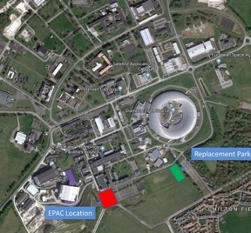
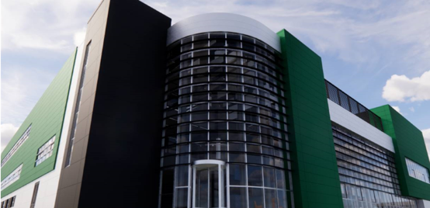
EPAC in a nutshell
£100M centre for applications of laser-driven sources in industry, medicine, defense and security
EPAC will host a 1PW laser at 10Hz driving plasma accelerators
Designed for 10GeV electron beams and energetic protons, ions and secondary radiations
EPAC will drive fundamental science and applications: Non-perturbative QED to Non-destructive Testing in industrial environments
Building completed; installations ongoing; commissioning in 2025.

Slide 14
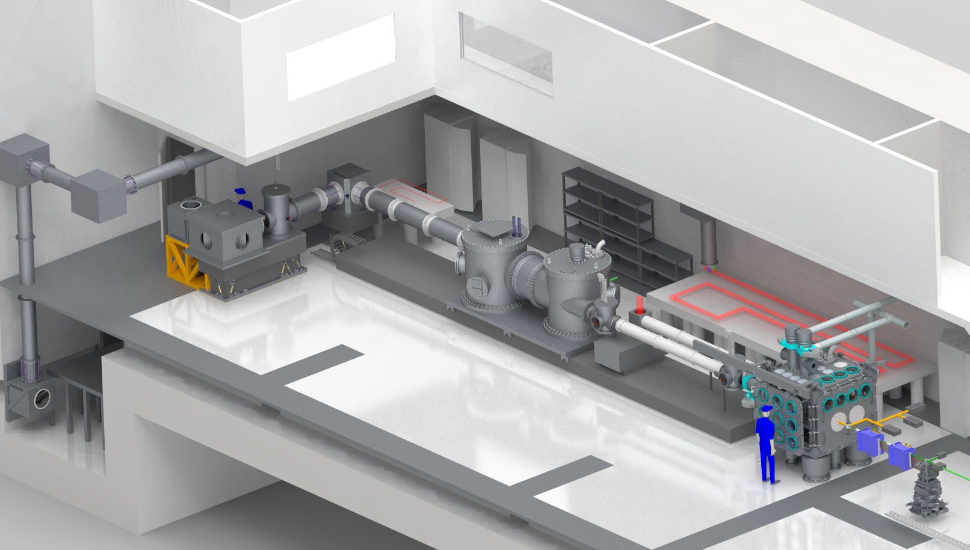
Experimental Area 1
EA1 will be configured for Laser-driven Wakefield acceleration, 1 PW drives a laser plasma accelerator
Target is a few cm of gas Focused to relativistic intensity (above 10¹⁸ Wcm⁻²).
Generates multi-GeV electron
(up to 10GeV) beams and x-ray
EA2 has 2 distinct zones: laser interaction, secondary source application area
EA1 has been designed to house a 2nd PW beamline & auxiliary/probe beams
1 PW beam
EA1 target chamber
Houses :gas cell/ gas jet,
Laser Beam dumps, magnets
Focussing chamber contains 2 optics :
Large area adaptive optic AO
Off-axis parabola
Granite beamline support structure for stability
Maximum focal length 14 m (f / 65)
Electrons
X-rays

Slide 15
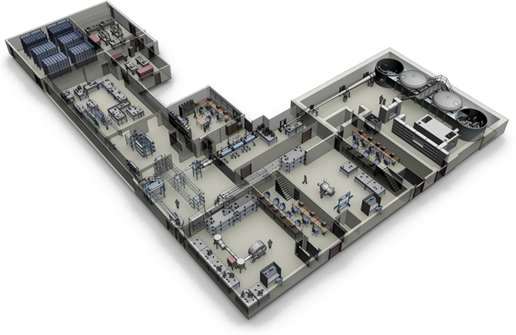
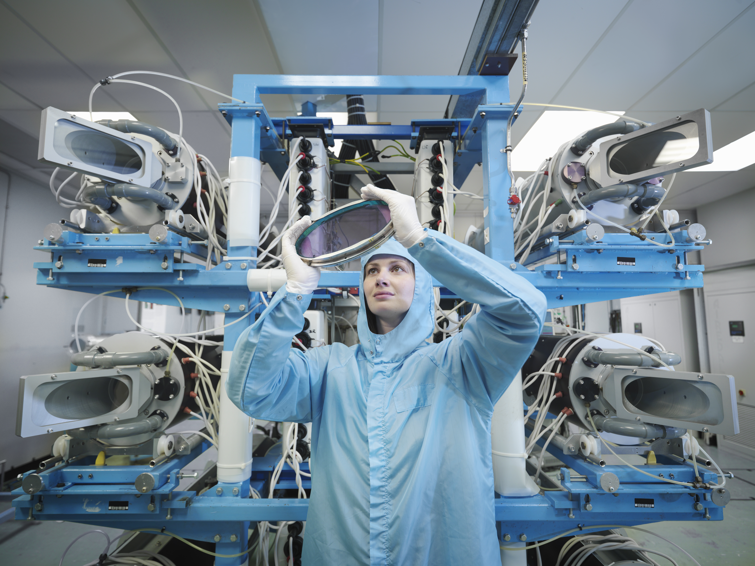
Vulcan 20-20
Vulcan facility
Vulcan was the original laser that established the CLF in 1977
It is 45 years old and has had 3 major upgrades over that time
  8 beam Disk Amplifiers / New experimental areas Target Area East / Target Area West Chirped Pulse Amplification & 100 TW
  Vulcan PetaWatt and Target Area Petawatt (TAP)
The last of these, Vulcan PW, came online in 2002
Vulcan 20-20 –Will significantly increase peak power and energy.
20PW 20kJ
Extreme Field Science/ HEDP
Vulcan current capabilities
Nd:Glass system, 1 PetaWatt beam (E=500J, t=500fs)
2 kJ long pulse across all 8 beams
Two experimental Areas

Slide 16
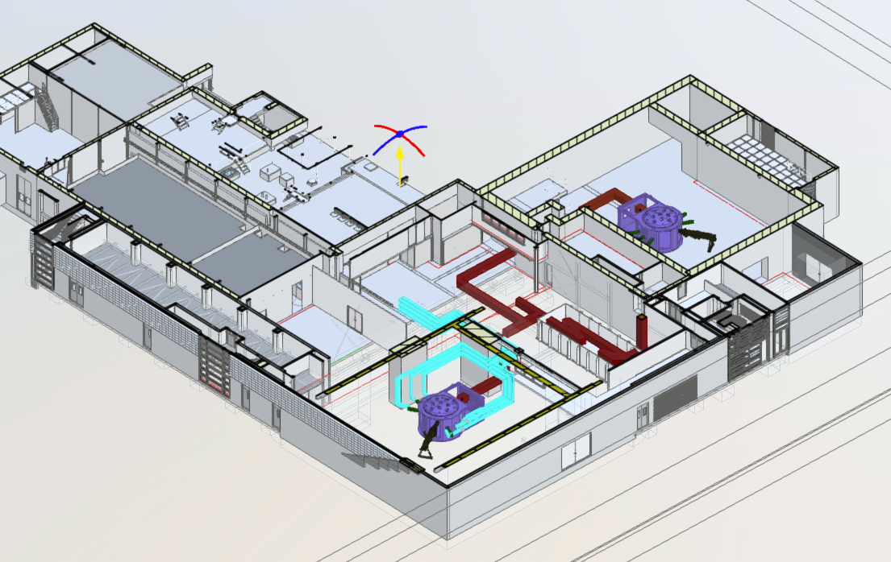
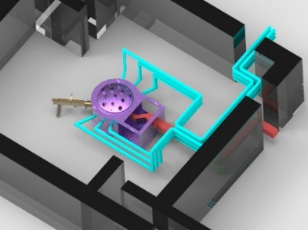
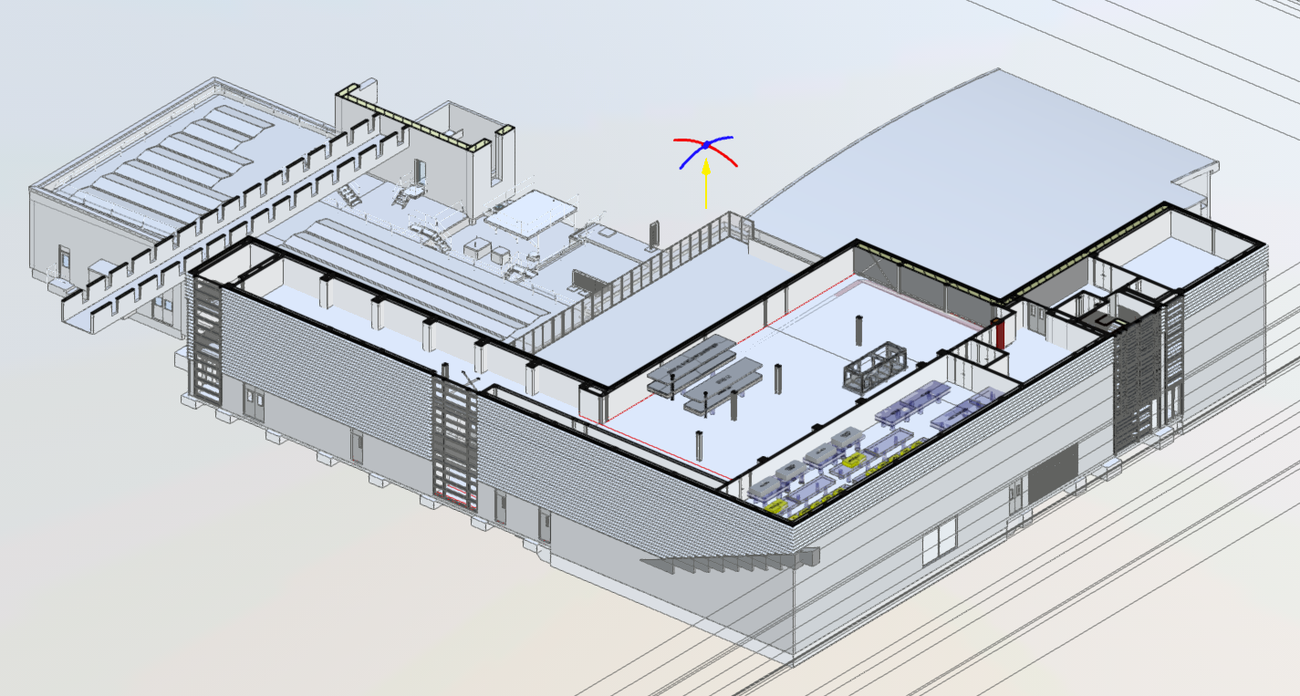
New Building Schematic
Ground floor –Extension to existing building and it will house
Existing Laser areas: Long pulse amplification area and beam transport
New laser area to house new 20PW compressor chamber
Two experimental areas
  Experimental Area 1 (VTA1). Concrete walls for radio protection, Double height , ~20 m x 21 m
  Existing Target Area Petawatt (TAP) ~20 m x 25 m will be refurbished to add a same beam extension
Brand new 3rd floor to house short pulse laser systems:
20 PW amplification areas and laser control room and 1 PW laser beam
Existing Target Area Petawatt
New Experimental Area
New compressor area
Ground floor
Laser Control Room
Laser front End
Laser Amplification Area
Third Floor

Slide 17
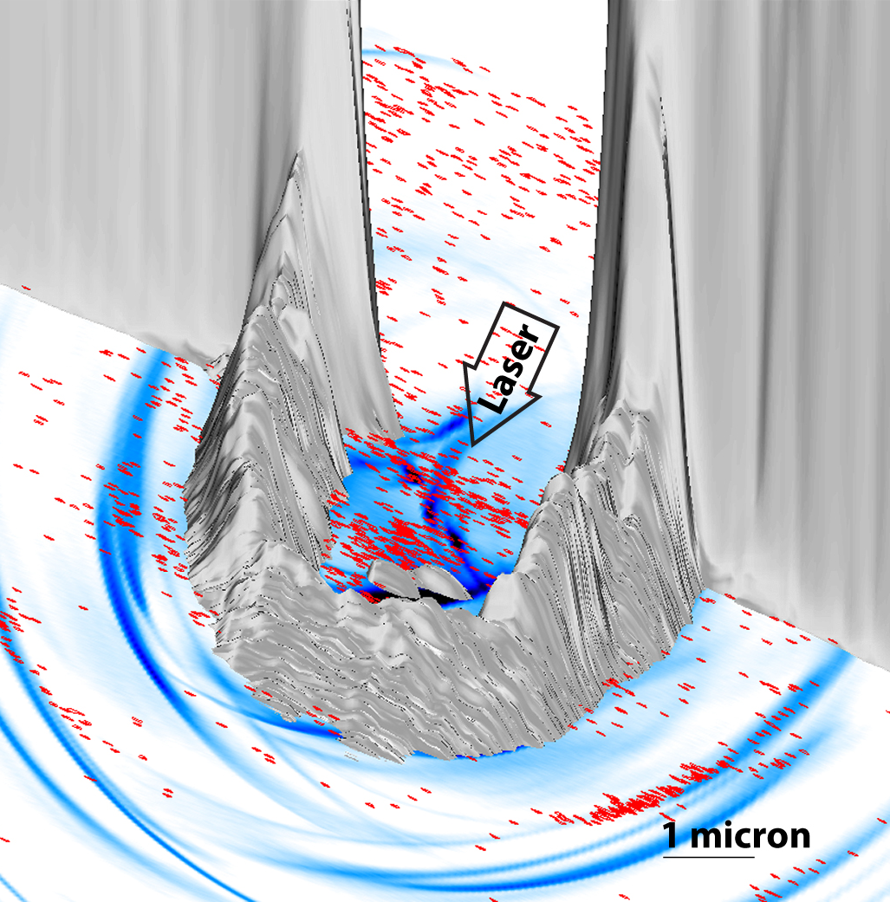
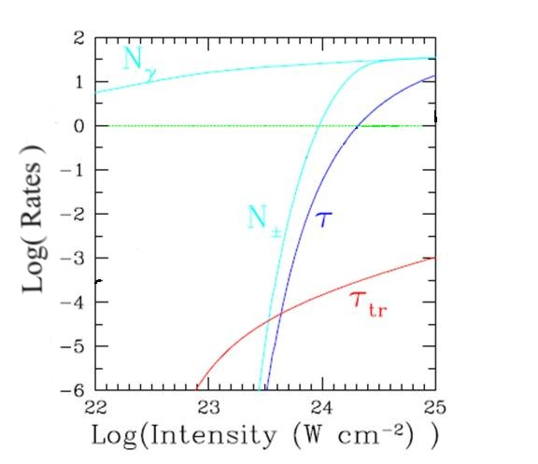
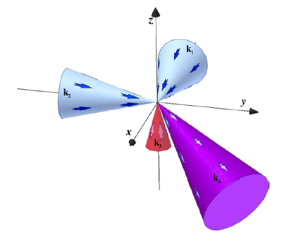
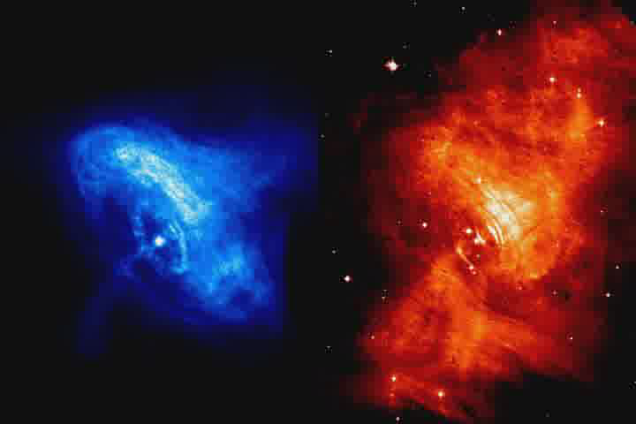
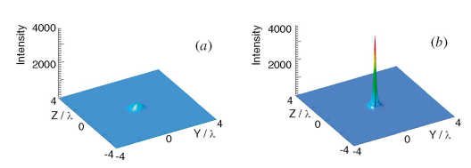
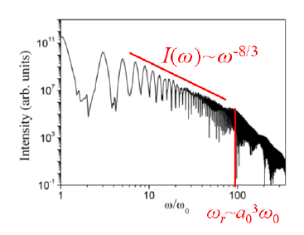
Vulcan20-20 science
Significant Quantum-electrodynamic processes in Plasma – Compton cascades; radiation reaction, photo-nuclear processes etc.
Fundamental Physics: access to vacuum non-linearity, breakdown; Unruh radiation EM equivalent of Hawking radiation); non-pertubative QED
Novel states of matter/warm dense matter: superconductivity; new material structures; phases Exoplanet & gas giant formation
Astro-physical science : SNR; Cosmic magnetic field; turbulent amplification; e+e- pair plasmas, pulsar winds; GRB;
Powerful, unusual sources : accelerators, Industrial use; technological base; Relativistic harmonics to the Schwinger Field ?
Laser driven inertial fusion : basic physics; novel schemes; basis of future US cooperation for UK
Bell et al, PRL
Marklund et al, PRL
Baeva et al, PRL

Slide 18
Laboratory Astrophysics

Slide 19
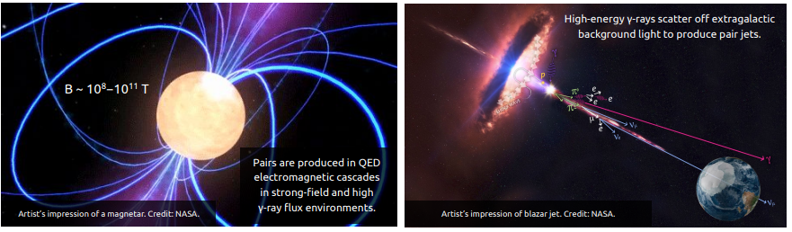
Pair beams in astrophysics
➔ Relativistic outflows/jets enriched with electron-positron (e+/e−) pair plasma can be found around
pulsars, black holes and blazars.
➔ To explain the intense radiative signatures from these astrophysical sources relies on an understanding of the stability and energy dissipation mechanisms of pair beams in ambient plasmas.

Slide 20
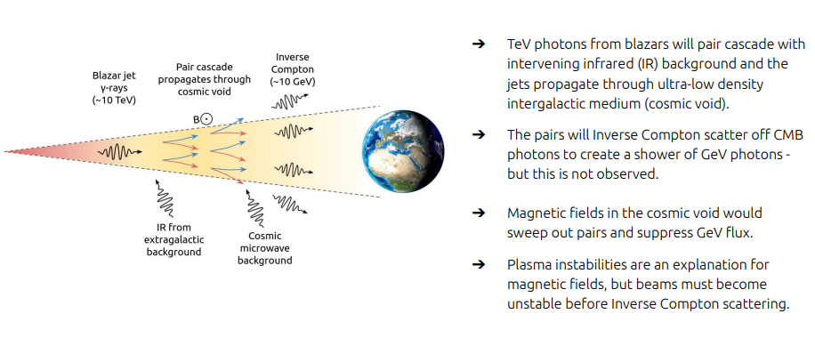
Pair beams in astrophysics - Example: Blazar jets in the cosmic voids - are they stable?

Slide 21
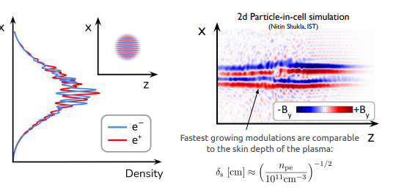
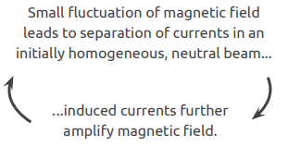
Filamentation instability of e+/e− beams in plasma
➔ The system is unstable because it is highly anisotropic.
➔ If the beam is sufficiently directional, small fluctuations in magnetic fields can grow exponentially as induced currents produce stronger fields.
➔ Bulk kinetic energy is dissipated into electric and magnetic fields, pairs are deflected.

Slide 22
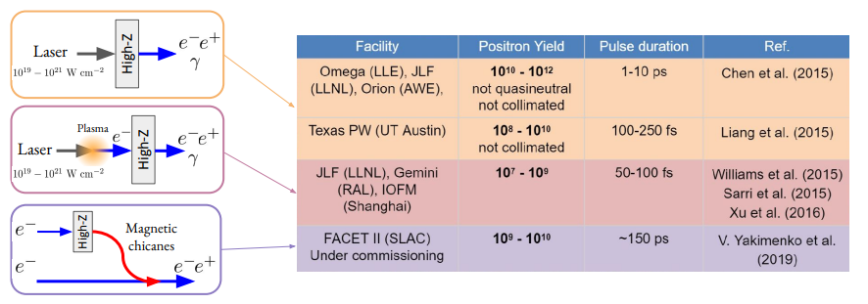
Producing electron-positron jets using high-power lasers
➔ Current facilities cannot produce high enough densities of quasi-neutral beams.
➔ Pulse durations are very short, so 3D plasma effects are strongly suppressed.

Slide 23
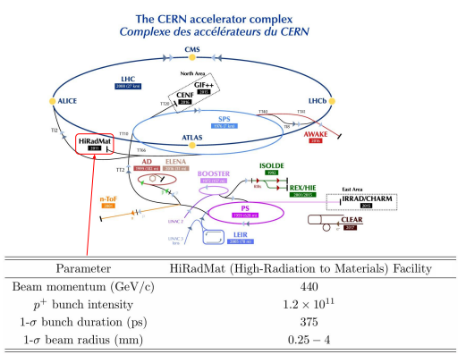
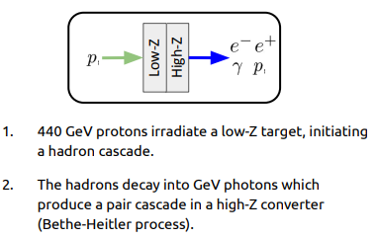
Producing electron-positron jets using 440 GeV protons at CERN (HiRadMat Facility)

Slide 24
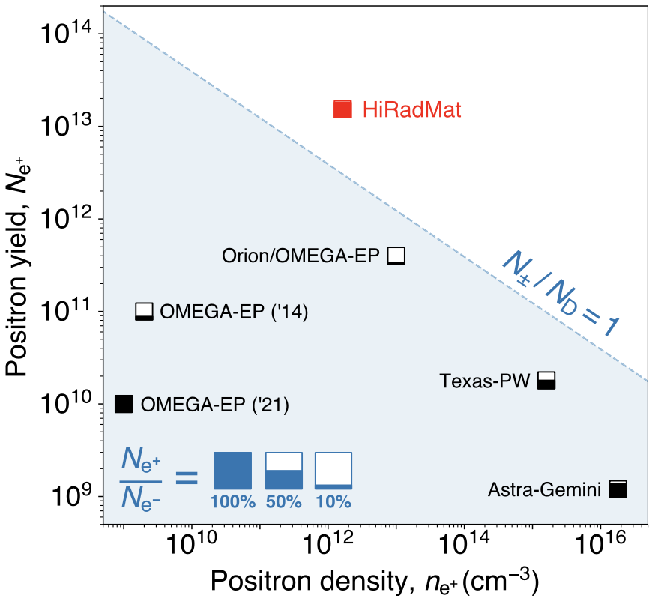
Fireball: Comparison with other experiments
HiRadMat achieves all requirements to study Fireball model
Recent review article : Chen & Fiuza, “Perspectives on relativistic electron–positron pair plasma experiments of astrophysical relevance using high-power lasers” Physics of Plasmas 30.2 (2023).

Slide 25
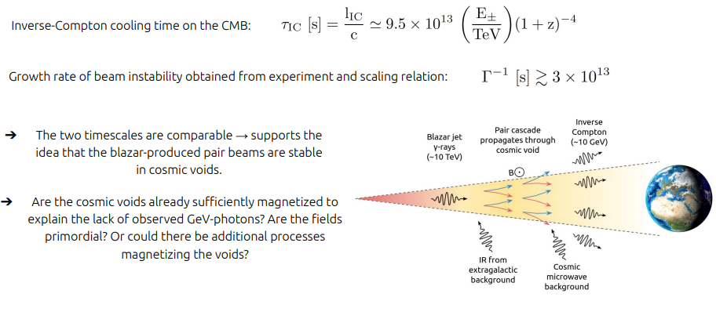
Application: Scaling the growth rate to blazar pair jets propagating through the void

Slide 26
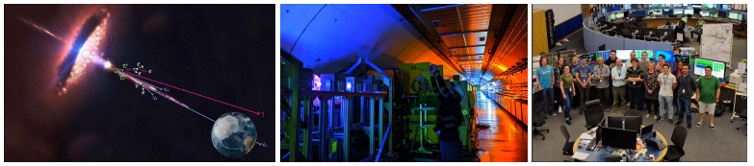
CERN Fireball Summary
➔ We have presented a platform at CERN for producing high-yield electron-positron pair beams to study
stability and energy dissipation mechanisms in ambient plasmas.
➔ In preliminary analysis of the first campaign, we have seen confirmation of the high-yields of e+/e−
predicted by FLUKA simulations (watch this space). We have put a preliminary upper bound on the beam
instability growth rate - the result supports behaviour shown in PIC simulations that beam instability is strongly suppressed when realistic assumptions about the beam divergence are assumed.
➔ The experimentally obtained upper bound has been scaled to the astrophysical case of blazar pair jets and the results imply that the pair beams should be stable to plasma instability in the cosmic voids.

Slide 27
Photon-Photon Scattering

Slide 28
Photon-Photon Scattering
Electron-positron fluctuations can mediate a pure quantum
interaction among laser beams in the vacuum in many ways
Multi-PW laser systems may open the possibility of observing for the first time direct photon-photon scattering in vacuum
Lundstroem et al., Phys. Rev. Lett. 2006
A matterless double-slit setup has been put forward
Ben King et al., Nature Photonics 2010

Slide 29




Photon Photon Scattering
An effective field theory containing only the electromagnetic fields can be formulated in terms of the Heisenberg-Euler Lagrangian.
Valid for field strengths below the QED critical field 10¹⁶ V/cm and for wavelengths larger than the Compton wavelength 10⁻¹⁰ cm.
The Heisenberg-Euler Lagrangian is
For Four wave interaction
Scattered wave electric field
Lundstrom et al PRL, 2006,
Lundin et al Phys Rev A, 2006

Slide 30
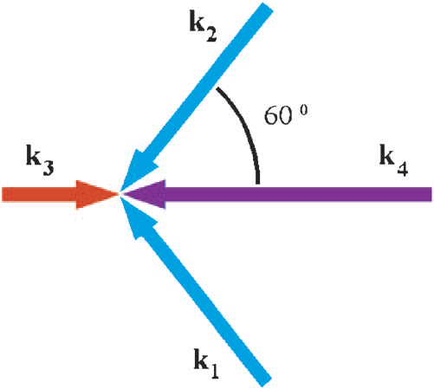
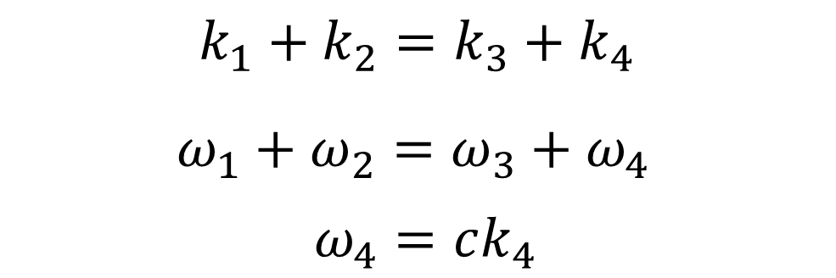
Proposed four-wave mixing experiment
2D Geometry
Matching conditions
k₄ is the scattered beam
Three incident PW class laser beams will generate a fourth beam k₄ with measurable number of photon per pulse
Problem: in 2D scattered photon k₄ is emitted along beam axis making detection difficult.

Slide 31
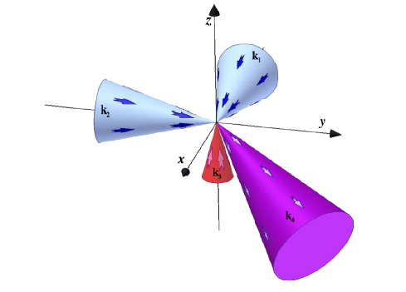

Proposed four-wave mixing experiment
3D geometry
Matching conditions:
k₄ is the scattered beam
Three incident PW class laser beams will generate a fourth beam k₄ with measurable number of photon per pulse (assuming Heisenberg-Euler Lagrangian)
Lundstrӧm et al., PRA (2006)
Number of scattered photons per shot N_{γ}
Laser power [PW] N_{γ}
0.5 0.27
1 2

Slide 32
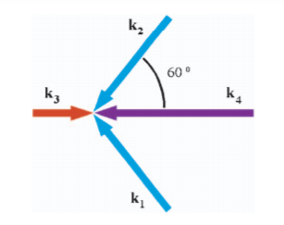

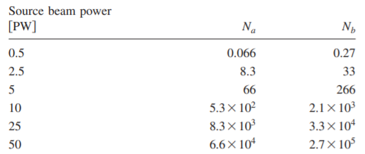
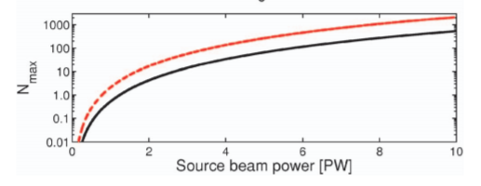
Photon Photon Scattering
Number of scattered photons
N_{a} 2 pump waves, N_{b} 3 pump waves.
Lundstrom et al PRL, 2006,
Lundin et al Phys Rev A, 2006

Slide 33
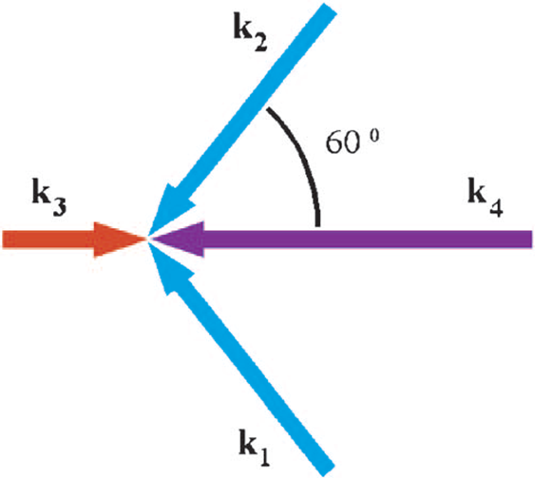
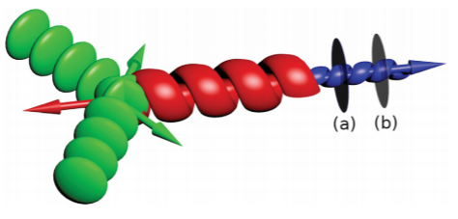
Photon Photon Scattering using Orbital angular momentum lasers
Three incident PW class laser beams will generate a fourth beam k₄ with measurable number of photon per pulse
Lundstrom et al PRL, 2006,
Lundin et al Phys Rev A, 2006
Lasers with OAM interact producing a unique OAM l mode
structure making for easier differentiation.
R. Aboushelbaya, et al Physics of Plasmas, 27(5):053107, 2020.
R. Aboushelbaya et al Phys. Rev. Lett., 123:113604, 2019.

Slide 34
Photon-Axion Coupling

Slide 35
Parametric co-linear axion photon instability
Axions and axion-like particles generically couple to QED via the axion-photon-photon interaction. This leads to a modification of Maxwell’s equations known in the literature as axion-electrodynamics.
The new form of Maxwell’s equations gives rise to a new parametric instability in which a strong pump decays into a scattered light wave and an axion. This axion mode grows exponentially in time and leads to a change in the polarisation of the initial laser beam, therefore providing a signal for detection.
Currently operating laser systems can put bounds on the axion parameter space, however longer pulse lengths are necessary to reach the current best laboratory bounds of light-shining through wall experiments.
We will demonstrate the existence of a new parametric decay instability of one photon in the seed pulse into an axion and a secondary photon, satisfying
Beyer et al PRD, 839, 137759, 2023

Slide 36
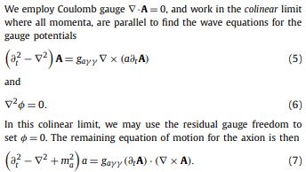


Nonlinear photon axion coupling
Axions generically couple to Standard Model photons via the Lagrangian
The axion-photon vertex (1) introduces a source
and current to the vacuum Maxwell’s equations
Equations 5-7describe the nonlinear coupling between the photons and axions
A stability analysis yield the dispersion relation

Slide 37


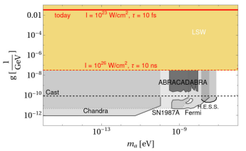
Nonlinear photon axion coupling
Solving the dispersion equation results in intense laser beams generating axions with a growth rate:
The instability is sensitive to axion masses satisfying:
Results
Axion exclusion plot indicating past experiments and the current work. The coloured regions correspond to purely laboratory based experiments; grey scale indicates astrophysical and dark matter bounds, yellow results from light-shining through wall experiments are shown.
Beyer et al PRD, 839, 137759, 2023

Slide 38


Searches for heavy axion like particles with the Eu.XFEL
Most laboratory axion searches have concentrated on the 0.001-0.1 meV mass range however there is growing interest in heavier (DFSZ) axions above 10 meV
A new laboratory search for axions at EuXFEL Hamburg, sensitive to a mass range including 1 meV-1keV.
Our work is a first step in developing a platform with improved sensitivity thanks to an increase in brightness by ~10^10 at EuXFEL.
The experiment exploits the Primakoff effect through the Lagrangian.
Two Germanium (Ge) crystals oriented in the Laue geometry and parallel to one another. The s-polarised XFEL beam impinged from the right and so there was a parallel component between the B-field associated with the XFEL beam and the effective electric field of the crystal.
Jack W. D. Halliday, et al. Bounds on Heavy Axions with an X-Ray Free Electron Laser. Phys. Rev. Lett. 134, 2025. DOI: https://doi.org/10.1103/PhysRevLett.134.055001.

Slide 39


Axion searches at EuFEL Results
Reconverted photons observed using a JUNGFRAU3 hybrid pixel detector. The device was operated in a time-gated mode, with an acquisition time of 2 µs, centred on the X-Ray pulse trains. The XFEL was operated at 10 Hz, in a seeded mode, with a photon energy of 9.8 keV and one pulse per train.
Exclusion diagram indicating the bounds imposed
by our initial experiment (red).
Proposed changes for future experiments:
• Implement an active cooling scheme to mitigate the heat load on crystals
• XFEL can increase X-Ray flux.
• Moving to a Bragg scattering geometry with HOPG (graphite) crystal will increase interaction length by factor ~ 50.
These changes improve sensitivity by a factor of 10⁴.
Halliday et al 2025.

Slide 40
Photon-gravitational wave coupling

Slide 41

Detecting gravitational waves via the inverse Gertsenshtein effect
In presence of a magnetic field, gravitons can convert into photons and vice-versa.
M Gertsenshtein Soviet Physics JETP 14, 84-85 (1962).
Gertsenshtein demonstrated that the process is similar to neutrino flavour oscillations.
The photon axion mixing is also essentially the same process.
In plasma the photons can also mode couple to plasmons described by similar equations.
The MSW effect couple neutrinos with electron density gradients.

Slide 42


Detection of high-frequency gravitational waves using high energy lasers
Inverse Gertsenshtein effect
Laser photons backscatter from Gravitational waves
Process maximized when gravitational wave frequency is twice the laser frequency.
Experiment using high energy lasers to
Observe high frequency gravitational waves
The range 10¹³ -10¹⁹ Hz for strains h $≥$10⁻²⁰
ω_{g} = 2ω
G Vacalis et al., Class. Quantum Gravity 2023.

Slide 43


Detection of gravitational waves using high energy lasers
G Vacalis et al Class. Quantum Gravity 2023

Slide 44
Electroweak plasma instabilities
Two stream instability
Neutrinos driving electron plasma waves v ~ c
Anomalous heating in SNe II
Collisionless damping of electron plasma waves
Neutrino Landau damping
Anomalous cooling of neutron stars
Electroweak Weibel instability
Generation of quasi-static B field
Primordial B and structure in early Universe

Slide 45
Neutrino dynamics in dense plasma
Dynamics governed by Hamiltonian (Bethe, ‘87):
G_{F} - Fermi constant
n_{e} - electron density
Effective potential due to weak interaction with background electrons
Repulsive potential
Force on a single electron due to neutrino distribution
Ponderomotive force* due to
neutrinos pushes electrons to
regions of lower neutrino density
Force on a single neutrino due to electron density modulations
Neutrinos bunch in regions of
lower electron density
* ponderomotive force derived from
semi-classical (L.O.Silva et al, ‘98) or quantum formalism (Semikoz, ‘87)

Slide 46
Anomalous heating by neutrino streaming instability
Neutrino heating to re-energize stalled shock
Sufficient neutrino energy deposited into electron energy to restart the stalled shock and explode the star.
(Silva et al., PoP 2000)

Slide 47
Neutrino Landau Damping I
What if the source of free energy is in the plasma?
Thermal spectrum of neutrinos interacting with turbulent plasma
Collisionless damping of EPWs by neutrinos moving resonantly with EPWs
v_{ν} = v_{φ}
N_{ν}
Physical picture for electron Landau damping (Dawson, ‘61)
v_{ν}
General dispersion relation describes not only the neutrino fluid instability but also the neutrino kinetic instability
(Silva et al, PLA 2000)

Slide 48
Neutrino Plasma Interactions
Intense neutrino beam generates relativistic plasma waves by the two-stream instability.
Neutrinos can be accelerated by plasma waves.
Neutrinos may be responsible for supernovae explosions.

Slide 49
Unruh Radiation?

Slide 50

Probing Event Horizon
Chen and Tajima, PRL (1999)

Slide 51

Detecting Unruh Radiation

Slide 52
Conclusions
Lasers are closing in on the intensity frontier.
New compact accelerators in the 10’s GeV
New compact light sources.
Fundamental physics using lasers developing fast.

Slide 53




Fundamental Physics During Violent Accelerations
Estimate the electric field strength for which the energy gain of an electron accelerated over one Compton length equals the electron rest energy:
$\frac{ℏ}{mc}×{eE}_{cr}\sim mc^{2}≈{10}^{16}V/cm$
This defines the critical electric field in QED
$$I_{cr}=\frac{cE_{cr}^{2}}{8π}=4.6×10^{29}W/{cm^{2}}$$
The acceleration of a free electron in this case is so
violent that the interaction is nonlinear.
Probing $E_{cr}$ tests QED in a completely different non-perturbative regime
A regime not covered by Standard Model
The strong-field QED regime is largely unexplored

Slide 54

Photon-photon scattering with multiple high power laser beams
The excitation of quasi-particle states gives rise to a quantum vacuum which is polarized and magnetized
As a result, there is a non-zero third order non-linear susceptibility which allows for wave mixing, etc.
Formally, start with a Born-Infeld Lagrangian
Where $κ$ is a coupling constant (standard electrodynamics is retrieved with a proper choice for the coupling). This accounts for the possibility of a modified electrodynamics theory
The idea is to test with Lagrangian (and the electromagnetic coupling) using three high intensity laser beams to generate a fourth one.
$$ℒ=κ^{2}\left[1−\sqrt{1−\left(E^{2}−B^{2}\right)/2κ^{2}−{\left(E.B\right)}^{2}/16κ^{4}}\right]$$

