Slide 1
Building a Data Analytics Platform for Bioscience
Dr Laura Shemilt
Head of Research Software Engineering
Advanced Research Computing

Slide 2
Outline
Computational Challenges in Bioscience
Examples from The Rosalind Franklin Institute
How our platform meets our challenges
Working with us

Slide 3
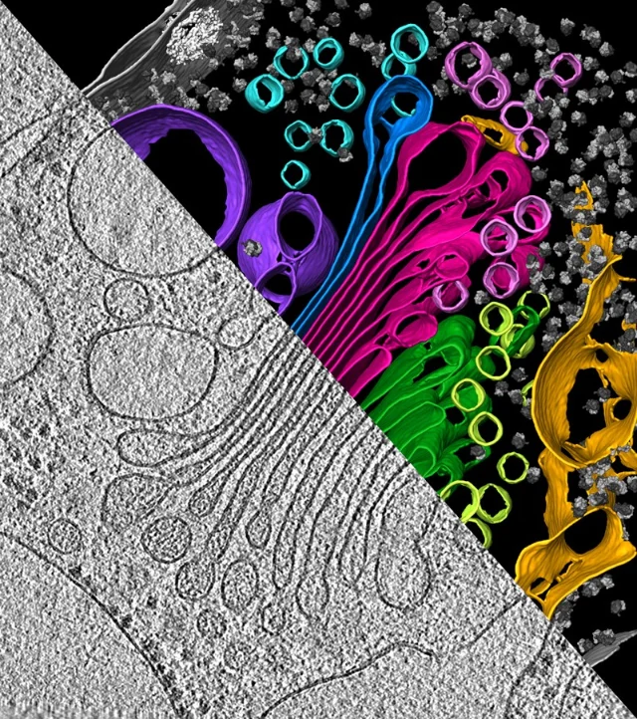
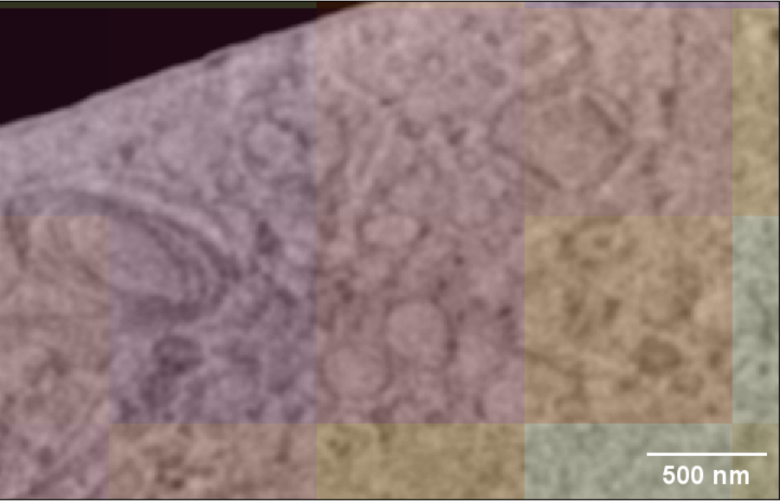
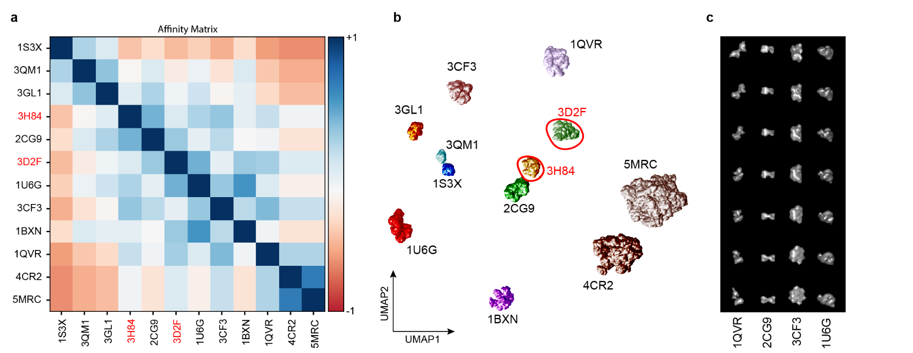
Computational Challenges in Bioscience
HeLa cells, 6.74 nm pixel size, SEM angle = 52°, shaded areas represent different quality metrics. E. Ho et al. The Rosalind Franklin Institute
Learning a representation of protein shapes. (a) The Affinity matrix calculated using SOAP descriptors. (b) UMAP embedding of latent vectors from CNN-aVAE where 3D2F and 3H84 are unseen during training and only used for evaluation. The placement of these proteins in the latent space is as expected from their shape similarity to the training classes. (c) Interpolation within the 1D pose channel for four example
proteins. Image: M. Famili et al. https://arxiv.org/abs/2209.04517v2
Algal cell under cryo-ET shows the endoplasmic reticulum (in yellow), the pouches of the Golgi apparatus (green and magenta) and the vesicles (small circles of various colors). Image: Y. S. Bykkov et al./eLIFE (CC BY 4.0)

Slide 4
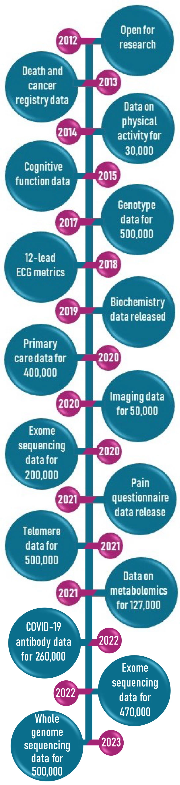
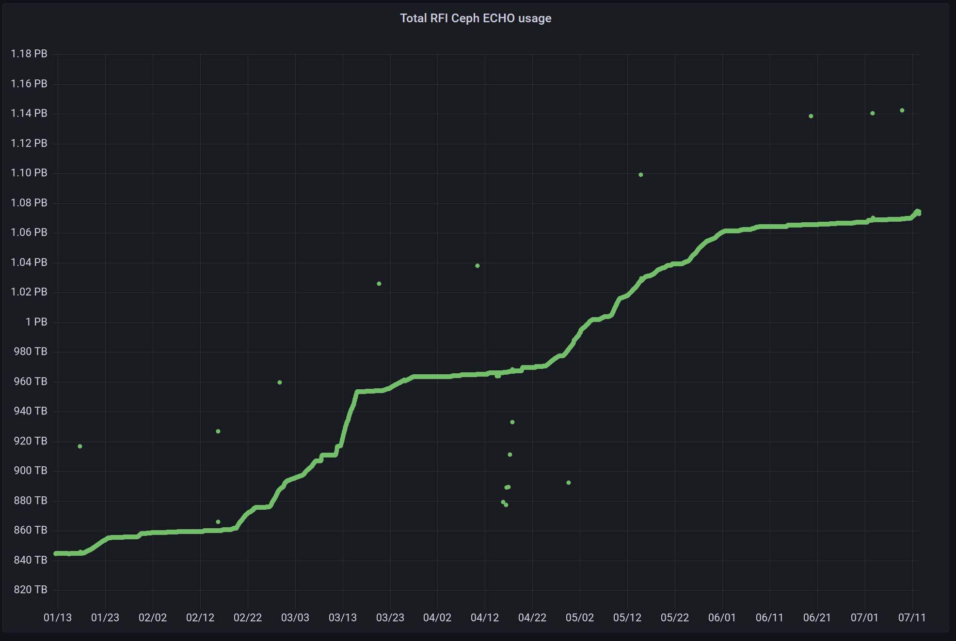

Challenge: Exploding Data Volumes
https://www.ukbiobank.ac.uk/enable-your-research/about-our-data
The Franklin achieved its first petabyte of curated data in July 2024. Currently at 1.6PB of data June 2025.
UK Biobank is 30 PB today and expected to grow to 40PB

Slide 5
Challenge: New methods requiring Advanced Computation
Alphafold2
  At least one NVIDIA GPU with 80GB of RAM (e.g., A100 80GB)
  At least 128GB of RAM
  A CPU with at least 36 available cores
  At least 1250GB of free fast NVMe SSD drive space.
https://docs.nvidia.com/nim/bionemo/alphafold2/latest/prerequisites.html
GenAI
  High end GPU NVIDIA Tesla v100, A100
  32 GB + RAM
  Fast storage
LLM
  OLLAMA (https://ollama.com/) project compresses these to run on your laptop

Slide 6
Cost Implications
Model | Compute | Estimates from Digital Ocean in USD
Alphafold 2 | 1x NVIDIA H100 + 5TiB NvME | $ 96 per day
Llama4 | 64 GiB RAM + 16 vCPU + 400 GiB SSD | $ 24 per day
FBGaN | 1x NVIDIA RTX 6000 ADA + 500GB NvME | $ 45 per day

Slide 7
Challenge: Software
Might be accessible but not open source
No installers
Bad documentation
Too old to run on modern hardware with no alternative
No longer maintained

Slide 8

Challenge: New Skills in the sector
Research Software Engineering (RSE)
Version Control
Scaling
Containerisation
UX/UI
Databases
HPC
GPU Acceleration
“A growing number of people in academia combine expertise in programming with an intricate understanding of research…this combination of skills is extremely valuable, the Research Software Engineer was created.”
Advanced Computing Research Centre website, University of Bristol

Slide 9
Examples of Bioscience challenges at The Rosalind Franklin Institute

Slide 10
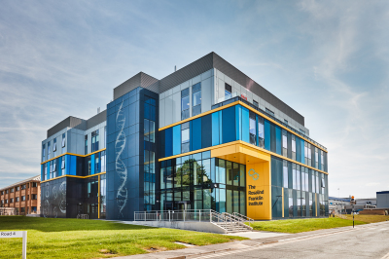
The Rosalind Franklin Institute
technology innovation
transforming life science
improving human health

Slide 11
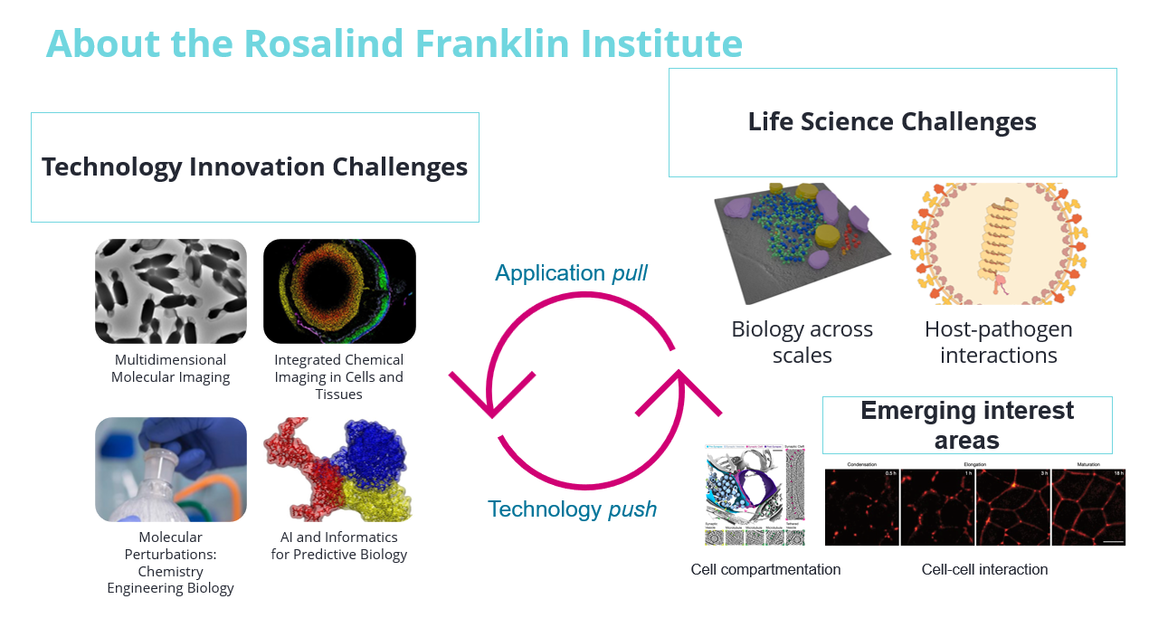

Slide 12
The Rosalind Franklin Institute
Management challenges
Data challenges
Heterogeneous
Compute challenges
Heterogeneous Compute
Software Challenges
70TB per month
Support for different OSs
Some proprietary some open
Instrument Challenges
Restrictions on software installs
Restrictions on network access
Limited local storage
Infrastructural requirements
Data transfers
Fast
Automation Workflows
Efficient
Secure
Robust
Reproducible
Sustainable

Slide 13
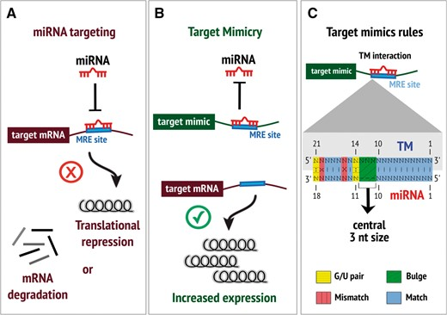
Bioscience Example 1: investigating Mirtrons using GANs
MicroRNAs are a type of non-coding RNA used in inhibiting genes
Mirtrons are a type of microRNA
They are hard to identify and sequence leading to a very small dataset of sequences
Alisson Chiquitto , Dr Alexandre Paschoal, Dr Mark Basham- The Rosalind Franklin Institute

Slide 14
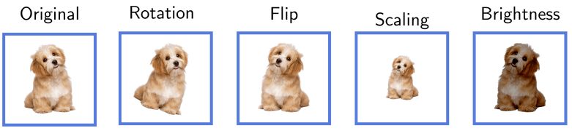

Bioscience Example 1: investigating Mirtrons using GANs
Small datasets lead to:
Overfitting
Limiting features
Difficulty in training models
With Images we can augment our data using properties of the image, but how do we do this for sequence data?
5’ GCTTTATTC 3’
miRNA
5’ GCTTTATTC 3’
5’ CTTATTTCG 3’
miRNA?
Delete nucleotides?
???
Alisson Chiquitto , Dr Alexandre Paschoal, Dr Mark Basham- The Rosalind Franklin Institute

Slide 15
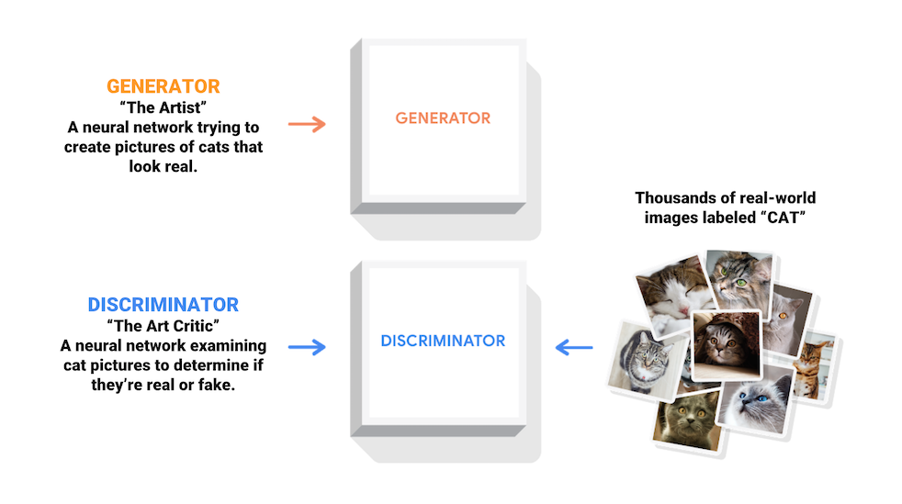
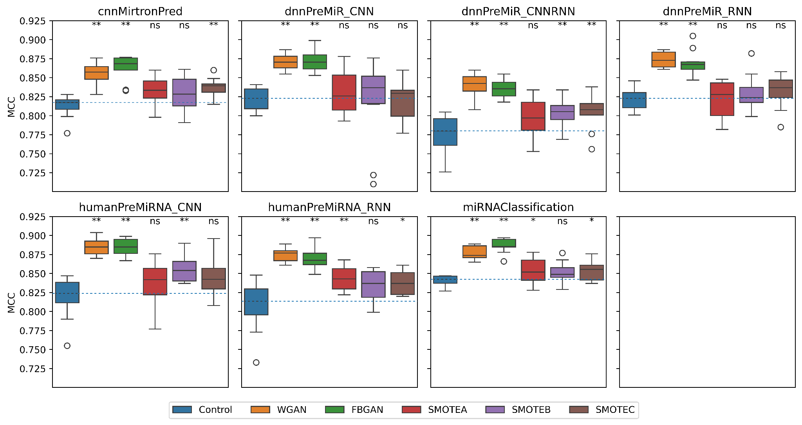
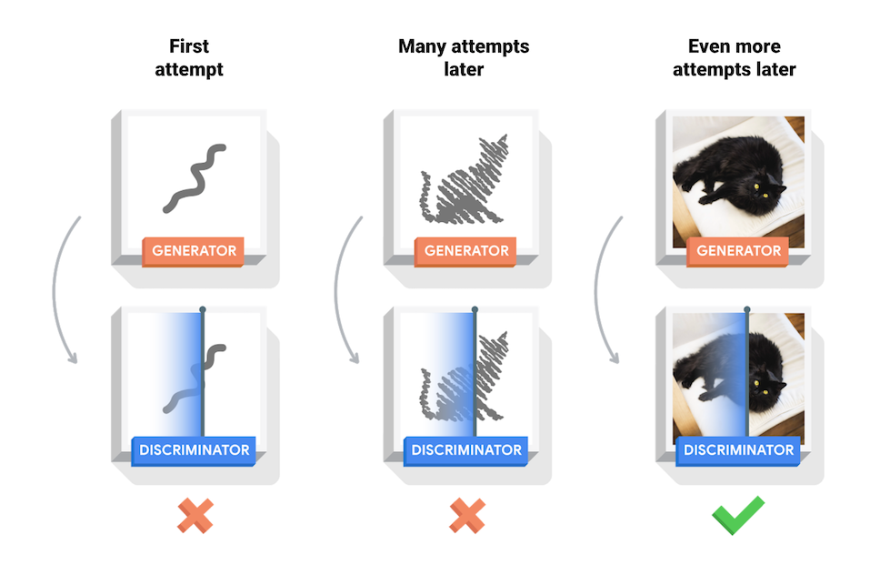
Bioscience Example 1: investigating Mirtrons using GaNs
Alisson Chiquitto , Dr Alexandre Paschoal, Dr Mark Basham- The Rosalind Franklin Institute

Slide 16
Bioscience Example 1: Computational Requirements
Computation – 4 x A100 GPU
80 GB VRAM
300 TB Storage
Requirement: Virtual Machine

Slide 17
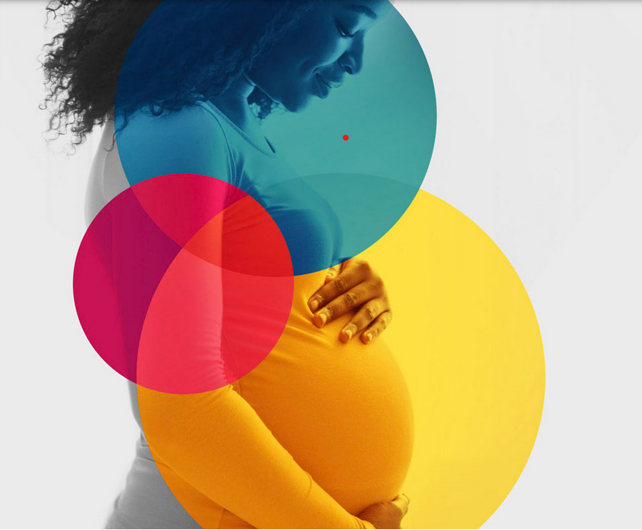
Bioscience Example 2: Analysing Placenta to improve birth outcomes
Women’s Health is Human Health
Every 16 seconds a baby is still born
We need better ways to assess gestational development in utero
https://wellcomeleap.org/inutero/
Dr Avery Pennigton, Dolapo Adebo, Sam Kersley and Dr Michele Darrow - The Rosalind Franklin Institute

Slide 18
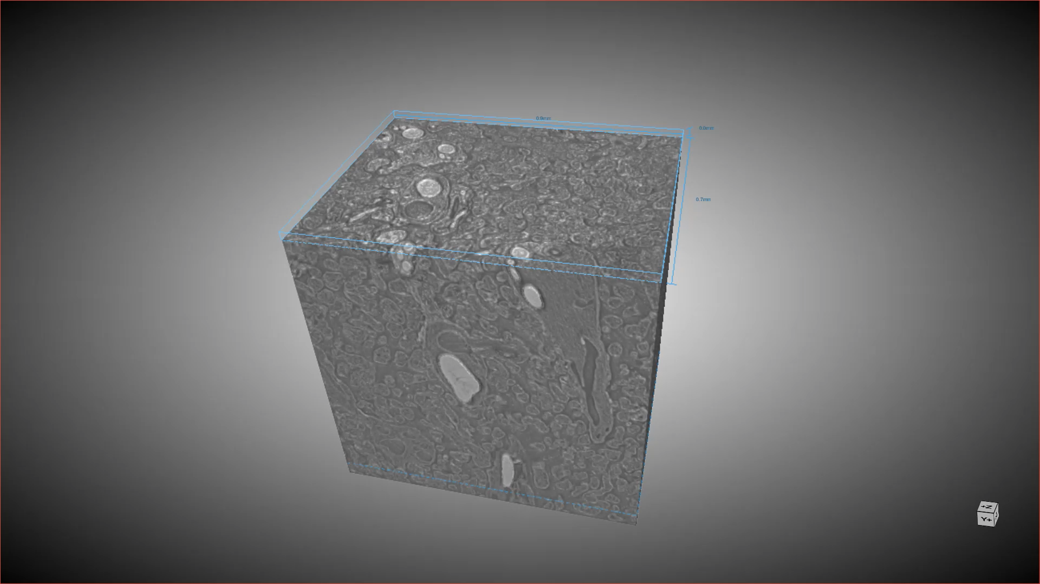
Bioscience Example 2: Analysing Placenta
Dr Avery Pennigton, Dolapo Adebo, Sam Kersley and Dr Michele Darrow - The Rosalind Franklin Institute

Slide 19
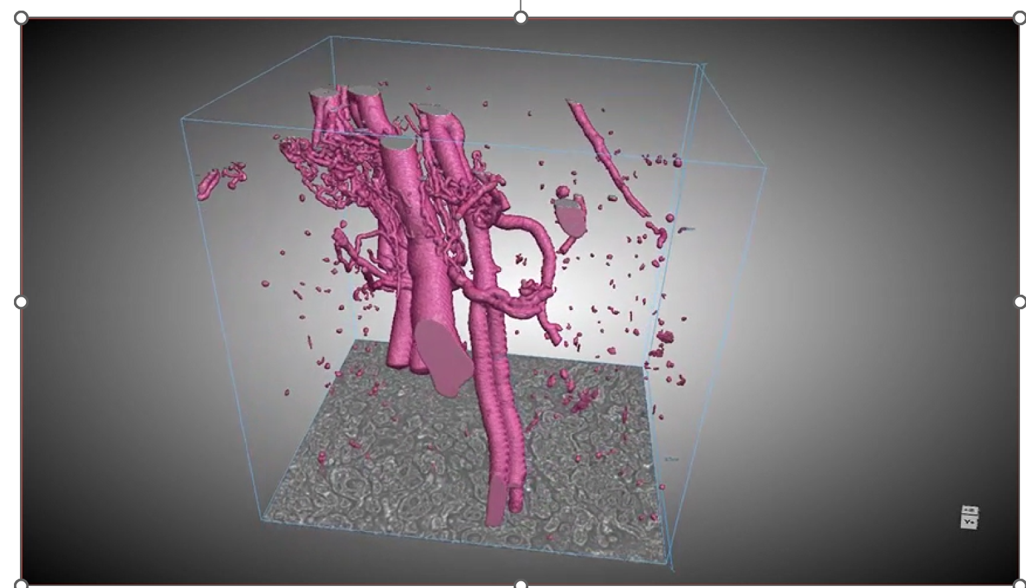
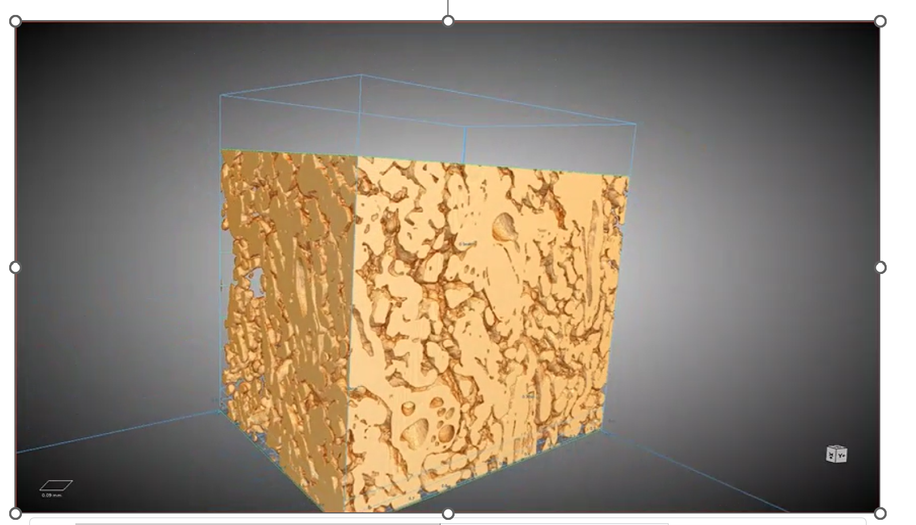
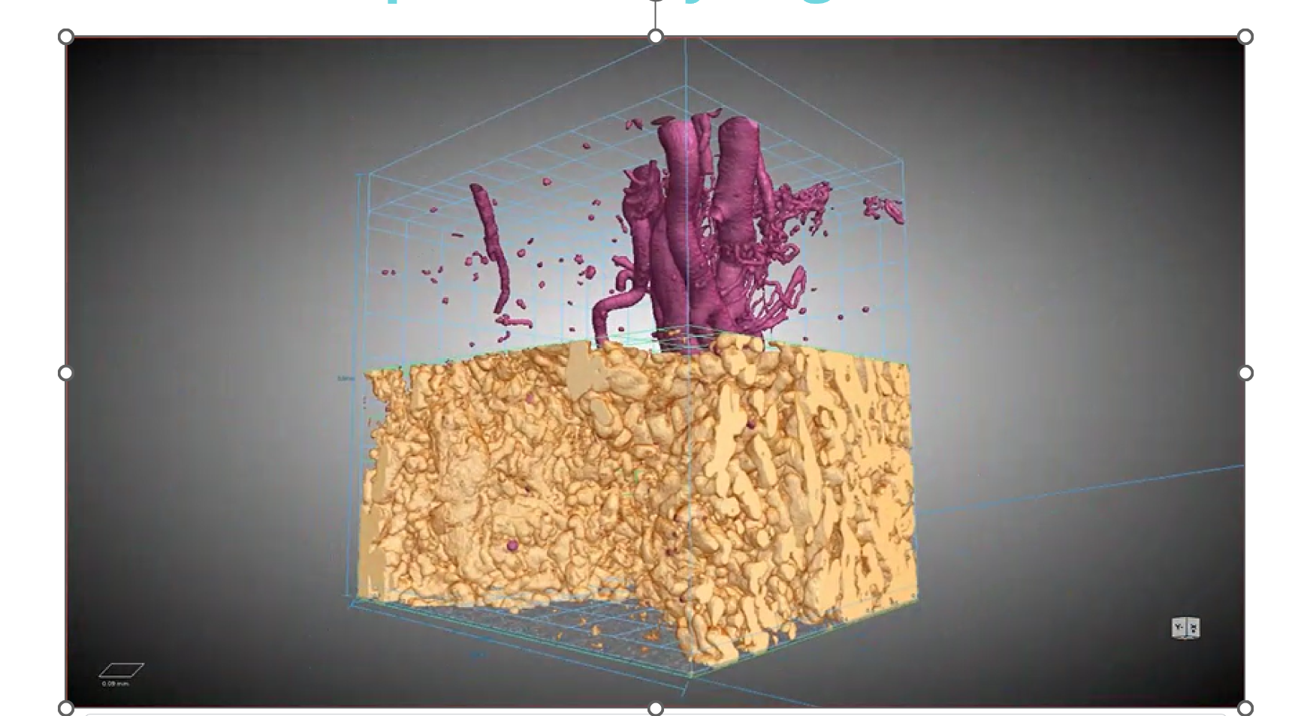
Bioscience Example 2: Analysing Placenta

Slide 20
Bioscience Example 2: Computing Requirements
Computation: 20-30 GPU hours – NVIDIA A100 per Image
200 GB node VRAM
scale to x2 or x4 compute nodes
Requires: High Performance Computing
Dr Avery Pennigton, Dolapo Adebo, Sam Kersley and Dr Michele Darrow - The Rosalind Franklin Institute

Slide 21
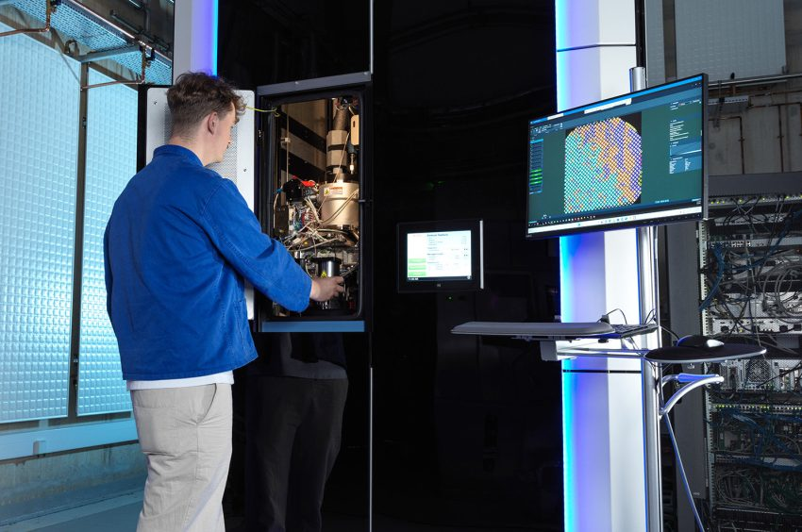
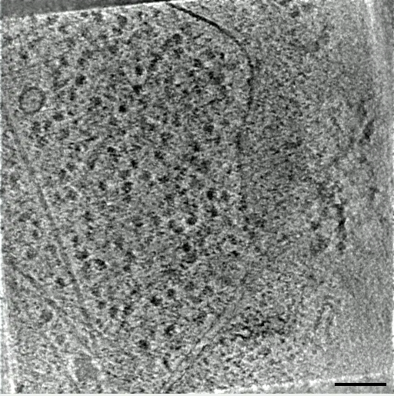
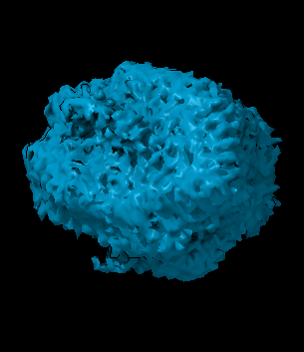
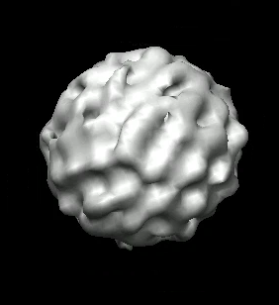
Bioscience Example 3: Building an automated pipeline for Subtomogram Averaging
Dr Elaine Ho, Dr Neville Yee, Dr Maud Dumoux, Dr Michele Darrow and Dr Mark Basham - The Rosalind Franklin Institute

Slide 22
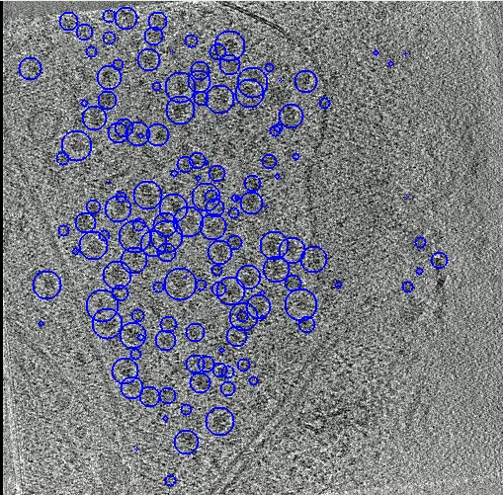
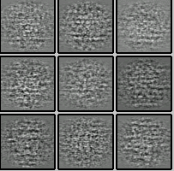
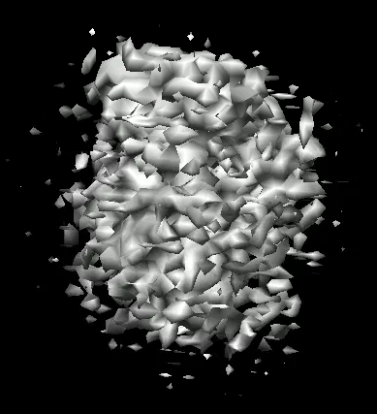
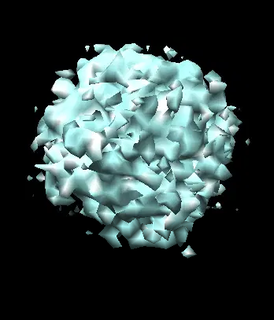
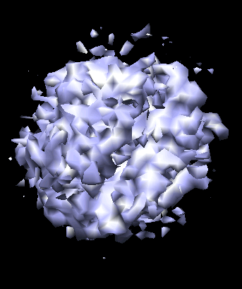
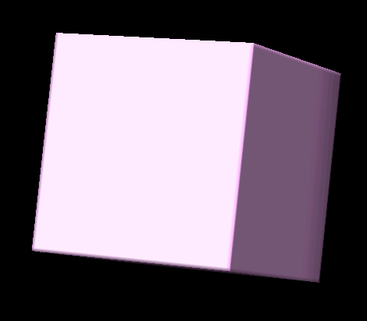
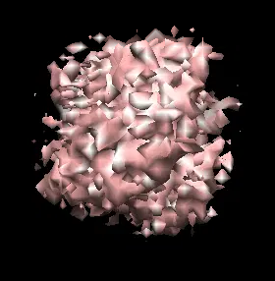
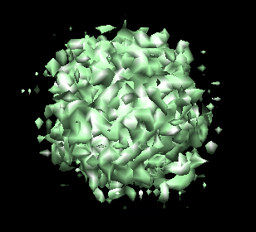
Bioscience Example 3: Building an automated pipeline for Subtomogram Averaging
Motion + CTF correction
Align + reconstruct tomograms
Particle picking
Subtomogram extraction
Initial/
reference model
3D classification
3D refinement
Final structure of interest
Dr Elaine Ho, Dr Neville Yee, Dr Maud Dumoux, Dr Michele Darrow and Dr Mark Basham - The Rosalind Franklin Institute

Slide 23






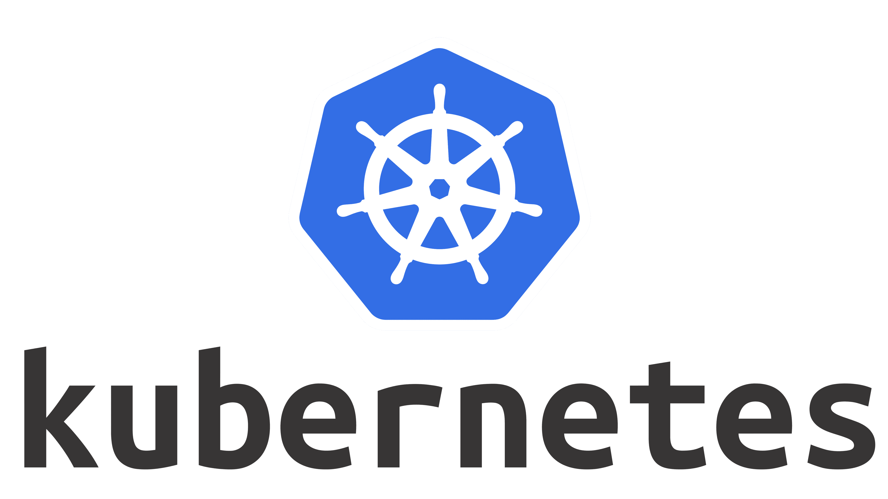

Bioscience Example 3: Computational Requirements
Microscope
Visualisation
View images in the browser (Neuroglancer)
View reports on quality metrics
Heterogenous architecture large number CPU , 1x GPU – v100 or higher
Large Data volumes
High throughput
Consistent approach
Requires: Cloud Native (Kubernetes)
Subset selection
Choose most promising data for further analysis
Curate training data for machine learning
Publish
Scicat records contain information needed for community databases, e.g., EMDB, EMPIAR
CPU jobs
motion correction, CTF estimation
GPU jobs
tilt series alignment, tomogram reconstruction, particle picking
ceph-echo longer term storage

Slide 24
Summary of the Bioscience Challenges
Example | Compute Requirements | Challenge | Solution
Augmenting Mirtron Data | GPU, Large Storage | New methods advanced computing | Virtual Machines in Cloud
3D Segmentation of Placenta | GPU, high VRAM, multiple nodes | New methods advanced computing Big data | High Performance Computing Cluster
Pipeline for Sub-Tomogram Averaging | Heterogeneous architecture, high throughput | Big data Advanced computing Legacy Software | Distributed workflow with Kubernetes

Slide 25
Meeting the Challenge

Slide 26
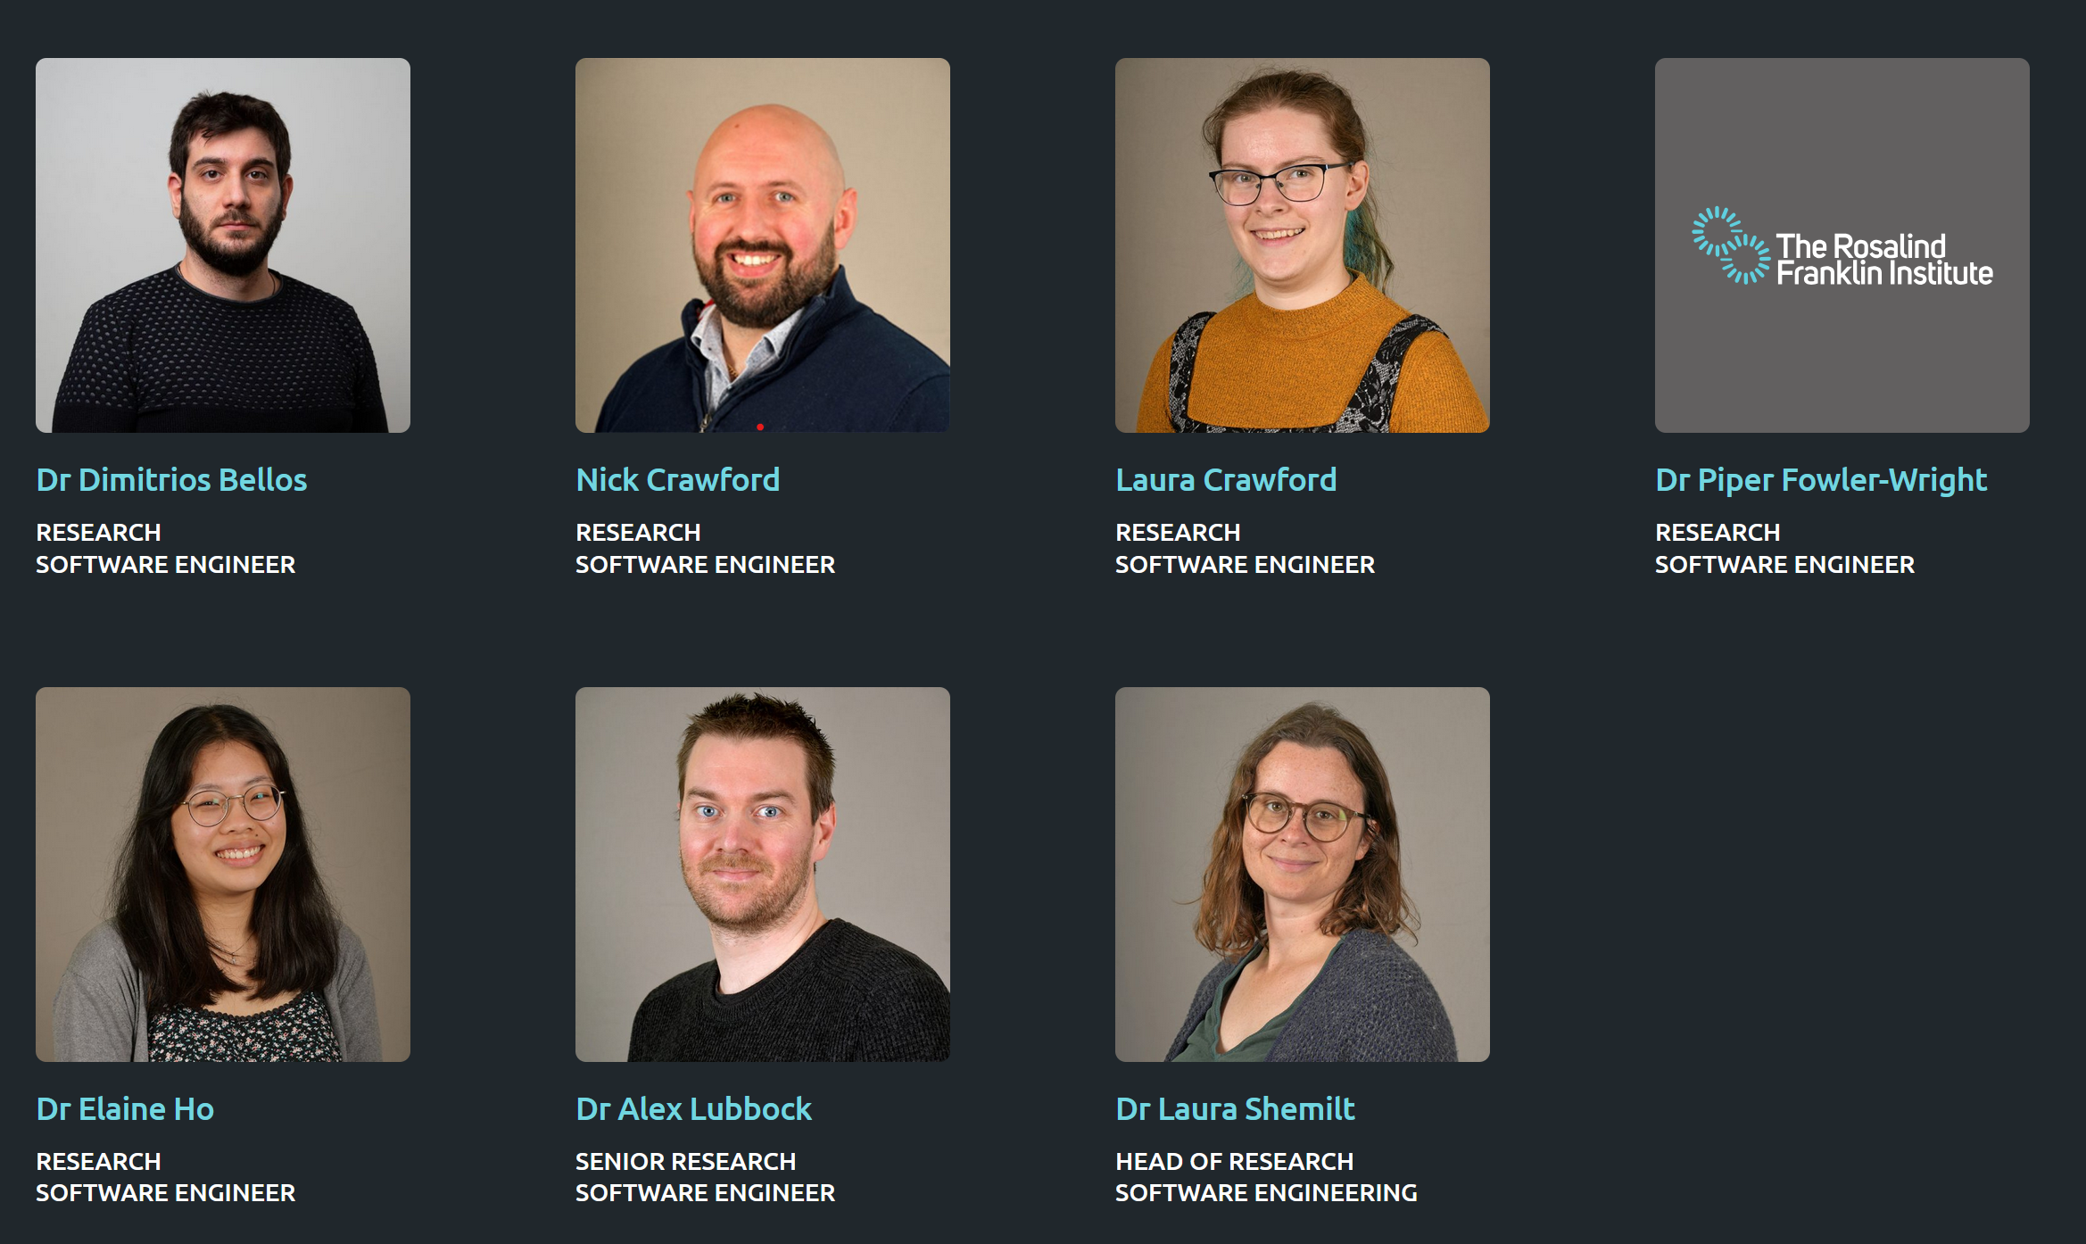
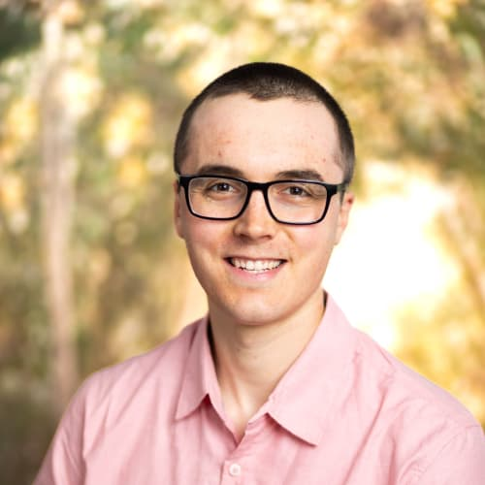
Advanced Research Computing
Advanced Research Computing
Research
Infrastructure
Software Engineering

Slide 27
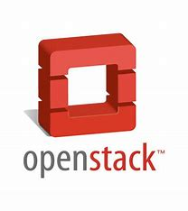


Our Partners: STFC – Cloud Computing
Scientific Computing Division
Private IaaS: GPU and CPU Virtual Machines
Storage provided by CEPH

Slide 28
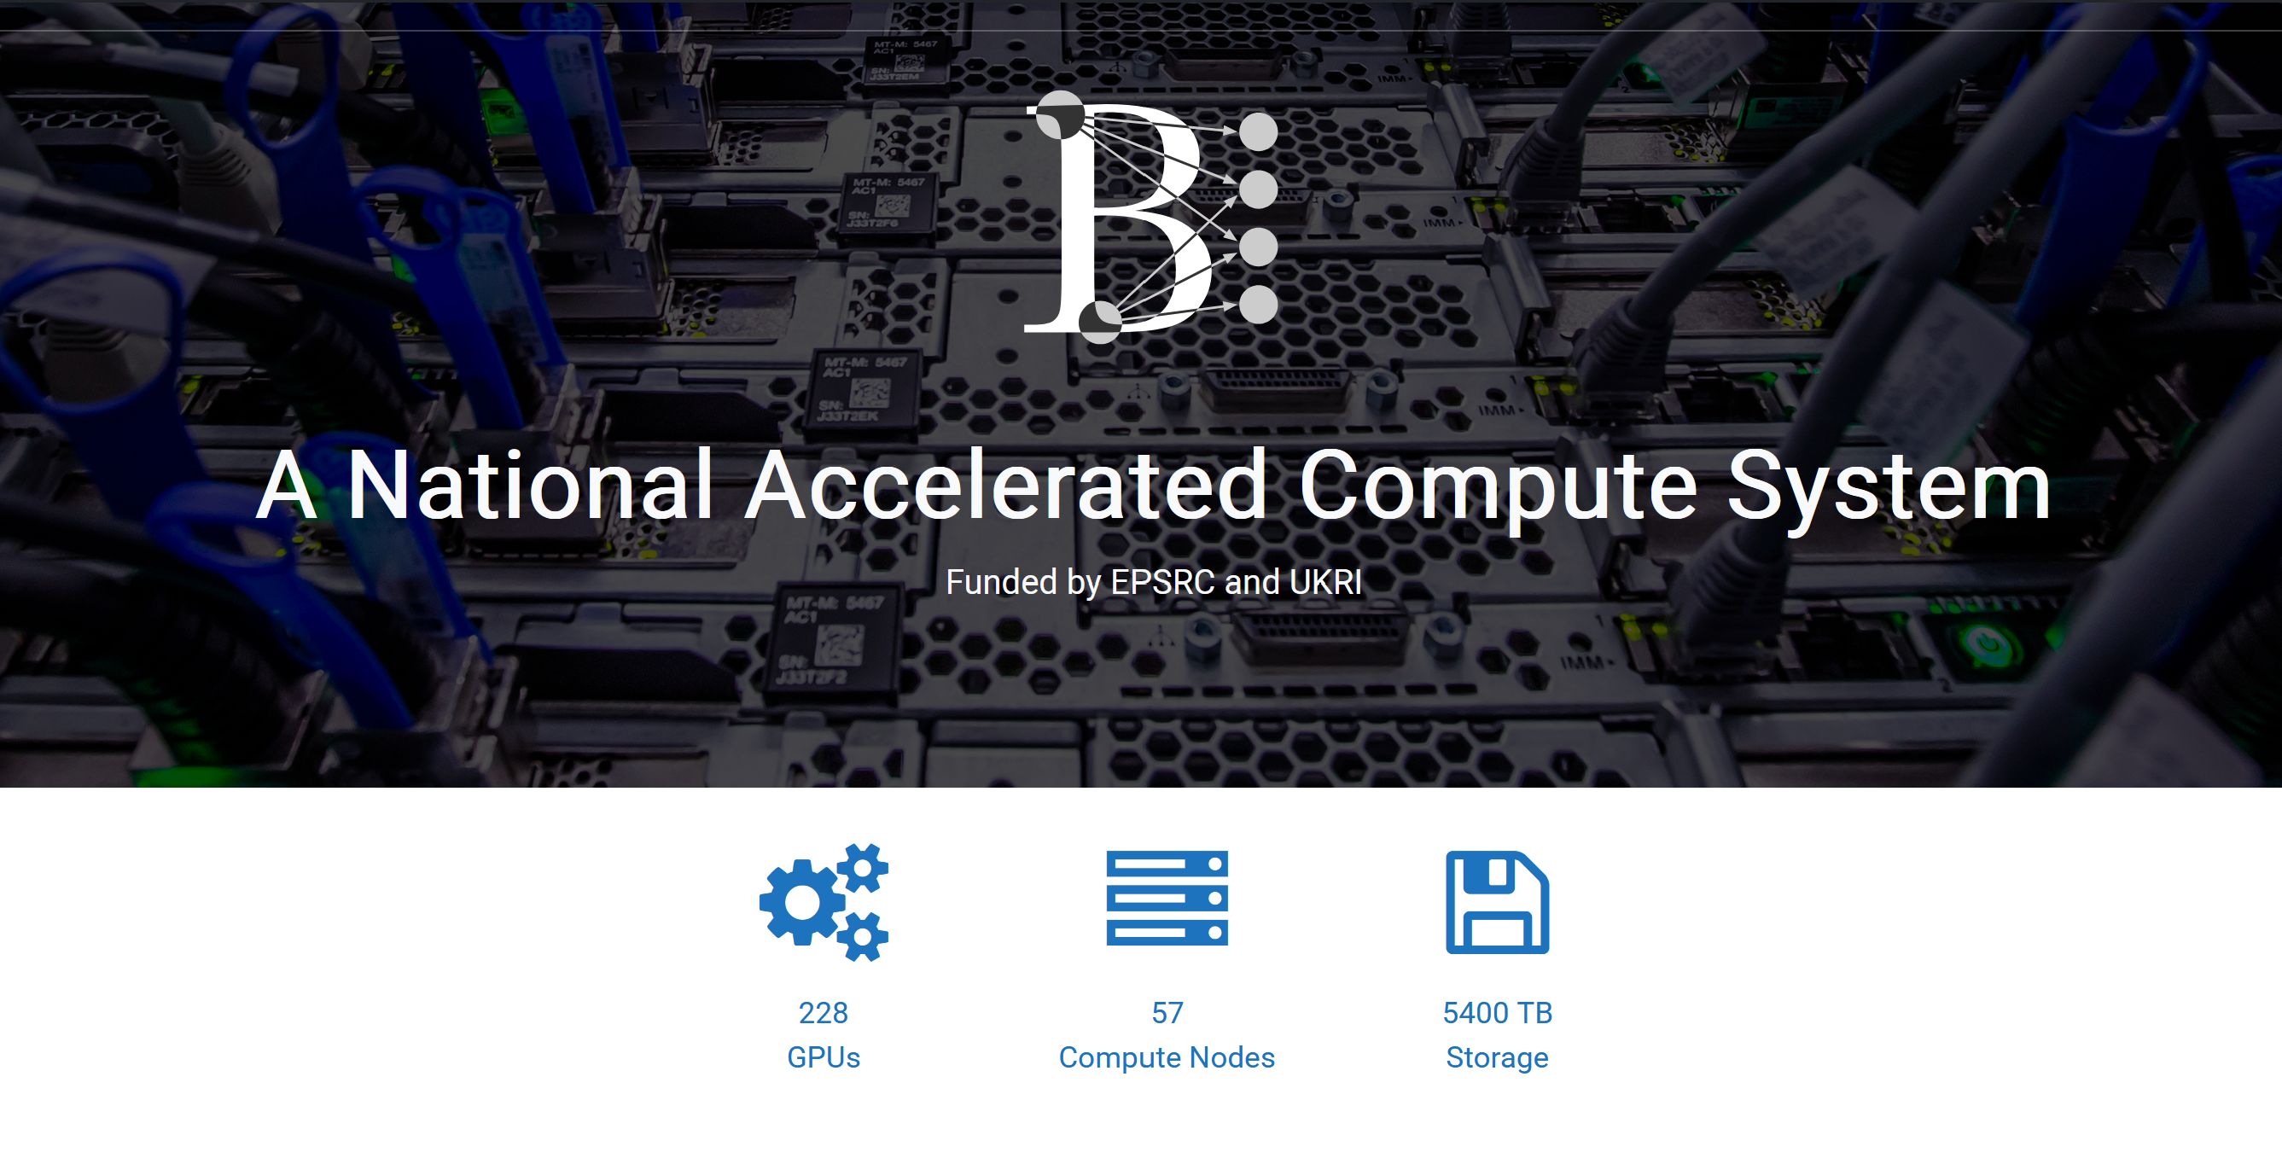




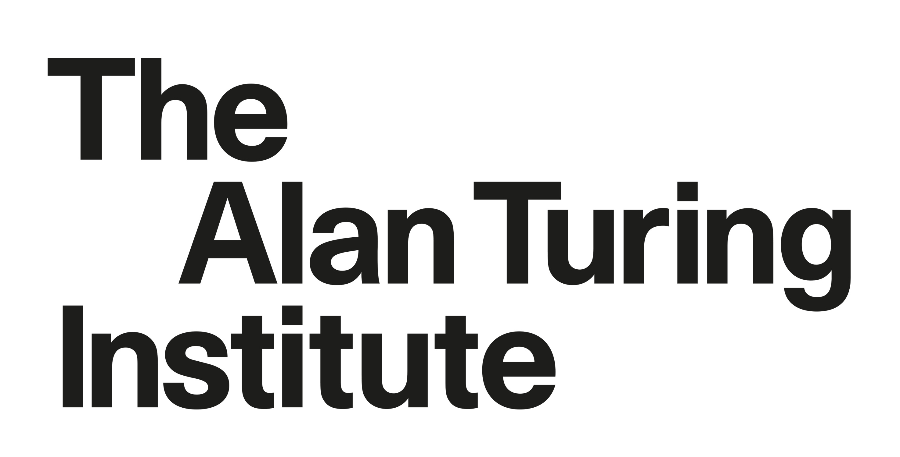
Baskerville– High Performance Computing

Slide 29
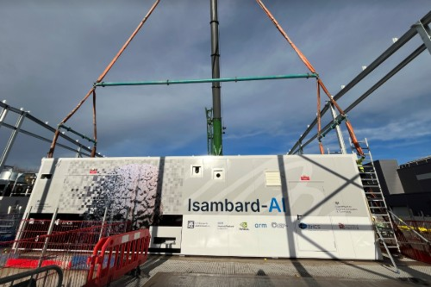
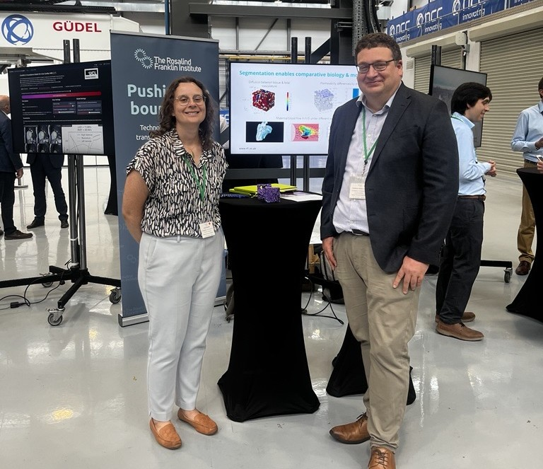
Isambard-AI – The UK’s largest Supercomputer
5280 NVIDIA GH200 Grace Hopper Superchips
Storage 29 PB
The Franklin and University of Southampton at the Isambard-AI Launch, Bristol, July 2025
https://www.bristol.ac.uk/news/2025/january/isambard-ai-govt-action-plan.html

Slide 30
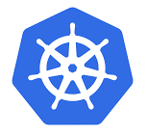


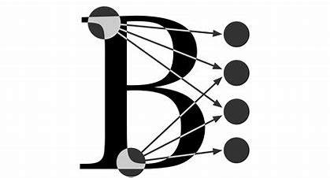

Our platform
Instruments
Cloud
HPC
Metadata catalogue
k8s
Data
Data
Data
Storage

Slide 31
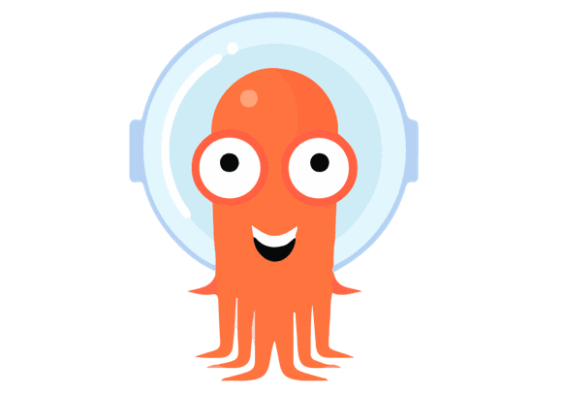

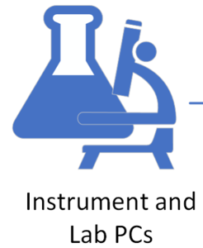






Rosalind Franklin’s GlobusAPI
ArgoWF Workflows - Automated backup of raw instrument data
S3
Ceph Echo S3 Object Storage
Instrument Raw Data
RFI-GlobusAPI
SciCataloggerAPI
Sync Instrument data to Object Storage
Inform MetadataAPI for new files to find metadata
Ingest metadata to SciCat including HTTPS Globus link
MetadataAPI

Slide 32

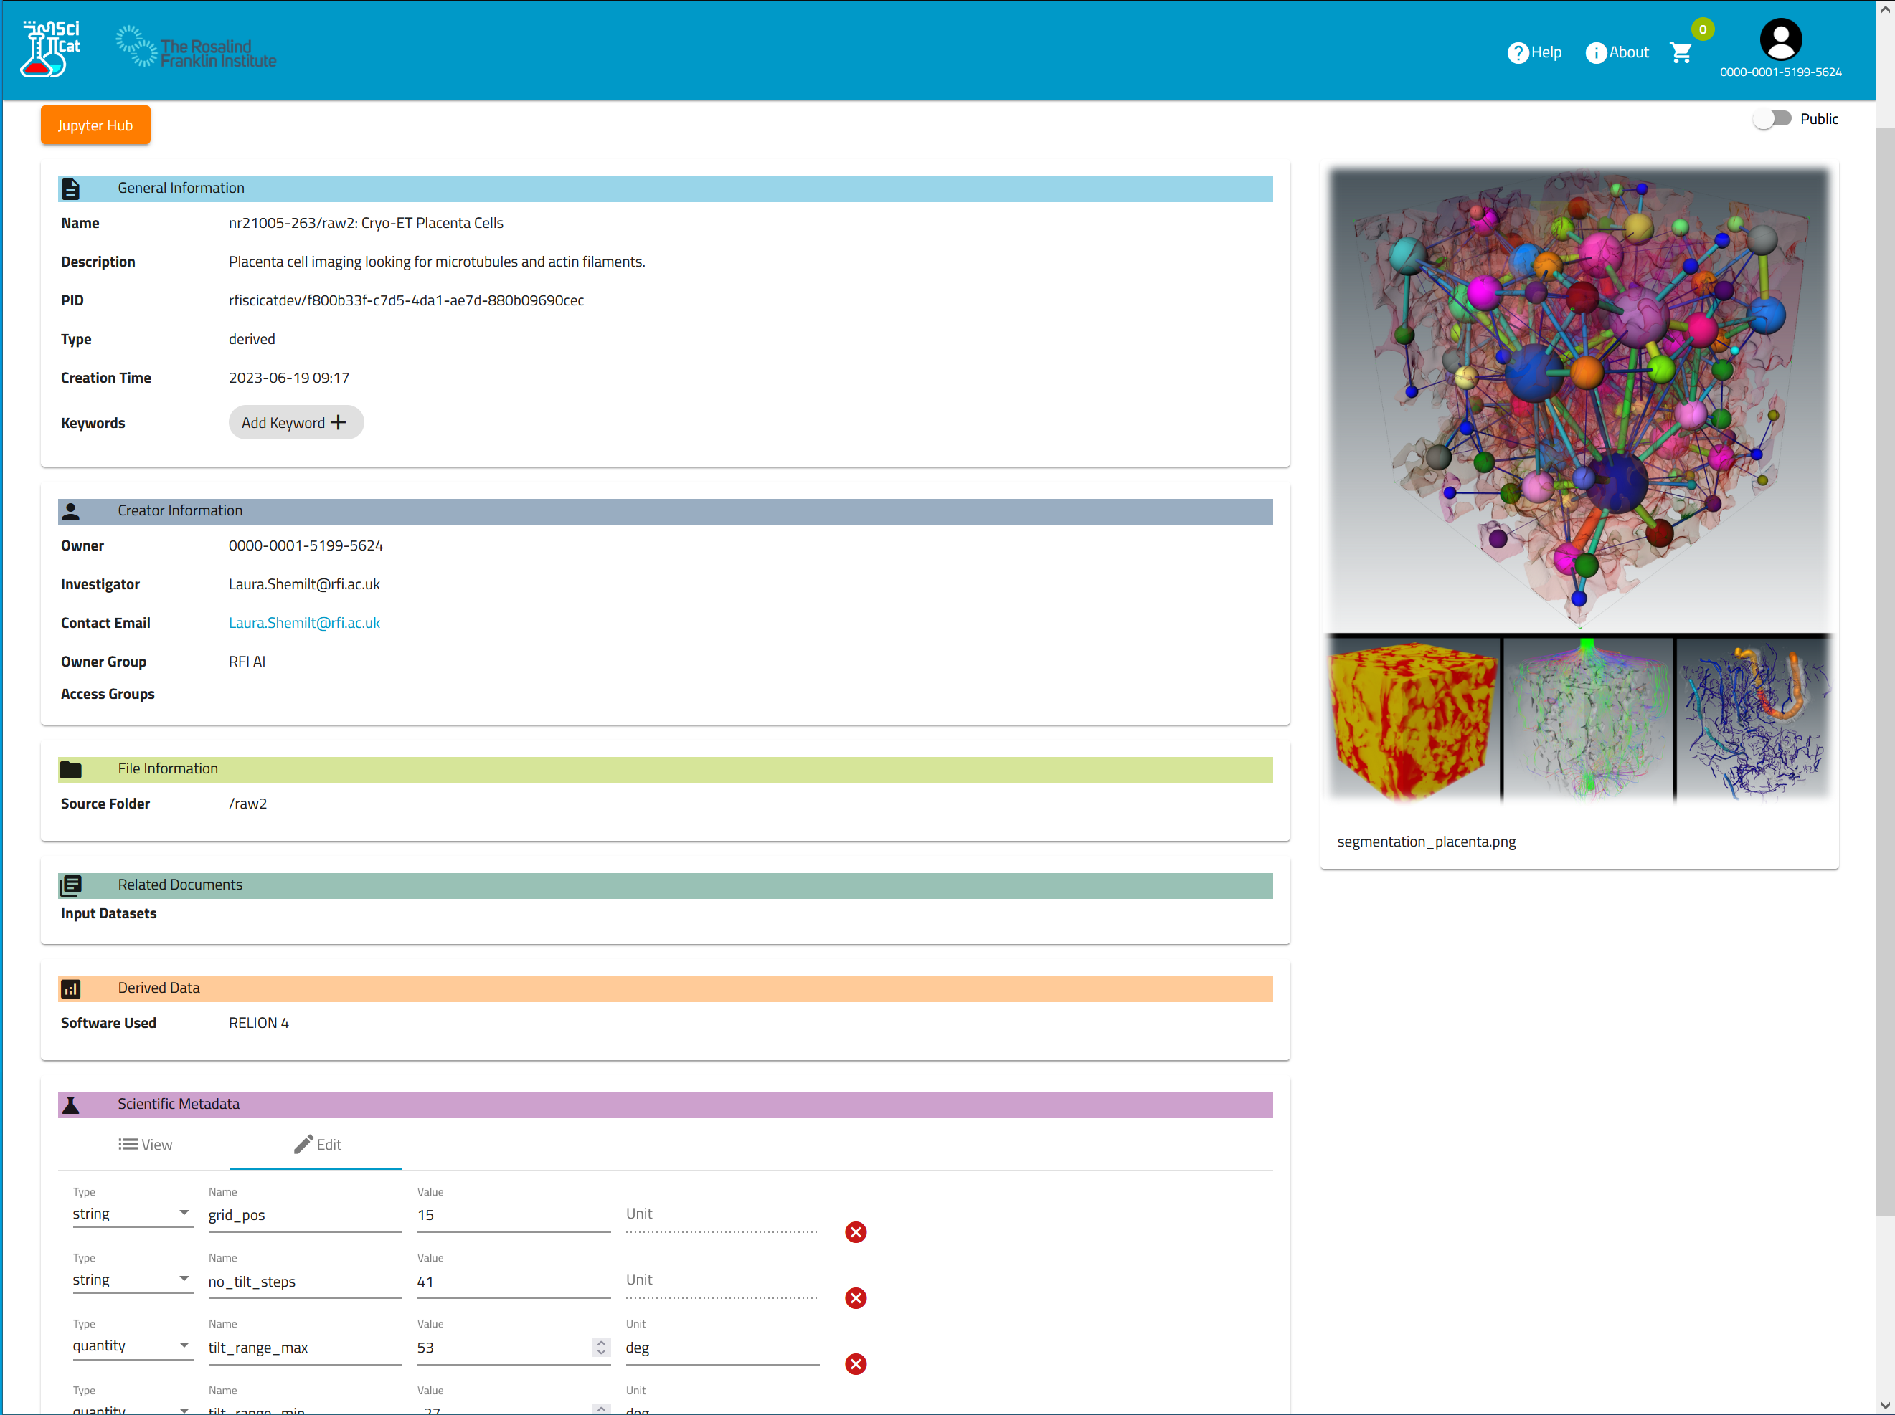
Opensource Metadata Catalogue
Easy to share data between your teams and collaborators
Use SciCat get an overview of your team’s data
Routes to publish data sets and mint DOIs

Slide 33

Do we solve the Bioscience Challenges?
Example | Compute Requirements | Challenge | Solved
Augmenting Mirtron Data | GPU, Large Storage | New methods advanced computing
3D Segmentation of Placenta | GPU, high VRAM, multiple nodes | New methods advanced computing Big data
Pipeline for Sub-Tomogram Averaging | Heterogeneous architecture, high throughput | Big data Advanced computing Legacy Software

Slide 34
Summary
Computational Challenges can be over come
It takes new skills in the sector
Collaboration between scientists/bioinformatitions and RSE software Engineering
It takes effort and is not trivial to do

Slide 35
Working with us

Slide 36

Open Source Software
International metadata catalogue for Science
Website: https://scicatproject.org

Slide 37

Open-Source Software
The rosalindfranklininstitute organisation on Github
FlowCron | ease of use data transfer and slurm script execution
DiSTraX | Distributed storage system in HPC nodes to reduce effects of I/O
Parakeet | TEM digital twin
RFI-Globus-API | easy programmatic interaction with Globus

Slide 38
Thanks to
The Rosalind Franklin Institute
Mark Basham
Michelle Darrow
Alexandre Paschoal
Alex Lubbock
Avery Pennigton
Maud Dumoux
Dimitrios Bellos
Laura Crawford
Elaine Ho
Nick Crawford
Piper Fowler-Wright
Neville Yee
James Parkhurst
Fabiana Roderigues de Goes
Dolapo Adebo
Sam Kersley
Tibor Auer (Former)
Silvia Ramos (Former)
Joss Whittle (Former)
BriCS
Matthew Williams
Christopher Woods
Sadaf Allam
Wahab Kawafi
James Allam
Baskerville
Andrew Morris
Gavin Yearwood
James Allsop (Former)
With special thanks to
Globus
Worktribe
STFC
Martin Summers
Tom Byrne
Jacob Ward
John Good
Aidan McCoomb
SciCat
Max Novelli (ESS)
Dylan McReynolds (ALS)
Carlo Minotti (PSI)
Daphne Van Dijke (Dectris)

