Slide 1


Doctoral focal award: nuclear skills
22 July 2025

Slide 2
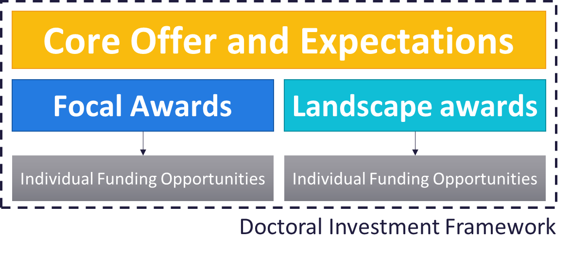
The UKRI Doctoral Investment Framework
We are reframing our support around the two types of doctoral award
Alongside an overarching core offer (published 30 January 2024)
We aim to:
  retain the key features of support in our current schemes while building on their strengths and commonalities
  better support innovative training approaches/models
Blog December 2022: How UKRI will transition to collective talent funding – UKRI​
News November 2023: Update on collective talent funding – UKRI
News January 2024: Update on UKRI doctoral funding and training – UKRI
Web page January 2024: Supporting doctoral students – UKRI
Notes:
From January 2024, all UKRI doctoral funding is simplified into two types of awards:
Doctoral focal awards - delivering a concentration of studentships in combination with a highly tailored training programme, like EPSRC’s centres for doctoral training
Doctoral landscape awards - broad flexible funding to fit the needs of relevant disciplines or sectors. Studentships can be tailored to meet individual project needs.
The difference between the two award types focuses on the general type of investment supported, not operational decisions e.g., both have the potential to support community-driven and targeted opportunities, or certain eligibility criteria.
Both are underpinned by a core offer applying to all UKRI-funded students across all doctoral training investments.

Slide 3
Focal Awards in Nuclear skills
To deliver high quality, cohort-based doctoral training in nuclear skills for the UK nuclear civil and defence sectors, for students starts autumn 2026.
Centres will train the next generation of researchers and innovators in cutting-edge nuclear skills, leading to careers in the UK nuclear sector.
This opportunity will be open to new centres, and to expand or extend existing investments.
Research organisations can only apply as project lead on one submitted application
Funding to be provided by the Ministry of Defence.
Possible additional funding from the Department for Energy Security and Net Zero.
Expected to open July 2025 and close October 2025.
Mandatory intent to submit. Plan to publish details of intent to submit
Notes:
Intent to submit :
Project lead and email address
Project Lead Institution
Collaborating team with institution
Summary proposed focal award
Consent to publish: project lead, institution and summary

Slide 4
Doctoral focal award: nuclear skills timeline
Decisions - Week commencing 19 January 2026
Expert sift Panel
Week commencing 24 November 2025
Funding Opportunity opens 25 July 2025
Webinars
31 July
6 August
19 August
Intent to Submit
12 Sept 2025
Funding Opportunity Closes
23 October
2025
Notify applicants of invite to interview
Interview panels
Week commencing 12 January 2026
Applicants informed week commencing 26 January 2026

Slide 5
Doctoral focal award: nuclear skills - details
Support for students eligible for home fee status
Centres will be funded for 4 cohorts of at least 10 students on 4-year studentships
No restrictions on research doctoral qualification (for example, PhD, EngD)
Lead by EPSRC but scope crosses remits of STFC and NERC
Applications welcome in all areas relevant to nuclear skills across breath of nuclear lifecyle
Additional cash/appropriate in-kind leverage is expected
Webinars
  31 July 2025 11:00am to 12:00pm UK time
  6 August 2025 1:00pm to 2:00pm UK time
  19 August 2025 2:00pm to 3:00pm UK time.
  Please complete the form to register interest in the webinar.
  Teams links will be sent the day before each webinar to everyone who has signed up by that time.
Notes:
Intent to submit :
Project lead and email address
Project Lead Institution
Collaborating team with institution
Summary proposed focal award
Consent to publish: project lead, institution and summary

