Slide 1
UK Nuclear Theory Activity
15 July 2025 @ UoG
Prof Paul Stevenson
University of Surrey

Slide 2
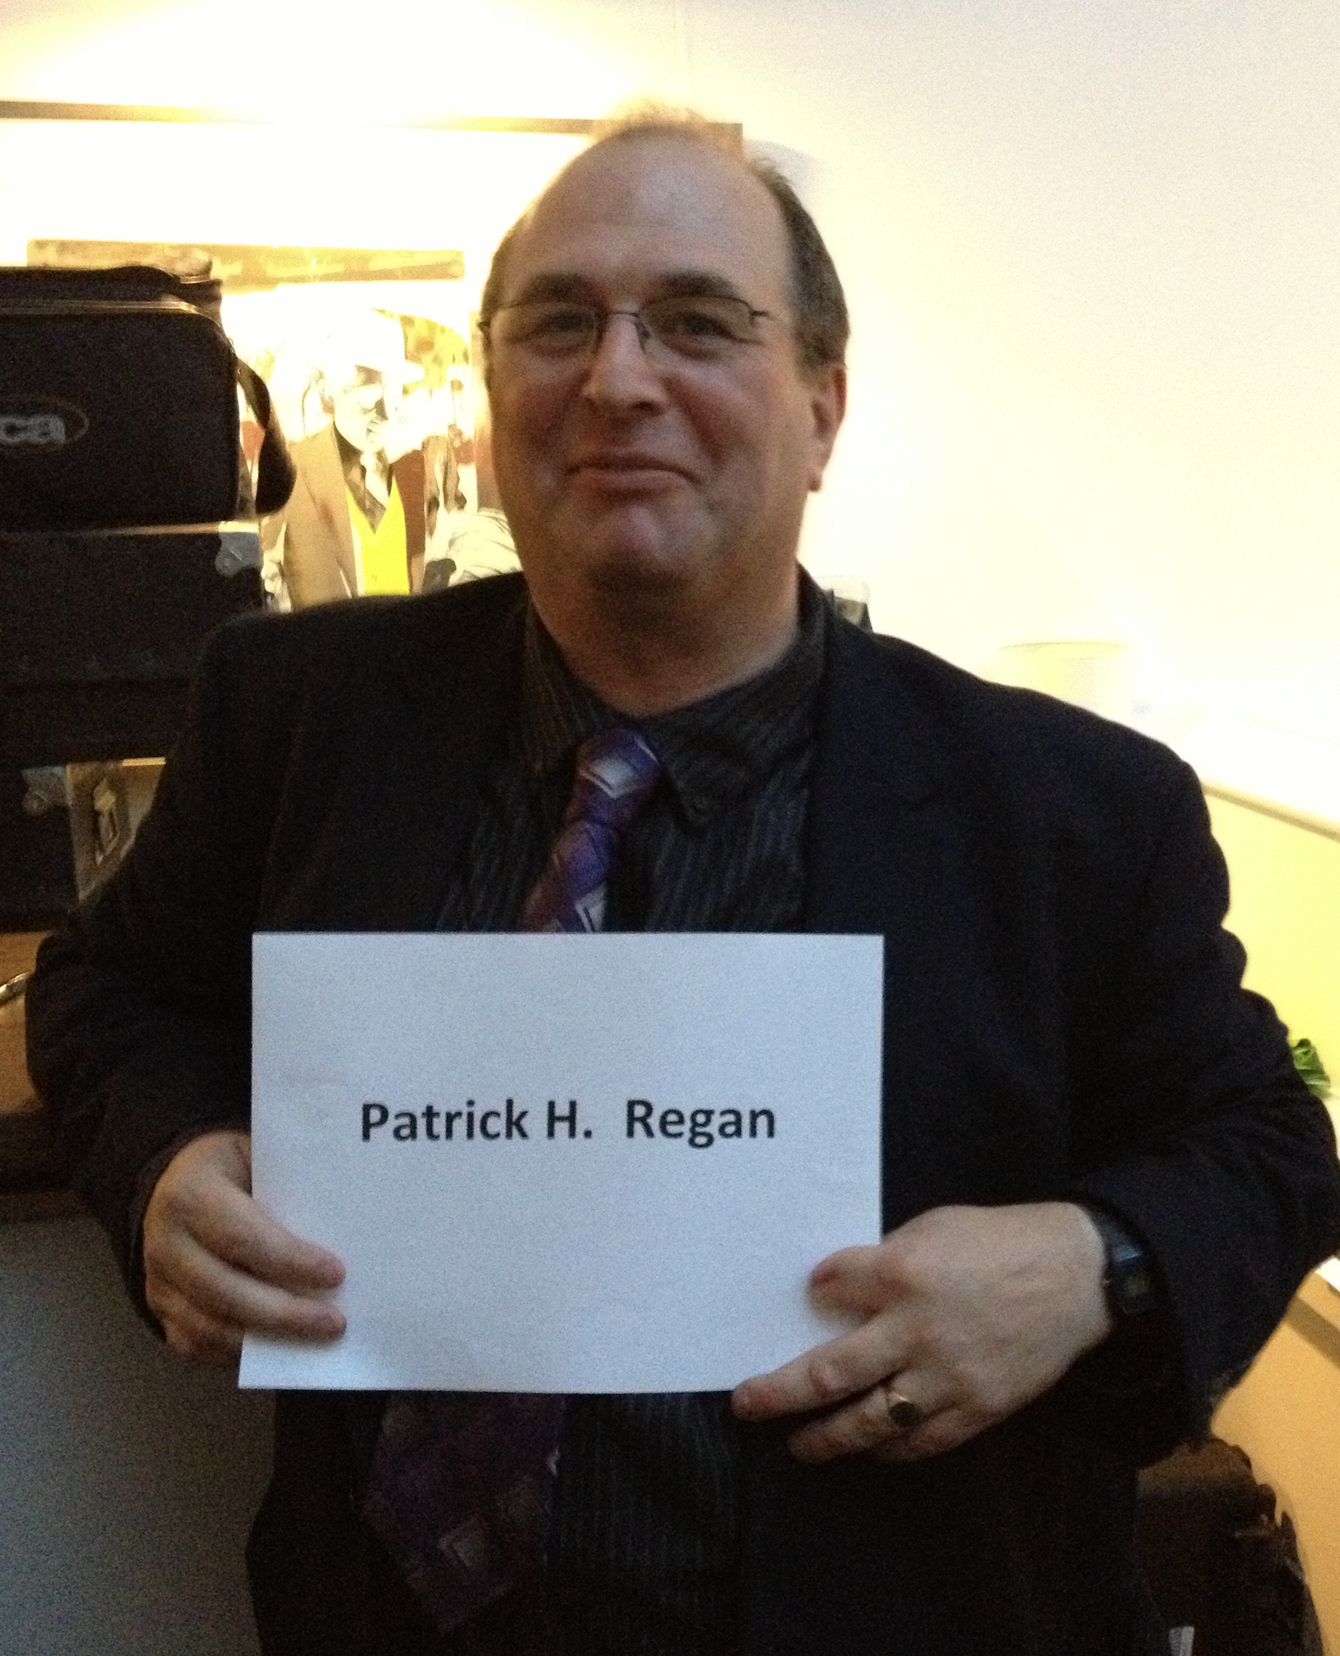

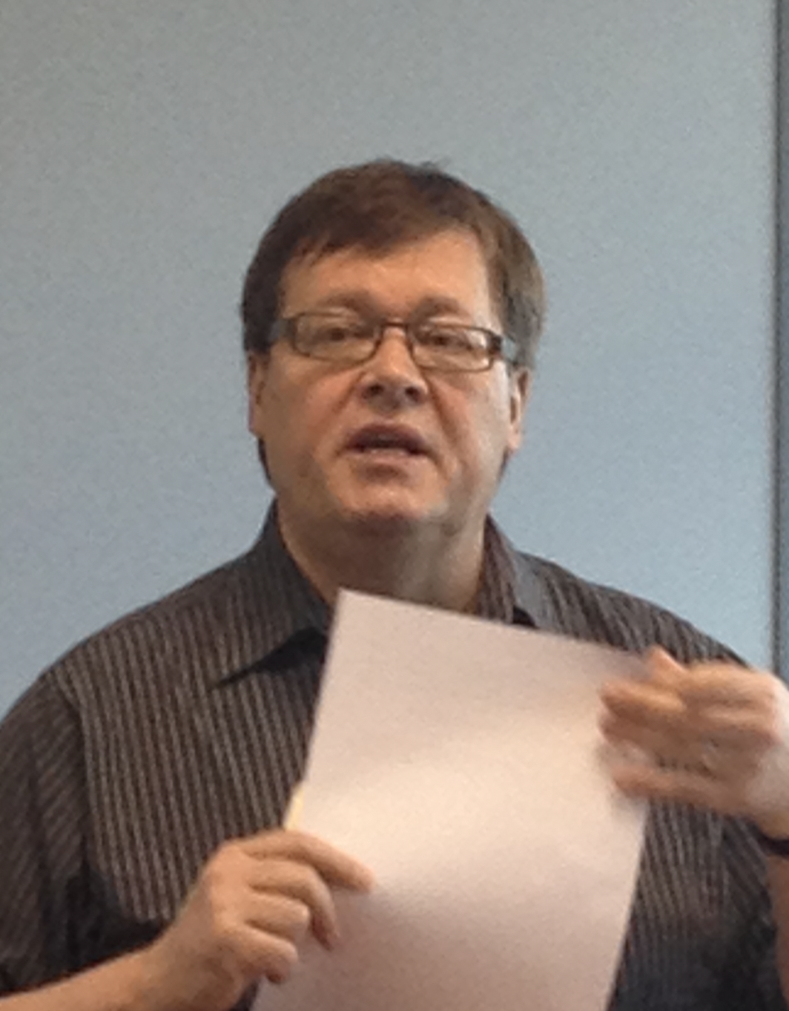



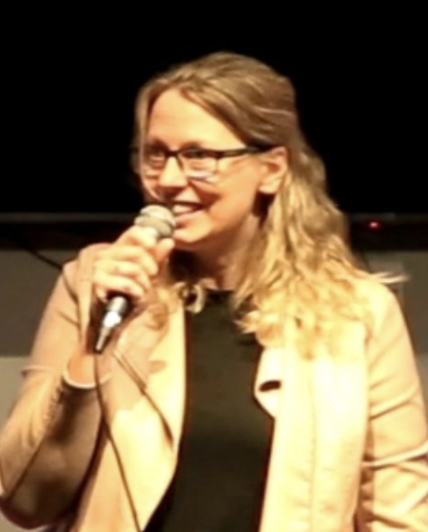
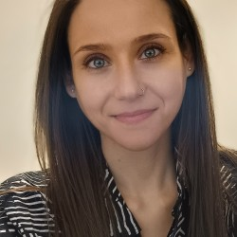
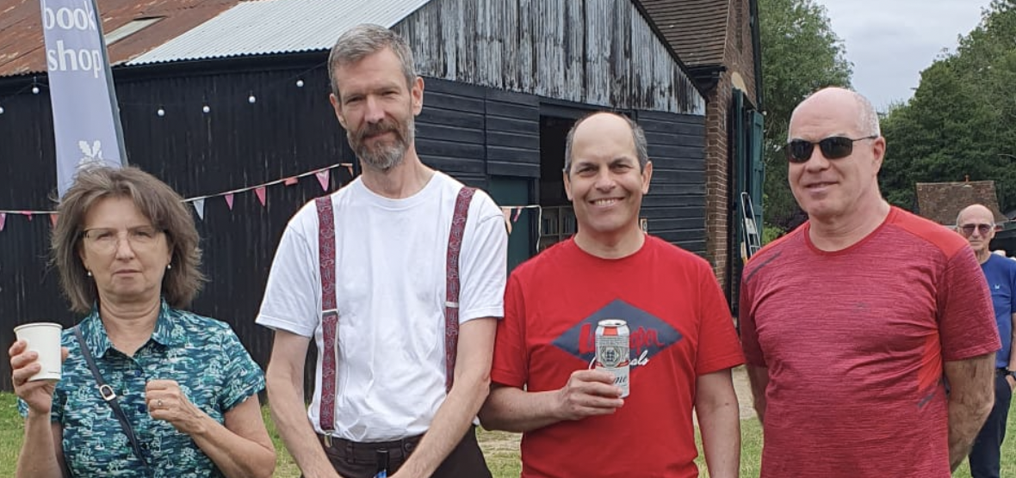
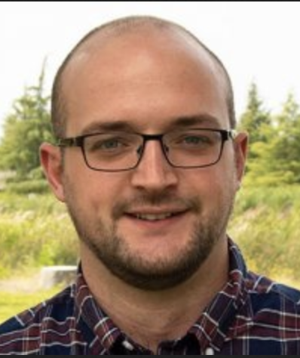

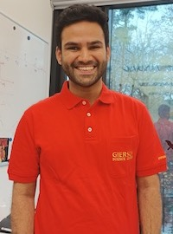
Nuclear group @ Surrey
Gavin Lotay
Wilton Catford
+ Emeritus: Gelletly, Walker, Tostevin, Johnson, Al-Khalili (all published nuclear physics papers in last year)
Dan Doherty
Esra Yüksel
Caroline Shenton-Taylor
Matteo Vorabbi
Lisa Morrison
Paul Stevenson
Zsolt Podolyák
Alexis Diaz-Torres
Matt Williams
Ragandeep Singh Sidhu
Natasha
Timofeyuk
Jack Henderson

Slide 3
Slides For Nuclear Data Meeting
Nuclear Data in the Cosmos
Dr. Matthew Williams
STFC Ernest Rutherford Fellow

Slide 4

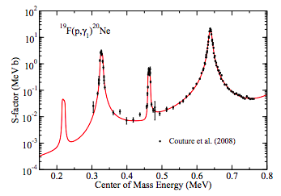

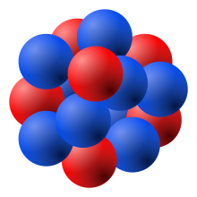





Nuclear Reactions in Stars
Understanding the origin of the elements requires many nuclear physics inputs (masses, half-lives, reaction rates)
Particle Emission
Cross-section depends on:
Number of states.
Energies of states.
Spin & parity of states.
Total and partial decay widths.
$$E_{cm}$$
$$S_{p}$$
$$Q_{α}$$
Almost all reactions in stars proceed via excited states in nuclei.
Proton-, alpha- and neutron-induced reactions being the most common.
Radiative Capture

Slide 5
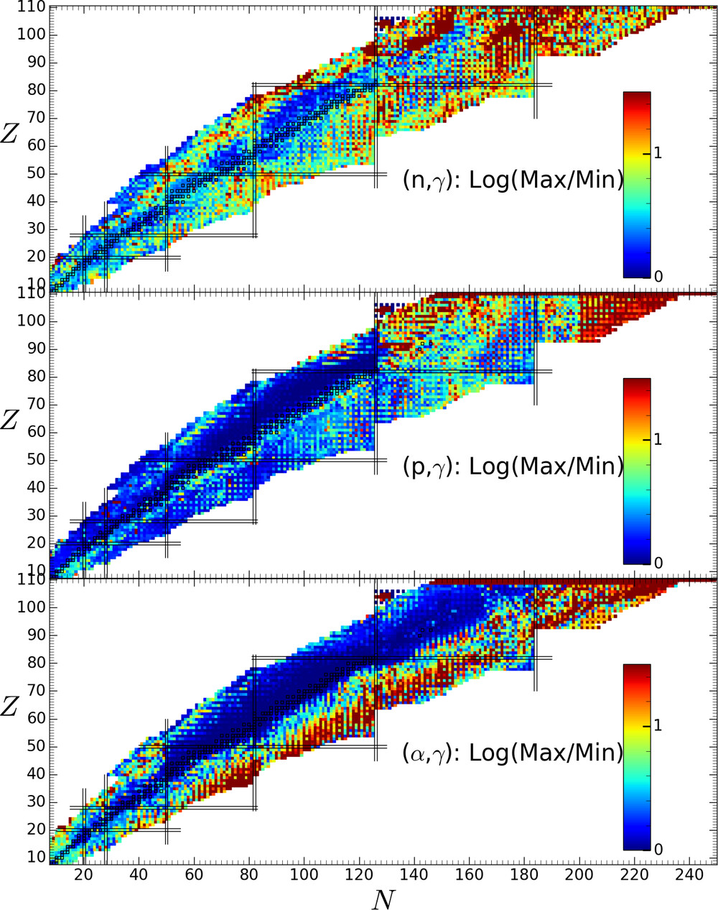
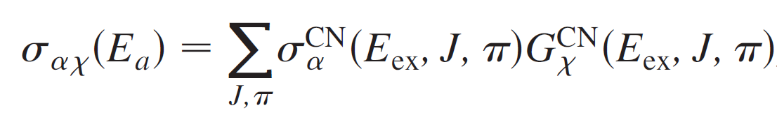
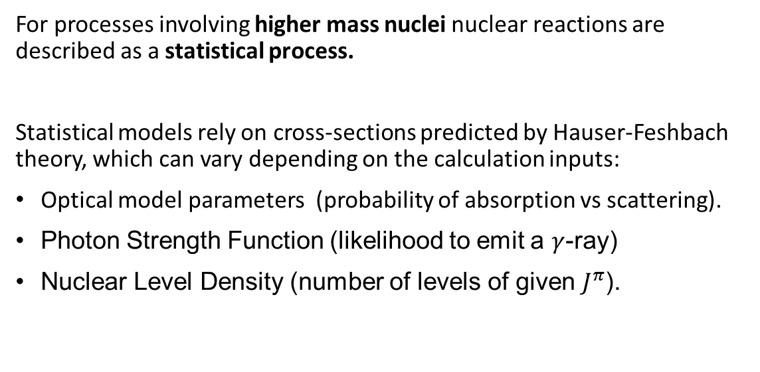
Statistical Model Uncertainties
For processes involving higher mass nuclei nuclear reactions are described as a statistical process.
Statistical models rely on cross-sections predicted by Hauser-Feshbach theory, which can vary depending on the calculation inputs:
Optical model parameters (probability of absorption vs scattering).
Photon Strength Function (likelihood to emit a $γ$-ray)
Nuclear Level Density (number of levels of given $J^{π}$).
Formation cross-section.
Decay probability.
Above shows sensitivity of radiative capture rates to the choice of photon strength function model.
Wiedeking, and Goriely. Philosophical Transactions A 382.2275 (2024): 20230125.

Slide 6
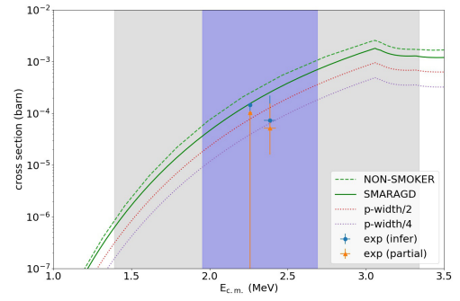
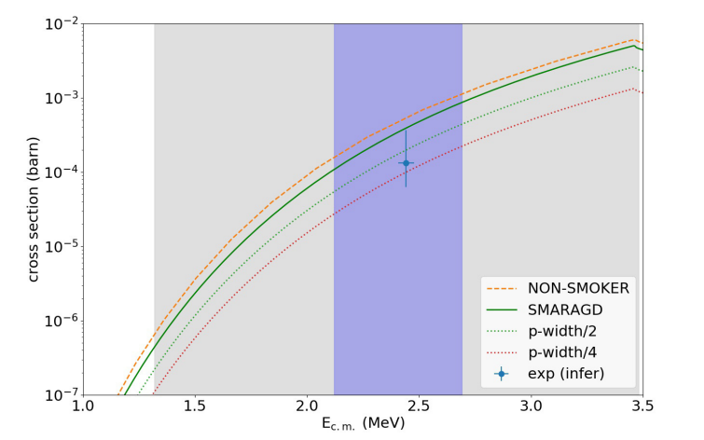
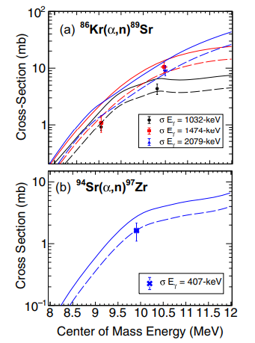


Direct Measurements: Recent Highlights
Surrey experimental group have led a number of direct measurements to constrain astrophysical reaction rates
⁸³Rb$(p,γ)$⁸⁴Sr
⁸⁴Kr$(p,γ)$⁸⁵Rb
Above is from a study of proton capture on radioactive ⁸³Rb and stable ⁸⁴Kr motivated to understand how neutron deficient p-nuclei are formed.
First measurement of a p-process reaction on a radioactive nucleus [1, 2]
Right is from a study of $(α,n)$ reactions on stable 86Kr and radioactive 94Sr.
First measurement of a weak r-process reaction on a radioactive nucleus [3]
[1] G. Lotay, S. Gillespie, M. Williams, et al., Phys. Rev. Lett. 127, 112701
[2] M. Williams, et al., Phys Rev C 107, 035803 (2023)
[3] M. Williams, et al., Phys. Rev. Lett. 134, 112701 (2025)

Slide 7
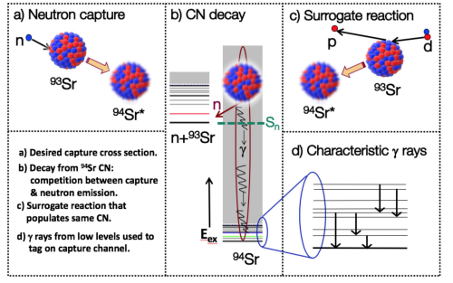
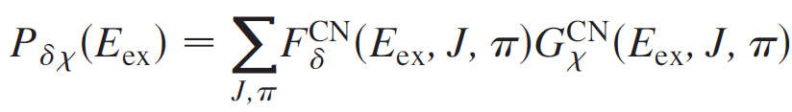
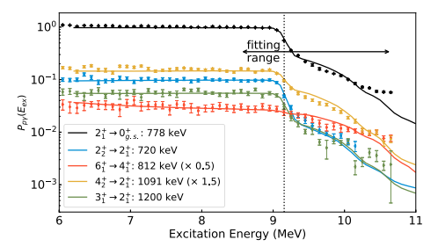
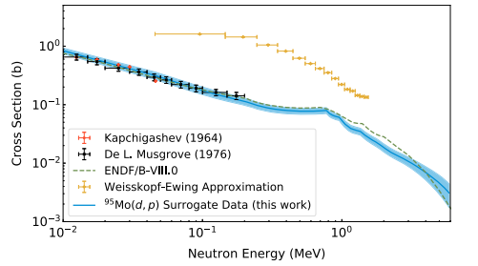
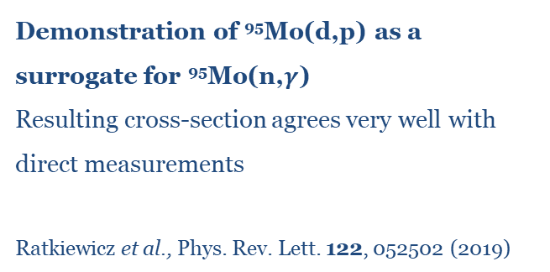
Surrogate reactions for neutron-capture
Many astrophysical processes involve neutron-capture on radioactive nuclei (e.g. r-process, i-process)
Currently no way to measure directly a neutron-induced rection on short-lived radioactive nuclei (can’t make a target)
Measure
Theory
Surrogate Reaction Method
constrain
Demonstration of ⁹⁵Mo(d,p) as a surrogate for ⁹⁵Mo(n,$γ$)
Resulting cross-section agrees very well with direct measurements
Ratkiewicz et al., Phys. Rev. Lett. 122, 052502 (2019)

Slide 8
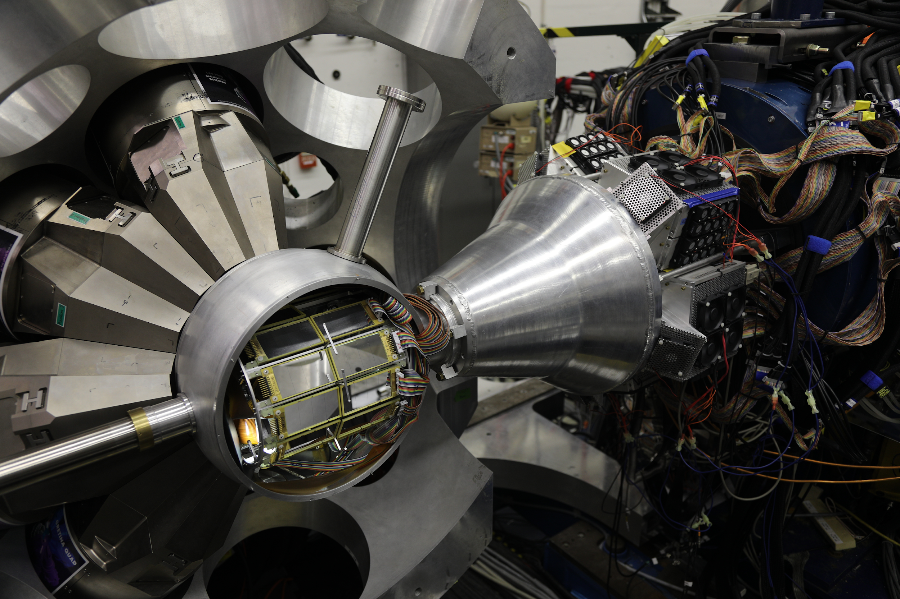
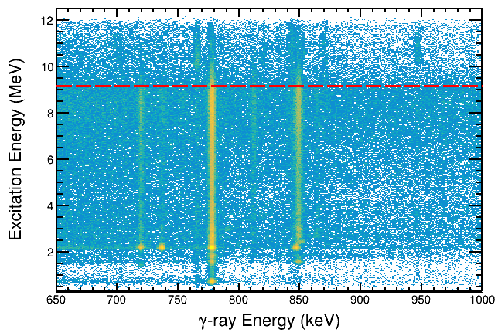
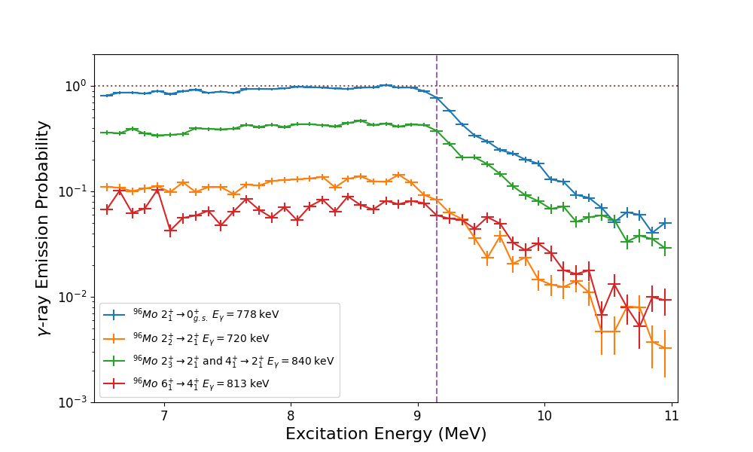
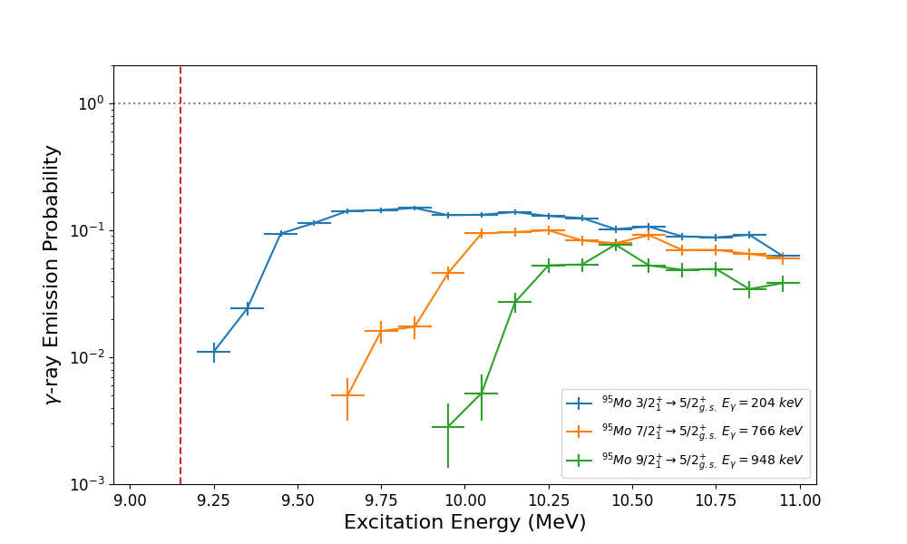
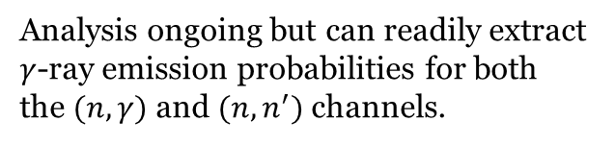

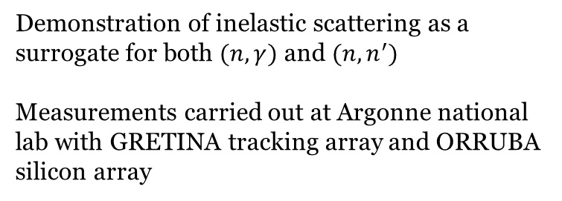


M. Williams prior research at Lawrence Livermore National Lab
Demonstrating the SRM for inelastic scattering ⁹⁶Mo(p,p’)
GODDESS @ Argonne
Particle-$γ$ matrix. ⁹⁶Mo states
Demonstration of inelastic scattering as a surrogate for both $(n,γ)$ and $(n,n^{′})$
Measurements carried out at Argonne national lab with GRETINA tracking array and ORRUBA silicon array
⁹⁶Mo $γ$-ray emission probabilities
⁹⁵Mo $γ$-ray emission probabilities
Analysis ongoing but can readily extract $γ$-ray emission probabilities for both the $(n,γ)$ and $(n,n^{′})$ channels.

Slide 9
AWE Nuclear Data Group + UK Theory
Past & Current projects
  Stevenson William Penney Fellowship (2020-2023 / 2023-2026)
  PhD studentship in quantum computing for nuclear data (Hobday, completed 2024, now at U Glasgow)
  0.2FTE Timofeyuk + PhD studentship in few-body nuclear structure (Kenyon-Reyero, started 2024)
  PhD Studentship for staff member on quantum computing (Gibbs, to 2026)
  PhD Studentship for machine learning methods in nuclear data (Sullivan, from 2024)
  2 x studentships in nuclear applications with Shenton-Taylor
  Benstead (AWE) is visiting professor & external supervisor of several PhDs
  Dobaczewski @ York hosting project work

Slide 10
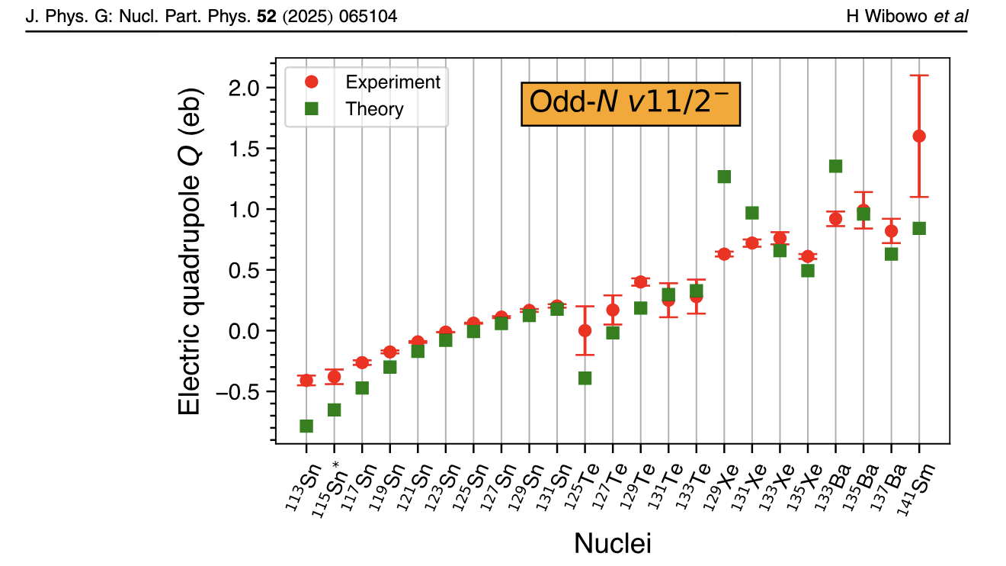
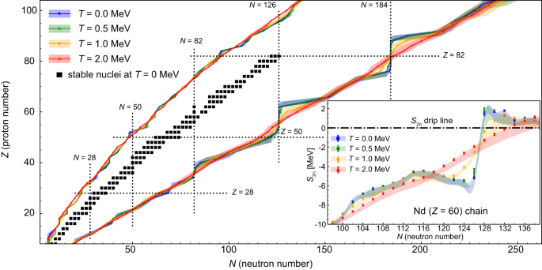
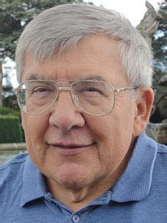
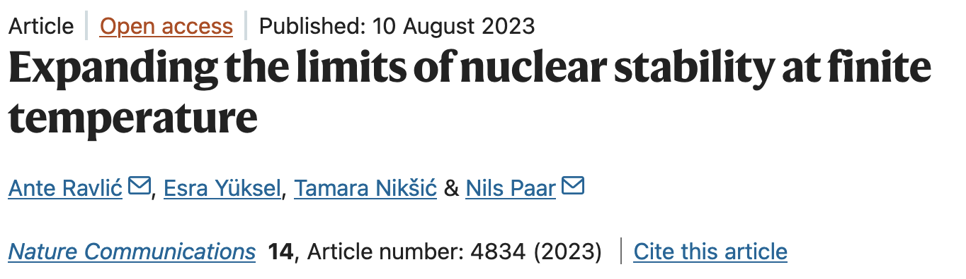
DFT for extensive studies of data
Group of Dobaczewski at York

Slide 11
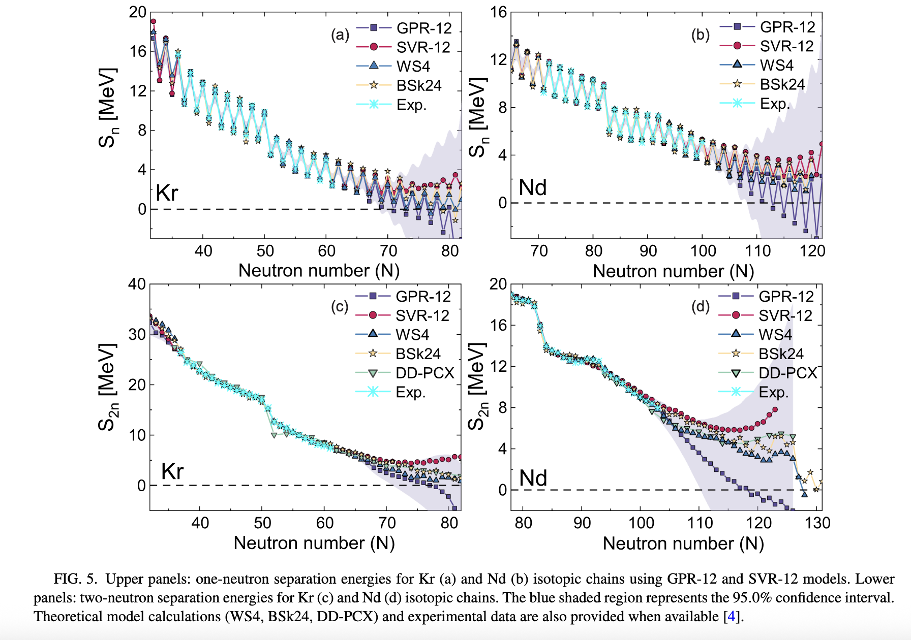
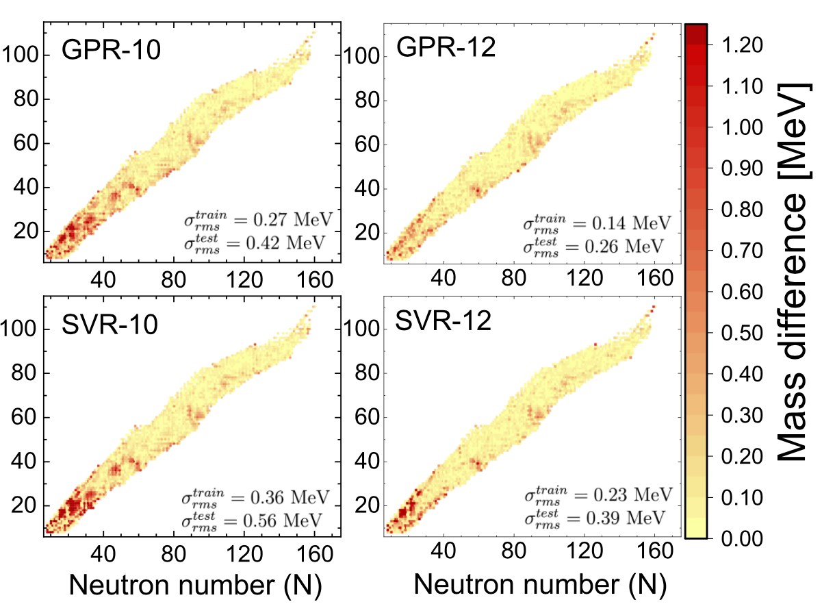
Machine Learning in Nuclear Theory: Yüksel (Surrey), Stevenson (Surrey)
Esra Yüksel, Derya Soydaner and Hüseyin Bahtiyar, Phys. Rev. C 109, 064322 (2024)
Notes:
Yüksel paper uses GPR = Gaussian Process Regression and SVR = Support Vector regression to train on mass excesses. Models were trained on 75% of AME2020 Atomic Mass Evaluation data with 25% used for testing. Training set randomly sampled across Segre chart.
Sullivan stuff is collaboration on nuclear data work with industry (AWE) in this case looking at parts of the nuclear data pipeline where AI/ML methods might help in data evaluation.

Slide 12
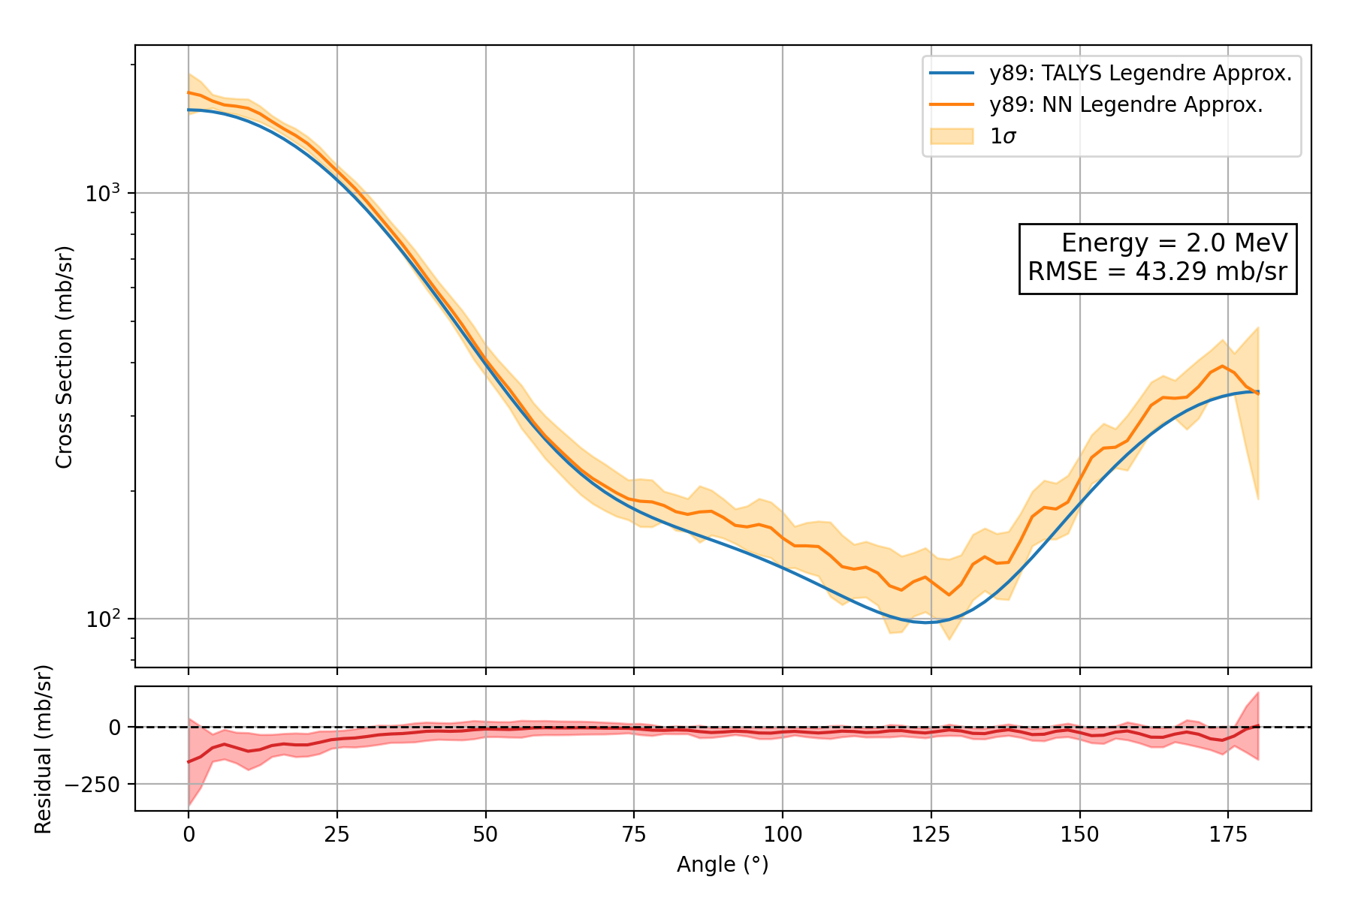
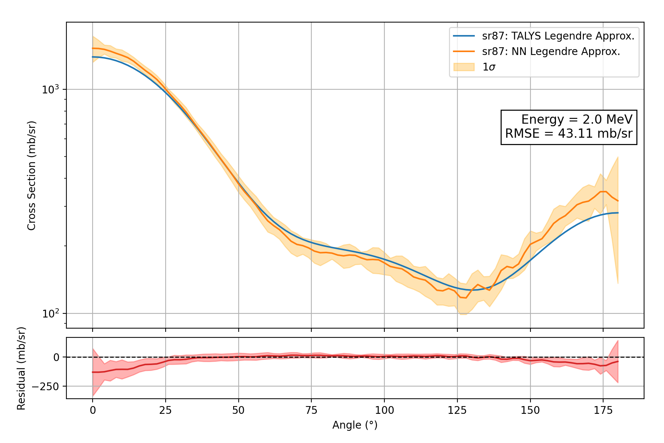
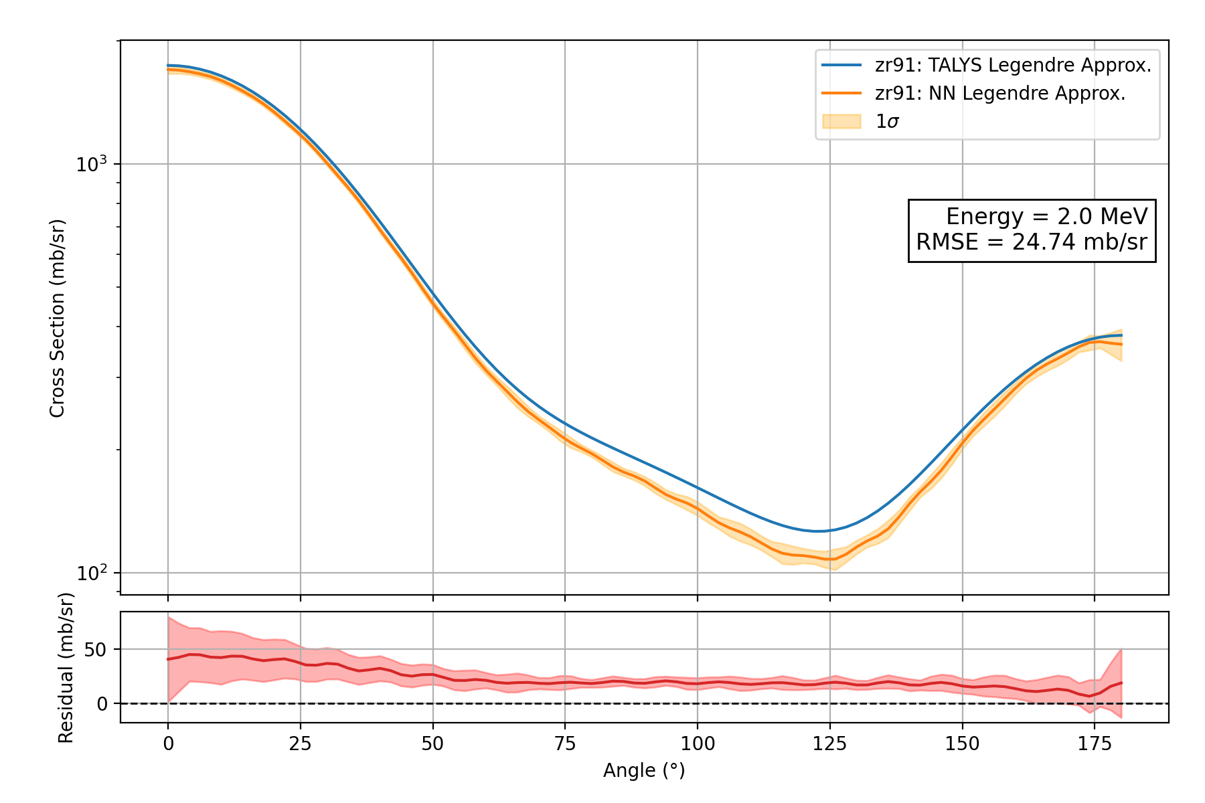
Emulator Results
Machine learning: Nuclear Data applicatoin
⁸⁹Y
⁸⁹Sr
⁹¹Zr
Sullivan, Stevenson, Benstead, Morgan
ND2025 presentation (June 2025 Madrid)

Slide 13
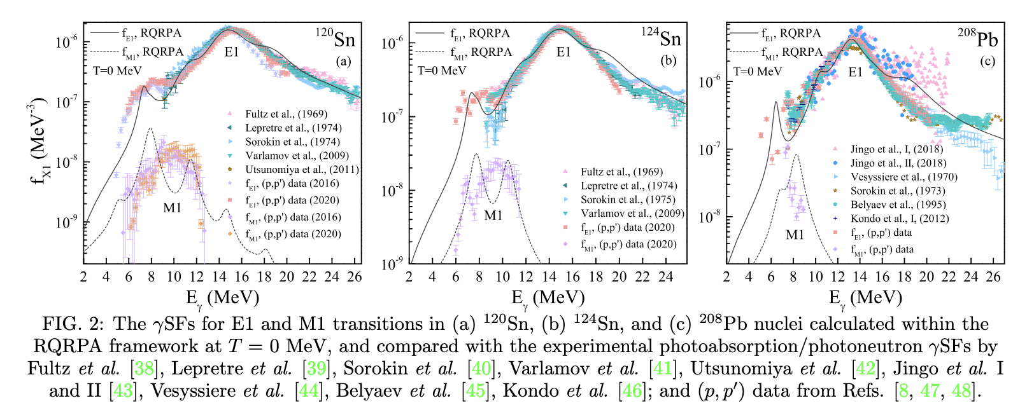
Gamma-ray strength functions via RQRPA
Kaur, Yüksel and Paar, Phys. Rev. C 112, 014307 (2025)

Slide 14
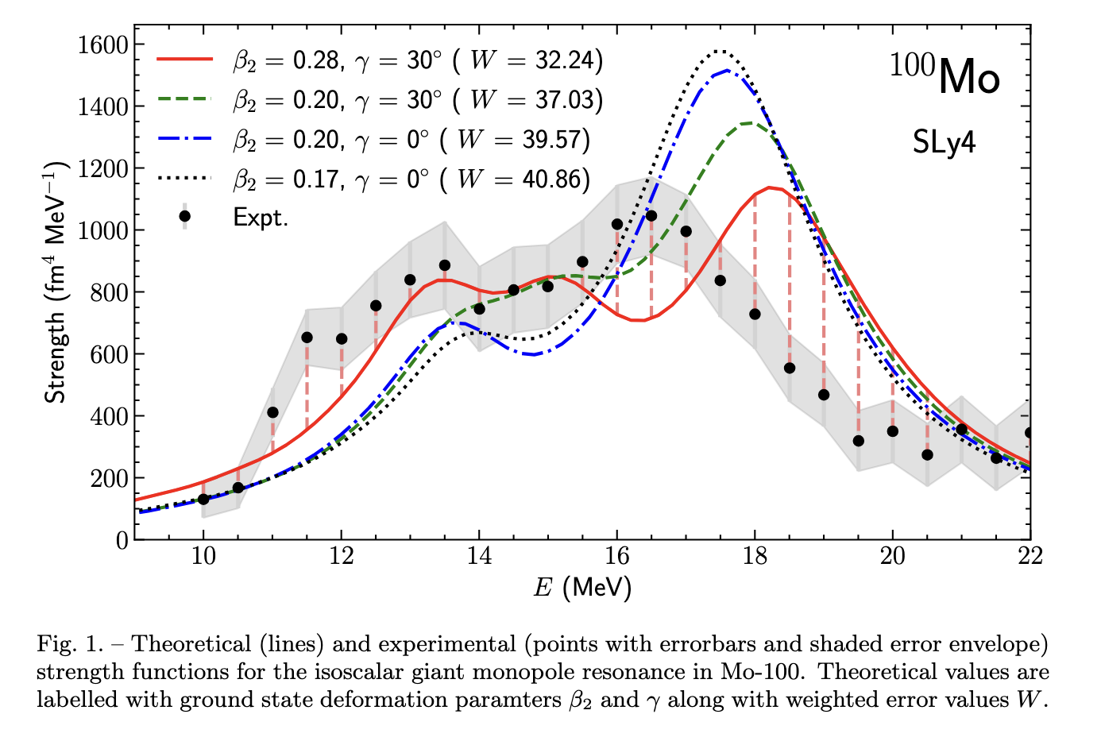
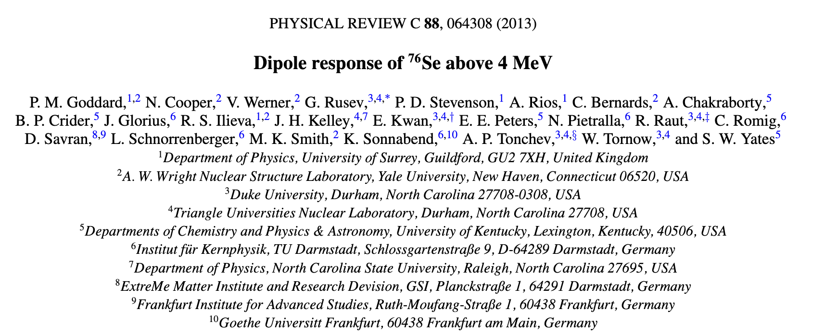
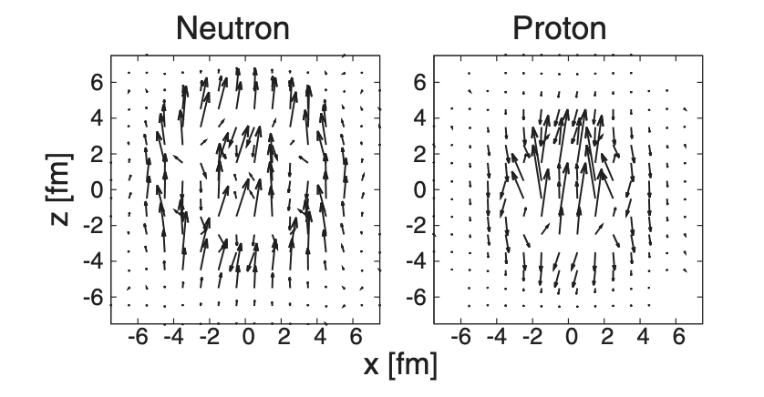
Gamma-ray strength functions via TDHF
PD Stevenson, Abhishek, Y Shi
Nuovo Cimento C 47 (2), 26

Slide 15

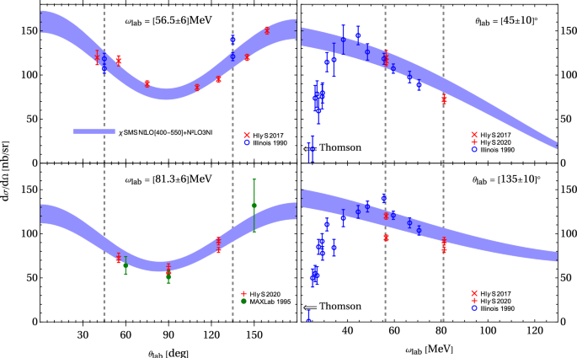
Few-body approaches to nuclear structure and reactions (UoM Nuclear Theory) -I
Using the Transition-Density Formalism in the First Computation of 4He Compton Scattering
Development of a novel approach for the calculation of few-body response functions
Deuteron Photo-Disintegration
Solid line- New theory results
Dots- Expt. data
Walet, Singh, Kirscher, Birse, Griesshammer, McGovern, Few Body Systems 64, 56 (2023).
Griesshammer, Liao, McGovern, Nogga, Phillips
Eur.Phys.J.A 60, 132 (2024).
Notes:
On the left: the UoM group has developed a new stochastic variational-based bound-state approach to extract nuclear response functions without unstable numerical inversion. By analysing the integrated response, the approach is more robust, especially in complex multi-channel problems, compared to traditional Lorentz Integral Transform (LIT) based methods. This has been validated for deuteron photodisintegration, as shown here, and we are extending this to 3- and 4-body breakup processes. These upcoming results will support recent and future campaigns at HIGGS and MIAMI.
The right plot shows the result of the first calculation of Compton scattering from Helium-4 in chiral effective field theory, to N3LO in the delta-expansion (capturing leading chiral and Delta-baryon contributions). The Transition Density Method is used to handle the few-body matrix elements and should be readily scalable to larger systems. The width of the band spans a range of chiral potential. The disagreement with data below 50 MeV is expected and is due to the absence of the propagation of the interacting nuclear system between photon absorption and emission, that is the focus of the work (on the deuteron in that case) in the left-hand plot. Including the one that will restore the Thompson limit but is expected to have a limited (and decreasing) effect above 50 MeV.

Slide 16
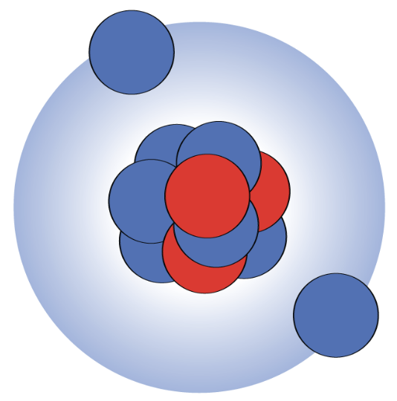
Few-body approaches to nuclear structure and reactions (UoM Nuclear Theory)-II
Prediction of two-neutron halos in the N = 28 isotones
Two-cluster approach to the properties of one- and two-neutron-halo nuclei
Singh, Casal, Horiuchi, Walet, Satula, Physics Letters B 853, 138694 (2024).
Maridi, Singh, Walet, Sharp
Phys. Rev. C 111, 034616 (2025).
Notes:
On the left, we are supporting the search for new and heaviest Borromean nuclei. Despite limited experimental data, our theoretical models predict that Borromean states may exist in neutron-rich sodium (39Na) and magnesium isotopes (40Mg). This will be tested at the FRIB facility, where the reaction cross-section of 40Mg will be studied. The plot shows theoretical cross-section predictions.
On the right, we have developed a simple, approximate method to model neutron-halo nuclei. This approach captures key physical features like the rms radius and separation energy, enabling reasonable predictions of dipole strength and Coulomb dissociation with minimal computational effort. It gives good agreement for the dipole response and Coulomb dissociation in both one- and two-neutron halo nuclei

Slide 17
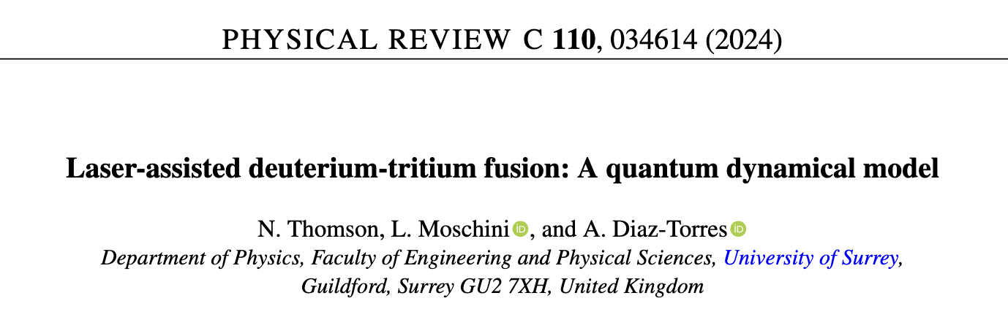
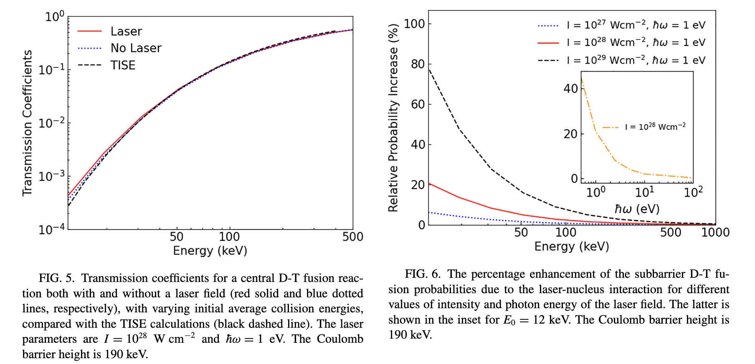
Fusion

Slide 18
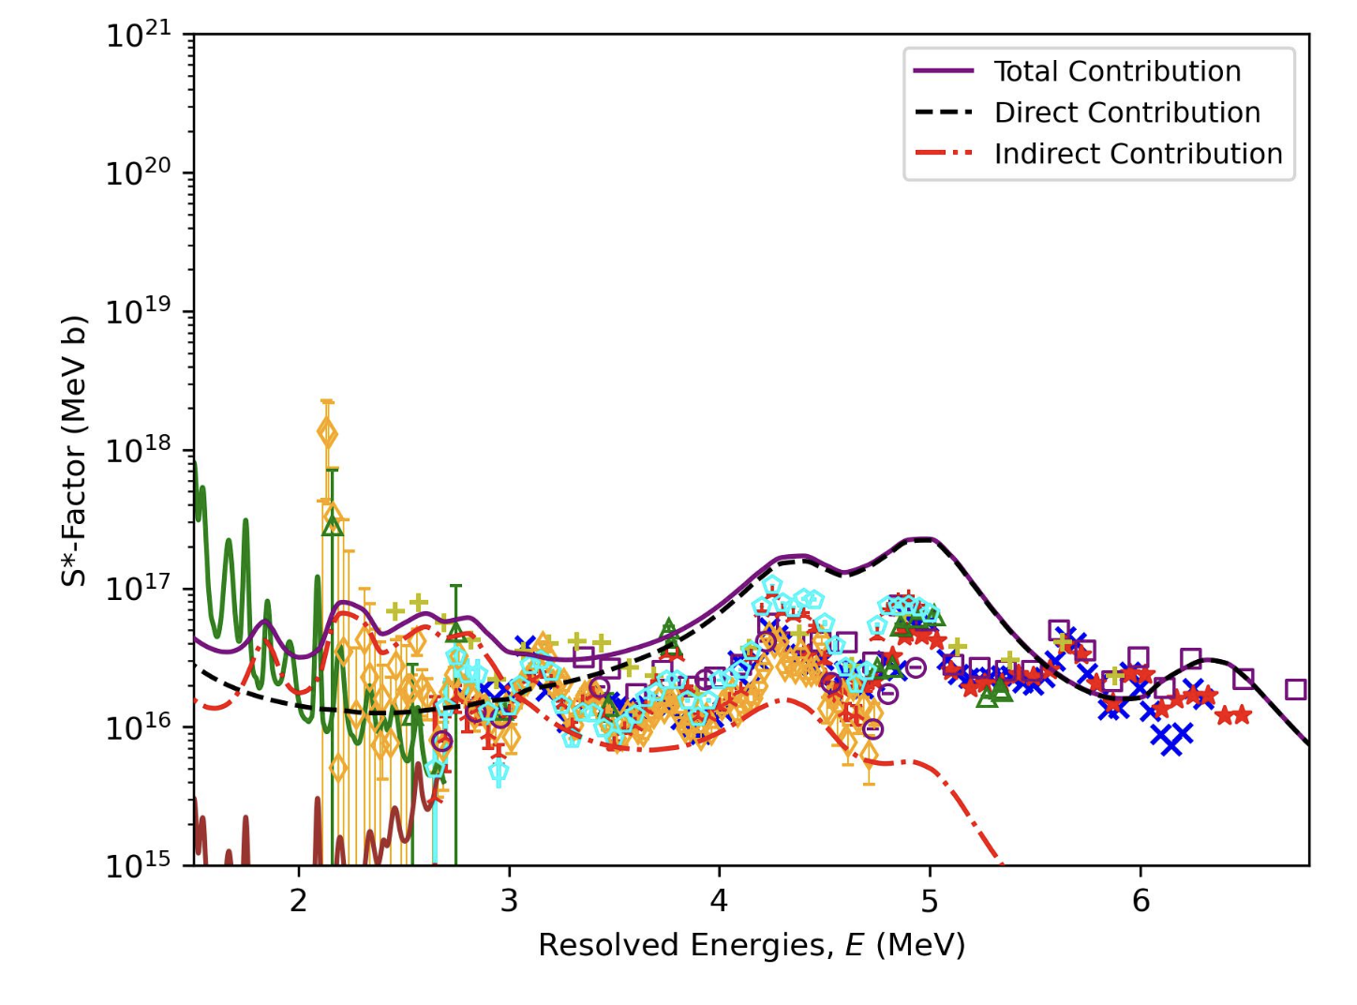
Structure in C-12 + C-12 fusion (Surrey)
•Ion-ion potentials from density functional theory
• quantum scattering calculation
• resonances from underlying DFT included with Breit-Wigner peaks
Grant Close, Paul Stevenson, Alexis Diaz-Torres, arXiv: 2502.11240

Slide 19
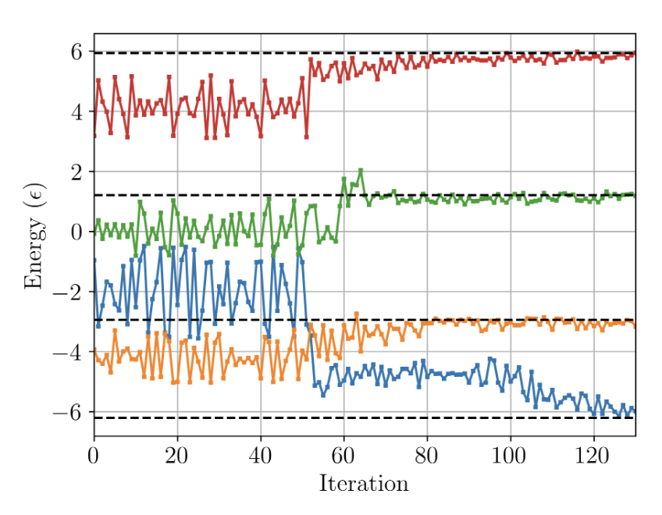
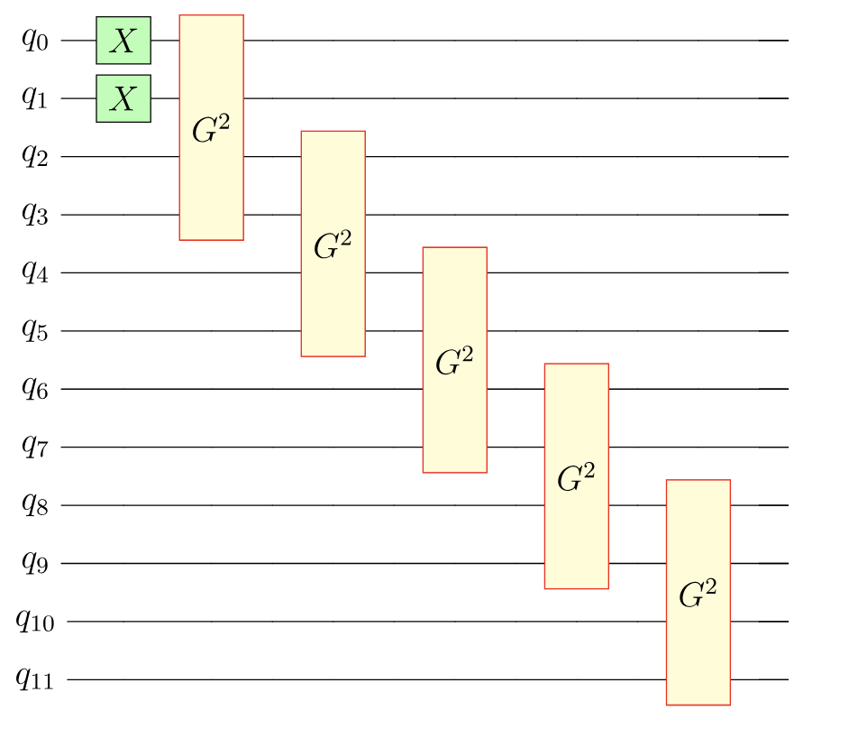
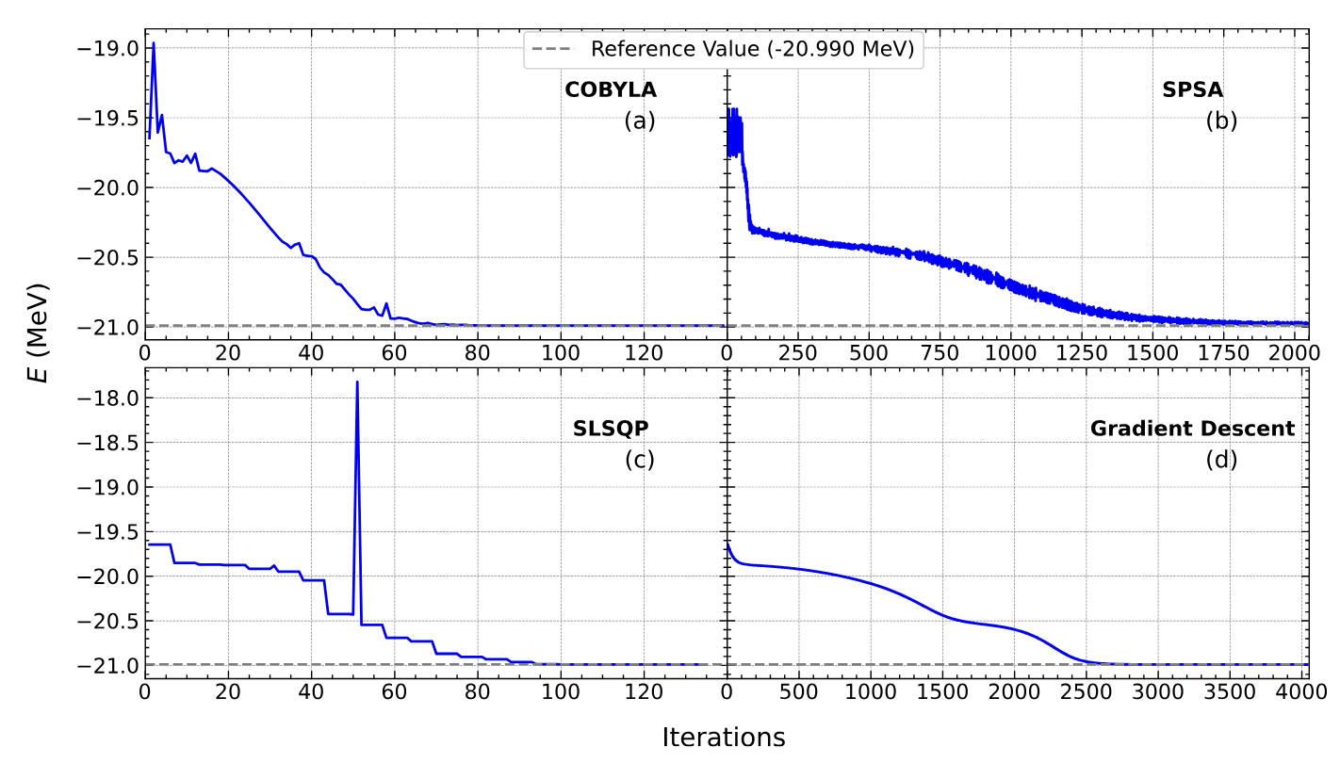
Quantum Computing for Nuclear Theory Stevenson (Surrey)
Hobday, Stevenson & Benstead, arXiv 2403.08625
Variational algorithm to target excited states, on IBM_Nairobi quantum computer
Bhoy and Stevenson, New J Phys 26, 075001 (2024) quantum circuit to prepare ⁵⁸Ni state in shell model & variational determination of gate parameters
Notes:
Hobday et al work shows the development of a method to use an adapted variational algorithm to target excited states in a simple shell model (the Lipkin-Meshkov-Glick model). The calculations shown here were obtained on one of the IBM quantum computers.
The lower plot shows the development of an algorithm to calculate more realistic shell model states on a quantum computer. The circuit shown on the left uses domain knowledge to optimize the circuit (unlike many applications so far which throw a generic algorithm at the problem). The convergence plots on the right show results on a simulated quantum computer.

Slide 20
Summary
Wide variety of skills in nuclear structure and reactions encompassing variety of methods and models across range of complexity
Observables in structure and reaction: masses, spectra, moments, cross-sections (inclusive, exclusive), transition rates …
Some very blue skies / low-TRL research, but with clear link to data
Nuclear theory is a very small community. Manpower lacking to exploit theory – necessary for data application
Happy to collaborate!

Slide 21
Blank spacer slide

Slide 22
ERF Panel Reflections
For Oct 2025-start ERF round, STFC restructured the panel groupings. Full list of Groupings:
Sifting panel for Nuclear:
  Particle Physics Experiment, Accelerator, and Nuclear Physics
Guarantee that each area can put one candidate forward
37 applicants in PPE, Accel & NP
6/37 nuclear 2/6 went to interview
Chair | Professor James McLaughlin | Northumbria
Accelerator Physics | Dr Tim Noakes | STFC Daresbury
Astronomy Extragalactic | Dr Julie Wardlow | Lancaster
Particle Physics Experimental | Professor Helen O’Keeffe | Lancaster
Particle Physics Theory | Dr Pavel Buividovich | Liverpool
Particle Astrophysics and Cosmology | Dr Djuna Croon | Durham
Astronomy Near Universe | Dr Andreea Font | LJMU
Astronomy Near Universe-Exo/Sol | Dr Vincent Van Eylen | UCL
Nuclear Physics | Professor Paul Stevenson | Surrey

Slide 23
Blank Spacer Slide

Slide 24
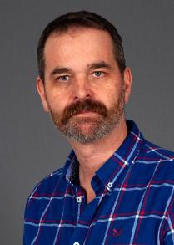
Nuclear Data DFA
A group led by Dave Jenkins (York) is planning a “Nuclear Data”-centred bid for the DFA on the stated assumption that there may be several awards made.
This bid would be heavy on the STFC side to bring in those students interested in blue skies research who would otherwise not think to go for a broader nuclear science doctorate
Nuclear Data as link between blue skies work and nuclear industry
Working group: York, Surrey, Manchester, Cambridge + Lancaster? + Edinburgh?

