Slide 1

NPAP Community Meeting July 2025
David Sharp
Chair, Nuclear Physics Advisory Panel (NPAP)
22nd July 2025

Slide 2
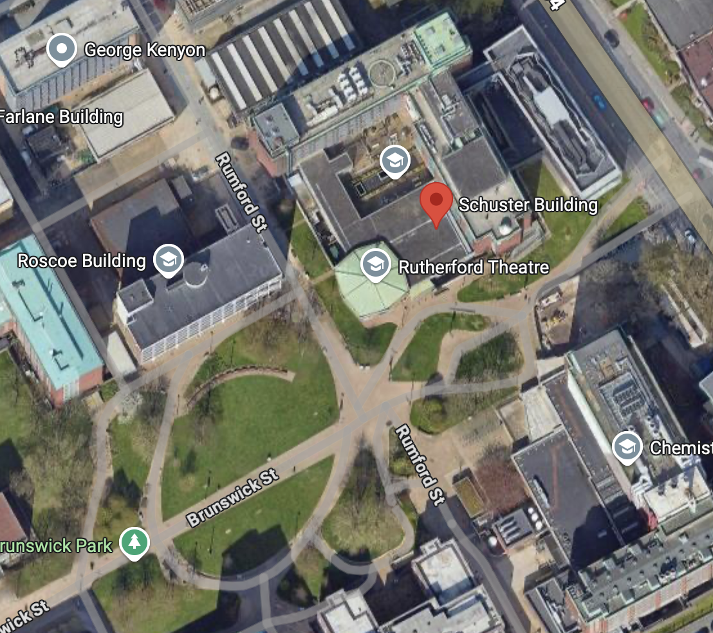
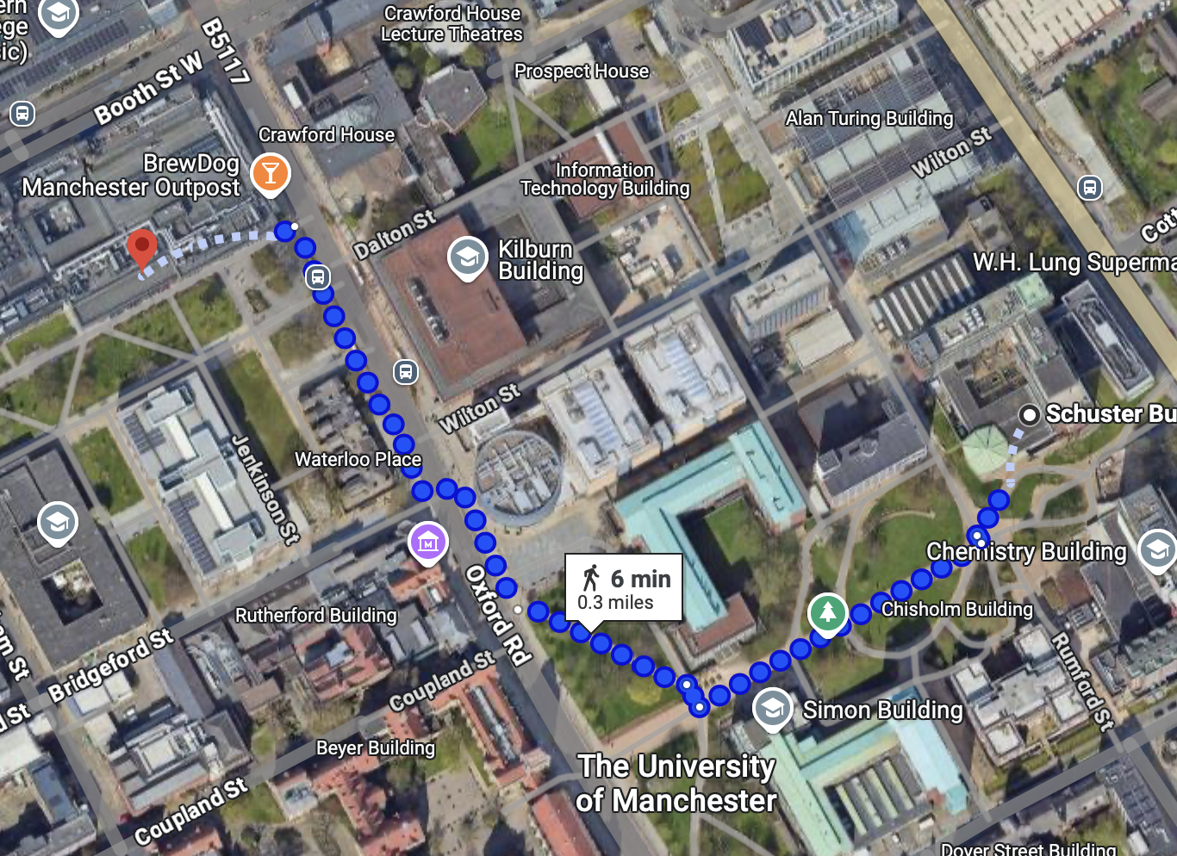
Housekeeping
In case of a fire.
Lunch/tea/coffee served in this room.
Dinner for those joining.
Lunch/tea/coffee served in this room.
Dinner for those joining is at Navarro Lounge.

Slide 3
Purpose of meeting
Review last consolidated grants round (this morning) Keith Grange SB update
UK Nuclear Data activities and emerging opportunities (this afternoon).
Past and present funding schemes - Nuclear Priorities/Early-Stage R&D/PPRP (both days).
Outline future project prioritisation process by NPAP (tomorrow).
Panel updates (tomorrow).
Science (tomorrow).
Discussion.

Slide 4
STFC science advisory structure
STFC Executive Board
STFC Council
Science Board (PPAN)
Science Board (Facilities and Laboratories)
Nuclear Physics
Advisory Panel
Education, Training, Careers Committee (ETCC)
Physical Sciences &
Engineering Advisory Panel
Astronomy
Grants Panel
Astronomy
Advisory Panel
Advisory Panel for Public Engagement (APPE)
Life Sciences & Soft Materials Advisory Panel
Nuclear Physics
Grants Panel
Particle Astrophysics
Advisory Panel
Particle Physics
Grants Panel (x2)
Solar System
Advisory Panel
Projects Peer
Review Panel
Particle Physics
Advisory Panel
NB: STFC e-infrastructure advisory group (SEAG) reforming into Computing Advisory Panel (CAP)
Notes:
If a new version of this diagram exists with CAP then that would be nice

Slide 5
NPAP Membership
David Sharp University of Manchester
Rachel Montgomery University of Glasgow
Philippos Papadakis STFC Daresbury
Paul Stevenson University of Surrey
New Members Joining Soon!
3 new members identified from applications – should hear from STFC shortly.
Chair position not yet filled.
If you would like to discuss the role then please get in touch david.sharp@manchester.ac.uk

Slide 6
STFC Advisory Panels
Nuclear Physics Advisory Panel
  Seeking additional institutional representation beyond those currently represented (Manchester, Glasgow, Surrey, DL)
  Seeking a replacement Chair of the Panel
Nuclear Physics Grant Panels
  Dan Watts – new Chair
  Seeking additional members both nationally and internationally
Cross-Community Committee
  Seeking new members
STFC will hold a recruitment exercise outside the normal Panel Recruitment exercise with further communication in September

