Slide 1

  Environmental Applications of Particle Accelerators
  Rob Edgecock
  University of Huddersfield
Waste water and sewage sludge, including pharmaceuticals & microplastics
Exhaust gases from marine diesel engines
Ship ballast water
Seeds and bulbs
“Cleaner” sterilisation, avoiding the use of chemicals
Work carried out in collaboration with Institute of Nuclear Chemistry and Technology in Warsaw, who lead the world in this area

Slide 2
Basic Process
Use of accelerated electron beams
In water:
H₂O → [2.7] OH• + [2.6] e⁻_{aq} + [0.6] H• + [2.6] H₃O⁺ + [0.45] H₂ + [0.7] H₂O₂ - G-value: molecules/100 eV
In living organisms:
  Radicals react with and damage cell DNA
  Results in cell death
  Same as cancer therapy with x-rays
In everything else
  Various reactions with organic and inorganic molecules
  More complex
  But usually results in the breakup of the molecules

Slide 3
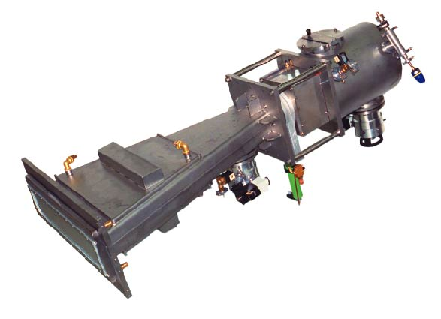
Accelerators Used
Beam energy:
  ~300 keV to 10 MeV
  Depends on penetration depth required
  Lower is better
Beam current:
  As high as possible
  Dose rate ~current
  Cancer therapy: 2 Gy/min; we need >kGy/s
300 keV
Electron Cross-linking

Slide 4
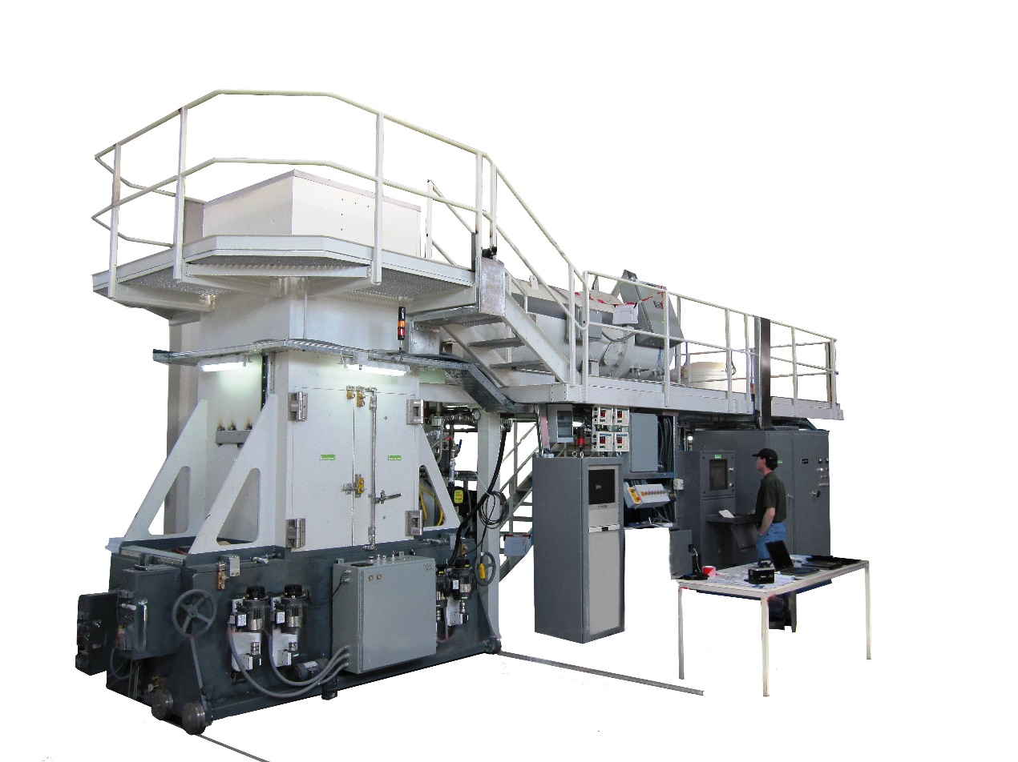
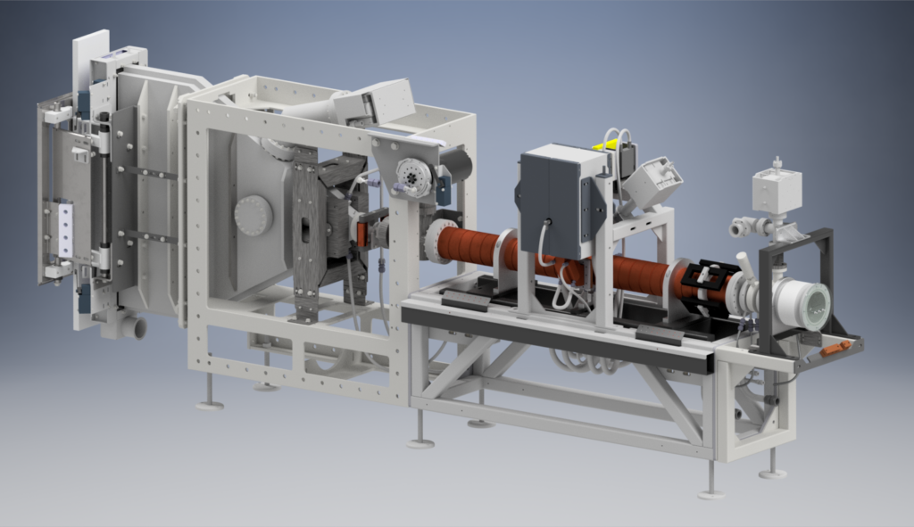
Accelerators Used
5 MeV
IBA
10 MeV
Mevex

Slide 5
Microorganisms
Include bacteria, viruses, archaea, fungi, algae, protozoa,etc
Oldest evidence: presence in 3.45B year old Australian rocks
Live in almost every habitat from poles to equator
  7km below Earth surface
  Deep sea
  High temperature: 130ºC; low temperature: -17ºC
  Up to 1000 atmosphere
  Can survive for extended periods in vacuum
  Some are radiation resistant, up to 5 kGy
Responsible for killing more humans than anything else by far
  Influenza, malaria, plague, TB, cholera, polio, etc
They can evolve very rapidly:
  Influenza, malaria, etc
  AMR
They should not be under-estimated!

Slide 6
  Sewage Sludge Treatment
Municipal waste water treatment plant
Sludge: highly contaminated – bacteria, viruses, parasite eggs, micro-plastics, pharmaceuticals, PCP, etc
Developed world: difficult to dispose of
Developing world: major source of ill-health and death

Slide 7
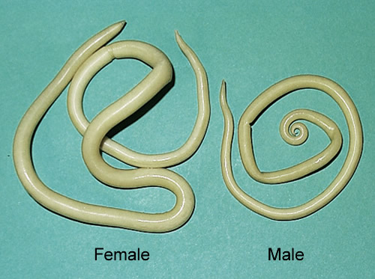
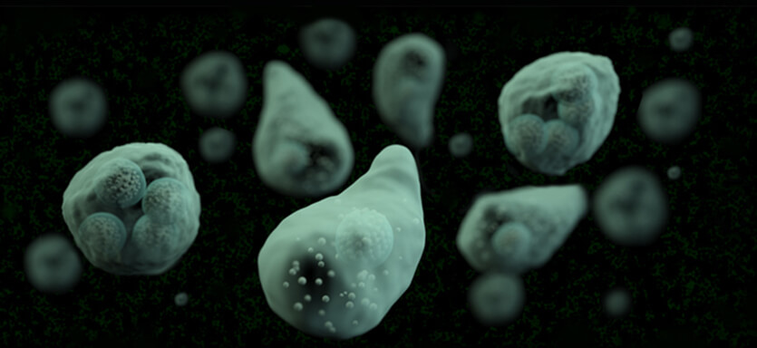
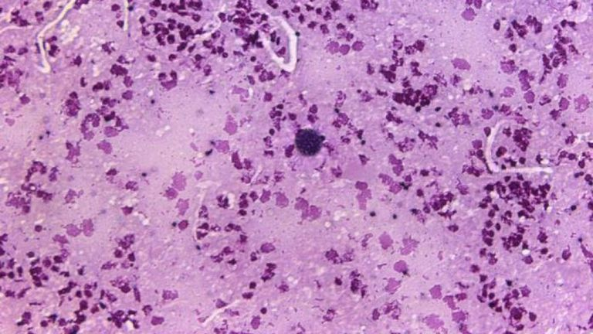
  Diseases Related to Poor Sewage Sludge Treatment
Ascaris parasites: 22% of world population have these - African countries: 40-98% Southeast Asia: 73% Central and South America: 45% United States: 2%
Entamoeba histolytica: >500M people have these – 100000 deaths/annum
Giardia lamblia: most common parasite in US – 10-13% of adults in Oregon
Toxoplasma gondii: causes 3500/annum birth defects in the US
Salmonella spp: 94530 cases in EU in 2016
Escherichia coli: 6378 (STEC) in 2016
Shigella: ~300000 cases/annum in US

Slide 8
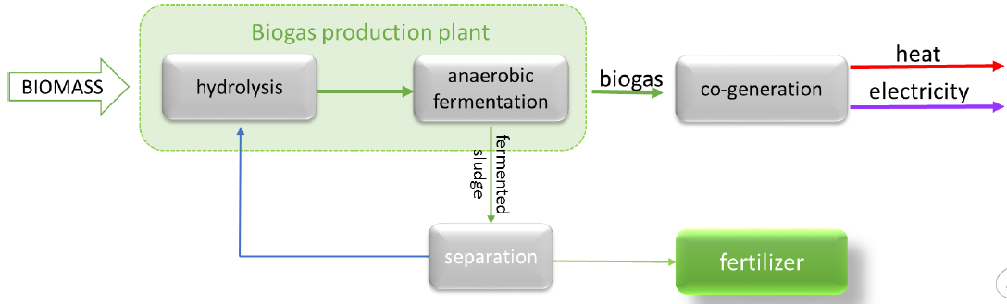
  Anaerobic Digestion
Waste
Anaerobic digestion: micro-organisms break down organic matter
Typically runs at 35-39ºC, takes around 20 days
Outputs - biogas: only 10% efficient - digestate: poor quality “fertiliser” - 50% less organic material

Slide 9
  Digestate use
EU restrictions:
Table 7: Safe Sludge Matrix

Slide 10
  Digestate use
Implemented by different countries in different ways
  UK: 90% AD; SSM used directly
  Germany: Much AD, but sludge can’t be used at all, incineration required
  Latvia
  Poland: 50% AD, rest is stored at WWTF
  Ukraine: No AD, 100% is stored at WWTF, ~1 billion tons already

Slide 11
  Enhanced Treatments
Thermal Hydrolysis Pre-treatment (THP): ~15% bio-gas efficiency
Biological hydrolysis: Acid Phase Digestion (APD) & Enzymatic Hydrolysis (EH)
UK 2015:

Slide 12
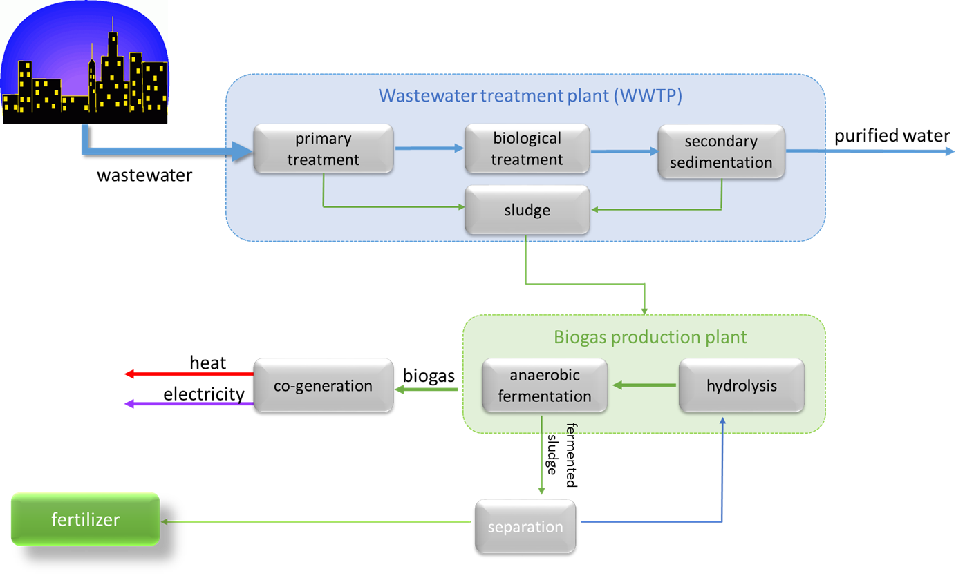


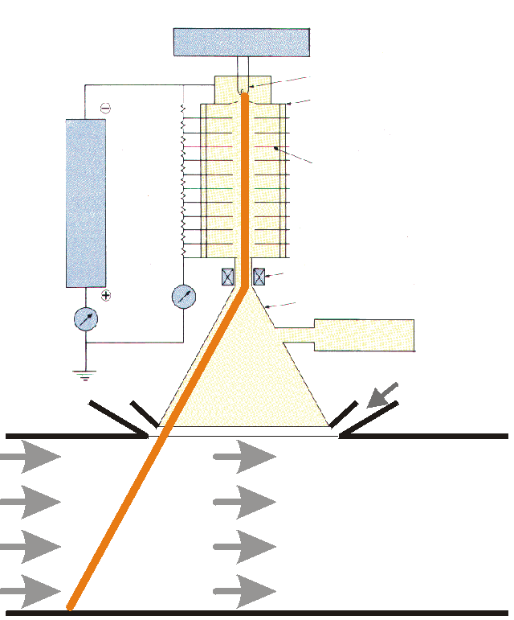
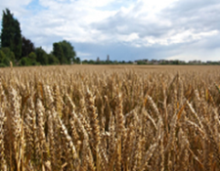
  Electron Beams

Slide 13
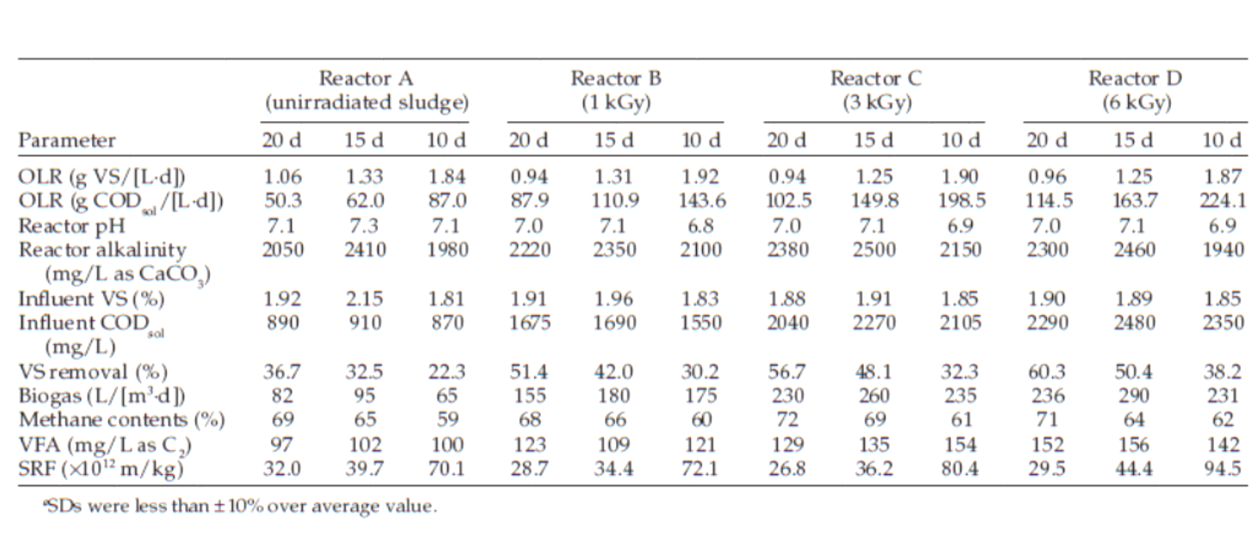
  Pre-AD
K. Shin and H. Kang, Appl. Biochem. Biotechnol., vol. 109, pp. 227–239, 2003

Slide 14
  Pre-AD
Has been tested in laboratories and pilot plants
Two full scale plants under construction in Poland
MWWTP Józefów

Slide 15
  Pre-AD
Process | Cost per TDS (2005 US$) | Value (2005 US$)
Incineration/co-generation | 600 to 1100 | 3 to 30 as ash reuse
THP | 500 to 1500 | 30 to 150 as a fuel and fertiliser
Anaerobic digestion | 350 to 650 | 30 to 200 as a fuel and soil amender
Aerobic digestion | 350 to 700 | 30 to 70 as a soil amender
Advanced alkaline stabilisation | 350 to 550 | 80 to 120 as a Ag lime agent
Acid stabilisation/disinfection | 350 to 550 | 30 to 70 as a soil amender
E-beam treatment | 100 to 250 | 30 to 70 as a soil amender

Slide 16
  Post-AD
Target pathogen reduction to meet “organic” requirements: 6 orders of magnitude
AD:
  Standard: ~2
  THP, etc: ~4
Electron beams
Microorganism | D₁₀ Value (kGy) | Reference
Acinetobacter radioresistens | 1.3-2.2 | [20]
Ascaris ova | 1.6-7.9 | [14], [21]
Aspergillus fumigatus | 0.6 | [22]
Aspergillus niger | 0.5 | [20]
Bacillus pumilus | 1.4 to 1.8 | [20]
Bacillus subtilis | 0.6 | [20]
Brucella abortus | 0.15 | [23]
Campylobacter sp. | < 0.2 | [23]
Candida albicans | 0.9 | [22]
Clostridium botulinum | 1.4 to 4.2 | [20]
Clostridium difficile | 0.9 | [22]
Clostridium sporogenes | 1.6 to 2.2 | [20]
Clostridium tetani | 2.4 | [20]
Cryptococcus albidus | 2.7 | [24]
Cryptococcus laurentiii | 3.1 | [24]
Cryptococcus uniguttilans | 1.4 | [24]
Escherichia coli | 0.3-0.4 | [13], [25]
Klebsiella pneumonia | 0.12-0.28 | [26]
Lactobacillus brevis | 1.2 | [20]
Listeria monocytogenes | 0.62 | [27]
Micrococcus radiodurans | 2.2 | [20]
Mycobacterium fortuitum | 0.6 | [22]
Mycobacterium tuberculosis | 0.3 | [13]
Pseudomonas spp. | 0.06 | [20]
Poliovirus | 1.85 | [13]
Saccharomyces cerevisiae | 0.5 | [20]
Salmonella muenster | 0.6 | [22]
Salmonella sp. | 0.6 | [23]
Salmonella typhimurium | 0.2 to 1.3 | [20]
Shigell dysenteriae | 0.6 | [13]
Staphylococcus aureus | 0.2-0.5 | [20], [23]
Streptococcus faecalis | 1.56 | [22]
Yersinia enterocolitica | 0.2 | [23]
Vibrio cholerae | 0.48 | [13]

Slide 17
  Post-AD
Pharmaceuticals and personal care products

Slide 18
  Emerging Problems
And those which look closest to resulting in new legislation
Anti-microbial resistance:
  Sludge plants are an important source of growth
  No clear method for dealing with this
  Except electron beams
  Measurements to demonstrate part done
  E-beam facility being added to largest pharma plant in China
Microplastics

Slide 19
  Microplastics
<5mm in size (<1µm: nanoplastic – very hard to measure)
Really interesting topic!
Main source: break up of macroplastics
Not yet clear if they are dangerous to consume
Also not clear how to remove them from sludge or anywhere else

Slide 20
  Microplastics
Studying removal from sludge
Tested 6 types of microplastics in various forms
Doses: 2, 5, 10, 56, 100, 200 kGy
Irradiation at INCT
Measurements at UoH
All but PP changed in some way:
  Physical structure
  Chemical bonds
Still very early days
Much further work needed and planned
Example….

Slide 21
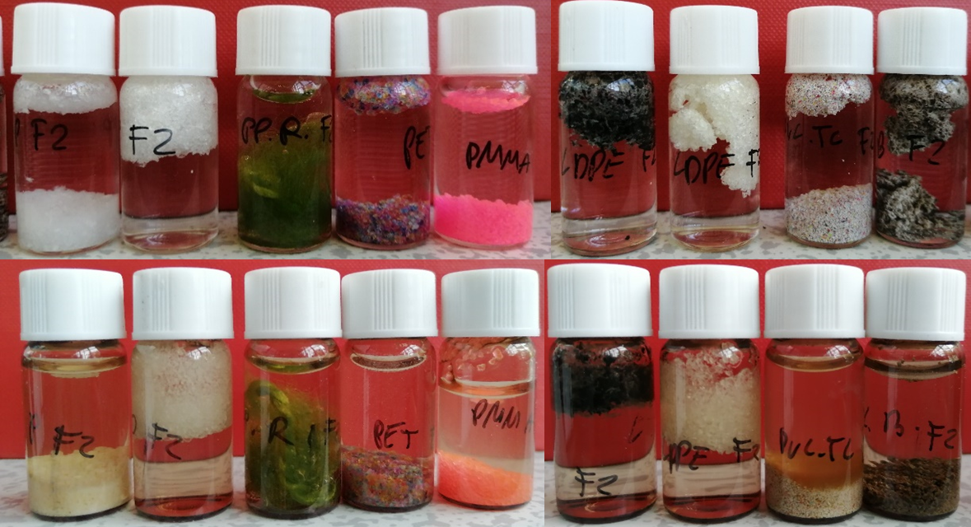
  Microplastics

Slide 22
  Air Pollution

Slide 23
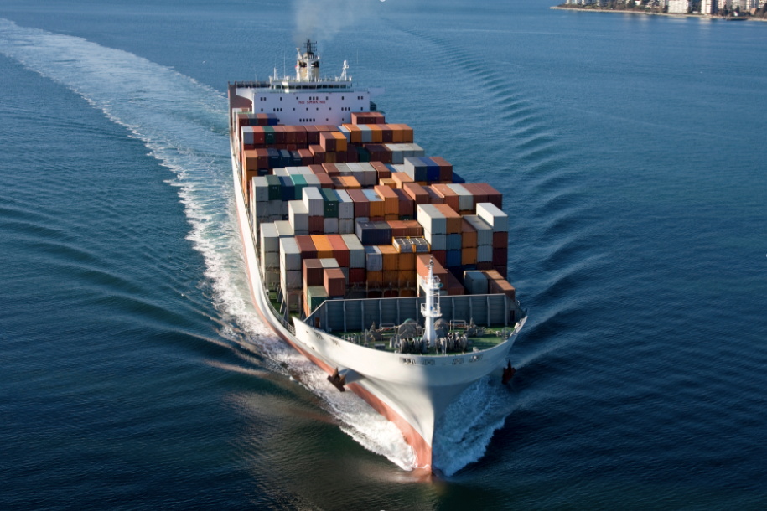
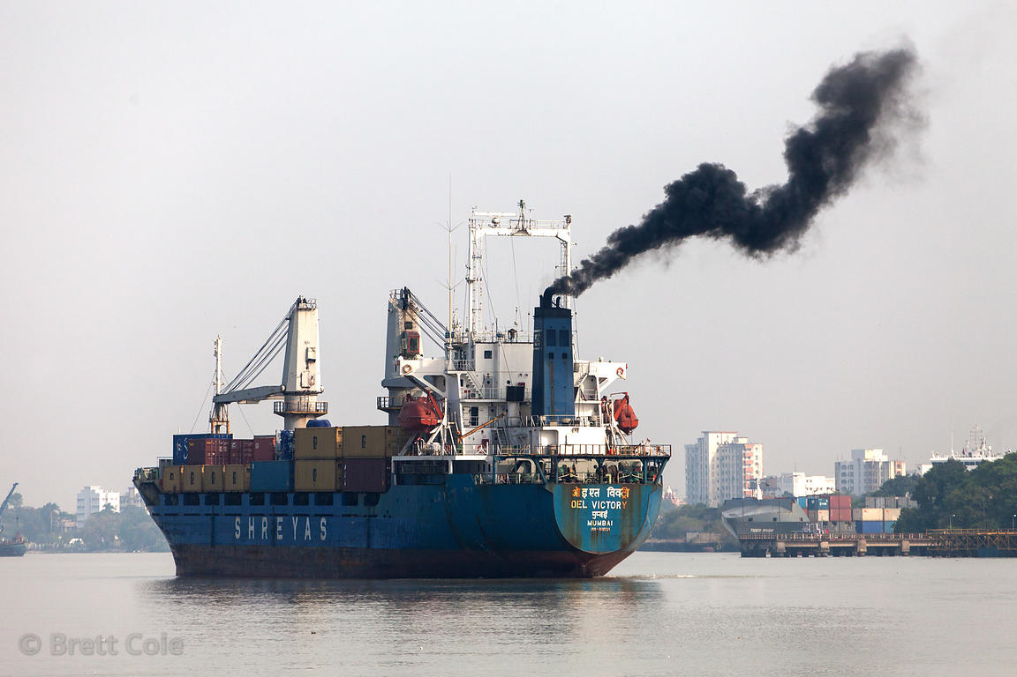
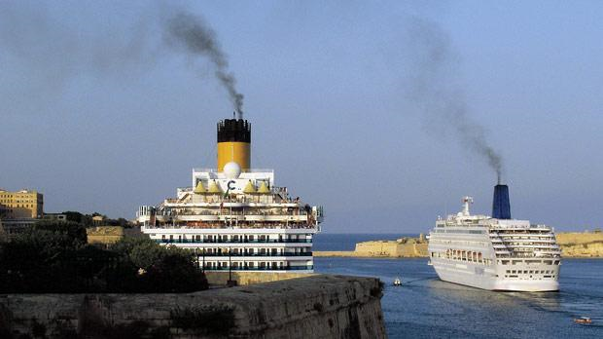
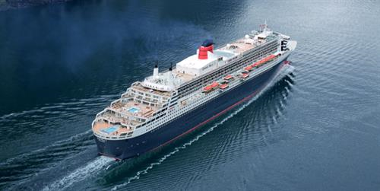
  Air Pollution
Larger ships: 80-100 MW diesel engines 134 kHP

Slide 24
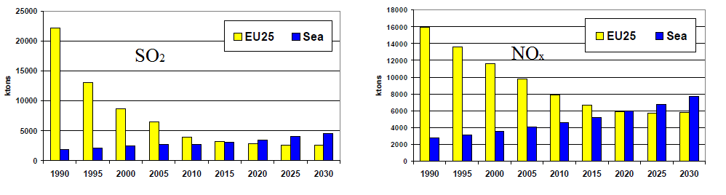
  Air Pollution from Shipping

Slide 25
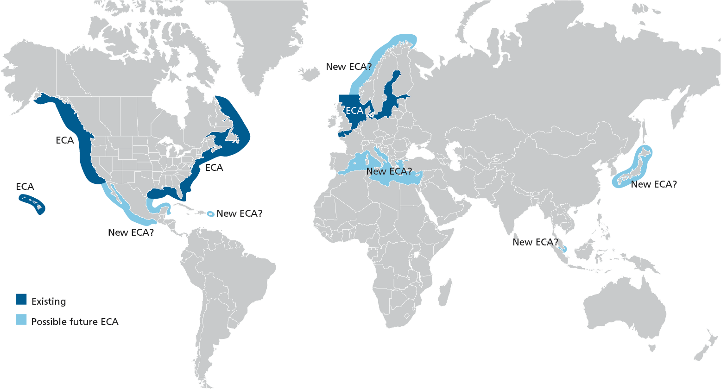
  IMO Control Areas and Limits

Slide 26
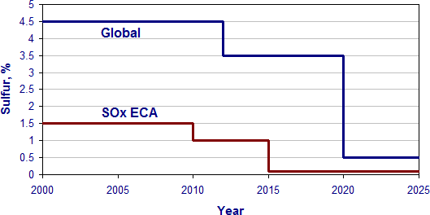
  IMO Control Areas and Limits
1.5% = 6g SO₂/kWh
Limit is only on SO₂, but it is well-known that NO_{x},VOC and PM limits are coming

Slide 27
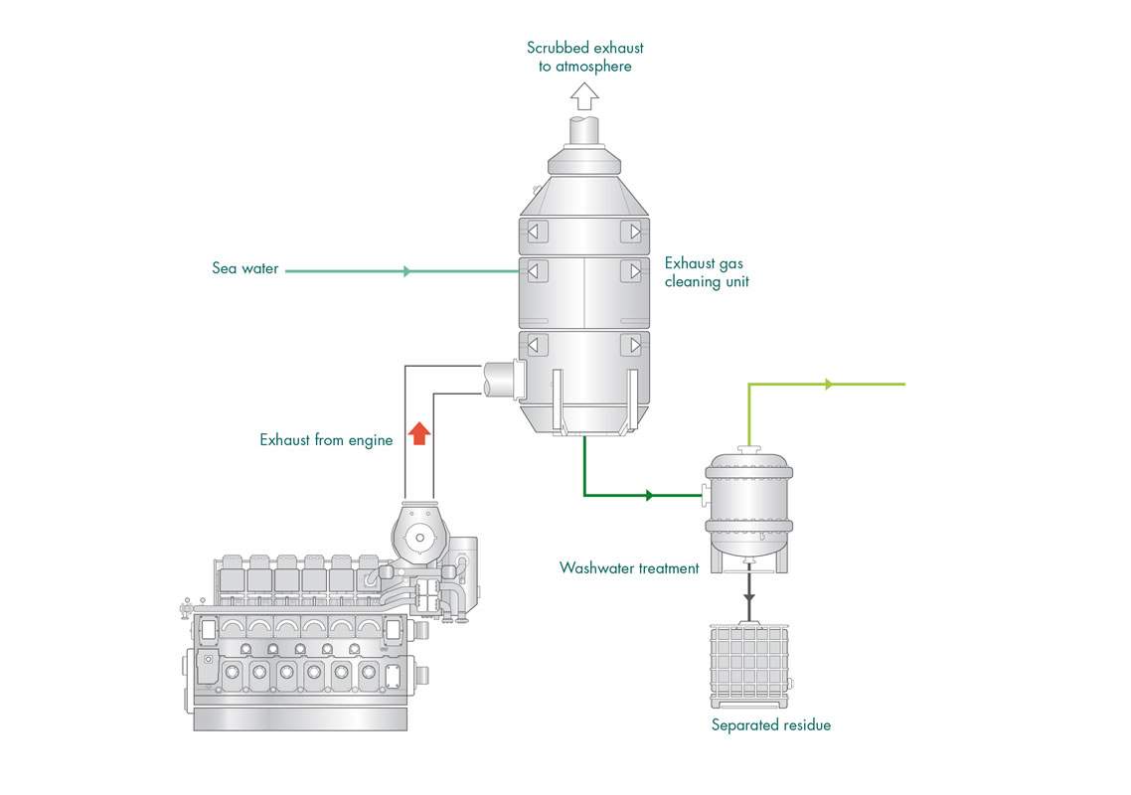
  Existing Solutions
Low sulphur fuel: - works - but only for SO₂ - costs >2 x current fuel
SO₂ scrubbing:

Slide 28
  Existing Solutions
Low sulphur fuel: - works - but only for SO₂ - costs >2 x current fuel
SO₂ scrubbing: - works - costs about 1 MEUR to install - requires about 1 month in dry dock - >50% bigger than standard exhaust systems - does not work for NO_{x} or VOC - separate NO_{x} system would be required and is incompatible

Slide 29
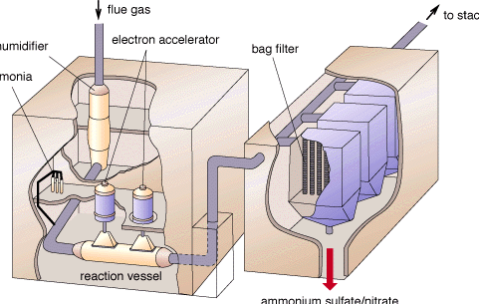
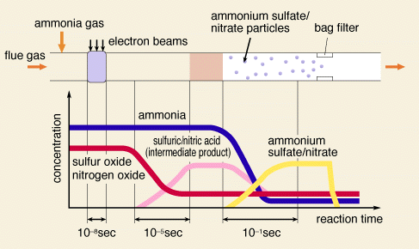
  Electron Beams
Have been used for removal of NOx, SOx and VOC from power stations
Current technique: - chemical - bi-product is gypsum
Electron beam technique:

Slide 30
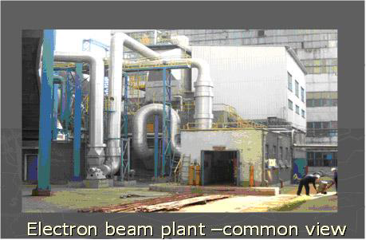
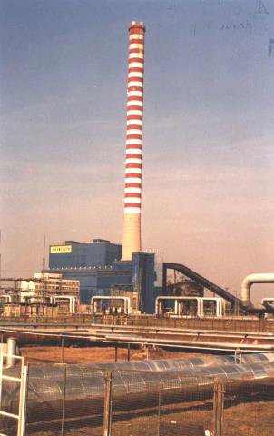
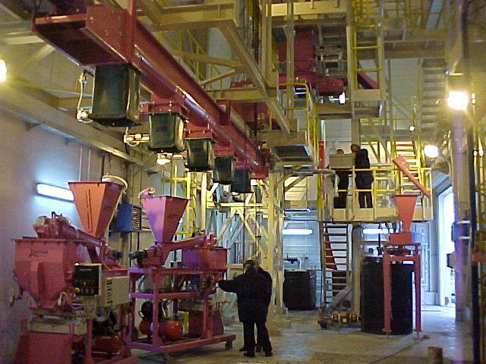
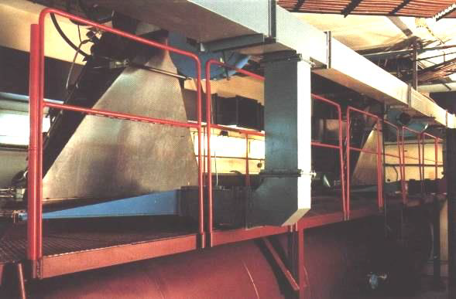
  Electron Beams
~4 pilot plants
Not used in production yet

Slide 31
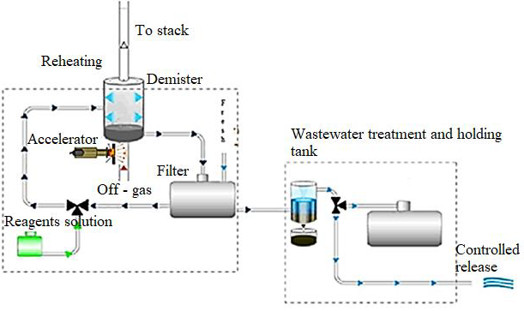
  Electron Beam Treatment of Diesel Engines

Slide 32
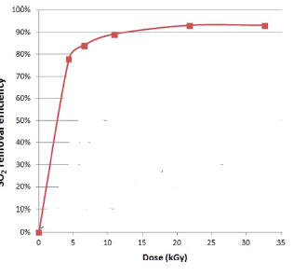
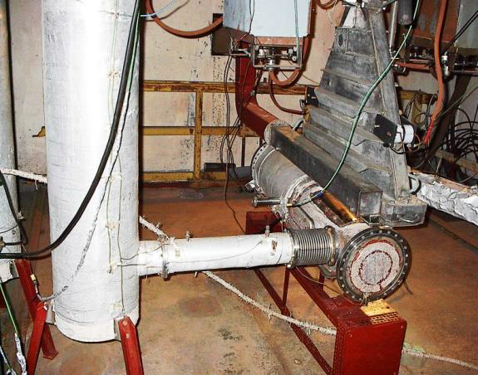
  Electron Beam Treatment of Diesel Engines

Slide 33
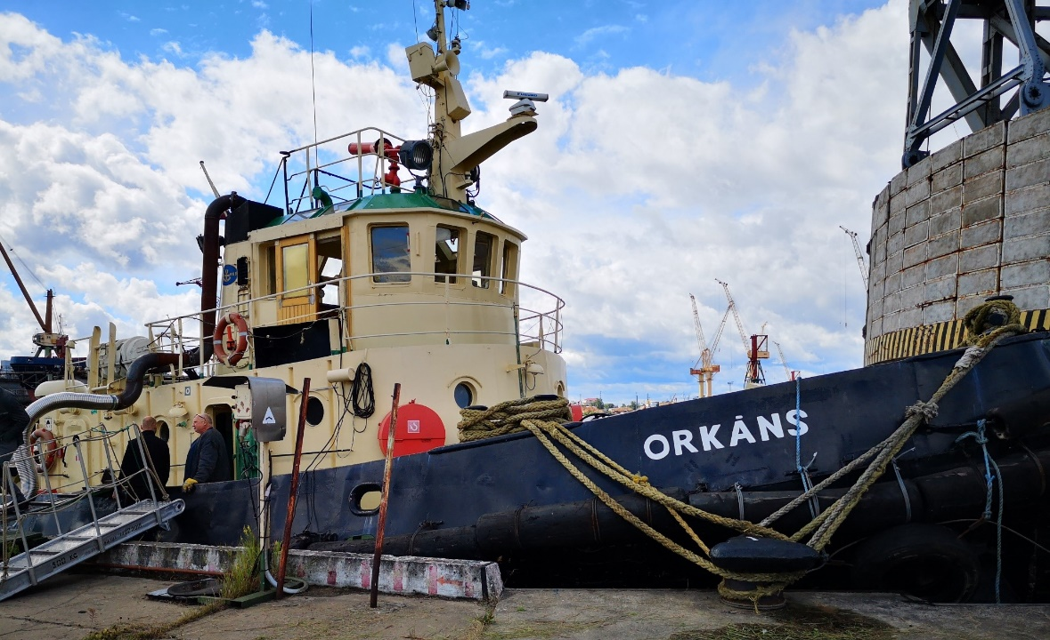
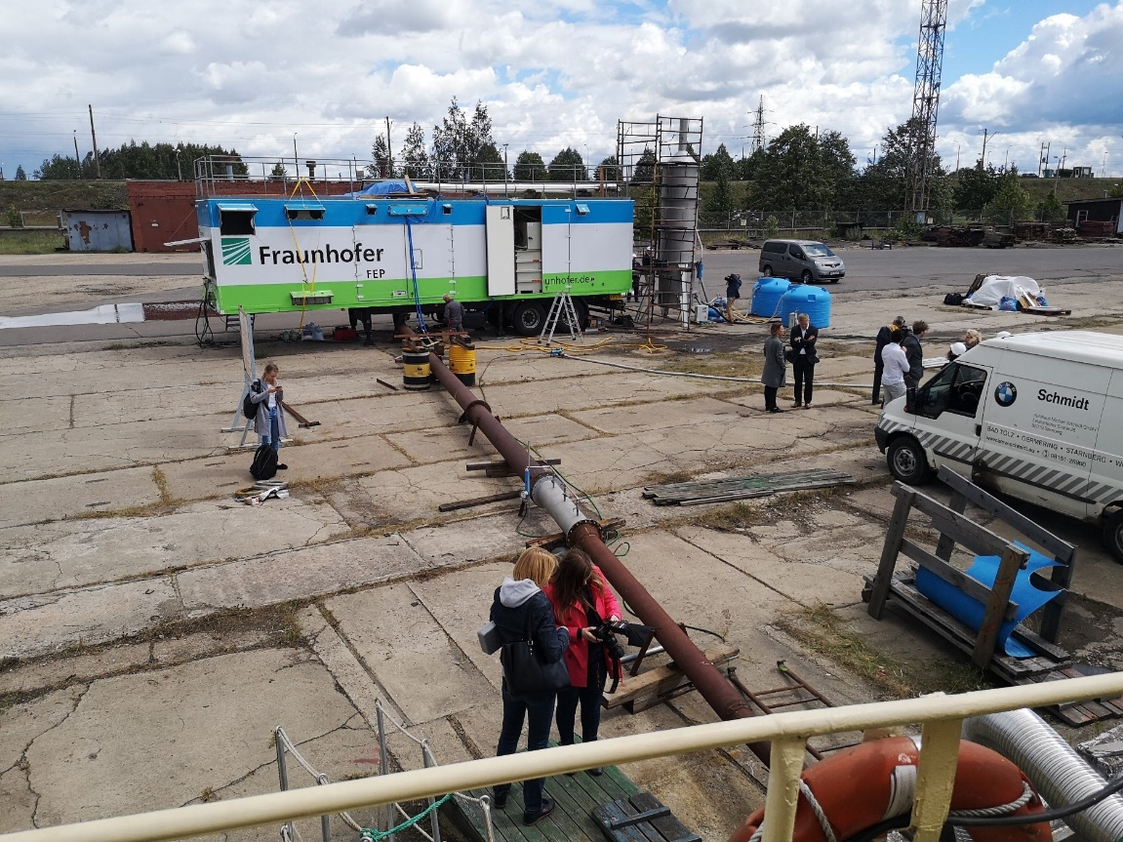
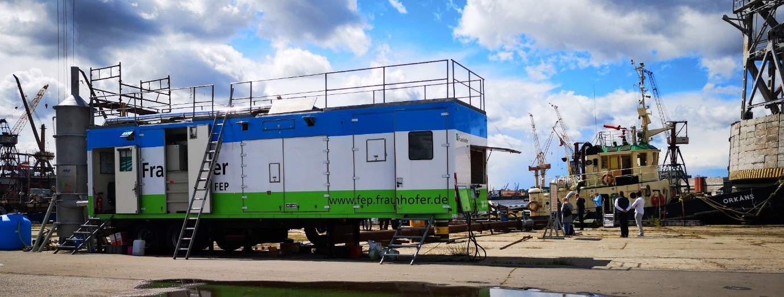
  Electron Beam Treatment of Diesel Engines

Slide 34
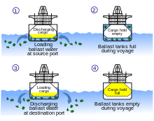
  Ship Ballast Water
Ballast water discharge typically contains a variety of biological materials, including plants, animals, viruses, and bacteria. These materials often include non-native, nuisance, exotic species that can cause extensive ecological and economic damage to aquatic ecosystems, along with serious human health issues including death.
Controlled by IMO
Usual method: chemical
Oil tanker: typically 30000 m³

Slide 35
  Electron Beam Treatment
Impossible to compete….unless there are regulations against dumping the chemicals
But ballast tanks must be cleaned periodically
Water is then much more contaminated
Concept is a “green” dock developed in Poland
Treat with e-beam
Better contaminate removal
Greater possibility of recycling
First tests at Remontowa shipyard

Slide 36
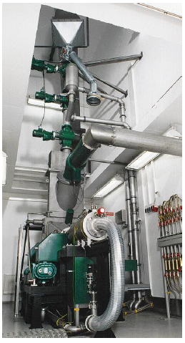
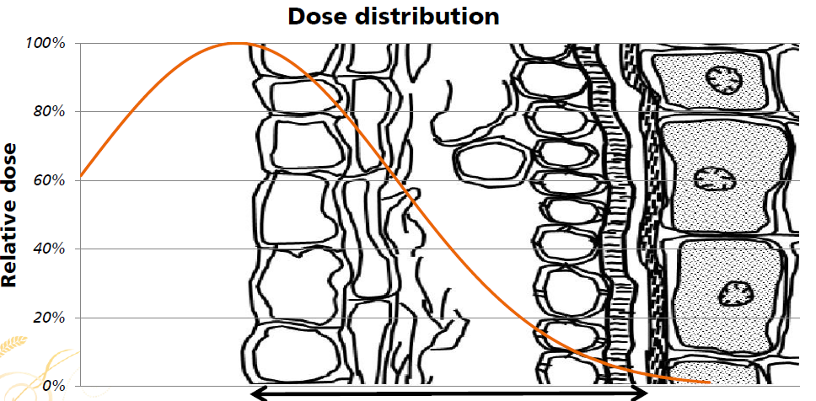
  Seed Treatment
Developed by Fraunhofer FEP in Germany
Due to E-coli outbreak

Slide 37
  Preservation of Cultural Artifacts
HISTORY
1977 the mummy of Ramses II, Nucléar laboratory CEA’s Grenoble Research Centre, dose 18 kGy
1980 The Gantt papers (U.S.A.), dose 4.5 kGy
1992 book collection, Leipzig University Library
dose 12 kGy
1997 500 000 books, wet, library of the Colorado University, dose 15 kGy
the end of 1990,National Film Archive of Romania, photographic films, dose 25-50 kGy
37

Slide 38
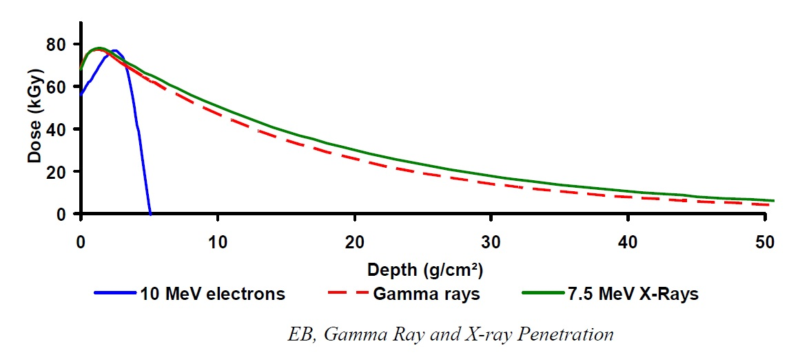
  Preservation of Cultural Artifacts
Gamma rays
Neutral conditions
No harmful residues
Gamma allows treating dense and thick products
Exposition time depends on the dose rate of the gamma cell (minutes-days)
Oxidative degradation
Safety precautions
Electron beam
Fast process
Neutral conditions
Exposition time: short
Much lower probability of oxidative degradation
No harmful residues
Limited depth of penetration
38

Slide 39
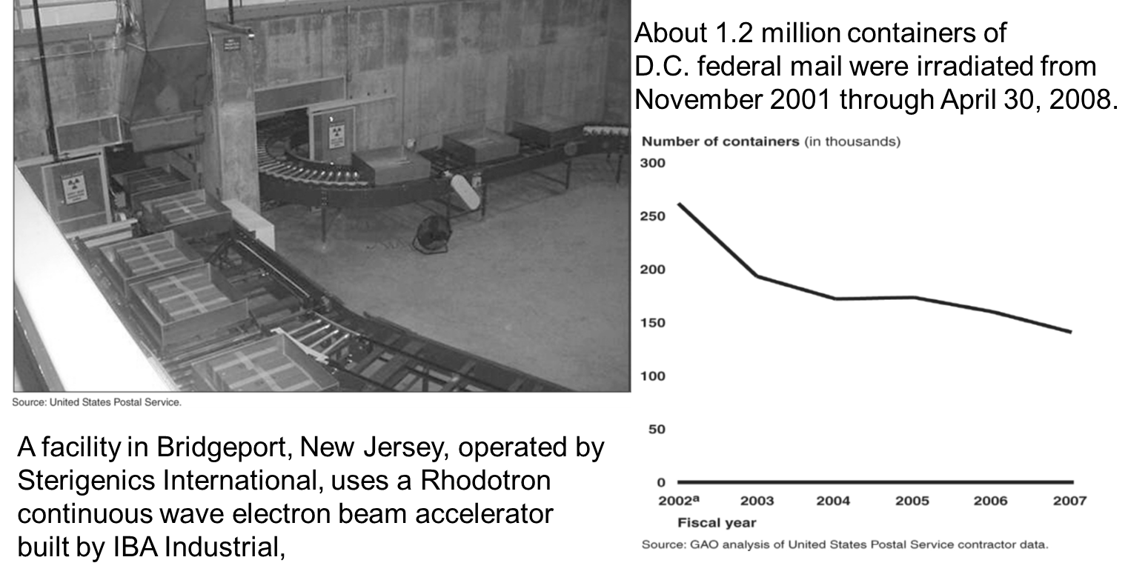
  Preservation of Cultural Artifacts
39

Slide 40
  Conclusions
Electron beams are already widely used
  Polymer cross-linking (wires & cables, car tyres, hydrogels, etc)
  Surface curing and preparation
  Sterilisation: medical and food (including COVID-19)
  Composite preparation
  Thermal applications
They have much further potential
Environmental area is of particular interest
They can do things which are otherwise very difficult
Penetration into this area is a challenge
As is getting funding, as usual

