Slide 1
LHCb RICH 2008-2018
Antonis Papanestis
RAL

Slide 2
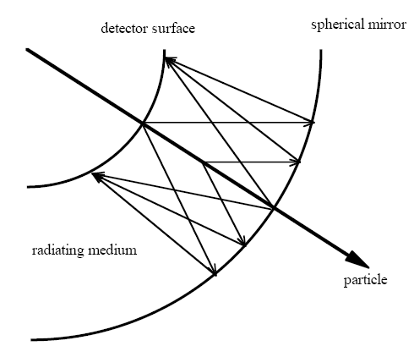
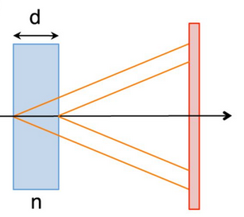
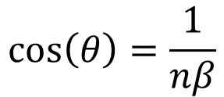
RICH Detectors
Proximity focusing geometry
$$\cos\left(θ\right)=\frac{1}{nβ}$$
Measures both the Cherenkov angle and the number of photoelectrons detected.
Can be used over particle identification over large surfaces.
Requires photodetectors with single photon identification capability.

Slide 3
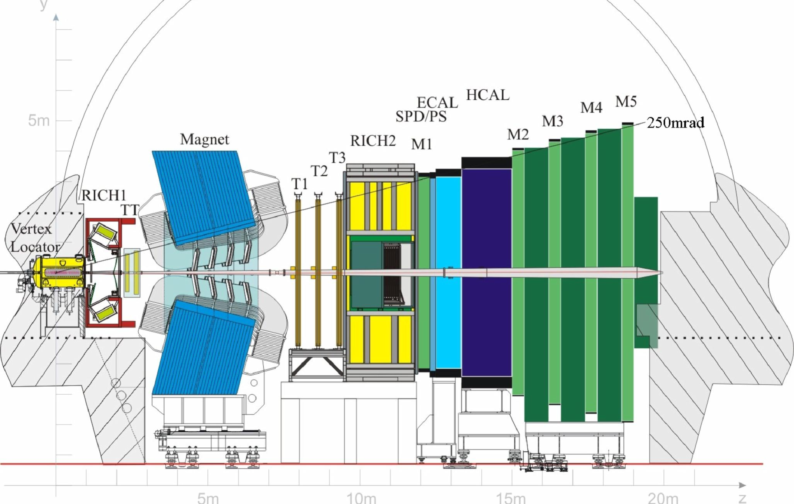
The LHCb Experiment

Slide 4
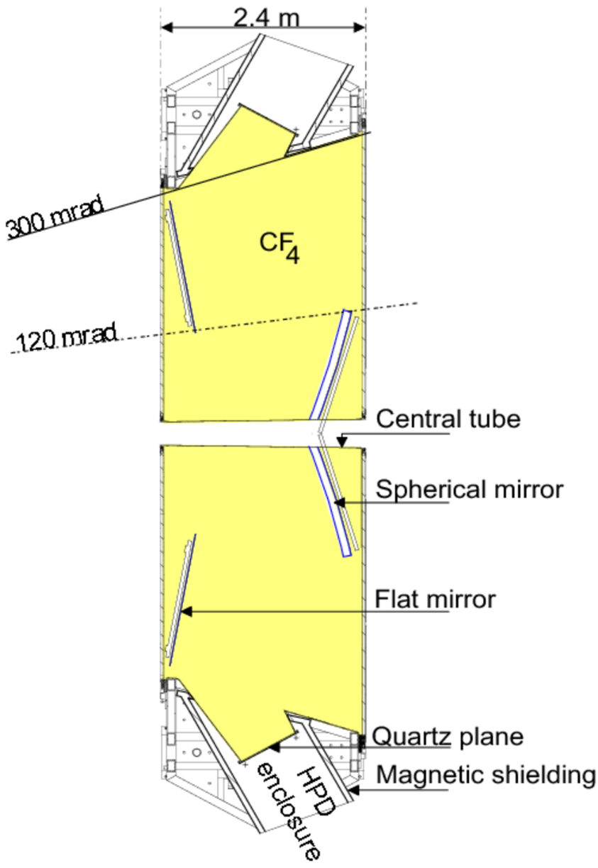
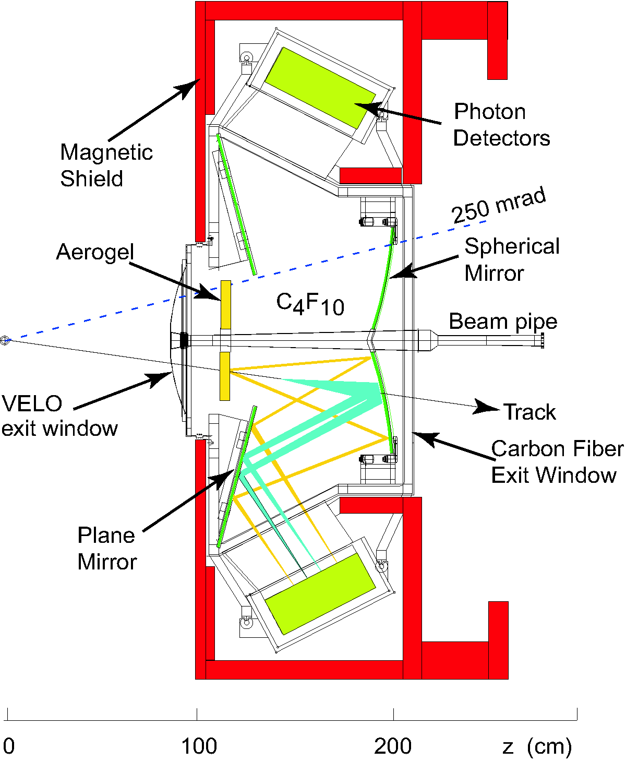
The original RICH detectors
Original RICH 1
RICH 2

Slide 5
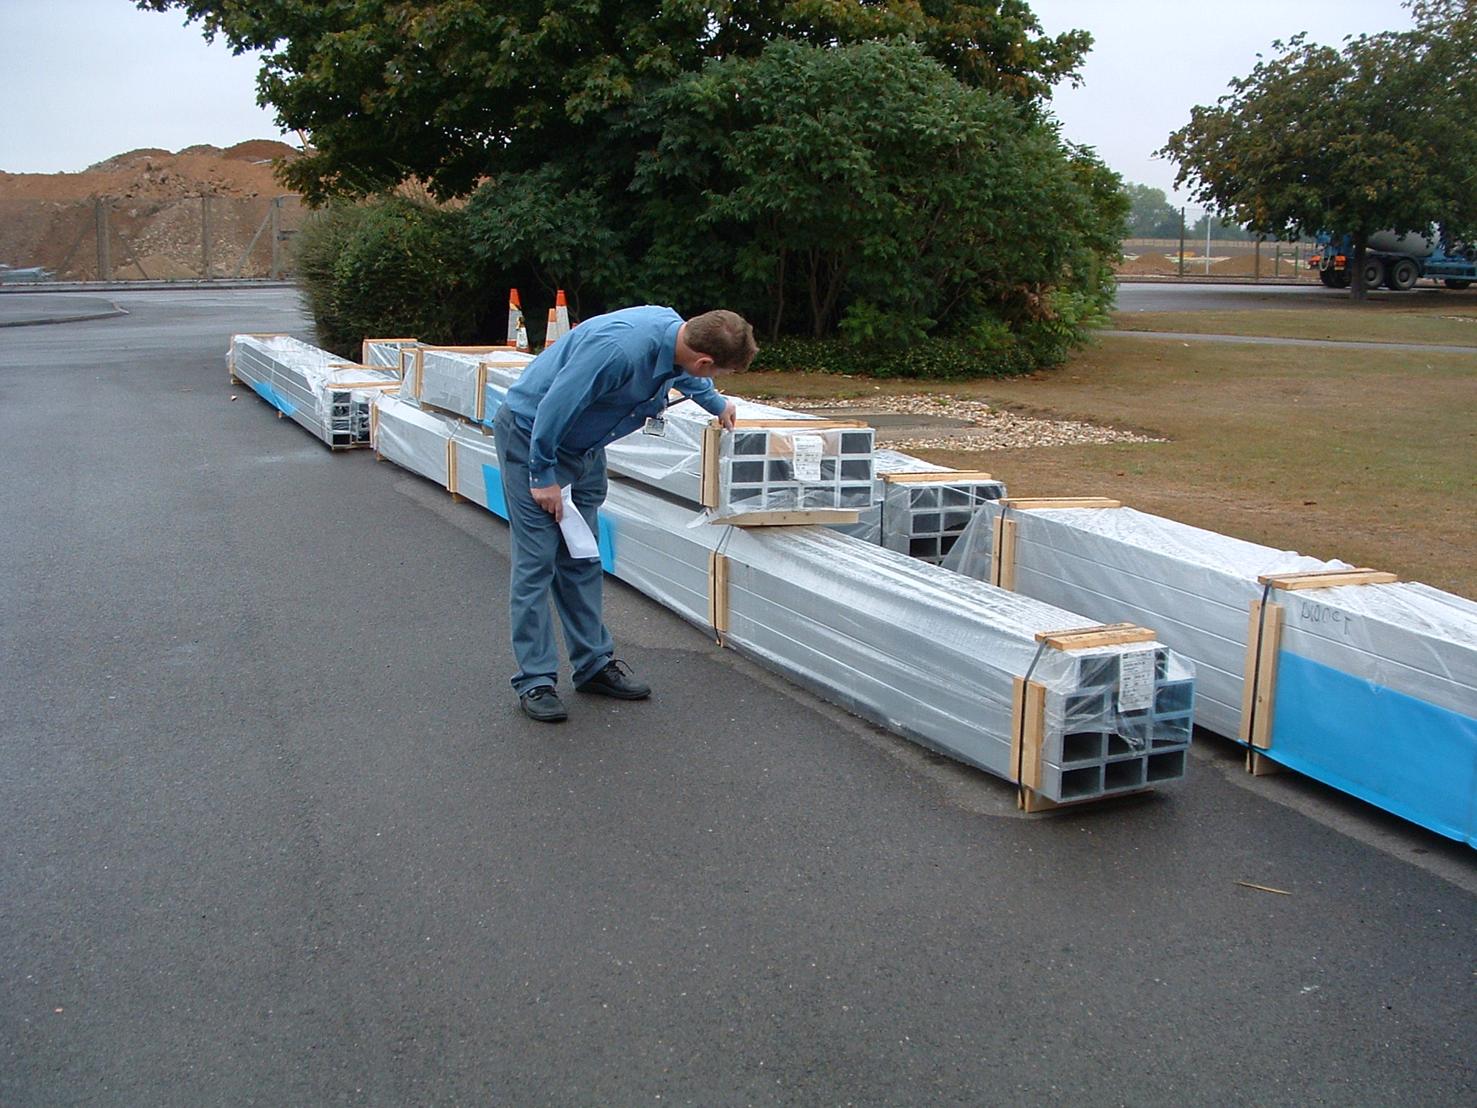
RICH 2 structure material

Slide 6
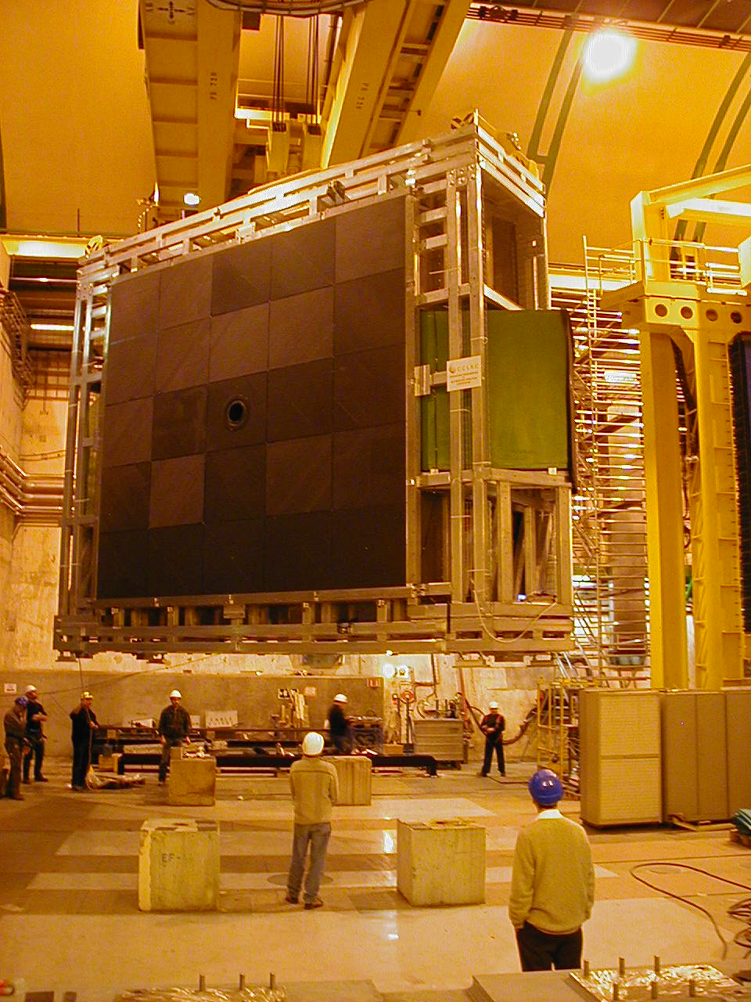
RICH2 in LHCb pit

Slide 7
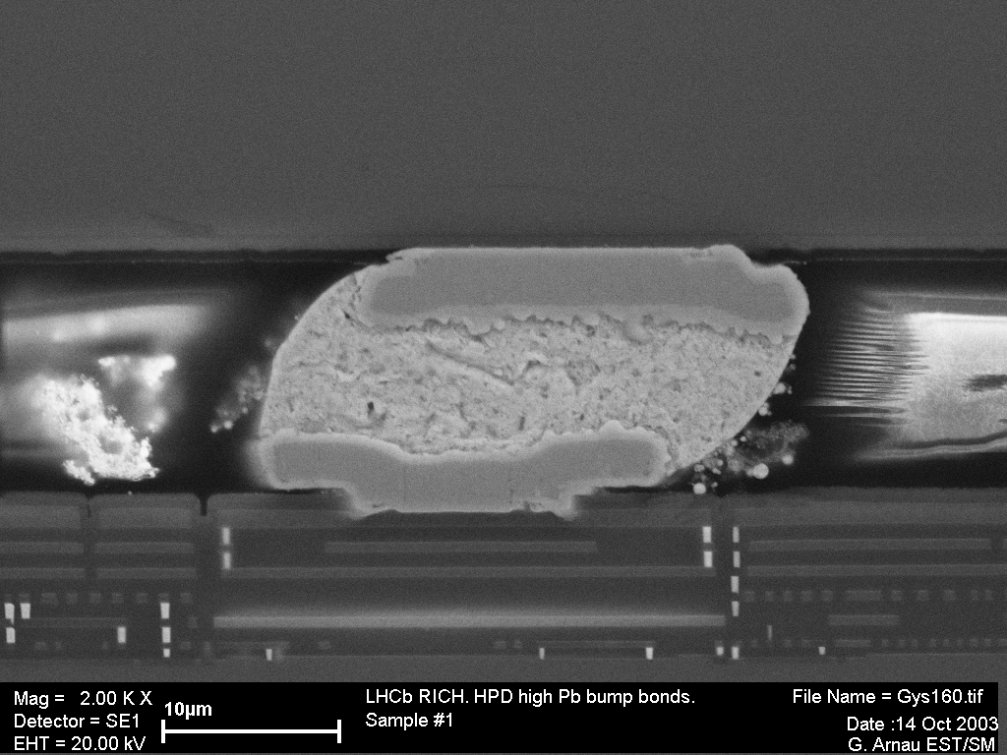
HPD flow chart: anode part
Detector chip (Canberra - B)
Bump-bonding (VTT - FIN)
Assembly probing
Readout chip (IBM - F)
Packaging (HCM - F)
Anode testing
Wafer probing
Brazing (DEP - NL) and gold-plating (CERN)
Ceramic carrier (Kyocera - JP)
Visual inspection and plating control

Slide 8
HPD flow chart: HPD tube part (DEP)
Tube body assembly
Photo-cathode deposition and vacuum sealing
HPD cabling and potting
Vacuum bake-out
@ 300°C
Anode incoming inspection
and testing
Anode testing
QE measurement and anode testing
Final HPD testing

Slide 9
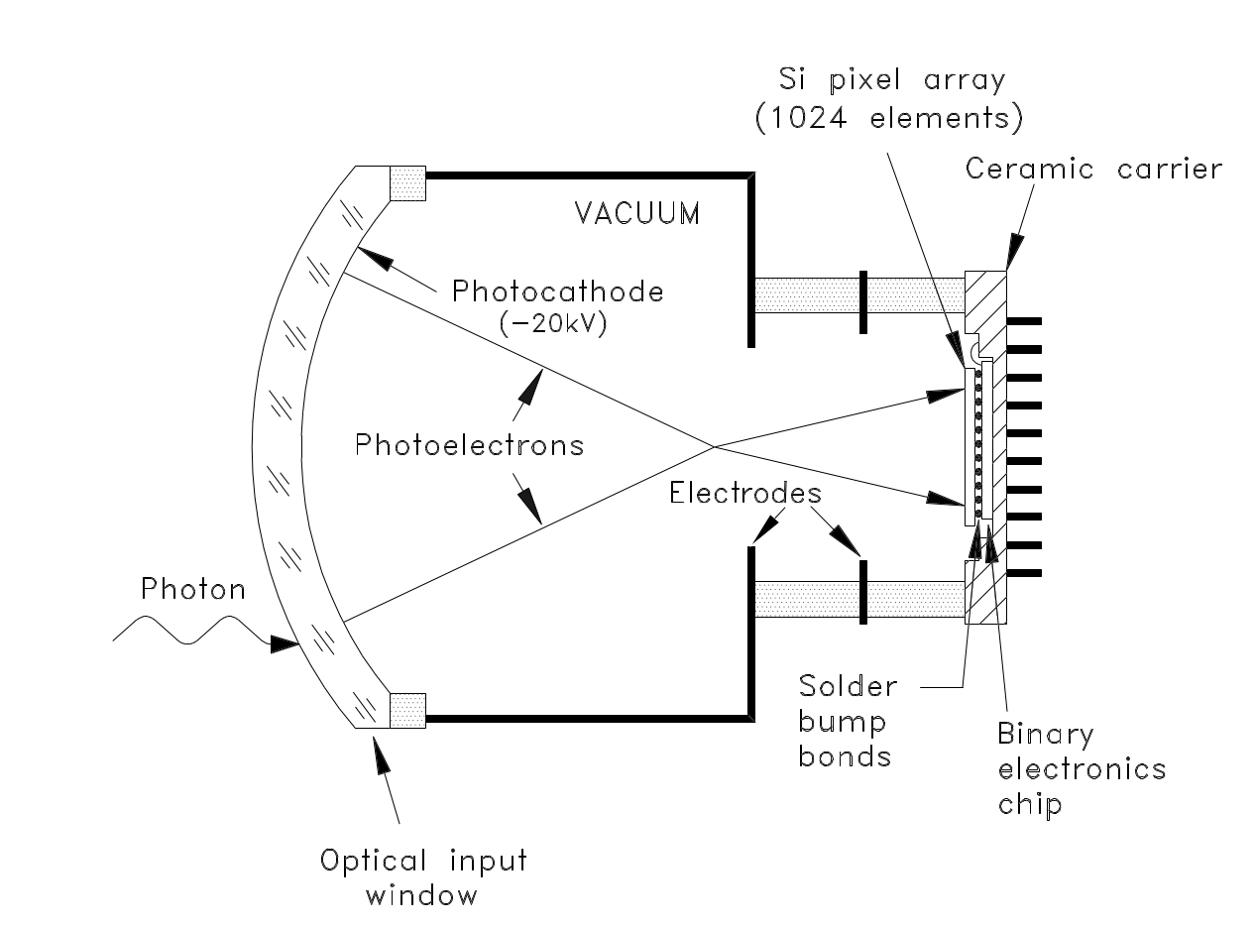
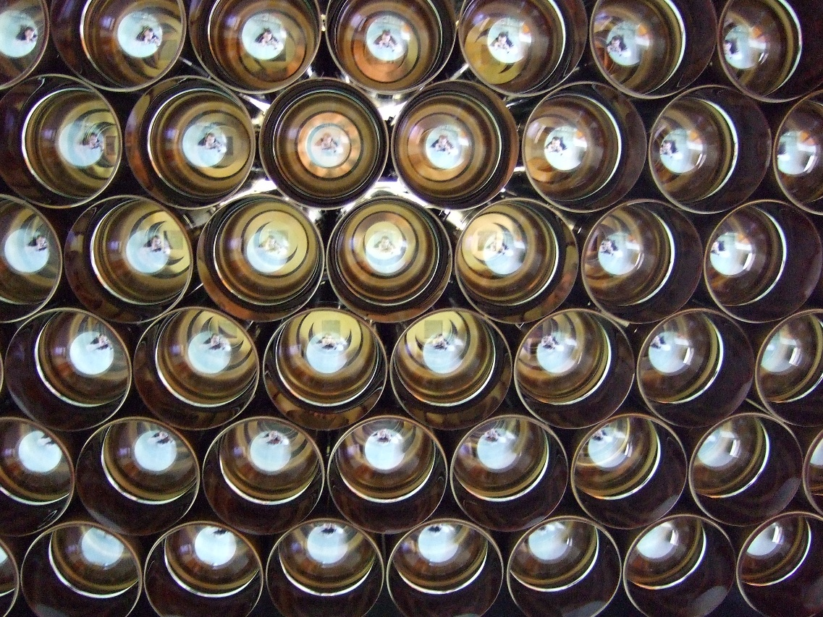
HPDs in the RICH

Slide 10
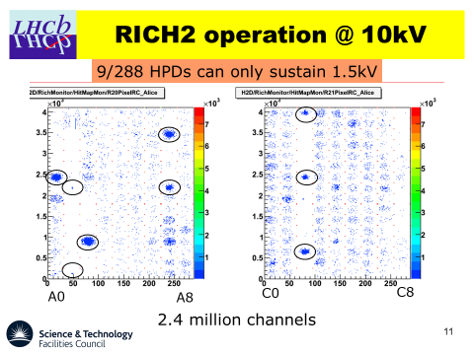
How it all started (Sep 2007)

Slide 11
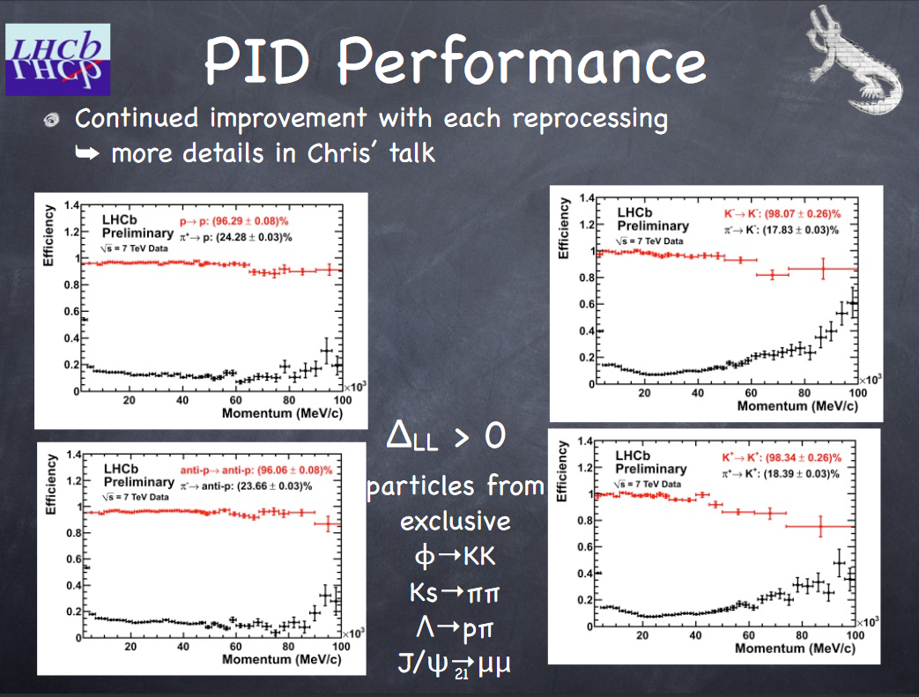
June 2010

Slide 12
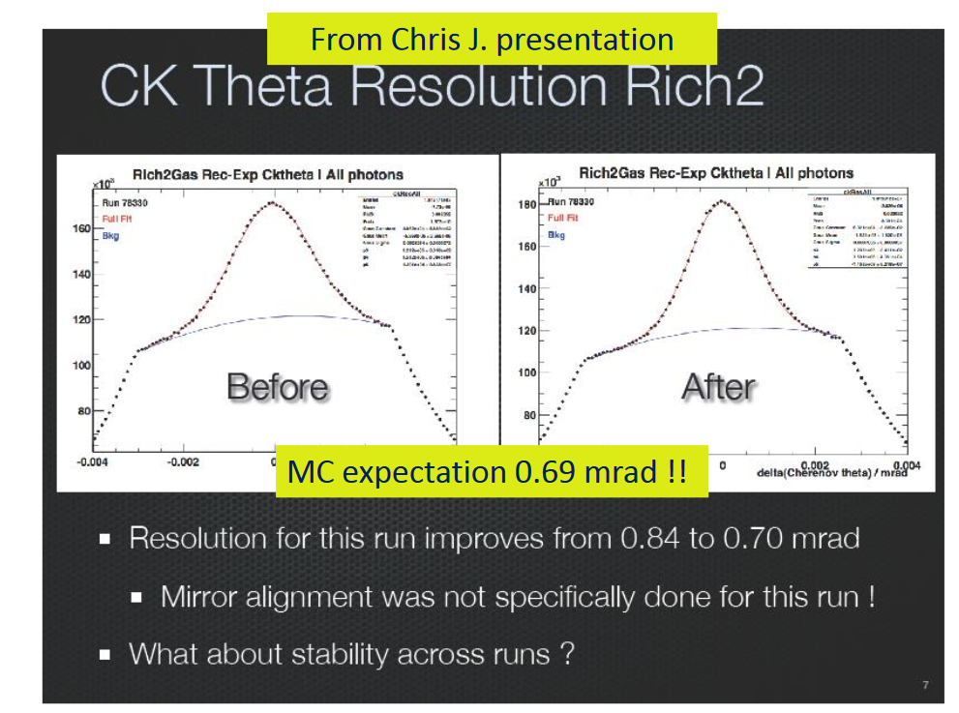
October 2010 (i)

Slide 13
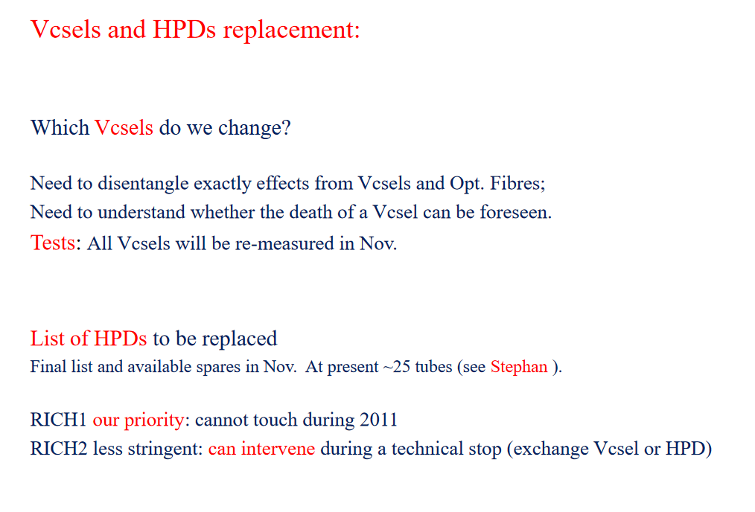
October 2010 (ii)

Slide 14
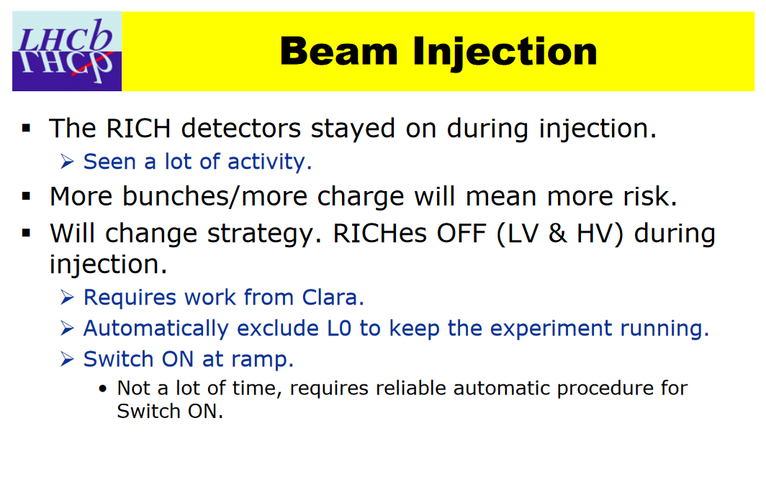
December 2010 (i)

Slide 15
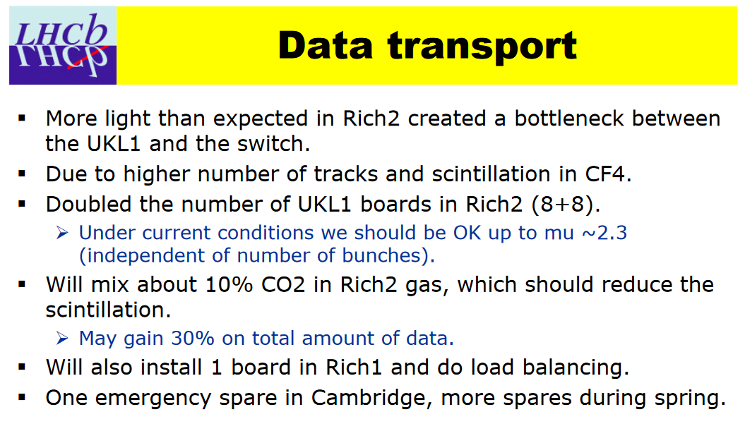
December 2010 (ii)

Slide 16
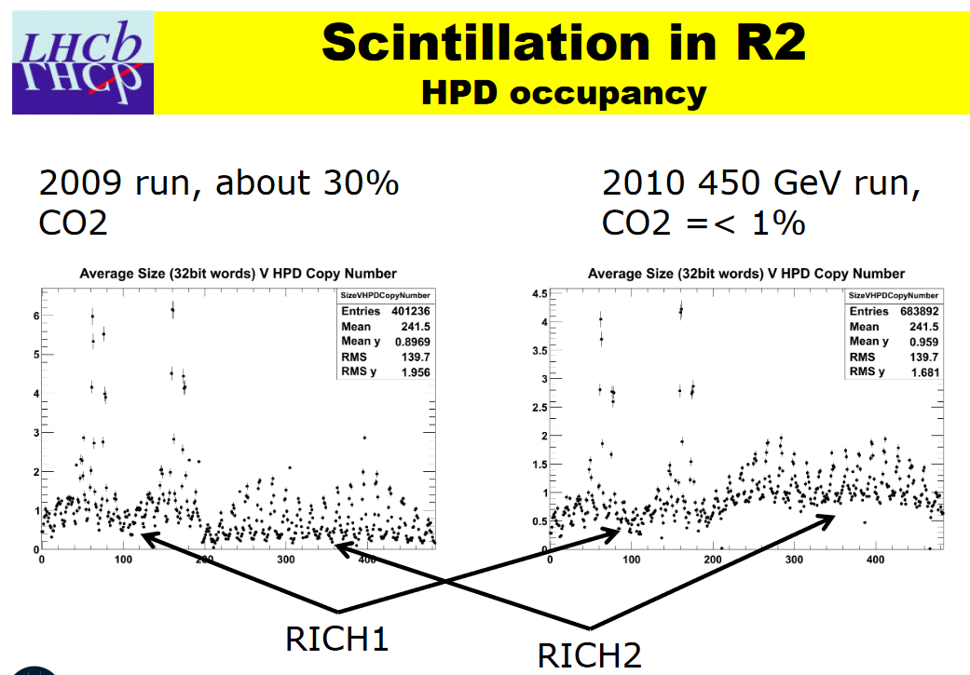
December (2010)

Slide 17
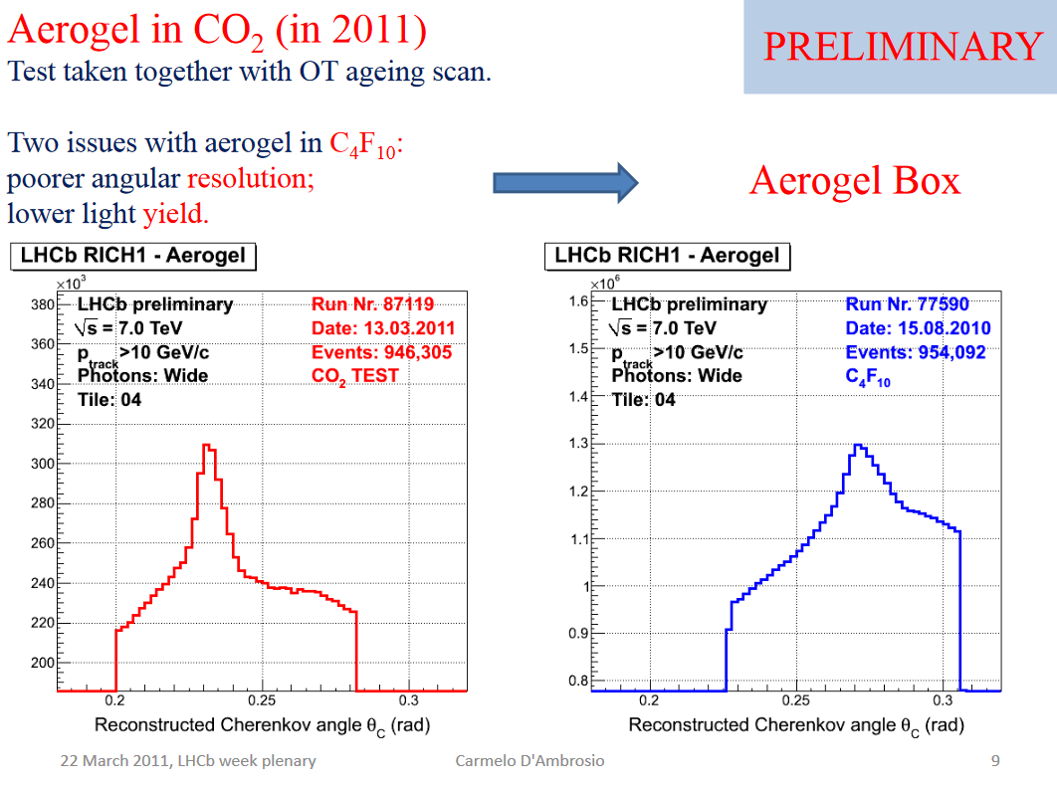
March 2011

Slide 18
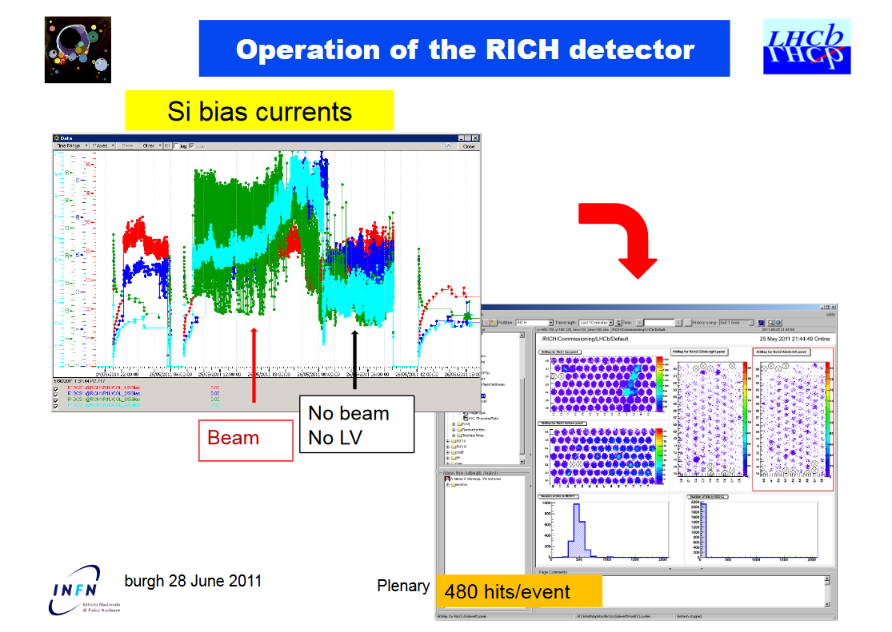
June 2011 (ii)

Slide 19
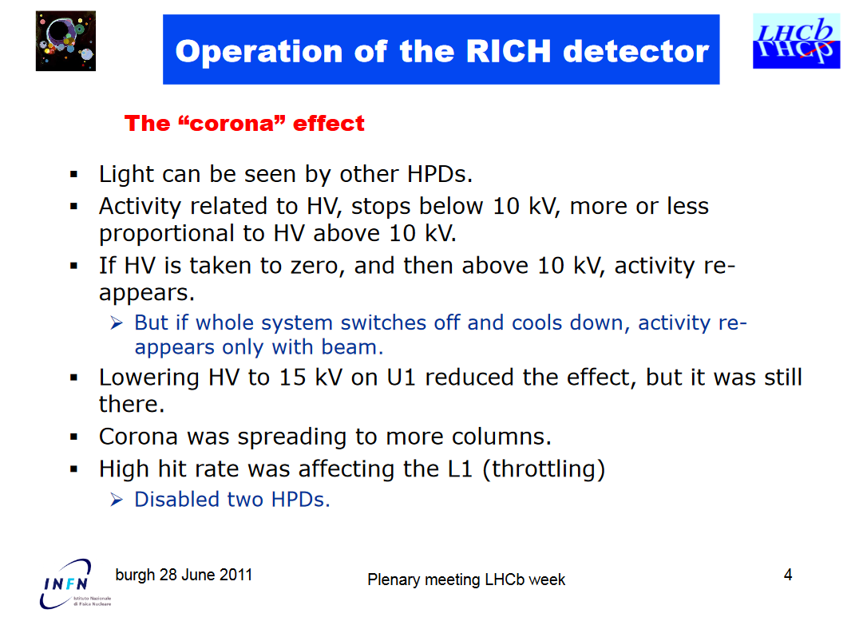
June 2011 (i)

Slide 20
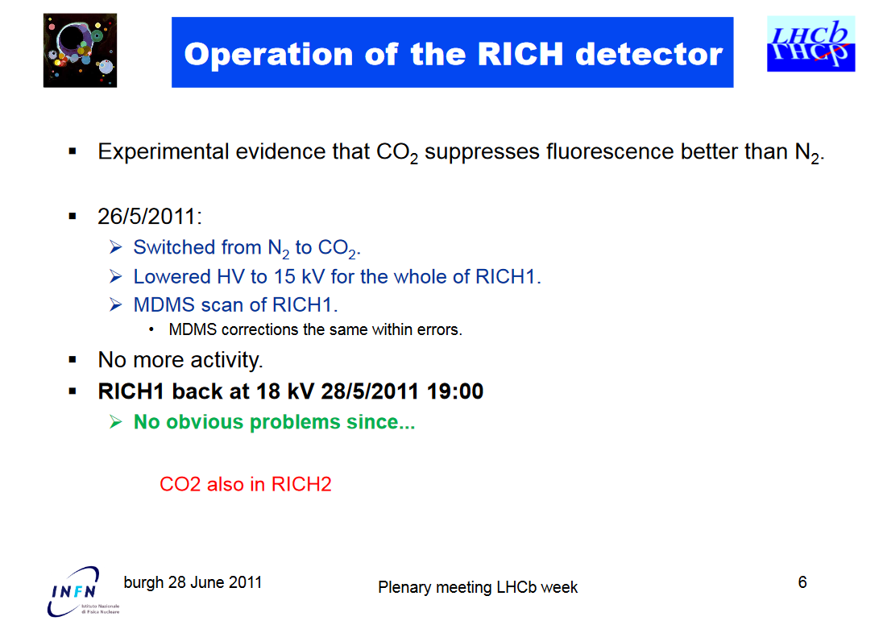
June 2011 (iii)

Slide 21
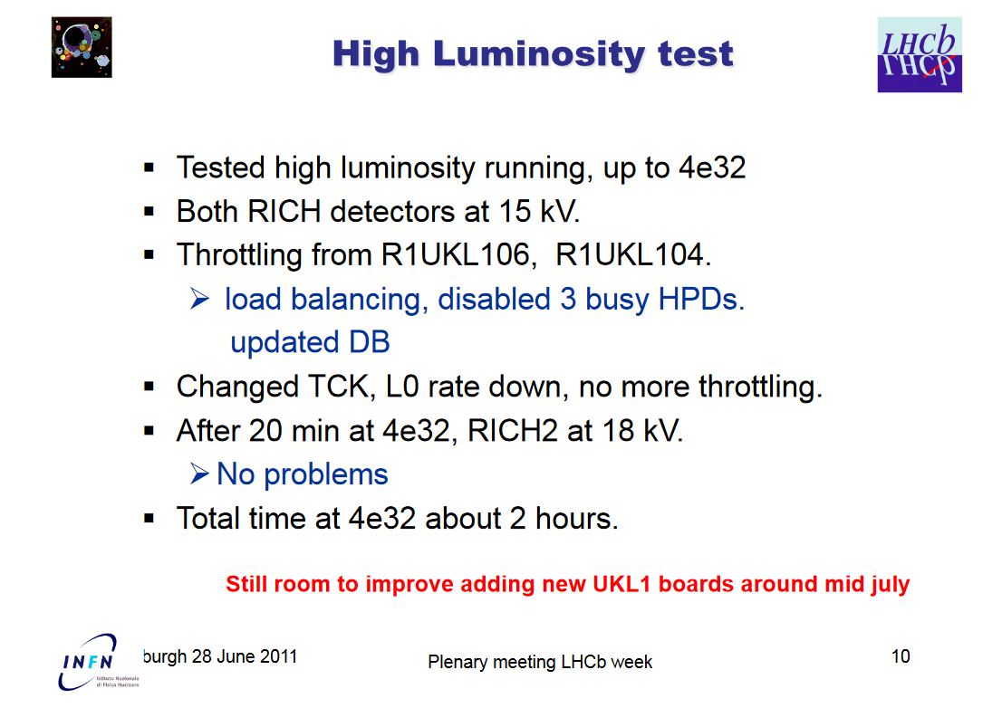
June 2011 (iv)

Slide 22
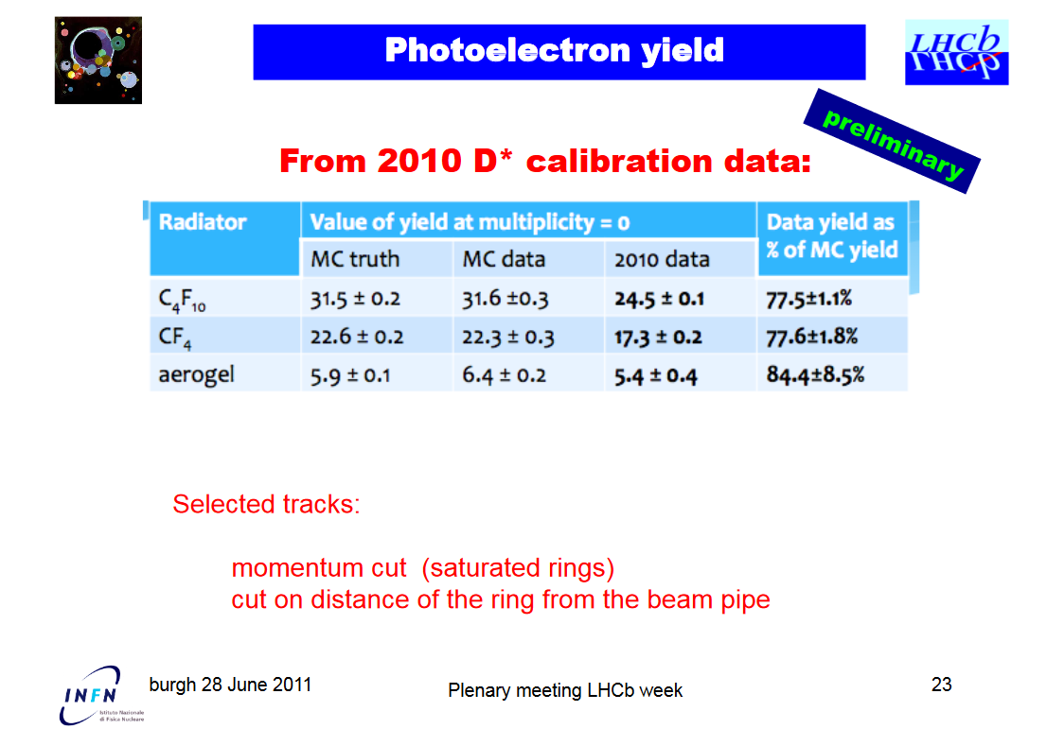
June 2011 (v)

Slide 23
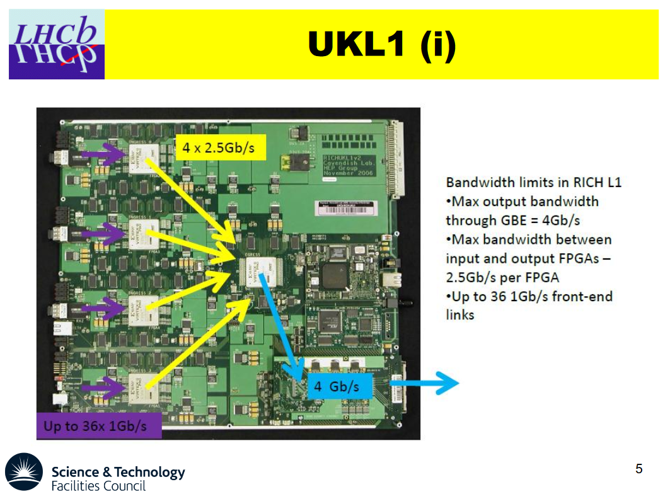
September 2011 (i)

Slide 24
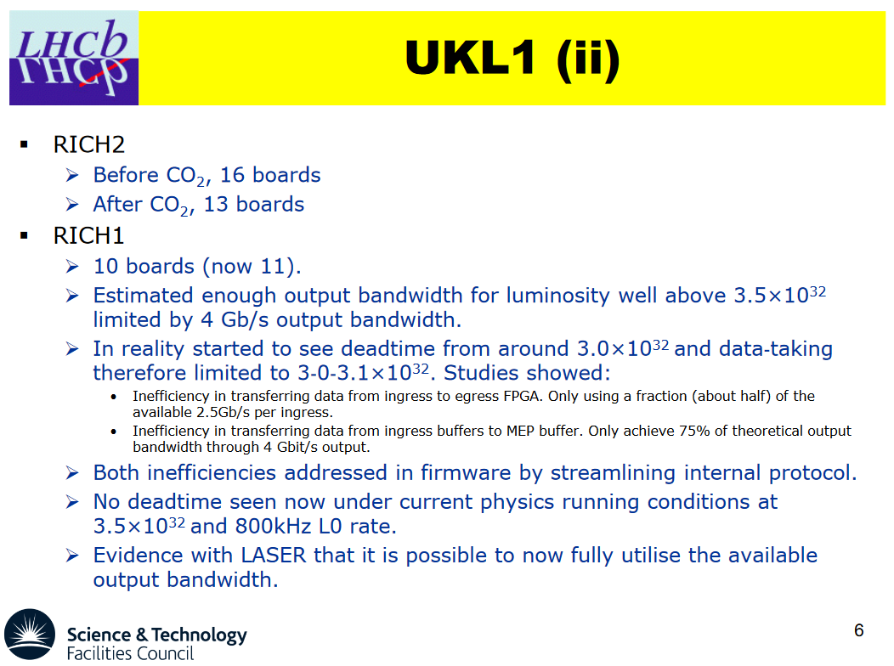
September 2011 (ii)

Slide 25
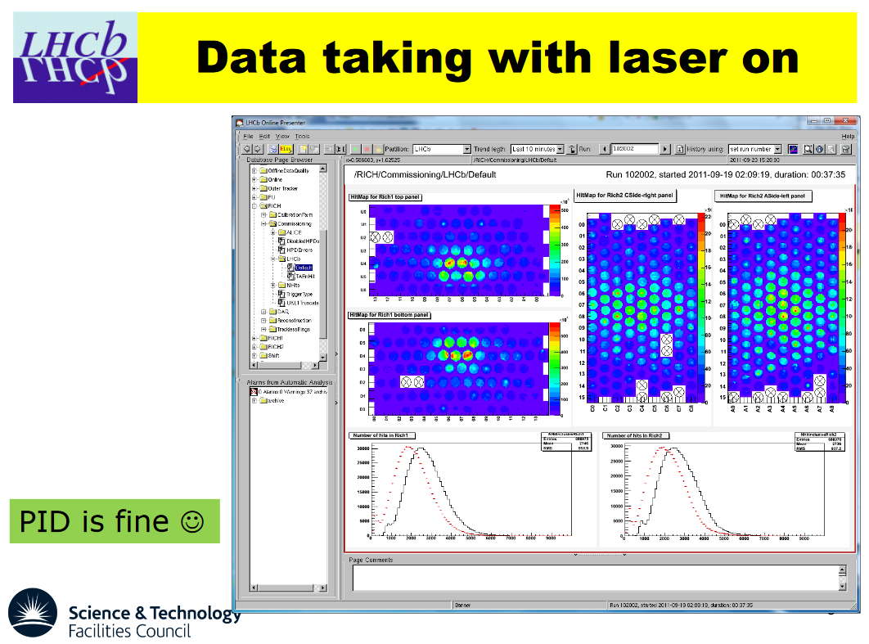
September 2011 (iii)

Slide 26
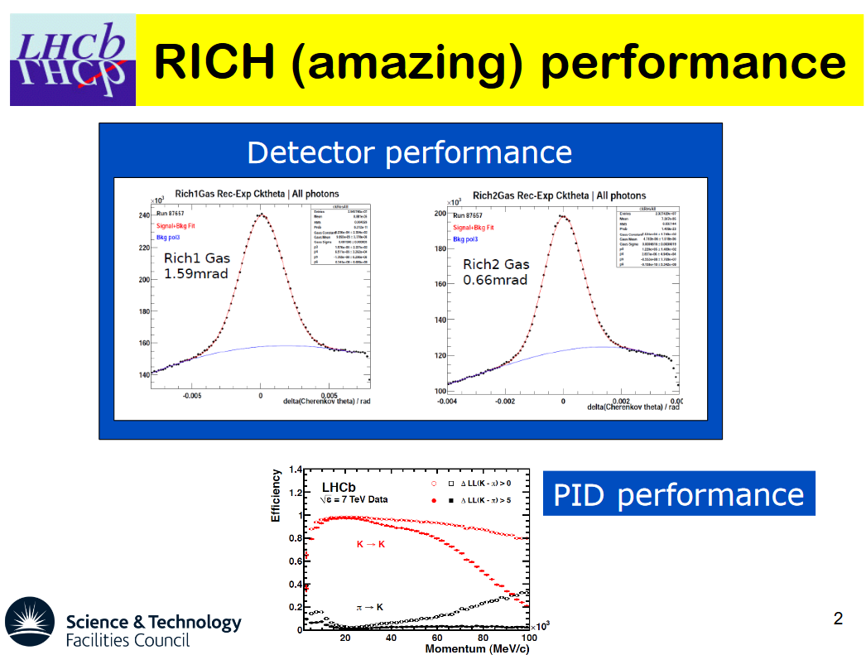
December 2011 (i)

Slide 27
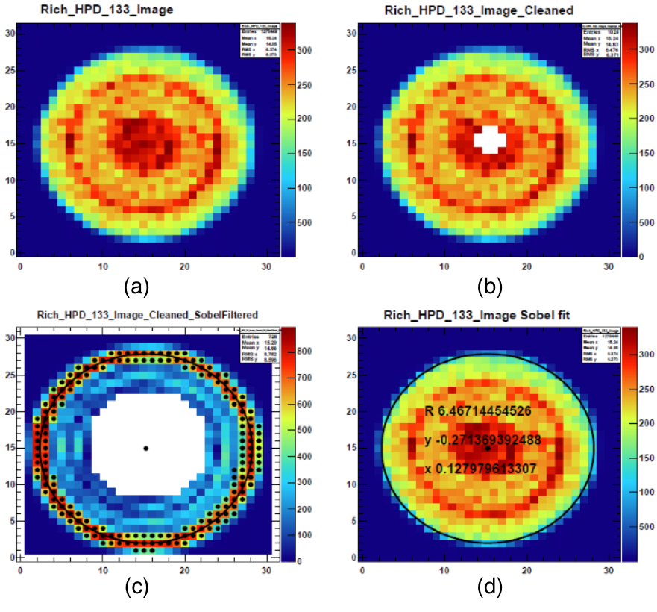
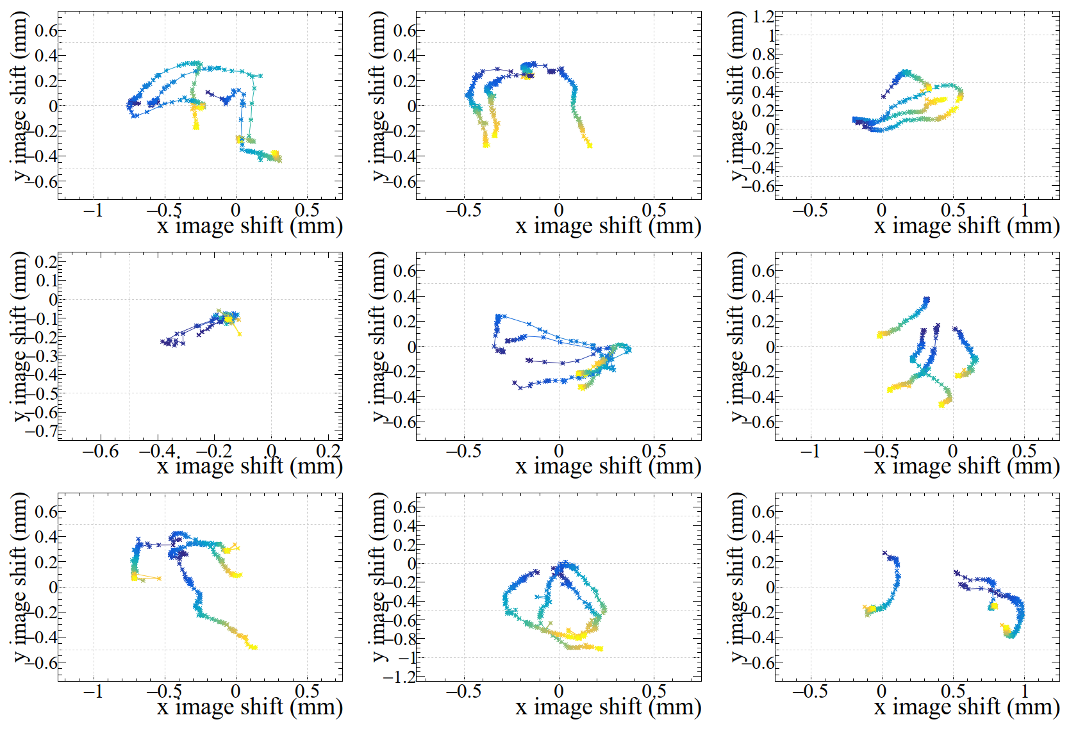
HPD photocathode position
One pixel
Automatic Online calibration for every run (max 1 hour)

Slide 28
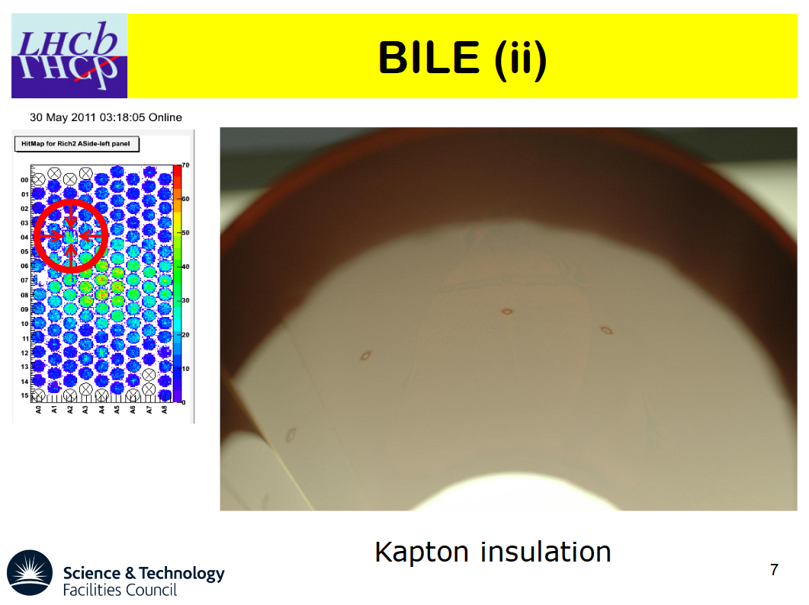
December 2011 (ii)

Slide 29
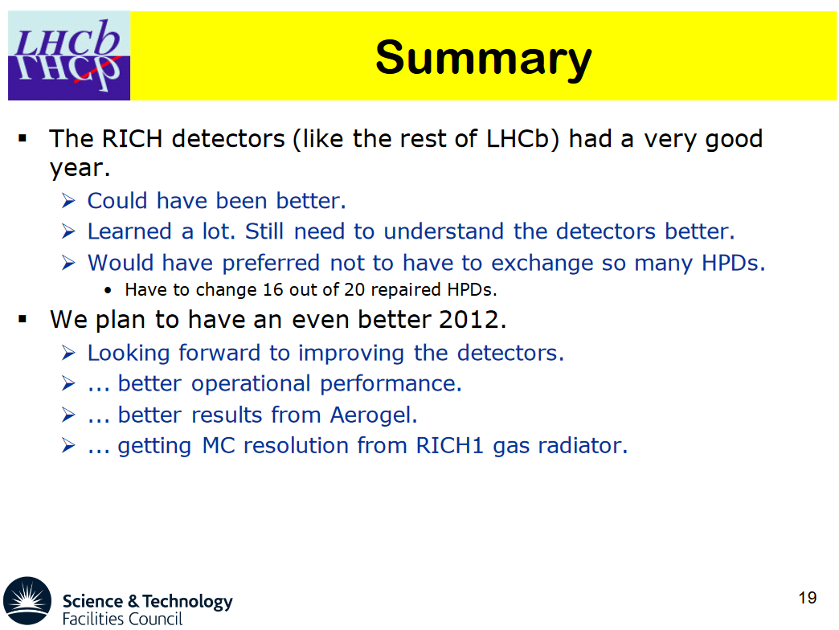
December 2011 (iii)

Slide 30
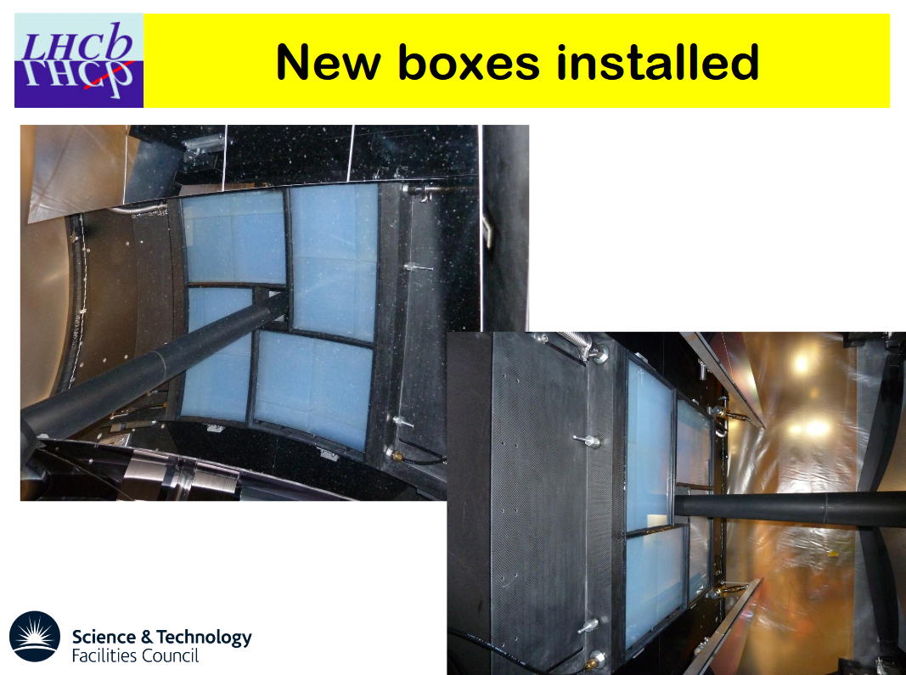
March 2012

Slide 31
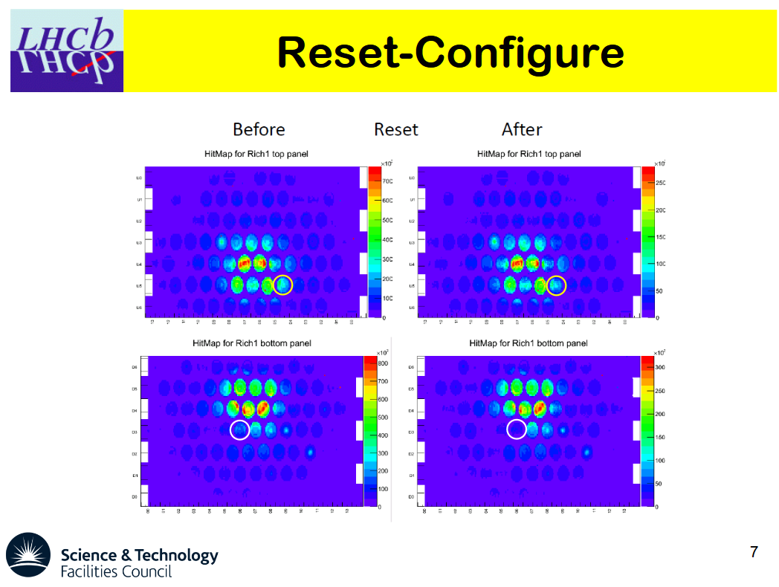
June 2012

Slide 32
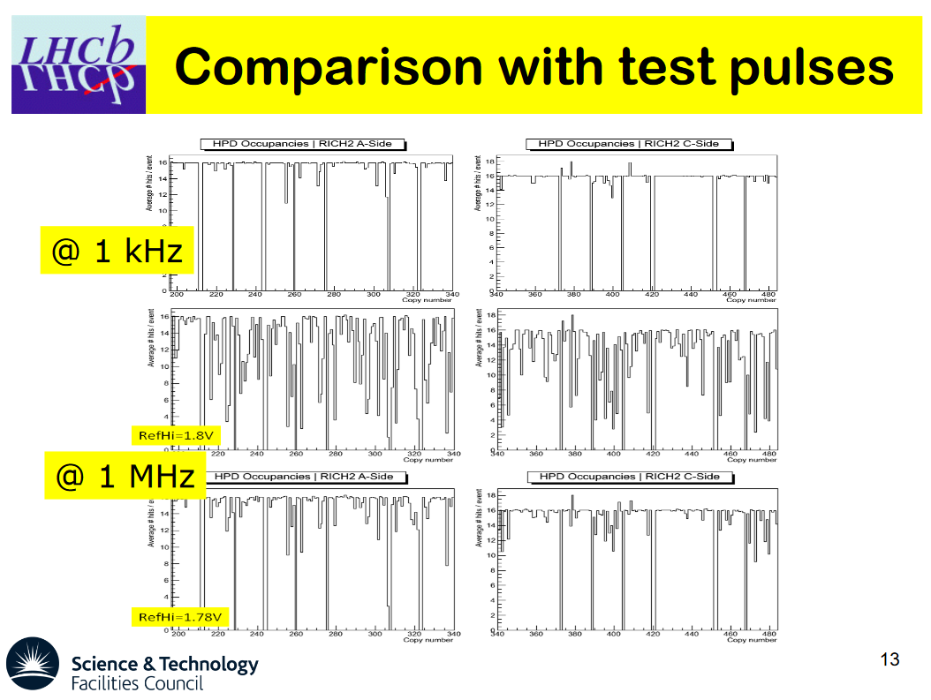
September 2012 (i)

Slide 33
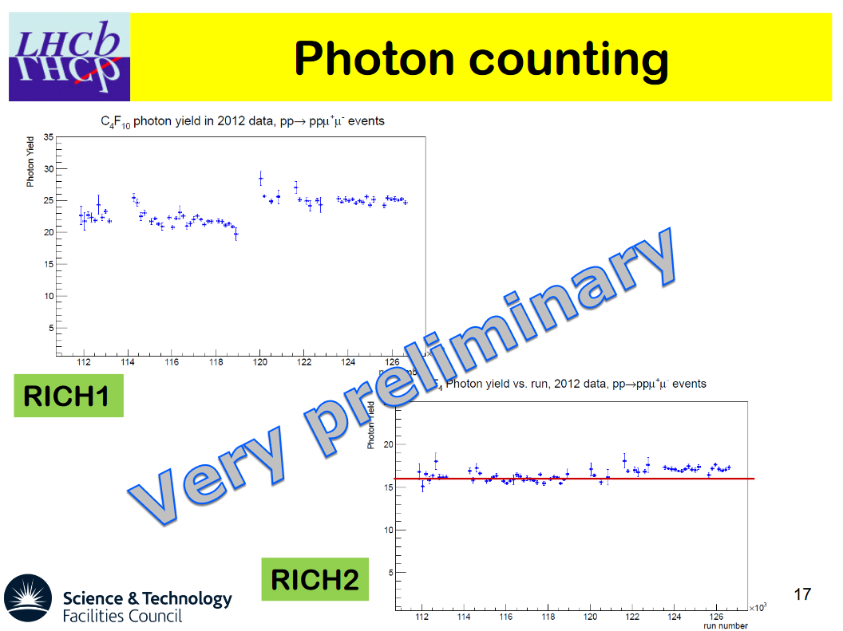
September 2012 (ii)

Slide 34
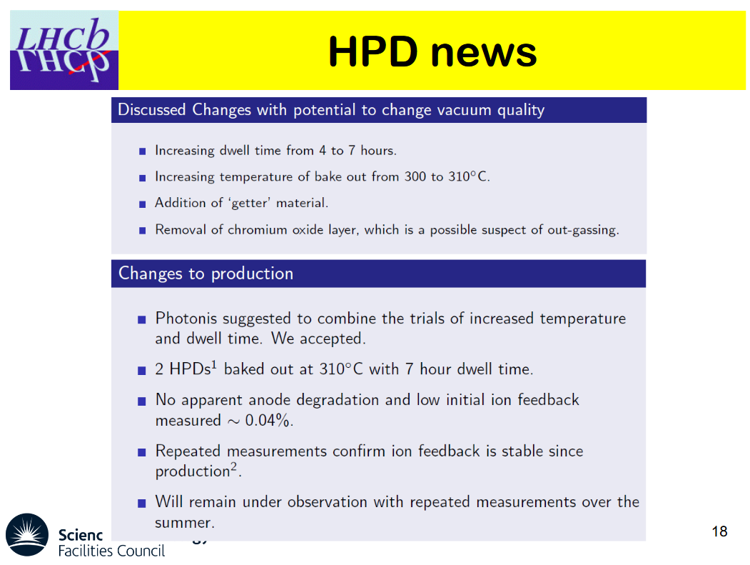
September 2012 (iii)

Slide 35
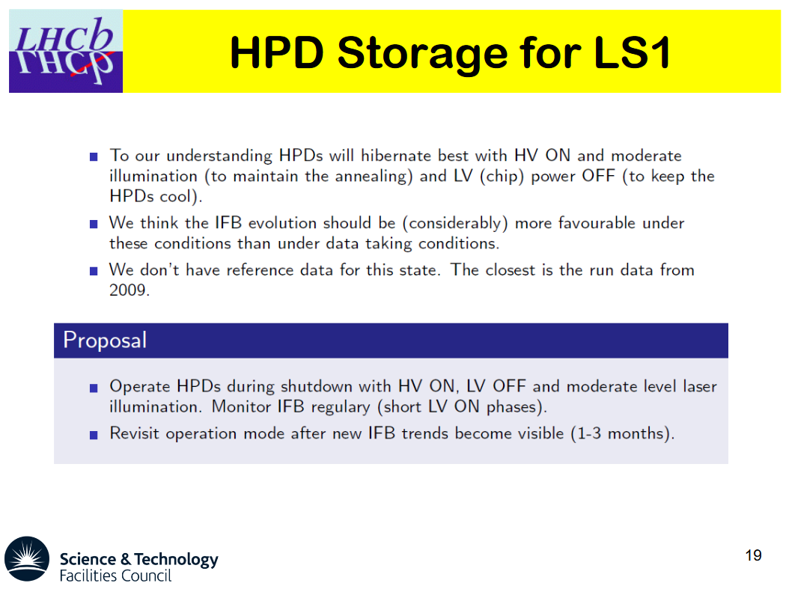
September 2012 (iv)

Slide 36
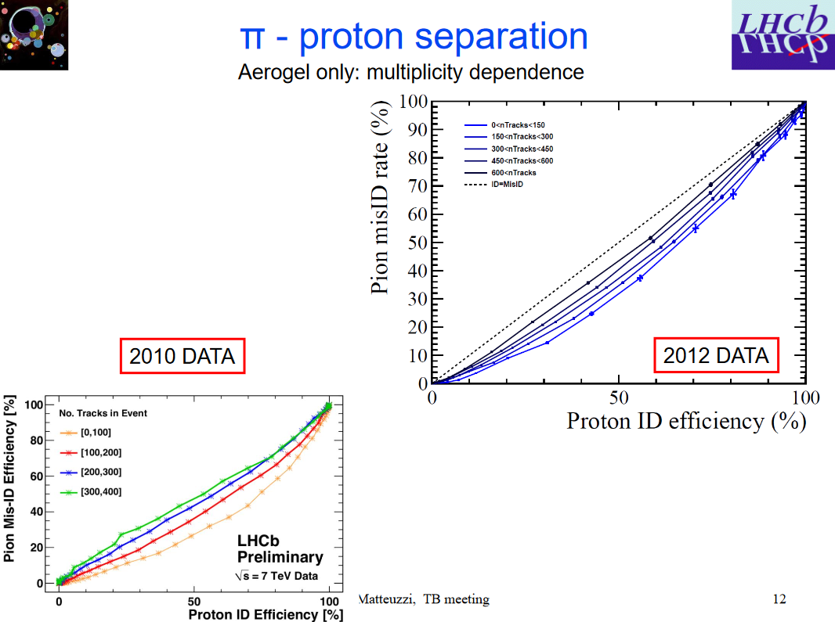
November 2012 (i)

Slide 37
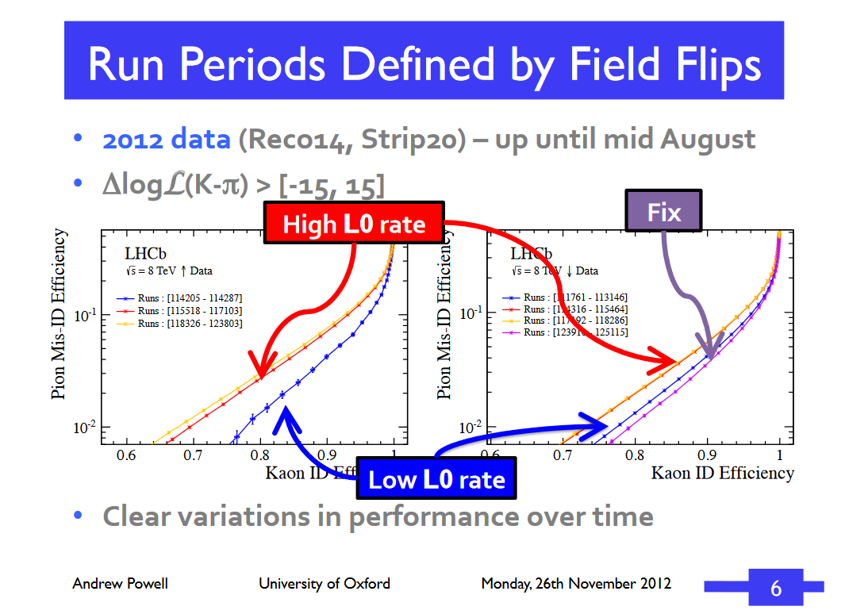
November 2012 (ii)

Slide 38
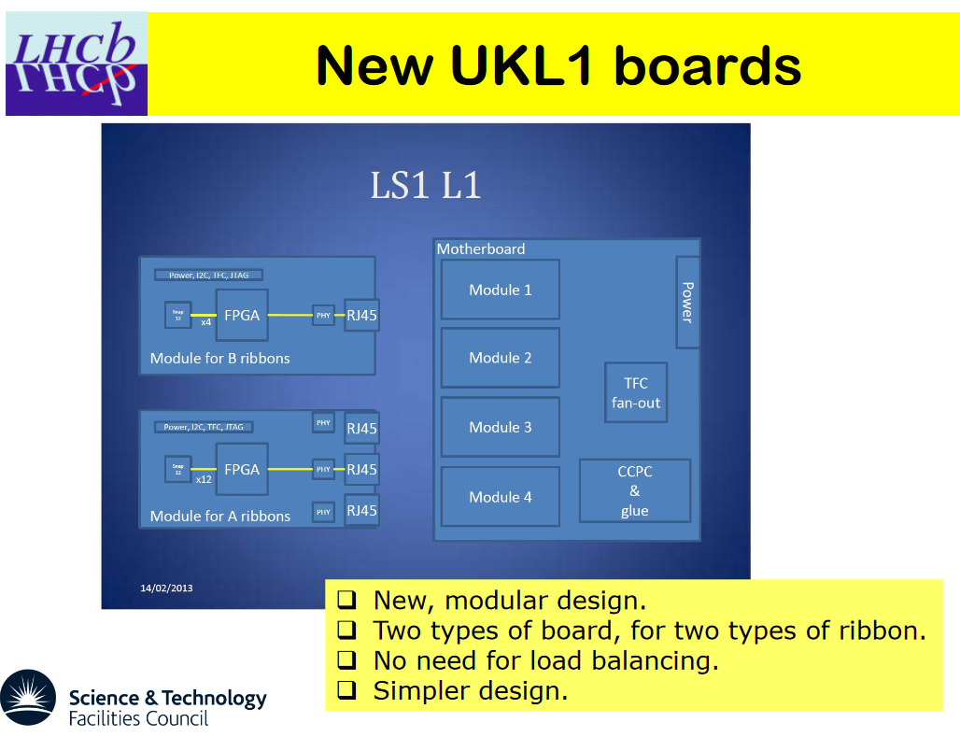
March 2013 (i)

Slide 39
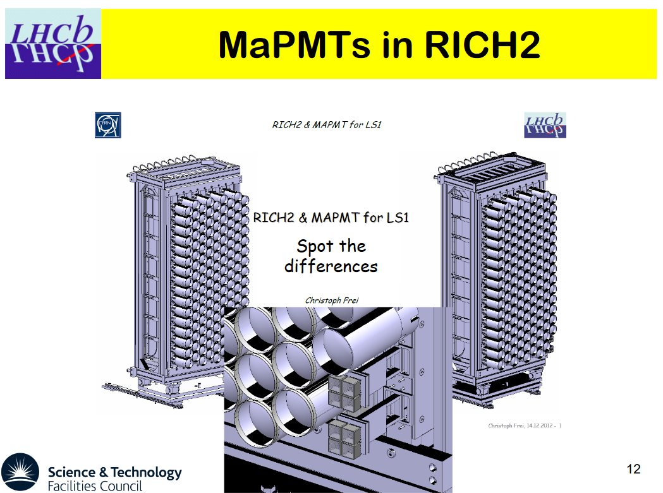
March 2013 (ii)

Slide 40
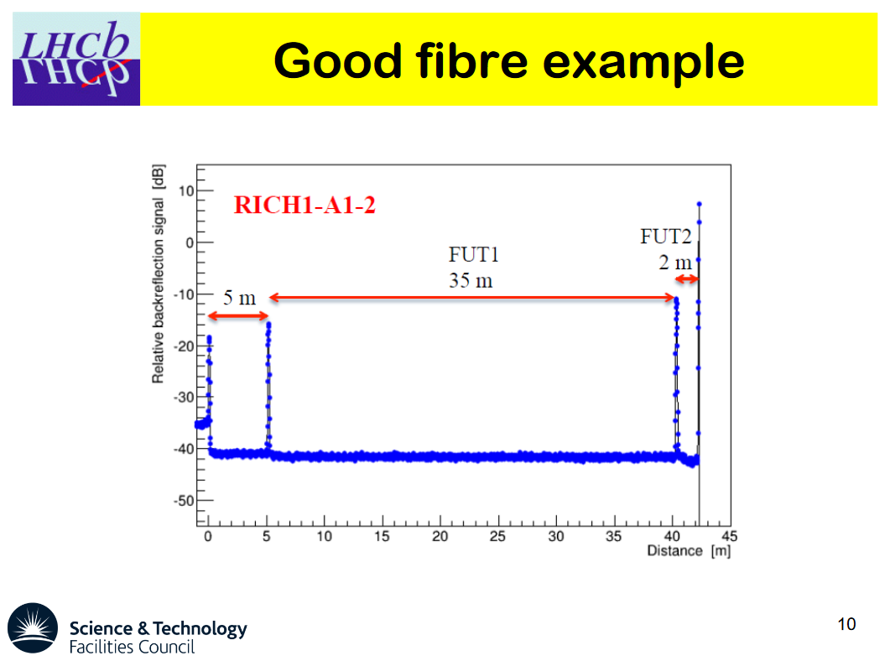
September 2013 (i)

Slide 41
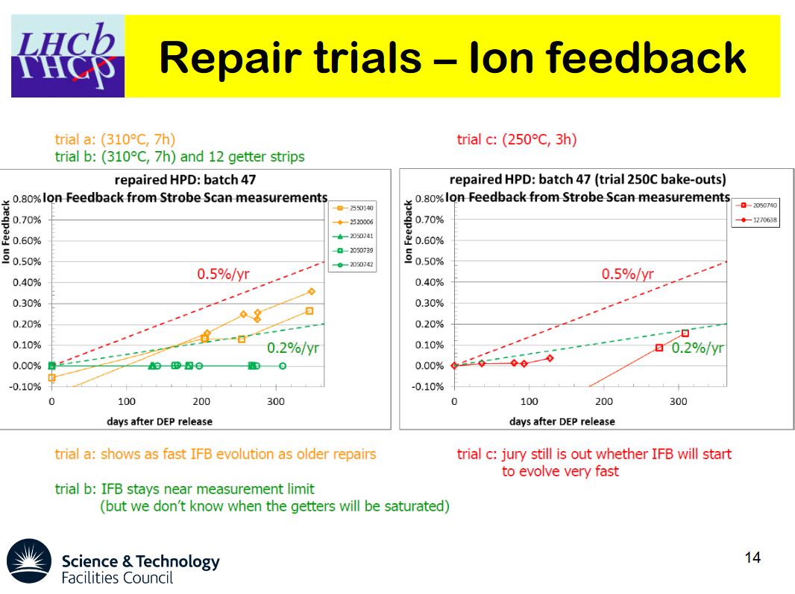
September 2013 (ii)

Slide 42
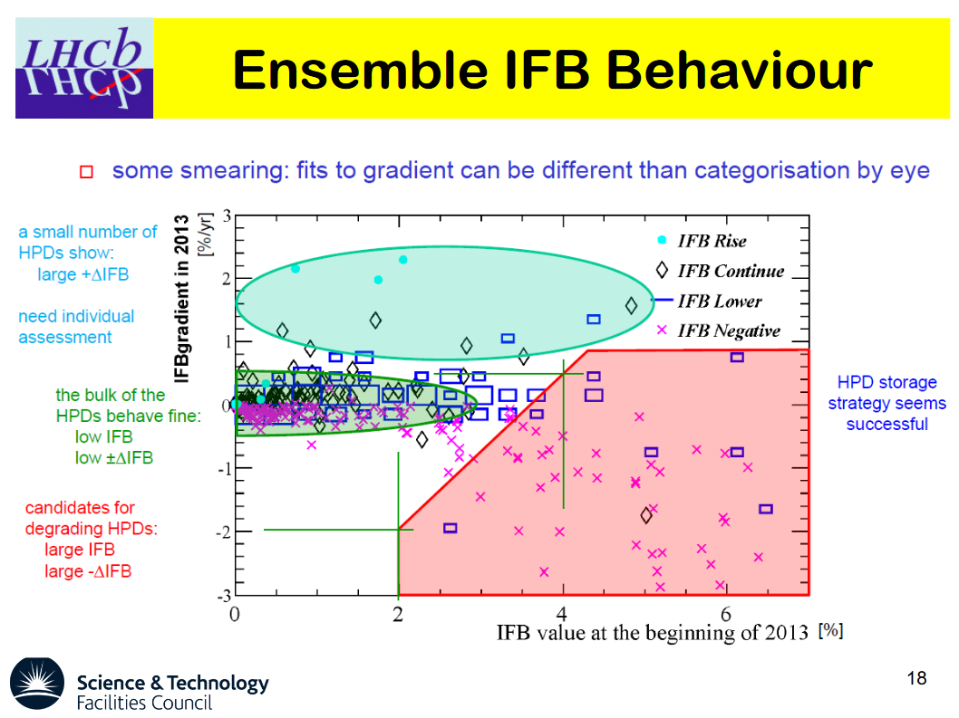
September 2013 (iii)

Slide 43
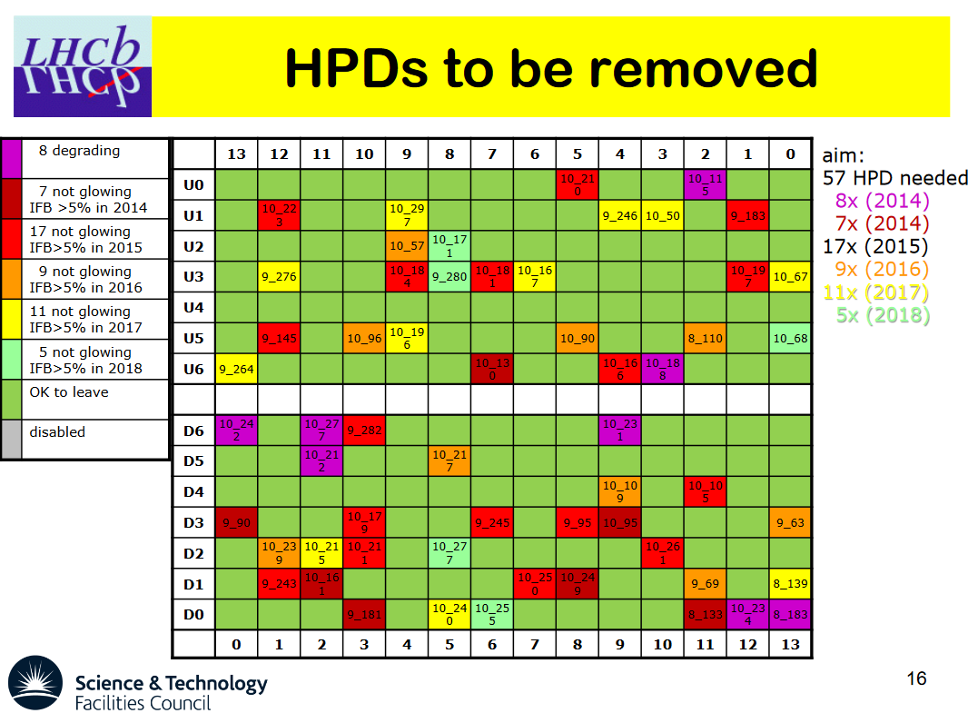
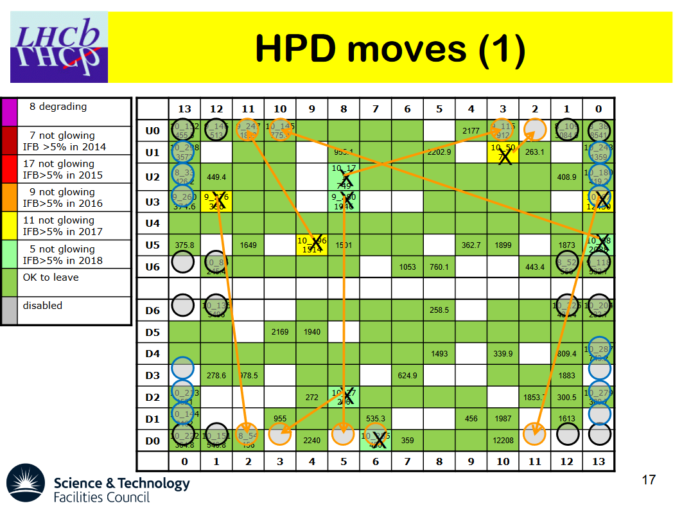
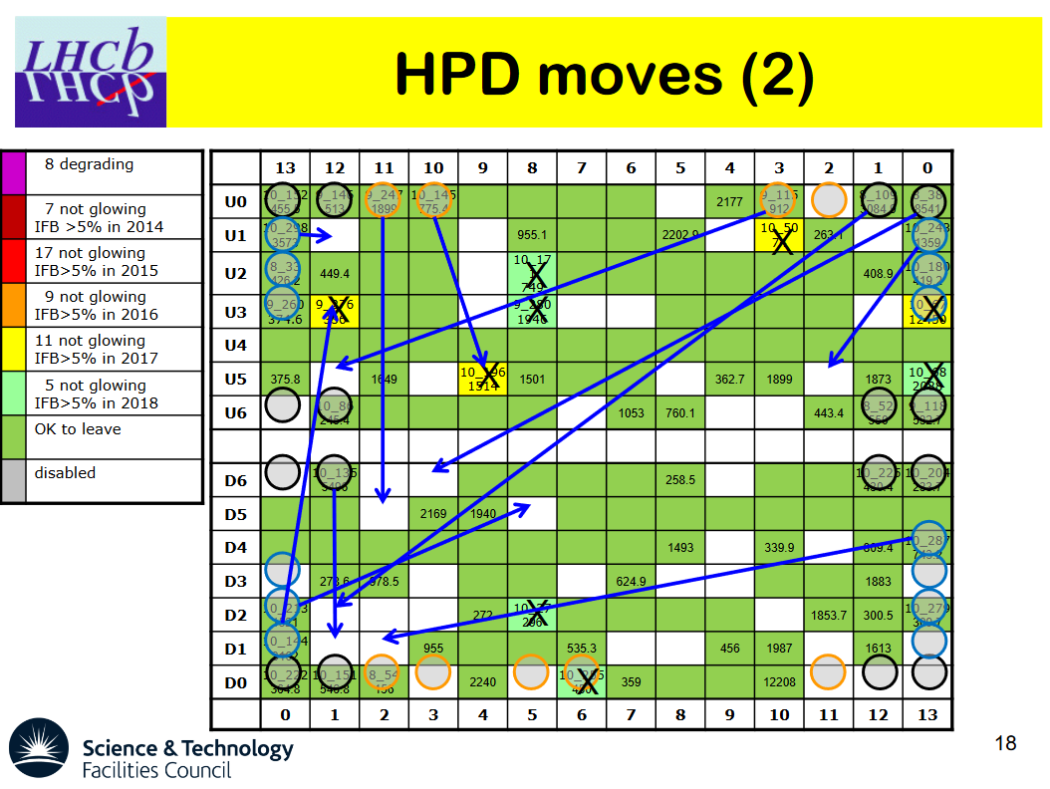
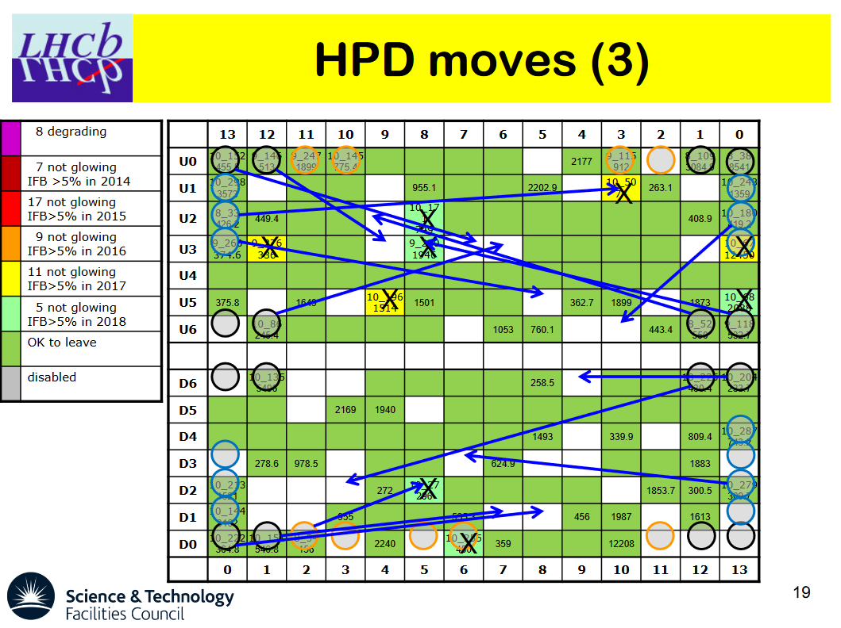
September 2014 (i)

Slide 44
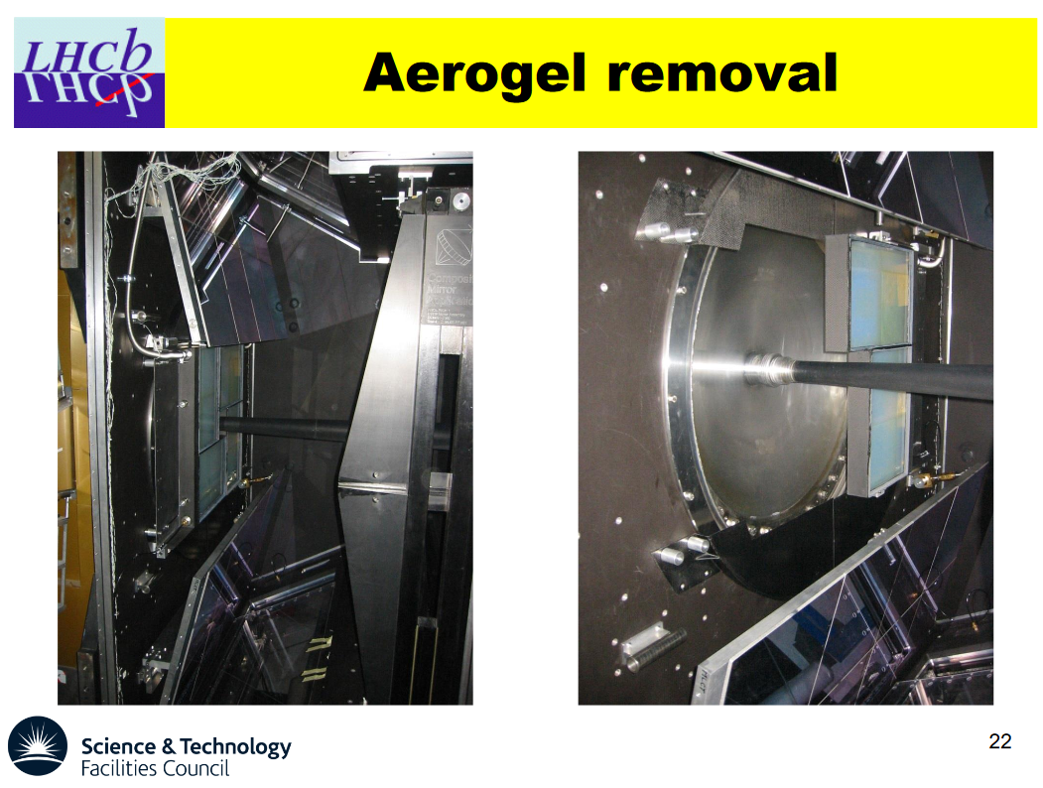
September 2014 (ii)

Slide 45

December 2015 (i)

Slide 46

December 2015 (ii)

Slide 47

September 2016 (i)

Slide 48

September 2016 (ii)

Slide 49

September 2016 (iii)

Slide 50

June 2017

Slide 51

September 2017

Slide 52

December 2017

Slide 53

2018 (i)

Slide 54

2018 (ii)

Slide 55

SIN

