Slide 1

UK Nuclear Physics
Nuclear Physics Advisory Panel update
April 2020
Robert Page
rdp@ns.ph.liv.ac.uk

Slide 2
Members of NPAP
Robert Page (chair) University of Liverpool
Christian Diget University of York
David O'Donnell University of the West of Scotland
Arnau Rios Huguet University of Surrey
Daria Sokhan University of Glasgow
Phil Walker University of Surrey
Thanks to Andy Boston, Kieran Flanagan, Judith McGovern
Public webpage:
http://www.stfc.ac.uk/about-us/how-we-are-governed/advisory-boards-panels-committees/nuclear-physics-advisory-panel/

Slide 3
UK Nuclear Physics
Science Areas are:
  Nuclear Structure and Nuclear Astrophysics
  Hadronic Physics
  Nuclear Theory
Industrial Nuclear Data
Public Engagement & Outreach
Applications and Innovation
Concentrate research on key areas where the community can gain leadership and influence

Slide 4
NPAP Activity
Minor update to Roadmap September 2019
Provided minor update on the NP Priority Projects to STFC
Input on briefing for Science on the landscape of neutrinoless double beta decay
Computing Capacity Resources for Nuclear Physics
UK Community meeting(s) including NPF meetings & Warwick meeting
Response to Balance of Programmes report
Input to review of STFC’s PRD scheme

Slide 5
Nuclear Physics Community meeting
Strategic reports
  Report from programmes directorate
  Update from Science Board
  Report from NPAP
  Report from NPGP
  EPSRC Nuclear community
Networks & other opportunities
  Physics presentations from Rutherford and Royal Society Fellows
  Education and training
    Report on NP Graduate School
    GCRF Network report

Slide 6
Nuclear Physics Community meeting
Status of UK community activities
  Update from theory
  Reports on current and future projects
Report from Cross-Community Group
Report from NuPECC & JENAS-2019
Report from IOP NP Group
Conferences & meetings

Slide 7
NUCLEAR PHYSICS ROADMAP

Slide 8
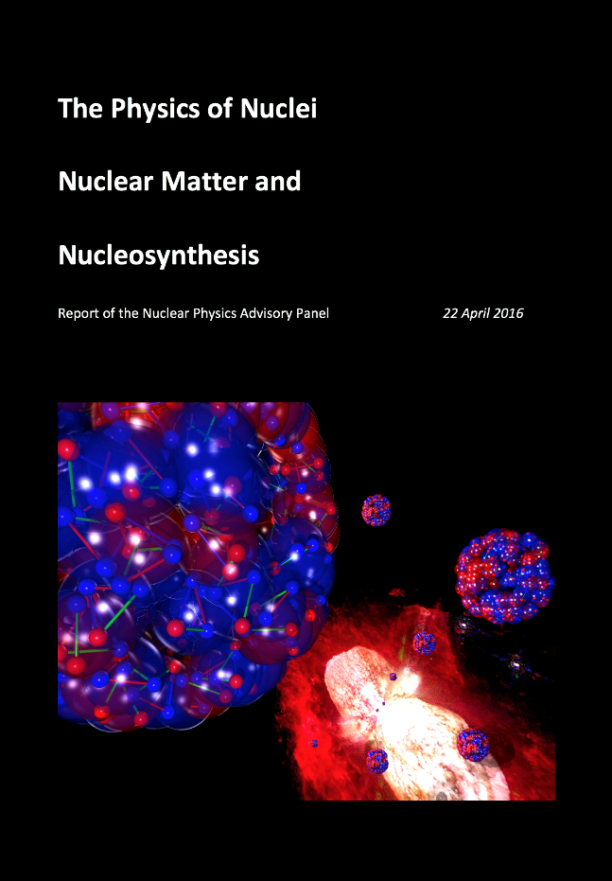
The Nuclear Physics Strategy document
Scope and range of Physics
Current projects
Future projects
Other issues
10 year horizon
Last revision Oct 2019
https://stfc.ukri.org/about-us/how-we-are-governed/advisory-boards-panels-committees/nuclear-physics-advisory-panel/

Slide 9
Roadmap for existing projects and future opportunities

Slide 10
Future projects and opportunities
Near-term
Advanced charged-particle array (ACPA@ELI) – funding “deferred”
  Silicon based granular array with a focus on ELI-NP Gamma-beam applications
DRACULA – on UKRI list of Priority Projects
  Direct Reaction Array for the Core Understanding of Light-nuclei and Astrophysics
  Silicon based granular array with a focus on FRIB for use with GRETA
AGATA upgrade – funded!
  Beyond 1pi
  Additional gamma detectors and optimisation of signal decomposition
  Focus on SPES and FAIR (HISPEC)

Slide 11
Future projects and opportunities
Mid-term
Jlab 2
  Kaon Flux Monitoring apparatus as part of the high intensity and clean neutral kaon beam (Klong@JLAB) development
Instrumentation@Jyväskylä
  Instrumentation to enhance the core physics programme at JYFL
  MARA Low Energy Branch (LEB)
Horizon
NuSTAR 2: DEGAS Ge, Schottky pickup for storage ring, MAPS
EIC / NG ALICE
EURISOL

Slide 12
Future projects and opportunities
Mid-term (PRD)
Scintillator tracking array (STAR)
  SiPM based highly granular gamma-ray array for ISOL facilities
EIC
  R+D to support the future UK contribution to the EIC.
  CD0 awarded & Brookhaven chosen as site for EIC.
Proposed Theory project
Neutrino-nucleus interactions
  Use modern ab-initio methods and effective field theory. Calculate experimentally-crucial cross-sections with greater precision and sophistication than most currently-used codes.
Theoretical studies of spontaneous and induced fission
  Leadership hub for theoretical studies of spontaneous and induced fission.
Proposed User facility
UK Accelerator Driven Neutron Facility – funded as part of NNUF

Slide 13
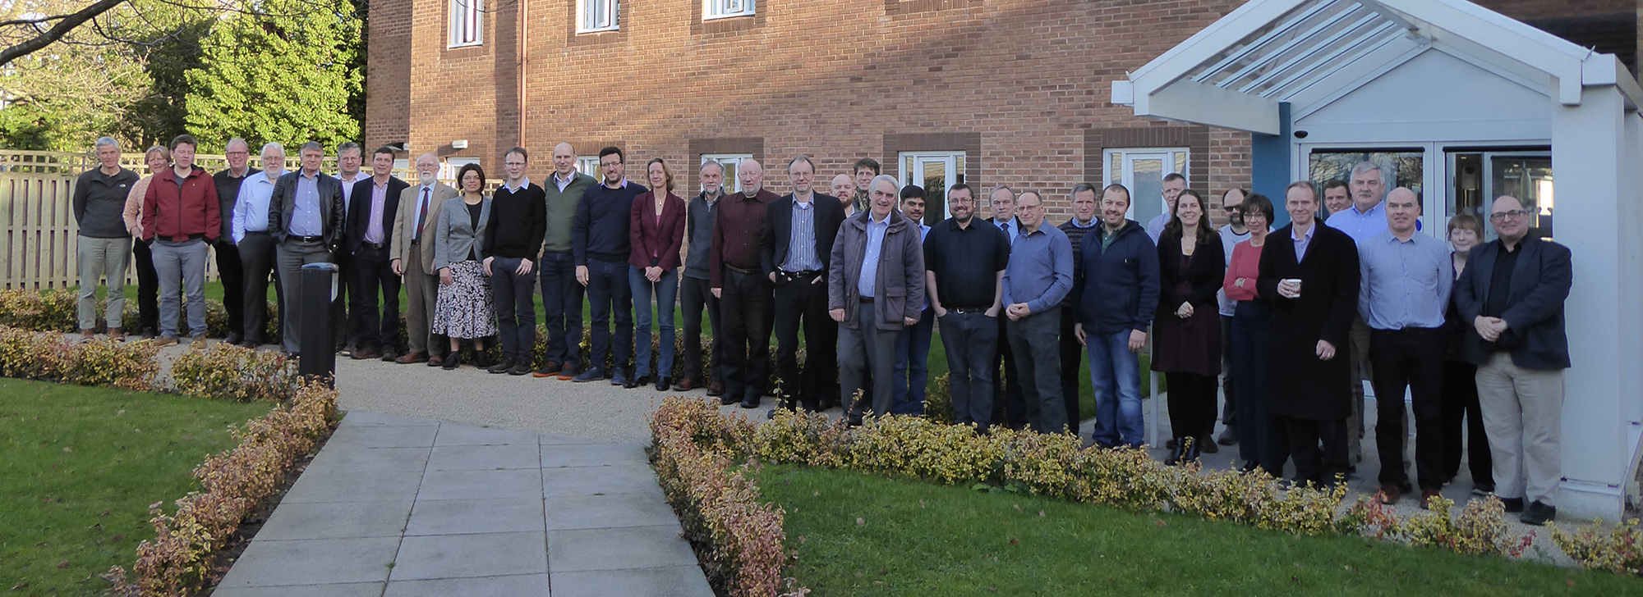
UK Nuclear Physics
Nuclear Physics Advisory Panel update
April 2020
Andy Boston
ajboston@liverpool.ac.uk

