Slide 1
STFC Town Meeting
7 April 2020

Slide 2
STFC Town Meeting Agenda
14:00 Update from STFC, Mark Thomson
14:40 Update from Science Board, Tara Shears
15:00 Update from the PPAP, Roger Jones
15:15 Update from NPAP, Robert Page
15:30 Discussion
16:00 Meeting end

Slide 3
Update from Mark Thomson
STFC Executive Chair

Slide 4
How is STFC contributing to the fight against Covid-19

Slide 5
UKRI Response
Activities to support the research effort:
UKRI is funding research and innovation work in response to Covid-19
The first round of the £20m rapid response call, and the announcement on the COVID-19 Genomics UK Consortium is on the UKRI website
There is an open call for short term projects (12-18 months) to address the health, social, economic and environmental impacts of the COVID-19 outbreak, either
Repurposing existing funded grant effort
New grant funding
In both cases, approval will be through light-touch rapid peer review
UKRI has also been working on a new website called Coronavirus: the science explained - this is very good
Notes:
UKRI is funding research and innovation work in response to the current pandemic. Here are the details of the first round of the £20m rapid response call, and the announcement on the COVID-19 Genomics UK Consortium on the website and twitter account, @UKRI_news. In addition there is now a call relating to this that interested university staff should apply to if they wish to allocate effort to this area https://www.ukri.org/news/ukri-open-call-for-research-and-innovation-ideas-to-address-covid-19/
UKRI has also been working on a new website called coronavirus: the science explained, which was launched last week. It is the result of discussions between UKRI and the UK Government’s Chief Scientific and Medical Advisers, Sir Patrick Vallance and Professor Chris Whitty. The aim of the website is to provide authoritative, up-to-date explanations of scientific evidence relevant to the coronavirus epidemic. The site has started small, but the intention is to rapidly populate it with further articles, including some based on feedback from website visitors.

Slide 6
STFC Response
Rapidly moved to home-working
Majority of STFC staff are working from home
STFC national laboratory sites are still open, but only for core essential activities as per government instructions, which includes the critical support of current Covid-19 research. We retain only a minimal number of staff (essential workers) on our sites at this time.
I want to emphasise that our work has not stopped. The majority of STFC staff are home-working and thanks to their efforts we are striving to deliver as normal a service as possible for our community.
Programmes and Grants teams have adapted well
We have a number of internal initiatives that are contributing to the fight against Covid-19

Slide 7
Diamond helps to search for a cure
Exscientia, an Oxford-based firm that uses AI to develop new medicines, has teamed up with Diamond to screen more than 15,000 drugs for their effectiveness as a treatment for Covid-19
Exscientia hopes to discover a drug that can be repurposed to treat coronavirus within the next 6 to 12 months, whereupon it would be tested on Covid-19 patients
Repurposing existing molecules can save a lot of time in the drug discovery process, meaning a faster route to clinical trials and, potentially, a treatment
Diamond will carry out screening and structural analysis, providing understanding how anti-viral drugs work at the atomic level. Supported by STFC’s Scientific Computing Dept.
Notes:
From Guardian article
An Oxford-based firm that uses artificial intelligence to develop new medicines has teamed up with a UK national science facility to screen more than 15,000 drugs for their effectiveness as a treatment for Covid-19.
Exscientia, a spinoff company from the University of Dundee that is now based in Oxford science park, said it had gained access to a large collection of existing drugs held by the Scripps research institute in California and funded by the Bill and Melinda Gates Foundation. It will screen them in partnership with Diamond Light Source near Oxford, which works like a giant microscope and generates bright light that allows scientists to study viruses.
Exscientia hopes to discover a drug that can be repurposed to treat coronavirus within the next six to 12 months, whereupon it would be tested on Covid-19 patients, Prof Andrew Hopkins, the firm’s chief executive, told the Guardian. Any potential treatment could be made available for compassionate use before clinical trials are completed, but this would depend on how much can be manufactured quickly.
Advertisement
The drug collection, which comprises more than 15,000 compounds that have been approved and tested for human safety in clinical trials or pre-clinical studies, has been shipped from California to Oxford.
Prof David Stuart, director of life sciences at Diamond and professor of structural biology at Oxford University, said: “The drugs we are testing have either been approved by the [US regulator] FDA for other diseases or have been extensively tested for human safety. By being able to repurpose existing molecules, we can save a lot of time in the drug discovery process, meaning a faster route to clinical trials, and potentially a treatment for patients.”
Exscientia is using its biosensor technology to screen the drug molecules for effectiveness against Sars-CoV-2, the virus responsible for Covid-19. Work will focus on components for viral replication and the interaction between the virus’s spike protein and a human cell receptor that enables the virus’s entry to human cells.
The project started in the last few days and the firm hopes to have full data sets within six to eight weeks. Any promising drug molecules will then be tested further to make sure they work as a treatment for Covid-19.
Exscientia is collaborating with Diamond and Oxford University, which have been working together since January to develop methods for the production of viral proteins for drug screening and structural analysis at Diamond. This can provide an atomic level of detail in understanding how anti-viral drugs can work.
FacebookTwitterPinterest
A French pharmacy employee holds up a pack of Plaquénil, the brand name for chloroquine. There are hopes the malaria treatment could help fight Covid-19. Photograph: Chesnot/Getty ImagesAdvertisement
Academics and companies around the world are racing to find a treatment for Covid-19. Efforts have focused on using existing drugs, including the antimalaria medicine chloroquine, the HIV treatment Kaletra, the Japanese anti-flu drug favipiravir and the Ebola drug remdesivir, which has emerged as a frontrunner. The first results from human trials of remdesivir in China and the US are due in April. The UK biotech firm Synairgen is trialling its lung-disease drug, an inhaler, in Covid-19 sufferers.
Exscientia, which was founded in 2012, specialises in the use of computer algorithms and machine learning, known as artificial intelligence (AI), to discover novel drugs. The algorithms learn what molecular features make for effective drugs, and the firm will apply this during its search for a Covid-19 medicine. As well as repurposing existing drugs, it plans to use its research to develop a novel treatment for the virus.
Exscientia recently claimed a world first when it announced that human tests of the first drug generated entirely by AI – for obsessive-compulsive disorder – would start in March. The project took less than 12 months, instead of the usual four to five years. Using AI to generate new medicines cuts nearly a third from the early-stage drug development cost, and big pharmaceutical firms such as GSK and AstraZeneca are investing heavily in AI.
Massachusetts Institute of Technology announced in February that it had used AI to develop a powerful antibiotic that wipes out a range of drug-resistant bacteria.

Slide 8
STFC support to fight Covid-19
A Covid-19 Rapid Call for Access to the Octopus Facility
The Central Laser Facility (CLF), is inviting rapid access proposals to its Octopus imaging facility for research relevant to Covid-19
The Octopus facility offers a comprehensive range of optical microscopy instruments and techniques including super-resolution single molecule imaging and tracking, light sheet microscopy, etc.
This is a unique research call:
To maintain social distancing physical microscopy will be undertaken by expert CLF staff, with samples being sent to the facility. Communication with users before and during the experiments will be by video link or telephone, and remote access to the microscopy instruments will be available

Slide 9
STFC support to fight Covid-19
Our Scientific Computing Department are supporting multiple projects around Covid-19 including:
Some of our Collaborative Computational Projects have developed software which forms part of the toolkit being used in the fight against Covid-19.
The SCD Cloud is providing compute capability for Diamond’s XChem Covid-19 work and our Software Engineering Group is helping Diamond with XChem software issues.
The Tier-1 Facility is donating around 30,000 cores to Folding@home
The SCARF platform has provided additional CPU resources to Diamond-related researchers at Oxford University
Notes:
Some of our Collaborative Computational Projects develop software for determining protein structures via crystallography (CCP4) and electron microscopy (CCP-EM), which form part of the toolkit being used in the fight against Covid-19. more info in recent news story https://www.scd.stfc.ac.uk/Pages/Researchers-help-efforts-to-fight-Covid-19.aspx)
The SCD Cloud is providing compute capability for Diamond’s XChem Covid work – 2000 cores and ~P100 GPU cards. The Cloud is also donating 13,000 new GPU cores to Folding@home.
The Tier-1 Facility is also donating around 30,000 cores to Folding@home.
Our Software Engineering Group is helping Diamond with XChem software issues. The group is also helping with open data, assigning Digital Object Identifiers and creating landing pages.
The SCARF platform has provided additional CPU resources to Diamond-related researchers at Oxford Uni.
Juan Bicarregui who heads our Data Division is co-chairing the RDA Covid-19 fast-track working group https://www.rd-alliance.org/rda-covid-19-working-group-urgent-call-expert-contributions-0 and
https://www.rd-alliance.org/groups/rda-covid19
DAFNI and JASMIN communities are offering a variety of support, including to the RAMP modelling initiative (Royal Society) https://epcced.github.io/ramp/
CCP Biosim & HEC Biosim communities are providing support for Covid-19 research
STFC HAVE ALSO DONATED MANY THOUSANDS OF PIECES OF PPE KIT TO LOCAL MEDICAL FACILITIES FOR USE BY NHS STAFF

Slide 10
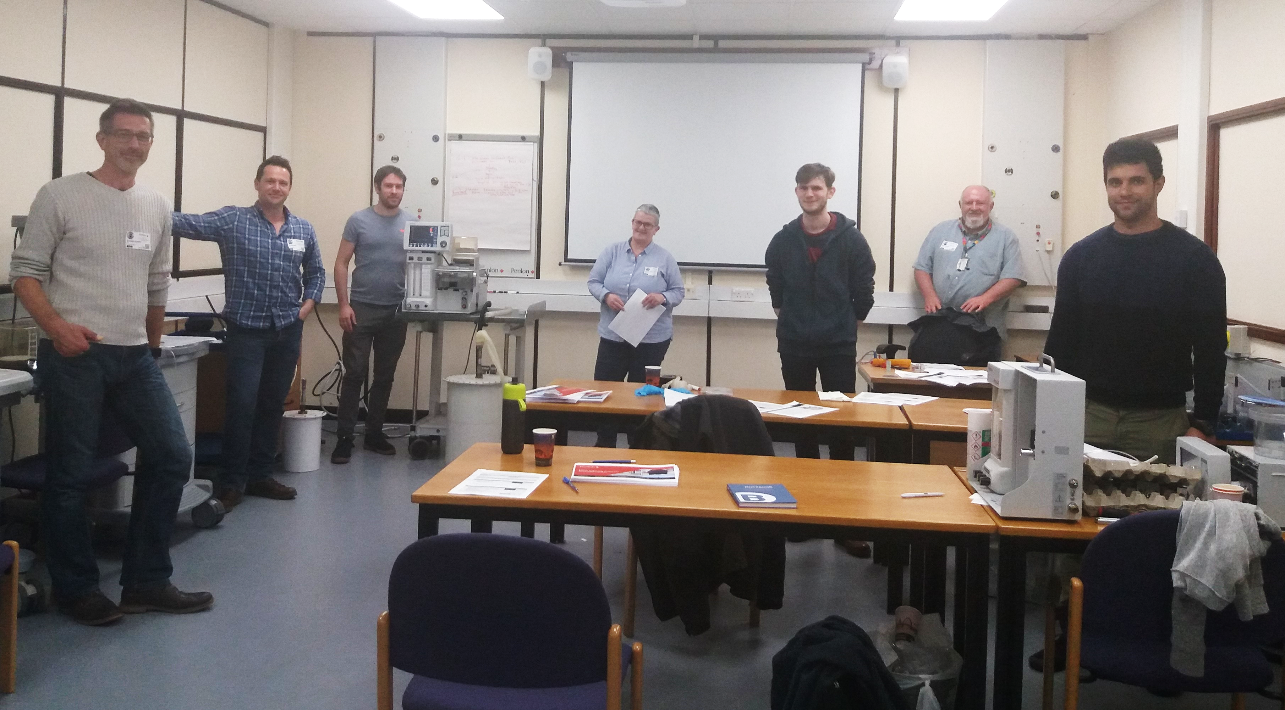
STFC joins the ventilator challenge
STFC are part of a national collaboration producing ventilators for the NHS
STFC staff are working with medical equipment manufacturer, Penlon, a key member of the VentilatorChallengeUK consortium, comprising Airbus, BAE Systems, Ford, Rolls-Royce & Siemens
The aim is to build 10,000 ventilators at pace
STFC staff will deliver high-quality training in how to test the ventilators to 300 staff from the other companies involved
Four ‘super trainers’, John Crawford (ISIS), Angela George (DLS), Phil Rice (CLF) and Mark Anderson (RAL Space), will train over 60 other STFC staff members so that they can train others by the time the ventilators come off the production line
Notes:
Production of ventilators
01 April 2020
Science news
STFC staff are forming part of a national collaboration that’s producing ventilators for the NHS; developing and delivering the training needed for others (including more STFC members) to carry out the necessary testing and calibration.
One of the major challenges for the UK in facing the Covid-19 pandemic is the production of ventilators, to keep patients with respiratory difficulties out of intensive care. The medical equipment manufacturer Penlon, based in Abingdon, already supplies the NHS with machines used by anaesthetists in operating theatres. After it was clear that the demand for ventilators was going to increase dramatically, the company developed a simpler device that can be mass produced and used on a ward as a ventilator: breathing for a patient when they are unable to do it themselves.
Penlon is part of a consortium, VentilatorChallengeUK, of over 20 companies including Airbus, Ford and McLaren, who will produce the ventilators on a large scale, as featured by the BBC and the Guardian. Before the tens of thousands of ventilators can be used by the NHS, they need to be tested and calibrated, to ensure they can be delivered under the company’s medical licence.
With their high level of technical skill, STFC staff members will deliver training in how to test the ventilators to some 300 staff from the other companies in the collaboration, who will then carry out the testing at Penlon’s facility, and others nearby.
The first four ‘super trainers’ from across the RAL campus; John Crawford (ISIS), Angela George (DLS), Phil Rice (CLF) and Mark Anderson (RAL Space) spent the weekend at Penlon developing a training manual that will then be used by the STFC expert trainers. During the evenings this week, these four will use their manual to train 30 other STFC staff members, to ensure that all are capable of training others by the time the ventilators come off the production line.
The test they will be training people to carry out is 30-40 minutes long and involves testing the pressure and air flow through the ventilator while it inflates/deflates a set of steel “lungs”. It is important for the STFC to ensure that all testers understand the strictness of the method and the clear boundaries that need to be followed when testing.
ISIS ‘super trainer’, John Crawford explains; “Our part in this huge project is to facilitate the testing and commissioning. It’s daunting and was initially overwhelming, like climbing a mountain, but it’s a great thing to be involved with. After the weekend, now we have the training manual developed, I can at least see a route to the top.”
Training this many people this quickly is always challenging, but the team are having to ensure they maintain social distancing while doing so, to make sure they stay safe and well. This restricts the number of people who can be trained as trainers at one time. There is also currently only one prototype that they can use for this training: one is with the NHS, and another will be arriving at Penlon on Wednesday and then they should be able to speed up the rollout of this training.
“It’s very hard for our team of STFC technicians to work from home, when the bulk of our roles is hands-on, based on site” says John; “so this is a good way for us all to be able to contribute.” This will especially be the case when the testing shifts begin at Penlon, GKN, and the other testing locations nearby.
ISIS Deputy Director, and Head of ISIS Operations, Zoë Bowden said; “Our technicians are some of the best in the country, its inspiring to see them adapt their skills so quickly to make such an important contribution at this critical time.”

Slide 11
STFC Programme Impacts
Issues & Status
Programmes Directorate is continuing to function well via remote conferencing and working from home. Thanks to great efforts from the team it is almost “business- as-usual”
All grants panels and oversight committees proceeding via video
many thanks to the community for their continued contributions
PD will review closing dates for grants calls and implement changes if necessary
No-cost extensions will be the default when the need is demonstrated
If the current situation goes on for 3 months, we believe we can manage by (near) normal in-year adjustments. A longer period will require more considerations
Broader grants policies being developed at government and UKRI-level
Please watch this space

Slide 12
Programme Impacts continued
Studentships and research:
We are working with UKRI to review situation with studentships
LTAs are on hold and will need to be rescheduled
We have actively gone out and contacted those universities where we are aware of a student on an LTA to check that the university is in touch.
We have all of the required information – thank you
Universities are being consulted by UKRI around whether to proceed with fellowships (FLFs, Hawking) or to delay. We will take this consultation into account for ERFs, but we are aware of the need to remain competitive with international recruitment rounds
We are postponing the planned panel membership call in order to maintain continuity through this challenging period

Slide 13
Funding Update

Slide 14
Funding: Context
Ten years of flat cash
Resources eroded by inflation over an extended period: ~25 % in real terms
This has impacted all of STFC’s activities
As far as possible, we have tried to protect the breadth of the science programme
However, flat cash is clearly having a significant impact
Formation of UKRI in 2018
Brought together the seven research councils within a single organisation
Significant additional “central” resources in a number of hypothecated “Cross-cutting” funds
Not the solution to the pressure on the core programme
Nevertheless, very positive news

Slide 15
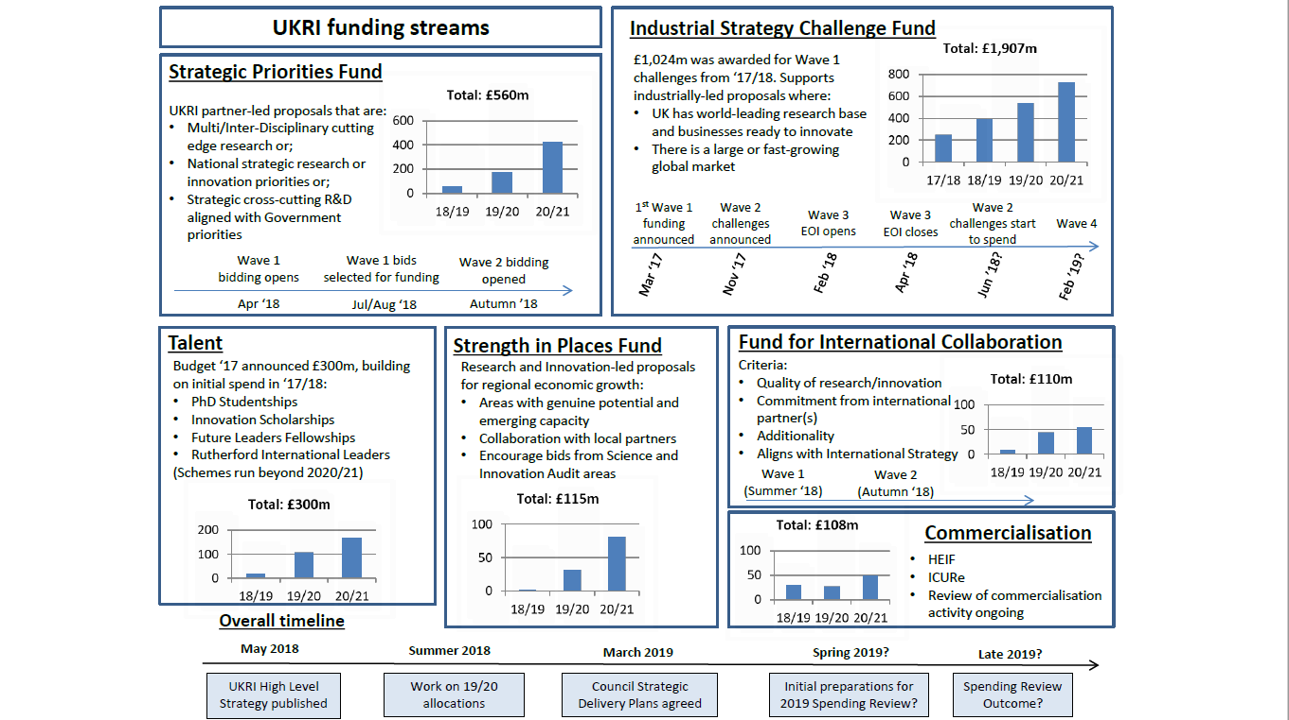
UKRI Cross-Cutting Funds

Slide 16
UKRI Cross-Cutting Funds
EPAC
NSTF
SWIMMR
TBA
ALIGO+
FLFs
In Progress?
AIT
EPIC

Slide 17
UKRI Future Leaders Fellowships
UKRI FLFs supporting early career researchers and innovators with outstanding potential across the whole of the UKRI:
Develop, retain, attract and sustain talent in the UK
Foster new research and innovation career paths including those at the academic/business and interdisciplinary boundaries and facilitate movement of people between sectors
Provide sustained funding and resources for the best early career researchers and innovators
Provide long-term, flexible funding to tackle difficult and novel challenges and support adventurous, ambitious programmes.

Slide 18
UKRI Future Leaders Fellowships
UKRI FLFs supporting early career researchers and innovators with outstanding potential across the whole of the UKRI:
Develop, retain, attract and sustain talent in the UK
Foster new research and innovation career paths including those at the academic/business and interdisciplinary boundaries and facilitate movement of people between sectors
Provide sustained funding and resources for the best early career researchers and innovators
Provide long-term, flexible funding to tackle difficult and novel challenges and support adventurous, ambitious programmes.
STFC Science community has done well
6 FLFs in wave 1
7 FLFs in wave 2
wave 3 to be announced
A real uplift in opportunities for young researchers

Slide 19
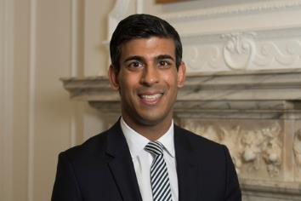
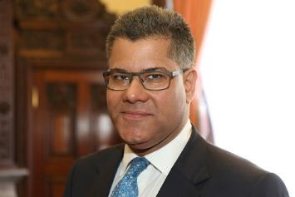
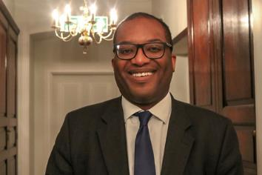
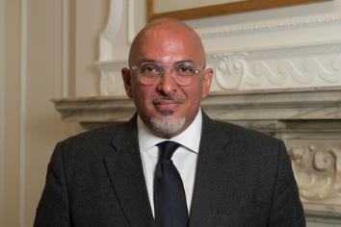
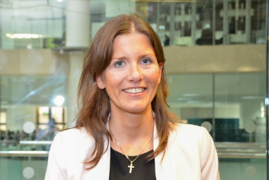
UK Government – post reshuffle
Rishi Sunak Chancellor
Alok Sharma BEIS Secretary
Kwasi Kwarteng Minister of State for Business, Energy and Clean Growth
Nadhim Zahawi Parliamentary Under Secretary of State for Business and Industry
Amanda Solloway Science Minister
Michelle Donelan Universities Minister
Notes:
Alok Sharma has been appointed as BEIS Secretary as well as Minister for COP26. He was previously International Development Secretary.
Rishi Sunak, MP for Richmond, has been appointed as the new Chancellor, replacing Sajid Javid who resigned.
Chris Skidmore is no longer Minister of State for Universities, Science, Research and Innovation.
Michelle Donelan, MP for Chippenham, has been named as Universities Minister in the Department for Education. This has role has now been split from the science brief for the first time since 2010.
Amanda Solloway, MP for Derby North, is the new Science Minister
Kwasi Kwarteng, MP for Spelthorne, has been re-appointed as Minister of State for Business, Energy and Clean Growth and Nadhim Zahawi remains Parliamentary Under Secretary of State for Business and Industry.
Many ministers have stayed in post, including Matt Hancock as Health Minister, Dominic Raab as Foreign Secretary and Priti Patel as Home Secretary.
The government has confirmed that No 10 and No 11 special advisor teams will merge.

Slide 20
The Budget
The Budget, delivered on 11 March, included several announcements relevant to STFC, including:
Increase in public R&D spending to £22bn per year by 2024/25
Over £900M to ensure UK businesses are leading the way in high-potential technologies
£800M investment in a new ‘blue-skies’ funding agency to fund “high-risk, high-reward research” (ARPA)
£180M for Natural History Museum facility at Harwell
Spending review to was to start immediately and be completed by July. Now likely to be pushed back
Very hard to predict the impact of the current crisis
Notes:
On 11 March, delivered his budget speech to the House of Commons in which a number of announcements relevant to research and innovation were made, including:
Increase research and development funding in the UK to £22 billion per year. This will mean that as a percentage of GDP, R&D spending will be the highest it has been for nearly 40 years: higher than the US, China, France and Japan.
Investment of over £900 million to ensure UK businesses are leading the way in high-potential technologies. This will involve commercialising nuclear fusion technology, offering potentially limitless clean energy, and supporting the government’s ambitious National Space Strategy and space innovation fund.
At least £800 million will also be invested in a new blue-skies funding agency here in the UK to fund high-risk, high-reward research. This will be modelled on the Defence Advanced Research Projects Agency (ARPA) in the USA.
In addition, a raft of measures were announced in response to COVID-19, totalling £30 billion.
See the UKRI Information hub for a summary of the main announcements relevant to UKRI.
UKRI are discussing the content of the budget with BEIS. We will keep staff updated and provide greater detail on any aspects of specific relevance to UKRI as soon as further information is available.

Slide 21
Spending Review: STFC Priorities
STFC previously identified five priority areas for the spending review:
Sustaining UK Research and Innovation Leadership
Investment in the core programme that underpins everything we do
Clear #1 priority for all Research Councils of UKRI
Investing in the Talent of the Future
Skills across a number of areas
Attracting Inward Investment with state-of-the-art laboratories and infrastructure
Inspiring Innovation
Technology and Innovation for UKRI

Slide 22
Frontier Science
Programme Update

Slide 23
Programme update
Covid-19 Context:
Coronavirus is likely to have a significant long-term impact on the physics community and our experiments
but we will recover
Programme management continues “as usual”, though perhaps a little slower
STFC is following UKRI grants guidance, which is being updated regularly
The guidance is that ‘no-cost' extensions can be requested for grants impacted by coronavirus
Please contact your Programme Manager if you have specific concerns about grants; current priority are grants due to conclude in the next three months
Notes:
The ongoing situation regarding coronavirus will likely have a long term impact the particle physics community and its experiments. STFC would like to reassure our grant holders that, while UKRI’s office based staff are now working from home, programme management continues as usual, though perhaps a little slower. We are following UKRI guidance, which is being updated regularly. If you have any concerns about your grant please contact Sarah Verth (sarah.verth@stfc.ukri.org) (or your usual programme manager), particularly if it is due to conclude in the next three months. We want to focus on the immediate issues at this busy time so for other grants that are due to conclude later in the year please wait a little longer to contact us.

Slide 24
Particle Physics Programme
The Particle Physics Progamme Evaluation has been published. Recognises the strength of the UK programme and its diversity, but highlights growing impact of ‘flat-cash’:
Balance of Programmes 2 is underway (Tara will provide an update)
The ATLAS and CMS Upgrades, and DUNE are underway.
The LHCb Upgrade is coming to conclusion
Milestones will be affected by current circumstances and STFC is working with the relevant PIs to understand the impact on their projects
We note that the theory grants are due to complete in September
Reviews of Hyper-K and R&D for the next phase of LHCb due to take place in 2020.
Planning is about to begin for the 2021 Particle Physics Experiment CG
Funding for HEPData has been provided until 2023

Slide 25
CERN Update
CERN site
On-site activities are limited to those essential for the safety and security of the site and equipment. Most people are homeworking. Latest news is linked here
Vacancy for Director for Finance and Administration is now open, deadline for applications is 30 April 2020
European Strategy for Particle Physics Update underway
Open Symposium 13 – 16 May, Granada, Spain
UK Community Meeting 1 July, London
Drafting sessions 20 – 24 January, Bad Honnef, Germany
Biggest questions around next global collider(s): ILC, CLIC, FCCee/FCChh
Timing of publication could be impacted by current situation
Impact evaluation of CERN to the UK, due to be published soon

Slide 26
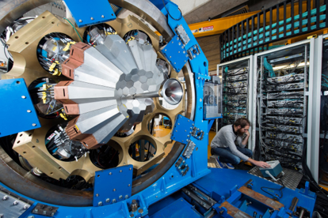
Nuclear Physics Programme
Highlights:
Programme Evaluation recognises the world-leading work in the programme but as in the 2017 grants round, there is significant pressure on the 2020 grants round
Nuclear physics has been under pressure for some years. This case has been made through the Balance of Programmes 2020 exercise, but NP is not alone
Because grants under pressure and this places increased pressure on the development line, without additional funding there may only be one project supported
Nevertheless, there is positive news:
AGATA (shown right) was funded recently
The UK element of the ALICE upgrade has delivered to CERN
Notes:
CG round is happening; funded AGATA; deferring decisions until CG is being sorted. Open to hearing new ideas (e.g. partnership with the US through FIC, or something.)
ALICE project has delivered the inner tracker modules and delivered to CERN.

Slide 27
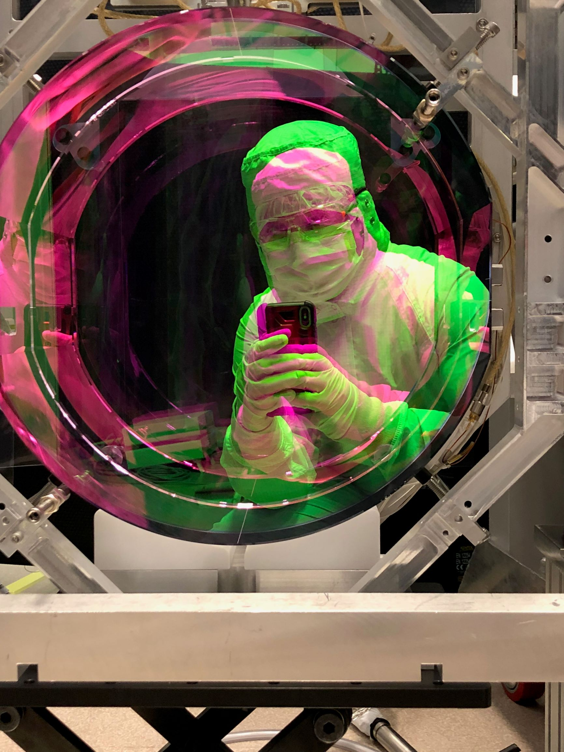
Particle Astrophysics Programme
Highlights:
Programme Evaluation recognises the world-leading work in the programme and also recognises the narrowness of the programme
Exciting age for Gravitational Wave observations. STFC looking at opportunities for the future
Lux Zeplin has been delivered in the US but there are some delays to commissioning due to Covid-19 impacts on travel
Delay in the gravitational wave grant round deadline due to Covid-19 planning (contact Jenny Hiscock)
Decisions to be taken on the experiment to be housed at the Advanced Instrumentation Testbed (AIT) at our Boulby Underground Laboratory due over the next 9 months.
Credit Karl Toland

Slide 28
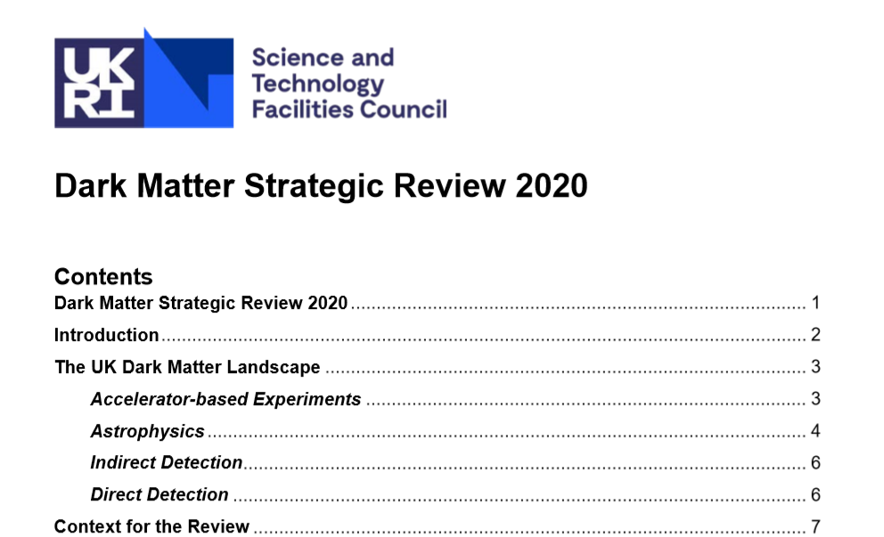
Dark Matter update
STFC panel carried out strategic review of UK dark matter research
Community views fed in through community consultation.
Long-term strategy for investment in dark matter research developed
Strategy presented to Science Board in December 2019
Was published in early 2020
Key recommendations:
The panel recommends that in the short-term the UK focuses on synergies and areas of commonality in R&D in the path towards either an Ar or X next generation experiment, for example a common R&D SiPM UK dark matter consortium.
Boulby Underground Laboratory represents a world-class facility and the possibility of hosting a next generation experiment should be fully investigated on a short timescale.

Slide 29
Accelerators and e-Infrastructure
Programme Evaluations:
The Accelerator Programme Evaluation Report
The Computing Programme Evaluation Report
In both cases, flat-cash is eroding both breadth and balance. Available funding is not keeping pace with the UK ambitions
Highlights from evaluations:
Accelerators: strong synergies with many areas, the accelerator institutes are world-leading and sought-after partners; community is reliant upon and does attract external/international funding (Brexit exposure); should explore applications funding and economic impact as great potential exists
Computing: integral, mission critical, and needs to match experiment and other investments; need to understand and plan now for future requirements and achieve efficiencies; need to work across UKRI

Slide 30
e-Infrastructure Programme
Highlights:
GridPP6: £32M for the 2020-2024 period - UK contribution to the WLCG in support of PP LHC experiment programme, and numerous non-LHC experiments, communities, and wider activities
DiRAC: £7M DiRAC-3 Operations - frontier theory and simulations, bleeding edge technology. Business Case for significant uplift is being developed
ExCALIBUR: £46M 2020-2025 SPF programme between UKRI, Met Office, and UKAEA. Software/code/algorithms for exascale machines of the 2020s
Efficient Computing for HEP: 2019 Opportunities Call (£50k) to improve software/computing efficiency
HEP Software UK: SoI to Science Board in April 2020 £1.2M project for 2021-2024 to tackle the data of the HL-LHC and other PP experiments
Notes:
ExCALIBUR - Exascale Computing Algorithms and Infrastructures Benefitting UK Research

Slide 31
Advisory Panels
Advisory Panels provide a link between Science Board and the community, and represent the needs of the community to STFC
STFC operates a Computing Advisory Panel with regards to the e-Infrastructure programme. Membership will be increased this year in anticipation of its workload following the appointment of James Hetherington as UKRI e-Infrastructure Director. Membership will be further expanded to include Early Career Researchers
Accelerator Advisory Panel (AccAP) – looking to set up this new panel to ensure that Programmes Directorate strategy can be covered with sufficient detail.
If you are interested in joining an Advisory Panel or any STFC board or committee, please contact your Programme Manager
We are looking to increase breadth and diversity
Notes:
Note that the 2020 nominations call is currently paused, it may be delayed or postponed.

Slide 32
Skills and training
Early career researchers:
At the beginning of March, UKRI announced 10 Stephen Hawking fellowships who will continue Professor Stephen Hawking’s legacy by furthering our understanding of the universe and communicating the wonders of science to the public.
These fellowships were jointly peer reviewed by STFC and EPSRC
We have also recently awarded 10 Ernest Rutherford fellowships
Researchers working on STFC science continue to be successful in obtaining UKRI Future Leadership fellowship awards
Significant uplift in post-doctoral support
Doctoral training grants for studentships starting October 2020 have also been awarded
Notes:
Note that the 2020 nominations call is currently paused, it may be delayed or postponed.
Re Stephen Hawking Fellows - The newly announced 2020 fellowships focus on a range of research across physics, maths and computer sciences.
They include the advancement of science’s knowledge of neutron stars and their unusual physical properties [Dr Danai Antonopoulou University of Manchester],
measuring signals from the early universe to understand its rapid expansion [Dr Scott Melville University of Cambridge]
and exploration of the formation of misaligned discs, which are formed by the gravitational collapse of gas and dust and serve as the birthplace of planets [Dr Rebecca Nealon University of Warwick].
Full list:

Slide 33
Opportunities and Challenges

Slide 34
Challenges (beyond Covid-19)
Flat-cash – biggest hit for exploitation grants
Programme evaluations support endeavours to secure and uplift to the core programme funding in the CSR
Lack of resources for new projects – v. difficult to be agile with funding
Important to keep your Advisory Panels informed of new opportunities to be included in their Roadmaps
EU Exit: need to ensure the UK remains a key global player
Technology: how do we ensure vitality and future proofing through active R&D?
Computing: GridPP, DiRAC and other big data needs all under pressure

Slide 35
Opportunities
PP, NP and PA communities are pro-active and respond to funding opportunities, but we need to strive to do more
Newton, GCRF, SPF, FIC, Fellowships
‘Opportunities’ call 2019 - significant number of PP, PA and NP proposals – outcome has been announced
Funding call in ‘Quantum Technologies for Fundamental Physics’ went out in the autumn and now going through peer review
Growing importance of working in partnership and across disciplines
When things settle down – we need to build relationships with New Science Minister and New Universities Minister
Notes:
Amanda Solloway is the new science minister, but with reduced responsibilities, after oversight of universities was split from the brief.
The downgrading of the post following a government reshuffle, is the first time responsibility for universities and science has been held separately since 2008-10, when there were separate ministers, but they both sat in Department of Business, Innovation and Skills. The new minister for universities, Michelle Donelan, is based in the Department of Education.
In a government that continually stresses its commitment to research and innovation, Solloway’s ranking of under-secretary sees science slip down a rung. Her predecessor Chris Skidmore held the more senior minister of state title.
Once lockdown is over we will strive in earnest to build a strong relationship with the Minister through briefings, visits to our sites including CERN etc

Slide 36
Final Words

Slide 37
Final Words
The current situation is a major challenge for everyone
However, it will end
STFC are working within UKRI to minimize the potential long-term impact on our research sector
By its nature, STFC-funded research is relatively robust in the short-term
Immediate actions have focused on protecting the health and safety of staff and students across the sector
It is not to early to plan for (most likely) a phased-recovery
We have started this work for STFC’s facilities
It is essential that we (STFC and our research communities) work closely together to best ride this storm
Notes:
Amanda Solloway is the new science minister, but with reduced responsibilities, after oversight of universities was split from the brief.
The downgrading of the post following a government reshuffle, is the first time responsibility for universities and science has been held separately since 2008-10, when there were separate ministers, but they both sat in Department of Business, Innovation and Skills. The new minister for universities, Michelle Donelan, is based in the Department of Education.
In a government that continually stresses its commitment to research and innovation, Solloway’s ranking of under-secretary sees science slip down a rung. Her predecessor Chris Skidmore held the more senior minister of state title.
Once lockdown is over we will strive in earnest to build a strong relationship with the Minister through briefings, visits to our sites including CERN etc

