Slide 1
Mental Health and Wellbeing in PPD
Marta Sabate-Gilarte and Ben Smart

Slide 2
Introductions
  Who are we?
    Marta Sabate-Gilarte – PPD Wellbeing Ally
    Ben Smart – PPD Mental Health First Aider
  But what do ‘Wellbeing’ and ‘Mental Health’ even mean?

Slide 3
What is Wellbeing?
  Wellbeing is defined by the UK Department of Health as:
‘feeling good and functioning well and comprises each individual's experience of their life and a comparison of life circumstances with social norms and values’
  Wellbeing can be both subjective and objective.

Slide 4
What is Mental Health?
  Mental health is emotional and psychological health:
  We talk about ‘physical health’ for our bodies, and ‘mental health’ for our minds
  Mental health encompasses all types of health related to the way we think, feel, and behave

Slide 5
Effects when low
  Consequences of poor wellbeing or poor mental health at work:
    Work-related Stress
    Burnout
    Presenteeism
    Absenteeism
    High Turnover
  Poor mental health has a negative impact on how we think, feel, and behave
    It can cause distress or inability in social, work, or family settings, and impact daily living, including how we relate and interact with those around us

Slide 6
Wellbeing Ally

Slide 7


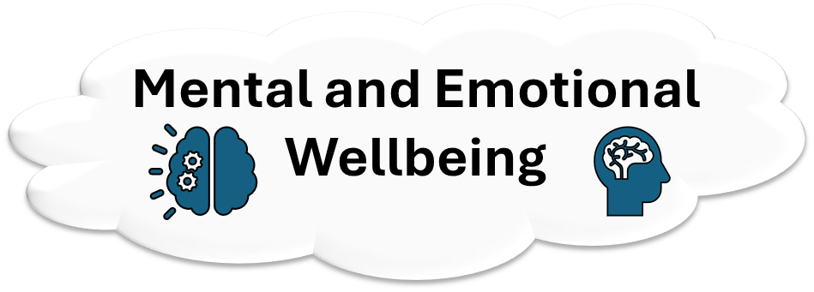

Purpose of a wellbeing ally
Spread the word!
Encourage others to take the training and become a Wellbeing Ally.
  Make people feel comfortable to talk about their wellbeing at UKRI.
  Facilitate the culture of respect and openness.
  Help others to find help for themselves or for a colleague.
  Support through PAM and other resources.
  The four pillars of Wellbeing:

Slide 8
The Four Pillars of Wellbeing
How you feel about money and how that impact your personal life.
It is a measure of your interpersonal relationships.
It relates to your sense of belonging, social inclusion and social stability.
The ability to maintain healthy quality of life without undue fatigue or physical stress on our daily activities:
Sleep, Activity, Nutrition
A dynamic mental state.
Feel relatively confident, cope with daily life stresses, maintain good relationships, feel engaged with the world and resilience.
poor wellbeing can lead to …
Stress
Anxiety
Depression
Phycological disorders
…
Tiredness
Difficult concentrating
Irritability
Detriment mental health
Loneliness

Slide 9
The role of a Wellbeing Ally
What it is …
What it isn’t …
Listen to you without judging and impartiality.
Give you support in a safe environment.
Enable that you handle the situation forward by finding your own way and solutions.
Signpost people on the right direction to support.
Stay connected: follow up.
We can be allies also in remote.
Provide support in crisis situations.
Your conversation is confidential. Unless handling a crisis situation as there is any indication of immediate harm to you or others.
We do not have the clinical governance.
We cannot tell you what to do.
We do not ‘diagnose’.
We are not arbitrators.

Slide 10


The Four Pillars of Wellbeing
Reduce stigma around money pressures.
Provide education, support and tools for financial management to help reducing financial stress.
Raise awareness of available rewards and benefits.
Financial
Wellbeing
Promote collaboration and create opportunities for connection.
Improve sense of belonging.
Provide inclusive and participative wellbeing events and promotions.
Social
Wellbeing

Slide 11



The Four Pillars of Wellbeing
Support in making positive health choices: sleep, nutrition, physical activities, etc
Establish programs for specific areas of needs.
Improve ways of working.
Physical
Wellbeing
Create an environment where you can feel supported and be yourself.
Culture of open discussion about stress, mental health, confidence in supporting, personal resilience, etc
Better access to support, advice and signposting.
Mental and Emotional
Wellbeing

Slide 12
Mental Health First Aider

Slide 13
Mental Health First Aider Role
  Mental Health Contact Person might be a better name for the role
  I see the role as having two distinct parts:
    General mental health support, discussions, and signposting
      Talking with people who might be experiencing low mental health,
      or are worried about others, and helping them find help, or self-help.
      This is just the same as the Wellbeing Ally, but focused on mental health
    First aid related to mental health
      Anything with a risk of harm
        Suicidal thoughts
        Psychosis (seeing or hearing things that aren’t real)
        Panic attacks

Slide 14
Mental Health First Aider Role
  A mental health first aider is trained to listen without judgement, and provide support
  We are trained in recognising and understanding a range of things that affect mental health
    While it’s not possible to understand everything someone is going through,
    we are trained to empathetically listen, discuss, support, and signpost
  As with the Wellbeing Ally, all conversations are confidential, unless there is a risk of harm
    For example, if someone even jokes about suicide, I’m obligated to take it seriously and not as a joke, (better that than missing a genuine statement)
  A mental health first aider is not:
    A clinician
    A therapist
    Someone who can make diagnoses

Slide 15
‘Mental Bandwidth’
  This is a concept I’ve come up with, but it can help understand the effects of low mental health
  We all have a certain amount of ‘mental bandwidth’:
    It allows us to process information, think, and deal with things
    When all your mental bandwidth is being used, you can’t process extra stuff at the same time, (in aviation this is called being task saturated)
    How much mental bandwidth we have changes day by day
      One day you might have less bandwidth due to illness or not sleeping well
    If you are stressed, or have things on your mind, those will take up some of your mental bandwidth, leaving less for other tasks
      Low mental health will eat up bandwidth, and may cause us to struggle with tasks we would normally find easy

Slide 16
Signposting

Slide 17
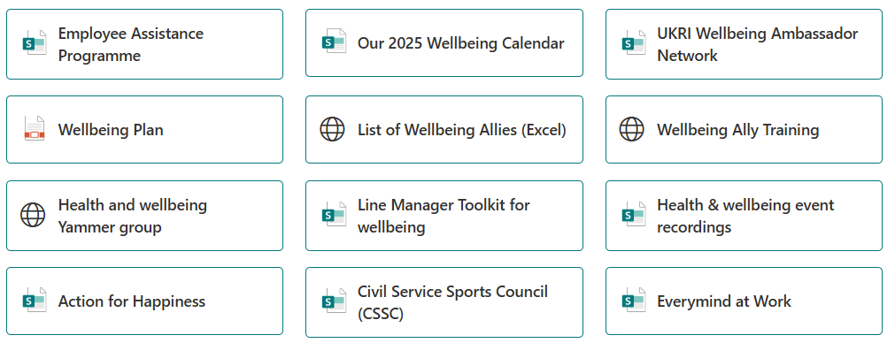
Signposting
  The Source: Our Wellbeing
  The Source: Employee Assistance Programme
  The Source: Wellbeing Calendar
  The Source: Wellbeing event recordings
The Source
The Wellbeing App: PAM-ASSIST
  Civil Service Sports Council (CSSC)
  Mental Health Matters
  Health and Safety Executive: Tackling work-related stress using the Management Standards approach
More

Slide 18
Signposting
Mental Health Support directory

Slide 19
Courses in Oracle
  Wellbeing Ally Training
  Stress Awareness
  Understanding Emotional Intelligence
  Building Resilience
  Assertiveness
  Mindfulness

Slide 20
Wellbeing: Meaningful May
World Environment Day: your own superhero – 4 June, 12pm to 1pm
Autism and ADHD: grandparents and extended family – 11 June, 10am to 11am
What about you? Wellbeing for carers – 11 June, 12:30pm to 1:30pm
Deputyship: how to apply and what the role involves – 12 June, 11:30am to 12:30pm
Pride: past, present and future – 18 June, 12pm to 1pm
What makes men healthy, physically and mentally? – 19 June, 10am to 11am
Menopause drop-in – 23 June, 12pm to 12:40pm

Slide 21
Self Care

Slide 22
Self Care
Self care is doing things to take care of our health,
and actively managing illness when it occurs
    This is just as applicable to mental health as it is to physical health
Some self care might be small things we do each day, or it could be bigger less-frequent things
Different self-care will work for different people

Slide 23
Self Care Examples
Drawing
DIY
Walking in nature
Unplugging from technology
Doing kind acts
Taking a break
Dancing
Learning
Cooking
Meditating
Watching a film
Going on holiday
Alone time
Having a bath
Laughing
Connecting with others
Making things
Spending time with animals

Slide 24
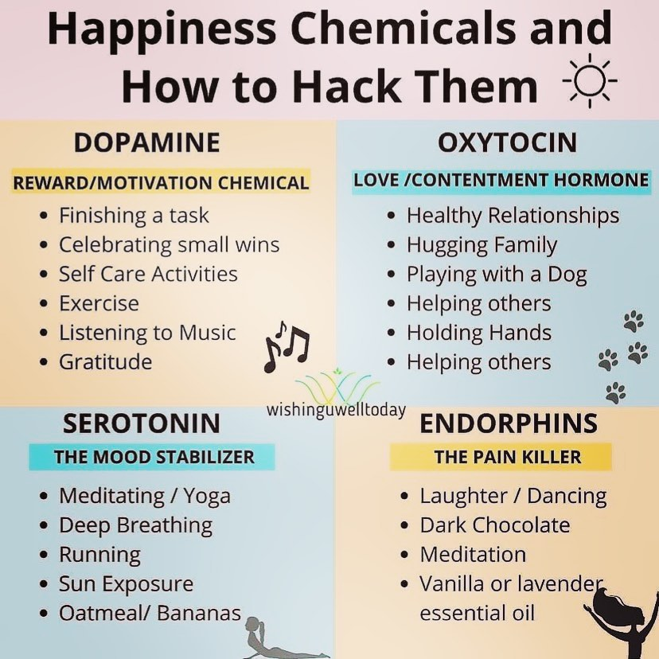
Self Care in our Brains
Sometimes it can be useful
to think about what brain
chemistry is going on
during self-care that
makes us feel good

Slide 25
Becoming a Wellbeing Ally or
Mental Health First Aider

Slide 26
Becoming a WA or MHFA
We need more Wellbeing Allies and Mental Health First Aiders in PPD!
Speak to Marta about Wellbeing Ally training
    Training is done in-house by UKRI
    Half a day training
    Useful for everyone, even if you don’t want to become an ally
Speak to Ben about Mental Health First Aider training
    Training is done externally by MHFA England
    4 day course
    Expectation is that you become a MHFA afterwards

Slide 27
Conclusions

Slide 28
Conclusions
Wellbeing and mental health are important,
both in work and outside of it
PPD has a Wellbeing Ally and a Mental Health First Aider
Speak to these people, or with a colleague or a friend or a relative, if you want to talk, have concerns, or are looking for help, we are here for you
External help is available
Self-care is important too

Slide 29
Take care!

