Slide 1




External Injection into Plasma to Produce VHEE Beams
Jordan Byrne^{1,4}, Oznur Apsimon^{1,4}, Mike Taylor^{1,2}, Guoxing Xia^{1,4}, Hossein Saberi^{1,4}, Jiaqi Zhang^{1,4}, Tom Pacey^{3,4}, Hywel Owen^{3,4}, Stewart Boogert^{1,4}
¹The University of Manchester, UK, ²The Christie NHS Foundation Trust, Manchester, UK, ³Accelerator Science and Technology Centre STFC/UKRI,
⁴The Cockcroft Institute of Accelerator Science and Technology, Warrington, UK
Driving Laser
Solenoid Magnet
LWFA Stage
RF Gun
Matching Section

Slide 2
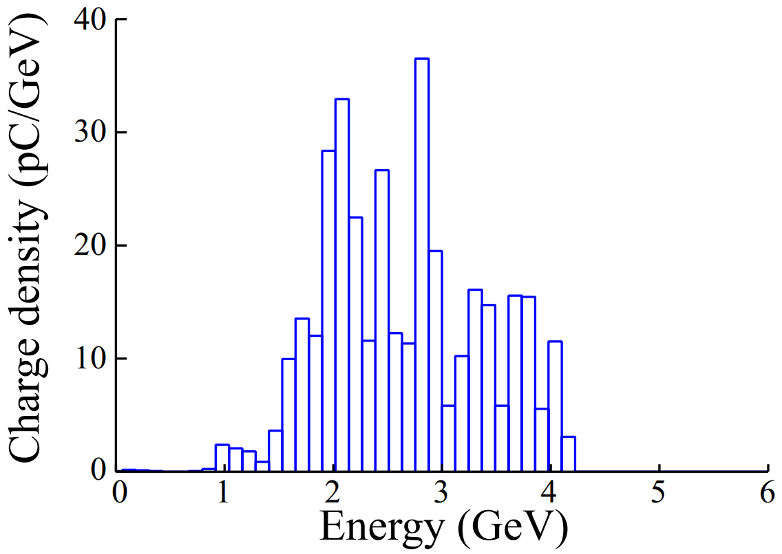
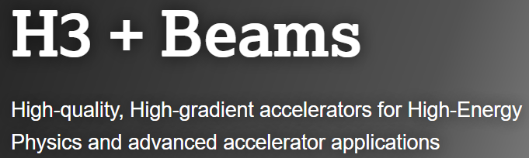
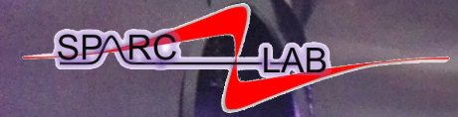
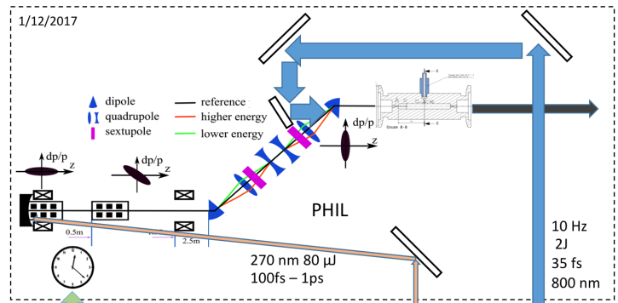
External Injection into Plasma to Produce VHEE Beams
Speaker: Jordan Byrne
Why use plasma?
Gonsalves, Anthony, et.al. "Multi-GeV Plasma Acceleration Results at BELLA." 6th International Particle Accelerator Conference. 2015.
🤔
Acceleration gradients orders of magnitude larger than conventional RF technology.
Still room for improvement in beam quality and stability.
Constantin Aniculaesei, et al.Matter Radiat. Extremes 1 January 2024; 9 (1): 014001
Okay, but why use external injection?
https://www.lancaster.ac.uk/physics/research/h3beams/
https://sparclab.lnf.infn.it/
🤔
Removes the reliance on self-injection and promises better beam quality and stability.
Increased beamline and timing complexity.
ESCULAP. Baynard, Elsa, et. al, Nuclear Instruments and Methods in Physics Research Section A: Accelerators, Spectrometers, Detectors and Associated Equipment 909. (2018): 46–48.

Slide 3
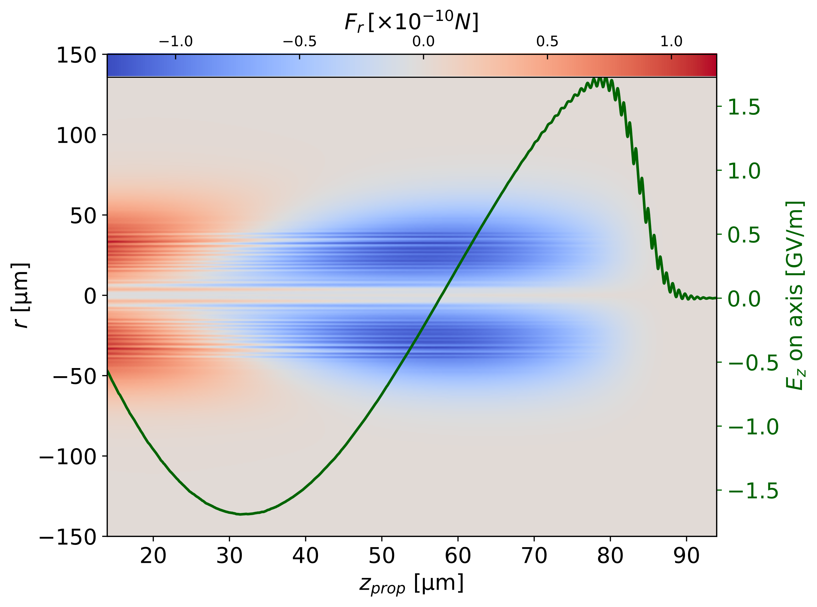
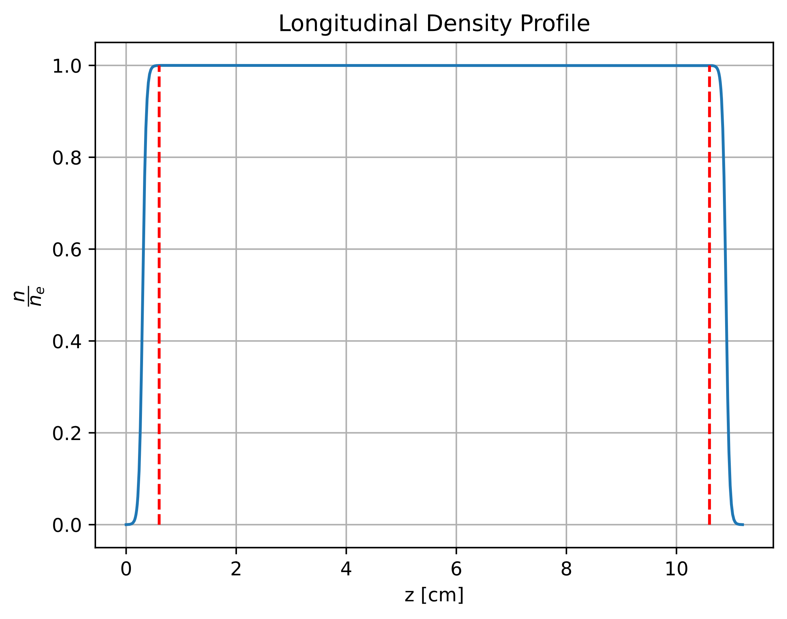
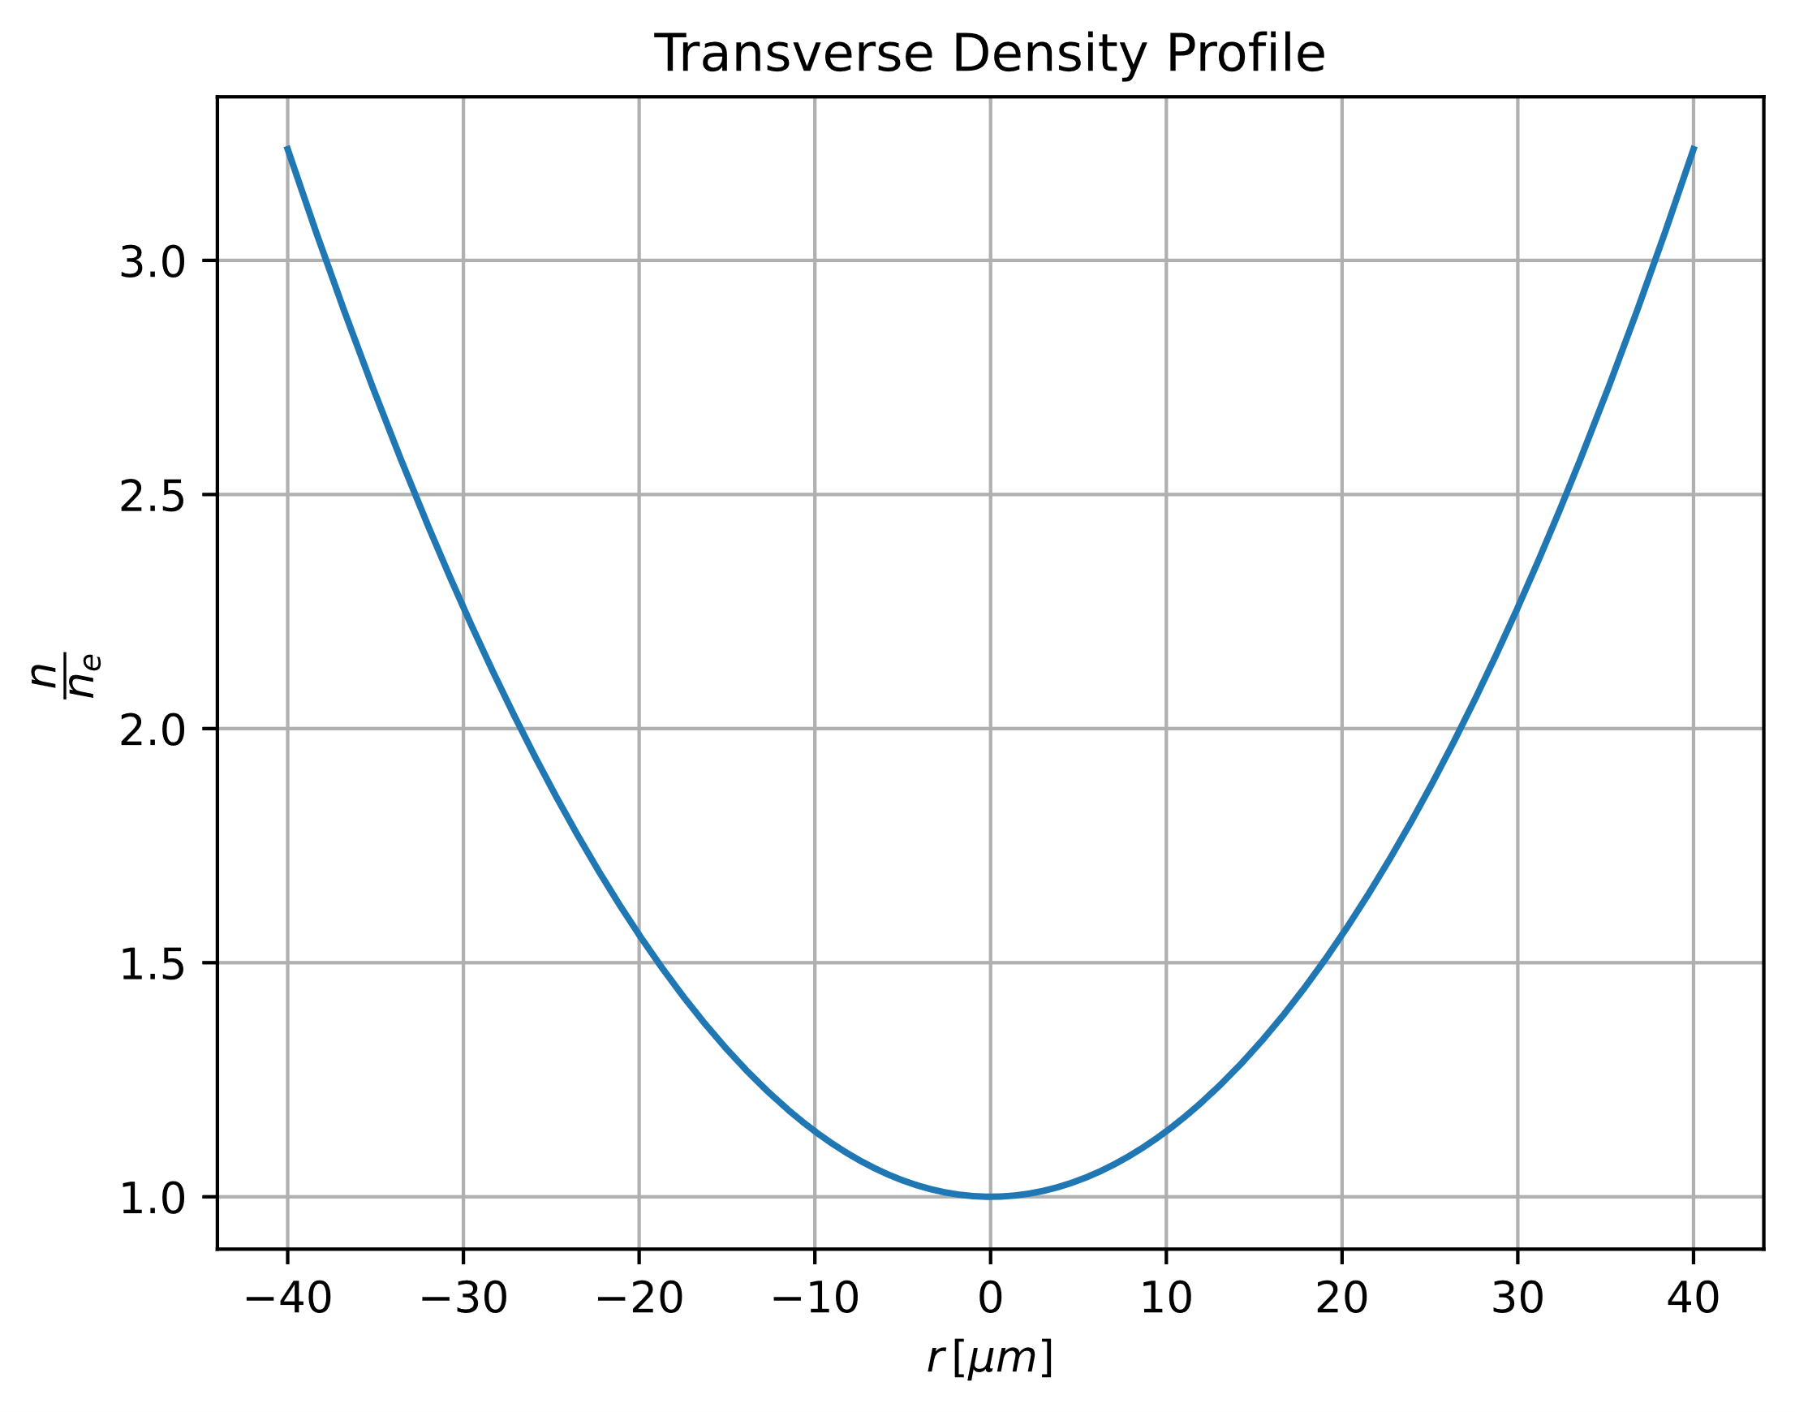
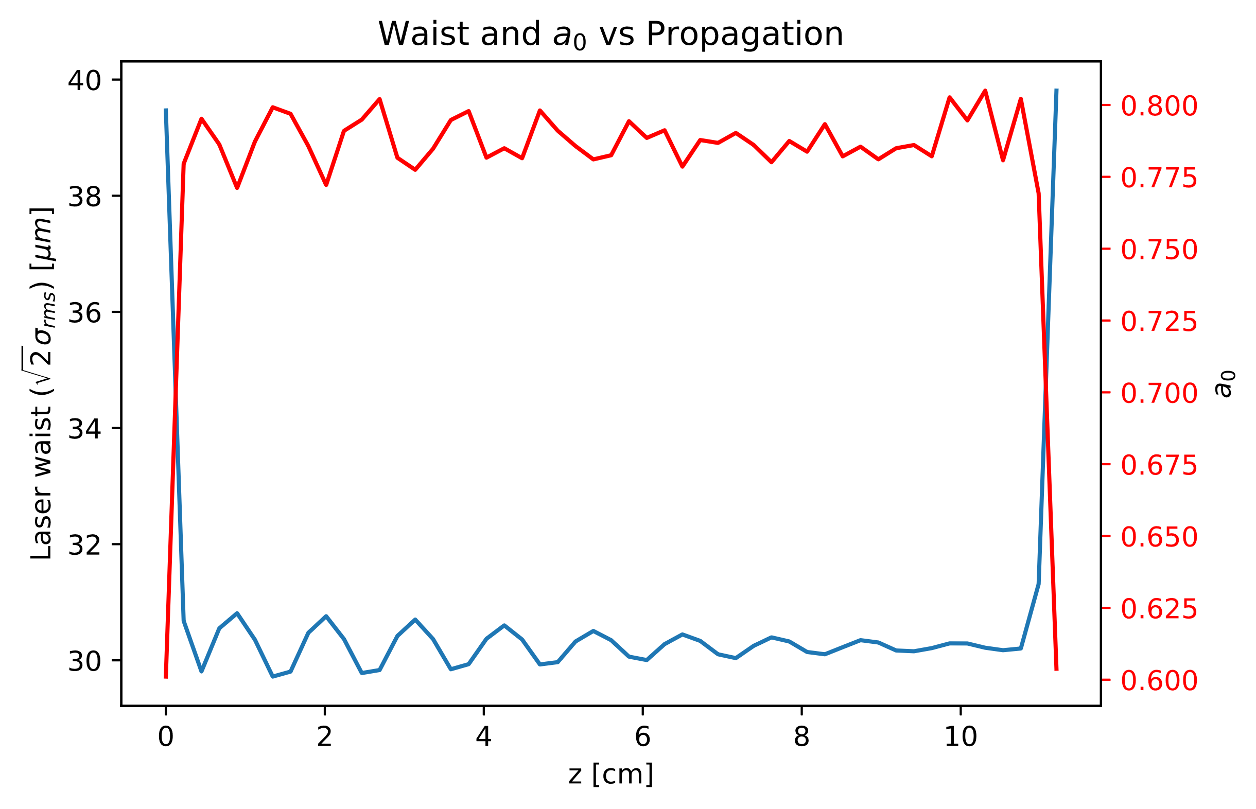
Laser Plasma Wakefield Acceleration
External Injection into Plasma to Produce VHEE Beams
Speaker: Jordan Byrne
Linear wakefield formation:
Laser Parameter | Value
λ [nm] | 800
a0 | 0.8
τ (1/e²) [fs] | 25
w [μm] | 50
Z_{focal} [mm] | 3
Plasma density: 1x10²³ m⁻³
a0 is comparatively low
Modest gradient: 1.7 GV/m
Plasma bucket (accelerating and focusing region): ~ 30 μm (100 fs)
(Z_{focal} and ramp length obtained through Bayesian optimisation)
+
➔

Slide 4
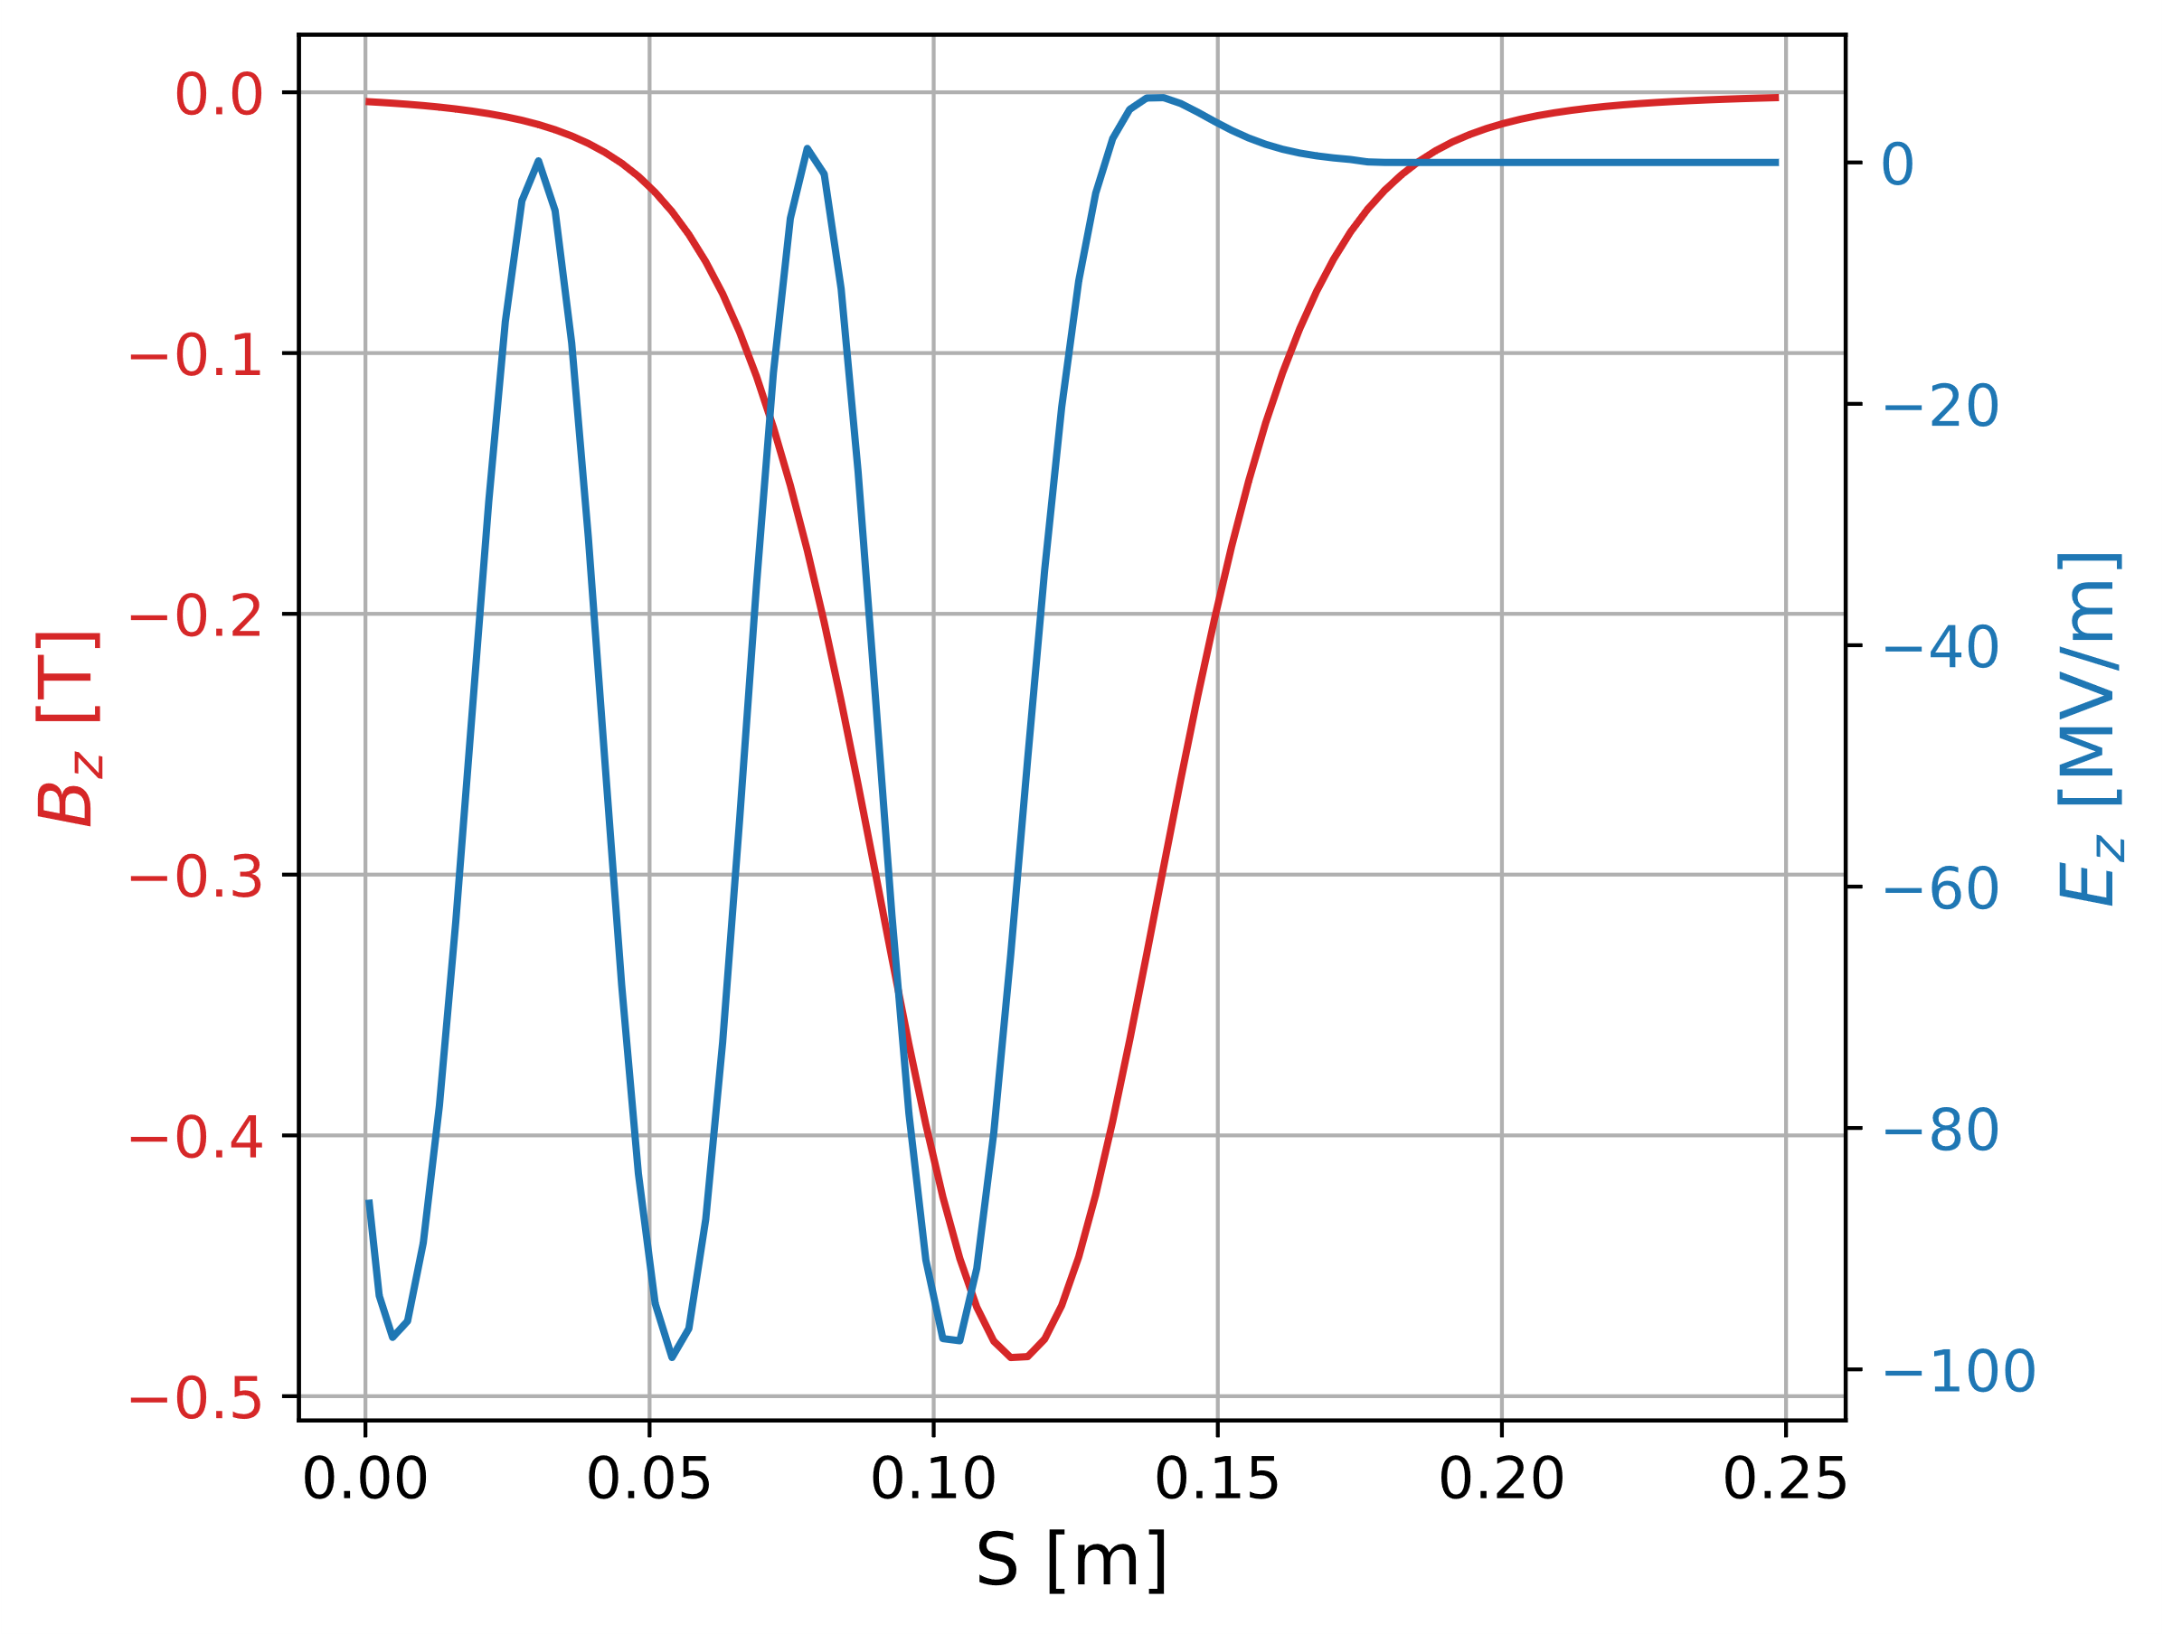
RF Gun
External Injection into Plasma to Produce VHEE Beams
Speaker: Jordan Byrne
PHIN 2.5 Cell, 3GHz gun simulated at 100 MV/m
Low energy
Bunch will slip back with respect to the wakefield.
Low charge
Implications on achievable dose rate.
Charge [pC] | 1 | 10 | 100
Laser pulse length [fs] | 30 | 50 | 50
Laser spotsize [μm] | 200 | 400 | 400
Energy [MeV] | 6.60 | 6.60 | 6.60
Normalized emittance [mm mrad] | 0.226 | 0.679 | 2.19
Beam size [mm] | 0.269 | 0.530 | 1.01
Bunch length [μm] | 13.0 | 26.0 | 104
Large beam size
Must use a transverse matching lattice in order to match the beam into the plasma.
Large bunch length
Bunch should occupy a fraction of the plasma bucket and hence requires bunch compression.

Slide 5






External Injection into Plasma to Produce VHEE Beams
Speaker: Jordan Byrne
Main research questions:
Can an external injection design produce VHEE quality beams?
Can the design offer a compact alternative to conventional RF linacs?
Next steps:
Obtain an idealistic low charge bunch distribution for external injection.
Perform a more detailed RF gun investigation to assess the cathode laser parameters.
Explore bunch compression options: magnetic compression? velocity bunching? Multi-cell phase modified RF gun?
Thomas Geoffrey Lucas, et al , "Femtosecond-Scale MeV-UED Beamline Using a Stand-Alone Multi-Cell RF Photogun." (2025).
Connect with me!
Thank you for listening!
Any questions?
Jordan.byrne@postgrad.manchester.ac.uk

