Slide 1





Development of Scattering Systems for Tumour Conformality with VHEE Beams
Sabrina Wang
Cameron Robertson, Andrea Latina, Manjit Dosanjh
VHEE’25, 15-17 September 2025, Daresbury Laboratory
Notes:
good afternoon
why and what i am doing

Slide 2
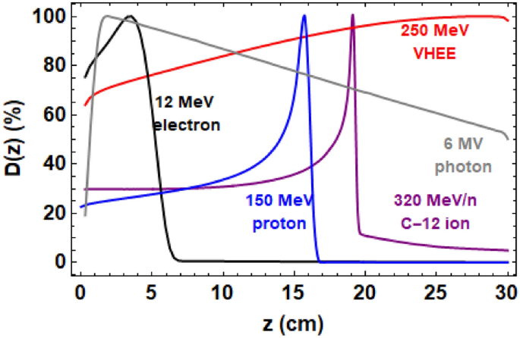
Background
1 in 2 people in the UK will develop cancer
Importance of RT for cancer treatment
Current Limitations:
X-ray therapy: Gradual dose attenuation harms deeper healthy tissues.
Hadron therapy: Superior precision (Bragg peak) but expensive and bulky machines
Emerging Modality: Very High Energy Electrons (VHEE, 50-250 MeV)
Can be steered, focused
Potential for FLASH radiotherapy
L. Whitmore et al., “Focused VHEE (very high energy electron) beams and dose delivery for radiotherapy applications,” Scientific Reports, vol. 11, p. 14013, 2021.
Notes:
1 in 2 people in uk develop cancer in their lifetimes, and roughly half require radiotherapy.
As you have heard many times in this conference already explained, different modalities shown in this graph
VHEE beams are an emerging modality. with benefits of deeper penetration,less sensitive to inhomogeneities Can be steered scanned, and focused and can be compact and cheaper than hadron machines
Very promising candicate for clinical use it for FLASH RT.

Slide 3
Challenge in delivering VHEE FLASH
FLASH effect (at UHDR ≥40 Gy/s selectively spares healthy tissue).
Pencil beam scanning not feasible in FLASH regime ~100ms
Extremely fast and precise steering
Beam Conformality- dual scattering system
High photon contamination degrades dose uniformity.
Require long drift spaces (>2.5 m) to reduce photon contamination.
Goal: Replace the pre-scatterer (S1) with quadrupole magnets to magnify the beam before flattening, reducing photons while maintaining uniformity.
Notes:
Heard already FLASH requires UHDR, healthy tissues selectively spared while maintaining tumour toxicity,
A challenge is to achieve a uniform dose across the tumour. Conventional method pencil beam scanning in proton therapy. Not currently feasible in flash regime with electrons
Previous work detailed using a dual scattering system, to enlarge the beam using prescatterer and flatten beam using the second gaussian shaped scatterer, will cover entire area of tumour.
In VHEE regime, generates significant Bremstrahlung photons especially in the first scatterer which is not flattened by the S2. This need long drift spaces to be diluted and is too large for a clinical setting
Goal is to use 4 quadrupole magnets to replace the first scatterer to achieve the same magnifying effect to reduce the photon contamination

Slide 4
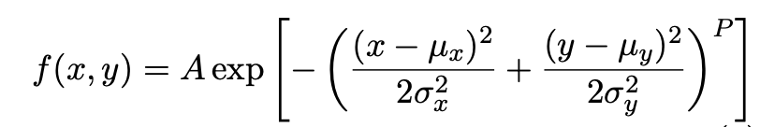

Principle + Simulation Tools
Dual-scattering System
Simulation Tools:
RF-Track: Beam tracking through quadrupoles.
TOPAS (GEANT4): Scattering/dose simulations in water.
Beam Profile Characterisation
Quadrupole-scatterer System
Notes:
2 setups
The simulation split into two parts, the accelerator components which is the quadrupoles done in RF Track,
and the rest which is simulates the scattering effects with scatterers and particle distribution at the water phantom done in TOPAS.
The beam profile at the phantom is characterized using a supergaussian function, from which we can calculate a parameter r_90, used as the uniform radius. This is the radius at which intensity is at 90%of the peak and is used as a measure of the beam size.

Slide 5
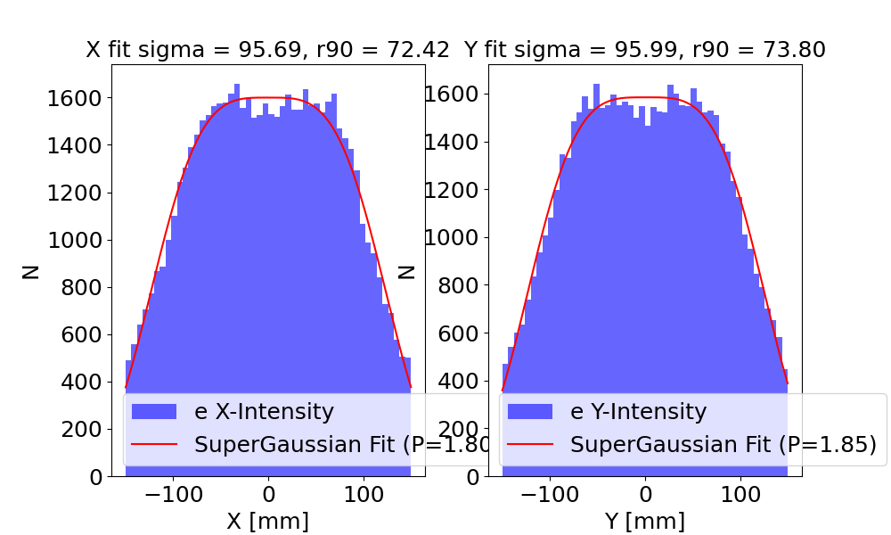
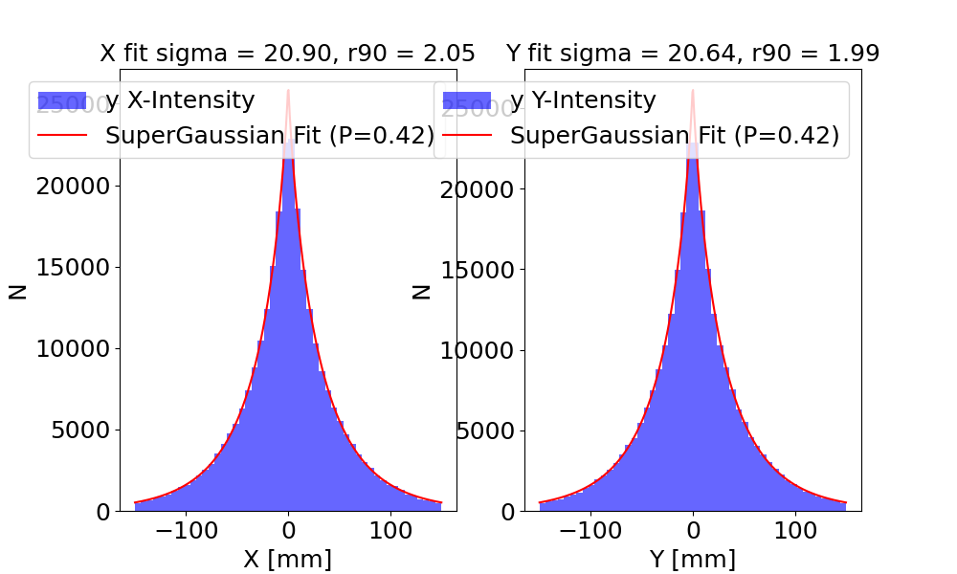
Dual-Scatterer System
Simulation: 200 MeV, 3e6 particles
Dynamical optimisation of
S1 thickness for beam size
S2 parameters to control uniformity
Photon component 80.3% of final beam, degrades dose uniformity.
Notes:
I first simulated a dual-scattering system and roughly optimized it to reach a uniform radius size of around 75mm for tumour treatment
The parameters S1 thickness, S2 thickness and S2 widths were tuned dynamically to achieve a flattened beam of the target beam size
Top plot electron distribution flattened,
Bottom plot photon not flat with very hign count- 80%
-------------------
No.of particles

Slide 6
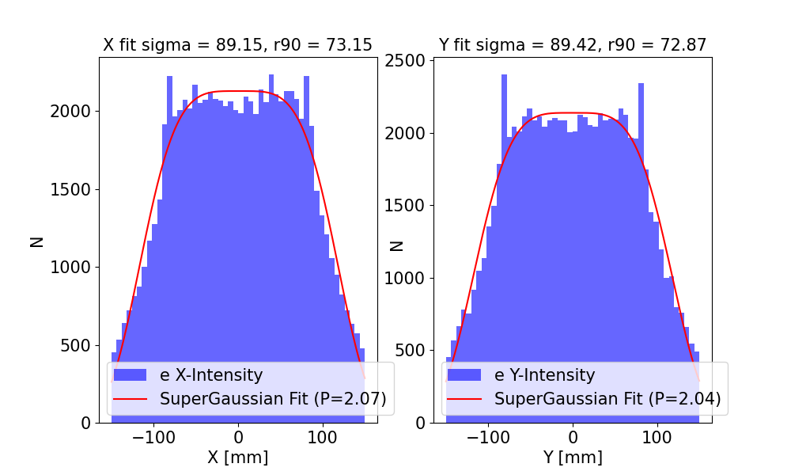
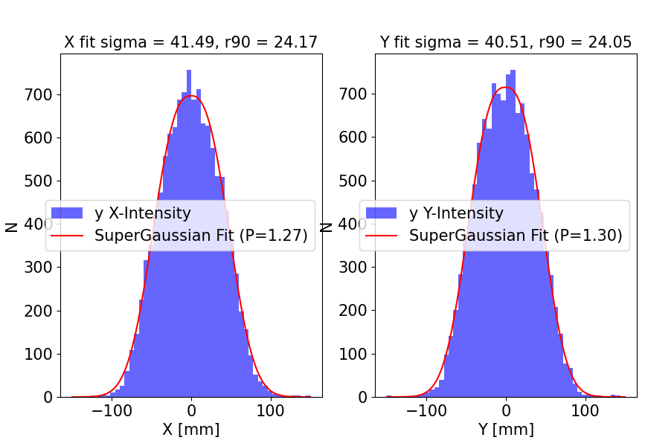
Quadrupole-Scatterer System
Quadrupole Configuration Optimisation:
Nelder-Mead optimiser for large symmetric beam with symmetric divergence
Dynamical variation of S2 parameters to flatten
Photons component:14.6% of all particles
Notes:
To find a quadrupole strength combination that achieves the same effect, a NM optimizer is used with a merit function that aims for the target beam size, symmetric beam and divergence
Then S2 parameters adjusted to flatten
This results in a very similar electron dose profile, with r90 also around 73mm the target radius
Photon count drastically decreased to making up only 14.6% all particles at the water phantom

Slide 7
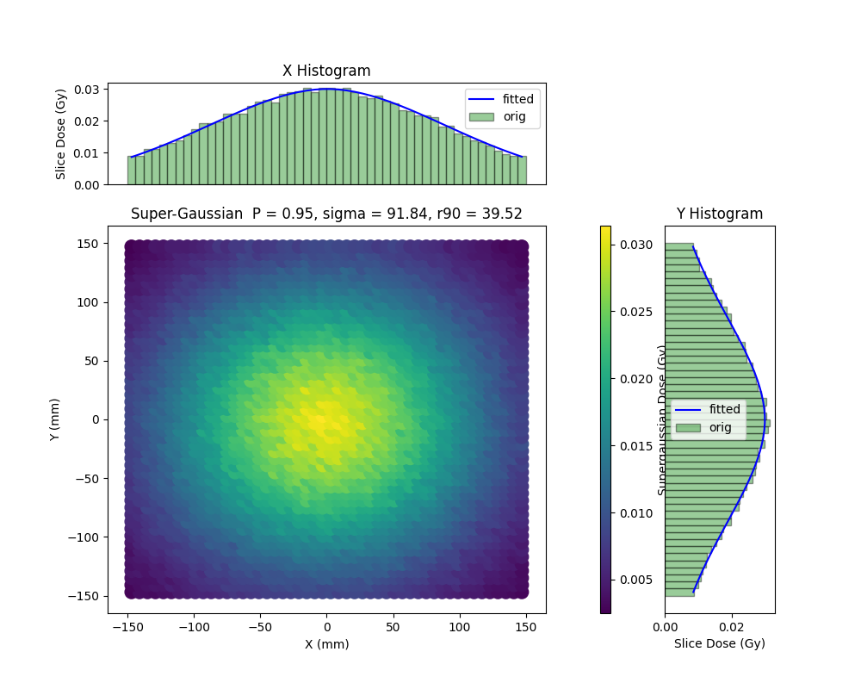
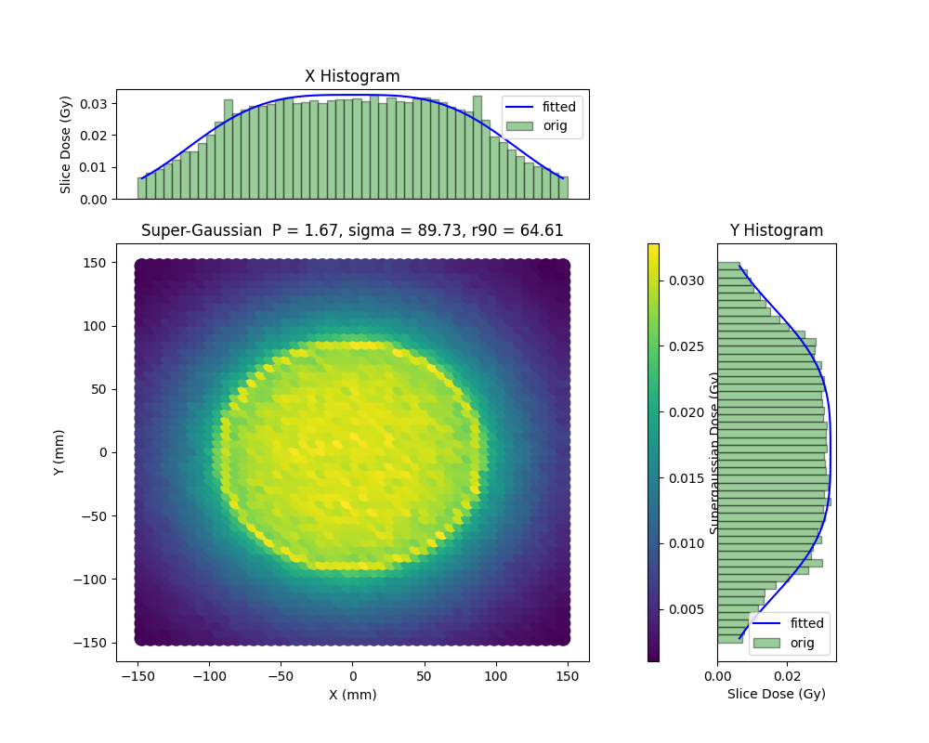
Dose Map Comparison
Dual-scattering system
Quad-scattering system
Notes:
Dual scattering system can clearly see effect of photons

Slide 8
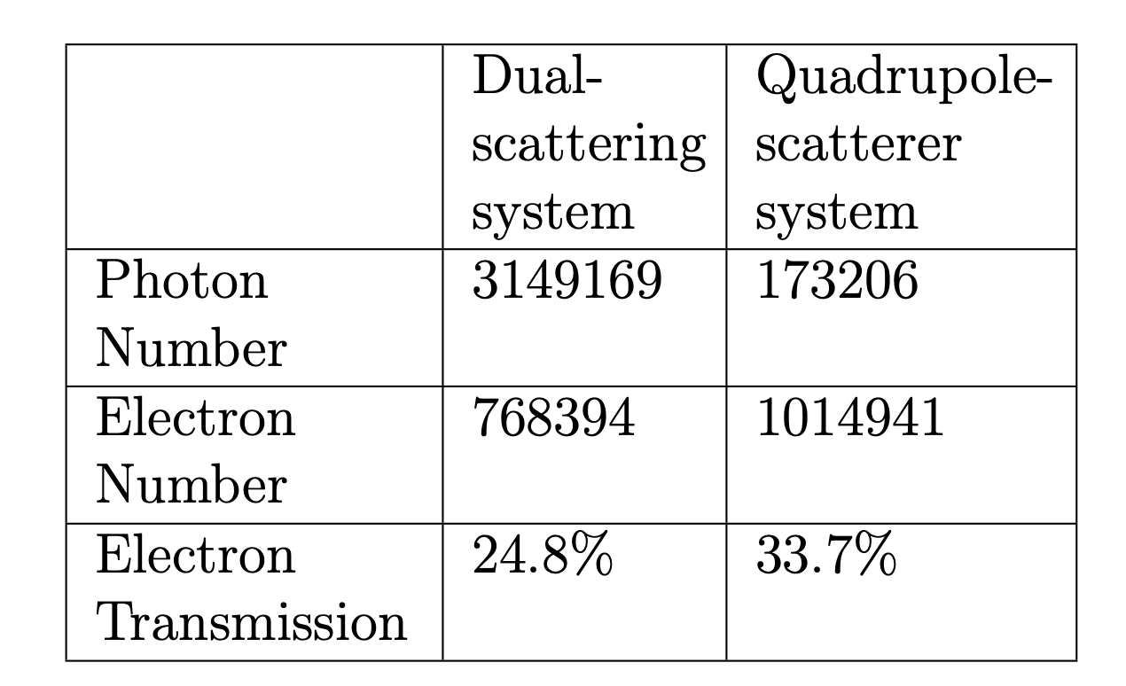
Results
Key Achievements:
Uniformity: Achieved r₉₀ ≈ 75 mm (similar to dual-scatterer).
Photon Reduction: 94.5% fewer photons (14.6% vs. 80.3%).
Electron Transmission: Improved to 33.7% (vs. 24.8%).
Notes:
R90 around 75mm, first part of proof of principle, can replace first scatterer, able to magnify beam for same effect
Successfully reduced 94.5 % of photons
Electron transmission (proportion of electrons within r90) is better , less electrons losses system more effective
Plot on the right is dose map showing that the dose which is combined electron and photon energy deposits indeed gives a flattened beam

Slide 9
Conclusion
Success: Quadrupole-scatterer system reduces photons by 94.5% while maintaining transverse electron intensity uniformity.
Impact: Time independent, cost-efficient method of conformal beam delivery for VHEE FLASH.
Next Steps: More realistic simulation and experimental validation at CLEAR and CLARA
Notes:
There remains much work to be done for a more complete study.
***
Only particle intensity profiles are investigated, need to check the correspondence of dose profile – combined effect of electrons and photons
Previous work shows the uniformity of his flattened beam degrades again with depth inside the water phantom, this effect should be investigated for quadrupole-scatterer system with mitiation techniques– double peak
Eventually lose uniformity deep, but not significant, uniformity up to quite significant depths, . Dose profile vs intensity check.
***
The simulation assumed an infinite beamline aperture and no energy spread or misalignments. In reality these could all contribute greatly to beam losses and the effectiveness of the quadrupole-scatterer system
A more realistic model is needed that incorporates finite apertures as well as a typical beam spread and beam misalignments to assess beam envelope growth and particle losses.
The 4-quadrupole system is also not commonly seen facilities able to test for VHEE FLASH. The feasibility of the method need to be checked for simpler beamlines with doublets or triplets at the end.
Hence a better optimiser is needed for the above and automatically generate quadrupole and S2 parameters
This should then be tested experimentally
Conclude: proof of principle investigation success, it has high impact and the next steps will be more realistic testing and clinical adaptation

