Slide 1




Transfer Matrix Formalism of In-Air VHEE Beam Profile Measurements at PEER
J. Valerian*, M. Volpi, P. Giansiracusa¹, P. Pushkarna, R. Rassool, S. L. Sheehy²
University of Melbourne, Melbourne, Australia
Y.-R. E. Tan
Australian Synchrotron – ANSTO, Melbourne, Australia
¹also at Australian Synchrotron – ANSTO, Melbourne, Australia
²also at ANSTO, Sydney, Australia
*joel.valerian@student.unimelb.edu.au
The 4th International Workshop on Very High Energy Electron Radiotherapy (VHEE’25)
15 – 17 September 2025, Daresbury, UK

Slide 2
Objective
Characterise our VHEE beams at PEER
What do I mean by “characterise the beam”?
How do you characterise the beam?
Can you do that at PEER?
Why do you need to characterise the beam?

Slide 3
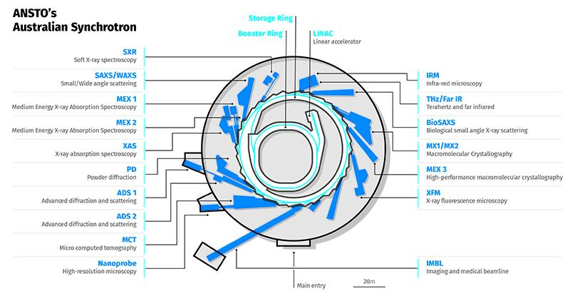
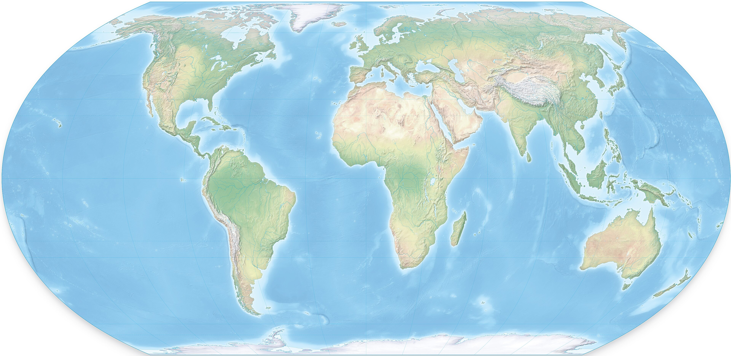
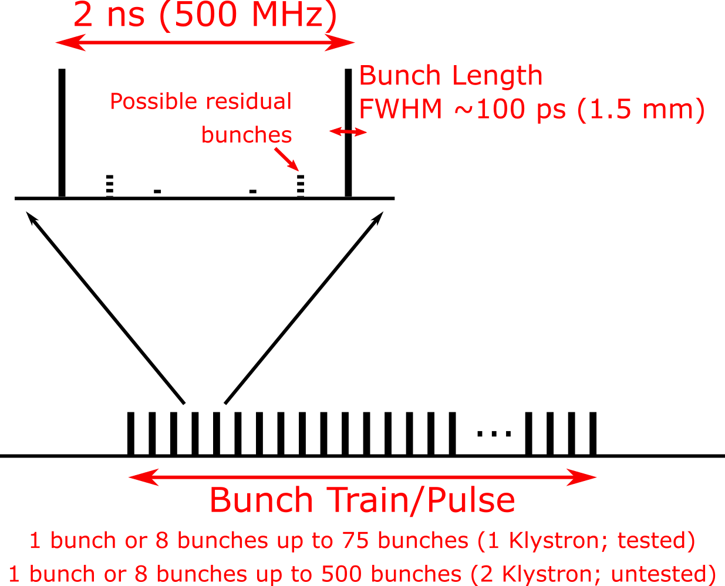
Tangent: PEER at Australian Synchrotron
Source: ansto.gov.au
Geomagnetic North Pole
Melbourne, Australia
17.000 km
Pulsed Energetic Electrons for Research (PEER)
RF: 3 GHz (S-band), Buncher: 500 MHz
Gun: Thermionic triode
Energy: ~100 MeV ( 70 – 110 MeV) +/- 1%
Bunch length: ~100 ps*
Single bunch mode: 30 fC to 12 pC
Multi bunch mode: 0.48 – 4.8 nC (1 – 500 bunches)
Train length: 16 ns – 1000 ns
Repetition: 1 – 5 Hz
Daresbury, UK
Geomagnetic South Pole

Slide 4
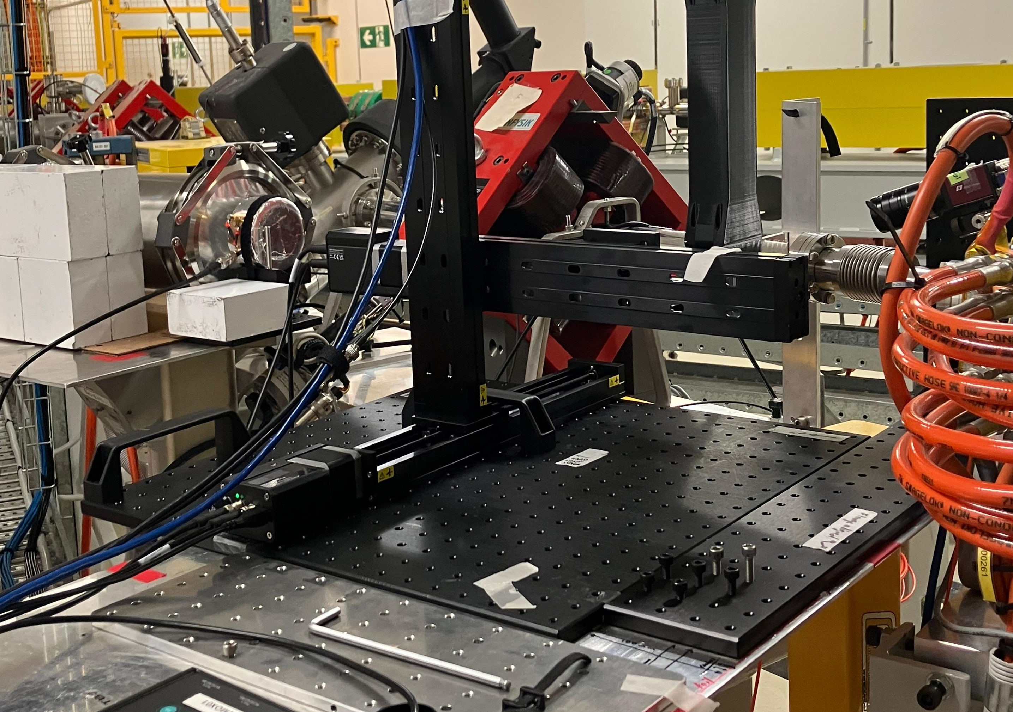
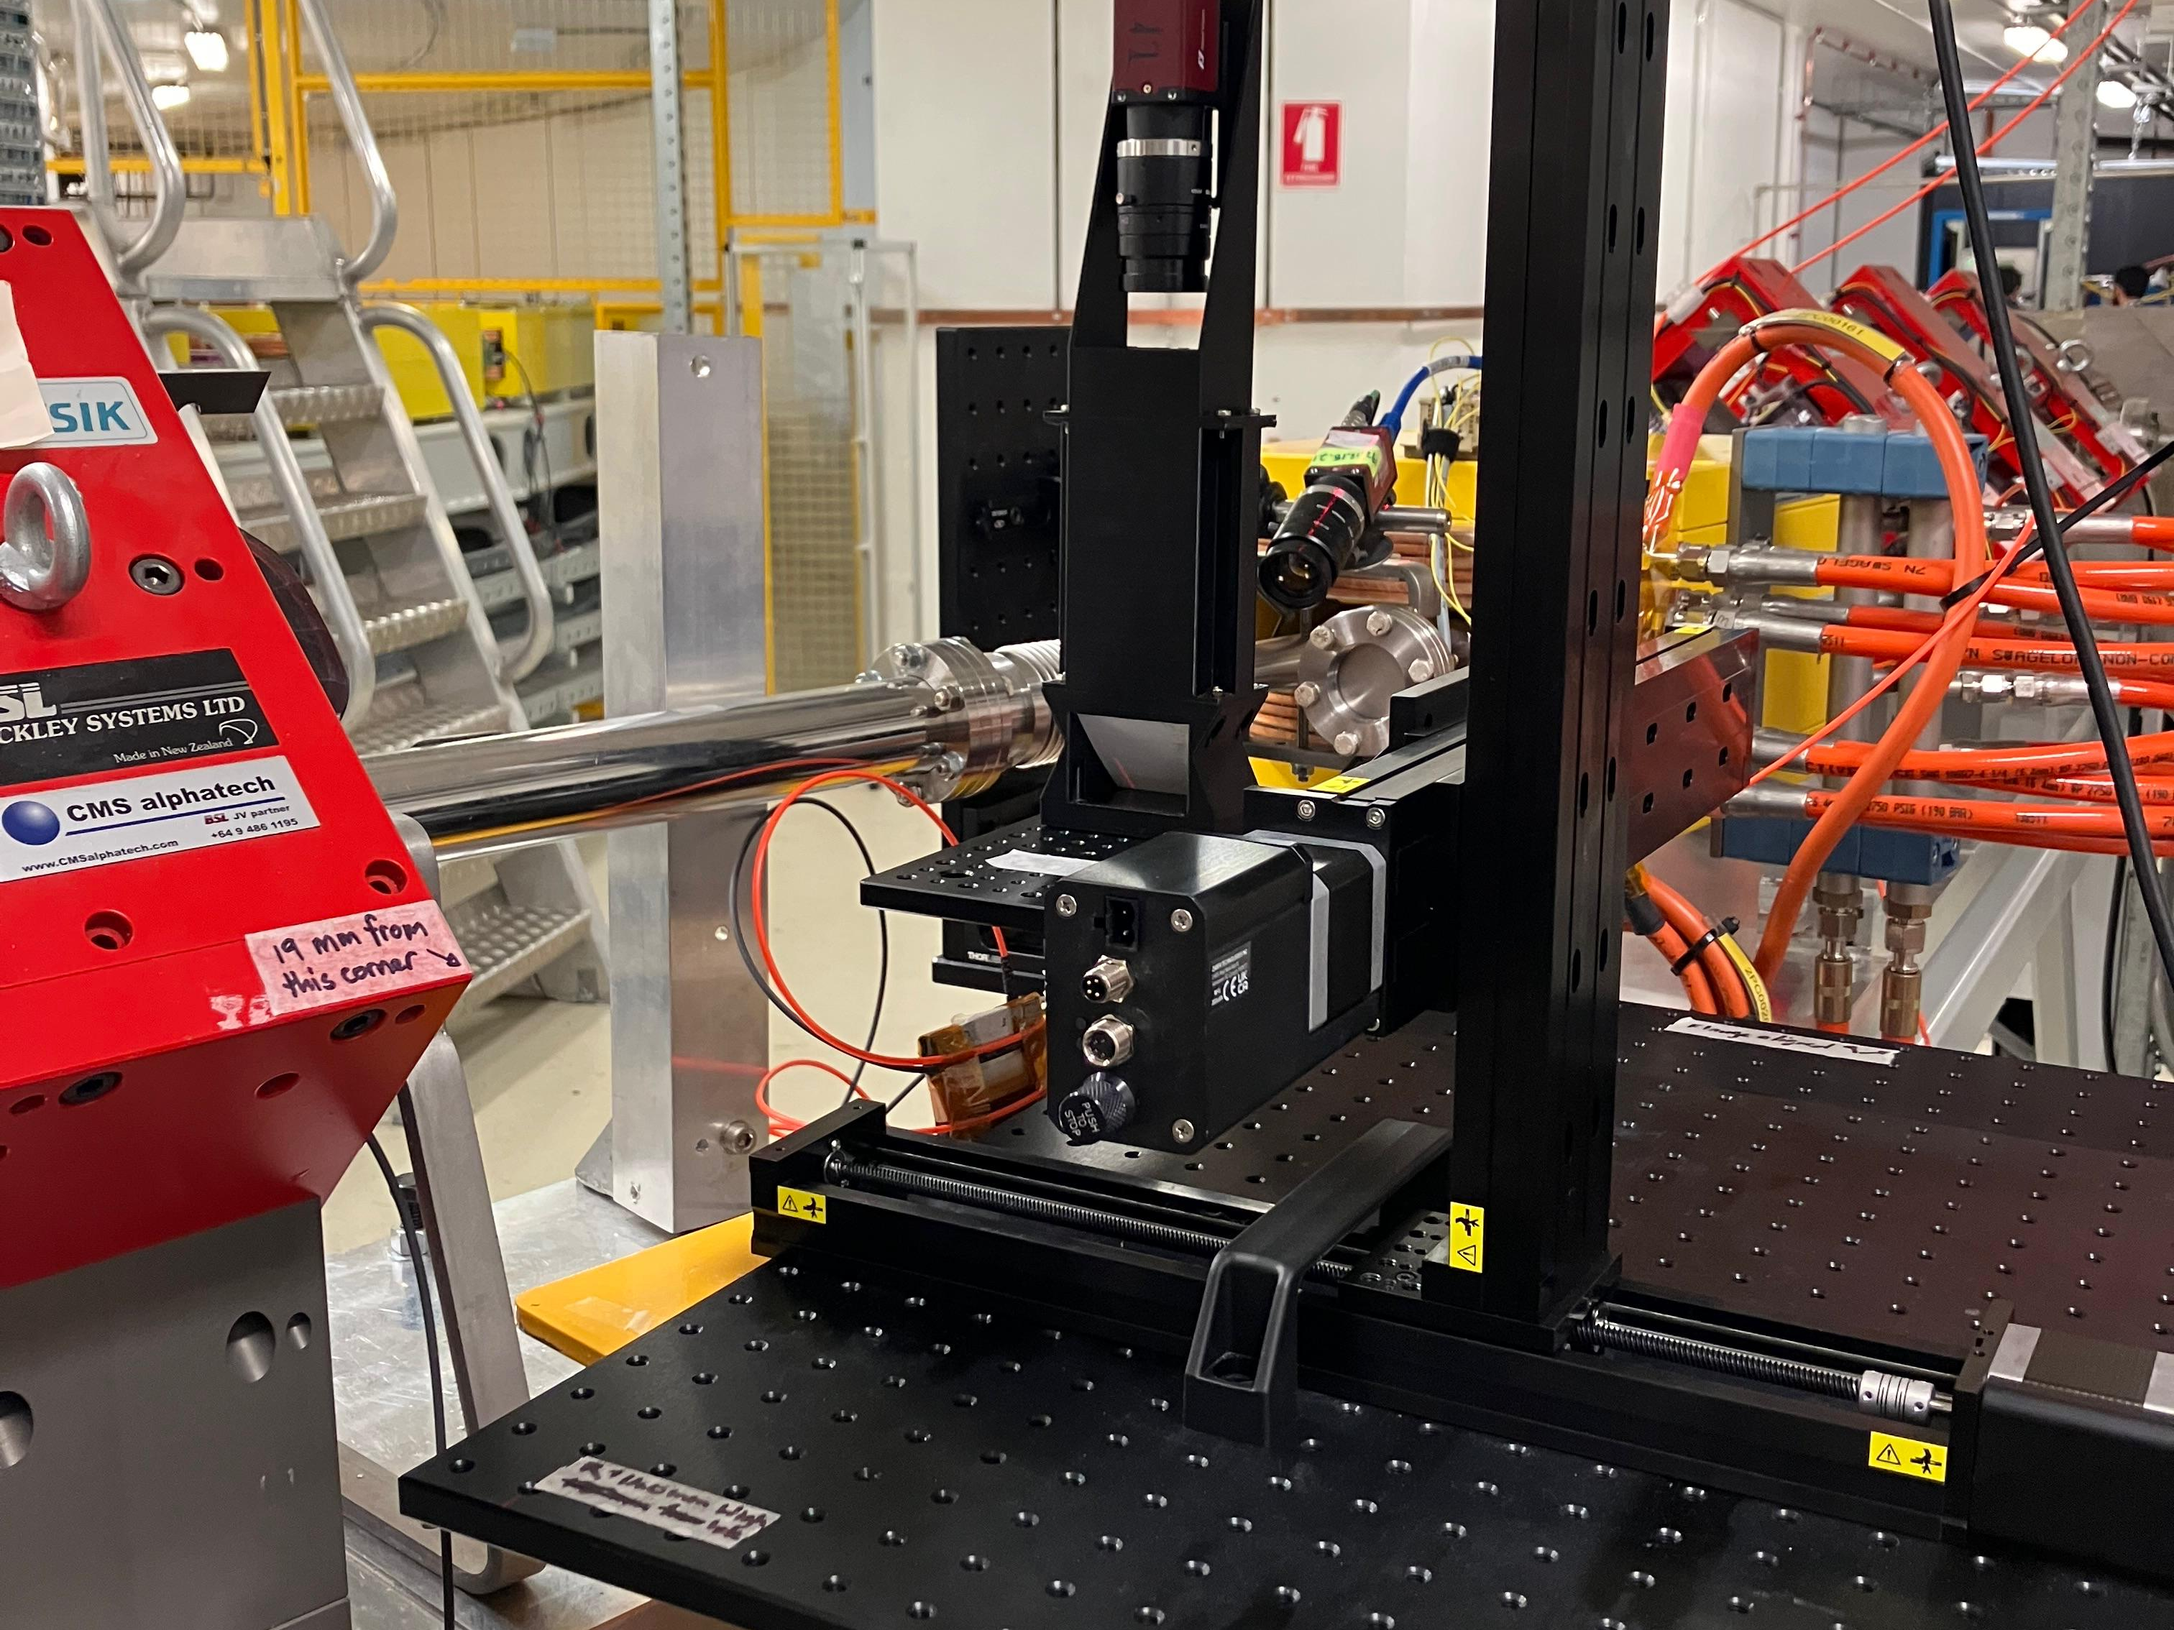
Pulsed Energetic Electrons for Research (PEER)
PEER End Station
LINAC: Linear Accelerator
HC: Horizontal Corrector
FCT: Fast Transformer
QF: Focusing Quadrupole
QD: Defocusing Quadrupole
VC: Vertical Corrector
D: Dipole
W: Vacuum Window
127 µm Titanium
To Booster Ring
~100 mm
~400 mm
W
D
(Off)
QD3
VC
QD2
QF1
FCT
HC
LINAC
Vacuum Beam Pipe
Ø 42.5 mm
Limited in x-axis now, possible plan to extend beamline 🤞
127 µm
150 mm
300 mm
198.6 mm
150 mm
302.3 mm
150 mm
301.8 mm
150 mm
732.5 mm
2 S-Band Structures @ 100 MeV
Faraday Cup
Transfer Line to Booster Ring
Quadrupole
Triplet
(QF1, QD2, and QD3)
XYZ Linear Motion Stage
XYZ Linear Motion Stage

Slide 5
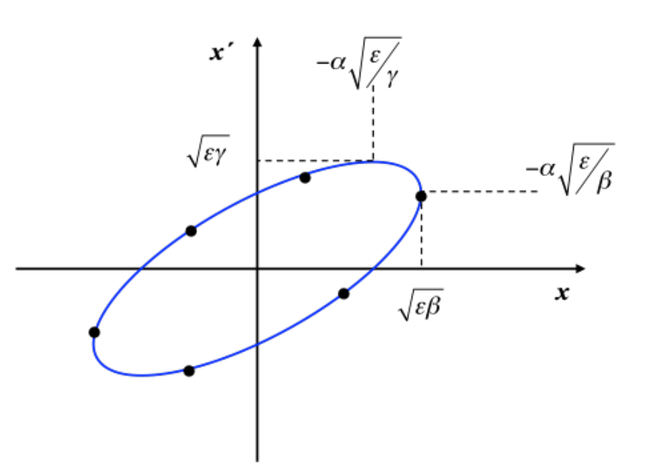
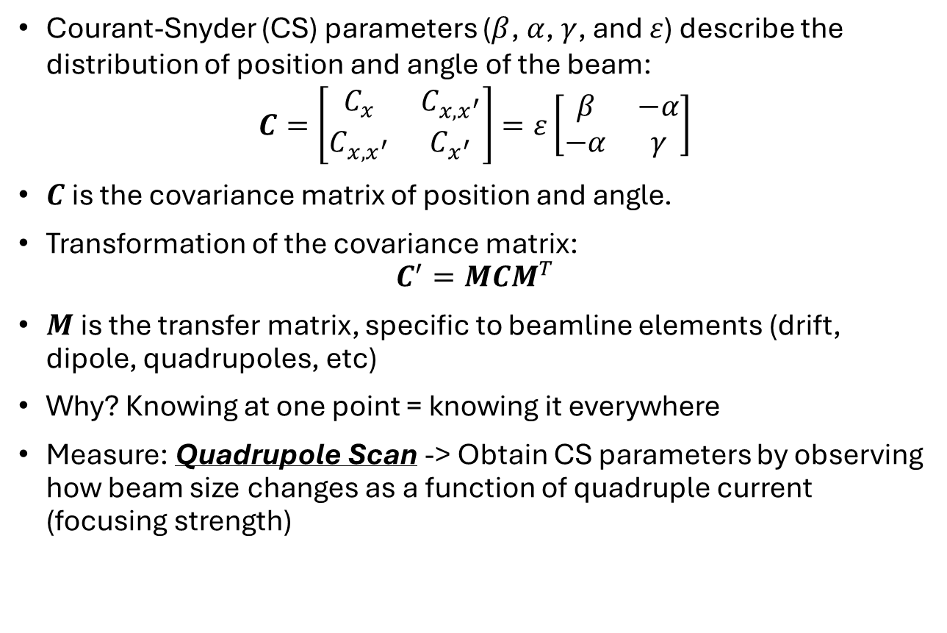
What do you mean by characterise?
Courant-Snyder (CS) parameters ($β$, $α$, $γ$, and $ε$) describe the distribution of position and angle of the beam:
$$C=\left[\begin{matrix}C_{x} & C_{x,x^{′}} \\ C_{x,x^{′}} & C_{x^{′}}\end{matrix}\right]=ε\left[\begin{matrix}β & −α \\ −α & γ\end{matrix}\right]$$
$C$ is the covariance matrix of position and angle.
Transformation of the covariance matrix:
$$C^{′}=MCM^{T}$$
$M$ is the transfer matrix, specific to beamline elements (drift, dipole, quadrupoles, etc)
Why? Knowing at one point = knowing it everywhere
Measure: Quadrupole Scan -> Obtain CS parameters by observing how beam size changes as a function of quadruple current (focusing strength)
Phase (Trace) Space
*Beam Profile Monitor (Scintillating Screen)
BPM*
QUAD2
QUAD 1
LINAC

Slide 6
Can we do that at PEER?
LINAC: Linear Accelerator
HC: Horizontal Corrector
FCT: Fast Current Transformer
QF: Focusing Quadrupole
QD: Defocusing Quadrupole
VC: Vertical Corrector
D: Dipole
W: Vacuum Window
S: Scatterer
BPM: Beam Profile Monitor
PEER End Station
127 µm Titanium
To Booster Ring
BPM
W
D
(Off)
QD3
VC
QD2
QF1
FCT
HC
LINAC
Vacuum Beam Pipe
Ø 42.5 mm
Screen here?
2 S-Band Structures @ 100 MeV
127 µm
150 mm
300 mm
198.6 mm
150 mm
302.3 mm
150 mm
301.8 mm
150 mm
732.5 mm
No in-vacuum BPM along beamline except an OTR screen after dipole in transfer line
How do we characterise our beam??? In-air BPM?
Not valid because of scattering → we don’t know transfer matrix of the window and air…
or do we?

Slide 7
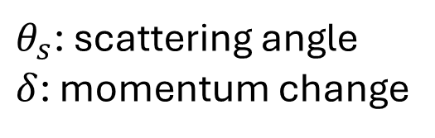


Can we include scattering?
Yes (Negra, 1971 and others):
$$C^{′}=M_{drift}CM_{drift}^{T}$$
$$C^{′}=M_{drift}CM_{drift}^{T}+ΔC$$
$$ΔC=\left[\begin{matrix}\frac{s^{2}}{3}θ_{s}^{2}\left(1+\frac{δ}{2}\right) & \frac{s}{2}θ_{s}^{2}\left(1+\frac{δ}{3}\right) \\ \frac{s}{2}θ_{s}^{2}\left(1+\frac{δ}{3}\right) & θ_{s}^{2}\left(1+δ\right)\end{matrix}\right]$$
Include scattering
$θ_{s}$: scattering angle
$δ$: momentum change
PDG and NIST database
Assumption:
Multiple Coulomb scattering only (small scattering)
Linear energy loss
Uncoupled beam

Slide 8
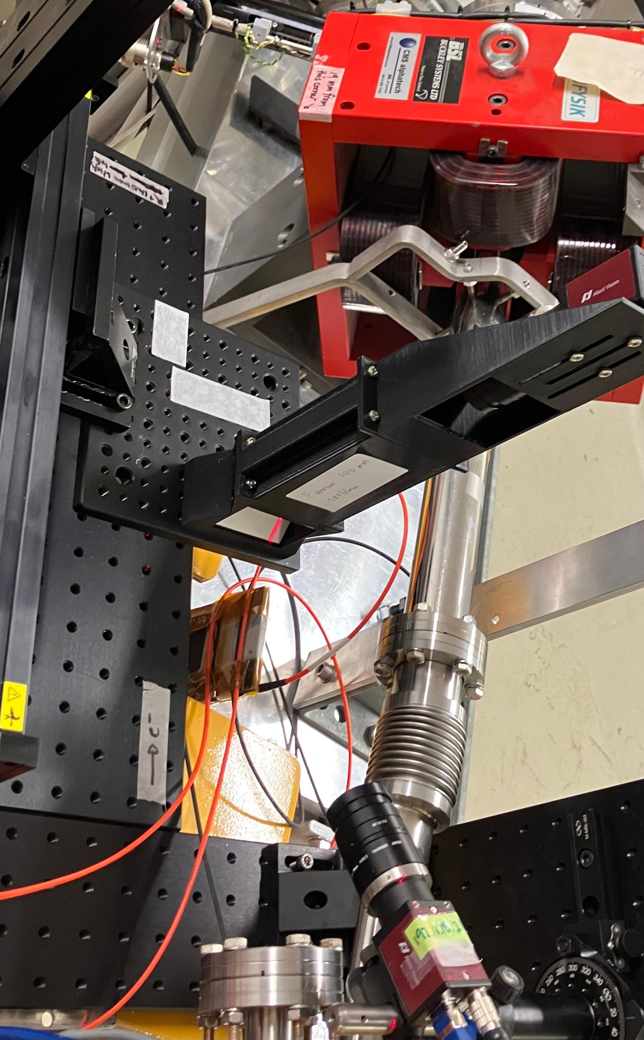
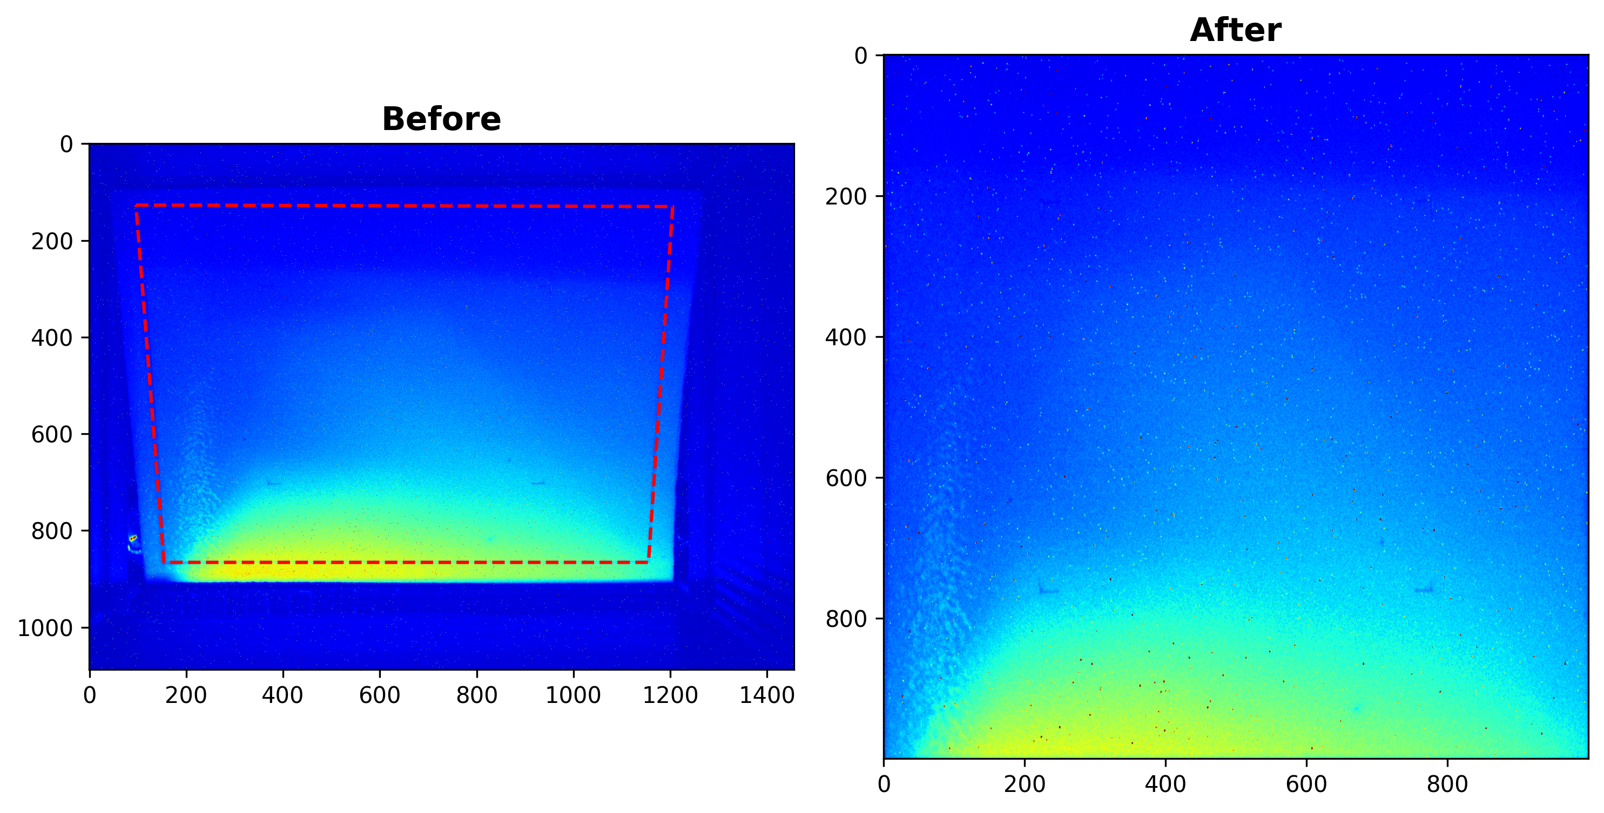
Let’s do our (modified) quad scan!
Experiment parameters:
Fix charge to around 1 nC
Turn off correctors
Set QD2 to 9 A and turn off QD3
Scan QF1 from 0 A to 14 A
PEER End Station
LINAC: Linear Accelerator
HC: Horizontal Corrector
FCT: Fast Current Transformer
QF: Focusing Quadrupole
QD: Defocusing Quadrupole
VC: Vertical Corrector
D: Dipole
W: Vacuum Window
S: Scatterer
BPM: Beam Profile Monitor
127 µm Titanium
To Booster Ring
BPM
W
D
(Off)
QD3
(OFF)
VC
(OFF)
QD2
(9 A)
QF1
(Scan)
FCT
HC
(Off)
LINAC
Vacuum Beam Pipe
Ø 42.5 mm
162.5 mm
127 µm
150 mm
300 mm
198.6 mm
150 mm
302.3 mm
150 mm
301.8 mm
150 mm
732.5 mm
2 S-Band Structures @ 100 MeV
Setup:
Screen Calibration:
Camera
Transfer Line
Screen marked by a 45 mm square box using laser cutter
Width x Height
45.00 mm x 31.82 mm
(4.5 µm/px x 3.2 µm/px )
Window
100 MeV Electrons
Screen
XYZ Linear Motion Stage

Slide 9
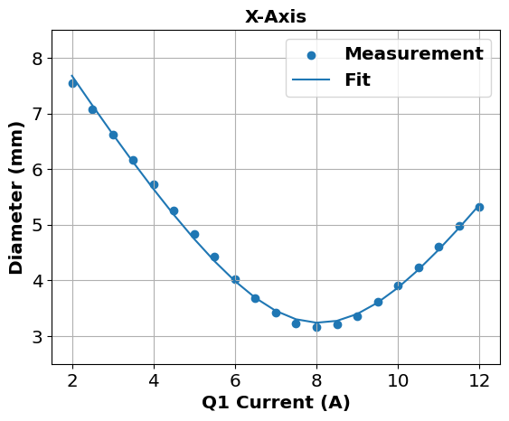
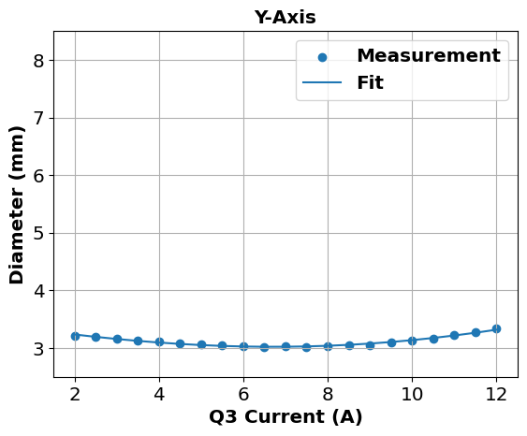
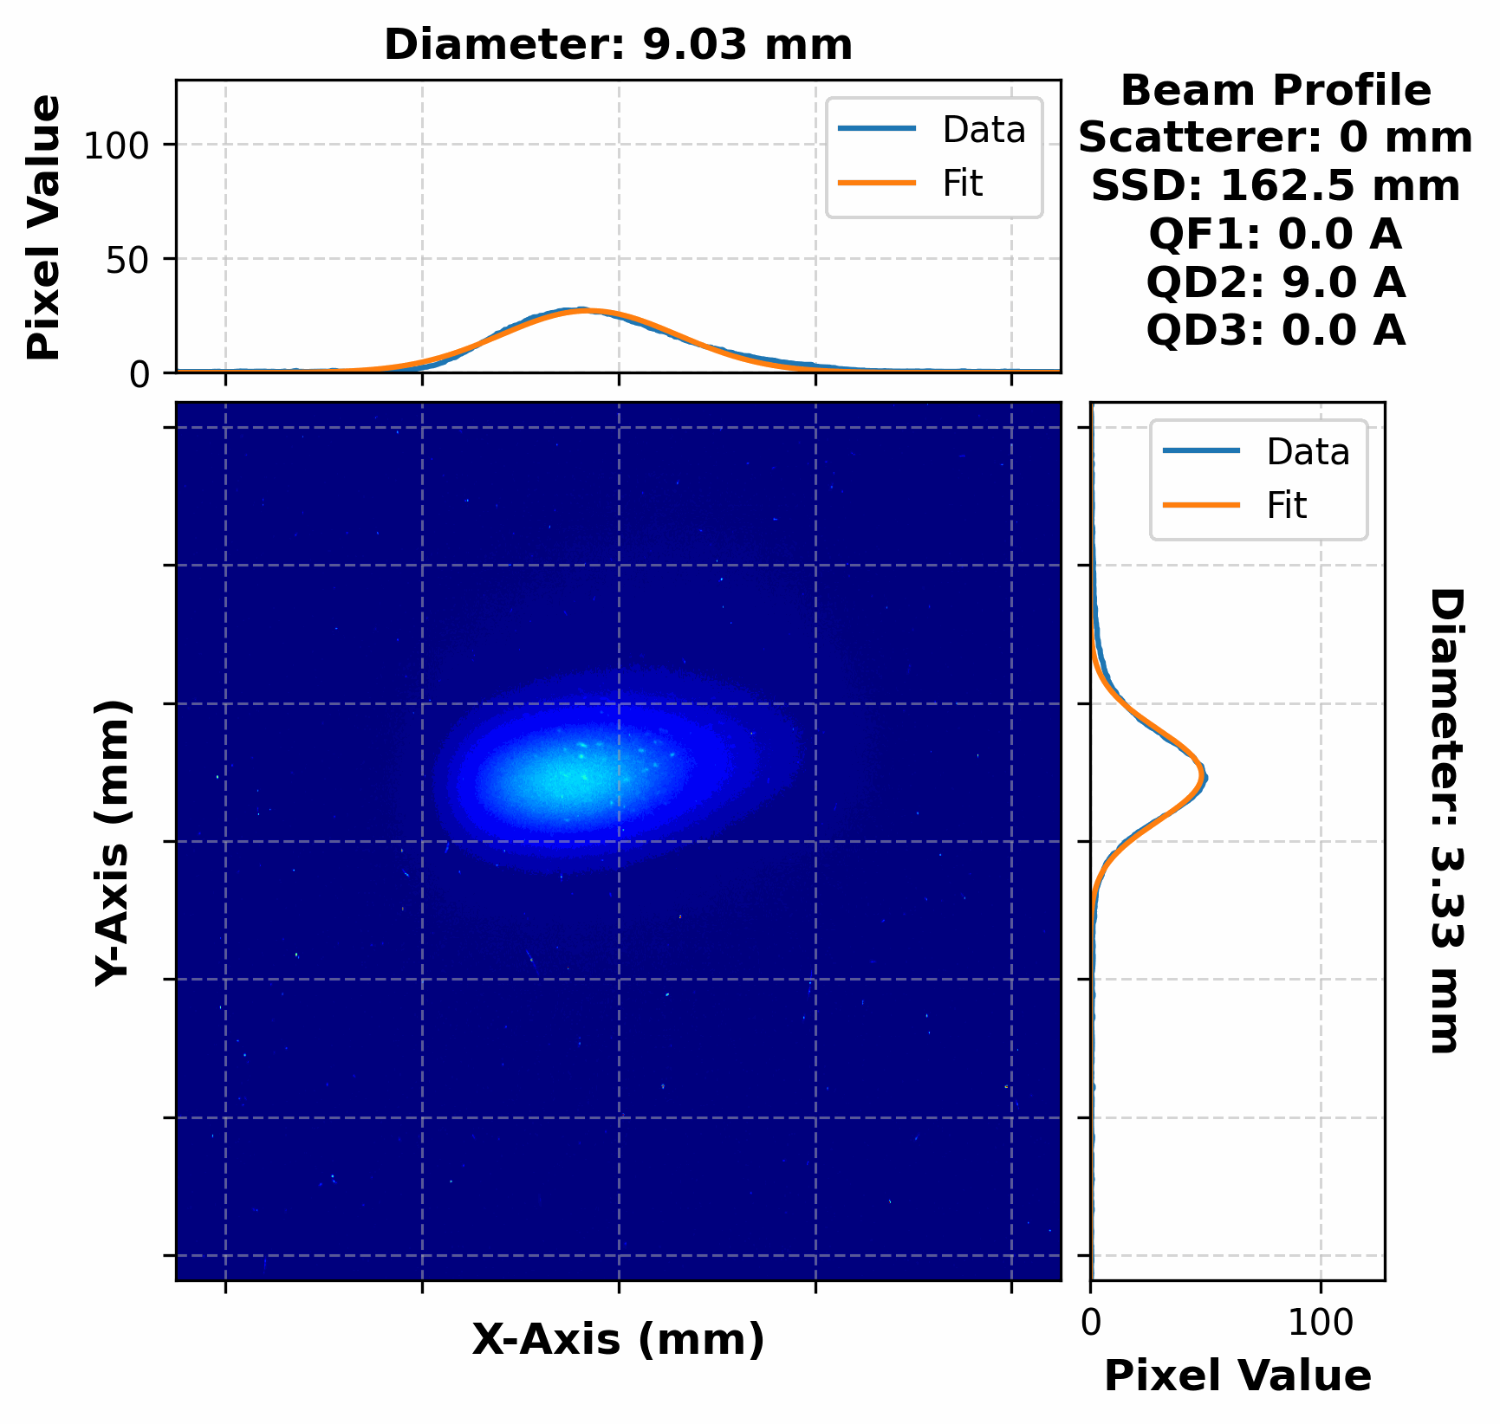
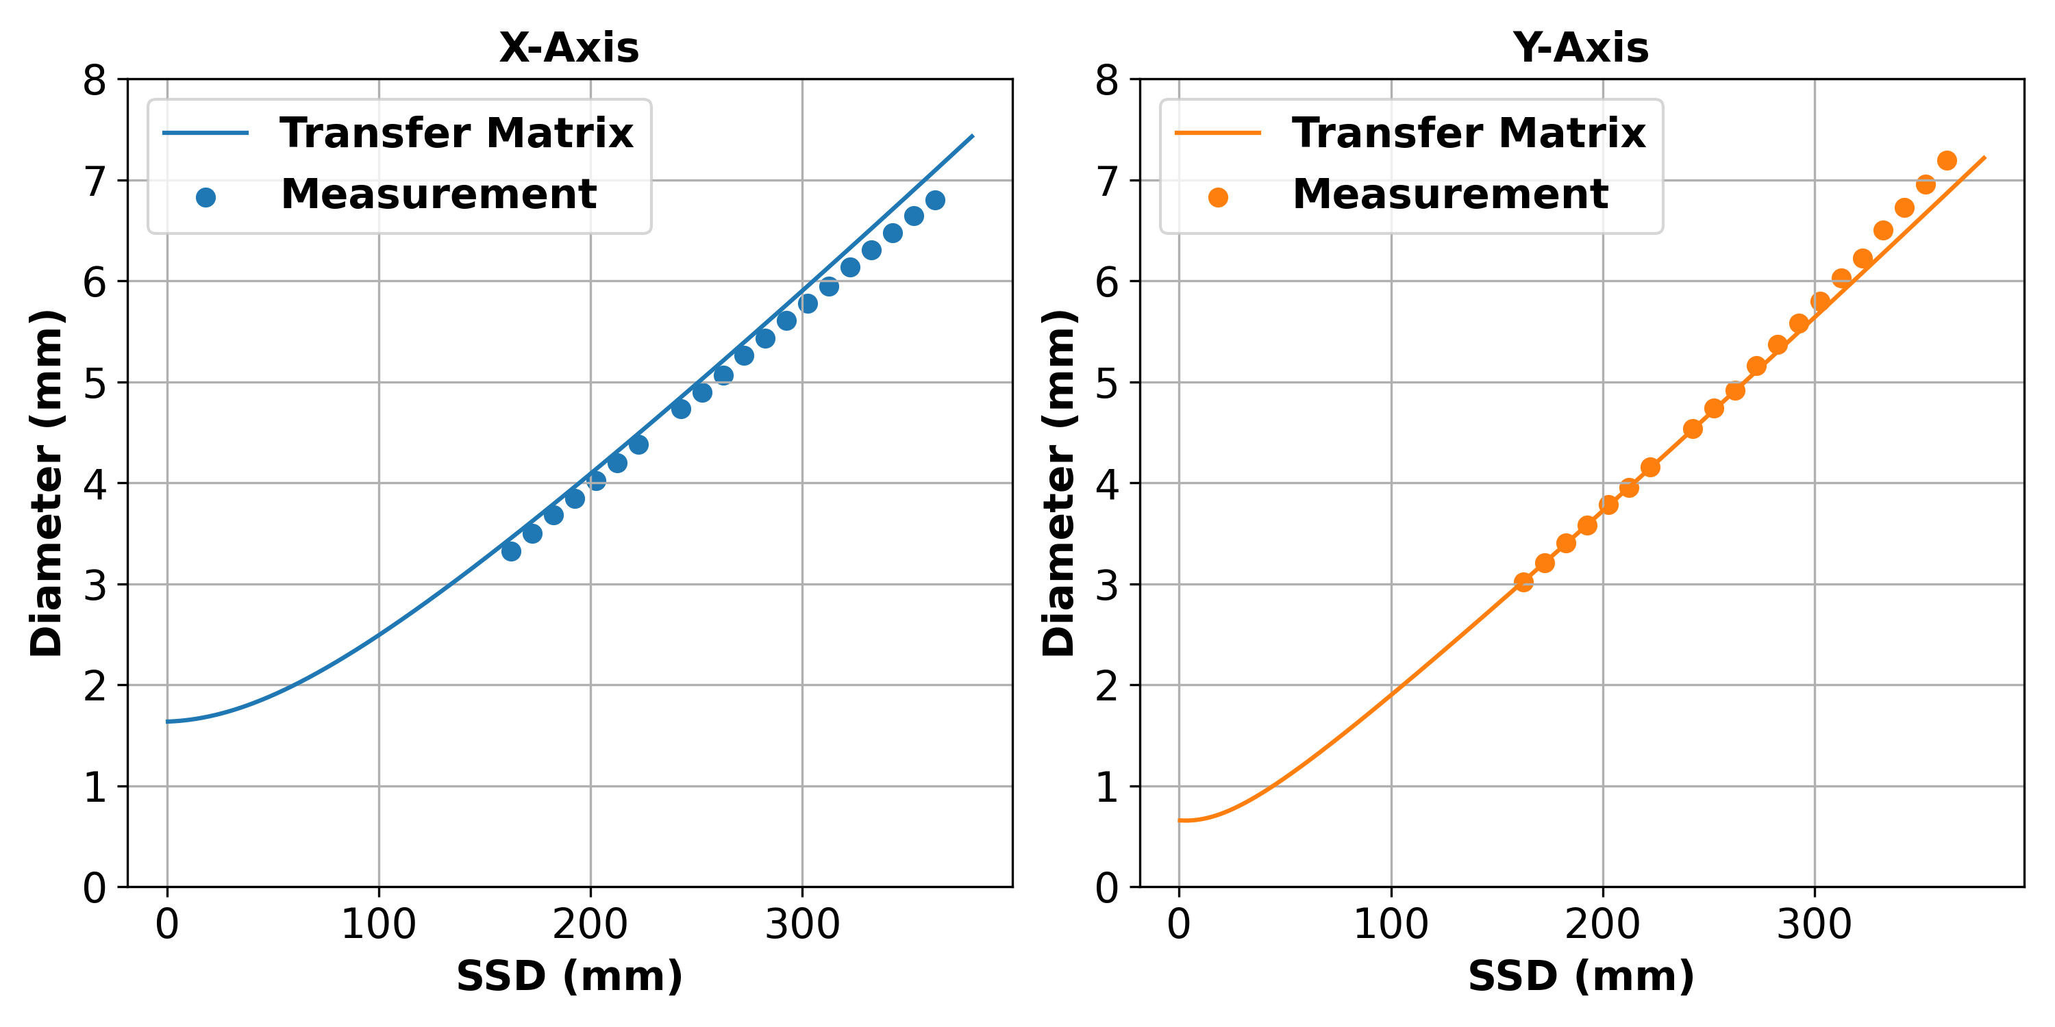
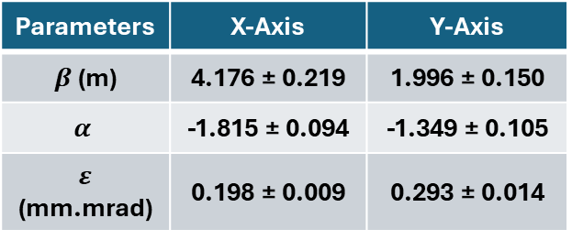
Result
Quad Scan Measurement
Search for CS parameters that best fit data
Expected emittance: 0.17 – 0.62 mm.mrad
Parameters | X-Axis | Y-Axis
$β$ (m) | 4.176 ± 0.219 | 1.996 ± 0.150
$$α$$ | -1.815 ± 0.094 | -1.349 ± 0.105
$ε$ (mm.mrad) | 0.198 ± 0.009 | 0.293 ± 0.014
We claim transfer matrix can find the beam at any point, can we predict beam size then?
Beam size over distance
All good, …right?
NO

Slide 10
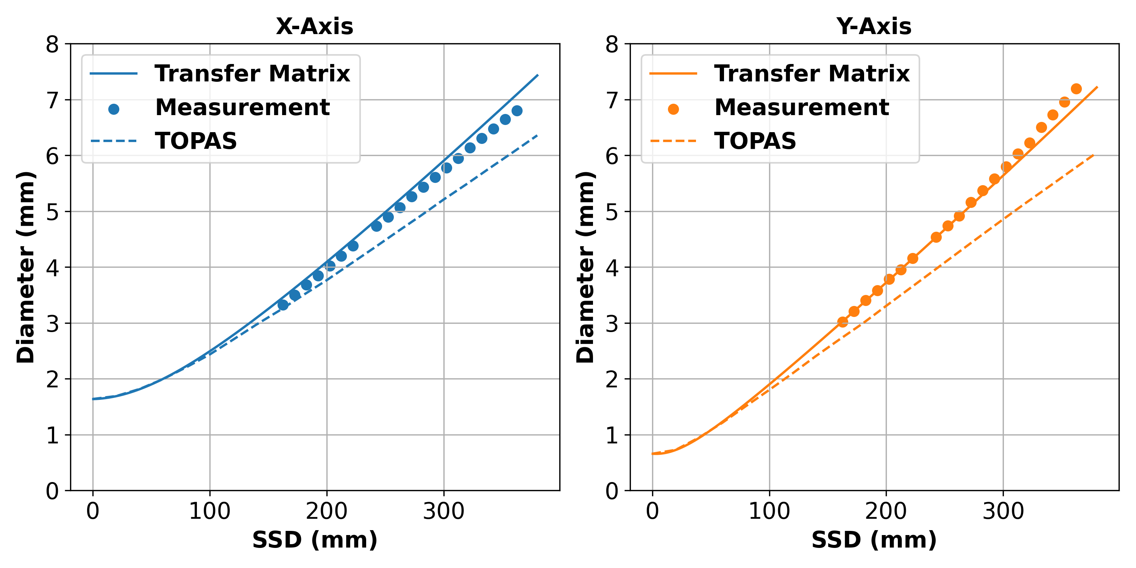
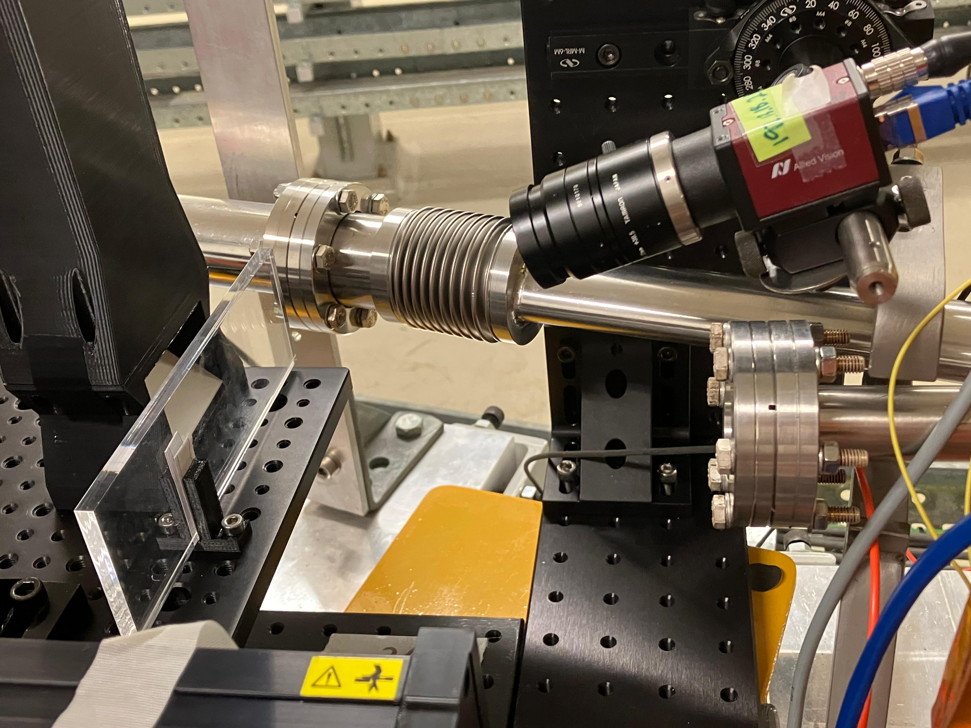
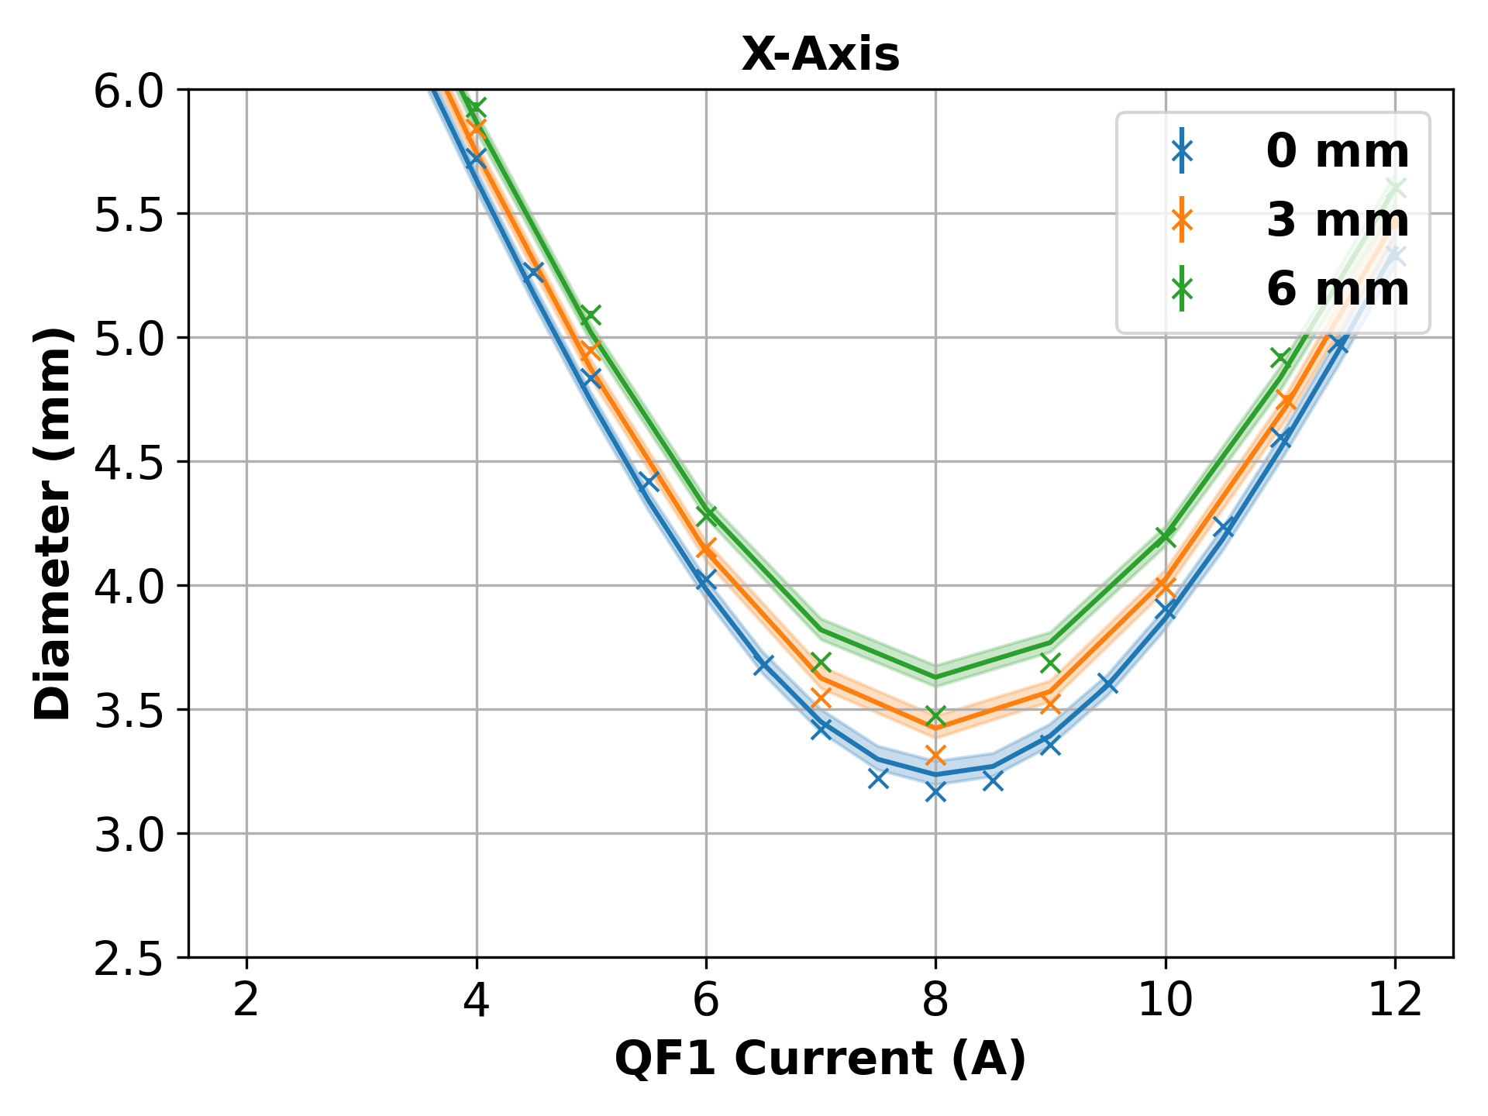
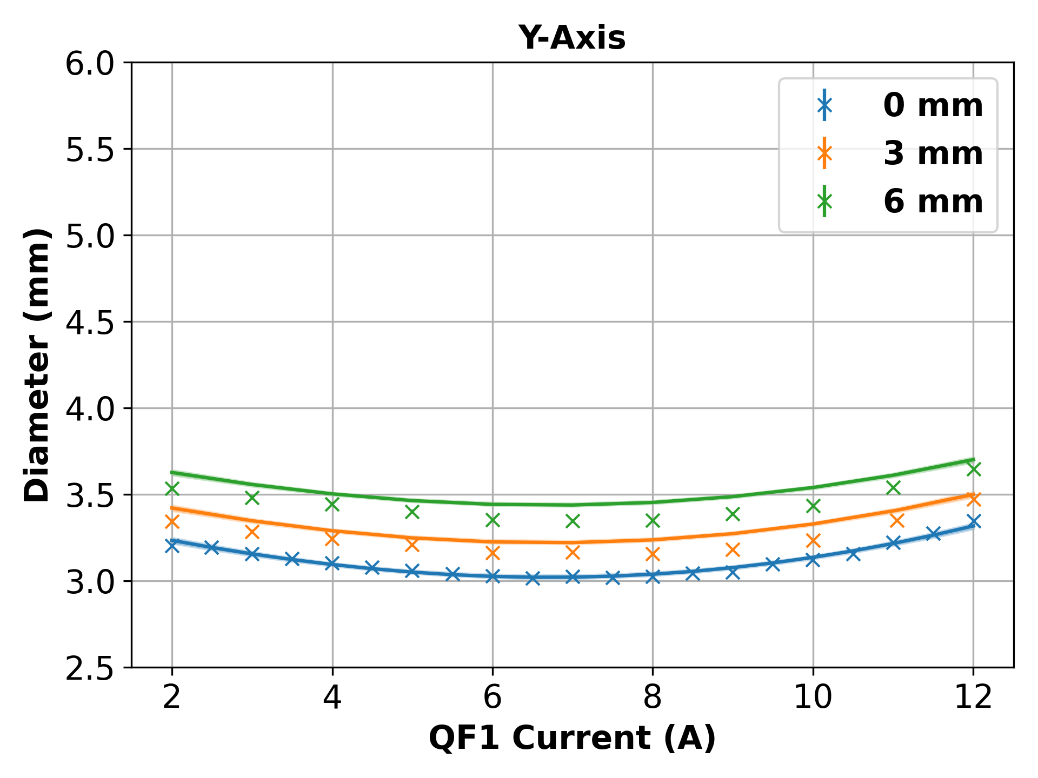
Not quite right!
1. Simulate titanium window AND air in TOPAS:
2. Introduce additional scatterer:
BPM
100 MeV Electron Beams
Optimisation can match the measurement but reach the wrong actual CS parameter by a bit
Window
Repeat quad scan, overestimate again!
PMMA
The real emittance should have been bigger than our prediction because our model overestimate the scattering
More work needs to be done, but seems like we’re on the right track…

Slide 11
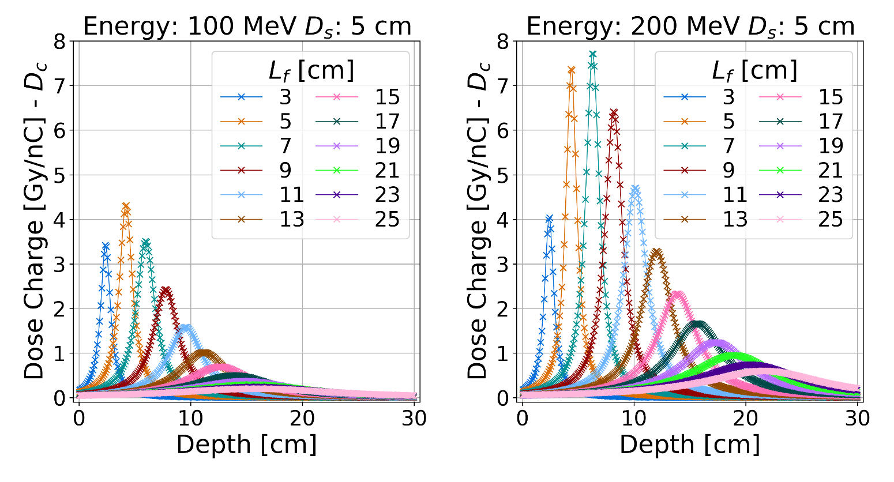
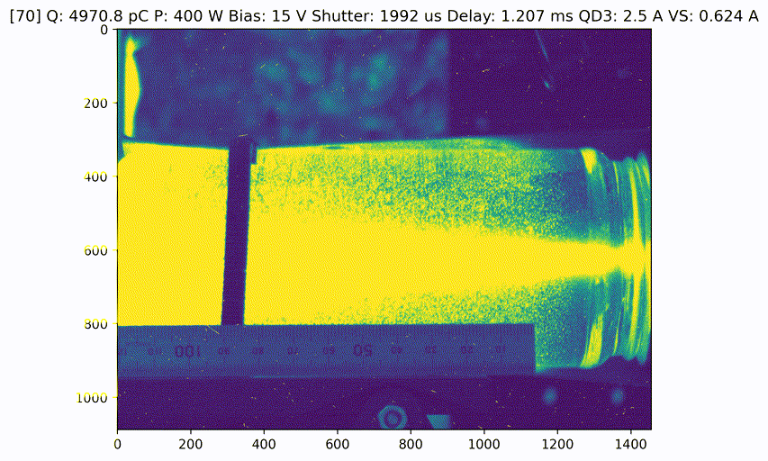
Why do we need to know the CS parameters?
Beam manipulation (focusing/defocusing beams)
Beamline development (e.g. CLEAR 2nd beamline)
Accurate Monte Carlo simulation (beyond point-like source + simulating secondaries)
Dosimetry study
Can Cherenkov radiation from water be used for VHEE beams dosimetry?
Optimising focusing parameters of VHEE beams for radiotherapy using MC simulation. J. Valerian. Proc. IPAC’25, Taiwan
Takeaway
Modelling scattering in the transfer matrix formalism allows us to:
Find the initial CS parameters with in-air BPM
Predict beam diameter in air (or water?) only by knowing the upstream quadrupole setting
“Bypass” compute-heavy Monte Carlo in optimisation loop
Cherenkov radiation from VHEE beams traversing a water jar with various magnet and charge setting

Slide 12
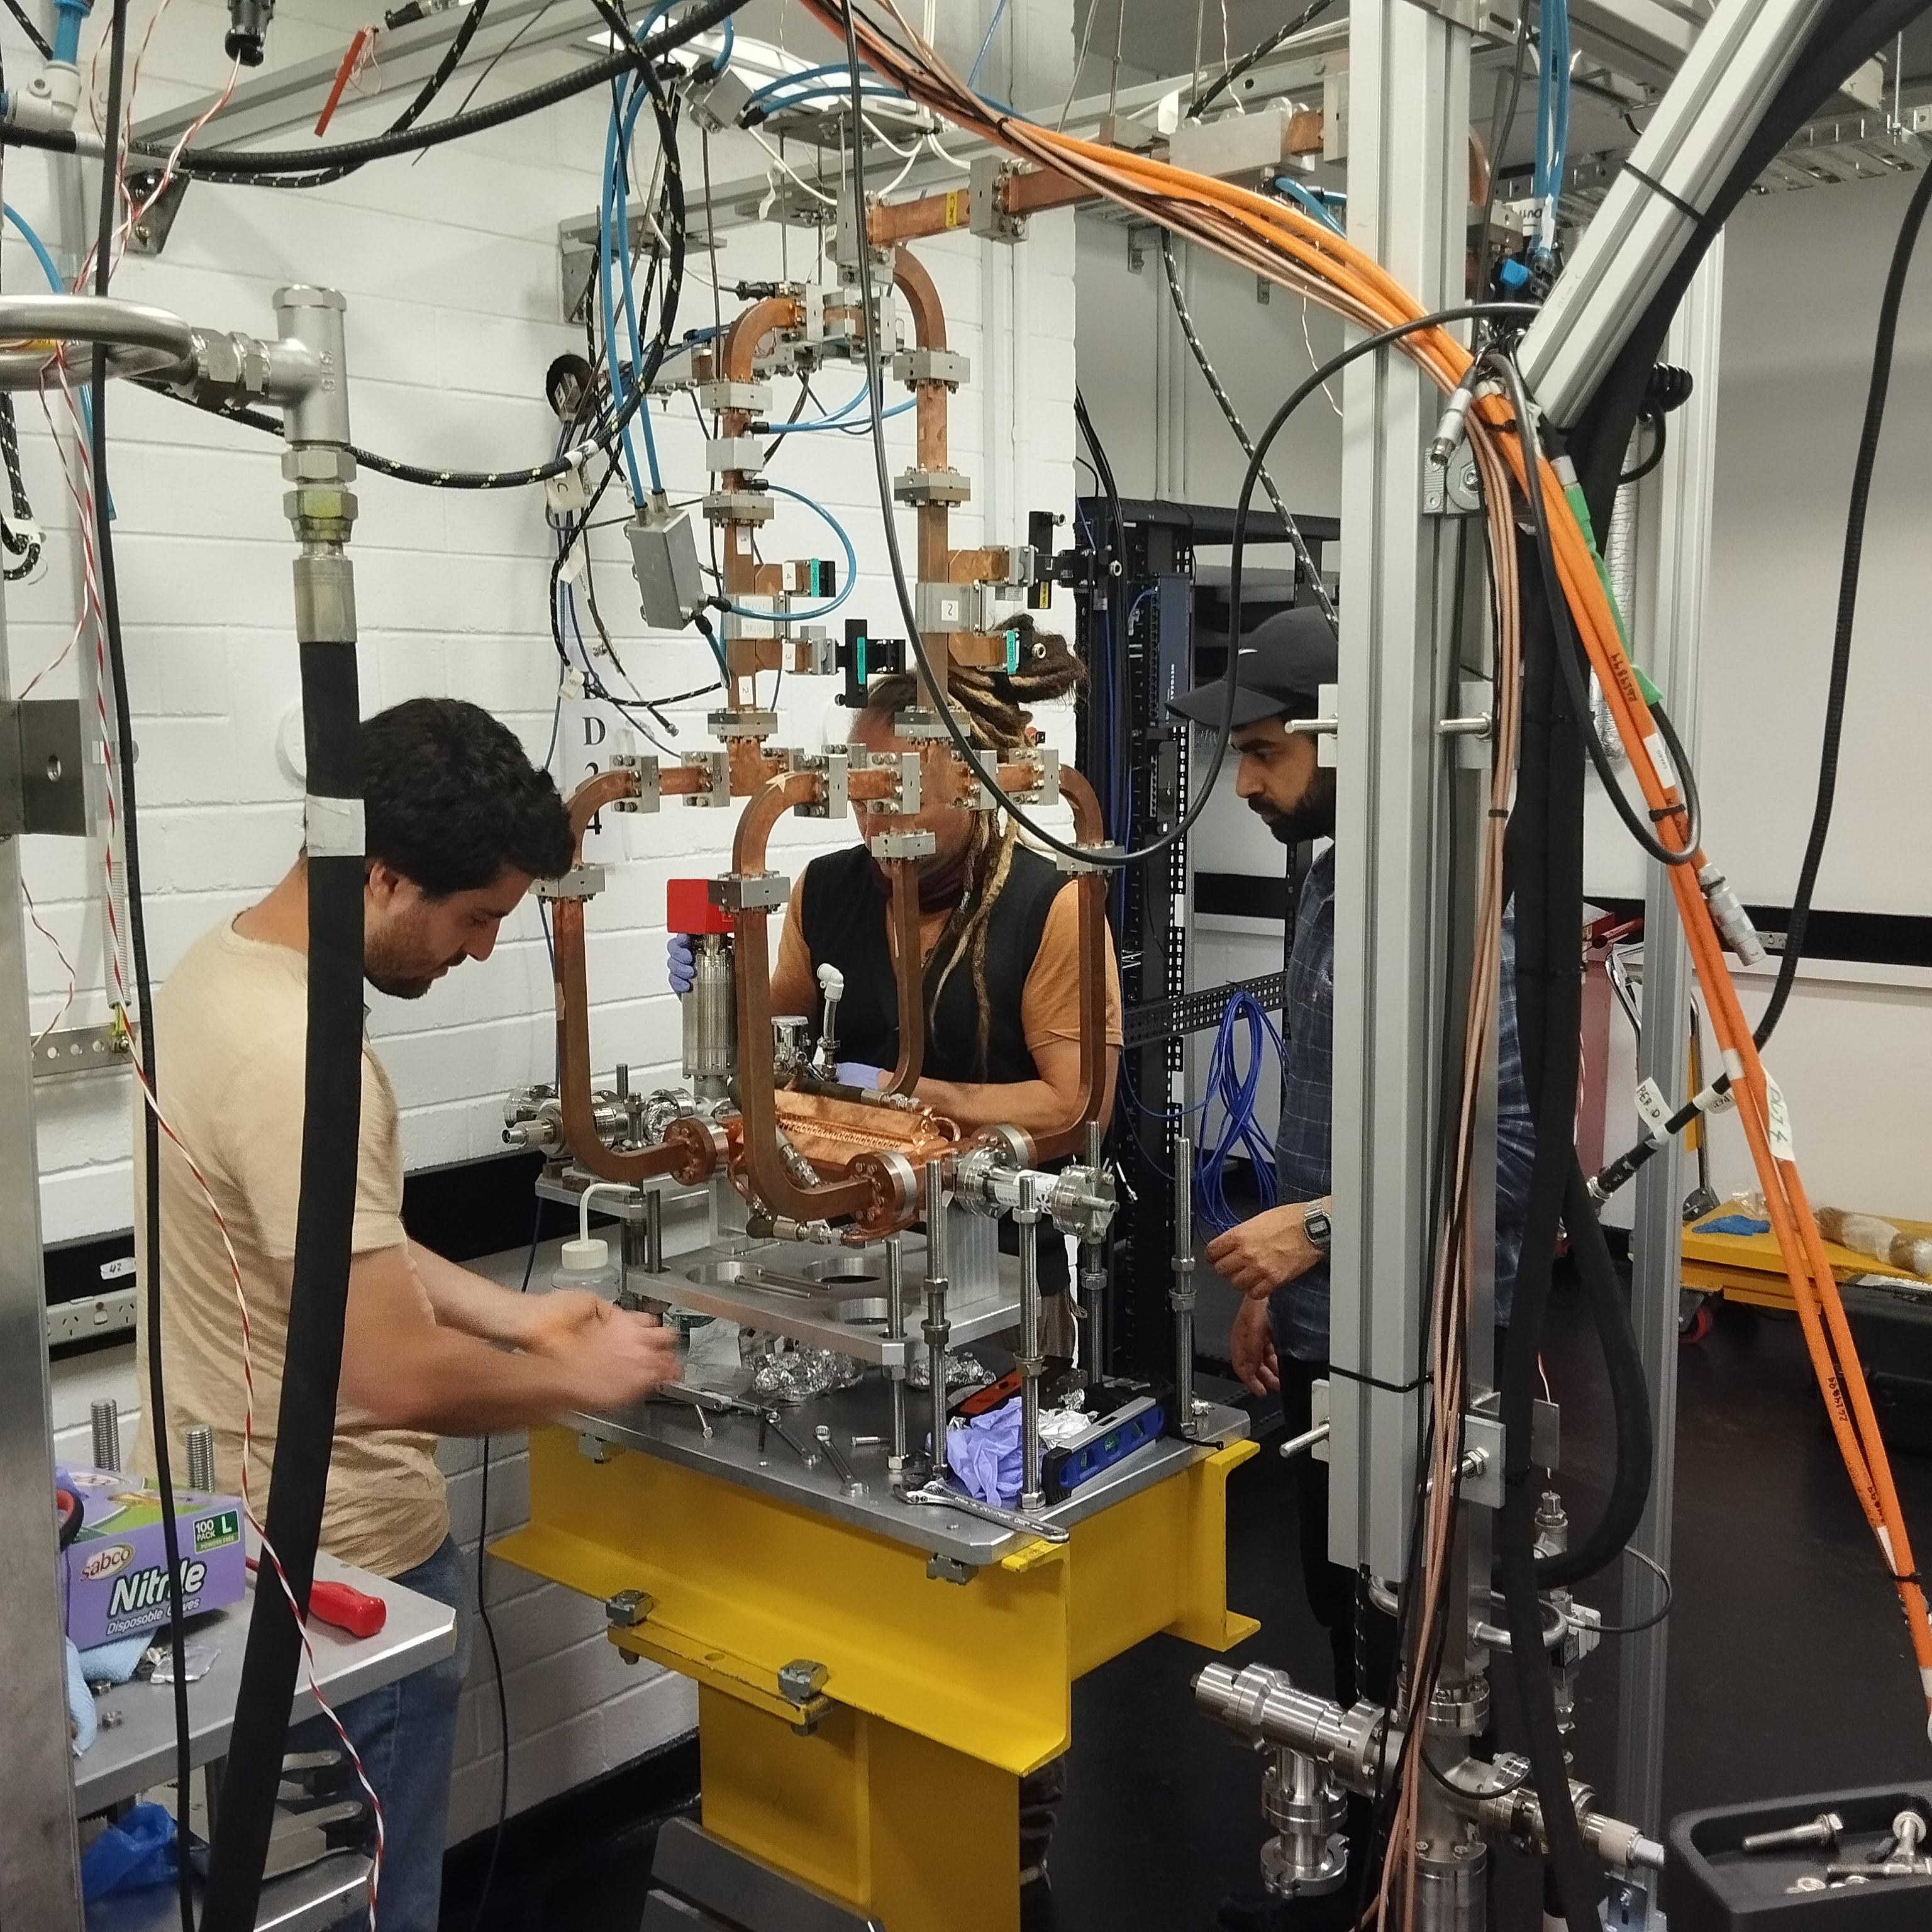

Thank you! Joel Valerian joel.valerian@student.unimelb.edu.au
Installation of one of the two X-band TD24 accelerator structures at the University of Melbourne, c. 2024.

Slide 13
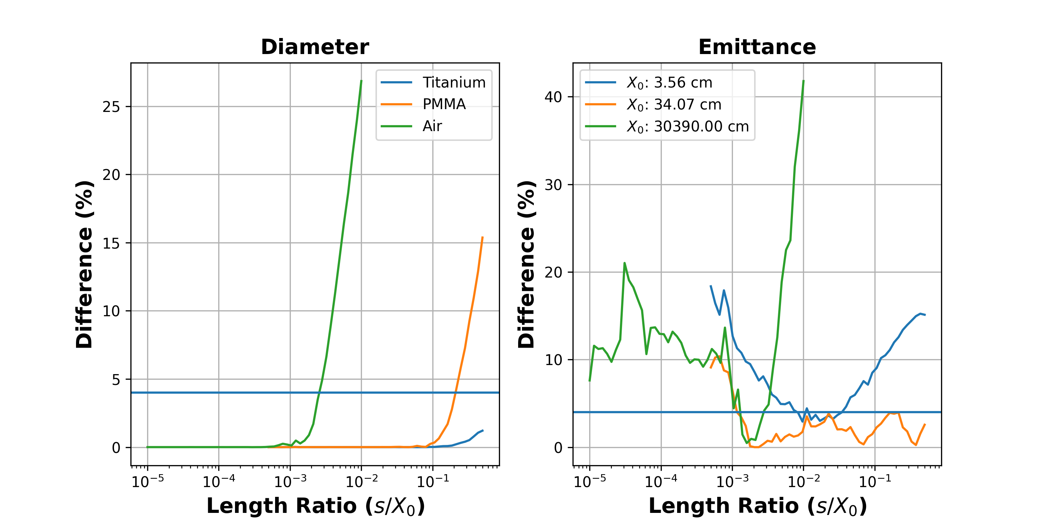
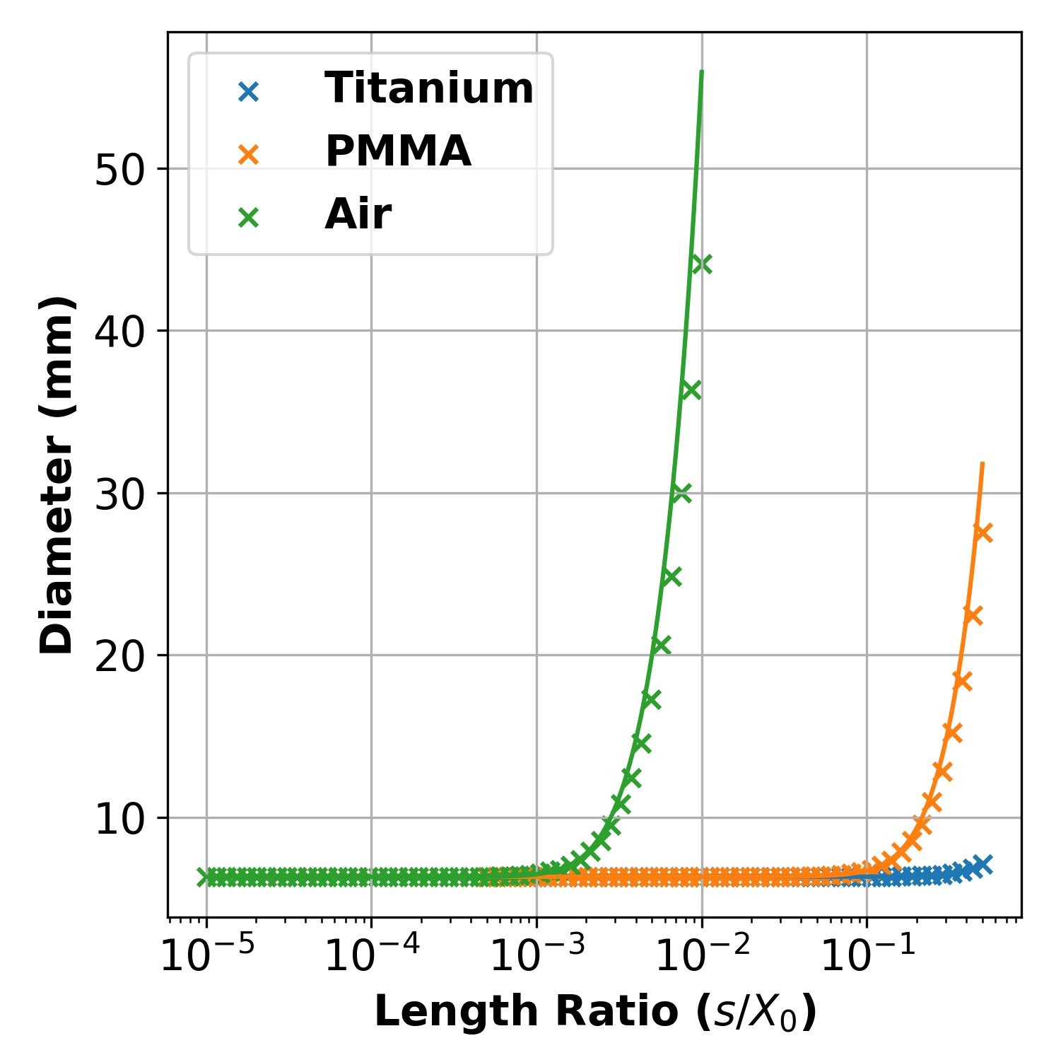
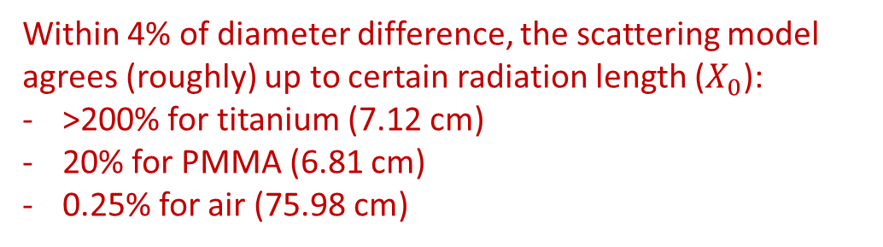
How valid is this?
Simulate different material of interest and score the final phase space in TOPAS*:
*Monte Carlo Particle Transport Simulation based on Geant4
Simulation parameters:
1 million 100 MeV electrons
Physics list:
g4em-standard_opt4
g4h-phy_QGSP_BIC_HP
Within 4% of diameter difference, the scattering model agrees (roughly) up to certain radiation length ($X_{0}$):
>200% for titanium (7.12 cm)
20% for PMMA (6.81 cm)
0.25% for air (75.98 cm)

Slide 14
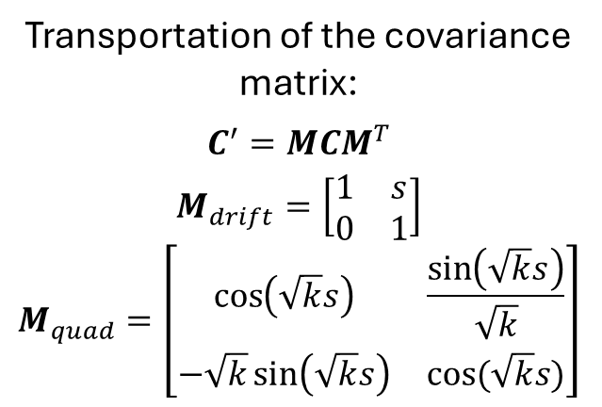
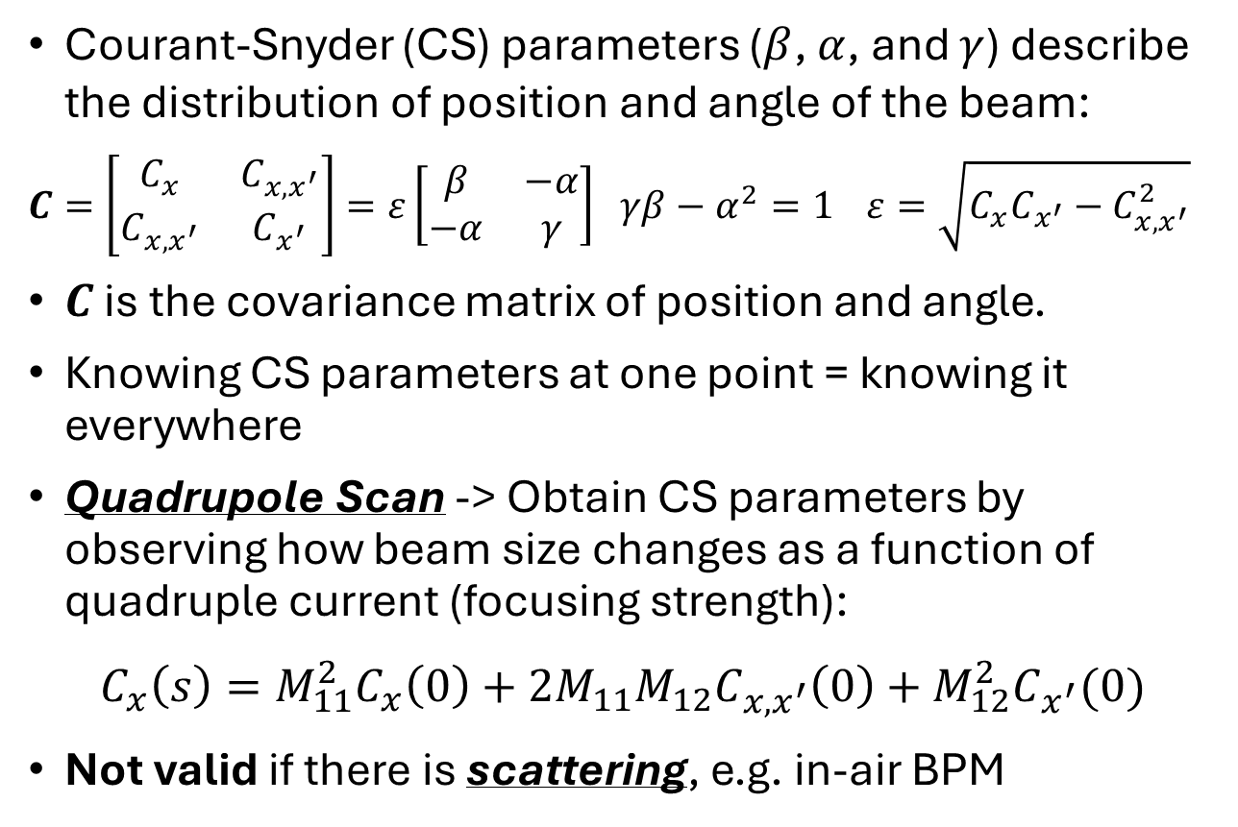
What do you mean by characterise?
Courant-Snyder (CS) parameters ($β$, $α$, and $γ$) describe the distribution of position and angle of the beam:
$C=\left[\begin{matrix}C_{x} & C_{x,x^{′}} \\ C_{x,x^{′}} & C_{x^{′}}\end{matrix}\right]=ε\left[\begin{matrix}β & −α \\ −α & γ\end{matrix}\right]$ $γβ−α^{2}=1$ $ε=\sqrt{C_{x}C_{x^{′}}−C_{x,x^{′}}^{2}}$
$C$ is the covariance matrix of position and angle.
Knowing CS parameters at one point = knowing it everywhere
Quadrupole Scan -> Obtain CS parameters by observing how beam size changes as a function of quadruple current (focusing strength):
$$C_{x}\left(s\right)=M_{11}^{2}C_{x}\left(0\right)+2M_{11}M_{12}C_{x,x^{′}}\left(0\right)+M_{12}^{2}C_{x^{′}}(0)$$
Not valid if there is scattering, e.g. in-air BPM
Phase (Trace) Space
Transportation of the covariance matrix:
$$C^{′}=MCM^{T}$$
$$M_{drift}=\left[\begin{matrix}1 & s \\ 0 & 1\end{matrix}\right]$$
$$M_{quad}=\left[\begin{matrix}\cos\left(\sqrt{k}s\right) & \frac{\sin\left(\sqrt{k}s\right)}{\sqrt{k}} \\ −\sqrt{k}\sin\left(\sqrt{k}s\right) & cos⁡(\sqrt{k}s)\end{matrix}\right]$$

Slide 15
Evaluation
Possible source of discrepancies:
Accumulation of hard scattering over multiple different scatterers
Moving centroids: quadrupole misalignment?
Rotated beam: transverse coupling due to upstream solenoids?

Slide 16
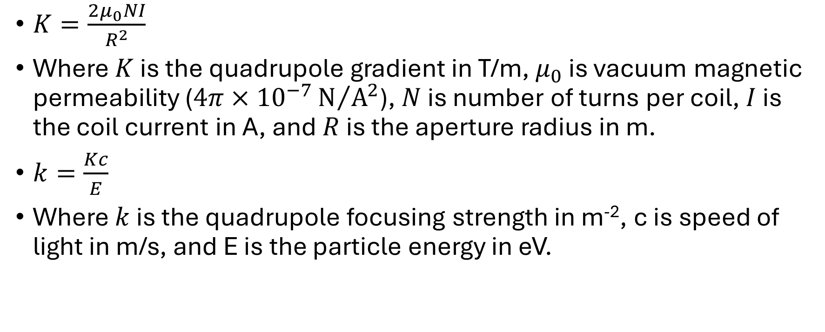
Quadrupole Current to Gradient and Focusing Strength
$K=\frac{2μ_{0}NI}{R^{2}}$
Where $K$ is the quadrupole gradient in T/m, $μ_{0}$ is vacuum magnetic permeability ($4π×{10}^{−7}{\text{N}}/{{\text{A}}^{2}}$), $N$ is number of turns per coil, $I$ is the coil current in A, and $R$ is the aperture radius in m.
$k=\frac{Kc}{E}$
Where $k$ is the quadrupole focusing strength in m⁻², c is speed of light in m/s, and E is the particle energy in eV.

Slide 17
References for Scattering in Transfer Matrix Formalism
Several references:
Electron beam emittance growth in thin foils: A betatron function analysis. M. Reid 1991. Journal of Applied Physics.
Thick Scatterers seen through the Twiss Functions. A. Maier 1998. CERN Note.
Description of Beam-Matter Interaction in the Covariance Matrix Formalism. A.-S. Muller 2001. CERN Note.
Multiple Coulomb Scattering of Beam Particles in the Phase Space Ellipse formalism. M. D. Negra 1971. SLAC Technical Note.
Introduction to Transfer Lines and Circular Machines. P.J. Bryant 1984. CERN Lectures.

Slide 18
Pulsed Energetic Electrons for Research (PEER)
PEER End Station
LINAC: Linear Accelerator
HC: Horizontal Corrector
FCT: Fast Current Transformer
QF: Focusing Quadrupole
QD: Defocusing Quadrupole
VC: Vertical Corrector
D: Dipole
W: Vacuum Window
S: Scatterer
BPM: Beam Profile Monitor
127 µm Titanium
To Booster Ring
0/3/6 mm
BPM
S
W
D
(Off)
QD3
(OFF)
VC
(OFF)
QD2
(9 A)
QF1
(Scan)
FCT
HC
(Off)
LINAC
Vacuum Beam Pipe
Ø 42.5 mm
37.5 mm
125 mm
127 µm
150 mm
300 mm
198.6 mm
150 mm
302.3 mm
150 mm
301.8 mm
150 mm
732.5 mm
2 S-Band Structures @ 100 MeV

